Slide 1

With Energy Recovery Linacs towards high-energy ep/eA physics
accelerator R&D for “Sustainable Accelerating Systems”
Jorgen D’Hondt
Vrije Universiteit Brussel
Epiphany Conference, Cracow, 16-19 January 2023

Slide 2
The scope
For ep/eA physics, the 2030’ies will be
the decade of the EIC
The next ambition for the community will be to enable ep/eA physics both at higher luminosities and at higher energies
In my opinion, major advances in science are enabled either by reaching major steps with today’s methods or by the development of major new methods
If we cannot make great strides into the unknown with current methods, we should concentrate on developing new methods
a great stride
orders of magnitude

Slide 3
at high energies
electron-proton colliders provide
a General-Purpose experiment

Slide 4
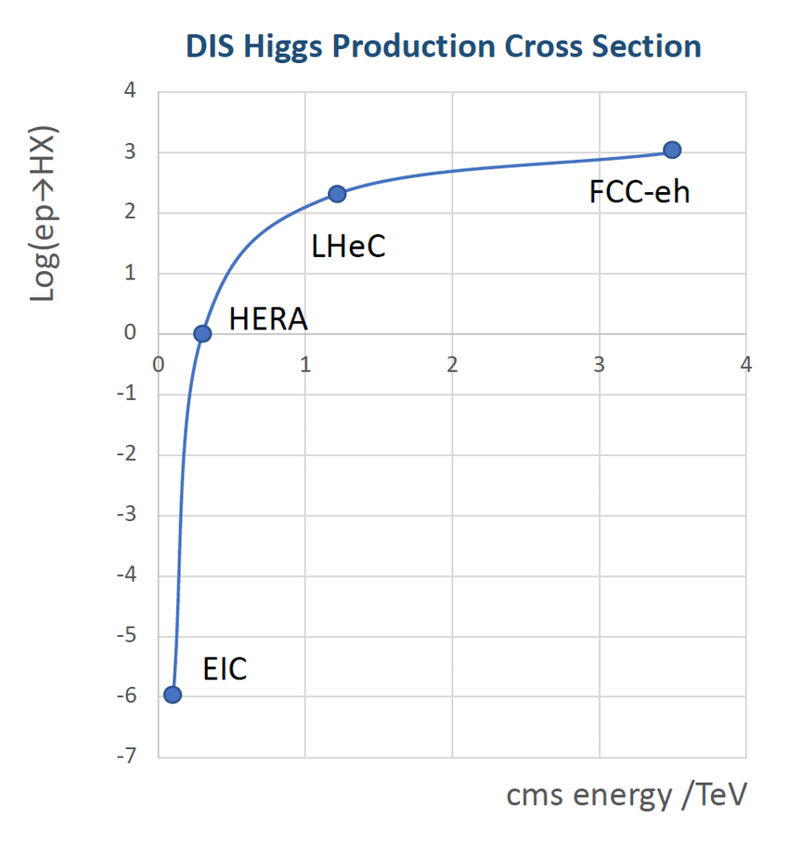
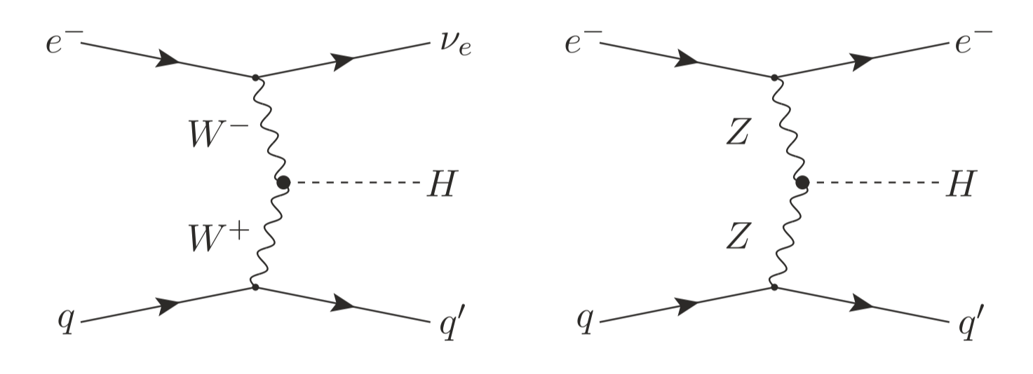
Collision energy above the threshold for EW/Higgs/Top
from mostly QCD-oriented physics to General-Purpose physics
The real game change between HERA and LHC/FCC
Compared to the LHC, these are reasonably clean Higgs events with much less backgrounds
at these energies, interactions with all particles in the Standard Model can be measured precisely

Slide 5
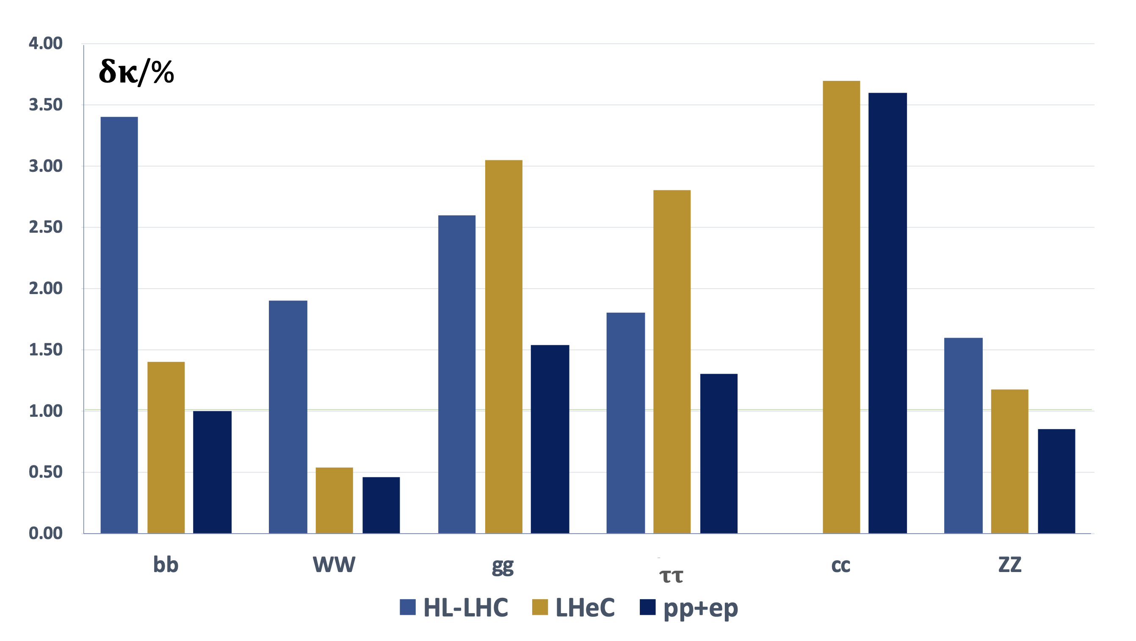
Some physics highlights of the LHeC (ep/eA@LHC)
on several fronts comparable improvements between LHC → HL-LHC as for HL-LHC → LHeC
Higgs physics
EW physics
improvement wrt LH-LHC
first
time
Δm_{W} down to 2 MeV (today at ~10 MeV)
Δsin²θ_{W}^{eff} to 0.00015 (same as LEP)
x3.5 better
x2
x1.5
x2
Top quark physics
1%
x4
|V_{tb}| precision better than 1% (today ~5%)
top quark FCNC and γ, W, Z couplings
DIS scattering cross sections
Strong interaction physics
PDFs extended in (Q²,x) by orders of magnitude
α_{s} precision of 0.1%
low-x: a new discovery frontier
The Large Hadron-Electron Collider at the HL-LHC, J. Phys. G 48 (2021) 110501, 364p (updated CDR)

Slide 6
Some physics highlights of the LHeC (ep/eA@LHC)
on several fronts comparable improvements between LHC → HL-LHC as for HL-LHC → LHeC
Higgs physics
EW physics
for EW/Higgs/top physics
improvement factor from
LHC → HL-LHC similar to HL-LHC → LHeC
improvement wrt LH-LHC
first
time
Δm_{W} down to 2 MeV (today at ~10 MeV)
Δsin²θ_{W}^{eff} to 0.00015 (same as LEP)
x3.5 better
x2
x1.5
x2
Top quark physics
1%
x4
|V_{tb}| precision better than 1% (today ~5%)
top quark FCNC and γ, W, Z couplings
DIS scattering cross sections
Strong interaction physics
PDFs extended in (Q²,x) by orders of magnitude
α_{s} precision of 0.1%
low-x: a new discovery frontier
The Large Hadron-Electron Collider at the HL-LHC, J. Phys. G 48 (2021) 110501, 364p (updated CDR)

Slide 7
Some physics highlights of the LHeC (ep/eA@LHC)
on several fronts comparable improvements between LHC → HL-LHC as for HL-LHC → LHeC
Higgs physics
EW physics
for EW/Higgs/top physics
improvement factor from
LHC → HL-LHC similar to HL-LHC → LHeC
A joint ep/pp interaction region with the same detector would correlate results and reach the ultimate precision
e.g. Δm_{W} ∼ 1 MeV might be within reach
improvement wrt LH-LHC
first
time
Δm_{W} down to 2 MeV (today at ~10 MeV)
Δsin²θ_{W}^{eff} to 0.00015 (same as LEP)
x3.5 better
x2
x1.5
x2
Top quark physics
1%
x4
|V_{tb}| precision better than 1% (today ~5%)
top quark FCNC and γ, W, Z couplings
DIS scattering cross sections
Strong interaction physics
Eur.Phys.J.C 82 (2022) 1, 40
PDFs extended in (Q²,x) by orders of magnitude
α_{s} precision of 0.1%
low-x: a new discovery frontier
The Large Hadron-Electron Collider at the HL-LHC, J. Phys. G 48 (2021) 110501, 364p (updated CDR)

Slide 8
Some physics highlights of the LHeC (ep/eA@LHC)
on several fronts comparable improvements between LHC → HL-LHC as for HL-LHC → LHeC
Higgs physics
EW physics
improvement wrt LH-LHC
first
time
Δm_{W} down to 2 MeV (today at ~10 MeV)
Δsin²θ_{W}^{eff} to 0.00015 (same as LEP)
In addition, unique potential with LHeC
to search for new physics phenomena
e.g. what if features appear in
the interactions between leptons and quarks
x3.5 better
x2
x1.5
x2
Top quark physics
1%
x4
|V_{tb}| precision better than 1% (today ~5%)
top quark FCNC and γ, W, Z couplings
DIS scattering cross sections
Strong interaction physics
PDFs extended in (Q²,x) by orders of magnitude
α_{s} precision of 0.1%
low-x: a new discovery frontier
The Large Hadron-Electron Collider at the HL-LHC, J. Phys. G 48 (2021) 110501, 364p (updated CDR)

Slide 9
Some physics highlights of the LHeC (ep/eA@LHC)
on several fronts comparable improvements between LHC → HL-LHC as for HL-LHC → LHeC
Higgs physics
EW physics
improvement wrt LH-LHC
first
time
Δm_{W} down to 2 MeV (today at ~10 MeV)
Δsin²θ_{W}^{eff} to 0.00015 (same as LEP)
A high-energy electron-proton experiment is a general-purpose experiment
i.e. H/EW/top/QCD/search factory
x3.5 better
x2
x1.5
x2
Top quark physics
1%
x4
|V_{tb}| precision better than 1% (today ~5%)
top quark FCNC and γ, W, Z couplings
DIS scattering cross sections
Strong interaction physics
PDFs extended in (Q²,x) by orders of magnitude
α_{s} precision of 0.1%
low-x: a new discovery frontier
The Large Hadron-Electron Collider at the HL-LHC, J. Phys. G 48 (2021) 110501, 364p (updated CDR)

Slide 10
Some physics highlights of the LHeC (ep/eA@LHC)
on several fronts comparable improvements between LHC → HL-LHC as for HL-LHC → LHeC
Higgs physics
New mandate from the CERN Directorate:
Following the publication of the updated LHeC CDR, CERN continues to support studies for the LHeC and the FCC-eh as potential options for the future and to provide input to the next Update of the European Strategy for Particle Physics. The study is to further develop the scientific potential and possible technical realization of an ep/eA collider and the associated detectors at CERN, with emphasis on FCC.
EW physics
improvement wrt LH-LHC
first
time
Δm_{W} down to 2 MeV (today at ~10 MeV)
Δsin²θ_{W}^{eff} to 0.00015 (same as LEP)
x3.5 better
x2
x1.5
x2
Top quark physics
1%
x4
|V_{tb}| precision better than 1% (today ~5%)
top quark FCNC and γ, W, Z couplings
DIS scattering cross sections
Strong interaction physics
PDFs extended in (Q²,x) by orders of magnitude
α_{s} precision of 0.1%
low-x: a new discovery frontier
The Large Hadron-Electron Collider at the HL-LHC, J. Phys. G 48 (2021) 110501, 364p (updated CDR)

Slide 11
Some physics highlights of the LHeC (ep/eA@LHC)
on several fronts comparable improvements between LHC → HL-LHC as for HL-LHC → LHeC
Higgs physics
EW physics
improvement wrt LH-LHC
first
time
Δm_{W} down to 2 MeV (today at ~10 MeV)
Δsin²θ_{W}^{eff} to 0.00015 (same as LEP)
x3.5 better
More in the upcoming talk of Nestor Armesto
x2
x1.5
x2
Top quark physics
1%
x4
|V_{tb}| precision better than 1% (today ~5%)
top quark FCNC and γ, W, Z couplings
DIS scattering cross sections
Strong interaction physics
PDFs extended in (Q²,x) by orders of magnitude
α_{s} precision of 0.1%
low-x: a new discovery frontier
The Large Hadron-Electron Collider at the HL-LHC, J. Phys. G 48 (2021) 110501, 364p (updated CDR)

Slide 12
The challenge
High-intensity electron beam
From HERA@DESY to LHeC@CERN
3 orders in magnitude in luminosity
1 order in magnitude in energy
beam current × beam energy
= beam power
LHeC ∼ 1 GW beam power
equivalent to the power delivered by a nuclear power plant

Slide 13

The challenge
High-intensity electron beam
From HERA@DESY to LHeC@CERN
3 orders in magnitude in luminosity
1 order in magnitude in energy
With the planned R&D on Energy Recovery Linacs we will prepare the path to provide
a 1 GW electron beam with only 50 MW power
beam current × beam energy
= beam power
LHeC ∼ 1 GW beam power
equivalent to the power delivered by a nuclear power plant

Slide 14
Where do we use power ?

Slide 15
Basic structures of a particle accelerator
particle production
beam preparation
beam acceleration
experiment
beam
dump

Slide 16
Basic structures of a particle accelerator
particle production
beam preparation
beam acceleration
experiment
beam
dump
cooling @ 2K

Slide 17
Basic structures of a particle accelerator
particle production
beam preparation
beam acceleration
experiment
beam
dump
∼50%
magnets ∼10%
others ∼35%
cooling @ 2K
∼5%
Typical power consumption for an electron-positron Higgs Factory
the highest priority next collider for particle physics
example FCC@250GeV

Slide 18
Basic structures of a particle accelerator
recover this
energy
reduce most of this energy
beam acceleration
particle production
beam preparation
beam acceleration
experiment
beam
dump
∼50%
∼50%
magnets ∼10%
others ∼35%
cooling @ 2K
∼5%
Typical power consumption for an electron-positron Higgs Factory
the highest priority next collider for particle physics
example FCC@250GeV

Slide 19

The energy efficiency of present and future
accelerators […] is and should remain an area
requiring constant attention.
A detailed plan for the […] saving and re-use of
energy should be part of the approval process
for any major project.
European Strategy for Particle Physics 2020

Slide 20

From Grid to Beam
RF power generation
GRID
cryogenics
Picture adopted from M. Seidel (IPAC 2022)

Slide 21
From Grid to Beam
RF power generation
efficiency ~30-60%
GRID
RF power demand
by detuned cavities
∼ Δω²
beam power
dumped
or
radiated
cryogenics
dissipated heat
∼ 1/Q₀
performance
∼ (300K – T) / T
power-inefficiency

Slide 22
From Grid to Beam
improve amplifier efficiency
e.g. solid state amplifiers for oscillating power demands
RF power generation
recover the energy from the beam
e.g. ERL reaching
100% recovery
efficiency ~30-60%
GRID
RF power demand
by detuned cavities
∼ Δω²
beam power
dumped
or
radiated
dealing with microphonics
e.g. Fast Reactive Tuners
cryogenics
dissipated heat
∼ 1/Q₀
mitigation with novel technologies
performance
∼ (300K – T) / T
operate cavities at higher T & improve Q₀ of cavities
e.g. Nb₃Sn from 2K to 4.4K ➔ 3x less cooling power needed

Slide 23
From Grid to Beam
improve amplifier efficiency
e.g. solid state amplifiers for oscillating power demands
Accelerating particles will always require a large amount
of energy, hence achieving a minimal energy consumption is
our unavoidable challenge and duty for future colliders
Thought for an overall R&D programme for
“Sustainable Accelerating Systems”
less energy, less cooling, less power loss, recover beam power
e.g. 4.4K SRF in the ERL world is equivalent to HTS in the magnet world
RF power generation
recover the energy from the beam
e.g. ERL reaching
100% recovery
efficiency ~30-60%
GRID
beam power
dumped
or
radiated
cryogenics
dissipated heat
∼ 1/Q₀
performance
∼ (300K – T) / T
operate cavities at higher T & improve Q₀ of cavities
e.g. Nb₃Sn from 2K to 4.4K ➔ 3x less cooling power needed

Slide 24
From Grid to Beam
improve amplifier efficiency
e.g. solid state amplifiers for oscillating power demands
Accelerating particles will always require a large amount
of energy, hence achieving a minimal energy consumption is
our unavoidable challenge and duty for future colliders
Thought for an overall R&D programme for
“Sustainable Accelerating Systems”
less energy, less cooling, less power loss, recover beam power
e.g. 4.4K SRF in the ERL world is equivalent to HTS in the magnet world
RF power generation
recover the energy from the beam
e.g. ERL reaching
100% recovery
efficiency ~30-60%
GRID
beam power
dumped
or
radiated
cryogenics
dissipated heat
∼ 1/Q₀
ALARA = As Low As Reasonable Achievable
principle enforced for nuclear safety,
also for energy consumption ?
performance
∼ (300K – T) / T
operate cavities at higher T & improve Q₀ of cavities
e.g. Nb₃Sn from 2K to 4.4K ➔ 3x less cooling power needed

Slide 25
The principle of Energy Recovery
ACCELERATOR CAVITIES
ACCELERATE
energy in cavities is given to the particle beam

Slide 26
The principle of Energy Recovery
>99.9999%
particles
experiment
100%
particles
ACCELERATOR CAVITIES
ACCELERATE
energy in cavities is given to the particle beam

Slide 27
The principle of Energy Recovery
>99.9999%
particles
experiment
100%
particles
phase-shift
180º
ACCELERATOR CAVITIES
ACCELERATE
energy in cavities is given to the particle beam
DECELERATE
energy of particle beam goes back to cavities

Slide 28
The principle of Energy Recovery
>99.9999%
particles
experiment
100%
particles
phase-shift
180º
ACCELERATOR CAVITIES
ACCELERATE
energy in cavities is given to the particle beam
DECELERATE
energy of particle beam goes back to cavities
energy recovered to accelerate the next particle beam

Slide 29
The principle of Energy Recovery
>99.9999%
particles
experiment
100%
particles
beam dump at low energy
phase-shift
180º
ACCELERATOR CAVITIES
ACCELERATE
energy in cavities is given to the particle beam
DECELERATE
energy of particle beam goes back to cavities
energy recovered to accelerate the next particle beam

Slide 30
The principle of Energy Recovery
beam brightness is maintained from
the injector
>99.9999%
particles
experiment
100%
particles
beam dump at low energy
phase-shift
180º
ACCELERATOR CAVITIES
ACCELERATE
energy in cavities is given to the particle beam
DECELERATE
energy of particle beam goes back to cavities
energy recovered to accelerate the next particle beam

Slide 31
The principle of Energy Recovery
beam brightness is maintained from
the injector
>99.9999%
particles
experiment
100%
particles
multiple turns towards higher energies
beam dump at low energy
phase-shift
180º
ACCELERATOR CAVITIES
ACCELERATE
energy in cavities is given to the particle beam
DECELERATE
energy of particle beam goes back to cavities
energy recovered to accelerate the next particle beam

Slide 32
The principle of Energy Recovery
other beam for collisions
beam brightness is maintained from
the injector
>99.9999%
particles
experiment
100%
particles
multiple turns towards higher energies
beam dump at low energy
phase-shift
180º
ACCELERATOR CAVITIES
ACCELERATE
energy in cavities is given to the particle beam
DECELERATE
energy of particle beam goes back to cavities
energy recovered to accelerate the next particle beam

Slide 33
The principle of Energy Recovery
other beam for collisions
beam brightness is maintained from
the injector
>99.9999%
particles
experiment
100%
particles
instead of re-circulating the beam (and loosing brightness),
the power is re-circulated (achieving optimal brightness with the next beam)
multiple turns towards higher energies
beam dump at low energy
phase-shift
180º
ACCELERATOR CAVITIES
ACCELERATE
energy in cavities is given to the particle beam
DECELERATE
energy of particle beam goes back to cavities
energy recovered to accelerate the next particle beam

Slide 34
The principle of Energy Recovery
other beam for collisions
beam brightness is maintained from
the injector
>99.9999%
particles
experiment
100%
particles
Technology is proven in operational facilities with lower energies and lower beam power
multiple turns towards higher energies
beam dump at low energy
phase-shift
180º
ACCELERATOR CAVITIES
ACCELERATE
energy in cavities is given to the particle beam
DECELERATE
energy of particle beam goes back to cavities
energy recovered to accelerate the next particle beam

Slide 35
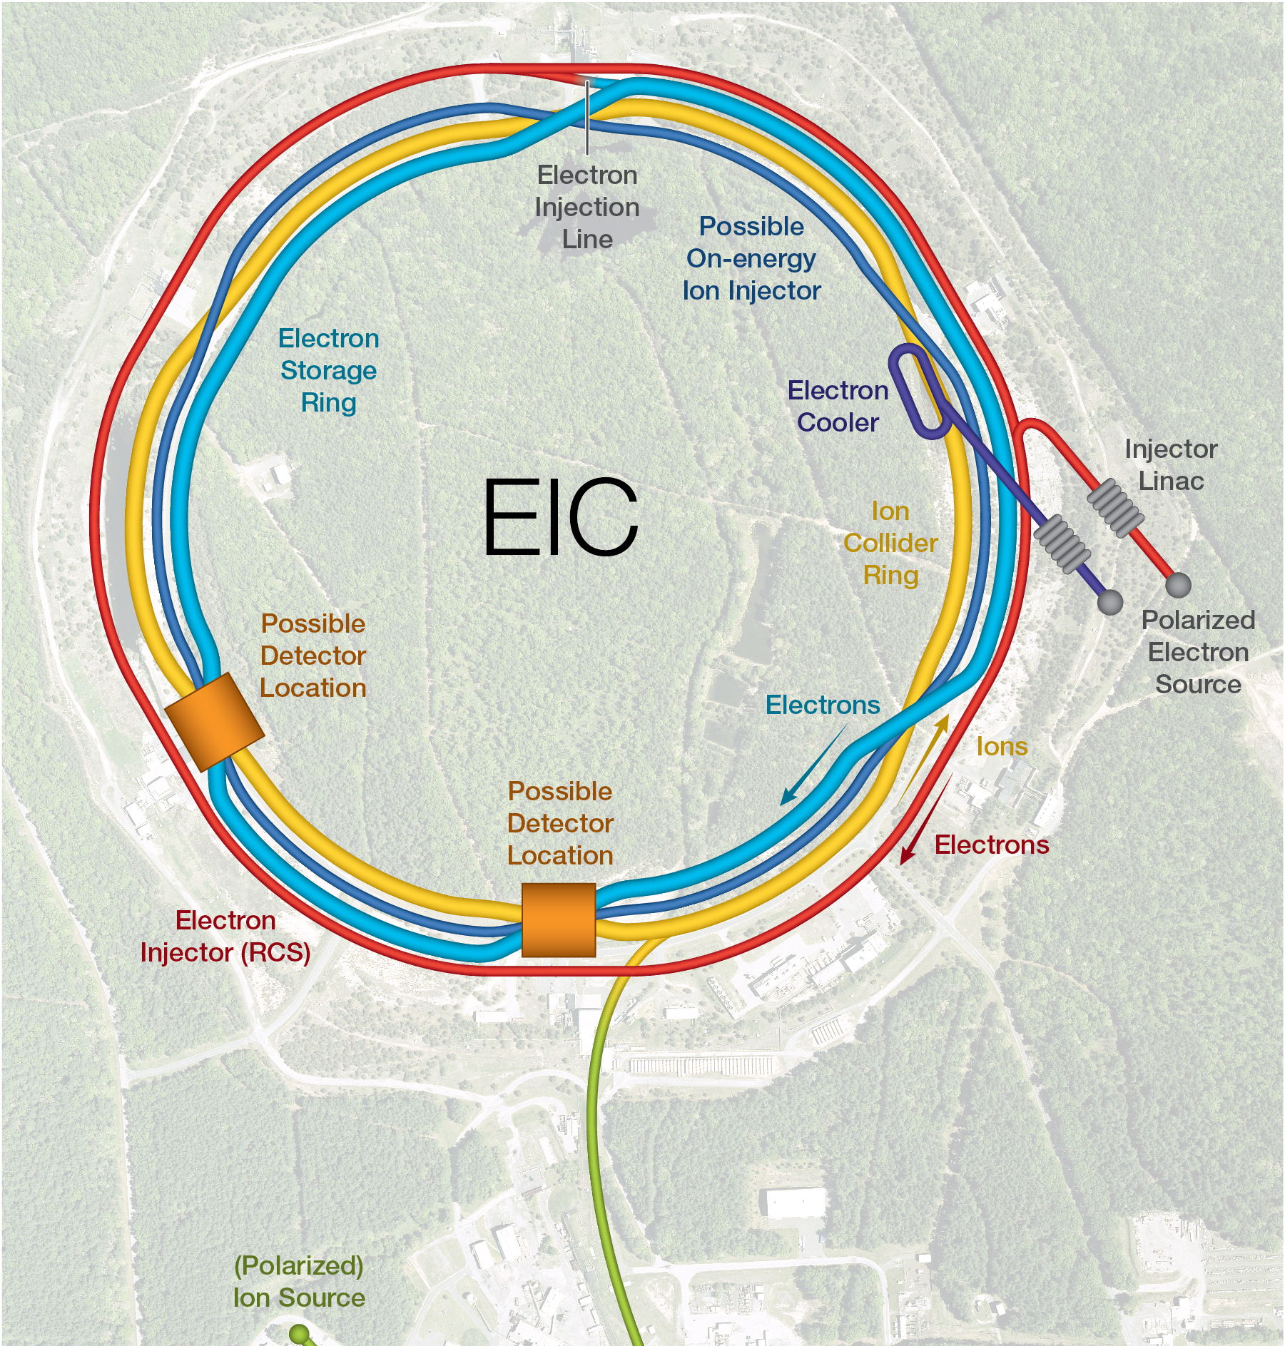
Ongoing & Upcoming facilities with ERL systems
worldwide several facilities are operational or are emerging
ongoing
ongoing
in progress
in progress
EIC Cooler BNL, USA
electron cooling with ERL
bERLinPro & PERLE (next slides)
More facilities in design
DIANA (STFC, UK)
DICE (Darmstadt, Germany)
BriXSino (Milano, Italy)
ongoing
ongoing
in progress

Slide 36
Energy Recovery Linac (ERL) technology
applications with a reduced energy footprint and cost
Based on 50 years of successful accelerator R&D developments
success builts easier on previous success
Minimal energy consumption to accelerator particles to high energies
    addressing scientific & societal challenges together with quasi 100% energy recovery
Maximal knowledge transfer to revolutionise applications in industry
    e.g. nanometer-scale semiconductors, medical isotopes, gamma sources for nuclear industry, X-ray Free-Electron Lasers (XFEL), … incl. career transfer opportunities to industry

Slide 37
European Accelerator R&D Roadmap
for particle physics
CERN Yellow Rep. Monogr. 1 (2022) 1-270 and arXiv:2201.07895

Slide 38
Identified the key aspects for an Energy Recovery accelerator
towards high-energy & high-intensity beams to be used at particle colliders
experiment
SOURCE
INJECTOR
ACCELERATOR CAVITIES
DUMP

Slide 39
Identified the key aspects for an Energy Recovery accelerator
towards high-energy & high-intensity beams to be used at particle colliders
experiment
HIGH-CURRENT ELECTRON SOURCES
for higher intensities
BEAM DYNAMICS & INSTRUMENTATION
for high-power beams at different energies & currents
SOURCE
INJECTOR
SC RF CAVITIES
DUMP
HIGHER-ORDER MODE DAMPING
efficient HOM extraction w/o increasing cryoload
HIGH-TEMPERATURE SC TECHNOLOGY
towards 4.2 K operation
FRT/RF power source
efficient RF operation

Slide 40
Translated into the main R&D objectives for Energy Recovery
geared towards high-energy and high-intensity accelerators incl. synergies with industry
HIGH-CURRENT e⁻ SOURCES
develop photocathode materials with high quantum efficiency
design of electron gun with high cathode field & high vacuum
SIMULATION & EDUCATION
beam dynamics studies to mitigate coherent synchrotron radiation, wake fields, beam breakup, …
BEAM DIAGNOSTICS & INSTRUMENTATION
develop & test beam profile wire-scanners with a high dynamic range (power, emittance, energy)
develop & test optical systems for beam imaging
develop & test beam position monitoring systems incl. a multi-turn beam arrival monitor system
very good beam loss and beam halo monitoring
SOURCE
INJECTOR
ACCELERATOR CAVITIES
DUMP
strategic
HIGHER-ORDER MODE DAMPING
understand HOM powers for cryomodules
design of HOM (on-cell) couplers
modelling of high-frequency wakefield
HIGH-POWER SRF TECHNOLOGY
SRF system design for very high beam currents
develop & test Fast Reactive Tuners (FRT)
deploy in beam-test facilities
towards 4.4K operation reduces the capital investment for the cooling plant (*)
coating SC compound materials on substrates (*)
DUAL AXIS CAVITIES
advance both options: single cavity with two beam tubes and two cavities joined by a power bridge
packing the cavity in cryomodule
connecting dual axis cryomodules
integrate HOM couplers in design
Most R&D objectives part of the bERLinPro and PERLE programs
(*) part of the RF R&D program

Slide 41
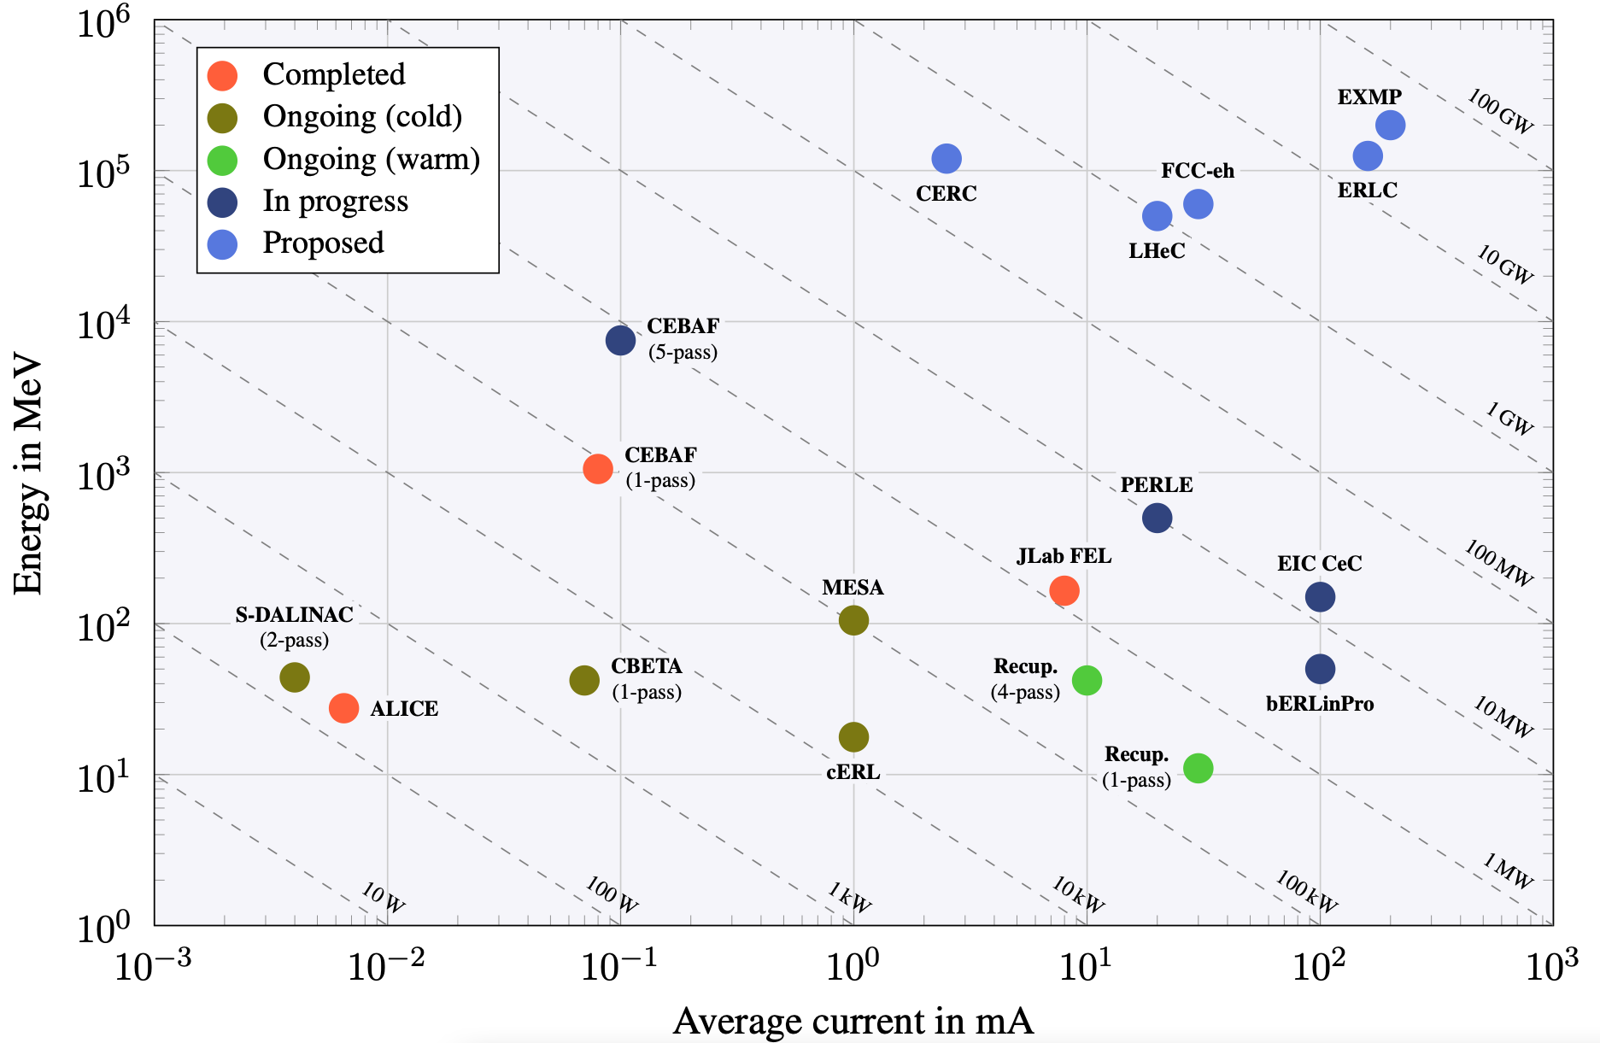
Energy Recovery – 50 years of innovation
from previous to current and future facilities as stepping stones for R&D
would be the required external power supply without Energy Recovery
nuclear power plant
ERL-based
HEP colliders
Energy Recovery
great achievements on all aspects and large research infrastructures based on Energy Recovery systems have been operated successfully
Power = Energy x Current
previous
&
current

Slide 42
Energy Recovery – 50 years of innovation
from previous to current and future facilities as stepping stones for R&D
would be the required external power supply without Energy Recovery
nuclear power plant
ERL-based
HEP colliders
Energy Recovery
great achievements on all aspects and large research infrastructures based on Energy Recovery systems have been operated successfully
Power = Energy x Current
planned
previous
&
current
bERLinPro & PERLE
essential accelerator R&D labs with ambitions overlapping with those of the particle physics community
towards high energy & high power
The Development of Energy-Recovery Linacs
arXiv:2207.02095, 237 pages, 5 July 2022

Slide 43
Energy Recovery – 50 years of innovation
from previous to current and future facilities as stepping stones for R&D
would be the required external power supply without Energy Recovery
nuclear power plant
ERL-based
HEP colliders
Energy Recovery
great achievements on all aspects and large research infrastructures based on Energy Recovery systems have been operated successfully
Power = Energy x Current
planned
previous
&
current
scaling
bERLinPro & PERLE
essential accelerator R&D labs with ambitions overlapping with those of the particle physics community
towards high energy & high power
The Development of Energy-Recovery Linacs
arXiv:2207.02095, 237 pages, 5 July 2022
technology

Slide 44
New: organising the European R&D for Energy Recovery in HEP
strengthen collaboration across the field to reach the HEP-related R&D objectives together

Slide 45
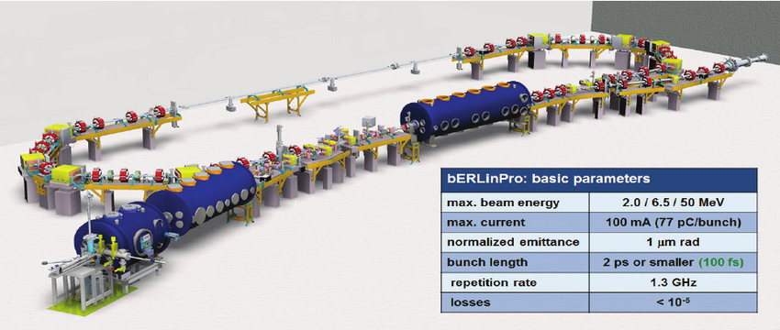
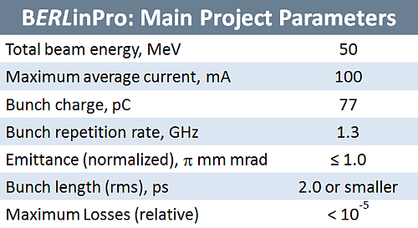
Upcoming facilities for Energy Recovery R&D
complementary in addressing the R&D objectives for Energy Recovery
bERLinPro @ Helmholtz Zentrum Berlin
generic accelerator R&D with several aspects as stepping stones towards HEP applications
bERLinPro – Berlin Energy Recovery Linac Project

Slide 46
Upcoming facilities for Energy Recovery R&D
complementary in addressing the R&D objectives for Energy Recovery
bERLinPro @ Helmholtz Zentrum Berlin
addressing HEP related challenges
bERLinPro ready for operation at 10 mA
contingent on additional budgets upgrades to 100 mA and ERL at 50 MeV can be planned to be operational by 2028
new 1.3 GHz LINAC module
three 7-cell cavities & design for FRT tests
100 mA booster assembly 2024
commissioning in 2025
develop
first SRF gun
with high-current
incl. cathode development
beam dump
beam diagnostics test line
recirculation tests
with 10 mA beam onwards

Slide 47
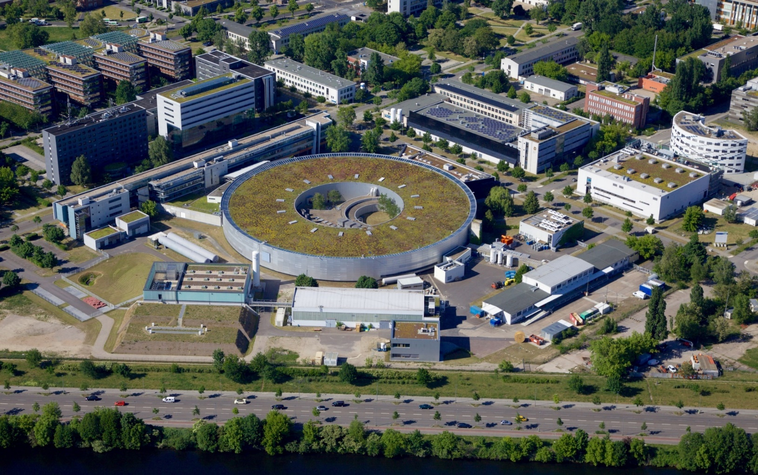
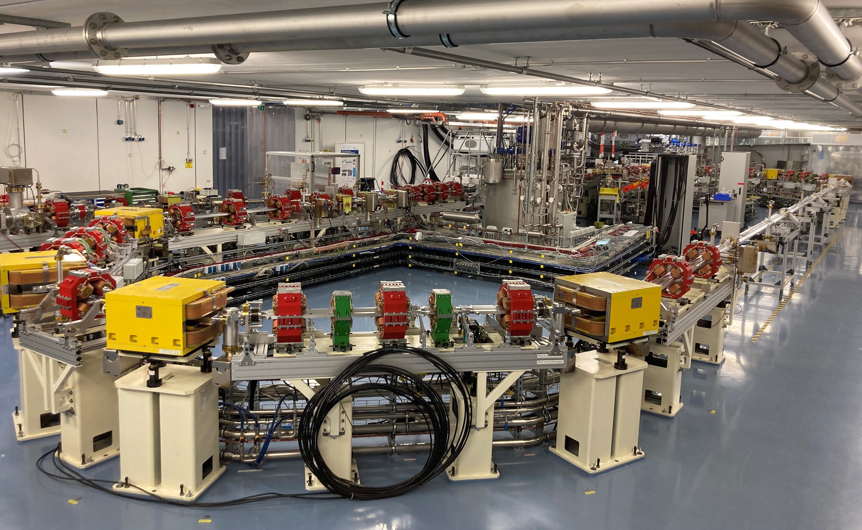
First beam of bERLinPro@SEALab to be expected around late Spring
to Summer 2023
BESSY II
SEALab facility
bERLinPro
focus on commissioning injector with SRF gun + diagnostic line
(map out the reachable parameter space)
installation of the Booster module
recirculation, when LINAC funding is secured

Slide 48
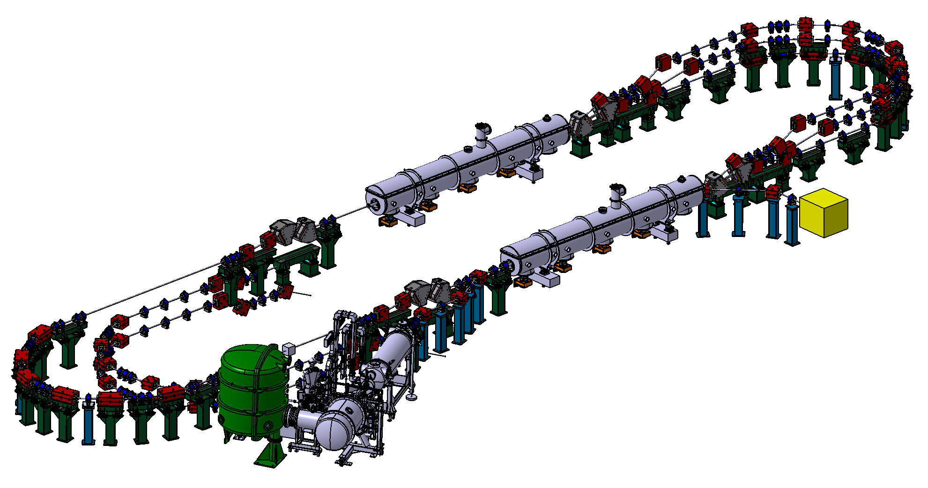
Upcoming facilities for Energy Recovery R&D
complementary in addressing the R&D objectives for Energy Recovery
3-turn ERL
PERLE @ IJCLab
international collaboration bringing all aspects together to demonstrate readiness of Energy Recovery for HEP collider applications
first multi-turn ERL, based on SRF technology, designed to operate at 10MW power regime
Target Parameter | Unit | Value
Injection energy | MeV | 7
Electron beam energy | MeV | 500
Normalised Emittance γε_{x,y} | mm mrad | 6
Average beam current | mA | 20
Bunch charge | pC | 500
Bunch length | mm | 3
Bunch spacing | ns | 25
RF frequency | MHz | 801.58
Duty factor |  | CW
PERLE – Powerful Energy Recovery Linac for Experiments [CDR: J.Phys.G 45 (2018) 6, 065003]

Slide 49
Upcoming facilities for Energy Recovery R&D
complementary in addressing the R&D objectives for Energy Recovery
PERLE @ IJCLab
international collaboration with several in-kind contributions
start with only one LINAC
beams up to 250 MeV
second LINAC design & built
integrate FRT & towards 4.4K
beams up to 500 MeV
beam dump
cryomodule from SPL @ CERN relevant in FCC-ee feasibility study
Booster from JLab/AES
ALICE electron gun from Daresbury
DC gun @ PERLE versus SRF gun @ bERLinPro

Slide 50

Upcoming facilities for Energy Recovery R&D
complementary in addressing the R&D objectives for Energy Recovery
PERLE @ IJCLab
international collaboration with several in-kind contributions
start with only one LINAC
beams up to 250 MeV
second LINAC design & built
integrate FRT & towards 4.4K
beams up to 500 MeV
beam dump
not enough space in cryomodule
cryomodule from SPL @ CERN relevant in FCC-ee feasibility study
FCC-ee cavities tested at PERLE ?
Booster from JLab/AES
ALICE electron gun from Daresbury
DC gun @ PERLE versus SRF gun @ bERLinPro

Slide 51
Upcoming facilities for Energy Recovery R&D
complementary in addressing the R&D objectives for Energy Recovery
PERLE @ IJCLab
international collaboration with several in-kind contributions
start with only one LINAC
beams up to 250 MeV
More in the upcoming talk of Achille Stocchi
second LINAC design & built
integrate FRT & towards 4.4K
beams up to 500 MeV
beam dump
not enough space in cryomodule
cryomodule from SPL @ CERN relevant in FCC-ee feasibility study
FCC-ee cavities tested at PERLE ?
Booster from JLab/AES
ALICE electron gun from Daresbury
DC gun @ PERLE versus SRF gun @ bERLinPro

Slide 52
Sustainable Accelerating Systems with Energy Recovery at future HEP colliders example of Higgs Factories

Slide 53
Impact for the current designs of Higgs Factories
Linear colliders
Circular colliders
ACC
ACC
radiation
ACC
dump >99.9999% of
the beam power
FCC-ee@250 ≃ 300 MW
∼2% of annual electricity
consumption in Belgium
radiate away very quickly
the beam power
about half of this is dumped or lost due to radiation
OBJECTIVE: develop accelerator technologies that recover the beam energy with an impact of saving ∼1% of Belgium’s electricity

Slide 54
Impact for the current designs of Higgs Factories
Linear colliders
Circular colliders
ACC
ACC
radiation
ACC
dump >99.9999% of
the beam power
FCC-ee@250 ≃ 300 MW
∼4% of annual electricity
consumption in Belgium
radiate away very quickly
the beam power
Energy consumption is reducing in Europe, not excluded with ½ by 2050-2060
about half of this is dumped or lost due to radiation
OBJECTIVE: develop accelerator technologies that recover the beam energy with an impact of saving ∼2% of Belgium’s electricity

Slide 55
Addressing with ERL the European Strategy for Particle Physics 2020
An electron-positron Higgs factory
is the highest-priority next collider.
The energy efficiency of present and future
accelerators […] is and should remain an area
requiring constant attention.
A detailed plan for the […] saving and re-use of
energy should be part of the approval process
for any major project.
European Strategy for Particle Physics 2020
ERL

Slide 56
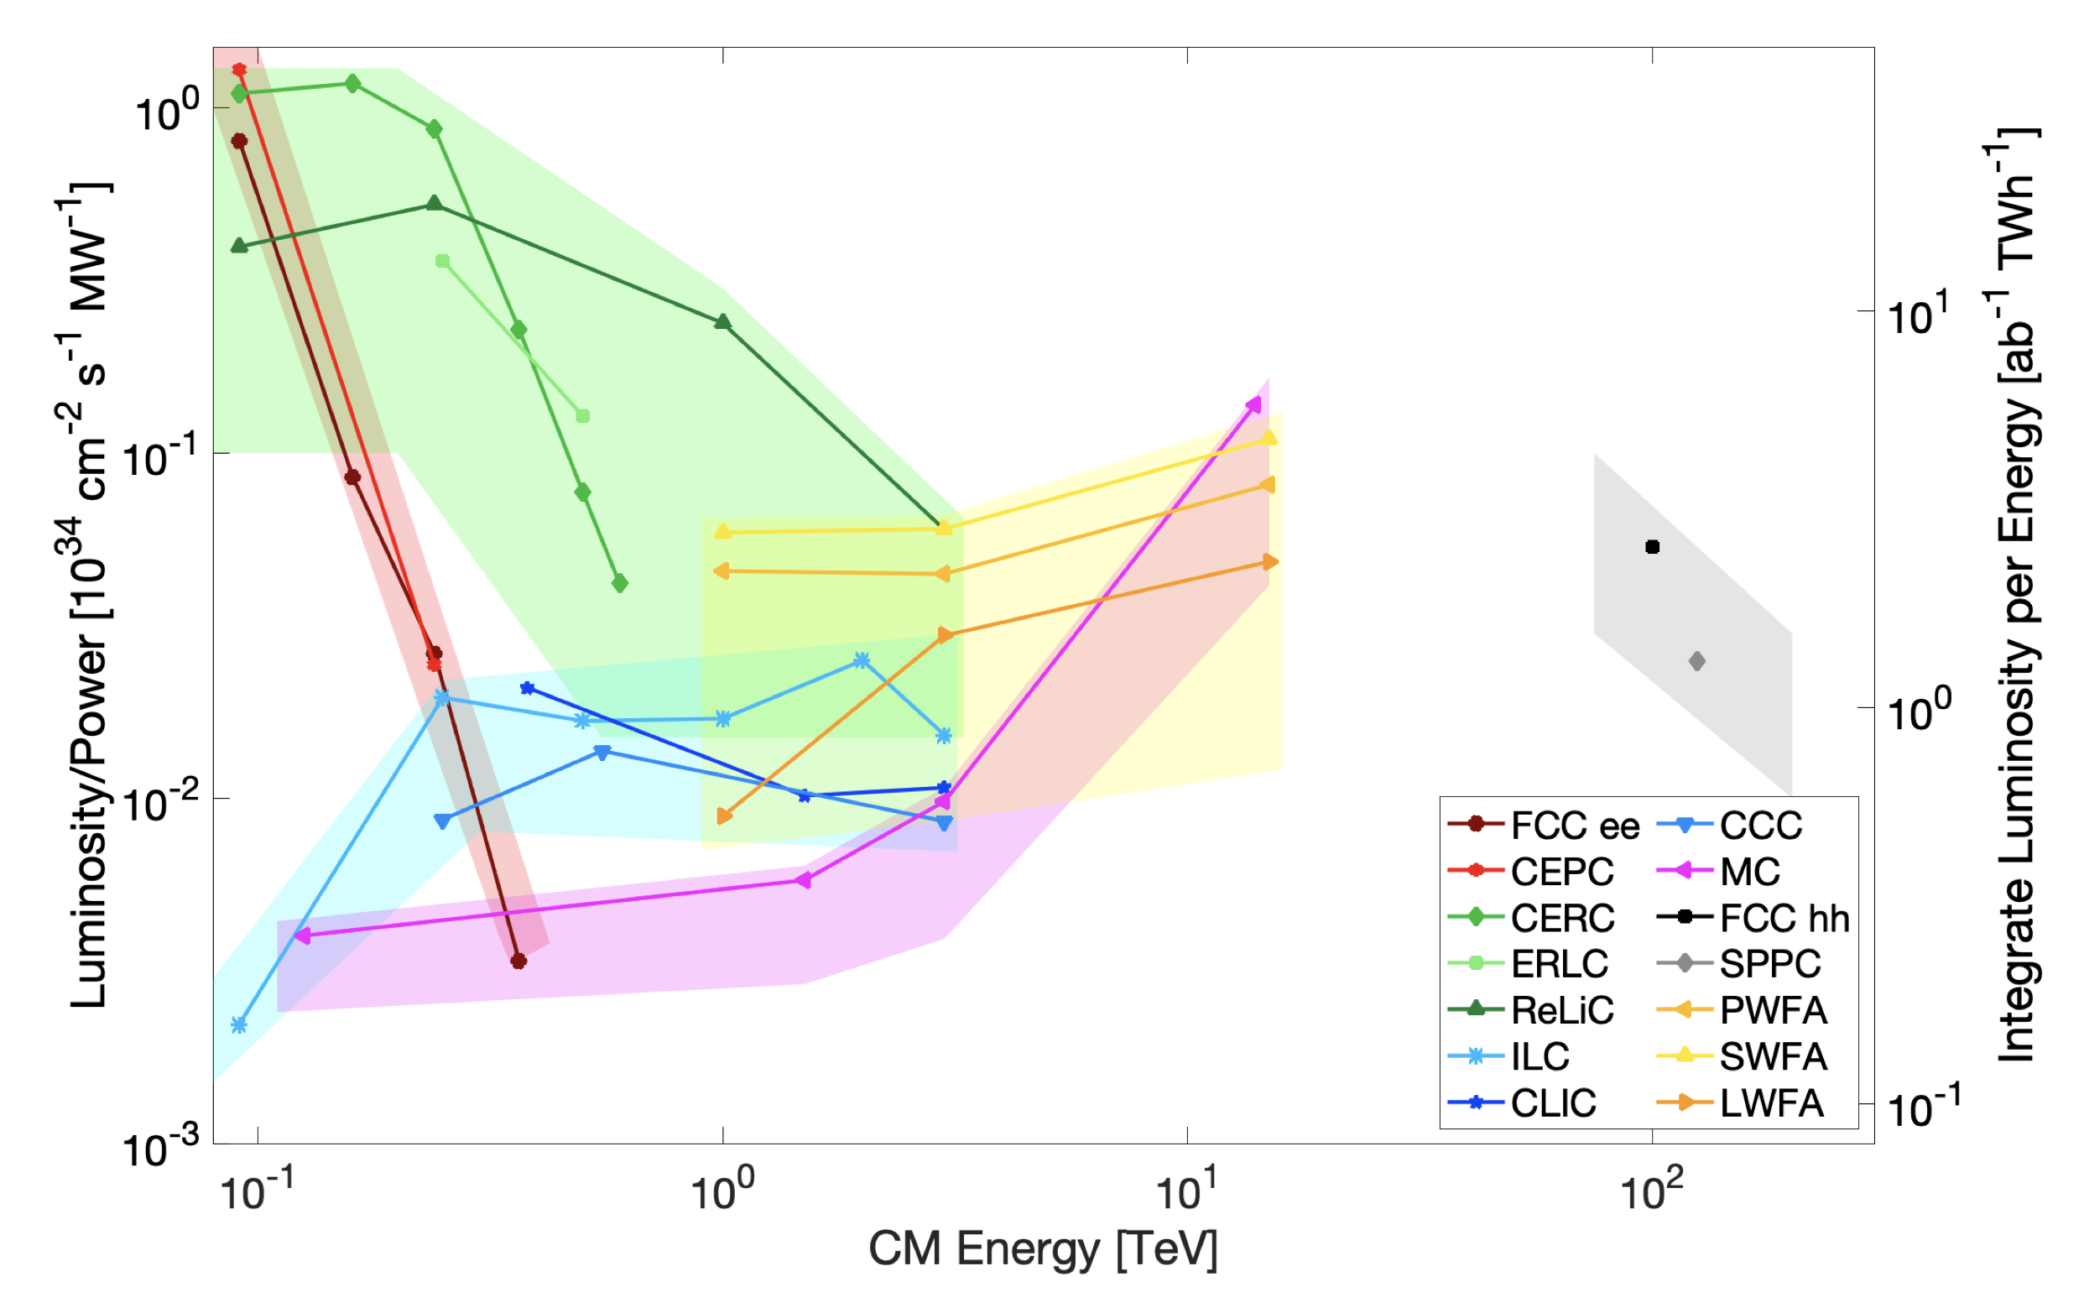
Energy Recovery applications for HEP e⁺e⁻ colliders
Z
CERC: ERL-based 100km e⁺e⁻ Higgs Factory
This plot suggests that with an ERL version of a Higgs Factory one might reach
x10 more H’s
or
x10 less electricity costs
NOTE: several additional challenges identified to realise these ERL-based Higgs Factories
WW
ZH
Collider Implementation Task Force
Snowmass Report
arXiv:2208.06030v1
CERC
snapshot of lots of work in progress
full scrutiny of ERL-based proposals yet to come
tt
FCC-ee
Refs for CERC: PLB 804 (2020) 135394 and arXiv:2203.07358

Slide 57
Energy Recovery applications for HEP e⁺e⁻ colliders
Z
CERC: ERL-based 100km e⁺e⁻ Higgs Factory
This plot suggests that with an ERL version of a Higgs Factory one might reach
x10 more H’s
or
x10 less electricity costs
NOTE: several additional challenges identified to realise these ERL-based Higgs Factories
WW
ZH
Collider Implementation Task Force
Snowmass Report
arXiv:2208.06030v1
CERC
snapshot of lots of work in progress
full scrutiny of ERL-based proposals yet to come
tt
FCC-ee
next slide: what would be
the concrete impact
Refs for CERC: PLB 804 (2020) 135394 and arXiv:2203.07358

Slide 58
Energy Recovery applications for HEP
Z
WW
ZH
Collider Implementation Task Force
Snowmass Report
arXiv:2208.06030v1
This plot suggests that with an ERL version of a Higgs Factory one might reach
x10 more H’s
or
x10 less electricity costs
CERC
tt
FCC-ee
the previous factor of 10x
Refs for CERC: PLB 804 (2020) 135394 and arXiv:2203.07358

Slide 59
Energy Recovery applications for HEP
Z
WW
ZH
Collider Implementation Task Force
Snowmass Report
arXiv:2208.06030v1
This plot suggests that with an ERL version of a Higgs Factory one might reach
x10 more H’s
or
x10 less electricity costs
CERC
tt
FCC-ee
even with only a factor of 2x
the impact is huge, >2.5 BCHF
the previous factor of 10x
Refs for CERC: PLB 804 (2020) 135394 and arXiv:2203.07358

Slide 60
Energy Recovery applications for HEP
Can we dream to have an ERL-based Higgs Factory in the LHC tunnel?
Power of Synchrotron Radiation ∼ 1/R
R : radius of circular collider
Synchrotron Radiation in 27km versus 100km e⁺e⁻ collider ∼ x4
LHC ERL-based Higgs Factory versus FCC-ee
the same electricity cost for the same number of Higgses ?
Z
WW
ZH
Collider Implementation Task Force
Snowmass Report
arXiv:2208.06030v1
This plot suggests that with an ERL version of a Higgs Factory one might reach
x10 more H’s
or
x10 less electricity costs
CERC
tt
FCC-ee
Refs for CERC: PLB 804 (2020) 135394 and arXiv:2203.07358

Slide 61
Energy Recovery applications for HEP
Can we dream to have an ERL-based Higgs Factory in the LHC tunnel?
Power of Synchrotron Radiation ∼ 1/R
R : radius of circular collider
Synchrotron Radiation in 27km versus 100km e⁺e⁻ collider ∼ x4
LHC ERL-based Higgs Factory versus FCC-ee
the same electricity cost for the same number of Higgses ?
Z
WW
ZH
Collider Implementation Task Force
Snowmass Report
arXiv:2208.06030v1
This plot suggests that with an ERL version of a Higgs Factory one might reach
x10 more H’s
or
x10 less electricity costs
CERC
tt
FCC-ee
Several aspects are to be verified in these initial thoughts, but it demonstrates the potential impact of ERL,
and motivates R&D support for ERL and
sustainable accelerating systems to further explore
Refs for CERC: PLB 804 (2020) 135394 and arXiv:2203.07358

Slide 62
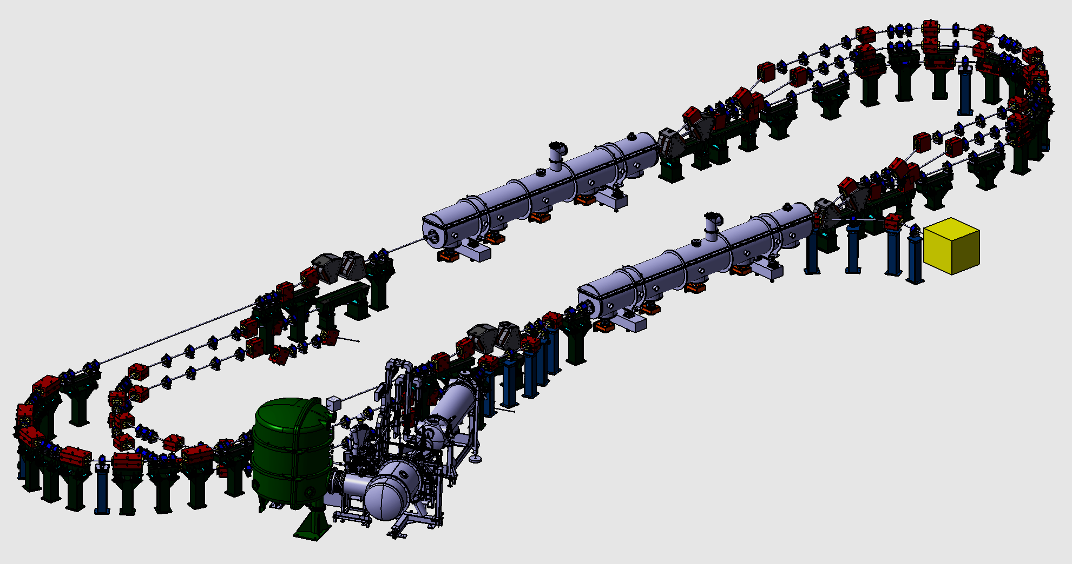
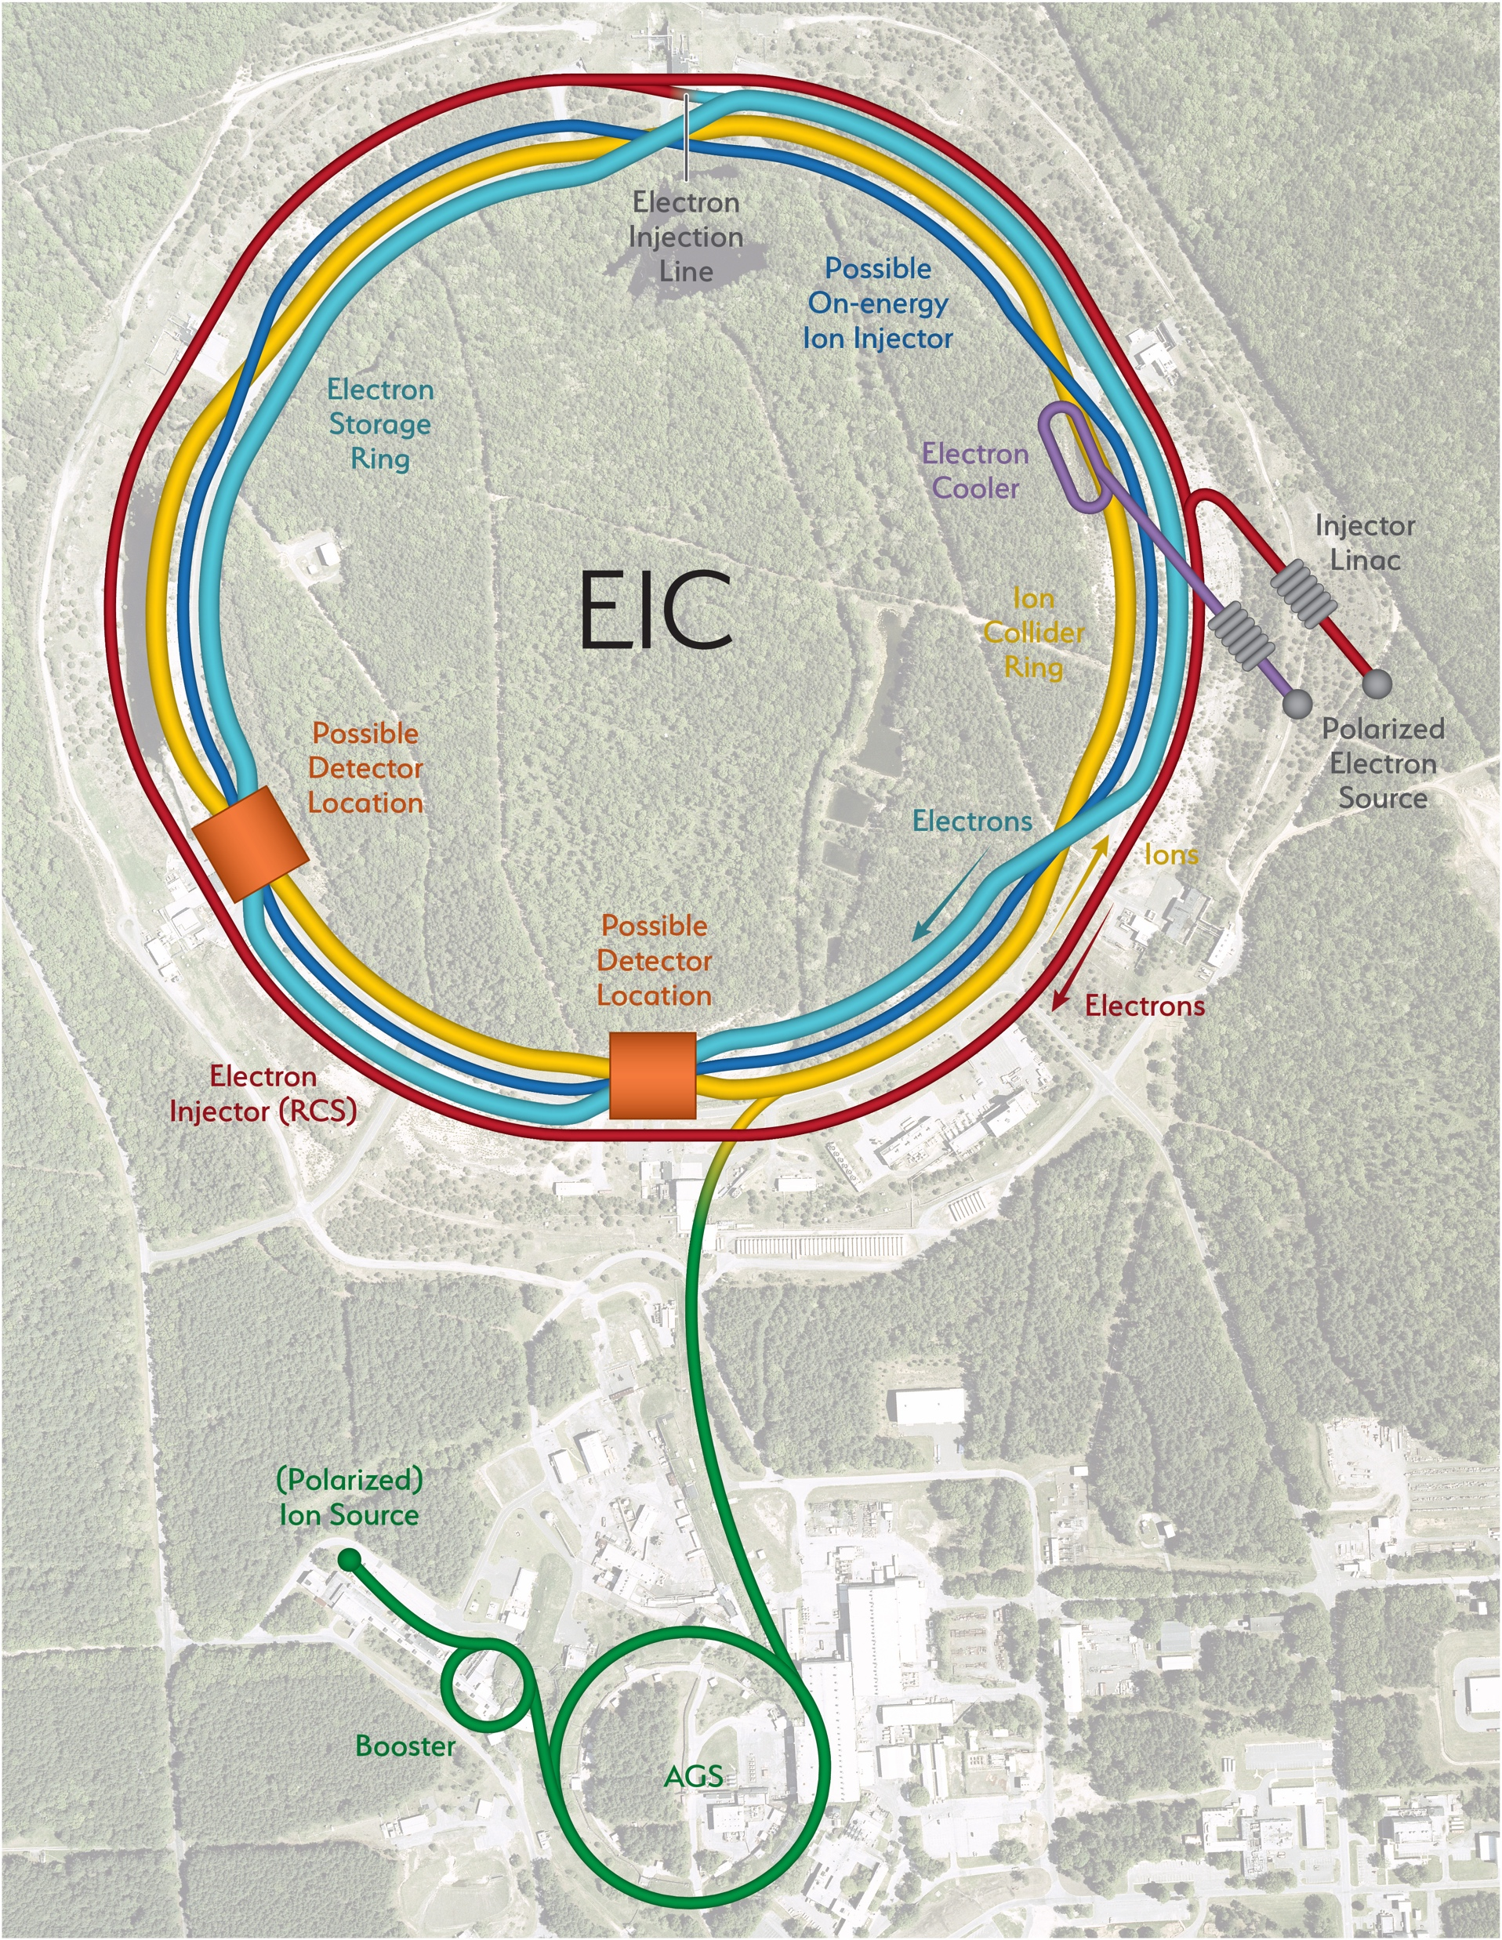

The future of ERL colliders
With stepping stones for innovations in technology
to boost our physics reach
2040-2050’ies
ERL Higgs Factory
2020’ies
2030-2040’ies
2 ERL beams
2020-2030’ies
PERLE
with high-power ERL
e⁺e⁻ Higgs Factory
(Z/W/H/top program)
EIC
1 ERL beam
bERLinPro
high-power ERL
e⁻ beam in collision
(ep/eA @ LHC program)
high-power ERL
demonstrated
ERL application
electron cooling

Slide 63
The future of ERL colliders
With stepping stones for innovations in technology
to boost our physics reach
2040-2050’ies
the ultimate upgrade
of the LHC programme
ERL Higgs Factory
2020’ies
2030-2040’ies
2 ERL beams
2020-2030’ies
PERLE
with high-power ERL
e⁺e⁻ Higgs Factory
(Z/W/H/top program)
EIC
1 ERL beam
bERLinPro
high-power ERL
e⁻ beam in collision
(ep/eA @ LHC program)
high-power ERL
demonstrated
ERL application
electron cooling
the next major collider

Slide 64
from the European Accelerator R&D Roadmap programme
together engaged into a concrete R&D project
proposal
“Innovate for Sustainable Accelerating Systems”
(iSAS)

Slide 65
“Innovate for Sustainable Accelerating Systems”
HORIZON-INFRA-2023-TECH-01-01
New technologies and solutions for reducing the environmental and climate footprint of RIs
REGULATIONS
Specific conditions
  Expected EU contribution per project: around 5M EUR.
  Consortia must include at least 3 different research infrastructures, each of them being an ESFRI infrastructure, and/or a European Research Infrastructures Consortium (ERIC) or another research infrastructure of European interest (i.e. a research infrastructure which is able to attract users from EU or associated countries other than the country where the infrastructure is located). Consortia should be built around a leading core of at least 3 world-class research infrastructures and can include a wider set of RIs.
  Other technological partners, including industry and SMEs, should also be involved, thus promoting innovation and knowledge sharing through co-development of new technical solutions for research infrastructures.
  Proposals should built on and explain any synergies and complementarities with previous or current EU grants, including those under other parts of the Framework Programmes.
Expected Outcome
Reduction of environmental impacts (including climate-related)
Optimisation of resource and energy consumption integrated through the full life cycle of research infrastructures
Increased long-term sustainability of European research infrastructures
Scope
      The aim of this topic is to deliver innovative technologies and solutions which reduce the environmental and climate footprint of RIs through the full life cycle of research infrastructures. Proposals should identify common methodologies, among the concerned RIs, to assess environmental impact and strategies to reduce it, as well as efficiency gains in the broader ecosystem.
      Proposals should address the following aspects, as relevant:
        new technologies and solutions for research infrastructures enabling transformative resource efficiency (e.g. energy consumption) and reduction of environmental (including climate-related) impacts, including, when relevant, more sustainable and efficient ways of collecting, processing and providing access to data;
        validation and prototyping;
        training of RI staff for the operation and use of the new solutions;
        action plans to deploy the new developments at wider scale and ensure their sustainability;
        measures to ensure an environmentally effective integration of the solutions in the local contexts;
        societal engagement to foster acceptance of the solutions in the local and regional communities.

Slide 66
“Innovate for Sustainable Accelerating Systems”
HORIZON-INFRA-2023-TECH-01-01
New technologies and solutions for reducing the environmental and climate footprint of RIs
REGULATIONS
Specific conditions
  Expected EU contribution per project: around 5M EUR.
  Consortia must include at least 3 different research infrastructures, each of them being an ESFRI infrastructure, and/or a European Research Infrastructures Consortium (ERIC) or another research infrastructure of European interest (i.e. a research infrastructure which is able to attract users from EU or associated countries other than the country where the infrastructure is located). Consortia should be built around a leading core of at least 3 world-class research infrastructures and can include a wider set of RIs.
  Other technological partners, including industry and SMEs, should also be involved, thus promoting innovation and knowledge sharing through co-development of new technical solutions for research infrastructures.
  Proposals should built on and explain any synergies and complementarities with previous or current EU grants, including those under other parts of the Framework Programmes.
Expected Outcome
Reduction of environmental impacts (including climate-related)
Optimisation of resource and energy consumption integrated through the full life cycle of research infrastructures
Increased long-term sustainability of European research infrastructures
Scope
      The aim of this topic is to deliver innovative technologies and solutions which reduce the environmental and climate footprint of RIs through the full life cycle of research infrastructures. Proposals should identify common methodologies, among the concerned RIs, to assess environmental impact and strategies to reduce it, as well as efficiency gains in the broader ecosystem.
      Proposals should address the following aspects, as relevant:
        new technologies and solutions for research infrastructures enabling transformative resource efficiency (e.g. energy consumption) and reduction of environmental (including climate-related) impacts, including, when relevant, more sustainable and efficient ways of collecting, processing and providing access to data;
        validation and prototyping;
        training of RI staff for the operation and use of the new solutions;
        action plans to deploy the new developments at wider scale and ensure their sustainability;
        measures to ensure an environmentally effective integration of the solutions in the local contexts;
        societal engagement to foster acceptance of the solutions in the local and regional communities.
Create strong and broad impact with a 5M EUR EU-project
Goal: develop, prototype and validate the essential energy-saving and energy-recovery technologies required to integrate in the design of a novel sustainable LINAC cryomodule with a broad portfolio of applications in industry and at accelerator research infrastructures
Sustain the impactful 20th-century accelerator applications into an energy-low 21st century!

Slide 67
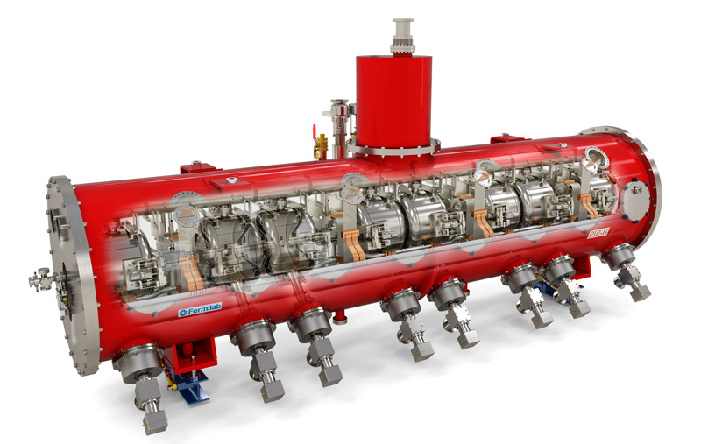
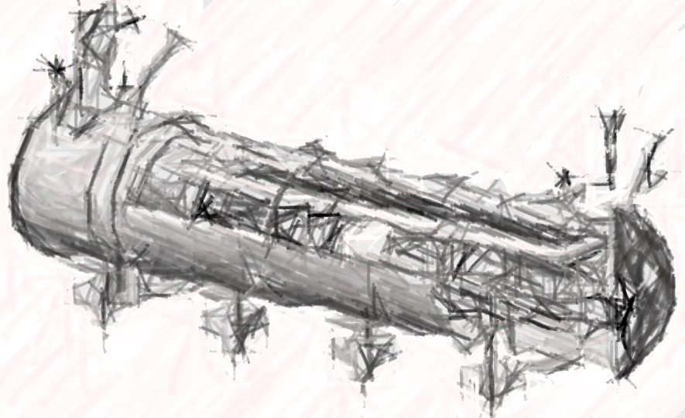
INNOVATE TECHNOLOGIES TOWARDS
A SUSTAINABLE ACCELERATING SYSTEM
TODAY
NEW DESIGN

Slide 68
DEVELOP ENERGY-SAVING & ENERGY-RECOVERY TECHNOLOGIES ESSENTIAL TO INTEGRATE IN THE DESIGN OF A SUSTAINABLE LINAC CRYOMODULE
INNOVATE TECHNOLOGIES TOWARDS
A SUSTAINABLE ACCELERATING SYSTEM
TODAY
NEW DESIGN

Slide 69
DEVELOP ENERGY-SAVING & ENERGY-RECOVERY TECHNOLOGIES ESSENTIAL TO INTEGRATE IN THE DESIGN OF A SUSTAINABLE LINAC CRYOMODULE
INNOVATE TECHNOLOGIES TOWARDS
A SUSTAINABLE ACCELERATING SYSTEM
TODAY
NEW DESIGN

Slide 70
DEVELOP ENERGY-SAVING & ENERGY-RECOVERY TECHNOLOGIES ESSENTIAL TO INTEGRATE IN THE DESIGN OF A SUSTAINABLE LINAC CRYOMODULE
others
others
R&D Pathfinders for new
energy-saving & energy-recovery technologies

Slide 71
DEVELOP ENERGY-SAVING & ENERGY-RECOVERY TECHNOLOGIES ESSENTIAL TO INTEGRATE IN THE DESIGN OF A SUSTAINABLE LINAC CRYOMODULE
INTEGRATING
others
others
R&D Pathfinders for new
energy-saving & energy-recovery technologies
integrating new technologies in the design of a new sustainable LINAC cryomodule

Slide 72
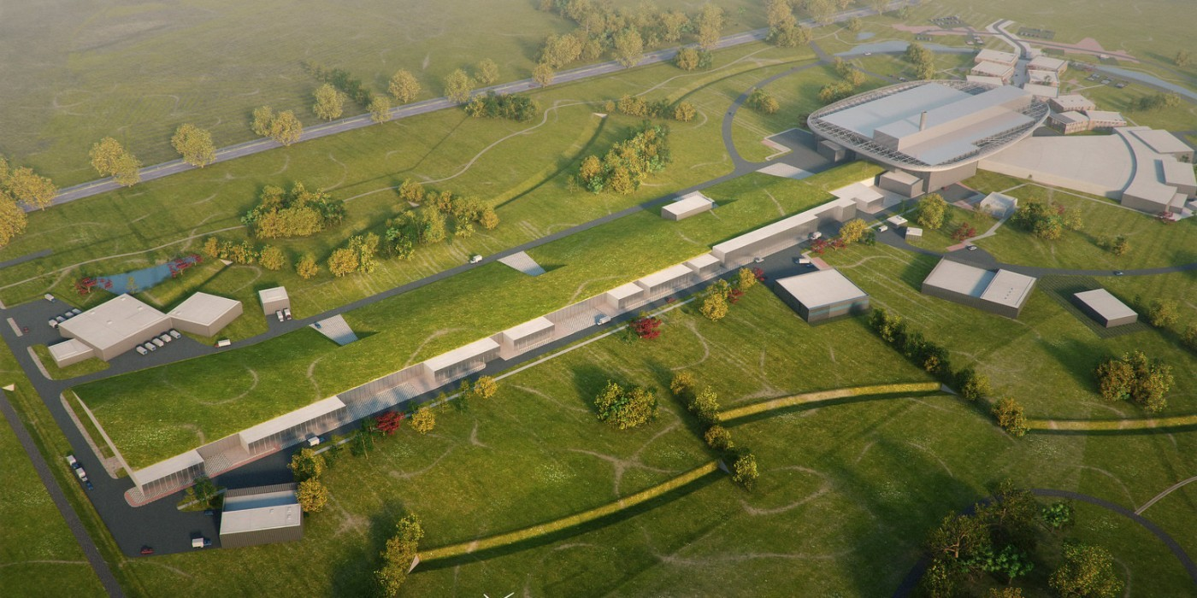
DEVELOP ENERGY-SAVING & ENERGY-RECOVERY TECHNOLOGIES ESSENTIAL TO INTEGRATE IN THE DESIGN OF A SUSTAINABLE LINAC CRYOMODULE
INTEGRATING
others
others
R&D Pathfinders for new
energy-saving & energy-recovery technologies
integrating new technologies in the design of a new sustainable LINAC cryomodule
others
ESS upgrade
full deployment of energy saving & energy recovery in collider RIs

Slide 73
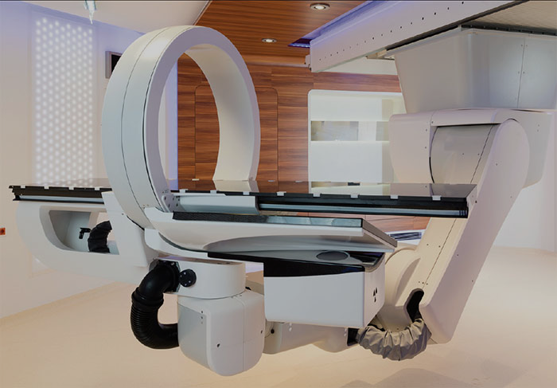
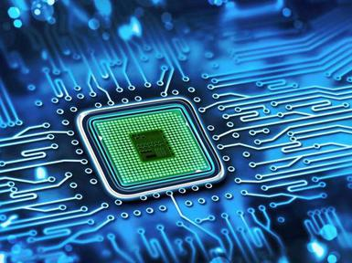
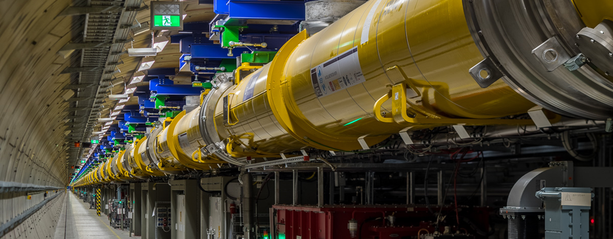
sustainable accelerator turn-key solutions with breakthrough applications
particle therapy
DEVELOP ENERGY-SAVING & ENERGY-RECOVERY TECHNOLOGIES ESSENTIAL TO INTEGRATE IN THE DESIGN OF A SUSTAINABLE LINAC CRYOMODULE
nanometer
semiconductors
Free Electron Lasers
INTEGRATING
others
others
R&D Pathfinders for new
energy-saving & energy-recovery technologies
integrating new technologies in the design of a new sustainable LINAC cryomodule
others
ESS upgrade
full deployment of energy saving & energy recovery in collider RIs

Slide 74
sustainable accelerator turn-key solutions with breakthrough applications
particle therapy
DEVELOP ENERGY-SAVING & ENERGY-RECOVERY TECHNOLOGIES ESSENTIAL TO INTEGRATE IN THE DESIGN OF A SUSTAINABLE LINAC CRYOMODULE
nanometer
semiconductors
Free Electron Lasers
WORK IN PROGRESS
INTEGRATING
others
others
R&D Pathfinders for new
energy-saving & energy-recovery technologies
integrating new technologies in the design of a new sustainable LINAC cryomodule
others
Deadline for applying is March 9, 2023.
Do not hesitate to contact me
for more information.
ESS upgrade
full deployment of energy saving & energy recovery in collider RIs

Slide 75
Electron-proton collisions at the core of particle physics
The high-energy electron-hadron programme at the LHC and FCC are truely general-purpose experiments reaching beyond current knowledge in QCD, Higgs, EW and top quark physics and with its own BSM discovery potential
At the same time, these programmes empower the current research in ATLAS and CMS, and are vital to unlock the full physics potential of a very-high-energy hadron collider
And surely, when we look deeper into the proton we significantly move the low-x frontier and in this terra incognita we do not know what to discover
The engine of our curiosity-driven exploration is society’s appreciation for the portfolio of technological innovations and knowledge transfer that we continue to realize… Energy Recovery systems deliver on this technology front

Slide 76
Innovate for Sustainable Accelerating Systems
Developing “Sustainable Accelerating Systems” is a vital topic for the future of particle physics colliders, and a challenging responsibility we share as a community
The R&D road ahead is very clear and well documented
The ambition is shared with major accelerator laboratories in Europe, with a clear path to prioritise the R&D for sustainable accelerating structures in their organisation
It is essential to demonstrate the performance of these innovative systems during this decade in order to integrate them timely in the designs of future colliders
76
76
76

Slide 77
Innovate for Sustainable Accelerating Systems
Developing “Sustainable Accelerating Systems” is a vital topic for the future of particle physics colliders, and a challenging responsibility we share as a community
The R&D road ahead is very clear and well documented
The ambition is shared with major accelerator laboratories in Europe, with a clear path to prioritise the R&D for sustainable accelerating structures in their organisation
It is essential to demonstrate the performance of these innovative systems during this decade in order to integrate them timely in the designs of future colliders
The time has come to promote and to commit to these technological efforts as a community, a very clear statement that our community is committed to strong R&D contributions to realize a broad R&D programme for Sustainable Accelerating Systems (incl. ERL) is welcome
77
77
77

Slide 78


Innovate for Sustainable Accelerating Systems
Developing “Sustainable Accelerating Systems” is a vital topic for the future of particle physics colliders, and a challenging responsibility we share as a community
The R&D road ahead is very clear and well documented
The ambition is shared with major accelerator laboratories in Europe, with a clear path to prioritise the R&D for sustainable accelerating structures in their organisation
It is essential to demonstrate the performance of these innovative systems during this decade in order to integrate them timely in the designs of future colliders
The time has come to promote and to commit to these technological efforts as a community, a very clear statement that our community is committed to strong R&D contributions to realize a broad R&D programme for Sustainable Accelerating Systems (incl. ERL) is welcome
Thank you for your attention!
Jorgen.DHondt@vub.be
78
78
78
78
78
78
78
78
78
78
78
78
78
78
78

