Slide 1
MuCol Study – Survey of the transverse HOM impedance of the NLSF, ERL-MA and TESLA cavity geometries

Slide 2
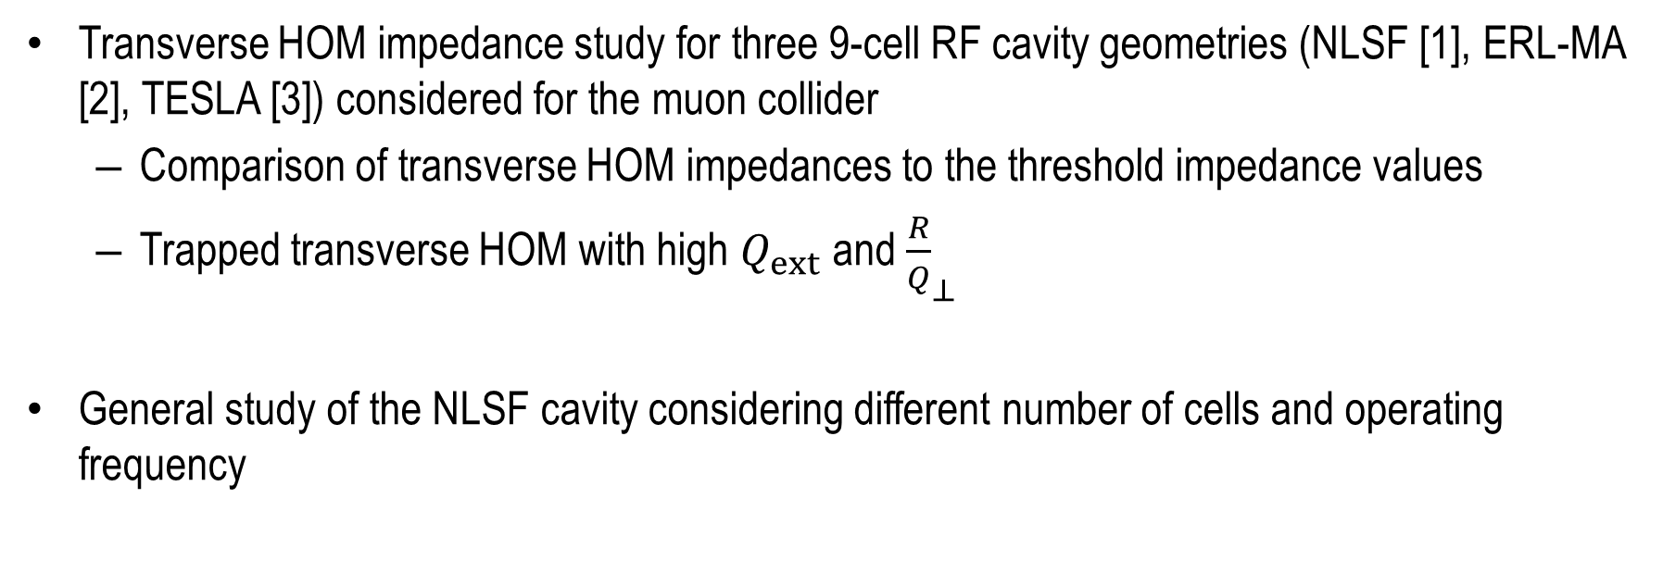
Content
Transverse HOM impedance study for three 9-cell RF cavity geometries (NLSF [1], ERL-MA [2], TESLA [3]) considered for the muon collider
  Comparison of transverse HOM impedances to the threshold impedance values
  Trapped transverse HOM with high $Q_{ext}$ and ${\frac{R}{Q}}_{⊥}$
General study of the NLSF cavity considering different number of cells and operating frequency
[1] N. Juntong, R.M. Jones, High Gradient Superconducting Cavity with Low Surface EM Fields and Well-Suppressed HOMS for the ILC, 2010.
[2] Valey Shemelin, Optimal choice of cell geometry for a multicell superconducting cavity, Physics Review Special Topics – Accelerators and Beamshttps://journals.aps.org/prab/pdf/10.1103/PhysRevSTAB.12.114701
[3] B. Aune et al, Superconducting TESLA cavities, Physical Review Special Topics - Accelerators and Beams, Volume 3, 092001 (2000).

Slide 3
Transverse HOM impedance study NLSF, ERL-MA, and TESLA cavity geometries

Slide 4
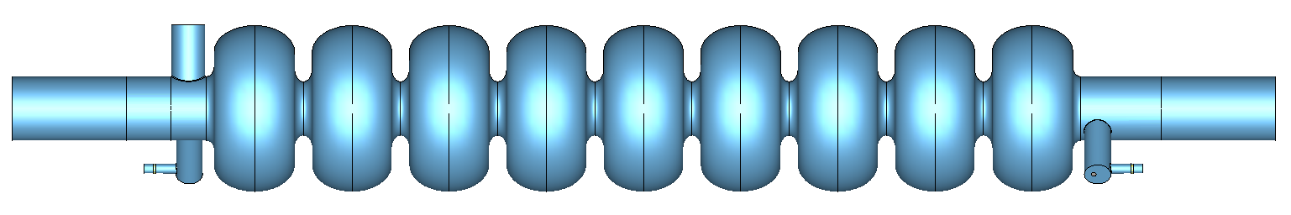
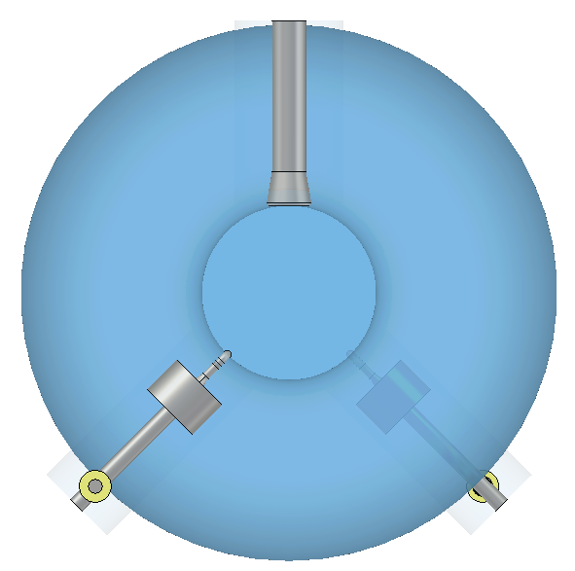
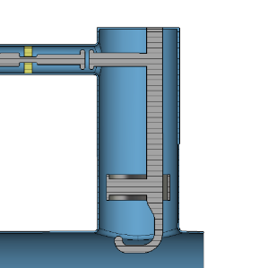

Simulation model setup for the NLSF and TESLA cavity geometries
Waveguide ports boundary condition
NLSF, TESLA
Waveguide ports boundary condition
Left end group:
1 FPC (TTF-III)
1 DQW coupler
Right end group:
1 DQW coupler
TTF-III FPC
Double Quarter Wave (DQW) HOM Coupler

Slide 5
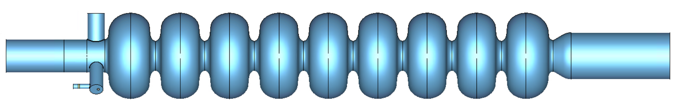
Simulation model setup for the ERL-MA cavity geometry
Waveguide ports boundary condition
Waveguide ports boundary condition
ERL-Max. Acceleration
Right end group:
Beam pipe expansion
Left end group:
1 FPC (TTF-III)
2 DQW coupler
TTF-III FPC
Double Quarter Wave (DQW) HOM Coupler

Slide 6
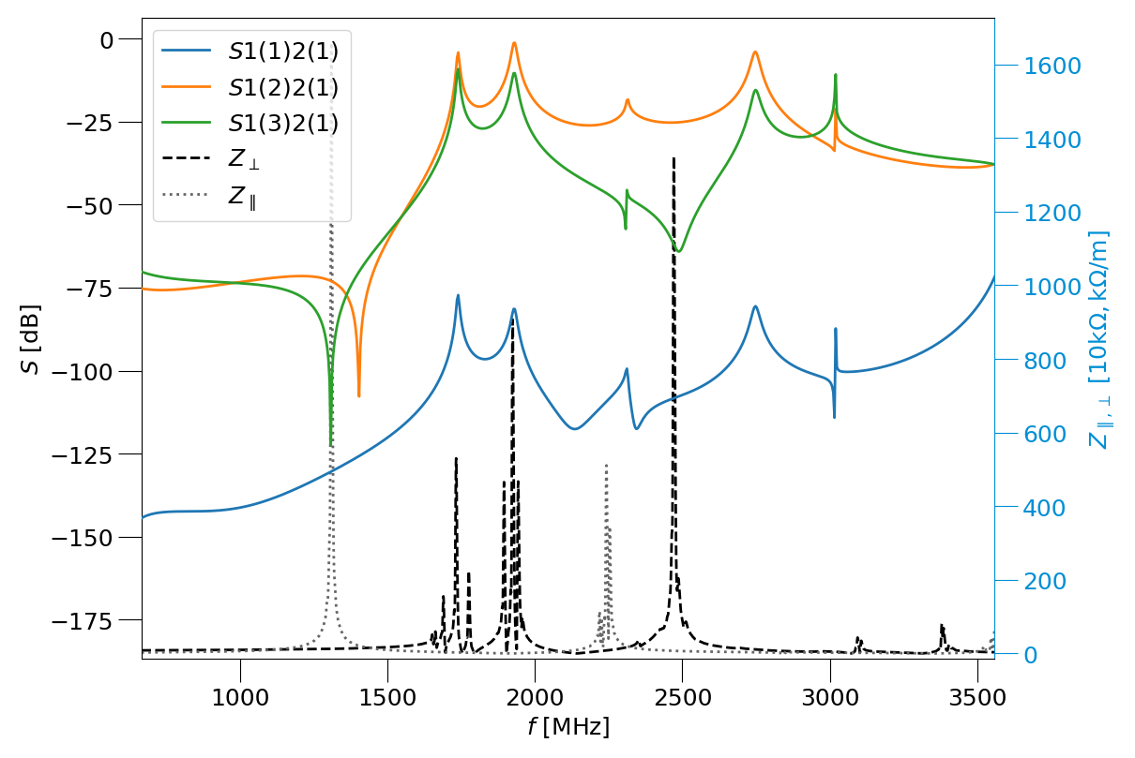
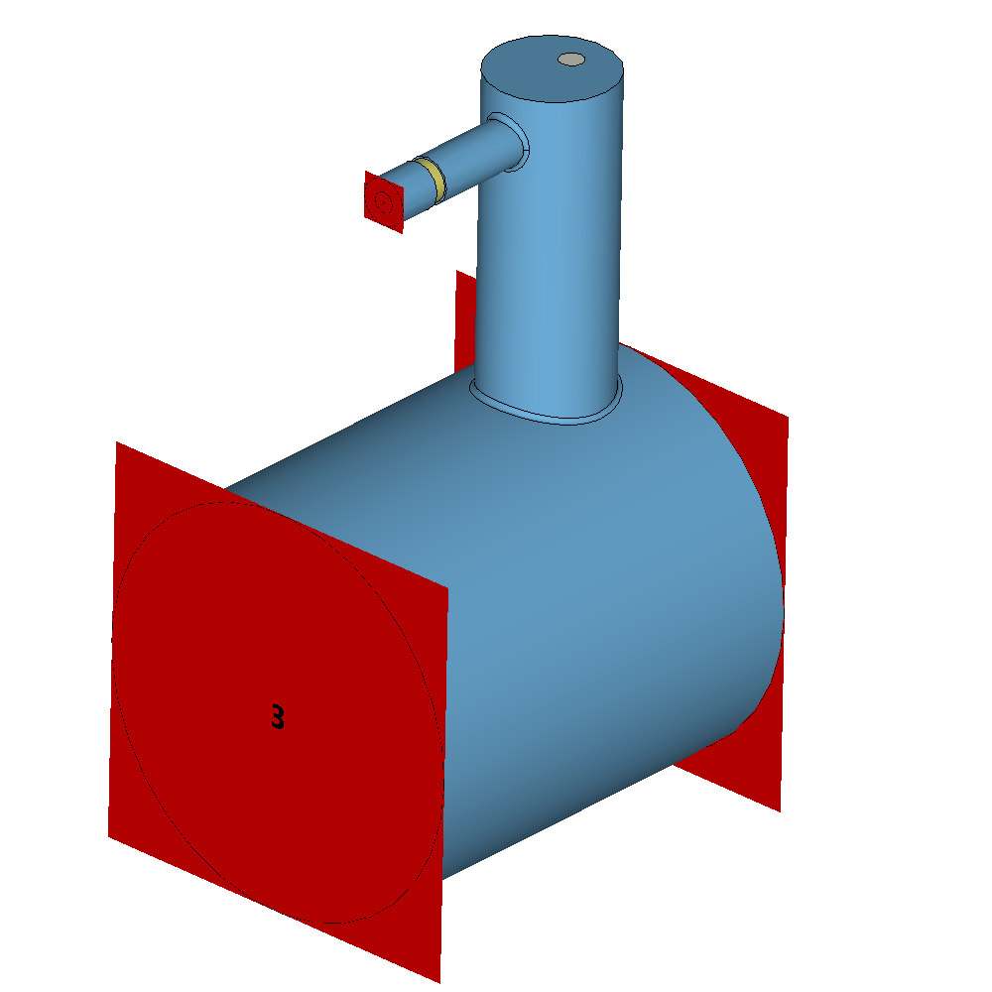
Transmission curves for DQW coupler
2
1
3
Simulation model for the Double Quarter Wave (DQW) HOM Coupler
Transmission curves of tuned DQW HOM coupler and longitudinal and transverse impedance of NLSF cavity.

Slide 7
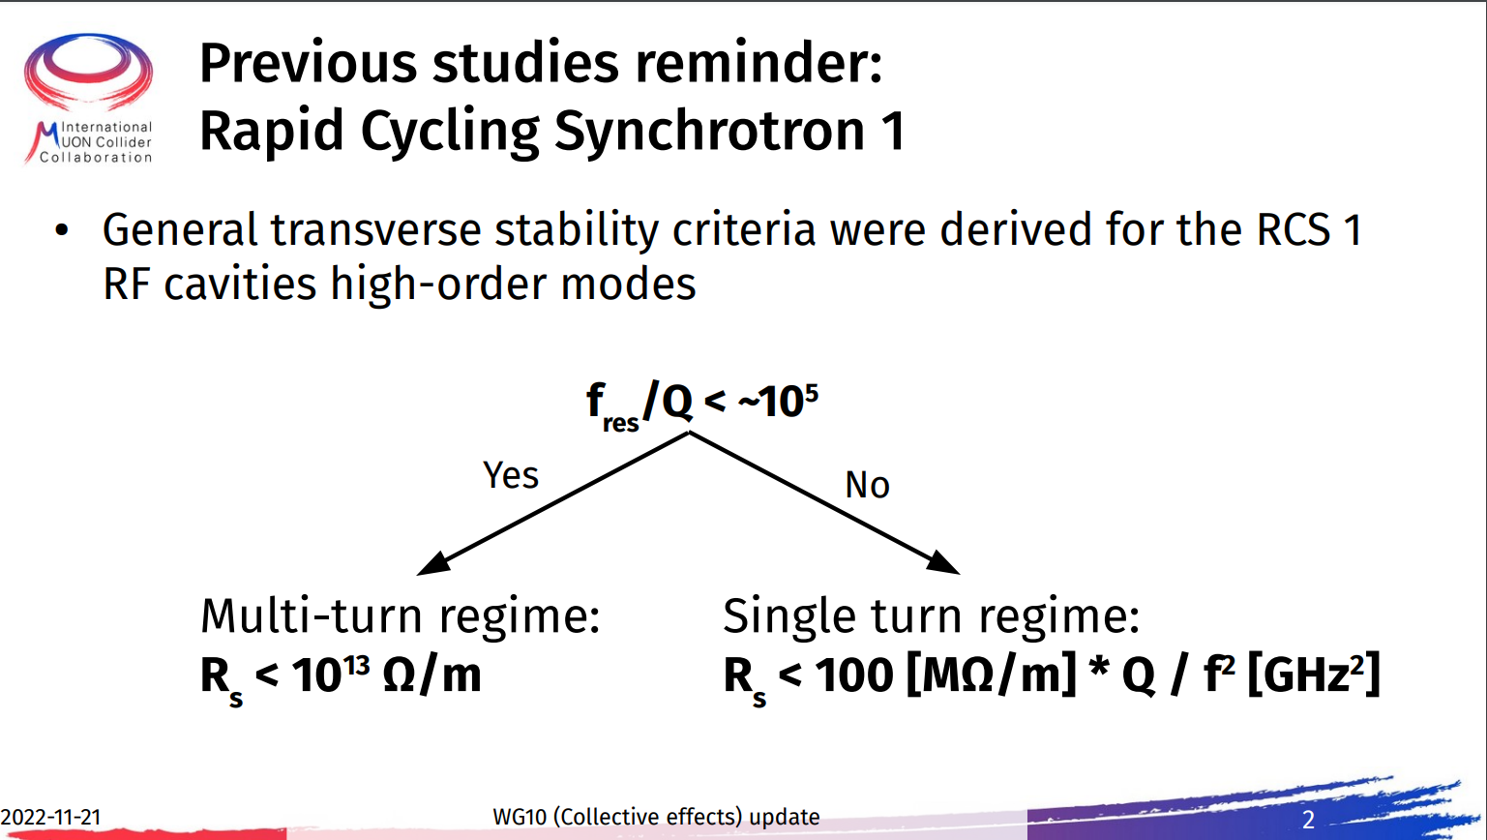
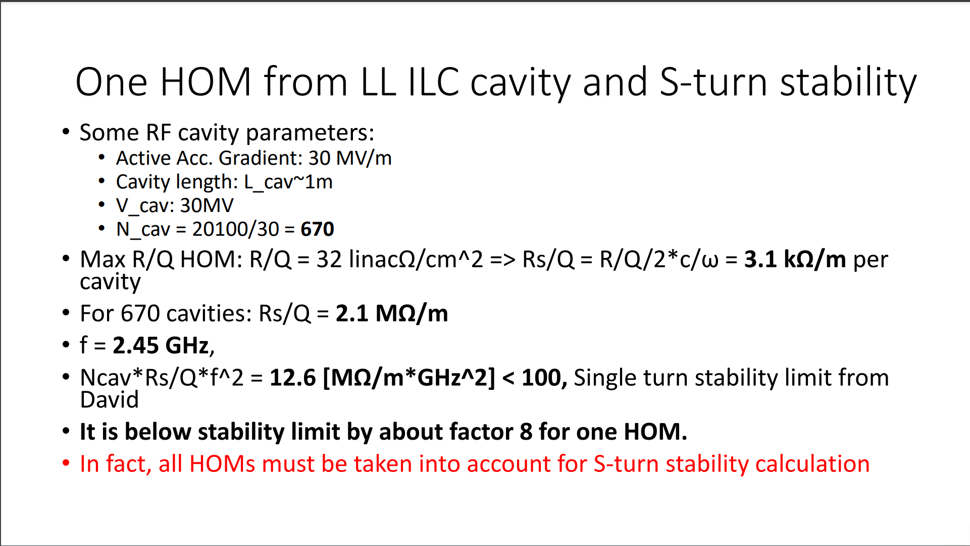
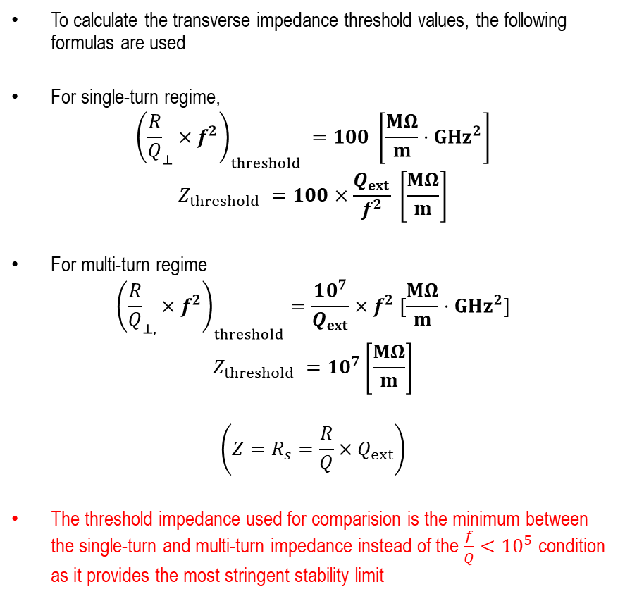
Transverse stability threshold calculation
To calculate the transverse impedance threshold values, the following formulas are used
For single-turn regime,
$${\left({\frac{R}{Q}}_{⊥}×f^{2}\right)}_{threshold} =100 \left[\frac{MΩ}{m}⋅GHz^{2}\right]$$
$$Z_{threshold} =100×\frac{Q_{ext}}{f^{2}} \left[\frac{MΩ}{m}\right]$$
For multi-turn regime
$${\left({\frac{R}{Q}}_{⊥,}×f^{2}\right)}_{threshold}=\frac{10^{7}}{Q_{ext}}×f^{2} [\frac{MΩ}{m}⋅GHz^{2}]$$
$$Z_{threshold} =10^{7}\left[\frac{MΩ}{m}\right]$$
$$\left(Z=R_{s}=\frac{R}{Q}×Q_{ext}\right)$$
The threshold impedance used for comparision is the minimum between the single-turn and multi-turn impedance instead of the $\frac{f}{Q}<{10}^{5}$ condition as it provides the most stringent stability limit
[4] D. Amorim, E. Métral, Working Group 10 (Collective effects) update
[5] Alexej Grudiev, Transverse stability in RCS and TESLA cavity Preliminary considerations

Slide 8
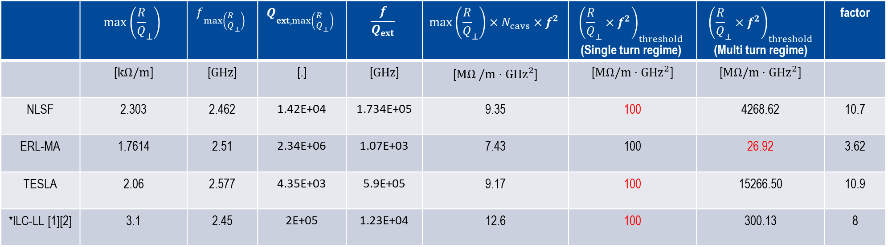

Comparision of maximum transverse R/Q mode impedance with threshold values
$$N_{cavs}=670$$
 | $$\max\left({\frac{R}{Q}}_{⊥}\right)$$ | $$f_{\max\left({\frac{R}{Q}}_{⊥}\right)}$$ | $$Q_{ext, max\left({\frac{R}{Q}}_{⊥}\right)}$$ | $$\frac{f}{Q_{ext}}$$ | $$\max\left({\frac{R}{Q}}_{⊥}\right)×N_{cavs}×f^{2}$$ | $${\left({\frac{R}{Q}}_{⊥}×f^{2}\right)}_{threshold}$$ (Single turn regime) | $${\left({\frac{R}{Q}}_{⊥}×f^{2}\right)}_{threshold}$$ (Multi turn regime) | factor
 | [$kΩ/m$] | [$GHz$] | [.] | [$GHz$] | [$MΩ /m⋅GHz^{2}$] | [$MΩ/m⋅GHz^{2}$] | [$MΩ/m⋅GHz^{2}$]
NLSF | 2.303 | 2.462 | 1.42E+04 | 1.734E+05 | 9.35 | 100 | 4268.62 | 10.7
ERL-MA | 1.7614 | 2.51 | 2.34E+06 | 1.07E+03 | 7.43 | 100 | 26.92 | 3.62
TESLA | 2.06 | 2.577 | 4.35E+03 | 5.9E+05 | 9.17 | 100 | 15266.50 | 10.9
*ILC-LL [1][2] | 3.1 | 2.45 | 2E+05 | 1.23E+04 | 12.6 | 100 | 300.13 | 8
*The transverse HOM impedance comparison for the ILC-LL as calculated by Alexej Grudiev is included only in this table for comparison
[1] Alexej Grudiev, SRF cavity parameter model for HEC RF system design, June 2021, https://indico.cern.ch/event/1049297/contributions/4408625/attachments/2268943/3852893/20210622_RFcavity%20parameter%20model%20for%20HE%20moun%20accelrators.pdf
[2] J. Sekutowicz, Design of a low-loss SRF cavity for the ILC, Particle Accelerator Conference, Knoxville, Tennesse, 2005, https://accelconf.web.cern.ch/p05/papers/tppt056.pdf.

Slide 9
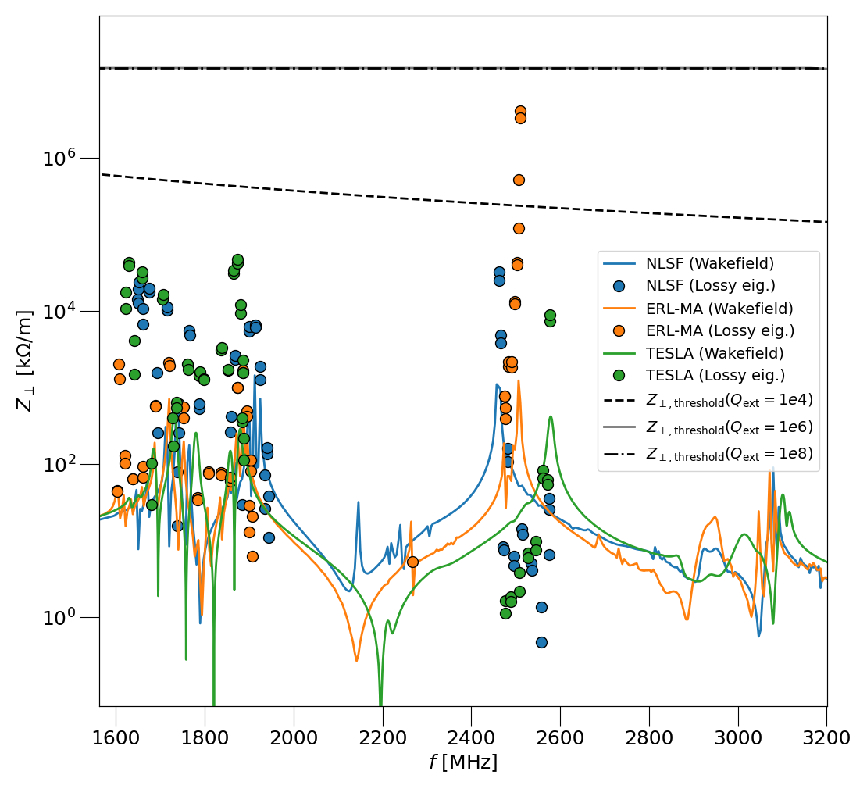
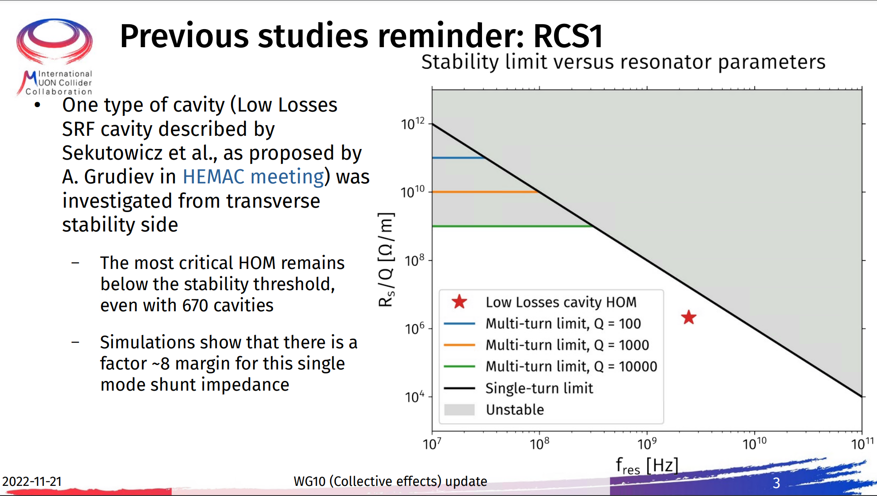
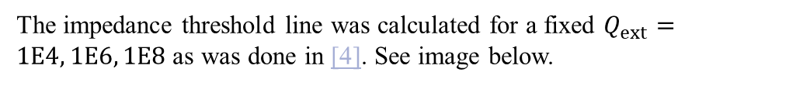
Transverse HOM impedance plot for analysed cavities
The impedance threshold line was calculated for a fixed $Q_{ext}=1E4, 1E6, 1E8$ as was done in [4]. See image below.
Lossy eigenmode and wakefield analysis transverse HOM impedance plot for analysed cavities

Slide 10
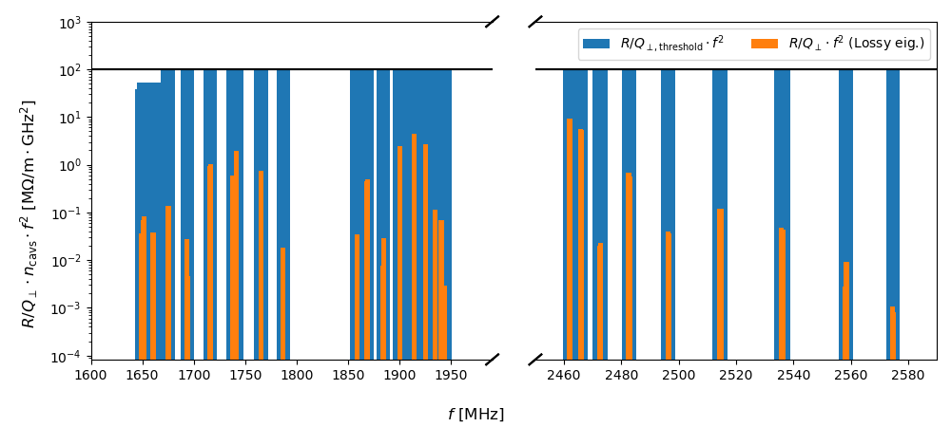
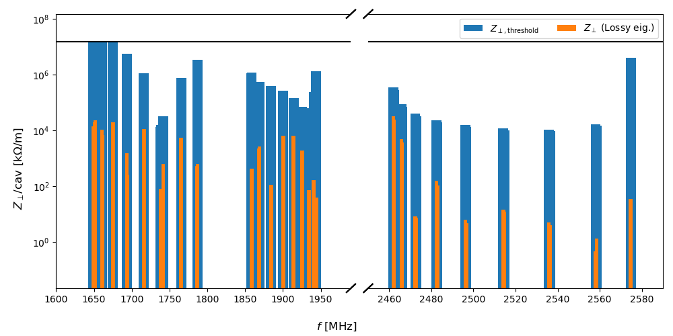
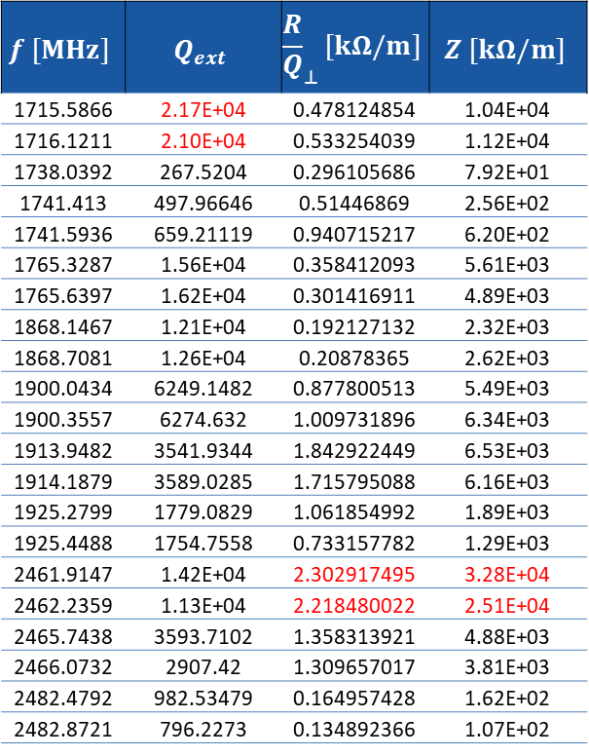
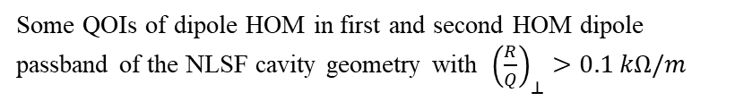
NLSF: Comparision of $Z_{⊥}$and $Z_{⊥, threshold}$
$$f [MHz]$$ | $$Q_{ext}$$ | $${\frac{R}{Q}}_{⊥}[kΩ/m]$$ | $$Z [kΩ/m]$$
1715.5866 | 2.17E+04 | 0.478124854 | 1.04E+04
1716.1211 | 2.10E+04 | 0.533254039 | 1.12E+04
1738.0392 | 267.5204 | 0.296105686 | 7.92E+01
1741.413 | 497.96646 | 0.51446869 | 2.56E+02
1741.5936 | 659.21119 | 0.940715217 | 6.20E+02
1765.3287 | 1.56E+04 | 0.358412093 | 5.61E+03
1765.6397 | 1.62E+04 | 0.301416911 | 4.89E+03
1868.1467 | 1.21E+04 | 0.192127132 | 2.32E+03
1868.7081 | 1.26E+04 | 0.20878365 | 2.62E+03
1900.0434 | 6249.1482 | 0.877800513 | 5.49E+03
1900.3557 | 6274.632 | 1.009731896 | 6.34E+03
1913.9482 | 3541.9344 | 1.842922449 | 6.53E+03
1914.1879 | 3589.0285 | 1.715795088 | 6.16E+03
1925.2799 | 1779.0829 | 1.061854992 | 1.89E+03
1925.4488 | 1754.7558 | 0.733157782 | 1.29E+03
2461.9147 | 1.42E+04 | 2.302917495 | 3.28E+04
2462.2359 | 1.13E+04 | 2.218480022 | 2.51E+04
2465.7438 | 3593.7102 | 1.358313921 | 4.88E+03
2466.0732 | 2907.42 | 1.309657017 | 3.81E+03
2482.4792 | 982.53479 | 0.164957428 | 1.62E+02
2482.8721 | 796.2273 | 0.134892366 | 1.07E+02
Some QOIs of dipole HOM in first and second HOM dipole passband of the NLSF cavity geometry with ${\left(\frac{R}{Q}\right)}_{⊥}>0.1 kΩ/m$
Transverse impedance of dipole modes in first and second HOM dipole passband and transverse impedance threshold bar plot for the NLSF cavity geometry

Slide 11
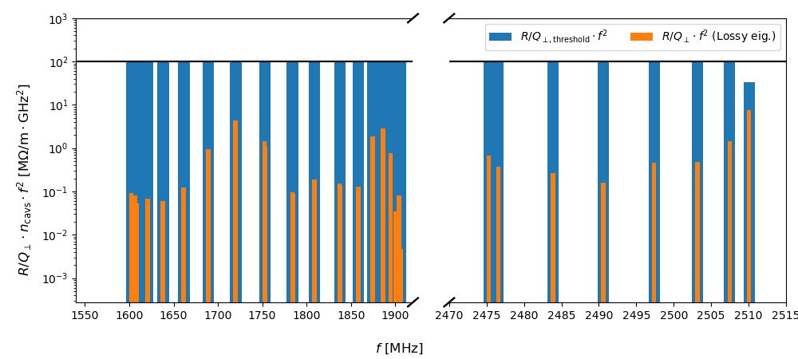
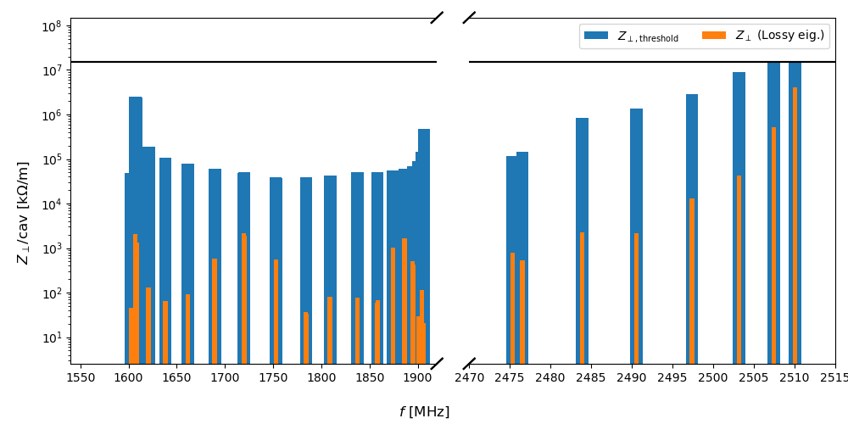
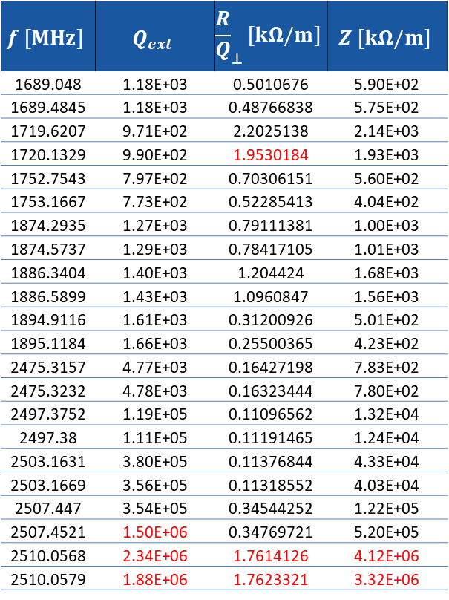

ERL-MA: Comparision of $Z_{⊥}$and $Z_{⊥, threshold}$
$$f [MHz]$$ | $$Q_{ext}$$ | $${\frac{R}{Q}}_{⊥}[kΩ/m]$$ | $$Z [kΩ/m]$$
1689.048 | 1.18E+03 | 0.5010676 | 5.90E+02
1689.4845 | 1.18E+03 | 0.48766838 | 5.75E+02
1719.6207 | 9.71E+02 | 2.2025138 | 2.14E+03
1720.1329 | 9.90E+02 | 1.9530184 | 1.93E+03
1752.7543 | 7.97E+02 | 0.70306151 | 5.60E+02
1753.1667 | 7.73E+02 | 0.52285413 | 4.04E+02
1874.2935 | 1.27E+03 | 0.79111381 | 1.00E+03
1874.5737 | 1.29E+03 | 0.78417105 | 1.01E+03
1886.3404 | 1.40E+03 | 1.204424 | 1.68E+03
1886.5899 | 1.43E+03 | 1.0960847 | 1.56E+03
1894.9116 | 1.61E+03 | 0.31200926 | 5.01E+02
1895.1184 | 1.66E+03 | 0.25500365 | 4.23E+02
2475.3157 | 4.77E+03 | 0.16427198 | 7.83E+02
2475.3232 | 4.78E+03 | 0.16323444 | 7.80E+02
2497.3752 | 1.19E+05 | 0.11096562 | 1.32E+04
2497.38 | 1.11E+05 | 0.11191465 | 1.24E+04
2503.1631 | 3.80E+05 | 0.11376844 | 4.33E+04
2503.1669 | 3.56E+05 | 0.11318552 | 4.03E+04
2507.447 | 3.54E+05 | 0.34544252 | 1.22E+05
2507.4521 | 1.50E+06 | 0.34769721 | 5.20E+05
2510.0568 | 2.34E+06 | 1.7614126 | 4.12E+06
2510.0579 | 1.88E+06 | 1.7623321 | 3.32E+06
Transverse impedance of dipole modes in first and second HOM dipole passband and transverse impedance threshold bar plot for the ERL-MA cavity geometry
Some QOIs of dipole HOM in first and second HOM dipole passband of the ERL-MA cavity geometry with ${\left(\frac{R}{Q}\right)}_{⊥}>0.1 kΩ/m$

Slide 12
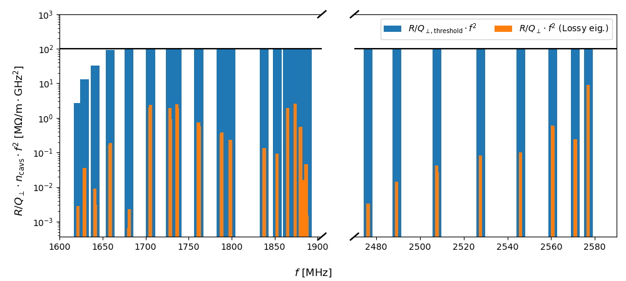
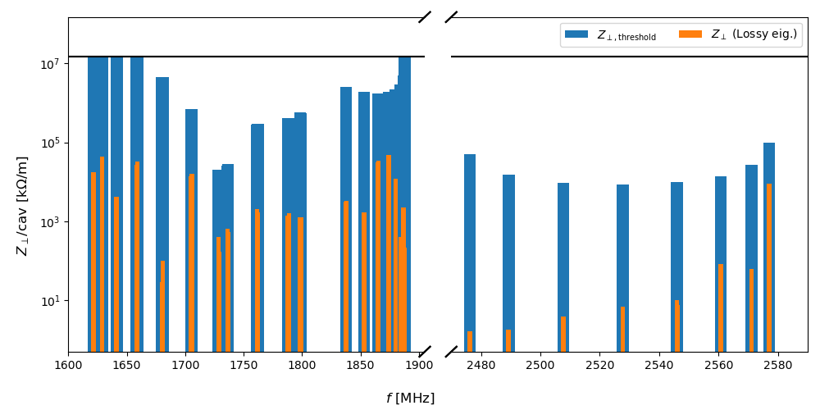
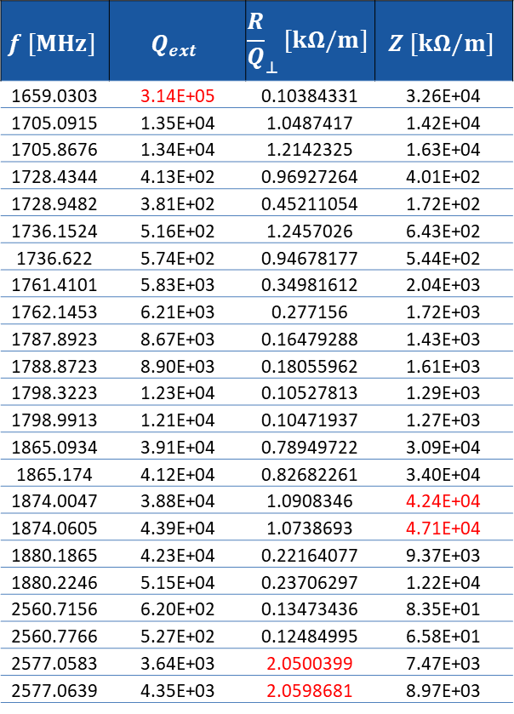

TESLA: Comparision of $Z_{⊥}$and $Z_{⊥, threshold}$
$$f [MHz]$$ | $$Q_{ext}$$ | $${\frac{R}{Q}}_{⊥}[kΩ/m]$$ | $$Z [kΩ/m]$$
1659.0303 | 3.14E+05 | 0.10384331 | 3.26E+04
1705.0915 | 1.35E+04 | 1.0487417 | 1.42E+04
1705.8676 | 1.34E+04 | 1.2142325 | 1.63E+04
1728.4344 | 4.13E+02 | 0.96927264 | 4.01E+02
1728.9482 | 3.81E+02 | 0.45211054 | 1.72E+02
1736.1524 | 5.16E+02 | 1.2457026 | 6.43E+02
1736.622 | 5.74E+02 | 0.94678177 | 5.44E+02
1761.4101 | 5.83E+03 | 0.34981612 | 2.04E+03
1762.1453 | 6.21E+03 | 0.277156 | 1.72E+03
1787.8923 | 8.67E+03 | 0.16479288 | 1.43E+03
1788.8723 | 8.90E+03 | 0.18055962 | 1.61E+03
1798.3223 | 1.23E+04 | 0.10527813 | 1.29E+03
1798.9913 | 1.21E+04 | 0.10471937 | 1.27E+03
1865.0934 | 3.91E+04 | 0.78949722 | 3.09E+04
1865.174 | 4.12E+04 | 0.82682261 | 3.40E+04
1874.0047 | 3.88E+04 | 1.0908346 | 4.24E+04
1874.0605 | 4.39E+04 | 1.0738693 | 4.71E+04
1880.1865 | 4.23E+04 | 0.22164077 | 9.37E+03
1880.2246 | 5.15E+04 | 0.23706297 | 1.22E+04
2560.7156 | 6.20E+02 | 0.13473436 | 8.35E+01
2560.7766 | 5.27E+02 | 0.12484995 | 6.58E+01
2577.0583 | 3.64E+03 | 2.0500399 | 7.47E+03
2577.0639 | 4.35E+03 | 2.0598681 | 8.97E+03
Transverse impedance of dipole modes in first and second HOM dipole passband and transverse impedance threshold bar plot for the TESLA cavity geometry
Some QOIs of dipole HOM in first and second HOM dipole passband of the TESLA cavity geometry with ${\left(\frac{R}{Q}\right)}_{⊥}>0.1 kΩ/m$

Slide 13
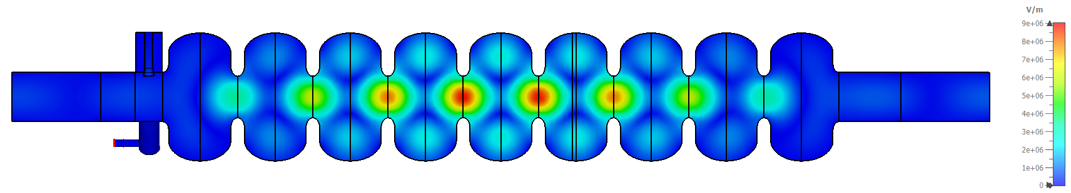
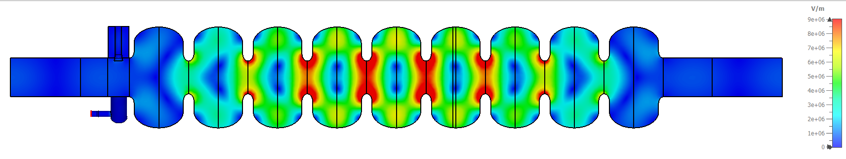
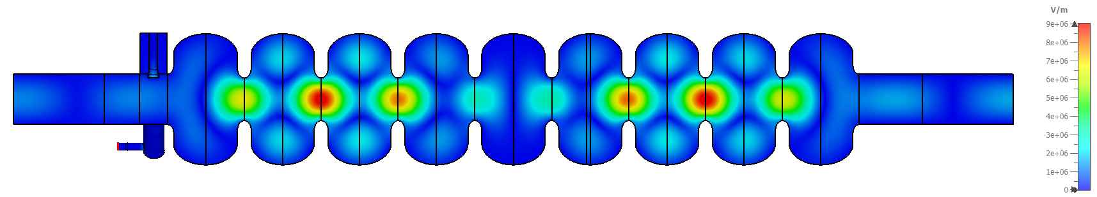
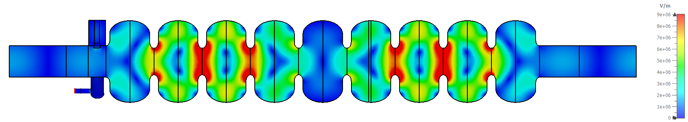
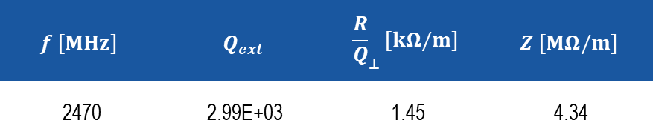
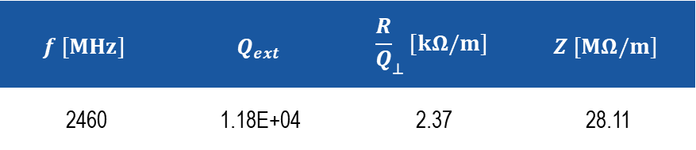
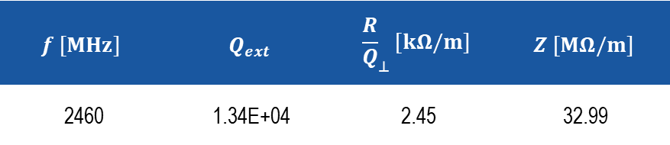
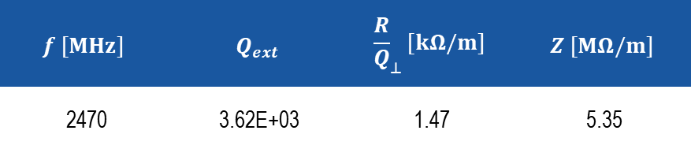
NLSF: Trapped TE121 Mode @~2470MHz
E-Fields scaled to a maximum of 9 MV/m
$$f [MHz]$$ | $$Q_{ext}$$ | $${\frac{R}{Q}}_{⊥}[kΩ/m]$$ | $$Z [MΩ/m]$$
2460 | 1.34E+04 | 2.45 | 32.99
$$f [MHz]$$ | $$Q_{ext}$$ | $${\frac{R}{Q}}_{⊥}[kΩ/m]$$ | $$Z [MΩ/m]$$
2460 | 1.18E+04 | 2.37 | 28.11
$$f [MHz]$$ | $$Q_{ext}$$ | $${\frac{R}{Q}}_{⊥}[kΩ/m]$$ | $$Z [MΩ/m]$$
2470 | 3.62E+03 | 1.47 | 5.35
$$f [MHz]$$ | $$Q_{ext}$$ | $${\frac{R}{Q}}_{⊥}[kΩ/m]$$ | $$Z [MΩ/m]$$
2470 | 2.99E+03 | 1.45 | 4.34

Slide 14
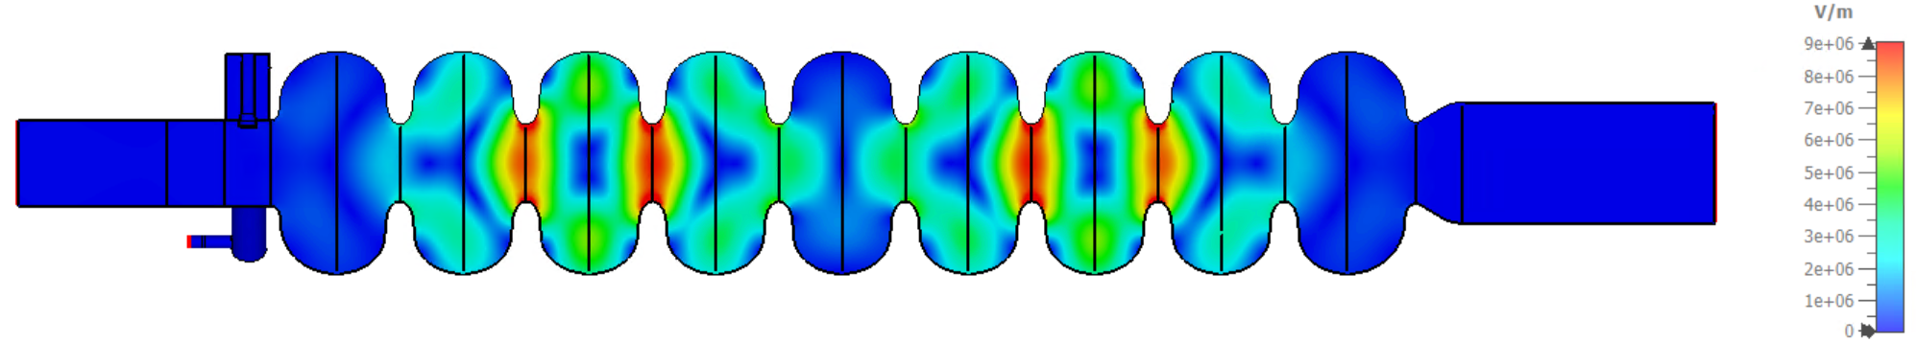
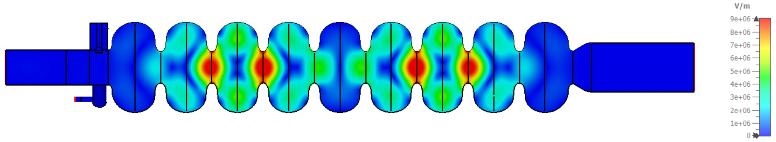
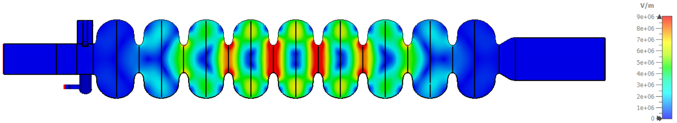
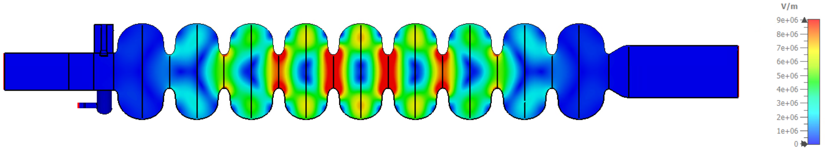
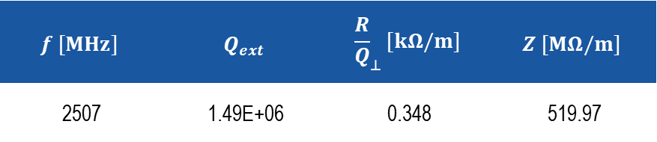
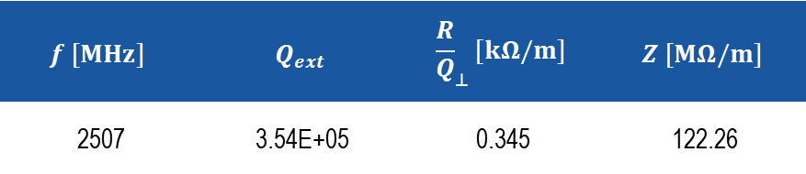
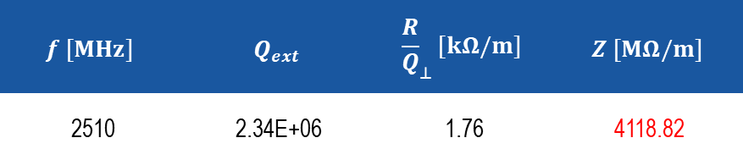
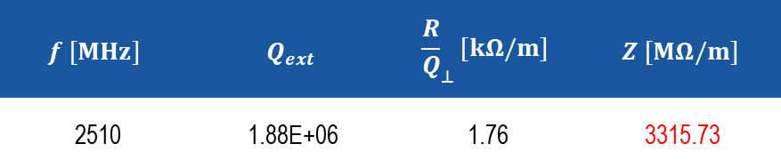
ERL-MA: Trapped TE121 Mode @~2510MHz
E-Fields scaled to a maximum of 9 MV/m
$$f [MHz]$$ | $$Q_{ext}$$ | $${\frac{R}{Q}}_{⊥}[kΩ/m]$$ | $$Z [MΩ/m]$$
2507 | 3.54E+05 | 0.345 | 122.26
$$f [MHz]$$ | $$Q_{ext}$$ | $${\frac{R}{Q}}_{⊥}[kΩ/m]$$ | $$Z [MΩ/m]$$
2507 | 1.49E+06 | 0.348 | 519.97
$$f [MHz]$$ | $$Q_{ext}$$ | $${\frac{R}{Q}}_{⊥}[kΩ/m]$$ | $$Z [MΩ/m]$$
2510 | 2.34E+06 | 1.76 | 4118.82
$$f [MHz]$$ | $$Q_{ext}$$ | $${\frac{R}{Q}}_{⊥}[kΩ/m]$$ | $$Z [MΩ/m]$$
2510 | 1.88E+06 | 1.76 | 3315.73

Slide 15
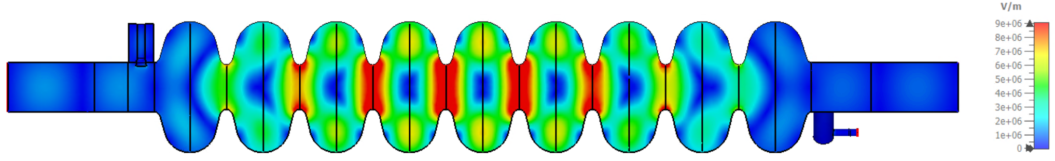
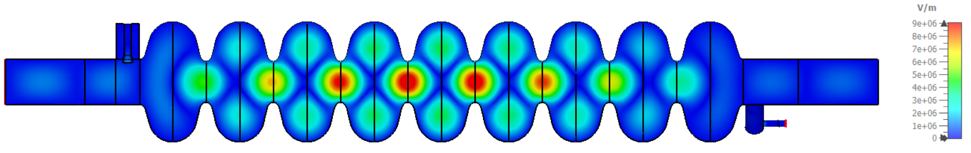
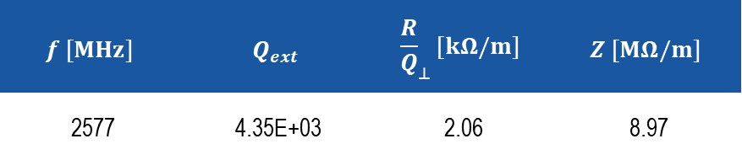

TESLA: Trapped TE121 Mode @~2577MHz
E-Fields scaled to a maximum of 9 MV/m
$$f [MHz]$$ | $$Q_{ext}$$ | $${\frac{R}{Q}}_{⊥}[kΩ/m]$$ | $$Z [MΩ/m]$$
2577 | 3.64E+03 | 2.05 | 7.47
$$f [MHz]$$ | $$Q_{ext}$$ | $${\frac{R}{Q}}_{⊥}[kΩ/m]$$ | $$Z [MΩ/m]$$
2577 | 4.35E+03 | 2.06 | 8.97

Slide 16
General study of the NLSF cavity considering different number of cells and operating frequency

Slide 17
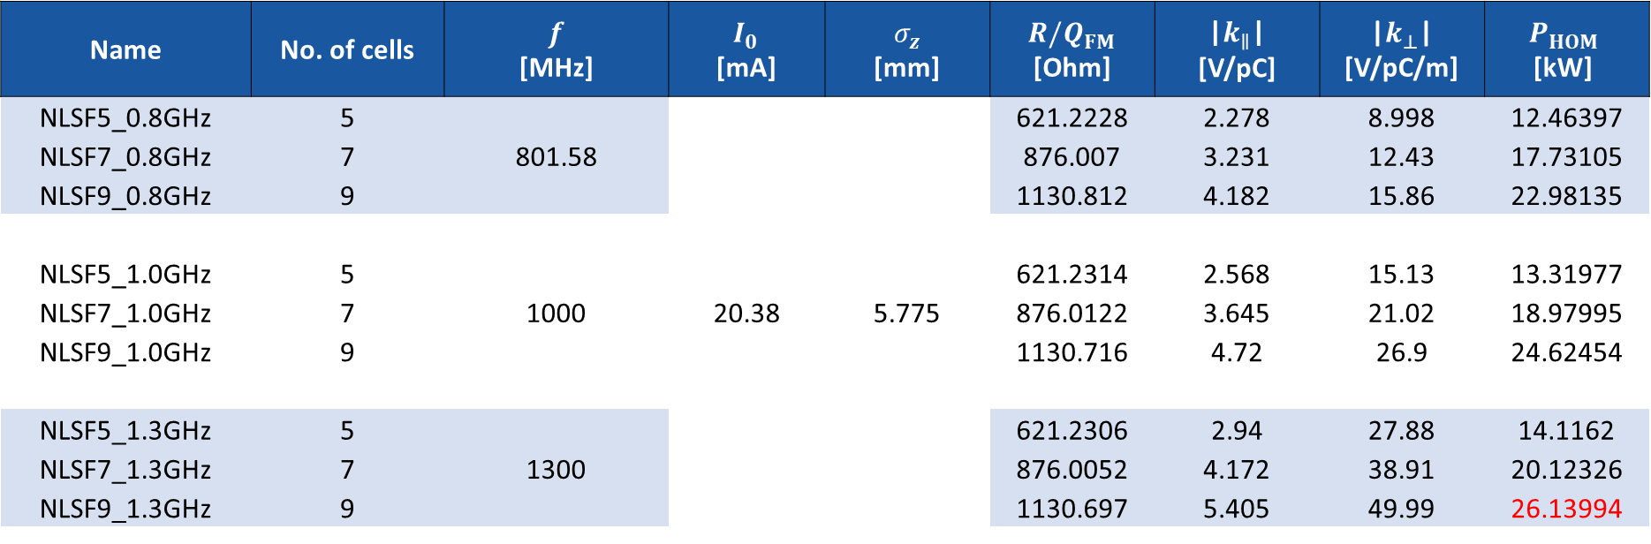
NLSF (Bare Cavity): Study Varying No. of Cells and Operating Frequency
Name | No. of cells | $f$ [MHz] | $I_{0}$ [mA] | $σ_{z}$ [mm] | $R/Q_{FM}$ [Ohm] | |$k_{∥}$| [V/pC] | |$k_{⊥}$| [V/pC/m] | $$P_{HOM}$$ [kW]
NLSF5_0.8GHz | 5 | 801.58 | 20.38 | 5.775 | 621.2228 | 2.278 | 8.998 | 12.46397
NLSF7_0.8GHz | 7 | 801.58 | 20.38 | 5.775 | 876.007 | 3.231 | 12.43 | 17.73105
NLSF9_0.8GHz | 9 | 801.58 | 20.38 | 5.775 | 1130.812 | 4.182 | 15.86 | 22.98135
NLSF5_1.0GHz | 5 | 1000 | 20.38 | 5.775 | 621.2314 | 2.568 | 15.13 | 13.31977
NLSF7_1.0GHz | 7 | 1E+09 | 20.38 | 5.775 | 876.0122 | 3.645 | 21.02 | 18.97995
NLSF9_1.0GHz | 9 | 1E+09 | 20.38 | 5.775 | 1130.716 | 4.72 | 26.9 | 24.62454
NLSF5_1.3GHz | 5 | 1300 | 20.38 | 5.775 | 621.2306 | 2.94 | 27.88 | 14.1162
NLSF7_1.3GHz | 7 | 1.3E+09 | 20.38 | 5.775 | 876.0052 | 4.172 | 38.91 | 20.12326
NLSF9_1.3GHz | 9 | 1.3E+09 | 20.38 | 5.775 | 1130.697 | 5.405 | 49.99 | 26.13994

Slide 18
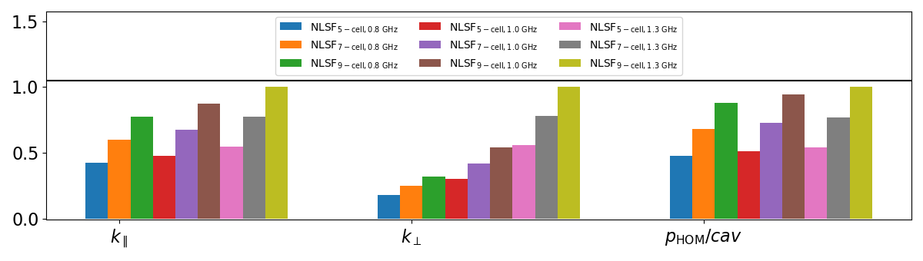
NLSF: HOM QOIs
Bar plot of normalized loss and kick factors, and HOM power

Slide 19
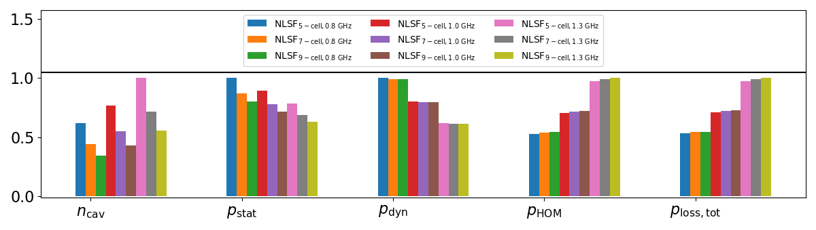
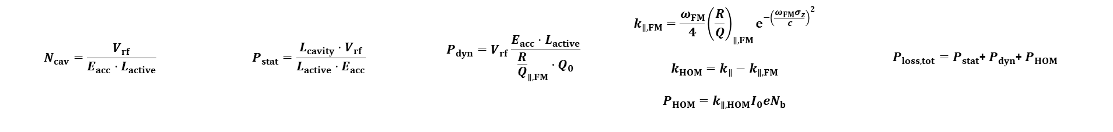
NLSF: Power Loss
Bar plot of normalized number of cavities, static power loss, dynamic power loss, HOM power loss and total power loss
$$N_{cav}=\frac{V_{rf}}{E_{acc}⋅L_{active}}$$ | $$P_{stat}=\frac{L_{cavity}⋅V_{rf}}{L_{active}⋅E_{acc}}$$ | $$P_{dyn}=V_{rf}\frac{E_{acc}⋅L_{active}}{{\frac{R}{Q}}_{∥, FM}⋅Q_{0}}$$ | $$k_{∥, FM}=\frac{ω_{FM}}{4}{\left(\frac{R}{Q}\right)}_{∥, FM}e^{−{\left(\frac{ω_{FM}σ_{z}}{c}\right)}^{2}}$$ $$k_{HOM}=k_{∥}−k_{∥,FM}$$ $$P_{HOM}=k_{∥, HOM}I_{0}eN_{b}$$ | ${P_{loss, tot}=P}_{stat}$+ $P_{dyn}$+ $P_{HOM}$

Slide 20
Summary
The maximum impedance of the analysed cavties are less than the transverse impedance threshold values by different factors. The least suitable, considering the impedance threshold value is the ERL-MA cavity geometry
The HOM impedance could be reduced further by optimizing the HOM couplers and/or increasing the number of couplers
The TE121 mode is a trapped mode and the cavity geometry(ies) need to be optimized to allow this mode propagate to the end cells for proper damping
There is about a 30% decrease in HOM and total power loss when comparing the 1300 MHz and 1000MHz operating frequency choices and about a 50% reduction when considering a frequency of 801.58 MHz

Slide 21





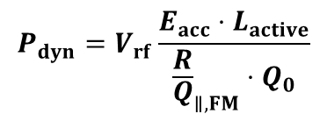


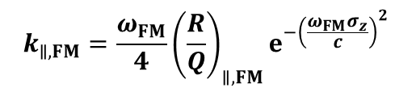

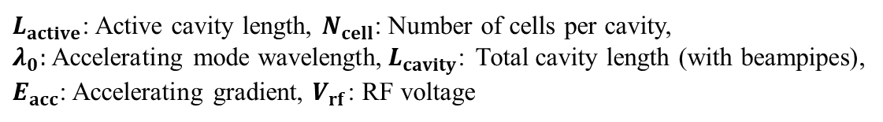
Some Formulas
$$L_{active}=\frac{N_{cell}λ_{0}}{2}$$
$$L_{cavity}=L_{active}+2λ_{0}$$
$L_{active}$: Active cavity length, $N_{cell}$: Number of cells per cavity,
$λ_{0}:$ Accelerating mode wavelength,${ L}_{cavity}$: Total cavity length (with beampipes),
$E_{acc}$: Accelerating gradient, $V_{rf}$: RF voltage
$$N_{cav}=\frac{V_{rf}}{E_{acc}⋅L_{active}}$$
$$k_{∥, FM}=\frac{ω_{FM}}{4}{\left(\frac{R}{Q}\right)}_{∥, FM}e^{−{\left(\frac{ω_{FM}σ_{z}}{c}\right)}^{2}}$$
$k_{∥, FM}$: Fundamental mode loss factor, $ω_{FM}$: Fundamental mode angular frequency,
$σ_{z}:$ Bunch length, ${\left(\frac{R}{Q}\right)}_{∥, FM}$: Fundamental mode R/Q, $c:$ Speed of light
$$k_{HOM}=k_{∥}−k_{∥,FM}$$
$k_{HOM}$: Higher order mode power loss factor, $k_{∥}$: Total loss factor
$$P_{HOM}=k_{∥, HOM}I_{0}eN_{b}$$
$P_{HOM}$: Higher order mode power, $I_{0}$: Beam current, $e$: muon charge, $N_{b}$: Bunch intensity
$$P_{dyn}=V_{rf}\frac{E_{acc}⋅L_{active}}{{\frac{R}{Q}}_{∥, FM}⋅Q_{0}}$$
$P_{dyn}$: Dynamic power loss
$$P_{stat}=\frac{L_{cavity}⋅V_{rf}}{L_{active}⋅E_{acc}}$$
$P_{stat}$: Static power loss
$P_{dyn}/cav=\frac{P_{dyn}}{N_{cav}}$, $P_{stat}/cav=\frac{P_{stat}}{N_{cav}}$

