Slide 1
Update on early design for TCCS/TCCP
Quentin Demassieux, Regis Seidenbinder on behalf of CERN SY-STI-TCD
15/02/2023

Slide 2
Summary
TCCS > Reuse of an old TCPC
TCCP > Possible designs
Design leads : adapted mecartex vs virtual pivot

Slide 3
TCCS > Reuse of a retired vertical TCPC
1. Check base functionality. LVDT measurements, heads alignment signal, axis motions check.
2. Remake piezo control
3. Check crystal alignment with survey. Mirrors alignments and checks with autocollimator.
i. (Optional*) Re-align the crystal. This would mean additional tests such as the leak test.
ii. (Optional*) Re-align the optical heads.

Slide 4
TCCS > Reuse of a retired vertical TCPC
Furthermore, this is also taking into account that we will NOT use the A6R7. If we need to us this device there are other things to do:
1. Rewire/replace the fiber optics (might require change of optical heads)
2. Replace optics feedthrough
3. Re-align optical heads.
4. Possibly need to dismantle the mercartex as well (if piezo was the problem of low range).

Slide 5
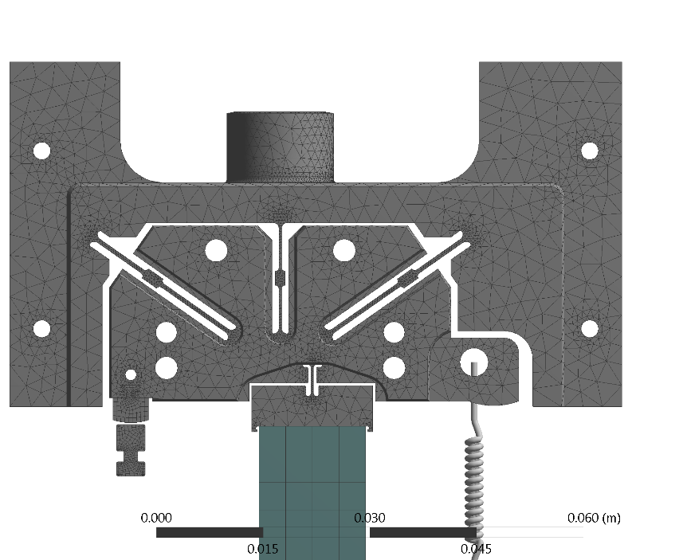
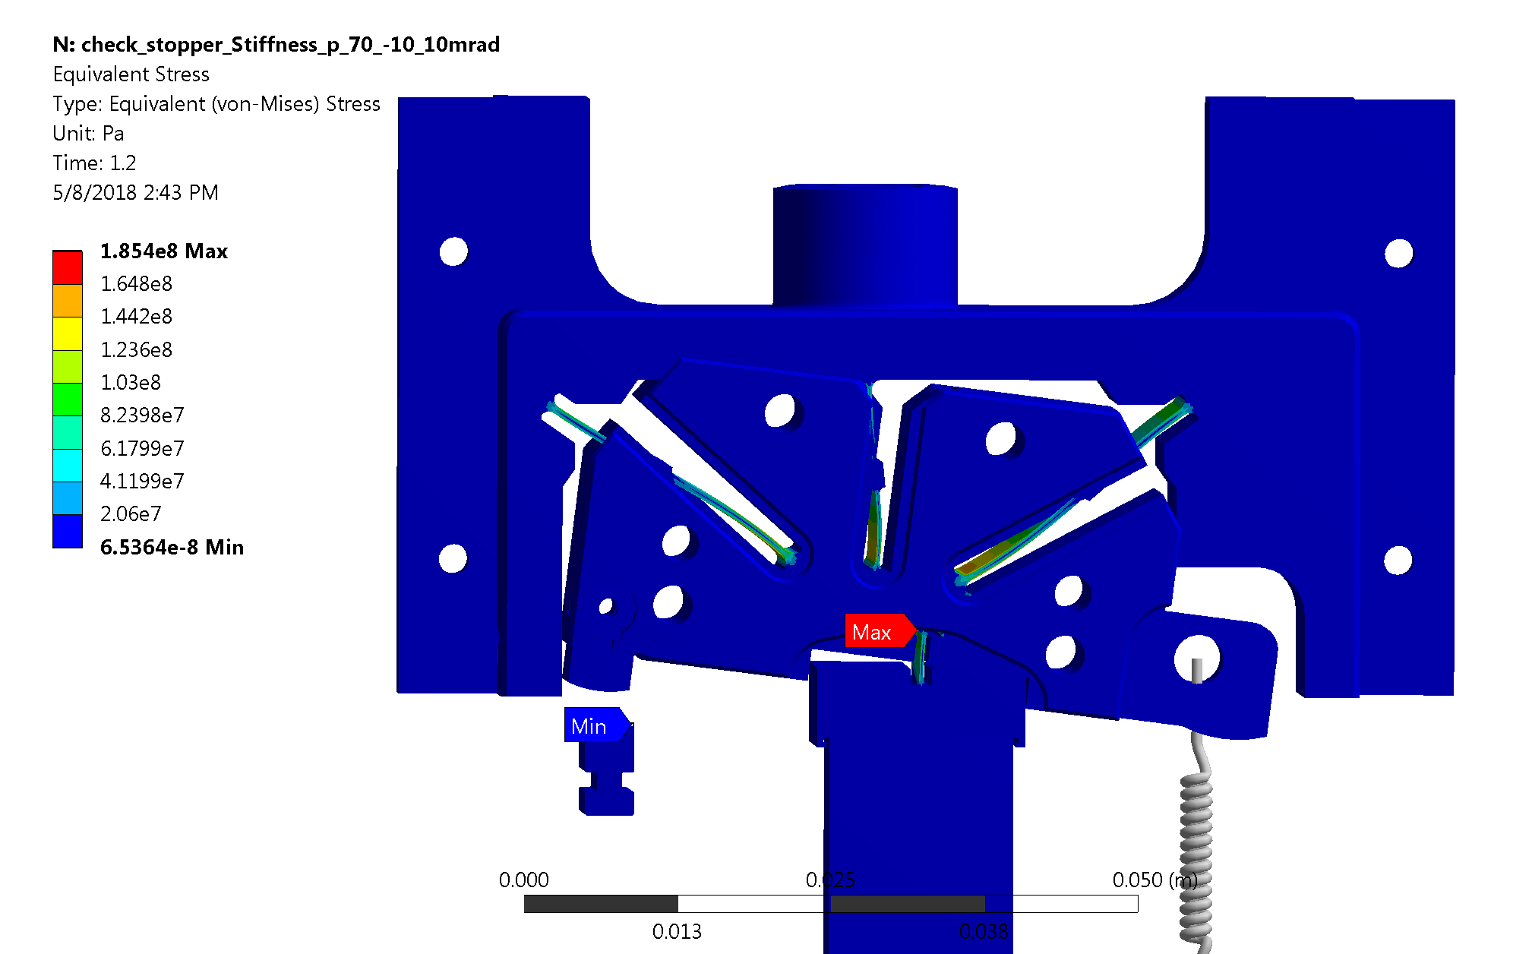
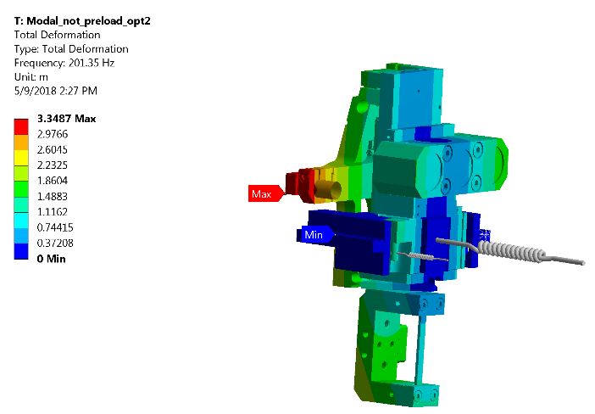
Design leads : adapted mecartex vs virtual pivot
Force
Pre-loaded spring
Von-Mises stress at -10.5 mrad (Pre-load 70N)
First natural frequency : 201Hz
(measured at 180Hz)
Test with mock-up dead mass to be performed by CEM

Slide 6
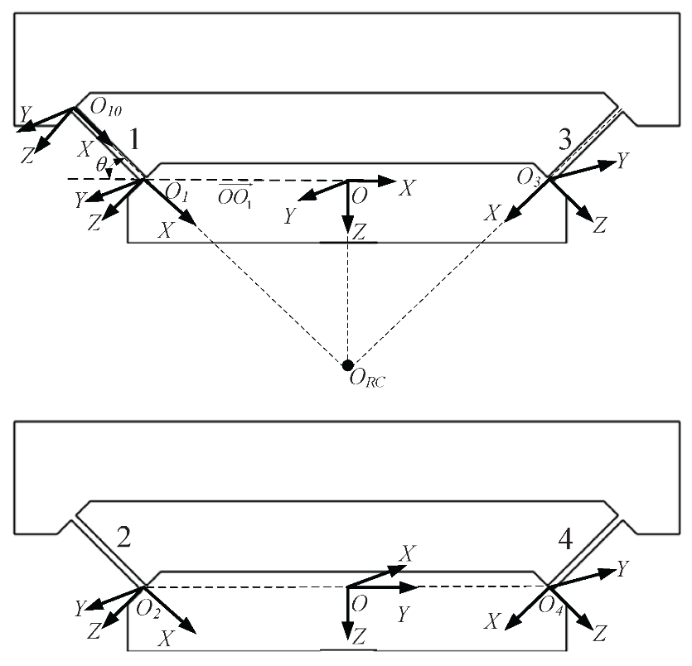
Design leads : adapted mecartex vs virtual pivot

Slide 7
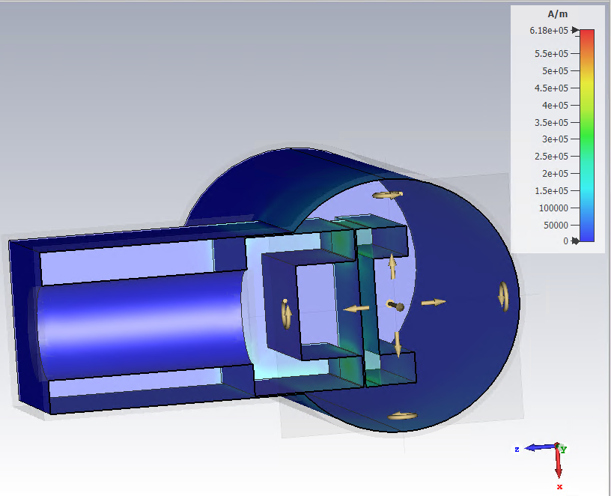
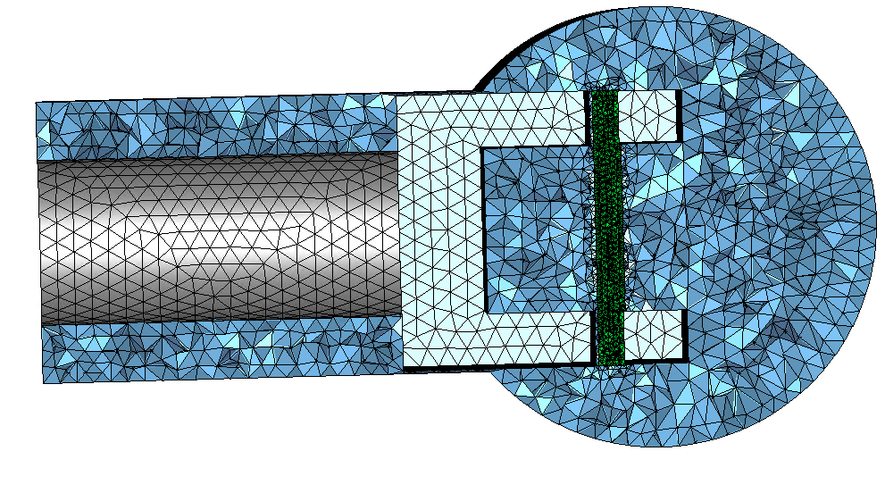
Possible designs for HL-TCCP
Ions runs with crystal in operating position : up to 10W
HL protons runs : up to 900W with crystal retracted
New Design is necessary
TCCS crystal in operating position for HL protons runs: up to 9W
TCCP long crystal in operating position for HL protons runs: up to 570W
Courtesy of Chiara Antuono, BE/ABP

Slide 8
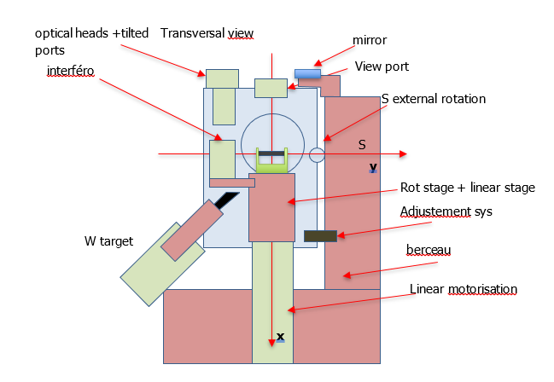
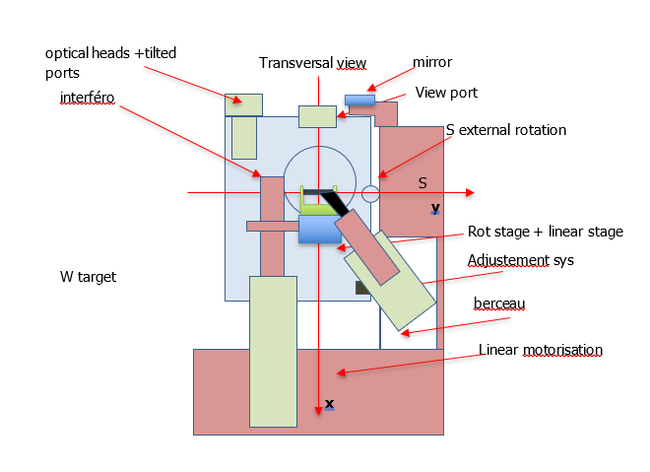
Possible designs for HL-TCCP
Rotational stage in line with the crystal (deported pivot)
Rotational stage above the crystal (mecartex)

