Slide 1
BCCM strategy for 2023
232nd Machine Protection Panel Meeting, 24/02/23
Marek Gasior, Tom Levens
SY-BI-IQ

Slide 2
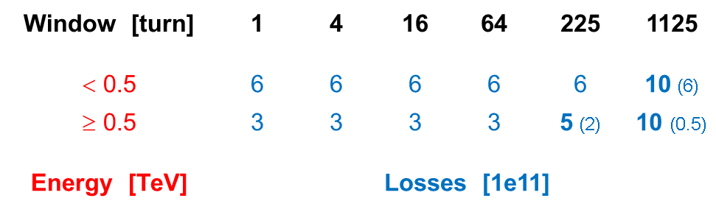
BCCM (dI/dt) system
The system is based on BPM signals shared with the standard BPM system (passive RF splitters)
The beam position dependence is removed by summing the four electrode signals
Analog operations to make the signals as slow as possible, allowing digitization with the highest possible resolution:
low-pass filtering, amplification, envelope detection + rectification + level shifting, low pass filtering
Digitization: 16-bit, 40 MHz beam-synchronous sampling, one revolution period is exactly 3564 ADC clocks
One turn “raw intensity” is a sum of ADC samples above a “beam presence threshold” minus “no beam offset”
One turn “raw dI/dt signal” is a difference of the one turn raw integrals from two consecutive turns
“Raw dl/dt signals” in the other five windows are calculated as running sums of the one-turn “raw dI/dt signals”
Every turn each of the “raw dI/dt signals” are compared to its corresponding raw dump threshold level and potential beam dump triggers are generated. All real-time calculations are done in the FPGA in an integer arithmetic.
The BCCM absolute intensities are calculated by scaling the “raw BCCM intensities” using a “BCCM/BCT scaling factor”.
The factor is a constant for each system and is obtained by matching the BCCM intensity to the corresponding BCT readings.
The absolute dump thresholds in elementary charges are translated into “raw dump thresholds” using the same “BCCM/BCT scaling factor”

Slide 3
As presented on 21/10/22: Conclusions and options to investigate
During the 2022 run the four BCCM systems have been evolving quite a bit and have been continuously tested
The hardware and FESA are “almost final” and very reliable
Operational extensive data logging implemented, including continuous turn-by-turn logging of the most important data
and on-demand 73-turn snapshots of the 40 MHz raw ADC samples (currently stored also every beam dump)
The residual bunch length dependence of the BPM signals is the only known problem with the current implementation
of the system. The problem shows up during beam injections, the RF longitudinal blow-up and beam instabilities.
The new dump threshold levels for the two longest integration windows help a lot to fulfil all the system specifications
New lengths of the two longest integration windows are being tested. To be decided whether they are helping enough
A 1st order low-pass filter compensating the 1st order high-pass characteristic of the BPM reduces the bunch length dependence. Unfortunately, the low-pass causes issues with the “stability of the signal baseline”.
Options to investigate:
A less aggressive 1st order low-pass, with the hope to improve the “stability of the signal baseline”
FBCTs with the flat frequency characteristic as the beam signal source

Slide 4
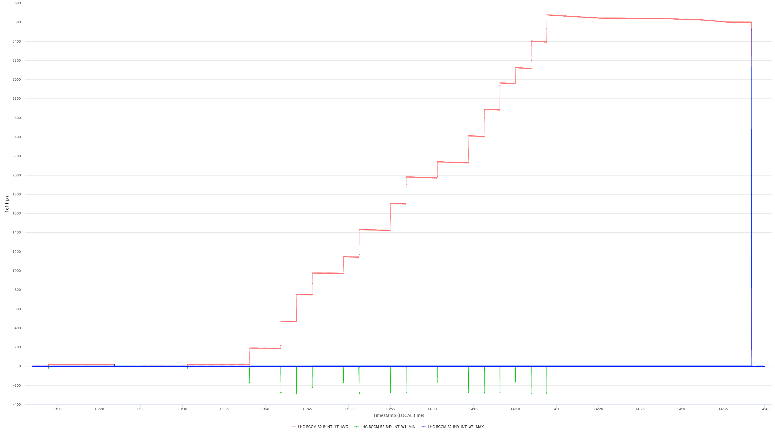
BCCM (– dI/dt) polarity convention
The focus is on beam losses,
so that on the positive dI/dt signals
beam intensity
dI/dt positive = intensity decrease
(here a beam dump)
dI/dt negative = intensity increase
(here beam injections)

Slide 5
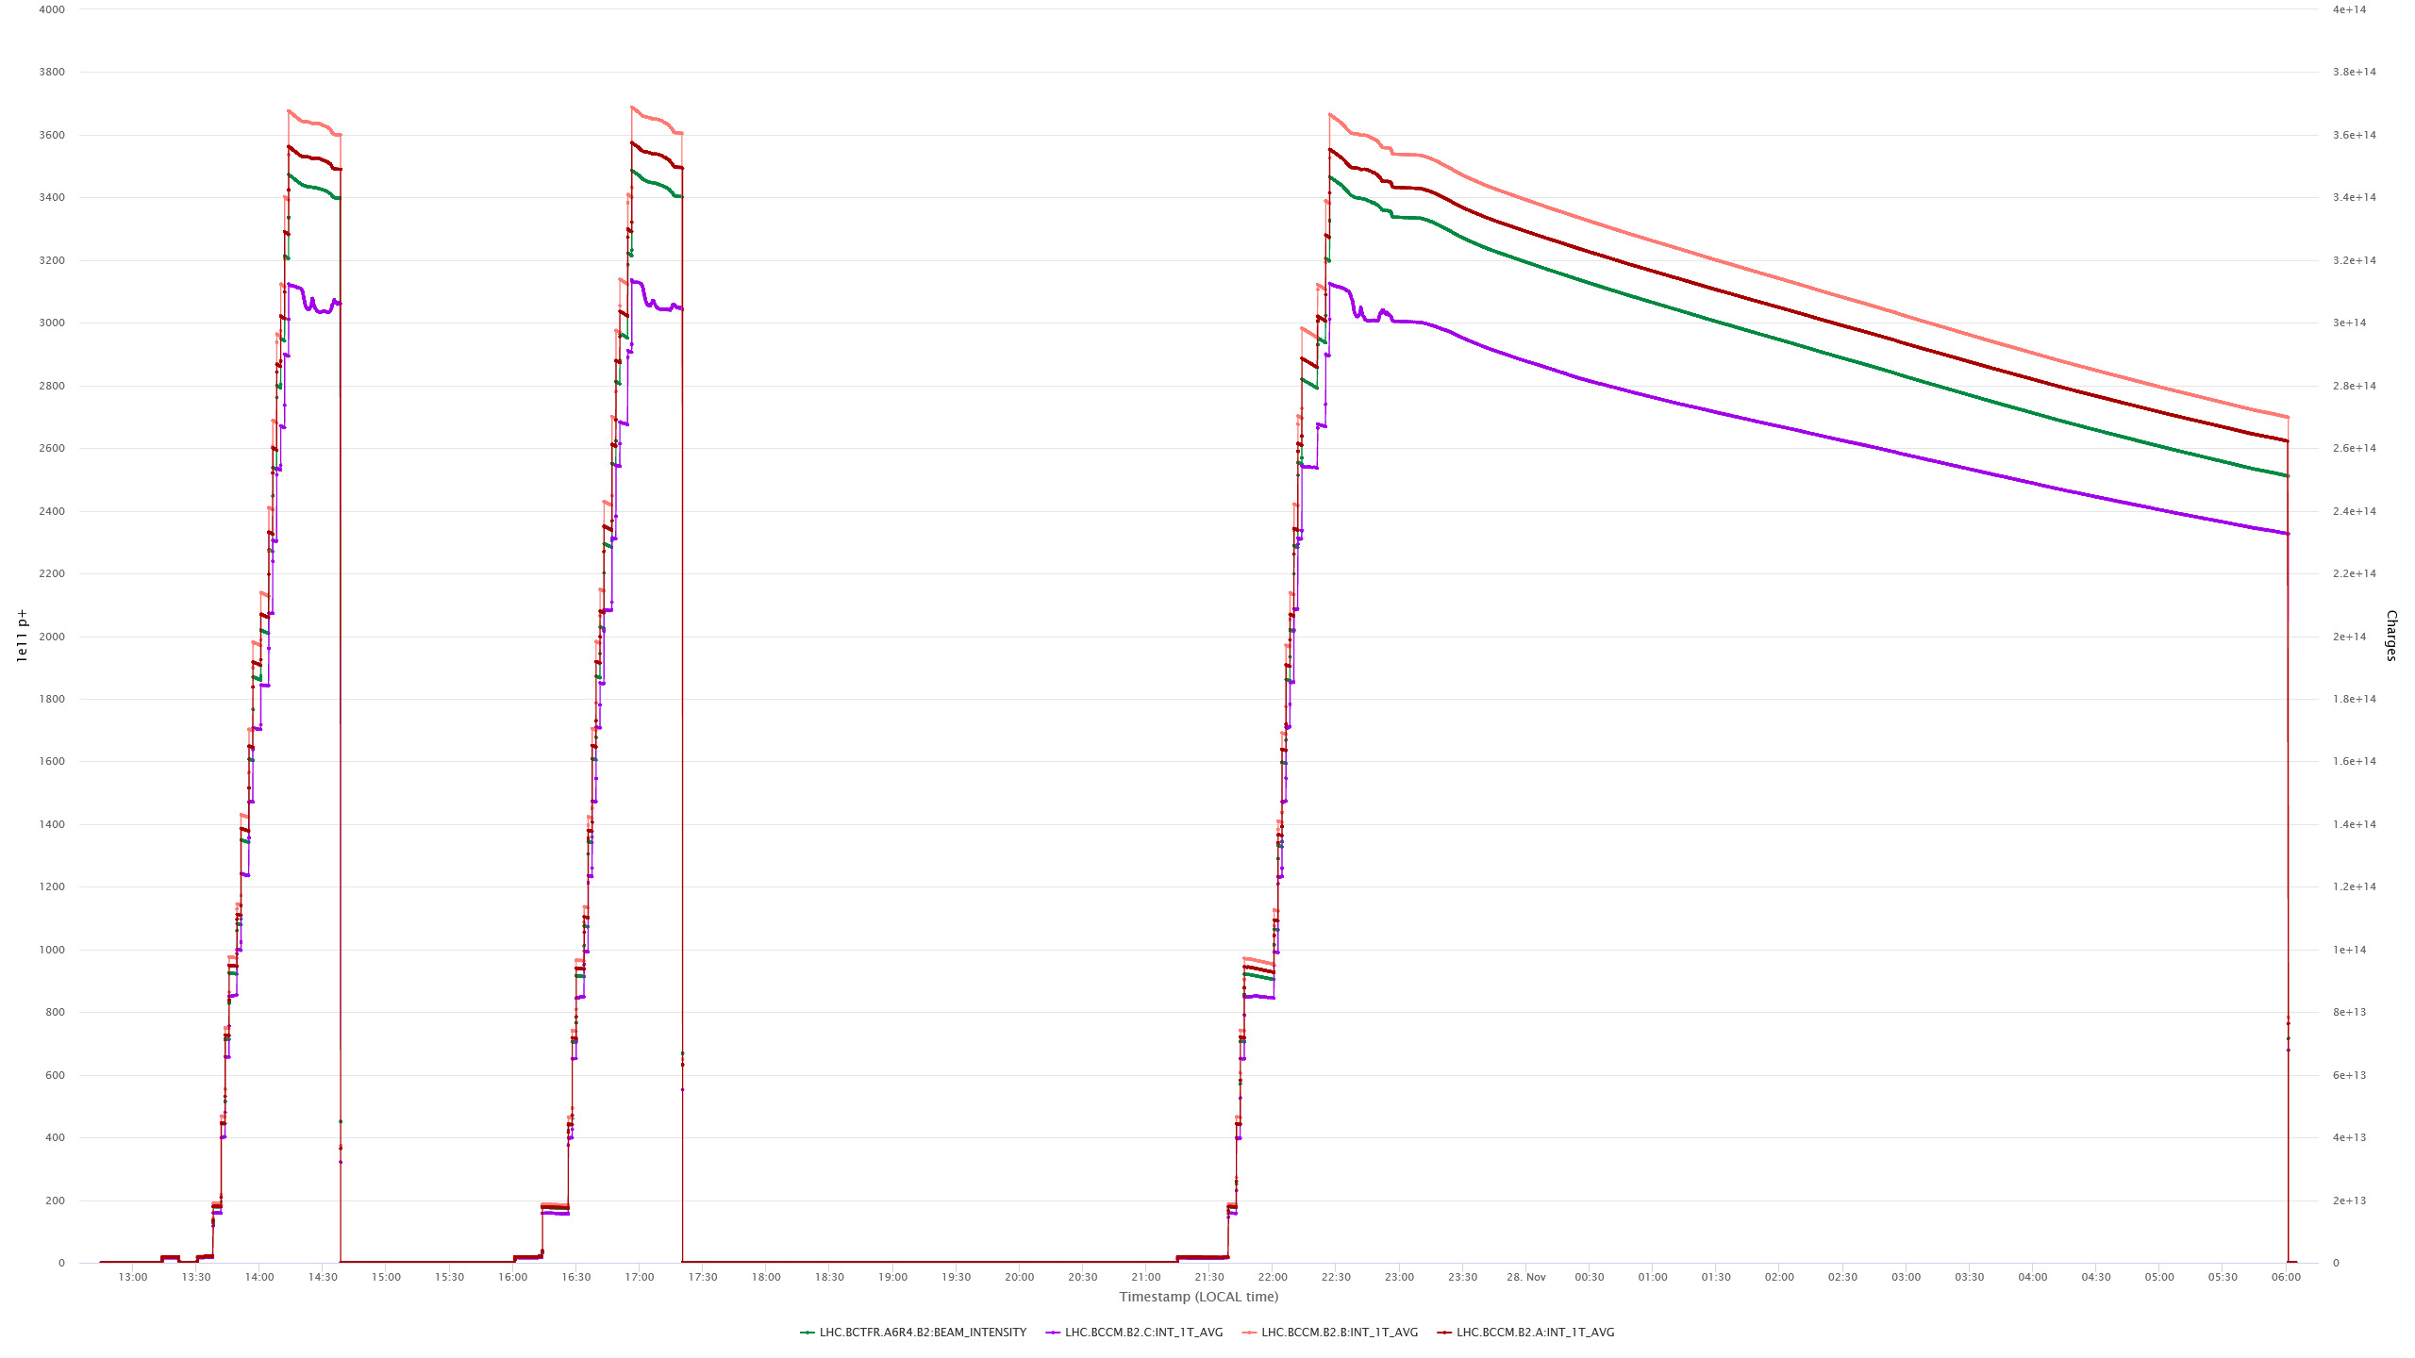
Performance at the end of the 2022 run – systems A, B, C + FBCT
A
B
C
FBCT

Slide 6
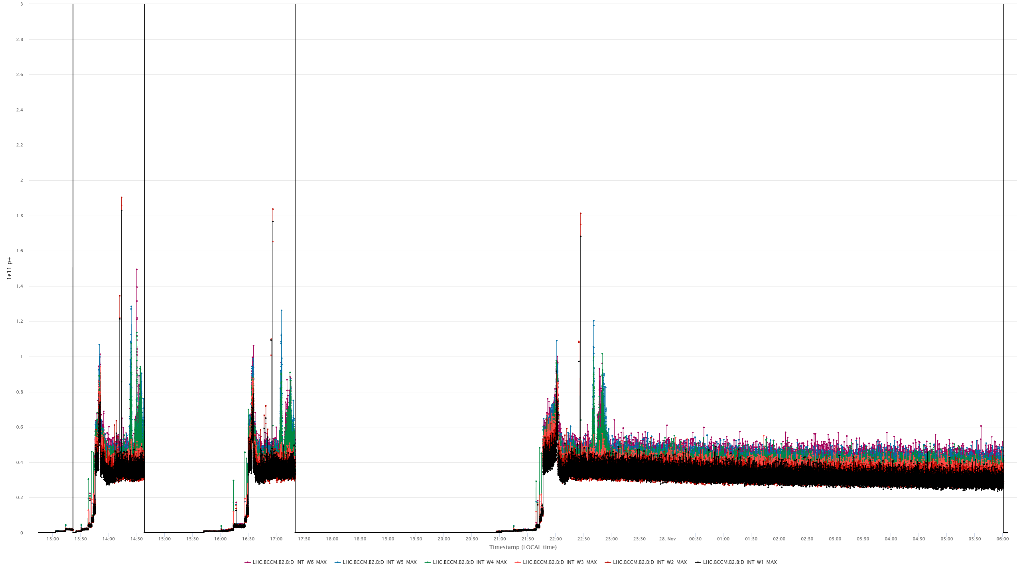
The 2022 filtering winner: dI/dt 1-s maxima for top intensities ≈3400e11
–––––– 3e11 = 50 % of the “< 0.5 TeV” dump threshold ––––––

Slide 7
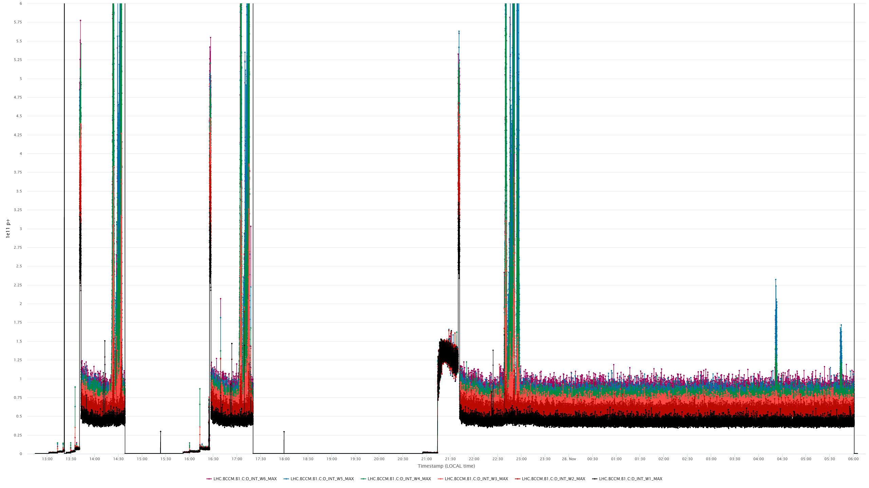
BCCM system C based on FBCT signals had very bad performance
–––– 6e11 = < “0.5 TeV” threshold ––––

Slide 8
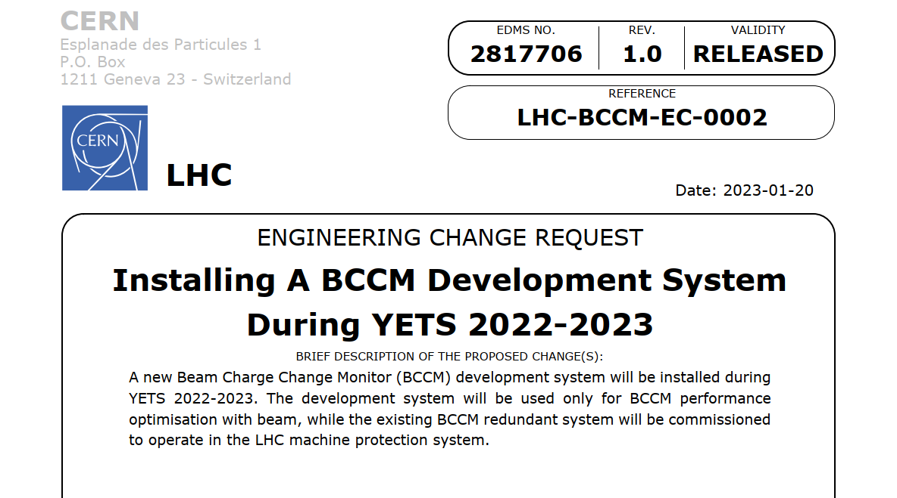
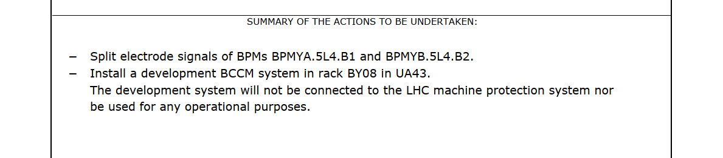
BCCM development system C
Once systems A and B become operational,
their state becomes frozen
To carry on with optimisations, we need
a development system, which is initially
a copy of the operational systems,
and can be modified easily
The development system C will not have
any connections to the interlock system
If significant improvements were achieved
on system C, they could be propagated
to the operational systems during YETS.
The improvements should be important enough to justify the system recommissioning

Slide 9
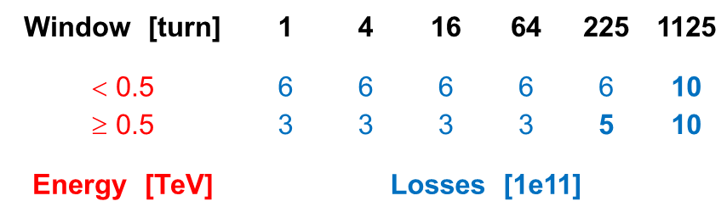
System status, the strategy and conclusions
Systems A and B with the new filtering scheme are installed and are ready for the beam
System C is still in the lab and is used for testing the newest FPGA and FESA codes.
The system will be soon moved to UA43 and connected to the BPM signals.
The system performance achieved at the end of the 2022 run should be enough to make the system operational.
The system hardware and software worked very reliably.
The 2023 intensity ramp-up will be used to optimise system settings and to check the system performance
Once the system is proven to operate well with the full beam intensity, it can be commissioned for operation
and its beam triggers unmasked. At this point also all critical system settings will become read-only.
This year we definitely should make the system operational
Plan B:
If the system had not enough robustness for the RF longitudinal blow up for some window lengths, maybe the thresholds for such windows could be relaxed to make the system operating reliably
A bit relaxed protection is better than no protection at all
System C could be used to fight for the missing performance

Slide 10
Spare slides

Slide 11
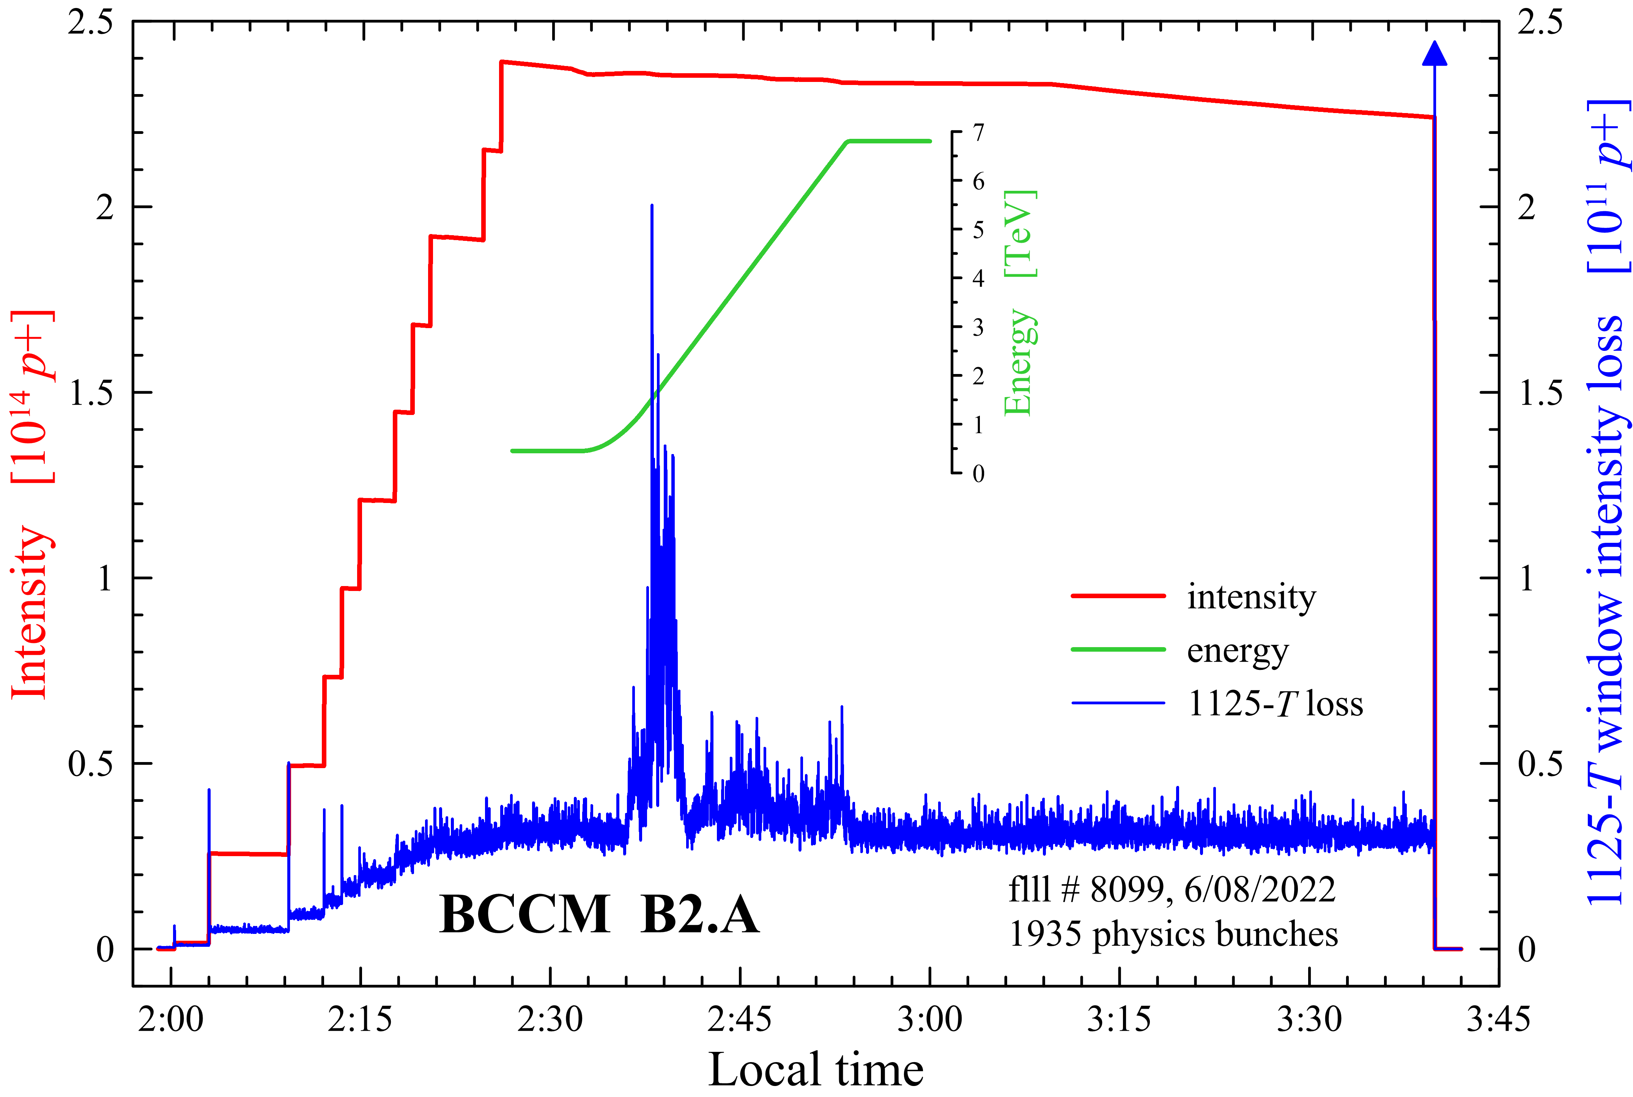
BCCM operation – perturbations during the ramp

Slide 12
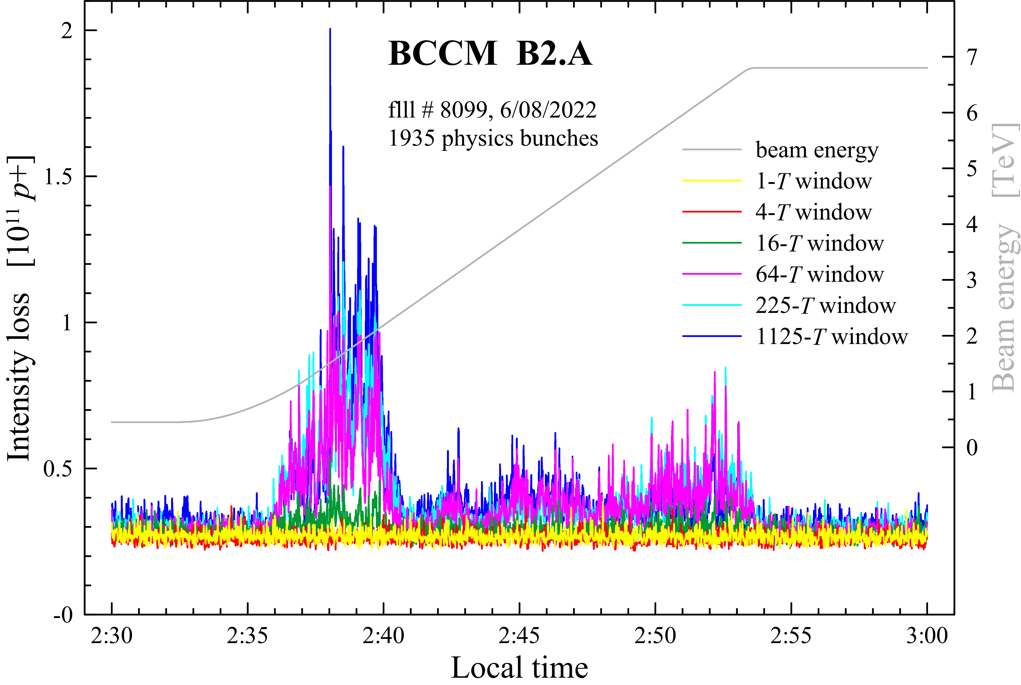
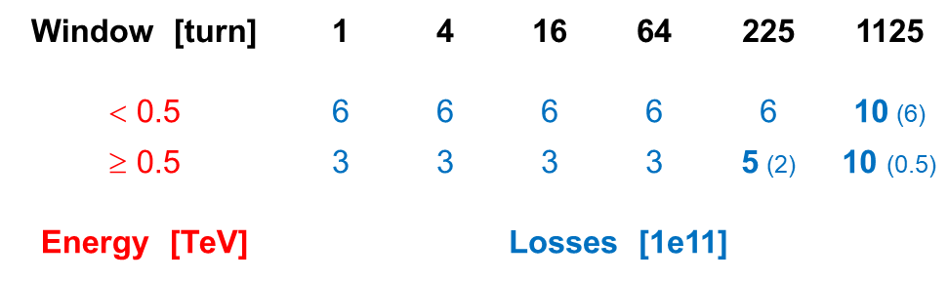
BCCM operation – perturbations during the ramp

Slide 13
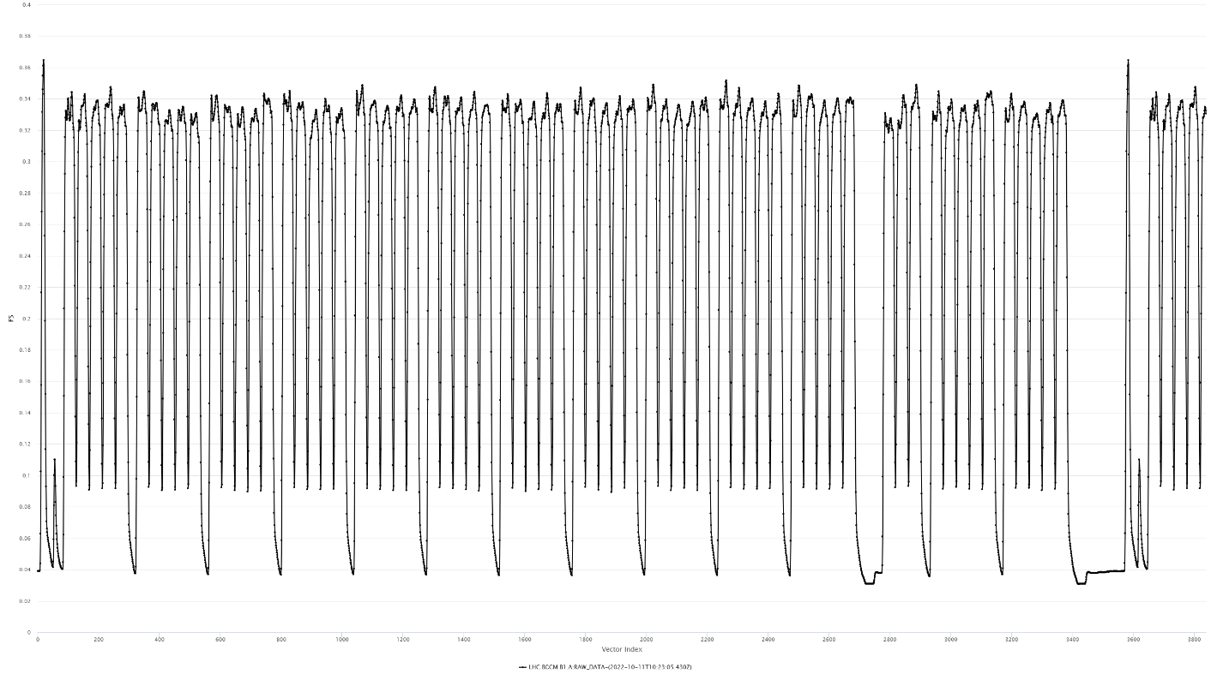
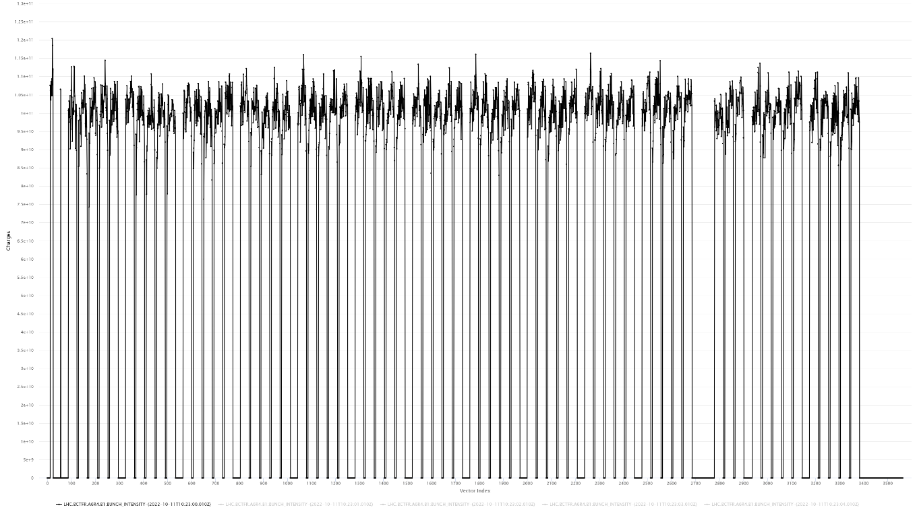
25 ns data: BCCM vs FBCT
one turn of BCCM data
one turn of FBCT data

Slide 14
Updated dump threshold tables
Window [turn] | 1 | 4 | 16 | 64 | 225 | 1125
< 0.5 | 6 | 6 | 6 | 6 | 6 | 10 (6)
≥ 0.5 | 3 | 3 | 3 | 3 | 5 (2) | 10 (0.5)
Energy [TeV] | Losses [1e11]
Window [turn] | 1 | 4 | 16 | 64 | 225 | 1125
< 0.5 | 1 | 1 | 1 | 1 | 1 | 1.7 (1)
≥ 0.5 | 0.5 | 0.5 | 0.5 | 0.5 | 0.8 (0.3) | 1.7 (0.08)
Energy [TeV] | Relative losses [‰] (FS = 6e14)

Slide 15
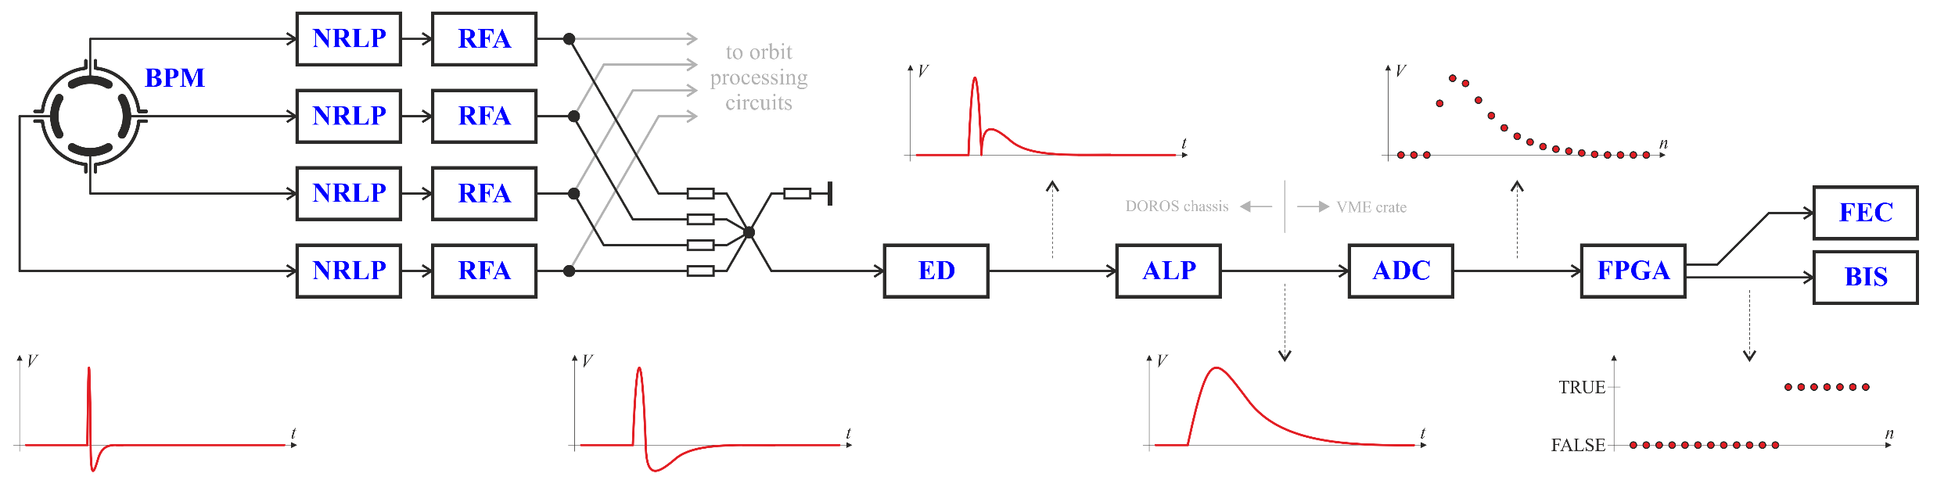
BCCM (dI/dt) system
shared BPMs:
system A: BPMYA.5R4.B1+B2
system B: BPMYA.6R4.B1+B2
NRLP – Non-Reflective Low-Pass (≈ 80 MHz)
RFA – RF Amplifier
ED – Envelope Detector
ALP – Active Low-Pass (≈ 2 MHz)
The system is based on BPM signals shared with the LHC beam position measurement system (passive RF splitters)
The beam position dependence is removed by summing the four electrode signals
Analog operations on the signals: low-pass filtering, amplification, envelope detection + rectification + level shifting, low pass filtering
Digitization: 16-bit, 40 MHz sampling synchronous to the circulating beam (one revolution period is exactly 3564 ADC clocks).
The 40 MHz ADC B1 and B2 clocks are derived from the 400 MHz RF frequencies received by optical fibers from the RF system.
One turn “raw intensity” is a sum of ADC samples above a “beam presence threshold” minus “no beam offset”, selected from one turn 3564 samples
One turn “raw dI/dt signal” is a difference of the one turn raw integrals from two consecutive turns
“Raw dl/dt signals” in the five other integration windows are calculated as running sums of the one-turn “raw dI/dt signals”
Every turn each of the “raw dI/dt signals” are compared to its corresponding raw dump threshold level and potential beam dump triggers are generated.
All real-time calculations are done in the FPGA in an integer arithmetic.
The BCCM absolute intensities in elementary charges are calculated by scaling the “raw intensities” using a “BCCM/BCT scaling factor”.
The factor is a constant for each system and is obtained by matching the beam intensity evaluated by the BCCM to the corresponding BCT readings.
The absolute dump thresholds in elementary charges are translated into “raw dump thresholds” using the same “BCCM/BCT scaling factor”.

