Slide 1
YBCO tapes in X band Hemispherical cavity
Mitchell Schneider

Slide 2
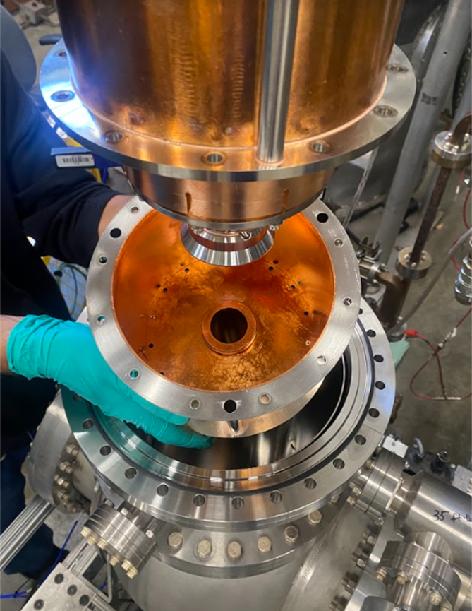
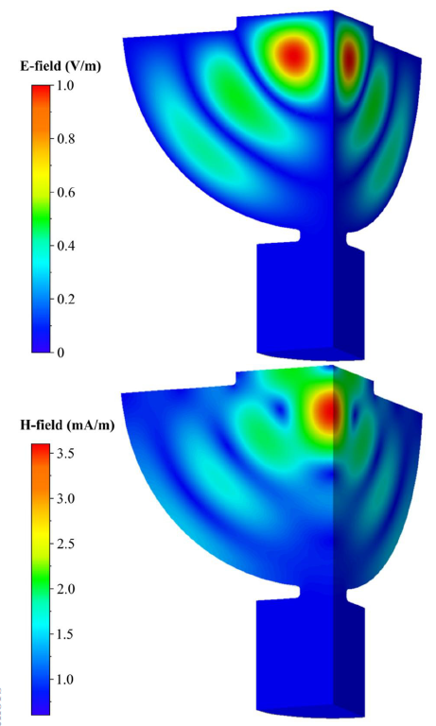

Problem statement
To determine the conductivity of the sample
We need to determine the Q of the sample
W$here σ_{sample}=σ_{Ref}{\left(\frac{Q_{s}}{Q_{s for σ_{Ref} form HFSS}}\right)}^{2}$
Which is a component of the intrinsic quality factor
As $\frac{1}{Q_{0}}=\frac{1}{Q_{cavity}}+\frac{1}{Q_{sample}}$
A TE11 mode hemispherical cavity to min E field on the surface and max H field to determine the quench field
We trying to find functional form the for the quality factor of copper cavity

Slide 3
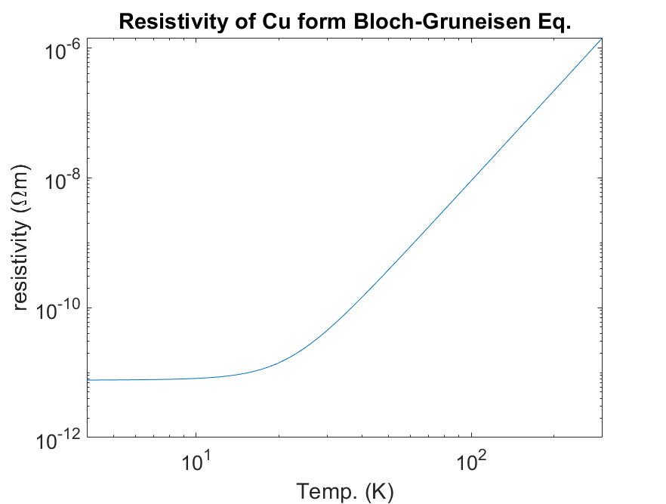
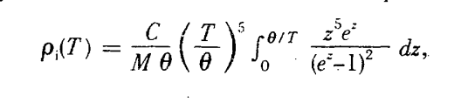

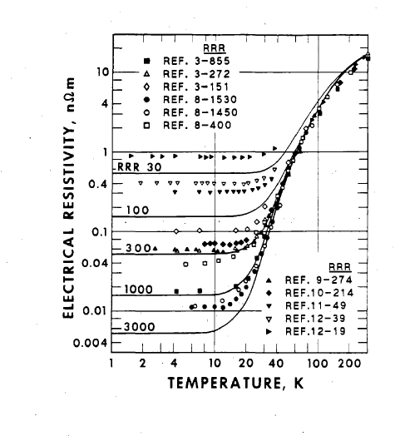


Classical theory of conductivity
To determine the conductivity of the walls of the cavity we find Conductivity(Temp)
Using the density of states Bloch-Gruneisen law for resistivity is
But for low temp we should the form Rphy. Rev. B D. B. Poker and CV. E. Klabunde 26 1270212 (1982)
Which matches with the national Institute of standards data that use a form of

Slide 4
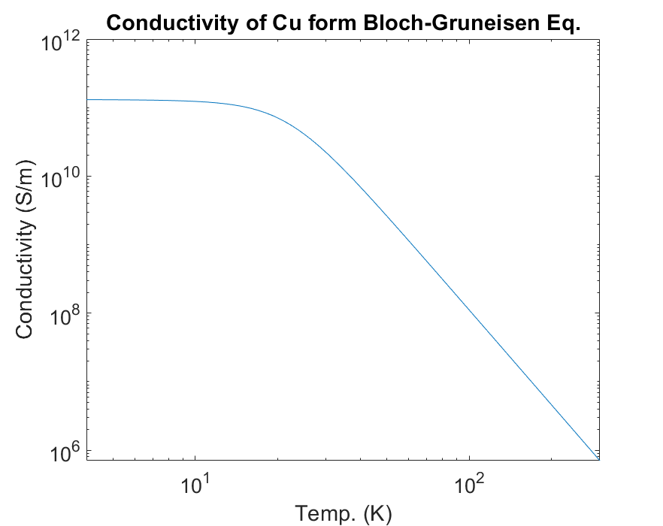
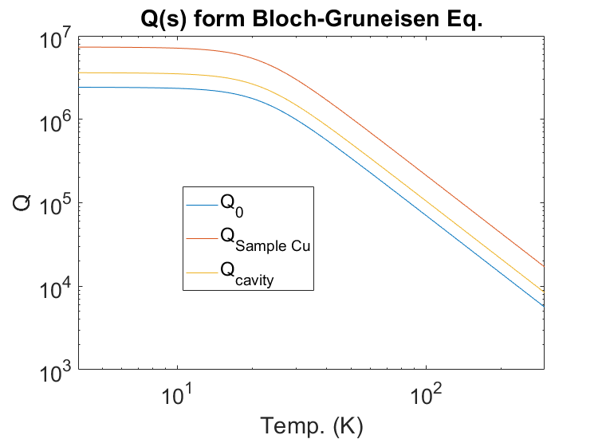
Q(s) form Bloch-Gruneisen law
Use Bloch-Gruneisen conductivity, then we model in HFSS the Q₀ , Q_{cavity ,}Sample Cu assuming that sample walls are equal
Q₀, Q_{sample}, and Q_{cavity} are parallel shifts of each other Assuming the same conductivity at a given temperature

Slide 5

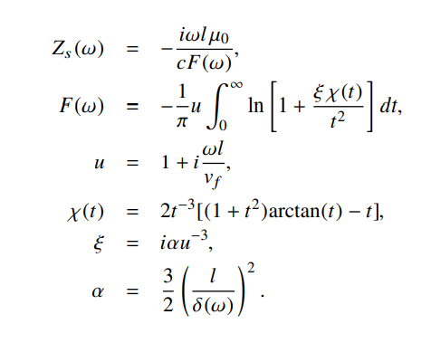

Anomalous Skin Depth to DC conductivity
Using A. Cahill et al IPAC 2016 and A. Cahill thesis
For anomalous surface Impedance can be given by
_{Where (l=σ ε vf)/wp^2}
Where wp=1.64e16 rad/s and vf=1.58e6 m/m for Cu
Then for this we get
And set magnitude equal magnitude of

Slide 6
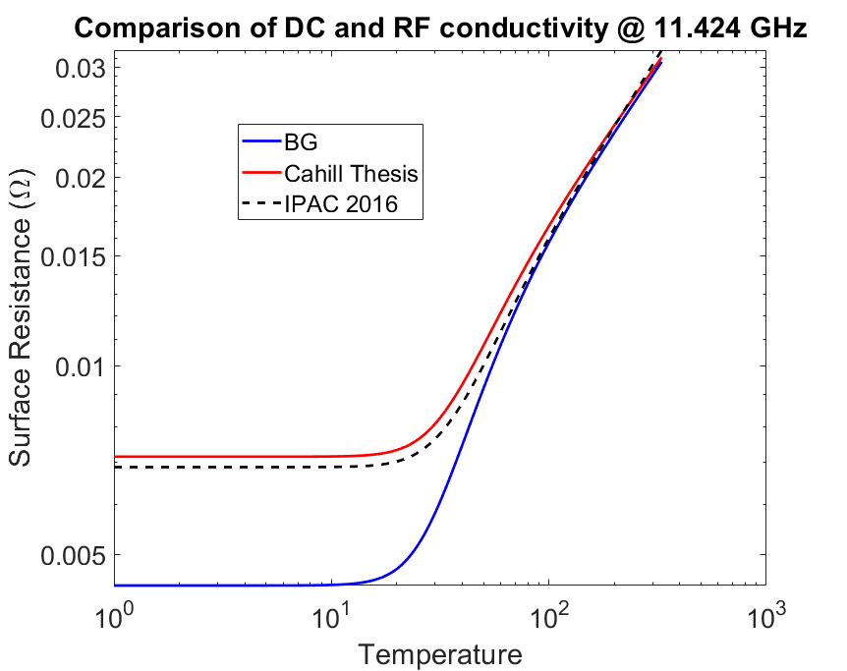
Full RF conductivity
We can then use this to again find Q₀ Q_{sample} and Q_{cavity} now with the correct conductivity

Slide 7


Samples tested to find Q cavity
We then tested the following samples to achieve the functional form of Q cavity
Where for Temp.<9K for Nb We can treat the Nb as a perfect conductor
Then is $Q_{sample}$>>$Q_{cavity}$ than $Q_{cavity}≈Q_{0}$
Then for any Residual resistance value (RRR) the conductivity above 40 K is approximately the same of both samples clean
We can then get the functional form from the copper sample scaled by the linear value we get for the niobium
To Fit VNA data we us to Find Q0 than Q cavity:
$$S_{11}=20 log\left|\frac{β−1−j Q_{0} δ}{β+1+j Q_{0} δ}\right|$$
$$δ=\frac{f}{f_{0}}−\frac{f_{0}}{f}$$
$$β=\frac{Q_{0}}{Q_{ext}}$$
The fitting gives us the Q factor
$$\frac{1}{Q_{0}}=\frac{1}{Q_{cavity}}+\frac{1}{Q_{sample}}$$
=>$\frac{1}{Q_{sample}}=\frac{1}{Q_{0}}−\frac{1}{Q_{cavity}}$ => $Q_{cavity}>$ $Q_{0}$

Slide 8
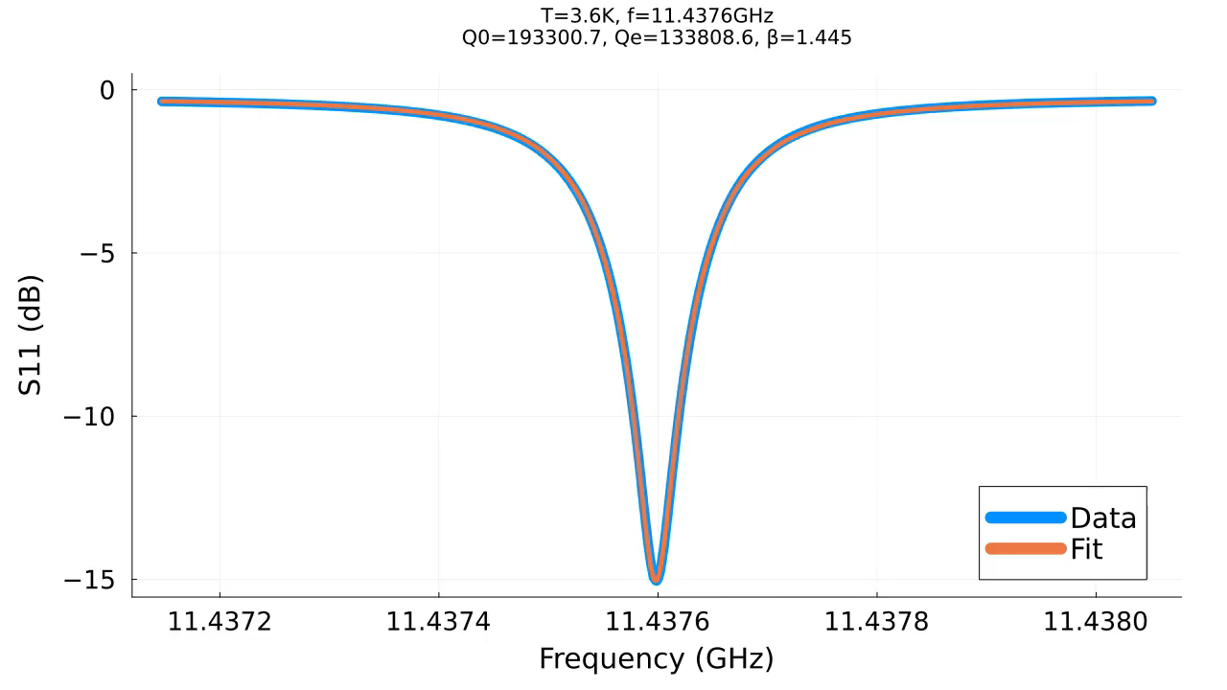
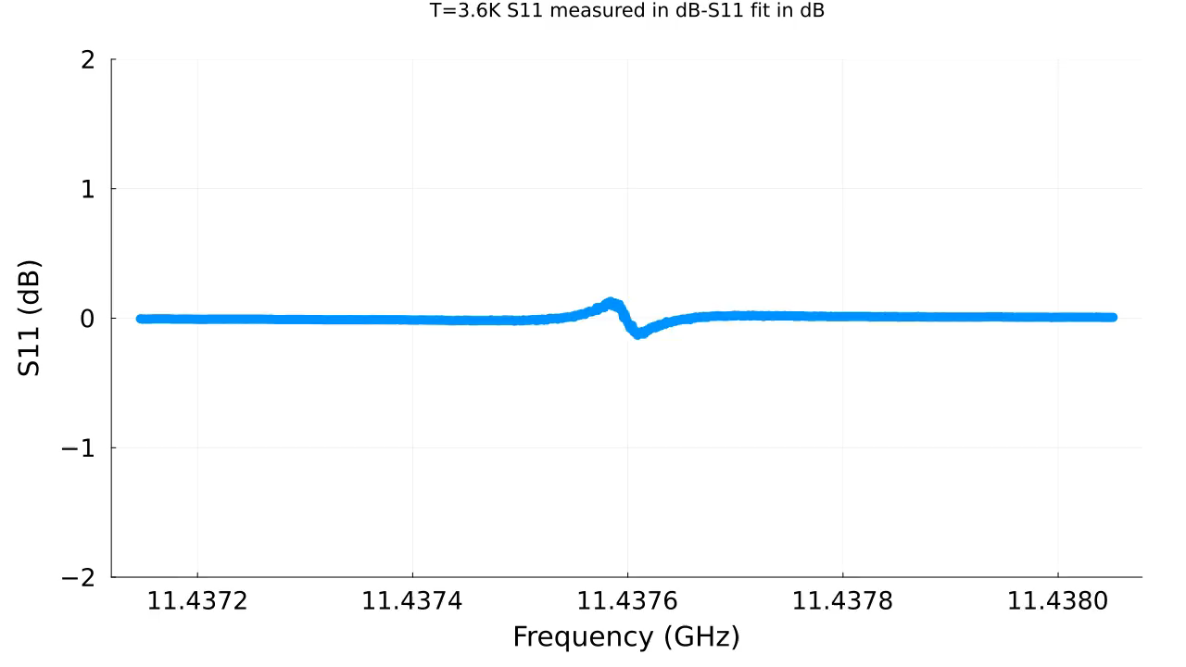

Find Functional Form of $Q_{cavity}$ from Nb
4K for Nb the $Q_{cavity}≈Q_{0}$

Slide 9
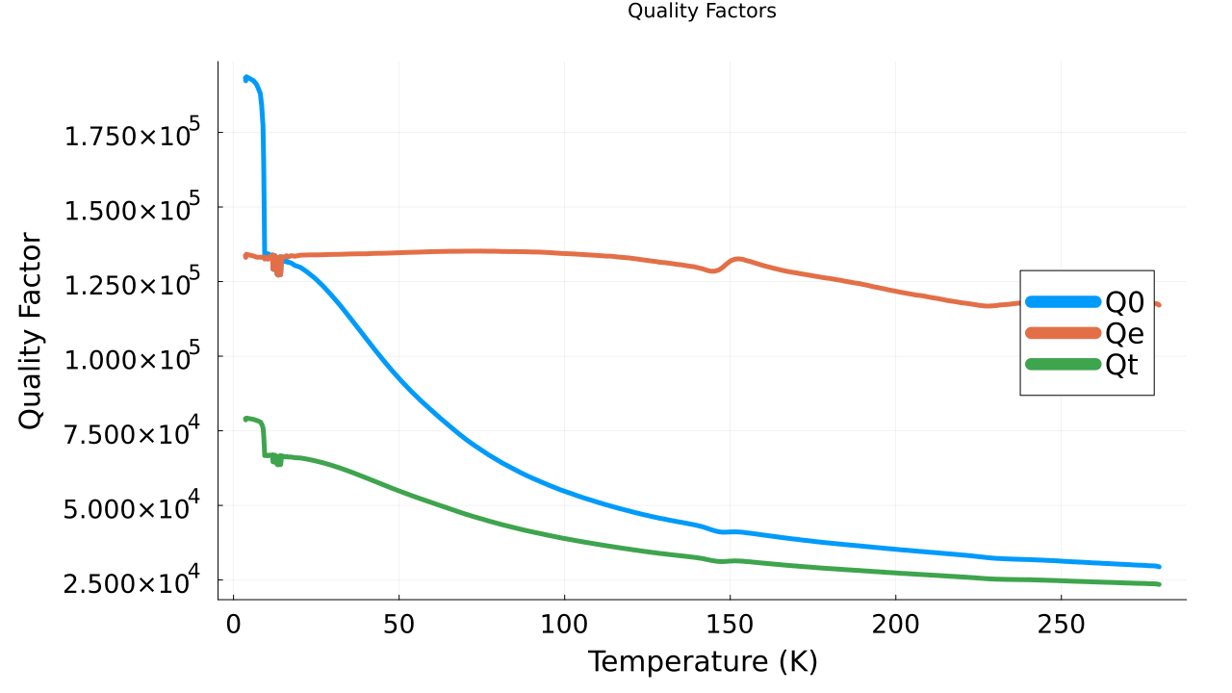
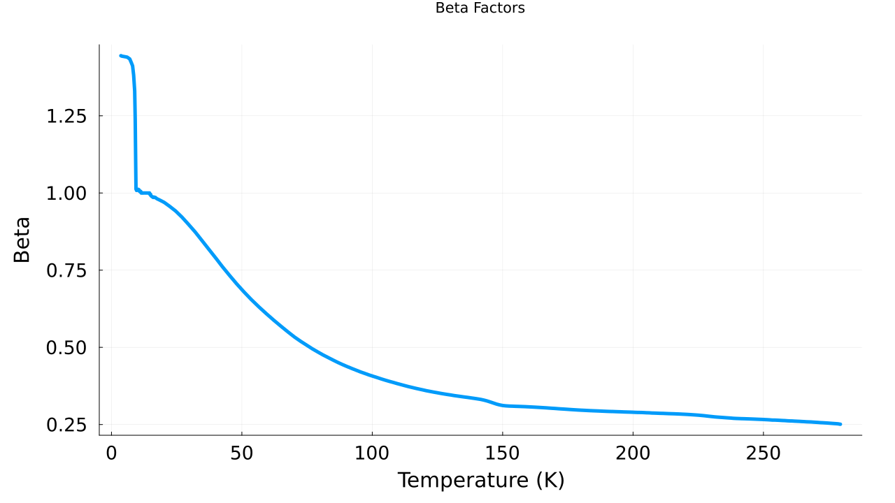
Add Q (T) beta (T) for Nb
4K for Nb the $Q_{cavity}≈Q_{0}$

Slide 10
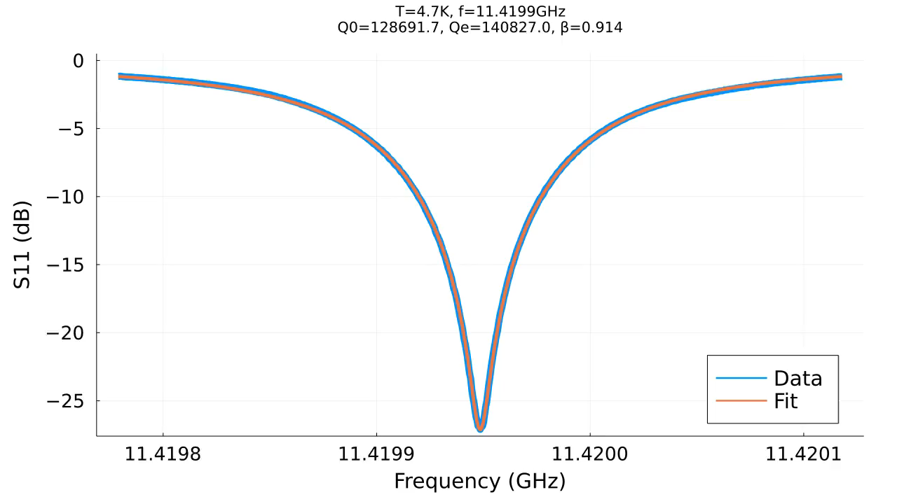
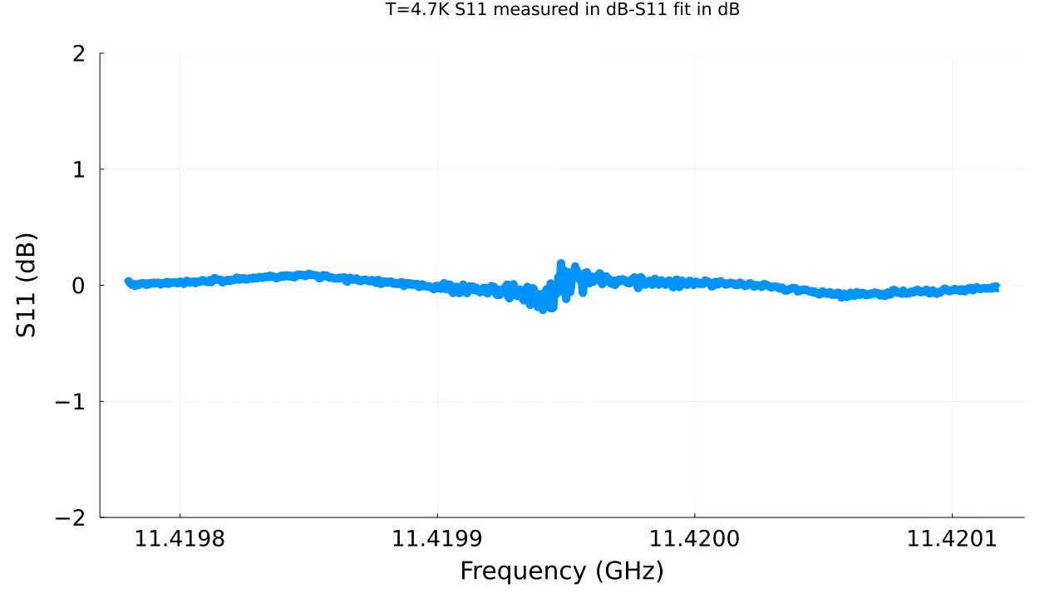
Find Functional Form of $Q_{cavity}$ at Cu

Slide 11
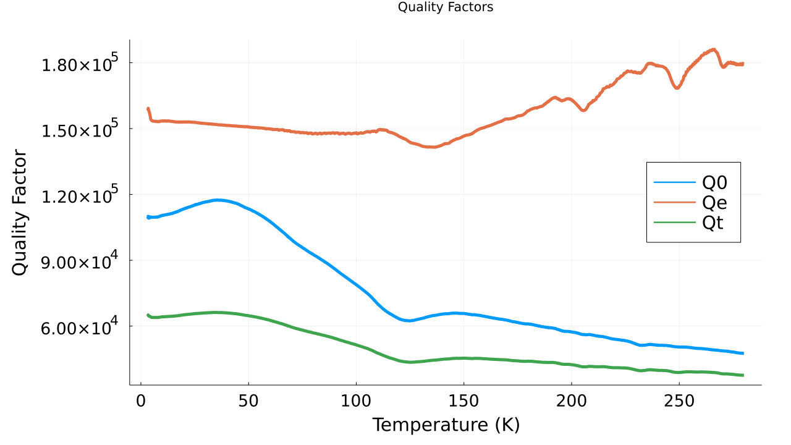
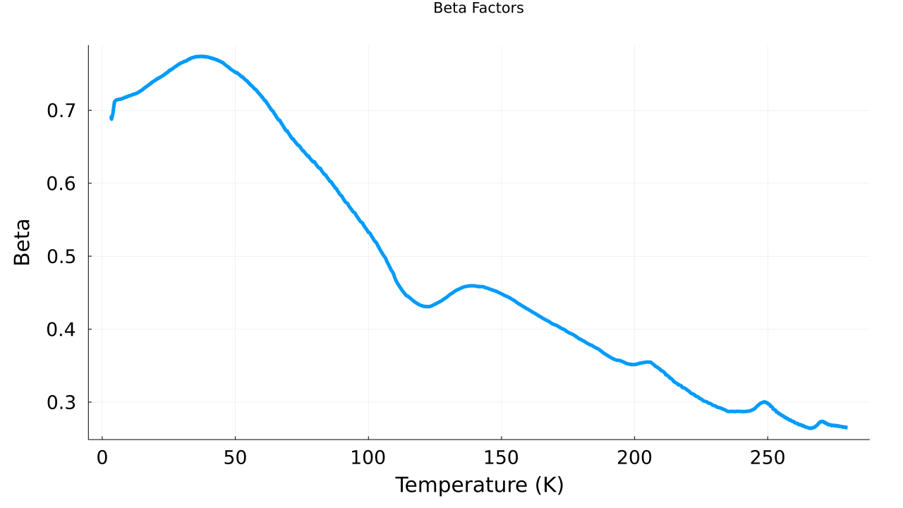
Find Functional Form of $Q_{cavity}$ at Cu

Slide 12
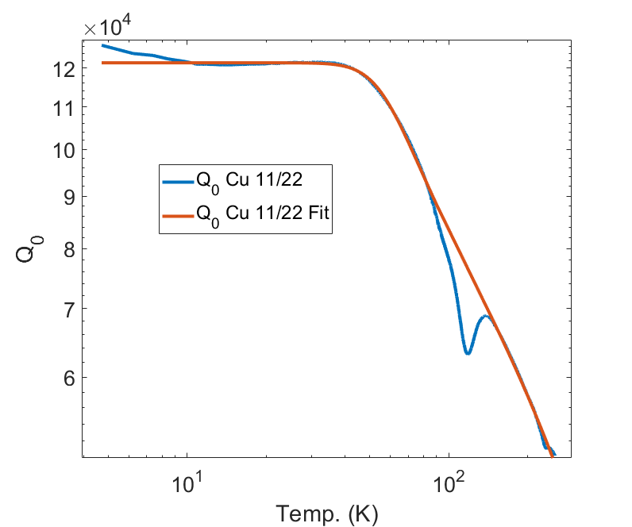
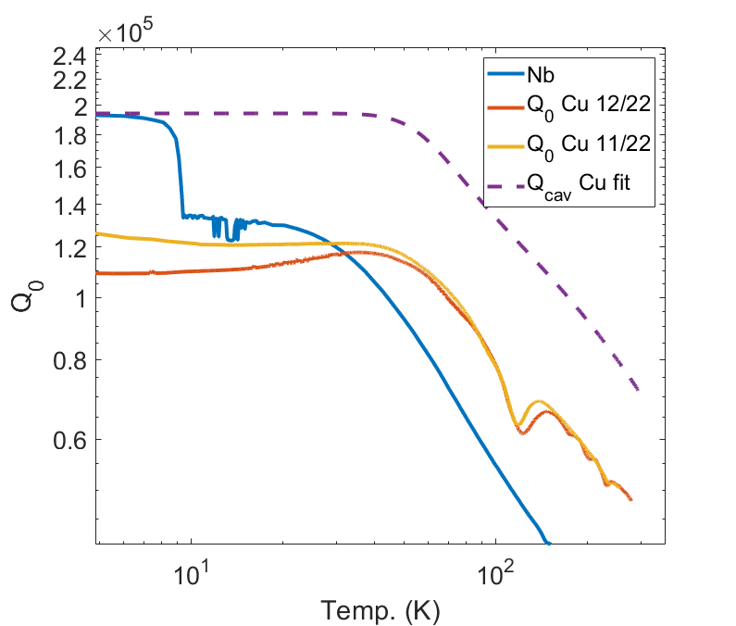

Functional form of Q cavity
Q₀ Q _{cavity} and Q_{sample} can be treated as parallel shifts of one another
The data can now be modeled with Generalized logistics equation multiplied by a power term which is in the same form of the national Institute of standards equation which itself can be taylor expanded into the BG
Q_{cavity} (T)=A+ $\frac{(K−A)T^{β}}{{(1+c∗e^{−B∗T})}^{α}}$
Where K,$y_{0}$,β,c, B and α Our fitting coefficients
And a is confined to the asymptotic limit for low temperatures by
$$A=\frac{{(1+c)}^{α}y_{0}−K}{{(1+c)}^{α}−1}$$
Where $Q amplitude$ was obtained from the niobium results and was found to be 1.942e5

Slide 13
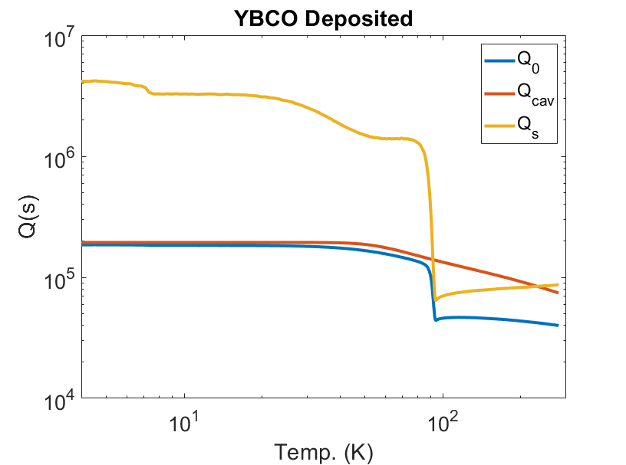
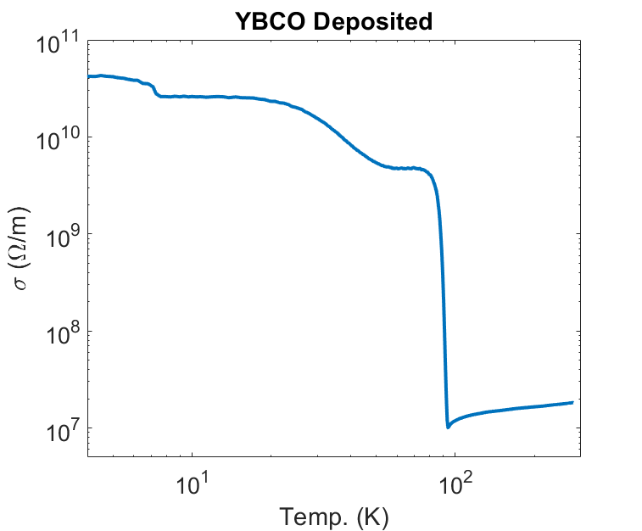
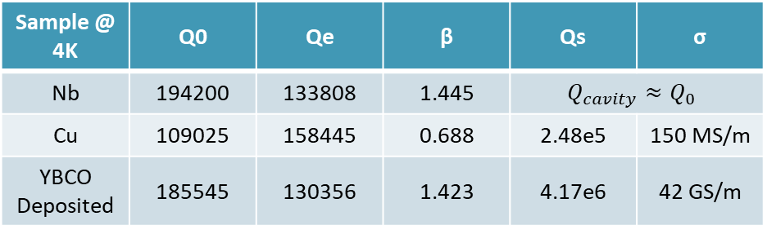
Analysis of YBCO Deposited Results
Using the Q cavity functional form
We can obtain the Q sample for YBCO
Qs from HFSS for YBCO Conductivity of 43 GS/m is 4.23e6 @ 4K In a bulk Ideal case
We find that the Conductivity for Deposited Sample to be match with 42 GS/m±1GS/m
More Modeling needs to be done to understand the tape geometries
Sample @ 4K | Q0 | Qe | β | Qs | σ
Nb | 194200 | 133808 | 1.445 | $$Q_{cavity}≈Q_{0}$$
Cu | 109025 | 158445 | 0.688 | 2.48e5 | 150 MS/m
YBCO Deposited | 185545 | 130356 | 1.423 | 4.17e6 | 42 GS/m

Slide 14
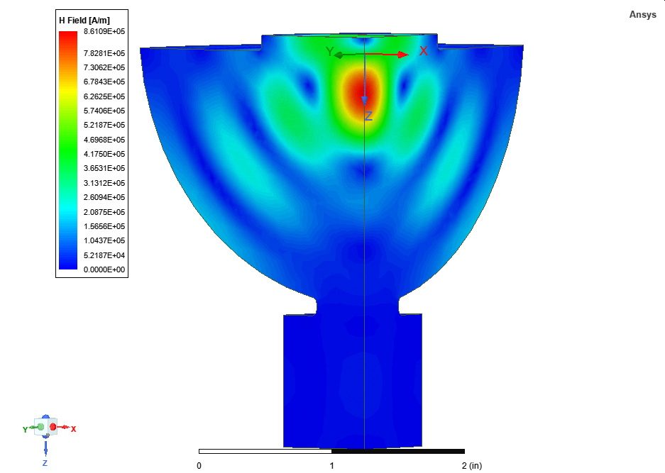
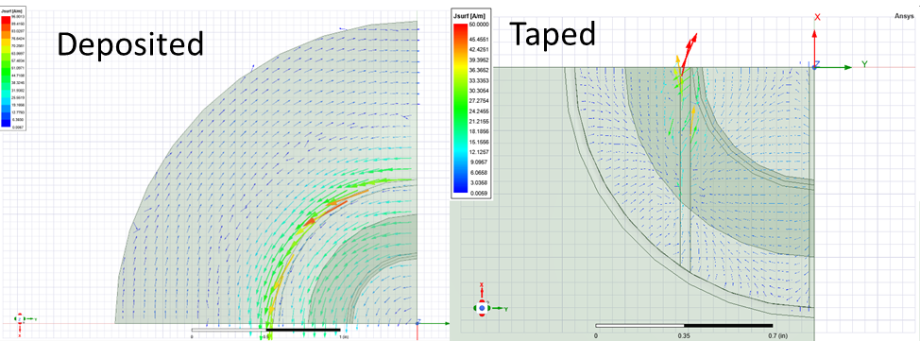
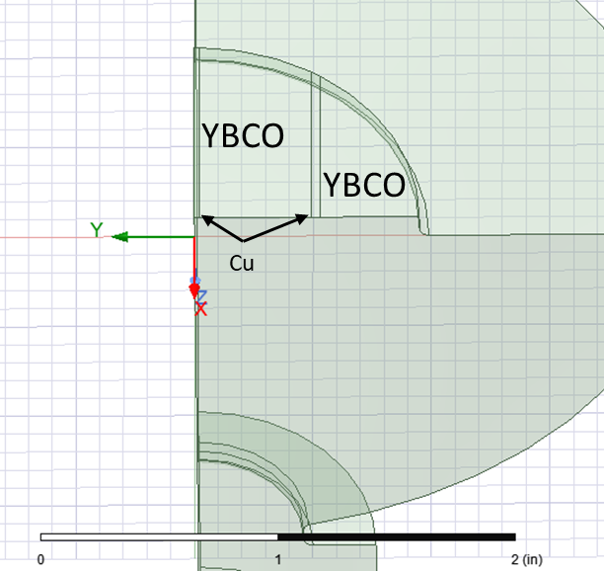
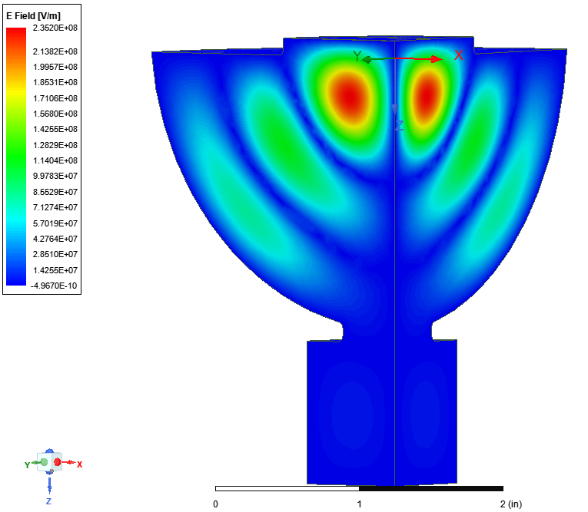
YBCO Tapes
YBCO
YBCO
Tape samples consisted of four tapes that were 12 mm wide separated by 1 mm tapes YBCO that were 600 nm thick
HFSS Simulations showed no change in the magnetic or electric fields
Cu
Deposited

Slide 15
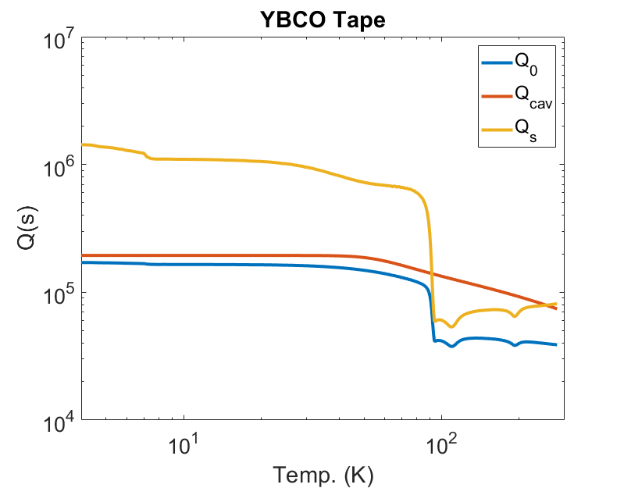
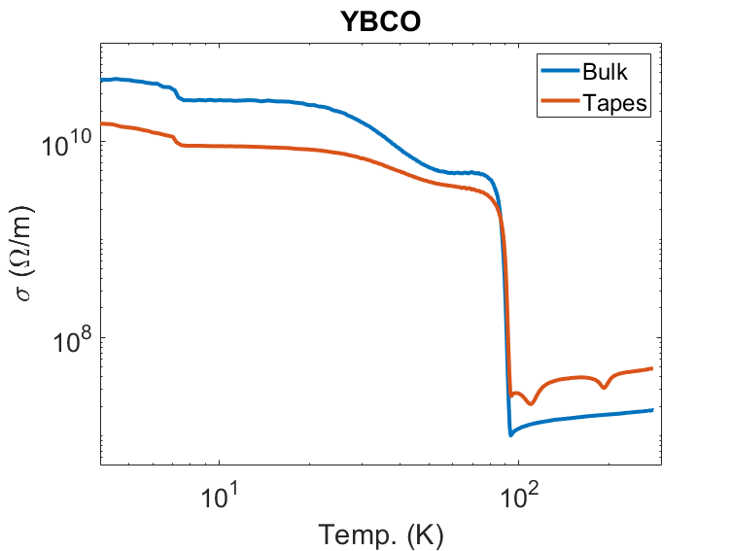
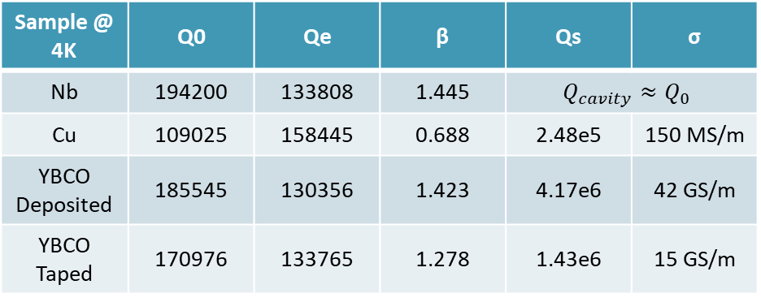
Taped YBCO Results
Then We find Q cavity, using a combination of the niobium and copper datasets
YBCO results agree with previous experiments
Model is consistent with HFSS simulations and classical theory
Tapes Qs ref. of 2.4e6 and conductivity at 4K of 15 GS/m ie 35% of Ideal
Sample @ 4K | Q0 | Qe | β | Qs | σ
Nb | 194200 | 133808 | 1.445 | $$Q_{cavity}≈Q_{0}$$
Cu | 109025 | 158445 | 0.688 | 2.48e5 | 150 MS/m
YBCO Deposited | 185545 | 130356 | 1.423 | 4.17e6 | 42 GS/m
YBCO Taped | 170976 | 133765 | 1.278 | 1.43e6 | 15 GS/m

Slide 16
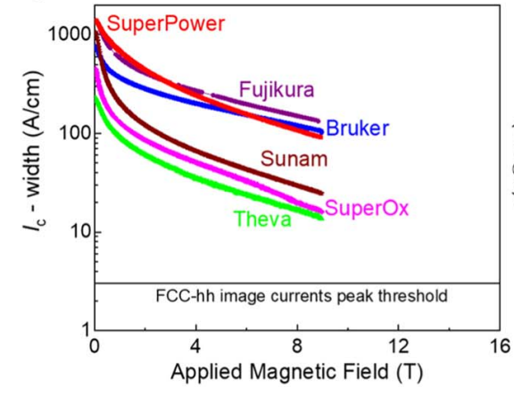
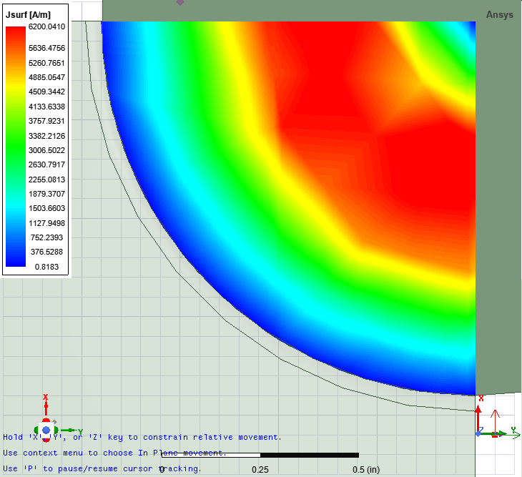
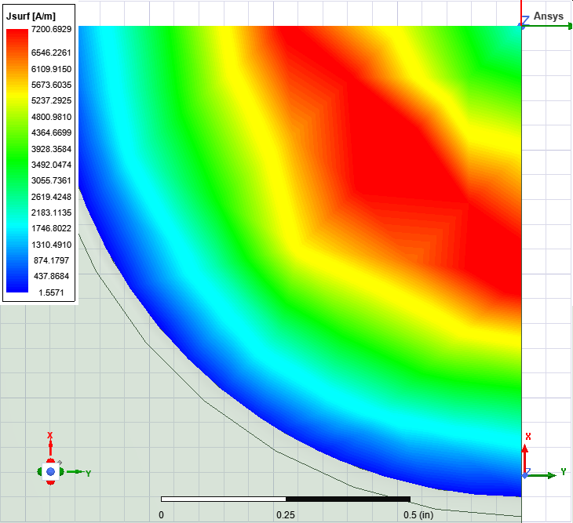
YBCO RF from TWT
TWT is 2.48 kW @ 11.7 µs Qtot is 75k and f0=11.43 GHz
=> fill time is 13.4 µs
Tape sample has Surface currents of 6.2 kA/m and deposited sample has 7.2kA/m
Bh~0.001 and 0.03 for Despoit and tapes but TWT will not have Enough to quench
Taped
Deposited

Slide 17
Taped YBCO Results 80 K
Sample @ 80K | Q0 | Qe | β | Qs | σ
Nb | 65566 | 135169 | 0.485 | 1.16e5 | 32 MS/m
Cu | 92481 | 147769 | 0.626 | 2.34e5 | 134 MS/m
YBCO Deposited | 135167 | 126911 | 1.065 | 1.30e6 | 4 GS/m
YBCO Taped | 120191 | 133041 | 0.903 | 5.99e5 | 2.6 GS/m
YBCO is factor 29 Greater for Deposited and 19 for tapes

Slide 18
BACK UP SIldes
* We need the new clear YBCO taped data before CERN

Slide 19
NB Movies

Slide 20
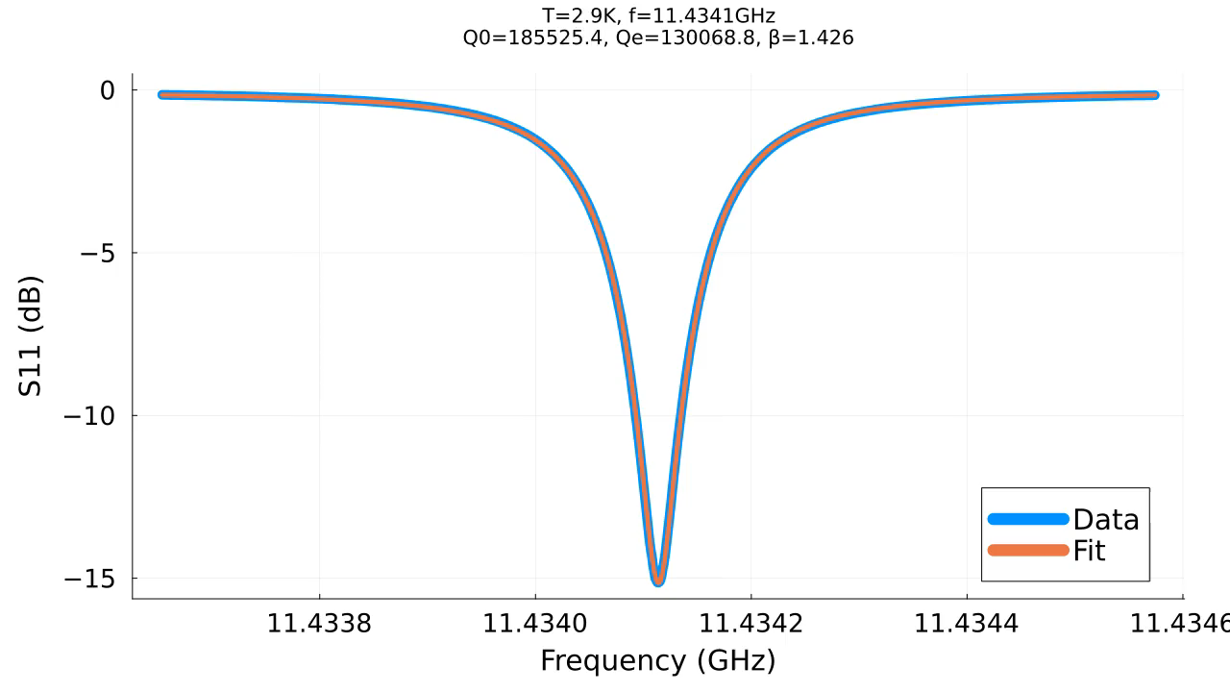
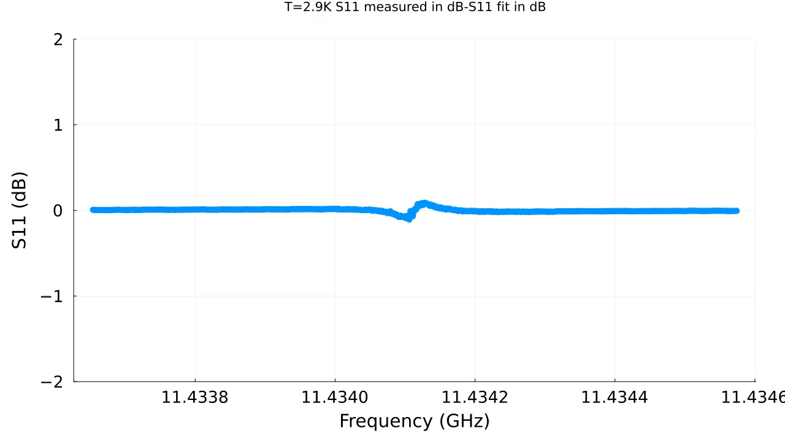
YBCO Movies

