Slide 1


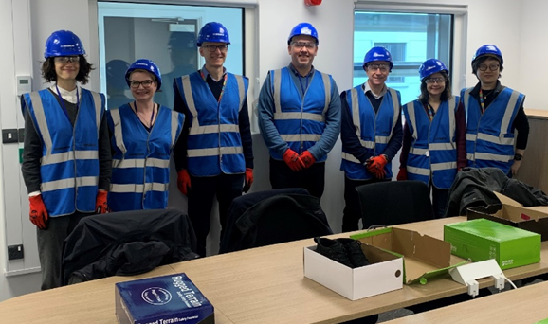

STFC Evaluation of RIs
Claire Dougan
Associate Director, Evidence and Impact
May 2023

Slide 2

Contents
1) Introduction to UKRI/STFC
Who are we
What do we do?
2) Recent evaluations
DLS
ESO
ESRF
3) Reflections
STFC International
May 2023

Slide 3


Introduction to UKRI/STFC

Slide 4

UK Research and Innovation
£8-9 billion per annum budget, ~ 8,000 staff

Slide 5
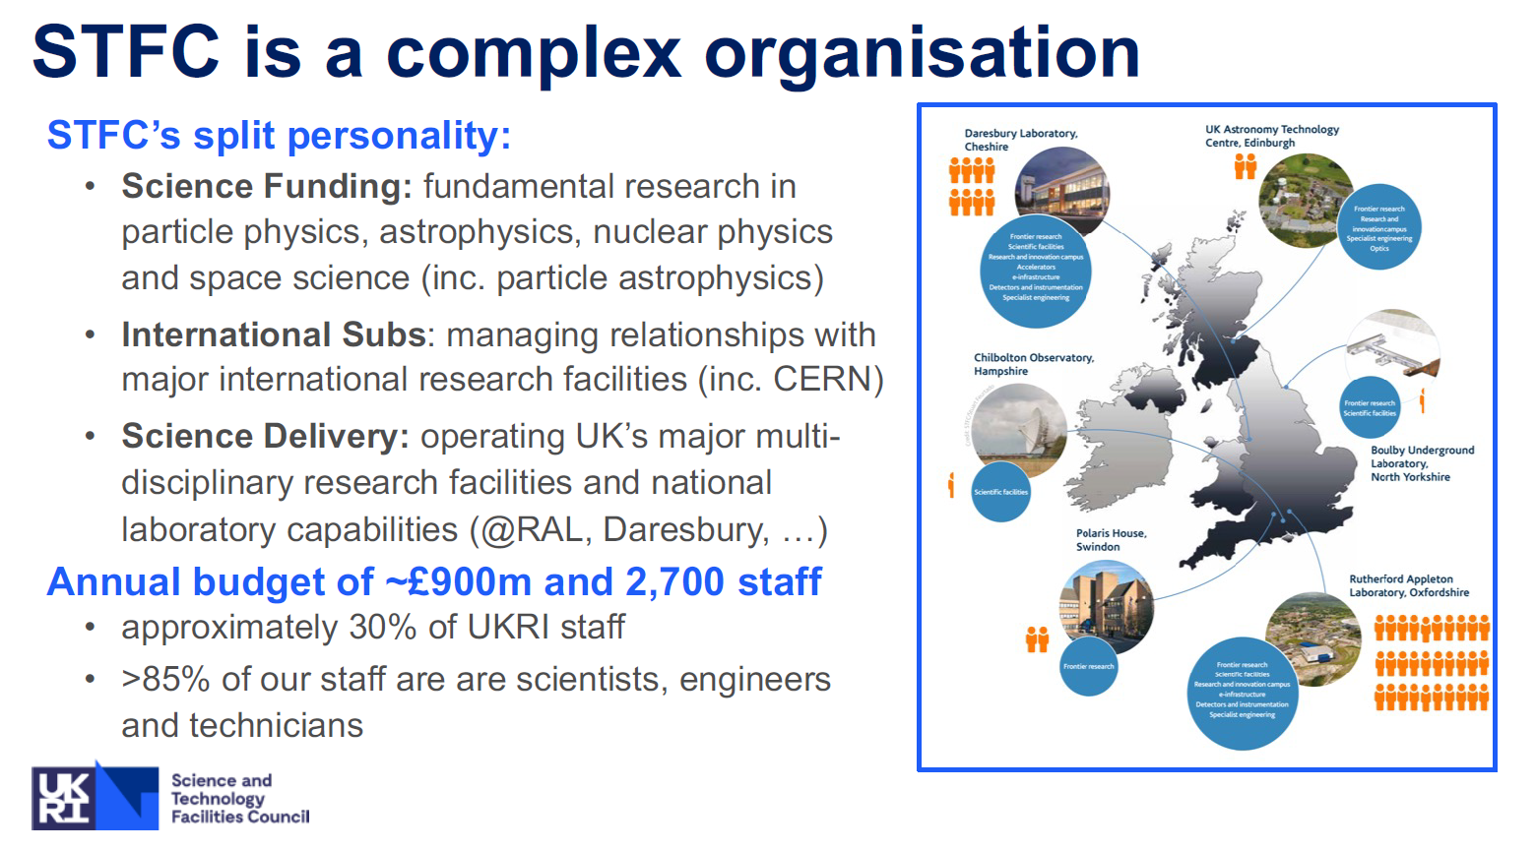
Notes:
STFC really does have a bit of a split personality, and when you compare us to other councils in UKRI, grant based funding is a really small proportion of what we do.
We then have international subscriptions
As well as science delivery in operating these national research facilities and labs- STFC provides the necessary high-tech scientific and engineering support for >7,500 industrial and academic researchers across all domains
Around 2,700 staff – accounting for about 30% of UKRI staff
85% are scientists, engineers and technicians

Slide 6

Why is evaluating RIs important?
UKRI has strategic aims of creating world-class R&I infrastructure and delivering world-class impact
R&I infrastructure fundamental to UK’s ambition of increasing investment in R&D to 2.4% of gross domestic product (GDP) by 2027
UKRI’s Infrastructure Fund will invest £481 million (2022/25) into a portfolio of infrastructure
Renewed focus on M&E of large RIs in UK and internationally
Becoming more important as justification for future funding

Slide 7
Vision
Maximise the impact of public investment in UKRI’s R&I
Strategic portfolio management
Monitoring and evaluation
Facility and department reviews
Impact evidence
STFC E&I team
We build evidence and create quality analysis to enable UKRI to make better policy, strategy and funding decisions, to maximise our impact on knowledge, the economy and society.
Small team – best practise & impact awareness
Economic analysis and expertise
Data analysis and insight

Slide 8
Evaluation examples
DLS
ESO
ESRF
Notes:
The abstract pattern can be removed or repositioned if required. Be careful to ‘Send to Back’ so that it does not obscure any important information.

Slide 9
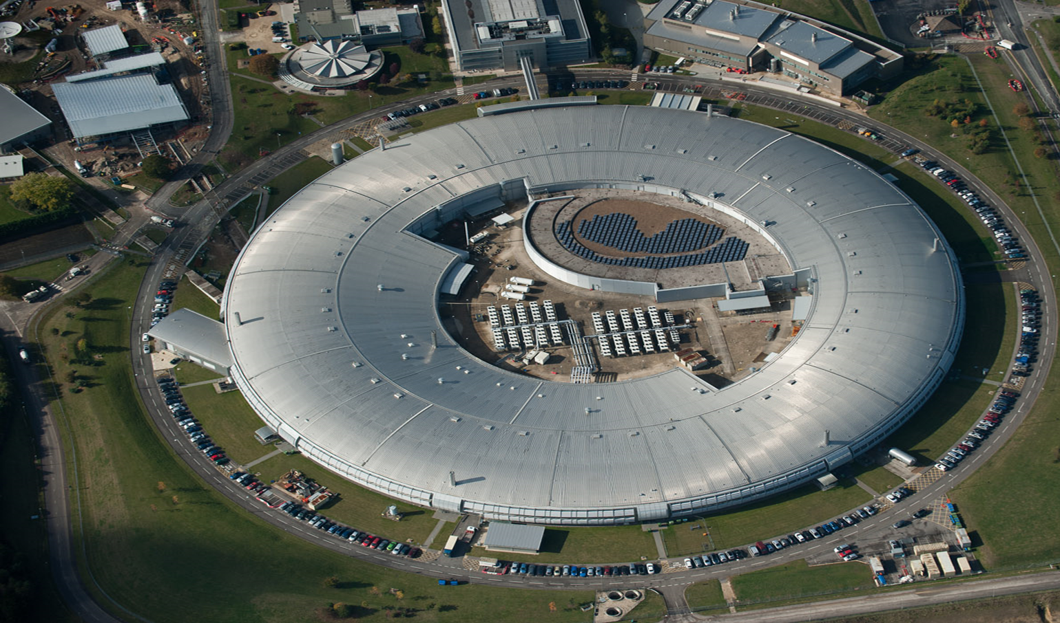
Diamond’s Socio-Economic Impact Study
Initial discussions 2016, published in 2021
Objectives – Set out to measure and demonstrate Diamond’s scientific, technological, societal, and economic benefits
Methodology – Bespoke. Classified with logic model - input, activity, output and outcome
Quantitative data – 350 + responses
Qualitative data – 25 + in depth interviews and a lot of desk research
Carried out by Technopolis
www.diamond.ac.uk/Home/News/LatestNews/2022/19-10-22

Slide 10
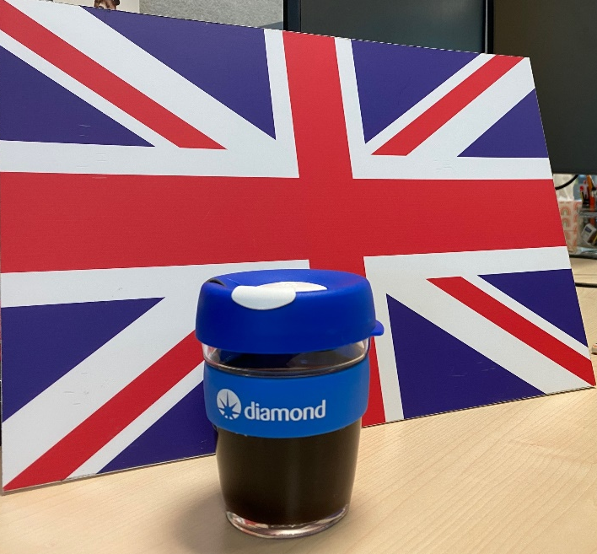
High level economic impact of the study
Cumulative monetised impact for Diamond of at least £2.6 billion
This reflects very favourably with the £1.4 billion investment to date
UK taxpayer contributes only £2.45 a year towards it

Slide 11
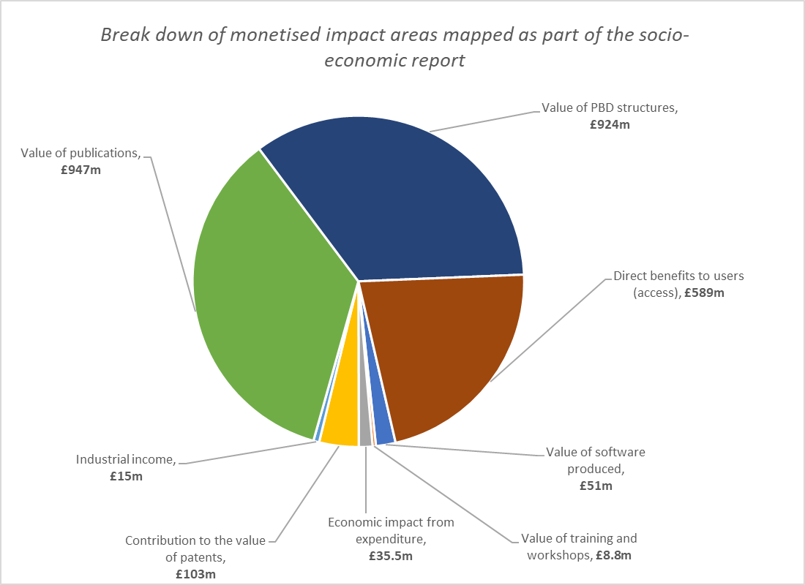
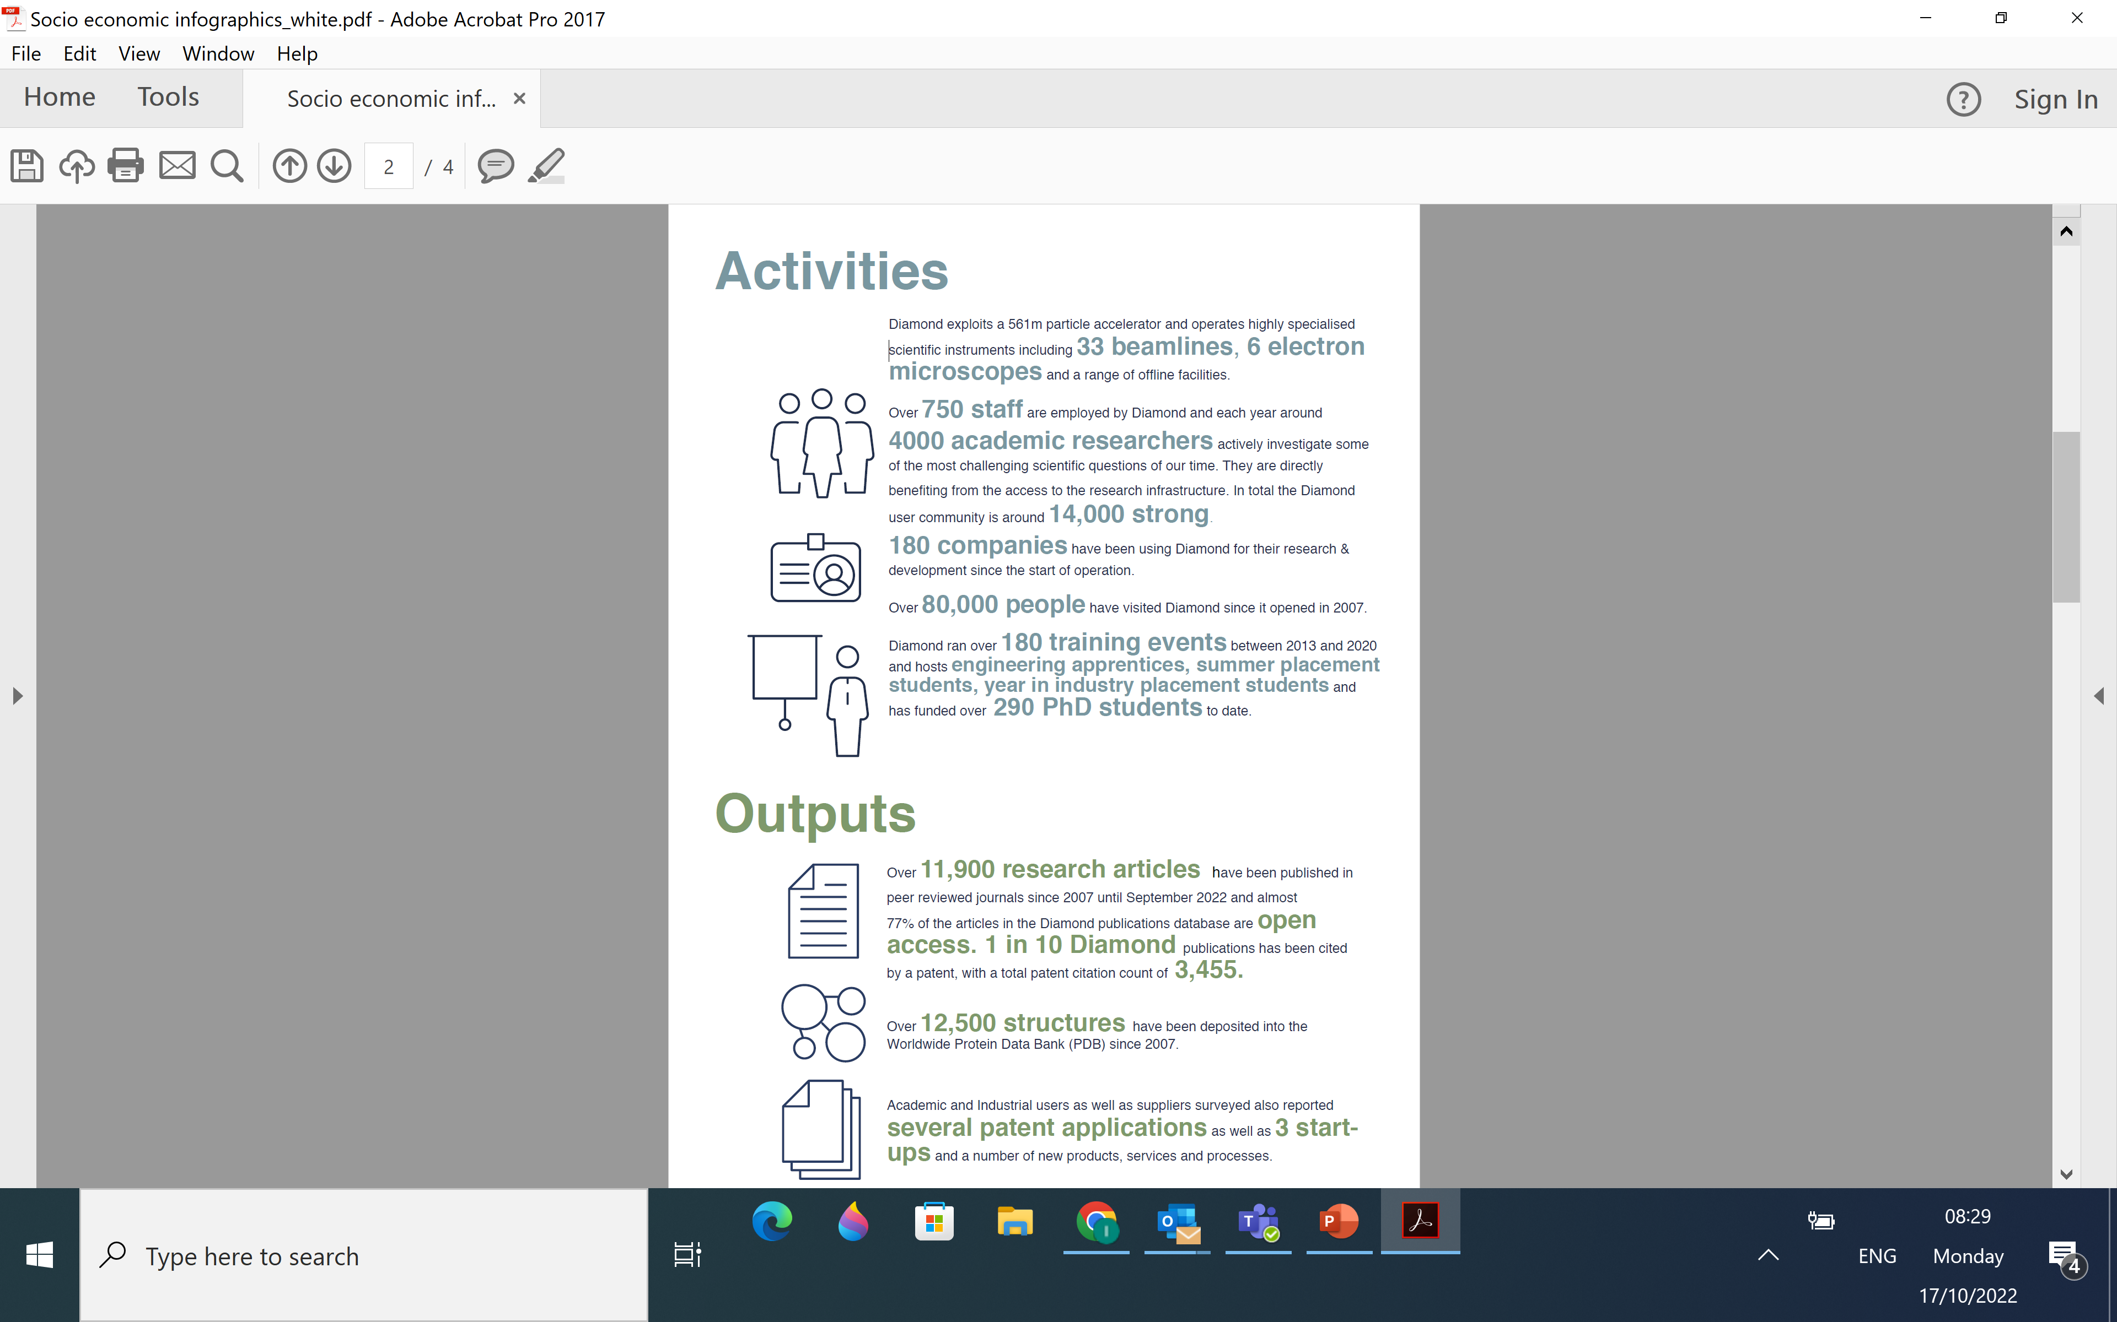



Summary of economic impact
…and societal impact

Slide 12
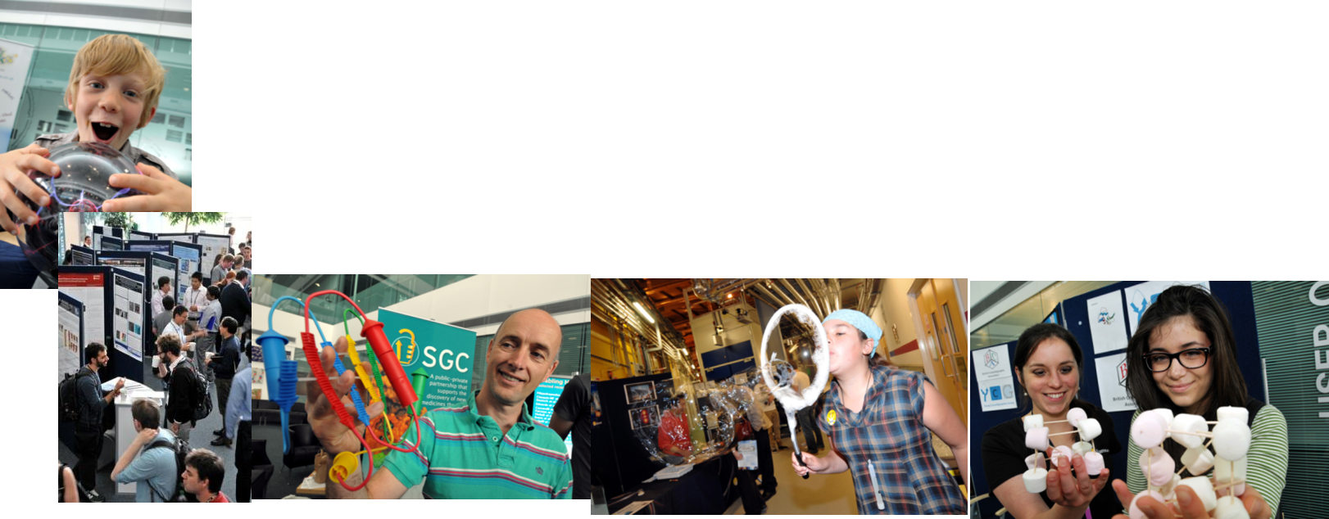
But beyond the monetary impact
Wider Societal Benefits - 80,000 visitors reached
…and a massive impact on skills for the UK

Slide 13

Socio-economic impact evaluation of the UK subscription to ESO
Published in 2022, in collaboration with Technopolis, reveals the benefits of the UK’s subscription to the European Southern Observatory (ESO)
From an annual commitment of £22.7M, the UK receives back the monetary equivalent of ~£45.5M each year (minimum estimate)
Based on available data and where a robust approach existed (telescope time, knowledge production & supply contracts)
Not all benefits were quantifiable
STFC-240222-BenefitsUKEuropeanSouthernObservatoryPartnership.pdf
Credit: ESO/M. Kornmesser

Slide 14

Research impacts
The UK has above average success rates for observing time
Awarded 29% of time in 2019/20 (while contributing 17% of fees)
UK scientists have used ESO to make critical contributions to understanding Universe
The UK’s high output and high citation profiles in astronomy since joining ESO is a very strong achievement
Credit: ESO/B. Tafreshi (twanight.org)

Slide 15

Innovation impacts
From 2004-2019:
258 UK organisations had successful contract bids to ESO
1,114 individual contracts awarded with UK involvement
£117M in ESO contracts has been secured by the UK between 2002 and 2020
Process evaluation made recommendations on how to increase industrial return
Credit:Y. Beletsky (LCO)/ESO

Slide 16
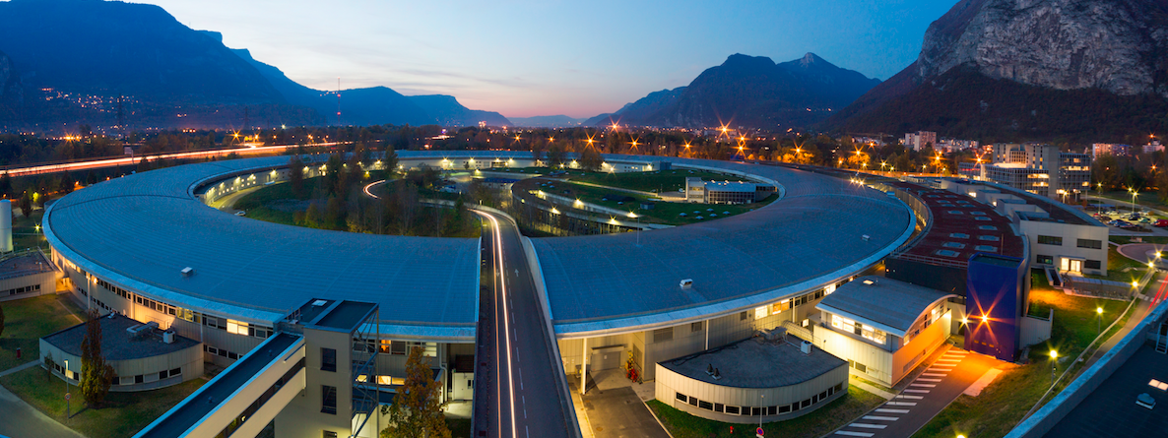
ESRF evaluation
Currently being signed off
Range of qualitative and quantitative impacts presented
Gaps in evidence and research/analysis methods to support a robust assessment of ESRF’s economic impact on the UK
Recommendations made on an M&E framework to facilitate future evaluations
European Synchrotron Radiation Facility, Grenoble, France

Slide 19

Reflections
Focus on impact & evaluation is still significant
RIs explicit in UKRI strategy as important to economic growth
Government spending and demand for evidence is increasing
Dichotomy of pressure on staff numbers and salary
Resources to ensure M&E frameworks implemented
Methodology/data still a challenge – Green/Magenta Books
Monetising the impact from Research Infrastructures challenging
Some issues working with consultants, diversity and methodology
Made big strides in the last few years, still lots to achieve

Slide 20






Science and Technology Facilities Council
@STFC_matters
Science and Technology Facilities Council
Notes:
The abstract pattern can be removed or repositioned if required. Be careful to ‘Send to Back’ so that it does not obscure any important information.

