Slide 1
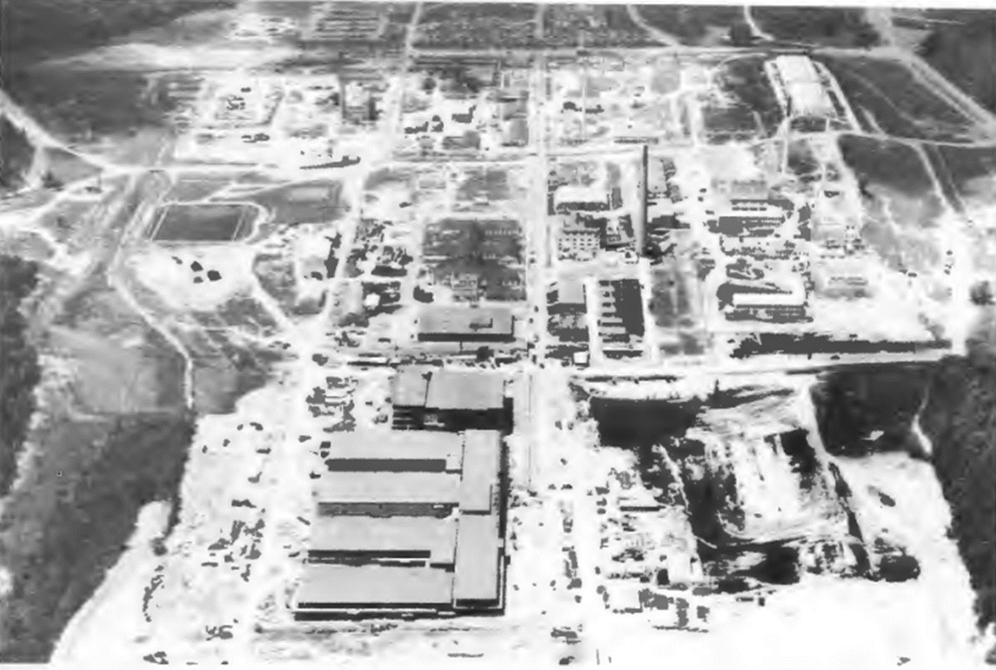


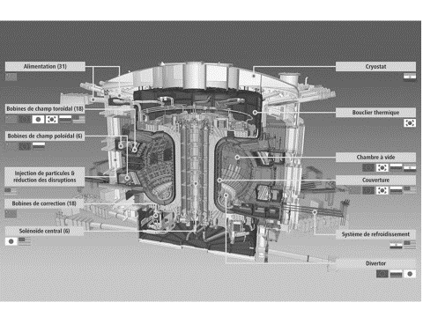
A Big Science 2.0? From the national laboratory to international collaboration (and science diplomacy)
Simone Turchetti, CHSTM, University of Manchester, UK

Slide 2

1950s - Big Science as the National Laboratory
Aerial view of the Oak Ridge National Laboratory in the early 1950s (photo: ORNL Review 5/3 – 1992, p. 92)

Slide 3
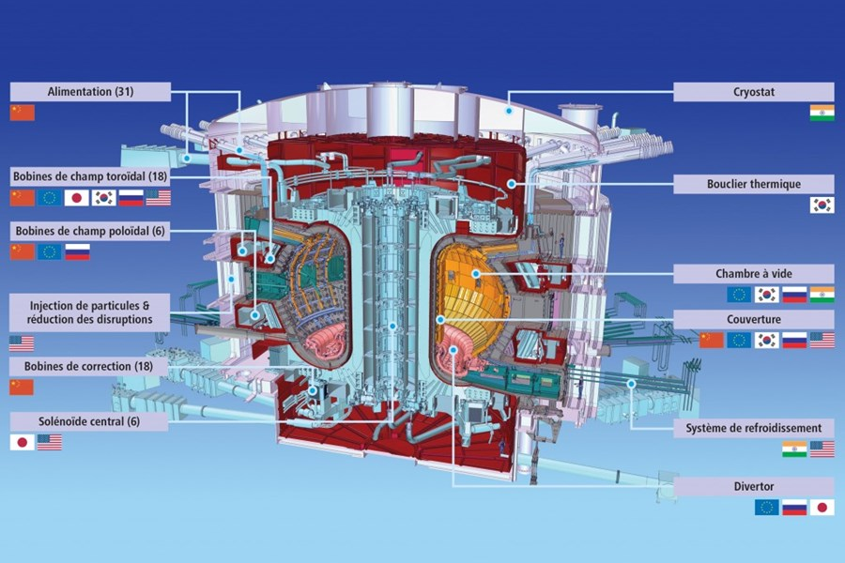
Tokamak of the International Thermonuclear Experimental Reactor (photo: ITER website)
2020s - Big Science as International Collaborative Enterprise

Slide 4
Big science as bridging concept* framing the scientific enterprise in a given period
*Bridging concepts that work as bridges by connecting between domains and areas of social life and giving meaning to specific societal enterprises. S D Reese (2007) J. Commun. 57 148–4
Driving questions: how does the meaning of ‘big science’ change overtime? How has it worked as ‘bridging concept’?

Slide 5
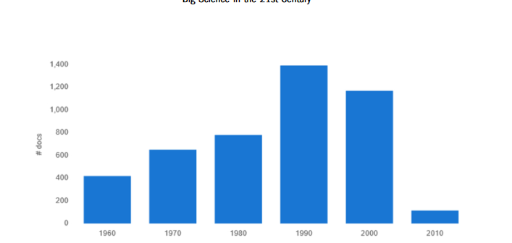
Text Mining exercise
Occurrence of the word Big Science in 5384 documents in JSTOR articles (1960-2010)

Slide 6
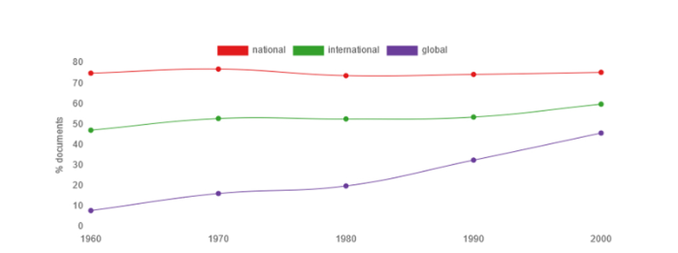
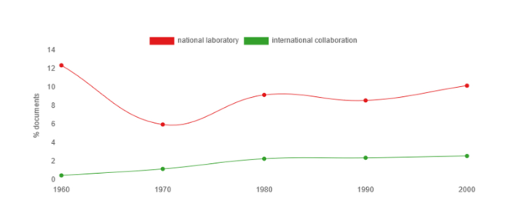
Frequency of occurrence (in percentage) of the words ‘national’, ‘international,’ and ‘global’ in the set JSTOR corpora
Frequency of occurrence (in percentage) of the words ‘national laboratory’ vs. ‘international collaboration,’ in the set JSTOR corpora

Slide 7
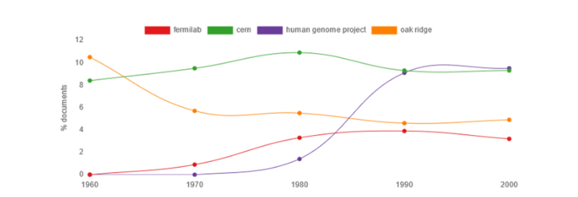
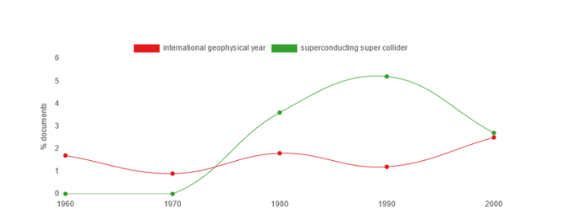
Frequency of occurrence (in percentage) of the words ‘fermilab’, ‘cern’, ‘human genome project’ and ‘oak ridge’ in the set JSTOR corpora
Frequency of occurrence (in percentage) of the words ‘international geophysical year’ vs. ‘superconducting super collider,’ in the set JSTOR corpora

Slide 8
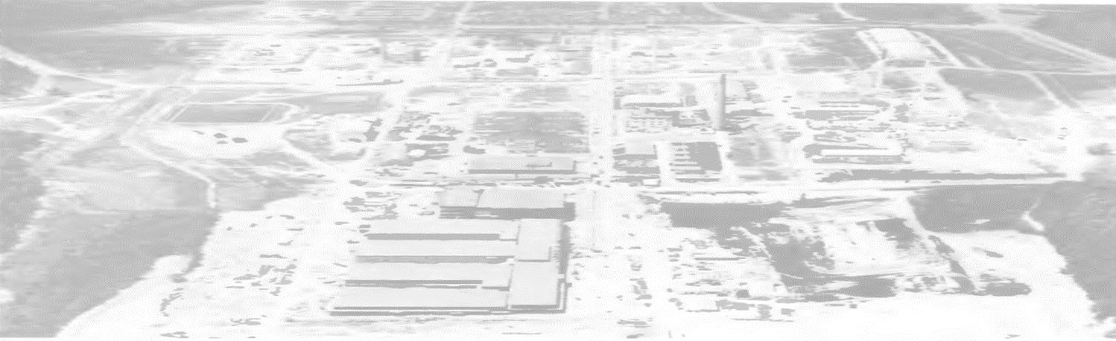
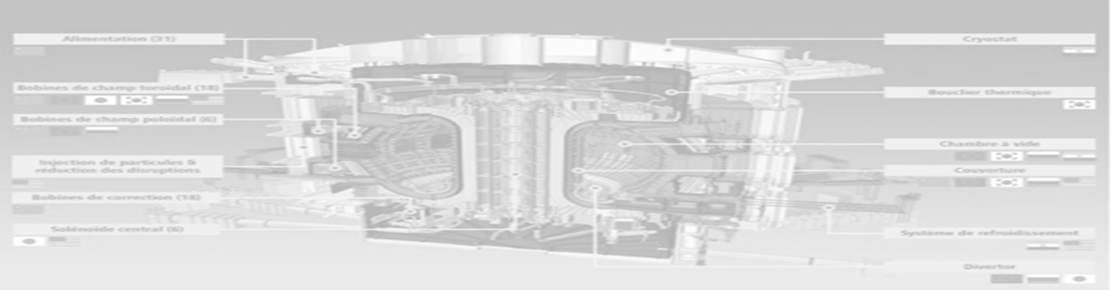
Big science
Shaping an historical narrative…
National
Laboratory
International
Collaboration
Centrally located
Big machines
Centralized management structures
Sited in multiple centres
Shared scientific resources
Distributed administrative structures

Slide 9
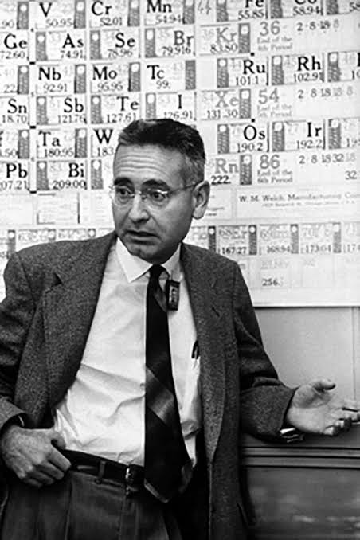
‘Big science’ in the age of the national laboratory
ORNL as the model. A Weinberg (1961) Science 134 161–4
Need to scale up to be ahead (also Big Science as malaise - ‘gigantism’)
Int. collaboration regarded as useful but not necessary:
CERN an instrument ‘set up to enable several countries to share costs that are too heavy for them to bear separately’ A Weinberg (1963) Minerva 1 159–71; an ‘internationally shared machinery’. H Rose (1967) Minerva 5 340–56
IGY not Big Science – which ‘[…] need not dominate geo­physics’. T Malone (1964) AGU Trans. 45 295–300
Alvin M. Weinberg
1915-2006
(photo: OakRidger)

Slide 10
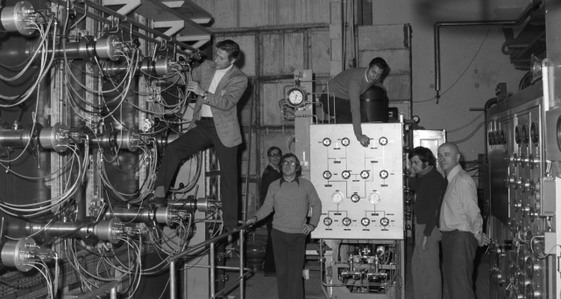
Traditional Big Science problematic!
‘the advent of these facilities (National Accelerator Laboratories) will hasten “big science” […] at the expense of smaller research group,’ A Hammond (1972) Science 177 597–9
New generation of scientists ‘threatened by the technology of Big Science,’ I D J Bross 1977 Science 195 933–4
Int. collaborative projects praised:
[…] as a tool for development. J J Salomon (1971) Sci. Stud. 1 23–42
CERN now framed differently:
nuclear physicists ought to travel regularly to CERN to be ‘at the frontier of [their] subject’,. J B Adams (1973) Dedalus 102 111–24
Criticism of the ‘national laboratory’ re-defining the meaning of Big Science
Collaboration for the Gargamelle bubble chamber in 1974 (Image: CERN)

Slide 11
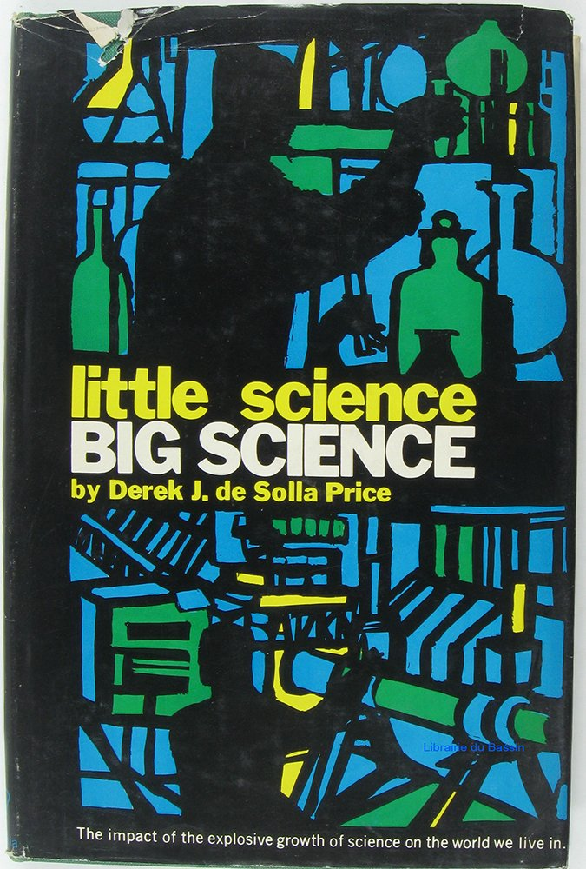
Science studies’ contribution to re-defining Big Science, 1970s-1990s
Celebration:
Derek de Solla Price, Little Science, Big Science (1963) as historical celebration of the Big Science phenomenon

Slide 12
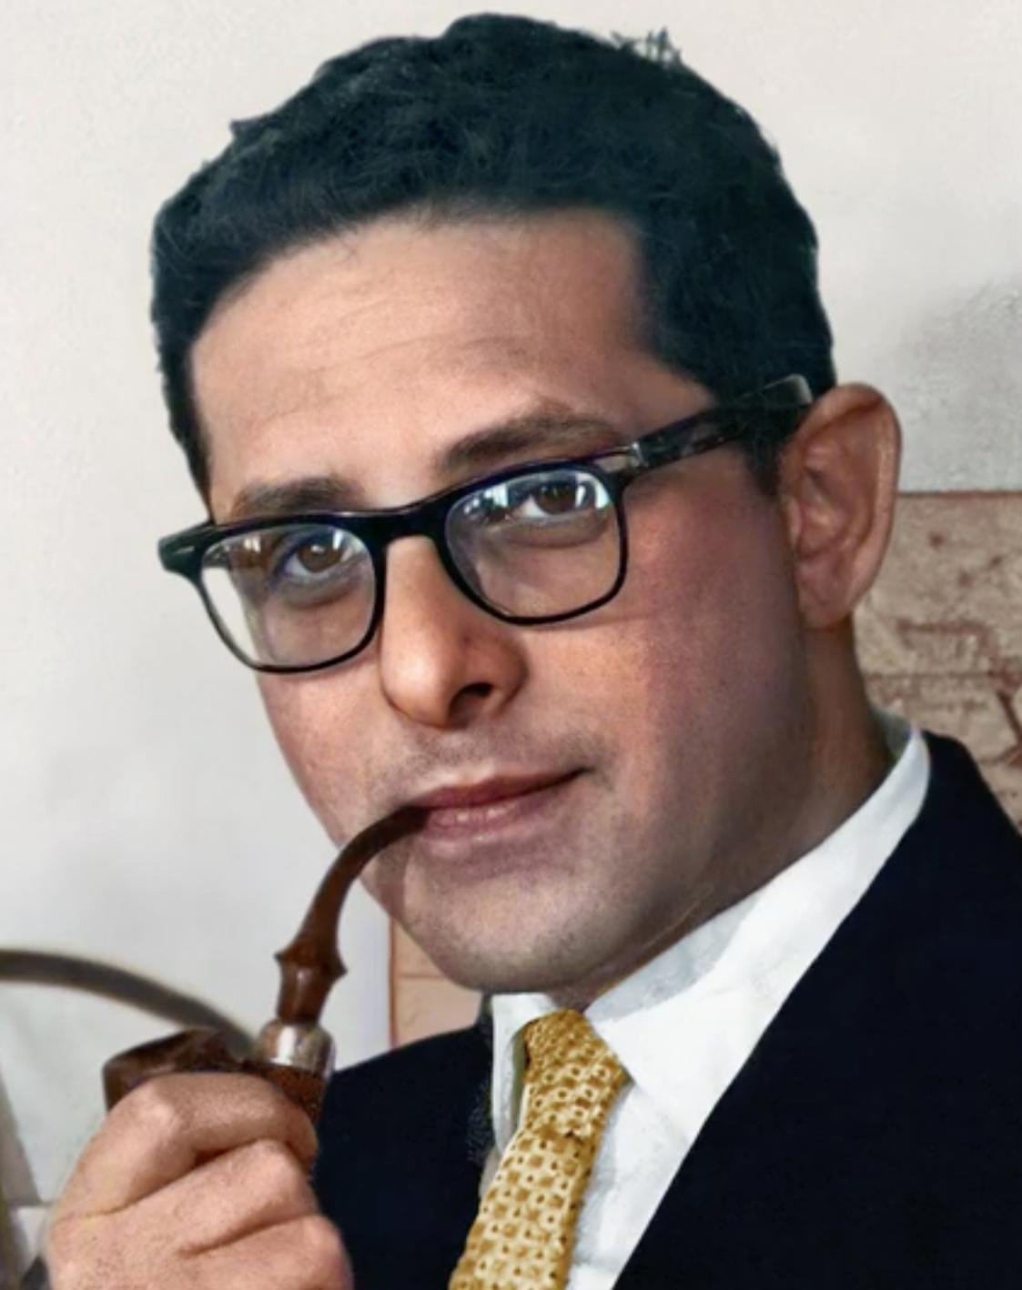
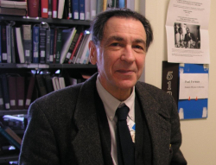
Science studies’ contribution to re-defining Big Science, 1970s-1990s
Derek de Solla Price, Little Science, Big Science (1963) as historical celebration of the Big Science phenomenon
Criticism:
In the 1970s Paul Forman replaced ‘the quantitative idiom [of Solla Price] with a language of morality’ H Menzel H and D Kaiser (2020) Hist. Stud. Nat. Sci. 50 31–40
Derek de Solla Price (top) and Paul Forman (bottom)

Slide 13
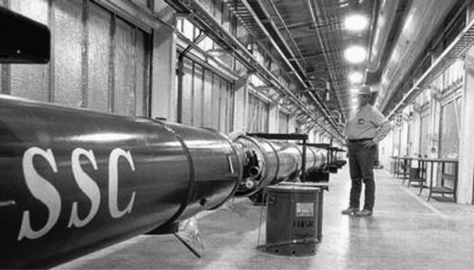

Science studies’ contribution to re-defining Big Science, 1970s-1990s
Derek de Solla Price, Little Science, Big Science (1963) as historical celebration of the Big Science phenomenon
In the 1970s Paul Forman replaced ‘the quantitative idiom [of Solla Price] with a language of morality’ H Menzel H and D Kaiser (2020) Hist. Stud. Nat. Sci. 50 31–40
Recent projects displaying failure of traditional nation-based schemes and the success of international ones
SSC, finally abandoned 1993
HGP, launched 1990 (20 universities in IHGSC)
Superconducting Supercollider in Texas (top - image: Facebook) and undated computer rendering of a fragment sequenced during the Human Genome Project (bottom - Image: AP)

Slide 14
Today, big science projects require massive state and intergovernmental funding support in an era of intense international competition for knowledge assets, which has forced governments and institutions to collaborate with one another M A Peters (2006) European Journal of Education 41 225-244

Slide 15
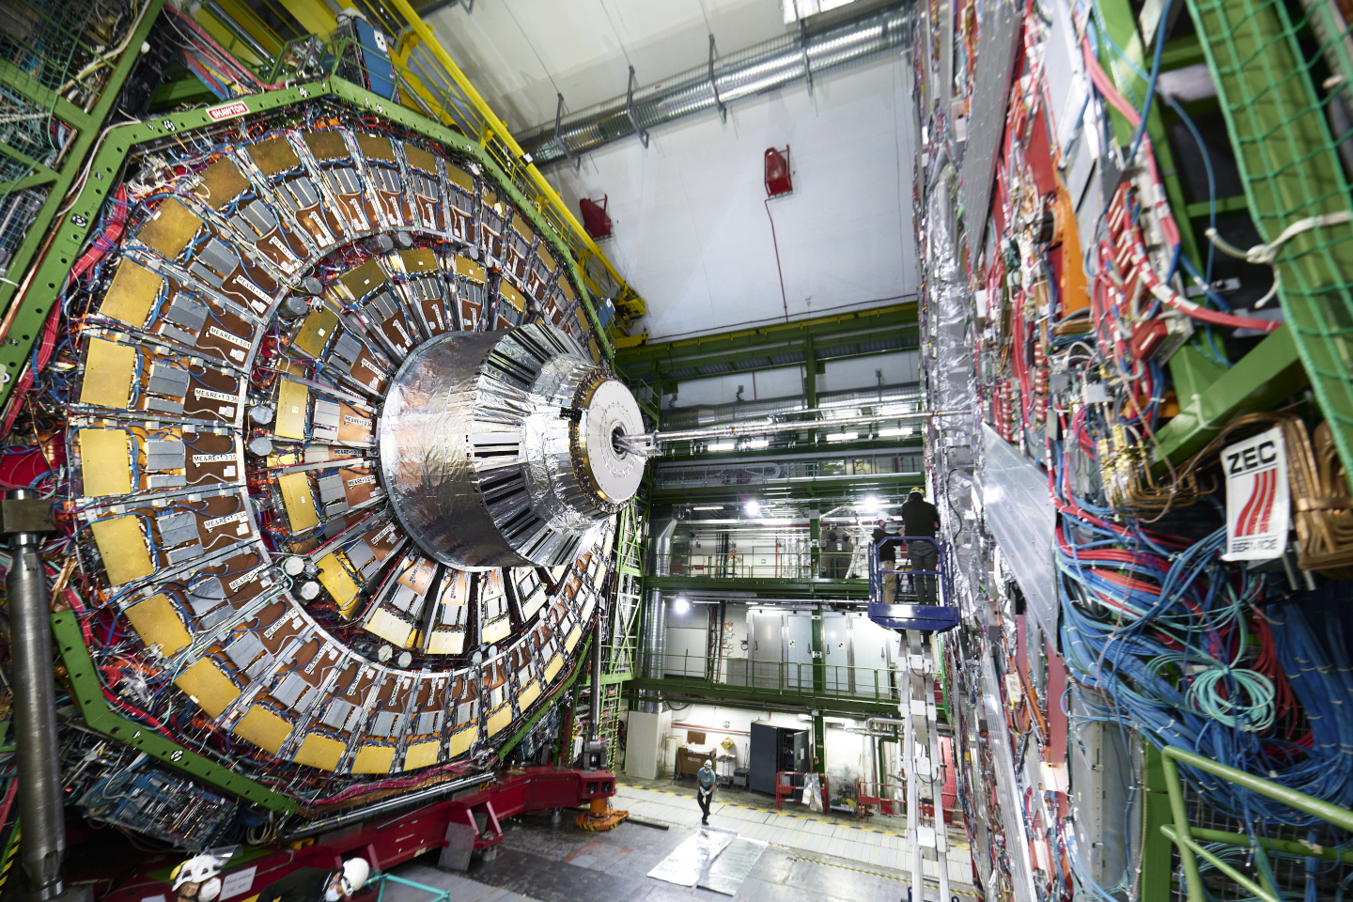
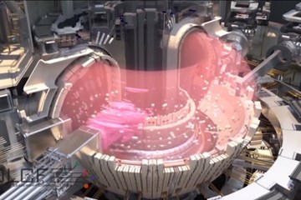

Three examples routinely cited!
Today’s CERN (in the top picture: compact muon solenoid detector of the Large Hadron Collider - picture: CERN)
ITER’s planned Tokamak (bottom left, picture: ITER)
International Space Station (bottom right, picture: NASA)

Slide 16
We should think of Big Science as an analytical and framing category equally serving diagnostic and promotional purposes during the Cold War and beyond

