Slide 1

STAY TUNED: MORE IS COMING
Massimo Florio
Università degli Studi di Milano
massimo.florio@unimi.it
www.massimoflorio.com
EIROforum - 2nd Edition - Economics of Big Science
24 May 2023

Slide 2
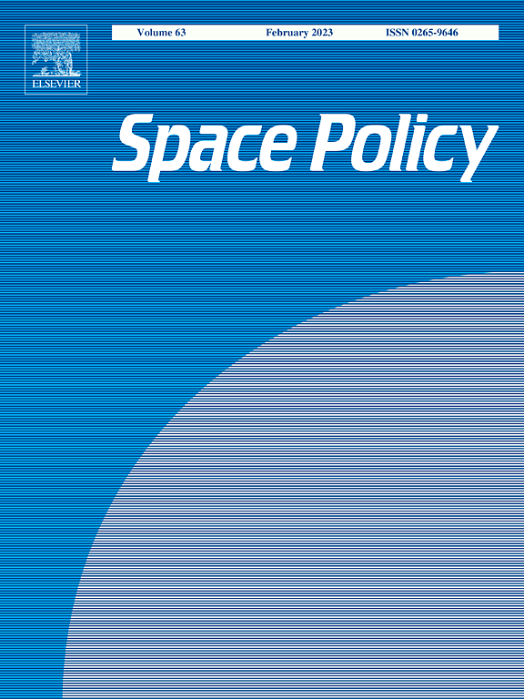
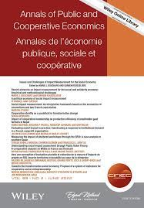
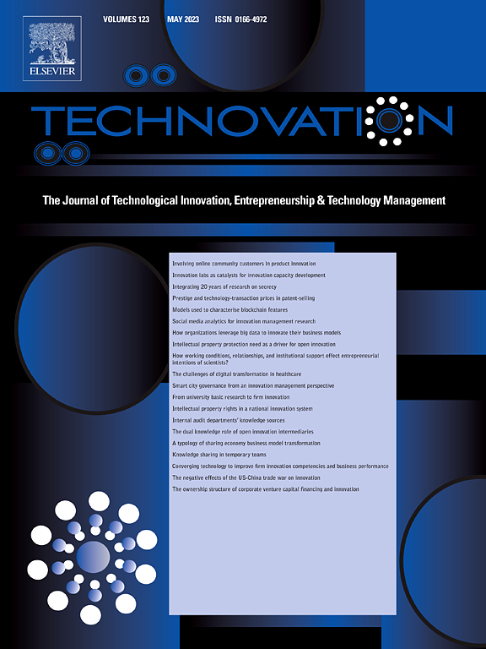
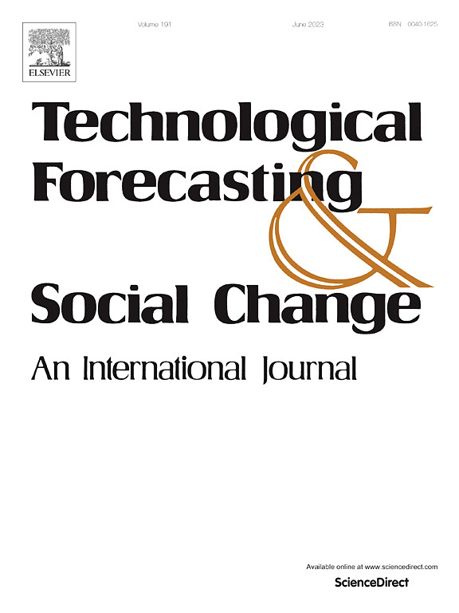
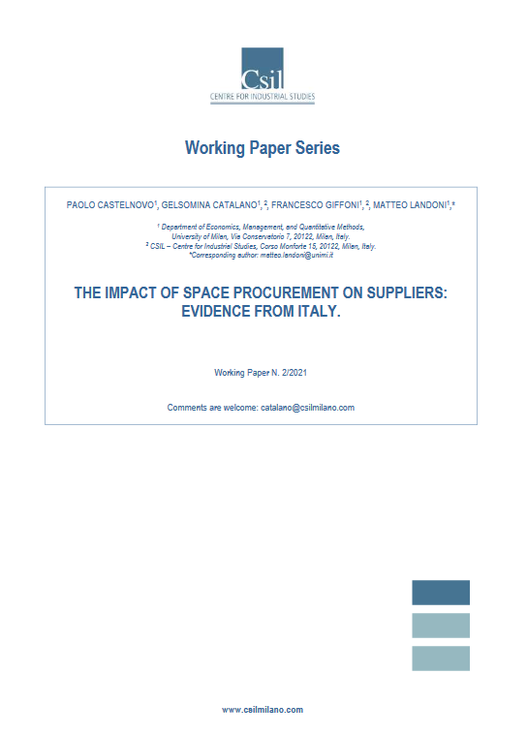
FOR EXAMPLE... ON THE ECONOMICS OF SPACE
Earth Observation and economic studies: a cross-fertilization perspective
Morretta, Florio, 2021
The impact of the Italian Space Agency on scientific knowledge: evidence from academic publications
Vurchio, Giunta, 2021
A quasi-experimental design to assess the innovative impact of public procurement: An application to the Italian space industry
Castelnovo, Clò, Florio, 2023
The socio-economic value of scientific publications: The case of Earth Observation satellites
Morretta, Vurchio, Carrazza, 2022
The impact of space procurement on suppliers:
Evidence from Italy
Castelnovo, Catalano, Giffoni, Landoni, 2021
WORK IN PROGRESS (selected):
The socio-economic benefits of Earth Observation: insights from firms of the Italian downstream sector, Morretta, Lupi, Zirulia – Under review
The socio-economic impact of public policies in the space sector in Italy, Florio et al. – Under review
A social cost-benefit analysis framework for Earth Observation infrastructures, Morretta, Florio, Landoni – Under review

Slide 3

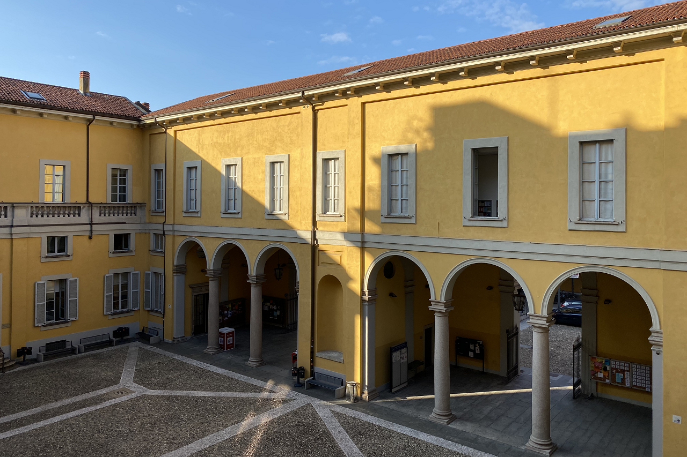



AND MUCH MORE:
Expected at the Fourth European Conference
Society for Benefit Cost Analysis
Milan, 11-12 September 2023
Deadline for abstract submissions: June 12
Inter alia sessions on:
Socio-economic impact of Open Science
Socio-economic Impact of New Space Activities
To know more: https://centrejeanmonnet.unimi.it/sbca-2023/

