Slide 1
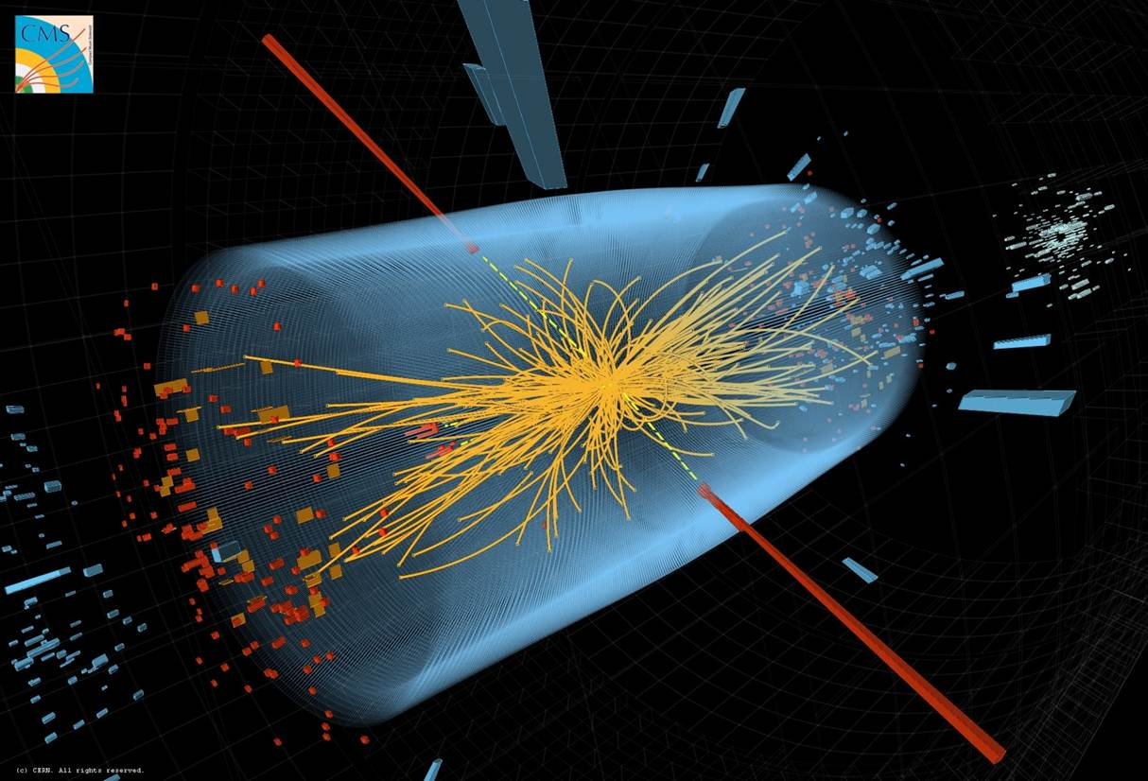
Physics at CERN in the Large Hadron Collider era
and Beyond
CERN School of Computing
CSC 2023, Tartu, Estonia
Joachim Mnich - CERN
August 21st, 2023

Slide 2

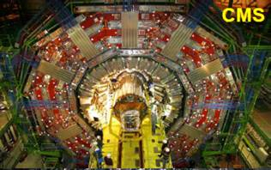


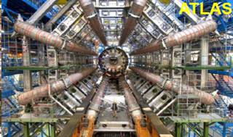


Large Hadron Collider (LHC)
Protons
(ions)
Atlas
Protons
(ions)

Slide 3

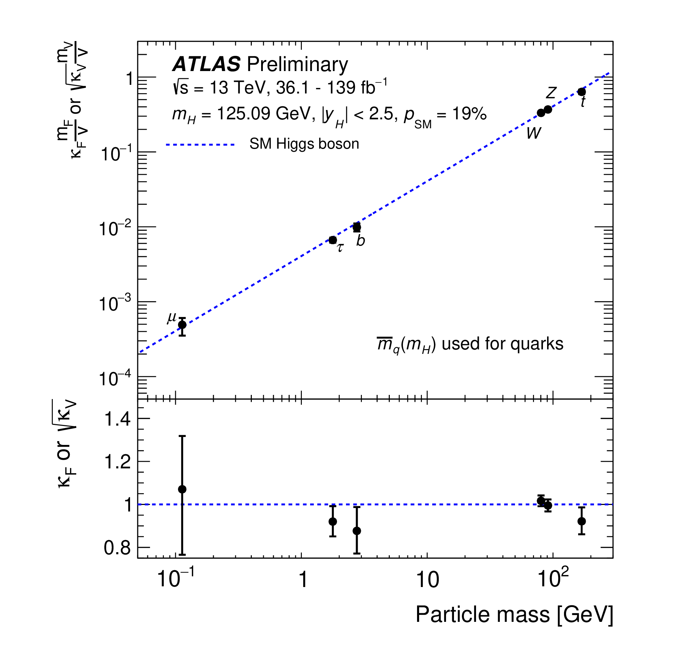
Achievements since the Higgs Boson Discovery
Coupling measurements (B_{i} = B_{u} = 0)
Example: measurement of the Higgs couplings to fundamental particles
ATLAS result based on the full data set (Run 2)
Key prediction of the Standard Model:
Higgs coupling to particles is proportional to their mass
Impressive verification with an accuracy often better than 10%
+0.07
+0.31
κ_{𝛾} = 1.04 ± 0.06, κ_{g} = 0.92 , κ_{Z𝛾} = 1.37
–0.06
–0.37
ATLAS-CONF-2021-053
Precision on couplings reached
κ_{µ} < 30%
κ_{𝜏} = 7%
κ_{b} = 11%
κ_{t} = 6%
κ_{W,Z} = 6%

Slide 4
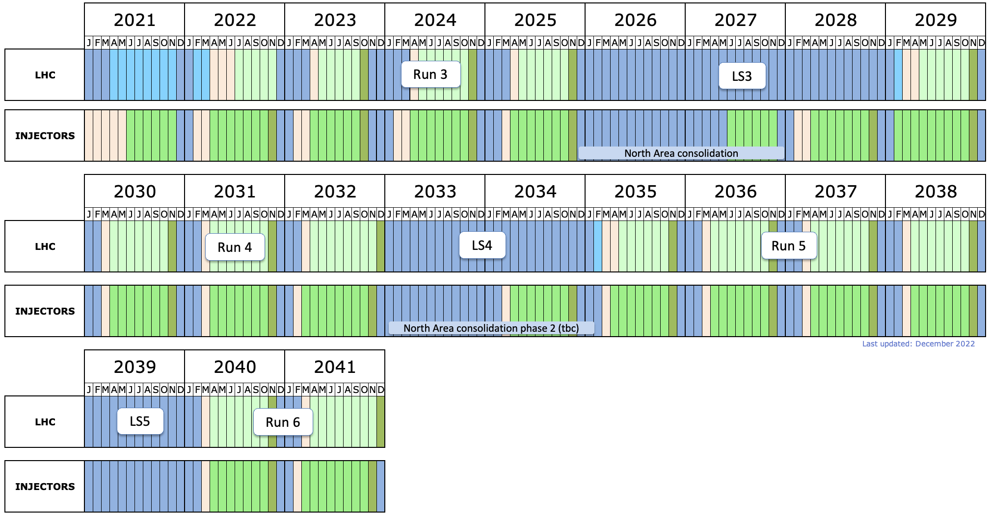
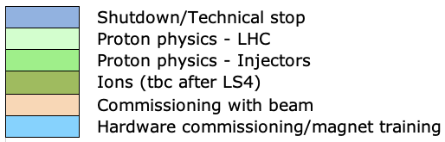
LHC Timeline
today
start HL-LHC
LS2: Upgrade of accelerator and detectors (Phase I)
LS3: Upgrade HL-LHC and Phase II ATLAS&CMS
North Area upgrade?
LS4: Upgrade
Phase IIb ALICE&LHCb
  HL-LHC target:
  Deliver 3000 fb⁻¹ pp luminosity to both ATLAS and CMS

Slide 5
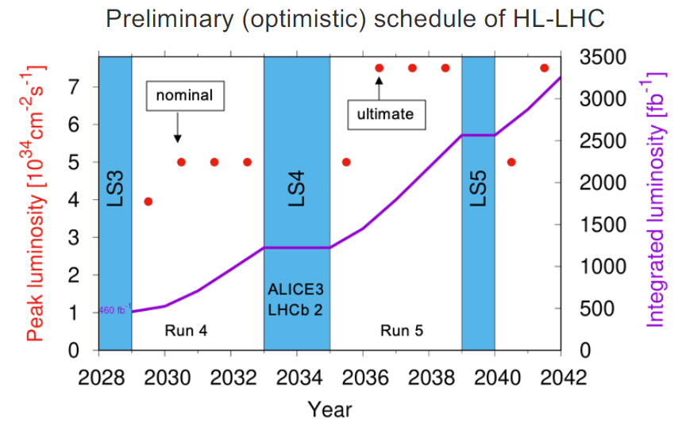
LHC Programme
Preliminary HL-LHC schedule
High Luminosity LHC
  Long shutdown 2026 - 28 to upgrade accelerator and detectors (ATLAS & CMS)
  Will increase luminosity by factors 5 to 7
Final goal is > 3000 fb⁻¹
  About 20 times the luminosity collected until today
ALICE and LHCb upgrade planned in the 2030ies

Slide 6
The High-Luminosity LHC
HL-LHC will provide 3000 – 4000 fb⁻¹ by ≈ 2040
i.e. ≈ 20 times the currently available data
Will allow measurement
Higgs couplings to the
percent-level
incl. establishing Higgs
self coupling
Significantly extend reach
for new physics
Start operation in 2029
2 examples for illustration
J. Mnich, CERN School of Computing 2023, Tartu, Estonia
August 2023
Notes:
CERN Yellow Report CERN-2019-007

Slide 7
Challenges for the Detectors
Example: event pile-up
in 2018 typically 20 - 40 pp collisions per bunch crossing
At the HL-LHC: 150 - 200 pp collisions per bunch crossing expected
Need to identify the right vertex at which the Higgs was produced
J. Mnich, CERN School of Computing 2023, Tartu, Estonia
August 2023

Slide 8
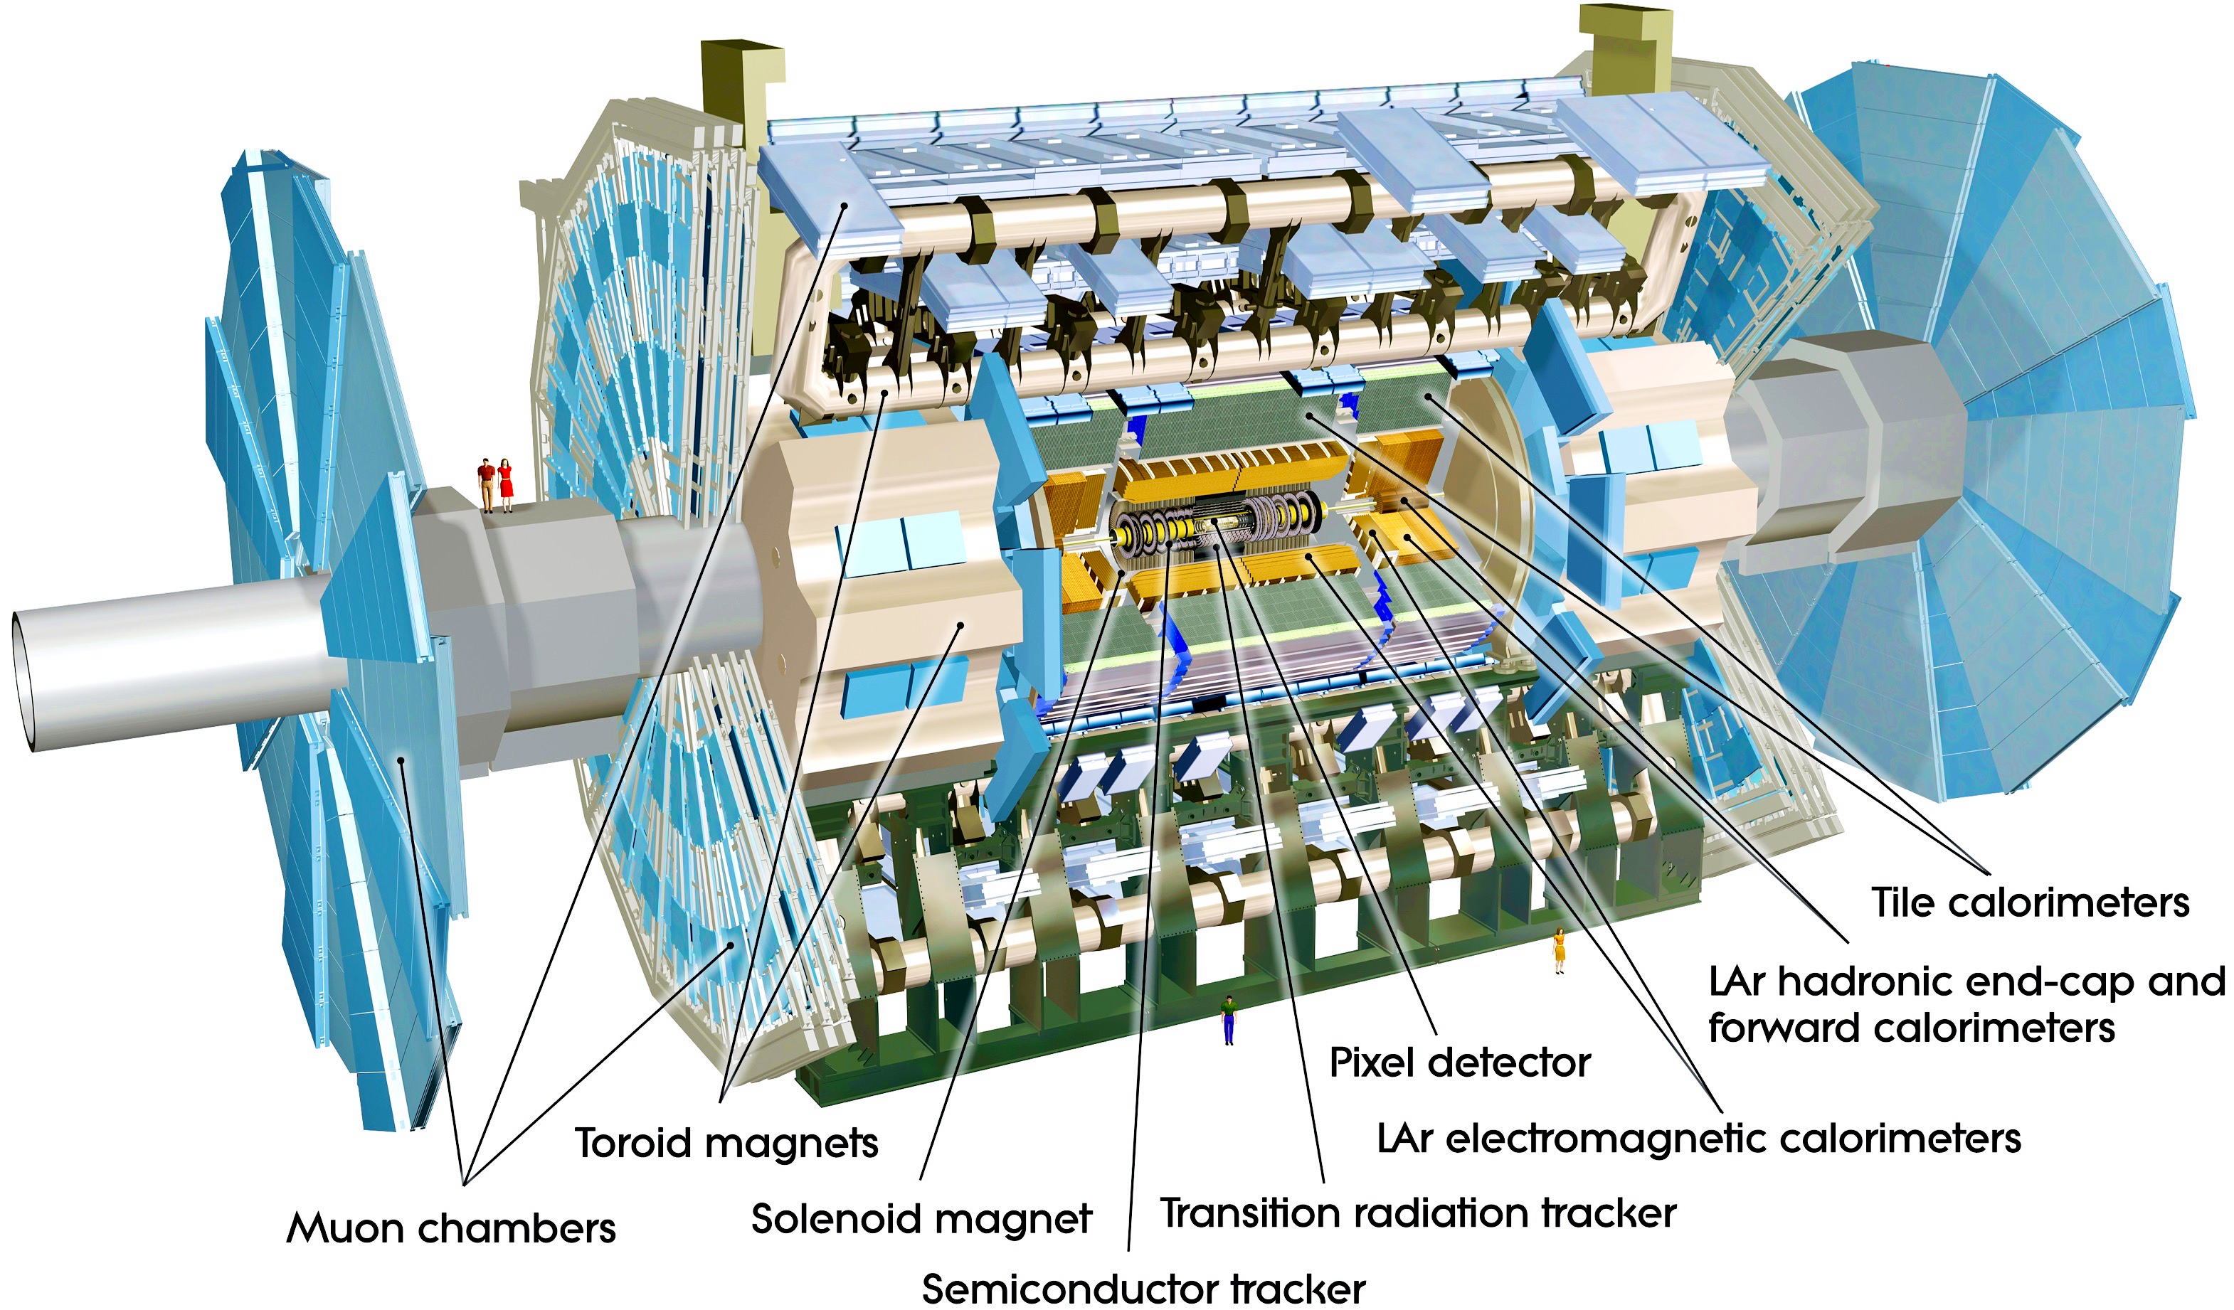
ATLAS Phase II Upgrades
Upgraded Trigger and Data Acquisition system
L0 at 1 MHz
Improved High-Level Trigger (100 kHz full-scan tracking)
The full scientific exploitation of the
HL-LHC requires major upgrades of the detectors, mainly for ATLAS and CMS
Higher granularity
Better resolution in space and time
→ Phase II upgrades
Electronics Upgrades
LAr Calorimeter
Tile Calorimeter
Muon system
High Granularity Timing Detector (HGTD)
Forward region
Low-Gain Avalanche Detectors (LGAD)
New Muon Chambers
Inner barrel region
New Inner Tracking Detector (ITk)
Pixel and Strip detectors
All silicon, up to |η| = 4
J. Mnich, CERN School of Computing 2023, Tartu, Estonia
August 2023

Slide 9
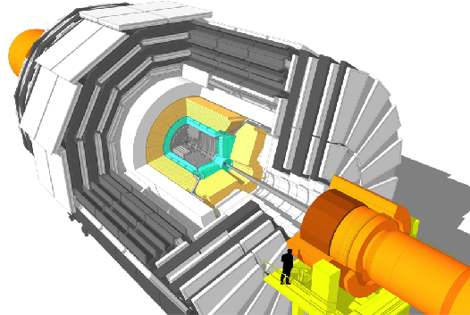
CMS Phase II Upgrades
L1-Trigger HLT/DAQ
https://cds.cern.ch/record/2714892
https://cds.cern.ch/record/2283193
Tracks in L1-Trigger at 40 MHz
PFlow selection 750 kHz L1 output
HLT output 7.5 kHz
40 MHz data scouting
Barrel Calorimeters
https://cds.cern.ch/record/2283187
ECAL crystal granularity readout at 40 MHz with precise timing for e/γ at 30 GeV
ECAL and HCAL new Back-End boards
Muon systems
https://cds.cern.ch/record/2283189
DT & CSC new FE/BE readout
RPC back-end electronics
New GEM/RPC 1.6 < η < 2.4
Extended coverage to η ≃ 3
Calorimeter Endcap
https://cds.cern.ch/record/2293646
3D showers and precise timing
Si, Scint+SiPM in Pb/W-SS
Beam Radiation Instr. and Luminosity
http://cds.cern.ch/record/002706512
Bunch-by-bunch luminosity measurement: 1% offline, 2% online
Tracker
https://cds.cern.ch/record/2272264
Si-Strip and Pixels increased granularity
Design for tracking in L1-Trigger
Extended coverage to η ≃ 3.8
MIP Timing Detector
https://cds.cern.ch/record/2667167
Precision timing with:
  Barrel layer: Crystals + SiPMs
  Endcap layer: Low Gain Avalanche Diodes
J. Mnich, CERN School of Computing 2023, Tartu, Estonia
August 2023

Slide 10
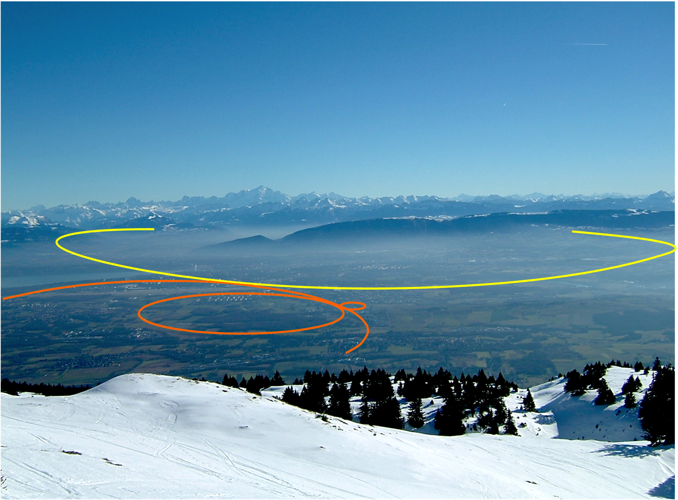
Future Circular Collider (FCC)

Slide 11
Future Circular Collider (FCC): Feasibility Study
European Strategy for Particle Physics:
An electron-positron Higgs factory is the highest-priority next collider. For the longer term, the European particle physics community has the ambition to operate a proton-proton collider at the highest achievable energy.
“Europe, together with its international partners, should investigate the technical and financial feasibility of a future hadron collider at CERN with a centre-of-mass energy of at least 100 TeV and with an electron-positron Higgs and electroweak factory as a possible first stage.
Such a feasibility study of the colliders and related infrastructure should be established as a global endeavour and be completed on the timescale of the next Strategy update.”
CERN has launched the FCC feasibility study to address these recommendations
J. Mnich, CERN School of Computing 2023, Tartu, Estonia
August 2023

Slide 12

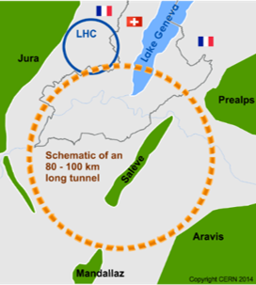
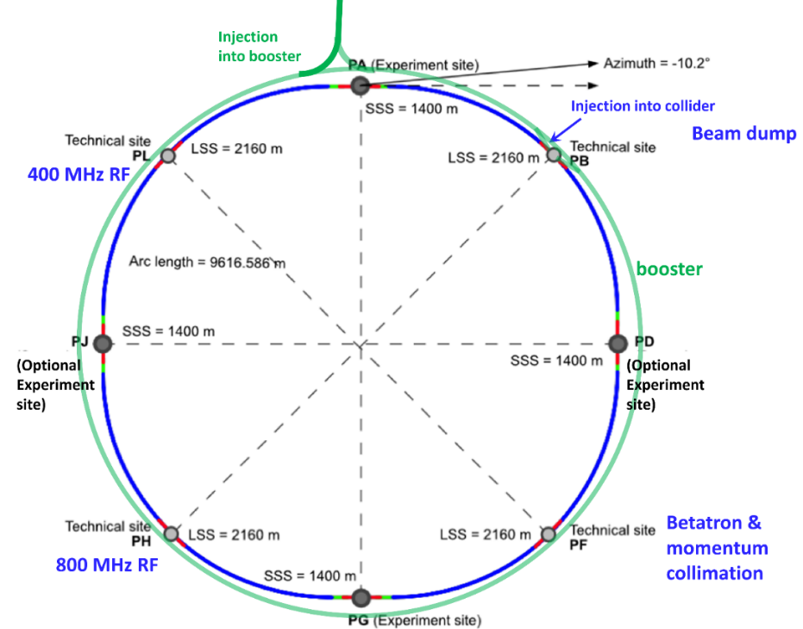
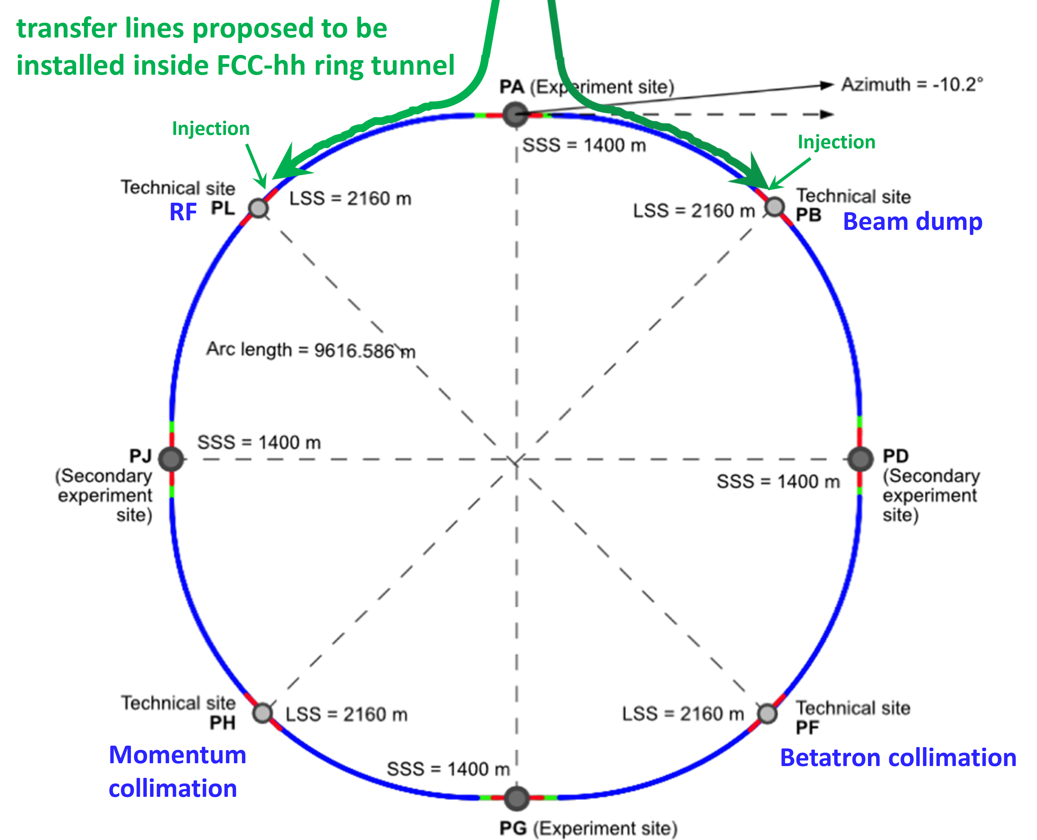
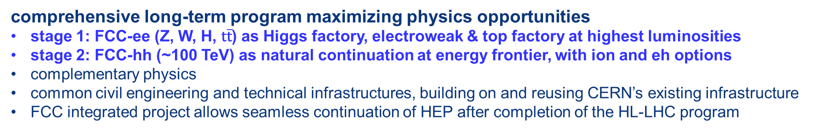
The FCC integrated program
inspired by successful LEP – LHC programs at CERN
comprehensive long-term program maximizing physics opportunities
stage 1: FCC-ee (Z, W, H, $\text{t}\overline{\text{t}}$) as Higgs factory, electroweak & top factory at highest luminosities
stage 2: FCC-hh (~100 TeV) as natural continuation at energy frontier, with ion and eh options
complementary physics
common civil engineering and technical infrastructures, building on and reusing CERN’s existing infrastructure
FCC integrated project allows seamless continuation of HEP after completion of the HL-LHC program
M. Benedikt
April 2022
FCC-ee
FCC-hh
2020 - 2040
2045 - 2060
2065 - 2090
J. Mnich, CERN School of Computing 2023, Tartu, Estonia
August 2023

Slide 13
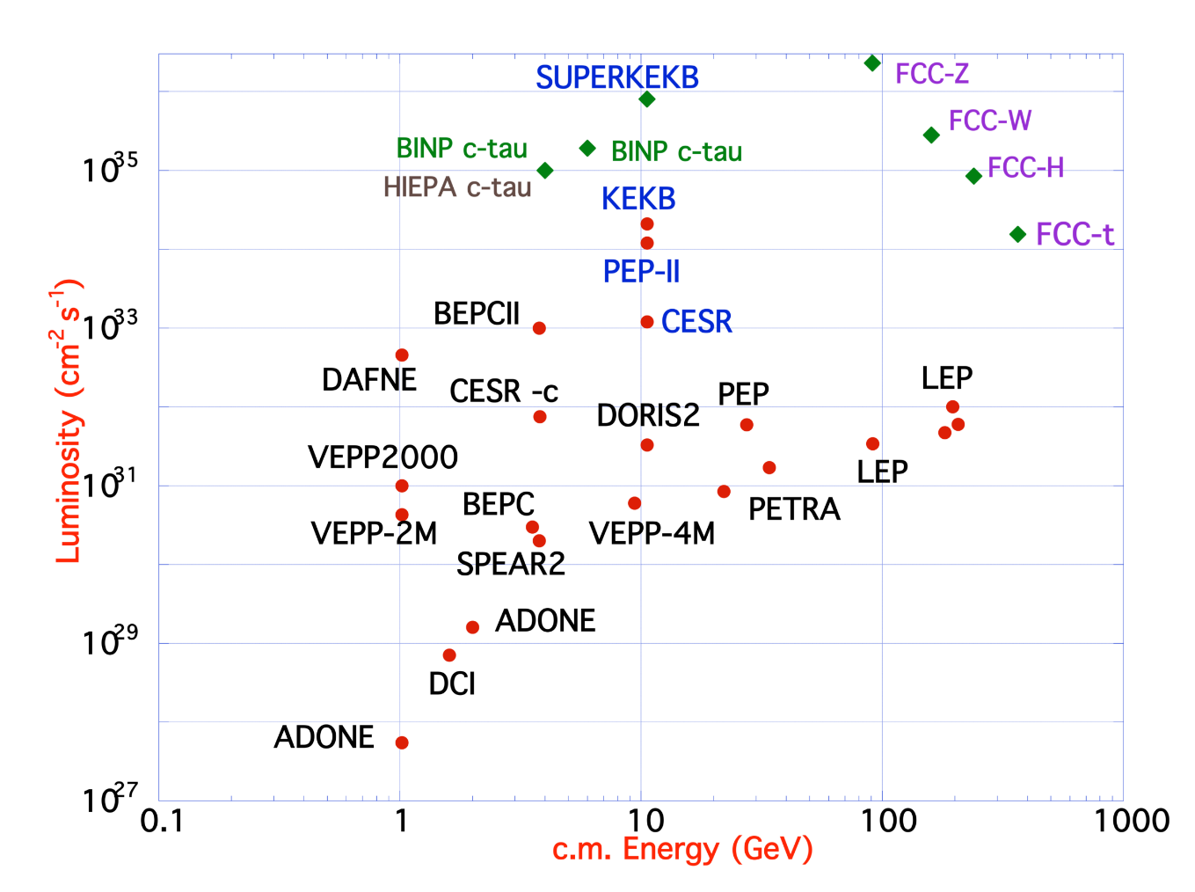
FCC-ee Design Concept
  Based on lessons and techniques from past colliders (last 40 years)
  B-factories: KEKB & PEP-II:
    double-ring lepton colliders,
    high beam currents,
    top-up injection
  DAFNE: crab waist, double ring
  S-KEKB: low by*, crab waist
  LEP: high energy, SR effects
  VEPP-4M, LEP: precision E calibration
  KEKB: e⁺ source
  HERA, LEP, RHIC: spin gymnastics
Marica Biagini
Marica Biagini
Combining successful ingredients of several recent colliders → highest luminosities & energies
J. Mnich, CERN School of Computing 2023, Tartu, Estonia
August 2023

Slide 14
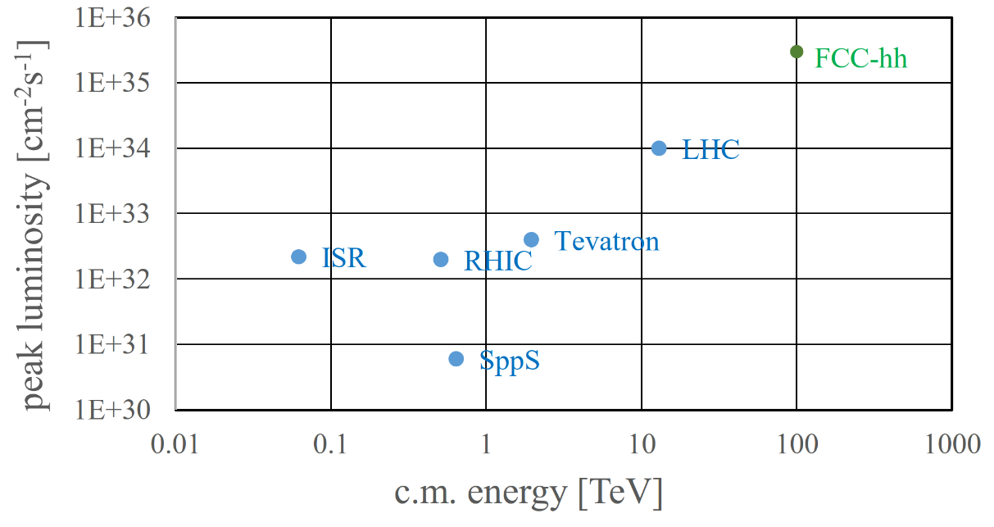
FCC-hh: Highest Collision Energies
Key challenges:
Order of magnitude performance increase in both energy & luminosity
100 TeV cm collision energy (vs 14 TeV for LHC)
20 ab⁻¹ per experiment collected over 25 years of operation (vs 3 ab⁻¹ for LHC)
Similar performance increase as from Tevatron to LHC
Key technology: high-field magnets
J. Mnich, CERN School of Computing 2023, Tartu, Estonia
August 2023

Slide 15
Conclusion
The CERN Scientific programme has an agenda for the next 20 to 40 years
The existing LHC machine will continue do deliver unprecedented data for the next 20 years
The future FCC will open new frontiers in the High Energy Physics research and will bring new extreme challenges that will require de development of new technologies
New technologies will be needed for these new research horizons and scientific computing will be one of the main areas of challenges and innovations
The CERN Schools, and in particular the CERN School of Computing, will be at the forefront of delivery education on the solutions needed for scientific computing in large international projects and collaborations

