Slide 1
Announcements
Thursday 31st of August

Slide 2
Deadlines
Meme and Photo competition
  Today, at the end of the football match
Visits tomorrow
  No visit - Default if you do not subscribe
  GSCAN
  Observatory – practically complete

Slide 3
Lightning talks (Tomorrow, Friday 8:45)
Please send the slides by 08:00 on Friday
Matic Orehar | Positron Emission Tomography - the basics
Rabia Shaheen | Emittance Scans at ATLAS, CERN
Enrique Garcia Garcia | The Virtual Research Environment
Marco Faltelli | "Data's Need for Speed: InfiniBand and RDMA Driving HPC Evolution"
Andrea Valenzuela Ramirez | CernVM-FS for Efficient Software Distribution at CMS
Lorenzo Santi | Investigating the impact of 4D Tracking in ATLAS Beyond Run 4
Elizabeth Mamtsits | My journey on refactoring and translating legacy code
Natalia Szczepanek | Benchmarking ATLAS Distributed Computing Resources
Alberto Pimpo | Unveiling containers
Jamie Gooding | 40 MHz or bust: real-time triggering on full-detector readout at LHCb
Javier Romero Castro | Empowering Research through Invenio RDM: Managing, Sharing, and Preserving Research Data
Matteo Marchegiani | PocketCoffea: a configuration layer for CMS analyses with Coffea
Patin Inkaew | Data Scouting Jet for Run 3 at CMS

Slide 4
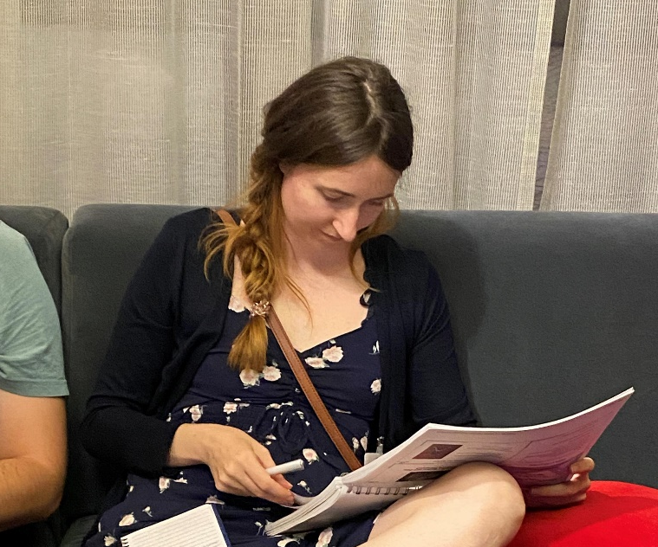
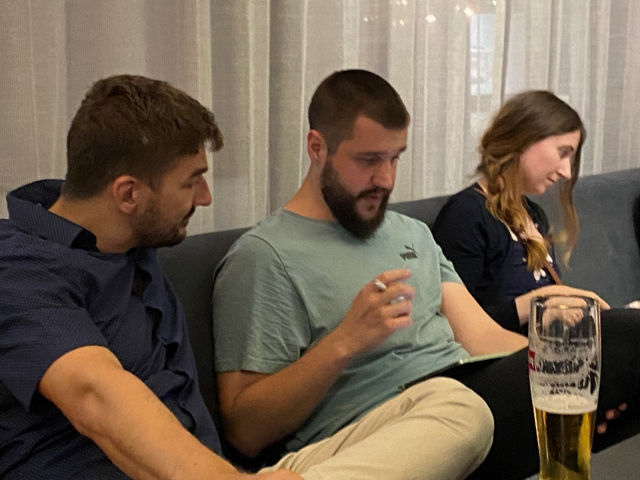
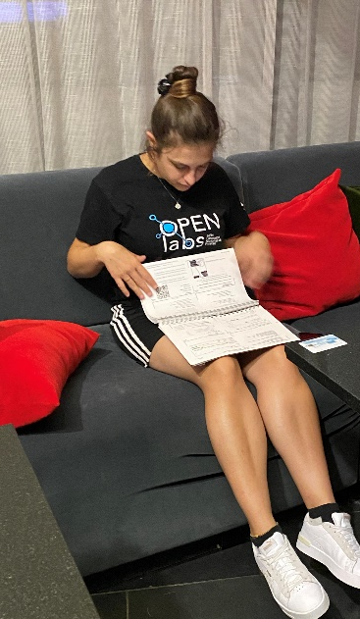
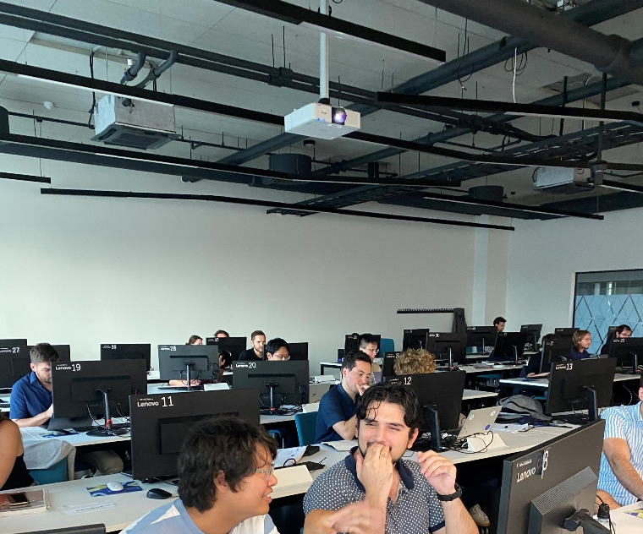
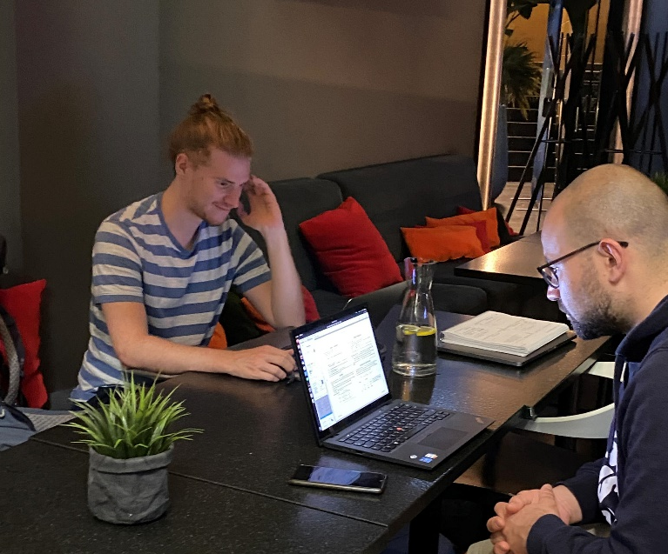
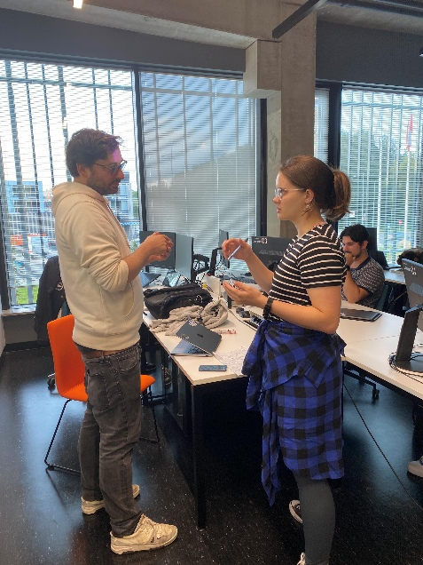

Slide 5
More on the exam
We will publish the list of persons that passed the exam
We will not publish the names :
  Of those who did not take the exam
  Of those who did not pass the exam

Slide 6
Exam (Thursday after lunch)
https://indico.cern.ch/event/1254984/contributions/5512739/
Covering all lectures (except the Estonia E-data guest lecture)
1-2 questions per lecture → ~ 35 questions
Duration: ~ 45-55 minutes
Multiple choice questions: 4 answers possible – only one is correct
The passing threshold is 50% of correct answers
Rules:
- you cannot consult materials (slides etc.)
- you must not use external help, or communicate with other people
Results will be available online after the exam
Bring your laptop and charger
and a pen

Slide 7
Example
This is a difficult question for which no person know the answer.
What is the answer ?
23
67
87
91

Slide 8
Example
This is a difficult question for which no person know the answer.
What is the answer ?
23
67
87
91

Slide 9
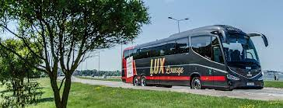
Reserve your buses!
Make sure you reserve your bus for Saturday, there are many people leaving Tartu!
You can buy your ticket online, or at the busstations at the Dorpat hotel (for a paper ticket).

Slide 10
Football match draw

Slide 11
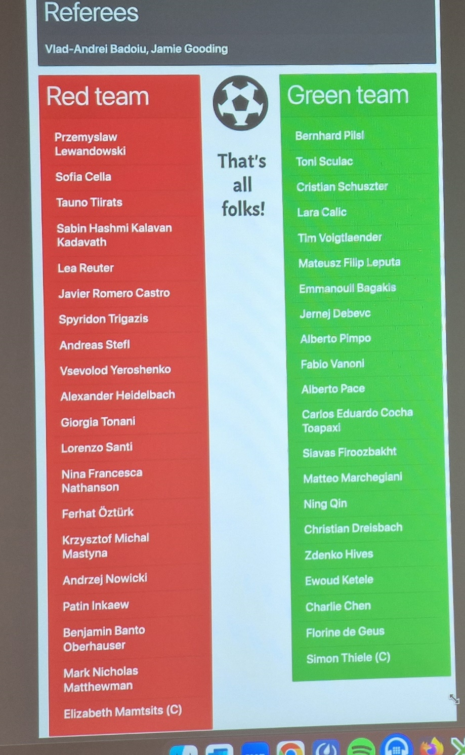

Slide 12
CERN School of Computing 2023
Tartu, Estonia

