Slide 2
Recommissioning 2023
M. Solfaroli

Slide 3
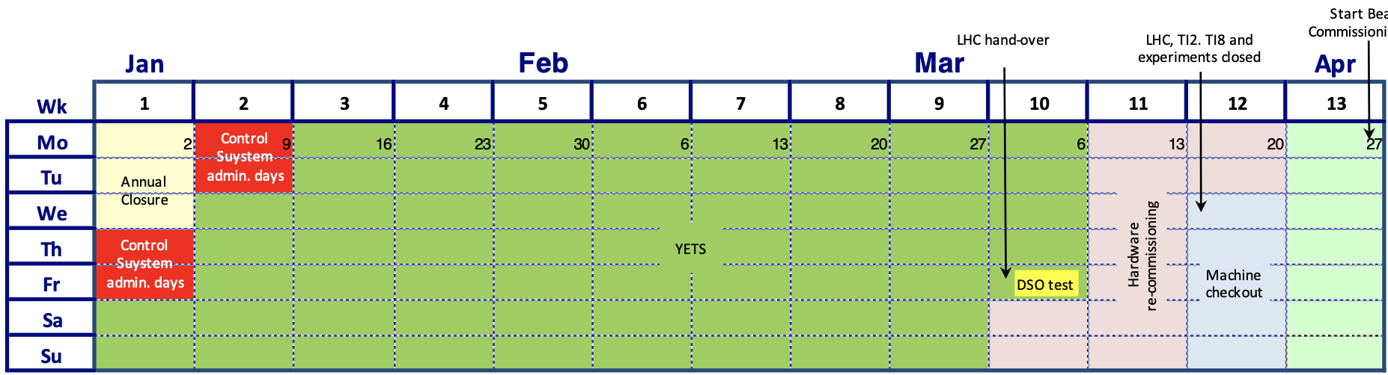
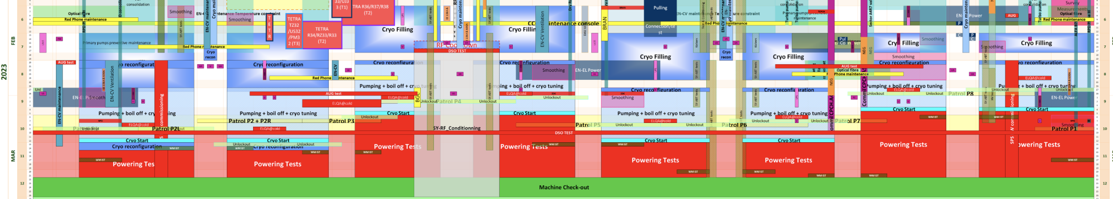
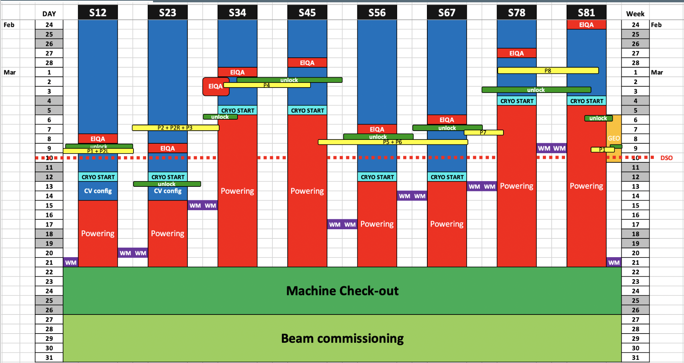
Plannings
DSO tests (needed for Ph2 powering) – March 10th
S34/S45/S78/S81
  CRYO-OK Monday 6th - phase1 next week
  IP1 - PIC intervention to be completed
S56/S67
  CRYO-OK Monday 13th
S12/S23
  CRYO-OK Wednesday 15th

Slide 4
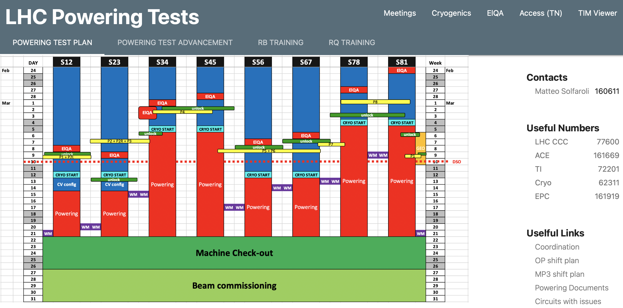
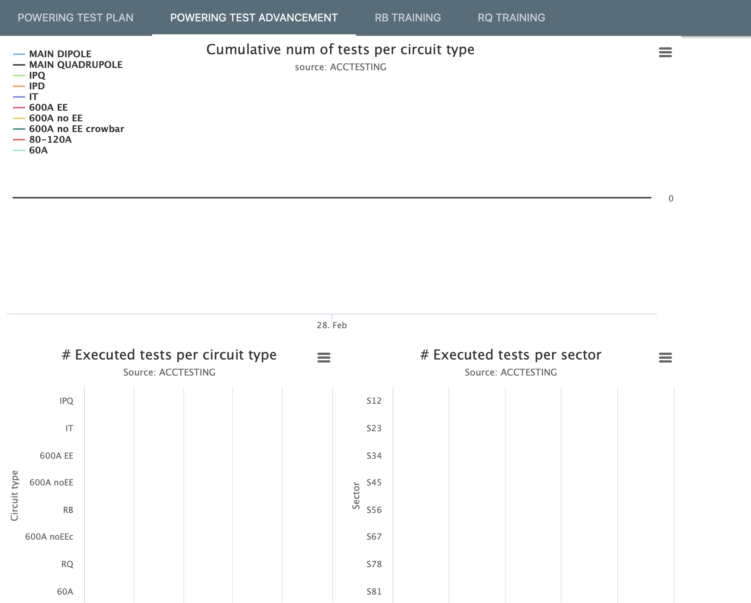
webpage
www.cern.ch/poweringtests

Slide 5
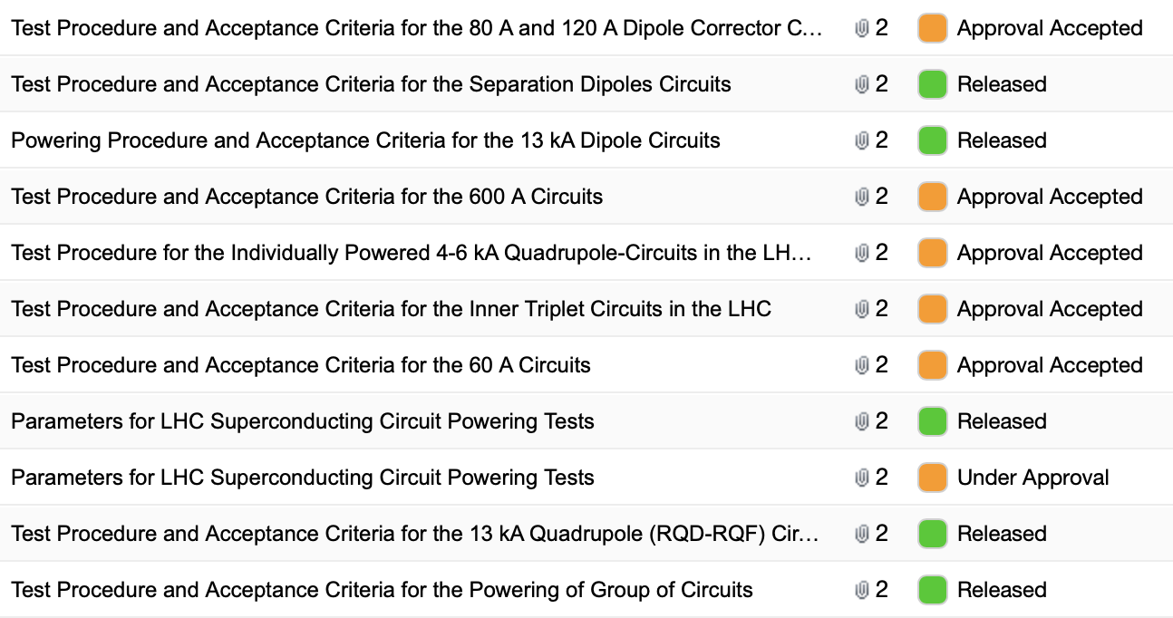
Procedure status
Procedures will be approved…

Slide 6
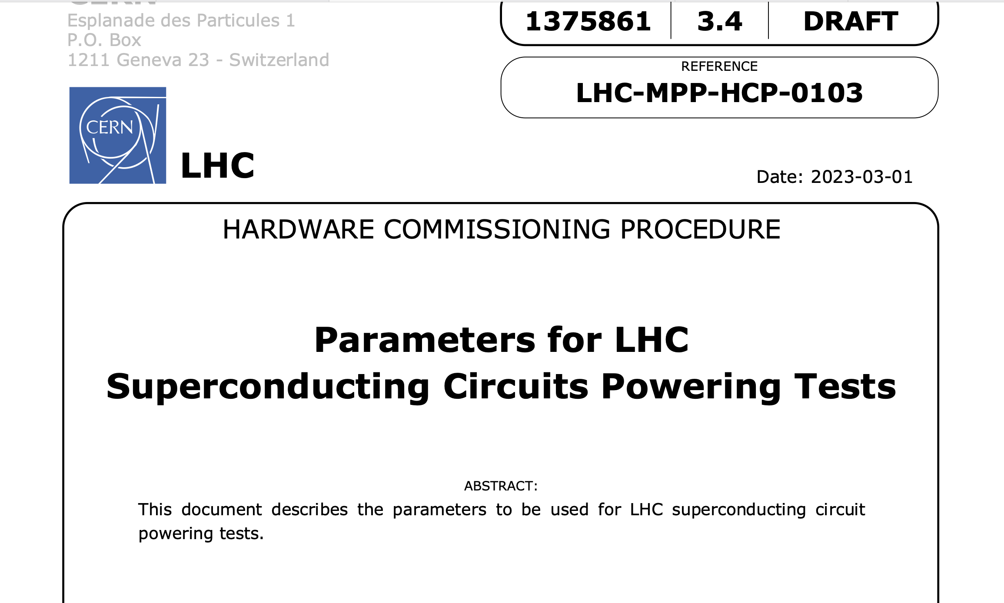
Parameters document
New version of the documents containing the powering tests parameters:
Updated with modifications occurred during the 2021/2022 campaigns
I_{PNO} for IT main quads and correctors in IP1 and IP5 modified, following recommendation from the IT lifetime taskforce.
I_{PNO} for RD circuits set to operational value for 6.8 TeV
I_{PNO} for RCD/RCS reduced to the operational needs
Max operational values will be restored in case of needs, as circuits have been commissioned in 2021/2022 to those values and NO thermal cycle was performed

Slide 7
STEPS activated (other than powering steps)
IST.QDS_FIELD (for 13 kA circuits)
ElQA + CC.ELQA (ONLY valid for RB & RQD/F & 600 A of S34 (DFBLC))
IST.QDS_REMOTE (if present)
PC Unlock
QDS.QHD (QH discharge at all levels, for all circuit equipped with QH)
  _LOW1
  _LOW2
  _NOMINAL
IST.QDS (for circuits other than 13 kA)
PIC – CRYO OK
PIC2 (ALL tests for all circuit, BUT the water interlock on 13 kA)
…
PIC-BIC

Slide 8
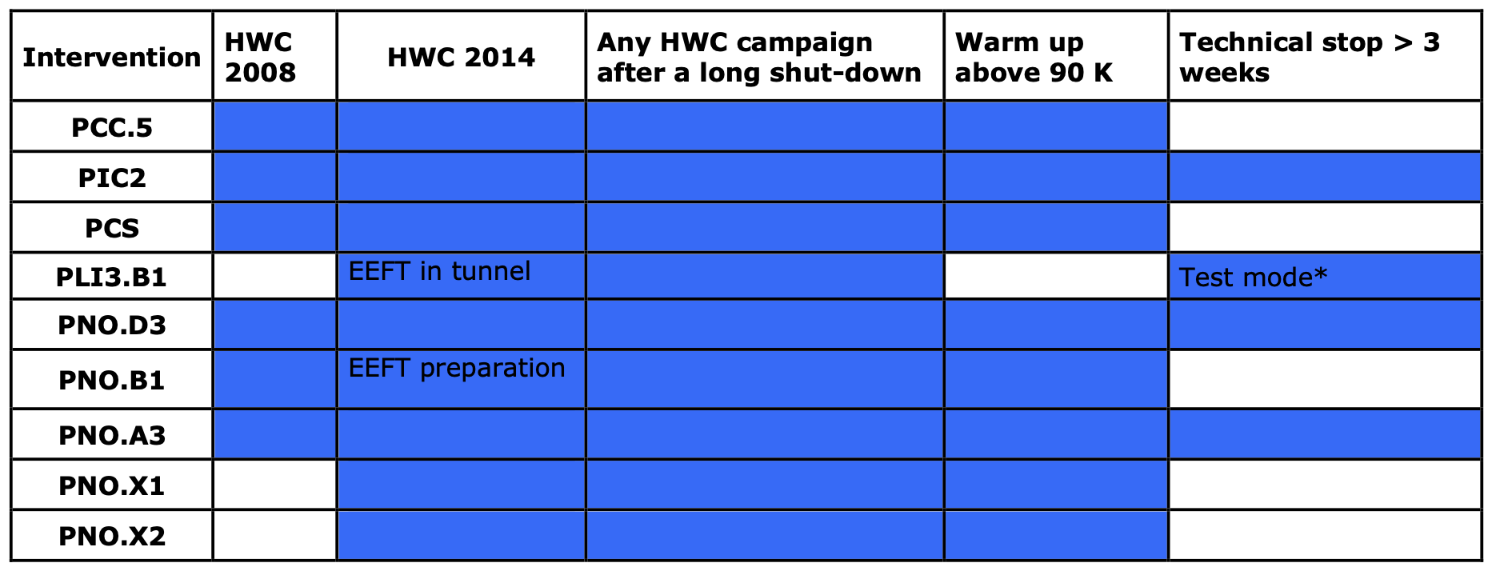
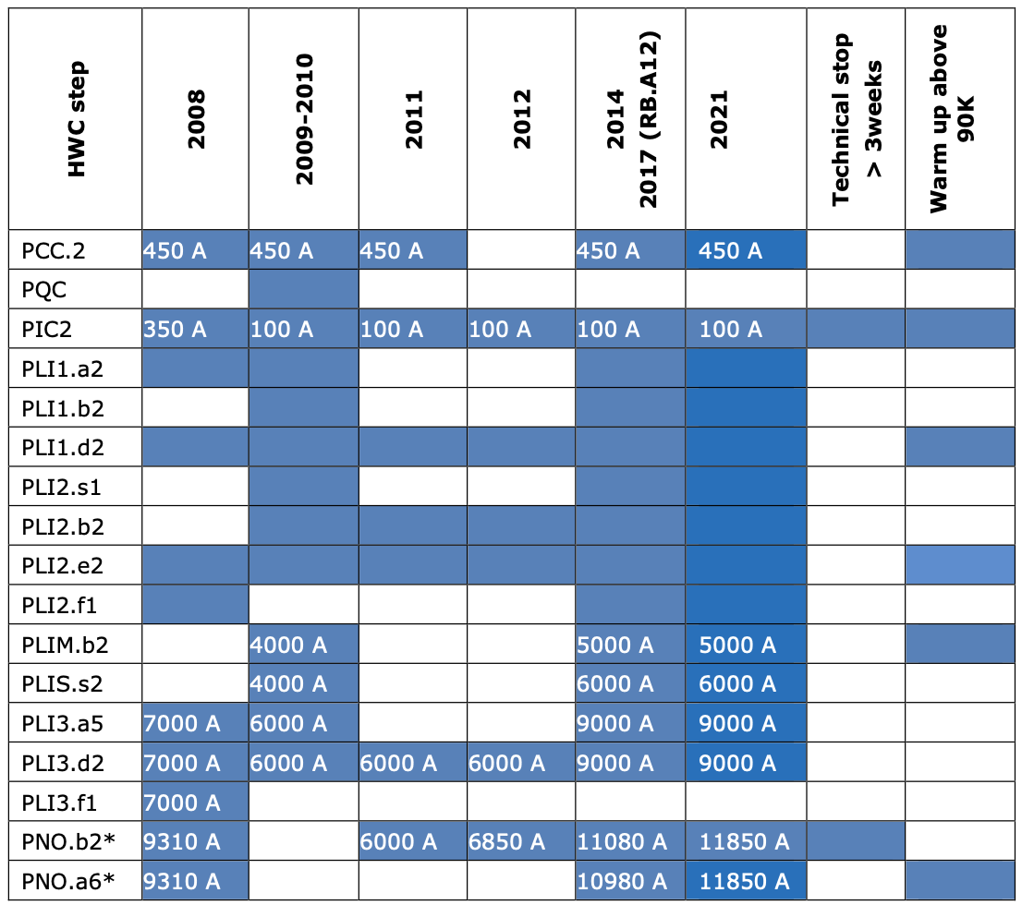
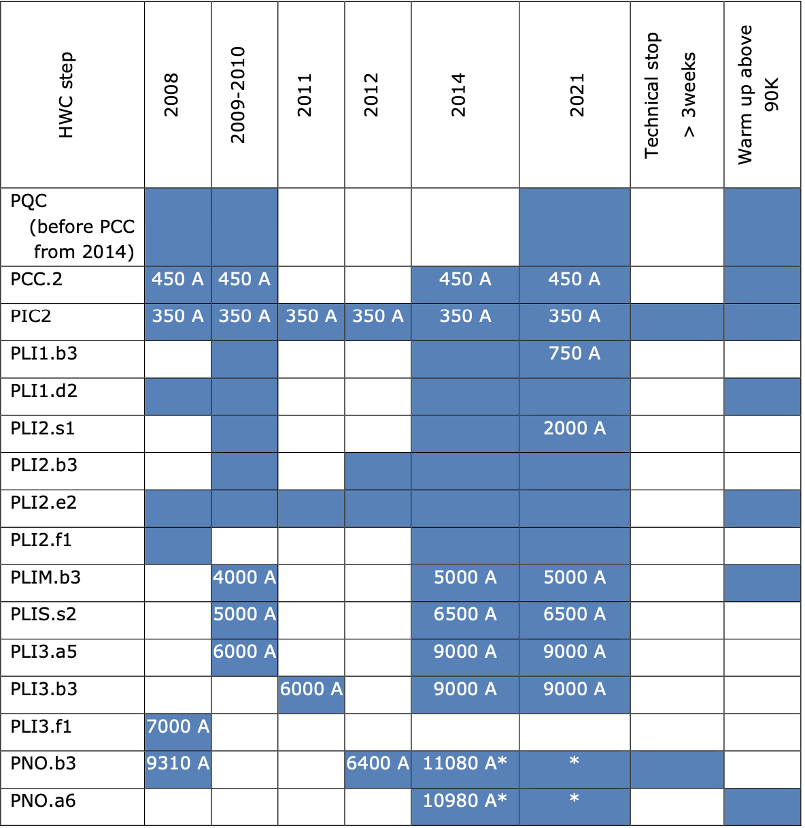
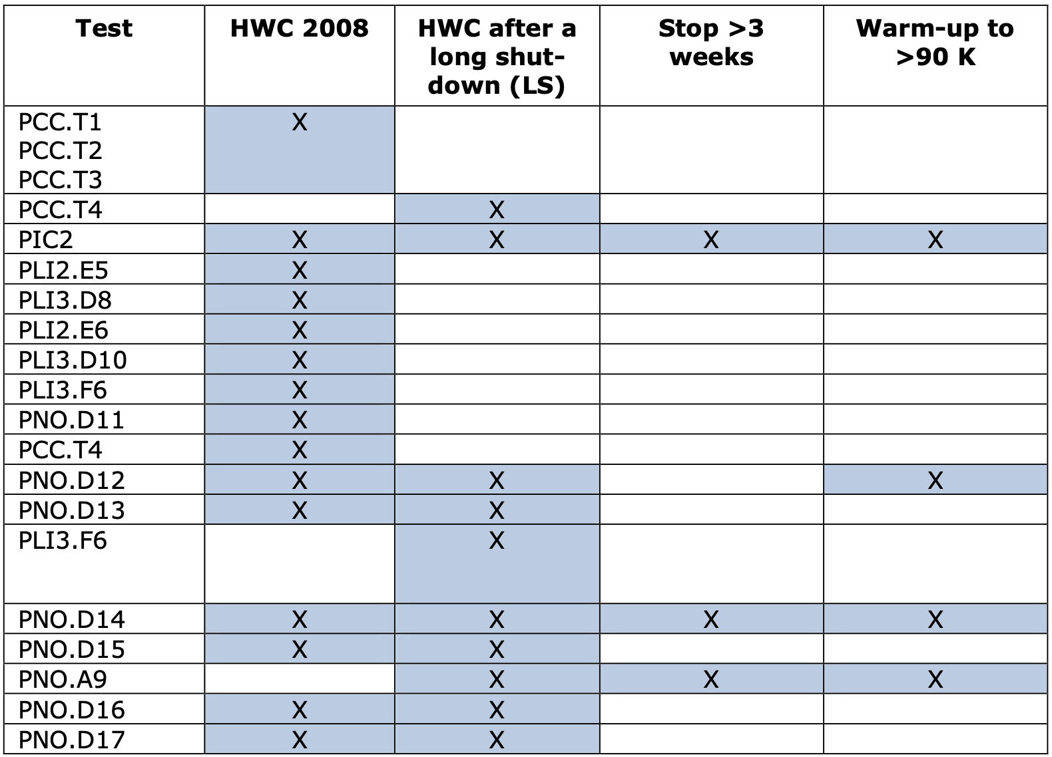
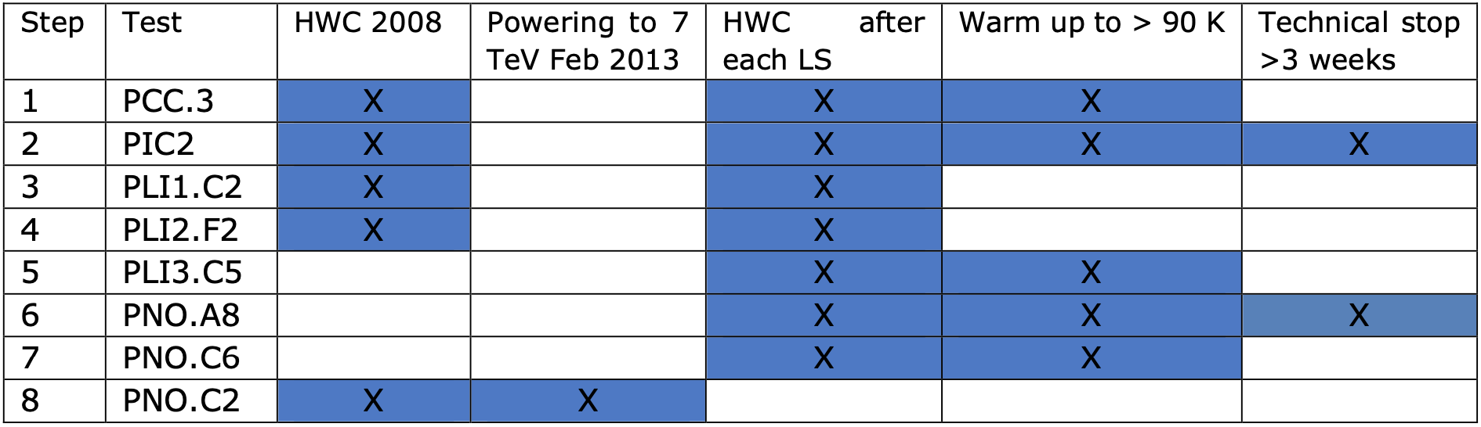
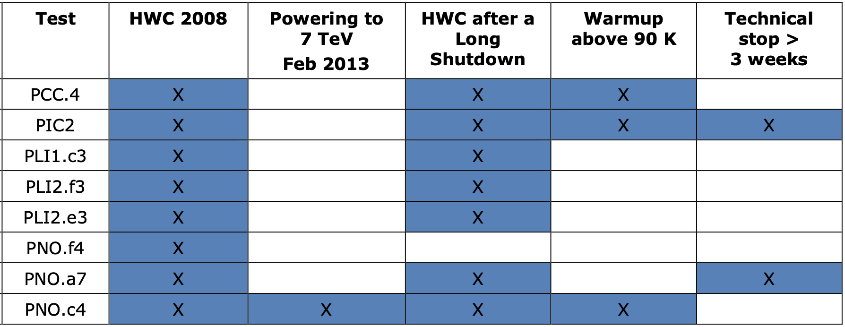
Tests
600 A
RB
RQD/F
60 A
80/120 A
IT
IPD
IPQ
PLI2.e3 will be performed instead of PNO.a7

Slide 9
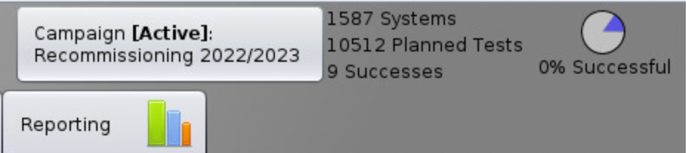
Tests
New campaign (Recommissioning 2022/2023) created in ACCTESTING
10512 tests to be executed and analysed in less than 2 weeks, 9 already successful ;-)
Sign-only tests are ready for experts
  Please sign them as soon as the activity is done
  As usual you can count on me to sign them, if you provide the info!

Slide 10
Additional validation
RD1.L2/R2/L8/R8 - QDS have been upgraded and behave now as all other IPD/IPQ
  PCC + QDS_integrity
RBs + RQD/Fs – EE maintenance
  PLI1.b2/b3 + PLI2.b2/b3
600 A QDS crates in IP2 and IP6 (IP4 to be confirmed) were removed from LHC and refurbished in the QDS labs during this YETS (TRACO power supply problem)
  PCC + QDS_integrity
RTQX2.L5 DC cables “repaired”
  ADDED PNO.d12 (10% of I_{NOM}) – first measure of the contact R by the circuit power
  PNO.d14 (50% of I_{NOM}) – confirmation of R measurements and verification of absence of premature warming by thermal camera
  PNO.a9 (100% of I_{NOM}) validation of electrical contact @nominal current

Slide 11
Special tests
PGC.2 – In order to check the global reaction to FPA of main circuits, a FPA test at 6.8 TeV (using nominal cycle) will be performed in each arc
FPA of RB circuits at 10 A/s is requested by MP3:
  @2kA (adjustment of iQPS settings is needed to ensure tripping BS boards AND reset to nominal situation after the test)
  @11kA

Slide 12
Resources
MP3 2 persons per day, starting on Monday 6th (not much to do next week as mostly small circuits with automatic analysis)
EPC piquet (availability for signature 8am-10pm), no interventions outside working hours (until machine check-out)
PIC on best effort
MPE piquet will start with the machine check-out, MPE activities will be carried out during working hours
Weekends of 1/12 and 18/19 March - OP shifts are planned and will be confirmed (or not) as we go
  Support support needed from MP3 on 18/19
  Support needed from EPC on 18/19
Mon/Wed/Fri short zoom meetings, starting on Wednesday 8th March

