Slide 2
RD Line 3 Kick-off Forum Meeting
Nb₃Sn ultimate performance dipole models
Introduction to the activities of WP3.5
Author: J.C. Perez,
Date: Wednesday 22 February 2023

Slide 3
Table of contents
Scope of the Work Package
Status
14 T Dipole design
eRMC/RMM
Running and future activities

Slide 4
Scope of the Work Package
WP3.5: Nb₃Sn ultimate performance dipole models
Pursue the work started in the frame of the FCC Magnet development Program towards 16 T Dipole models
  Demonstrate Nb₃Sn potential above 14 T and in terms of ultimate performance (16 T target)
  Design and construction of a 14 T+ accelerator quality dipole model magnet
  Explore alternatives and develop design and technology for ultimate performance Nb₃Sn magnets

Slide 5
Introduction and notes
Milestones and deliverables of WP3.5 were presented during the HFM workshop held at CERN in November 2022. To be noted that:
  At that time no resources were assigned to this WP
  During this workshop A. Siemko and JM Jimenez asked to compress the initial program as we need to show results before 2026
  In spite of the fact that our experience accumulated during this last decade, when building similar magnets, shows that 3 years for design and fabrication is extremely ambitious, we decided to reduce intermediate steps to shorten the schedule.
  We will design and produce a non-graded bock coil type with flared-ends magnet using a B&K structure.

Slide 6
What has changed since last November?
We have now a small team of motivated people working on the 14 T design
  Lucio Fiscarelli, E. Gautheron, S. Izquierdo, JC Perez, E. Todesco
  A new fellow will join the team during spring
  A draftsman has been identified and will join the team when required
A working program has been stablished for 2023 aiming to get relevant design results of a 14 T model magnet by the end of the year
  2D electromagnetic conceptual design 2 in1 configuration (Completed)
  2D mechanical conceptual design 2 in1 configuration (started, preliminary design expected early summer 2023)
    In parallel, the feedback from the mechanical design will be feed to the electromagnetic design
  Winding test (feedback expected ≈ May 2023):
    Strand/Cable selection
    Minimum bending radius (soft-way and hard-way)
    Feedback will be incorporated in the detailed electromagnetic design (2D & 3D, by early summer 2023)
  Scale down from double aperture to single aperture (Summer 2023)
  Detailed engineering design of the single aperture magnet to produce a demonstrator magnet (starting second half of 2023)

Slide 7
Design Target
> 14 T bore field with ≈ 20 % load line margin
Protection time margin > 40 ms
Aperture = 50 mm
“Accelerator coil size”, i.e, < 60 mm
Field quality within 10 units at all current levels (excluding PC effects)
Magnet OD: take Euro-Circol dimensions as reference
  Intra-beam distance: 250 mm
  Cold mass OD: 800 mm and Magnet OD : 760 mm
  For the 1 in 1, we will scale down

Slide 8
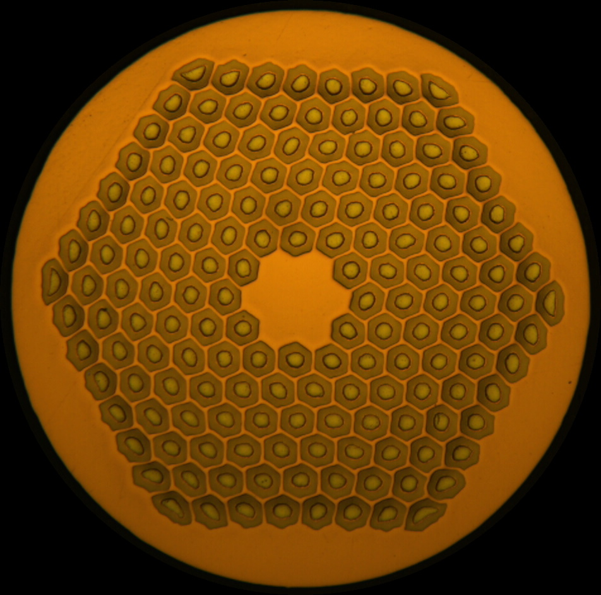
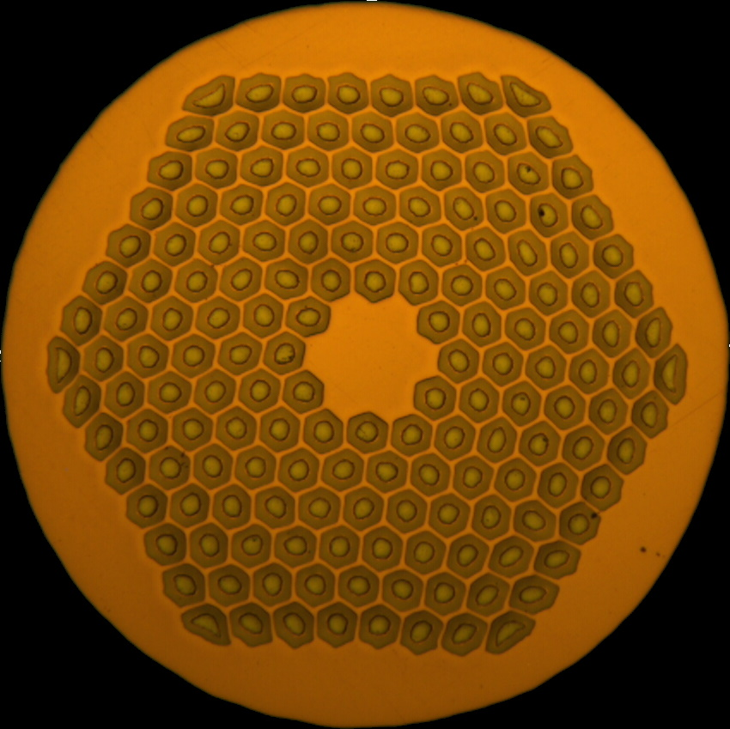
Strand options
 | HFM |  | HL-LHC
 | ERMC-1 | DEM-1.1 | MQXF-0.85
Diameter (mm) | 1.0 | 1.1 | 0.85
Layout | 162/169 |  | 108/127
d_{s} (µm) | 58 | 64 | 54
Cu/non-Cu | 0.9 ± 0.2 |  | 1.2 ± 0.1
Nb:Sn | 3.4 (standard Sn) |  | 3.6 (reduced Sn)
Heat treatment | 650 °C 50 h | 665 °C 50 h | 665 °C 50 h
See Simon Hopkins, https://indico.cern.ch/event/1218461/

Slide 9
Cable options
Magnet aperture (50 mm) and 2 double-layer coils → desired cable width: ~25 mm
Cable mechanical stability and cable cross section aspect ratio → number of strands and strand diameter: ~44 at ~1.1 mm or ~48 at ~1.0 mm, ~10% thickness reduction, typical cable twist angle
Relevant CERN & LBNL experience
  CERN: FRESCA2/RMM (40 x 1.0 mm); LBNL: LD/HD (51 x 0.8 mm), NED (40 x 1.25 mm)
  44 strands x 1.1 mm cable is being produced at LBNL for the TFD magnet.
    Preliminary winding trials with a 44 x 1.1 mm cable performed at CERN for a 50 mm aperture block magnet; challenging but manageable.
    First contact with LBNL stablished, very positive and willing to maximize synergies among projects.
 |  | Cable#1 | Cable#2 | Cable#3
strand diameter | mm | 1.1 | 1.0 | 0.85
Cu/SC | -- | 0.9 | 0.9 | 1.2
# of strands/cable | -- | 44 | 48 | 56

Slide 10
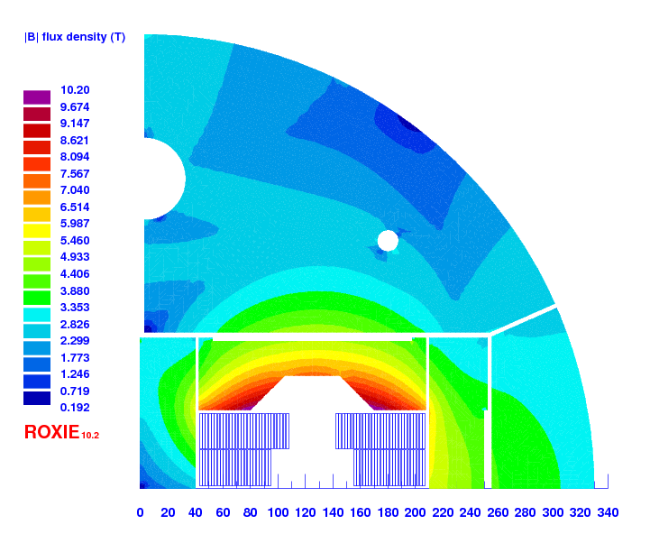
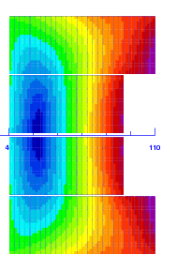
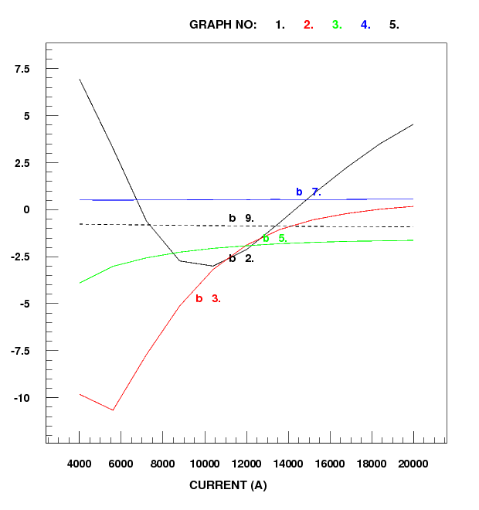
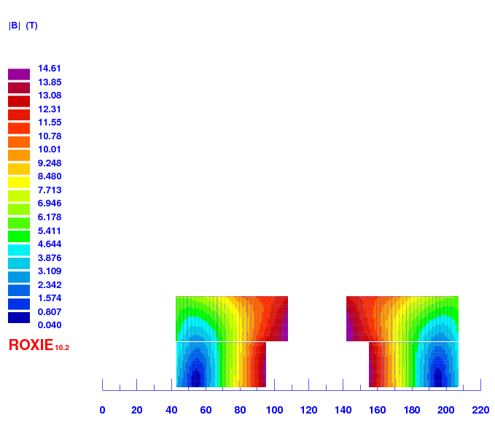
Electromagnetic design
Conceptual design with acceptable field quality (< 10 units at all current levels, excluding PC) for cable #1 and cable #2
Electromagnetic design will evolve based on the feedback form the mechanical design and winding tests
Field errors as a function of the current (geometric + iron saturation)
CABLE #2
CABLE#1
R_{min} = 14.8 mm
Inner support = 4 mm
N_{turns} = 50
CABLE #2
R_{min} = 17 mm
Inner support = 5 mm
N_{turns} = 54
Courtesy of S. Izquierdo

Slide 11
Overview on magnet parameters
RMM non graded
DEMO (16 T graded)
14T +
 |  | RMM non graded | 14T-V1 2in1 | DEMO
 |  |  |  | HF | LF
strand diameter | mm | 1 | 1.10 | 1.1 | 0.85
Cu/SC | -- | 1 | 0.90 | 0.8 | 1.2
# of strands/cable | -- | 40 | 44 | 44 | 56
# turns/quadrant | -- | 132 | 50 | 13 | 42
coil width | mm | 86 | 56 | 53
I_{nom} | A | 8850 | 21667 | 21000
J_{overall} | A/mm² | 248 | 350 | 339 | 422
J_{cu} | A/mm² | 735 | 1094 | 904 | 1454
J_{sc} | A/mm² | 735 | 985 | 1130 | 1212
Ratio LF/JF | -- | n.a. | n.a. | 1.25
B₀ at I_{nom} | T | 16 | 14.00 | 15.43
B_{p} at I_{nom} | T | 16 | 14.64 | 16.08 | 13.22
B_{ss} | T | 19.3 | 17.67 | 18.6 | 13.9
Energy density | J/cm³ | 88 | 86 | 112
F_{x}/h at I_{nom} | MPa | 122 | 112 | 141
F_{y}/w at I_{nom} | MPa | -46 | -57 | -72
Remark: MQXF at I_{nom} J_{Cu} ≈ 1300 A/mm² e_{d} ≈ 125 J/cm³ J_{overall} ≈ 450 A/mm²
Courtesy of S. Izquierdo

Slide 12
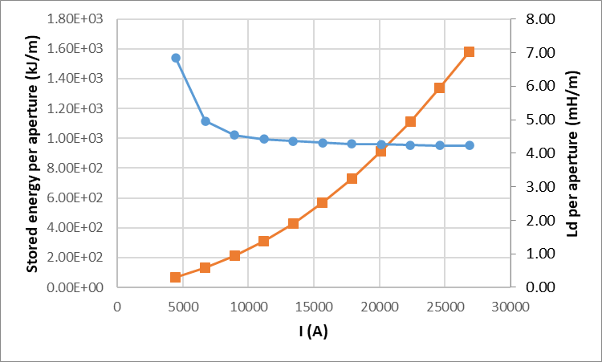
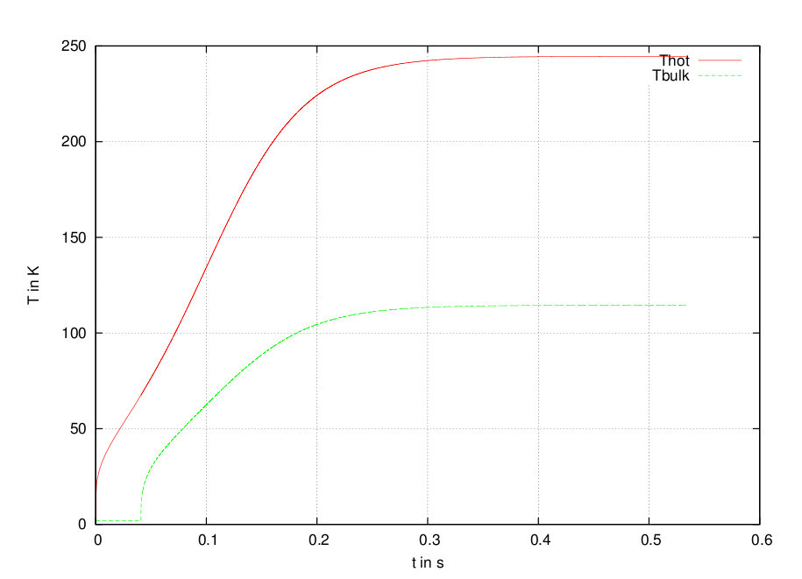
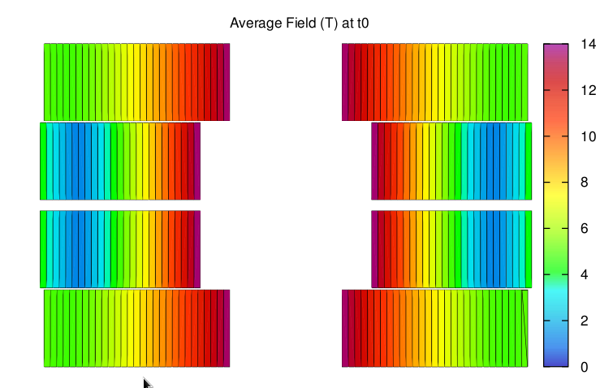
Protection
Magnet protection should not be very challenging, as we are relatively low in terms of current density/energy density. Should be easier than HL-LHC magnets
Assuming 40 ms to detect and protect…
We are now ready to start working with MPE experts
Courtesy of S. Izquierdo

Slide 13
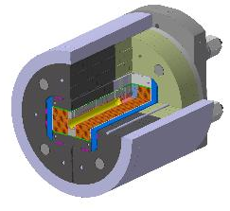
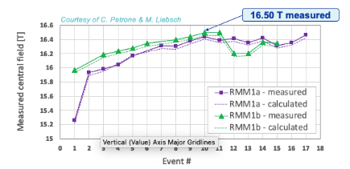
eRMC/RMM activities
    Exploration of high field in the straight section of a dipole block configuration
    Field record of 16.5 T (87.5 % of the short sample limit) in a 50 mm diameter and 431 mm long closed cavity during summer 2022
    No sign of conductor degradation
    Suspicion of mechanical limitation
    Transverse preload increase for conservative preload study on RMM1b has started
    3 eRMC cable Uls produced and being insulated
    Coil fabrication and first assembly expected second half on 2023

Slide 14
Running and future activities
The feasibility study for a 14 T+ dipole block-coil type with flared-end has started
  We propose a double layer coil block configuration, using ≈ 25 mm width cable.
  The main magnet parameters are a bit ‘less challenging’ than HL-LHC magnets (lower current density, lower energy density, similar stress level due to electromagnetic forces)
Design study for 2 in1 configuration expected to be completed in early summer, followed by a detailed conceptual and engineering design of the 1 in 1 configuration
  Mechanical design started, feedback will be included in the electromagnetic design
  Winding test in the coming months will define the baseline cable and the main parameters for the detailed 3D electromagnetic design.
  The two activities must progress in parallel for a quick and smooth transition to the engineering design of the 1in1 configuration
eRMC/RMM program will run in parallel to further explore the straight section of a coil block configuration:
  RMM conservative preload study running until end of 2023
  Winding of 3 eRMC coils will start early spring 2023
  eRMC2 magnet will be assembled and tested in 2024
  RMM2 powering tests scheduled in 2024
Thank you for your attention

