Slide 1
CEA Roadmap for High Field Nb₃Sn Magnets
E. Rochepault, M. Abel Hafiz, V. Calvelli, G. Campagna, M. Durante, H. Felice, E. Fernandez Mora, G. Lenoir, G. Minier, S. Perraud, J. C. Perez., F. Rondeaux
RD Line 3 kick-off Forum meeting, 22 Feb. 2023

Slide 2
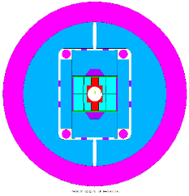
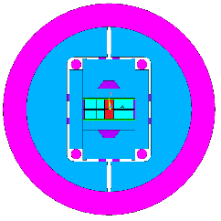
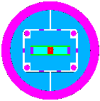
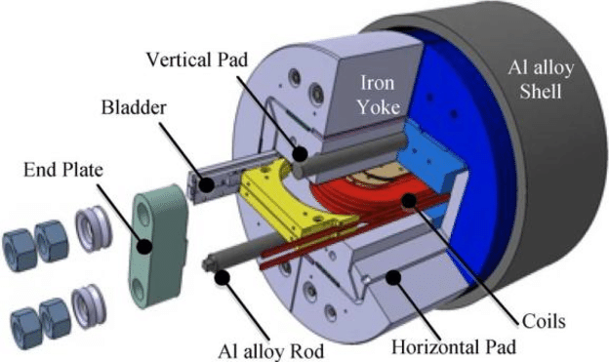
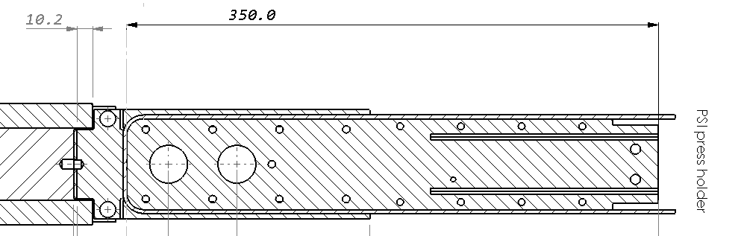
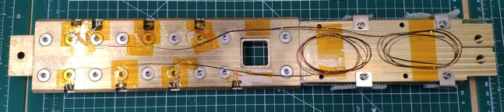
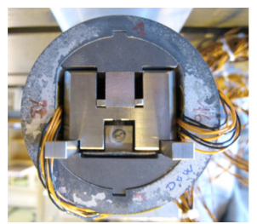
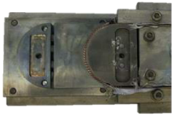
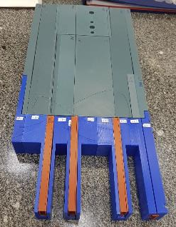
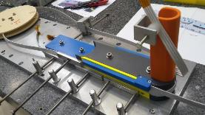
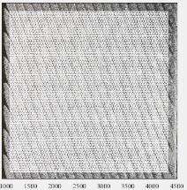
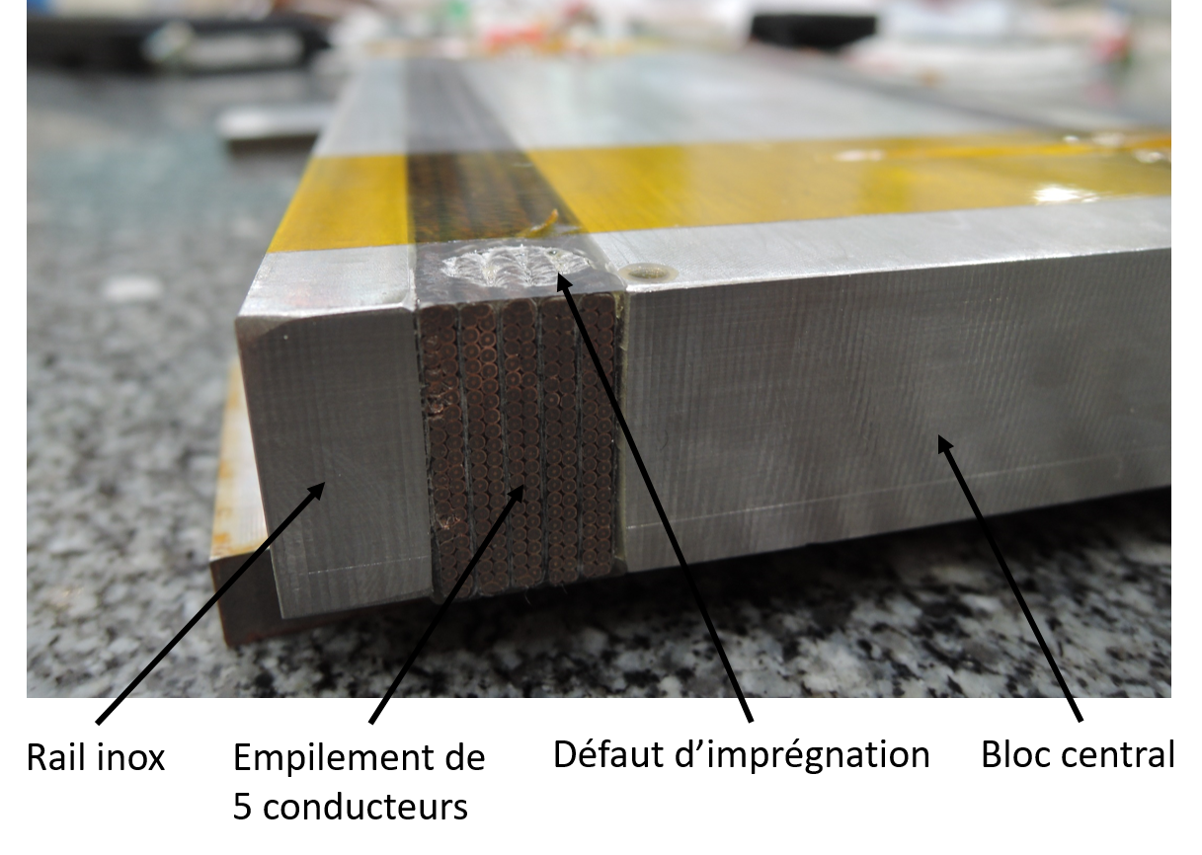
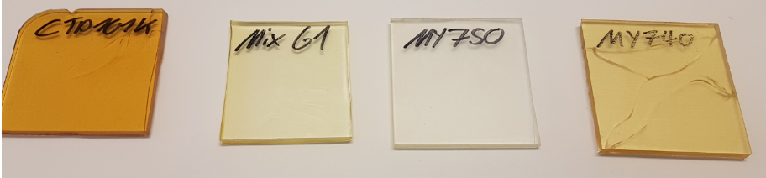
Development Plan towards 16 T Nb₃Sn Dipoles
16 T
demo
12-14 T demo
Subscales
Powered samples
Non-powered samples
F2D2
D5
FD
D5
SMC
D3
R2D2
D4

Slide 3
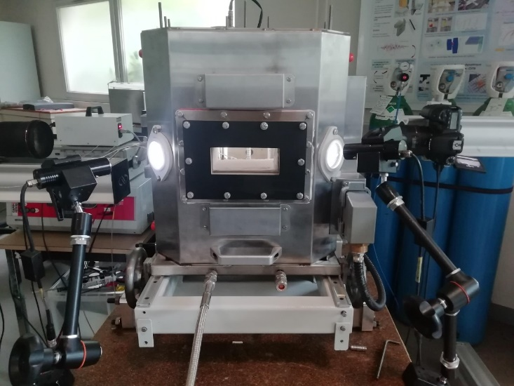
‘Non-powered’ samples
Mechanical characterization of coil segments at ambient/nitrogen
Characterization of conductors during heat treatment at 650°C → PhD M. Abdel Hafiz
Winding mockups
Junction mockups
Characterization of resins at ambient/nitrogen (at CERN)

Slide 4
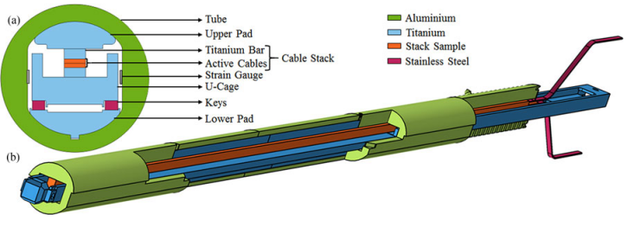
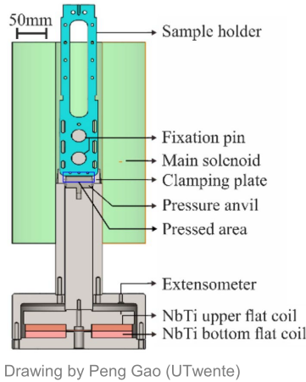
‘Powered’ samples
Training of cables at high field, high current, under debonding, at 4.2 K
Courtesy University Twente
→ PhD G. Campagna
Ic measurement of cables at high field, high current, high stress, at 4.2 K
Courtesy CERN

Slide 5
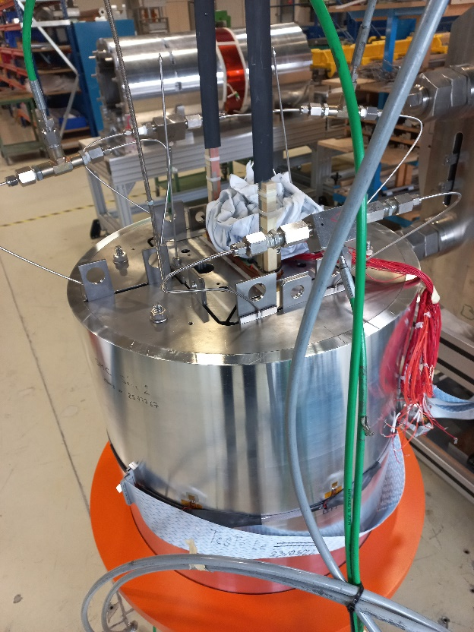
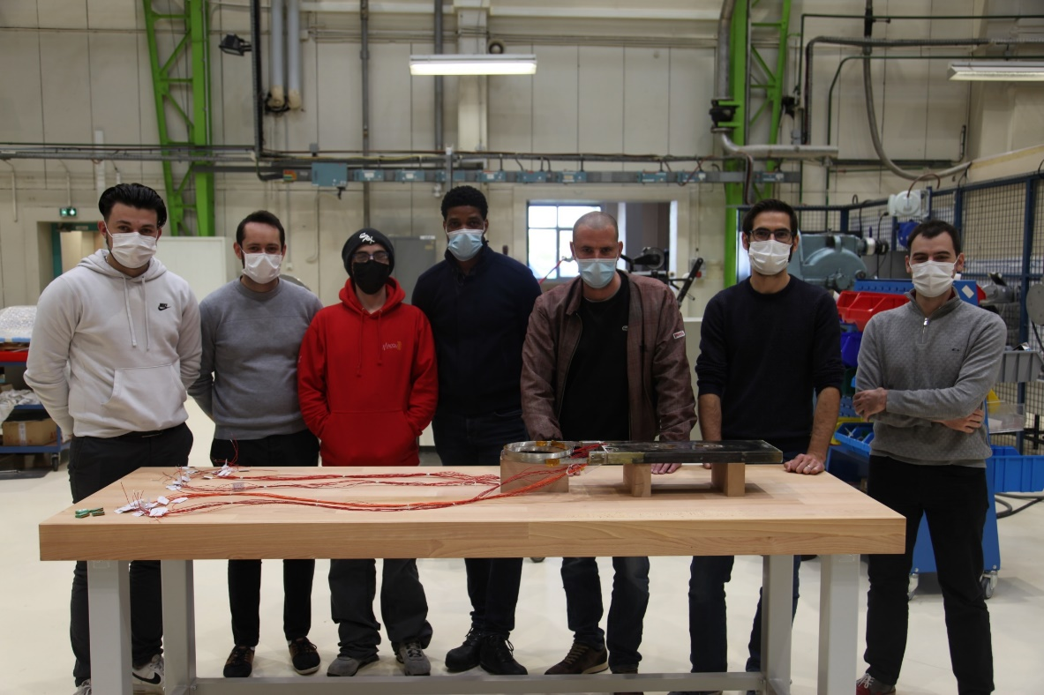
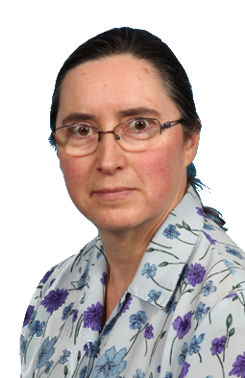
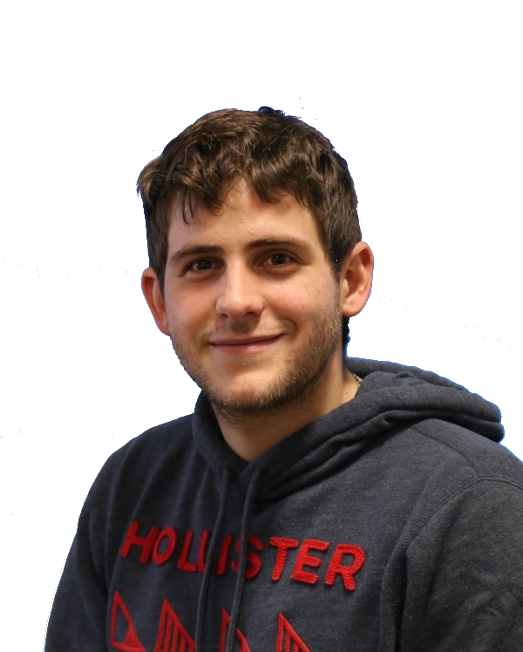
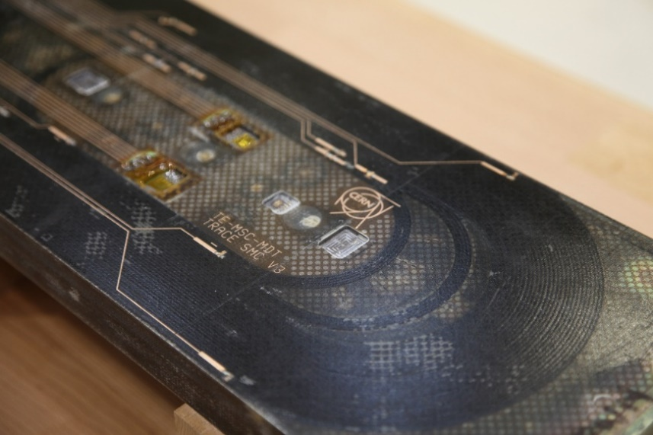
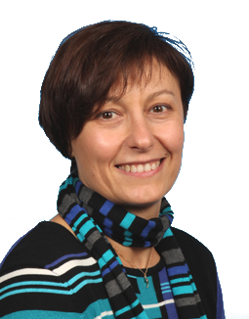
SMC subscale
SMC-CEA #1 fabricated at Saclay in 2021
Assembled and tested at CERN in 2022
  95 % of the Ic limit at 4.5 K !
  No sign of degradation, no loss of pre-stress
SMC-CEA #2: ongoing fabrication at Saclay

Slide 6
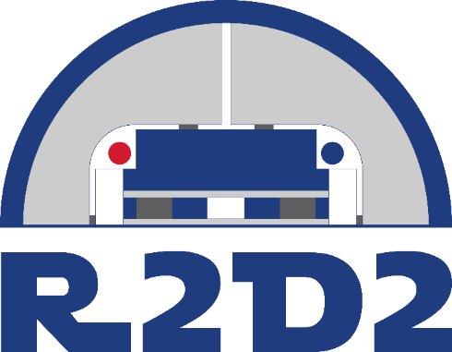
R2D2 12T demonstrator magnet
CEA conceptual design validated by an external committee
Fabrication, assembly and pre-stress at Saclay
Tests at cold at CERN
Main goal: demonstrate feasibility of grading
  Winding two cables on top of each other
  Heat treating two different cables together
  Jonctions of the 2 cables → 1st option: external Nb₃Sn-NbTi joints
R2D2 = Research Racetrack Dipole Demonstrator
Aperture | None
Outer diameter | 480 mm
Structure length | 2.0 m
Nominal central field | 11.1 T
Ultimate central field | 12.0 T
Nominal peak field | 12.7 T
Ultimate peak field | 13.7 T

Slide 7
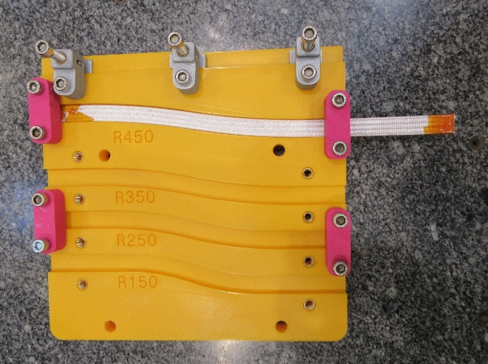
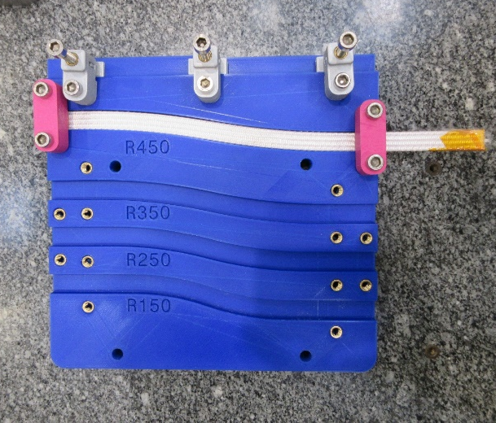
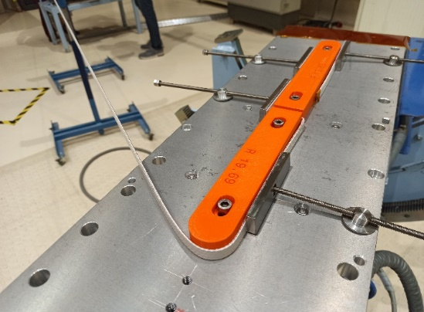
R2D2 12T demonstrator magnet
Cu prototype UL received from CERN
Validation of easy-way and hard-way bending
Nb₃Sn short prototype cables received
Validation of easy-way and hard-way bending
Parameter | Unit | HF cable | LF cable
Strand type |  | DEM-1.1 | DEM-0.7
Strand layout |  | RRP® 162/169 | RRP® 60/91
Strand diameter | mm | 1.1 | 0.7
Number of strands |  | 21 | 34
Cable mid-thickness | mm | 1.969 ± 0.010 | 1.253 ± 0.010
Cable width | mm | 12.579 ± 0.050 | 12.579 ± 0.050
Pitch | mm | 84 ± 3 | 79 ± 3
Core |  | No core | No core

Slide 8
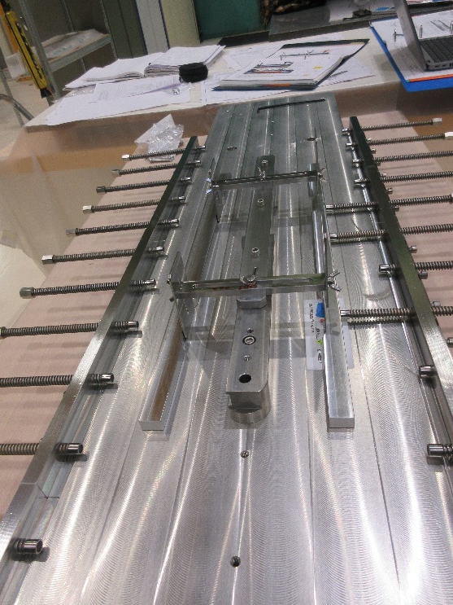
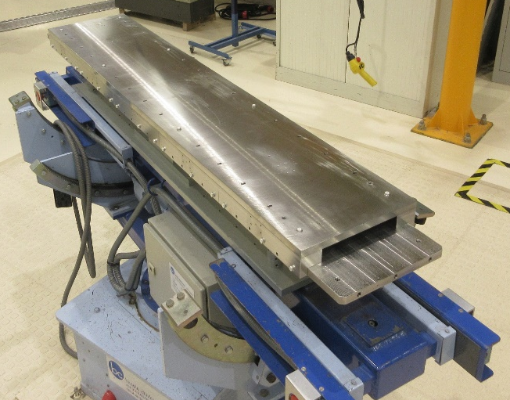
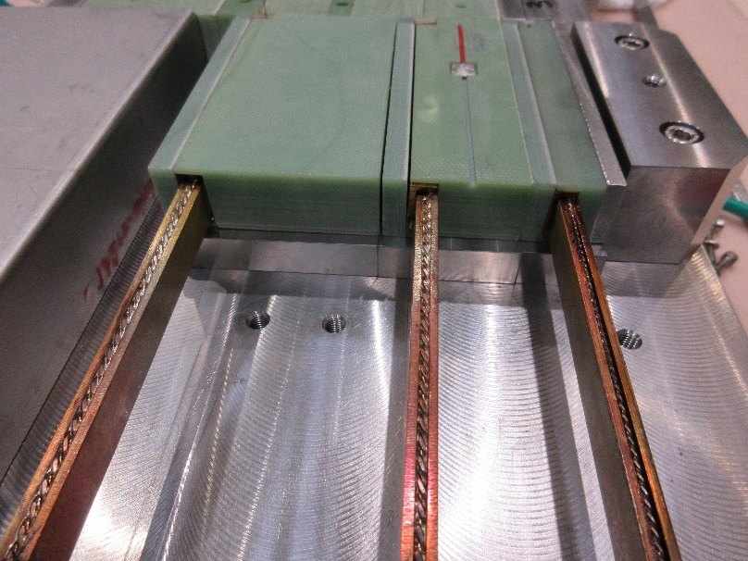
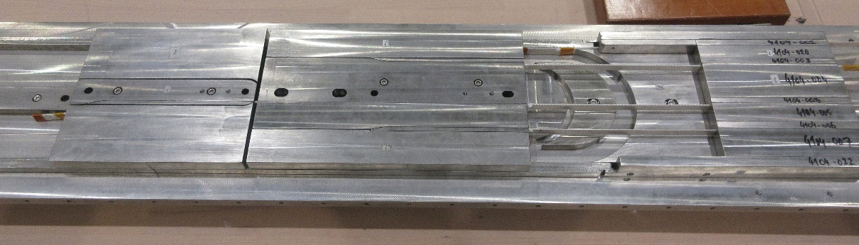
R2D2 12T demonstrator magnet
Components received at Saclay and validated
Winding and heat treatment tooling received at Saclay and validated
Junction procedures validated on mockups
Impregnation tooling expected end of Feb.
Winding of a prototype Cu coil foreseen March 2023

Slide 9
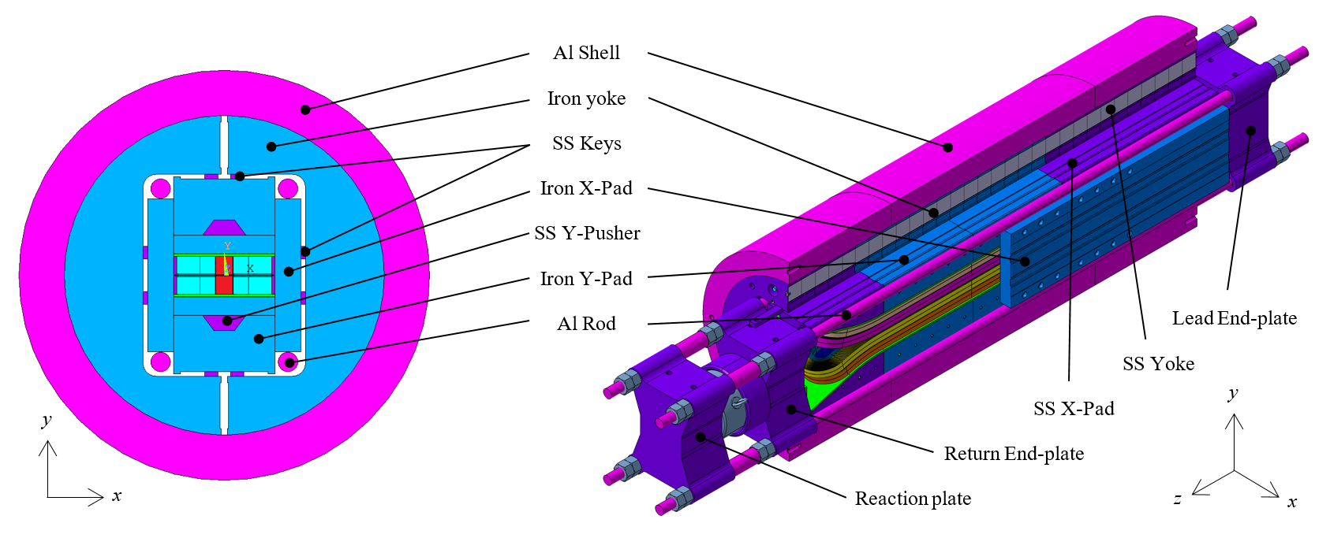
FD 14T demonstrator magnet
Conceptual design stage
Fabrication, assembly and pre-stress at Saclay ~S2 2025
Tests at cold at CERN ~early 2026
Main goal: demonstrate key technologies
  Representative of high field magnets: grading, joints, flared-ends, high field and high stress
  Some simplifications: 1 type of coils, no bore
FD = Flared Dipole
Aperture | None
Outer diameter | 650 mm
Structure length | 2.0 m
Nominal central field | 14.9 T
SS central field | 16.6 T
Nominal peak field | 15.6 T
SS peak field | 17.4 T

Slide 10
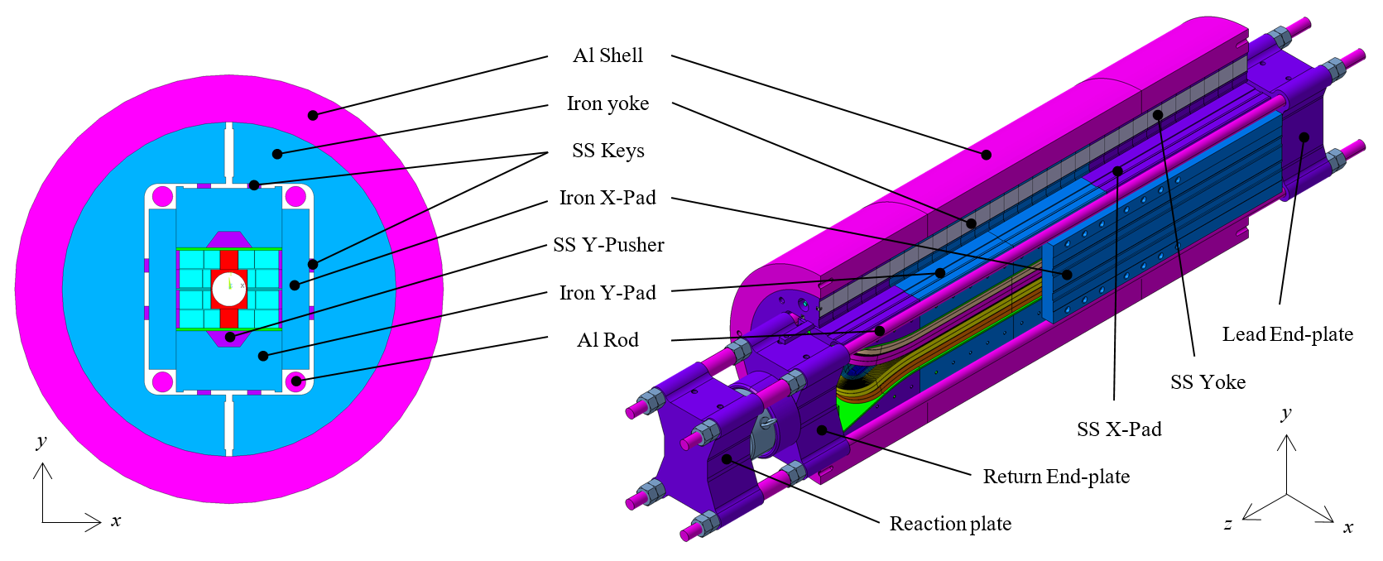
F2D2 16T demonstrator magnet
Conceptual design stage
Fabrication, assembly and pre-stress at Saclay ~ 2026-2027
Tests at cold at CERN ~mid 2027
Main goal: demonstrate all technologies
  Representative of high field magnets: grading, joints, flared-ends, high field and high stress
  Representative of accelerator magnets: 50 mm bore,
  field quality
F2D2 = Future Flared Dipole Demonstrator
Aperture | 50 mm
Outer diameter | 650 mm
Structure length | 2.0 m
Nominal central field | 15.5 T
SS central field | 17.8 T
Nominal peak field | 16.2 T
SS peak field | 18.6 T

Slide 11
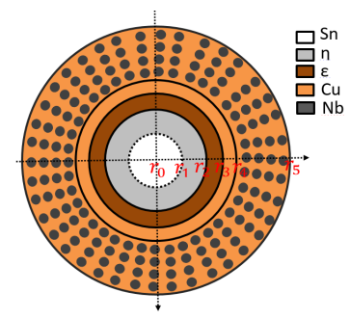
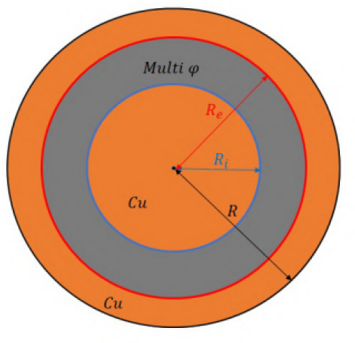
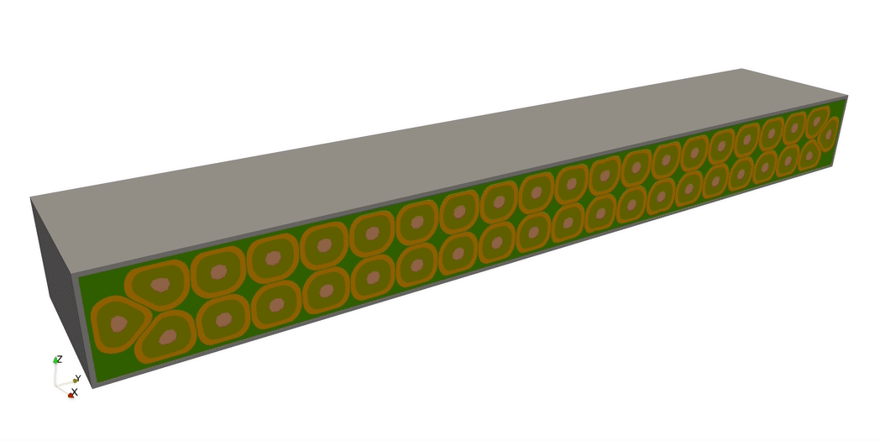
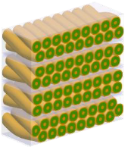
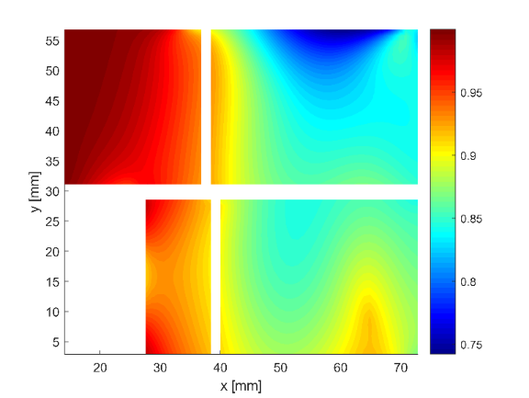
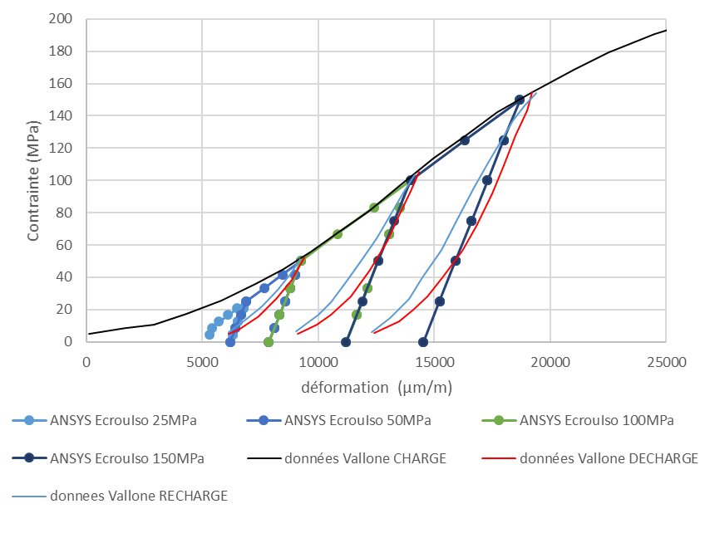
Modeling activities
Sub-elements
Diffusion phenomena → Jc, dimensions, stress…
Strands
Dimension/stress during HT
Jc, B, stress, strain in operation
Cables (Cocascope)
Dimension/stress during HT
Jc, B, stress, strain in operation
Coils
Stress/strain behavior of coil composite
Interfaces with components → training behavior
Magnets
Assembly, CD-WU, powering, quench
Stress/strain-induced current limit
Training

Slide 12
Conclusion
Development of Nb₃Sn magnets towards 16 T at CEA Saclay:
« Non-powered samples » → Characterizations of materials, development of processes, validation of concepts
« Powered samples » → Study of performances of Nb₃Sn
Model coil SMC : successful test! → Development of fabrication processes, infrastructure, gain of experience
Demonstrator magnet R2D2 → Proof of concept of the technology for 16 T
Demonstrator magnet F2D2 → Design of a 16 T accelerator-type magnet
But also a need to be connected to the other programs!

