Slide 1
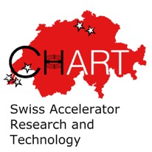
Introduction to the activities of WP3.8 at PSI
B. Auchmann (PSI/CERN) for the MagDev LTS team: D. M. Araujo, A. Brem,
M. Daly, C. Hug, O. Kirby T. Michlmayr with support from PSI Magnet Section, CERN, LBNL, FNAL, and uTwente
22.02.23 – HFM RD3 Kickoff
Work supported by the Swiss State Secretariat for Education, Research and Innovation SERI.

Slide 2
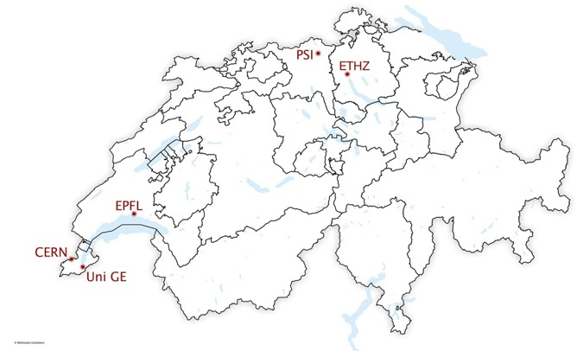




CHART Network and ESPPU
“CHART, the Swiss Center for Accelerator Research and Technology, was founded to support the future oriented accelerator project Future Circular Collider (FCC) at CERN and the development of advanced accelerator concepts in Switzerland beyond the existing technology. […] The high field magnet R&D has strong synergies with PSI projects […]”
[Application for support of the Swiss Accelerator Research and Technology Initiative, 2018]
Swiss national centers of competence in HFM:
  EPFL Swiss Plasma Centre:
  Infrastructures and Instruments,
  Materials
  ETHZ: Materials, Models, Powering
  PSI: LTS and HTS Magnet R&D,
  Infrastructures, Materials
  UniGE: LTS and HTS Conductors
http://chart.ch

Slide 3


CHART – What, Who How?
Topics and FTEs of ongoing ASC projects in CHART:
  WireChar – SC wire and tape characterization (1 FTE)
  WireDev – Nb₃Sn wire development (3 FTE)
  MagRes – resin development (1 FTE)
  MagComp – coil composite characterization and constitutive modeling (1 FTE)
  MagAM – additive manufacturing for coil components (1 FTE)
  MagNum – model-based systems engineering for magnets (1 FTE)
  FCCee CPES – cryogenic power supply development (1 FTE)
  MagDev1/2 – SC magnet development (8 FTE)
  HTS Bulk Undulator – Bulk REBCO undulator technology (2 FTE)
  FCCee Injector –NI solenoid for injector test at SwissFEL (1 FTE on ASC)
  FCCee HTS4 – HTS Short Straight Section Demo for FCCee (4 FTE)
  Total: 24 FTE
Other ongoing CHART projects:
  FCC / LHC Lumi
  FCCee Beam Dynamics Simulation
  FCChh Stability
  FCCEe SPIN POL
  FCCee Lumi
  Muon Collider Feasibility Studies
  FCCee Injector
  FCC Geodesy
  FCC Geology 3D Model

Slide 4
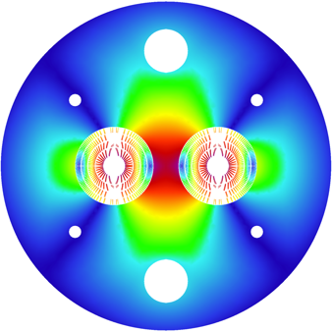
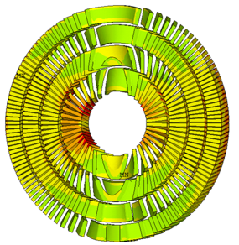
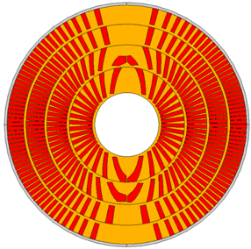
CHART1 MagDev0 Goals
CHART1 goals (mid-2016 to mid-2019) :
  the design of an optimised 16 T Canted Cosine Theta (CCT) dipole magnet,
  as an option for the FCC hadron collider main magnet;
  the development (design and prototype) of a high-field dipole
  magnet with CCT technology and a 90 m² lab.
[B. Auchmann et al., Electromechanical Design of a 16-T CCT Twin-Aperture Dipole for FCC, IEEE Trans. on Appl. SC 28 (April, 2018) no. 3.]

Slide 5
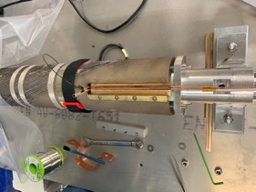
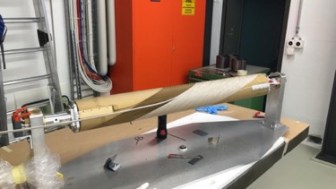
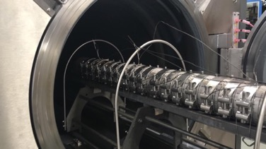
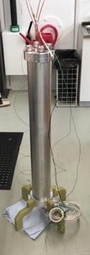
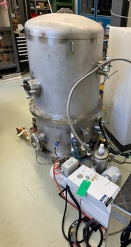
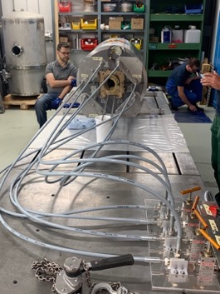
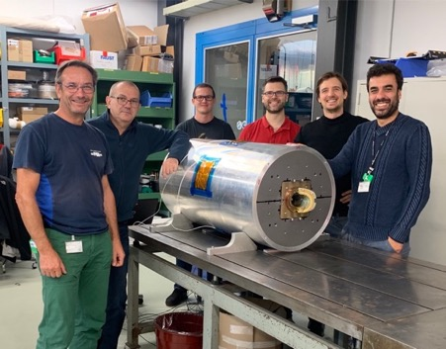
CHART1 Goals
CHART1 goals (mid-2016 to mid-2019):
  the design of an optimised 16 T Canted Cosine Theta (CCT) dipole magnet,
  as an option for the FCC hadron collider main magnet;
  the development (design and prototype) of a high-field dipole
  magnet with CCT technology and a 90 m² lab.
[G. Montenero et al., Coil Manufacturing Process of the First 1-m-Long Canted-Cosine-Theta (CCT) Model Magnet at PSI, IEEE Trans. on App. SC., Vol 29(5), 2019.
G. Montenero et al., Mechanical Structure for the PSI Canted-Cosine-Theta (CCT) Magnet Program, IEEE Trans. on Appl. SC., Vol 28(3), 2018.]

Slide 6


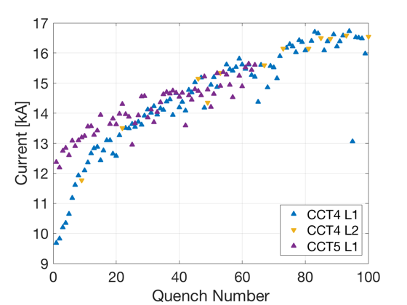
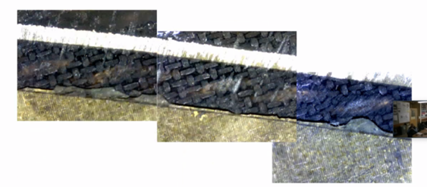
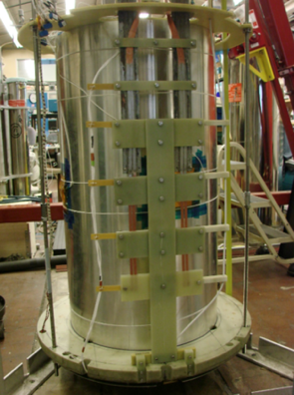
CD1 Testing Odyssey
Magnet was shipped to LBNL in Nov. 2019.
The test preparation was interrupted by COVID 19 and resumed in Aug. 2020.
Magnet test started in Sept. 2020 but interrupted by cryo problem.
Max. current after 2 quenches: 11.1 kA or 62.5% of short sample, 6 T in the bore.
CHART has built a magnet (no more and no less can be said at this stage).
Test to be continued at CERN in Q1 Q2’22.
LBNL experience points to a debonding and cracking
problem in the impregnated channels,
causing excessive training.
CD1
Courtesy D. Arbelaez, LBNL.

Slide 7

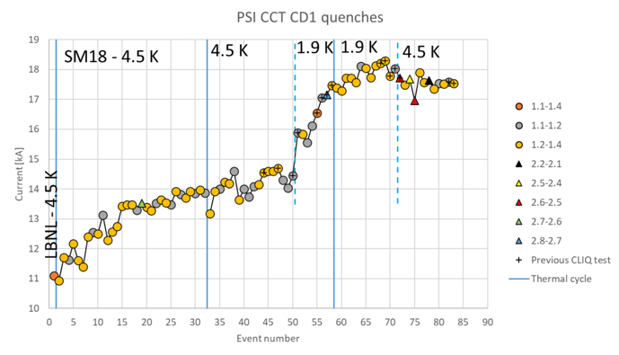
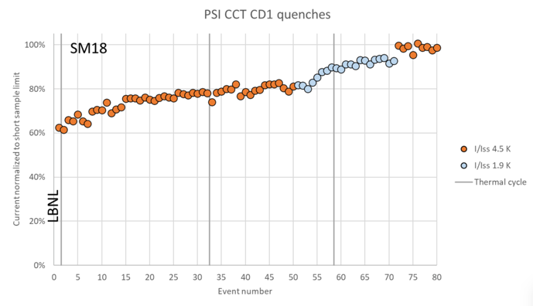
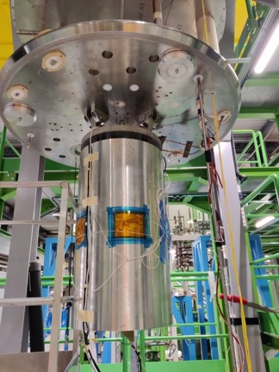
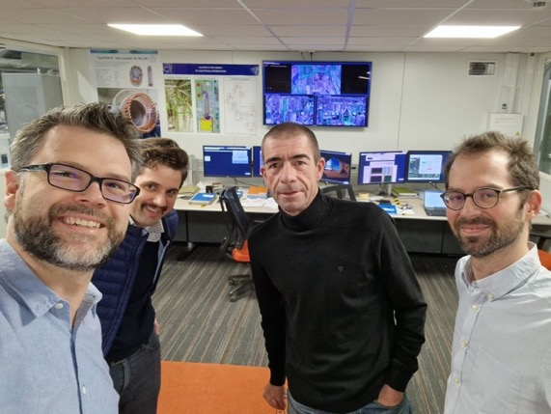
Record Field after a Long Delay
October 2019, the CD1 magnet was finalized and shipped to LBNL, Berkeley, US, for testing.
An Odyssey began:
The magnet was blocked for 3 months in US customs and the transport crate heavily damaged by a fork lift.
COVID delayed the start of testing by 6 months.
After several ramps, the LBNL test station had technical problems. The repair grew into an upgrade project.
After the return of the test station, the PSI magnet lost in priority over other delayed LBNL projects.
Upon invitation by CERN, the magnet was shipped there and arrived in November 2021.
A dangerous electrical incident at CERN interrupted all testing at CERN for several months.
Upon resumption of testing, HiLumi magnets received priority.
CD1 was eventually tested at CERN in November 2022.
It reached 10.1 T in the bore at 94% of Iss at 1.9 K; 9.9 T and 100% of Iss at 4.5 K..
Courtesy F. Mangiarotti (CERN) and M. Daly (PSI).
Bottom line: Stress-management works –
no conductor degradation by handling, assembly, powering, cycling.

Slide 8
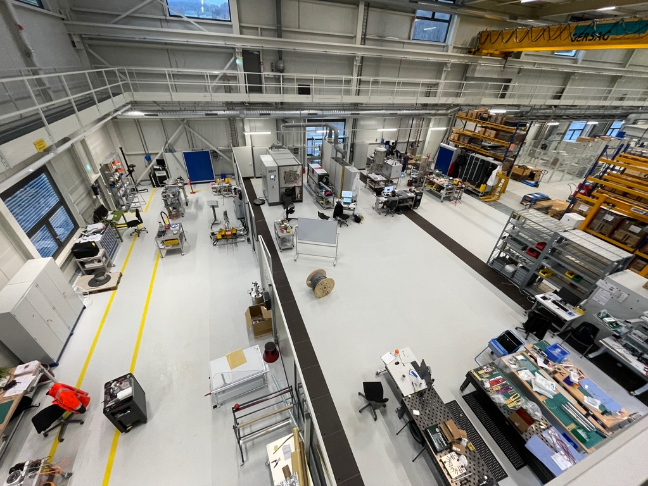
CHART2 MagDev Laboratory Layout
3D Scanning
Impregnation
Heat treatment
LTS re-reeler
HTS winding
Storage
Instrumentation
LTS winding
Loading / Assembly

Slide 9






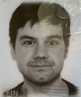



MagDev Team and CHART collaborations
Douglas Araujo
Engineer LTS
Jaap Kosse
Engineer ReBCO
P3 Project, Magnet Section
Michael Daly
Engineer LTS
Henrique Rodrigues
Technician ReBCO
WireChar, WireDev
Dmitry Sotnikovs
Engineer HFM ReBCO
Christoph Hug
Technician LTS
MagNum (D-ITET)
Design
Materials
Processes
Oliver Kirby
Internship LTS
MagRes (D-MAT SMG)
MagComp (D-MAT SMG)
André Brem
Material Scientist
MagAM (pd|z, inspire AG)
Thomas Michlmayr
CAD, Technical Design
Instrumentation, Protection, Testing

Slide 10

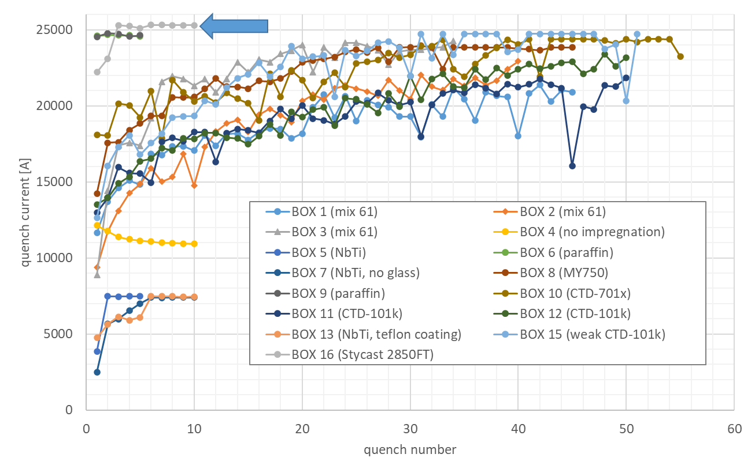
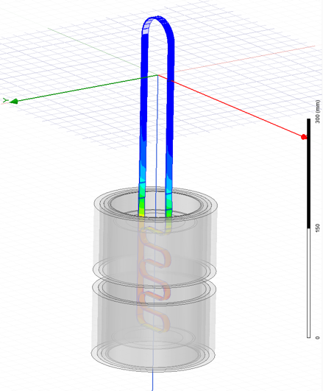
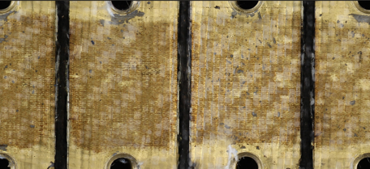

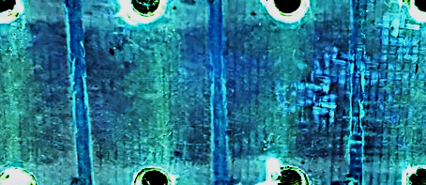
BOX Program
Pictures by M. Daly, S. Sidorov, S. Otten
BOX (BOnding eXperiment) program with uTwente has shown a wide variety of results,
from complete conductor degradation (no impregnation) to substantial training (epoxy) to
no-training (wax, Stycast), with 15 BOX samples successfully manufactured and tested to date.
Notes:
LBNL is preparing a wax impregnated subscale CCT magnet

Slide 11
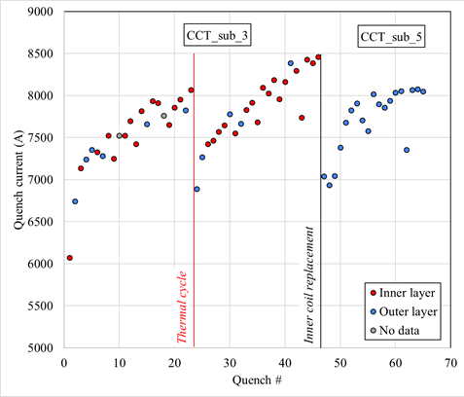
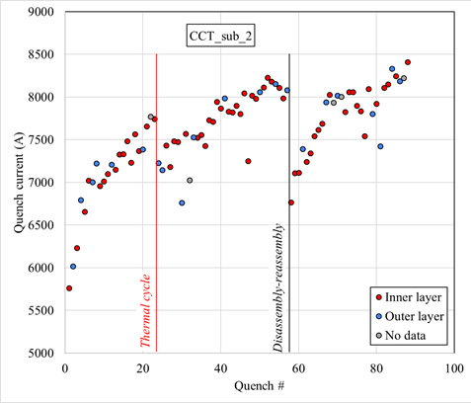
Wax Sub-scale Layer tested at LBNL
All data courtesy of D. Arbelaez for the LBNL CCT program.
  Sub_2: epoxy in inner and outer, inner with thin spar
  Sub_3, epoxy in inner and outer, inner with thick spar
  Sub_5, wax in inner, epoxy in outer, outer layer re-used from sub_3
Wax inner layer did not show any training quenches.
Also Stycast will be investigated.
Wax-impregnation is under preparation by Wigner institute (HU) and under discussion for iFAST project at INFN and at CERN (G. Kirby et al.).

Slide 12
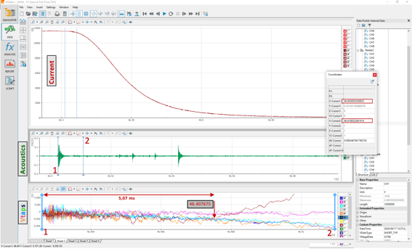
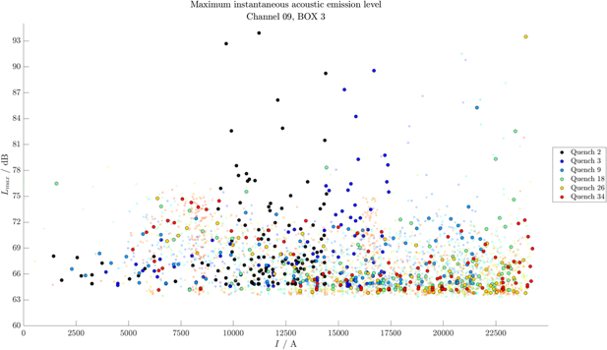
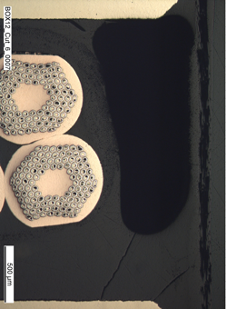
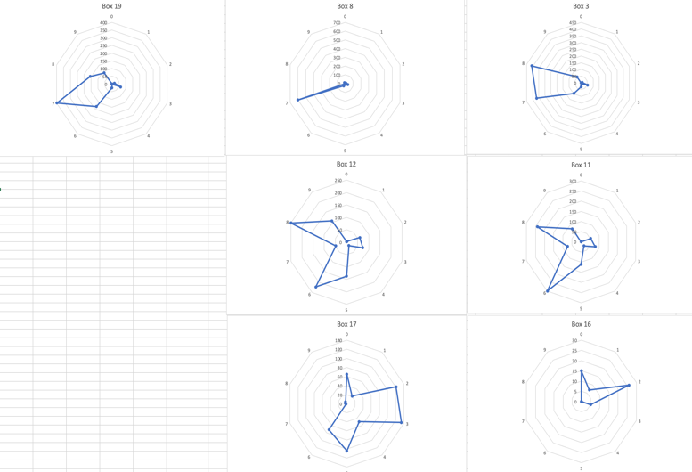
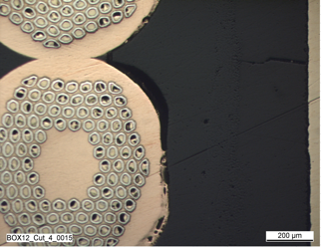
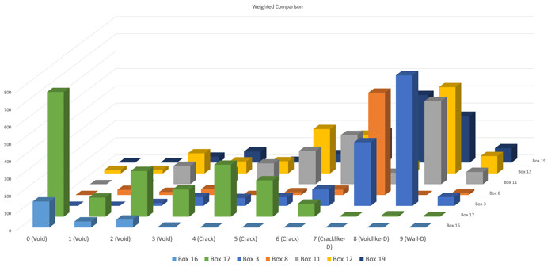
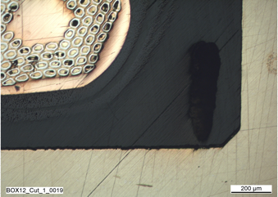
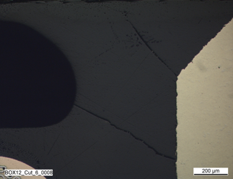
BOX Analysis
Goal1: quantify accoustic events and
post-mortem defects and correlate
them with material parameters.
Goal2: Correlate observed failure mechanism
after wire-saw cutting and polishing.
[Courtesy of M. Daly, collaboration with EMPA.]
[Courtesy of O. Kirby, M. Daly.]

Slide 13

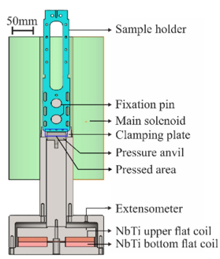
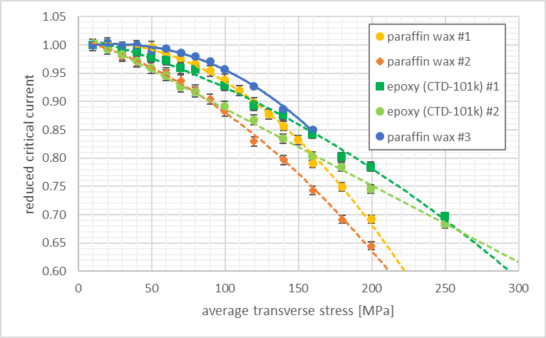
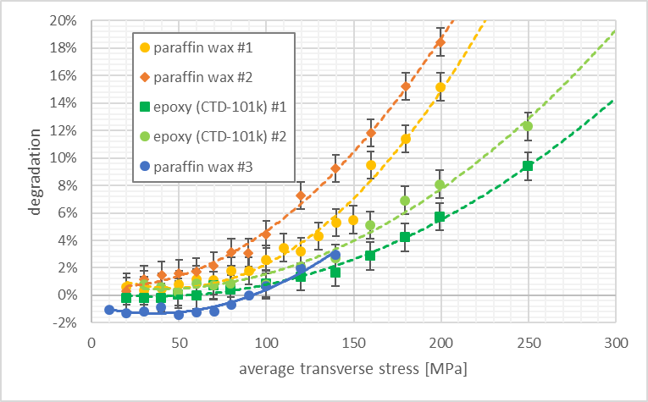
BOX Compression
Successful systems can be characterized and benchmarked against CTD101-K in U Twente’s transverse-compression setup.
CTD 101-K measurements reproduce previous results.
Paraffin wax’s lower modulus and yield increase degradation.
Courtesy M. Daly
Courtesy S. Ott et al.

Slide 14
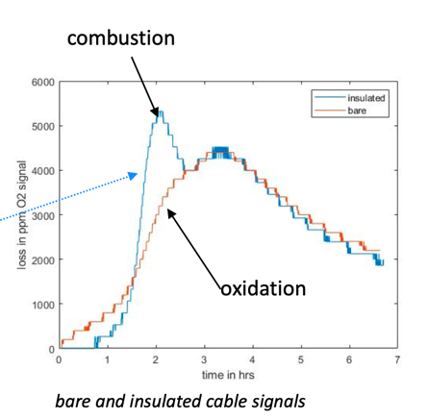
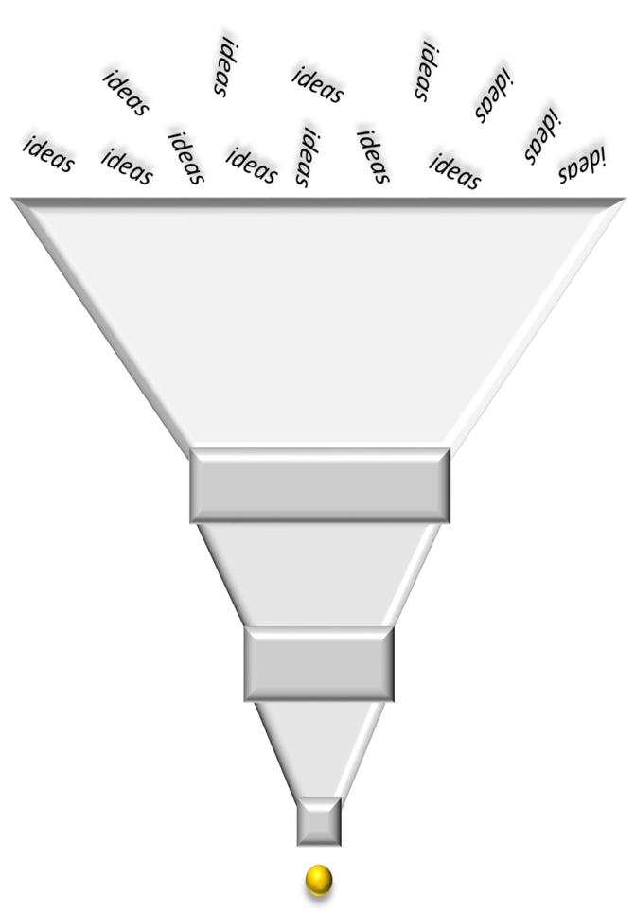
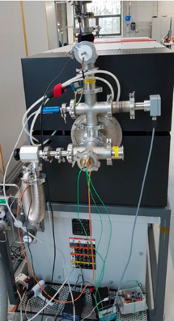
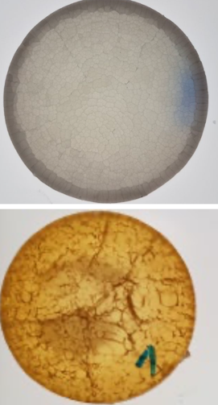
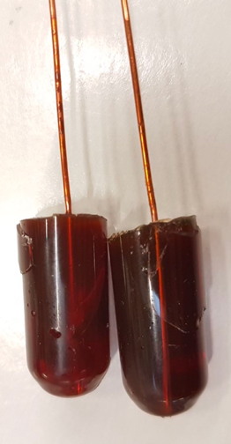
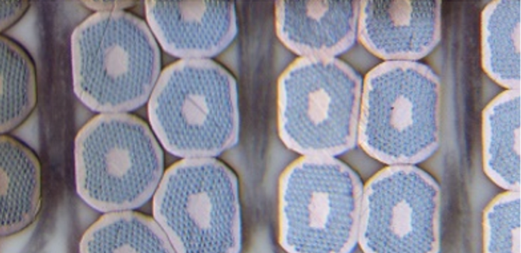
Materials R&D
Burn-off of organic residues
Spray- or dip-coating and glazing
process with heat-resistant
insulating paint
No-bond epoxy
Cryogenic tribology with BAM Berlin.
Filled-epoxy/wax process
development
  Dispersion, processing
  VPI with vacuum bag
Courtesy A. Brem.

Slide 15
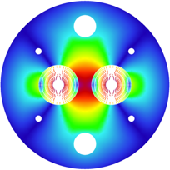
CCT4FCC Pros and Cons
Design:
  Mechanical support of each turn
  → reduced coil stress and avoidance of stress-induced degradation.
  Easy field quality (on paper).
  Ideally suited for LTS/HTS hybrid magnets due to easy stacking of heterogeneous layers.
  Simpler external mechanical structure → more iron between the apertures and better magnetic separation → less cross-talk.
  Hope to fix training: getting one turn “right”, the entire magnet would work; no discontinuities towards the end regions
Fabrication:
  Simple and safe coil-manufacturing process; little tooling needed; coil always protected by former.
Instrumentation and protection:
  Efficient CLIQ protection as every turn is a high-field turn.
  Co-winding of instrumentation (fibers, wires, etc.) is supposedly easy.
Design:
  Every turn must be glued to metal surfaces; delamination would preclude good performance.
  Reduced efficiency by winding angle, rib thickness, and spar thickness.
  Check FQ variation along z-axis due to lack of control on turn position.
  Some axial strain on cable in every turn.
  No radial pre-compression possible.
Fabrication:
  Tricky winding on small ID with wide cable.
  Difficult to obtain reliable insulation.
  Difficult to keep cable in groove on small IDs.
  Interplay between former and cable during reaction.
Instrumentation and protection
  No heater protection possible.
Scaleup:
  Involved former manufacturing; cost and time consuming; difficult to scale to 15 m.
  Difficult assembly and alignment for long magnets – assembly gaps reduce performance.

Slide 16
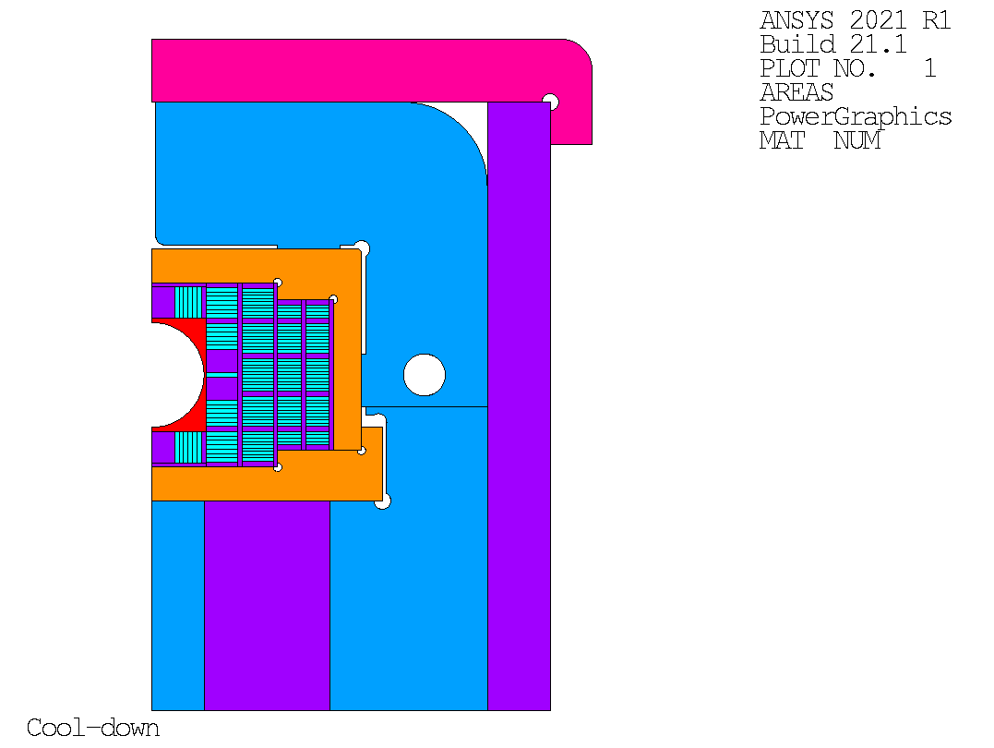
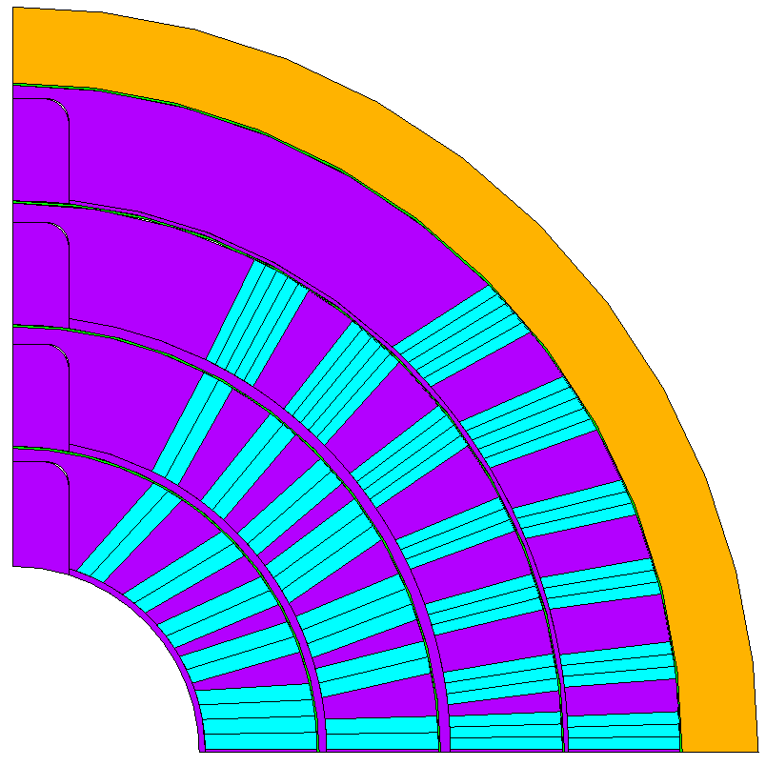
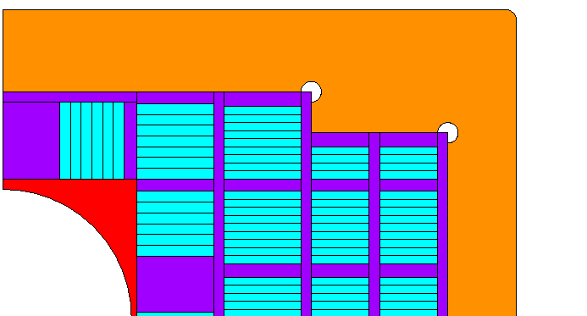
Stress-Management Continued
CCT for Nb₃Sn promised reduced conductor stress by introducing stress management.
The BOX program provided a handle on the vexing interface problem.
Other difficulties intrinsic to CCT technology remain for FCC-hh main dipoles.
Stress-managed on other geometries promise to combine the benefits of SM with the (relatively) easier manufacturability.
Courtesy of D. M. Araujo – images show snapshots of design studies for illustration purposes – not final designs!

Slide 17
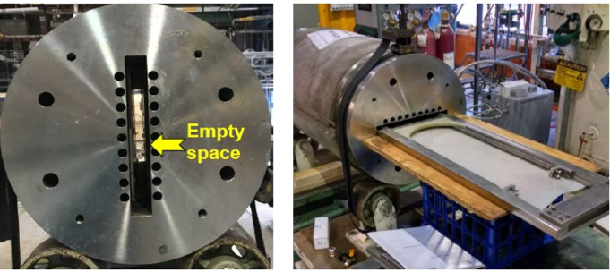
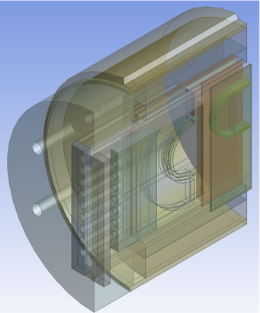




BigBOX – at BNL for Testing
Brookhaven DCC17 magnet provides 9.2 T field.
A 13-turn Nb3Sn hardway-bend racetrack coil will see
~125 MPa with ~20% margin – the most strenuous operating condition expected
for a stress-managed coil.
Training opportunity for the entire team.
BigBOX was delivered in June 2022. Test expected soon ...
Courtesy of D. M. Araujo

Slide 18
Outlook
2023-2024 will see the sub-scale program, that shall tune and validate manufacturing processes and
discover major design issues
(3-4 magnet tests).
2024-2026 will see the ultimate-
field program (at lest 1 magnet test).
Material sample and powered-sample R&D will continue in support of large- scale magnets.
Collaboration remains a center-piece of our methodology. CHART collaborations, close exchanges with the CIEMAT program, and open exchanges and cooperation throughout the HFM Programme will remain a priority.
Materials and Composite Samples (not powered)
Powered Samples and Mechanical Models
Sub-scale Magnets
2023-2024
2024-2026
Short Magnets
Ultimate Field (14…16T)
Long Magnets Ultimate Field Magnets
(14…16 T)

