Slide 2
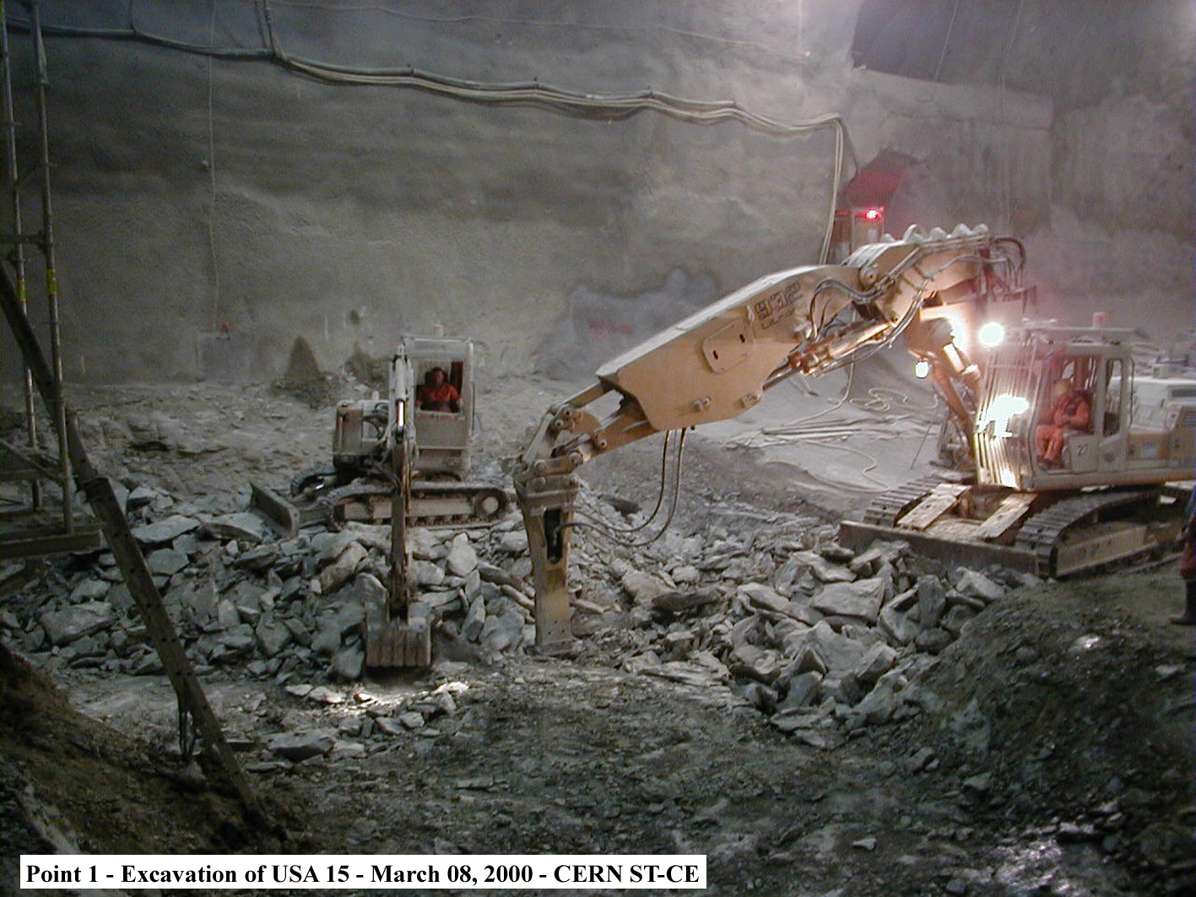

Workshop Summary
CERN Tunnelling Workshop
26-27 October 2023
John Osborne
FICE
Email: john.andrew.osborne@cern.ch
CERN, European Centre for Nuclear Research

Slide 3
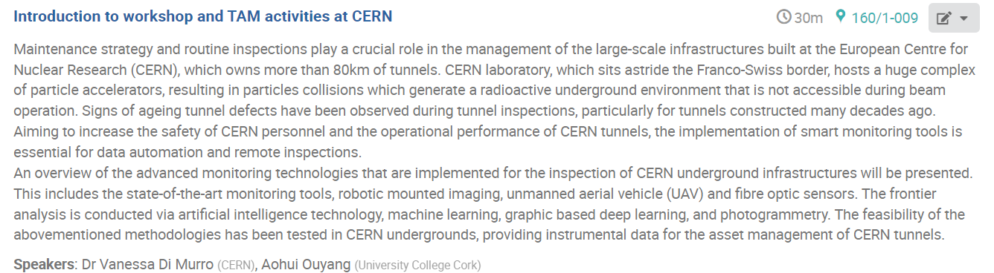
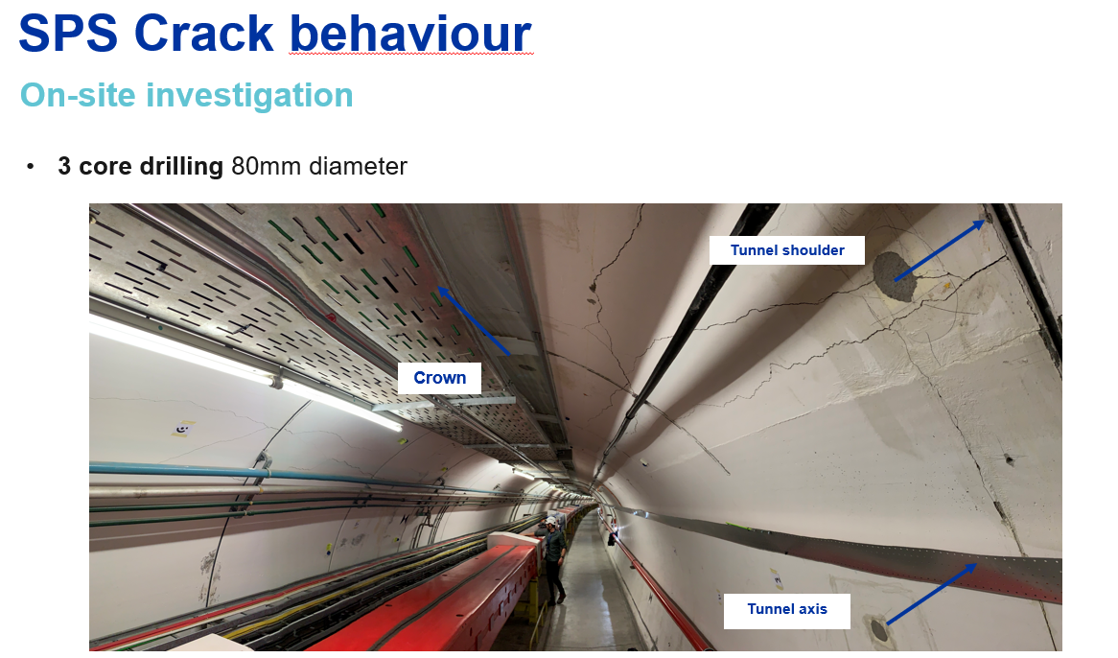
Notes:
Lots of interest in our SPS case study, VA

Slide 4
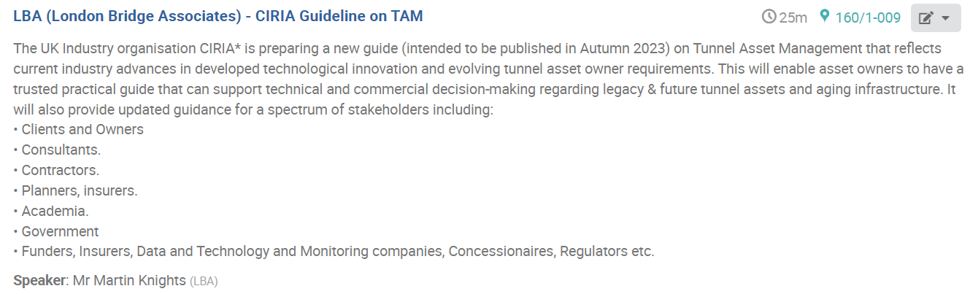
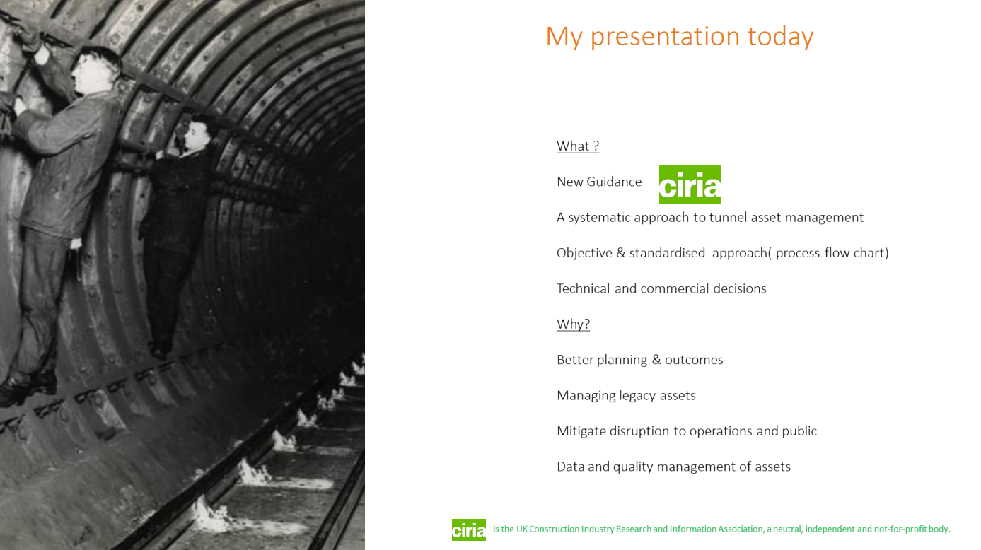
“Politicians often more interested in Shiny New Projects that TAM”
Notes:
Politicians often more interested in Shiny New Projects that TAM.

Slide 5
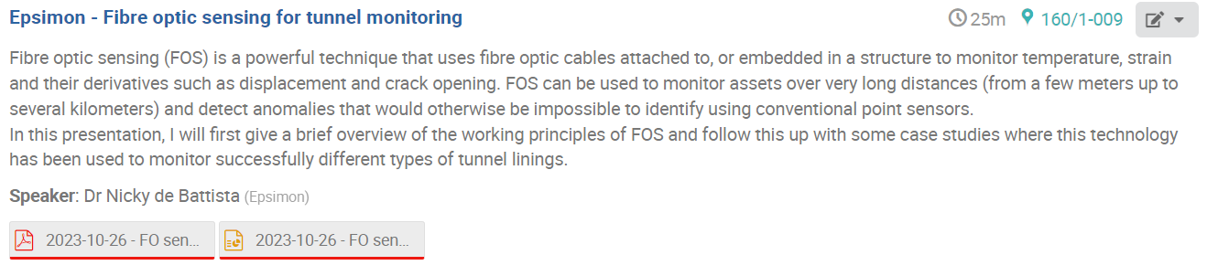
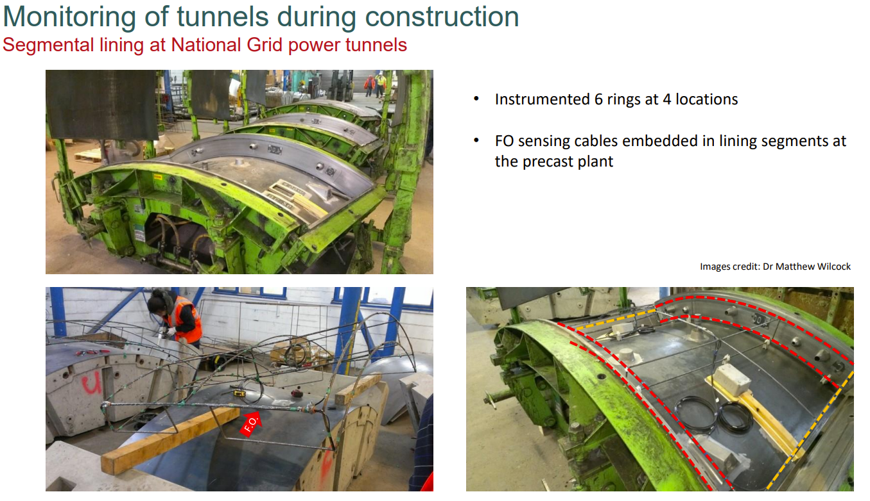
Complex systems.
Case study : Monitoring only during 1yr after construction

Slide 6
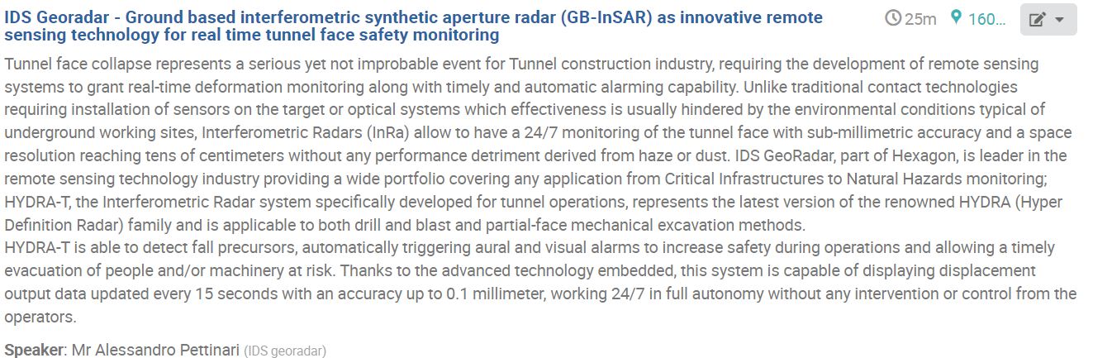
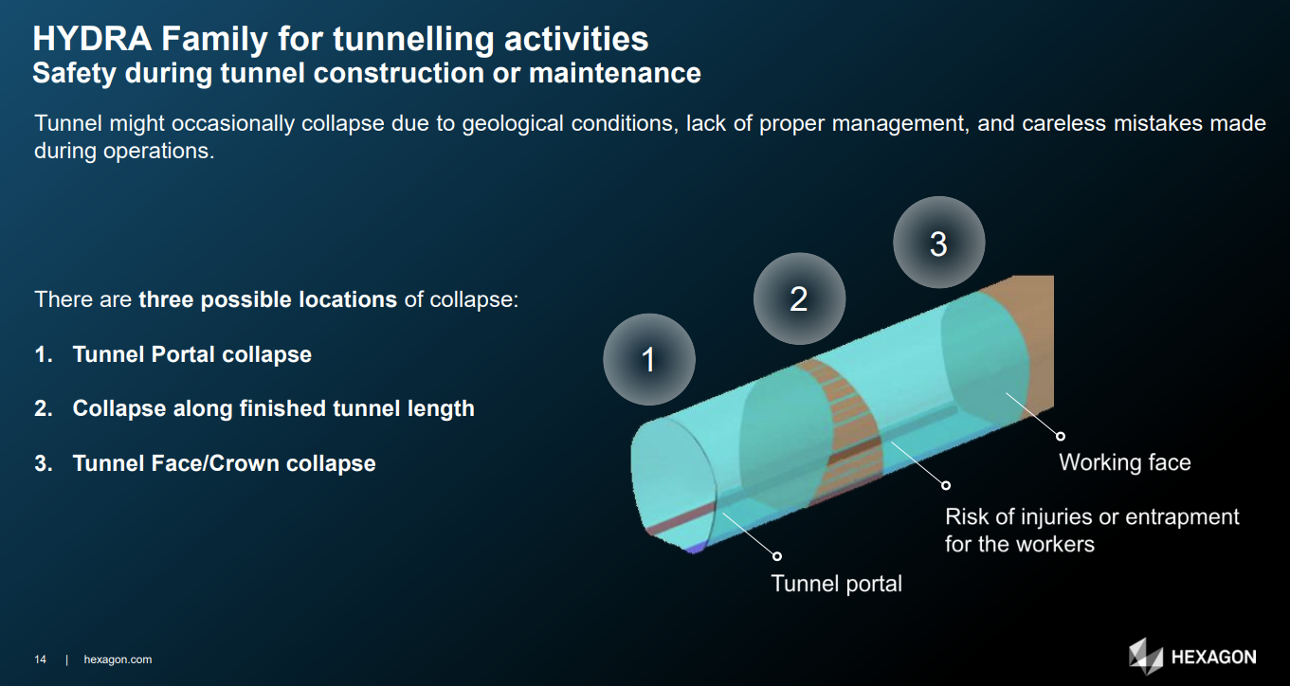
Safety monitoring during tunnel construction
Notes:
Real time monitoring during construction like portal collapse, tunnel face etc. 10-15m from tunnel face

Slide 7
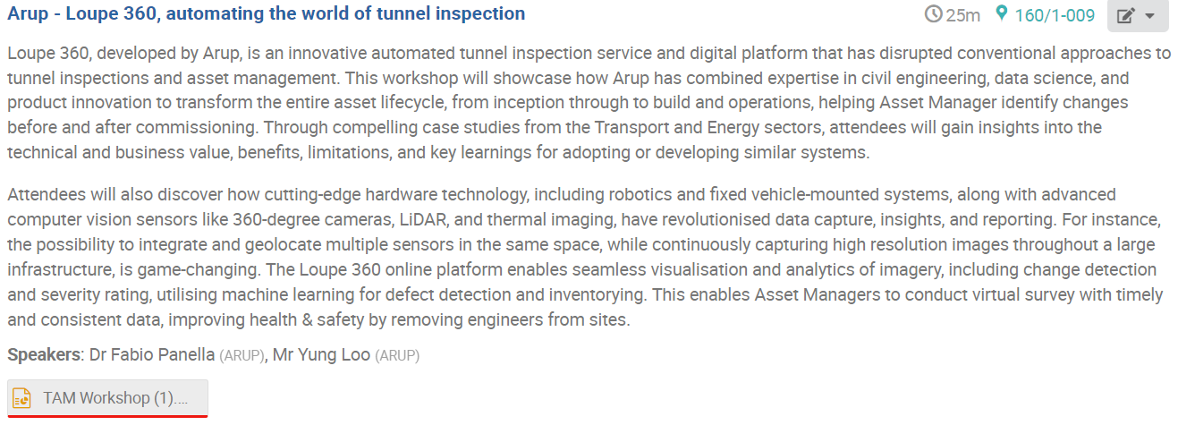
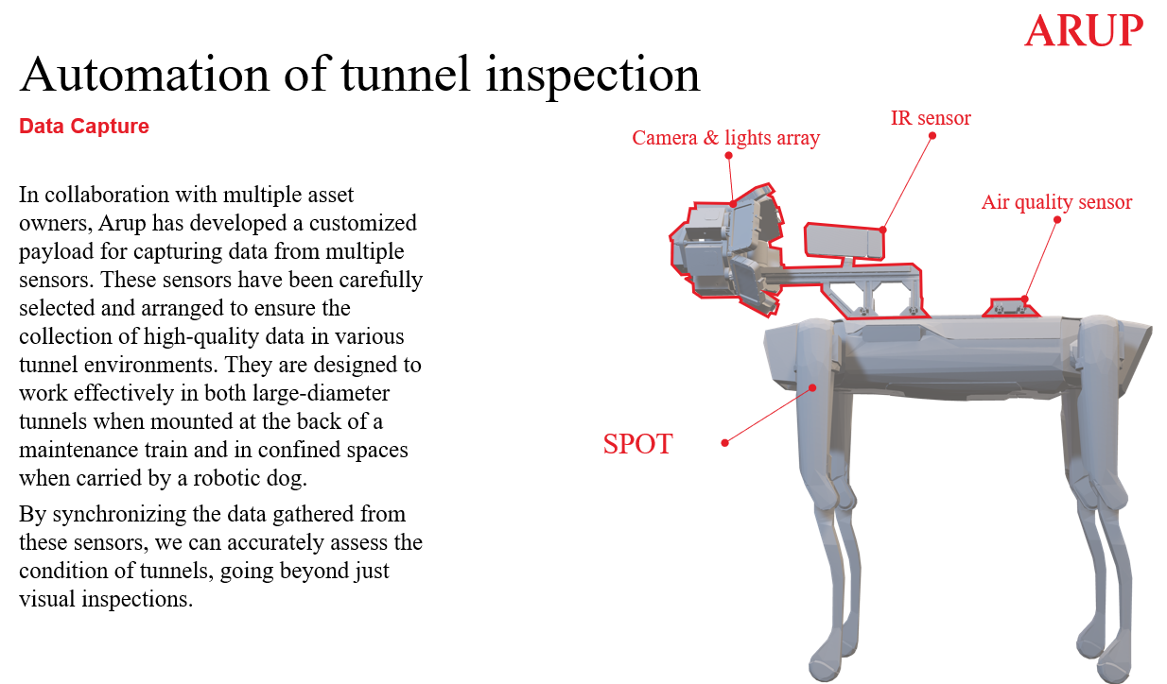
Automated Data Capture, ML, Data Visualization eg Robotic Dog

Slide 8
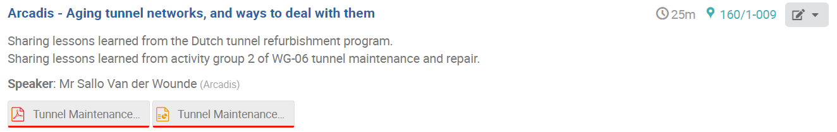
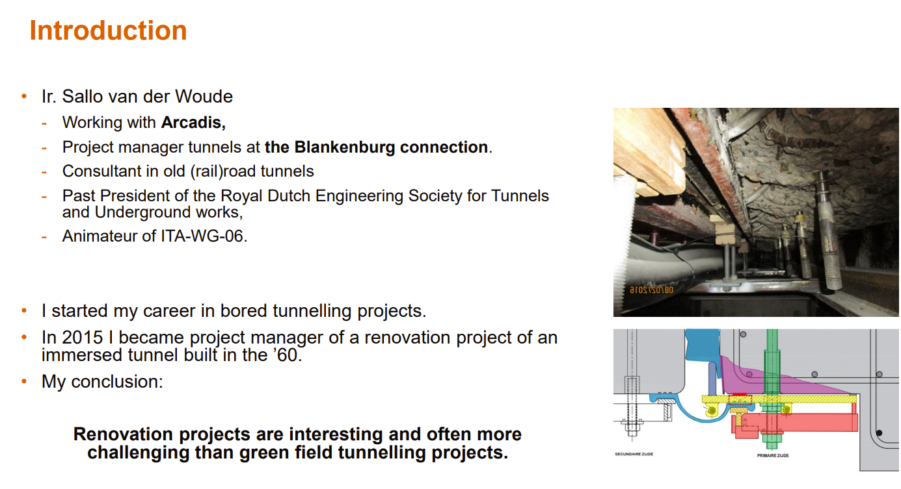
Renovation of ITT “often more challenging than green field projects”
ITA WG6 activities

Slide 9
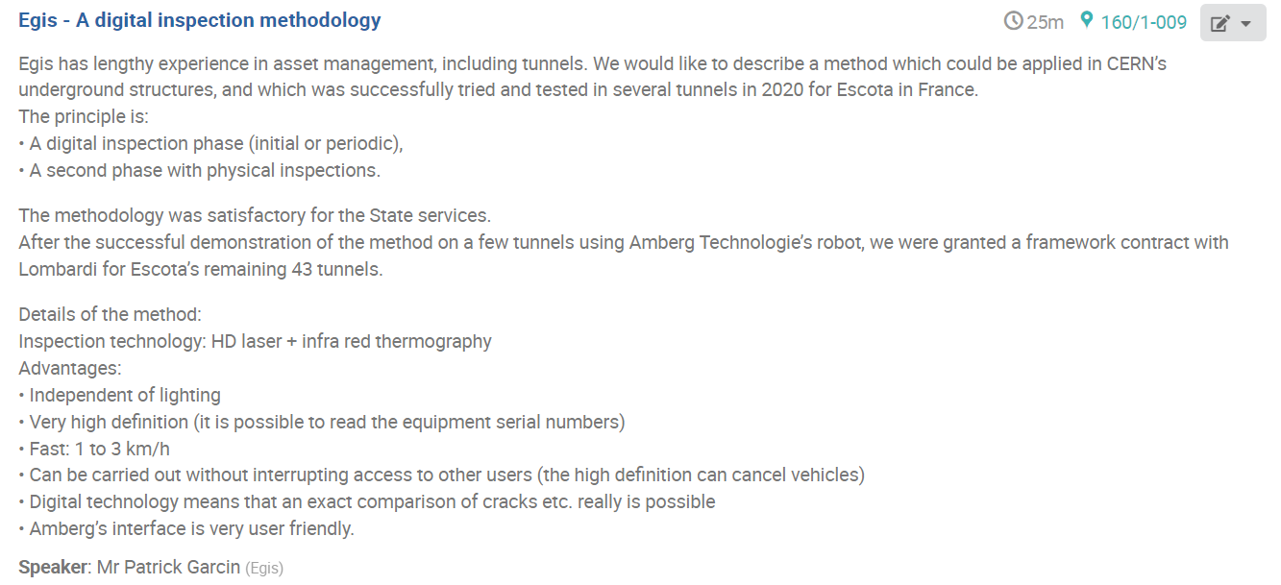
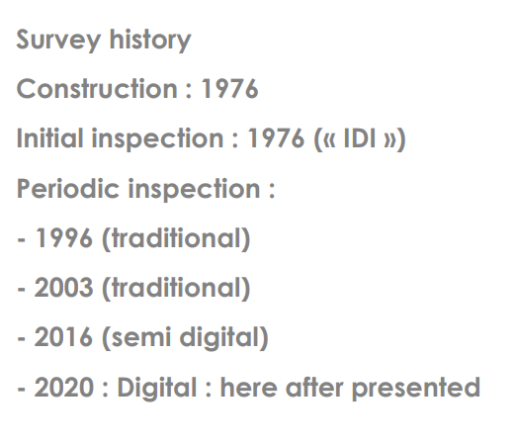
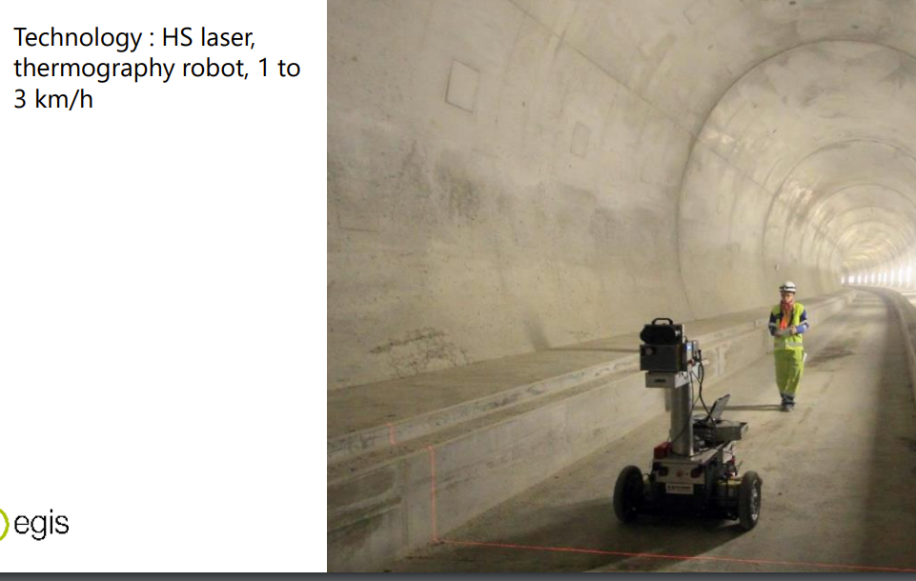
History of inspections in France and Case Studies

Slide 10
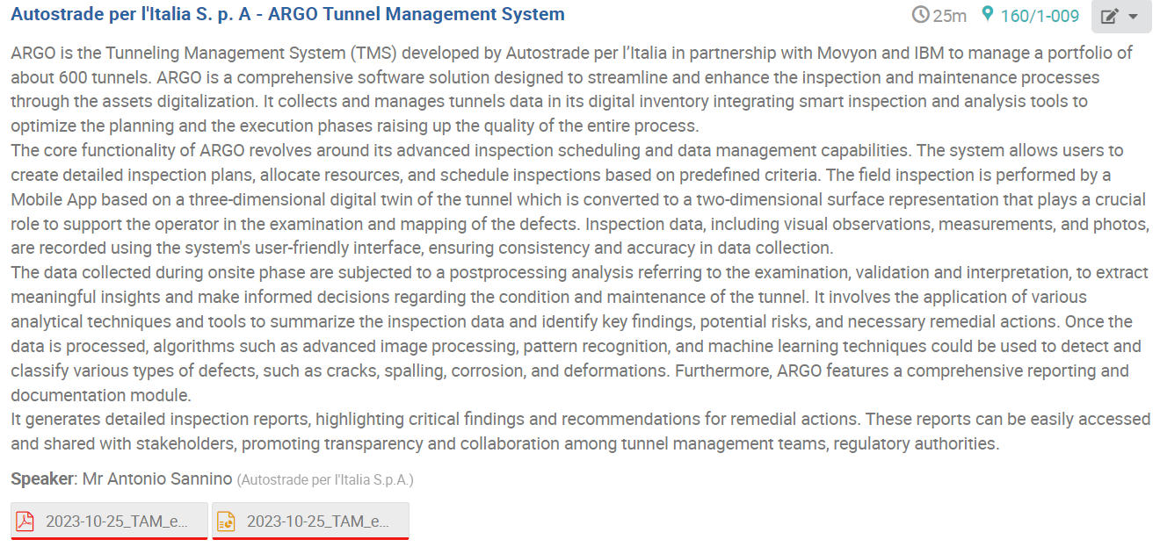
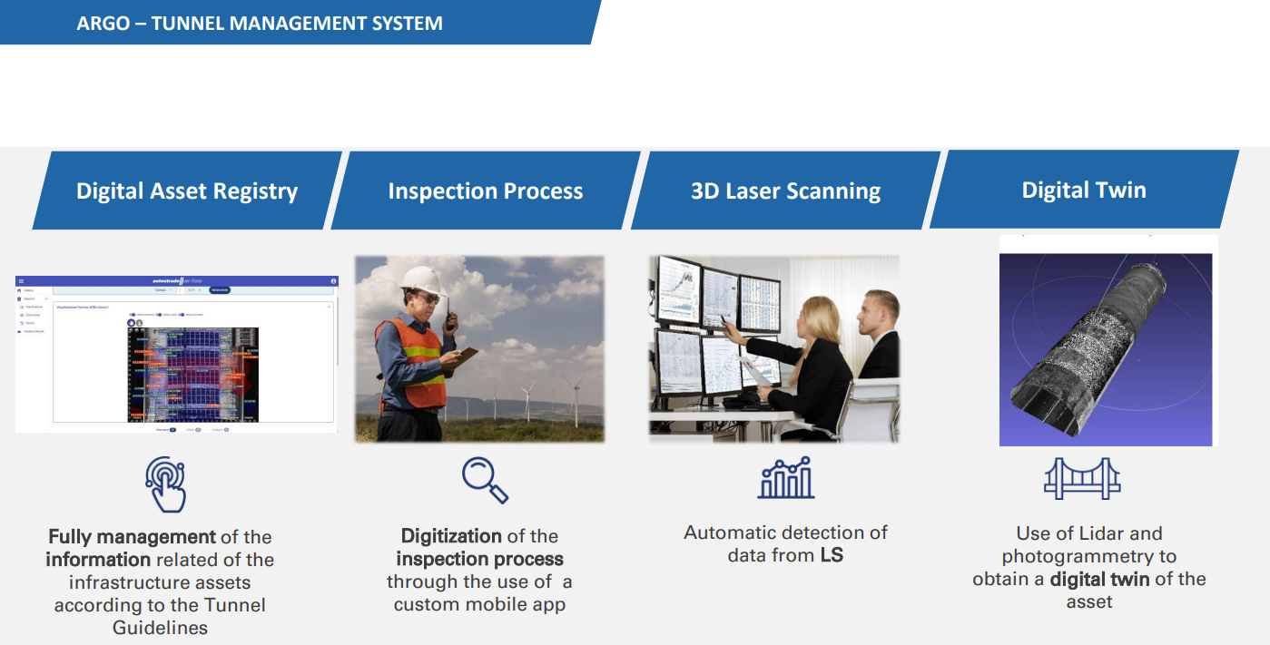
ARGO Platform : Data Collection, 3D Scanning and Digital Twin using Risk Based Classification System

Slide 11
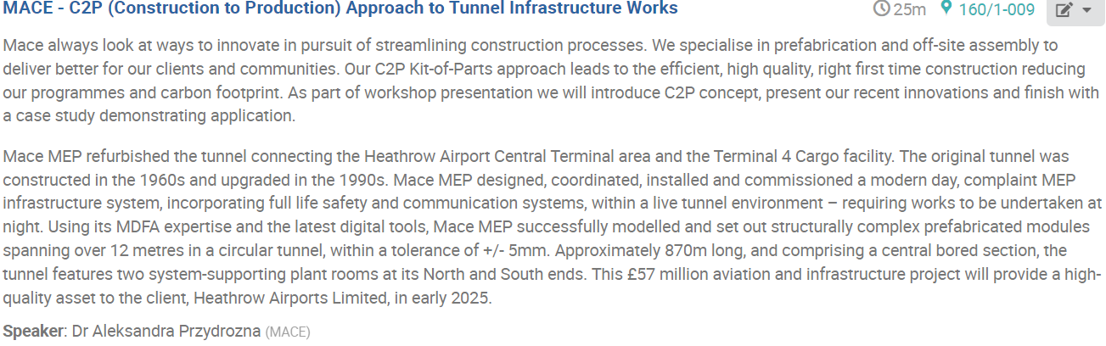
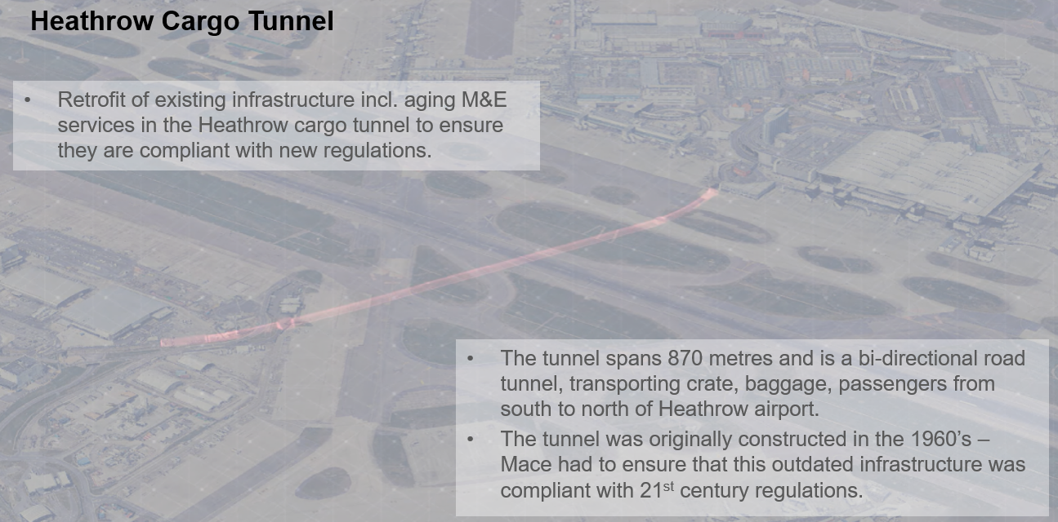
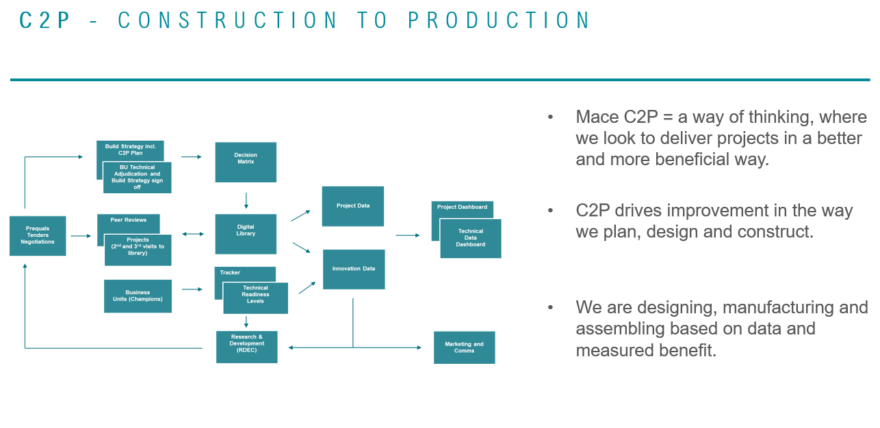
Approach to Tunnel Infrastructure Works : C2P

Slide 12
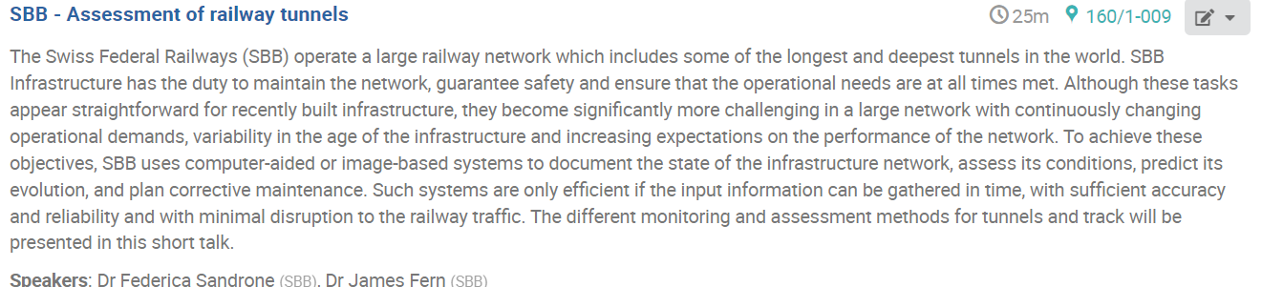
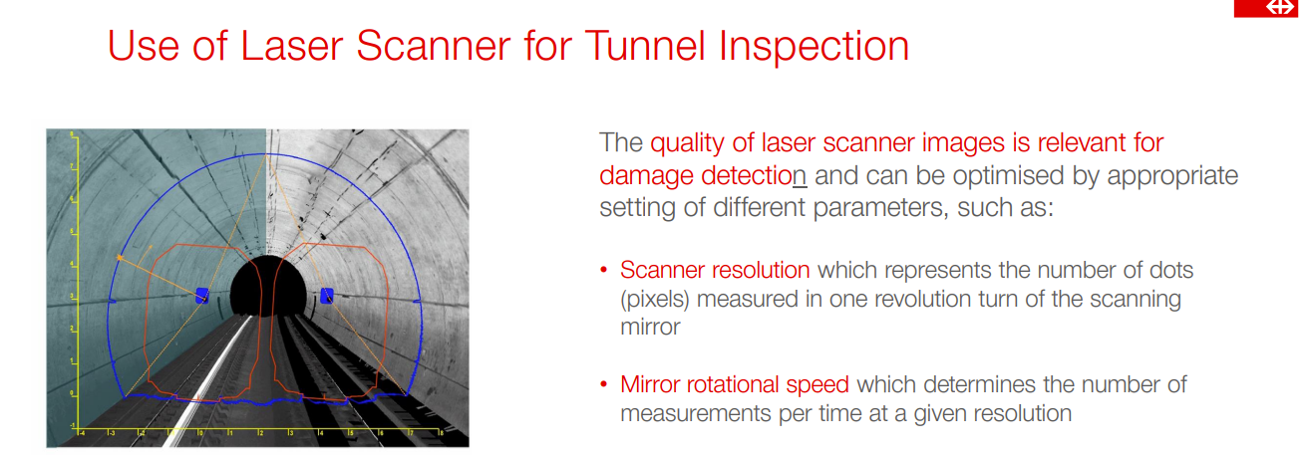
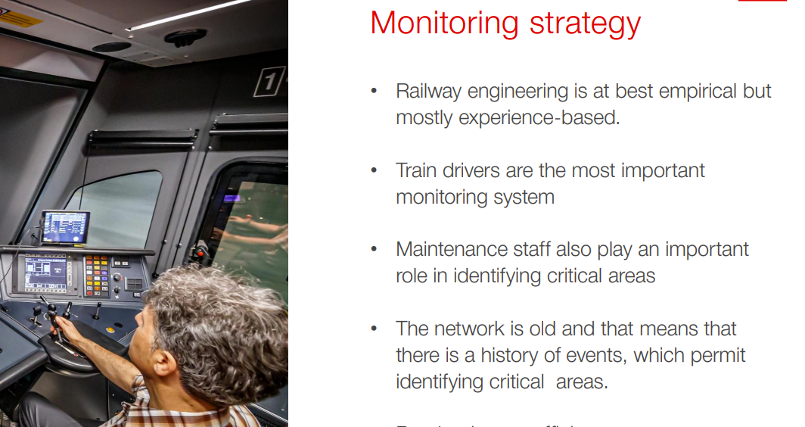
Inspection and monitoring methods for +400km tunnels : Insourced !
Notes:
Most entertaining talk !

Slide 13
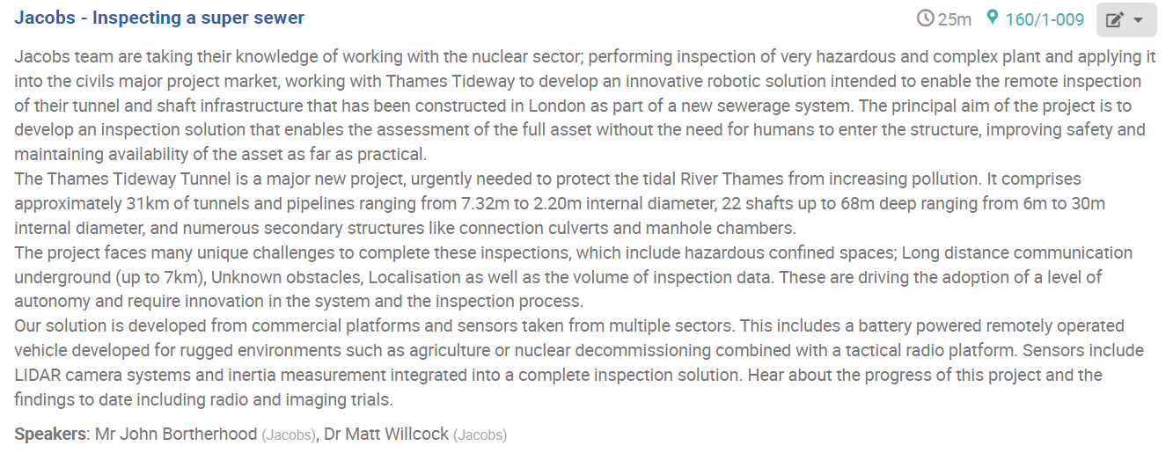
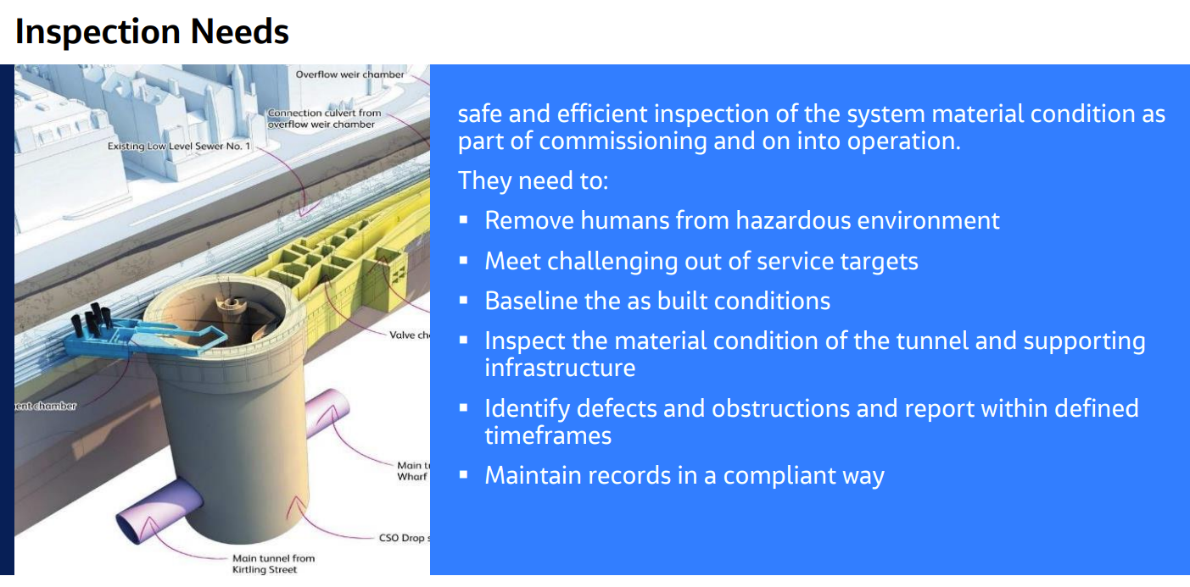
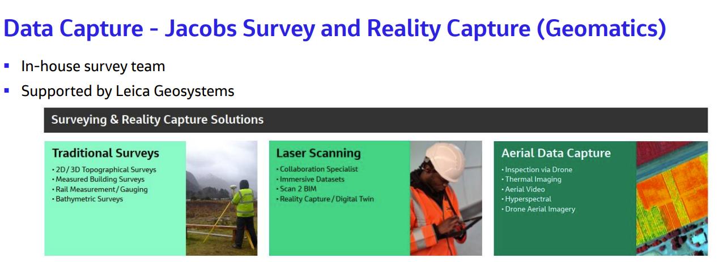
Jacobs experience in Tunnel Monitoring. Example of using robotics for Thames Tideway

Slide 14
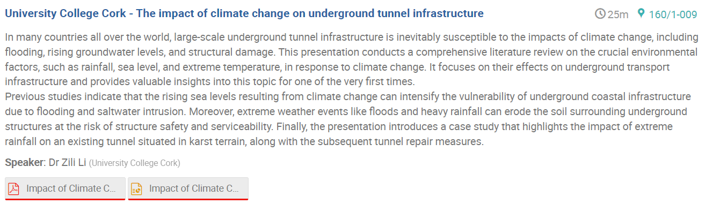
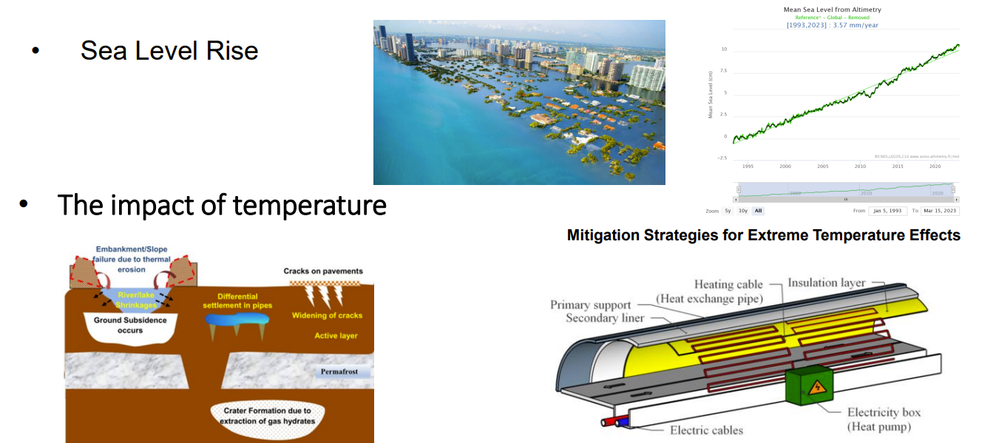
Impact of climate change on tunnels, modeling, simulations and mitigation strategies. Case studies.

Slide 15
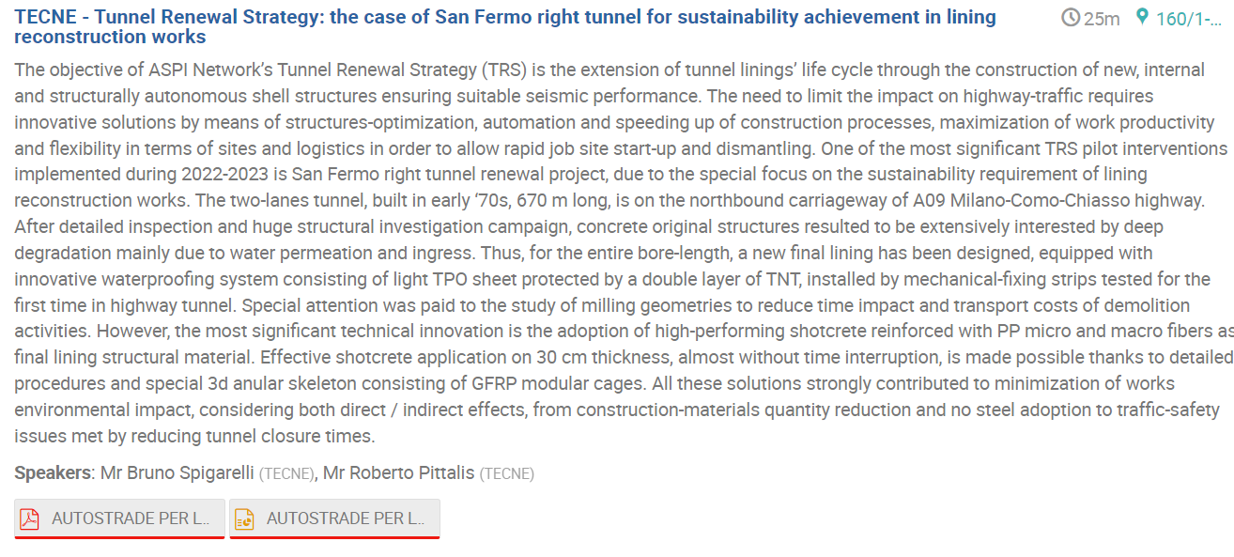
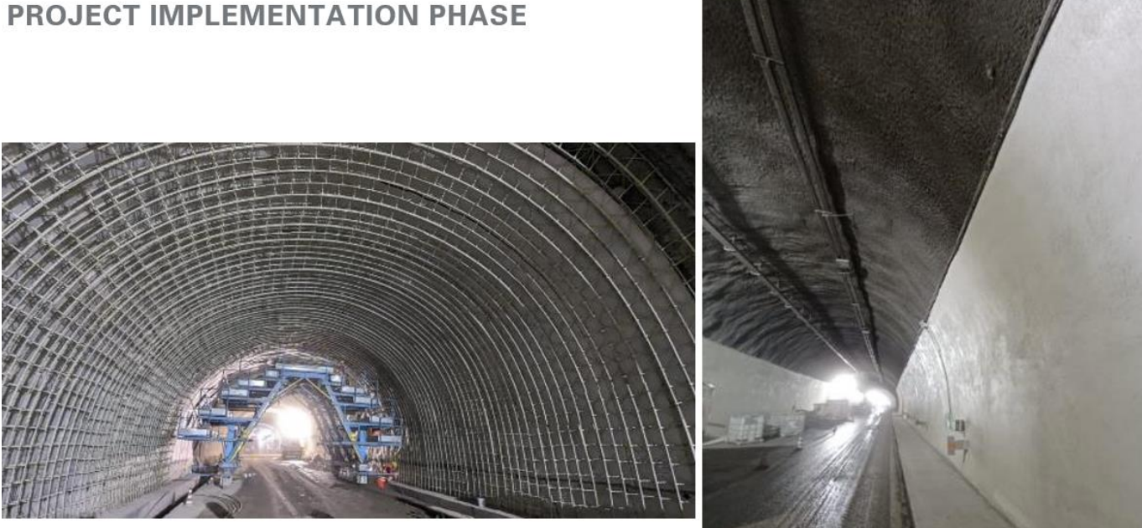
365km of tunnels.
Case Study : Replacement of secondary lining with new high performance shotcrete lining.

Slide 16
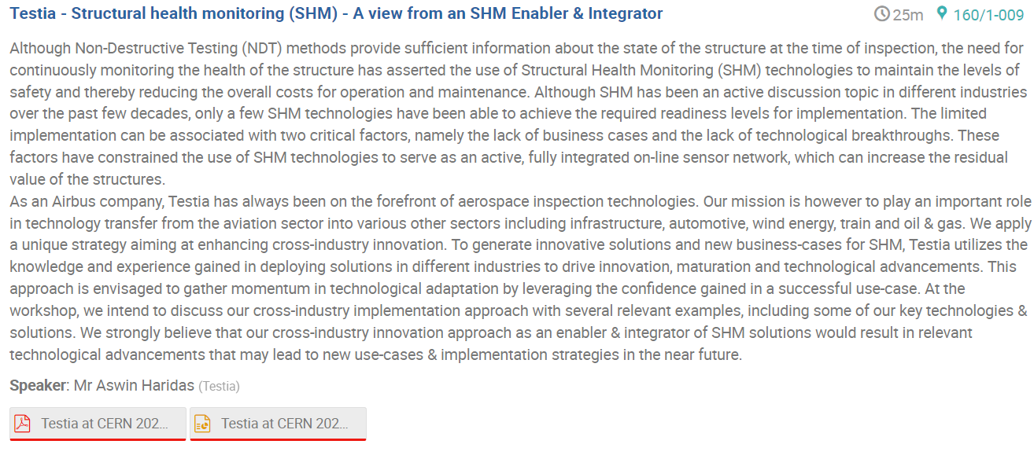
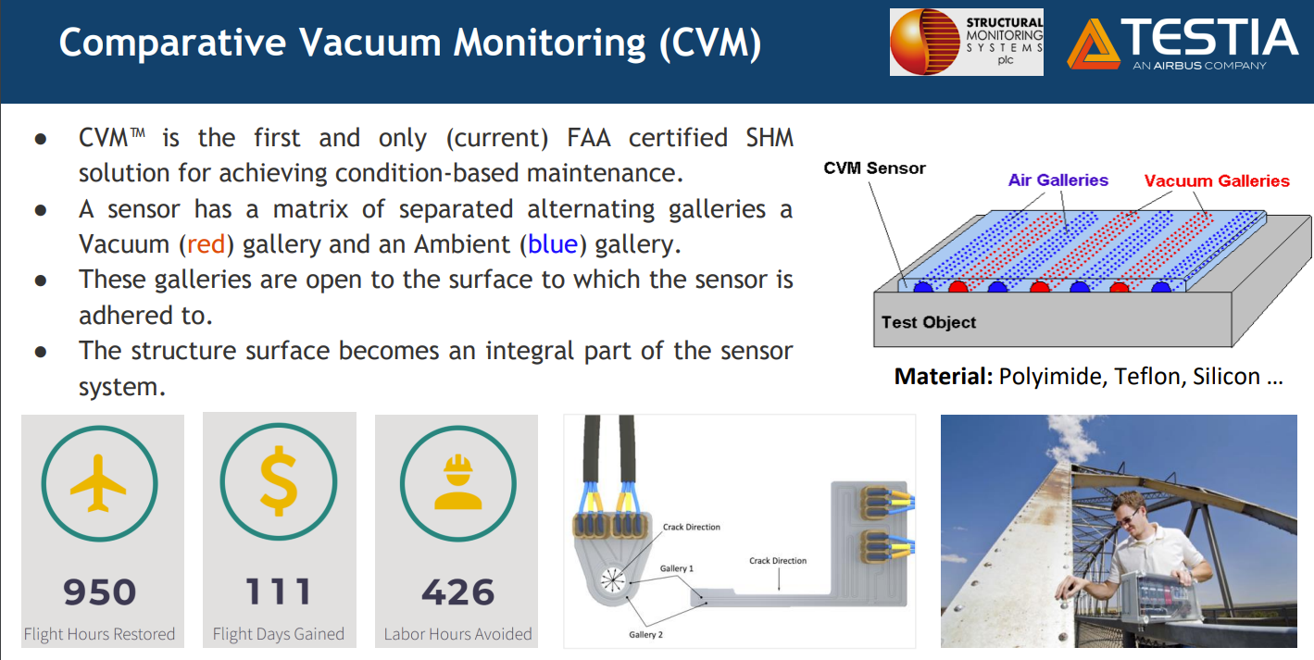
Viewpoint from the Aviation Industry eg CVM : “Now scared of driving on the highway”

Slide 17
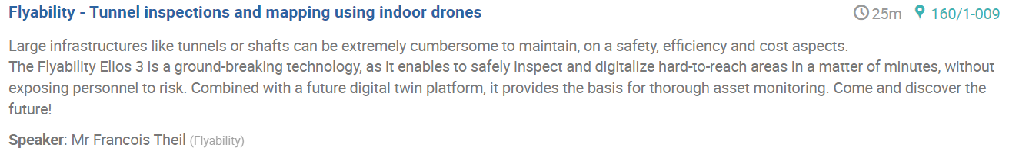
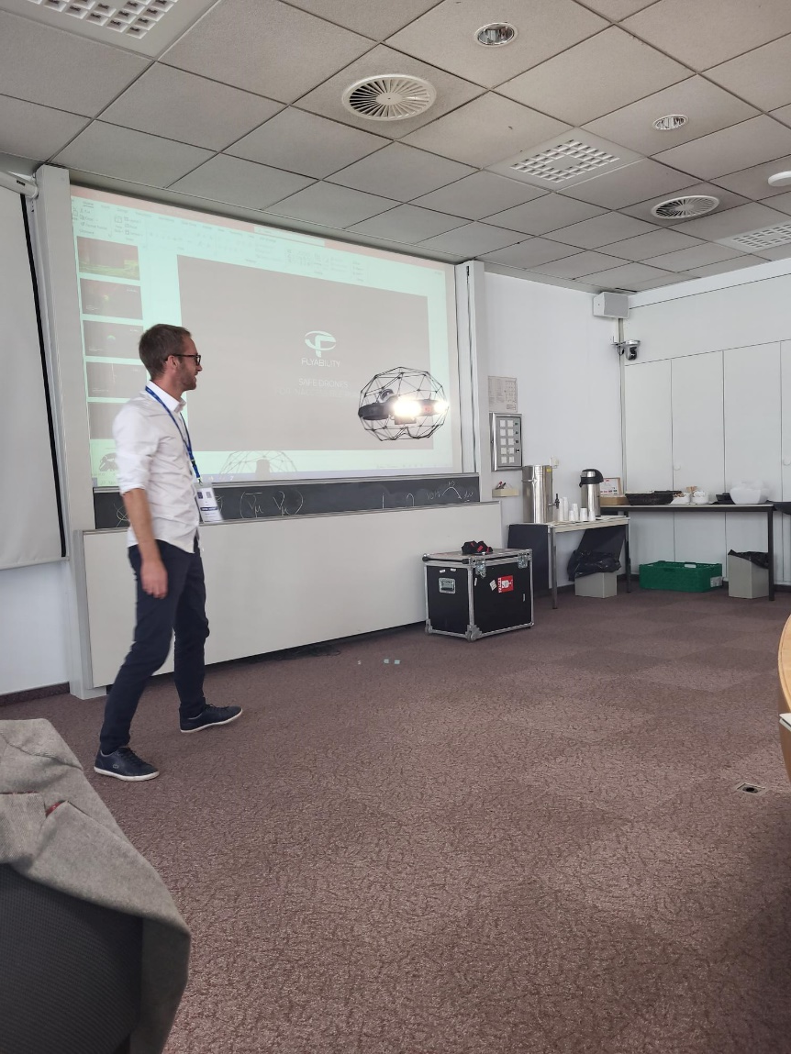
Benefits of using drones for inspections in difficult area : Sewers, Shafts etc.

Slide 18
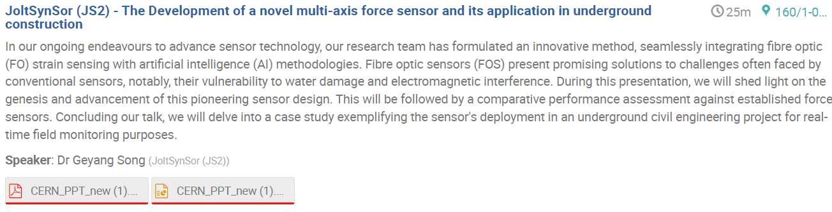
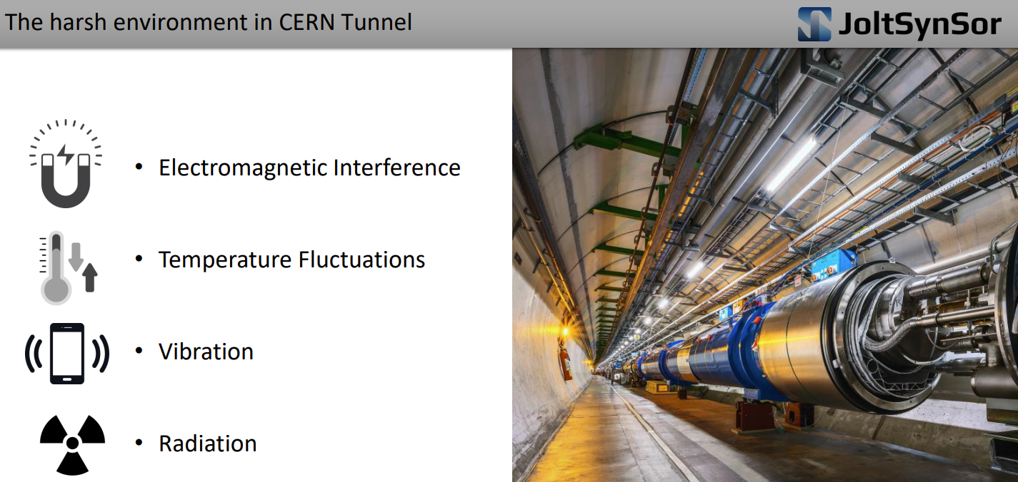
Spin-Off company from Cambridge University : Sensor Technology in harsh underground environments

Slide 19

Main Goals of this workshop
CERN to present what technology is being deployed for underground monitoring
Understand what is industry best practice for tunnel monitoring and building of maintenance programs
Knowledge sharing and Networking
Build any new monitoring ideas into our future projects at concept stage
Work with industry partners to implement any new monitoring
CERN to promote opportunities for companies to contribute to Future Projects (eg FCC, Linear Colliders..)
FEEDBACK ?

Slide 20
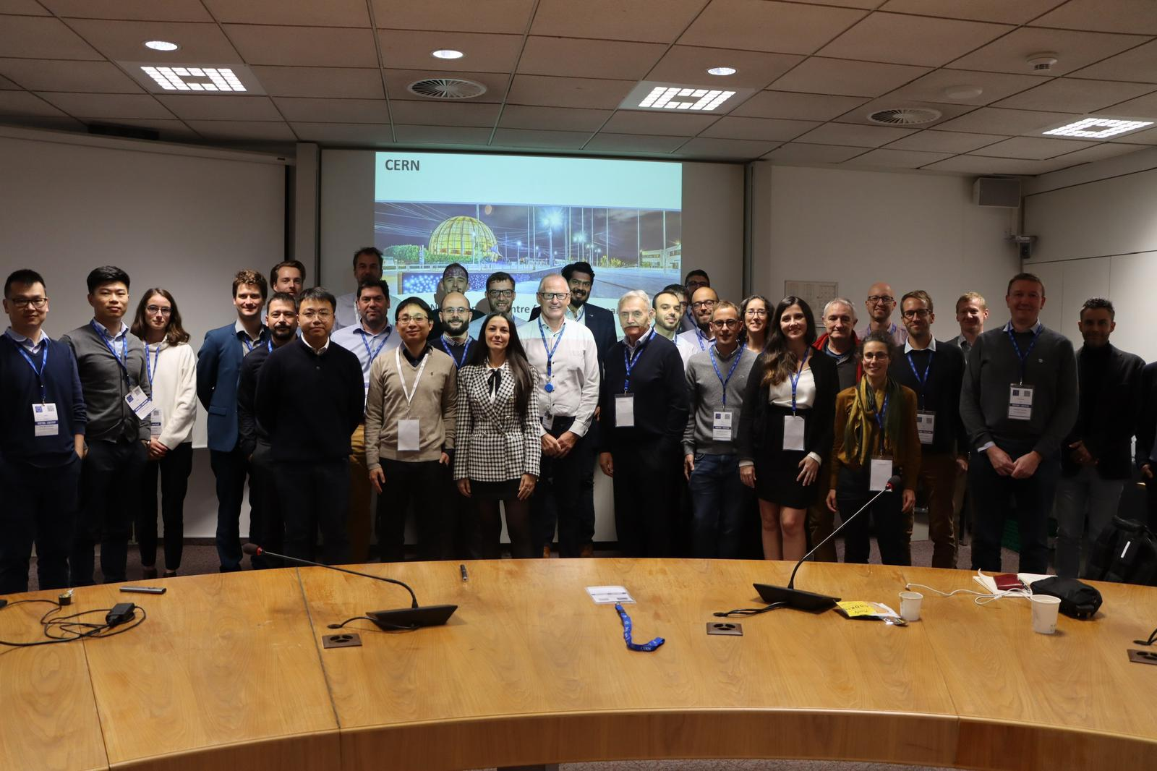
Workshop Photo
(Selection of Photos will be uploaded onto the INDICO meeting Page, Thanks to Vanessa Aidan !)

Slide 21
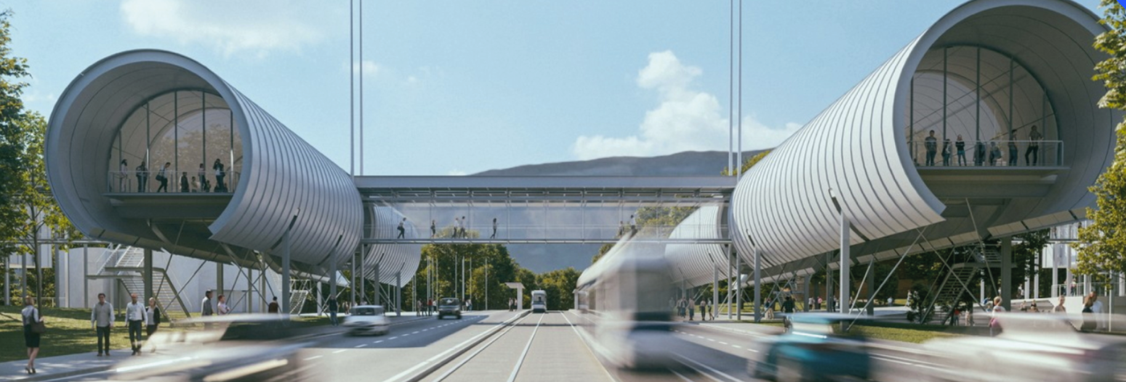
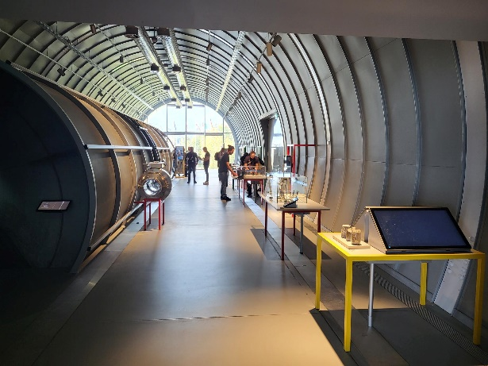
Site Visits : Science Gateway
Architect : Renzo Piano
Check out Tunnel Exhibit !

Slide 22
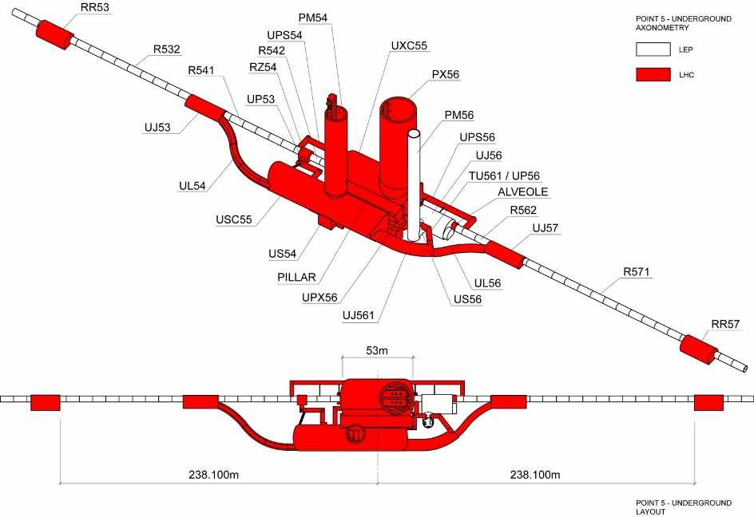
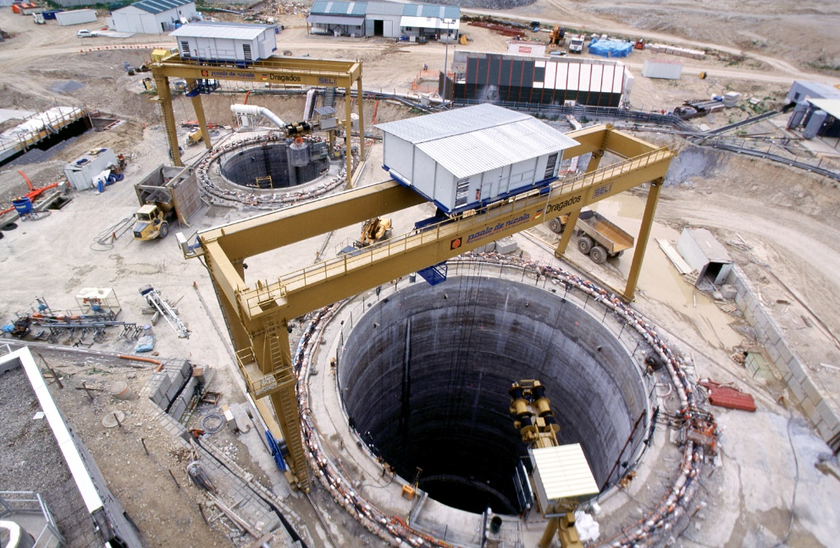
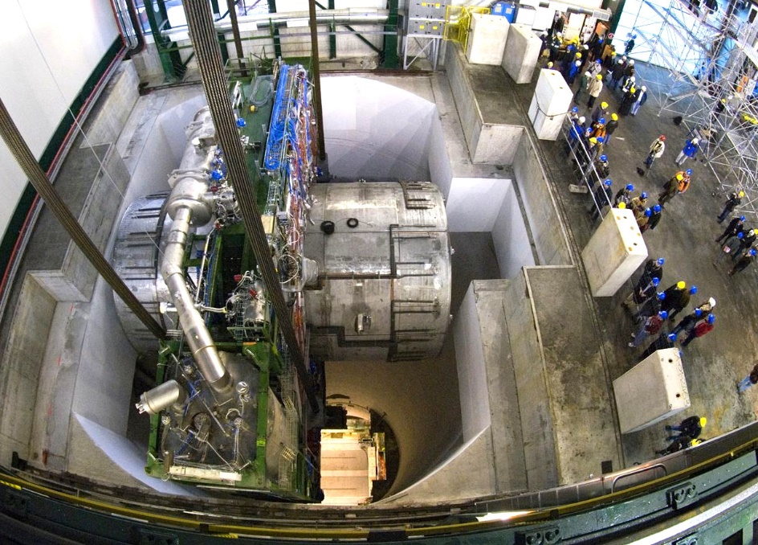
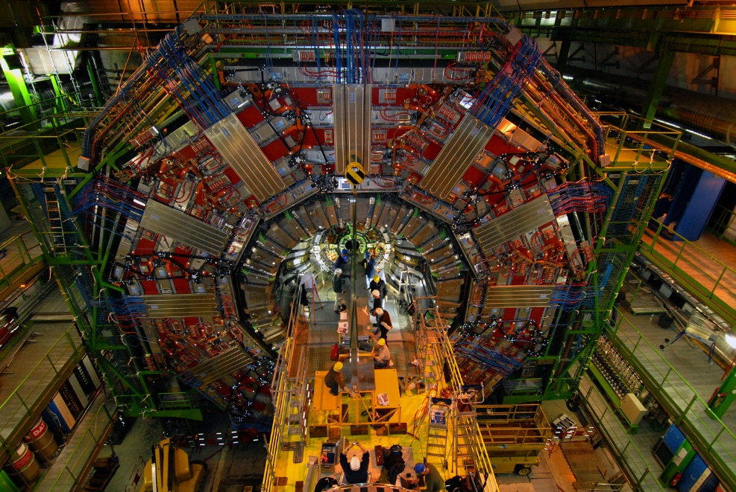
CMS Underground tour

Slide 23
Some logistics :
Room will be locked now
Go directly from lunch to Site Visits
Meet at Coffee area after lunch at …..
Back to this room around 5-5:30pm

