Slide 1


Introduction
Collaboration Meeting
Patric Muggli AWAKE collaboration
Max Planck Institute for Physics
Munich
muggli@mpp.mpg.de
https://www.mpp.mpg.de/~muggli

Slide 2
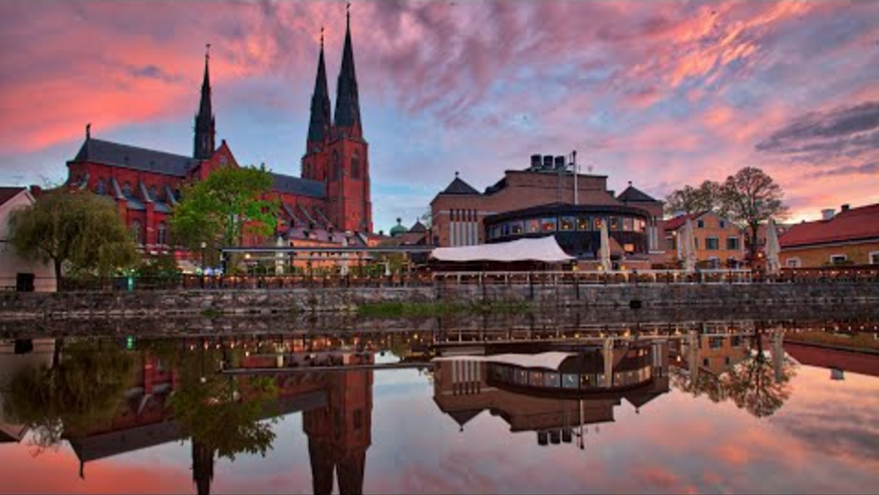
WELCOME TO UPPSALA
Thank you to Kevin et al.
Welcome to the collaboration meeting

Slide 3

NEWS
New Spokesperson: Patric Muggli
New people @ CERN:
  Marlene Turner (CERN staff, 1st January)
  Nikita van Gils (PhD, 1st April)
  Arthur Clairembaud (Master student, 1st April)
  Bethany Spear (PhD, October 22, 1 year)
  Jan Mezger (Master, April 1)
  Fern Pannel (PhD, April 1, 1 year)
  …
Important to be at CERN to effectively contribute to the experiment!
3/127

Slide 4

NOT NEWS
Run 1: 2018-2021
  Self-modulation
  Acceleration of test e-
Run 2a => 2022
  e-bunch seeding of SM
Run 2b => 2024
  Plasma density step
  Discharge plasma source
Run 2c 2028 =>
  Injection of witness e-bunch into second, accelerator plasma
Run 2d
  Operation with scalable accelerator plasma
    Discharge, helicon source
March 2023
  Run 2c preparation retreat @ CERN
    What?
    Who?
    Outcome: Q4-2023

Slide 5

NOT NEWS
Run 1: 2018-2021
  Self-modulation
  Acceleration of test e-
Run 2a => 2022
  e-bunch seeding of SM
Run 2b => 2024
  Plasma density step
  Discharge plasma source
Run 2c 2028 =>
  Injection of witness e-bunch into second, accelerator plasma
Run 2d
  Operation with scalable accelerator plasma
    Discharge, helicon source
March 2023
Run 2c preparation retreat @ CERN
  What?
  Who?
  Outcome: Q4-2023

Slide 6

NOT NEWS
Run 1: 2018-2021
  Self-modulation
  Acceleration of test e-
Run 2a => 2022
  e-bunch seeding of SM
Run 2b => 2024
  Plasma density step
  Discharge plasma source
Run 2c 2028 =>
  Injection of witness e-bunch into second, accelerator plasma
Run 2d
  Operation with scalable accelerator plasma
    Discharge, helicon source
Application to particle physics 2030’s
March 2023: Run 2c preparation retreat @ CERN
  What? Who? How much?
  Outcome: Q4-2023

Slide 7


COLLABORATiON MEETiNG
Opportunity to:
  Meet new people …
  Make personal contacts …
  Be informed about plans …
  Generate new ideas …

Slide 8
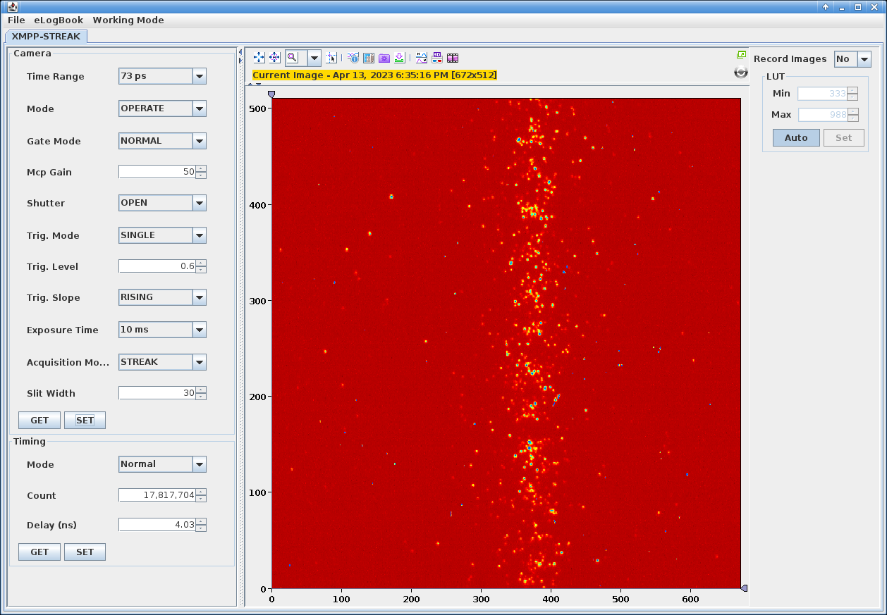
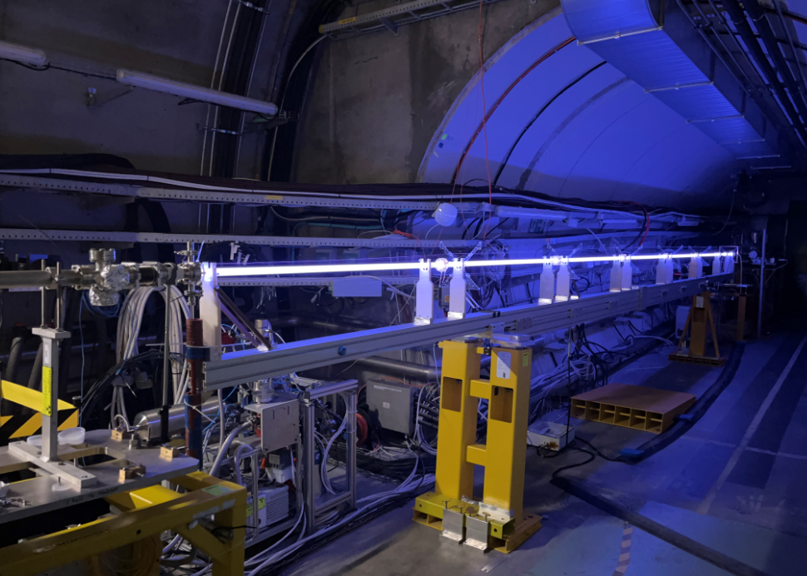
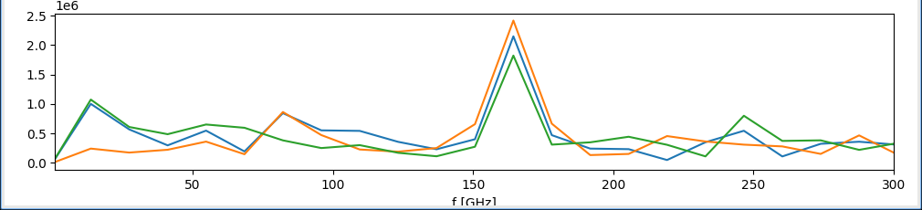
DiSCHARGE PLASMA SOURCE
Research topics, 10m discharge plasma source (DPS), May 2023:
  Plasma source: Ar, Xe, He
  Self-modulation instability (SMI)
  Current filamentation instability (CFI)
  Ion motion on SMI, Xe-Ar-He
  Hose instability at low plasma density, flat beams?
  Plasma light: diagnostic for wakefields
Installed and running!
3h test 13/04/2023
t
SMI!
f_{mod}~164GHz~f_{pe}(n_{e0}~3.4x10¹⁴cm⁻³)
Time-resolved image shows SMI with DPS

Slide 9
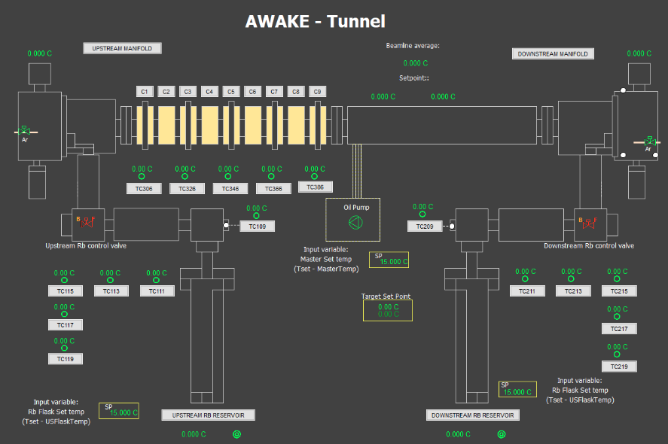
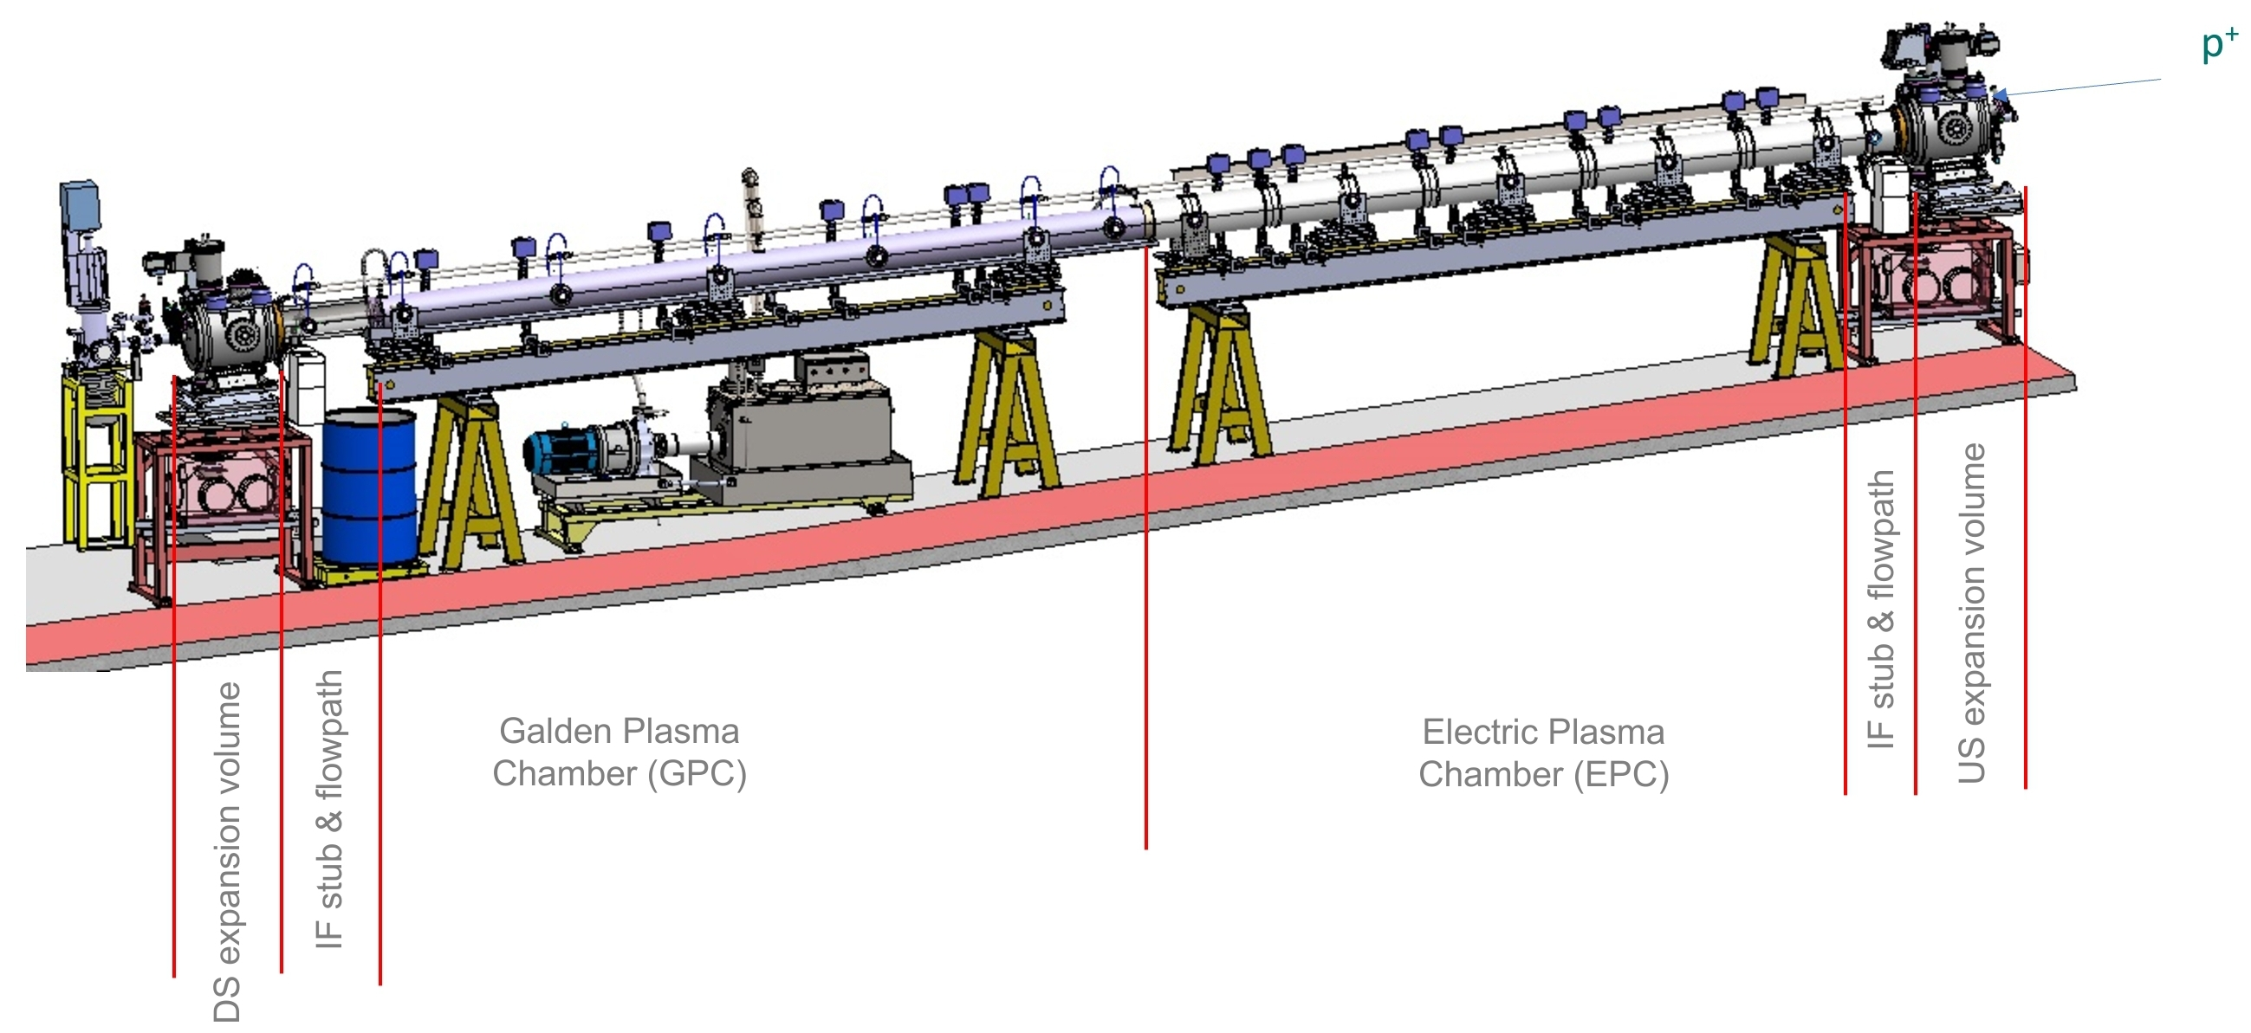
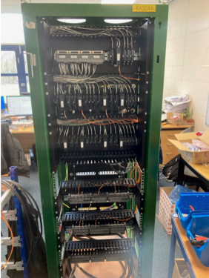

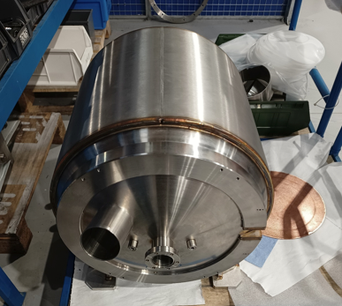
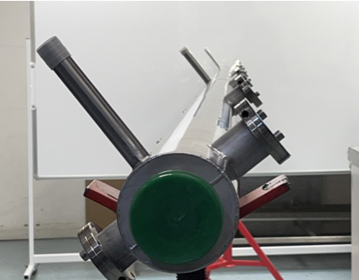
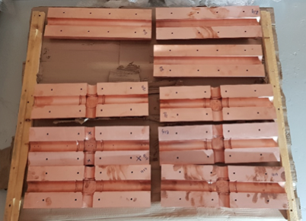
VAPOR SOURCE: DENSiTY STEP
Research topics, vapor source, August 2023-2024:
  Effect of plasma density step on:
    Proton bunch, time resolved and integrated images
    Plasma light, wakefield diagnostic
    e- acceleration
    Seeding of self-modulation, RIF and e-bunch
    Short plasma (4m?) for self-modulation
On schedule!
Heat exchanger
Copper integrators
Control
Expansion volume

Slide 10
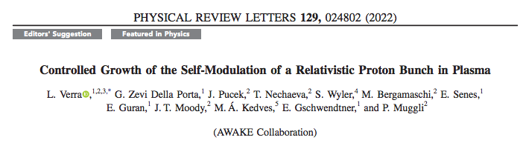
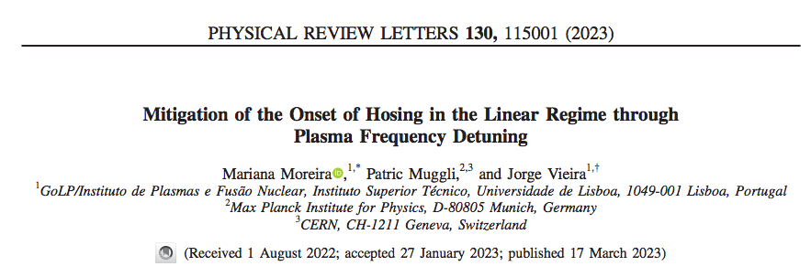
PARTICIPATE
In preparation (Collaboration manuscripts, Run 2a):
  Livio: SMI or not (today)
  Tatiana: hosing
  Jan: e- in density ramp
  Jan: SM RIF seeding
  ...
Experiments
Simulations

Slide 11
WELCOME TO UPPSALA
Thank you to Kevin et al.
Welcome to the collaboration meeting

Slide 12
WELCOME TO UPPSALA
Thank you to Kevin et al.
Welcome to the collaboration meeting

Slide 13
NEW PEOPLE
Marlene Turner (staff, 1st January)
Nikita van Gils (PhD, 1st April)
Arthur Clairembaud (Master student, 1st April)
Bethany Spear (PhD, Oxford-CERN, October 22, 1 year)
Jan Mezger (Master, MPP, April 1)
Fern Pannel (PhD, UCL, April 1, 1 year)
Important to be at CERN to effectively contribute to the experiment!

Slide 14
NEW PEOPLE
Marlene Turner (staff, 1st January)
Nikita van Gils (PhD, 1st April)
Arthur Clairembaud (Master student, 1st April)
Bethany Spear (PhD, Oxford-CERN, October 22, 1 year)
Jan Mezger (Master, MPP, April 1)
Fern Pannel (PhD, UCL, April 1, 1 year)
Important to be at CERN to effectively contribute to the experiment!

Slide 15
NEW PEOPLE
Marlene Turner (staff, 1st January)
Nikita van Gils (PhD, 1st April)
Arthur Clairembaud (Master student, 1st April)
Bethany Spear (PhD, Oxford-CERN, October 22, 1 year)
Jan Mezger (Master, MPP, April 1)
Fern Pannel (PhD, UCL, April 1, 1 year)
Important to be at CERN to effectively contribute to the experiment!

Slide 16
NEW PEOPLE
Marlene Turner (staff, 1st January)
Nikita van Gils (PhD, 1st April)
Arthur Clairembaud (Master student, 1st April)
Bethany Spear (PhD, Oxford-CERN, October 22, 1 year)
Jan Mezger (Master, MPP, April 1)
Fern Pannel (PhD, UCL, April 1, 1 year)
Important to be at CERN to effectively contribute to the experiment!

