Slide 1



Beam instrumentation development for Run 2c
Joseph Wolfenden, Catherine Swain, Debdeep Ghosal, and Carsten Welsch
26/04/2023

Slide 2
Overview
CxR imaging bunch length monitors
Emittance diagnostics
Proton halo angular imaging with DMD-masking
Optical fibre beam loss monitor
Betatron radiation-based diagnostics
J. Wolfenden (joseph.wolfenden@cockcroft.ac.uk)
AWAKE collaboration meeting 26/04/2023
1

Slide 3
CxR imaging bunch length monitors
J. Wolfenden (joseph.wolfenden@cockcroft.ac.uk)
AWAKE collaboration meeting 26/04/2023
2

Slide 4


CxR imaging bunch length monitors
Types of CxR under investigation
  CTR – Coherent Transition Radiation
  CSR – Coherent Synchrotron Radiation
Simulation work as a base
Experimental work at MAX IV Short Pulse Facility
Machine learning-based analysis
J. Wolfenden (joseph.wolfenden@cockcroft.ac.uk)
AWAKE collaboration meeting 26/04/2023
3

Slide 5
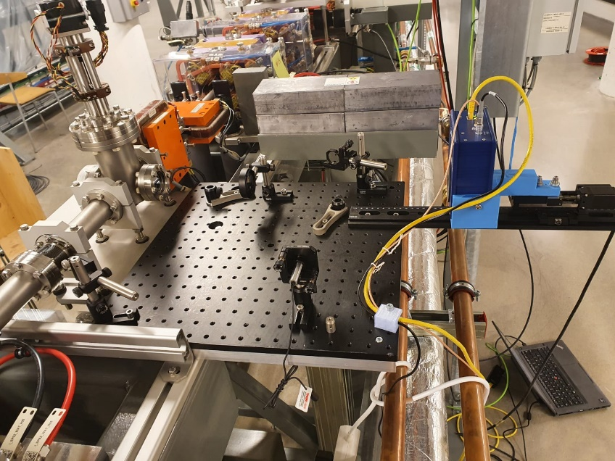
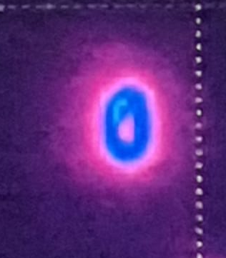
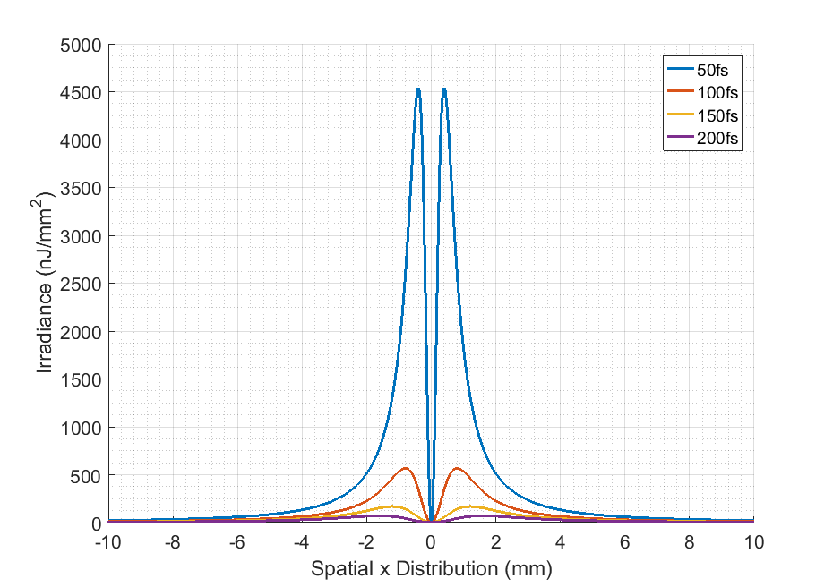
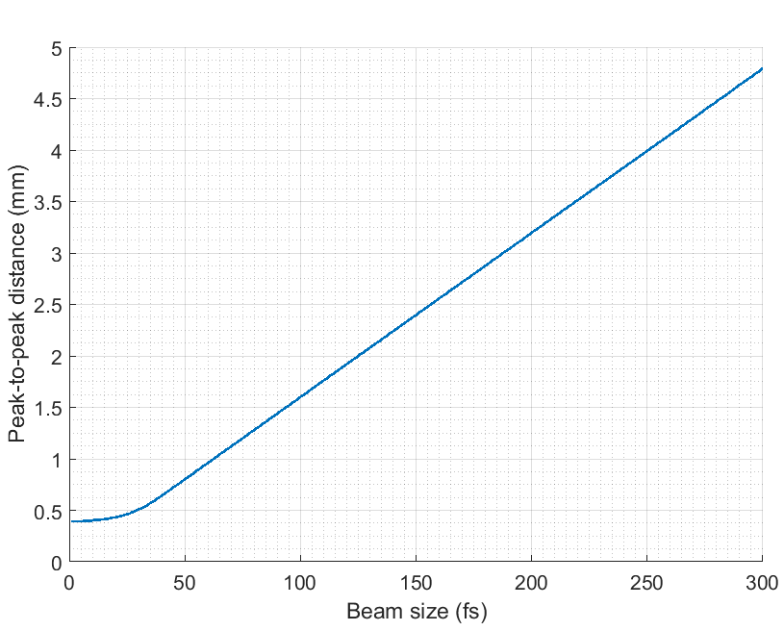
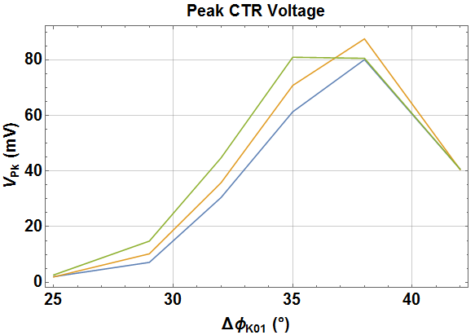
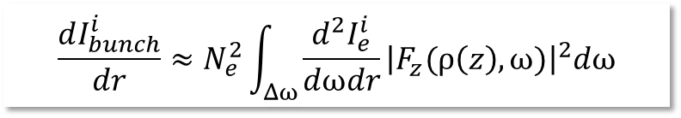
CTR imaging bunch length monitor
$$\frac{dI_{bunch}^{i}}{dr}≈N_{e}^{2}\int_{Δω}{\frac{d^{2}I_{e}^{i}}{dωdr}{\left|F_{z}(ρ\left(z\right),ω)\right|}^{2}dω}$$
HRFZ Si Lens
Pyrocam
Pyrocam
[1]
Next steps:
New measurements with improved image resolution
Upgrade to OAP-based system
Test of ML-based analysis on experimental data
J. Wolfenden (joseph.wolfenden@cockcroft.ac.uk)
AWAKE collaboration meeting 26/04/2023
4

Slide 6
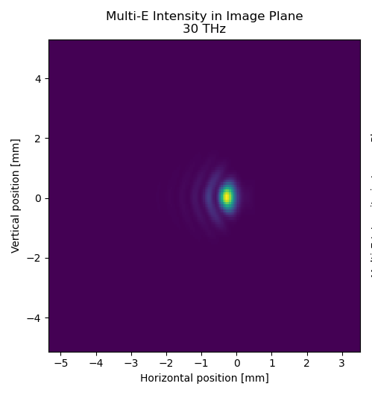
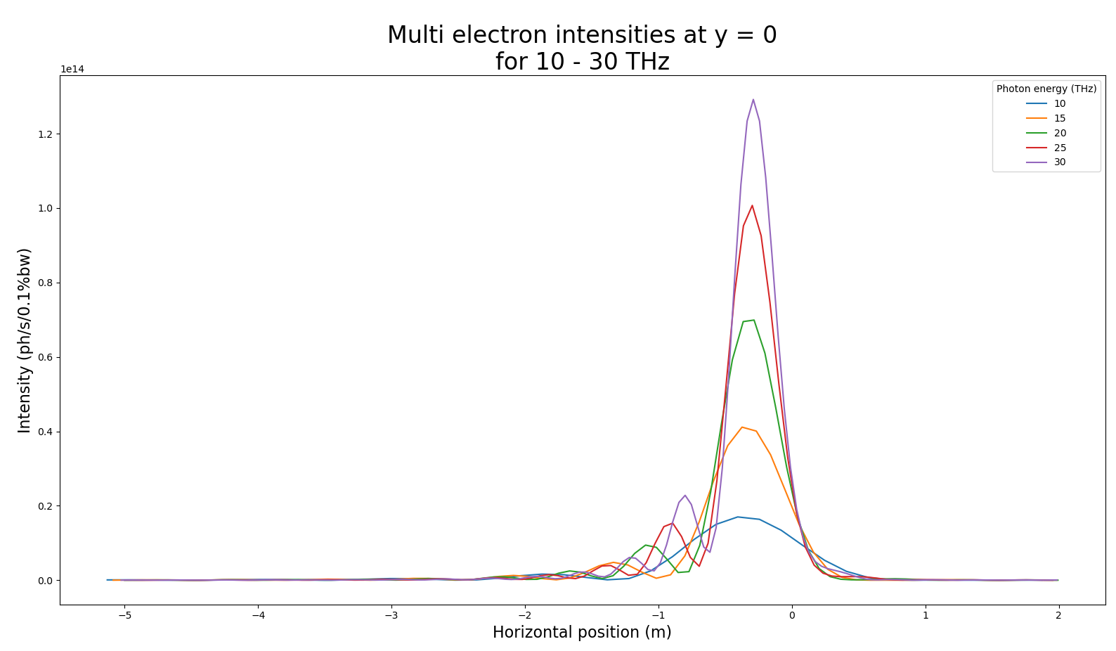
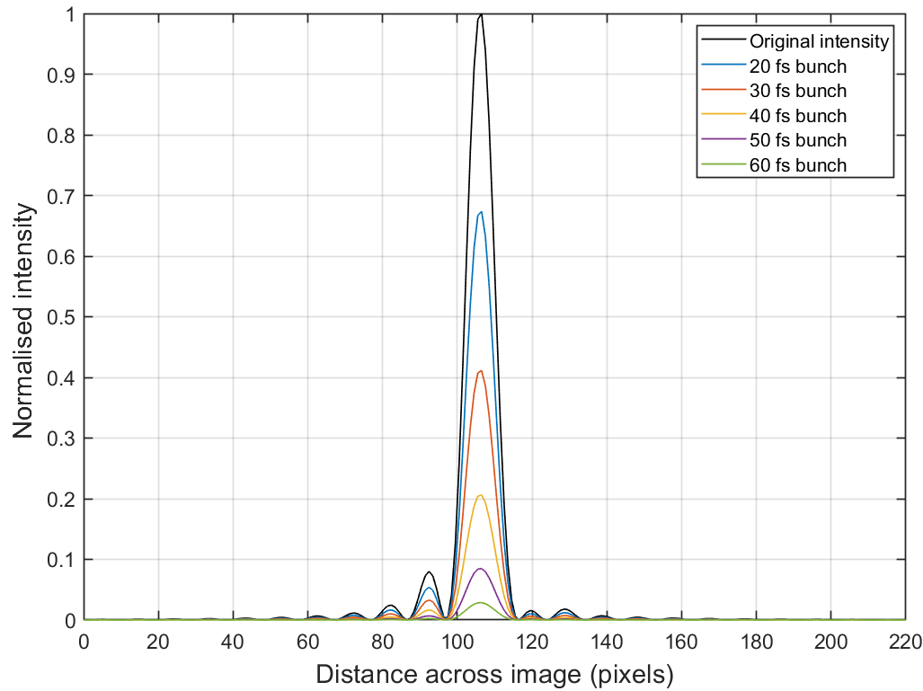
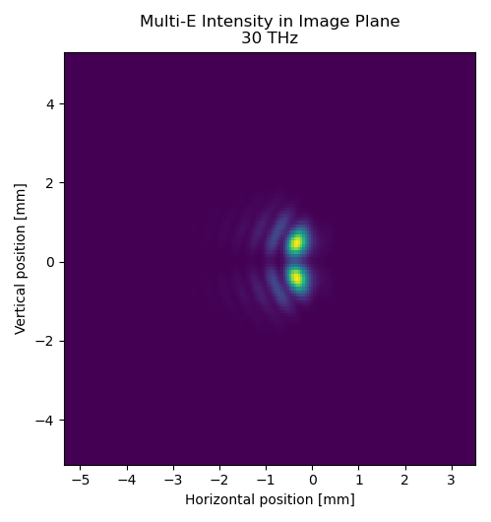
CSR imaging bunch length monitor
σ-mode
Total Pol.
Intensity at 5 THz
π-mode
Next steps:
Repeat simulations with full diagnostic set up (windows, mirrors, etc.)
Experimental proof of concept measurements
Implement similar ML code for analysis
J. Wolfenden (joseph.wolfenden@cockcroft.ac.uk)
AWAKE collaboration meeting 26/04/2023
5

Slide 7
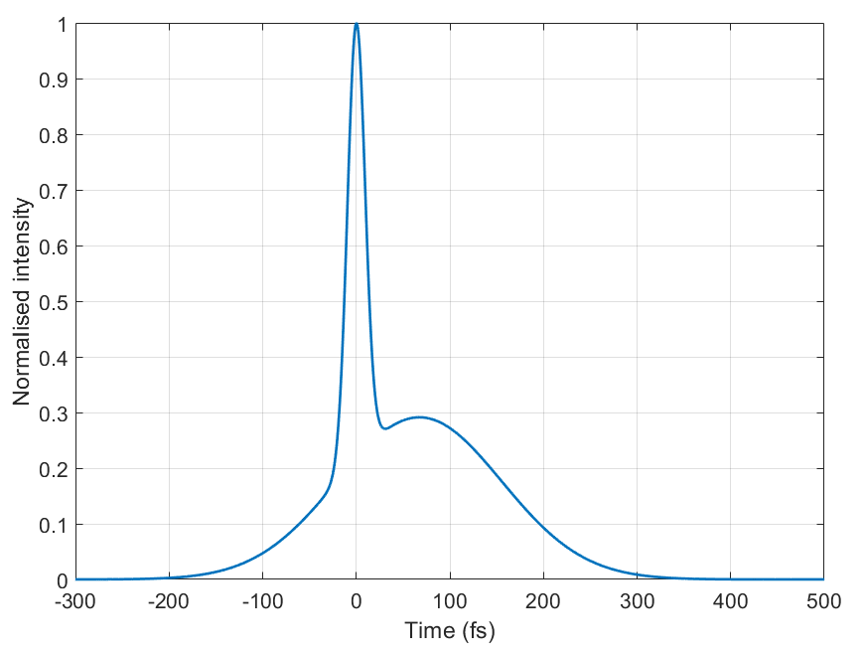
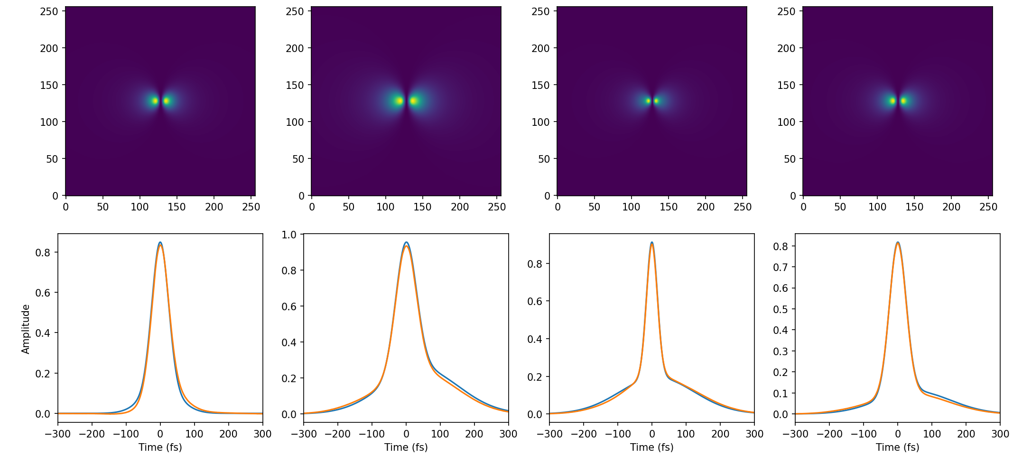
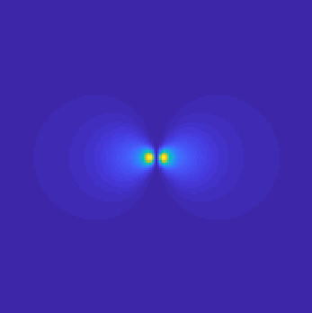
CxR imaging bunch length monitors
Ground Truth
Model Prediction
x100,000
Next steps:
Training with more realistic beam-based profiles
Application to CSR simulations
Application to CxR data
J. Wolfenden (joseph.wolfenden@cockcroft.ac.uk)
AWAKE collaboration meeting 26/04/2023
6

Slide 8
CxR imaging bunch length monitors
Possible integration scenarios
Pre-plasma
  CTR off existing/planned screen (e.g. Al screen could be used for OTR and CTR)
    Would need to be post-compression to maximise signal intensity
  CSR from final dipole in e⁻ beam line
    Could be a viewport from within the dipole or a screen to extract downstream
Post-plasma
  CTR on common beamline would be dependent on e⁻ bunch length and charge
    Beam separation (for HEP applications?) would enable low charge version
  CSR from spectrometer dipole?
    Any dipoles in potential separation optics could be used
J. Wolfenden (joseph.wolfenden@cockcroft.ac.uk)
AWAKE collaboration meeting 26/04/2023
7

Slide 9
Emittance diagnostics
J. Wolfenden (joseph.wolfenden@cockcroft.ac.uk)
AWAKE collaboration meeting 26/04/2023
8

Slide 10
Emittance diagnostics
Optical versions of slit/pinhole scans and pepper-pot
Focusing on OTR – Optical Transition Radiation
  Could also be done with other types of radiation, e.g. OSR
Two methods under investigation:
  DMD – Digital Micro-mirror Device
  MLA – Micro Lens Array
J. Wolfenden (joseph.wolfenden@cockcroft.ac.uk)
AWAKE collaboration meeting 26/04/2023
9

Slide 11
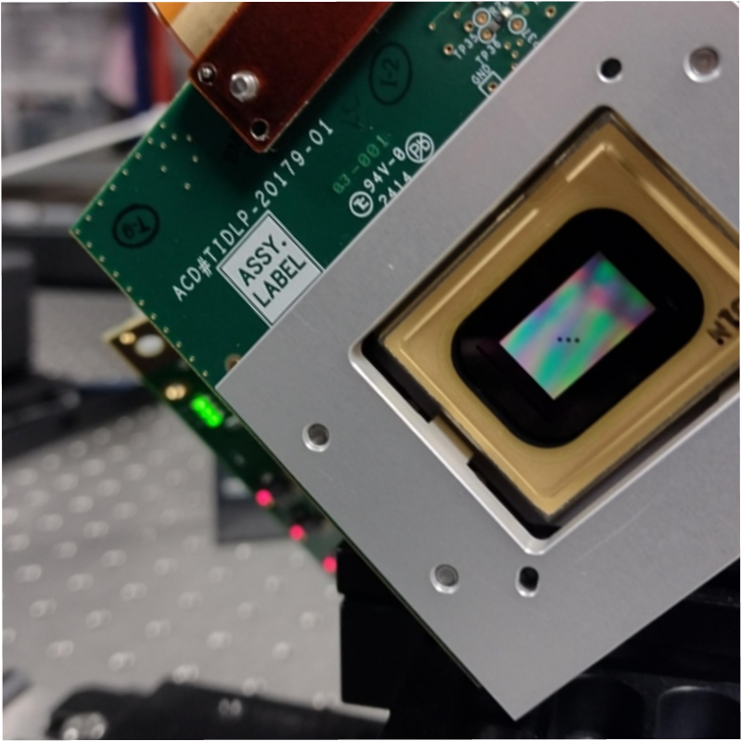
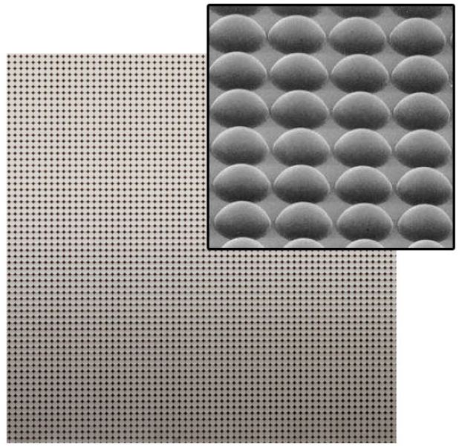
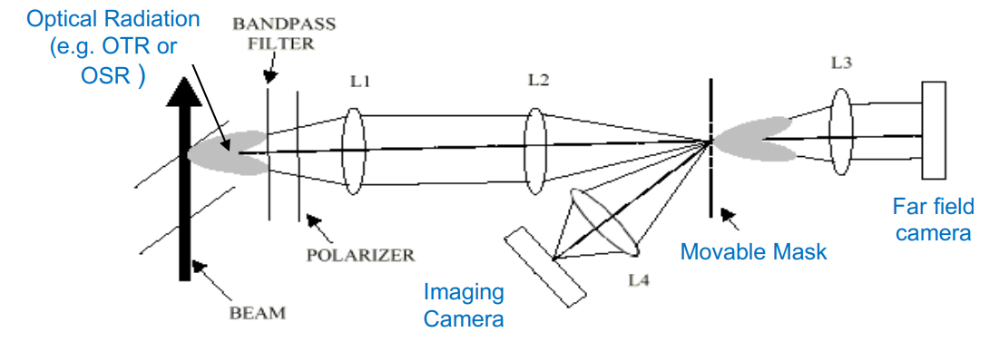
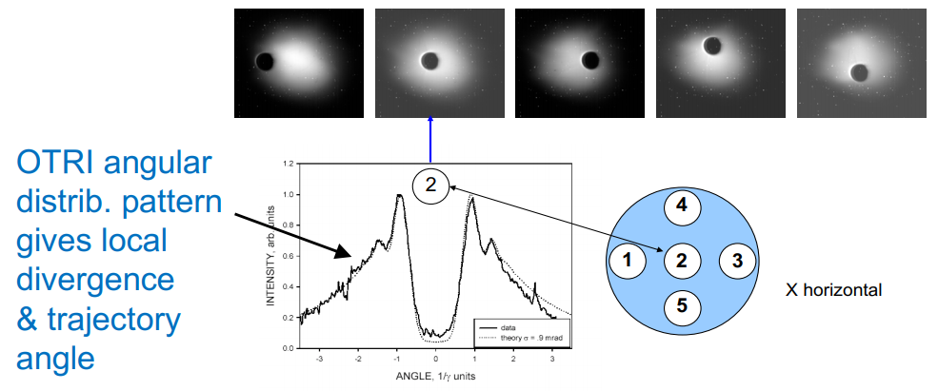
Emittance diagnostics
[4]
Screen
Mask
j^{th} beamlet intensity
n_{j}
Beam
σ_{j}
Beamlets
x_{j}
0
Analysis based on existing pinhole/slit beam-based methods [5]
Optical version provides two main benefits:
  Measured emittance is much closer to actual as subset of measured particles is much higher
  Space-charge contribution from “beamlets” is completely avoided
Non-invasive if radiation can be produced non-invasively (e.g. OSR)
[2, 3]
J. Wolfenden (joseph.wolfenden@cockcroft.ac.uk)
AWAKE collaboration meeting 26/04/2023
10

Slide 12

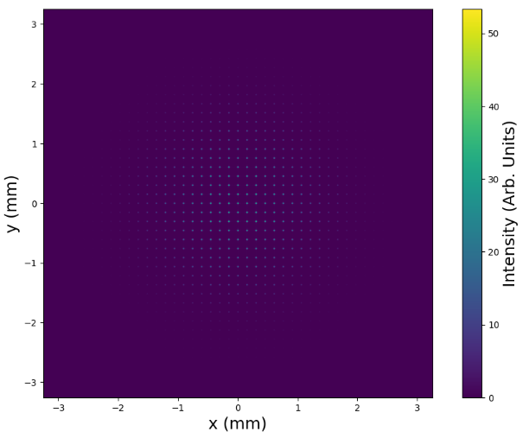
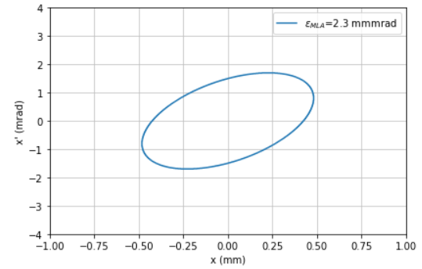
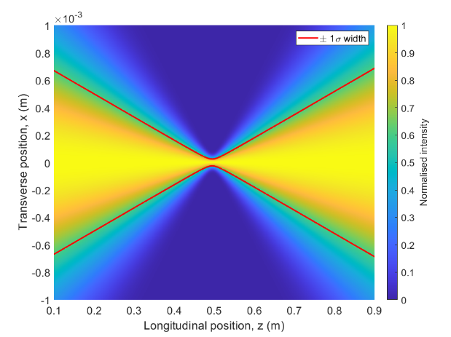
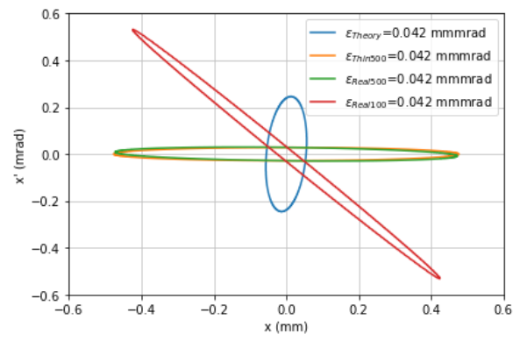
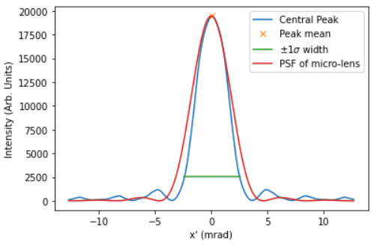


Emittance diagnostics - Simulation
[5]
Next steps:
Simulate DMD-type measurement – should be able to improve resolution over MLA
Test with laser in optics lab – effectively an M² measurement – should hit similar resolution limit
Simulate OTR – resolution should improve with double lobe distribution and energy dependence
J. Wolfenden (joseph.wolfenden@cockcroft.ac.uk)
AWAKE collaboration meeting 26/04/2023
11

Slide 13
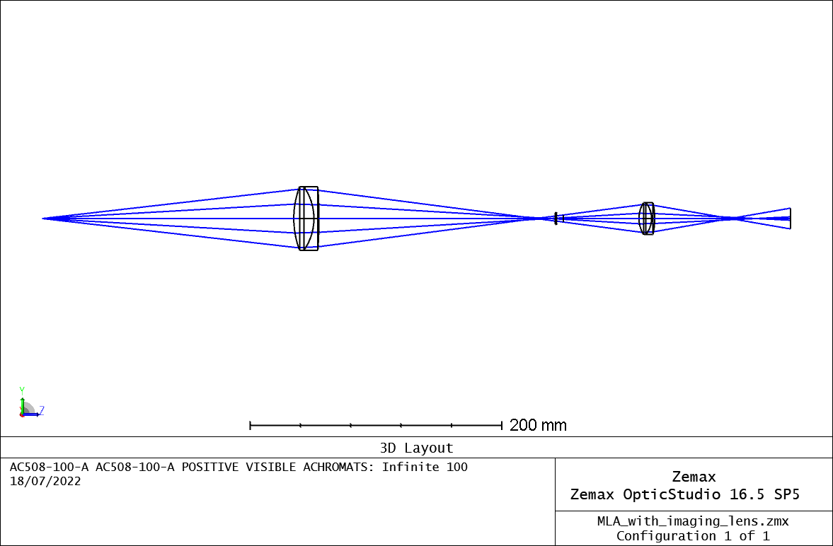
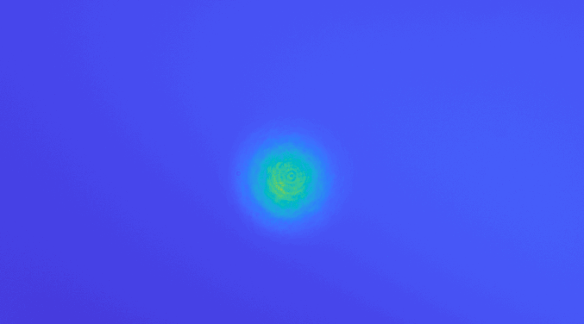
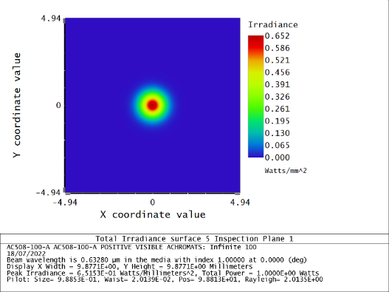
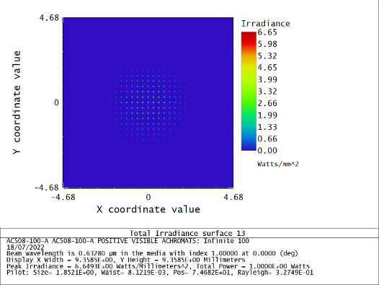

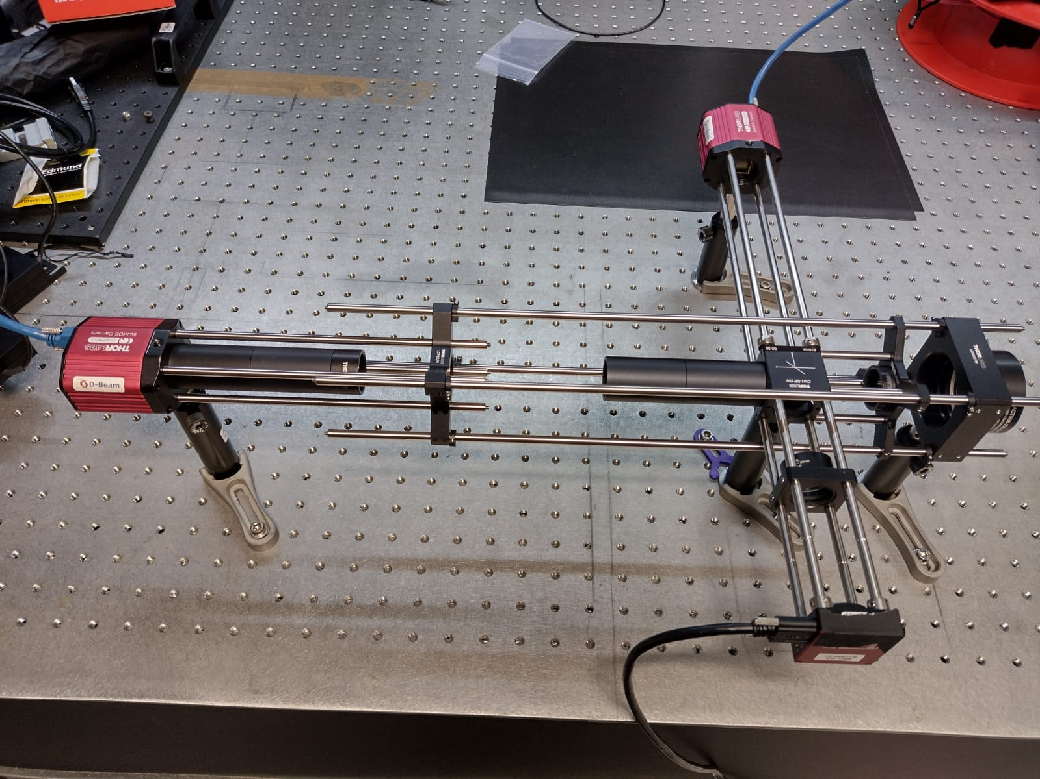

Emittance diagnostics - MLA
I1
L1
L2
L1
L2
I1
I1
Next steps:
Analyse laser measurements
Simulate OTR source
PoC measurements (CLEAR)
ML-based image-to-phase space analysis
I2 - collimated
I2
I2
Micro-Lens Array
Micro-Lens Array
I1
I1
L1
L1
I2 - diverging
L2
I2
L2
I2
[6]
Pellicle Beamsplitter
Pellicle Beamsplitter
J. Wolfenden (joseph.wolfenden@cockcroft.ac.uk)
AWAKE collaboration meeting 26/04/2023
12

Slide 14
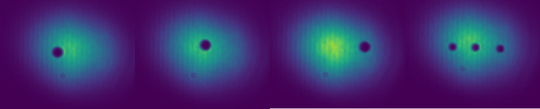
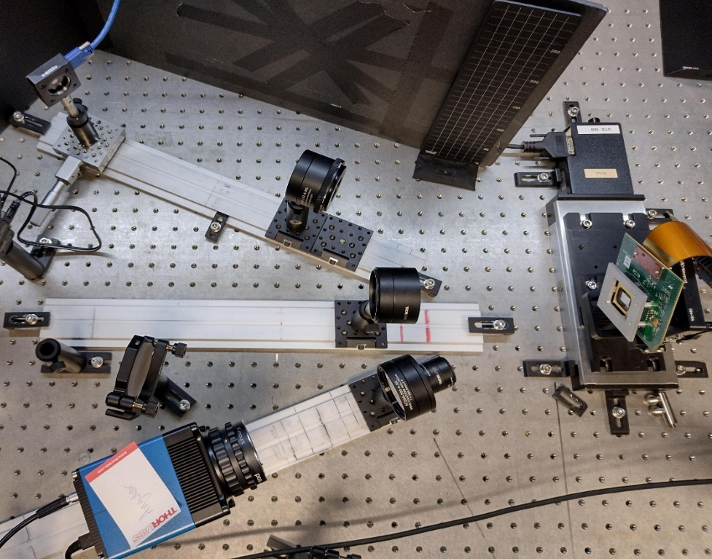
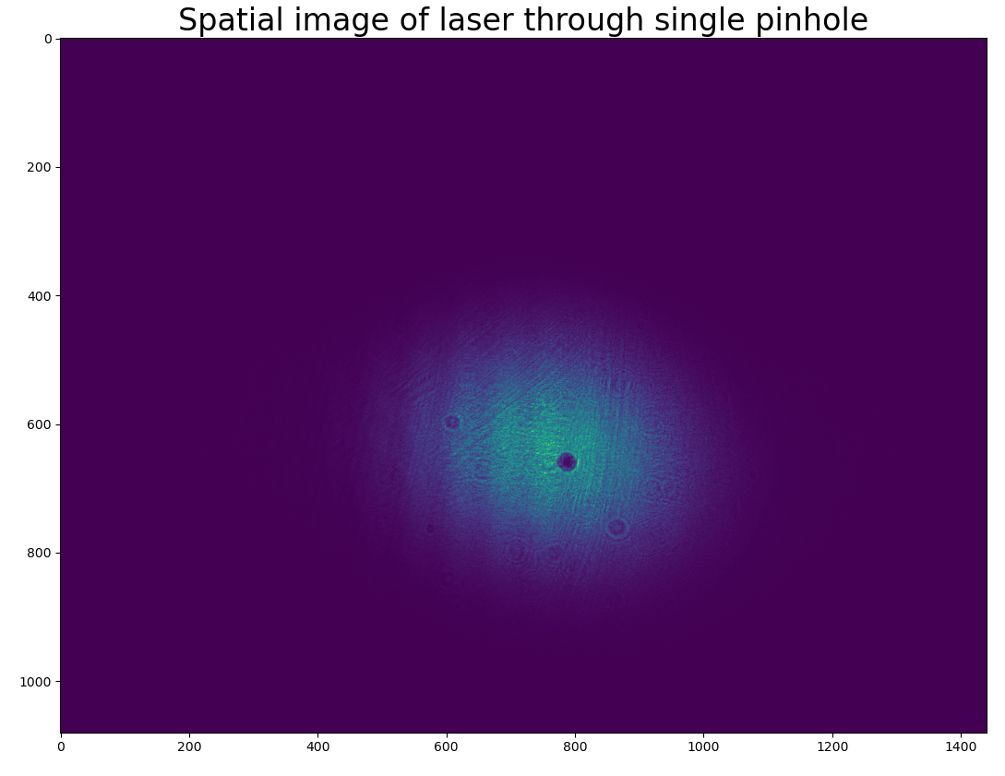
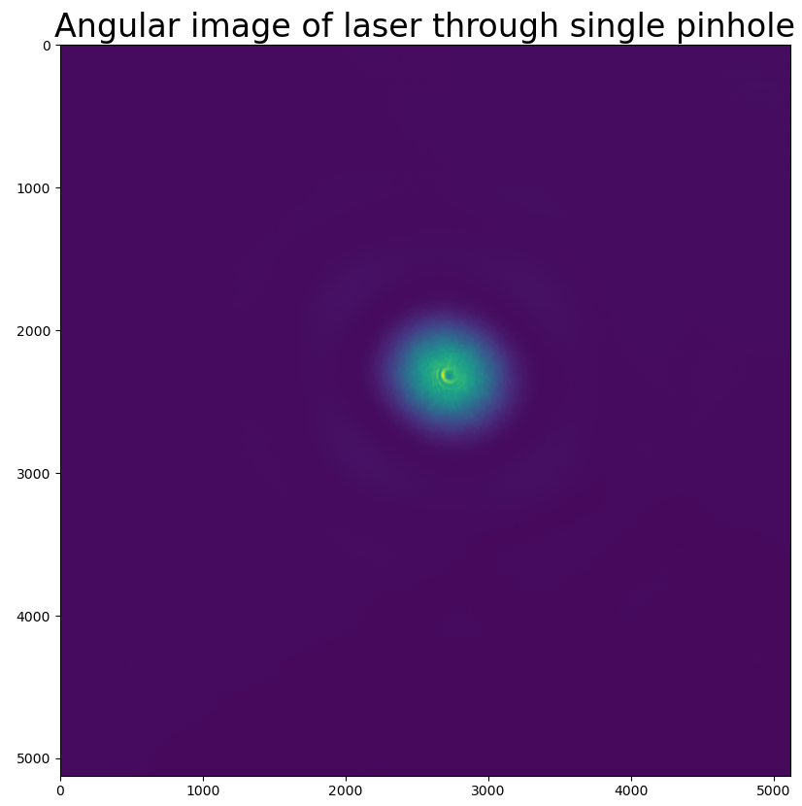
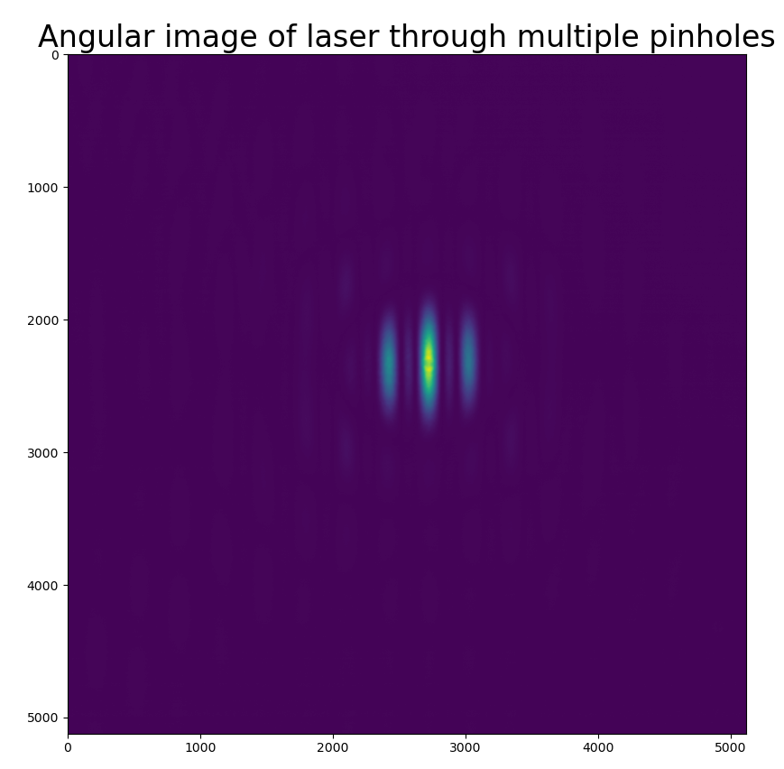
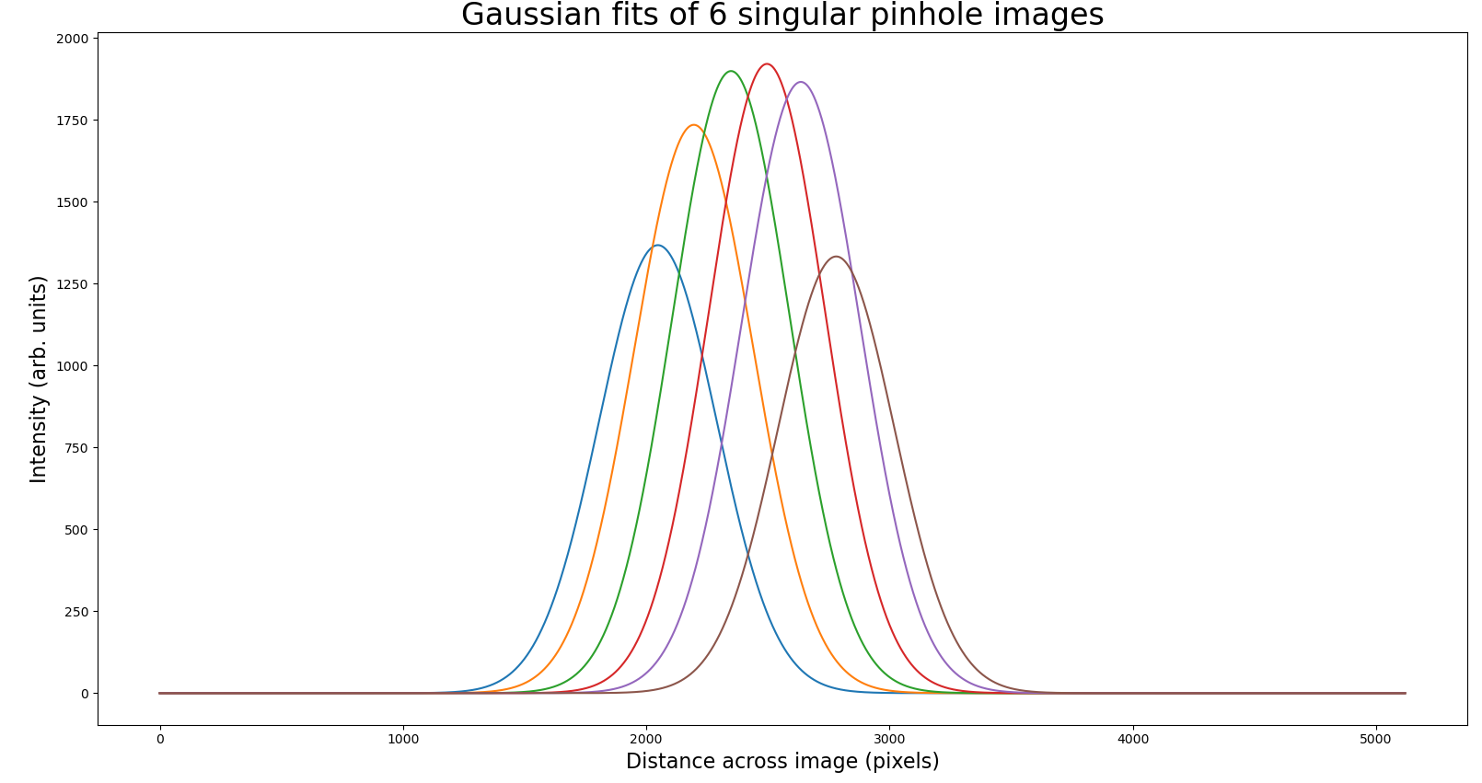
Emittance diagnostics - DMD
Spatial camera
DMD
Angular camera
Next steps:
Analyse laser measurements
Simulate OTR source
PoC measurements (CLEAR)
ML-based image-to-phase space analysis
J. Wolfenden (joseph.wolfenden@cockcroft.ac.uk)
AWAKE collaboration meeting 26/04/2023
13

Slide 15
Emittance diagnostics
Possible integration scenarios
Pre-plasma
  OTR off existing/planned screens (same screens as CTR)
    DMD or MLA, depending on resolution requirements
  OSR from final (injection) dipole in e⁻ beam line
    Viewport from within the dipole or an off-axis screen to extract downstream
Post-plasma
  OTR on common beamline will not work given p⁺/e⁻ intensity difference
    Beam separation (for HEP applications?)
  OSR from spectrometer dipole?
    Again, any dipoles in potential separation optics could be used
  Would require MLA or single-shot version of DMD
J. Wolfenden (joseph.wolfenden@cockcroft.ac.uk)
AWAKE collaboration meeting 26/04/2023
14

Slide 16
Proton halo angular imaging with DMD-masking
J. Wolfenden (joseph.wolfenden@cockcroft.ac.uk)
AWAKE collaboration meeting 26/04/2023
17

Slide 17
Proton halo angular imaging with DMD-masking
Installed DMD-based halo monitor alongside existing system (late 2021)
  Enabled DMD operation tests in AWAKE environment
Opportunity in mid 2022 to move downstream, look at far-field OTR of SSM protons
Goal: measure proton angular distribution in different regions of the bunch
  Very similar situation to the emittance method – different masks
J. Wolfenden (joseph.wolfenden@cockcroft.ac.uk)
AWAKE-UK collaboration meeting 17/03/2023
18

Slide 18
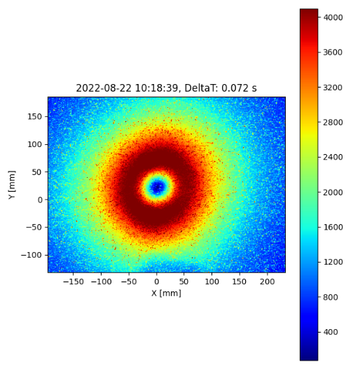
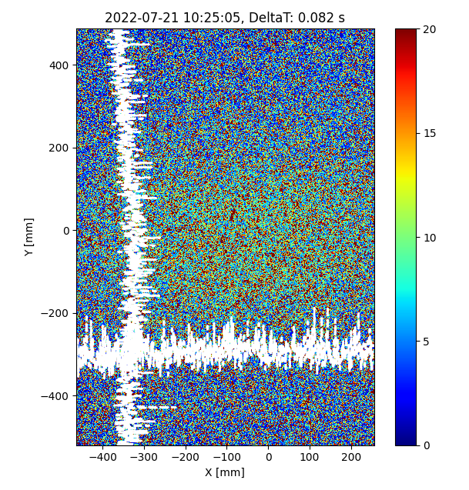
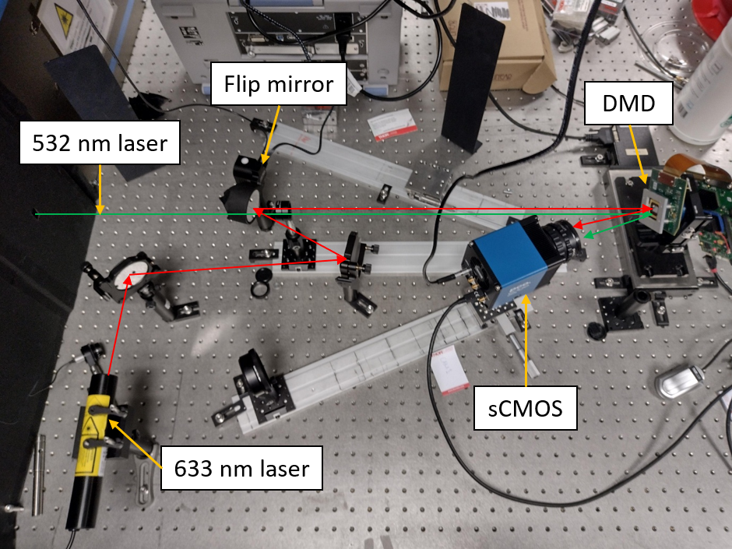
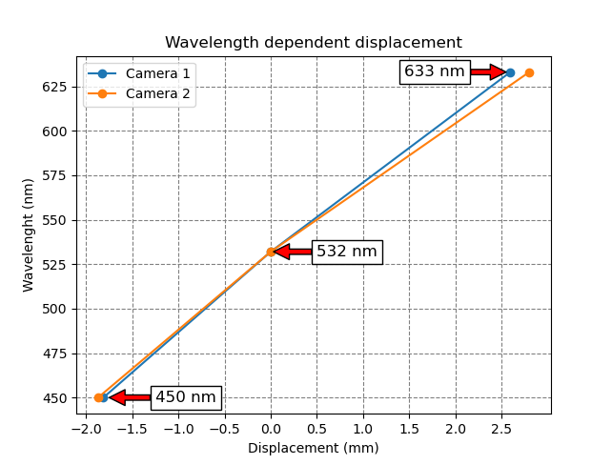
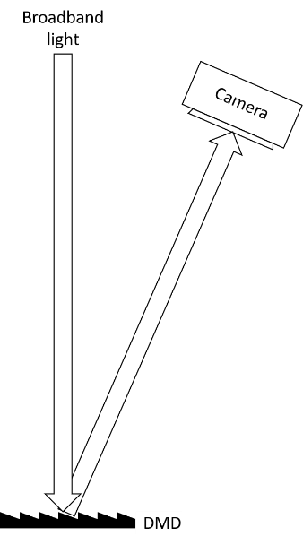
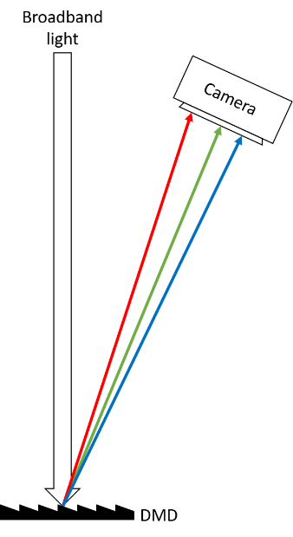
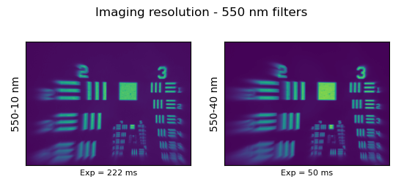
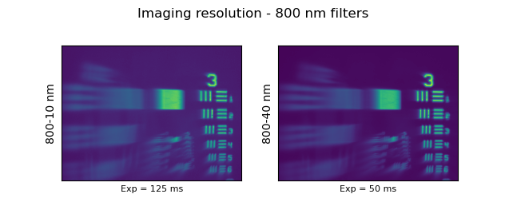
Proton halo angular imaging with DMD-masking
Without DMD
With DMD
July 2022
Dispersion from DMD – filter required
Alignment with wavelength close to measurement
MLA test?
J. Wolfenden (joseph.wolfenden@cockcroft.ac.uk)
AWAKE collaboration meeting 26/04/2023
19

Slide 19
Optical fibre beam loss monitor
J. Wolfenden (joseph.wolfenden@cockcroft.ac.uk)
AWAKE collaboration meeting 26/04/2023
20

Slide 20
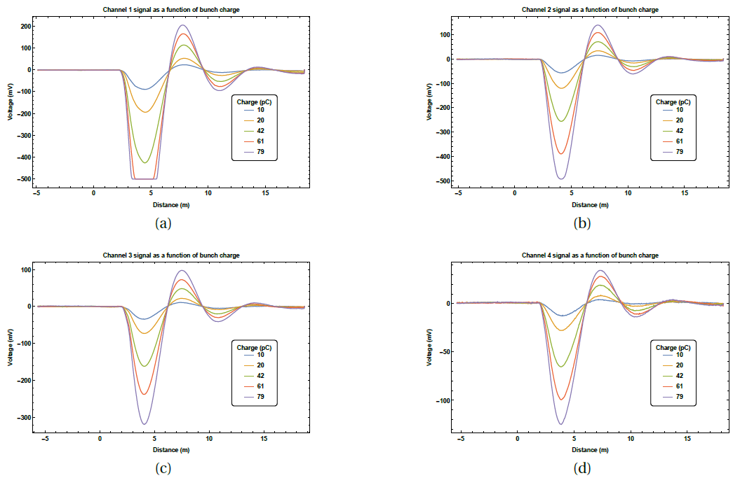

Optical fibre beam loss monitor
Particle bunch
Loss
v
Beam pipe
[7, 8, 9, 10]
Sensor Unit
Optical-fibre
Charge shower
Cherenkov radiation
oBLM operating principle
  * J. Wolfenden et al. Sensors 23(4), 2248 (2023); https://doi.org/10.3390/s23042248
Improved loss location resolution, <10cm, and applications of RF breakdown detection – New paper*
Two new PhD students working in this area
Beginning simulation studies
  Investigate possible applications as an energy spectrometer and plasma diagnostic
J. Wolfenden (joseph.wolfenden@cockcroft.ac.uk)
AWAKE collaboration meeting 26/04/2023
21

Slide 21
Betatron radiation-based diagnostics
J. Wolfenden (joseph.wolfenden@cockcroft.ac.uk)
AWAKE collaboration meeting 26/04/2023
22

Slide 22
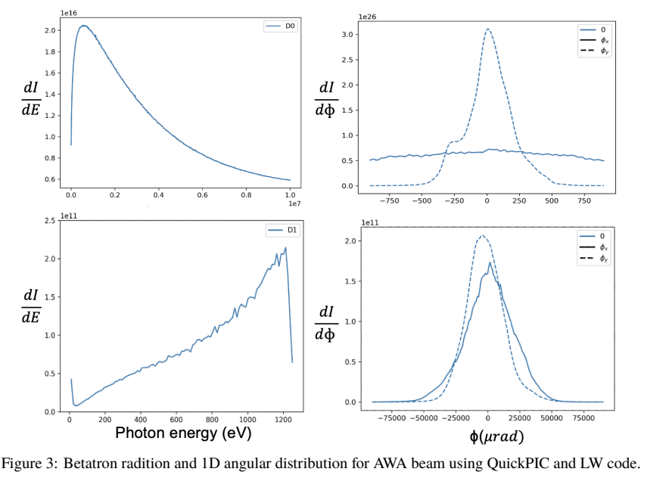
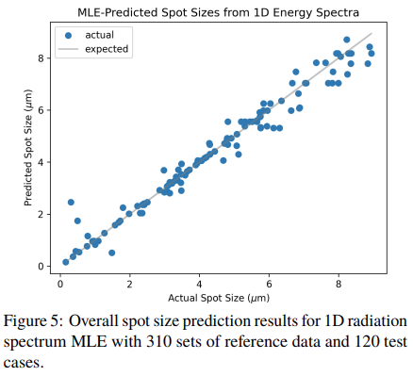
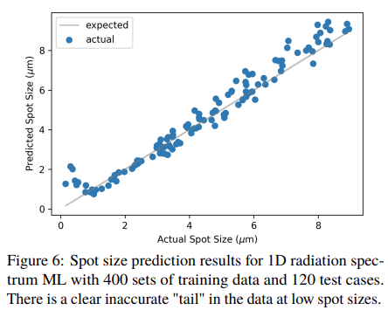

Betatron radiation-based diagnostics
Next steps:
Build upon and expand collaboration with UCLA
Identify possible areas for application to AWAKE
[11, 12]
J. Wolfenden (joseph.wolfenden@cockcroft.ac.uk)
AWAKE collaboration meeting 26/04/2023
23

Slide 23
Summary
J. Wolfenden (joseph.wolfenden@cockcroft.ac.uk)
AWAKE collaboration meeting 26/04/2023
24

Slide 24
Summary
CxR bunch length monitor
  CxR imaging set up currently in place at MAX IV
  ML analysis of simulated images capable of predicting bunch profile characteristics - tests with data soon
Emittance diagnostics
  Both MLA and DMD systems currently being tested and benchmarked at CI
  Plans in place to test both systems at CLEAR(?) and FEBE CLARA
Proton halo angular imaging with DMD-masking
  Found potential solution to dispersion, hope to test at AWAKE this year
Optical fibre beam loss monitor
  Two new PhD students started recently focused solely on OBLM (ERL and SPS/LHC)
  Test new prototype in research and industrial setting, concentrating on novel applications – particularly for AWAKE
Betatron radiation-based diagnostics
  Build on and expand existing collaboration with UCLA, looking at application to AWAKE
J. Wolfenden (joseph.wolfenden@cockcroft.ac.uk)
AWAKE collaboration meeting 26/04/2023
25

Slide 25
Thank you for your attention!
Questions?
References:
[1] B. Kyle et al., Proc. IPAC2019, MOPRB061
[2] G. Le Sage et al., PRAB (1999)
[3] R. Fiorito et al., AIP Conf. Proc. 648, (2002)
[4] Thorlabs Inc., https://www.thorlabs.com/newgrouppage9.cfm?objectgroup_id=2861
[5] M. Zhang, FERMILAB·TM-1988
[6] F. Bisesto et al., Nucl. Instrum. Methods Phys. Res. A 909, 364 (2018)
[7] M. Kastriotou et al., Proc. IBIC2016, WEPG20
[8] A. Alexandrova et al., Proc. IBIC2017, WEPWC01.
[9] A. Alexandrova et al., Proc. IPAC2018, THPML090.
[10] J. Wolfenden et al., Sensors 23(4), 2248 (2023)
[11] M. Yadav et al., Proc. IPAC2022, WEPOST042
[12] S. Zhang et al., Proc. IPAC2022, MOPOPT063
J. Wolfenden (joseph.wolfenden@cockcroft.ac.uk)

