Slide 1

DRD6 plans for noble liquid calorimeters
Nikiforos Nikiforou (CERN)

Slide 2
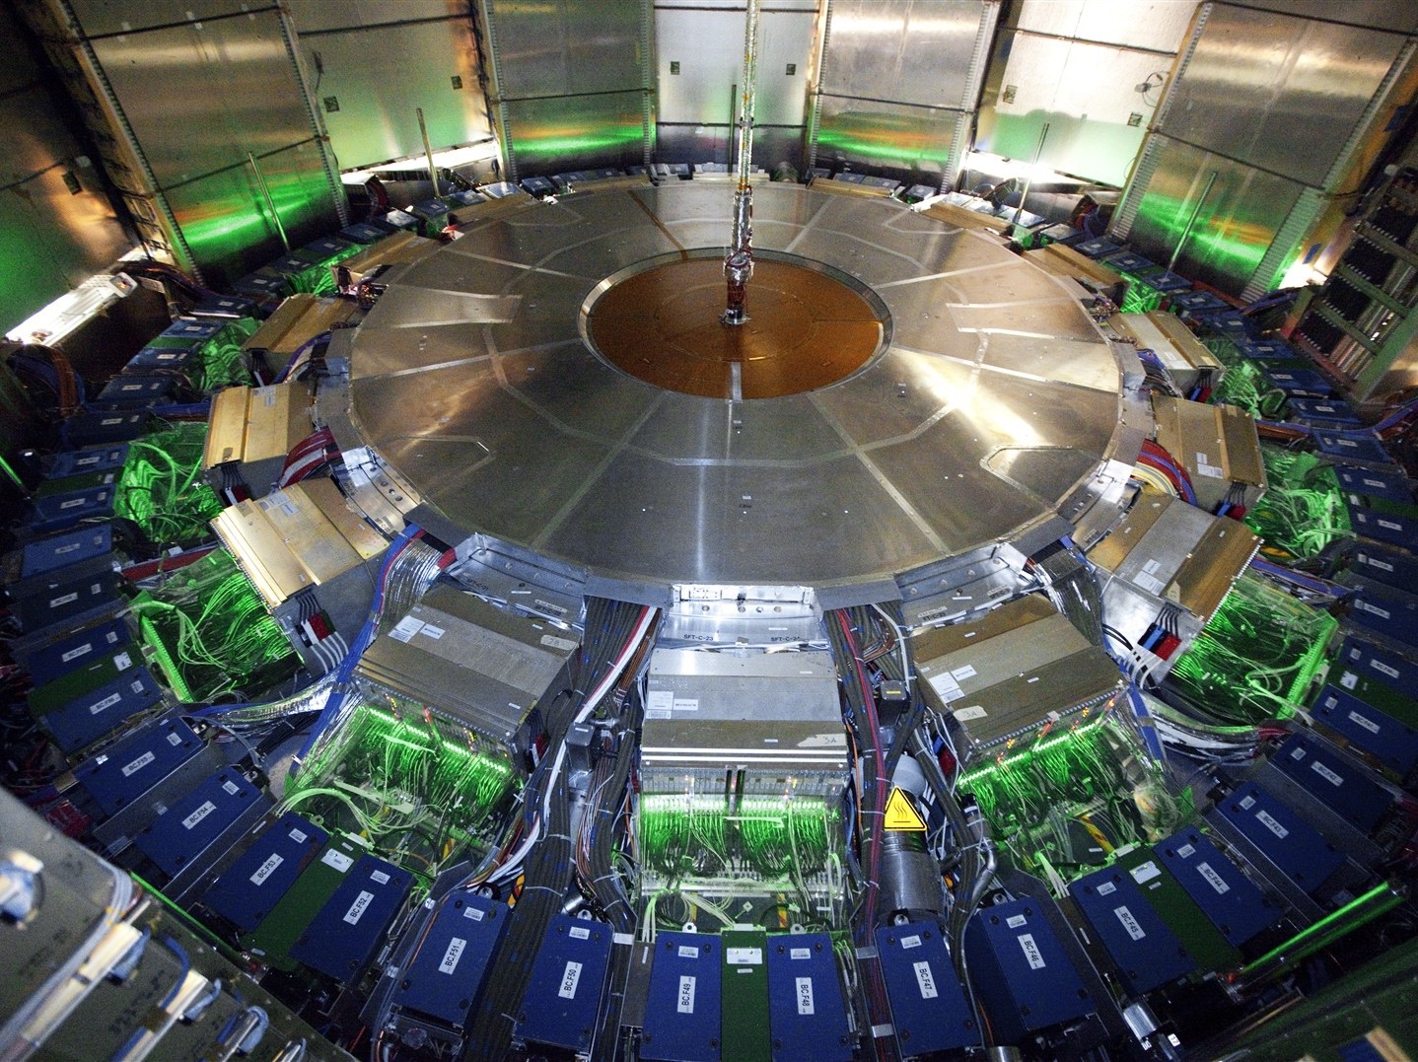
introduction
Noble-liquid calorimeter R&D presented by Jana Faltova yesterday
Will not repeat many of the details but will focus on the plans
This is the work of a relatively small team of people which is growing!
  Interests of various institutes are still evolving
The Noble-Liquid calorimeter proposal for FCC-ee is nevertheless very advanced
  Expanding and adapting work done for calorimetry at FCC-hh (see arxiv:1912.09962)
  Taking advantage of experience in successful construction and operation of the ATLAS LAr Calorimeter at the LHC
  See also recent talk by Nicolas Morange and elsewhere also by Martin Aleksa, Brieuc Francois and others from which this material was borrowed

Slide 3
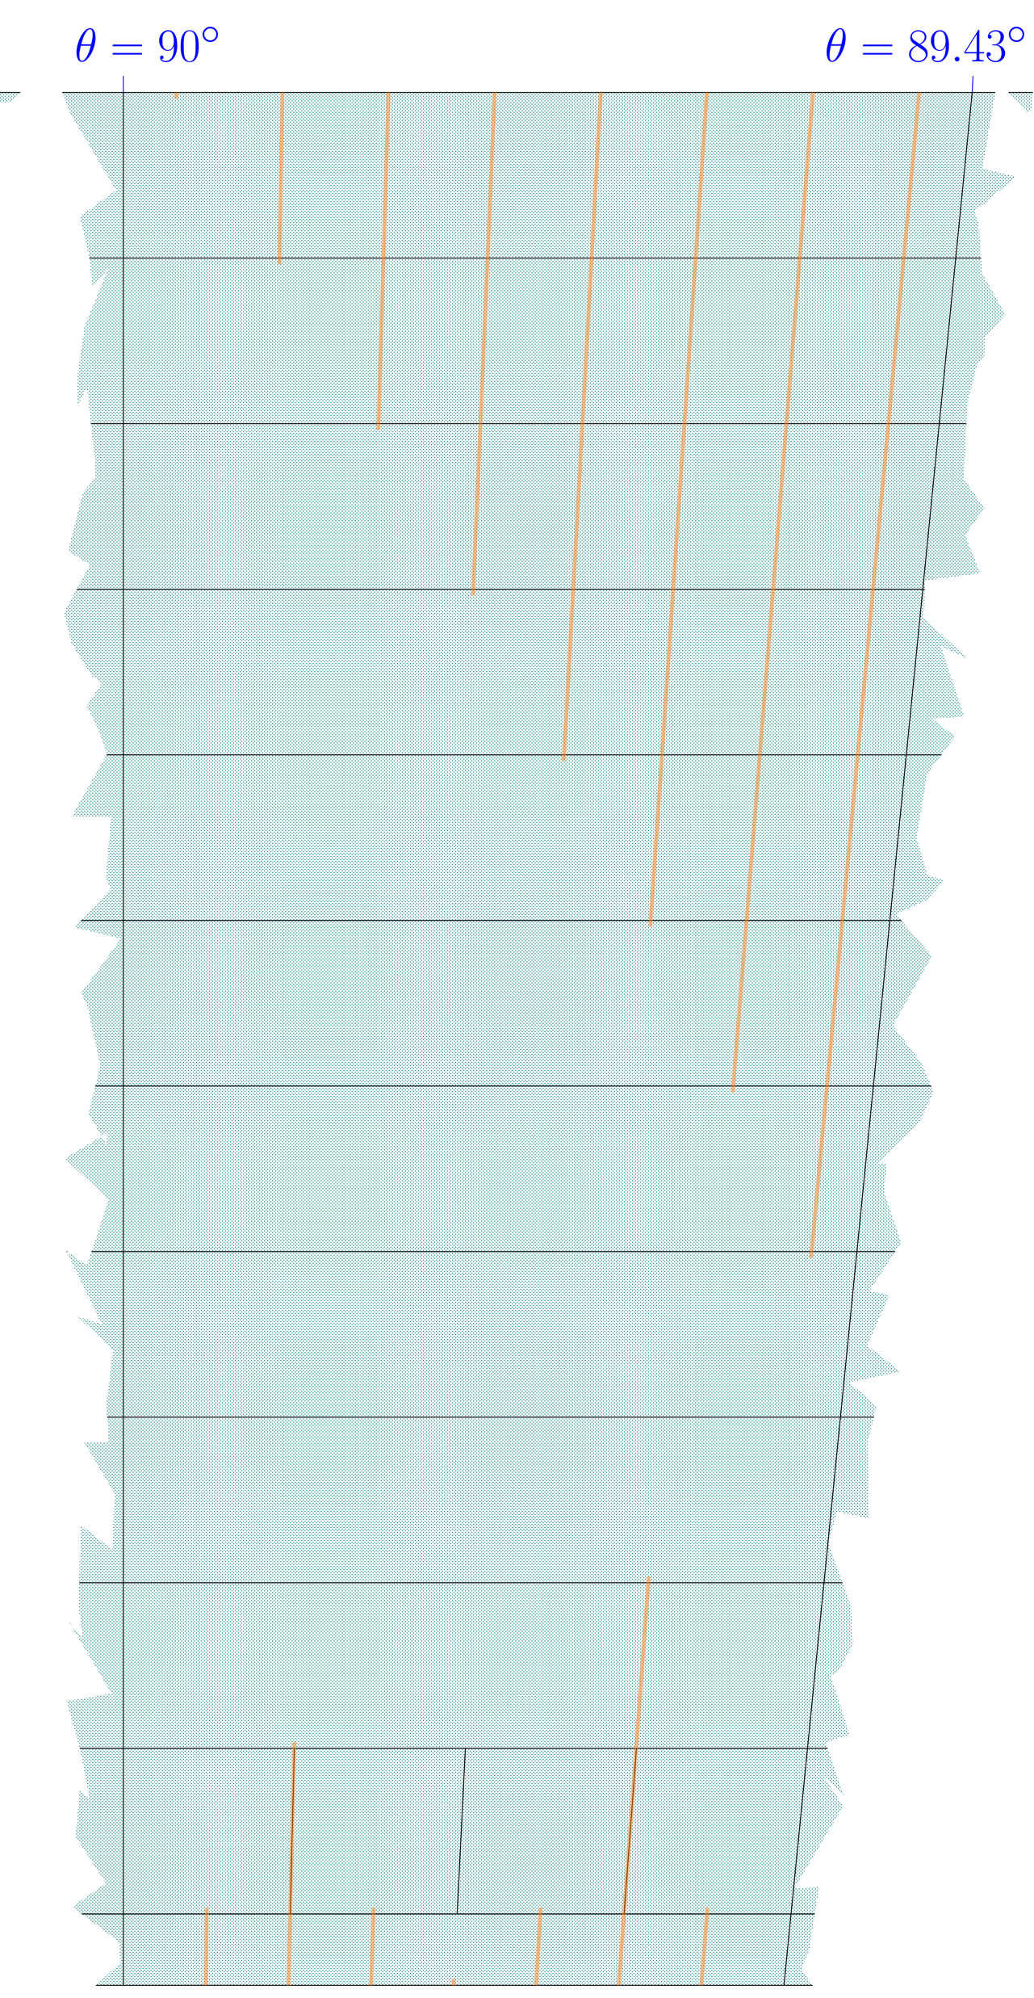
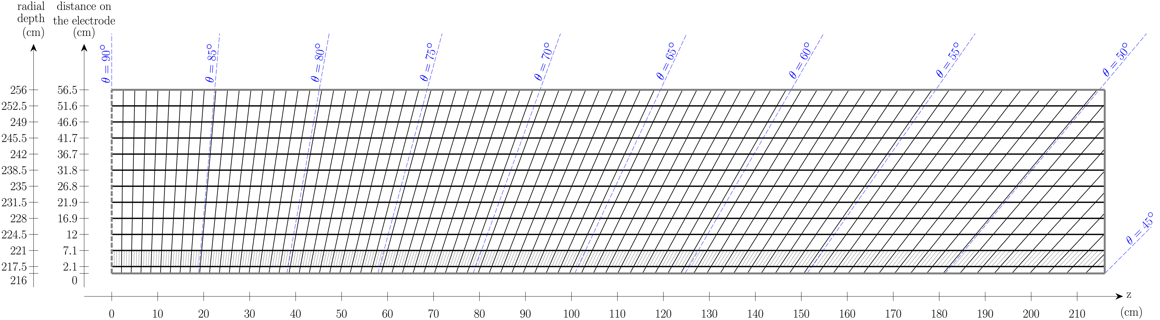
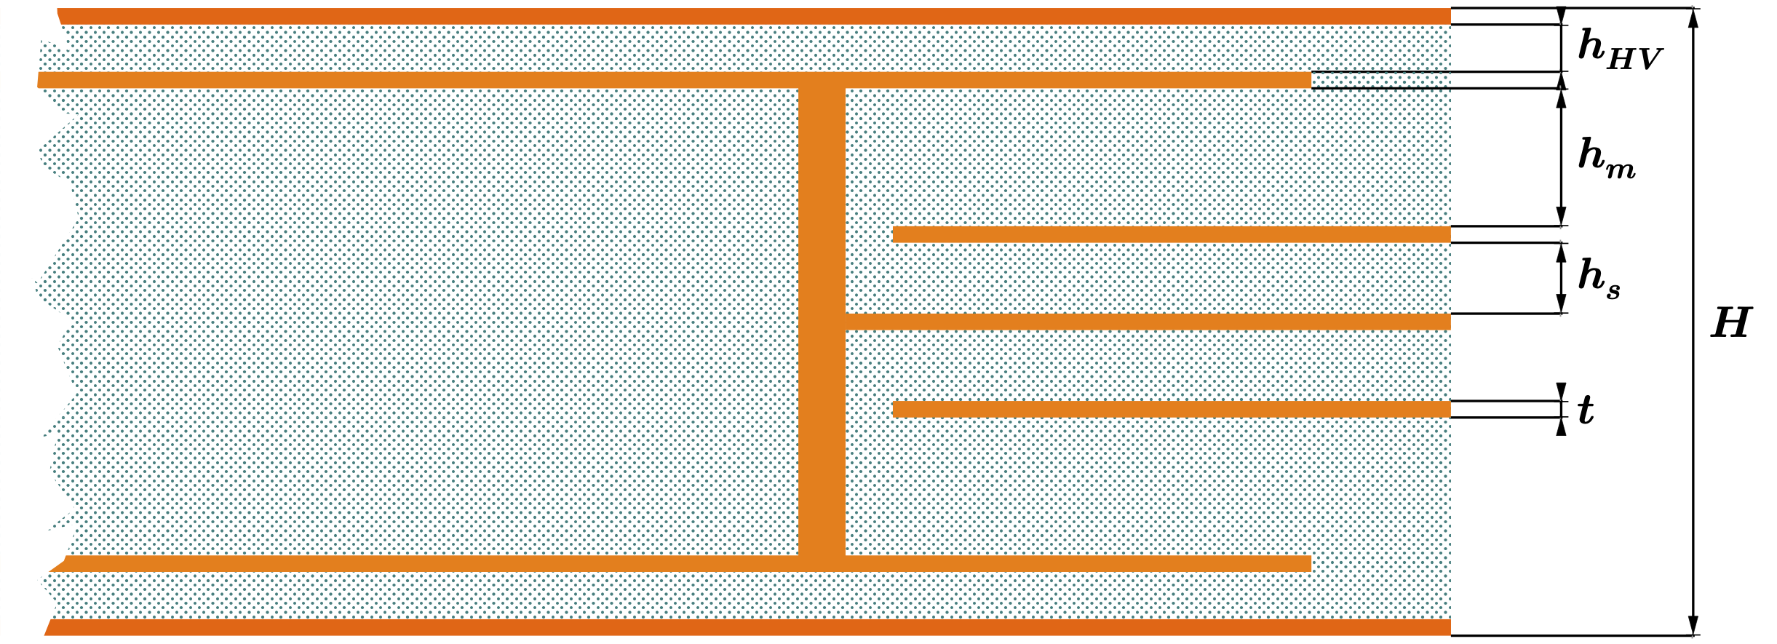
High Granularity Noble-Liquid Calorimeter
High Granularity Noble-Liquid Calorimeter
Baseline design
1536 straight inclined (50.4º) 1.8mm Pb absorber plates
Multi-layer PCBs as readout electrodes
1.2 – 2.4 mm LAr gaps
40 cm deep (≈ 22 X₀)
Segmentation:
  𝛥𝜃 = 10 (2.5) mrad for regular (1st comp. strip) cells,
  𝛥𝜙 = 8 mrad
  → cell size in strips: 5.4mm x 17.8mm x 30mm
12 layers
Implemented in FCC-SW Fullsim
One ‘theta tower'
Possible Options
LKr or LAr, W or Pb absorbers,
Absorbers with growing thickness
Granularity optimization
Al or carbon fiber cryostat
Warm or cold electronics
Scale 10:1
HV
Multi-layer read-out electrode for FCC
Signal Pad
Via
Ground shield
Absorber
Signal Trace
Readout electrode

Slide 4
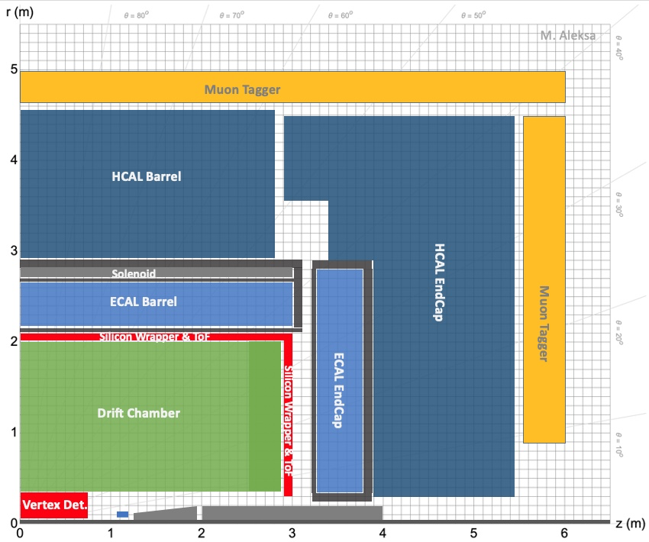
Noble-Liquid ECAL Based Detector Concept
Vertex Detector:
  MAPS or DMAPS possibly with timing layer (LGAD)
  Possibly ALICE 3 like?
Drift Chamber (±2.5m active)
Silicon Wrapper + ToF:
  MAPS or DMAPS possibly with timing layer (LGAD)
High Granularity ECAL:
  Noble liquid + Pb or W
  Particle Flow reconstruction
Solenoid B=2T, sharing cryostat with ECAL, outside ECAL
  Light solenoid coil ≈ 0.76 X₀ (see back-up)
  Low-material cryostat < 0.1 X₀ (see back-up)
High Granularity HCAL / Iron Yoke:
  Scintillator + Iron (particle flow reconstruction)
    SiPMs directly on Scintillator or
    TileCal: WS fibres, SiPMs outside
Muon Tagger:
  Drift chambers, RPC, MicroMegas
See e.g talk by M. Aleksa

Slide 5
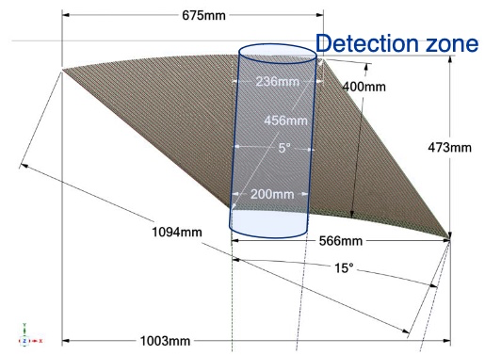
The way forward
Further develop the overall design and study is performance in full simulation
Determine required granularity
Develop and freeze readout electrode design
Investigate and decide on readout electronics (cold vs warm?)
Study mechanics, structural/assembly aspects of calorimeter
Build a prototype module in cryostat and study it in test beam some time in 2028

Slide 6













collaboration
Many opportunities for contributions
Most of the institutes have experience in the design, construction, and operation of the ATLAS LAr Calorimeter

Slide 7
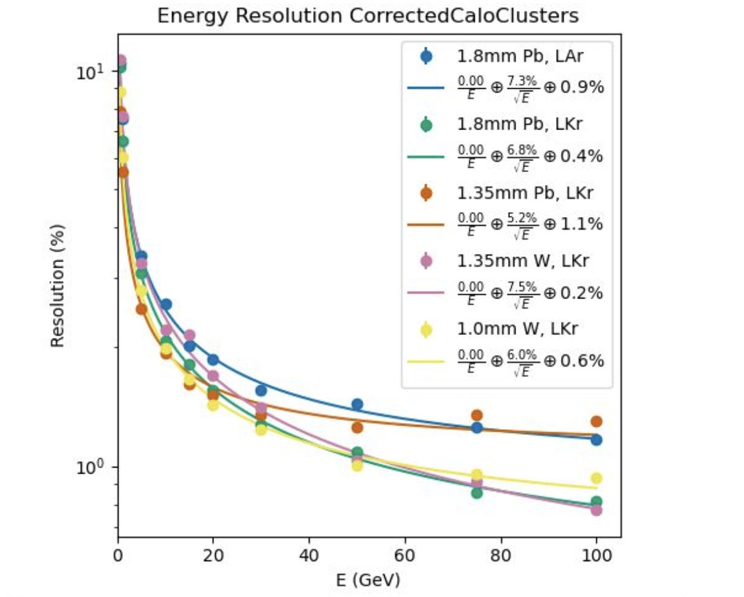
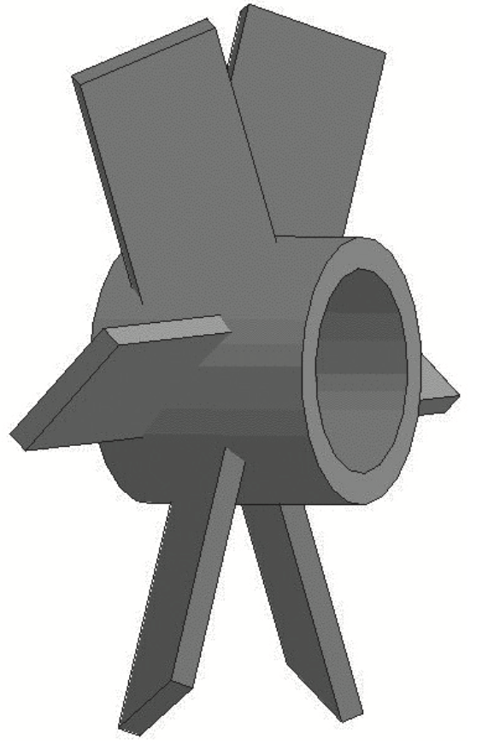
Design optimization
Performed in full Geant4 simulation within the FCC software chain
  First EM physics studies performed in 2022 but much more can be done:
    LAr vs LKr, Pb vs W, granularity, layer structure, sampling fraction, …
Investigate solutions for Endcaps
    Possibly use “Windmill/turbine” geometry?
Investigate possibility to readout Cerenkov light
    Feasibility of design?
Next studies should be performed with full detector and full reconstruction, including Particle Flow
  At least with HCAL and truth-tracker
Work needed on reconstruction
  Study shower-shapes, employ cut-based PID, traditional clustering,…
  But also work on more modern ML techniques

Slide 8
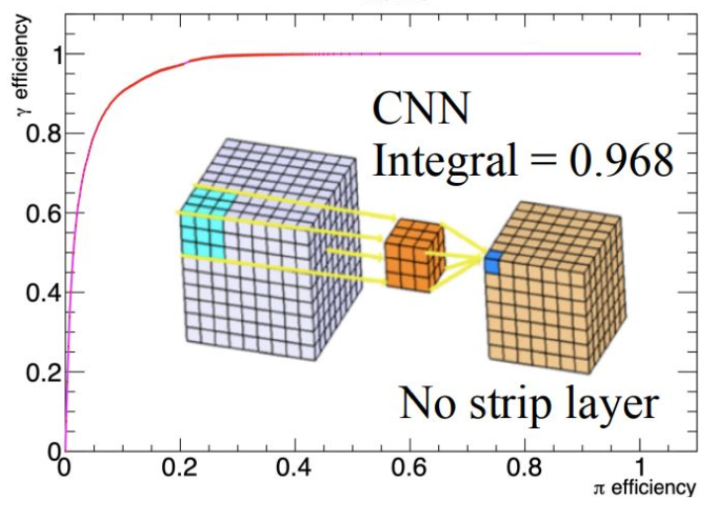
Granularity
Example from ATLAS LAr Calorimeter
Need to understand the required granularity
  Study pion ID (tau physics)
  Axion-like particle searches
    Including Long-lived signatures → Employ pointing/diphoton vertex reconstruction
  Jet energy reconstruction
  Using 4D imaging techniques, ML, PFlow
Optimize design for EM resolution
  Electron and photon resolutions
  Pions, b-physics
  Gap size, sampling fraction, active and passive material...

Slide 9
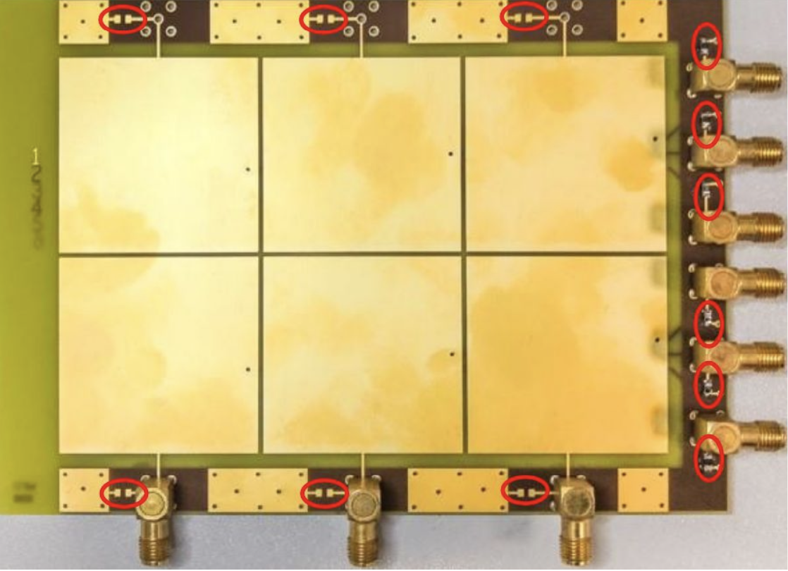
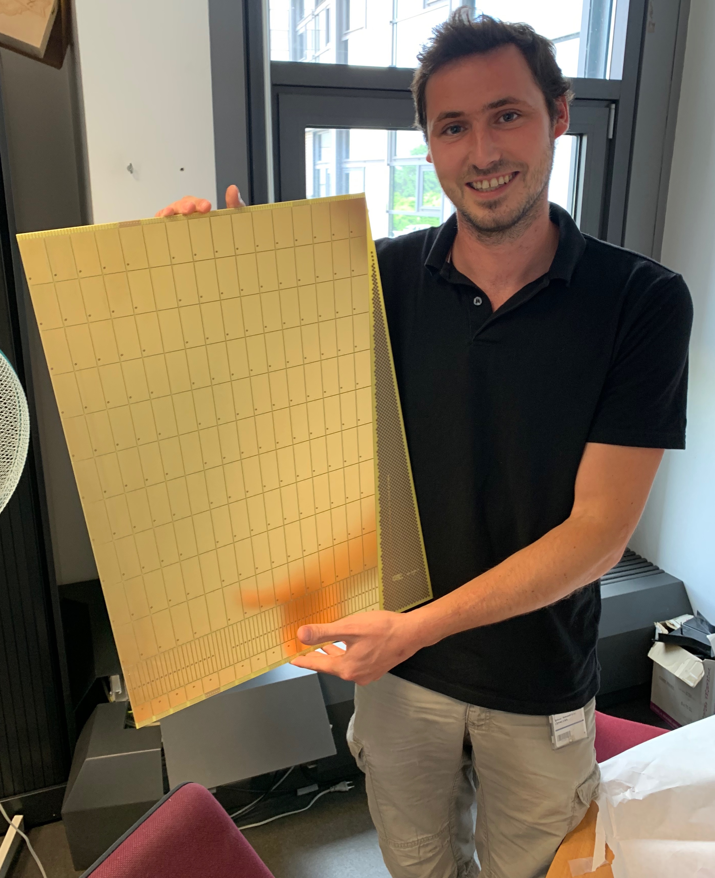
electrodes
Small-scale PCB prototype at IJCLAB
Continue lab tests with small-scale electrode PCB and first large-scale prototype
  Measurements of x-talk and other cell properties
    Promising to reach <1% x-talk target
    Minimize noise aiming for photons down to 300 MeV and S/N>5 for MIPs
  Comparing lab results with Finite Element simulations
Develop endcap design
  Depends on geometry
  Optimize granularity
Finalize barrel design and produce prototype (~2024)
  Readout signals at the back → chose connectors
Manufacture test-module electrodes by 2027
  Potentially foresee half of module read-out by cold electronics, other half send signals outside of cryostat with coax
58 cm x 44 cm x 1.2 mm electrode prototype at CERN

Slide 10
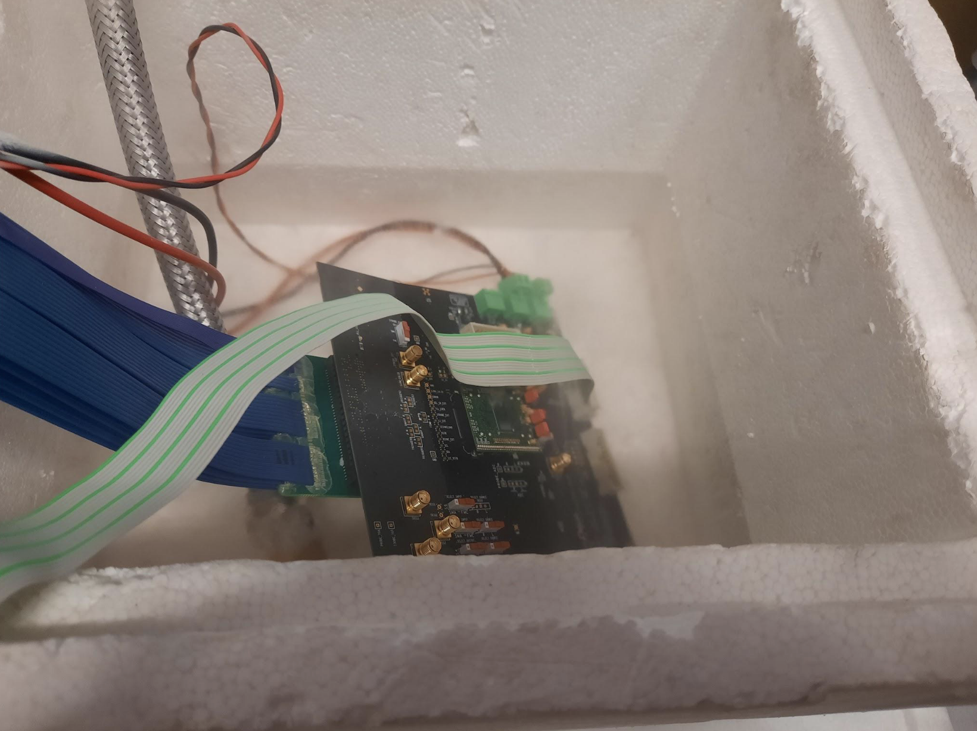
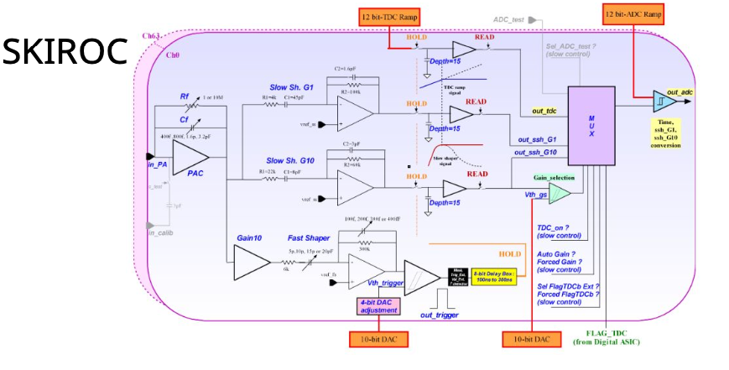
Readout electronics
On-detector Electronics: two options under consideration
  Warm option (outside cryostat)→ requires work on cables inside the cryostat and feedthroughs to get the many signals out
  Cold option (inside cryostat) → very appealing, but also requires work
    Noise reduction up to factor ~5
    If all the electronics are inside the cryostat, it is easier to extract the signals
    Power consumption is a huge challenge
Intention to reuse/adapt existing readout chips and/or exploit synergies for the test module
  E.g. ATLAS LAr, CMS HGCAL, DUNE, … SKIROC
  Significant interest/work planned at OMEGA, BNL, …
Timing? Requirements not fully defined yet/performance not fully explored
  But heavily depends on choices on the electronics
Off-detector electrons/DAQ: requirements not yet defined
  Also try to reuse available electronics for the test-beam
HGROC in cold bath

Slide 11
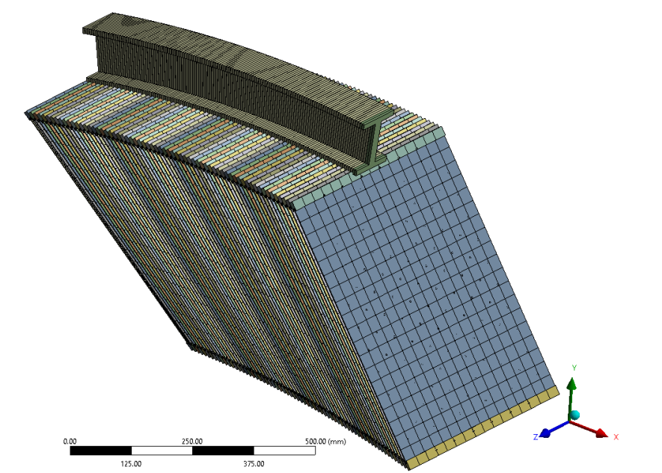
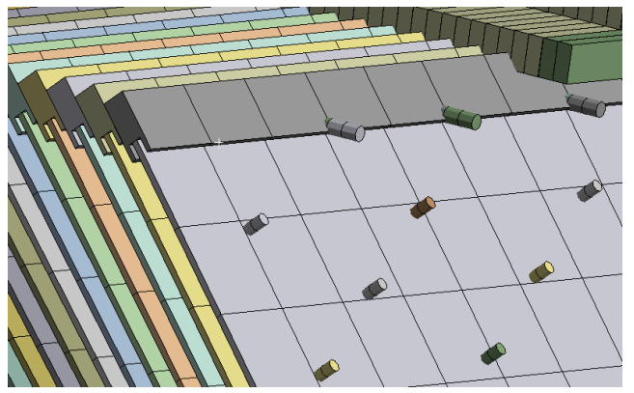
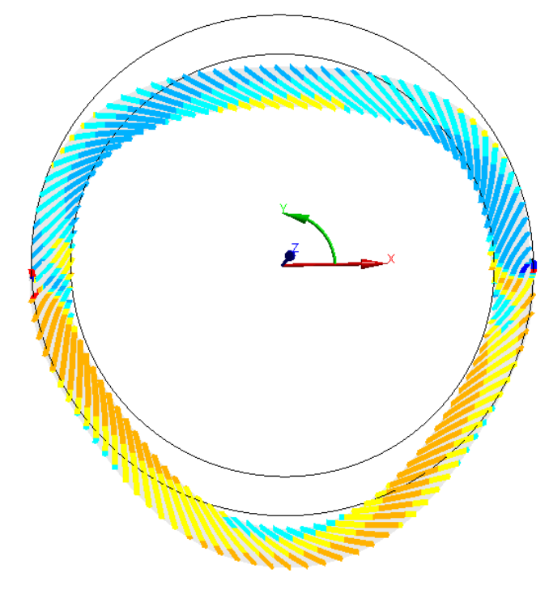
MECHANICS
Challenge: assemble electrodes and absorbers in a rigid structure with relatively light-weight support
  Successful example with ATLAS LAr
    Though accordion structure contributes to rigidity. On the other hand, assembly of straight plates should be easier
Work recently started in earnest but quite encouraging
  FE analysis, deformation under own weight
But also studying feasibility of additional ideas:
  Trapezoidal absorbers
  3D-printed pins for precision spacing/maintaining gaps

Slide 12
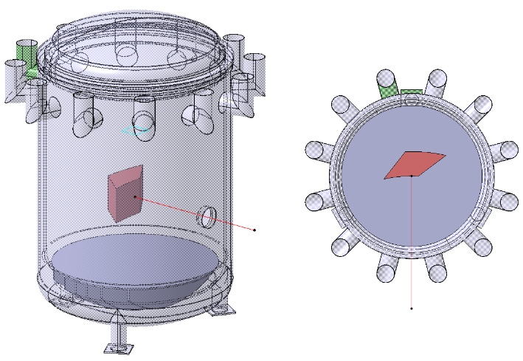
Test module
Mechanical design of testbeam module (64 absorbers) has started
Finite element calculations including
  Rings and G10 bars
  Absorbers and electrodes as shell (2D) elements using layers
  Distance pins
  Six M5 beams join electrodes and absorbers in each side (inner-outer)
Plan to place module into cryostat available at CERN
  But looking into thin carbon-fiber cryostats
Assembly and first tests at warm ~2027, cold tests and test-beam in 2028

Slide 13
Conclusions
Growing collaboration with new institutes recently joining the effort
  Interests of institutes still evolving
More contributions and ideas welcome!
First definition of milestones and deliverables
Simulation work to define and optimize design
First prototype in test beam by 2028
  Challenging, but exciting work ahead!

Slide 14
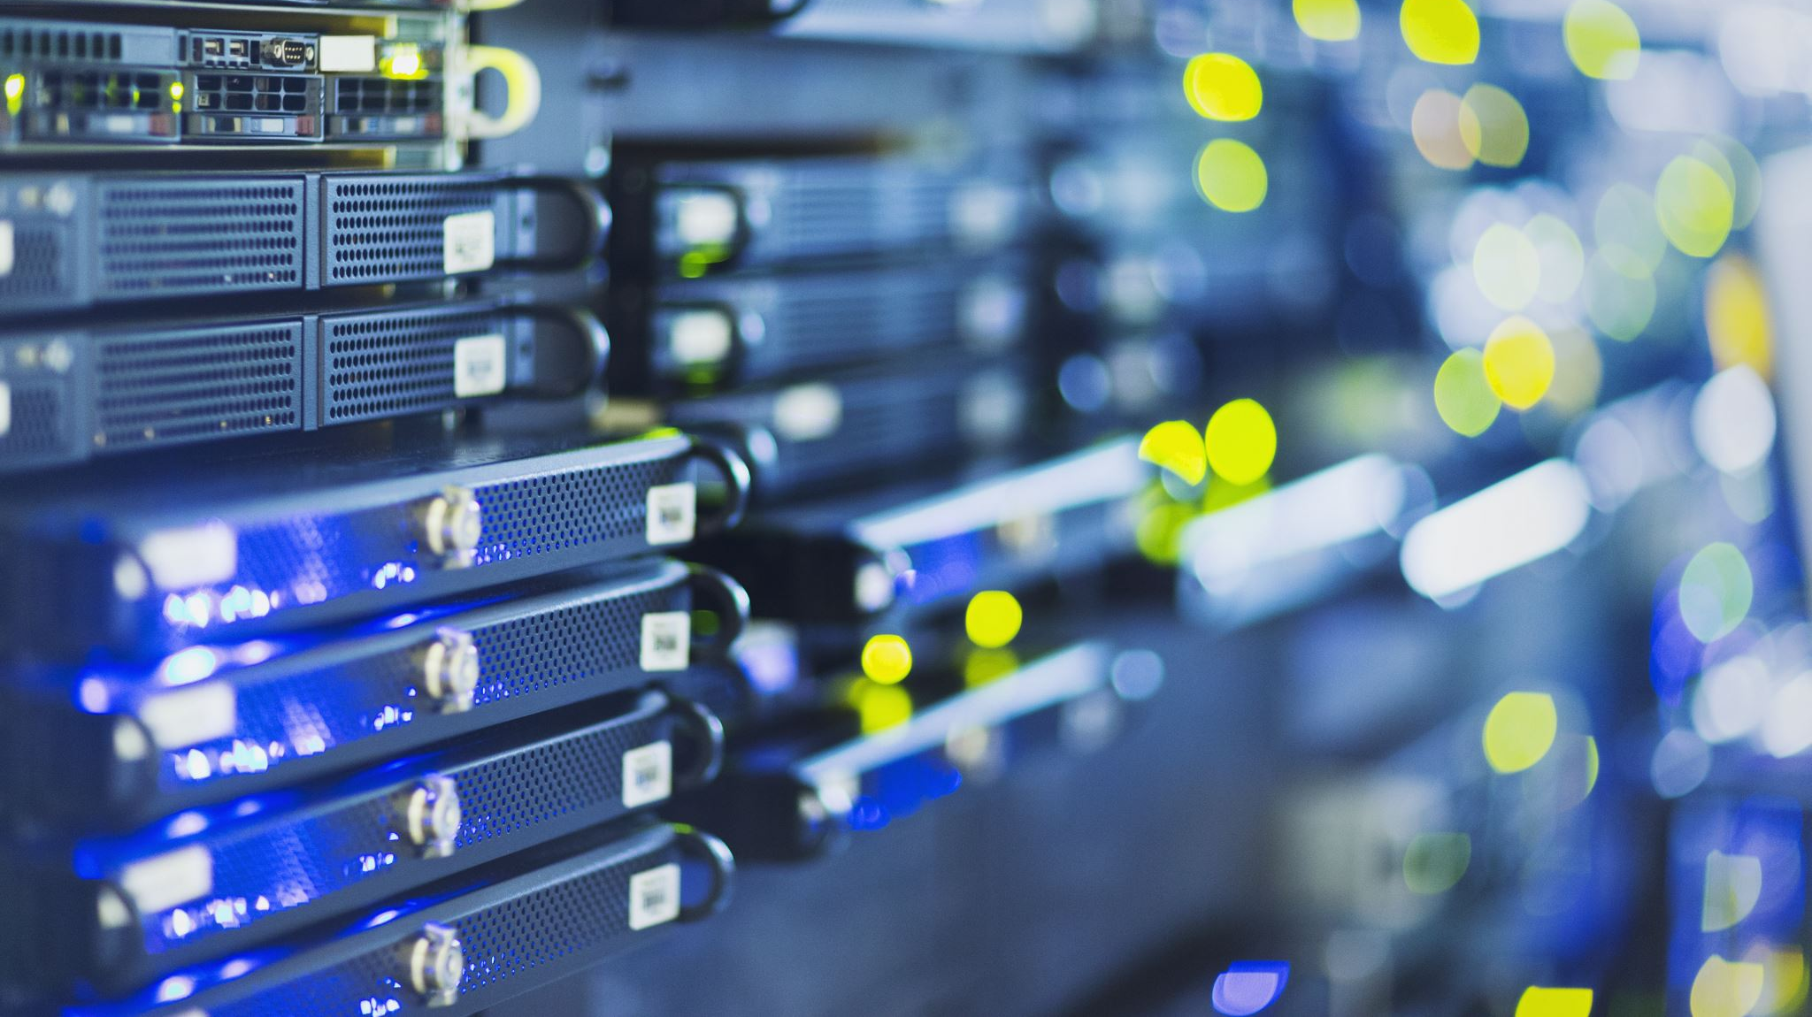
Backup material

Slide 15
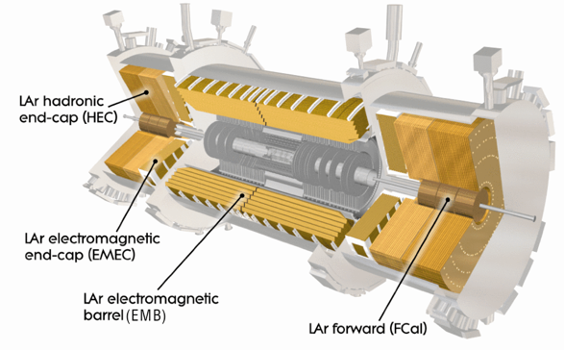
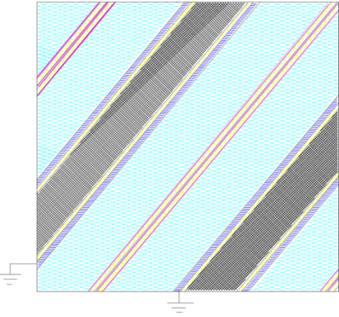
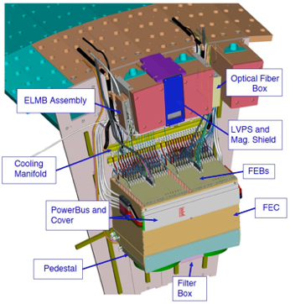

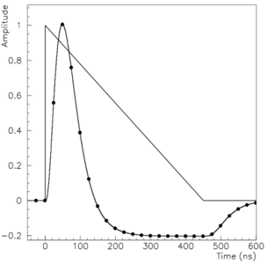
THE atlas LAr calorimeter
absorber
readout electrodes
outer copper layer inner copper layer
kapton
outer copper layer
stainless steel
Glue
lead
(~2 mm)
_{e or γ}
liquid argon gap
liquid argon gap
HV
HV
Front-End readout Boards on detector shape LAr ionization signal and sample in 4 positions apart in 3 gains
Only one of the gains digitized and transmitted via optical fibers to Off-detector Electronics
  Optimal Filtering Technique used to calculate deposited cell energy and pulse peaking time (requires good knowledge of pulse shape)
Cells are clustered together to create photon or electron candidates
2
3
1
0

Slide 16
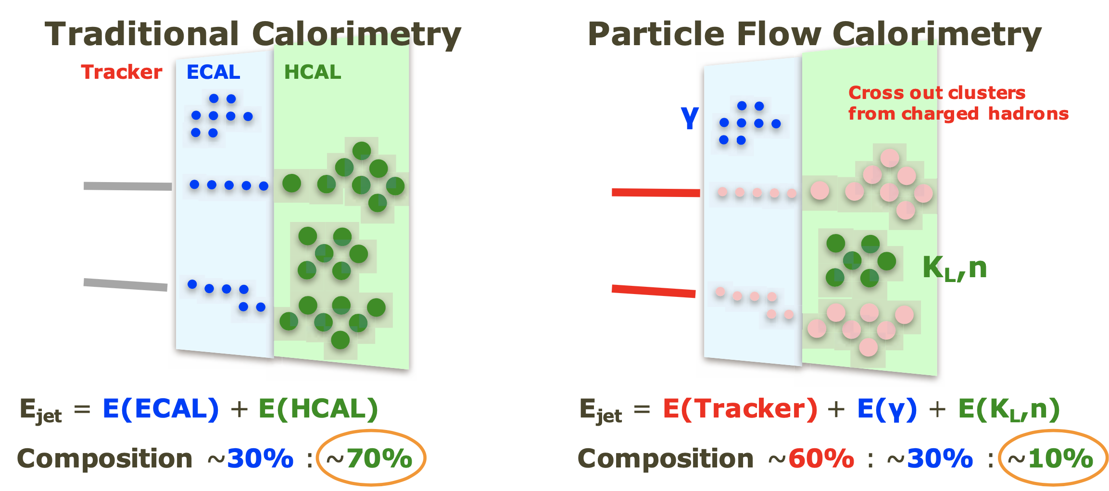
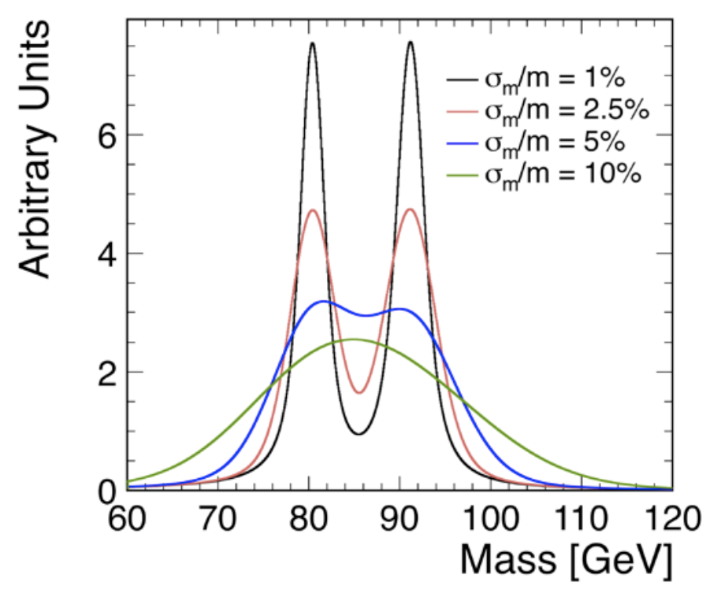
Calorimetry – Jet Energy Resolution
Energy coverage < 300 GeV : 22 X₀, 7λ
Precise jet angular resolution
How to achieve jet energy resolutions of ~3-4% at 50 GeV:
Highly granular calorimeters
Particle Flow reconstruction and possibly in addition techniques to correct non-compensation (e/h≠1), e.g. dual read-out
Jet energy: σ(E_{jet})/E_{jet} ≃ 30% / √E [GeV] ?
⇒ Mass reconstruction from jet pairs
Resolution important for control of (combinatorial) backgrounds in multi-jet final states
Separation of HZ and WW fusion contribution to ννH
HZ ➝ 4 jets, tt events (6 jets), etc.
At σE/E ≃ 30% / √E [GeV], detector resolution is comparable to natural widths of W and Z bosons
→ High granularity and/or dual read-out

