Slide 1
ID cards for LHC
MAB, 27/02/2023
S. Le Naour

Slide 2
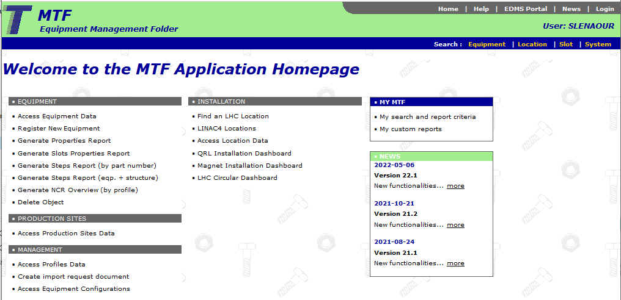
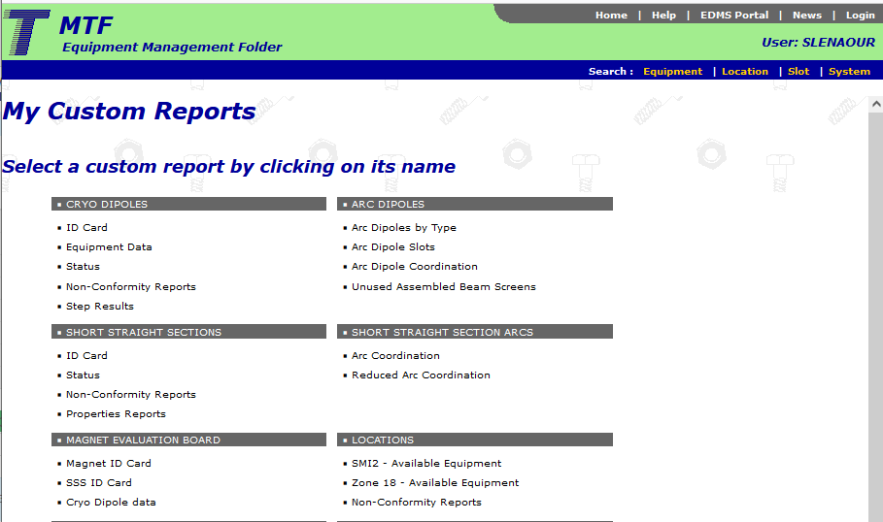
Extraction from MTF

Slide 3
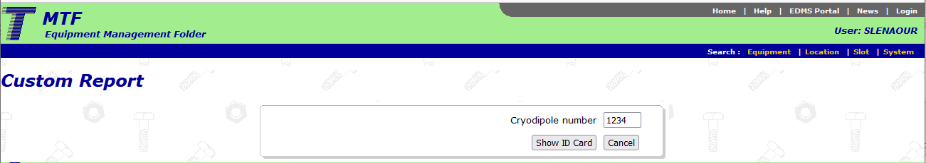
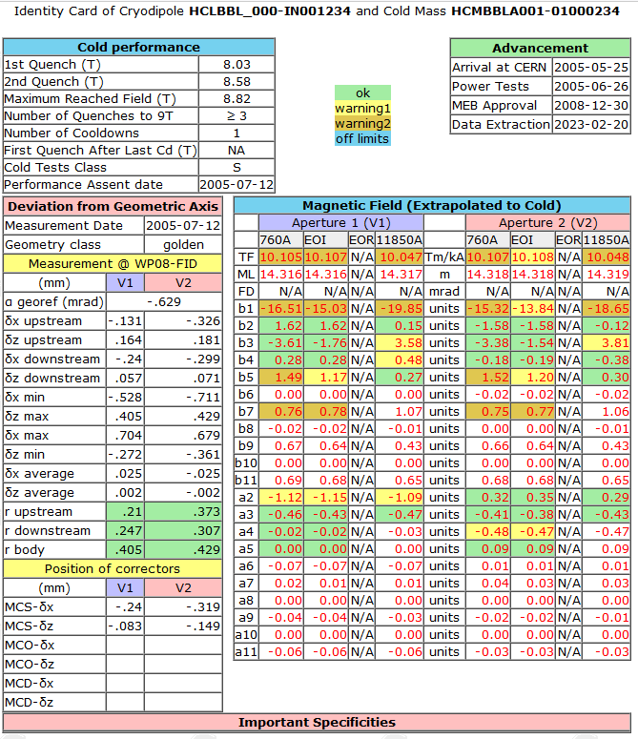
Ex : MB 1234
Data extracted from MTF (equipment data of the cryo-dipole)
Data extracted from MMSMA
An Excel file is also available in step 19 : WP08 Fiducialisation

Slide 4
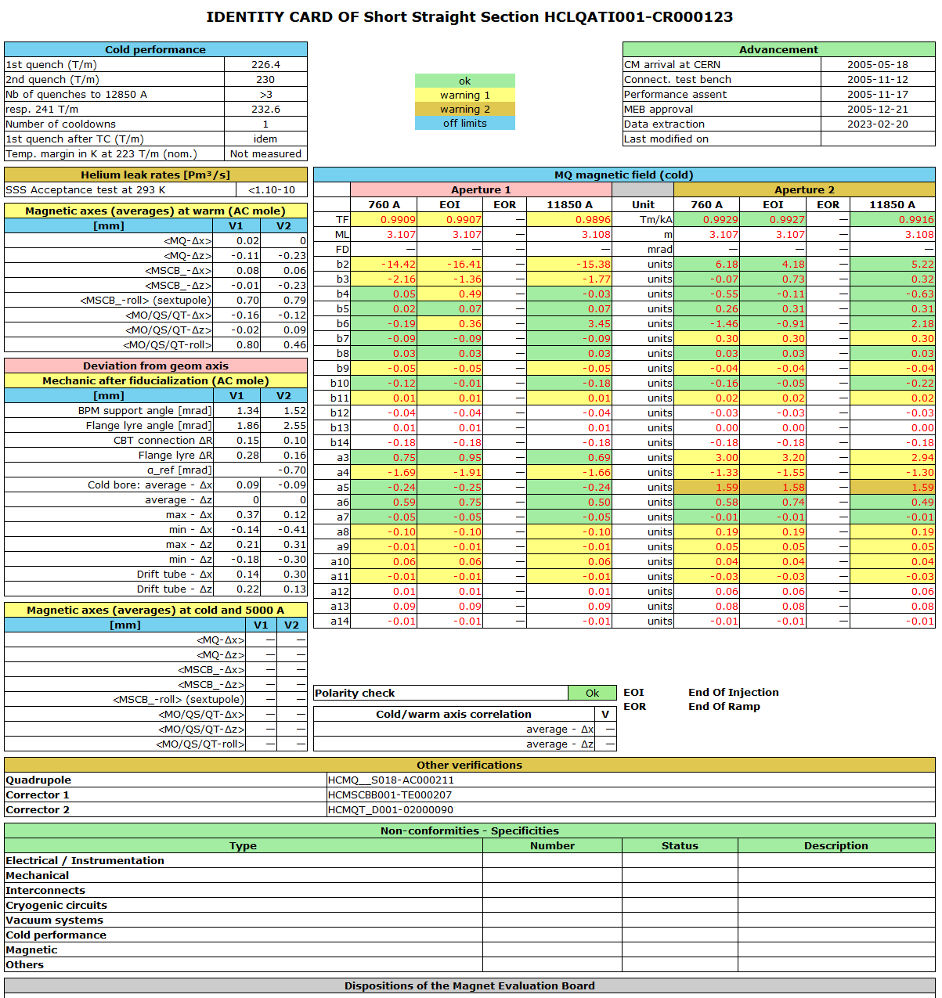
Ex: SSS 123
SSS5xx (MQ+MQTL) & SSS6xx (MQM or MQY) are also available

Slide 5
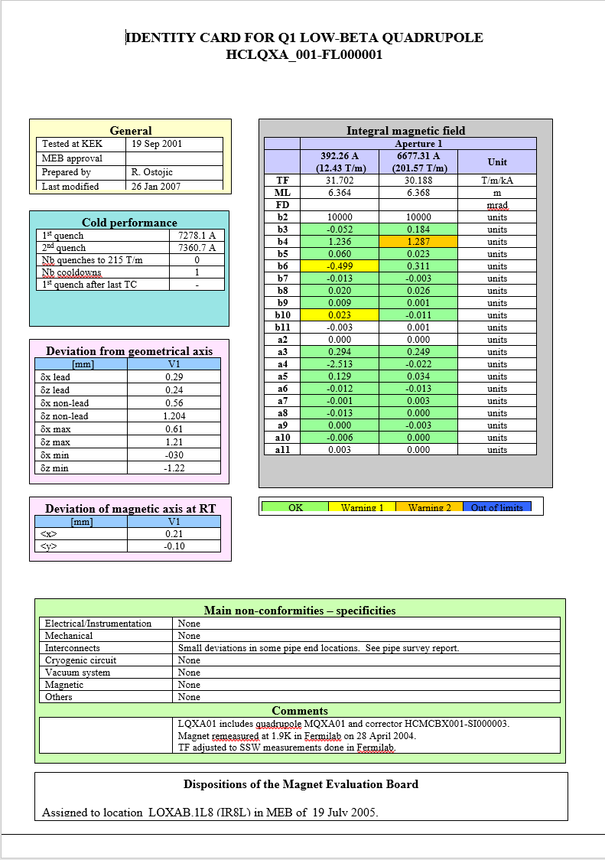
Other magnets ?
Triplets : individual ID cards available in Ranko’s Public directory
IPD, RU: ??

Slide 6
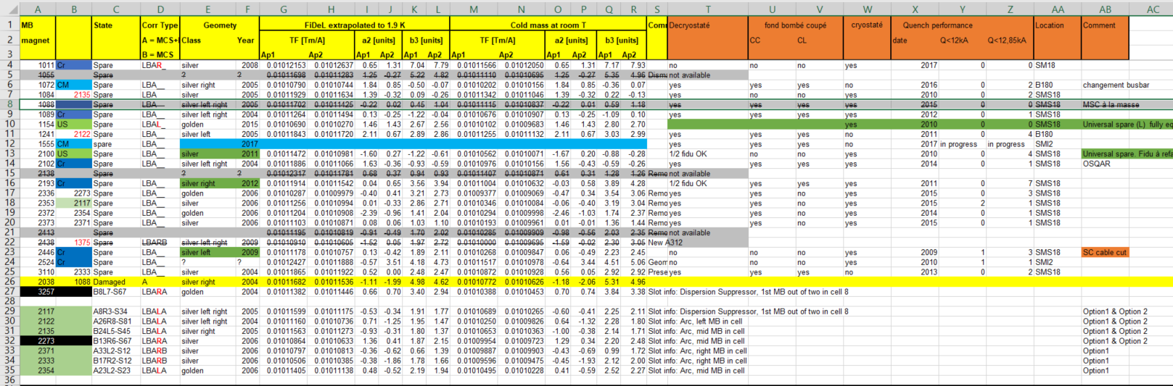
Magnets replacement for LS2
Dipole selection made with an excel file (Ex MBA)

