Slide 1
EIROforum CM workshop (25-26 Apr’23)
ESA presentation
Fernando Aldea-Montero
ESA Science Operations – Product Assurance
Notes:
For additional information in this slide deck please check the Additional Notes section below the slide

Slide 2

We Are ESA
EUROPE’S GATEWAY TO SPACE
WHAT
22 Member States, 5000 employees
WHY
Exploration and use of space for exclusively peaceful purposes
WHERE
HQ in Paris, 7 sites across Europe and a spaceport in French Guiana
HOW MUCH
€6.49 billion = €12 per European per year
Notes:
Additional Notes
Who: Austria, Belgium, the Czech Republic, Denmark, Estonia, Finland, France, Germany, Greece, Hungary, Ireland, Italy, Luxembourg, the Netherlands, Norway, Poland, Portugal, Romania, Spain, Sweden, Switzerland and the United Kingdom. Slovenia, Latvia and Lithuania are Associate Members. Bulgaria, Croatia, Cyprus, Malta and Slovakia have cooperation agreements with ESA. Canada takes part in some ESA programmes under a Cooperation Agreement.
ESA and the EU are two different organisations but they work together with the same goal: to benefit European citizens. They work together on projects that represent about 20% of ESA’s budget.
Employees: 2300 permanent staff; the rest are provided by European industry to work on site as local contracted experts.
When: The idea for an independent European space organisation developed in the 1960s. Two existing organisations, ESRO for space research and ELDO for launchers, were merged in May 1975 to form ESA.
Where: choose which Establishments to highlight, covering all will make the presentation longer than 5’.
How much: 85% of ESA’s budget is spent on contracts to industry in ESA Member States. Citizens of Europe can enjoy the results, for just €12 per year.
Pie charts by programme and MS: http://www.esa.int/About_Us/Welcome_to_ESA/Funding

Slide 3
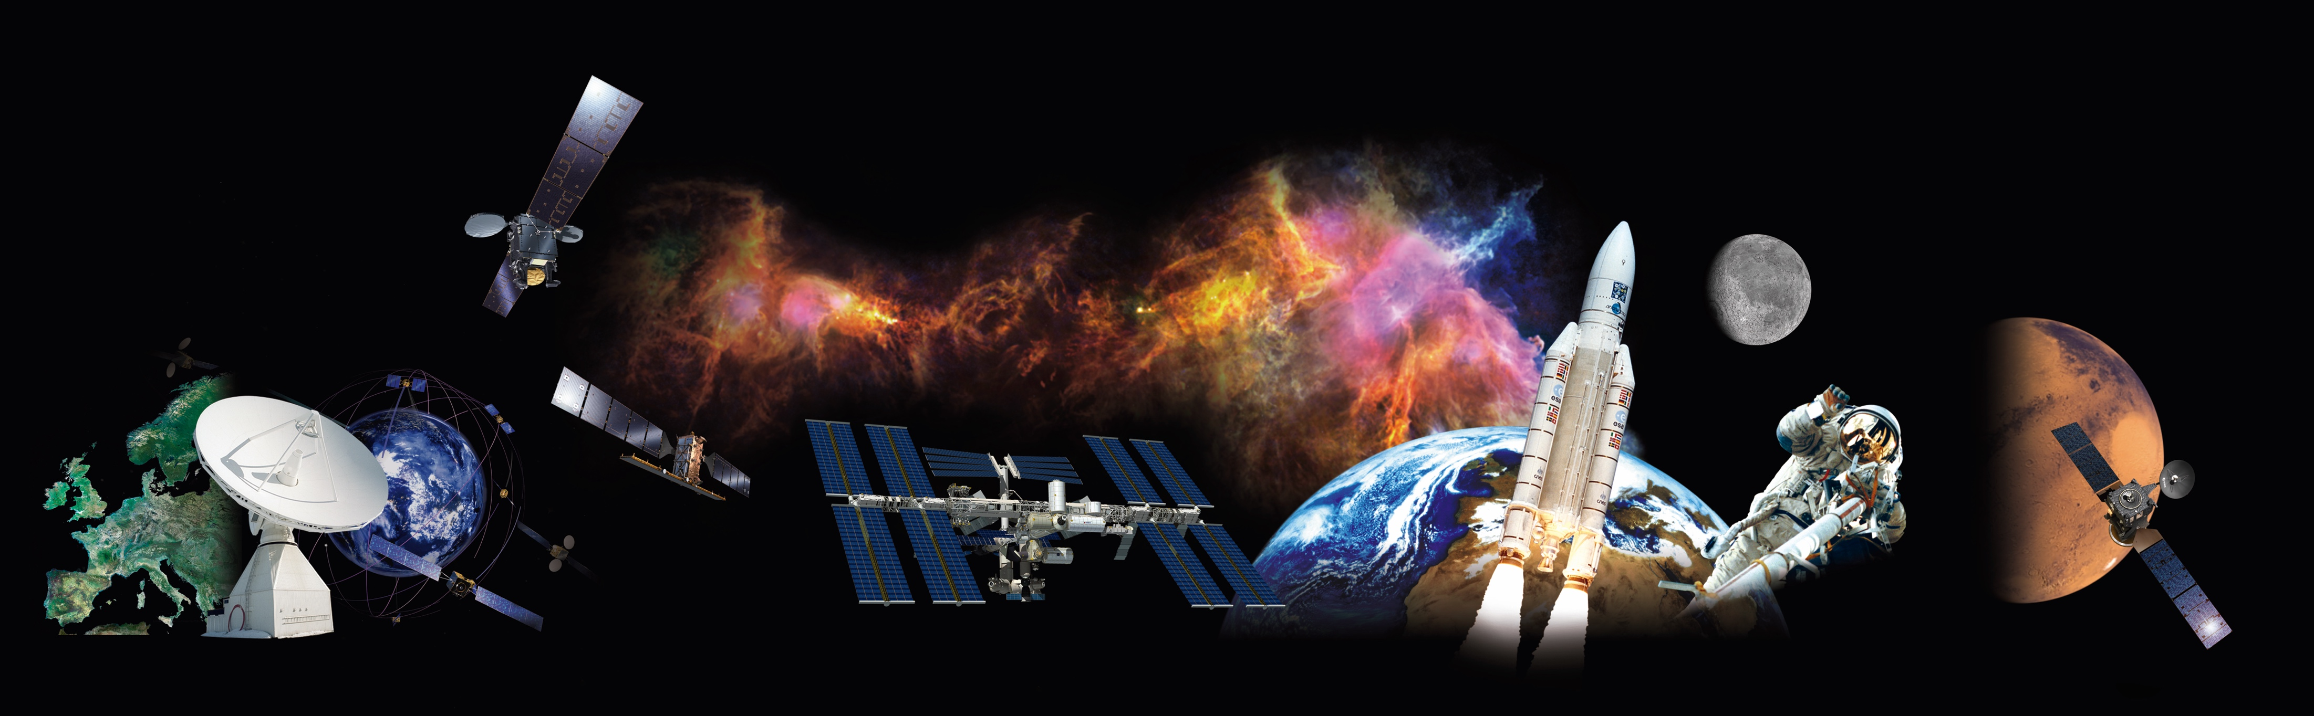
What Does ESA Do?
ALL OF THIS IS POSSIBLE THANKS TO THE COLLABORATION OF MEMBER STATES
ESA is active across every area of the space sector
World leader in science and technology
Over 80 satellites developed, tested, and operated since 1975
More than 220 launches from Europe’s Spaceport in Kourou
Notes:
Additional Notes
Unlike many other national space agencies, ESA covers all areas of space activities: space science, human spaceflight, exploration, Earth observation, space transportation, navigation, operations and space safety, technology and telecommunications, plus active industrial development. This makes ESA unique.
Europe’s spaceport in Kourou means that Europe has independent access to space for scientific and commercial missions; autonomous operations and space safety capabilities through ESA’s mission control centre and Estrack deep-space network mean that ESA is a much sought-after partner for international collaboration.

Slide 4
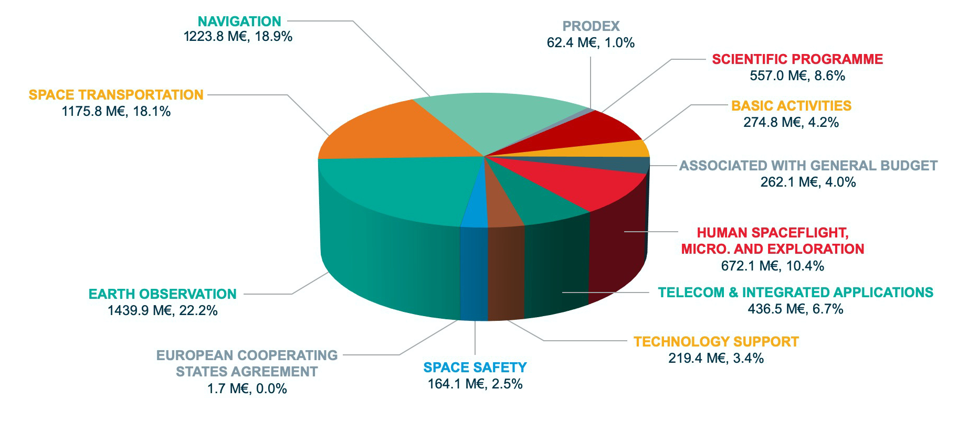
ESA Budget by Domain for 2021: 6.49 B€
Notes:
Additional Notes
This figure includes activities implemented for other institutional partners

Slide 5
CORPORATE ACTIVITIES
ESA Establishments

Slide 6
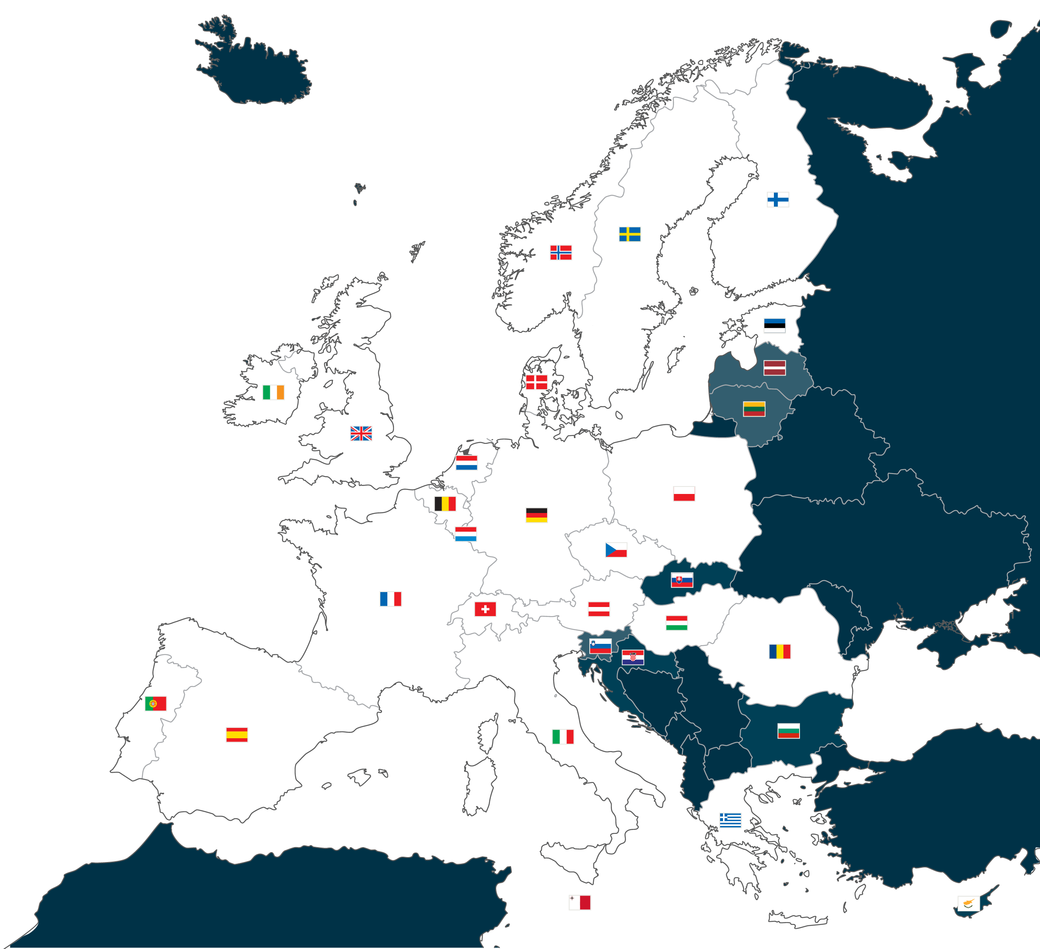
ESA Establishments (1)
Headquarters
Located in Paris, home to the main programme
directorates that steer and formulate ESA policy.
ESRIN
ESA’s centre for Earth observation activities, near
Rome, Italy, also develops information systems
and hosts the Vega launcher project.
ESTEC
The European Space Research and Technology
Centre, Noordwijk, the Netherlands, is the largest
site and the technical heart of ESA.
ESOC
The European Space Operations Centre, Darmstadt,
Germany, tracks and controls European spacecraft.
EAC
The European Astronaut Centre, Cologne, Germany,
trains astronauts for missions to the International
Space Station and beyond.

Slide 7
ESA Establishments (2)
ESAC
The European Space Astronomy Centre, near
Madrid, Spain, hosts the science operation centres
and archives for ESA’s astronomy and planetary missions.
Harwell (ECSAT)
Harwell Centre, in Oxfordshire, UK, is focusing
on commercialisation and partnerships in space activities.
Redu (ESEC)
The European Space Security and Education Centre in Belgium is part of ESA's ground station network and has specialised on operating small satellites and security relevant, sensitive operations.
Guiana Space Centre
ESA’s launchers lift off from Europe’s Spaceport in
Kourou, French Guiana. It is jointly operated by the
French space agency (CNES) and Arianespace with
the support of European industry.
Notes:
Additional Notes
Regarding ESEC in Redu: ESEC also hosts the core of ESA's Cyber Security capability as well as key Education related activities
More premises:
Liaison offices : Brussels, Washington, Moscow
Ground stations : Kiruna (Sweden), Cebreros (Spain), Kourou (French Guiana), Perth (Australia)…
Integrated teams : Baltimore (NASA), Pasadena, (NASA), Toulouse (CNES)
In addition, there is more than 300,000 m² total building surface and 5000 on site employees

Slide 8
SCIENCE & EXPLORATION
Notes:
Additional Notes
Transition: Now that we can launch, build and control our satellites, where do we go next? These are some of the questions that ESA tries to answer, together with scientists across the world:
Are we alone? What is the origin of our solar system and stars? What is the origin of life?

Slide 9
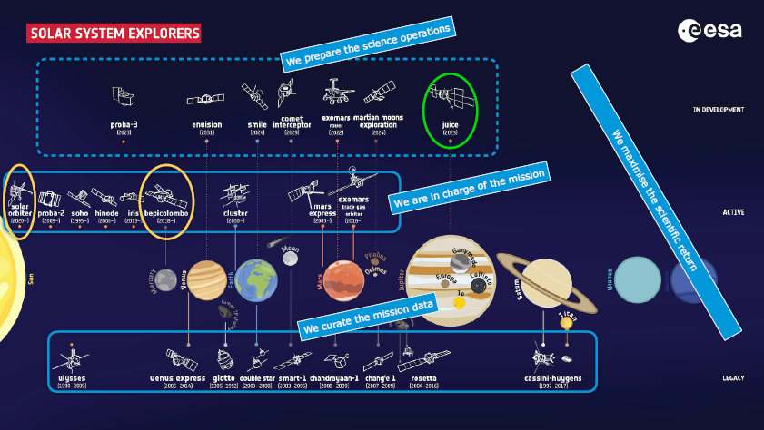
Some of Today and Tomorrow’s Science Missions (1)
Notes:
Additional Notes
Synthesis charts:
Solar system: https://www.esa.int/spaceinimages/Images/2019/02/ESA_s_fleet_of_Solar_System_explorers
Cosmic observers: https://www.esa.int/spaceinimages/Images/2019/02/ESA_s_fleet_of_cosmic_observers

Slide 10
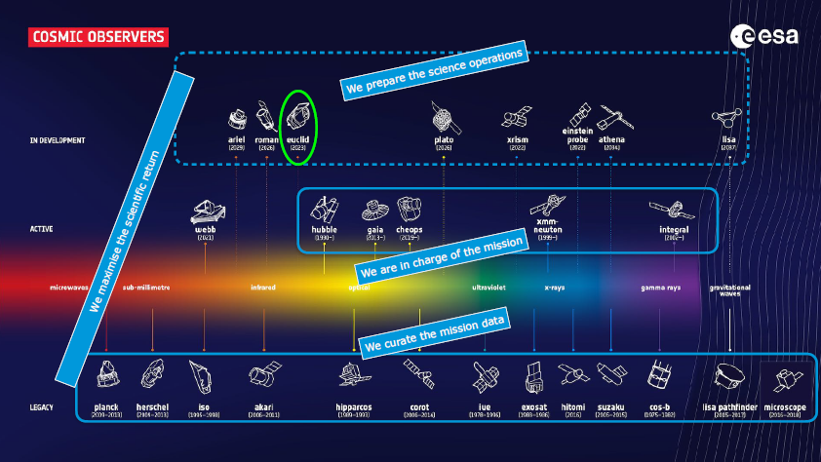
Some of Today and Tomorrow’s Science Missions (2)
Notes:
Additional Notes
Synthesis charts:
Solar system: https://www.esa.int/spaceinimages/Images/2019/02/ESA_s_fleet_of_Solar_System_explorers
Cosmic observers: https://www.esa.int/spaceinimages/Images/2019/02/ESA_s_fleet_of_cosmic_observers

Slide 11
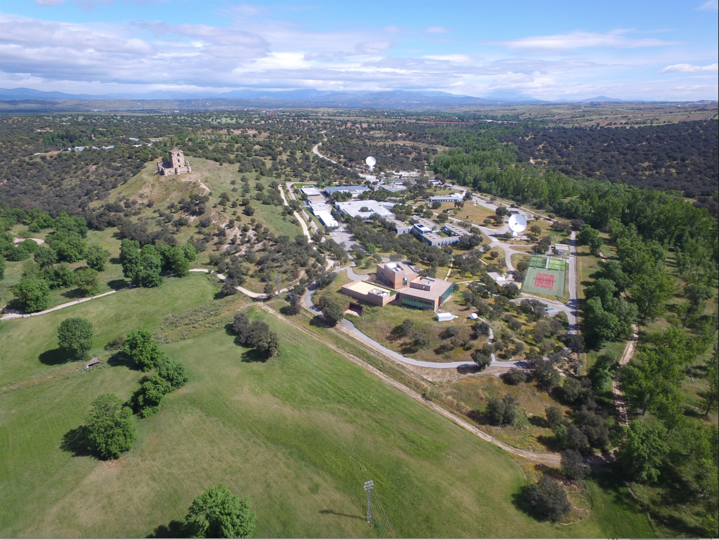
Science Operations
ESAC (near Madrid, Spain) is ESA’s centre for science operations.
ESAC
ESAC hosts ESA’s Science Operations Centre (SOC) for ESA astronomy and Solar System missions.
Notes:
Additional Notes
The scientific archives for the majority of ESA’s science missions are kept here so that researchers have a single ‘entry point’ for accessing the wealth of scientific data.
Science operations include: the interface with scientific users, mission planning, payload operations and data acquisition, processing, distribution and archiving

Slide 12
OTHER PROGRAMME DIRECTORATES
Human and Robotic Exploration
Observing the Earth
Telecommunications
Navigation

Slide 13
ESA CM CONTEXT & CHALLENGES

Slide 14
ESA context (1)
Very diverse missions, e.g.
  SCIENCE: one-off missions (little or no repetition)
  EARTH OBSERVATION: family of satellites (e.g. SENTINEL’s)
  NAVIGATION: recurrent satellites (e.g. GALILEO)
OPERATIONS with diverse entities, e.g.
  ESOC (internal missions)
  EUMETSAT (meteorological missions)
  EUSPA (navigation missions)
  LAUNCHERS, TELECOMMUNICATIONS…
  Also INTER-AGENCY missions, e.g.
  BepiColombo (with JAXA)
  James Webb (NASA mission with ESA participation)
  SMILE (with CAS - Chinese Academy of Science)

Slide 15
ESA context (2)
INDUSTRIAL projects (mainly):
  ESA as final customer; industry as system prime
  INDUSTRY remain responsible for CM processes & tools
    (at their level & lower-levels)
  Satellite configuration only transferred to ESA as documentation
    (PDF/Excel copy of AS-BUILT & INVENTORY)
  GEODIS (geographical distribution) contracting policy
    (mission consortia often complex & difficult to manage)
Some exceptions:
  COPERNICUS (Earth Observation)
  GALILEO (Navigation)
    (in partnership with EC (European Commission) as final customer)

Slide 16
ESA context – Science Operations (1)
Complexity of MISSION CONSORTIA
  ESAC as Science Operations prime (SOC)
  ESOC as Mission Operations prime (MOC)
  Various external partners (instrument teams)
    (Universities & Scientific institutes)
  No CUSTOMER-SUPPLIER, but PARTNERSHIP agreements
    (difficulty to establish/harmonize CM processes & tools)
  On-site SERVICES (rather than INDUSTRIAL projects)
  Small PROJECT TEAMS – lack of support resources
    (e.g. no dedicated documentalists)

Slide 17
ESA context – Science Operations (2)
No dedicated OPERATIONAL NETWORK; use of CORPORATE network instead
  Commercial hardware infrastructure (even if powerful)
  Huge amount of software (third-party & ESA own software)
  Operations & CM processes are therefore much SW-oriented
Diversity of roles
  SCIENTISTS vs ENGINEERS vs MANAGERS
    They do not speak the same language!

Slide 18
ESA context – Mission Operations (ESOC)
SATELLITE handover after LAUNCH
Not really a SATELLITE CM process as such:
  Starting from SATELLITE AS-BUILT & OPERATIONAL PROCEDURES
  Mainly consists of OPERATIONAL SETTINGS, e.g.:
  Mission Timeline
  Operational configuration
    (e.g. UNITS on/off, MAIN or REDUNDANT unit in use, SATELLITE MODE)
  ON-BOARD SOFTWARE CONFIGURATION
    (the only thing you can really change after launch)
    SATELLITE INVENTORY aspects – not dealt with by OPERATIONS
      (Exception: configuration of Satellite EM – Engineering Model)

Slide 19
ESA context – Standardization (1)
ECSS = European Cooperation for Space Standardization
  Applicable baseline for all space projects (theoretical base)
  Free registration (https://ecss.nl)
  In particular, ECSS-M-ST-40C for CM aspects
  This standard defines CM concepts, processes, requirements, documentation templates, etc; but no specific CM tools are imposed
  Some CM training material is available too
  KEY CONCEPT in ECSS CM: from AS-DESIGN to AS-BUILT

Slide 20
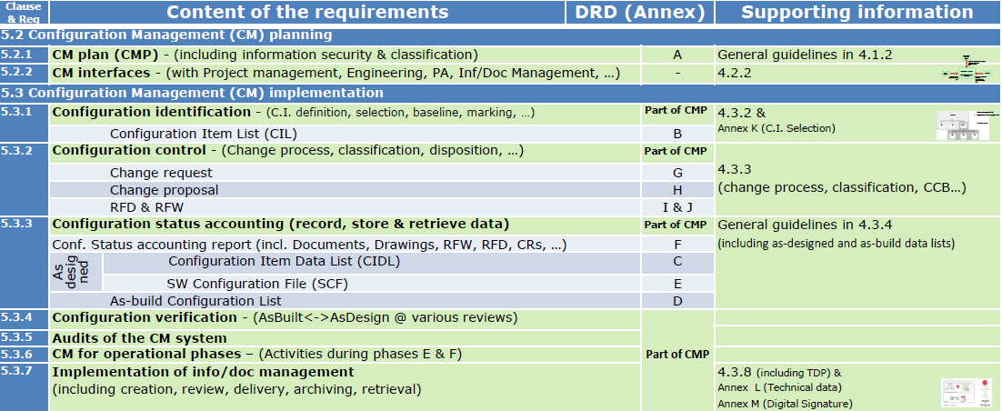
ESA context – Standardization (2)

Slide 21
ESA context (Science) – CM tool landscape
Tool / Area | Product in use
Document Management (PDM) | Official documents: Eclipse, Content Server/Livelink (based on OpenText) Informal/collaboration documents: Confluence, Sharepoint, MS Teams (some only Windows) Latex (legacy missions)
Asset Management | Excel (inventory from lower-level contractors) Sci-image (Digital Asset Management), based on AssetBank
Computerized Maintenance Management System (CMMS) | esanow (based on ServiceNow)
Change Management (CM) | Source code: Gitlab (mainly) & SVN (legacy missions), Confluence/Jira Documentation: same as PDM Requirements management: Confluence/Jira, DOORS
Other tools | SOCCI & S2E2 (based on Confluence/Jira) – methodology to support system engineering activities and processes Risk Management: Confluence/Jira, Excel (in the future maybe ERiS, already in use in D-EOP)

Slide 22
ESA CM tool landscape – SOCCI/S2E2
SOCCI = Science Operations Configuration Control Infrastructure
  Methodology to support system engineering activities & processes
    (e.g. Project Management, Change Management, Problem Resolution, Requirements Engineering, etc)
  Based on state-of-the-art tools (configured and enhanced as needed)
  Driven by ECSS standards & processes
  Implemented as a set of project templates in the SCI-S System Engineering Environment (S2E2)
  Based on Atlassian tools (Confluence, Jira, Bitbucket)
  More information here:
    https://socci.esa.int/www/socci_science/SUM_-_Software_User_Manual.html

Slide 23
ESA challenges – Inventory process (1)
Asset Management at satellite level
SCIENCE → one-off satellites but lots of commonality in (lower-level) parts
Equipment storage after satellite launch (thousands of items!)
ESA goal → exploit reuse potential for other missions
  Huge potential for financial & schedule savings!
Example 1 (JUICE):
  More than 1.000 spare items relocated to other projects
    (e.g. Solar arrays, EEE parts, capacitors…)
Example 2 (Bepi-Colombo):
  Motorized container found in inventory → 6-month schedule saving!

Slide 24
ESA challenges – Inventory process (2)
HOWEVER…
Complex initiative as many companies involved (> 60), with diversity of tools & formats
Collection of information: pictures (a lot) & on-site inspections (fewer)
  More on-site inspections would help (accurate info & saving storage costs)
EXCEL is the only tool used so far (at ESA level)
INVENTORY items are offered in this order:
  To other Science missions (same directorate)
  To other ESA directorates (Earth Observation, Telecommunications, etc)
  To external partners (universities, scientific institutes)
  Last option: donation to museums
  If nothing else works, disposal of items

Slide 25
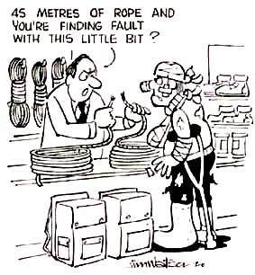
QUESTIONS?

