Slide 2
Technical Galleries Consolidation Program
Priorities in terms of integration
Integration meeting on February 23rd, 2023
S. EVRARD

Slide 3
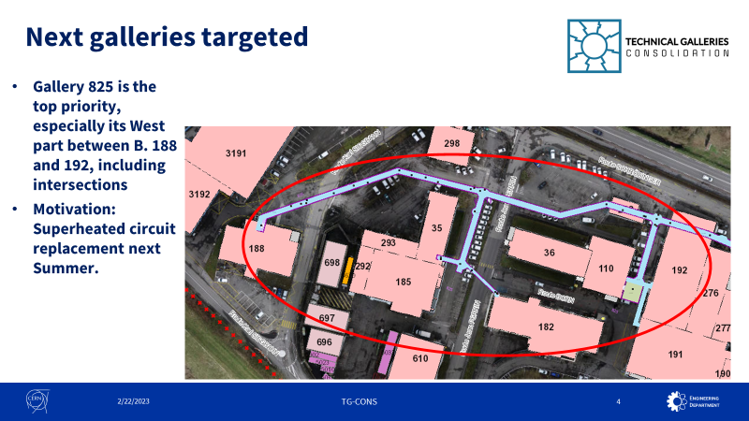
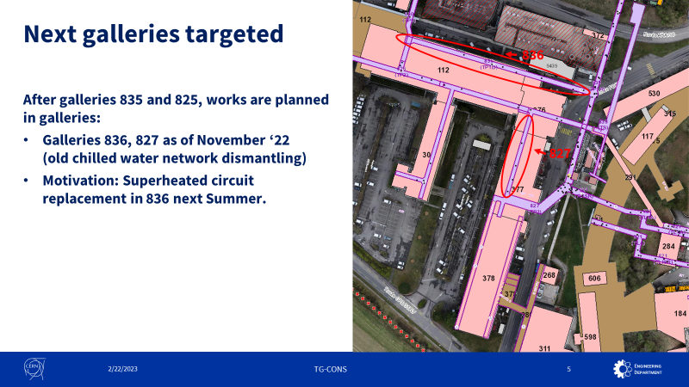
Reminder from September 2022

Slide 4

Update of integration priorites
It is now time to review our priorities
Work oriented decision-making process and definition
Visibility for the whole year 2023 for the design offices
In line with Project 2023 road map presented @ PT21
Already presented at Coordination meeting # 11 for info
Today, collection of feedbacks from the various design offices
The dates mentioned are tentative proposals and not binding deadlines
Inputs from design offices and integration team are necessary to confirm /modify the proposals and adapt resources if needed.

Slide 5
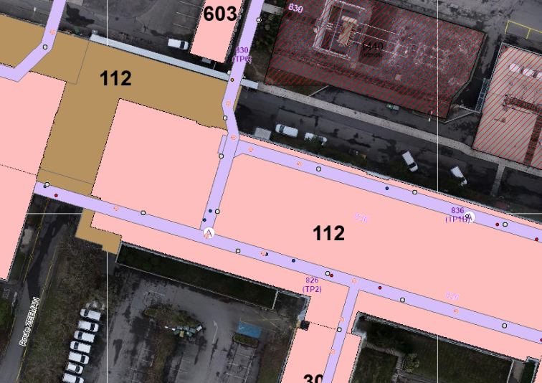
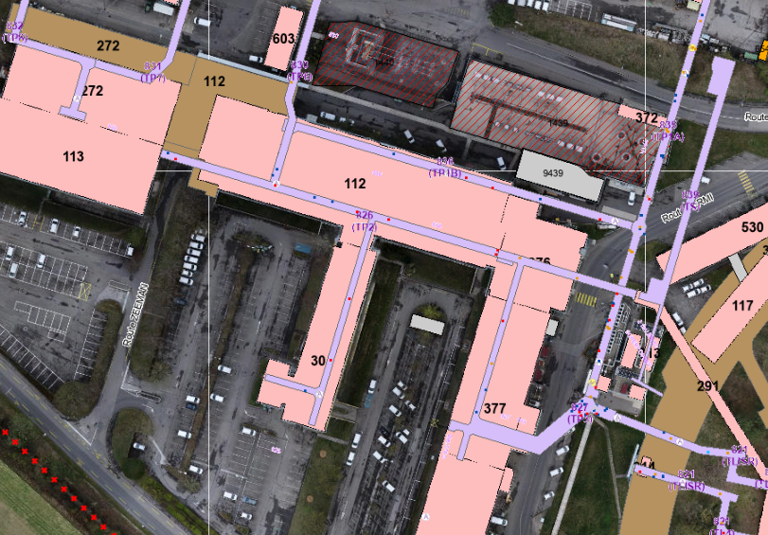

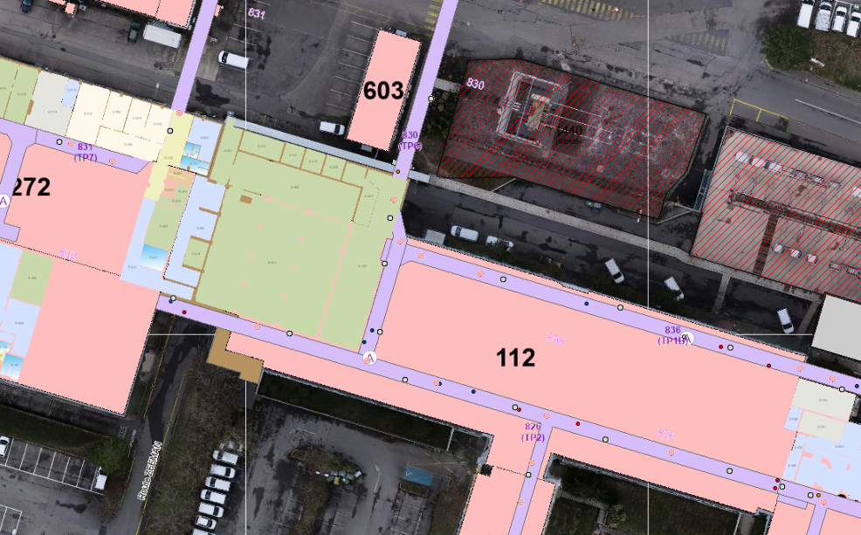
Milestones proposal – chronological order
RE= Reverse Engineering, FC = Future Configuration, AB = As-Built
Activity | Milestone | Date | Gallery | Location
RE | Delivery | 22/2/23 | 836 | Corner GT836
FC | Validation | 23/2/23 | 825 | b.188-b.35 (with branch)
RE | Validation | 23/2/23 | 836 | Corner GT836
FC | Delivery | 2/3/23 | 836 | Corner GT836
RE | Delivery | 9/3/23 | 836 | 112/S-403
FC | Validation | 9/3/23 | 836 | Corner GT836
RE | Validation | 23/3/23 | 836 | 112/S-403
FC | Delivery | 23/3/23 | 836 | 112/S-403
FC | Validation | 6/4/23 | 836 | 112/S-403
RE | Delivery | 6/4/23 | 826 | whole
RE | Validation | 20/4/23 | 826 | whole
FC | Delivery | 20/4/23 | 826 | whole
826 whole
Courtesy: Iga Maria Krautsztrung

Slide 6
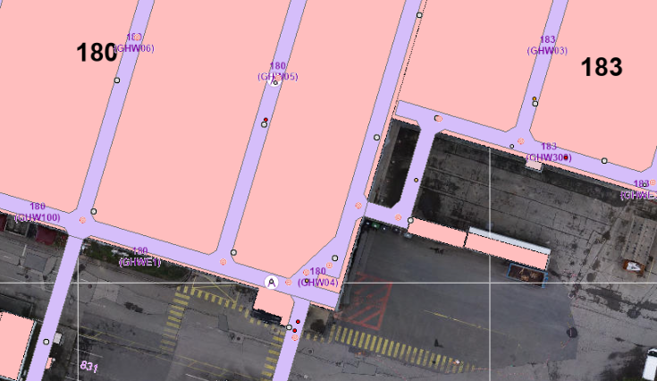
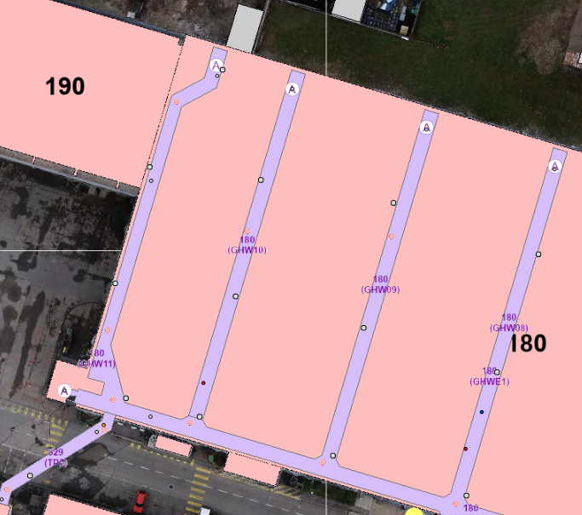
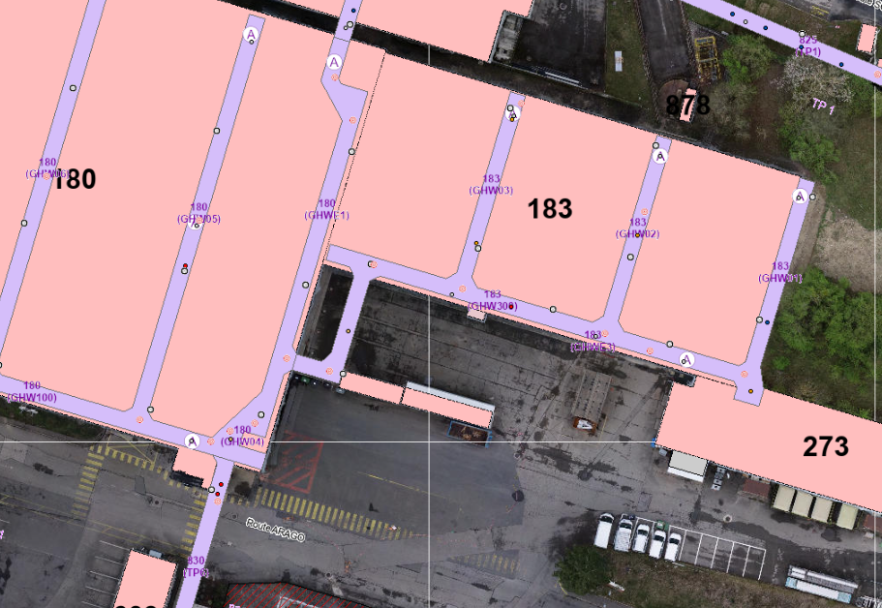
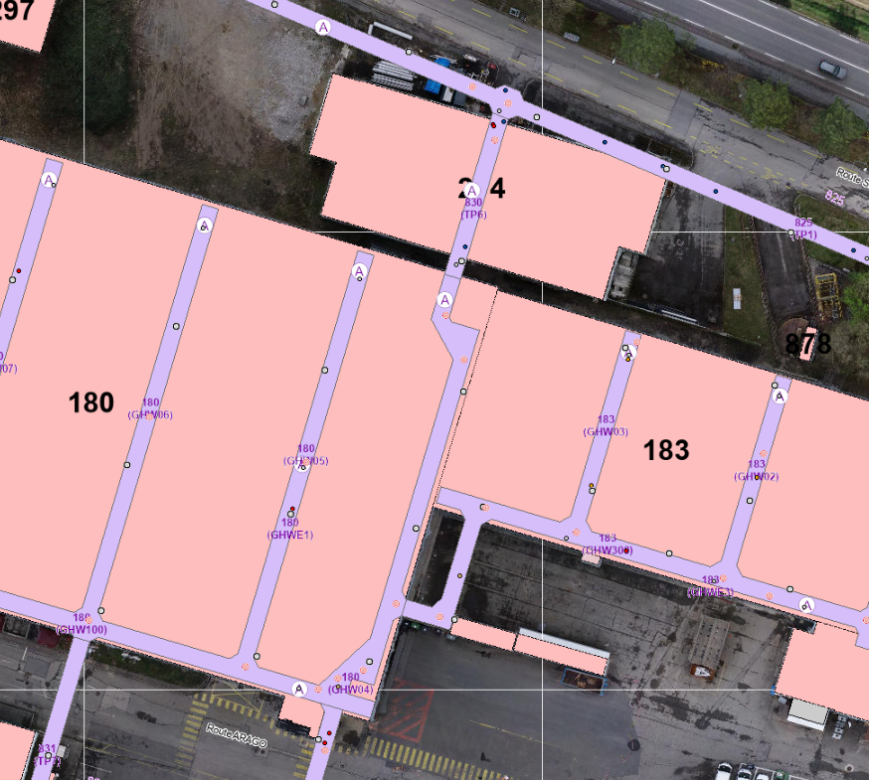
Milestones proposal – chronological order
RE= Reverse Engineering, FC = Future Configuration, AB = As-Built
Activity | Milestone | Date | Gallery | Location
FC | Validation | 4/5/23 | 826 | whole
RE | Delivery | 4/5/23 | 830* | Cross GT830-GHW100 & Cross GHW11 and corridor GHW11
RE | Validation | 18/5/23 | 830* | Cross GT830-GHW100 & Cross GHW11 and corridor GHW11
FC | Delivery | 18/5/23 | 830* | Cross GT830-GHW100 & Cross GHW11 and corridor GHW11
RE | Delivery | 1/6/23 | 830 | Cross GHW100 up to GT825 (b.274)
FC | Validation | 1/6/23 | 830* | Cross GT830-GHW100 & Cross GHW11 and corridor GHW11
RE | Validation | 15/6/23 | 830 | Cross GHW100 up to GT825 (b.274)
FC | Delivery | 15/6/23 | 830 | Cross GHW100 up to GT825 (b.274)
RE | Delivery | 29/6/23 | 830 | Under b.183
FC | Validation | 29/6/23 | 830 | Cross GHW100 up to GT825 (b.274)
RE | Validation | 13/7/23 | 830 | Under b.183
FC | Delivery | 13/7/23 | 830 | Under b.183
FC | Validation | 27/7/23 | 830 | Under b.183
Cross GHW11 and corridor GHW11
Cross GHW100 up to GT825 (b.274)
* Not gallery 830 but to be done chronologically together with gallery 830 (for the moment included in 830 tab in Detailed Schedule
Courtesy: Iga Maria Krautsztrung

Slide 7
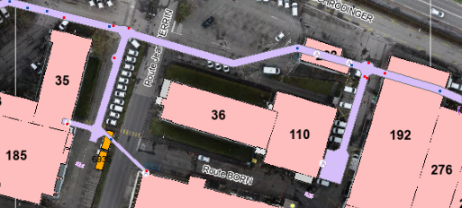
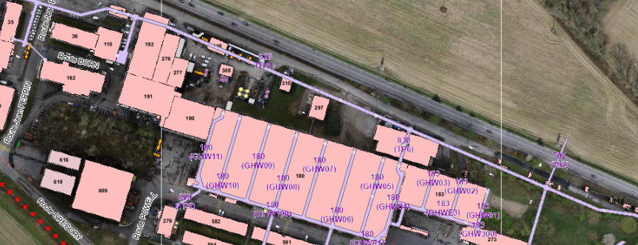
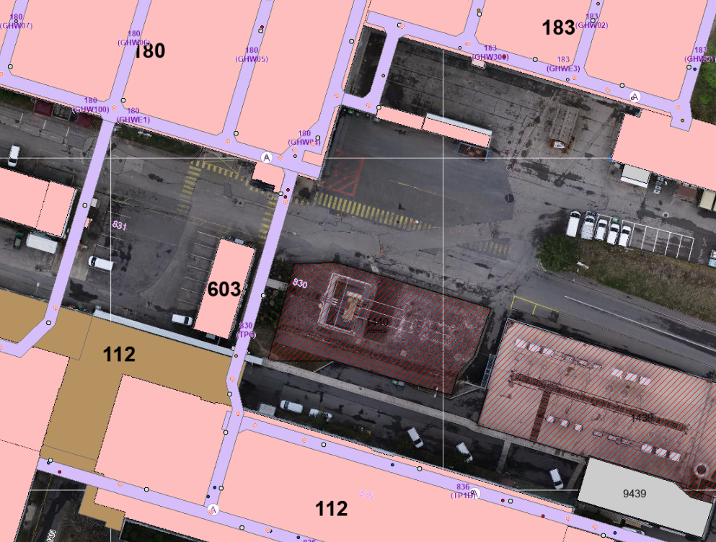
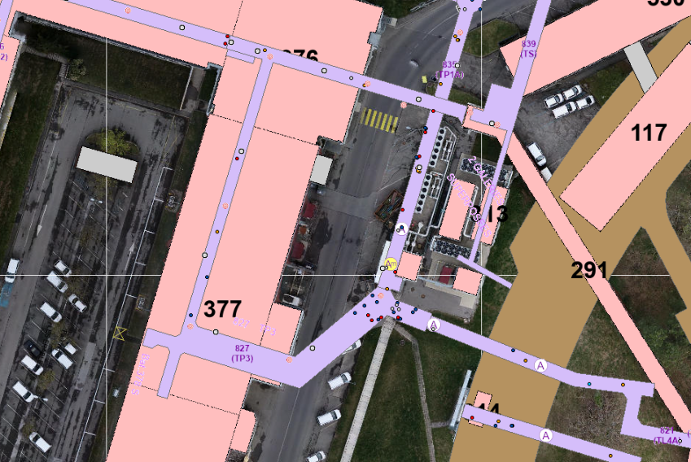
Milestones proposal – chronological order
RE= Reverse Engineering, FC = Future Configuration, AB = As-Built
Activity | Milestone | Date | Gallery | Location
RE | Delivery | 27/7/23 | 825 | b.35-b.110 (with cross next to b.110 and branch)
RE | Validation | 10/8/23 | 825 | b.35-b.110 (with cross next to b.110 and branch)
FC | Delivery | 10/8/23 | 825 | b.35-b.110 (with cross next to b.110 and branch)
RE | Delivery | 24/8/23 | 825 | b110-GT835
FC | Validation | 24/8/23 | 825 | b.35-b.110 (with cross next to b.110 and branch)
RE | Validation | 7/9/23 | 825 | b110-GT835
FC | Delivery | 7/9/23 | 825 | b110-GT835
RE | Delivery | 21/9/23 | 825 | b110-GT835
AB | Delivery | 21/9/23 | 827 | whole
AB | Validation | 5/10/23 | 827 | whole
AB | Delivery | ? | 830 | GT 836 - b.180
AB | Validation | ? | 830 | GT 836 - b.180
Courtesy: Iga Maria Krautsztrung
827 whole
Notes:
Dates highlighted in yellow to be discussed, according to resources availability

