Slide 1
Transverse Excitation in Xsuite
Thomas Bass
14 March 2023

Slide 2
RFKO Slow Extraction Simulations
Simulating RFKO Slow Extraction requires a transverse exciter element to provide the emittance blow-up
These exciters require a signal frequency different to the revolution frequency
This can be challenging in MAD-X using standard elements, as you are often limited by the turn frequency
500 measurements
1ms interval
256 turns
Q=1/3
frequency/amplitude
frequency
time
time

Slide 3
Exciter element in Xtrack
Developed by Philipp Niedermayer (GSI), github.com/Xsuite/Xtrack/pull/279
Provides a transverse exciter as a time-dependent thin multipole
Allows for an arbitrary sample frequency and thus frequency spectrum
exciter = xt.Exciter(
_context = ctx, # CPU or GPU context
samples = exciter_signal, # Array of values for signal
sampling = exciter_sampling_freq, # Sample frequency
frev = frev, # Particle revolution frequency
start_turn = 0, # Which turn to start excitation
knl = [knl1] # Integrated multipole strength
)

Slide 4
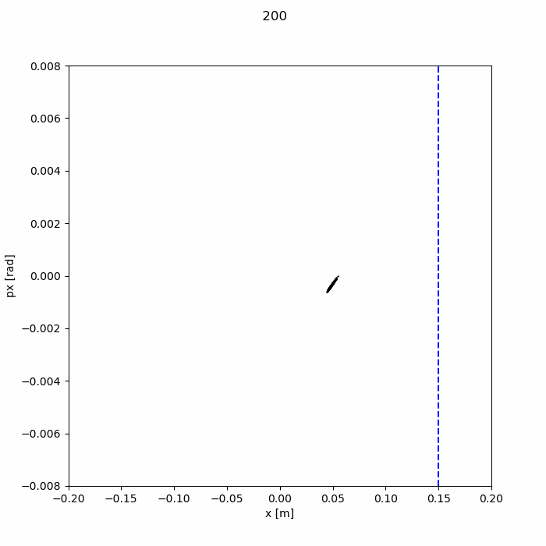
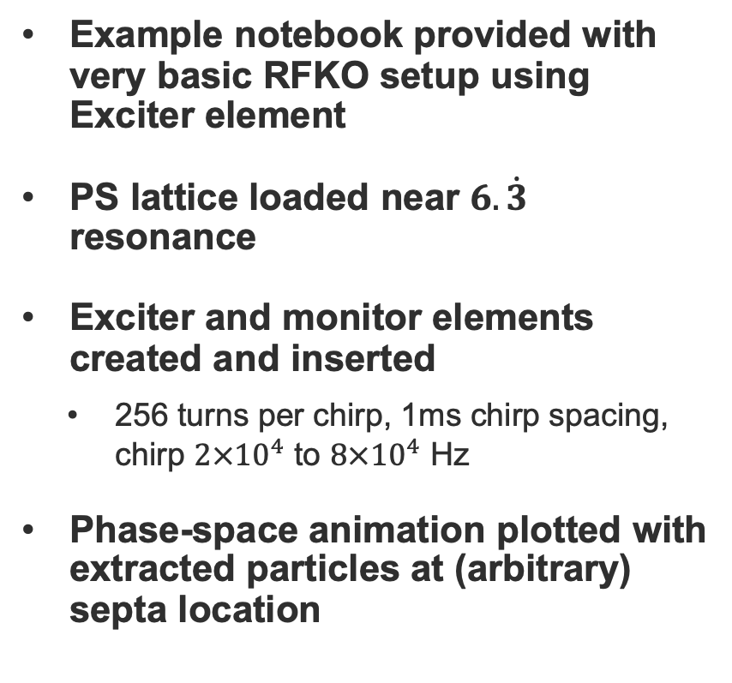
Demonstration of Signal Generation gitlab.cern.ch/tbass/xtrack-exciter-demo
Example notebook provided with very basic RFKO setup using Exciter element
PS lattice loaded near $6.\dot{3}$ resonance
Exciter and monitor elements created and inserted
  256 turns per chirp, 1ms chirp spacing, chirp $2×{10}^{4}$ to $8×{10}^{4}$ Hz
Phase-space animation plotted with extracted particles at (arbitrary) septa location

Slide 5
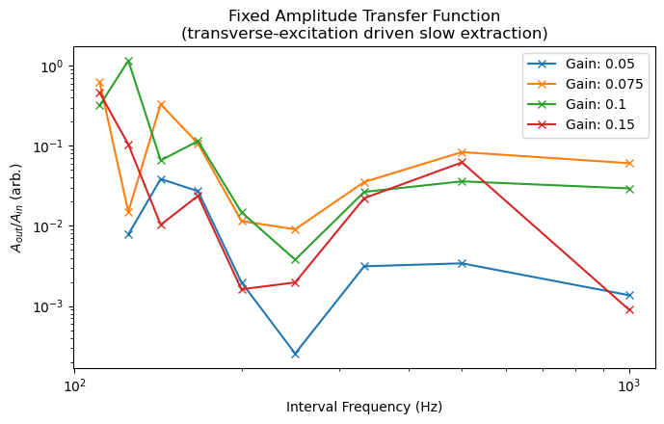
Next Steps
Particle distribution matching for RFKO slow extraction
  RFKO requires tune to be parked close to 1/3rd integer resonance
  This makes creating matched particle distributions challenging
  Overcome by creating distributions from simulations starting far from resonance
Build accurate simulations of Qmeter RFKO in the PS
  Measurements taken last year on the PS with ion run using Qmeter/BBQ to drive RFKO
  Plan to accurately simulate these measurement to compare results
Experimental results taken last year with Pb54 on PS

