Slide 1
Status of the Experiments
2022 run
A few physics results
YETS and preparation 2023 run
Progress Phase II upgrades
WLCG & Computing
Plenary RRB 56th Meeting
Joachim Mnich
April 24th, 2023

Slide 2
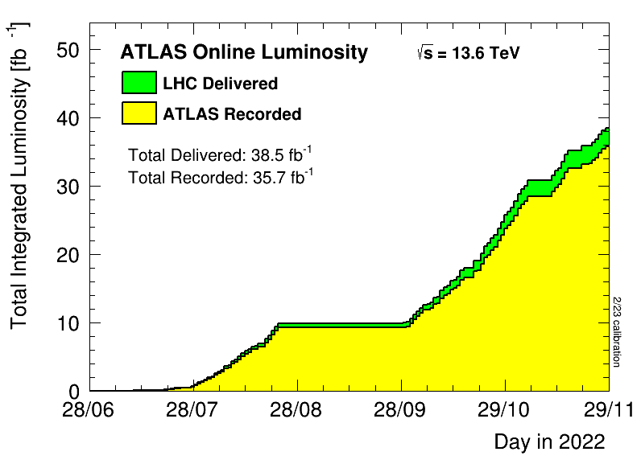
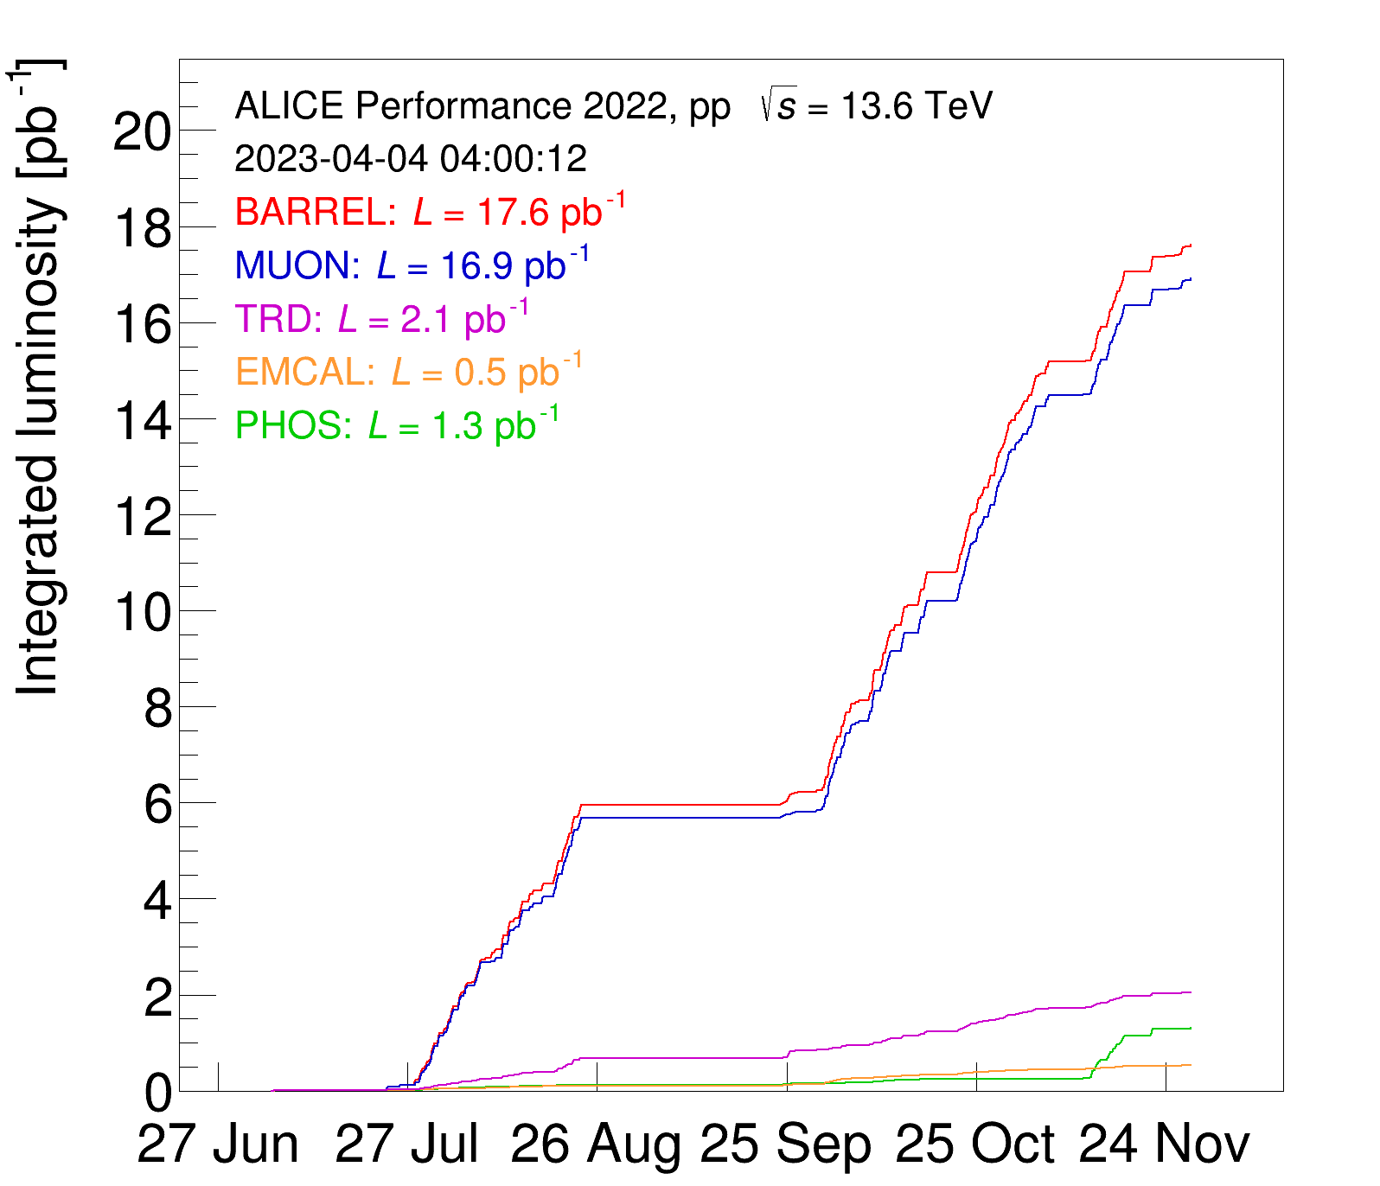
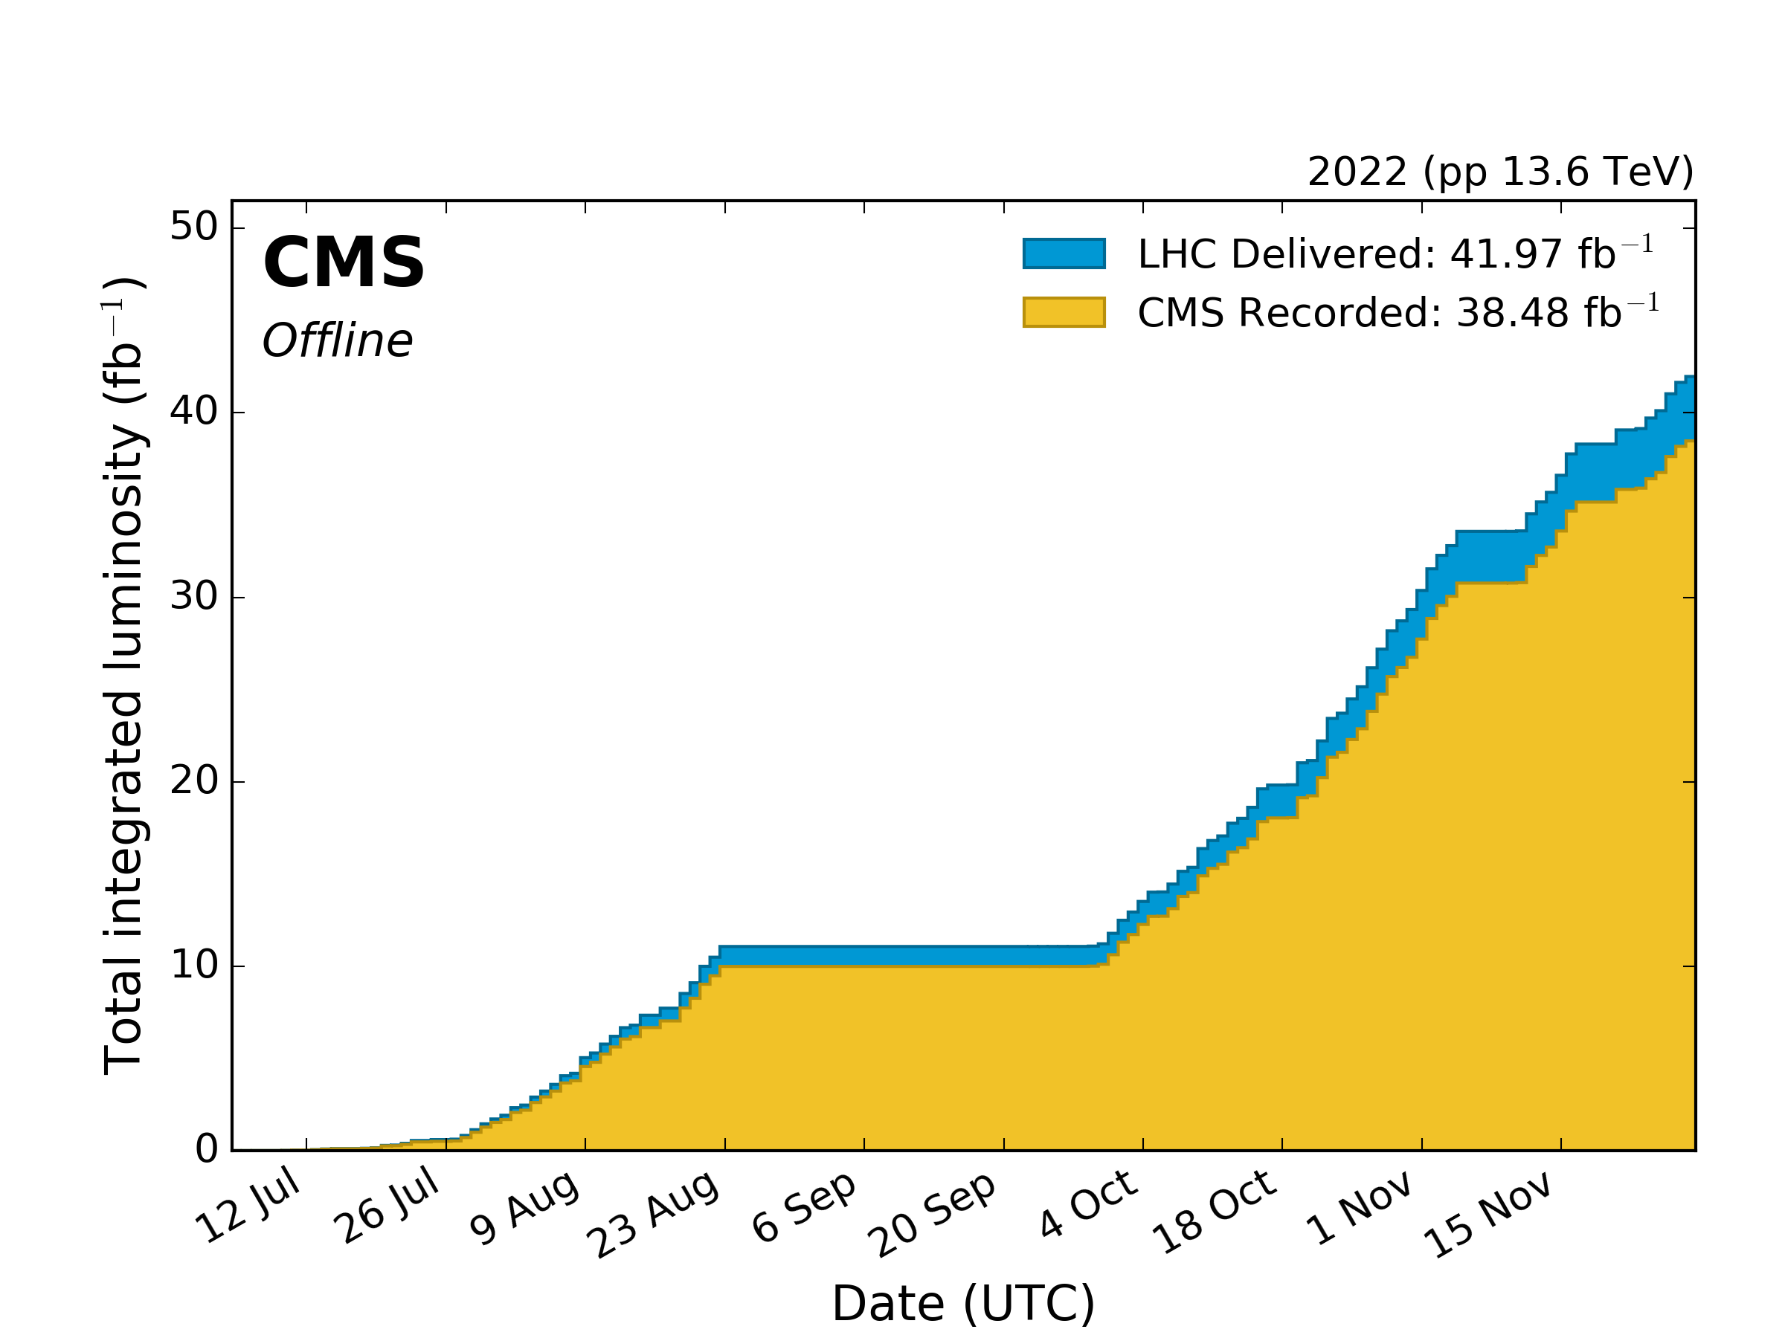
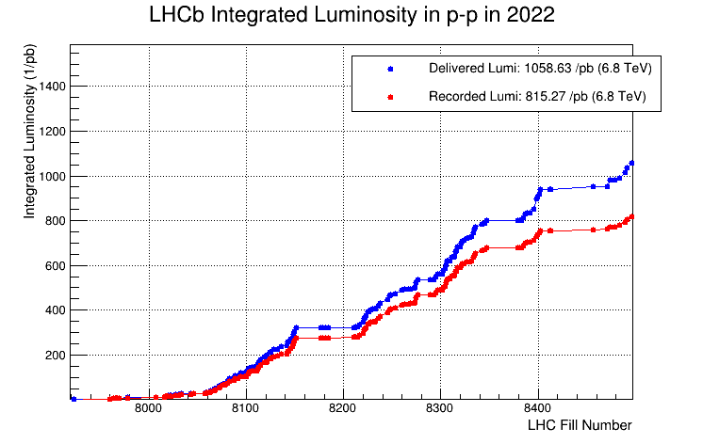
2022 Data Taking
Approx. 40 fb⁻¹ pp delivered to ATLAS & CMS
Run was shortened by 2 weeks to help mitigating energy crisis
Only pp, no significant HI run
will be compensated in 2023
ALICE
LHCb

Slide 3

ATLAS: 2022 Higgs Analysis
H → 𝛾𝛾 re-observation at 13.6 TeV (2022 data, 31.4 ± 0.7 fb^{–1})
Measured fiducial cross section: (SM: )
ATLAS-CONF-2023-004

Slide 4
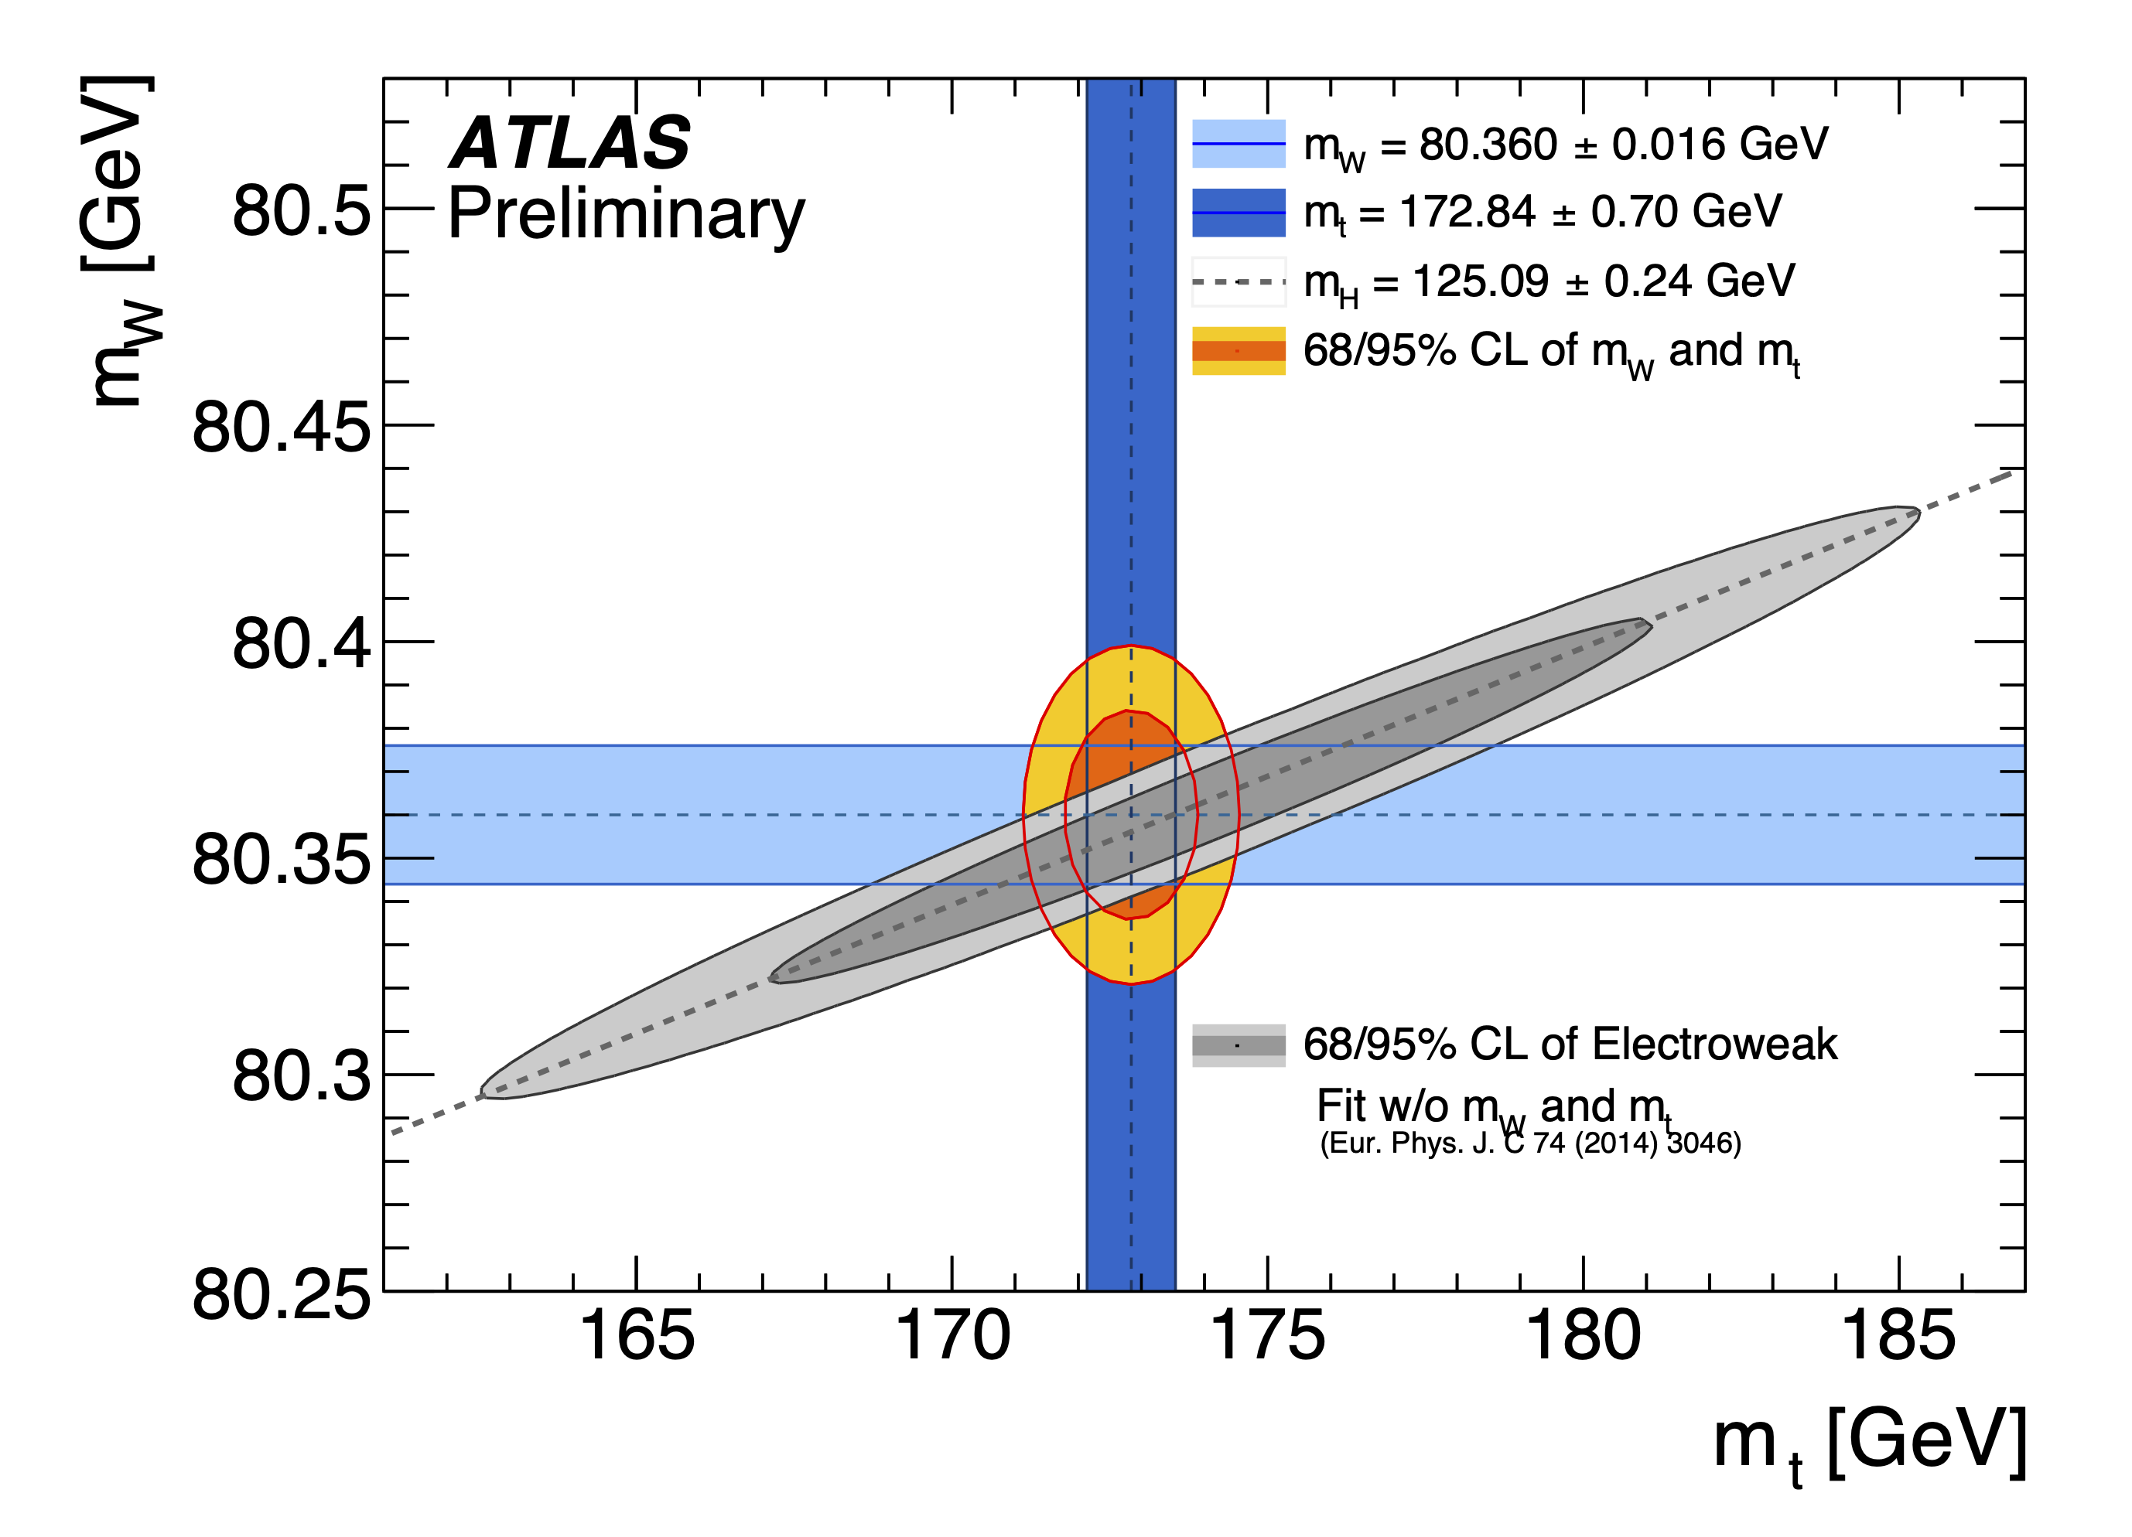
ATLAS: Improved Measurement of the W Mass
Re-analysis of 7 TeV data with improved precision: m_{W} = 80360 ± 16 MeV (previous ATLAS results: 80370 ± 19 MeV)
Based on sample of 5.9 million W → e𝜈 and 7.8 million W → μ𝜈 events
More recent PDF, constrained profile likelihood fit, verification of p_{T},W modelling with dedicated Run 2 low-pileup data
Agreement with SM
arXiv:1701.07240

Slide 5

CMS: Measurement of Tau Polarisation
https://cds.cern.ch/record/2848665?ln=en
Tau polarization determined from the angular distributions of the visible τ decay products in Z → τ τ (leptonic or hadronic)
Average polarization is extracted from a template fit in an invariant mass interval of the τ τ pairs of 75-120 GeV
Major uncertainties come from reconstruction of the hadronic decay mode of tau leptons

Slide 6

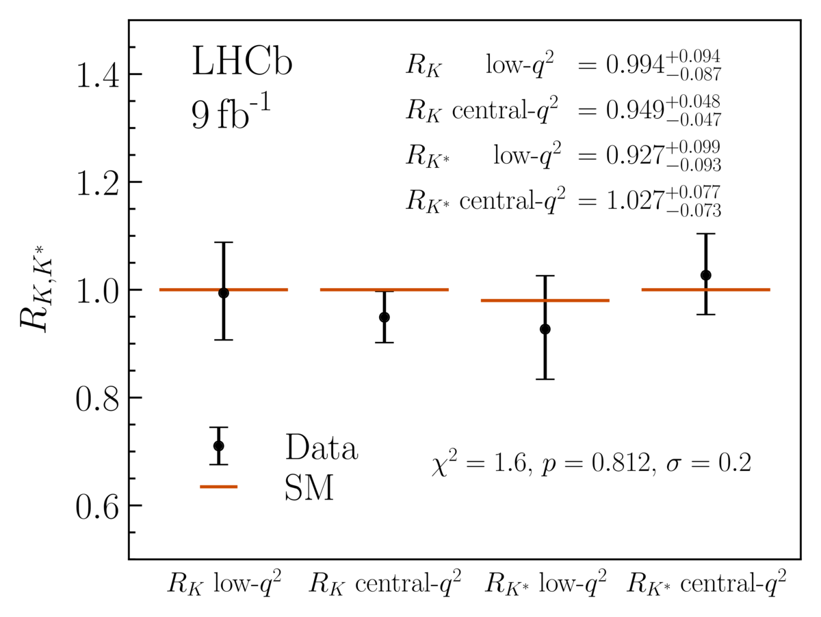
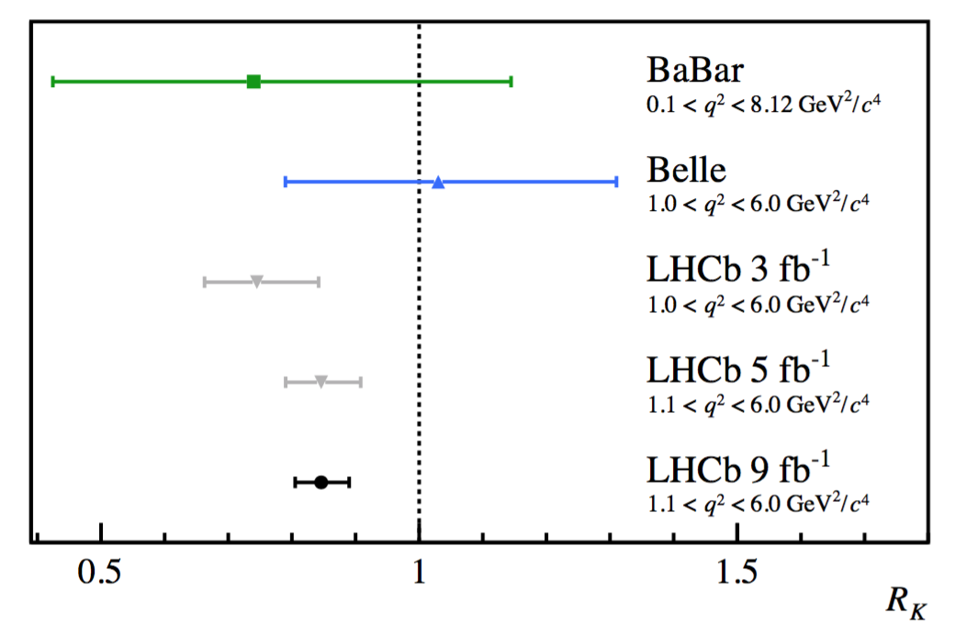

LHCb: B Anomalies R(K) & R(K*)
New analysis:
  New treatment of hadronic misidentified background to electrons
  All results in good agreement with SM
Test of lepton flavour universality ratios in rare
b→sll processes
2021 LHCb paper reported 3.1σ deviation from SM prediction (R_{K} = 1):
arXiv:2212.09153 arXiv:2212.09152
$R_{K}=N(B→Kμ^{+}μ^{−}$)/$N(B→Ke^{+}e^{−}$)

Slide 7

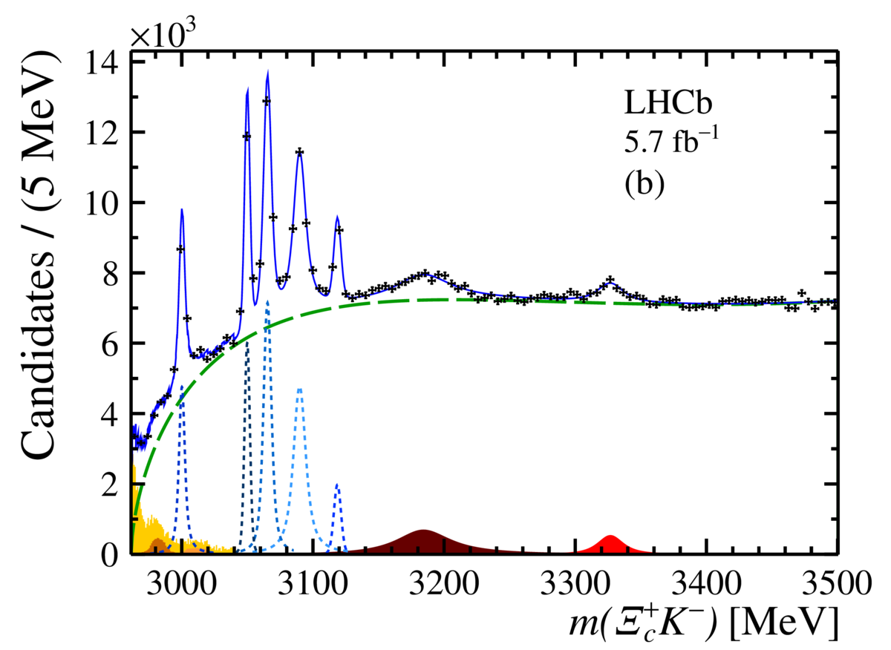
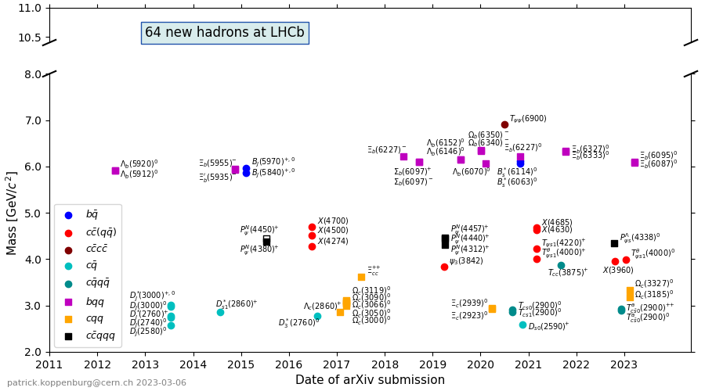
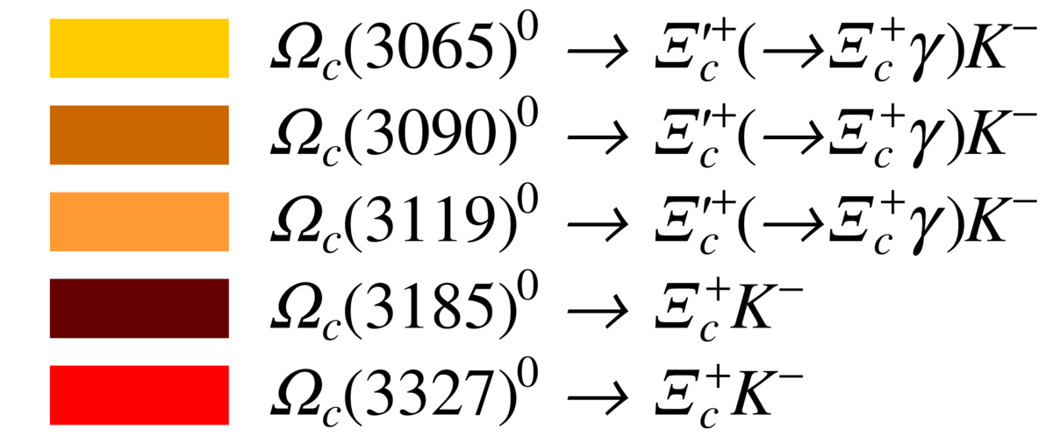
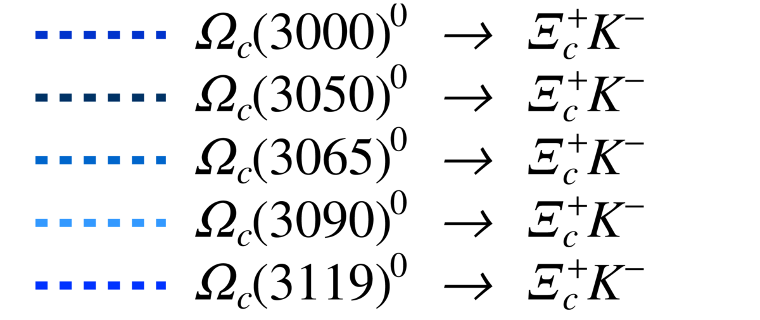
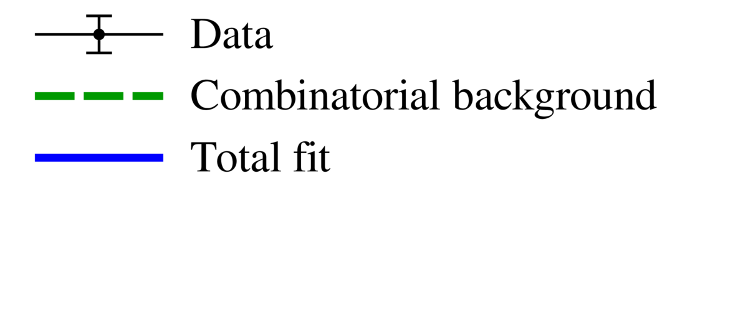


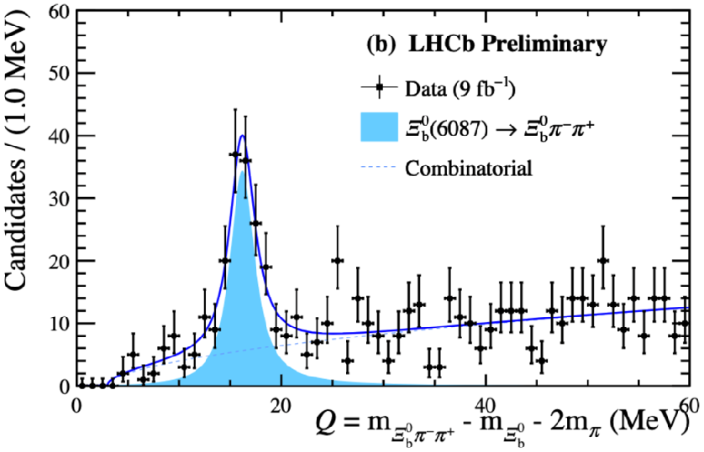
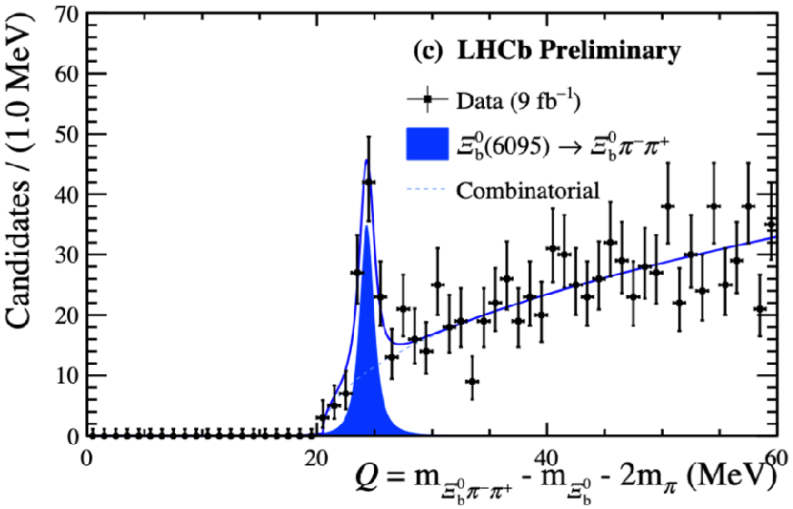
LHCb: New Heavy Baryons Observed
Observation of two new states:
Observation of two new states: and
New observations brings total to
64 particles discovered at LHCb
7

Slide 8

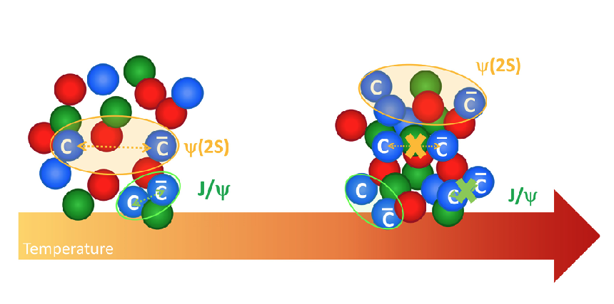
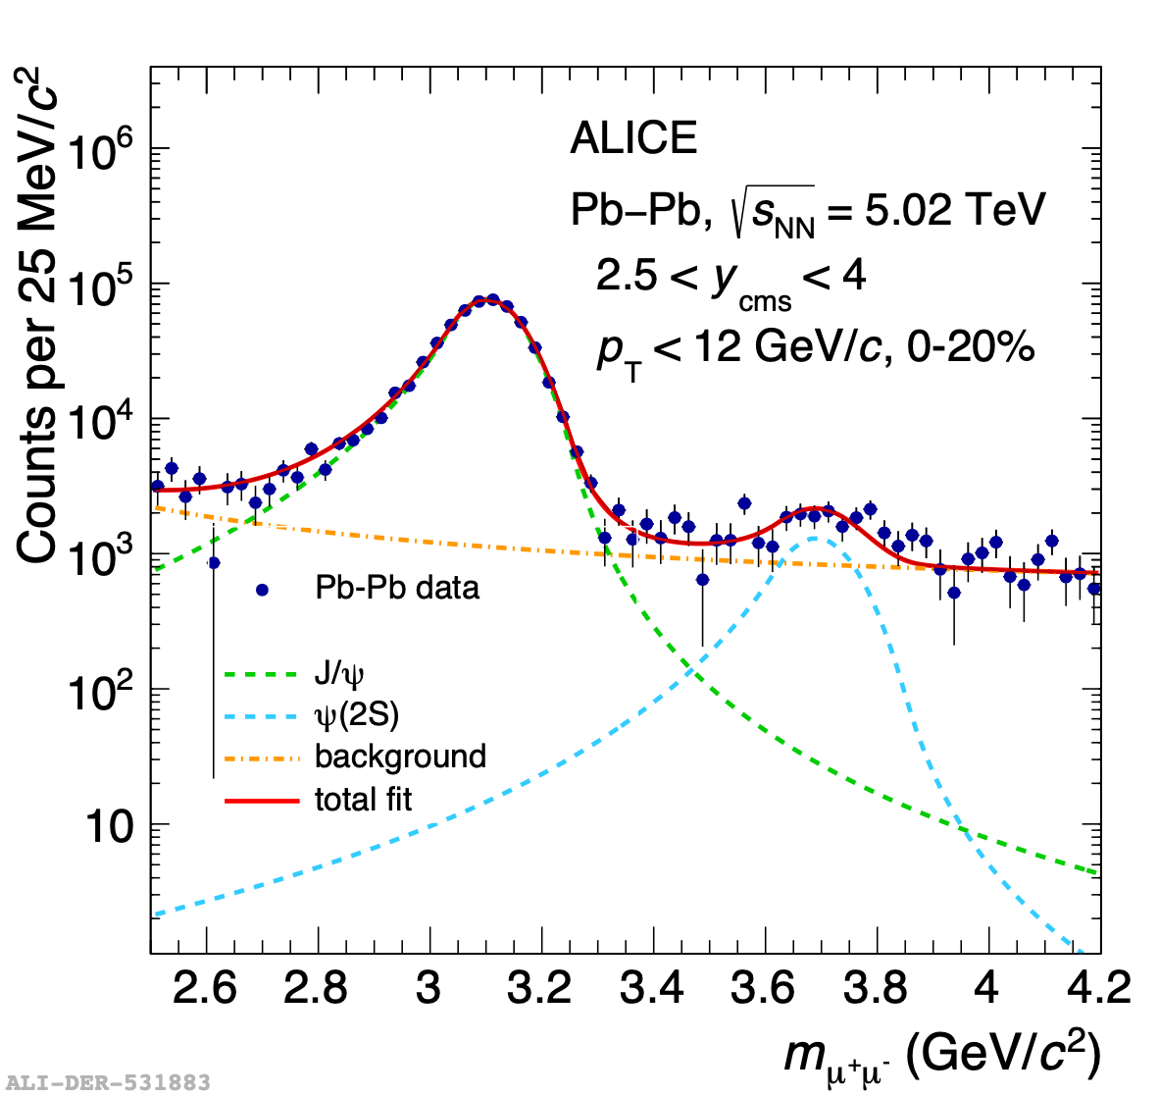
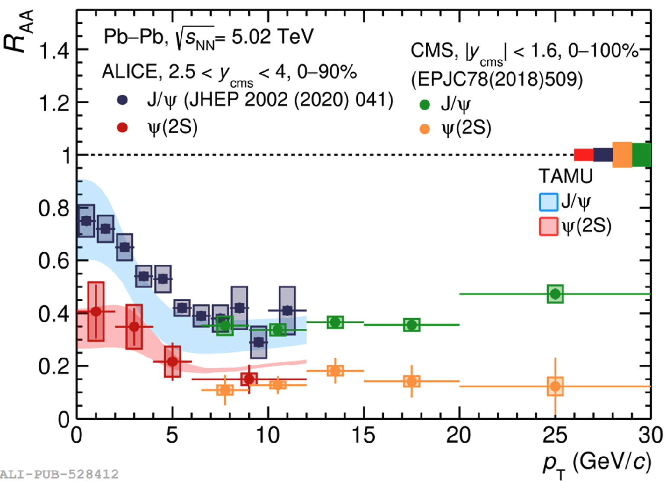


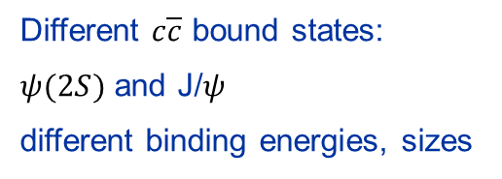
ALICE: Melting and Regeneration of Charmonia
$ψ(2S)$ vs J/$ψ$
Nuclear modification factor vs pT
$$R_{AA}=\frac{dN/dp_{T}|_{AA}}{⟨N_{coll}⟩dN/dp_{T}|_{pp}}$$
Different $c\overline{c}$ bound states:
$ψ(2S)$ and J/$ψ$
different binding energies, sizes
arXiv:2210.08893
High p_{T}: stronger suppression of $ψ(2S)$— lower melting temperature
Low p_{T}: R_{AA} increases — regeneration similar to J/$ψ$
Notes:
It shows a larger suppression of the psi(2S) than J/psi, which is line with the expectation that the 2S melts at lower temperature than the 1S because it is more loosely bound. At low pt, we see a similar increase of RAA for both states due to recombination (the precision for 2S is not yet enough to make a strong statement; this will improve with run 3 data with the MFT).

Slide 9
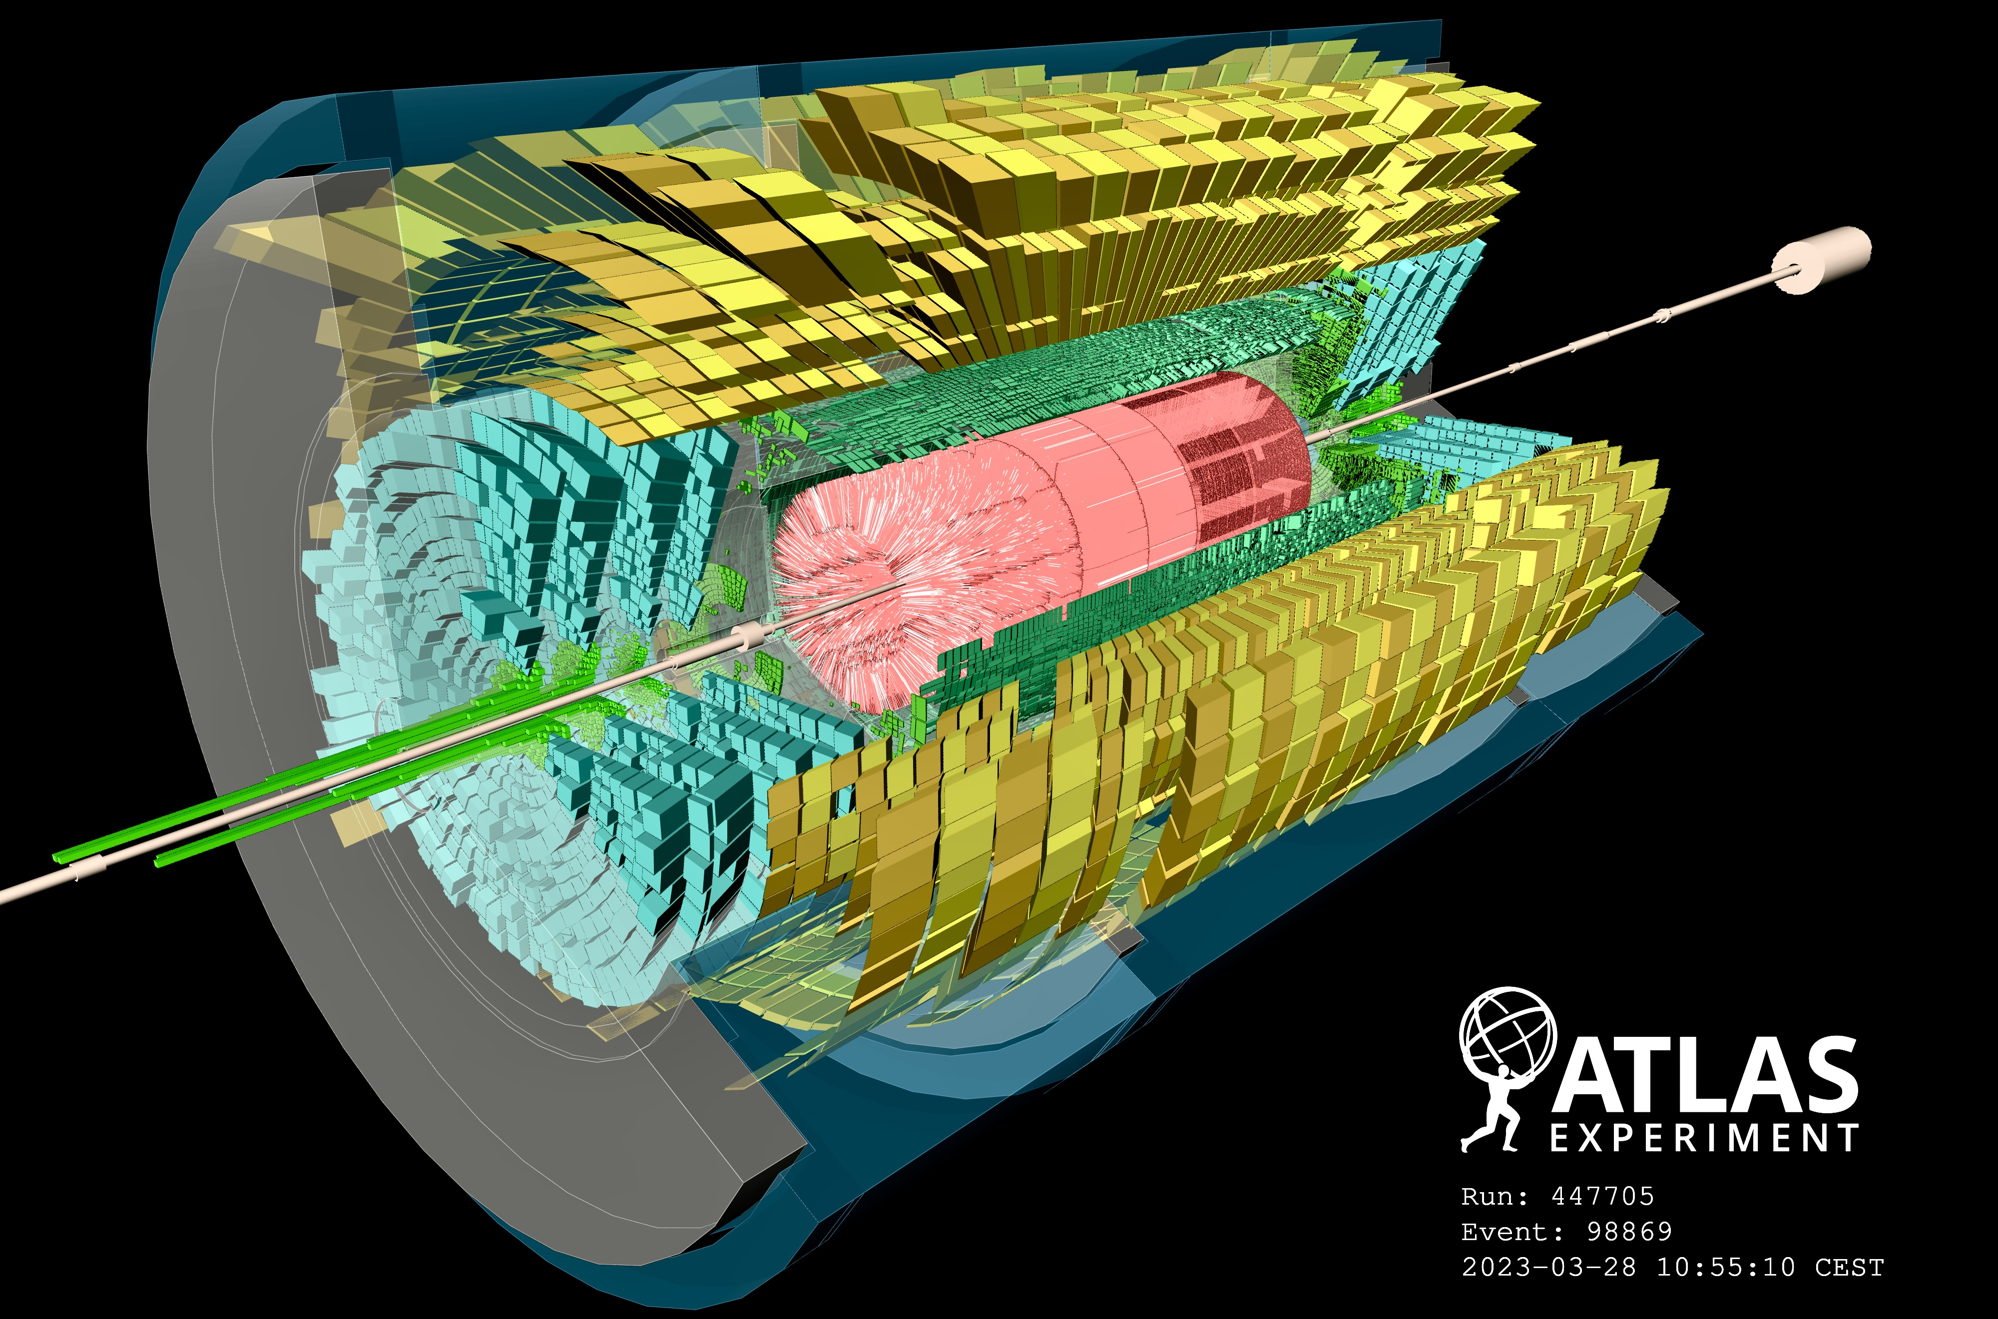
Recommissioning with beam in 2023

Slide 10
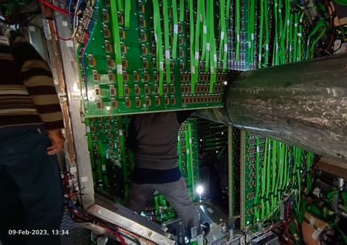
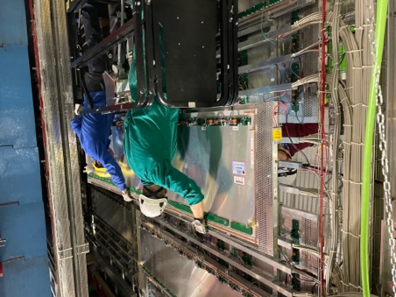
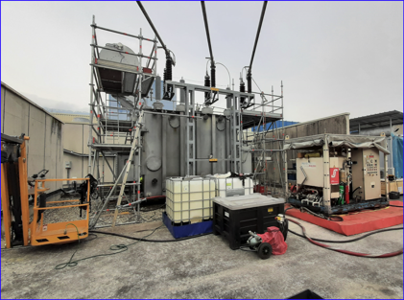
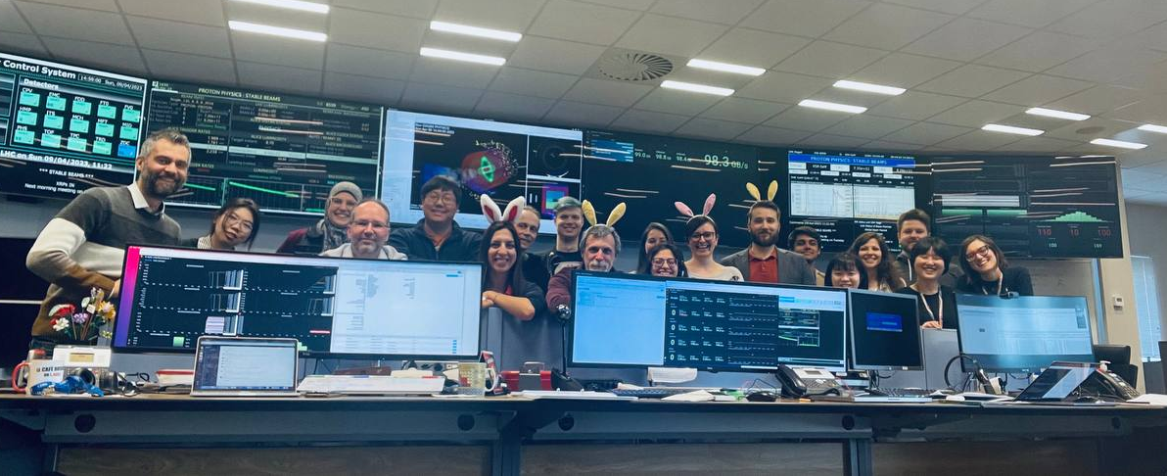
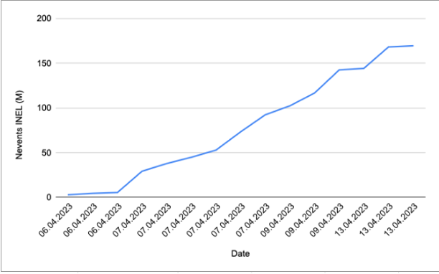
ALICE YETS and 2023 Startup
Year-end technical stop (YETS) activities:
Several routine maintenance items
Cleaning of a few muon chambers
Work on TOF cooling (unclogging)
Smooth restart of operations for 2023
Commissioning shifts started March 6th
First 900 GeV collisions on April 6th
Goals for 2023:
30 pb⁻¹ pp at full energy
3.25 nb⁻¹ of Pb-Pb collisions
3 pb⁻¹ pp collisions at Pb-Pb energy
(reference run)
Replacement MCH ST2 quadrant
Replacement MID RPCs
Maintenance on the 66kV transformer (EN-EL)
Easter morning: stable beam at injection energy
First runs at injection energy:
170M events recorded
ALICE is ready for data taking!

Slide 11
CMS YETS Activities
The YETS was successful
CMS is closed
ECAL water leak repaired
Flexible pipe replaced
Further analysis on the damaged pipe
did not reveal any issue
HCAL completed replacement of faulty frontend components
Significant update in automatization of detector calibration
Further improvements on the detector timing
CMS ready for 2023 data taking

Slide 12
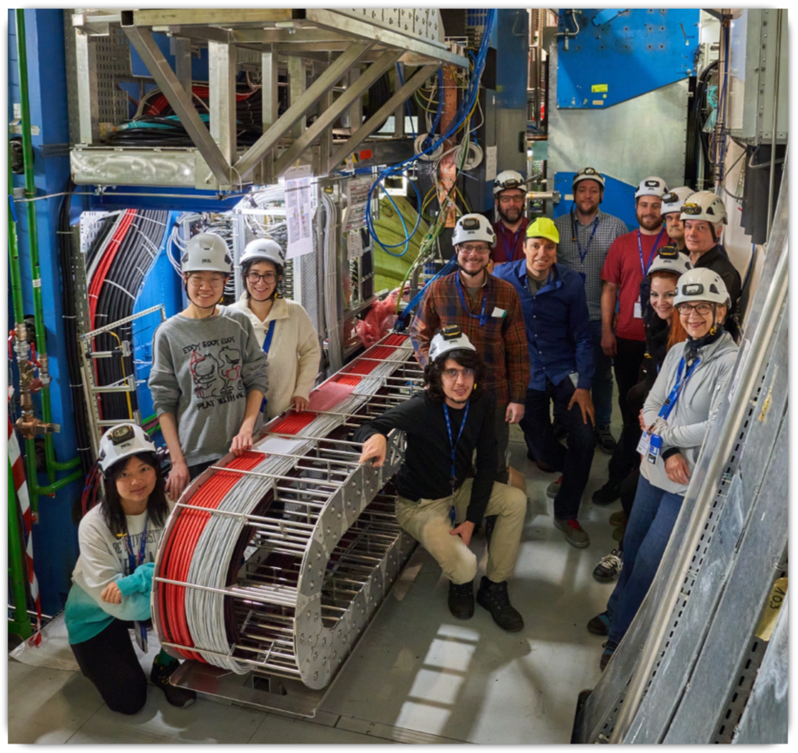
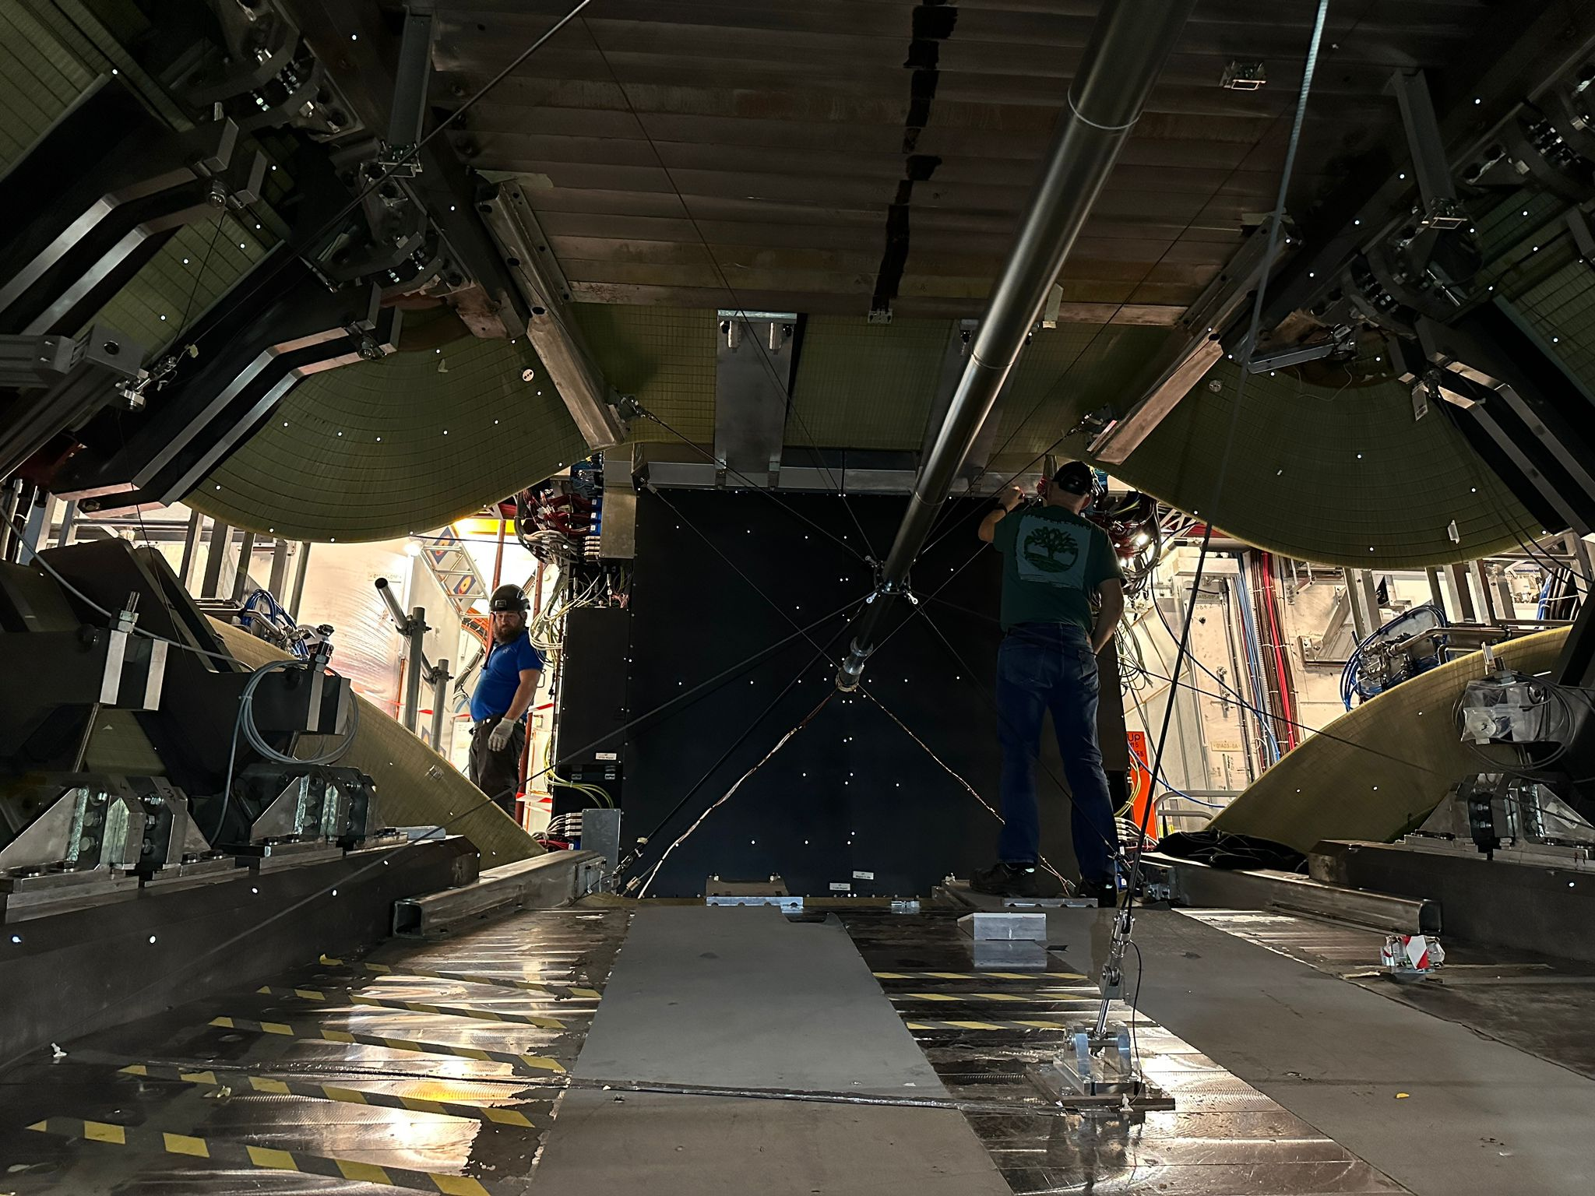
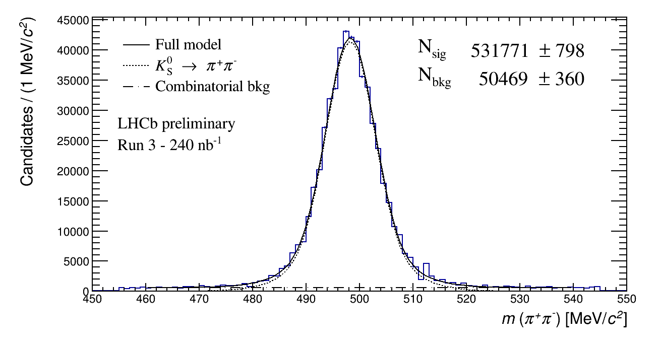
LHCb Commissioning & Upstream Tracker Installation
Silicon strip tracker successfully installed on tight schedule during shutdown
Final system of the Upgrade I for Run 3 & 4
  Upgrade I completed inside original budget
LHCb Upgrade implements innovative fully software trigger, with first level reconstruction in GPUs
  Additional GPUs installed following successful proof in 2022 run
  Good start made to detector commissioning in 2023
K_{s} reconstructed in real-time
GPU based trigger in 2022
RICH1 rings in first
fill of 2023
12

Slide 13
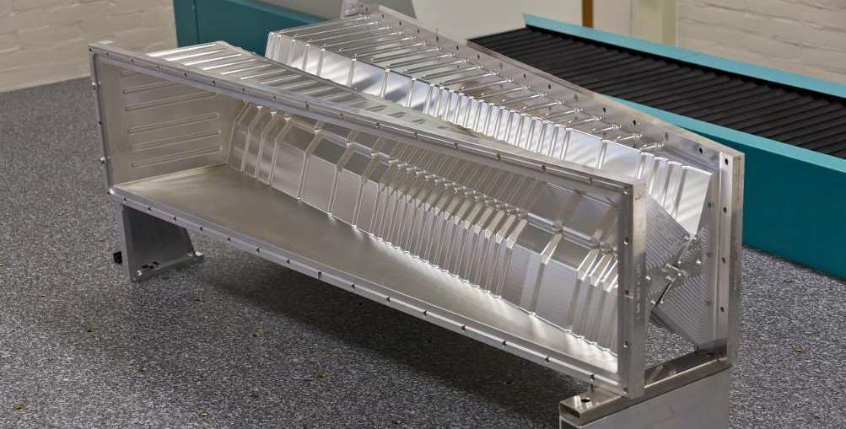
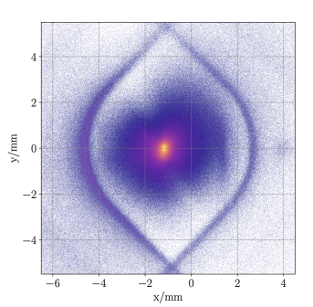
VELO Vacuum Volume Incident
RF Foil: 150-250 μm thick, separates
primary and secondary vacuum volumes
On January 10th, 2023 an incident occurred due to a failure of the vacuum system of the VELO
Detector modules & cooling are not damaged
The system has been returned to a safe situation
RF foil has undergone plastic deformation
Replace in the shutdown at the end of 2023
schedule: 13 weeks + contingency 3 weeks
Commissioning of Upgrade I systems proceeds
LHCb physics programme in 2023 affected
as VELO cannot be fully closed
but opportunities remain
Reconstructed vertices with fully closed VELO (2022 run)
Beamspot
Simulation of deformation
RF foils

Slide 14
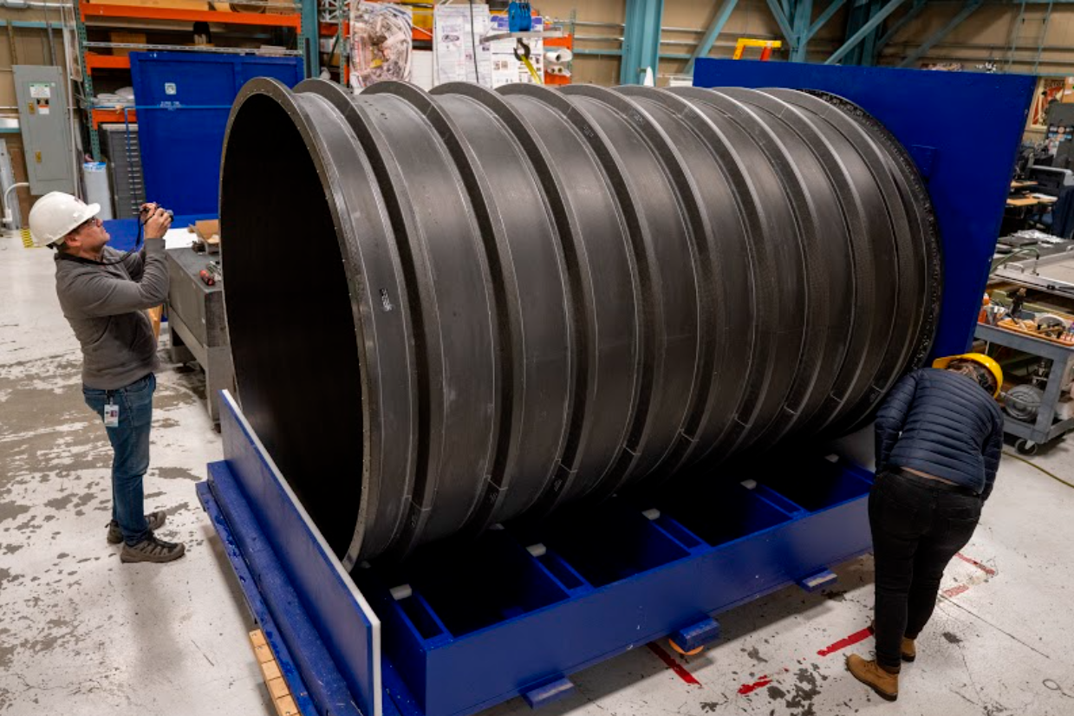
Phase II Progress
Production of large structures has started
Example:
ATLAS ITk Strip Barrel Layer 3 shell
Carbon fibre structure,
2.8 m long
Produced by a company in California under supervision of Berkeley
Now at Oxford: installation of locking points to mount the staves of layer 3
Notes:
Outer structure of the barrel strip detector

Slide 15
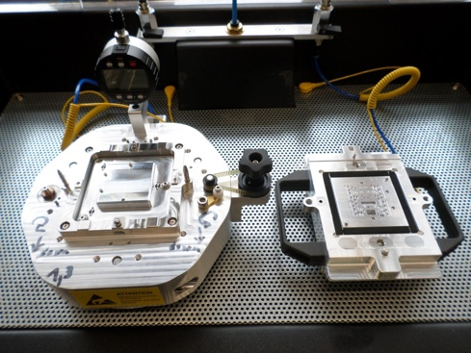
Status ATLAS ITk Pixel
Contingency is reduced to few months, driving the tracker readiness
Several areas close to the CP or critical:
FE ASIC: SEU vulnerability prevented the submission in November, unusable also for CMS
Few non-conformities remain but considered manageable in operation
Submitted in March!
  Module preproduction is now starting with site qualification
Excellent progress in other areas:
  Sensor production started
  Hybridization contracts signed and preproduction started. More than 200 modules already in hand
  Data transmission: first full chain tests completed
Module assembly jigs

Slide 16
Status CMS HGCAL
High Granularity Calorimeter (HGCAL):
Production silicon sensors arriving
ASICs: HGCAL ECON-D (on critical path) – submitted
Latest prototype modules perform well
Mechanics are going very well:
Engineering Design Review (EDR) in February
Pre-production steel plates arrived in Pakistan

Slide 17
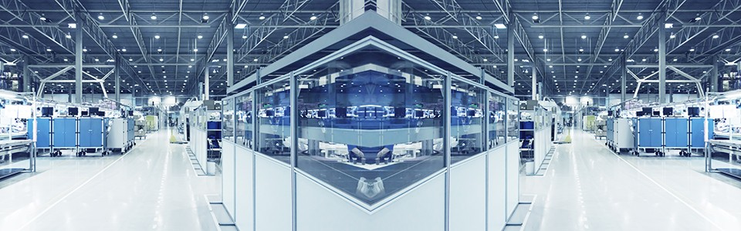
Phase II Schedule
  To regain contingency on the most critical projects during production phase workshops with external experts will be organised
Despite good progress areas of concern remain:
Projects with insufficient contingency:
ATLAS Pixel and Strip Tracker
CMS Tracker and HGCAL
  Deliverables from institutes in Russia (and Belarus)
  Redistribute contributions in the collaborations
  CMS HGCAL most exposed project
Fraunhofer Institute for Manufacturing Engineering and Automation
Factory Planning and Production Optimization
Stuttgart, Germany
CMS: 26. – 28. June 2023
ATLAS: in Q3 of 2023

Slide 18
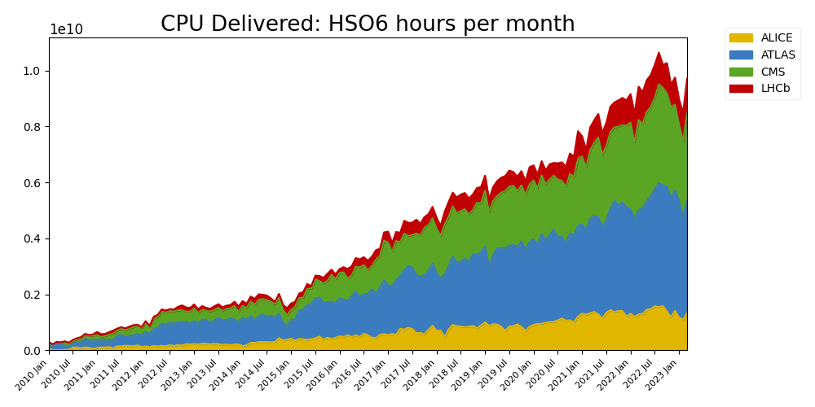
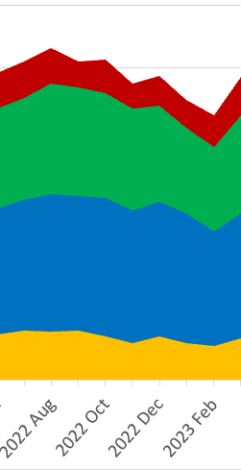
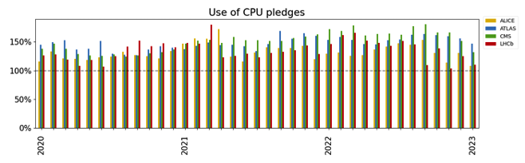
WLCG Run-3 Processing
Reduction of processing activities at WLCG sites in the last few months of 2022
Partially due to the external factors, e.g. to save energy
Partially to a lower experiments' activity
All experiments still benefit from more resources than pledged at WLCG sites
From HPCs, HLTs
WLCG is ready for the 2023 run
Many thanks to the Funding Agencies for the excellent support, also to mitigate the shortfall of resources from Russia
100%
Thanks to Simone Campana
Notes:
There basically two things:
* some sites did reduce the delivered capacity to face the increase in the cost of energy. CERN is the clear example. Some of that capacity will come back after winter. Some of it might not. The opportunistic capacity was the first one being under discussion
* some of the experiments, and particularly LHCb had less production in the last months than expected. LHCb took basically little physics this year and therefore they had to delay the MC production in the Run-3 configuration. So they did not submit a lot in the last months and that shows in the bit of a drop in used computing capacity

Slide 19
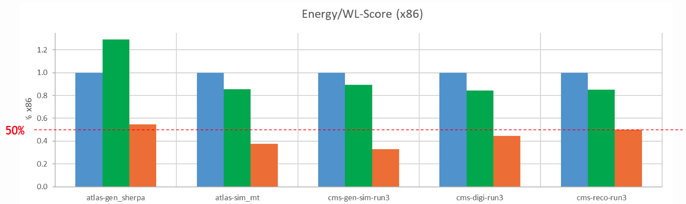
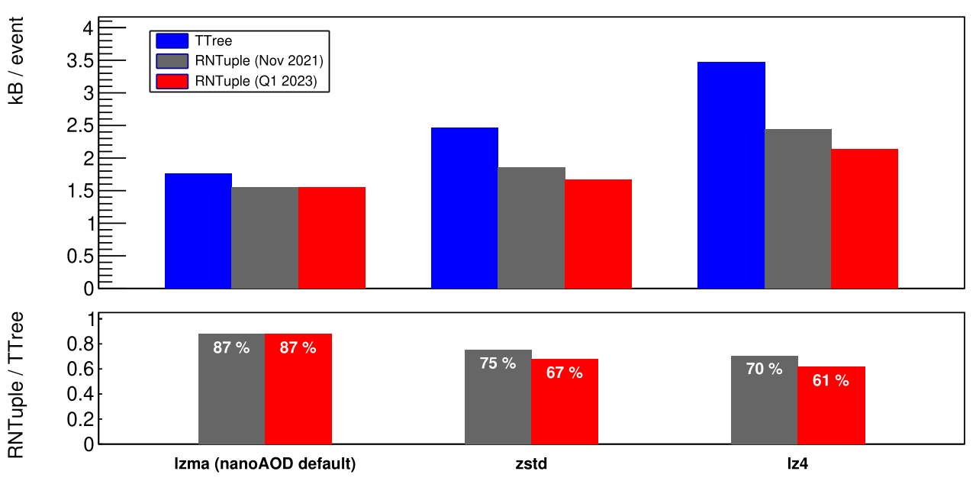
Reducing IT’s Energy Footprint: 3 lines of action
The Hardware
Procuring power efficient hardware
Extending hardware lifetime
CPU virtualisation, Disk Server densificaiton, Tape evolution
The Software
Improving software efficiency; focused C++ training courses
Innovating computing models
Using accelerators to improve efficiency of Generation & Simulation
The Data Centre
New data centre with efficient cooling and heat recovery
An optimized hardware life-cycle
ATLAS and CMS workloads: on ARM cf x86
ROOT foundation layer: less CPU, less disk hungry
Notes:
Advanced RISC Machines
Top Right plot:
BLUE: x86_64: Single AMD EPYC 7003 series (SuperMicro) @2.3GHz
GREEN: 2*x86_64: Dual AMD EPYC 7513 series Processors (DELL) @2.6GHz
ORANGE: arm64: Single socket Ampere Altra Processor (SuperMicro)
Middle right plot:
TTree is the original ROOT format
RNTuple is the major new optimised ROOT format. Two versions are shown. Still in development, for 2024 release
(Different columns are different compression algorithms)

Slide 20
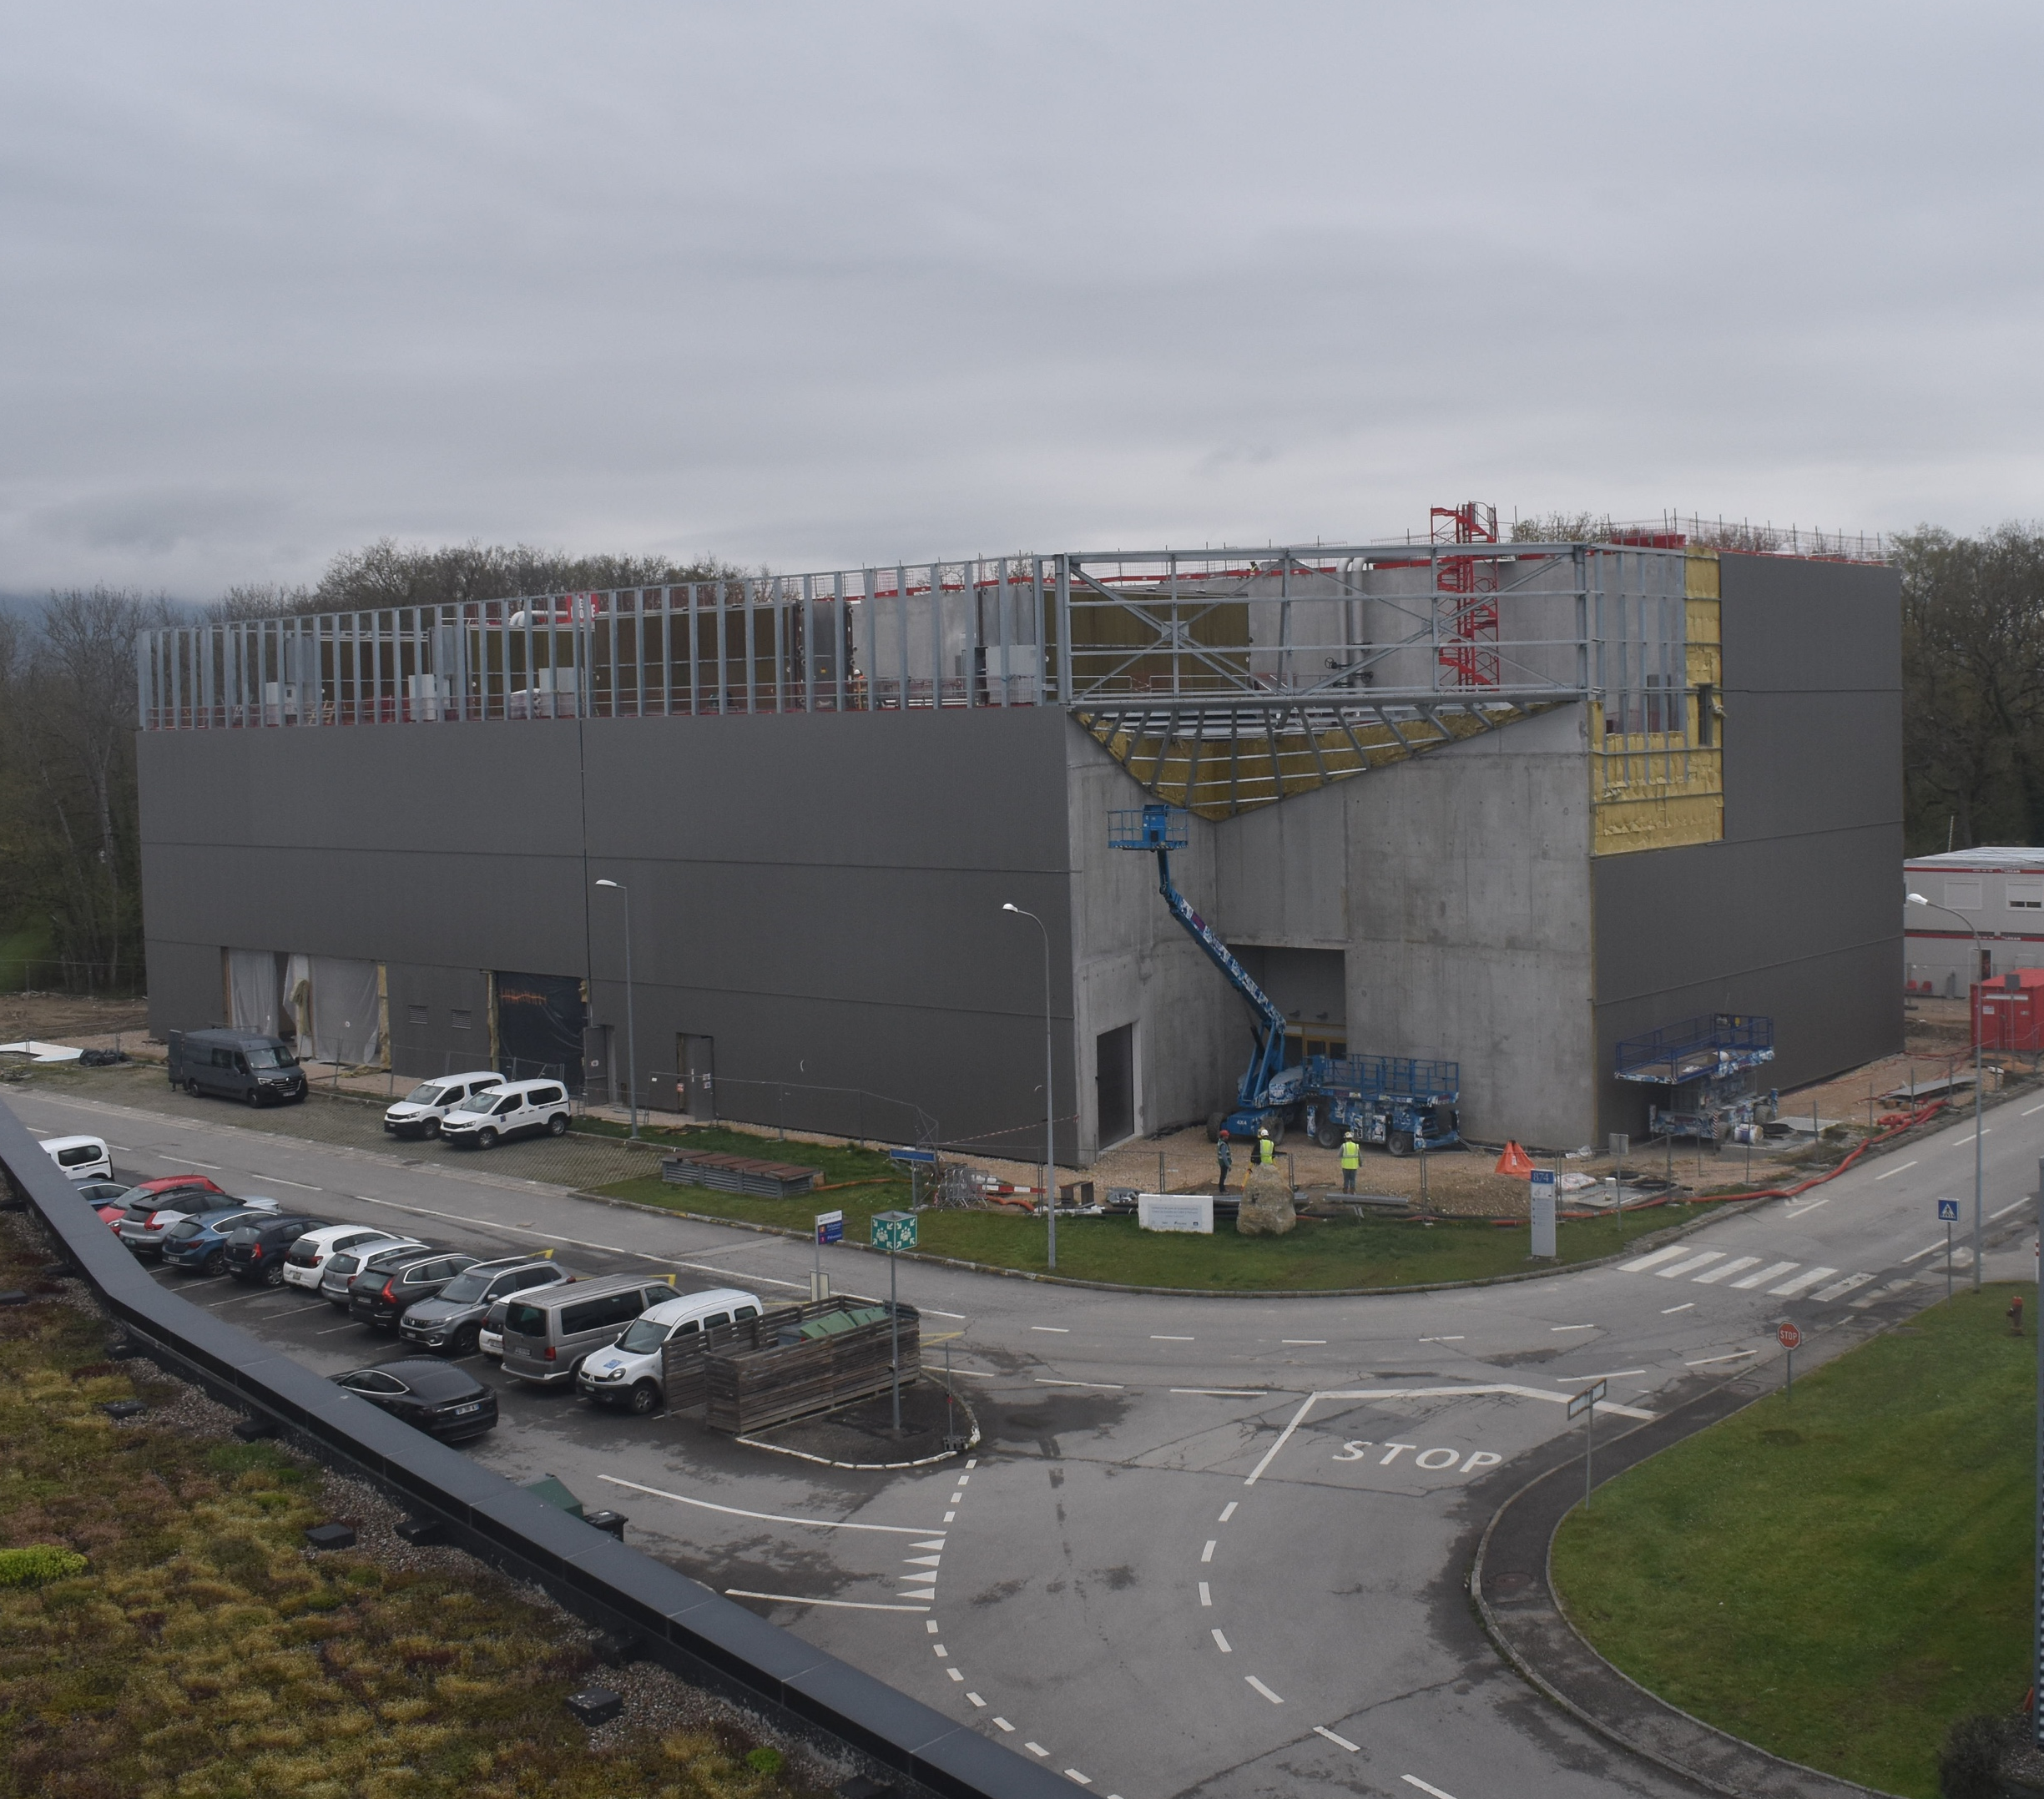
Prévessin Data Centre
  to end October
  Commissioning (incl. building and services such as electrical, cooling, ventilation)
  to end December 2023
  IT trial installation and tests (incl. one POD)
  POD = 2 rows of racks with hot aisle containment
  during January 2024
  Installation of the rest of the first batch of equipment
Exterior Finishings (Thu 20th April)

Slide 21
Summary
Experiments are ready for 2023 run
  only major issue is the VELO
Experiments continue to produce excellent physics results
Agreement on author/institution list found and being applied
Good progress in Phase II upgrades
  but challenges remain on the schedule and due to worldwide economic and political situation
WLCG is ready for 2023 run
  progress in addressing HL-LHC and energy challenges
Big thank you to
All people who contributed to the successful start of 2023 Run
All Funding Agencies for their continuous support

Slide 22
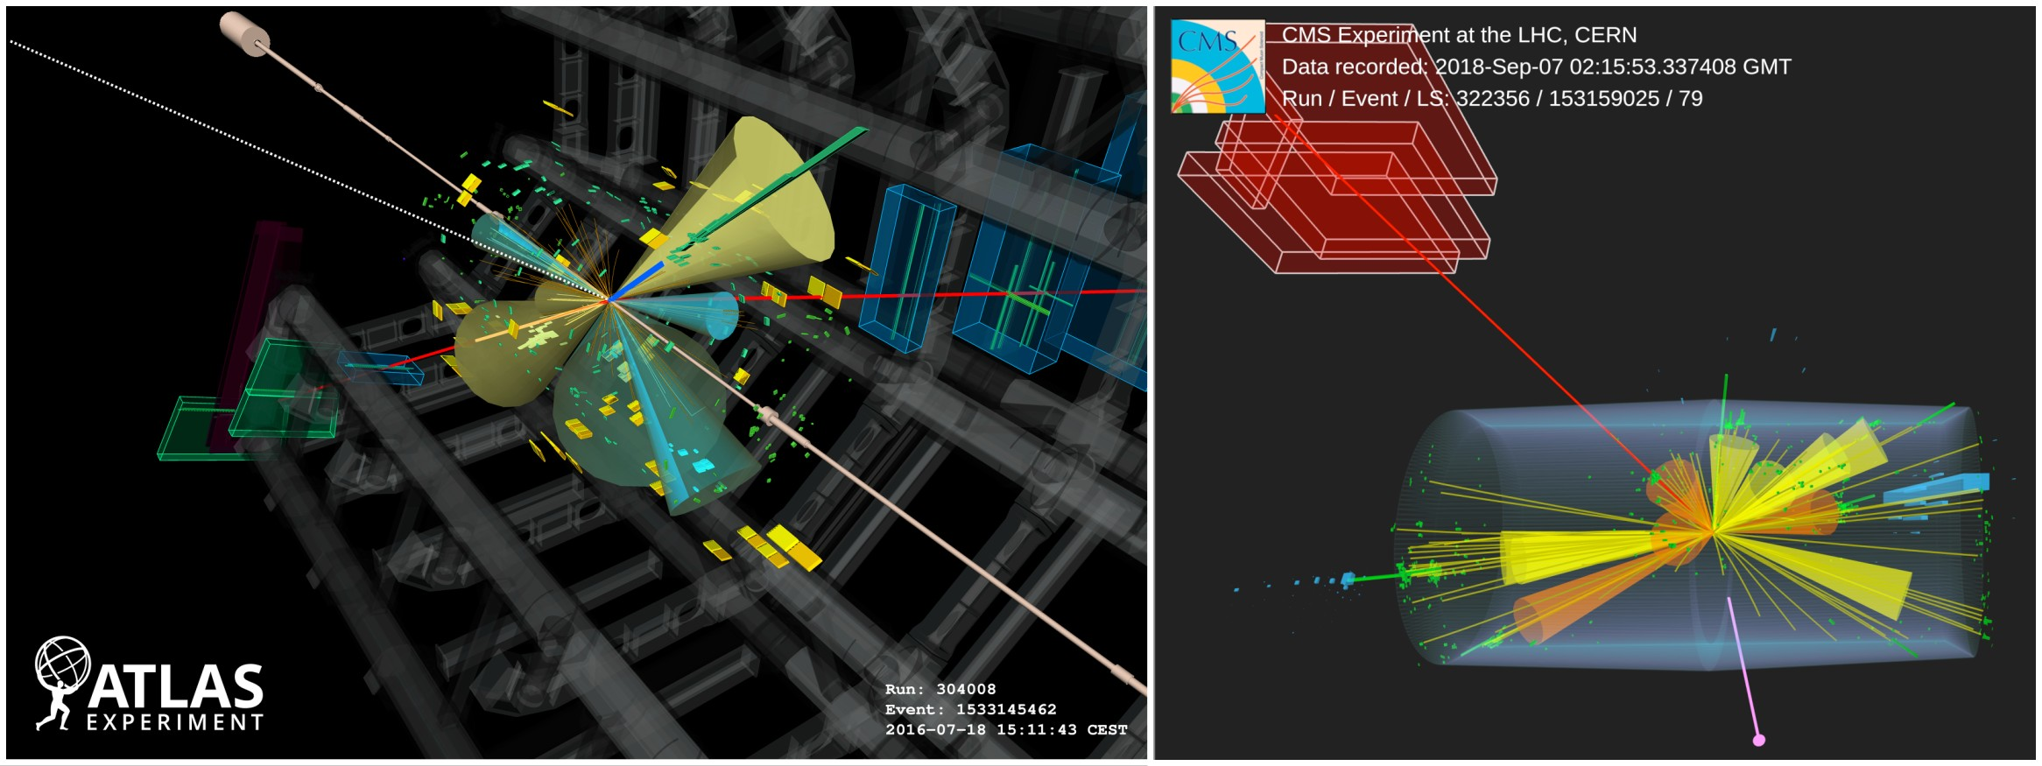
Simultaneous Production of Four Top Quarks
ATLAS and CMS presented the observation pp → 4 top + X at the winter conferences

Slide 23
Backup

Slide 24
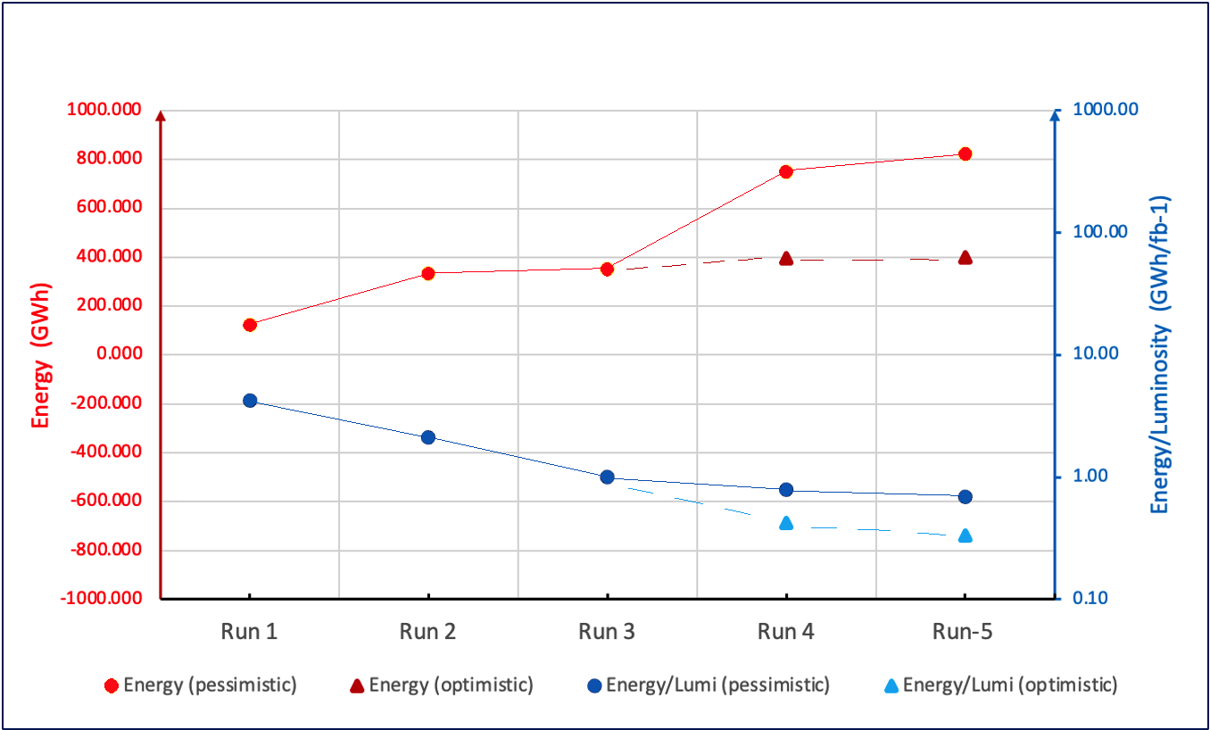
WLCG: Energy Efficiency
RED scale shows the energy needed to analyse the data of each run
i.e. consumption of all WLCG sites (T0+T1+T2) in a Run plus the following LS
pledged CPU only
BLUE scale shows the energy per unit of luminosity recorded needed to analyse the data in each run
(nb log scale)
Based on the ATLAS and CMS resource projections made in 2022. More details here
Pessimistic scenario: Run-4/5 +100% compared to Run-2
Optimistic scenario: Run-4/5 +10% compared to Run-2
Thanks to Simone Campana
Notes:
It is the consumption at all WLCG sites (T0+T1s+T2s) in Run-2 + LS2. Some precisions: it is the energy from CPUs only (but that is what consumes the most anyways). Also it takes into account only pledged resources (not the opportunistic ones). So, the absolute value has to be taken with a grain of salt, but the relative difference between Run-1, Run-2, Run-3, etc .. is a good measurement of the trend.

