Slide 1
CERN Status and News
Plenary RRB 56th Meeting
Joachim Mnich
April 24, 2022

Slide 2
Main Discussion Points 56th LHC RRB
M&O budget requests for 2024
Status & Progress Phase II Upgrades
  Schedule and cost developments
  Compensation for contributions from institutes in Russia, Belarus & JINR
Publications: agreement on author/institute list
Phase IIb upgrades ALICE and LHCb
  Special meetings on Thursday
Schedule of future RRB meetings

Slide 3
Council Resolution June 17th, 2022
Reminder:
The Council declared that it intends to terminate CERN’s International Cooperation Agreements (ICAs) with the Russian Federation and the Republic of Belarus at their expiration dates in 2024 (Dec 2024 and Jun 2024, respectively). However, the situation will continue to be monitored carefully and the Council stands ready to take any further decision in the light of developments in Ukraine.
The Council also decided to review CERN’s future cooperation with the Joint Institute for Nuclear Research (JINR) well in advance of the expiration of the current ICA in January 2025.
(see https://council.web.cern.ch/en/content/resolutions for details)
Note:
Experiments will present the 2024 M&O A/B requests including the expected contributions from Russia/Belarus and JINR
Council will have to decide & announce its decision on the termination/continuation at least 6 months before the expiration date

Slide 4
Publications
Agreement between the 4 large LHC collaborations found:
Common voting of the Collaboration Board members
Largest support found for so-called option C (see below)
LHC collaborations are gradually starting publishing again (backlog was > 100 papers)
Management strongly encourages all other CERN experiments to adopt the same procedure
Authors affiliated with Russian or Belarussian institutes, or with JINR, sign the Collaboration’s scientific publications with their names and ORCID identifiers (where available), and the institute affiliation is replaced, respectively, by the reference:
"Affiliated with an institute [or an international laboratory] covered by a cooperation agreement with CERN."
The complete author list including all institute affiliations is made available to the journal in a non-public form for the purpose of machine-readable analysis or as historical data.
The publication committees of the collaborations will be charged with investigating the technical implementation details with the journals.
No acknowledgement to the Russian and Belarussian funding agencies and JINR is made.
On request, the experiment management will release a certificate attesting the contribution of the aforementioned institutes and funding agencies, or of JINR, to the work presented in the publication
This agreement has been communicated in two letters to Russian Minister Falkov and JINR Director Trubnikov

Slide 5
Visitors: 49 protocol visits Jan-Mar 2023

Slide 6
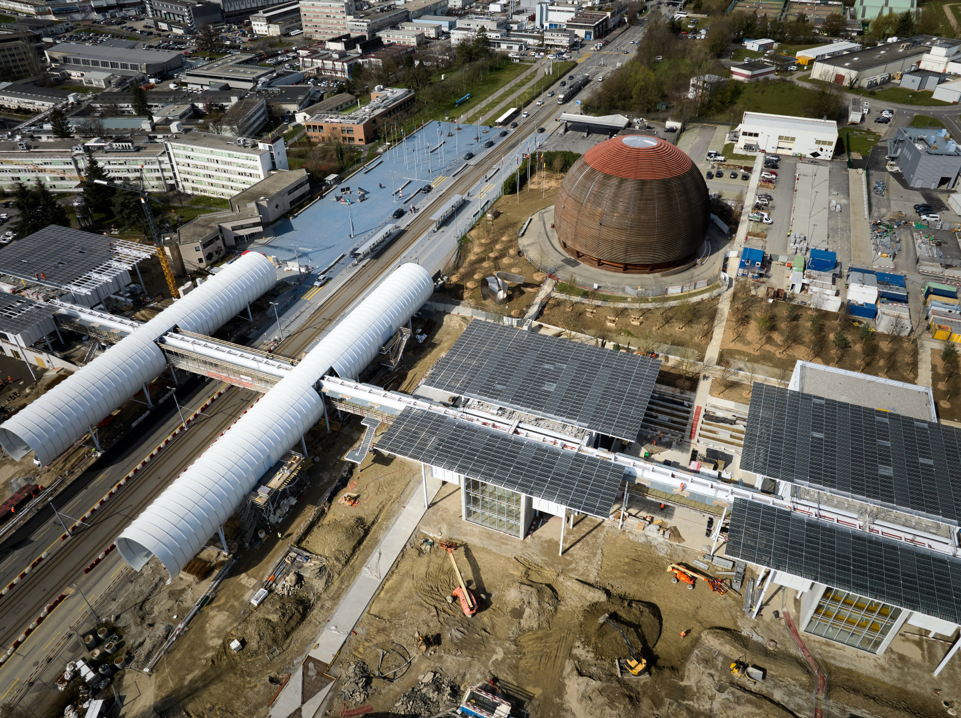
Science Gateway
March 29, 2023
Nearing completion
Inauguration Saturday October 7th, 2023
Event with High-level invitees planned
First scientific event in Science Gateway:
Celebrate 50 years of neutral current and 40 years of W/Z discoveries
  looking back at the discovery,
  what has been learned since then,
  prospects for future precision measurements
Date still to be announced

Slide 7
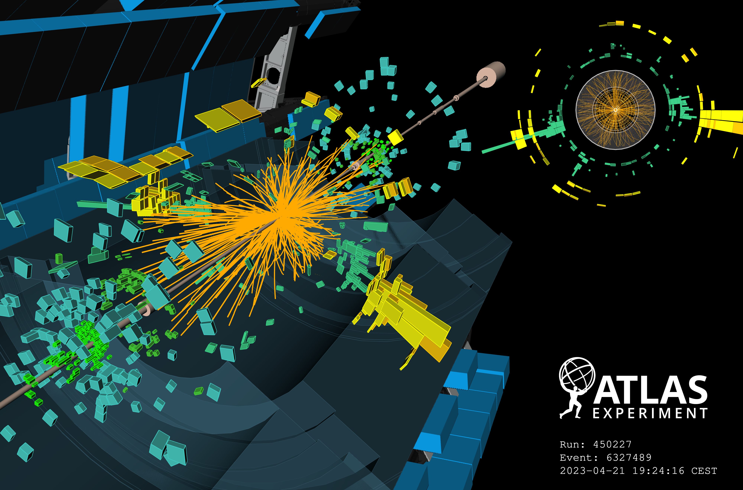
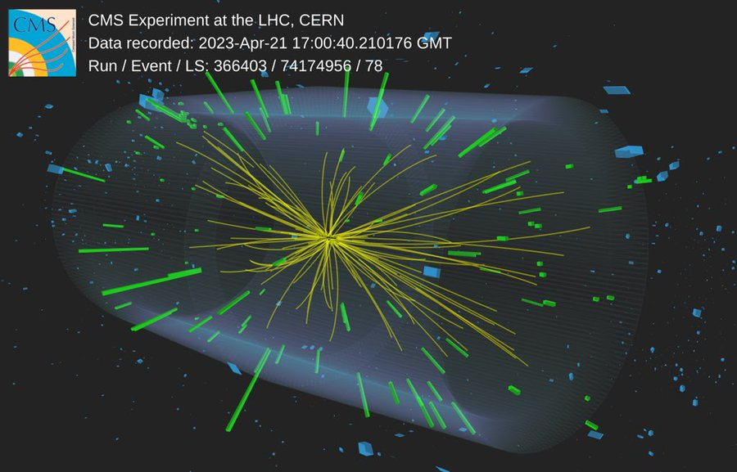
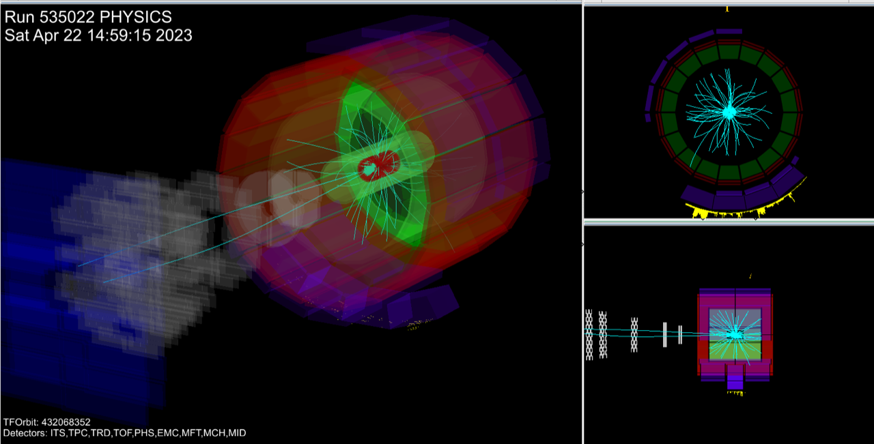
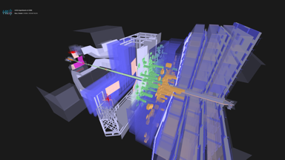
2023 Run started: First 13.6 TeV collisions last Friday
ALICE
LHCb

Slide 8
Backup

Slide 9
CERN’s Response to the Energy Crisis
In response to the apparent shortage of (electrical) energy in Europe, and in particular France, and as a mark of social responsibility CERN decided to
  Start the 2022 Year-End-Technical-Stop (YETS) 2 weeks earlier (November 28 rather than mid December)
  Prepare reduced power configurations for possible EDF load shedding scenarios
  Reduce the operation of the accelerator complex in 2023 by 20% (YETS 2023/24 will be extended from 15 to 19 weeks)
To address the potential longer-term impact of high electricity costs a package of measures for 2024-2032 is being prepared to be discussed with Council in December
  Including stretching/de-scoping of CERN’s activities, savings on personal costs, indexation of member states contribution beyond the 2% cap
  Measures to reduce energy consumption on the CERN campus are being implemented

Slide 10
Impact of Council Resolutions on the LHC Experiments
Institutes in Russia, Belarus and JINR remain members of the collaborations (until 2024/25)
    Collaborators from these institutes continue to contribute to the operation of the experiments
    Expect contributions, incl. outstanding contributions, to the M&O budgets from these institutes
    Note: transfer of money from Russia to CERN is complicated but at the moment still possible
  Contributions (ca. 20 MCHF) to ATLAS & CMS Phase II upgrades from institutes in Russia, Belarus and JINR
    Strong recommendation by LHCC to develop plans to become as much as possible independent of (time-)critical in-kind contributions
    Will require additional contributions from collaborating partners
    Fair share may not be fully applicable as special expertise and infrastructures are required to avoid time delays and loss of quality
    Note: contributions to the HL-LHC accelerator upgrade have been fully in-sourced by CERN
Phase IIb upgrades for ALICE & LHCb are future projects and following the March Council resolutions CERN cannot engage in future projects with institutes located in Russia or Belarus

