Slide 1
SAC Feedback 2023
I.FAST Meeting, Trieste, Italy
M Minty, A Yamamoto and C P Welsch

Slide 2
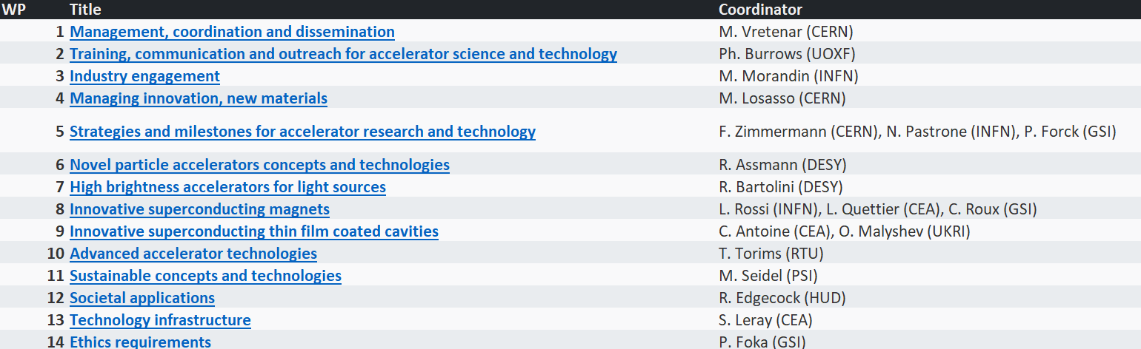
Reminder: I.FAST Work Packages

Slide 3
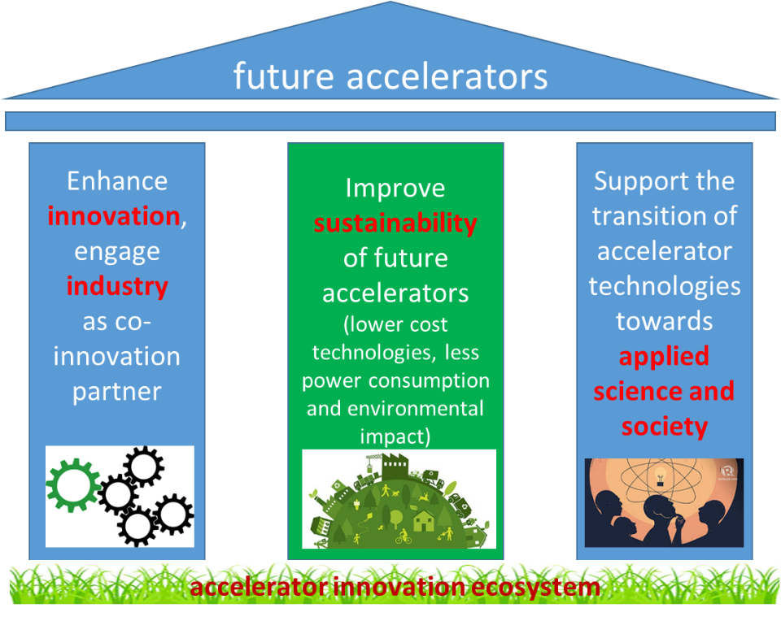

Slide 4
Industry Innovations
The SAC strongly supports the development of novel technologies with some excellent successes already visible: Thin-film coated cavities, novel power amplifiers, beam windows and HTS cables.
Developments in additive machining for beam instrumentation, collimators and photon absorbers.
I.FAST Industry Advisory Board provides strategic steer; Innovation Fund enables technology innovations.

Slide 5
Advanced Accelerators
I.FAST helps develop a landscape for future accelerators and events lead to recommendations that inform strategic roadmaps for required R&D.
Novel accelerator concepts require technology breakthroughs, e.g. high power lasers, fast ramping and high field magnets; development needs were clearly highlighted.

Slide 6
Sustainability
Sustainable concepts for research infrastructures are a clear I.FAST highlight and contribute to a global R&D drive.
High efficiency klystrons and permanent magnets as key technologies to reduce energy consumption.
AI-based classification of energy consumption as realistic pathway towards assessment of facility’s environment impact.
Increased awareness: Critical materials and life cycle management, importance of public perception of accelerator-related construction and operation.

Slide 7
Applied Science and Society
Good engagement with key industry players, e.g. adaptive manufacturing and laser technology, as well as online platforms for shared use.
Co-innovation: mutual benefits from early engagement with industry.
Excellent application of synchrotron light to contribute to cultural heritage
Good connection with UN’s Sustainable Development Goals (SDGs), e.g. Design of Advanced Electron Accelerator Plant for Biohazard Treatment.

Slide 8
SAC suggestions
These technologies should be critically assessed with regards to a realistic pathway to identified markets and the time scales required.
For each technology, it would be good to get idea of technology readiness level (TRL) as not all developments seem to have the same level of market-readiness.
It was not always made clear enough which developments are happening because of I.FAST.
It would be beneficial to have focus on developments during last year (rather than project lifetime).

Slide 9
Outreach and Communication
Good link with some established outlets, e.g. Accelerating News is to be commended as an efficient way of reaching out to the wider community.
SAC commends I.FAST for having clear communication targets and that these are well on track after only two years.
Communication expertise and channels at partner organization could be more actively tapped into.
There are relatively few news stories on the I.FAST website for a project of this size – SAC recommends more publications in the area of general communication and news.

Slide 10
I.FAST supported workshops
Impressive number of very successful events held across various work packages, underlining the project’s great impact on connecting the community and generating new ideas.
I.FAST brand not always visible (enough) on posters, websites and in announcements.

Slide 11
Training
Industrial training and knowledge transfer are key part of I.FAST programme.
I.FAST contributes to development of the next generation of accelerator scientists, engineers and technicians.
SAC suggests that I.FAST acts as an information hub about training opportunities to assist identifying and developing talent around the world.

Slide 12
Challenge-Based Innovation
Fantastic initiative that has excellent potential for generating enthusiasm in next generation of researchers.
This also has excellent potential for communicating I.FAST more widely and can act as a project showcase.
Applications mostly from established countries and channels, there seems to be room for wider promotion of the activity, opening CBI more widely and improving diversity of participants.

Slide 13
Conclusion
Impressive progress made and the collaboration is to be commended on their achievements to date.
SAC notes that some WPs have experienced delays due to difficulties in hiring, materials procurement and inflationary pressures (budget estimates were made in late 2019).
SAC appreciates that innovation requires diversity, but notes that diversity within I.FAST could be improved.
Collaboration should start thinking about how to ensure continuity of select initiatives, e.g. those benefiting the broader accelerator community, beyond the project lifetime.
Connection between individual projects/events and wider WP and project not always made clear enough – (more) closely connected communication will help maximize impact: Together, stronger!

