Slide 1
Report on the Innovation Fund,
outcome of the electronic vote,
updates
3rd I.FAST Governing Board meeting
Marcello Losasso (CERN, WP4 Leader)
Cloé Levointurier-Vajda (CERN, I.FAST Coordination Office)

Slide 2
Overview
8 projects selected
1,235M€ of funding
10 beneficiaries (950k€ budget as additional EU funding), including 4 industrial beneficiaries
4 new Partner organisations joining (285k€ budget), including 2 industrial partners
Budget share

Slide 3
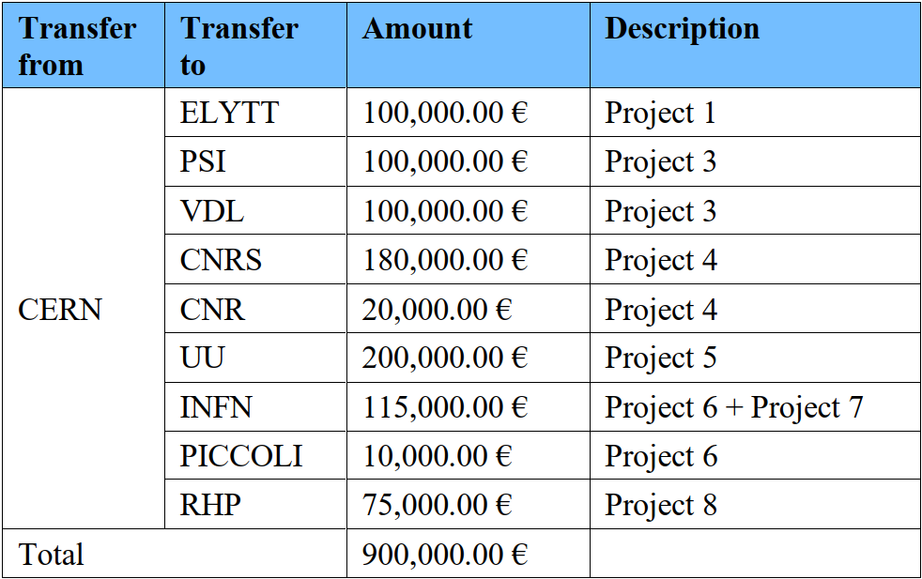
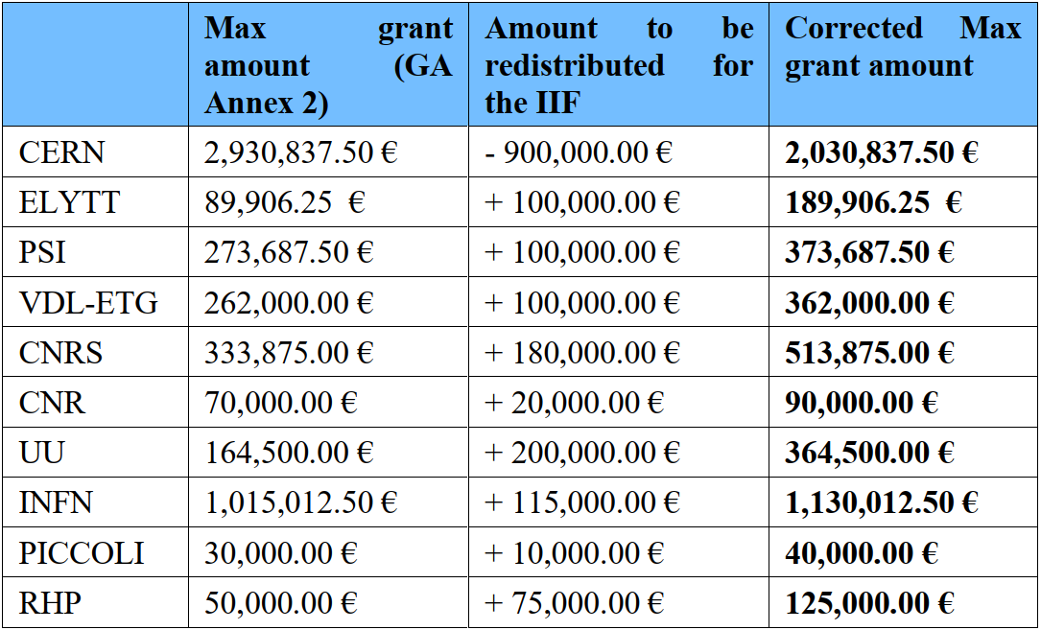
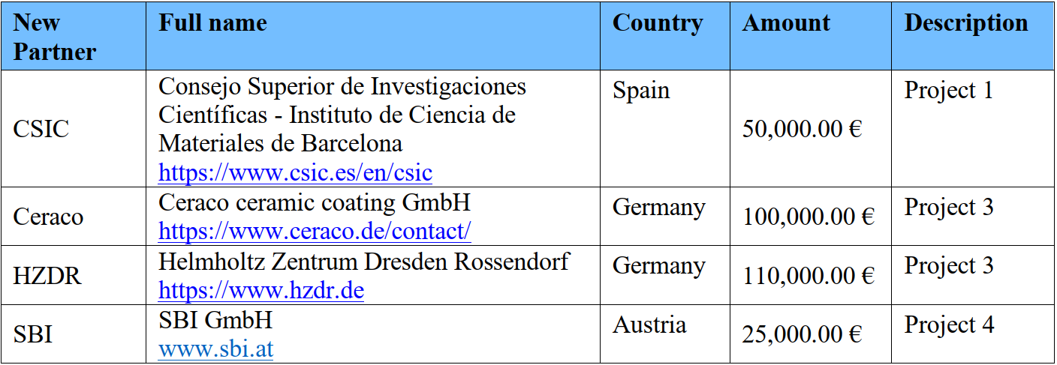
Reminder of electronic vote (Jan-Feb. 2023) outcomes
Redistribution of EC funding from CERN to the 10 I.FAST Beneficiaries (9 + CERN) that will execute the Projects
Accession of 4 new Partner Organisations that will participate in the execution of the Projects, receiving funding from CERN.

Slide 4
Update on what happened since then
Budget distribution for each project: breakdown per Party and per Cost categories → see changes in the following slides
Templates (Accession Form and Letter of Commitment) for new Partner Organisations
Signature of Accession Form and Letter of Commitment with:
  HZDR (involved in Project 6 msec flash)
  SBI (involved in Project 8 AM vacuum chambers)
Pre-financing (50%) payment for 5 Projects: on-going
  1. PM for klystron, 5. SSPA driven CFA, 6. msec flash,
  7. AM for ion source, 8. AM vacuum chambers

Slide 5
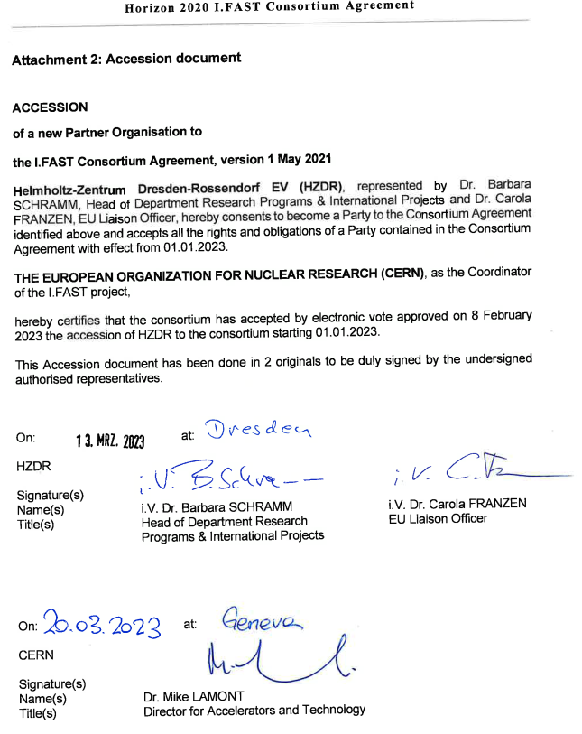
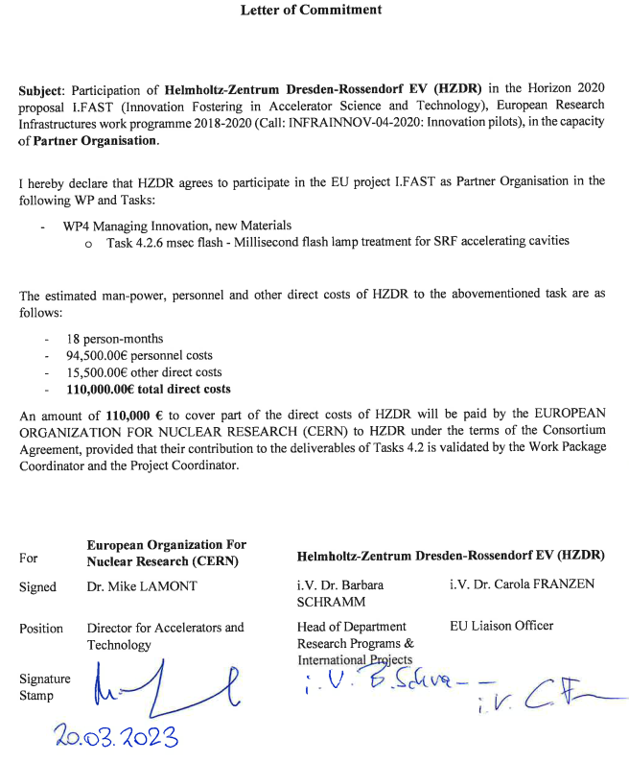
Accession form and Letter of Commitment
Accession document (Att. 2 of CA)
= signature of Consortium Agreement as Partner Organisation
Letter of Commitment
= financial information and WP/Task

Slide 6
Changes since the electronic vote
Project 2: HIGHEST ran by CERN, CSIC and KCT
  Initial mini consortium was CERN, CSIC and Ceraco, but Ceraco is replaced by KCT
  Due to reshuffling of Consortium
Project 3: FE cathode ran by PSI and VDL-ETG
  Budget redistribution compared to the vote, from 100k€ for PSI and 100k€ for VDL-ETG to 190k€ for PSI and 10k€ for VDL
  Due to unclear and modified communication between project leader and IIF Management
Project 4: KAIO Accelerator ran by CNRS and CNR
  CNRS Laboratory involved includes experts from Ecole Polytechnique, that has to join the Consortium as CNRS’s Linked Third Party (Art. 14 of GA)
  Due to Ecole Polytechnique staff expertise

Slide 7
Budget distribution (projects 1-3)
Beneficiary / Partner | Person-Months | Personnel costs | Other direct costs | Funding
Task 4.2.1: PM for klystron
CERN | 0 PM | 0k€ | 12k€ | 15k€ incl. indirect costs
Elytt | 10 PM | 65k€ | 15k€ | 100k€ incl. indirect costs
Task 4.2.2: HIGHEST
CERN | 0 PM | 0k€ | 8k€ | 10k€ incl. indirect costs
CSIC | 12 PM | 40k€ | 10k€ | 50k€
KCT | 8.5 PM | 80k€ | 20k€ | 100k€
Task 4.2.3: FE cathode
PSI | 12 PM | 112k€ | 40k€ | 190k€ incl. indirect costs
VDL-ETG | 1.2 PM | 8k€ | 0k€ | 10k€ incl. indirect costs

Slide 8
Budget distribution (projects 4-6)
Beneficiary / Partner | Person-Months | Personnel costs | Other direct costs | Funding
Task 4.2.4: KAIO Accelerator
CNRS | 0 PM | 0k€ | 70,6k€ | 180k€ incl. indirect costs
CNRS linked third party: EP | 18 PM | 73,4k€ | 0k€
CNR | 2 PM | 14k€ | 2k€ | 20k€ incl. indirect costs
Task 4.2.5: SSPA driven CFA
UU | 18 PM | 100k€ | 60k€ | 200k€ incl. indirect costs
Task 4.2.6: msec flash
INFN | 6 PM | 30k€ | 2k€ | 40k€ incl. indirect costs
HZDR | 18 PM | 95k€ | 15k€ | 110k€
PICCOLI | 2 PM | 8k€ | 0k€ | 10k€ incl. indirect costs

Slide 9
Budget distribution (projects 7-8)
Beneficiary / Partner | Person-Months | Personnel costs | Other direct costs | Funding
Task 4.2.7: AM for ion source
INFN | 8 PM | 32k€ | 28k€ | 75k€ incl. indirect costs
CERN | 0 PM | 0k€ | 20k€ | 25k€ incl. indirect costs
Task 4.2.8: AM vacuum chambers
RHP | 8.5 PM | 36k€ | 24k€ | 75k€ incl. indirect costs
SBI | 4.3 PM | 20k€ | 5k€ | 25k€

Slide 10
Voting items
Change of Partner joining for Project 2: from Ceraco to KCT
Budget redistribution for Project 3: 90k€ transfered from VDL-ETG to PSI
Inclusion of EP as Linked Third Party of CNRS and budget redistribution (Amendment of the GA, Art. 14 and Annex 2) for Project 4: 92k€ transfered from CNRS to EP (CNRS LTP)

Slide 11
Vote 1
Do you approve to vote the 3 changes mentioned in the previous slide as a package?

Slide 12
Vote 2
Do you approve the changes (package)?
Change of Partner joining for Project 2: from Ceraco to KCT
Budget redistribution for Project 3: 90k€ transfered from VDL-ETG to PSI
Inclusion of EP as Linked Third Party of CNRS and budget redistribution (Amendment of the GA, Art. 14 and Annex 2) for Project 4: 92k€ transfered from CNRS to EP (CNRS LTP)

Slide 13
Next steps
Collection of missing bank details (Beneficiaries and Partner Organisations):
  CSIC, KCT, CNRS
Collection of missing signed documents (Partner Organisations):
  CSIC and KCT
Prefinancing payment for 3 projects to be launched:
  2. HIGHEST, 3. FE cathode, 4. KAIO Accelerator
Financial and technical reportings & Interim payments
  → see following slides

Slide 14
Interim technical reporting at M35
1 interim report by each project (max. 5 pages), due at Month 35 (March 2024), to report on:
  Summary of progress in the first year / year and a half of the project
  Achieved milestones and deliverables according to project plan
  Foreseen activities for the remaining time
Compiled by Task 4.2 Leader into a single report, reviewed by WP4 Coord. and Management Team [MS11 IIF Projects interim progress report due at Month 36]

Slide 15
Final technical reporting at M47
1 final report by each project (max. 10 pages), due at Month 47 (March 2025), to report on:
  Summary of progress for the entire duration of the project
  Accomplished activities compared to the project plan, including milestones and deliverables
  Achieved results and technical breakthroughs, wide impact of the project, including commercial/industrial exploitation if any and contribution to accelerator sustainability
Compiled by Task 4.2 Leader into a single report, reviewed by WP4 Coord. and Management Team [MS12 IIF Projects final progress report due at Month 48]

Slide 16
Beneficiaries costs: reporting and payments
1. CERN, 3. RHP, 7. CNRS, 21. CNR, 24. INFN, 26. PICCOLI, 30. VDL-ETG, 36. Elytt, 40. UU, 41. PSI
Prefinancing (50%), Q2 (Apr.-Jun.) 2023
P2 Interim payment: based on the costs reported in P2 Financial Statement, Q3 (Jul.-Sept.) 2024
P3 final payment: based on the costs reported in P3 Financial Statement, and GB vote, Q4 (Oct.-Dec.) 2025

Slide 17


Partner organisations costs: reporting and payments
CSIC, KCT, HZDR, SBI
Prefinancing (50%): once Accession form to the CA and Letter of Commitment signed ~Q2 (Apr.-Jun.) 2023
Y3 Interim payment (20%): based on the costs reported in Y3 IRUS, delivered report (Project interim progress report) and GB vote, Q3 (Jul.-Sept.) 2024
Y4 final payment (30%): based on the costs reported in Y4 IRUS, delivered report (Project final report) and GB vote, Q4 (Oct.-Dec.) 2025

Slide 18
Vote 3
Do you approve the interim (20%) and final payment (30%) for Partner organisations to be done based on financial and technical reporting?

Slide 19
Many thanks for your attention
Any questions?

Slide 20
Vote 2.1 – if vote 1 is not approved
Do you approve the following change?
Change of Partner joining for Project 2: from Ceraco to KCT

Slide 21
Vote 2.2 – if vote 1 is not approved
Do you approve the following change?
Budget redistribution for Project 3: 90k€ transfered from VDL-ETG to PSI

Slide 22
Vote 2.3 – if vote 1 is not approved
Do you approve the following change?
Inclusion of EP as Linked Third Party of CNRS and budget redistribution (Amendment of the GA, Art. 14 and Annex 2) for Project 4: 92k€ transfered from CNRS to EP (CNRS LTP)

Slide 23
Vote 3
Do you approve the interim (30%) and final payment (20%) for Partner organisations to be done based on financial and technical reporting?

