Slide 1

ISMD 2023
Report by the Chair

Slide 2
ISMD 2023 - Attendance
5 continents:
Asia, Australia, Europe, North and South America
Australia (2),
Austria (1),
Brazil (5),
Chile (4),
China (4),
Croatia (1),
Czechia (4),
Denmark (1),
Finland (2),
France (1),
Germany (7),
32 countries:
Hungary (18),
India (6),
Italy (3),
Japan (9),
Mexico (2),
Netherlands (2),
Norway (1),
Poland (16),
Romania (1),
Russia (6),
Serbia (4),
Singapore (4),
Slovakia (1),
Slovenia (1),
South Korea (2),
Sweden (1),
Switzerland (2),
Ukraine (4),
United Kingdom (1)
United States (14),
Vietnam (1)
Regional effect: All the seven neighbouring countries participated
32+68+31 = 129

Slide 3
ISMD 2023 - Attendance
129 participants
56 online
73 on-site
128 talks
56 online
72 on-site
30 supported participants
Including 22 PhD students
6 main local organizers

Slide 4
ISMD 2023 - Talks
128 talks
83 on-site talks
5 + 2 flash outreach talks
38 online talks
+ High scientific level
- Average talk time: 12+3 minutes

Slide 5
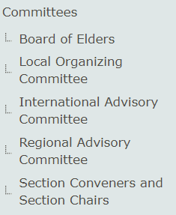
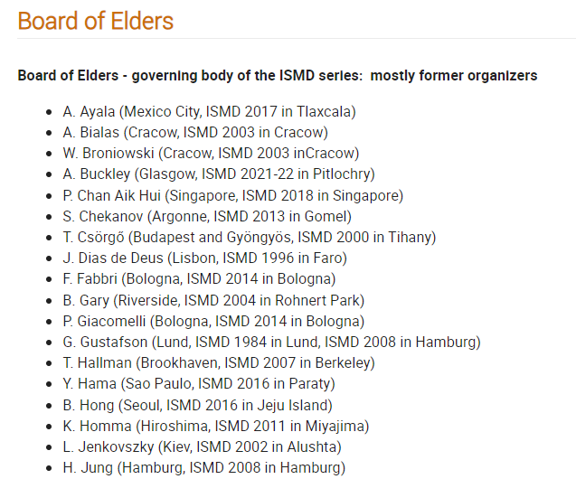
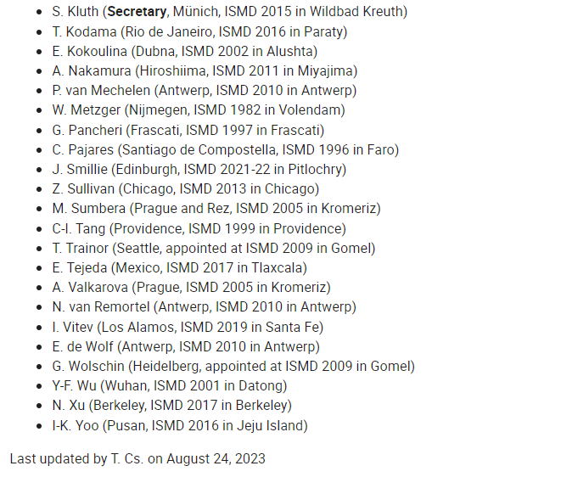
ISMD 2023 - Committees
BoE decisions:
Green light
Topics
Schedule

Slide 6
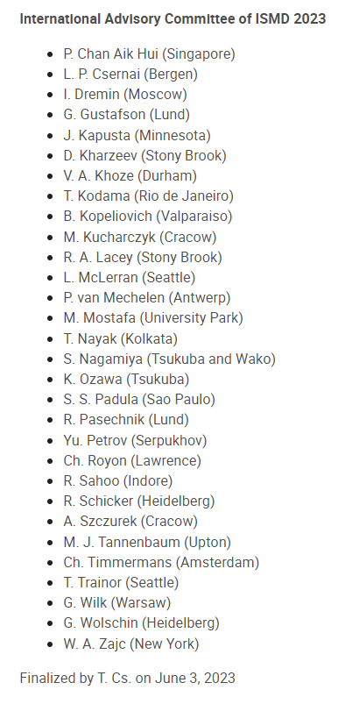
ISMD 2023 - Committees
IAC recommendations:
Speakers
Convenors
Hot topics

Slide 7
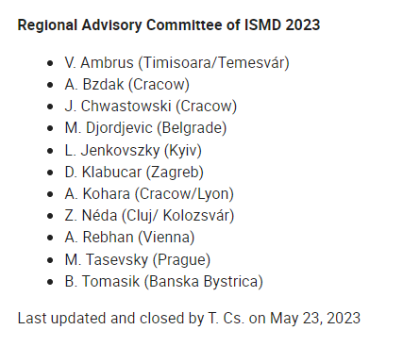
ISMD 2023 - Committees
RAC recommendations:
Speakers
Convenors
All from this region!
Regional effect achieved:
All the seven neighbouring countries participated

Slide 8
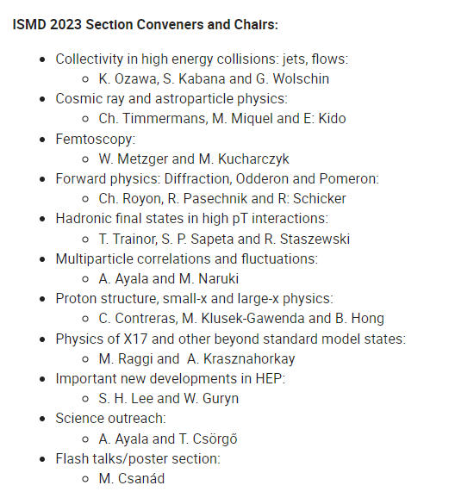
ISMD 2023 - Committees
So many IAC + RAC recommendations:
Weaker than usual convenor system
Proposing, inviting and chairing parts of programs

Slide 9
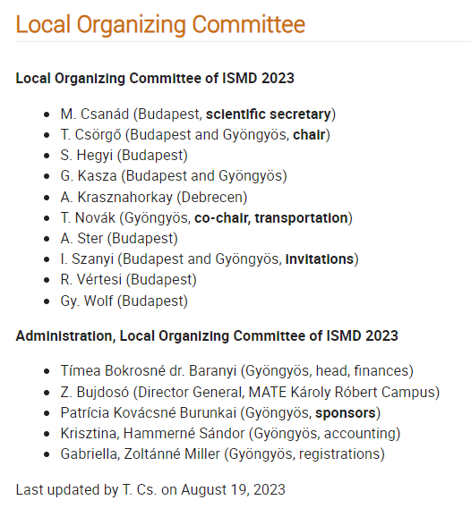
ISMD 2023 - Committees
Working people in LOC:
Balancing all aspects
Internal and external communications
Invitations, transportation, sponsors

Slide 10




















