Slide 1
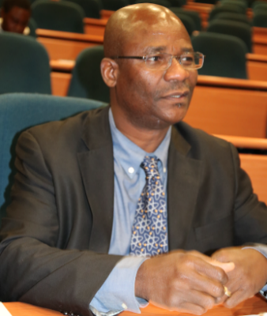
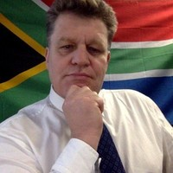

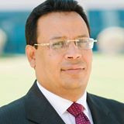
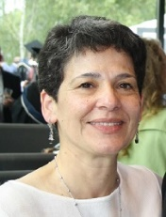
African Strategy for
Fundamental and Applied Physics
Pan-African, gender balanced and inclusive
Conveners Meeting : 2021-07-12
Mandating Body : African Physical Society
Steering Committee: ASFAP-SteeringCommittee@cern.ch
Dr. Kétévi Adiklè Assamagan (BNL, USA), ketevi@bnl.gov
Prof. Simon Connell (University of Johannesburg, SA), si@mykonos.org.za
Prof. Farida Fassi (Mohammed V University, Morocco), farida.fassi@cern.ch
Prof. Shaaban Khalil (CFP, Zewail City, Egypt), skhalil@zewailcity.edu.eg
Dr. Fairouz Malek (CNRS and Grenoble Univ., France), fmalek@lpsc.in2p3.fr
Web : https://africanphysicsstrategy.org/,
Wiki : https://twiki.cern.ch/twiki/bin/view/AfricanStrategy
Twitter: https://twitter.com/StrategyAsfap

Slide 2
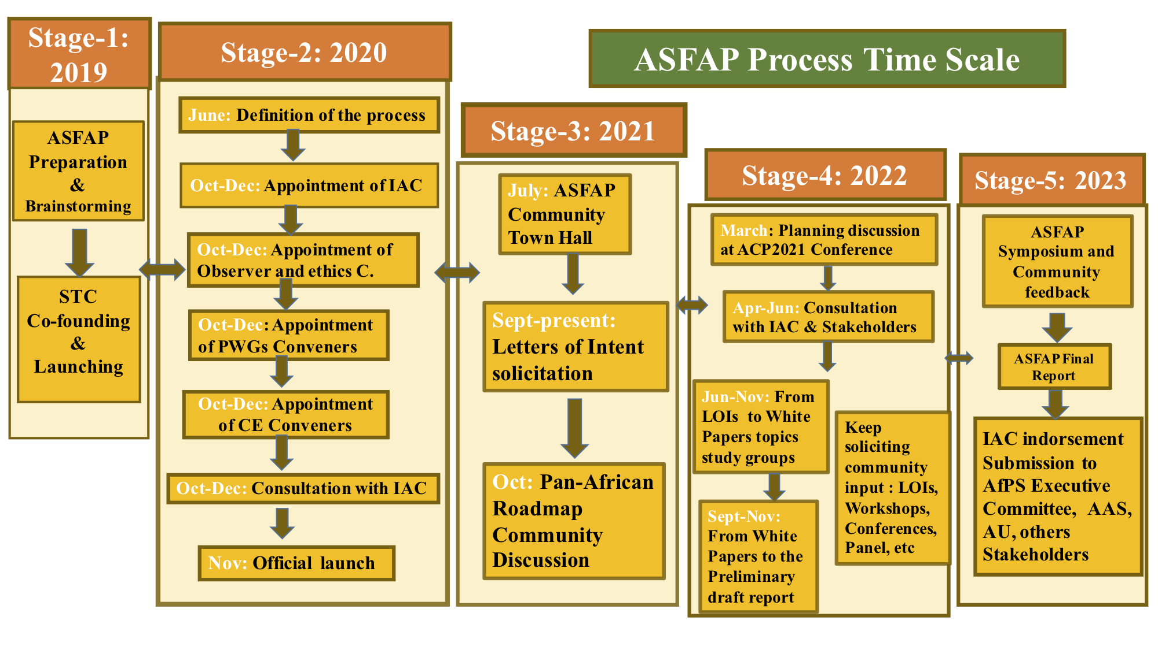
ASFAP Timeline – the last part Roadmap

Slide 3
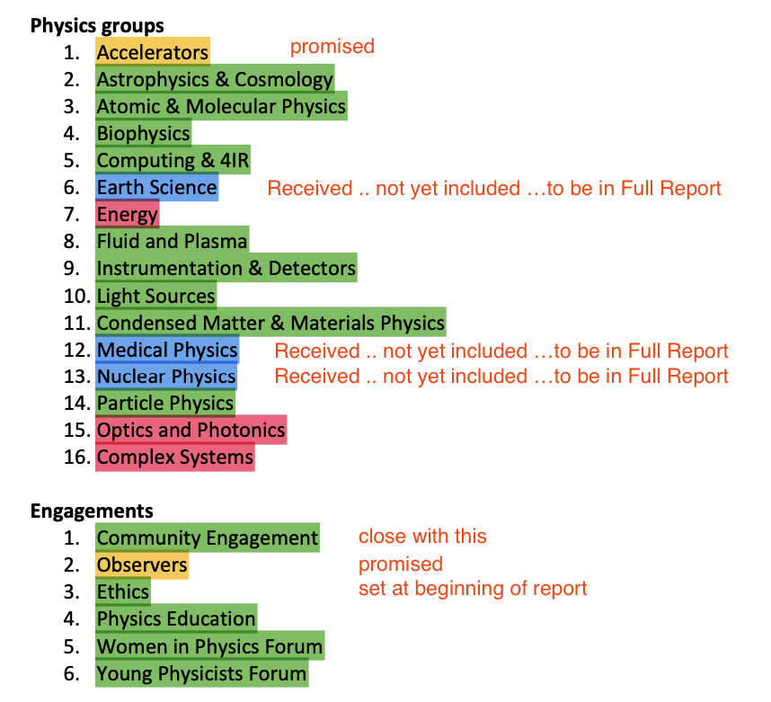
Current Situation
Follows intensive process of Community Consultation
Assess ASFAP Interim Report
  Some strong contributions, some absent, some could be augmentated.
    Considering detailed research area submissions and history of workshops etc
Encourage further work
  Realistic –
    Some groups are very active
    Some groups may have already exerted themselves as much as they can
    Not sure adding capacity to the groups is a solution
    SC and existing Convenors to step up
      Community needs
      (from LoI, White papers, additional solicitation
Include IAC recommendations in process

Slide 4
Way Forward
Status
  Many LoI
  Some White papers
Current
  LoI and White Paper submission is to stay Open
Actions for Working Groups and Subgroups for 2023 …. Are we sliding
  Review LoI, group common themes, invite White Papers
  Identify obvious gaps – share list of such with the SC
  Considering Gaps → Target groups and individuals pro-actively, solicit White papers
  Gaps are noted by field, area, geography, nationality, diversity area, political imperative.
Begin drafting the Report by Working group Area
  Use existing material
  Use blank heading where material is not available
  Option to use initiative to develop material
Group leads to produce a list of at least two WP they prioritise
Some WP exist.
  We want as many as possible
In the final analysis, as this is the first community driven African Strategy, .. It dose not yet have the full power of a very active community who understand their role in determining the future of their discipline, so this means the Group Leaders and the SC will ultimately shoulder a large burden to deliver the WPs and the Report
Draft emerges as LaTeX document on GitHub

Slide 5
Way Forward
Backup

Slide 6
The African Strategy
Objectives
  Develop a Strategy to increase African education and research capabilities, improve collaborations, and inform international partners, sponsors, policymakers on the strategic directions likely to impact African development
  Engage African scientists and the international community in the Strategy development
  The process to take a few years, to end with the release of the strategy report which will suggest the direction, with actionable items for the next decade. To be repeated periodically, every 7-10 years for the following decades with a review of the impact of previous Strategies
  This inaugural African Strategy to set the foundation and framework to draw the participation of African physicists —with inputs from the international communities—in defining education and physics priorities most impactful for Africa
General Structure
  Broad footprint by discipline and fields
  Steering Committee, Advisory Committee, Group Conveners, Sub-group Conveners
  Solicitation of inputs from the community in the form of Letters of Intent, and White Paper Study Groups
    Progress discussed in the relevant groups
    Subgroup and group final reports (at the subgroup and convener levels); Strategy report at the Steering Committee level
    Feedback and advice from the IAC
Logistics – Post COVID Virtual Working enabled by electronic technology platforms
  Website, Twiki pages for working groups, Cloud repository, multi-group mailing lists, discussion forums, Indico meeting Agendas and virtual workshops — continuous development

Slide 7
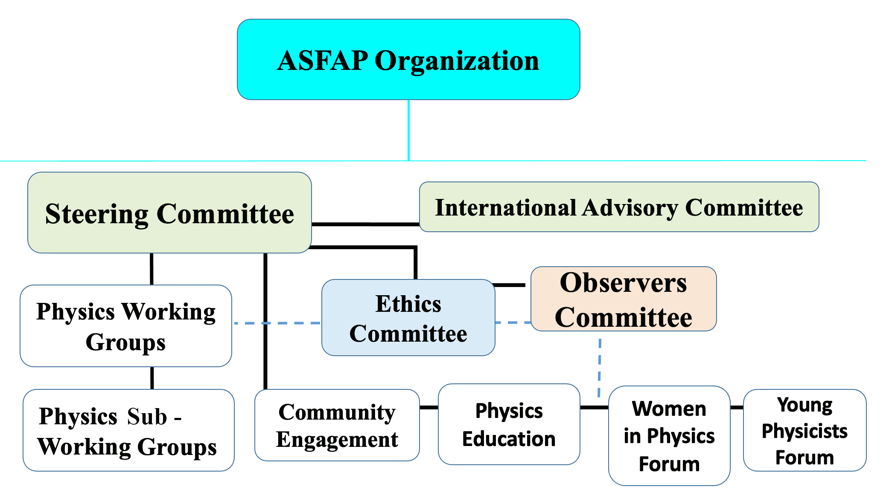
Structure and Organization
  Overall coordination
  Final report
  Review of progress
  Advice on scope
  Engage of stakeholders
  Review and endorsement Report
  ASFAP CoC
  Ombudspersons
  Intra-comms
  Review LOIs and WPs
  Help WGs in editing
  Wide solicitation of community inputs
  Preparation of Group reports
Physics Education, Knowledge Transfer, Entrepreneurship, Communication and outreach, Stakeholders and Funding and Govt agencies, Policy Makers, related affairs.
  WG has 3-4 Convenors
  WG defines Sub WGs

Slide 8


International Advisory Committee
Prof. Ahmadou Wagué (President AfPS)
Prof. Atish Dabholkar (Director of ICTP)
Prof Azwinndini Muronga (Dean of Science, NMMU, SA)
Prof. Emmanuel Tsesmelis (CERN IR)
Prof. Faiçal Azaiez (Director of iThemba LABS, SA)
Dr. Fadila Boughanemi (EU Deputy Head of Int Cooperation, R&I Unit)
Prof. Omar Fassi-Fehri (The perpetual secretary of Hassan II Academy of S&T, Morocco)
Prof. Fernando Quevedo (Former Director of ICTP)
Prof. James S. Gates (Brown University, President of APS)
Dr. Latifa Elouadrhiri (Physicist Jefferson Lab & DOE, USA)
Prof. Michel Spiro (President of IUPAP)
Prof. Mohamed Hassan (President of TWAS)
Dr. Najat Mokhtar (IAEA DDG, HoD of Nucl Sciences & App)
Prof. M. Norbert Hounkonnou (President, NASAC)
Prof. Petra Rudolf (U Groningen, President of EPS)
Prof. Raheel Qamar (Head S&T Sector, ICESCO)
Dr. Raïssa Malu (mem. DRC Presidential Panel to the AU)
Rob Adam (Director of SKA, South Africa)
Prof. Rohini Godbole (India Institute of Science)
Prof. Rolf Heuer (President of the SESAME Council)
Prof. Setsuko Tajima (President of the JPS, Osaka U., Japan)
Prof. Wang Yifang (Director at IHEP/CAS, China)
Prof. Winston Soboyejo (Former President of AUST, Nigeria, Provost Worcester Polytech, USA)
Dr. Shamila Nair-Bedouelle (UNESCO Assistant DG for Natural Sciences)
Dr. Takalani Nemaungani (DSI, Acting Chief Director of Astronomy, SA)
Prof. Young-Kee Kim (Louis Block Distinguished Service Professor of Physics Chair, U of Chicago, USA)
Prof. Zeblon Vilakazi (Vice Chancellor, U Witwatersrand, SA).

Slide 9
ASAFP General Structure
Submit LOIs : https://indico.cern.ch/event/1061921/
Steering Committee, Group & Subgroup Conveners
Engagement forums Observers & Ethics Committees
Conferences
Workshops
Panel Discussion
Solicitation of inputs from the community
Regular meetings
Letters of Interest
Surveys
White papers
Broad footprint by discipline and fields
Progress discussion in the relevant groups
Reports of the Groups/Subgroups and fora at the Conveners levels
Strategy report at the Steering Committee level
IAC provides feedback and advice
Summary
&
Final report
The process will take a few years and end with the release of the strategy report
The report will suggest the direction, with actionable items for the next decade
The process is to be repeated periodically, every 7-10 years for the following decades with a review of the impact of previous strategy

Slide 10
Committees & Conveners mission
Steering Committee (STC)
  Overall coordination
  Go-between IAC, OC, EC, W. Groups and Forums
  Final report preparation
International Advisory Committee (IAC)
  Review of progress
  Advice on scope
  Engage of International Communities and Policymakers
  Final Report Endorsement
Observers Committee (OC)
  Advising and conveying ideas between STC and WGs/forums
  Review LOIs and White paper
  Help WGs in report editing
Ethics Committee (EC)
  Responsible for dissemination and maintain
  the Guidelines of ASFAP Code of conduct
  A subset of EC might serve as an Ombudspersons
Groups / Subgroup Conveners/Liaisons between groups
  Encouraging and soliciting community inputs
  Preparation of the Group reports
  Liaisons have to ensure that cross-cutting topics receive proper coverage and consideration in all the relevant groups
ASFAP Working Group Guidelines is fleshed out

Slide 11
Groups & Forums mission
Community Engagement:
  Knowledge Transfer, Entrepreneurship
  Communication and Outreach
  Stakeholders and Funding, Government Agencies, Policy makers related business
Physics Education
  Promote science-led development on a sustainable basis
  Contribute to the scientific literacy of High Schools and Universities
  Revitalize Higher Education
Women in Physics Forum
  Mitigate the shortage participation of African Women in Physics
  Inspire Young Women to consider Scientific Careers
Young Physicists Forum
  Engaging Young people in Physics Science, Technology and Engineering

Slide 12
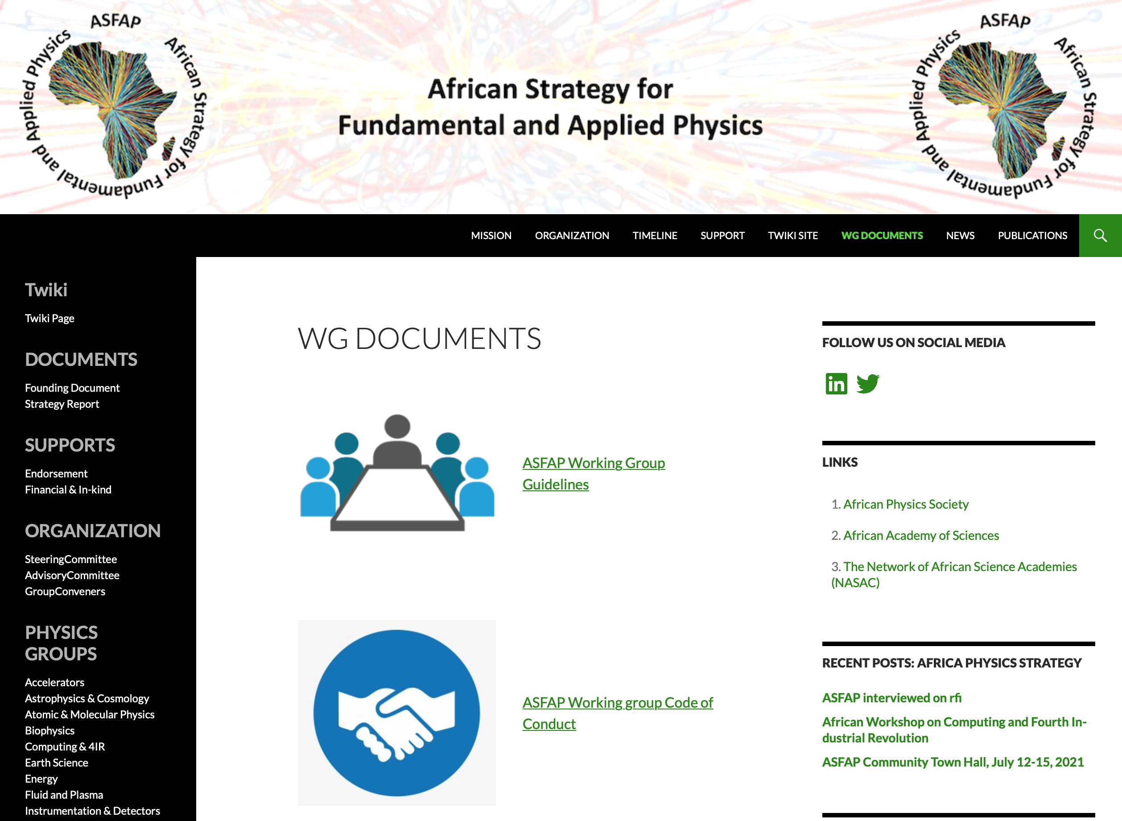
ASFAP Web ….. WG Docs

Slide 13
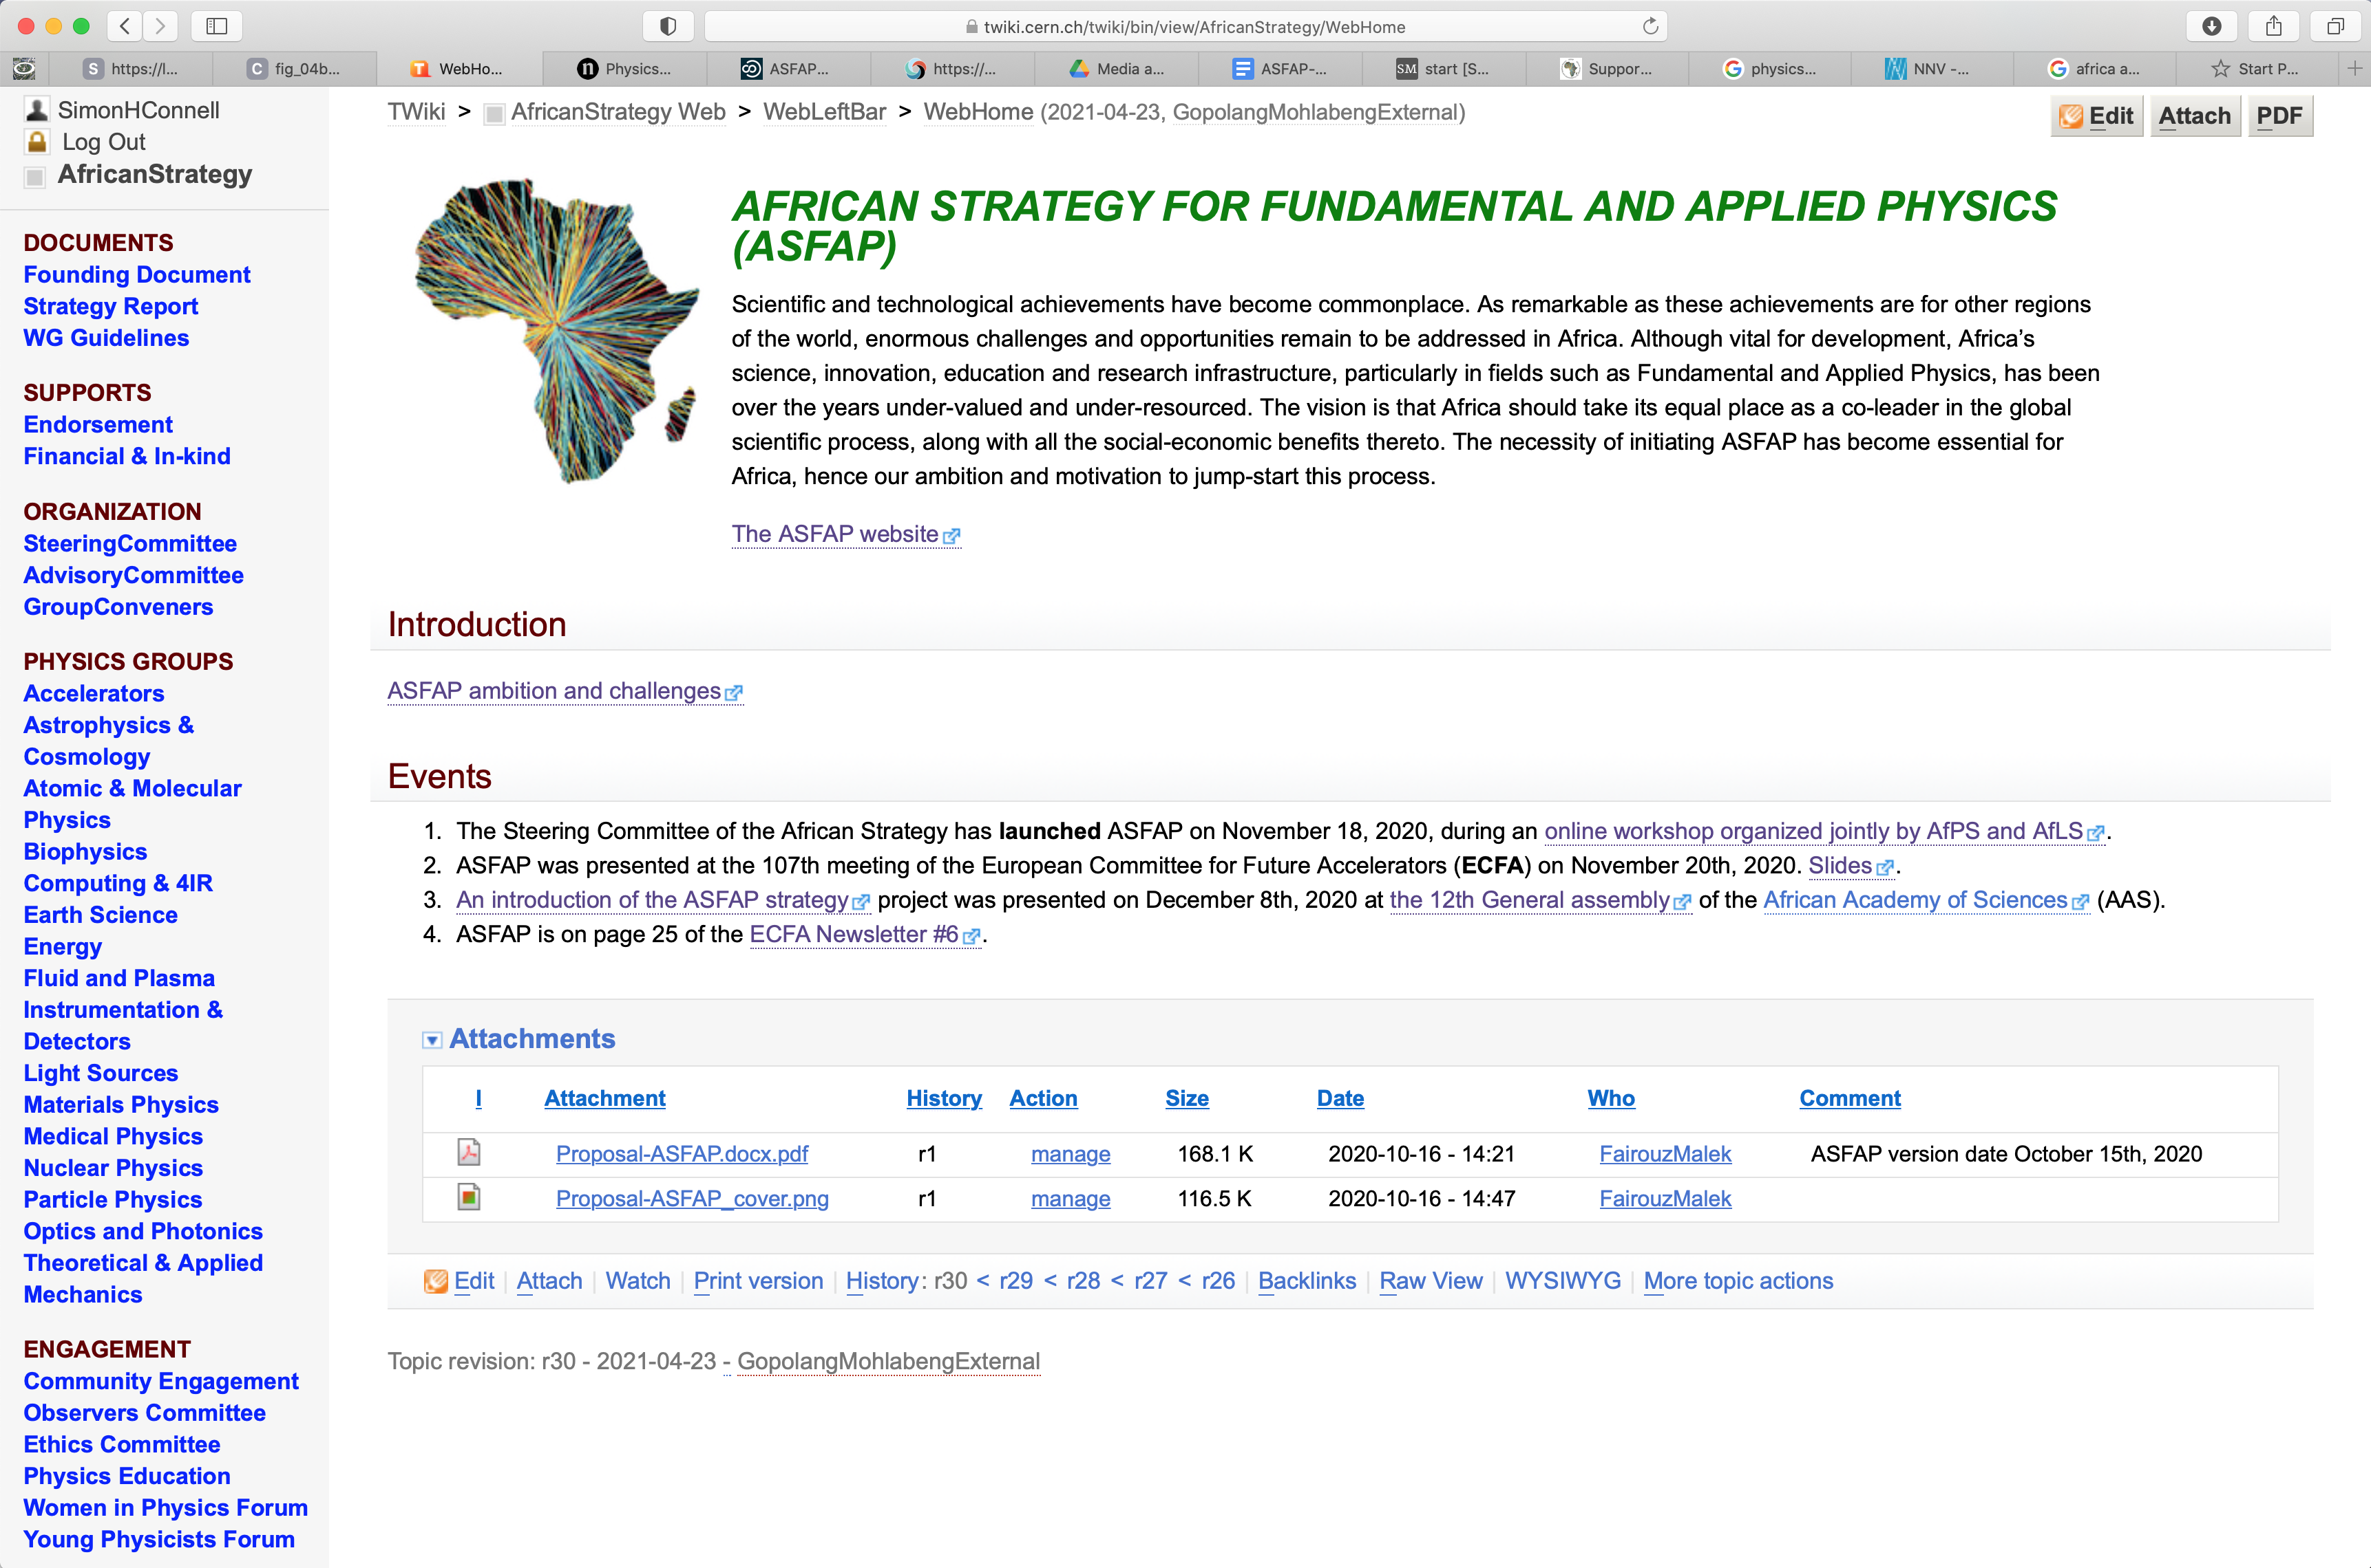
ASFAP Twiki ….. structure, activity

Slide 14

Support for ASFAP
General mandate
Close interaction
Final Report Endorsement
Funding Agencies and Governments
Organizations, Institutions, Academies

Slide 15


How can you get involved
Nominate subgroup conveners and liaisons
Volunteer for (sub)conveners
Submit LOIs / White papers
Participate in White Paper study groups
Participate in (sub)group meetings
  Offer your constructive opinions and expertise
Encourage your research groups to get involved
Encourage institutional credits for those working on this Strategy
  For people in leadership roles as (sub)conveners and liaisons
  White papers aim to be published
  White paper finding reviewed and referenced in the Strategy report
Thuma mina – Send Me
https://www.youtube.com/watch?v=d4Bwux-btq0
Musician Hugh Masekela
Inspired SA President Cyril Ramaphosa

