Slide 1



Tau data-driven evaluation of the HVP
Sixth Plenary Workshop of the Muon g-2 Theory Initiative
September 8, 2023
Alejandro Miranda
IFAE, Spain
In collaboration with:
Pere Masjuan (IFAE, UAB, Spain)
Pablo Roig (Cinvestav, IPN, Mexico)

Slide 2
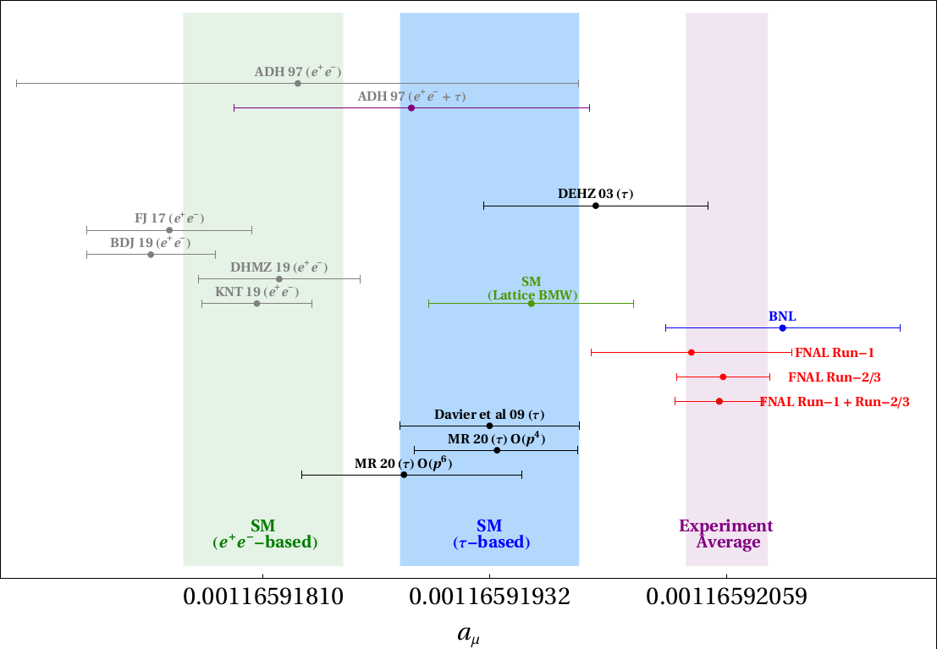
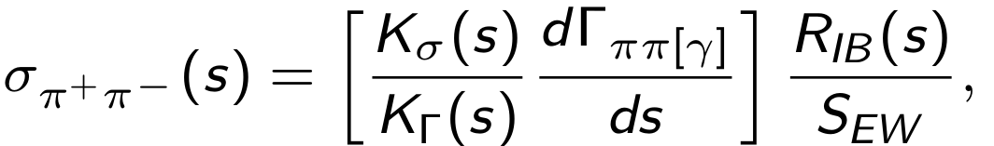
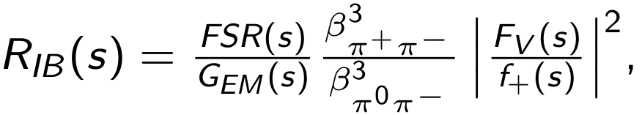
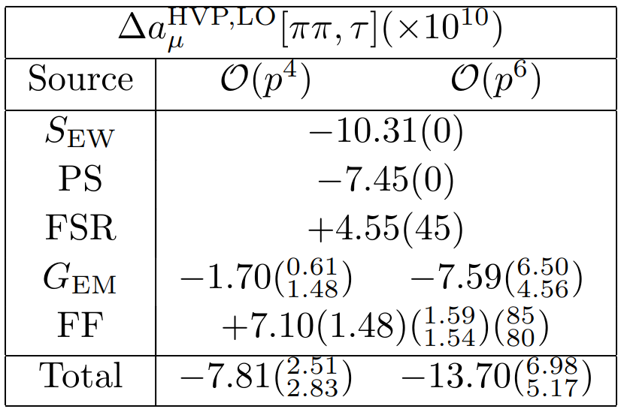
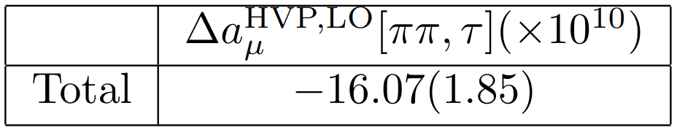
Data-driven calculations of HVP
SEW: Sirlin '78; Marciano-Sirlin '93
FF (Mixing,…) : Maltman '05; Maltman-Yorke '06, '11; Davier et al '09
EM: Cirigliano et al '01, '02; Flores-Tlalpa et al '06; Miranda and Roig '20;
Esparza-Arellano et '23
WP20 [Phys.Rept.887, arXiv:2006.04822]
Alejandro Miranda (IFAE)

Slide 3
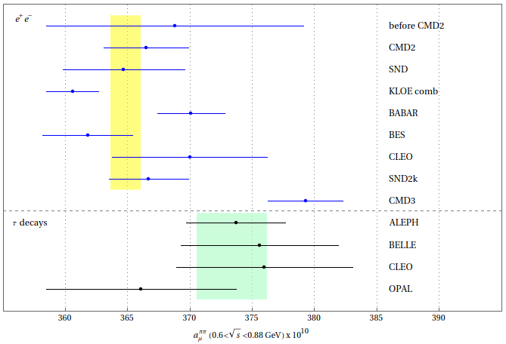
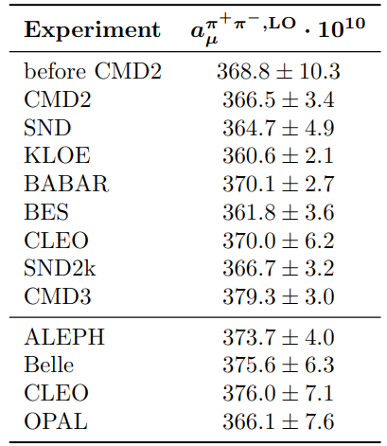
HVP, LO from data
Comparison of results for the HVP, LO, evaluated between 0.6 GeV and 0.88 GeV .
CMD-3. 2302.08834 [hep-ex]
Alejandro Miranda (IFAE)

Slide 4
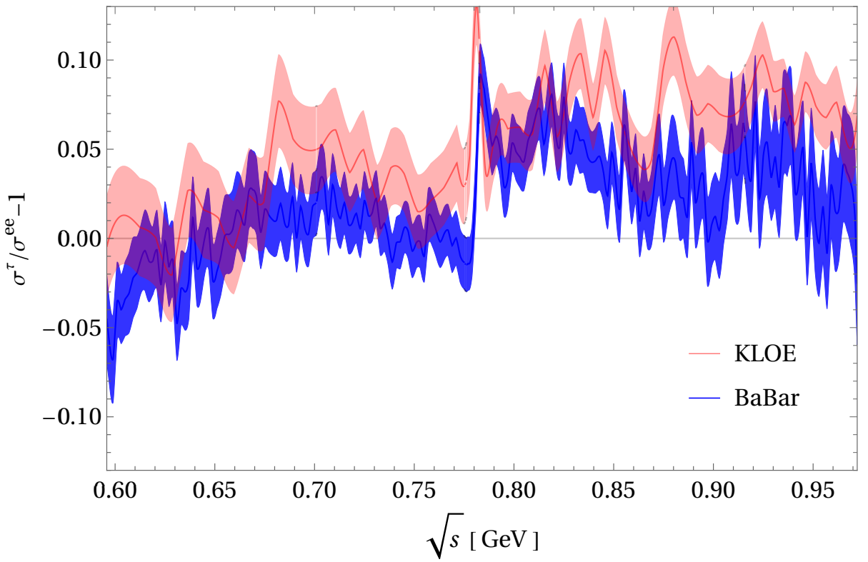
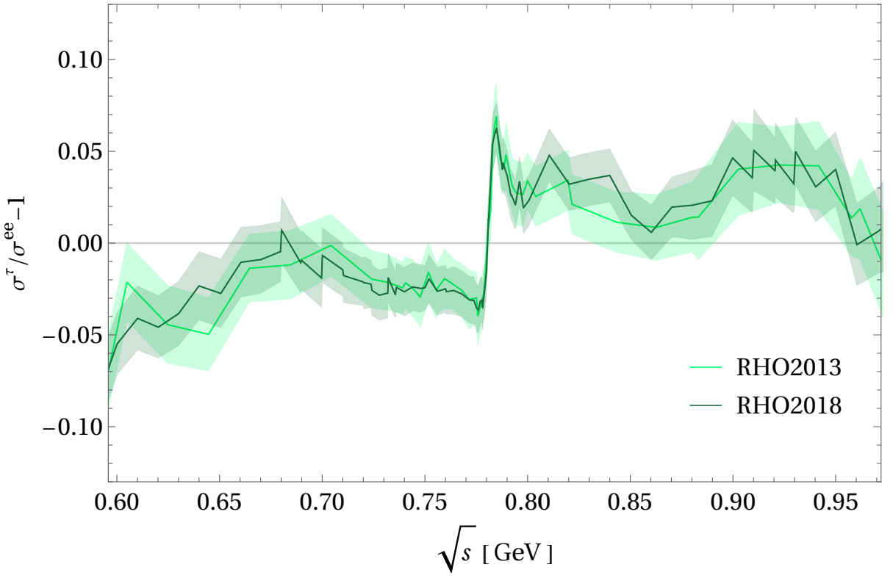
Large tensions among experiments: KLOE, BaBar and CMD3.
Comparison between the different data sets: KLOE and BaBar (left-hand) and CMD-3 (right-hand).
Alejandro Miranda (IFAE)

Slide 5
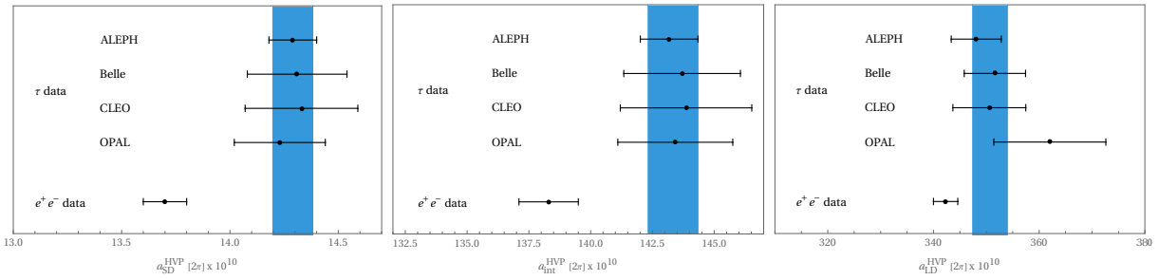
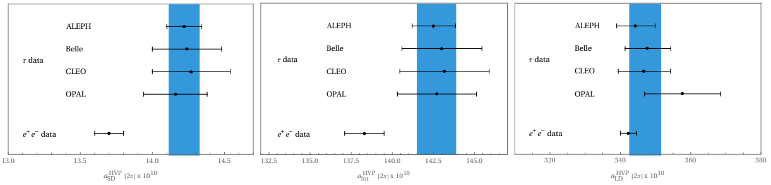
Windows quantities for 2π below 1.0 GeV.
+ 4.3 σ
+ 3.2 σ
+ 2.1 σ
+ 3.6 σ
+ 2.6 σ
+ 0.9 σ
Alejandro Miranda (IFAE)

Slide 6
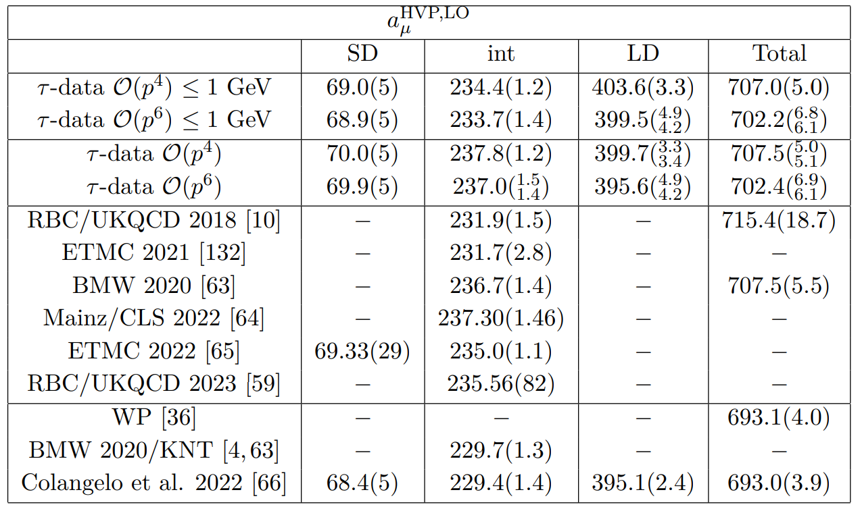
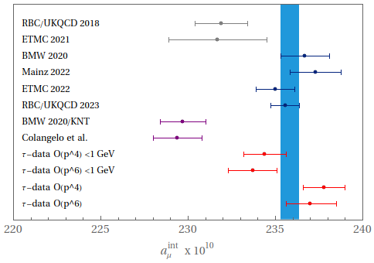
Window quantities for HVP
When all other contributions are added from Colangelo et al '22, we get the overall result for each window quantity.
The contributions of the intermediate window using tau data are slightly closer to the lattice results (~1.5σ).
Alejandro Miranda (IFAE)

