Slide 1
Introduction to prototyping
CERN IdeaSquare
Dina Zimmermann

Slide 2

What is a prototype?

Slide 3
Some definitions
“A prototype is a primitive representation or version of a product that a design team typically creates during the design process”
“Any representation of a design idea, regardless of the medium” (Houde and Hill, 1997)
“An approximation of the product along one or more dimensions of interest” (Ulrich & Eppinger, 2016)

Slide 4

What is the purpose of prototyping?

Slide 5
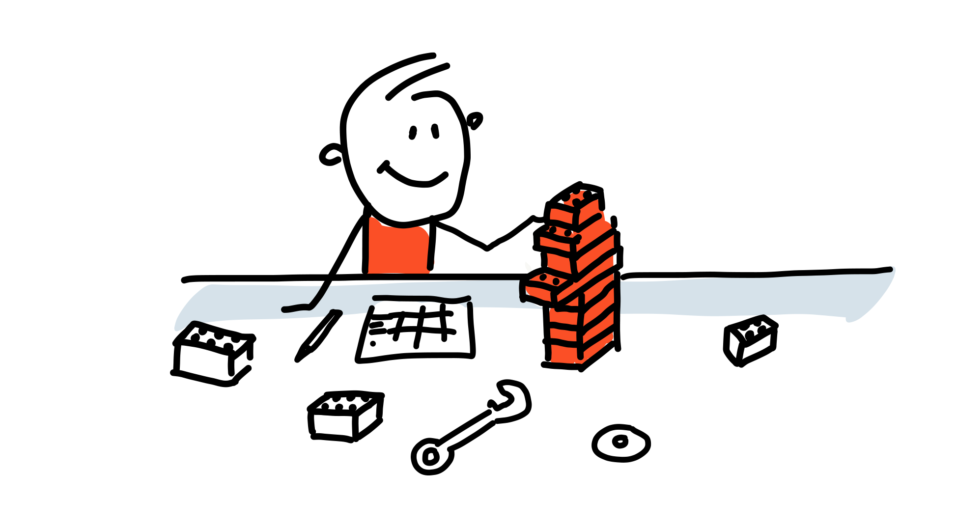
The purposes of prototyping
Learn
Feedback
Commication
Test

Slide 6

Different types of prototypes

Slide 7
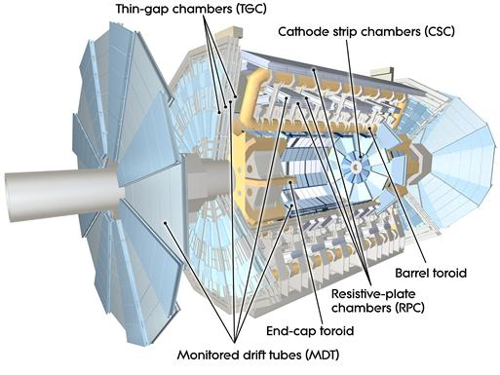
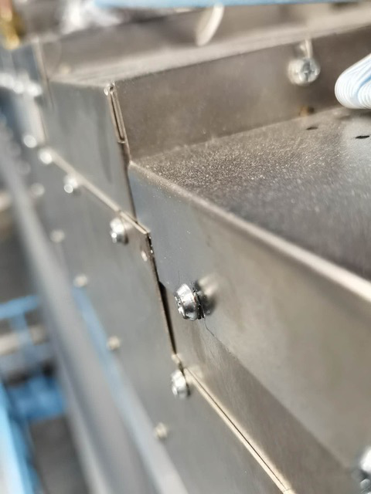
ATLAS MDT detector disassembly
Notes:
ATLAS Phase II Upgrade for High-Luminosity LHC from 2025-2027. Alt skal skje på disse to årene og alt må planlegges veldig nøye. Hver oppgave får en tidsramme som må følges. Dermed er det viktig å gjøre alle oppgavene veldig effektivt. En av gruppene har i oppgave å åpne alle dekslene til all elektronikken og gjøre oppgradering av elektronikkne.
Hvor vanskelig kan det være? Skru ut noen skruer?
Det er 1150 deksler. Dermed kan du se for deg at det vil ta en del tid å skru opp alle skruene som holder dekslene på plass. To formal:
Effektivisere (Raskt matche skrue med skrutrekker)
Unngå at skruer faller ut og at man mister de
Myoner
Linker: https://cds.cern.ch/record/2732959/files/ATL-UPGRADE-PROC-2020-001.pdf
https://atlas.cern/Discover/Detector/Muon-Spectrometer
https://cds.cern.ch/record/2770861/files/ATL-MUON-SLIDE-2021-175.pdf

Slide 8
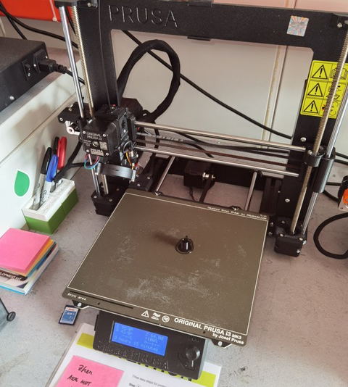

First prototype
Notes:
Utfordringer:

Slide 9

The iterative process of prototyping
Repeat
Build
Learn
Test

Slide 10
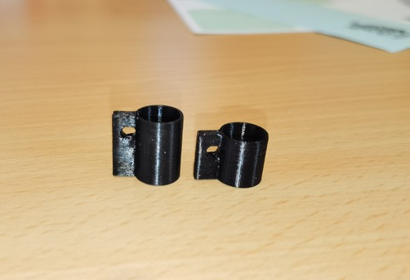
Second prototype
Notes:
Fortsatt utfordringer:
Lett å miste

Slide 11


But…
A prototype doesn’t have to be a product prototype

Slide 12
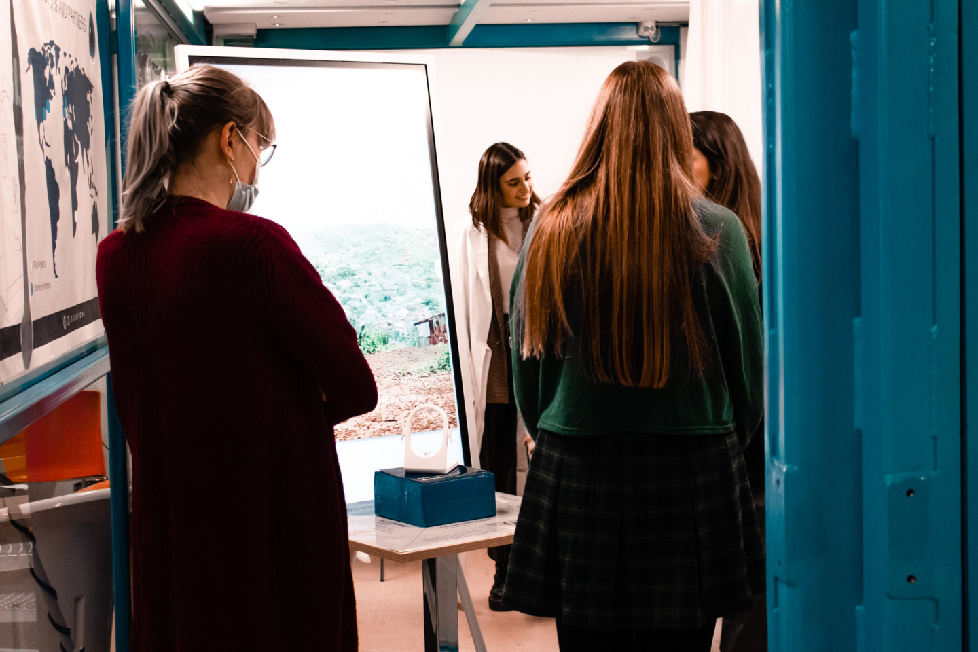
Example: CBI FusionPoint Final Presentation
Notes:
Mobile eye health clinic in Sierra Lone.

Slide 13
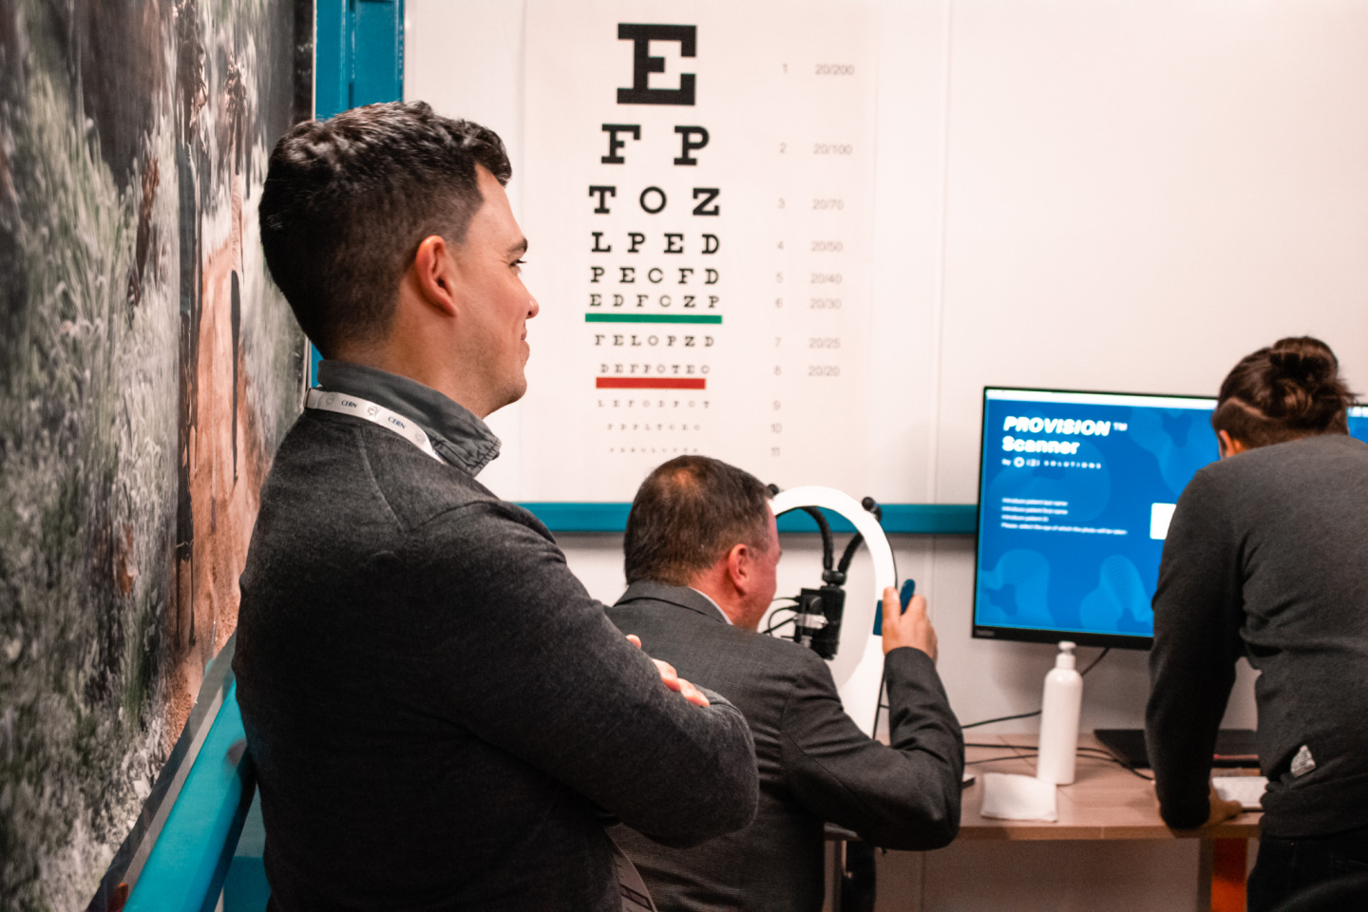

Slide 14
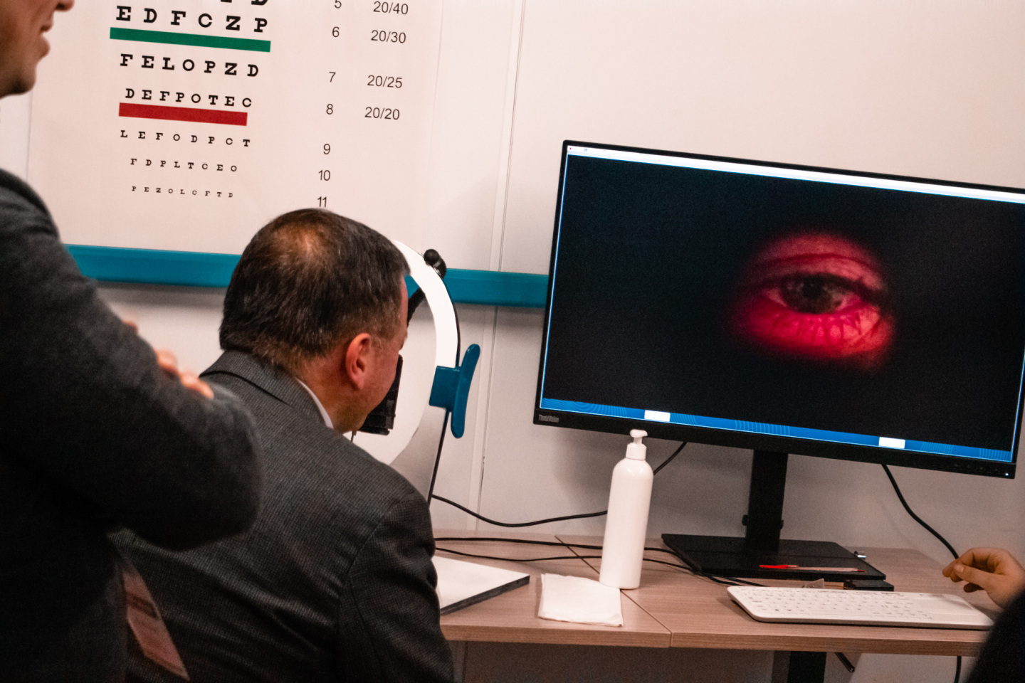

Slide 15

The fidelity of the prototype

Slide 16
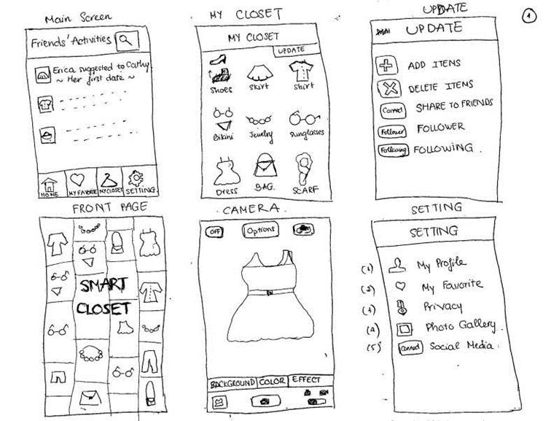
“Fidelity refers to how close a prototype is to the final product”

Slide 17
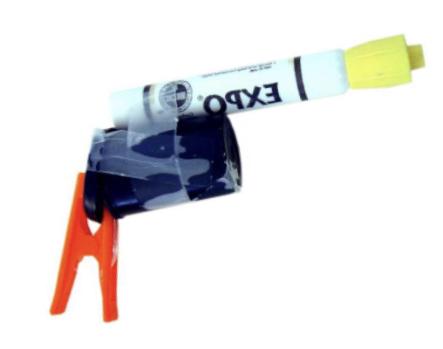
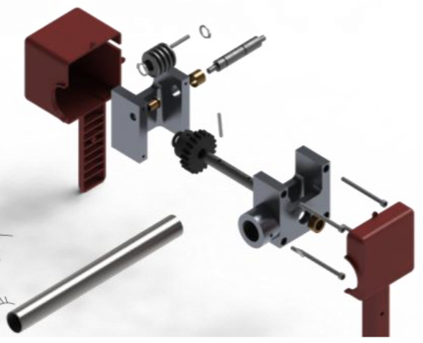
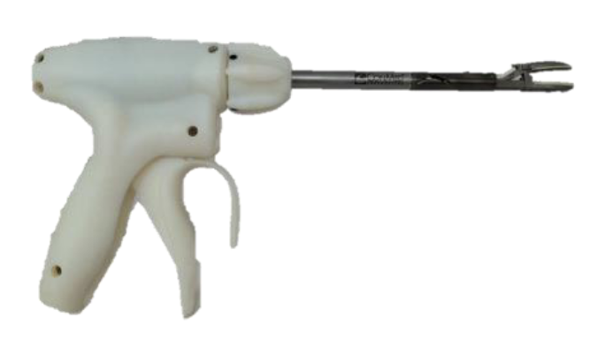
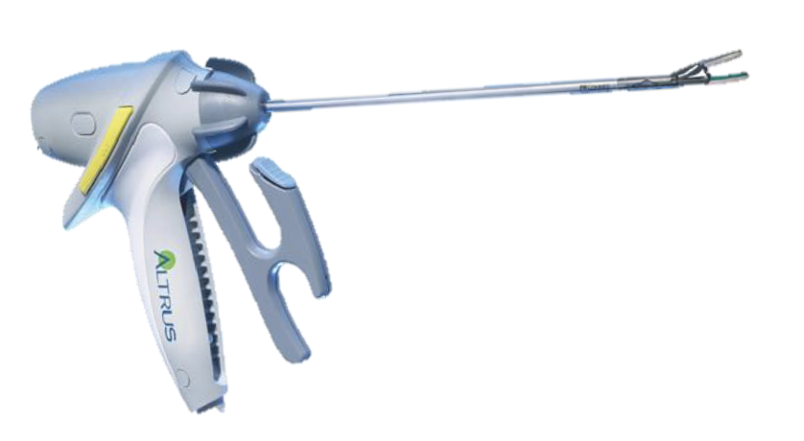
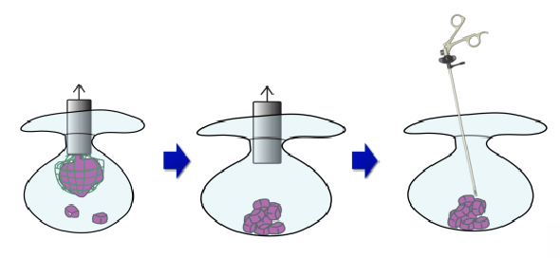
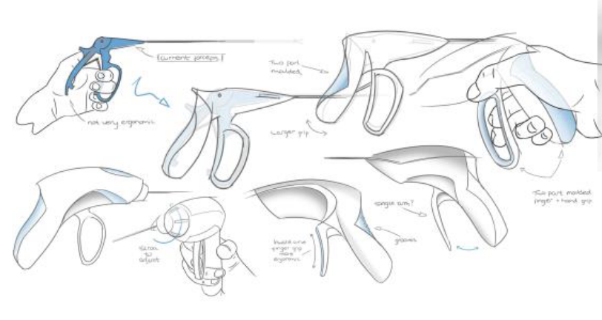
The fidelity of the prototype
Low fidelity
High fidelity
Concept
visualization
Sketching
Quick & dirty
mockup
3D model
Functional
Prototype
Pre-production
prototype
© Carlye Lauff, University of Colorado Boulder

Slide 18
The fidelity of the prototype
Low fidelity
High fidelity
FOCUS AREA TODAY
Concept
visualization
Sketching
Quick & dirty
mockup
3D model
Functional
Prototype
Pre-production
prototype
© Carlye Lauff, University of Colorado Boulder

Slide 19
Thank you for your time!

