Slide 1
Update: Science Gateway Education
TSF 21 March 2023 | sciencegateway.education@cern.ch

Slide 2
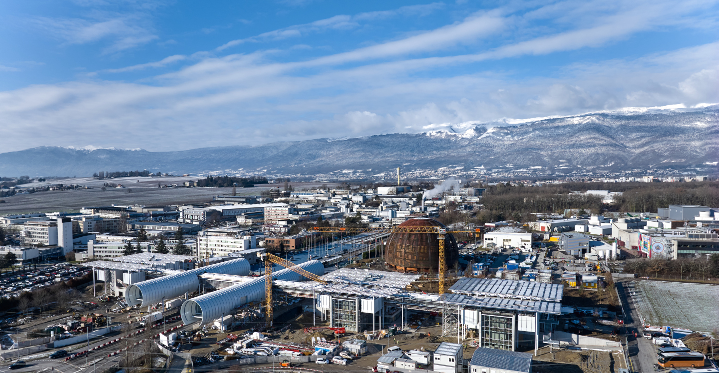
Drone image 19 January 2023

Slide 3
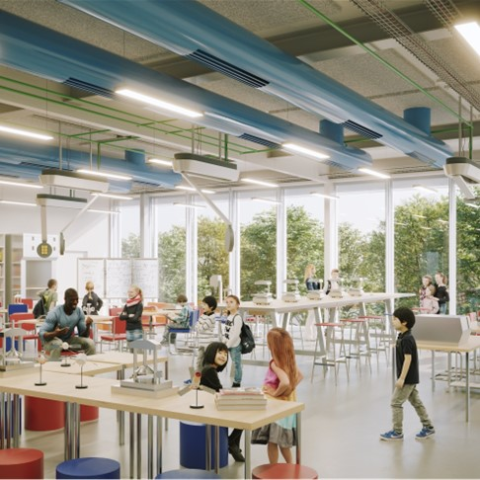
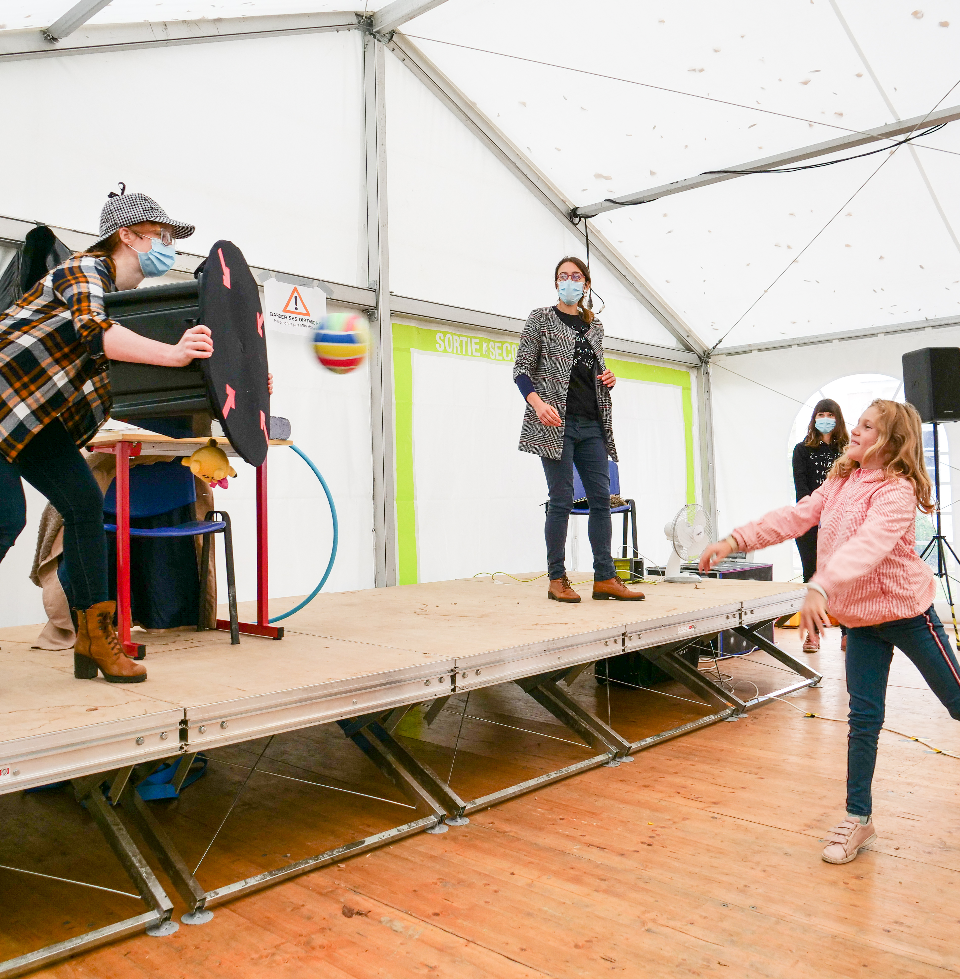
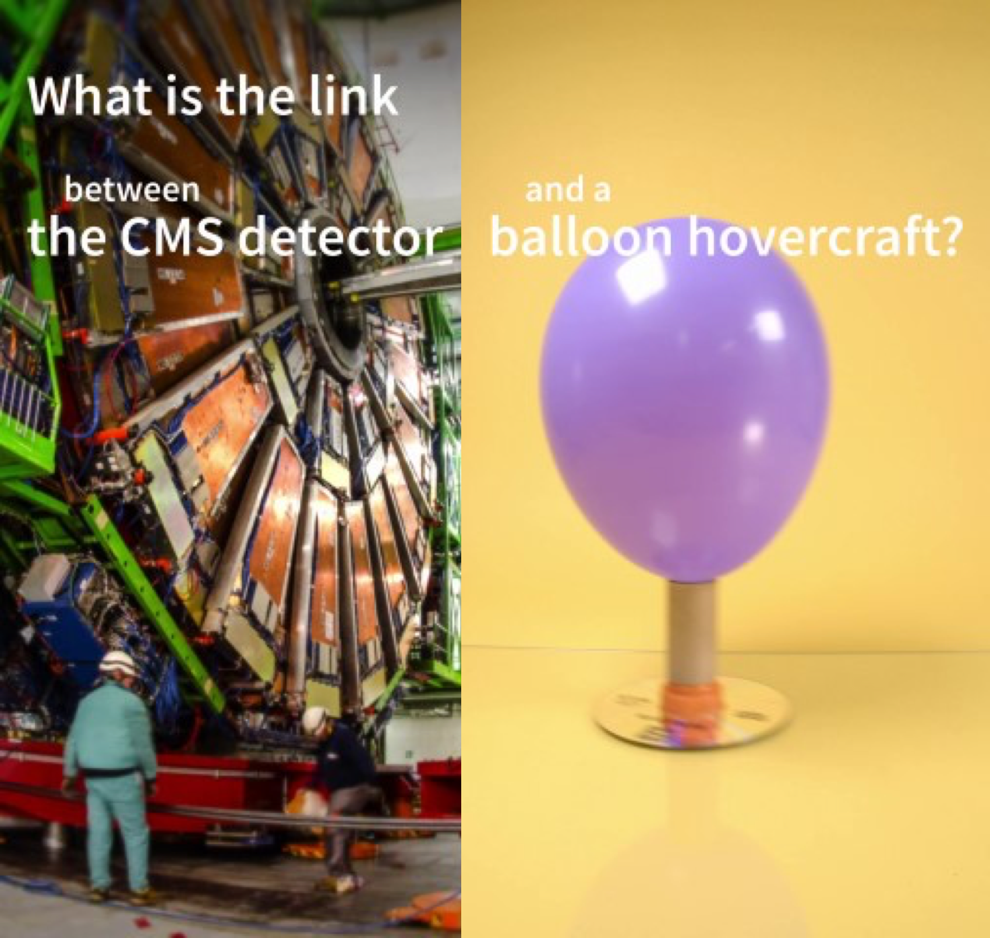

Science Gateway Education
Labs
Discover your inner scientist
Science Shows
Explore the stories of discoveries
Online Learning
Engage online to find out more
Notes:
Science Gateway will offer different education activities – each with a unique education potential:

Slide 4
Science Gateway Education
Labs
Discover your inner scientist
Science Shows
Explore the stories of discoveries
Online Learning
Engage online to find out more

Slide 5
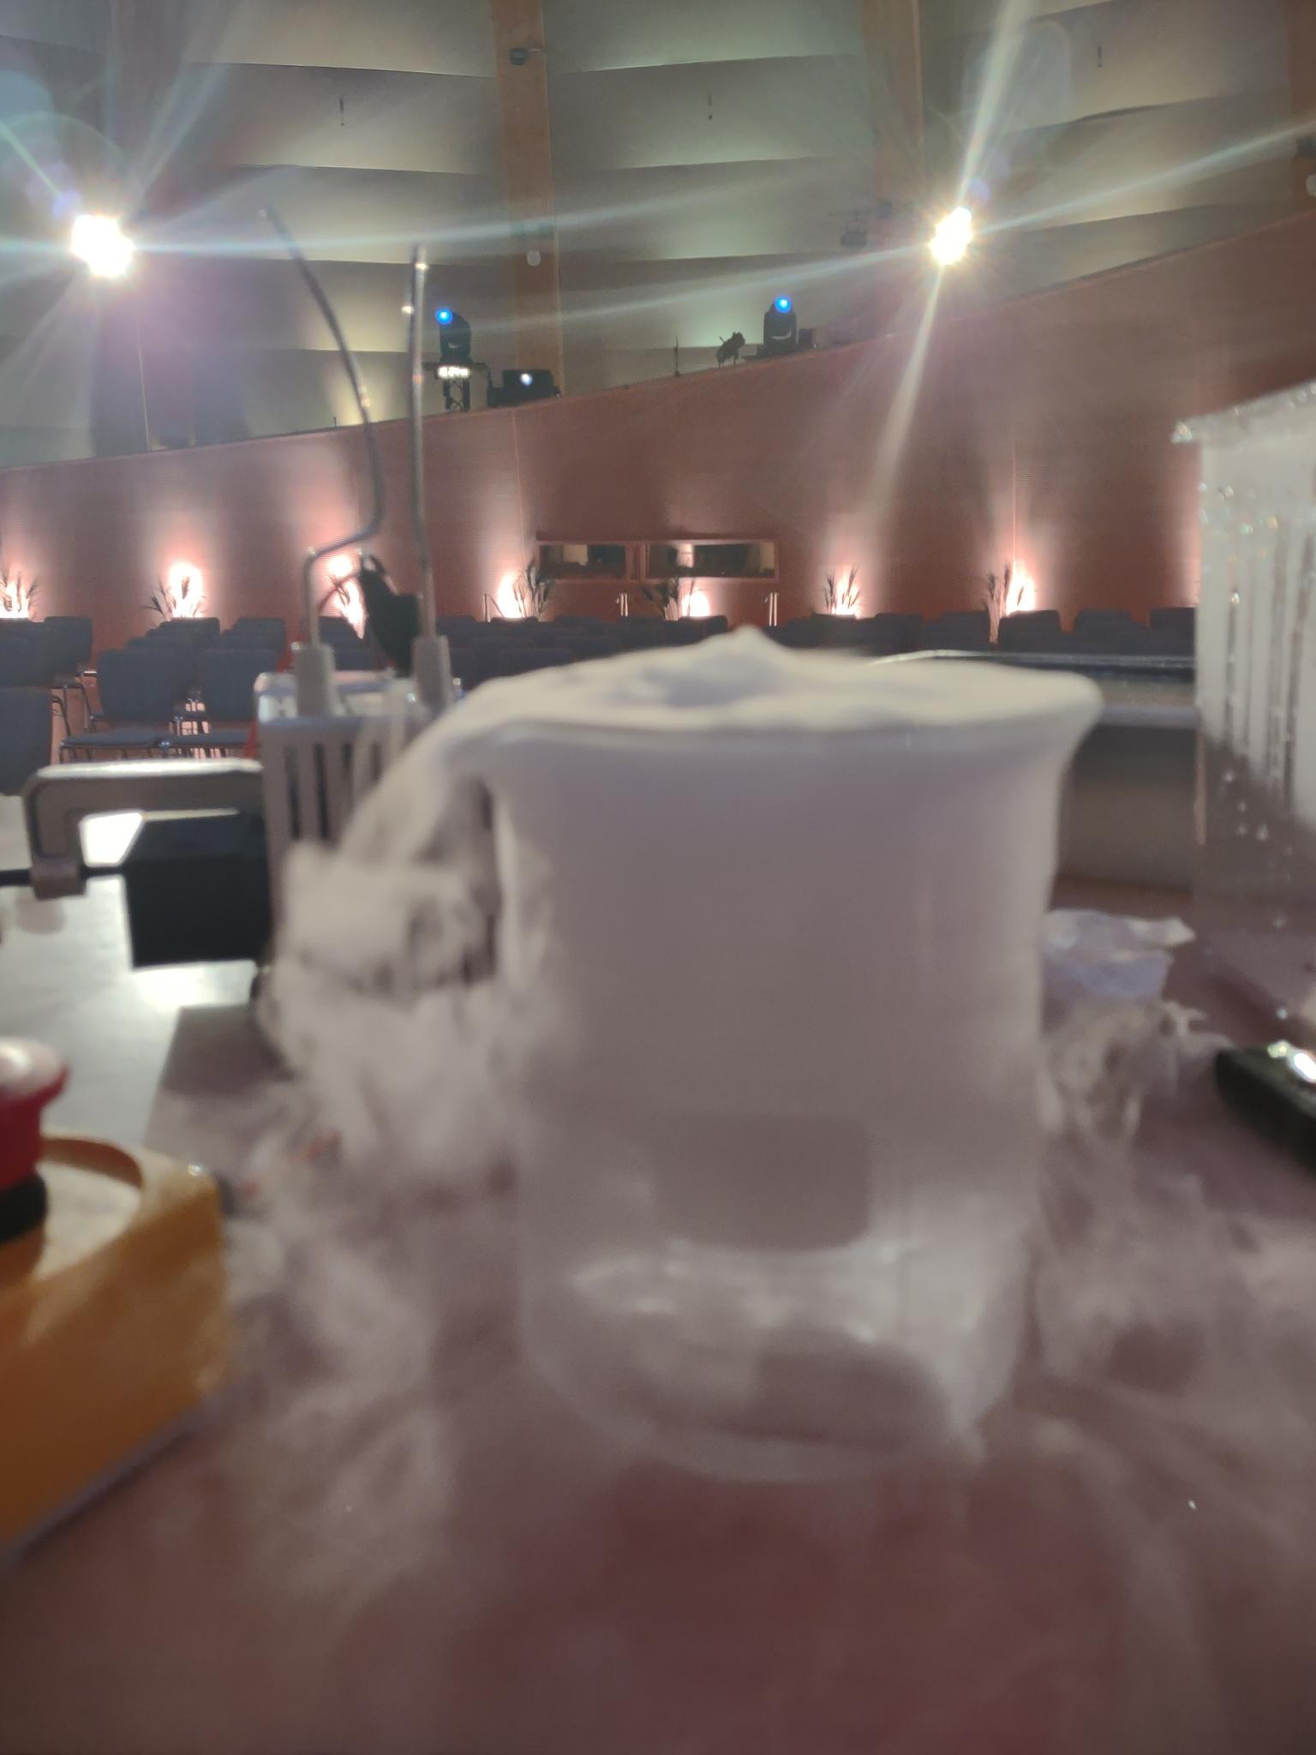
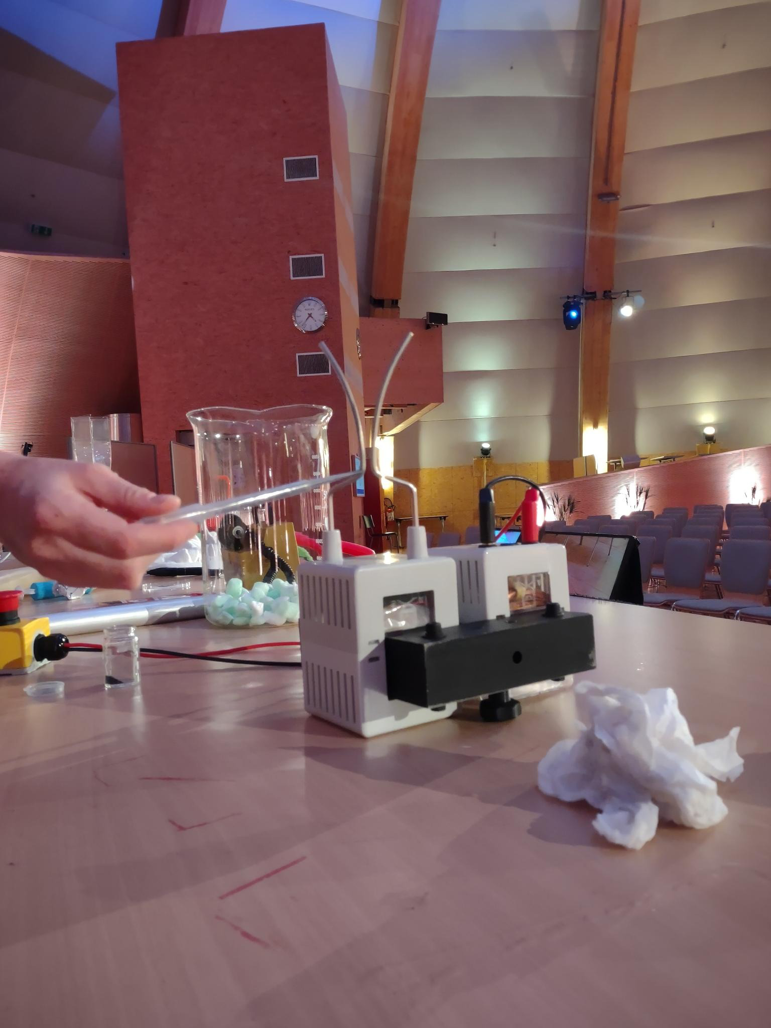
Development of Science Shows: on track
Three shows running in the Globe
  Seeing the invisible
  Seize the Data!
  Fun with Physics
Three shows in development
  Electromagnetism
  Quantum physics
  Frozen (for very young groups)

Slide 6
Science Gateway Education
Labs
Discover your inner scientist
Science Shows
Explore the stories of discoveries
Online Learning
Engage online to find out more

Slide 7



CERN-Solvay online course: 4 videos online
Online course for students aged 14-19
4 videos with embedded quiz questions, each 20-30 min long
Explaining advanced topics in an accessible way to provide a physics background relevant for the technologies and the science at CERN
Luminescence, electromagnetism mini-series
Certificate after 3 completed videos, required for camp application
cern.ch/solvay-course

Slide 8

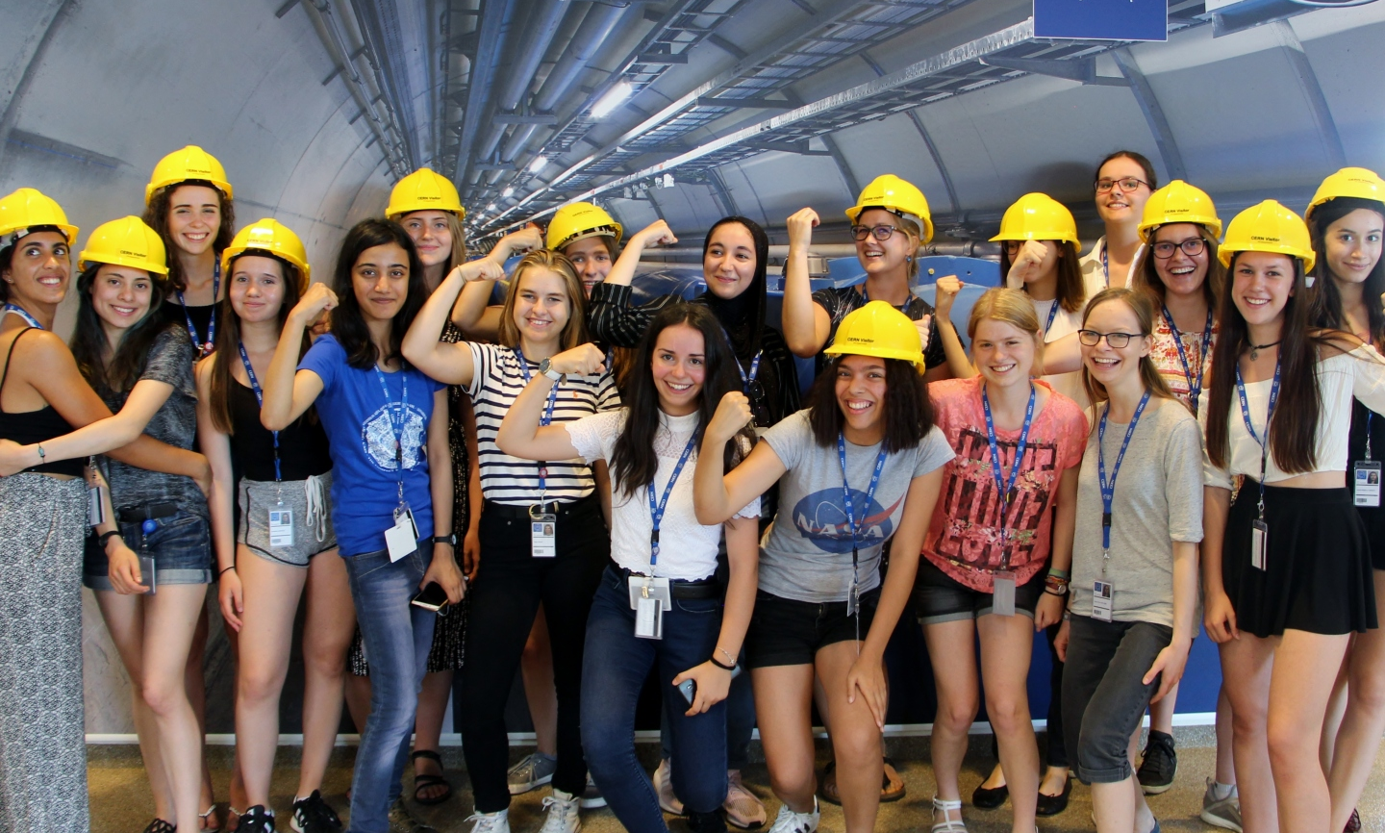
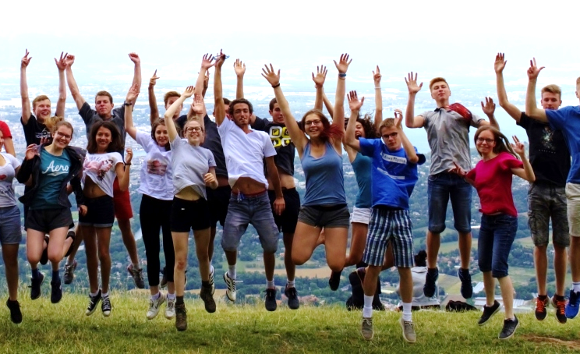
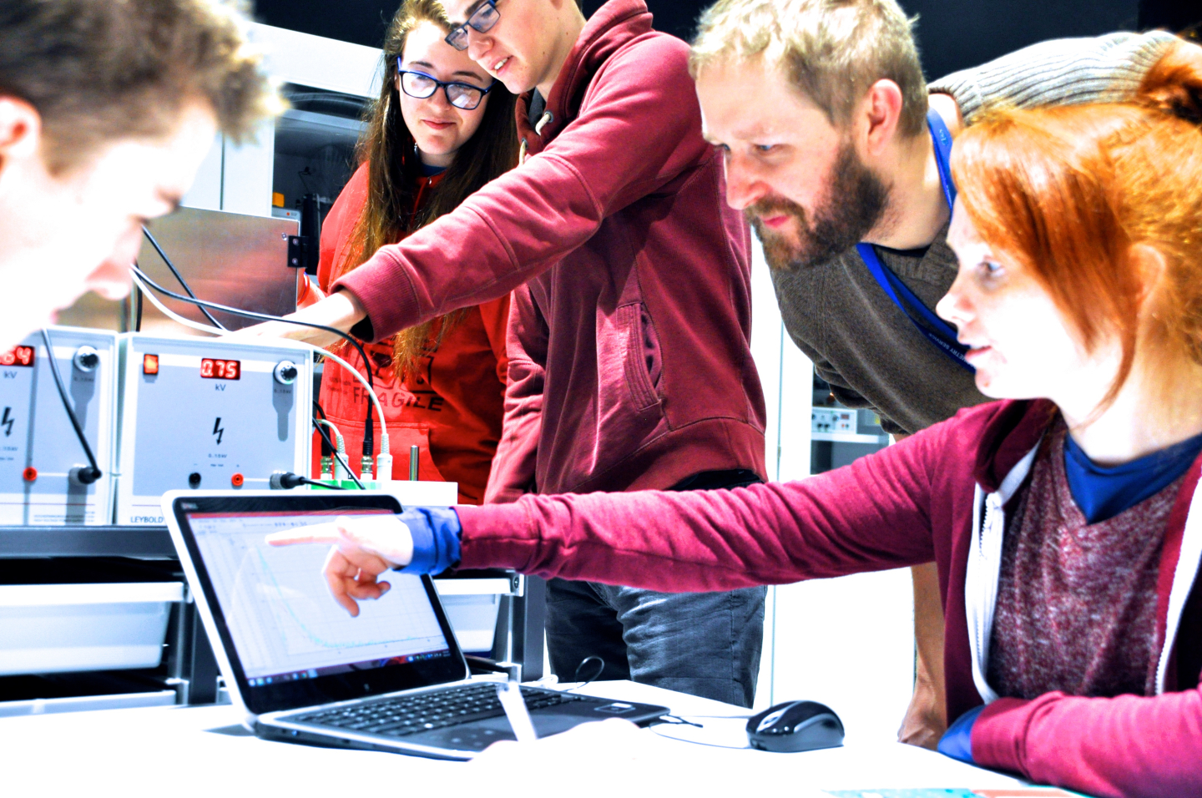
CERN-Solvay student camp: applications open
Bringing a selection of motivated high-school students aged 16-19 from around the world to CERN
Lectures, site visits, social events & work with CERN scientists on modern research topics in hands-on working group sessions
7-day camp for 30 students, once a year, first camp in Oct 2023, apply by 30 March
cern.ch/solvay-camp

Slide 9
Science Gateway Education
Labs
Discover your inner scientist
Science Shows
Explore the stories of discoveries
Online Learning
Engage online to find out more

Slide 10
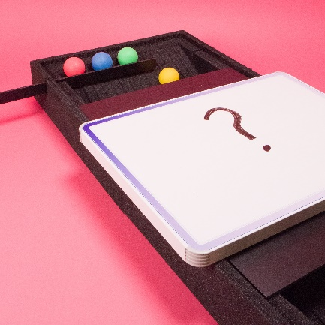
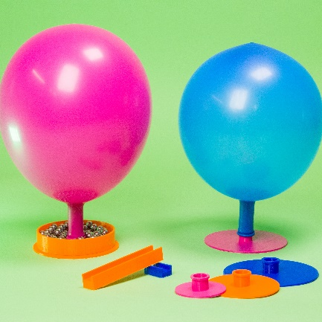
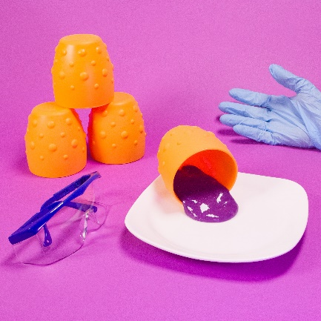
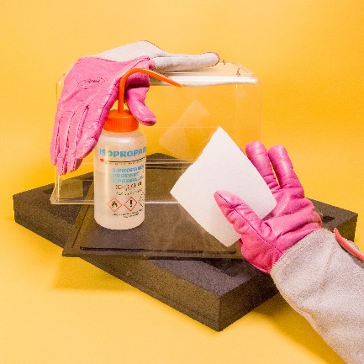
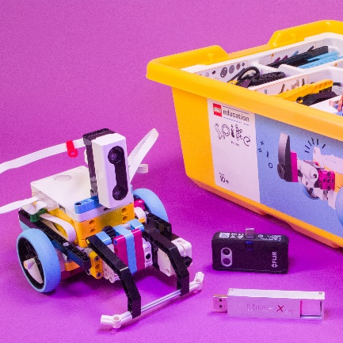
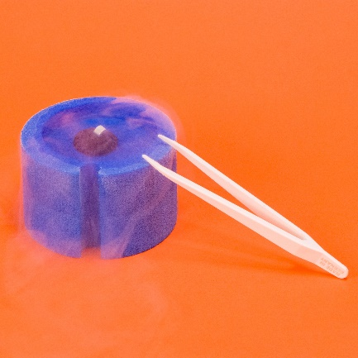
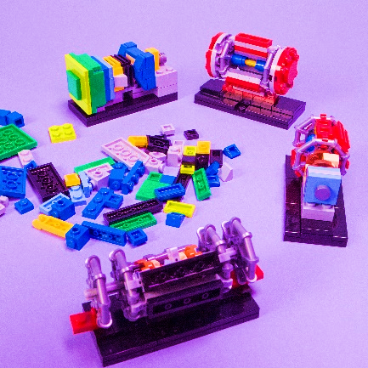
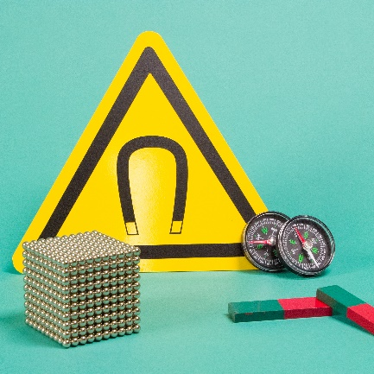
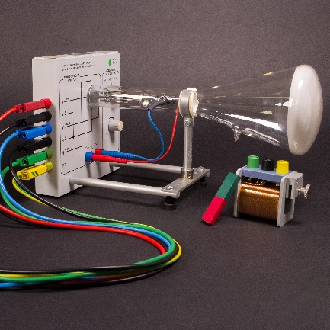
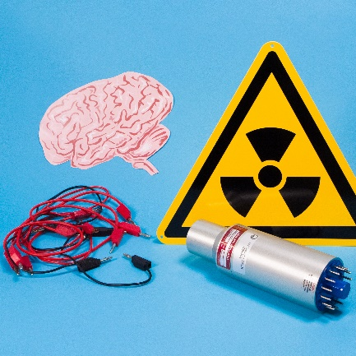
Development of lab workshops: on track

Slide 11
Development of lab infrastructure: on track
Task | Status Dec 2022 | Status March 2023
Furniture labs for 5+ year olds | 95% | 100%
Furniture for labs preparation rooms | 80% | 95%
Separation wall design | 70% | 85%
Room control system | 50% | 70%
Smartboards and A/V equipment | 50% | 75%
Integration into booking tool | 80% | 95%
Website content | 20% | 80%
Workshop tests with local schools | 30% | 90%
Design of intruction materials & icons | 50% | 60%
Prototyping and custom equipment | 40% | 60%
Hazards & safety files & equipment | 40% | 50%
Equipment orders | 60% | 80%
Evaluation protocol | 20% | 50%
Recruitment | 40% | 80%
Education content development | 60% | 80%

Slide 12
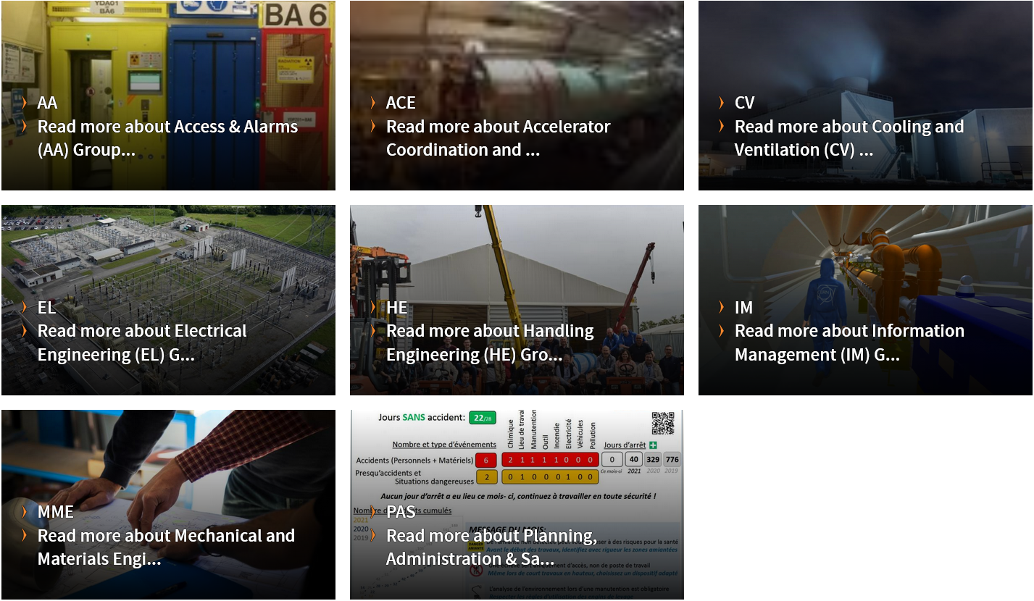

Summer student project: engineering escape game
Educational Engineering Escape Game for CERN Science Gateway
While CERN is well known for its particle physics discoveries, the remarkable engineering challenges and achievements required to make cutting-edge physics research possible often receive far less visibility.
This project aims to develop, test, and evaluate a learning activity in the form of an escape game showcasing the broad range of engineering topics and challenges at CERN.

Slide 13
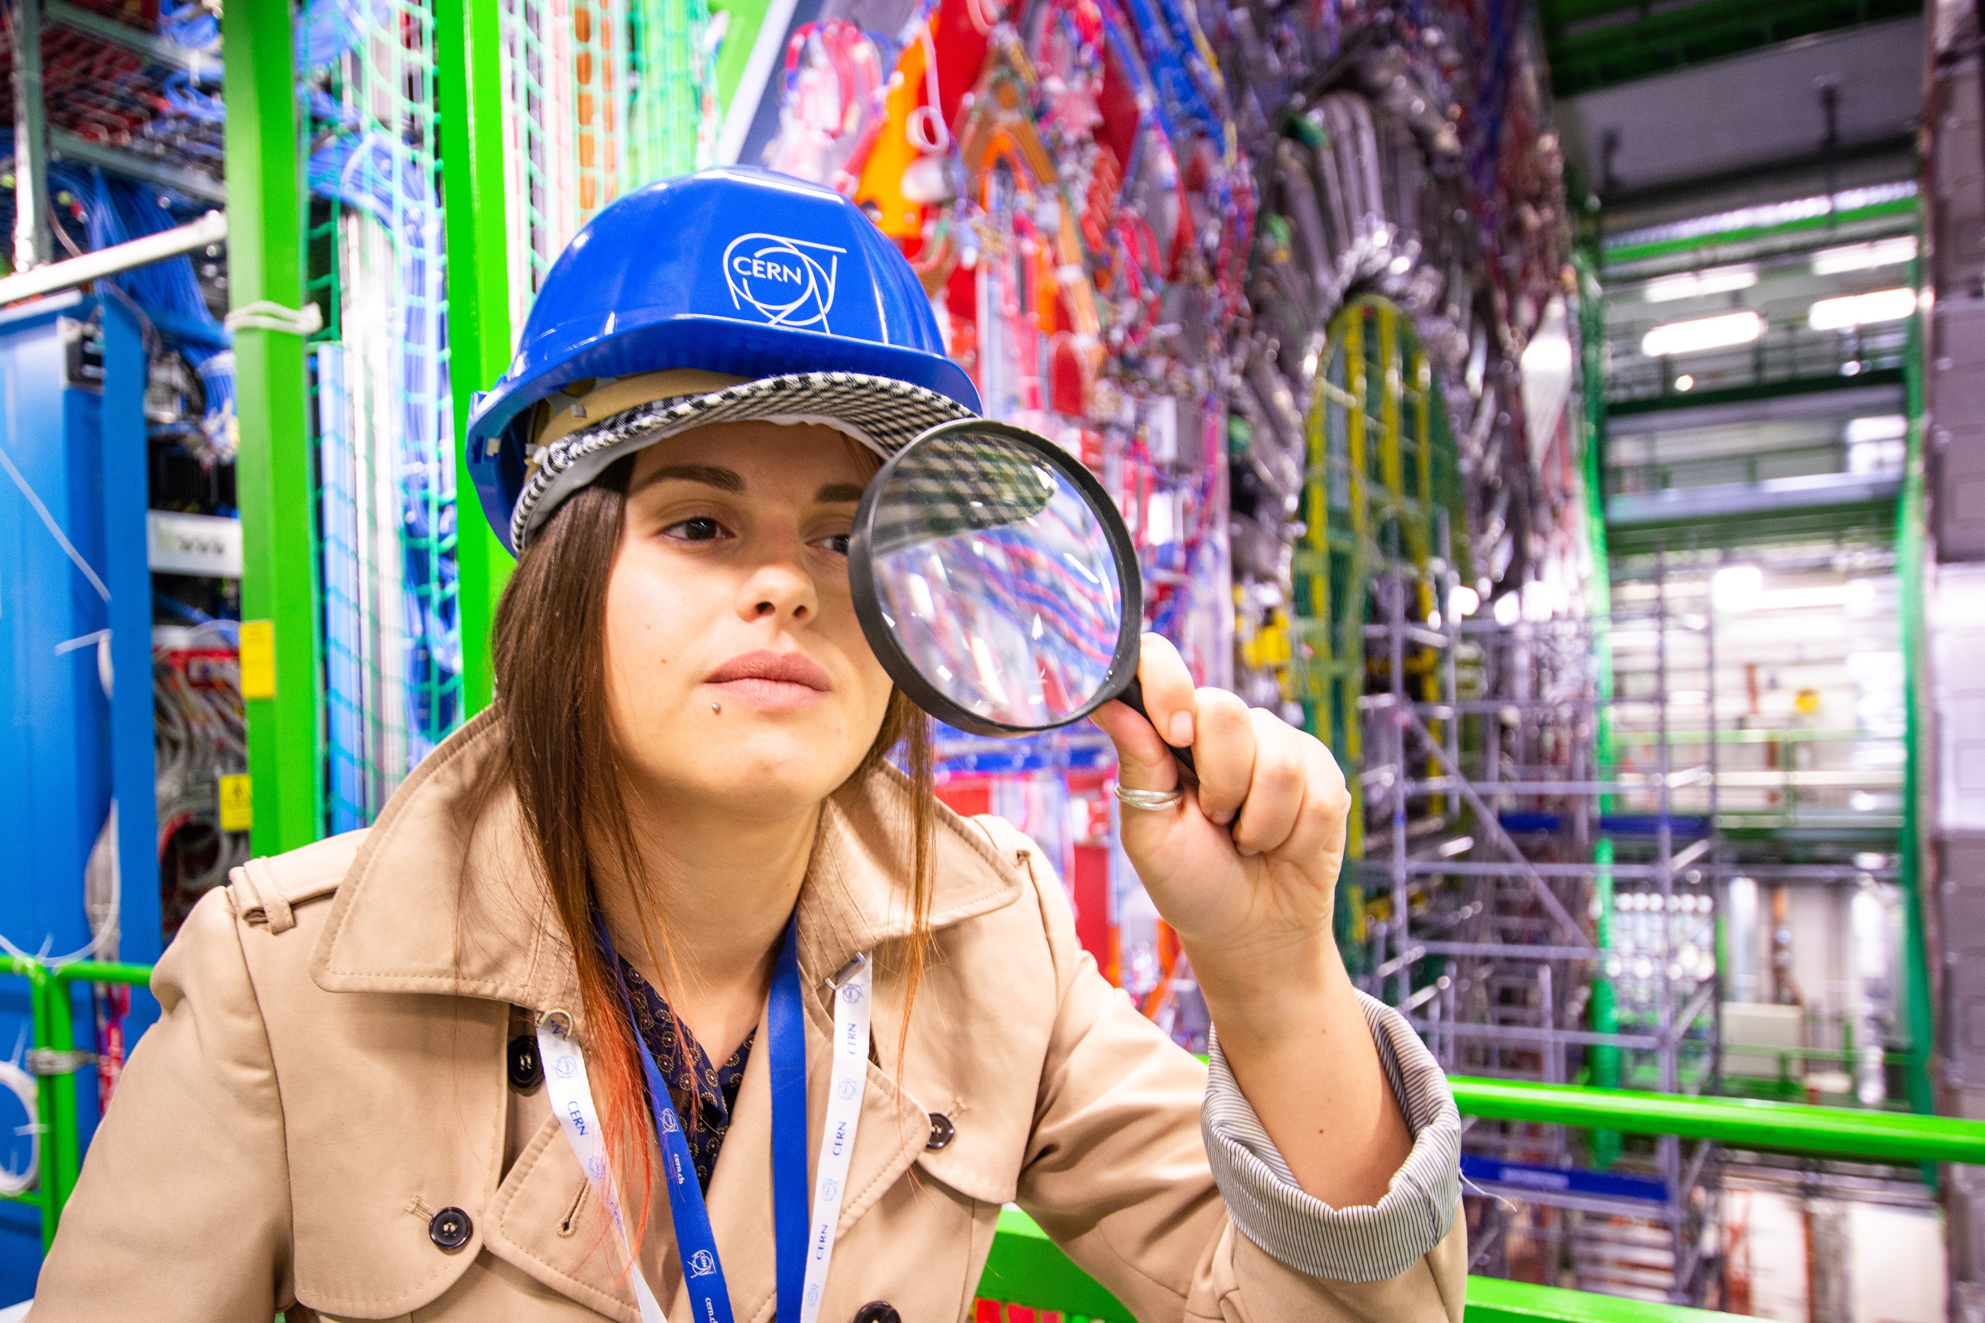
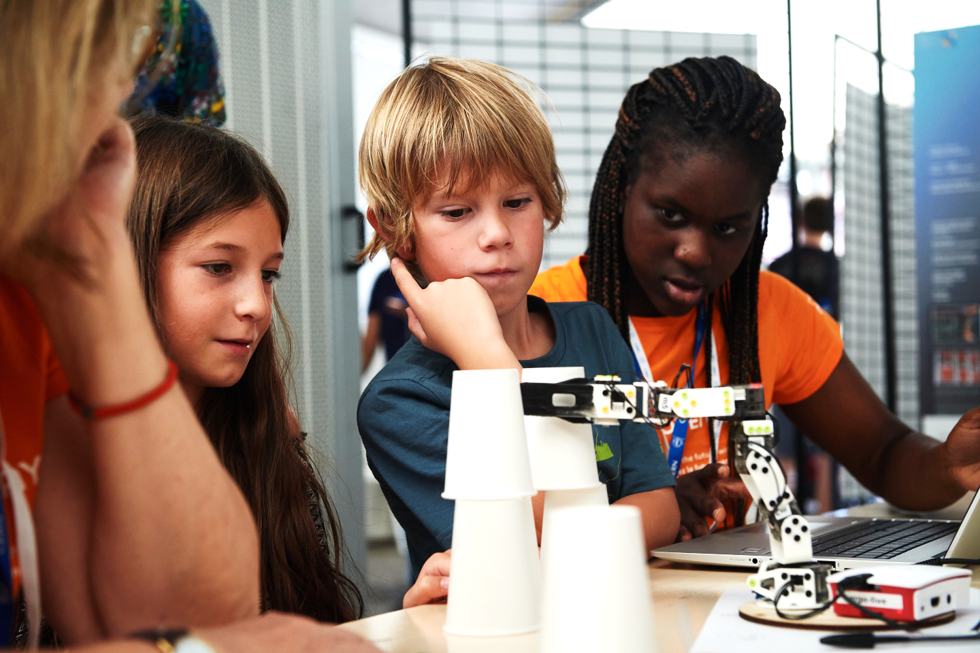
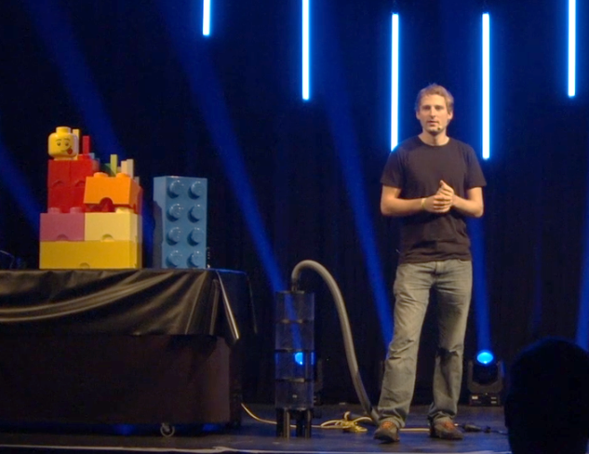
Job offer: Junior Science Educator
For CERN Science Gateway lab workshops & science shows | Application deadline 3 April
max. 2 years of work experience after Bachelor or Master | min. French B2
More info: https://international-relations.web.cern.ch/opportunities/2023/early-career-graduate-junior-science-educator-ref-ir-eco-tsp

Slide 14
Thanks for your attention!
Let’s discuss

