Slide 1
General information
G. Iadarola
ABP Computing Meeting

Slide 2
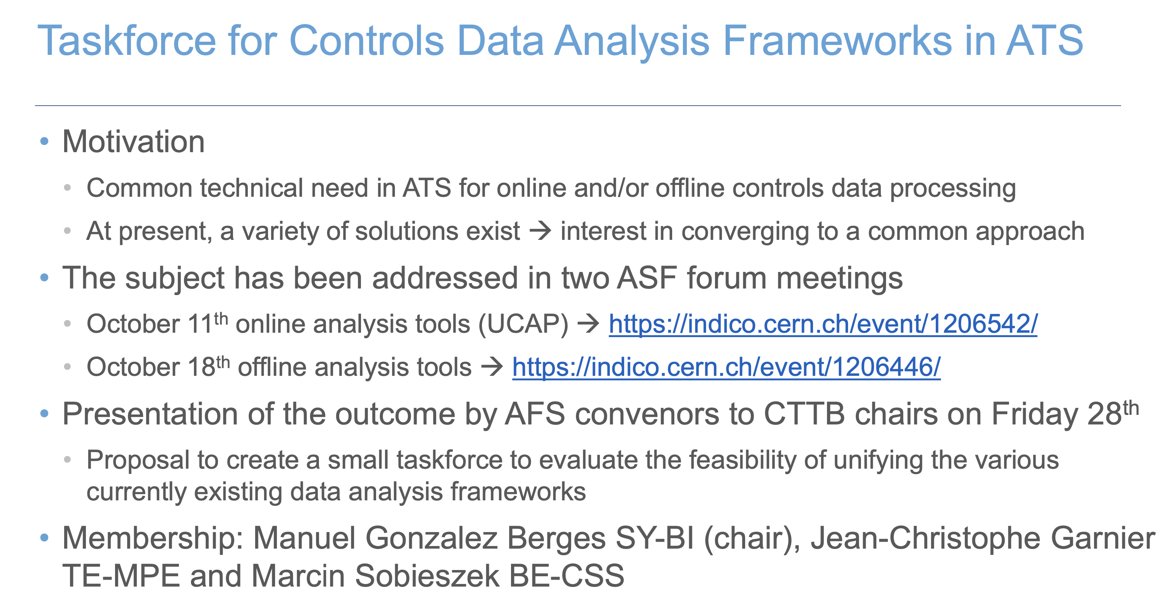
Information and points for discussion
https://indico.cern.ch/event/1146868/
Any message that we would like to pass?

Slide 3
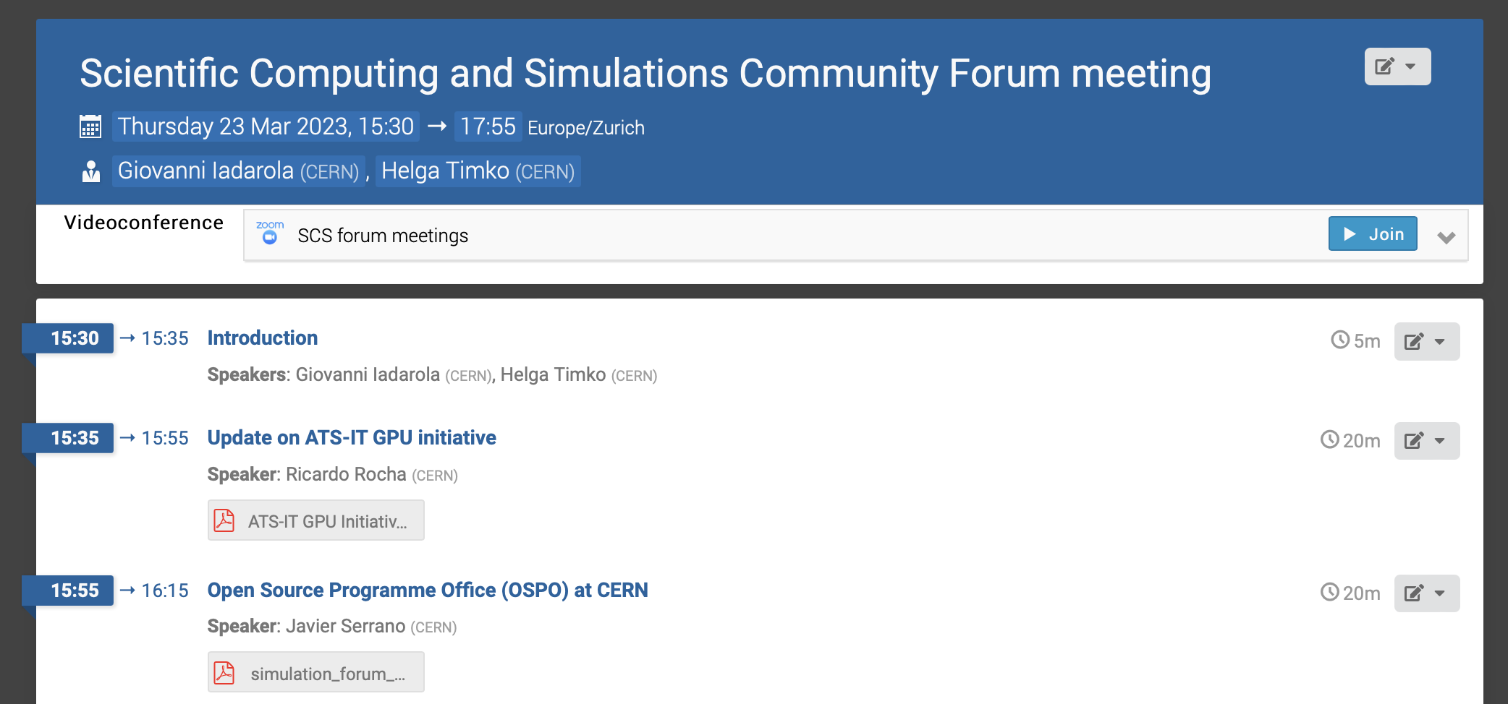
Information and points for discussion
CERN Open Science Working Group introduced at CTTB meeting #26 https://indico.cern.ch/event/1222571/
SCS meeting https://indico.cern.ch/event/1263237/
3

Slide 4
Information and points for discussion
IT Users meeting: https://indico.cern.ch/event/1229771/
Important points to look at (from Laurent):
- Email problems after migration to Exchange Online.
- Google Workspaces update.
- Windows 11 22H2 upgrade.
- Web infrastructure.
- Security with 2FA and Endpoint Protection.
- Authentication with e-groups to be replaced by Grappa.
- User/Work AFS volumes auto-blocked when causing high server latency.
- Anaconda mirroring feature requires a commercial license.

Slide 5
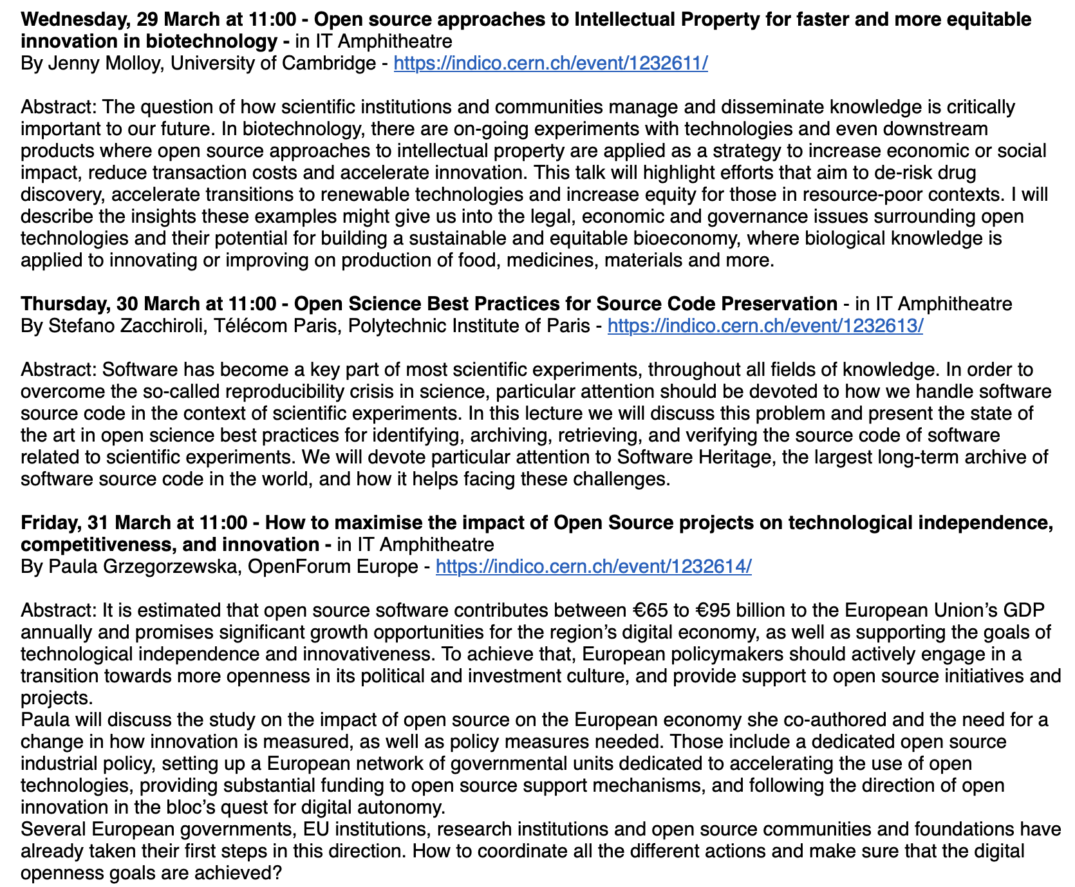
Academic training lectures

