Slide 1

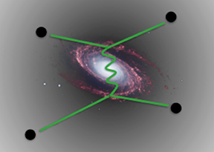




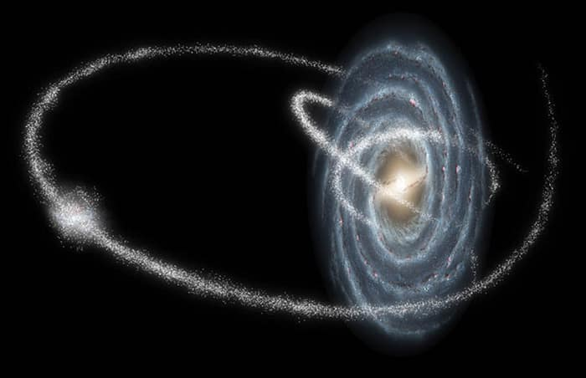
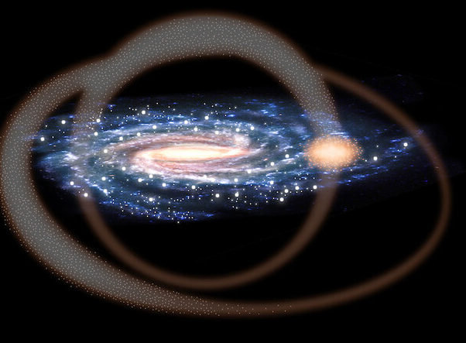


New insights on low-mass dark matter subhalo tidal tracks via numerical simulations
Based on arXiv:2506.01152
Alejandra Aguirre-Santaella (ICC Durham)
with Miguel A. Sánchez-Conde (UAM & IFT), Go Ogiya (Zhejiang U.)
ICRC, Geneva, 22 July 2025

Slide 2
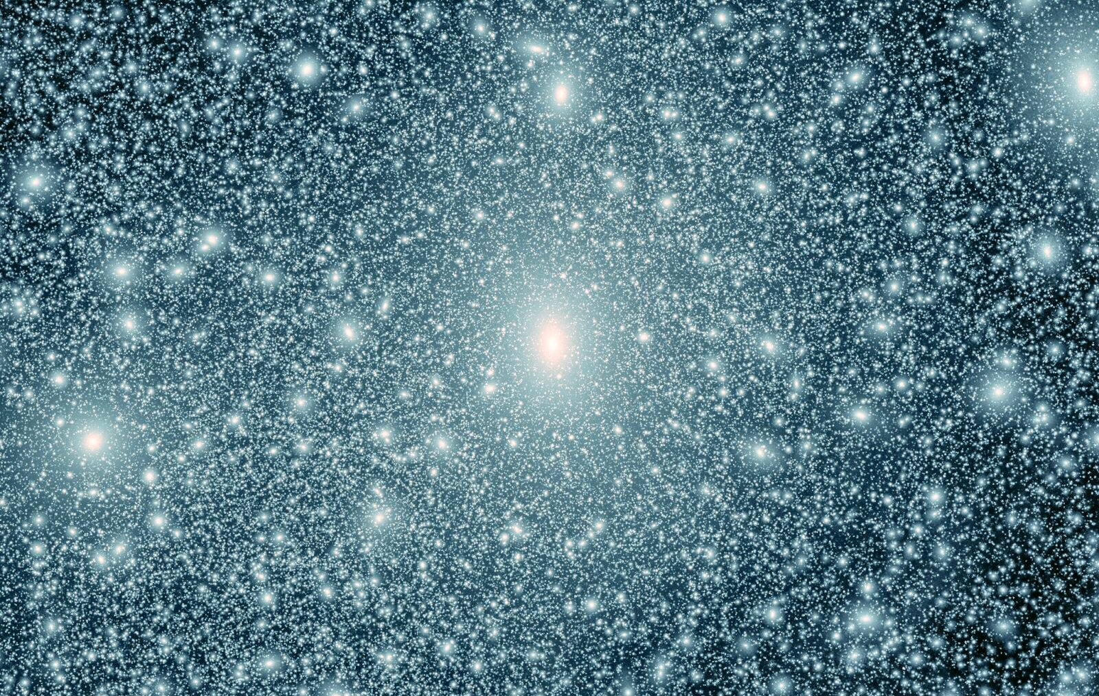
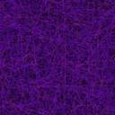

DM halo substructure
DM halo substructure
Dwarf galaxies
Dark satellites
x
Milky Way virial radius
GHALO simulation (Stadel+09)
Credit: Sánchez-Conde

Slide 3
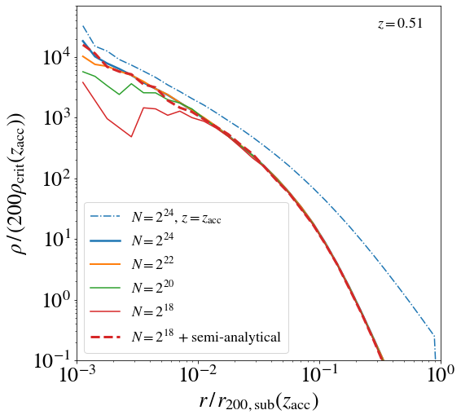
Survival of CDM substructure
The innermost part of the subhalo is not obtained accurately when the numerical resolution is insufficient
We still do not know what DM is made of: particle zoo
Weakly Interacting Massive Particles (WIMPs) among the preferred ones
  direct production at colliders
  direct detection through scattering
  indirect detection
  annihilation products:
Λ blablable
van den Bosch+18
Cuspy subhaloes are supposed to survive the host tidal forces: bound remnant
Many are missing in (zoom-in) cosmological simulations: limited by numerical resolution
A very high number of particles is needed to resolve the inner cusp properly
How to overcome this?
  Semianalytical approaches
  Focusing the computational resources on an individual subhalo
Ogiya+19
Errani+Peñarrubia20
Green+21
Delos+White23
The subhalo DM density profile gets truncated as
the mass loss takes place
AAS+23
Alejandra Aguirre-Santaella

Slide 4
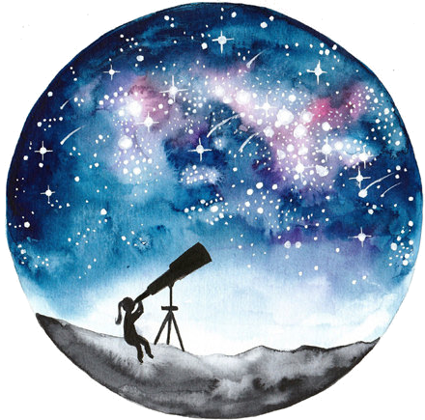
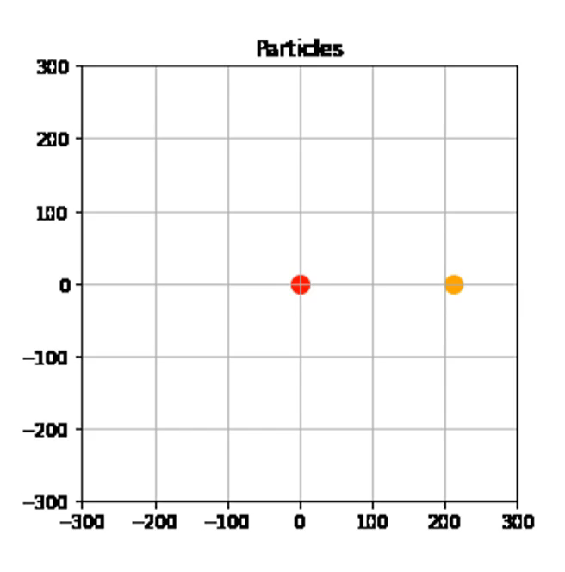
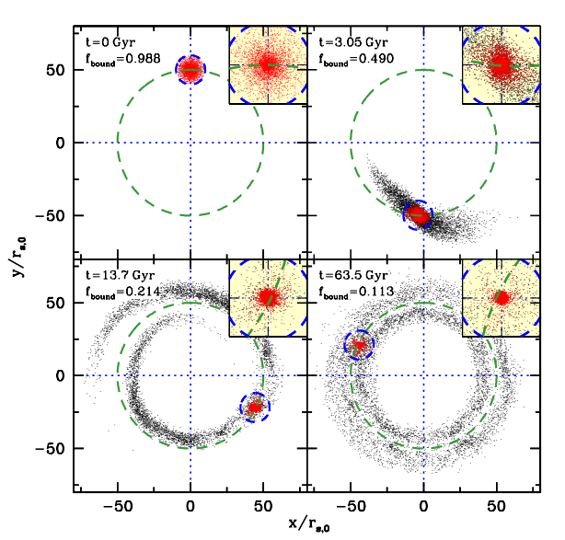
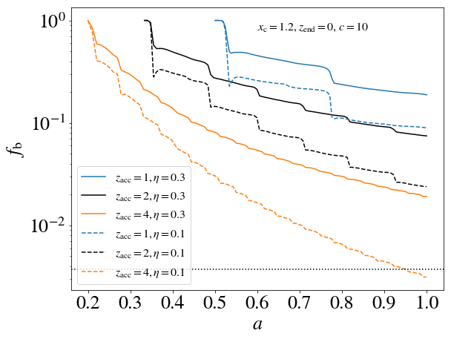
Focusing on individual subhaloes
High-resolution numerical simulations (DASH, Ogiya+19) to follow the evolution of the subhalo
Time-evolving host containing DM halo + baryonic disc + bulge
Several subhalo initial parameters are varied:
  Inner slope
  Orbital configuration (circularity, orbital energy, inclination angle)
  Accretion redshift
  Concentration
We already studied the evolution of the subhalo bound mass fraction (f_{b}) and annihilation luminosity (AAS+23)
Previous work has also explored the evolution of the subhalo internal structure parameters: Peñarrubia+10 (P10), Errani & Navarro 21 (EN21), Du+24 (D24), Green & van den Bosch 19, Stücker+23 (including AAS), … what do our simulations say?
N = 2²⁵ ~ 3.3 x 10⁷ particles in most cases
by J. Stücker
van den Bosch+Ogiya18
AAS+23

Slide 5
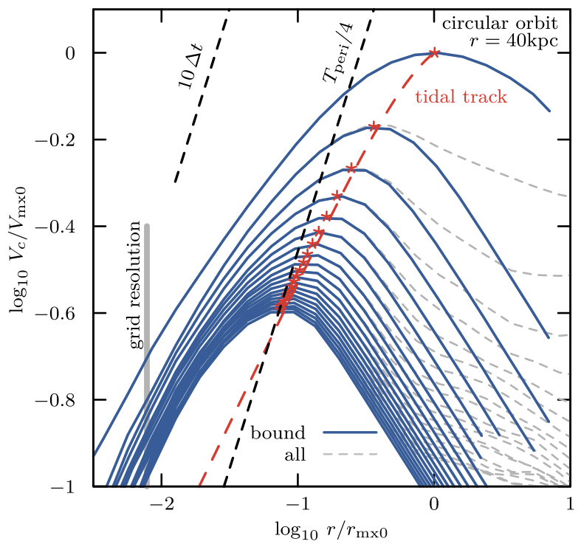
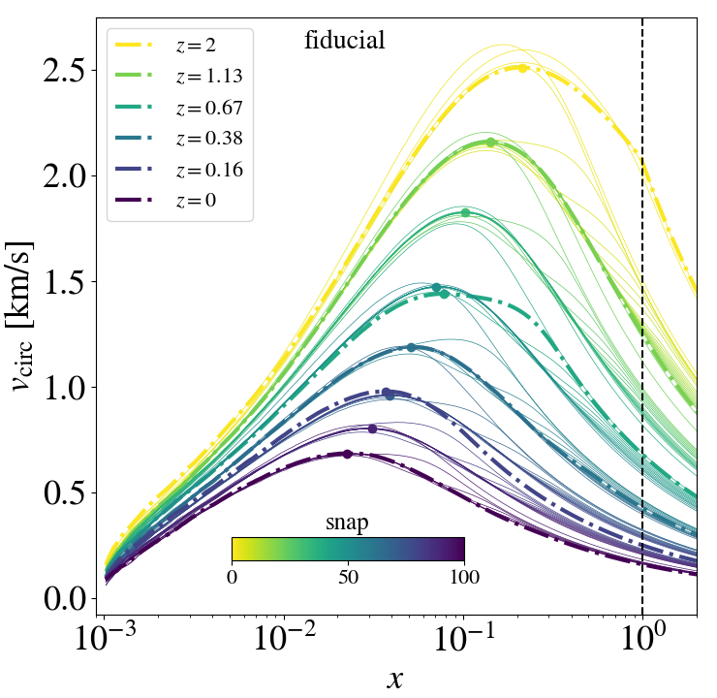
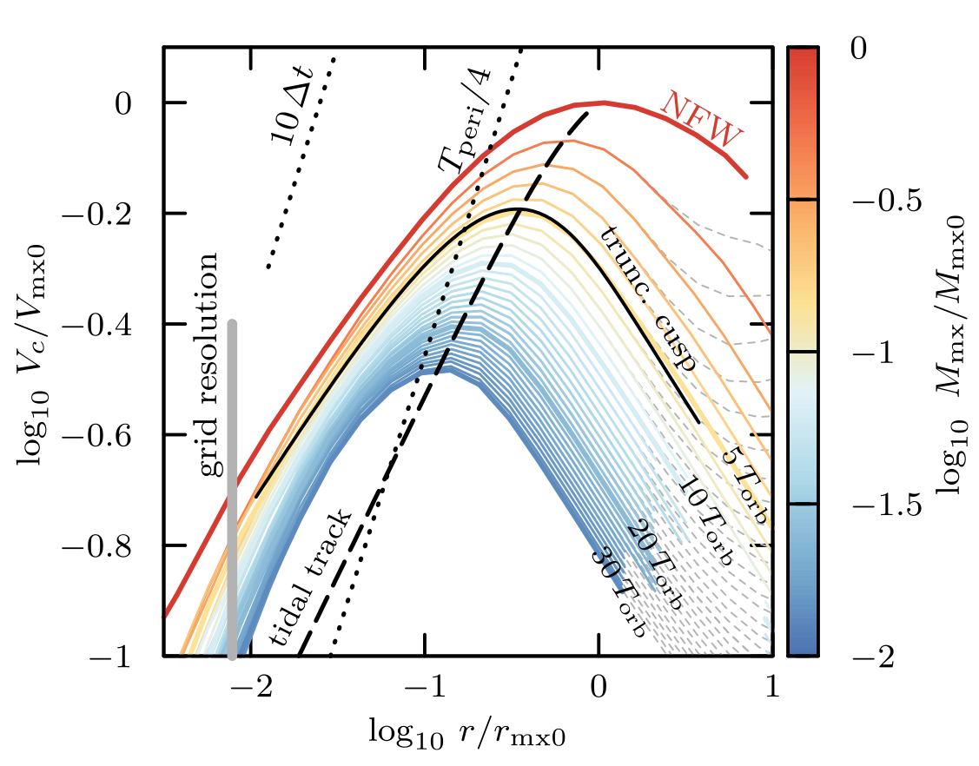

Circular velocities
How do (maximum) circular velocities evolve as the subhalo loses mass?
What about the radius where this V_{max} is located (r_{max})?
How does this evolution of V_{max} and r_{max} impact subhalo concentrations?
Tidal tracks
$$c_{V}=2 {\left(\frac{V_{max}}{H(z)R_{max}}\right)}^{2}$$
EN21
Errani+22
AAS+25

Slide 6
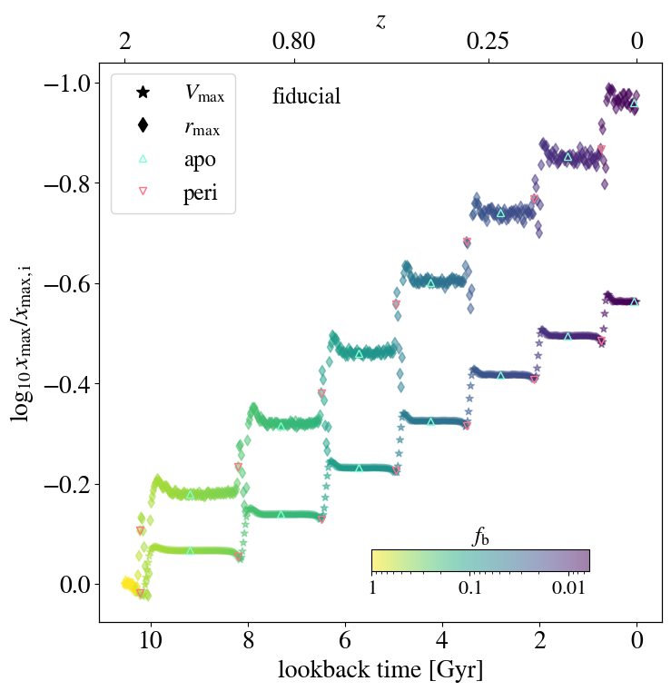
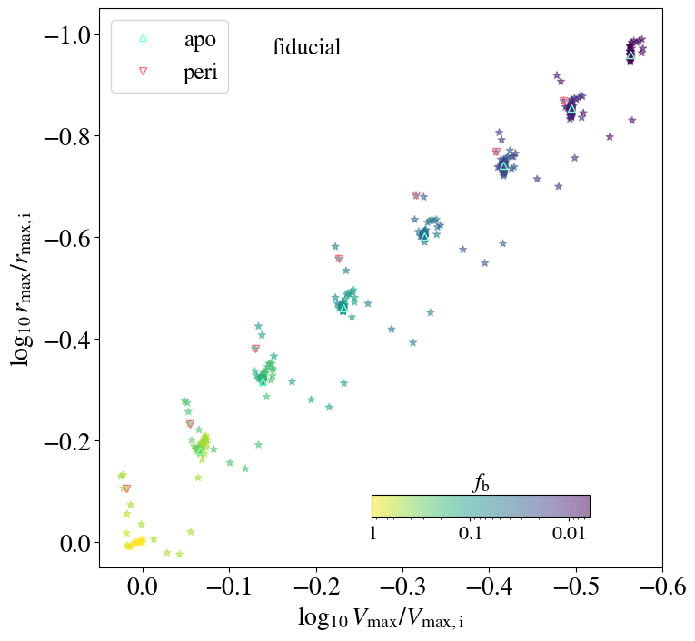
Evolution of internal structure
Both V_{max} and r_{max} decrease mainly at the pericentre (stronger tidal forces)
A stable tidal track can be found looking at the apocentre, but we want to explore the behaviour at the pericentre as well
V_{max} decreases less than r_{max} ; r_{max} becomes more stable with time
AAS+25

Slide 7

Tidal tracks for NFW subhaloes
Apocentre tidal track V_{max} - f_{b} below pericentre curve reflects V_{max} increase at pericentre
Apocentre tidal track consistent with P10
Peñarrubia+10 (left):
$g\left(x\right)= \frac{2^{μ}x^{ν}}{{(1+x)}^{μ}}$
EN21 (right):
$$g\left(x\right)= 2^{α}x^{β}{\left[1+x^{2}\right]}^{−α}$$
AAS+25

Slide 8
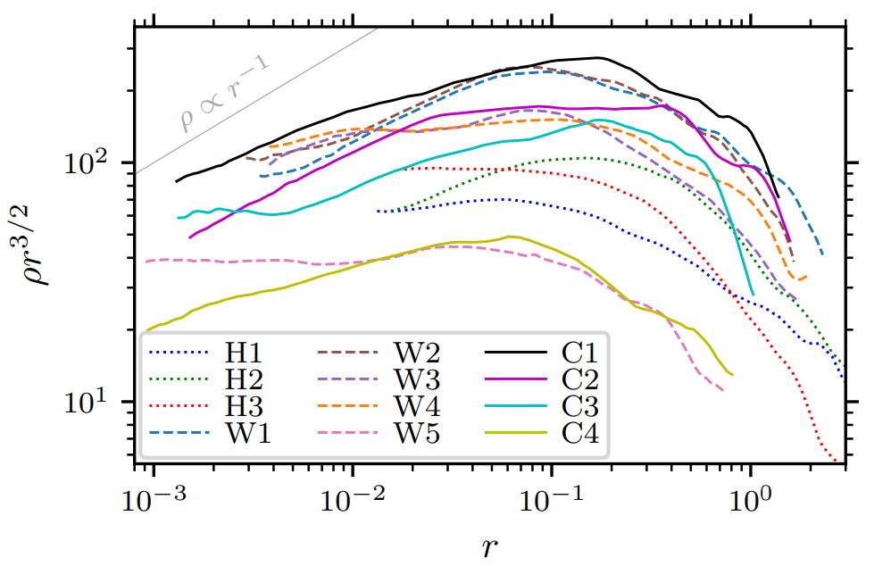
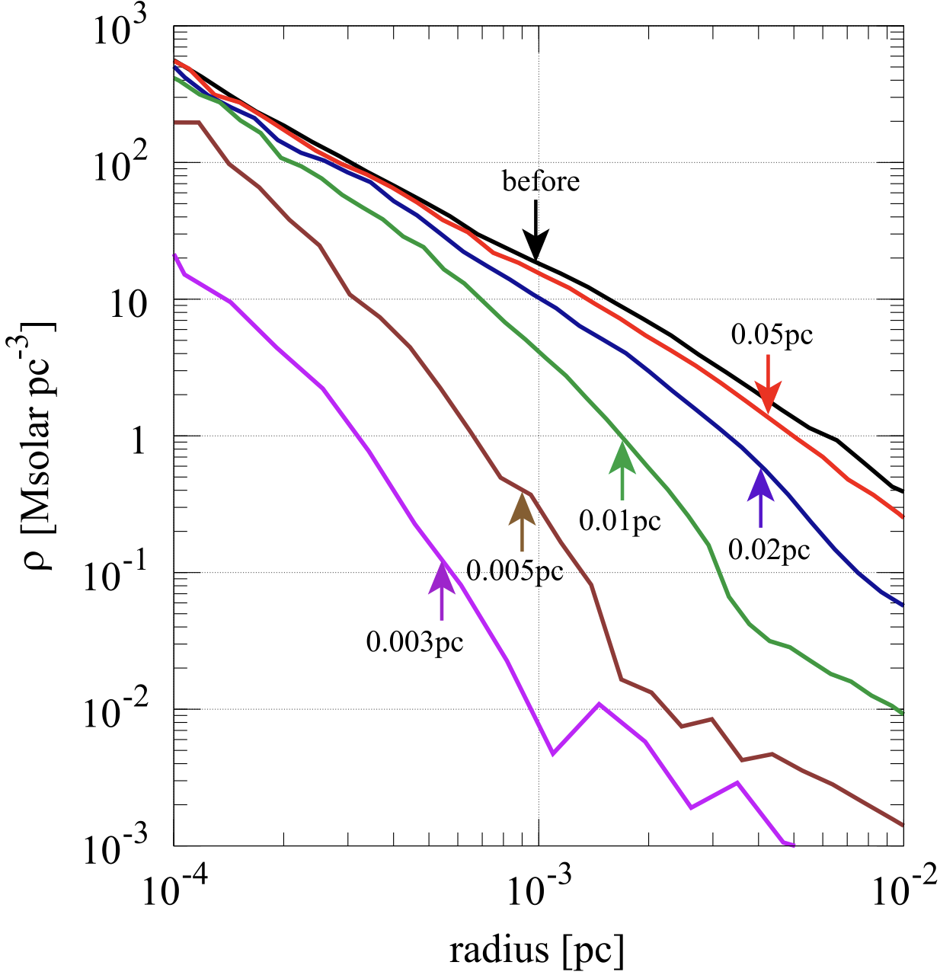

Steeper than NFW: prompt cusps
The first DM haloes (~Earth mass in CDM) formed from density peaks
Their density profile is supposed to exhibit a prompt cusp: $ρ∝ r^{−3/2}$
Even stellar encounters can have an impact on such small structures!
(Ishiyama+10)
(Delos+White23)
NFW-like
Prompt
cusp
Some SIDM models predict these steeper inner cusps in (sub)haloes (e.g., Nadler+25)
Delos+White23
Ishiyama+10

Slide 9








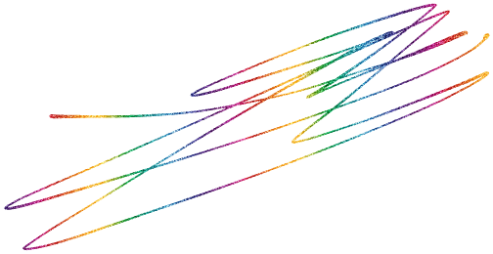




Tidal tracks for prompt cusps
V_{max} decreases less wrt NFW subhaloes
Pericentre tidal track reaches the apocentre
tt faster
Our fits lie between
D24 and P10
Peñarrubia+10 (left):
$g\left(x\right)= \frac{2^{μ}x^{ν}}{{(1+x)}^{μ}}$
EN21 (right):
$$g\left(x\right)= 2^{α}x^{β}{\left[1+x^{2}\right]}^{−α}$$
artificial relaxation
effects
AAS+25

Slide 10



Subhalo concentrations
Concentrations increase with time since r_{max} decreases more than V_{max}
c_{V} increase ~ two orders of magnitude (vs ~ one oom for field halos)
We find a significant scatter driven by $z_{acc}$
Higher c_{V} at pericentre
We propose:
$$\log_{10} g\left(x\right)={\left(a_{1}\left|\log_{10} x\right|\right)}^{1/a_{0}}$$
AAS+25

Slide 11
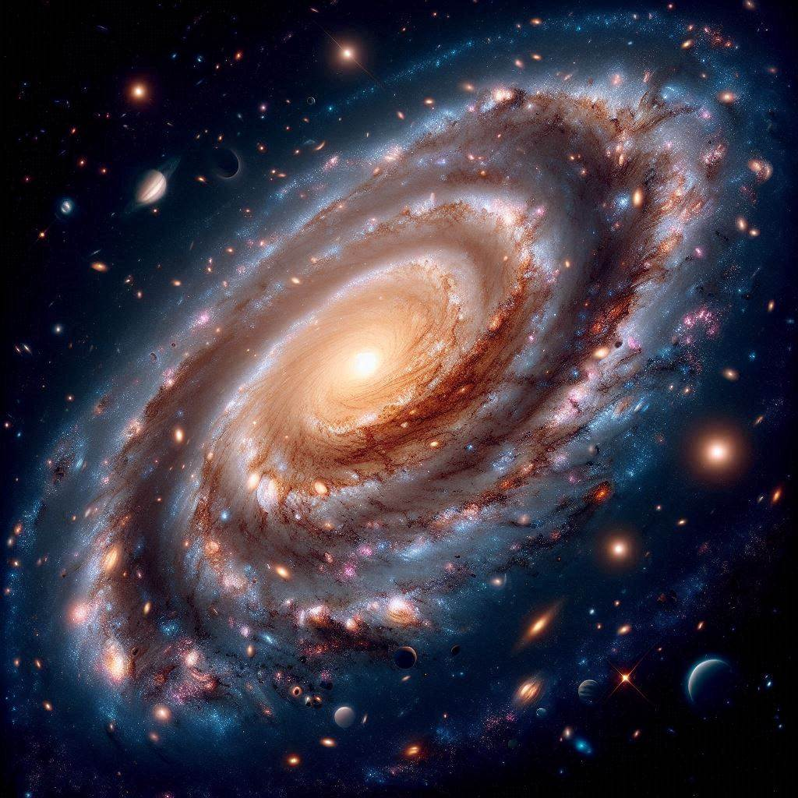

Summary & conclusions
After our survival work AAS+23, now we characterise subhalo tidal tracks with great particle resolution (O(10⁷) particles)
Extensive initial configuration parameter space: inner slopes (NFW & prompt cusps), concentrations, orbital parameters, accretion redshift. The host is described with a
time-evolving analytical potential including baryons
Our results show:
  Both V_{max} and r_{max} decrease with time
  While r_{max} shrinks more than V_{max} , its rate of decrease diminishes with time
  First prompt cusps tidal track V_{max} - r_{max} and pericentre tidal tracks
  Prompt cusps remain more stable (larger V_{max}) than NFW
  Velocity concentrations increase with time up to 2 orders of magnitude,
  this way enhancing concentrations wrt field haloes
Relevant for lensing, streams, indirect DM searches
Check it out! arXiv:2506.01152
Thank you!
alejandra.aguirre-santaella@durham.ac.uk

Slide 12
Back-up
slides

Slide 13












Tidal tracks r_{max} - f_{b}
V_{max} decreases less wrt NFW subhaloes
Pericentre tidal track reaches the apocentre one faster
Small scatter for apocentre tidal track
V_{max} - r_{max}
Our fits lie between
D24 and P10
Peñarrubia+10:
$g\left(x\right)= \frac{2^{μ}x^{ν}}{{(1+x)}^{μ}}$
EN21:
$$g\left(x\right)= 2^{α}x^{β}{\left[1+x^{2}\right]}^{−α}$$
AAS+25 (in prep)

Slide 14
Tidal track dependence on z_{acc}
We still do not know what DM is made of: particle zoo
Weakly Interacting Massive Particles (WIMPs) among the preferred ones
  direct production at colliders
  direct detection through scattering
  indirect detection
  annihilation products:
Λ blablable

Slide 15
Tidal track dependence on η
We still do not know what DM is made of: particle zoo
Weakly Interacting Massive Particles (WIMPs) among the preferred ones
  direct production at colliders
  direct detection through scattering
  indirect detection
  annihilation products:
Λ blablable

Slide 16
Tidal track dependence on c
We still do not know what DM is made of: particle zoo
Weakly Interacting Massive Particles (WIMPs) among the preferred ones
  direct production at colliders
  direct detection through scattering
  indirect detection
  annihilation products:
Λ blablable

Slide 17
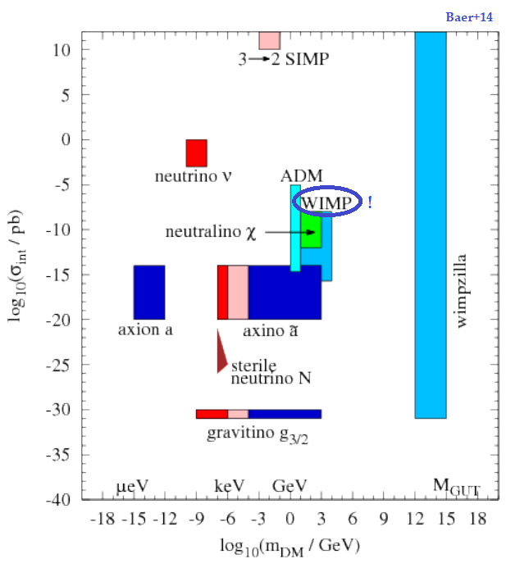
The nature of DM
We still do not know what DM is made of: particle zoo
Weakly Interacting Massive Particles (WIMPs) among the preferred ones
  direct production at colliders
  direct detection through scattering
  indirect detection
  annihilation products:
Λ blablable
We still do not know what DM is made of: particle zoo
Weakly Interacting Massive Particles (WIMPs) among the preferred ones
  direct production at colliders
  direct detection through scattering
  indirect detection
possible annihilation products:
ν
γ
e⁺

Slide 18
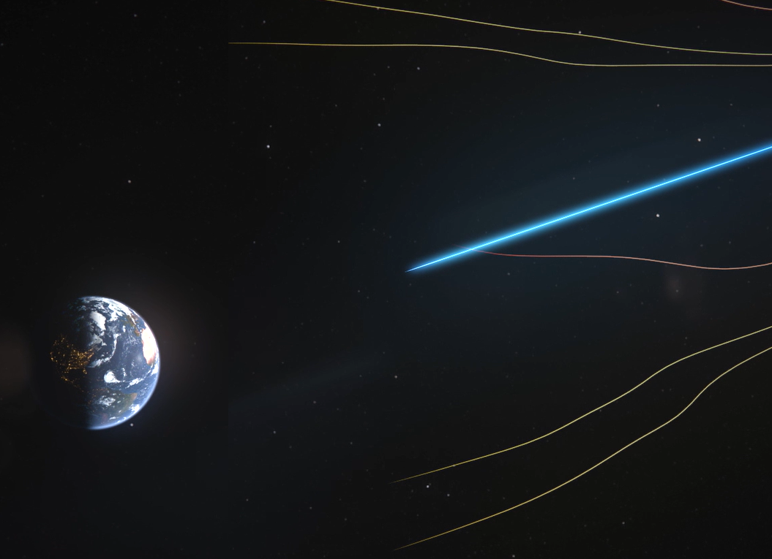

The ‘golden channel’: gamma rays
We still do not know what DM is made of: particle zoo
Weakly Interacting Massive Particles (WIMPs) among the preferred ones
  direct production at colliders
  direct detection through scattering
  indirect detection
  annihilation products:
Λ blablable
Neutrinos are difficult to detect
Antimatter can be deflected by magnetic fields and loses energy
Gamma rays travel following straight lines and do not undergo attenuation
Energy of annihilation products depends on DM particle mass: ~GeV-TeV
γ-ray flux: F = J · f_{pp}
particle physics factor:
depends on DM particle mass
and cross section
J-factor: astrophysical
DM density squared
J =$\int{d}\int_{l.o.s.}{}$

Slide 19
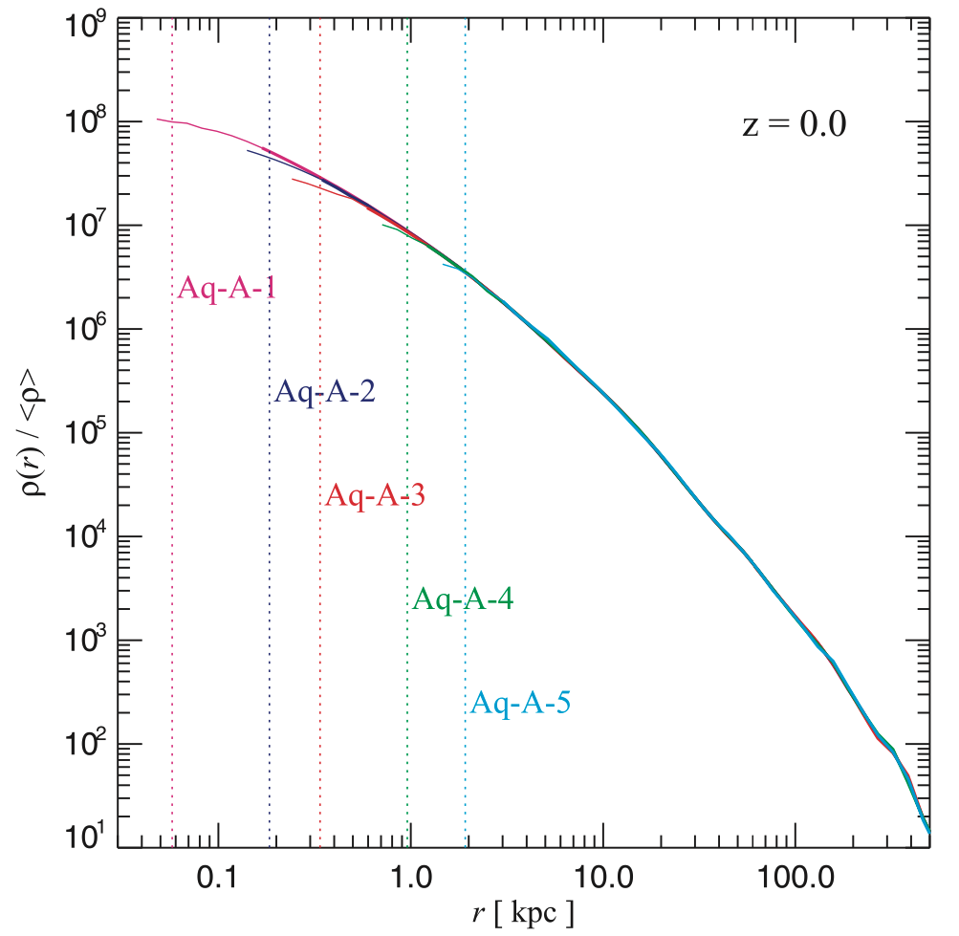

Simulations are great... until they are not
Cosmological simulations are great!
We still do not know what DM is made of: particle zoo
Weakly Interacting Massive Particles (WIMPs) among the preferred ones
  direct production at colliders
  direct detection through scattering
  indirect detection
  annihilation products:
Λ blablable
Best tools in the non-linear regime
Zoom-in simulations help analyse the details and substructure of haloes
Limited by numerical resolution
Subhaloes with masses smaller than several times the particle mass cannot be simulated
How to overcome this?
  Repopulation procedure: generating subhaloes below the resolution limit of the parent simulation via extrapolation
  Focusing the computational resources on an individual subhalo
IAC seminar next Tuesday!
Springel+08
Alejandra Aguirre-Santaella

Slide 20
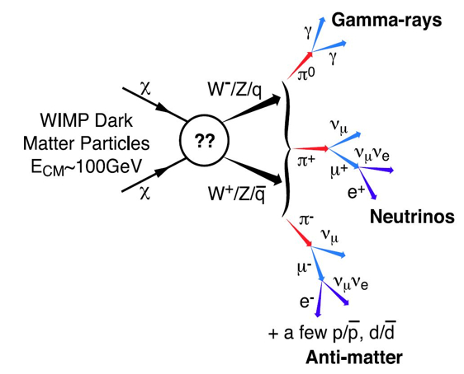
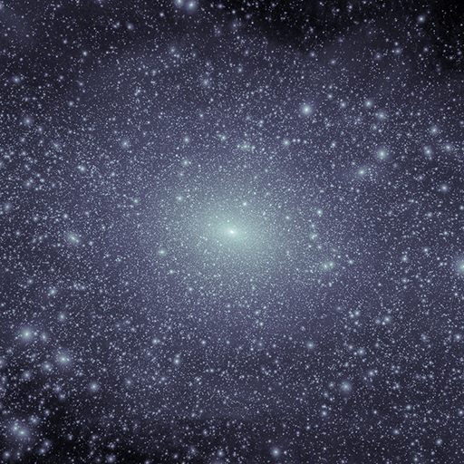
Motivation
Standard ΛCDM cosmology: bottom-up structure formation scenario → dark matter (DM) subhalos inside DM halos (e.g., Zavala & Frenk 20)
Well motivated DM candidate: WIMP → annihilation into gamma rays
Galactic subhalos → large annihilation fluxes → excellent targets for DM searches (e.g., Coronado-Blázquez+19)
Open debate: disruption or survival of small subhalos?
(van den Bosch+18, van den Bosch & Ogiya 18)
  Numerical resolution effects
  Tidal forces within the host
VL-II (Diemand+08)

Slide 21
This work
van den Bosch & Ogiya 18
Main goal: shed light on subhalo survival via numerical simulations and study its impact for gamma ray searches
We use a high-resolution numerical simulation to follow the evolution of the subhalo and choose several parameters:
  Number of particles to simulate the subhalo
  Softening length
  Initial subhalo mass
  Initial subhalo concentration c = r_{vir} /r_{s}
  Accretion redshift
  Orbital parameters: (Jiang+15)
    Circularity η = J/ J_{circ} (η = 0 → radial, η = 1 → circular)
    Orbital energy parameter x_{c} = r_{c} (E )/ r_{vir,h} (z_{acc})
  Inclusion (or not) of baryons in the host potential
The subhalo will lose mass mainly in every pericentric passage

Slide 22
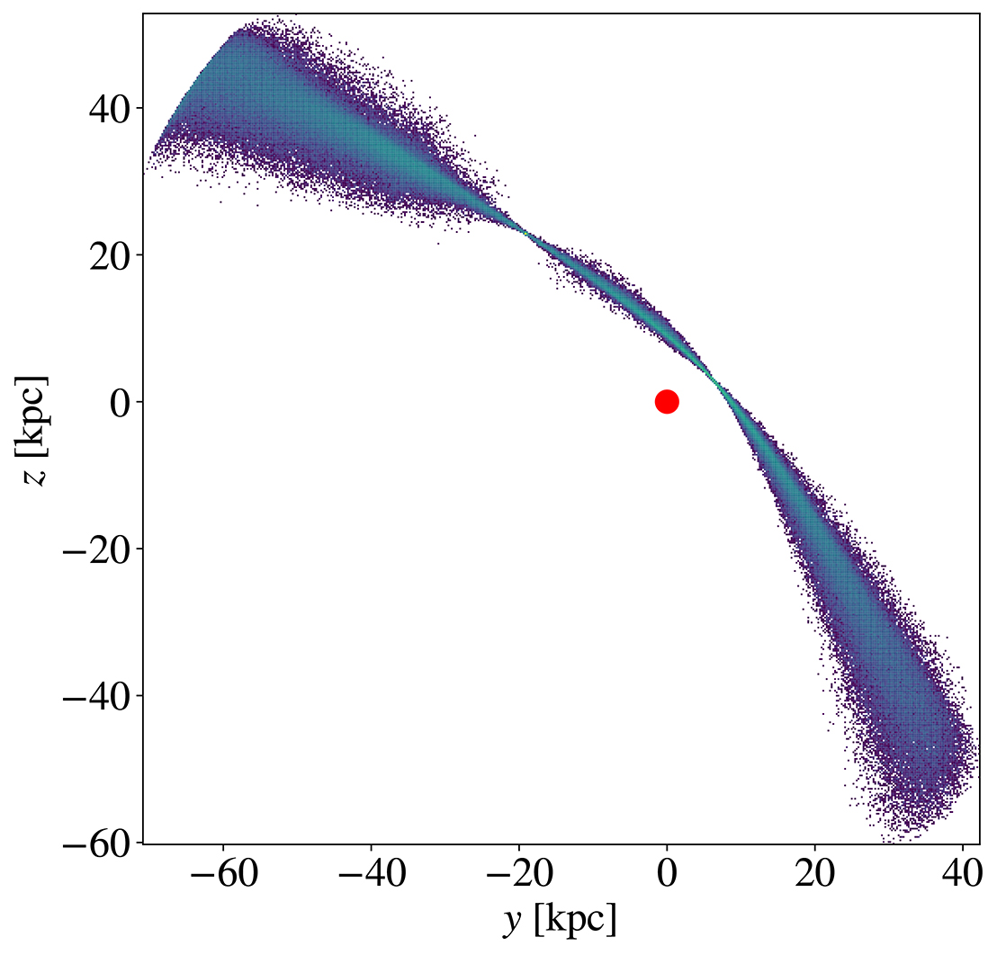
Our code: DASH
Developed by Go Ogiya (Ogiya+19) to follow the evolution of a subhalo in the host potential
Tree-code optimised for GPU clusters
Hierarchical tree algorithm; two working modes,
treecode and evolution
The subhalo is simulated using a very large number of particles, orbiting around its host halo since its accretion redshift z_{acc} until present (z=0)
The host is described as an analytical potential
Main further improvements for this work:
  Inclusion of baryonic components: (Kelley+19)
    Stellar: Miyamoto-Nagai disks
    Gas: Miyamoto-Nagai disks
    Bulge: Hernquist potential
  Time evolution of host potentials
by J. Stücker
Galactic Center
snapshot at z = 0.03

Slide 23
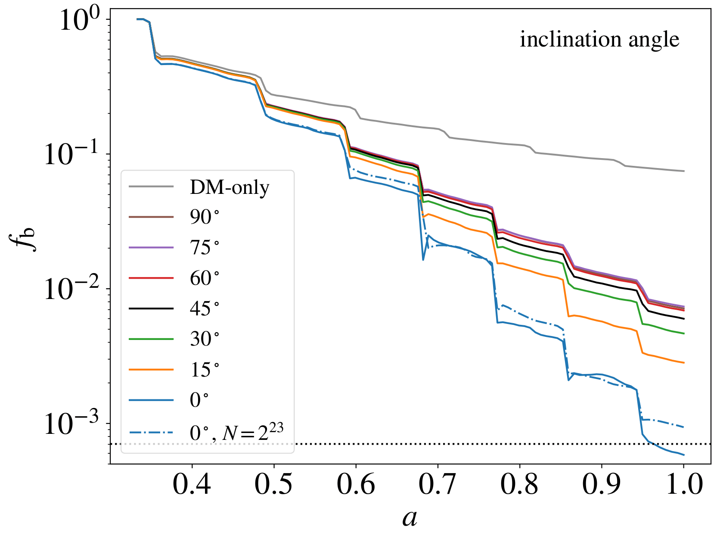
I. Bound mass fraction (f_{b})
Subhalos in parallel orbits with respect to the Galactic plane lose more mass than those in perpendicular orbits

Slide 24
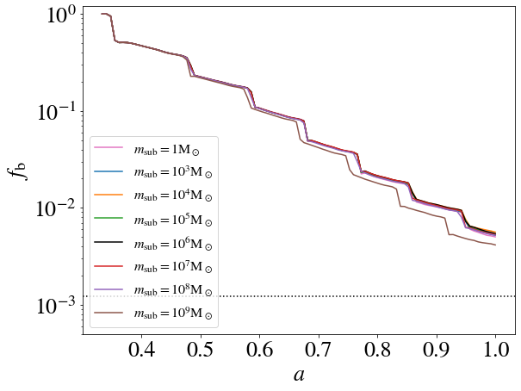
I. Bound mass fraction (f_{b})
Same mass loss
for subhalo
masses ≤ 10⁷ M_{sun}

Slide 25
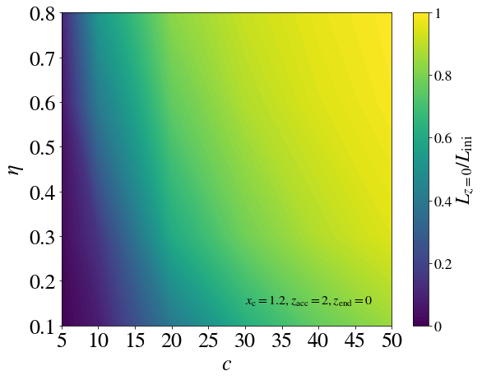
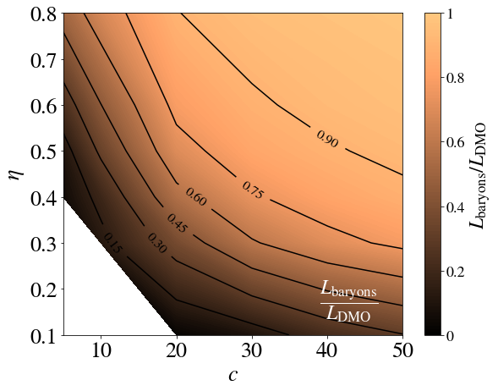
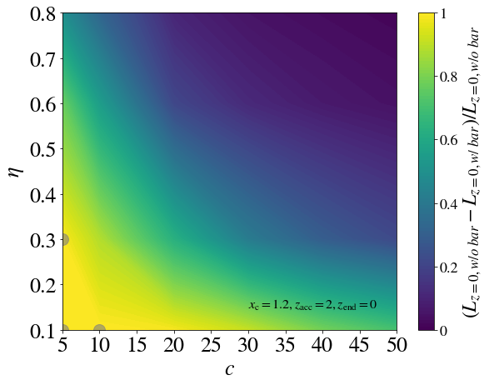
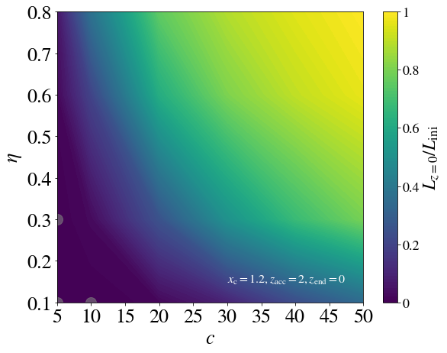
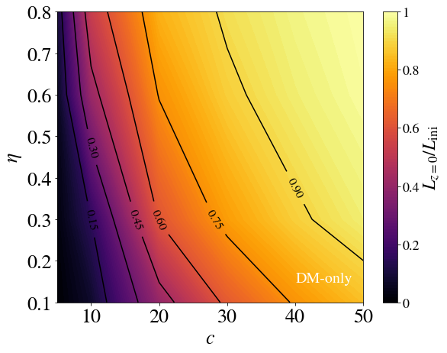
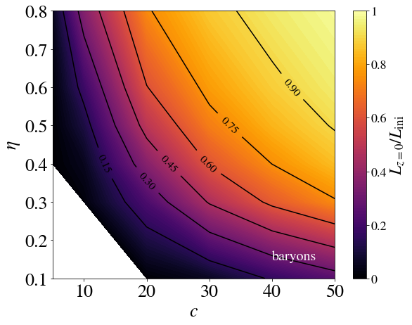
II. WIMP annihilation luminosity (L)
Concentration is the driving parameter when baryons are not included
The relevance of the circularity increases when one adds baryons
Subhalos in eccentric orbits are affected by baryons even if their concentration is high

Slide 26
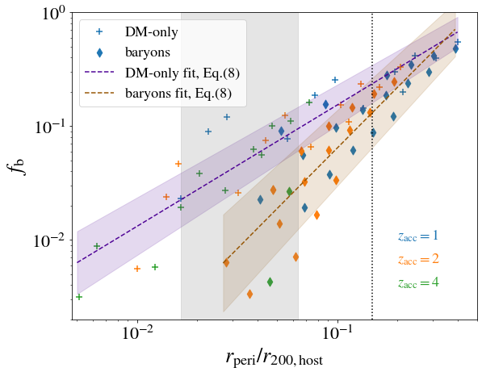
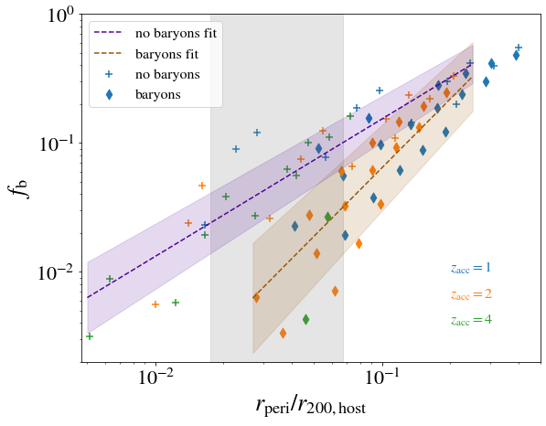
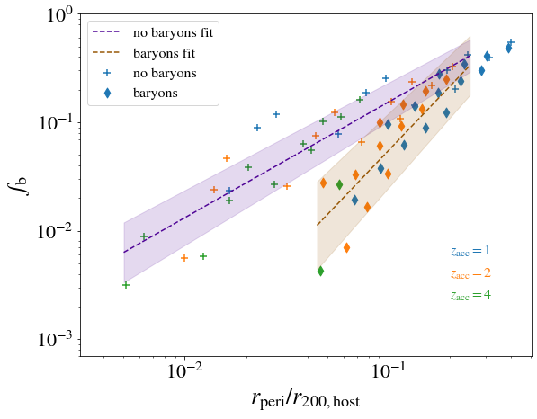
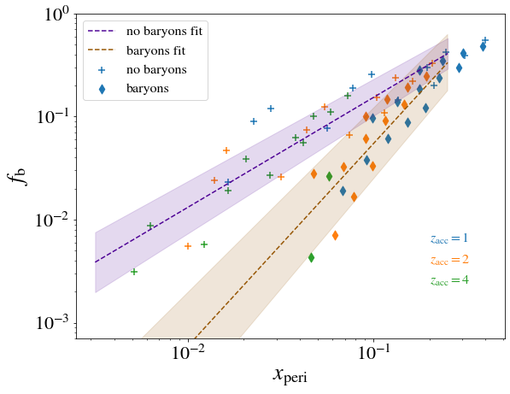
f_{b}-pericentre
We find a power-law behaviour of f_{b} against the pericenter of the orbit (with some scatter)
(8) f_{b} = e x^{m}
m log₁₀ e
no-baryons 1.07 ± 0.08 0.25 ± 0.10
baryons 1.77 ± 0.16 0.58 ± 0.17

Slide 27
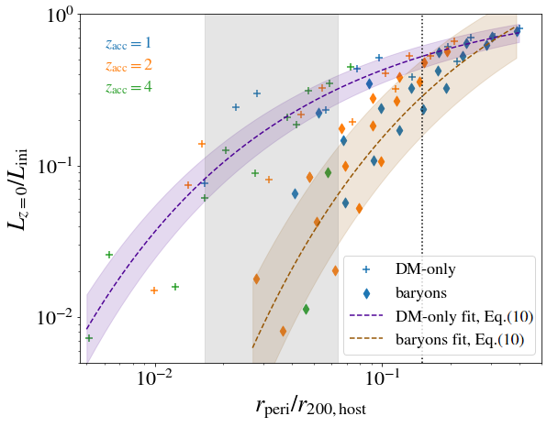
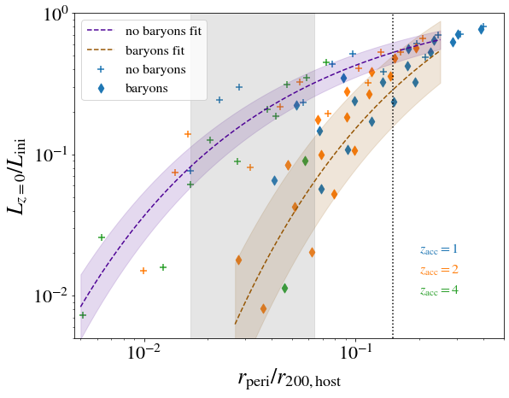
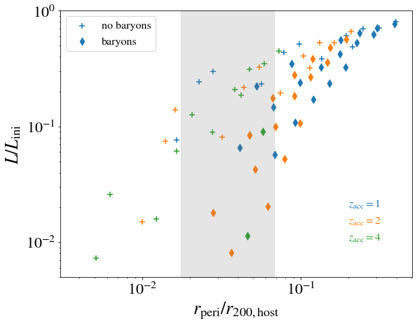
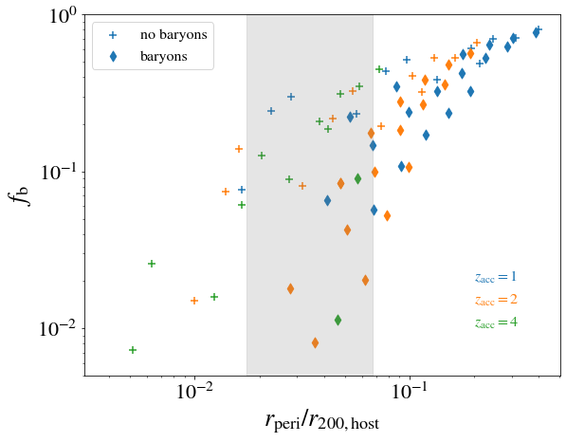
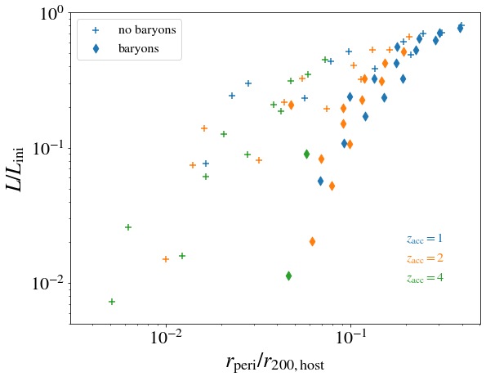

L-pericenter relation
Subhalos in the solar neighbourhood would have lost 60~90% of their initial annihilation luminosities without baryons and 90~99% with baryons
(10) L_{z=0} /L_{ini} = d · m^{-1/}$\sqrt{x}$
m d
no-baryons 1.43 ± 0.04 1.3 ± 0.1
baryons 3.0 ± 0.4 5 ± 1

Slide 28
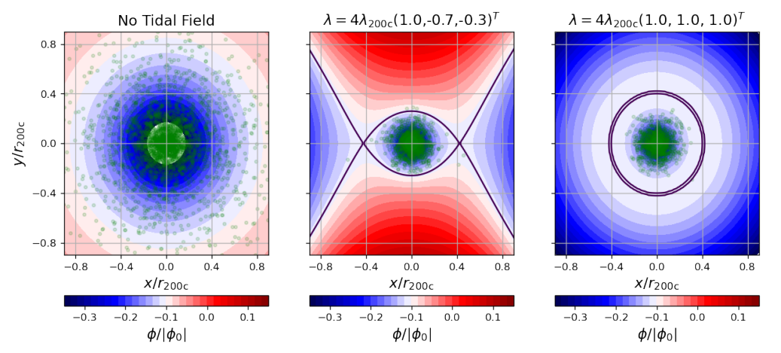
Tidal fields
left: no tidal field middle: trace-free right: spherically symmetric
From Stücker+22, arXiv:2207.00604

Slide 29
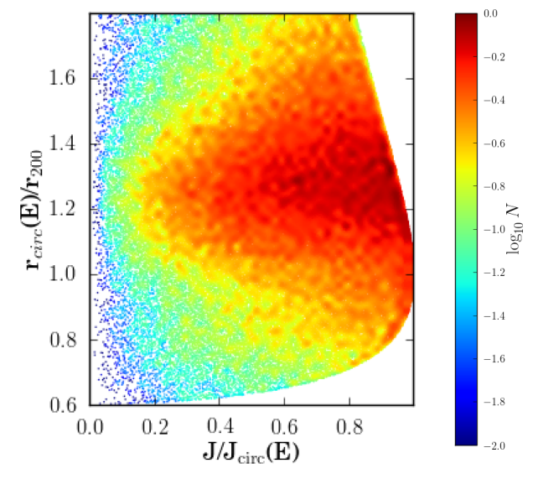
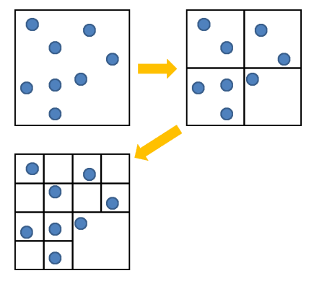
Swyft & survival
Smart initial parameters selection to fill
the relevant parameter space?
Force calculation: optimizing the
oct-tree algorithm?
Other possibilities?
Jiang+15
Thank you for listening!
Questions or
comments?
Ogiya+13

Slide 30
f_{b}-pericenter relation
We find a power-law behaviour of f_{b} against the pericenter of the orbit (with some scatter)
f_{b} = c x^{m}
m log₁₀ c
no-bary
bary

Slide 31
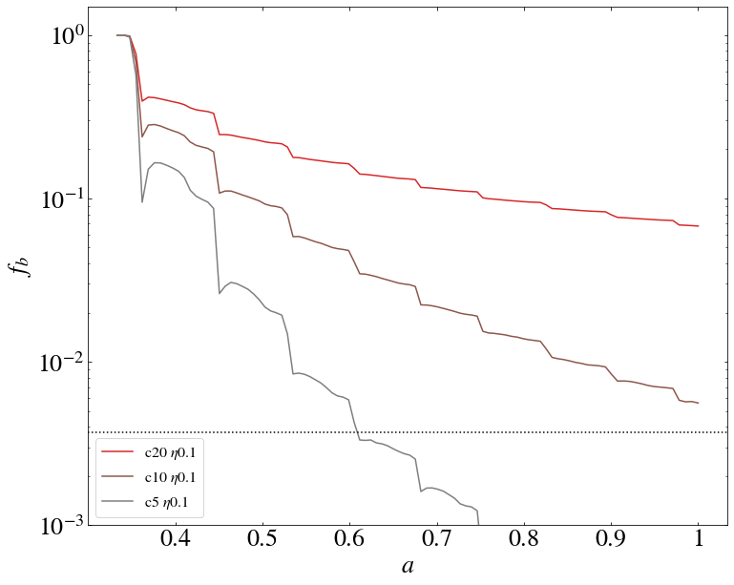
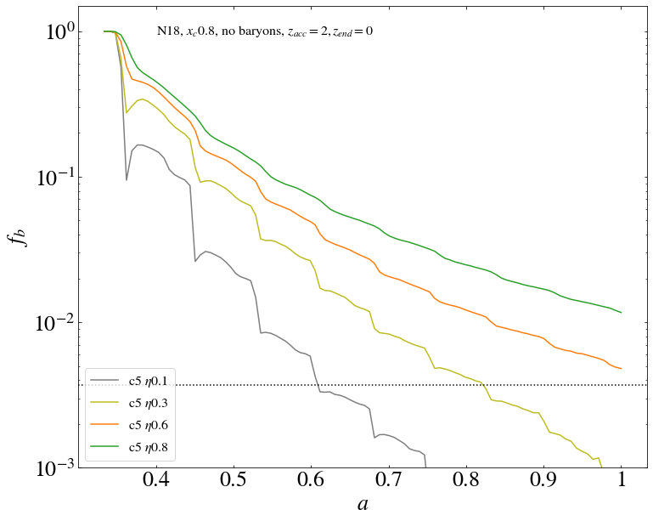
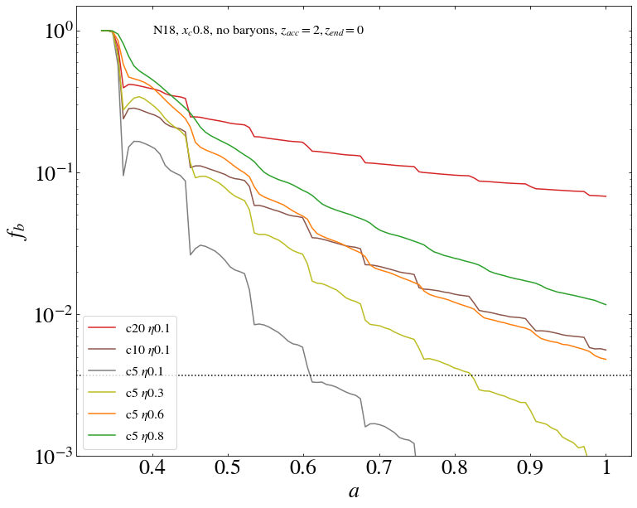
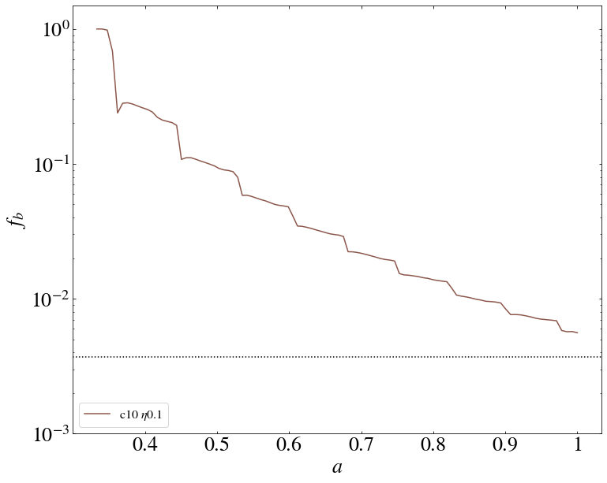
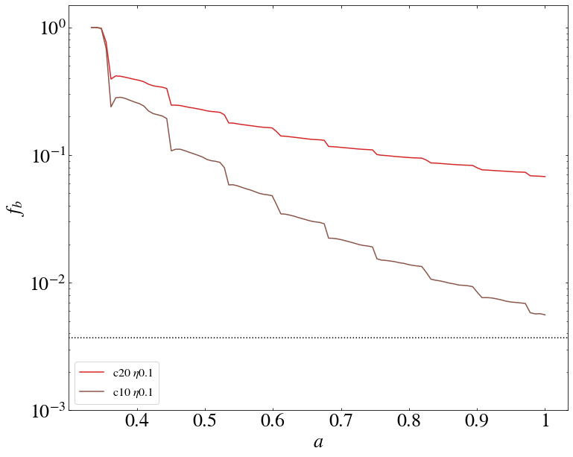




I. bound mass fraction (f_{b})
subhalo mass: 10⁶ M_{sun}
The subhalo loses more than 99% of its initial mass after several orbits
Large mass loss after every pericentric passage
Number of particles: 2¹⁸
orbital energy parameter
accretion redshift
When x_{c} is fixed, subhalos with more eccentric orbits (smaller η ⇒ smaller pericenter) lose more mass
pericentric passages
More concentrated subhalos lose less mass
Insufficient numerical resolution
Disrupted subhalo?
Convergence criteria:
(van den Bosch&Ogiya 18)
convergence line
= 1/(1+z)

Slide 32

Maximum circular velocities
Rmax shrinks more than Vmax

Slide 33


Concentrations
using scale radius and NFW+exp using Vmax, Rmax

Slide 34
Results: bound mass fraction (f_{b})
pericentric passages: large bound mass loss
pericentric passages
convergence line

Slide 35

Our code: DASH
Tree-code optimised for GPU clusters
Possibility to include baryons (stars, gas and bulge)
Time evolution of both DM and baryonic potentials included
Orbital parameters:
- xc measures the average distance to the host
- η measures the ellipticity of the orbit
Different subhalo concentrations at accretion redshift

