Slide 1

Observations and simulations of decay phases of solar energetic particle events
Ruth Hyndman, Silvia Dalla, Timo Laitinen, Adam Hutchinson, Christina Cohen, Robert Wimmer-Schweingruber

Slide 2
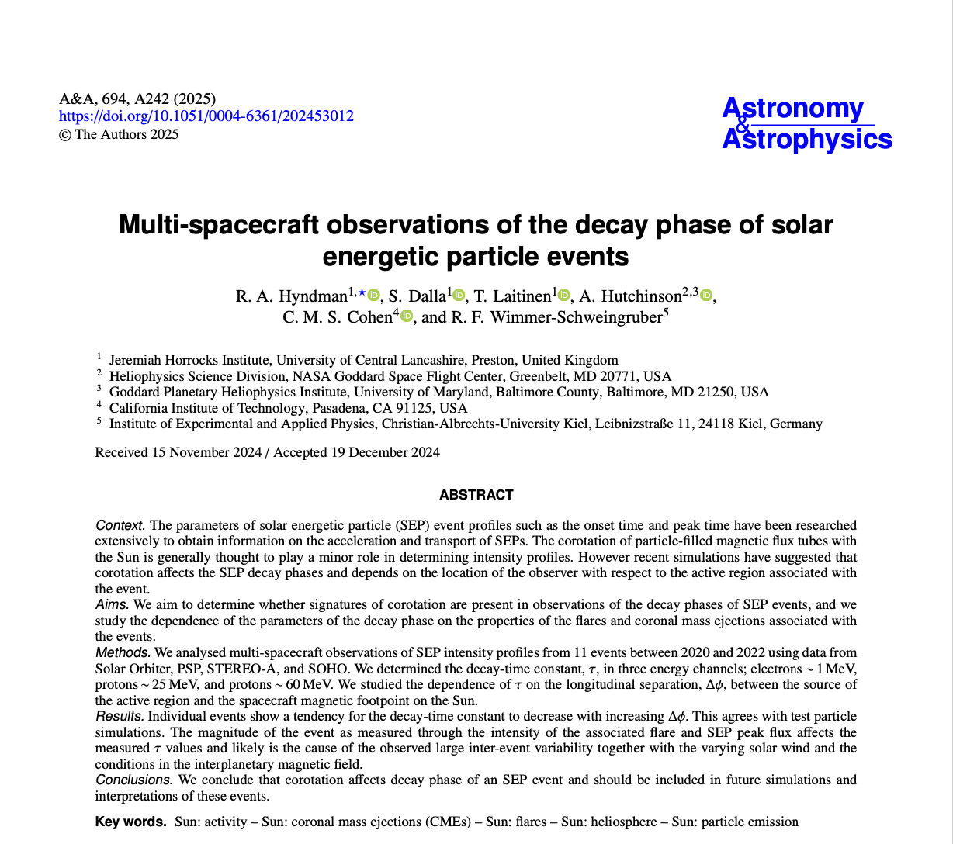
Introduction
Multi-spacecraft observations of the decay phase of solar energetic
particle events
R. A. Hyndman et al., A&A, 694, A242 (2025)
Intro – History – Data – Method – Results – Obs conclusions – Code so far – ⟂ transport – Our plan – Future runs

Slide 3
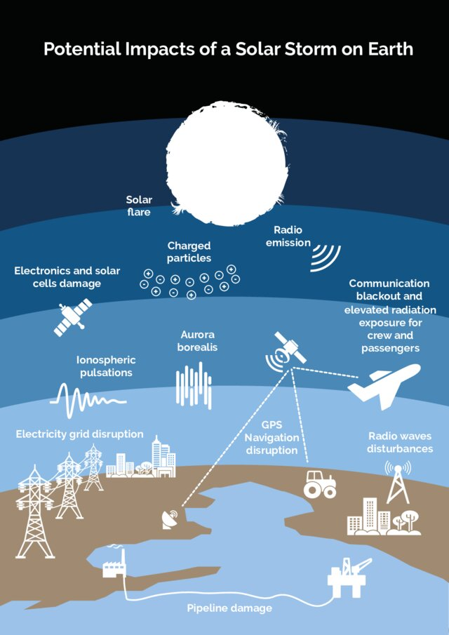
Introduction
Solar energetic particles (SEPs)
  Accelerated in solar flares and coronal mass ejections (CMEs)
Contribute to space weather
  Danger to satellites, spacecraft, astronauts
  Threat to technology on Earth
Credit: FHNW.
Intro – History – Data – Method – Results – Obs conclusions – Code so far – ⟂ transport – Our plan – Future runs

Slide 4
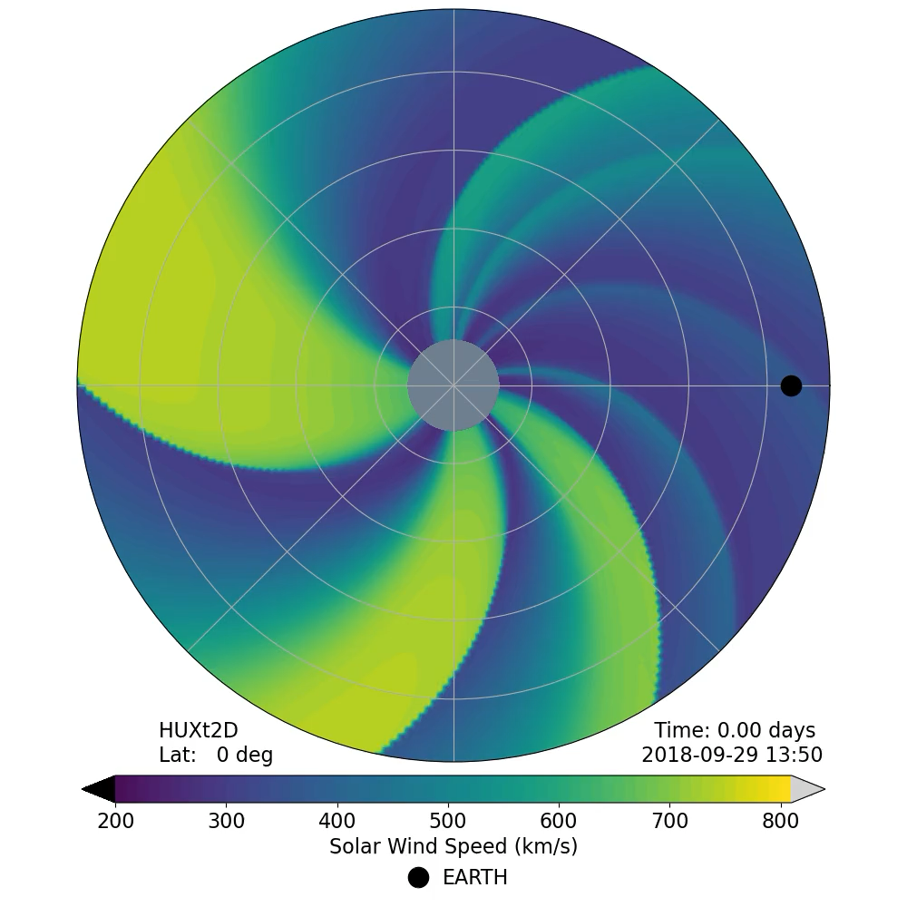
Introduction
Complex system
  Event parameters
  Interplanetary Magnetic Field
  Turbulence
    Particle scattering
    Meandering field lines
  Magnetic structures in the field
  Previous events
HUXt DOI:10.5281/zenodo.4889326
Intro – History – Data – Method – Results – Obs conclusions – Code so far – ⟂ transport – Our plan – Future runs

Slide 5
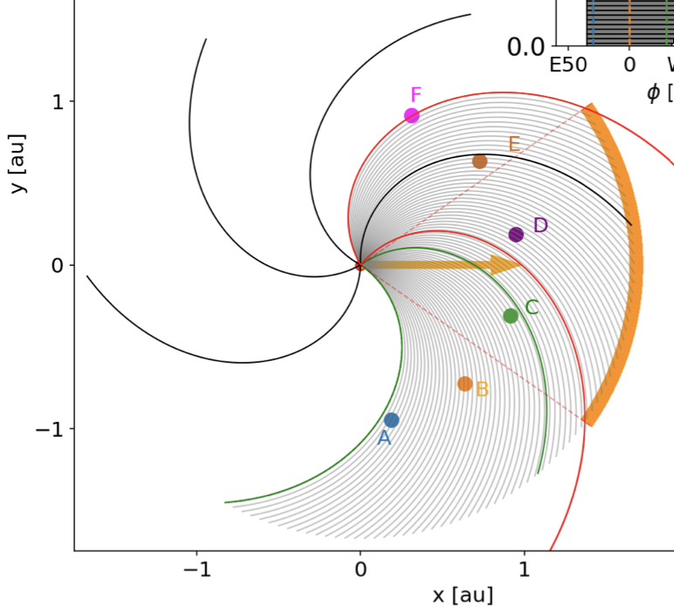
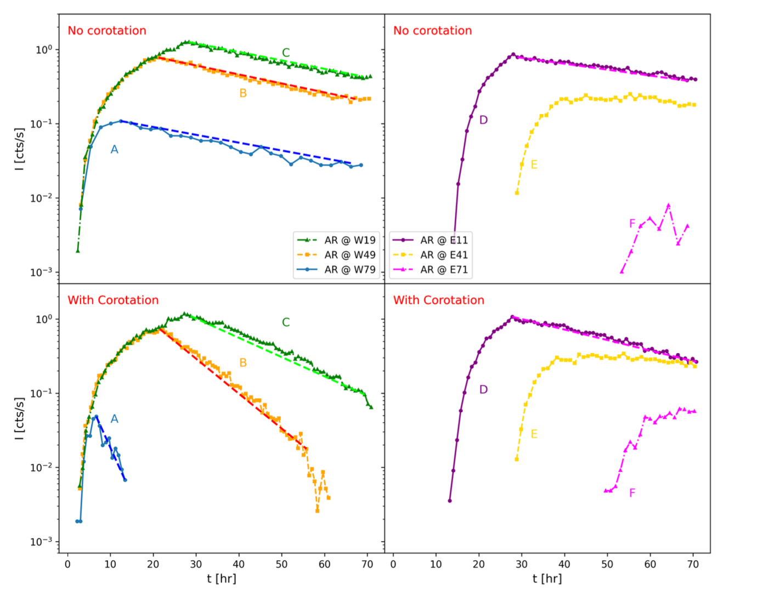
History
Corotation usually considered negligible
Hutchinson et al. (2023)
  Simulations show corotation could affect SEP event profiles
    East-west difference
What about observations?
  Do we see an east-west difference?
Fig. 1 (top) and Fig 2 (bottom) from Hutchinson et al. (2023)
Intro – History – Data – Method – Results – Obs conclusions – Code so far – ⟂ transport – Our plan – Future runs

Slide 6
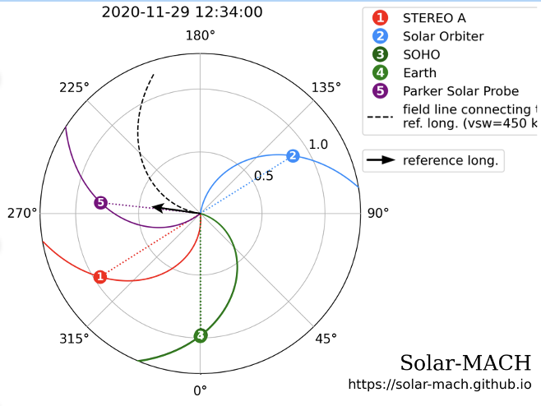
Data
Multiple spacecraft available
  Can compare observer location effects within one event
4 spacecraft used
Solar-MACH tool: Gieseler et al. (2022) doi:10.3389/fspas.2022.1058810
Intro – History – Data – Method – Results – Obs conclusions – Code so far – ⟂ transport – Our plan – Future runs

Slide 7
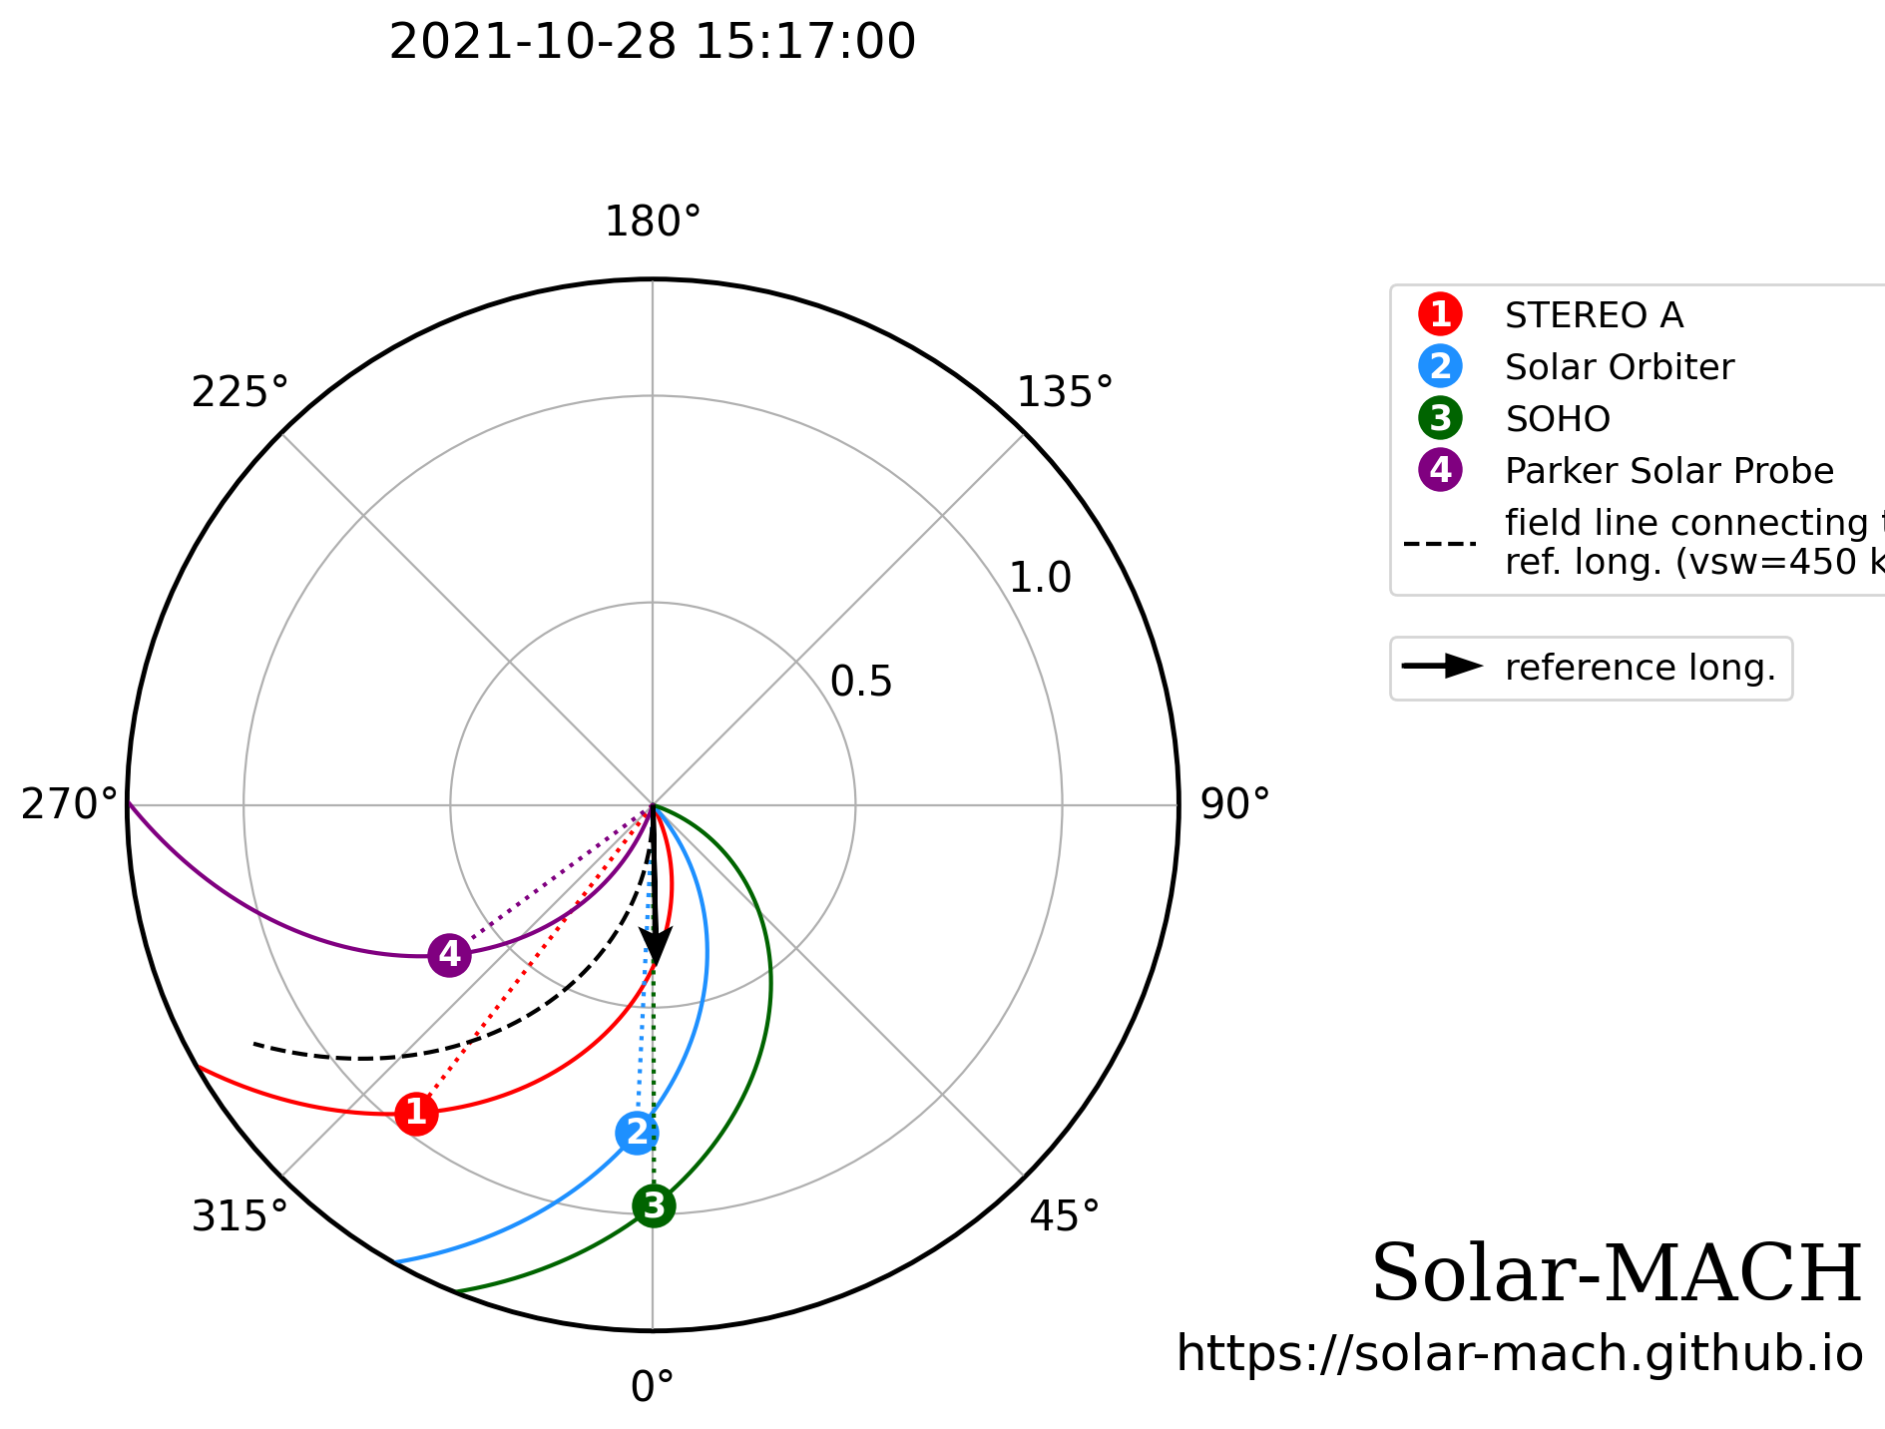
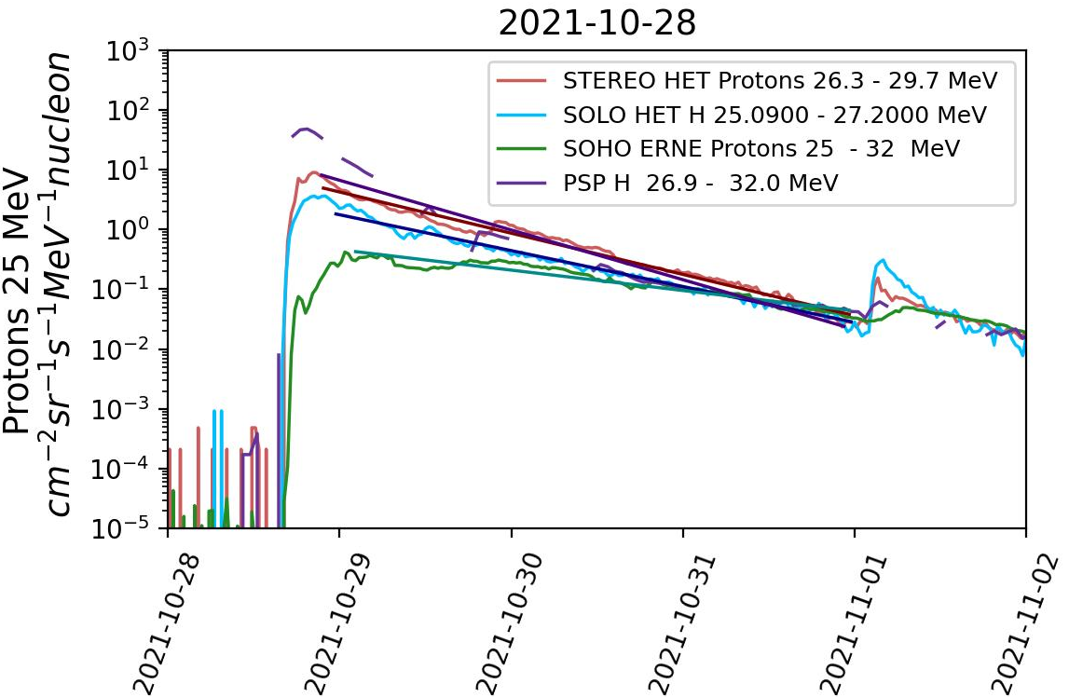

Method
Measured the decay phase
  90% of the peak value → background level
Convert to decay time constant
$$τ=−{\left(\frac{d(\ln{I)}}{dt }\right)}^{−1}$$
Plot against $Δφ$
$Δφ=φ_{AR}−φ_{ftpt}$
Intro – History – Data – Method – Results – Obs conclusions – Code so far – ⟂ transport – Our plan – Future runs

Slide 8
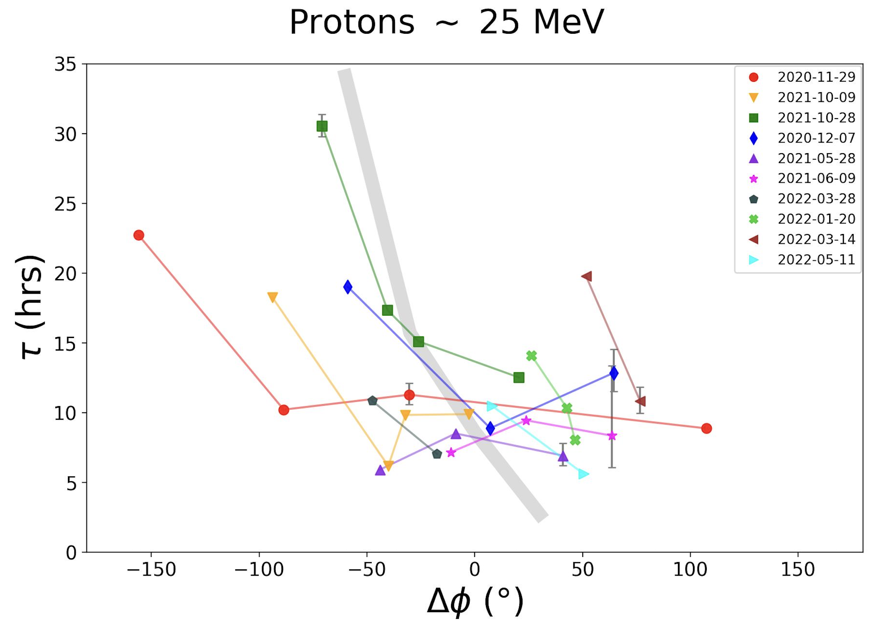
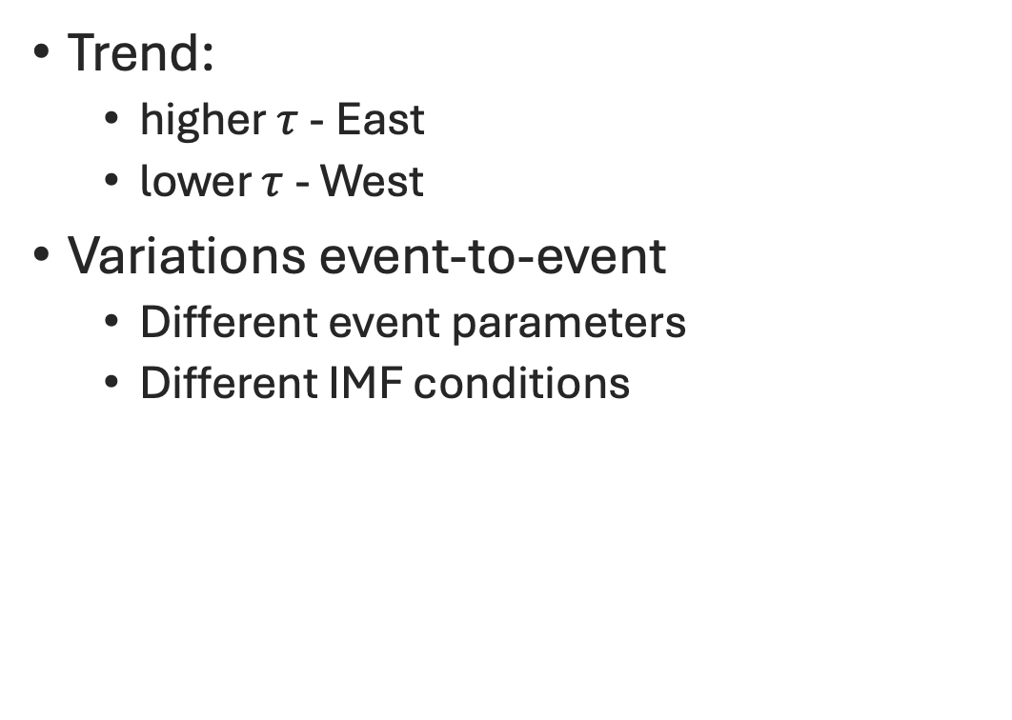
Results
Trend:
  higher $τ$ - East
  lower $τ$ - West
Variations event-to-event
  Different event parameters
  Different IMF conditions
Intro – History – Data – Method – Results – Obs conclusions – Code so far – ⟂ transport – Our plan – Future runs

Slide 9
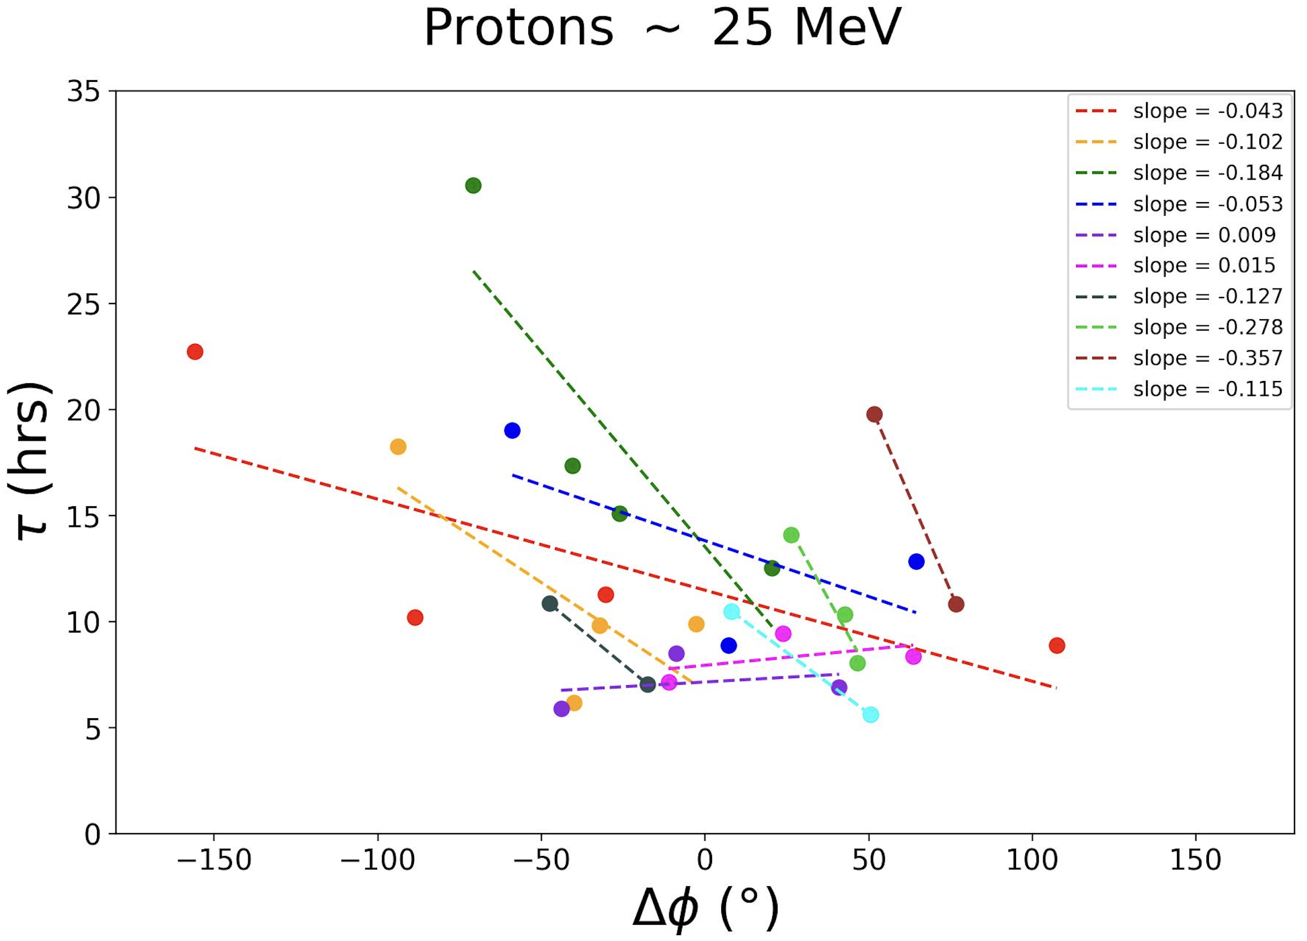
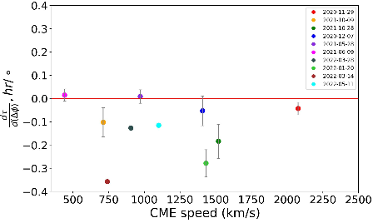
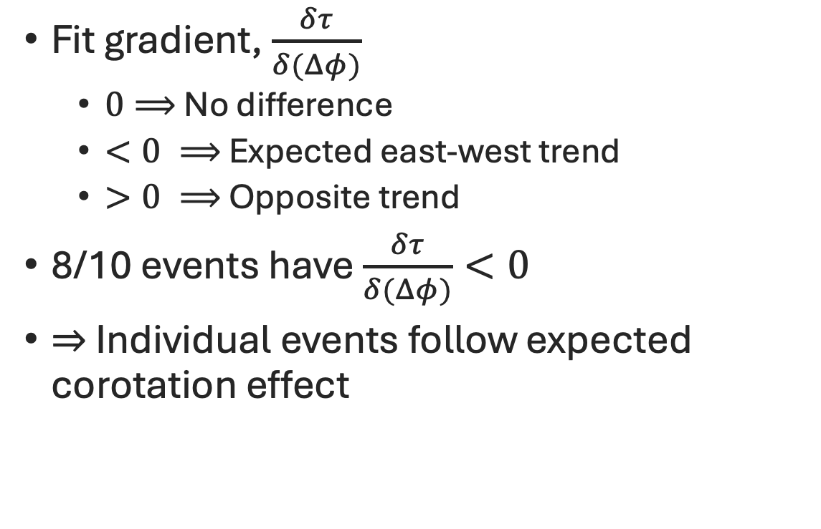
Results
Fit gradient, $\frac{δτ}{δ(Δφ)}$
  $0⟹$ No difference
  $<0 ⟹$ Expected east-west trend
  $>0 ⟹$ Opposite trend
8/10 events have $\frac{δτ}{δ(Δφ)}<0$
$⇒$ Individual events follow expected corotation effect
Intro – History – Data – Method – Results – Obs conclusions – Code so far – ⟂ transport – Our plan – Future runs

Slide 10
Observations conclusions
Difference in SEP decay phases depending on observer location seen
Consistent with corotation effect
Consider corotation in future simulations and predictions of SEP events
Intro – History – Data – Method – Results – Obs conclusions – Code so far – ⟂ transport – Our plan – Future runs

Slide 11
Next, simulations
3D test particle code + perpendicular scattering
Intro – History – Data – Method – Results – Obs conclusions – Code so far – ⟂ transport – Our plan – Future runs

Slide 12
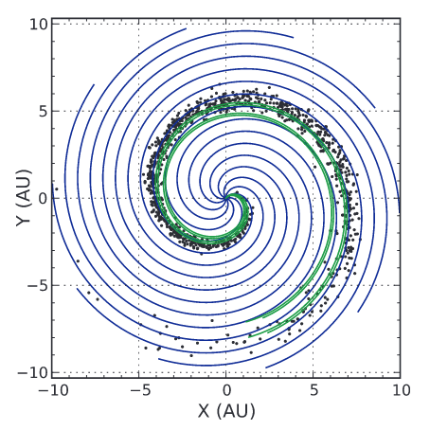
Code so far...
3D test particle code
Parker spiral B field structure
B field curvature and gradient drifts
Corotation
Parallel scattering
Heliospheric current sheet
Instantaneous/shock injection
Marsh et. al (2013)
Intro – History – Data – Method – Results – Obs conclusions – Code so far – ⟂ transport – Our plan – Future runs

Slide 13
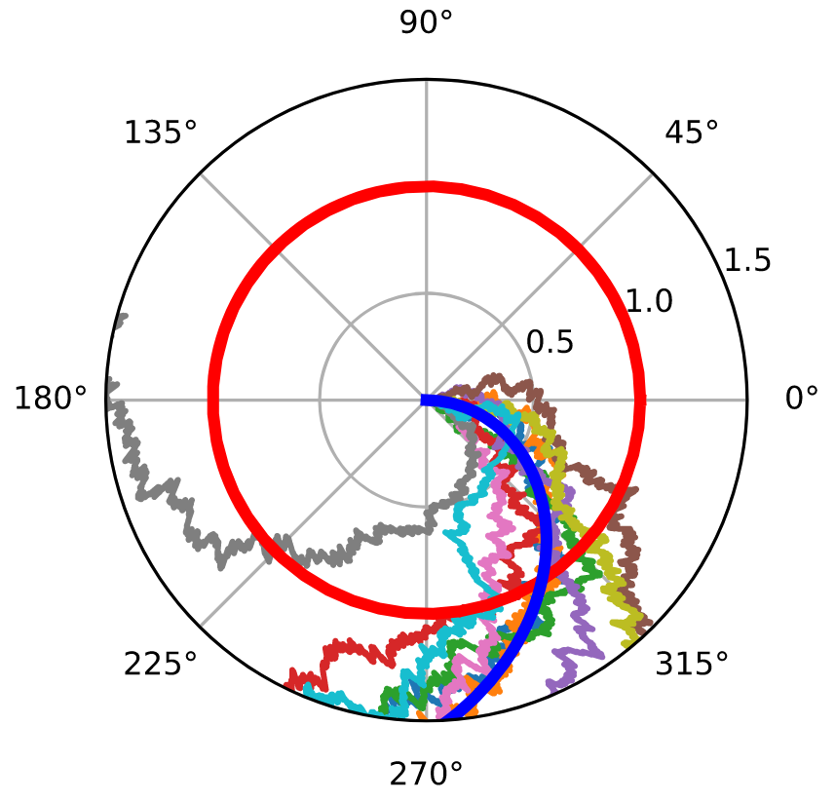
Perpendicular transport in simulations
Different mechanisms in earlier studies
  Meandering field lines - Laitinen & Dalla (2019)
  Diffusion term within model transport equations
    e.g. Parker or Fokker-Planck equations with diffusion descriptions (Parker 1965; Jokipii 1966, Zhang 2009)
Our plan: Include perpendicular particle scattering using a stochastic differential equation (SDE) approach
Fig. 3 from Laitinen & Dalla (2019)
Intro – History – Data – Method – Results – Obs conclusions – Code so far – ⟂ transport – Our plan – Future runs

Slide 14
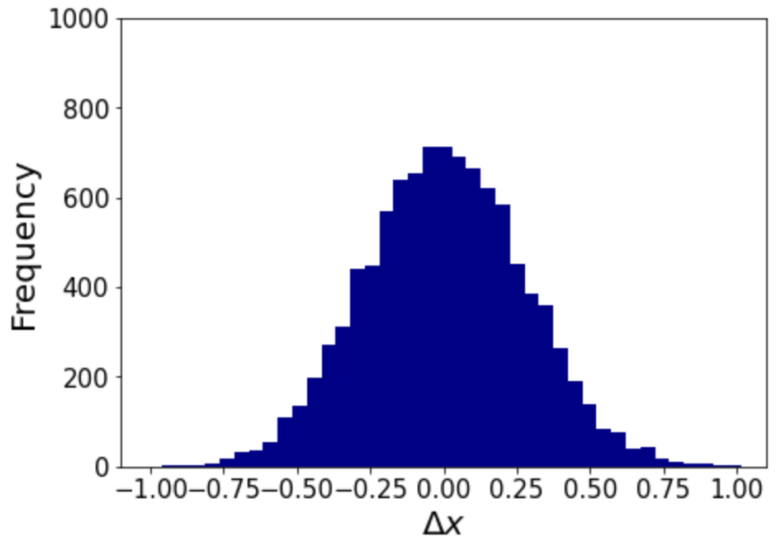
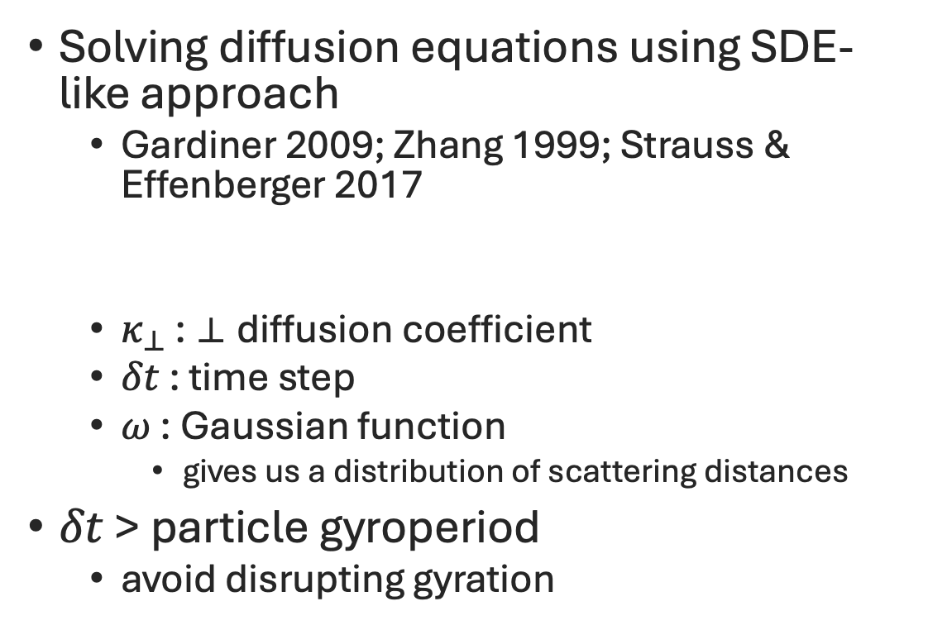

Our plan
Solving diffusion equations using SDE-like approach
  Gardiner 2009; Zhang 1999; Strauss & Effenberger 2017
  $κ_{⊥}$ : ⟂ diffusion coefficient
  $δt$ : time step
  $ω$ : Gaussian function
    gives us a distribution of scattering distances
$δt$ > particle gyroperiod
  avoid disrupting gyration
$$Δx= \sqrt{2 κ_{⊥}δt} ω\left(μ=0, σ=1\right)$$
Intro – History – Data – Method – Results – Obs conclusions – Code so far – ⟂ transport – Our plan – Future runs

Slide 15
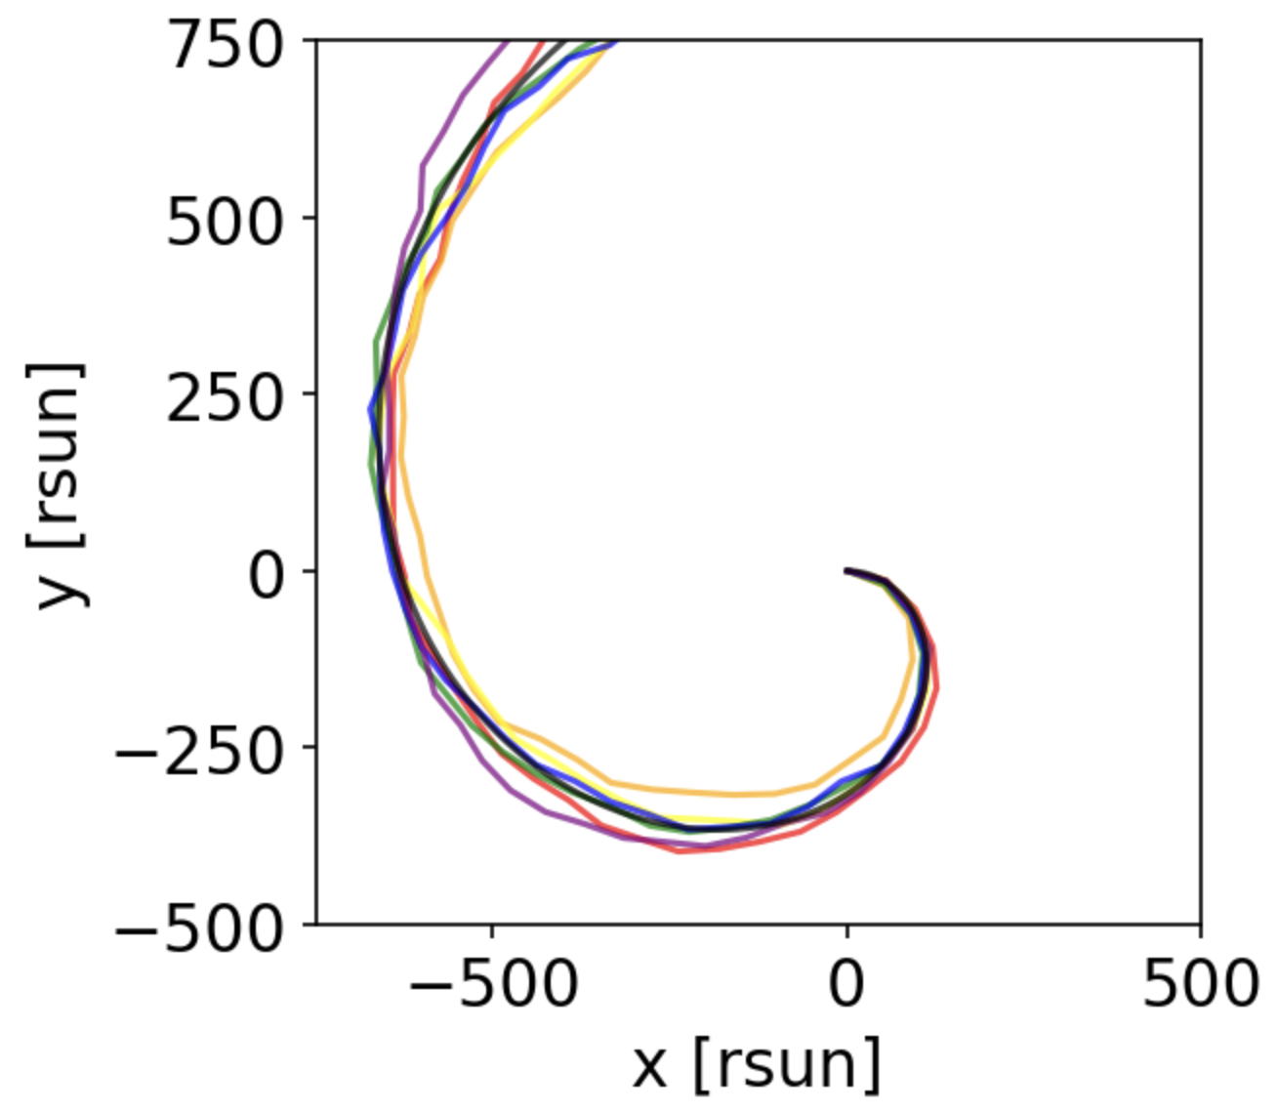
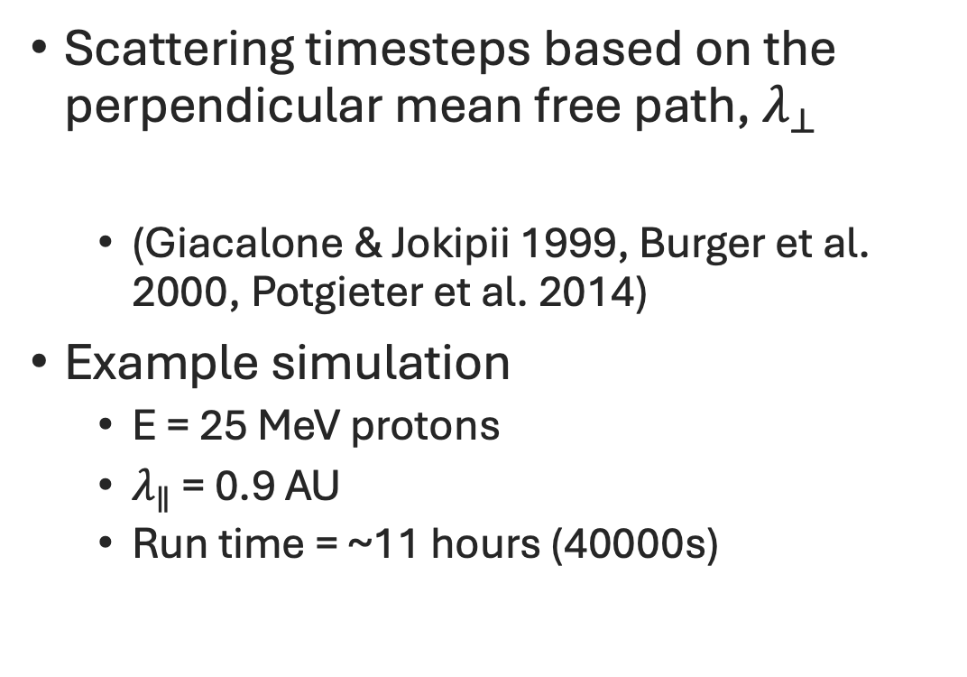

Our plan
Scattering timesteps based on the perpendicular mean free path, $λ_{⊥}$
  (Giacalone & Jokipii 1999, Burger et al. 2000, Potgieter et al. 2014)
Example simulation
  E = 25 MeV protons
  $λ_{∥}$ = 0.9 AU
  Run time = ~11 hours (40000s)
$λ_{⊥}≈0.01 λ_{∥}$
Intro – History – Data – Method – Results – Obs conclusions – Code so far – ⟂ transport – Our plan – Future runs

Slide 16

Future runs
3D test particle code + perpendicular scattering
Compare perpendicular scattering runs with and without corotation
Investigate contributions of corotation and perpendicular scattering to event decay time
Compare to observations
rahyndman@uclan.ac.uk
Intro – History – Data – Method – Results – Obs conclusions – Code so far – ⟂ transport – Our plan – Future runs

