Slide 1
Cosmogenic ¹⁰Be as a tracer of cosmic-ray variability: Atmospheric transport model
I. Usoskin¹, K. Golubenko¹, E. Rozanov², G. Kovaltsov³, M. Baroni⁴, T. Sukhodolov²
University of Oulu, Finland
Phys. Meteo. Observ. Davos, Switzerland
Ioffe Phys-Tech Inst., St. Petersburg
CEREGE, France

Slide 2
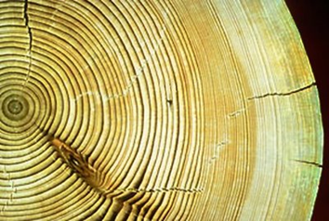
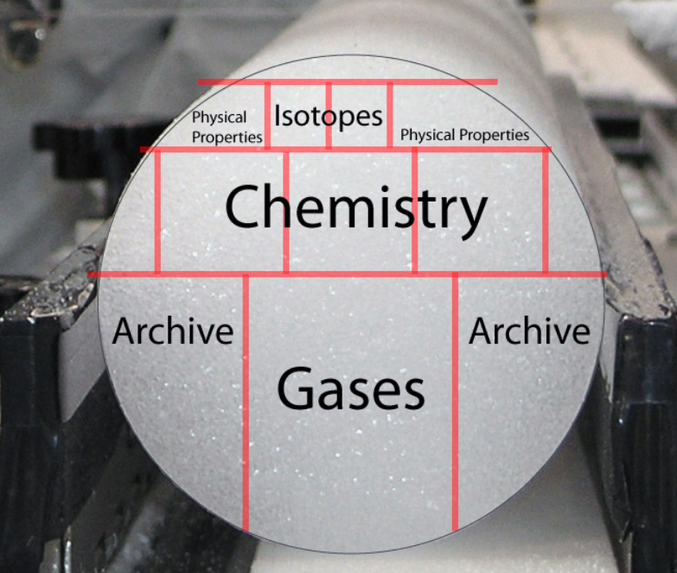
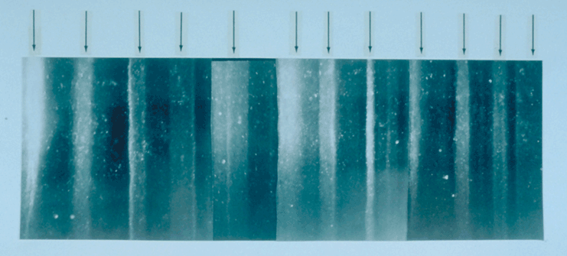
Cosmogenic isotopes: Holocene
¹⁴C: ¹⁴N(n,p)¹⁴C
Half-life ~5730 years,
Carbon cycle
Measured in trees
¹⁰Be: spallation of O and N
Half-life ~1.4 Myr;
Fallout on aerosols
Measured in ice cores
⁷Be: spallation of O and N
Half-life ~53 days;
Fallout on aerosols
Measured in air

Slide 3
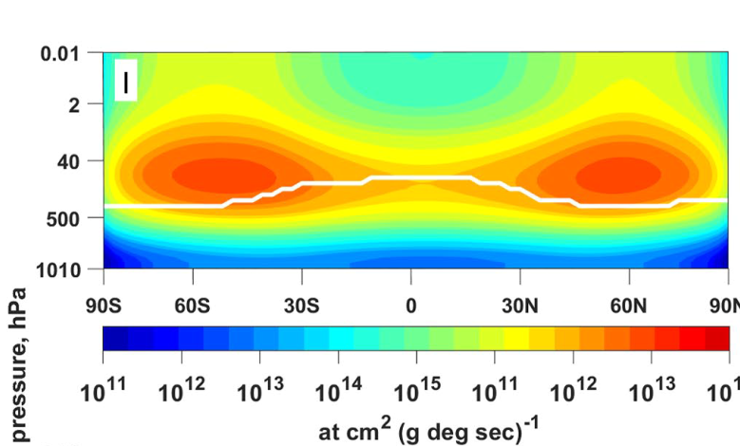
Beryllium production pattern
Production of ⁷Be in the atmosphere by GCR (solar minimum) → ~15 km altitude at mid-latitudes (Golubenko+2022)

Slide 4
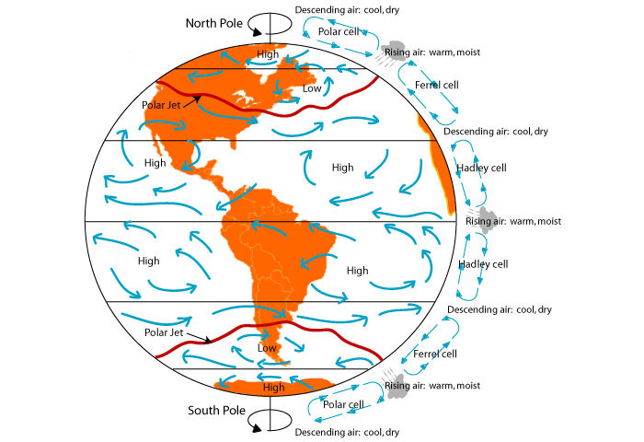
Large-scale transport
← Production:
mid-lat stratosphere
← Concentration:
Tropical troposphere
Measurements:
Polar ice cores

Slide 5
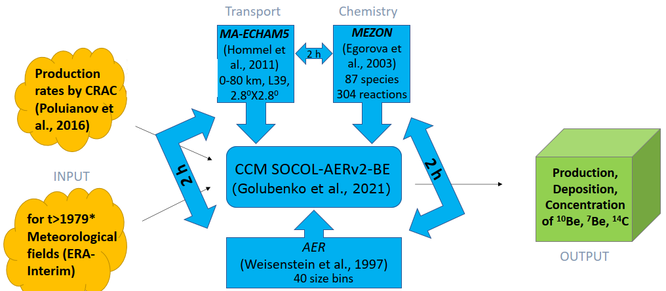
Chemistry-climate model SOCOL

Slide 6
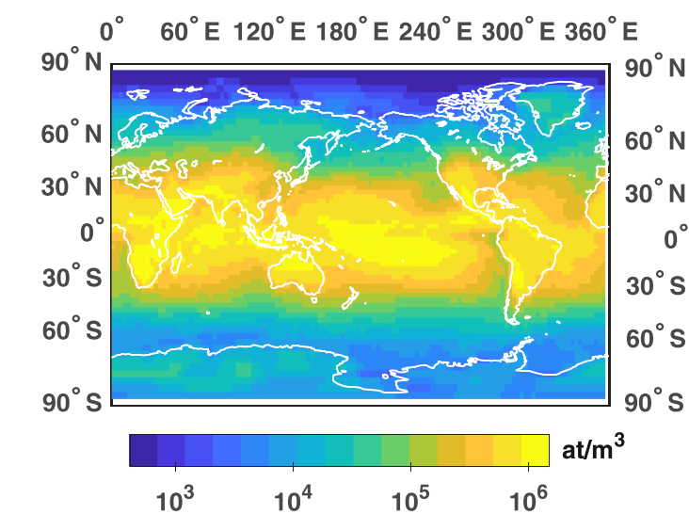
10Be concentration near surface
Near-ground concentration of ¹⁰Be in the atmosphere for GCR production → tropical zone (Golubenko+2024)

Slide 7
Test of the model: 7Be in air
7Be is a short-lived cosmogenic isotope routinely measured by the Comprehensive Nuclear Test-Ban-Treaty Organisation (CTBTO) around the Globe.
Weekly resolution near-ground concentration of ⁷Be in the atmosphere measured in sub-polar locations → excellent agreement (Golubenko+2021;Usoskin+2009)

Slide 8
HPC massive computations: 1 model year = 1 wall-clock day at LUMI Parameterisation Heikkilä+2009,2012

Slide 9
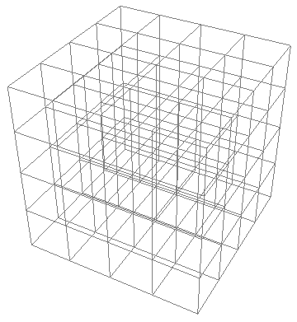

Simplified grid
Measurements
$$\sum_{ijk}{{Q_{ijk} Z}_{ijk}}$$
Altitude i = 1—4
Production rates
Transport coefficients
Latitude j = 1—6
Longitude k = 1—4

Slide 10
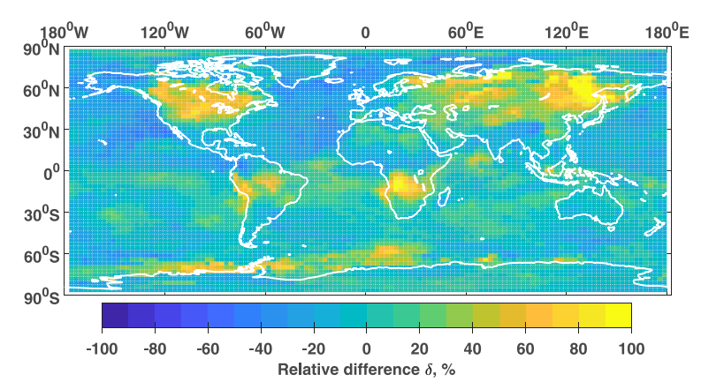
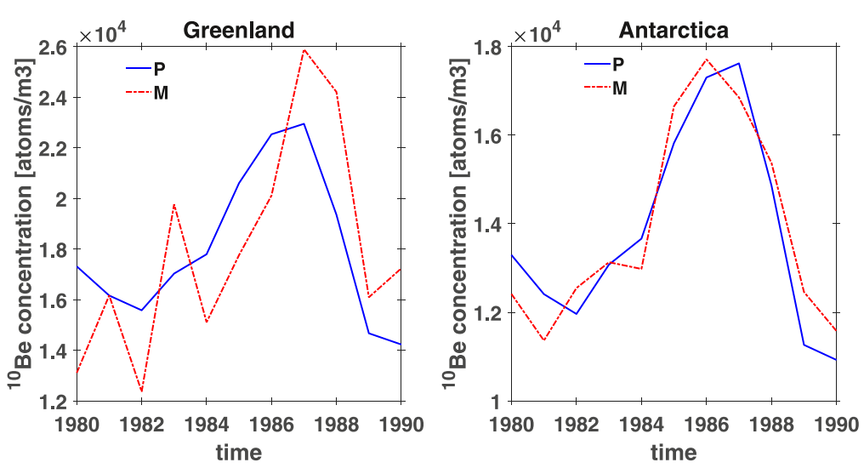
Parameterisation works ±20% in polar regions

Slide 11
Conclusions
Atmospheric transport of Be is important to study cosmic-ray variability.
Direct CCM is good and accurate, but heavy and slow.
A simple linear parametrisation is proposed using a 3x4x4 grid and a set of pre-computed transport coefficients.
The parametrised model is accurate within 20% in polar regions, making quick estimates of the transport effects in beryllium deposition possible.
This paves the way to consistent quantitative modelling of ESPEs in the past, using cosmogenic isotopes.

Slide 12


Slide 13
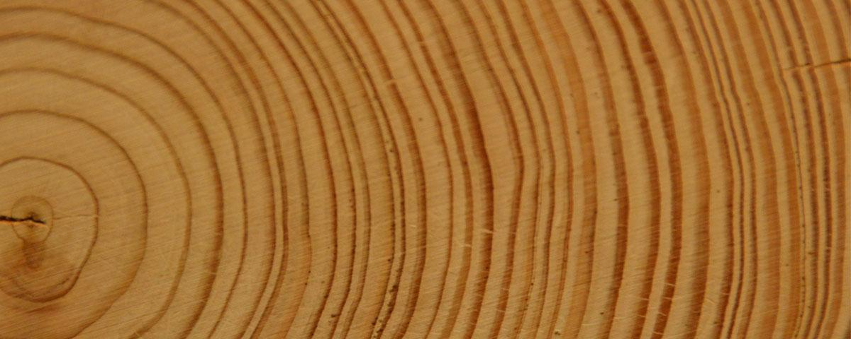

Atmospheric cascade
Time t₁
Time t₂ > t₁
CR₁ E₁
CR₂ E₂<E₁
CR₂
CR₁
¹⁴C
Time →
atmosphere
¹⁴C
ground
tree

Slide 14
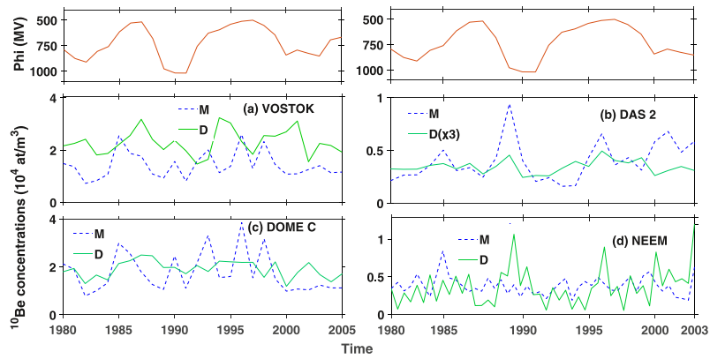
Why do we need transport models?
10Be in polar ice cores: -- production; -- measurements; -- model.

