Slide 1
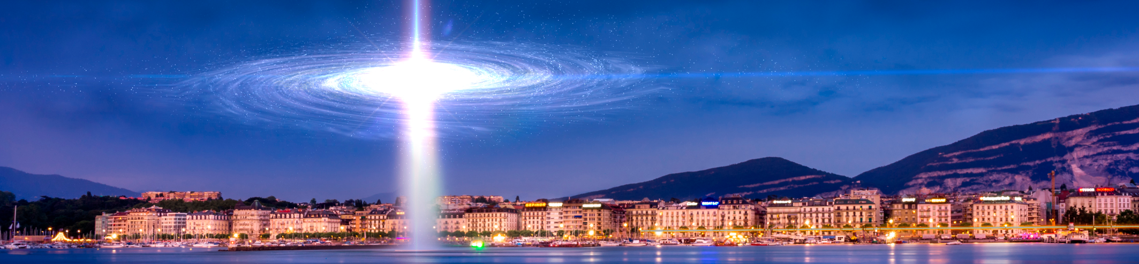
Solar Neutrino Data v.s. Standard Core Physics: Reconciling CNO Flux Anomalies via Opacity and Key Nuclear Cross-Section Revisions
Yu-Feng Li
Institute of High Energy Physics &
University of Chinese Academy of Sciences, Beijing
the 39th International Cosmic Ray Conference (ICRC 2025)
Geneva, Switzerland
21st July, 2025

Slide 2
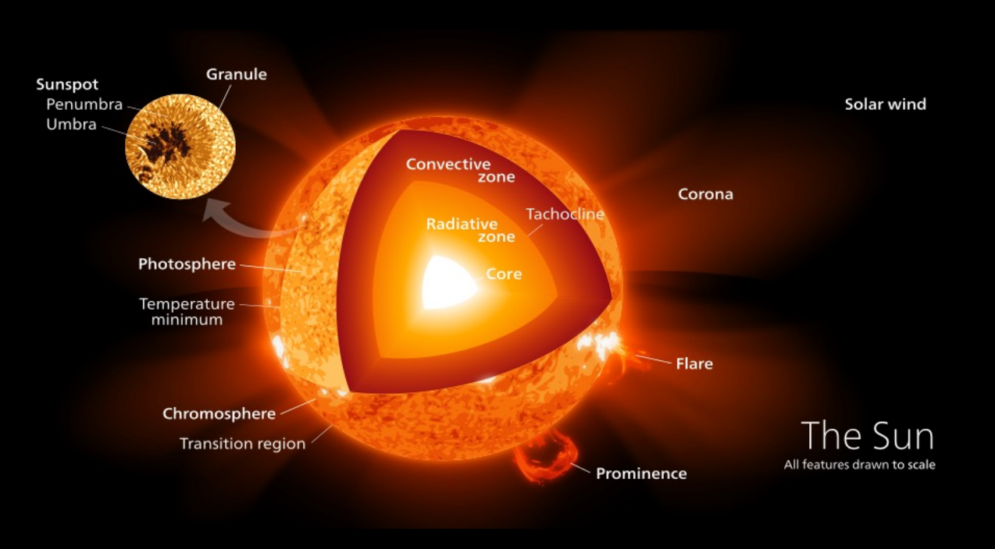
How to see the interior of the Sun?

Slide 3
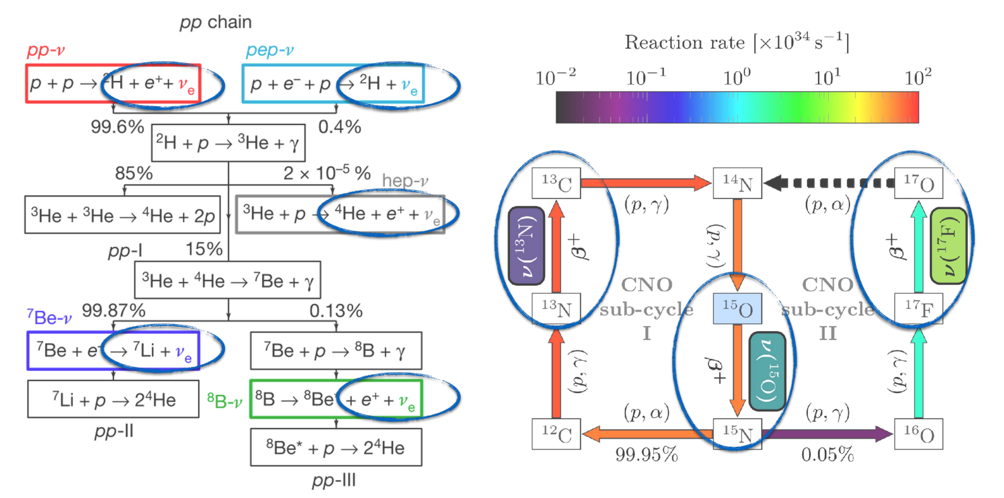
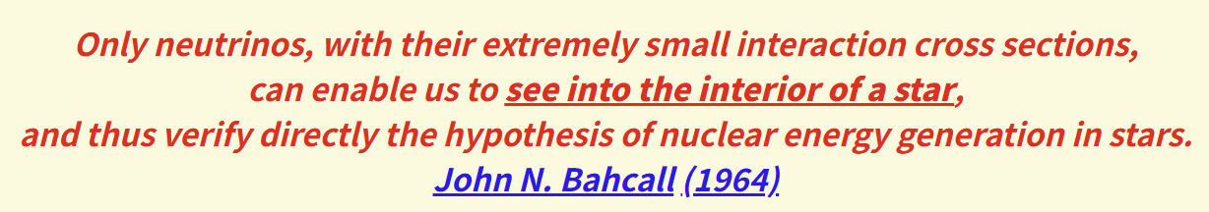
Solar neutrinos
Neutrinos produced from the fusion process of stellar evolution
Solar neutrinos have played a central rule in the establishment of neutrino oscillation phenomena.

Slide 4
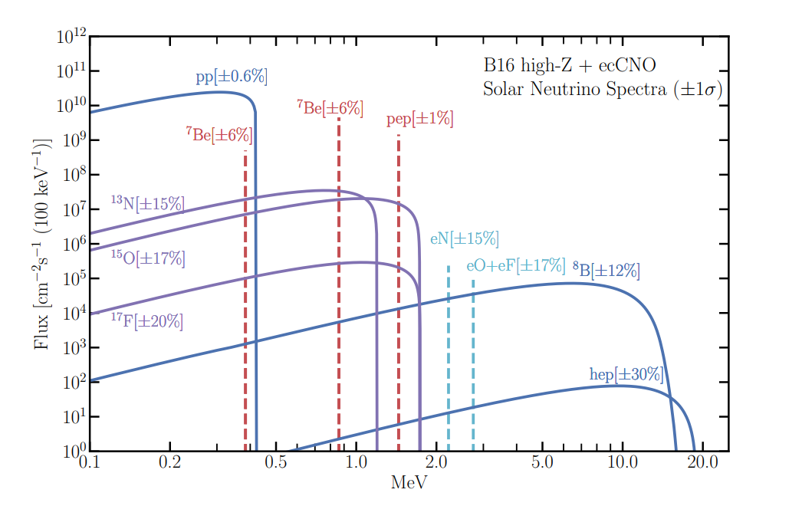
Solar neutrino spectra

Slide 5
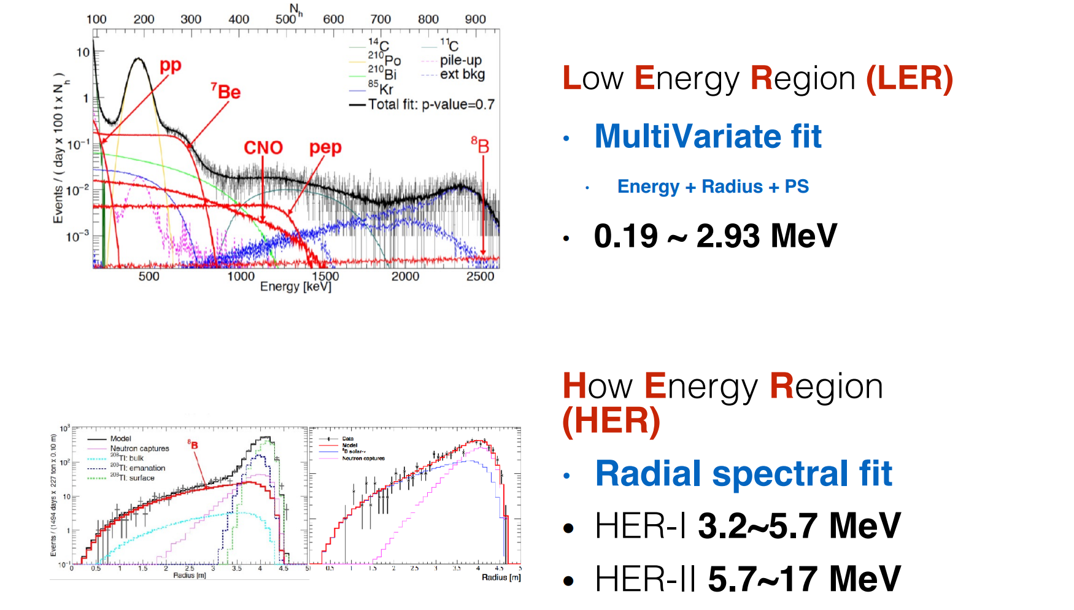
Solar neutrino observation
Radioactive chemical measurements: Homestake (1968), SAGE, …
B8 solar neutrino flux: Kamiokande-II, SK, SNO, … …
Borexino: solar neutrino spectroscopy Nature 562 (2018) 505-510

Slide 6
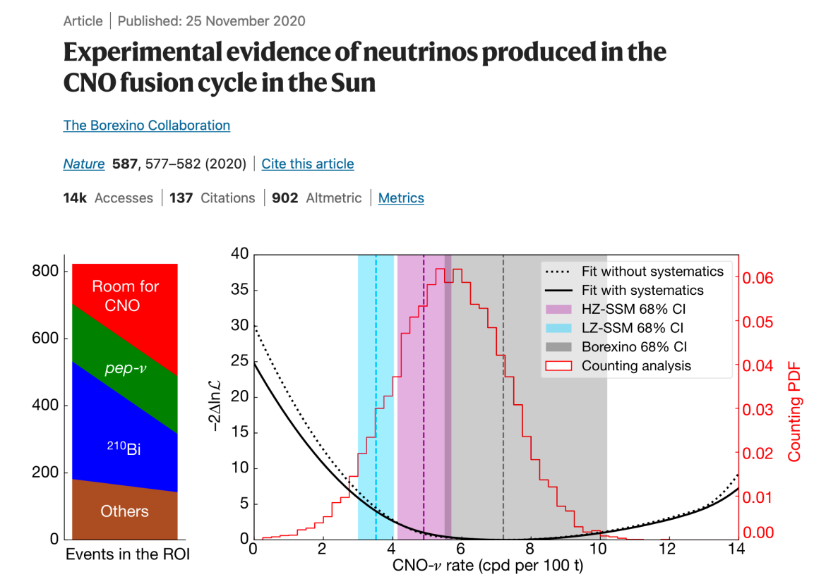


Solar neutrino observation
Phys.Rev.D 108 (2023) 102005

Slide 7
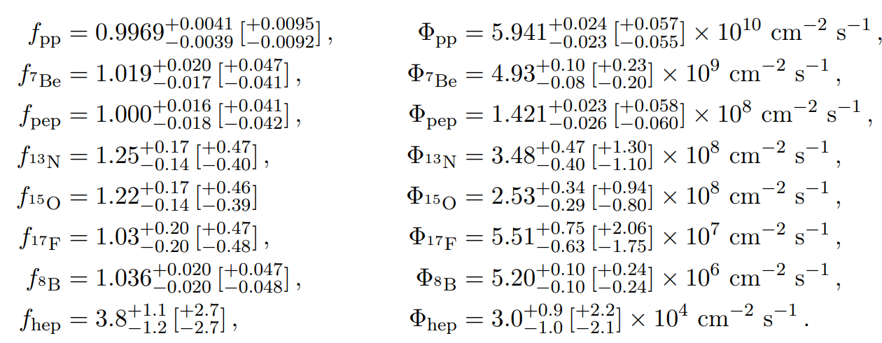
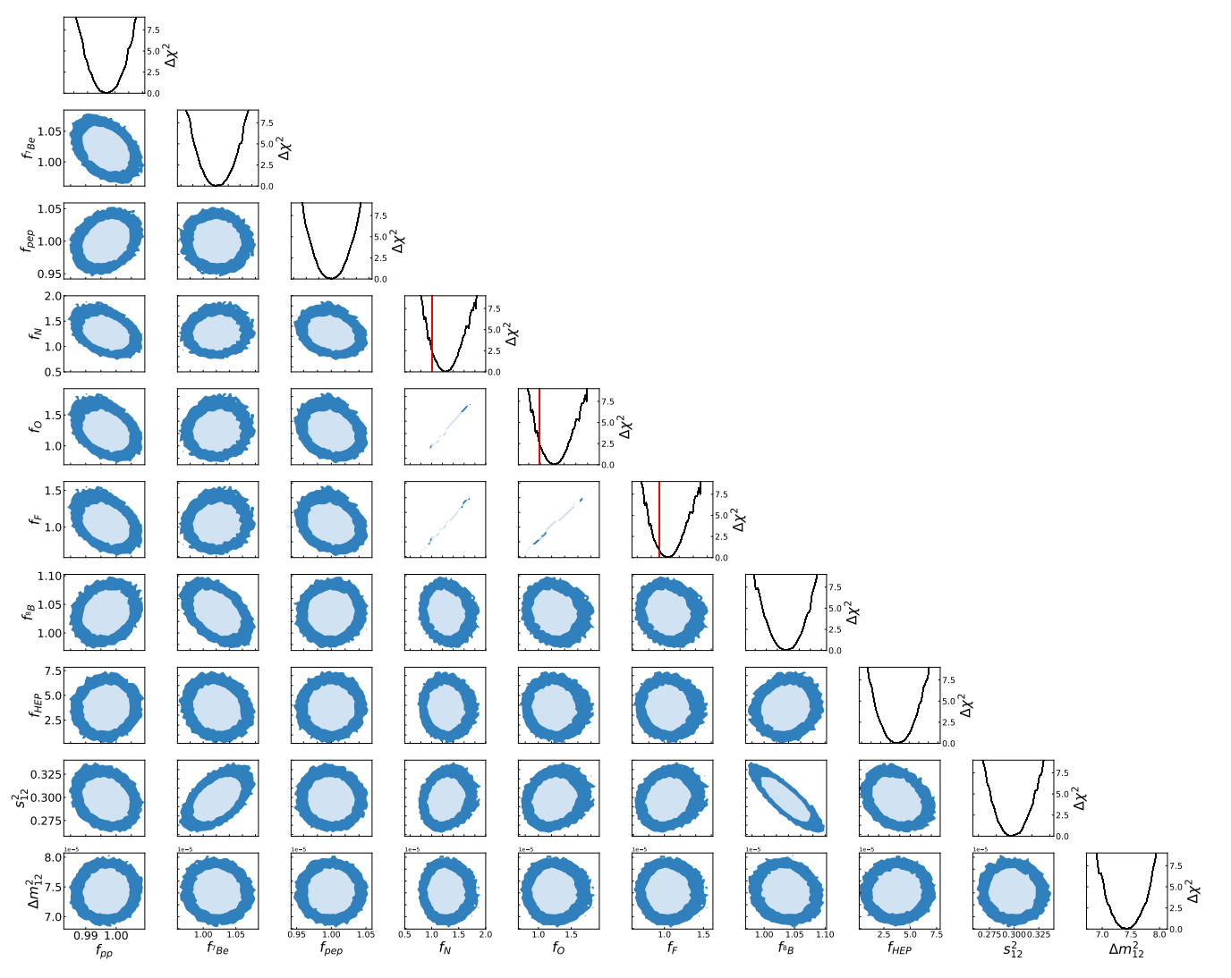
Solar neutrino observation
JHEP 02 (2024) 064

Slide 8
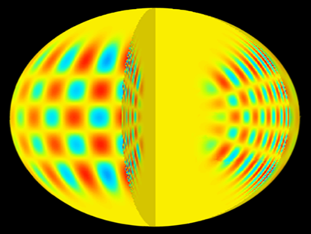
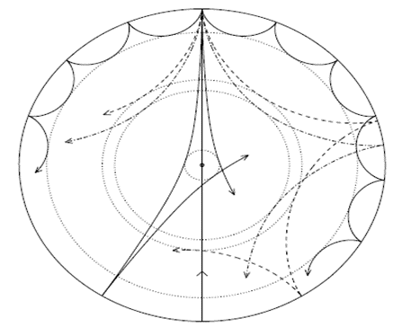
Helioseismology
The Sun is a non radial oscillator. The observed oscillation frequencies can be used to determine the properties of the Sun
In the form of stationary wave
Global Oscillation Network Group (GONG)
Birmingham Solar Oscillations Network (BiSON)
Solar Dynamics Observatory - Helioseismic and Magnetic Imager
→ Sound speed & Density profile: Impressive agreement with predictions (until some years ago)

Slide 9
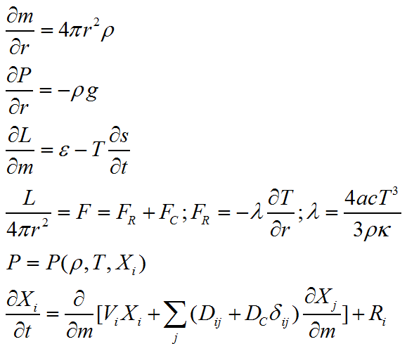
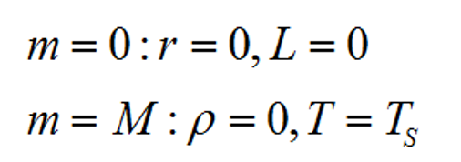
Standard solar model
Stellar evolution theory with initial and boundary conditions
Spherically symmetric, and hydrostatic equilibrium
Chemical element evolution:
nuclear reaction, convection
and microscopic diffusion
Initial condition:
homogeneous gas with given
mass and element abundance
Boundary condition:
Calibration with observation

Slide 10
Standard solar model
Equation of state: relationship between p, ρ, T
dilute electron gas, well described by an ideal gas EOS
Energy transport: radiation (interior) & convection (envelope): radiation over 98% mass (70% radius)
Energy production by nuclear reactions:
critically dependent on T
boundary condition:
mass, radius, luminosity; abundance ratios at ZAMS (zero-age main sequence): H: He: Z needed
Dimensionality: 1D vs. 3D
In 1962, Bahcall et. al. build such a model, and make the first flux predictions

Slide 11
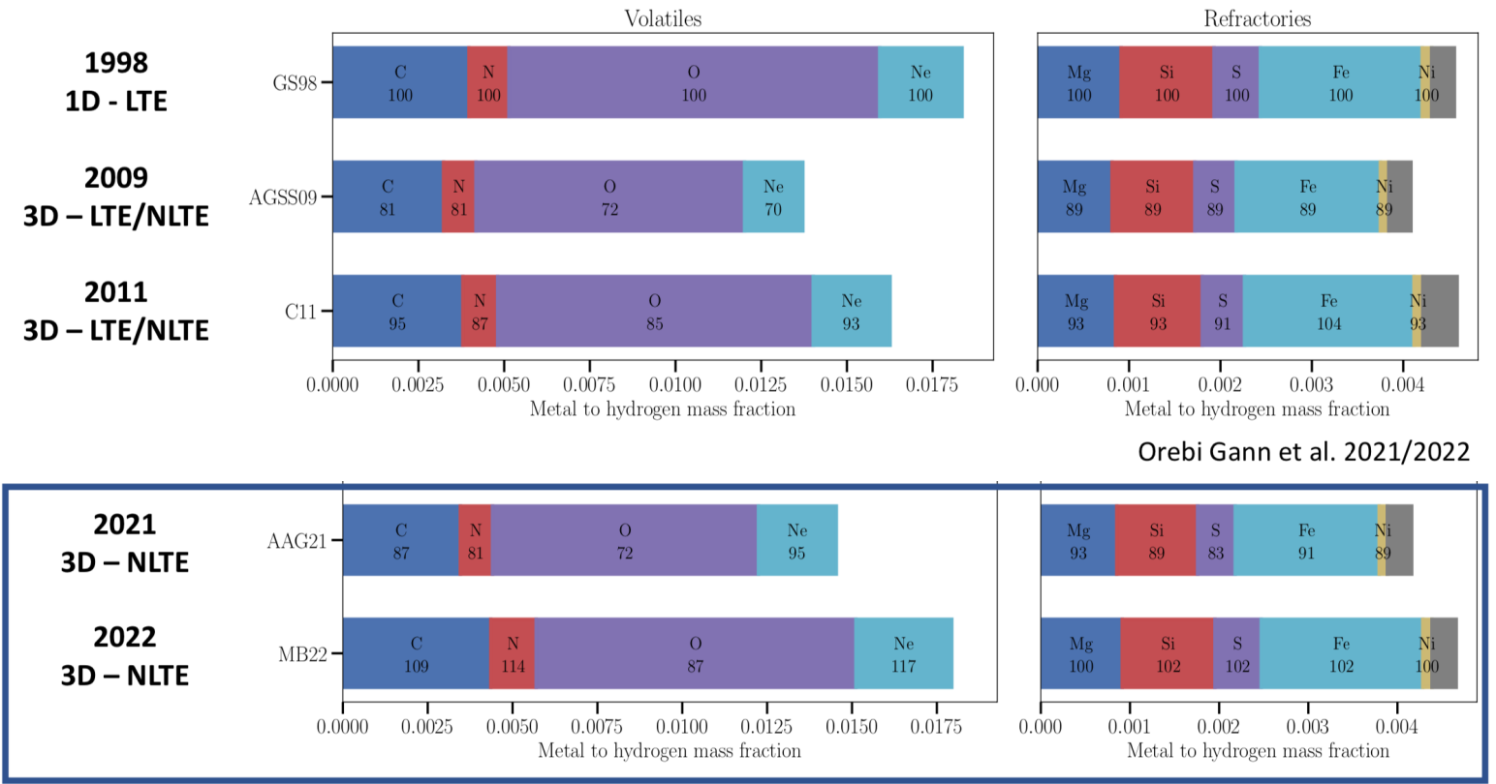
Surface abundance
Surface element abundance from solar spectral analysis:
Radiative fluid dynamics of solar atmospheric model
Analysis from 1D to 3D models

Slide 12
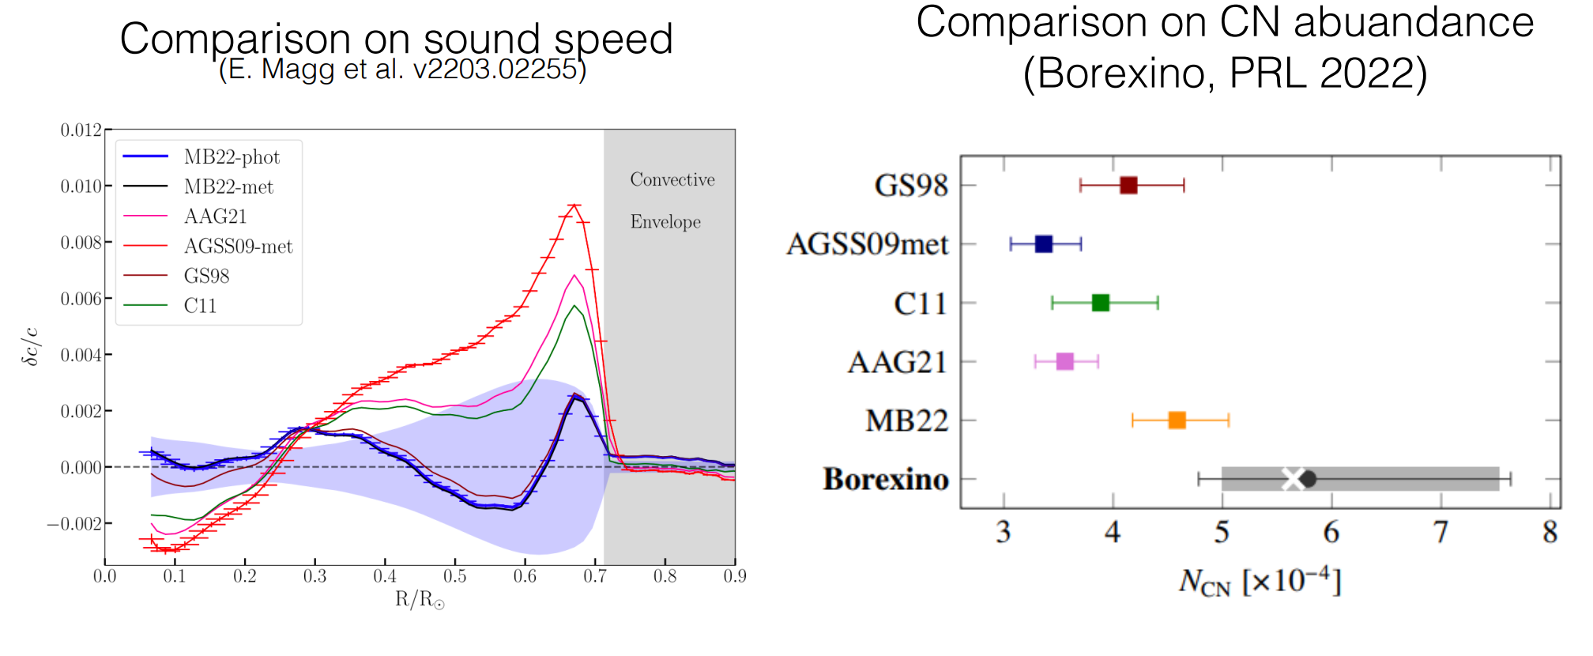
Solar metallicity problem
Which abundance model is correct ? (High Z v.s. Low Z)
High Z is favored with helioseismology and CNO neutrino data
Is the solar model self-consistent in light of neutrino data?

Slide 13
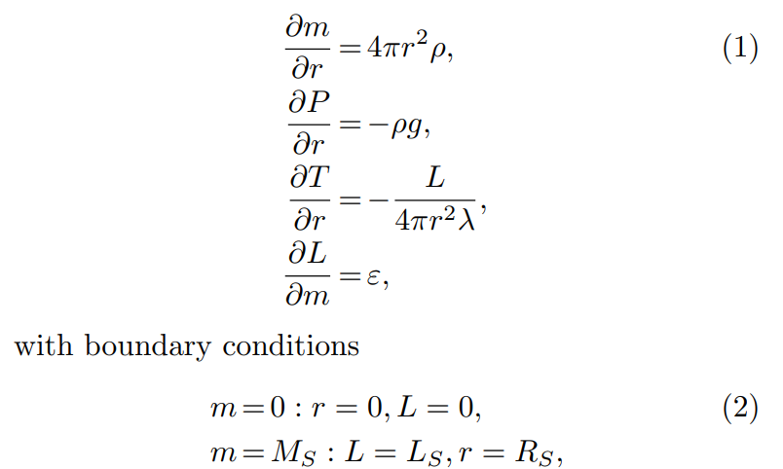


Solar core model v.s. Standard solar model
Standard solar model requires:
Input from surface abundance, and
constraints from sound speed of helioseismology data
Can we be able construct the solar core model, which is directly related to the production of solar neutrino fluxes?
Yes, we can separate the evolution of abundance and structure, since
Energy released by expansion
and contraction can be ignored.
There is no convection in the
solar core.
(SSM)

Slide 14
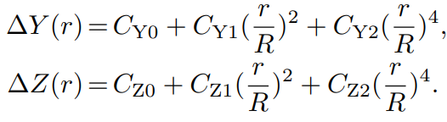
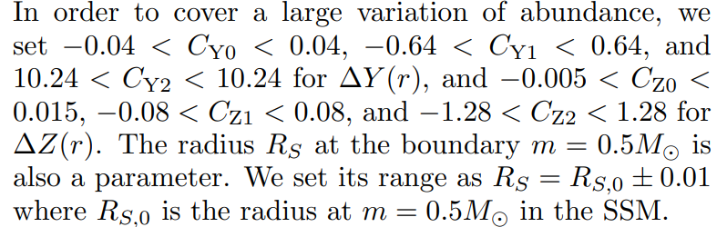
Solar core model: 1.5 million SCM models
In the solar core model, we assume
abundance for elements in the pp chain is in equilibrium, and
that of elements in CNO cycle is obtained by evolution equations
Then the structure of solar core will be determined.
Input physics involved in the SCMs:
equation of state (EOS), opacity, and nuclear burning rates.
We consider all possible variations of the abundance profiles in the solar core to investigate all possible structure variations of solar core.
We generate 1.5 million SCM models, by randomly scanning all parameters in abundance profiles, input physics and R_{S}

Slide 15

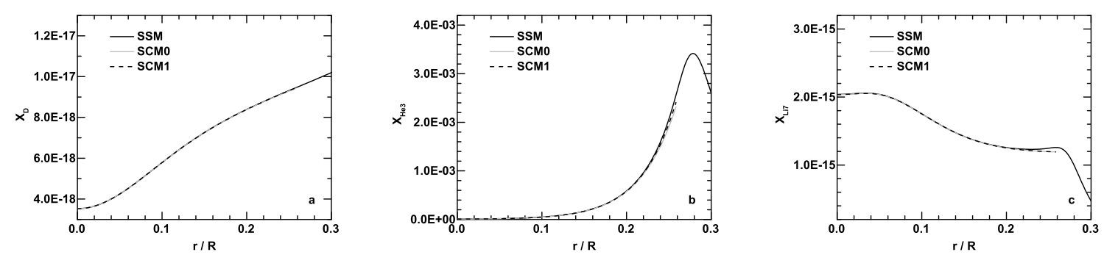
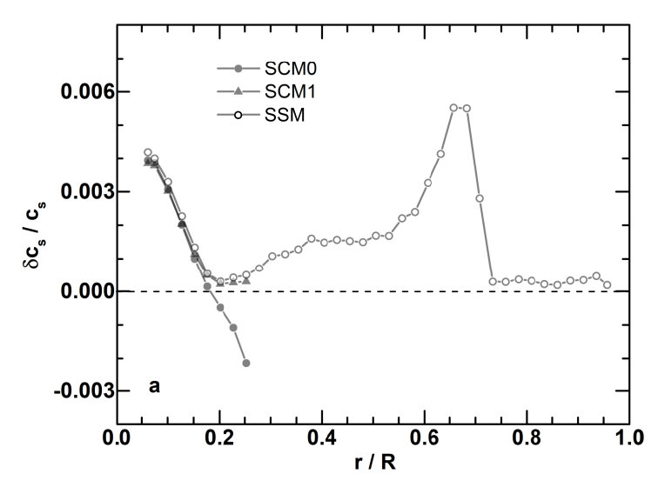
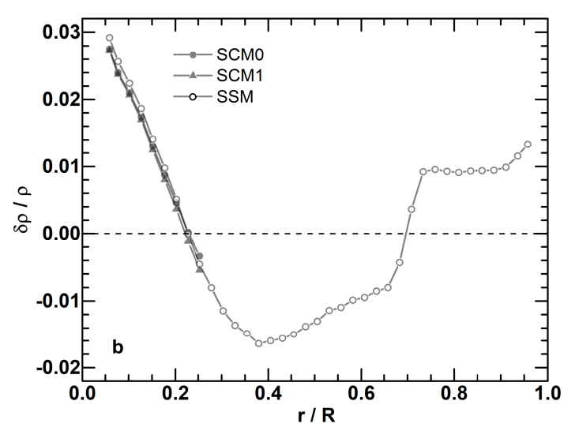
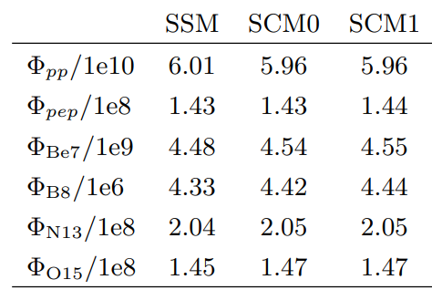
Solar core model: validation
Before looking into the distributions of these 1.5 M SCMs, one needs to prove the validation of this method.
SCM0: the same input physics and abundance profile as SSM.
SCM1: all the same but

Slide 16
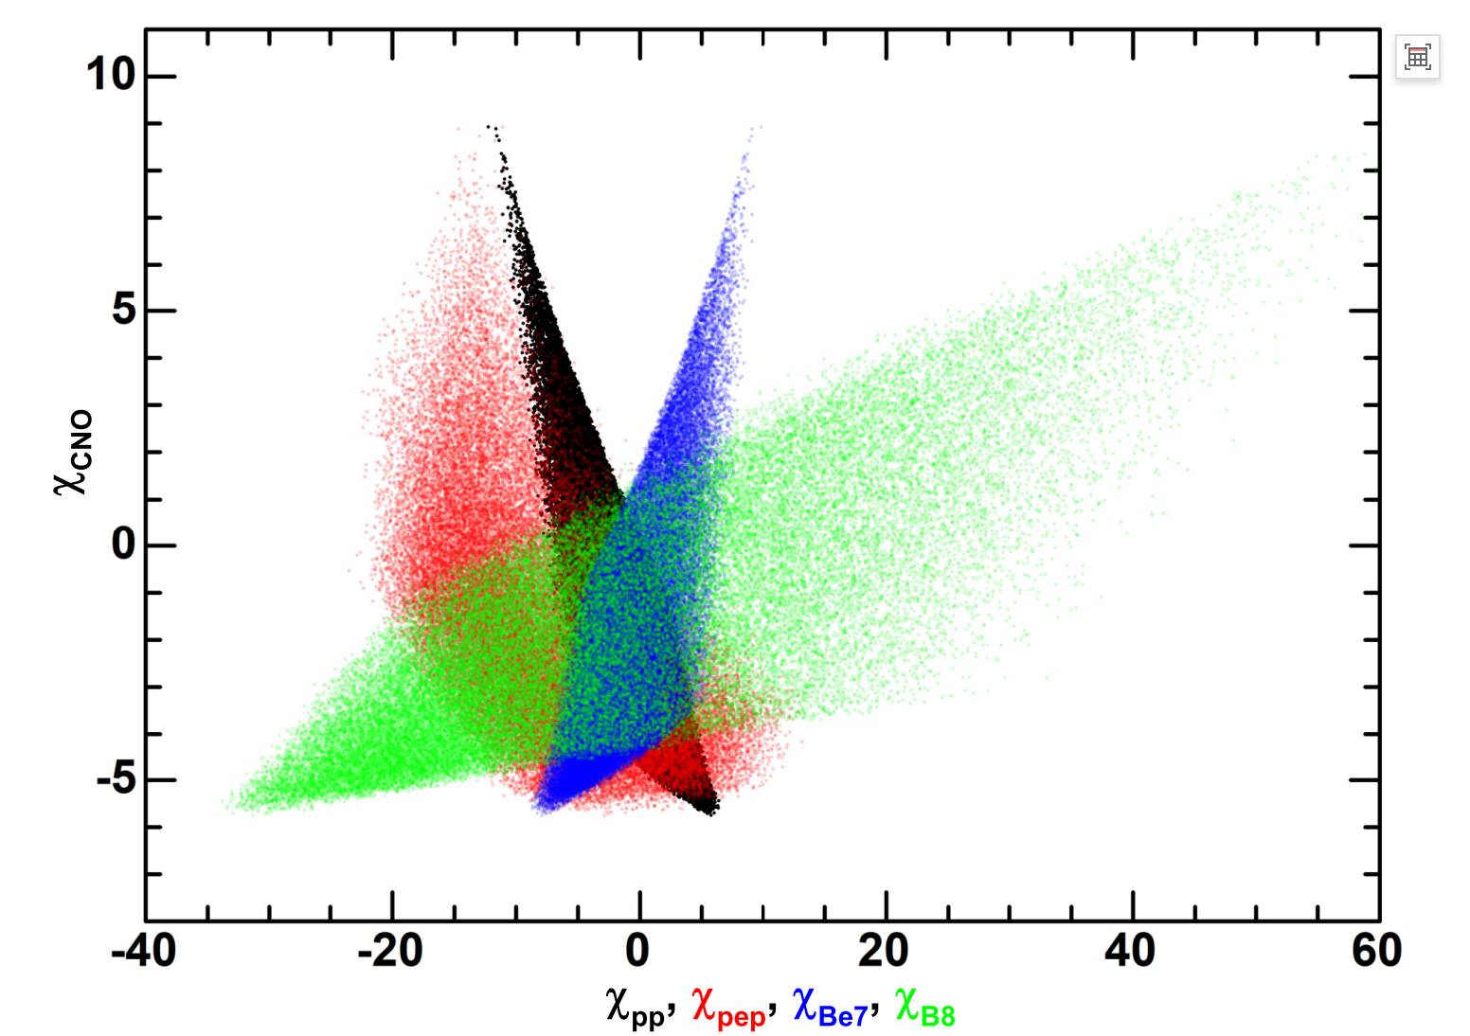
Solar core model: neutrino flux correlation
Strong correlation of different neutrino fluxes because of different temperature dependence in the solar core.
χ is the standard deviation of flux prediction v.s. data

Slide 17
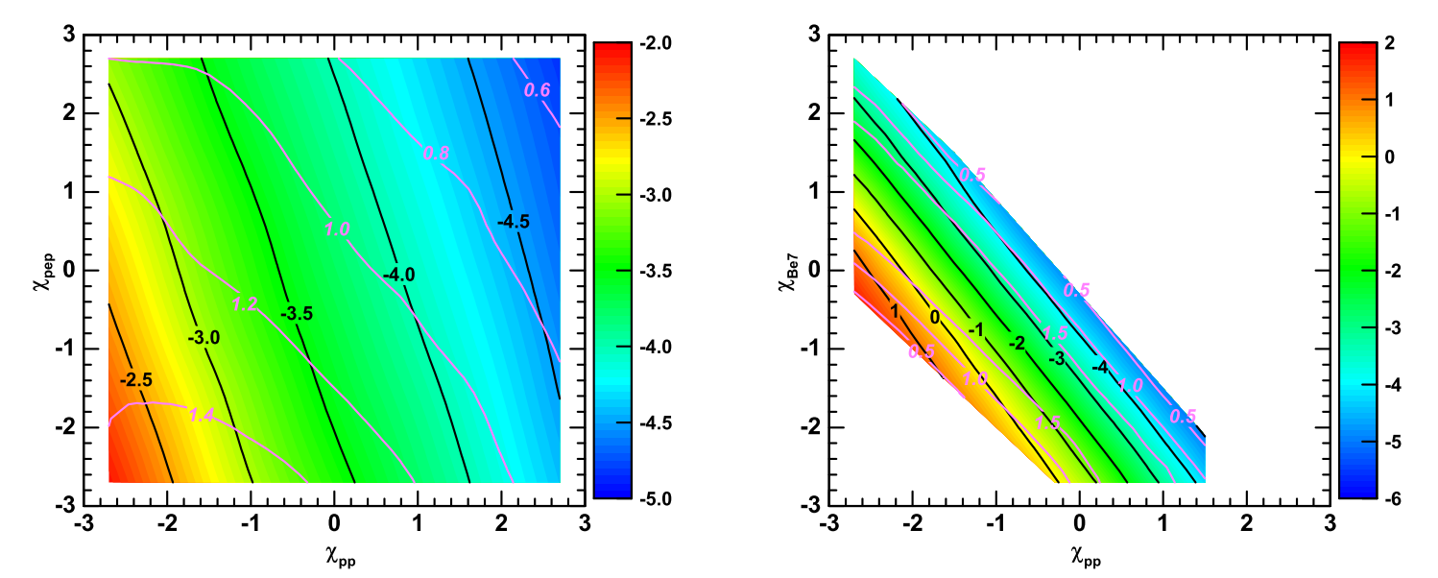
Solar core model: internal inconsistency
3D correlation of solar neutrino fluxes: CNO flux as the 3rd axis
Black and pink iso-curves are the average and dispersion Χcno
i.e., left corner (left plot): minimal CNO deviation: (-2.5+1.4)σ
CNO v.s. all six pairs of (pp, pep, Be7 & B8):
No model is found within 1σ of CNO flux, and 3σ of other fluxes

Slide 18
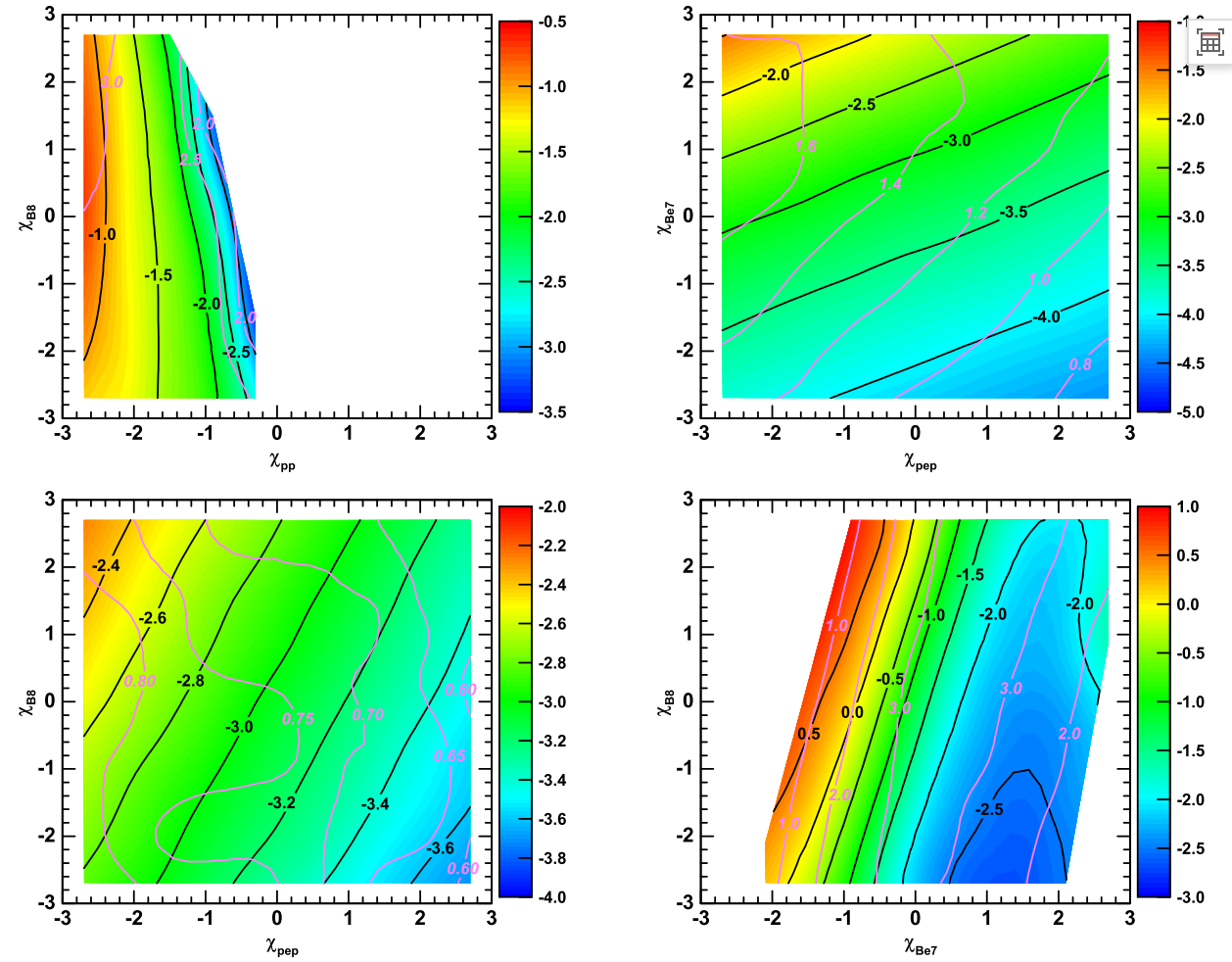
Solar core model: internal inconsistency

Slide 19
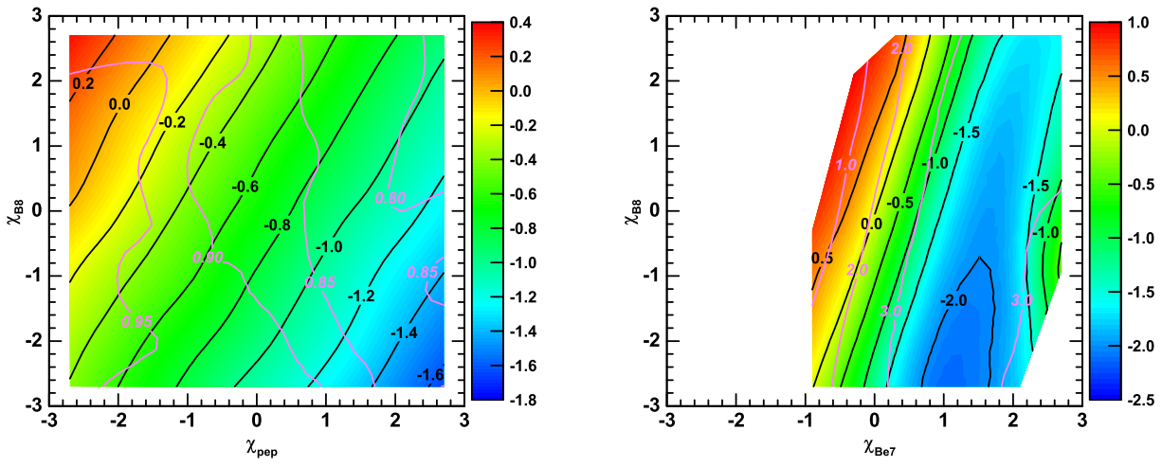
Solar core model: the role of opacity
Opacity is reduced by 20%
Better agreement between CNO flux and other neutrino fluxes
Opacity , core temperature , in order to maintain B8 & pep fluxes, metallicity ，CNO flux (10^{-0.06} ~ 13% is needed)
Underestimation or overestimation of opacity ?

Slide 20
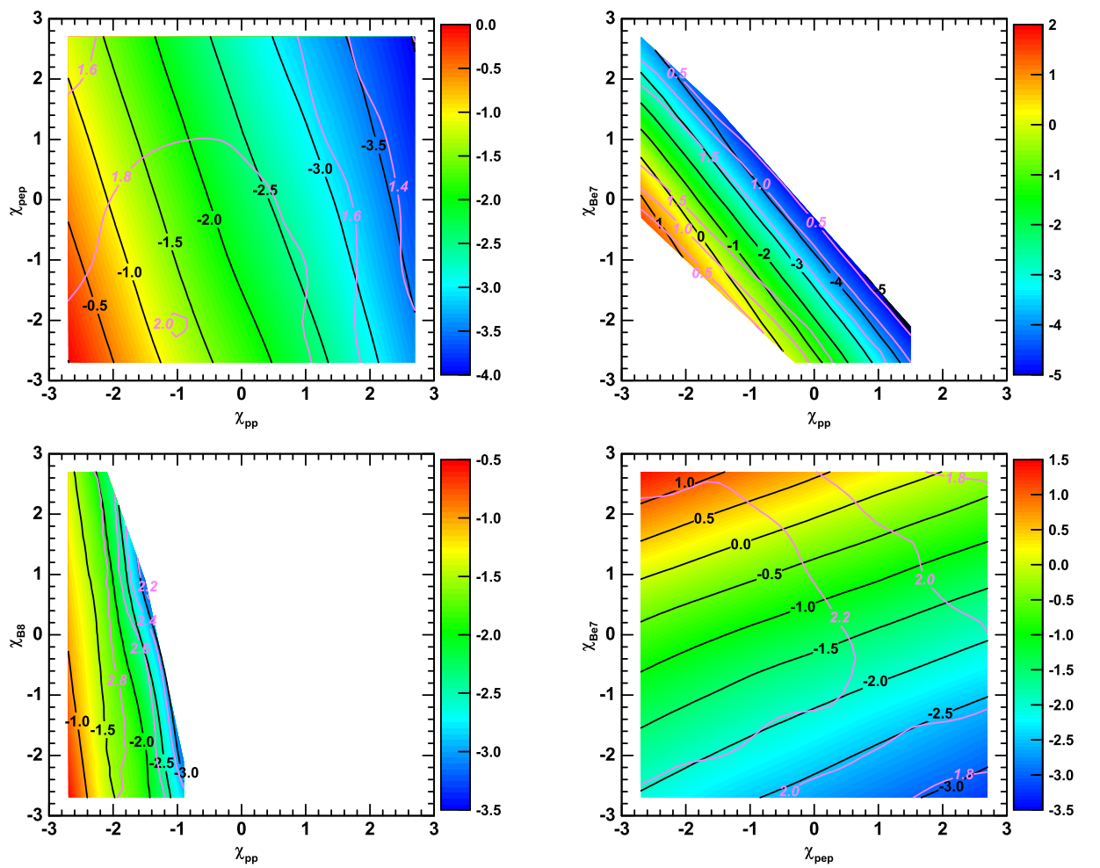
Solar core model: the role of opacity

Slide 21
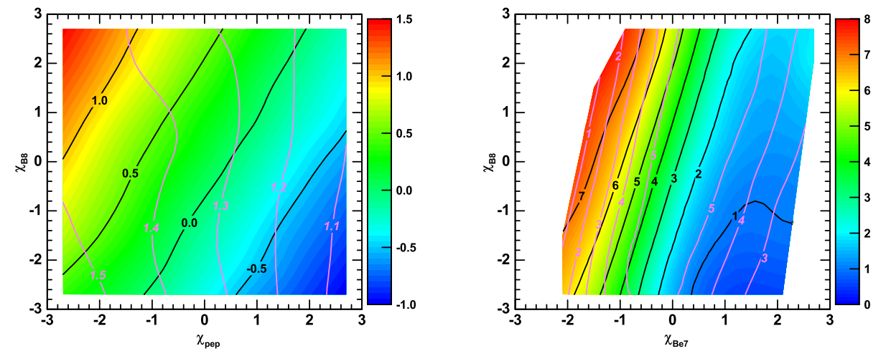
Solar core model: the role of N14 proton capture reaction
N14 proton capture reaction is increased by 100%
Better agreement between CNO flux and other neutrino fluxes
N14 reaction is the slowest in CNO cycle (others in equilibrium), and determine the reactor rate. (an increase of 26% is needed)
Current experimental uncertainty at level of ~10%

Slide 22
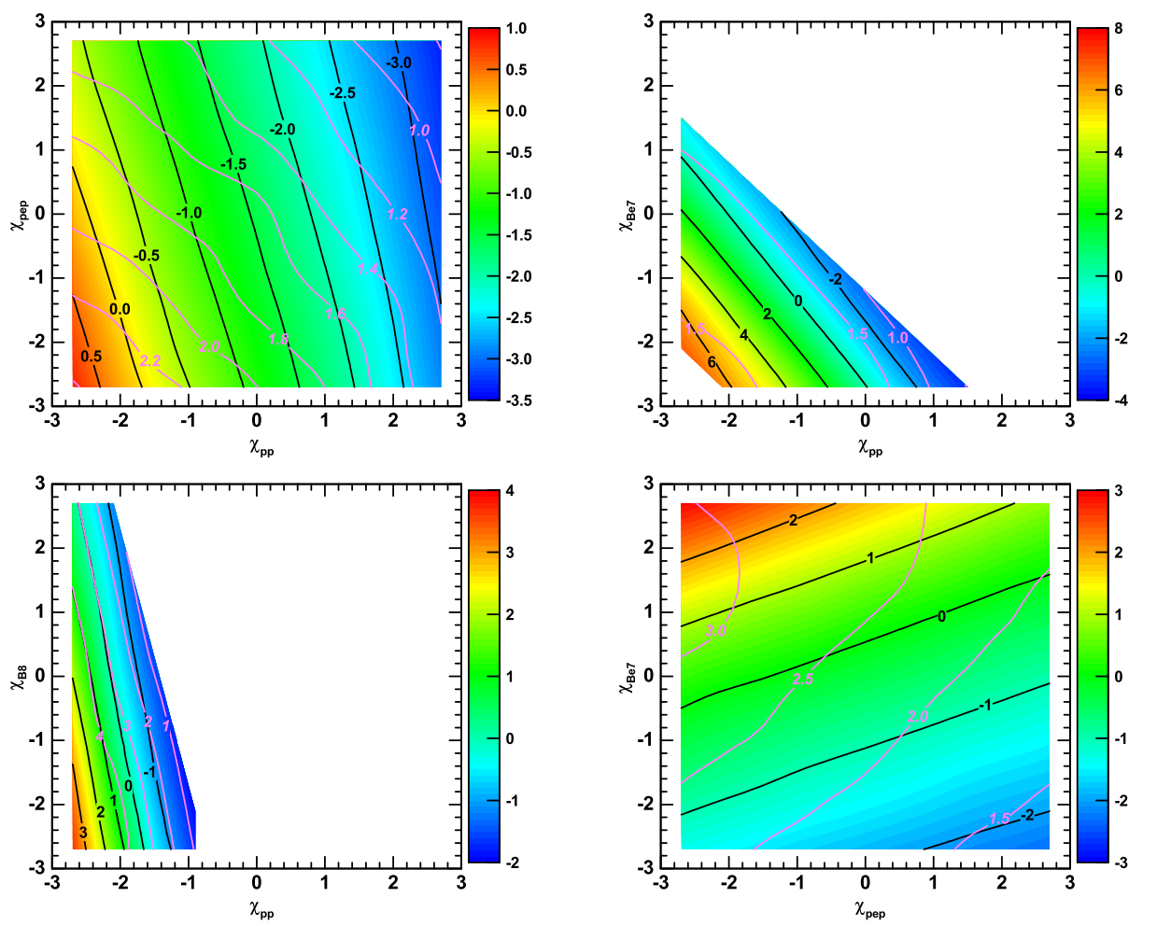
Solar core model: the role of N14 proton capture reaction

Slide 23
Concluding remarks
Current Standard Solar Model meets the metallicity (abundance) problem
High Z and low Z surface abundance contradiction
SSM with low Z v.s. sound speed and CNO flux
We introduce our construction of Solar Core Model, which only deal with solar neutrino fluxes, but irrelevant to surface abundance and helioseismology data.
We observed that high CNO flux from borexino is already not consistent with other solar neutrino flux observation, because of the intrinsic correlation from temperature profile.
Reduction of opacity and increase of the N14 proton capture reaction rate may reconcile the discrepancy.
Future outlook:
the best solution should include multiple factors of solar core physics
Thank you!

Slide 24
EXTRAS

Slide 25
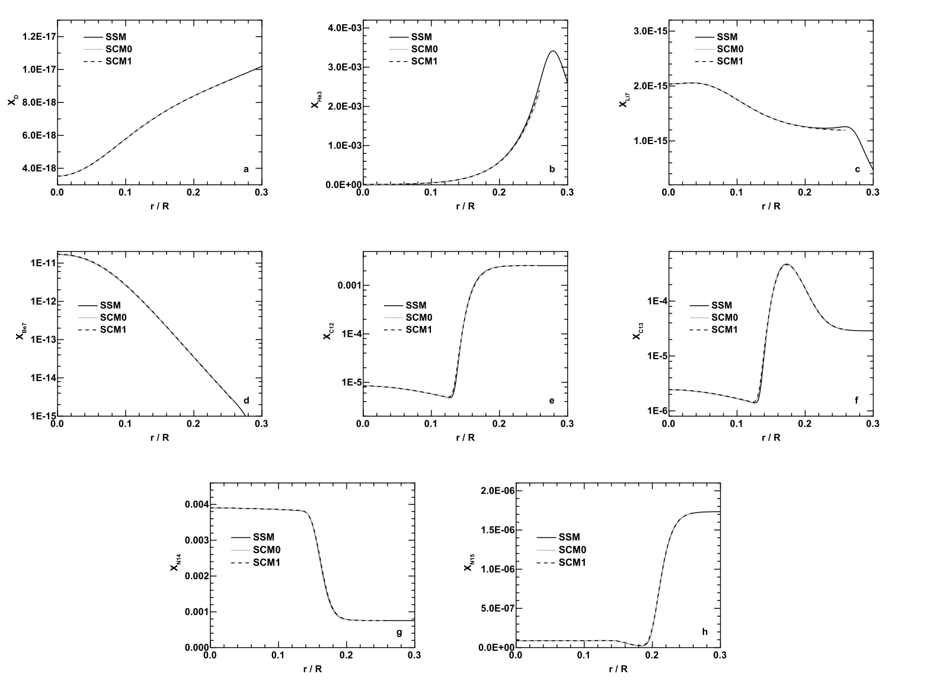

Slide 26
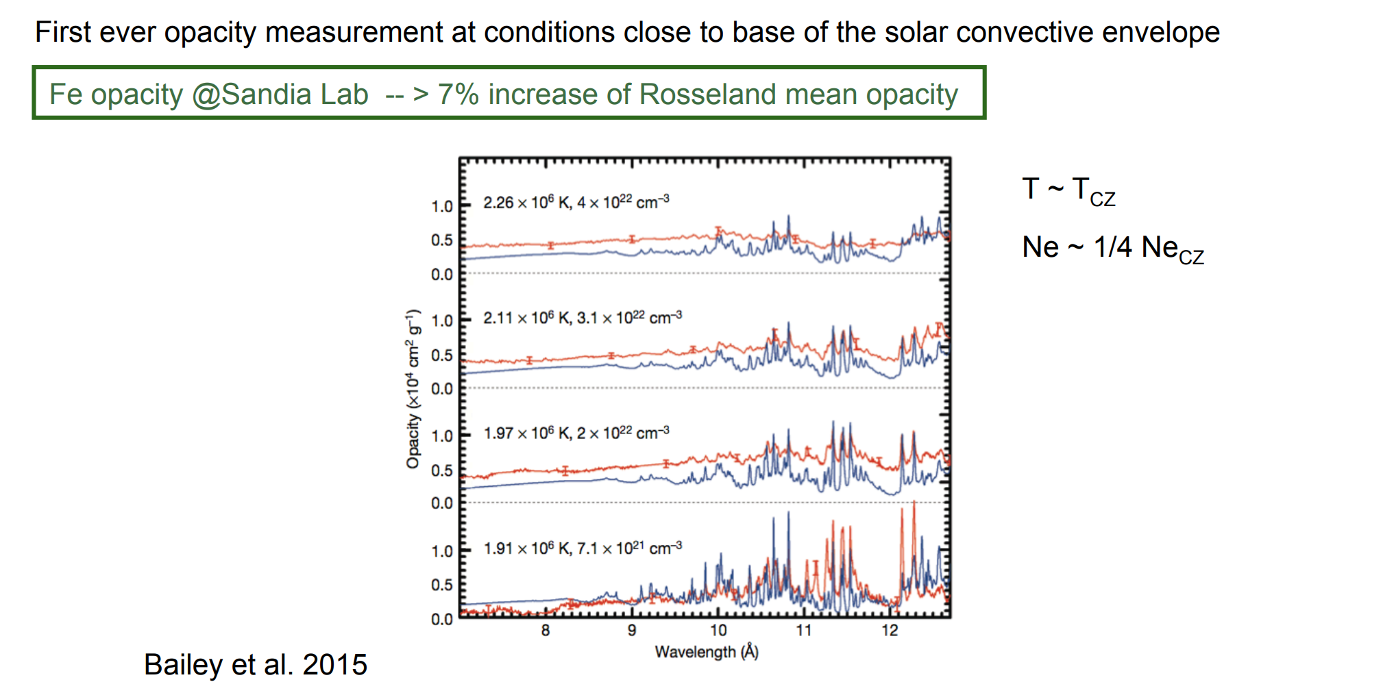
Opacity

Slide 27
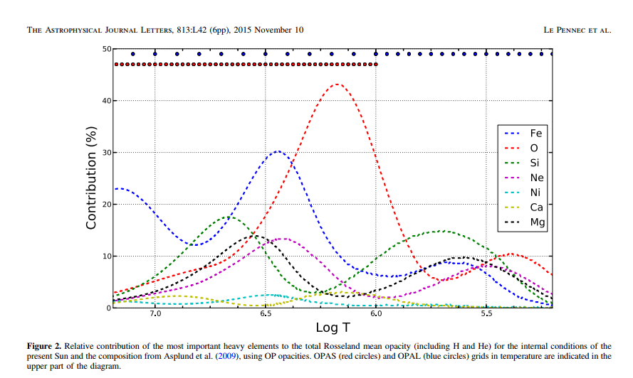
Opacity

