Slide 1

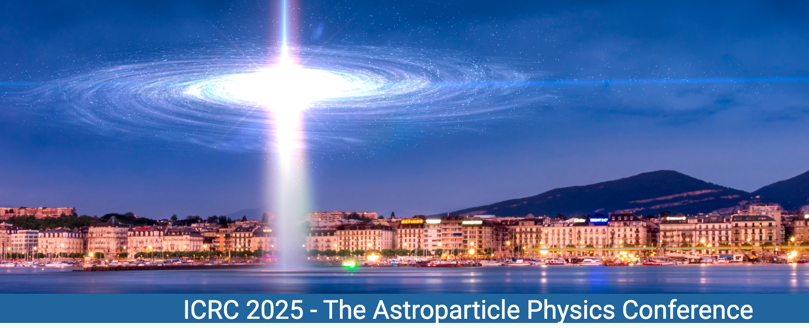

Implications of late-time XRT detected GRBs for particle acceleration
Zhi-Qiu Huang (SISSA)
Annalisa Celotti (SISSA)
Om Sharan Salafia (INAF)
Lara Nava (INAF)
Giancarlo Ghirlanda (INAF)
funded by the European Union – NextGenerationEU
PRIN Project code 202298J7KT

Slide 2
Relativistic shocks in GRB afterglows
A relativistic shock
would propagate
into the ambient
medium and accelerate
electrons.
Credit: Astrobites

Slide 3
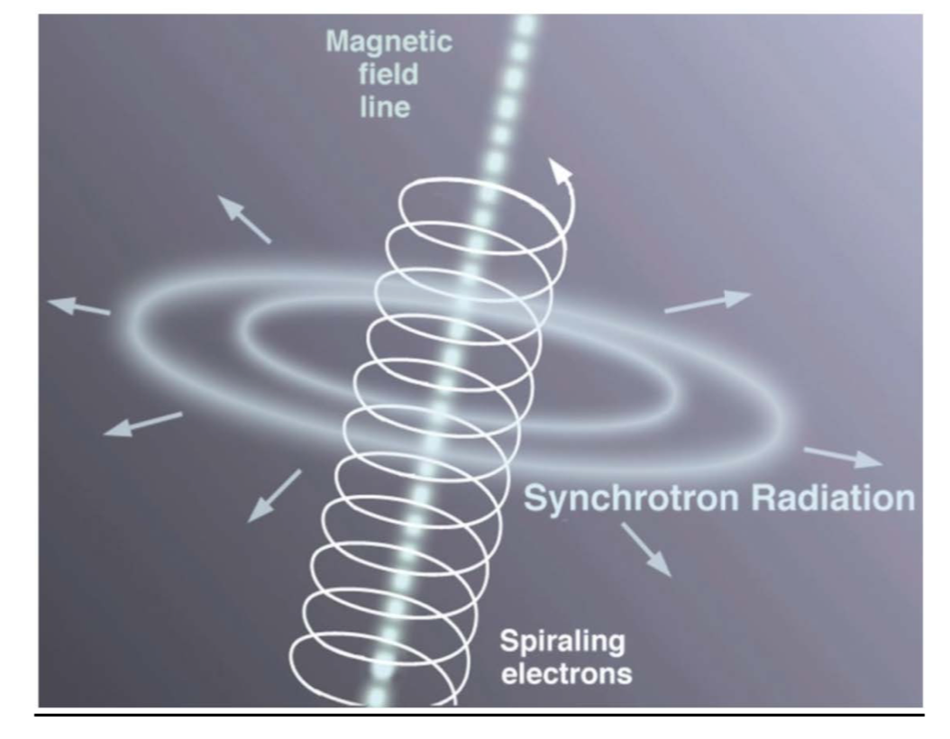
Radiative processes
Synchrotron
SSC
Credit: Jon Lomberg/Gemini Observatory
Credit: Michael D Wright

Slide 4
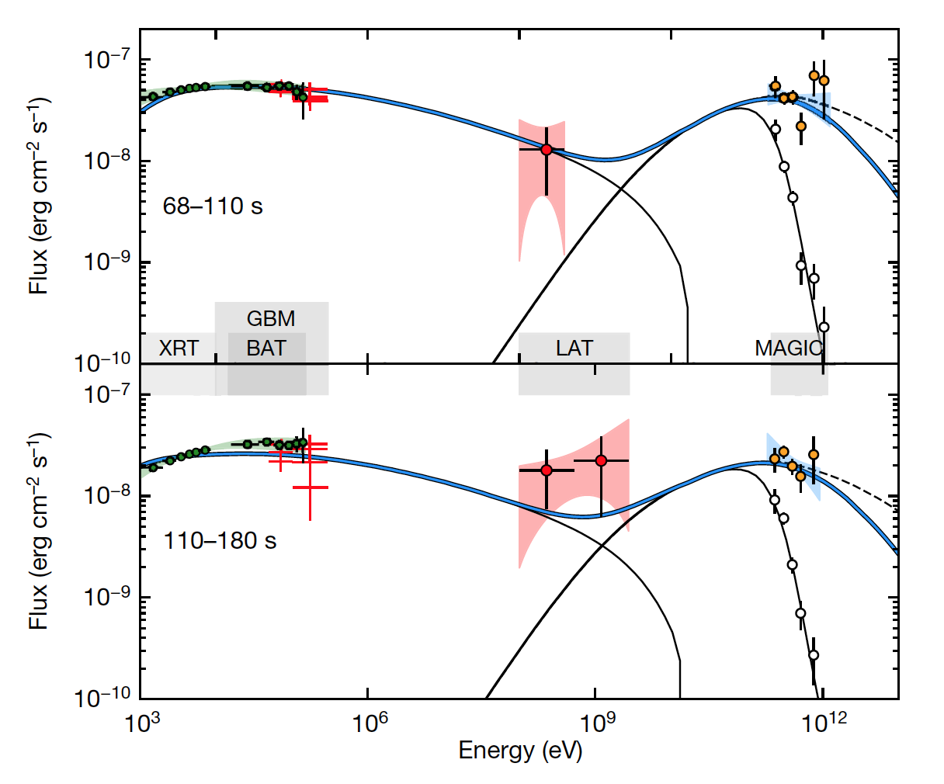
Afterglow spectrum
synchrotron
SSC
Synchrotron + SSC
Provides information on
the accelerated electrons,
i.e., the maximum energy
synchrotron
SSC
GRB 190114C
Credit: MAGIC Collaboration 2019

Slide 5
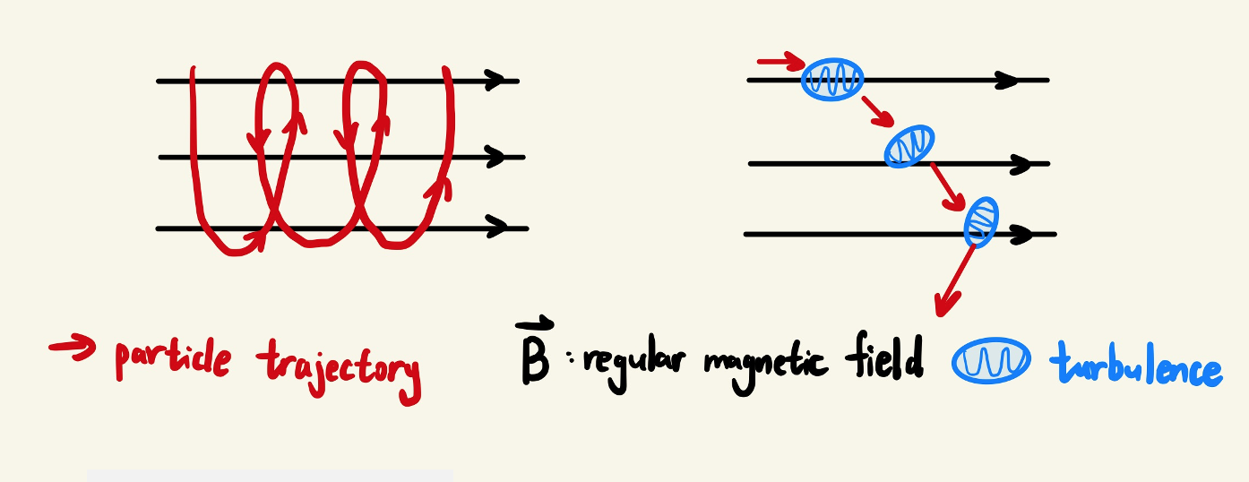
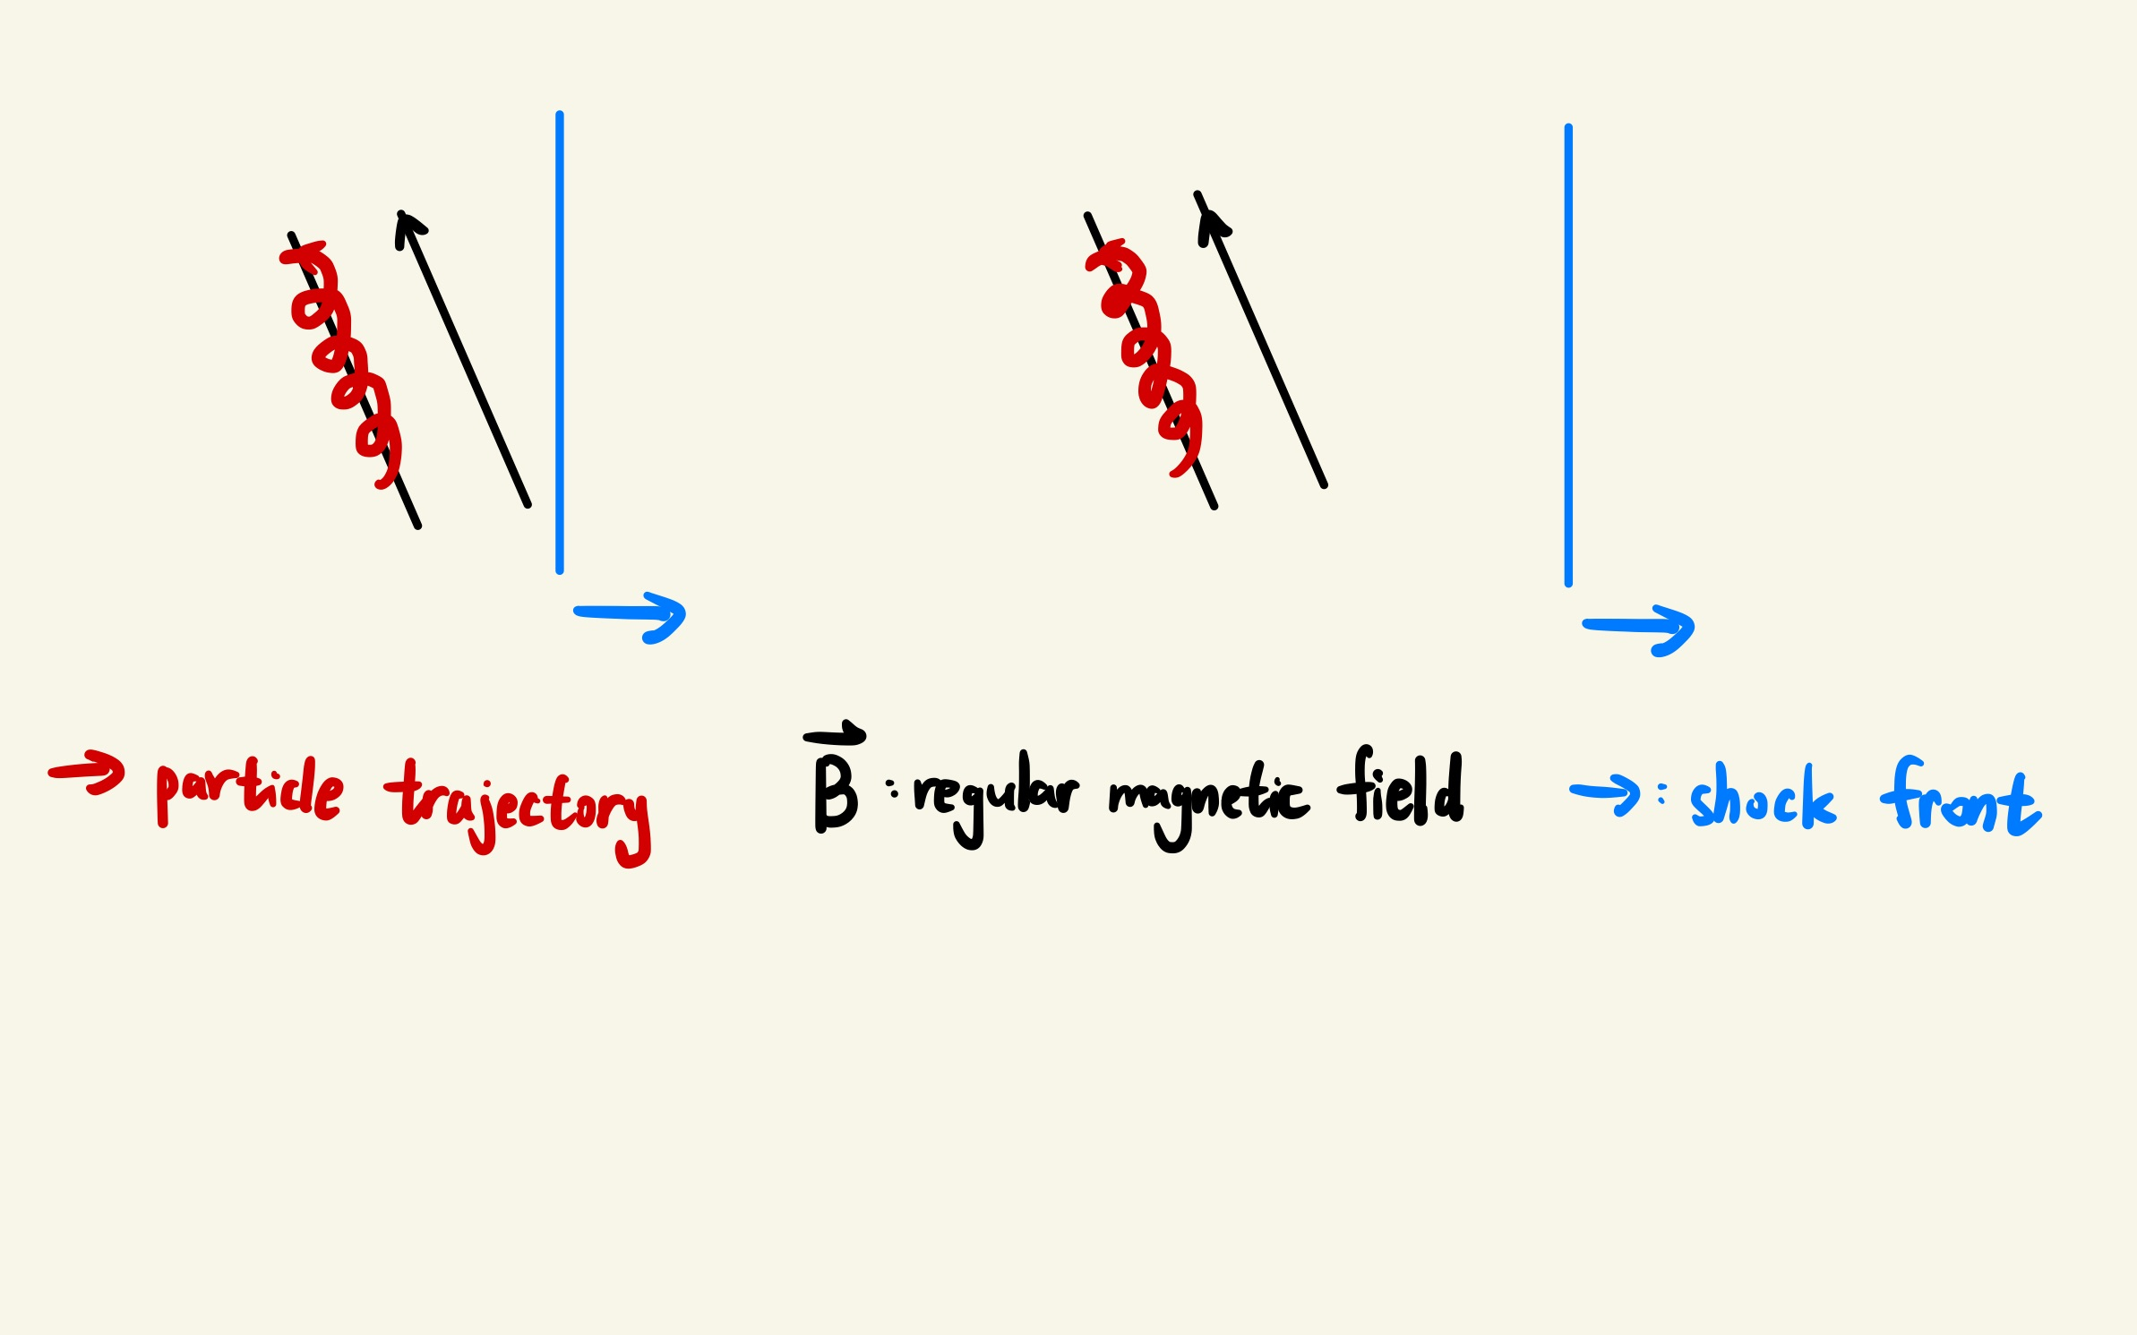

Particle trajectory at shocks
gyro-motion/regular deflection
Small-angle scattering
$$ν_{\text{sc}}< ω_{\text{g}}$$

Slide 6
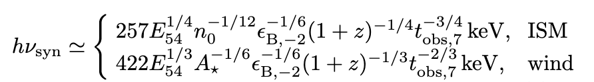
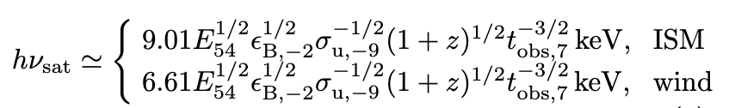
Maximum synchrotron photon energy
cooling limit: acceleration timescale = cooling timescale
saturation limit: particles downstream trapped by the regular field
Sironi et al. 2013

Slide 7
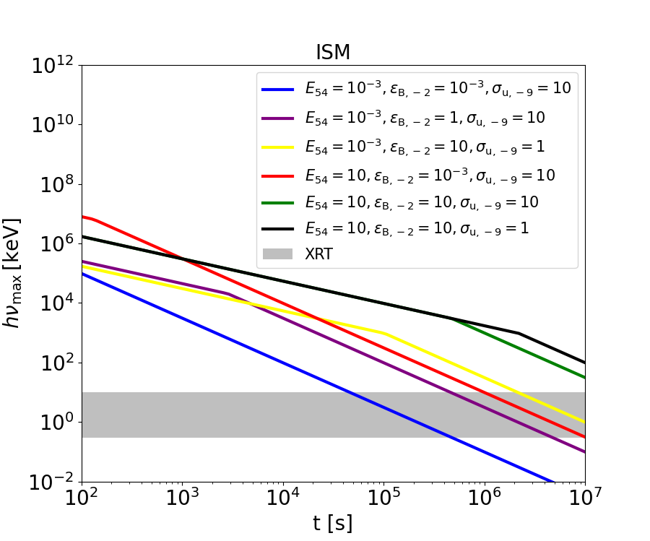
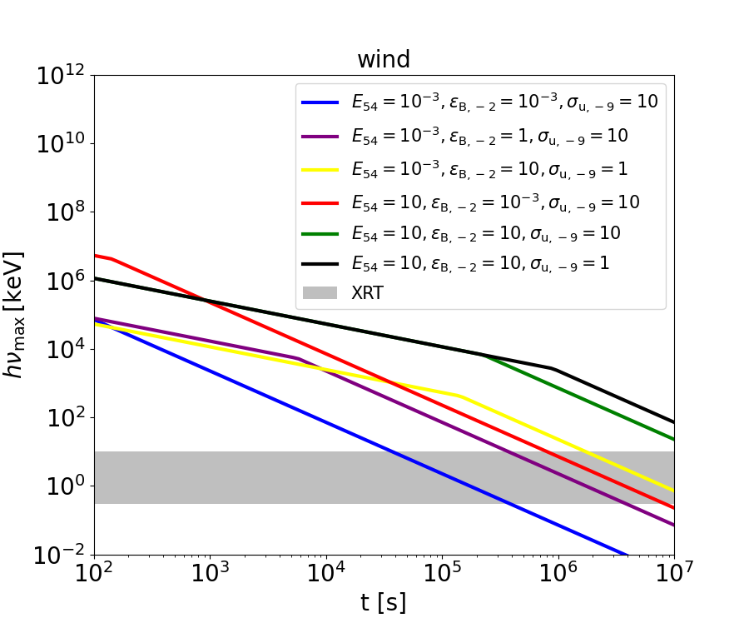




Maximum synchrotron photon energy
$$t^{−3/4}$$
$$t^{−2/3}$$
$$t^{−3/2}$$
$$t^{−3/2}$$
minimum of two photon energies

Slide 8
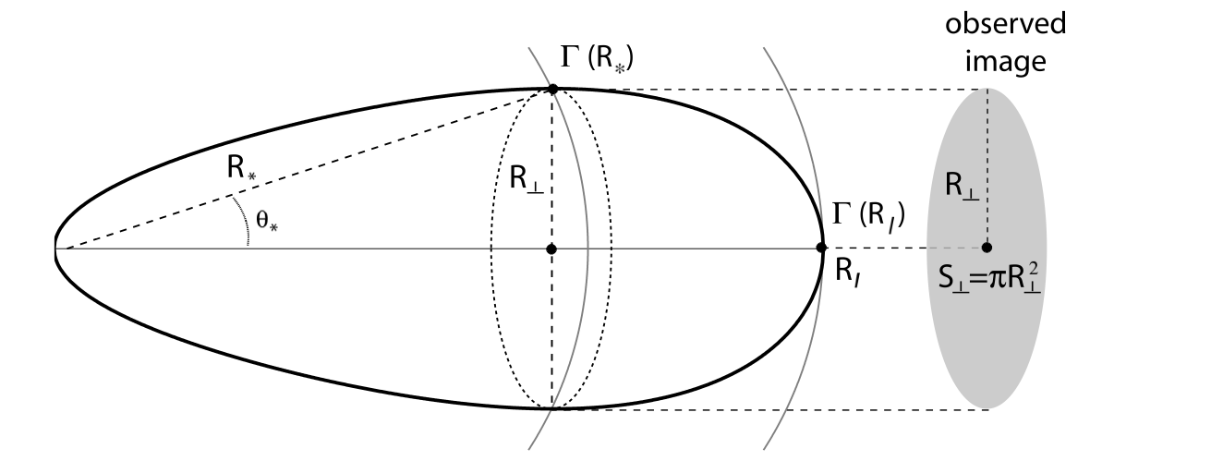
Equal arrival time surface
Schematic plot of EATS
Credit: Granot & Ramirez-Ruiz 2010

Slide 9
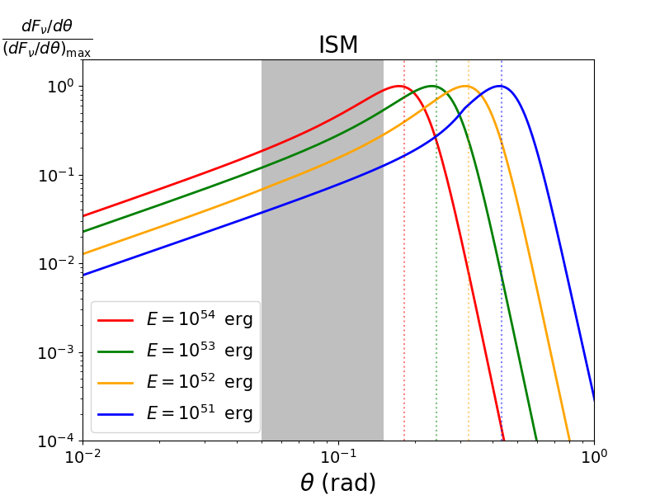
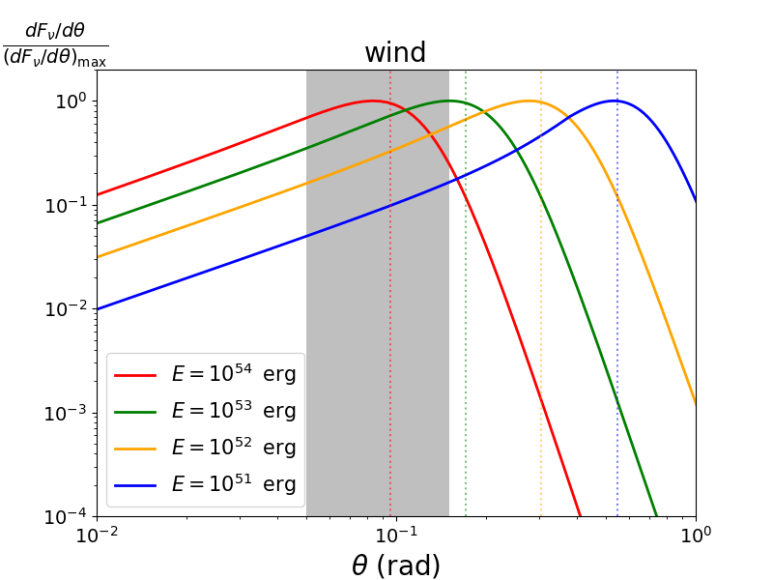
Emissions from high latitudes
θc
θc
Differential flux from different latitudes

Slide 10
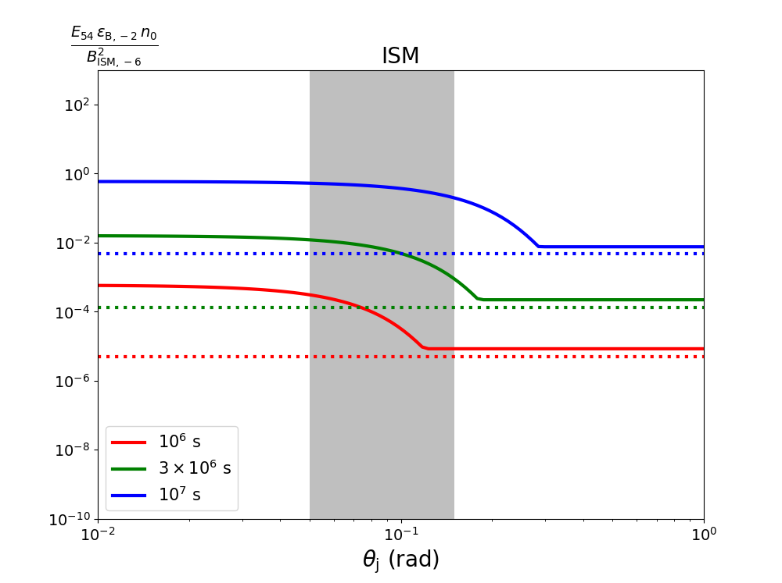
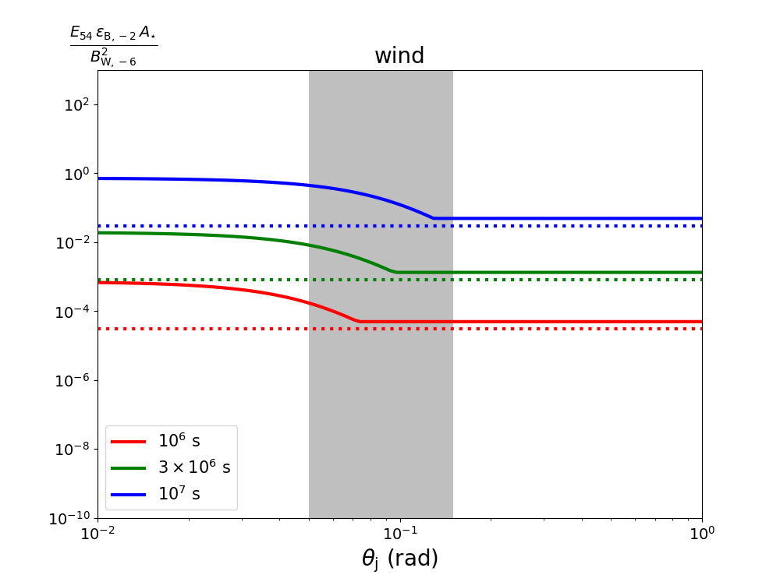
Photons from high latitude
Maximum photon energy (3 keV) from min[θj,θc]

Slide 11
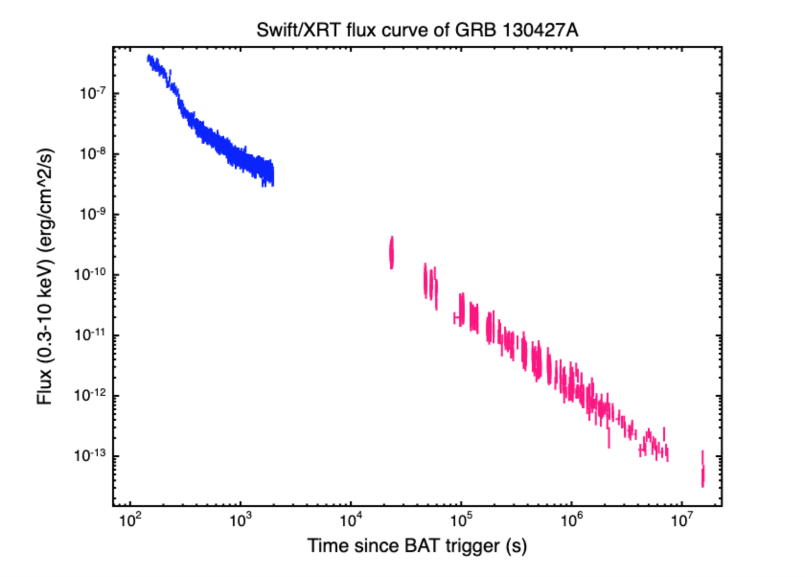
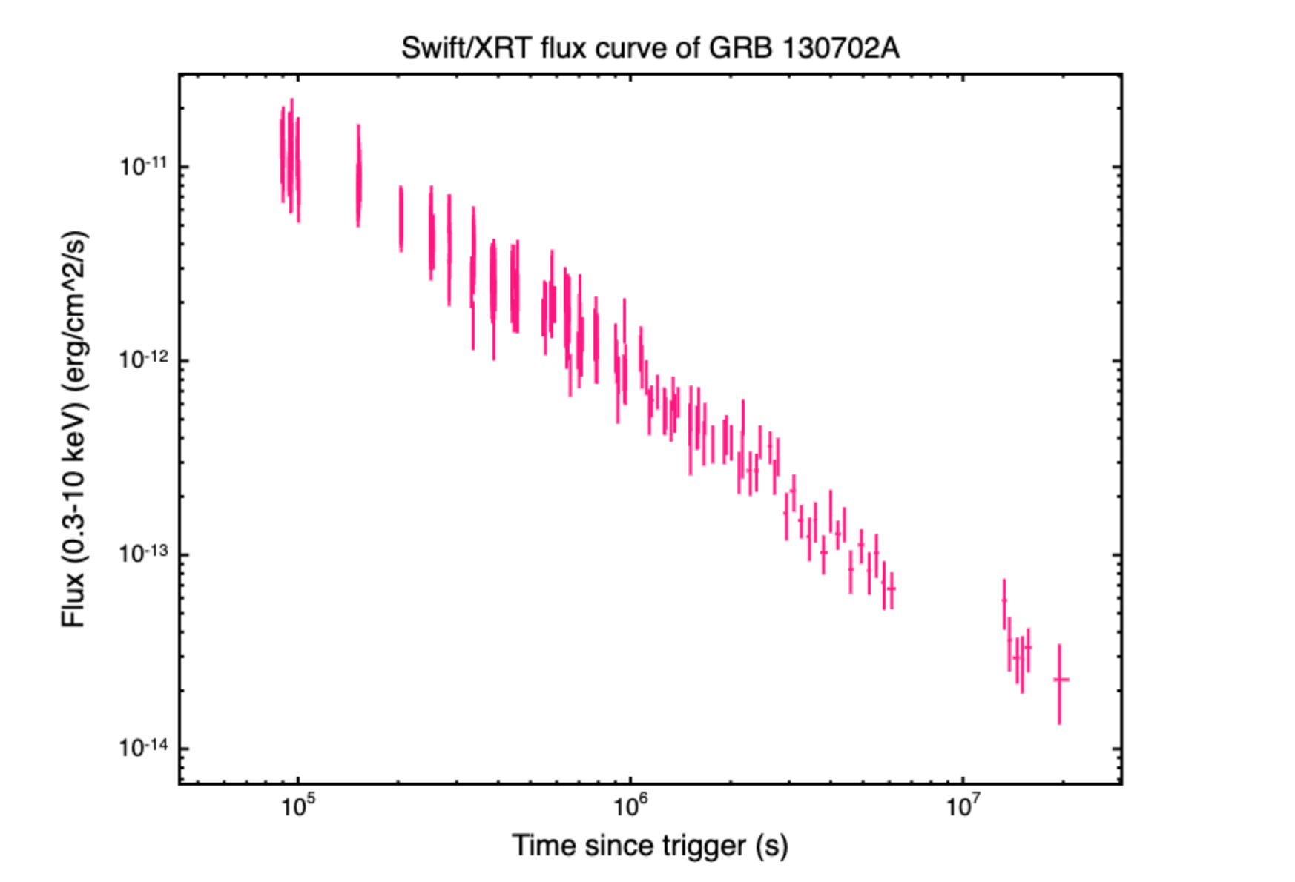
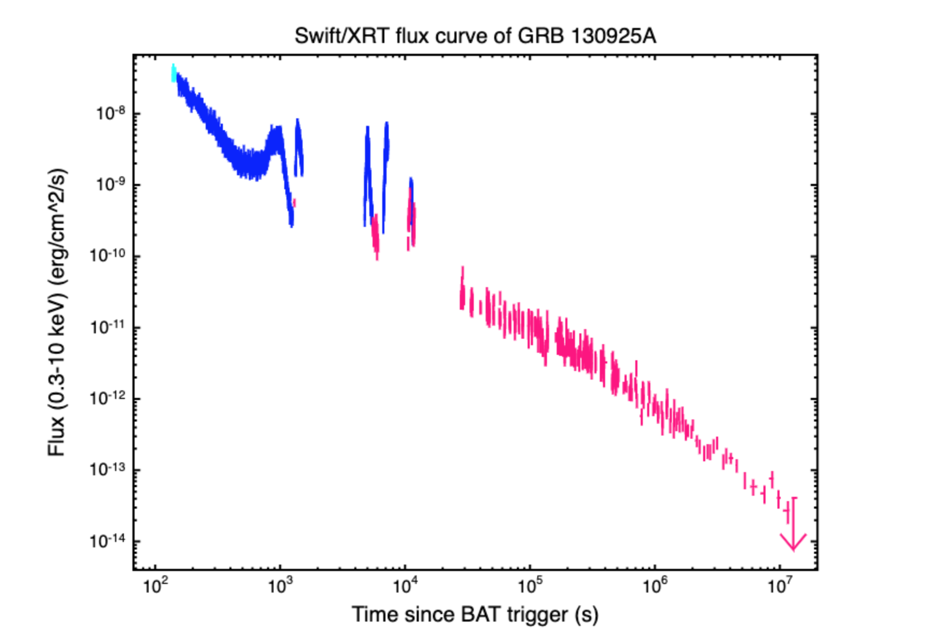
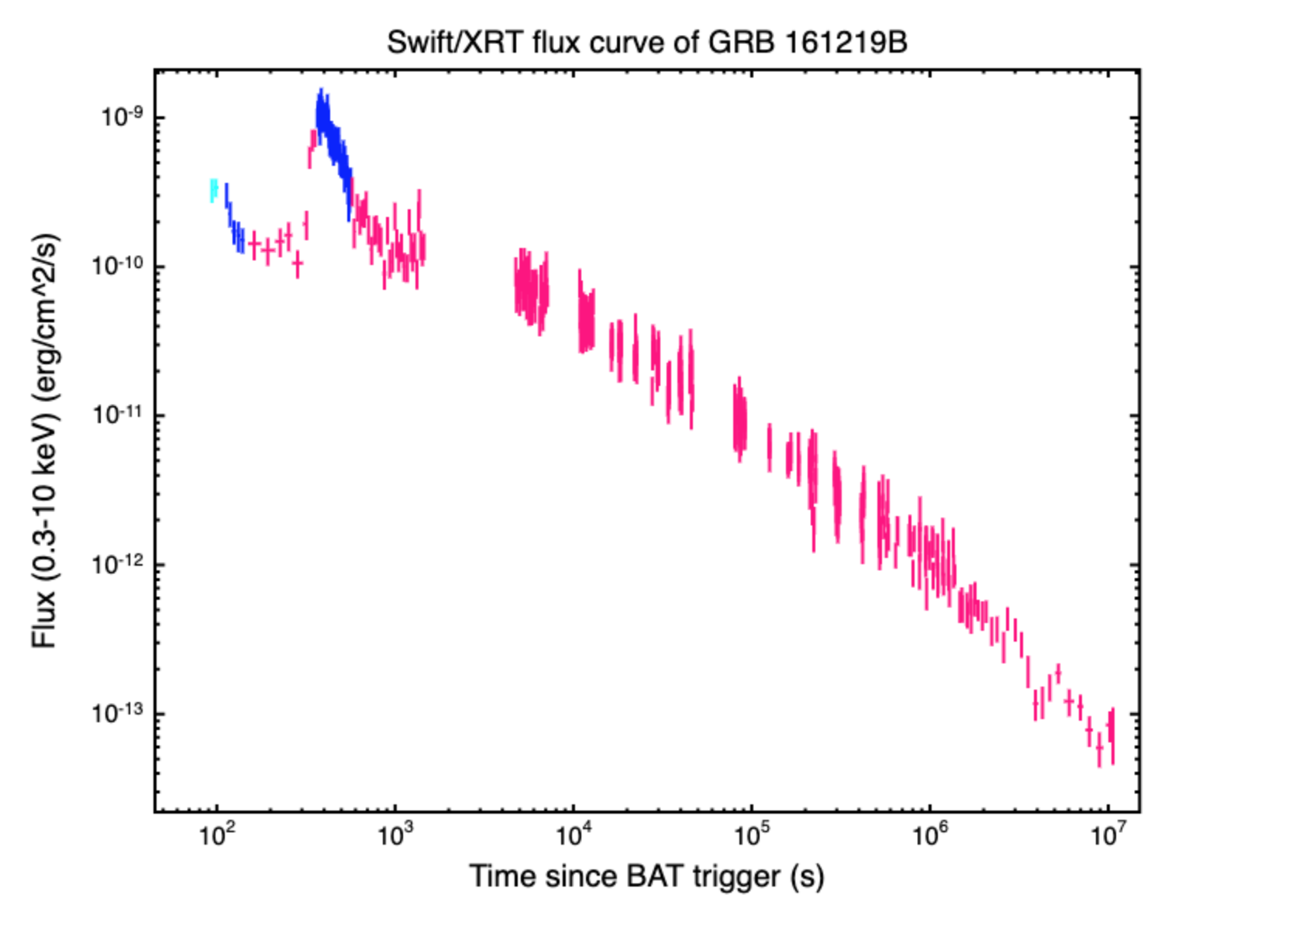
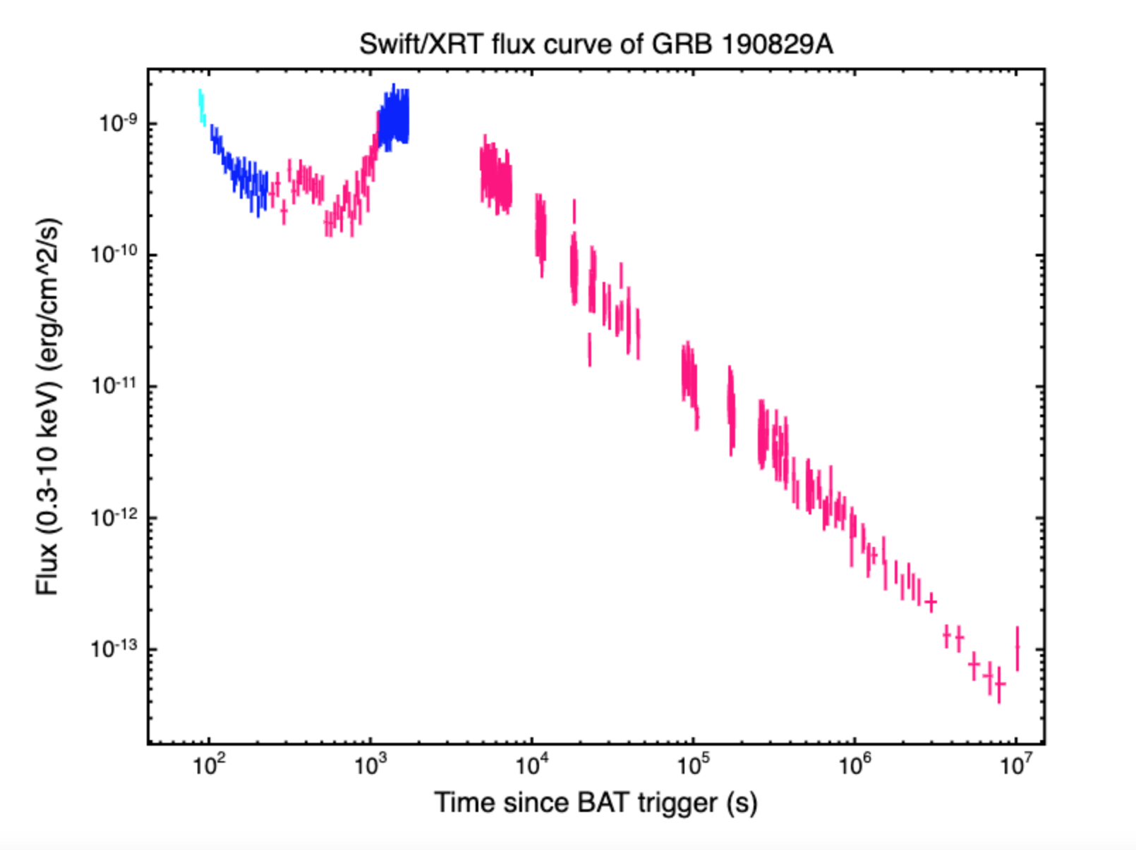
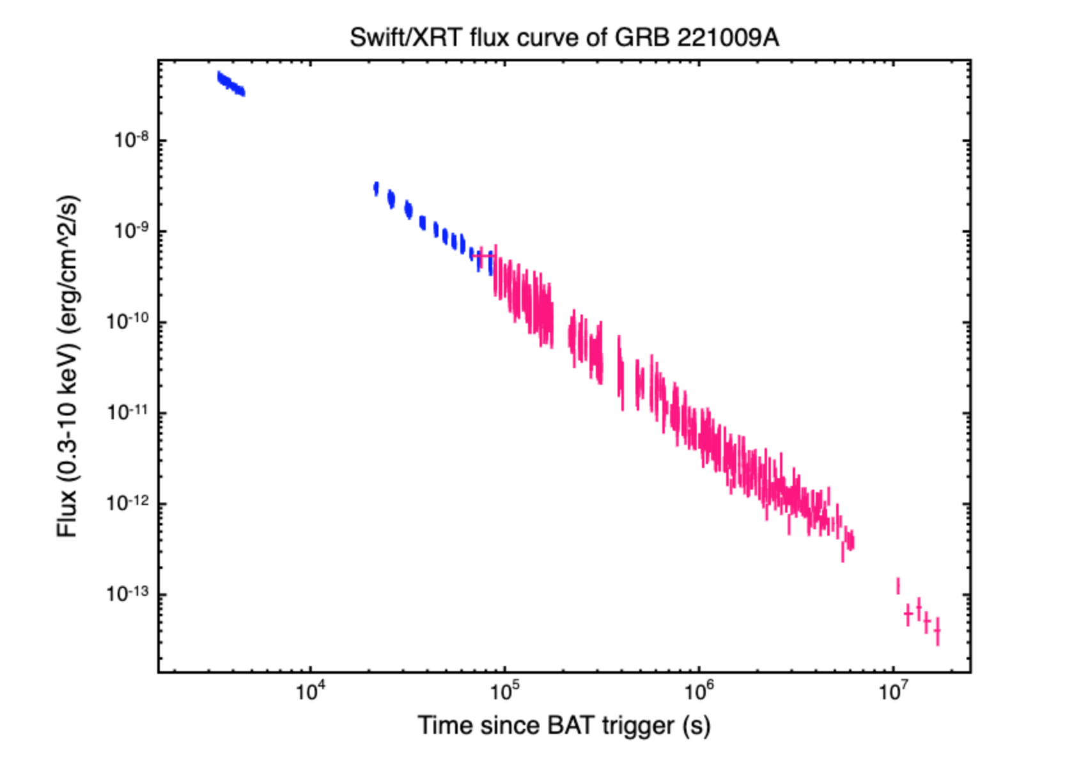
Constraints from observations
GRB 130427A
GRB 130702A
GRB 130925A
GRB 161219B
GRB 190829A
GRB 221009A
Lightcurves if 6 selected GRBs with XRT detections > 10^7 s and redshift

Slide 12
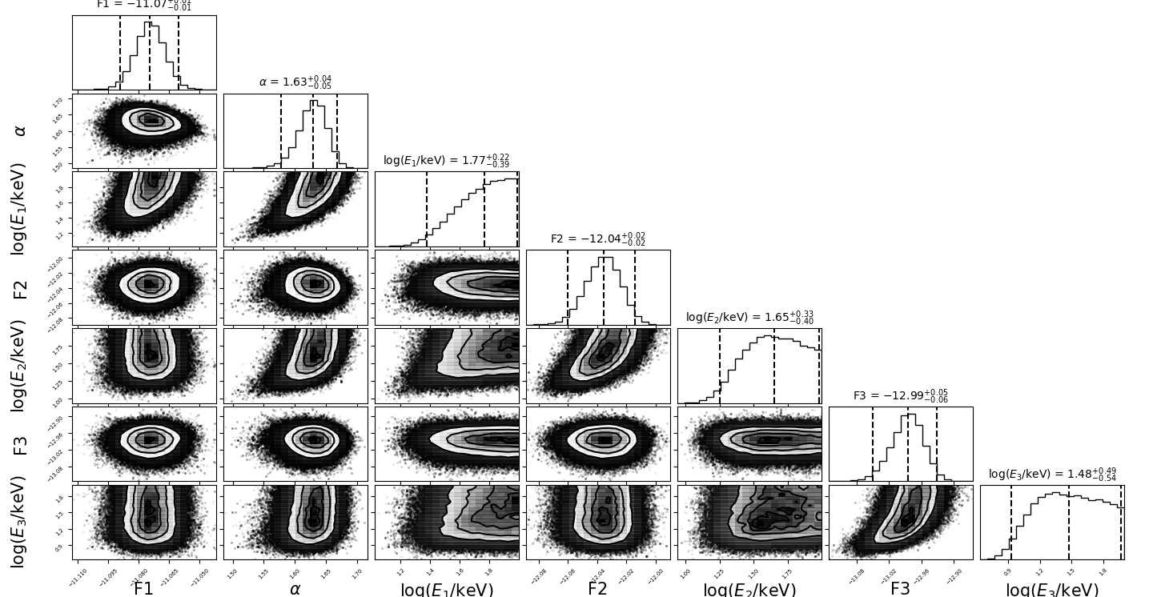
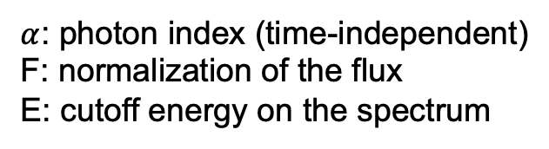
Constraints from observations
Xspec
$α$: photon index (time-independent)
F: normalization of the flux
E: cutoff energy on the spectrum
CPL model to fit spectra at different time intervals
MCMC corner plot for GRB 130427A

Slide 13
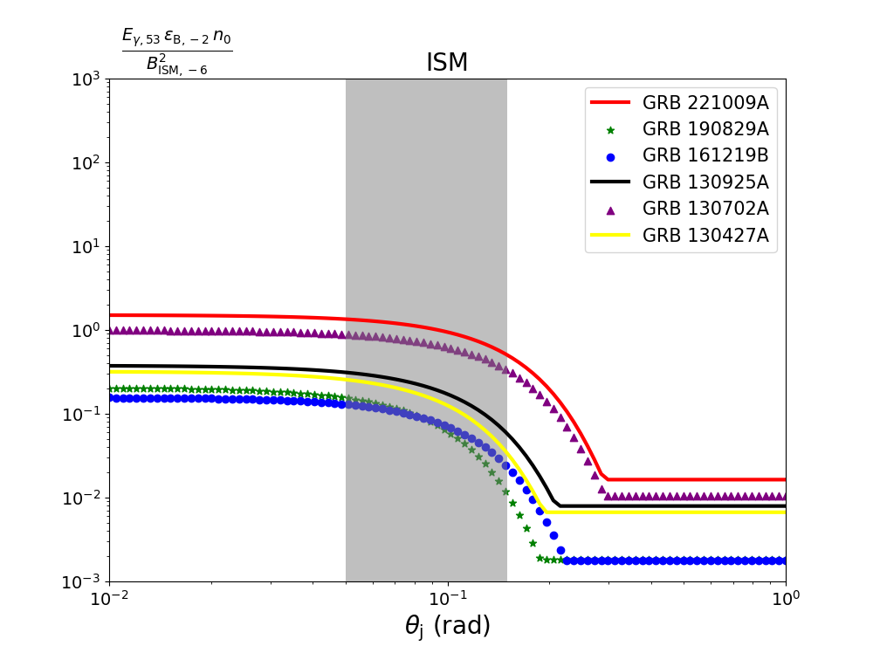
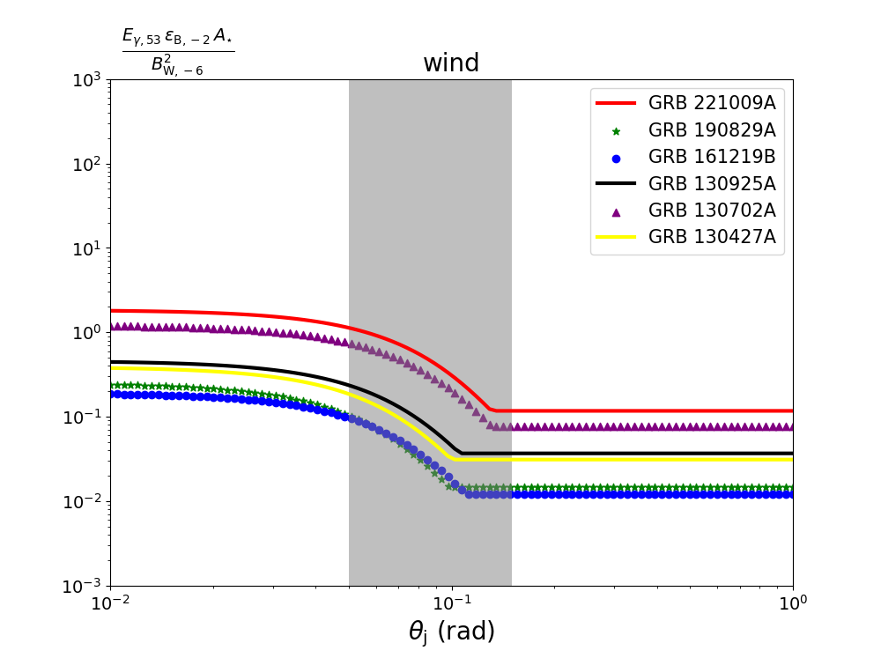

Constraints from observations
From constraints, $E_{γ}≈0.1 E_{sh}≳{10}^{53}$erg
For GRB 190829A GRB 161219B and GRB 130702A
$E_{γ}<1×{10}^{51}$erg, $hν_{max}$ should be much smaller than what we observed

Slide 14
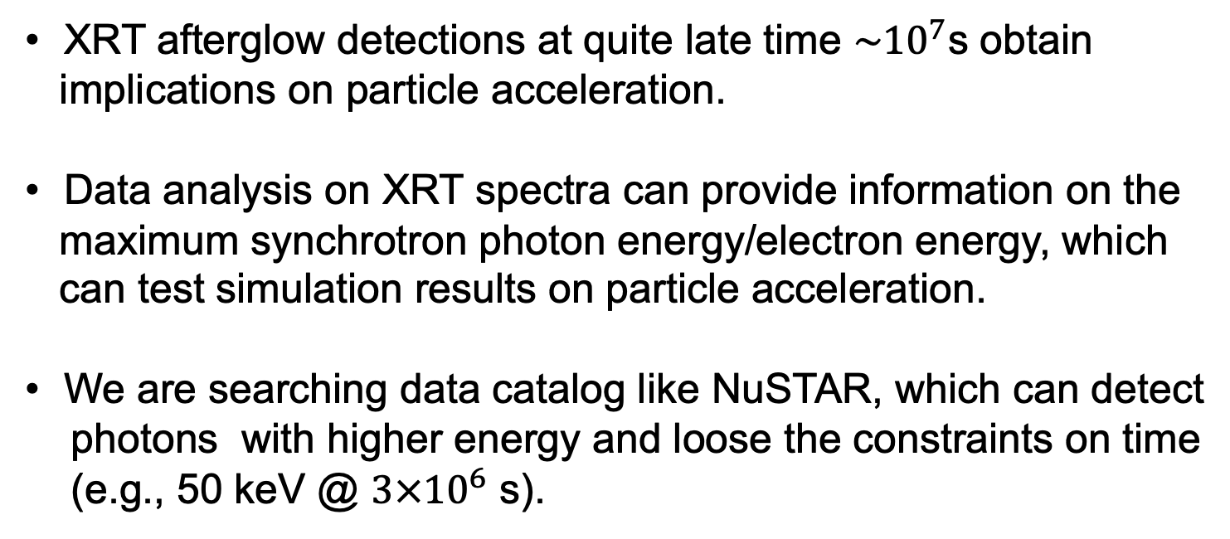
Conclusions
XRT afterglow detections at quite late time ${\sim 10}^{7}$s obtain
implications on particle acceleration.
Data analysis on XRT spectra can provide information on the
maximum synchrotron photon energy/electron energy, which
can test simulation results on particle acceleration.
We are searching data catalog like NuSTAR, which can detect
photons with higher energy and loose the constraints on time
(e.g., 50 keV @ $3×{10}^{6}$ s).

Slide 15
Thank you for your attendance.

Slide 16
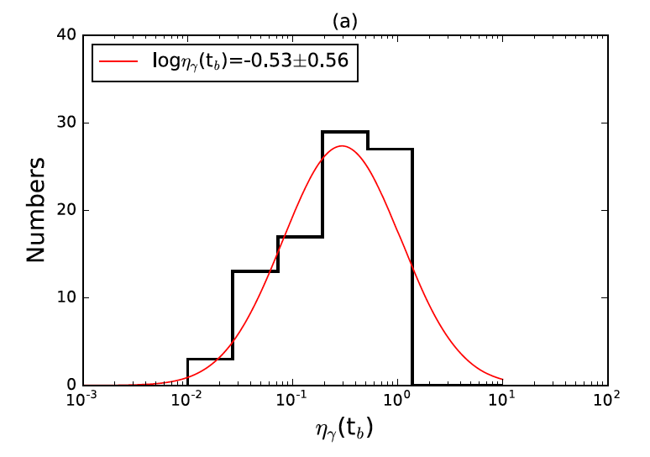

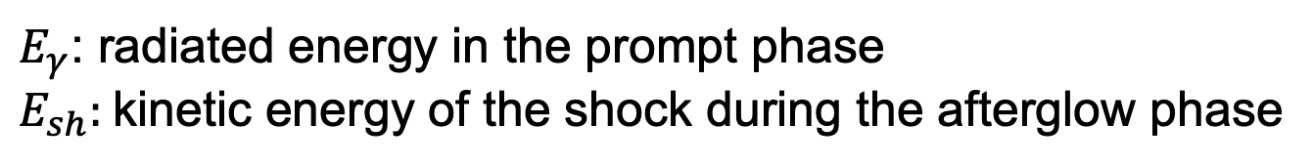
Radiative efficiency
$$η_{γ}= E_{γ}/(E_{γ}+E_{sh})$$
$E_{γ}$: radiated energy in the prompt phase
$E_{sh}:$kinetic energy of the shock during the afterglow phase
Li et al. 2018

Slide 17
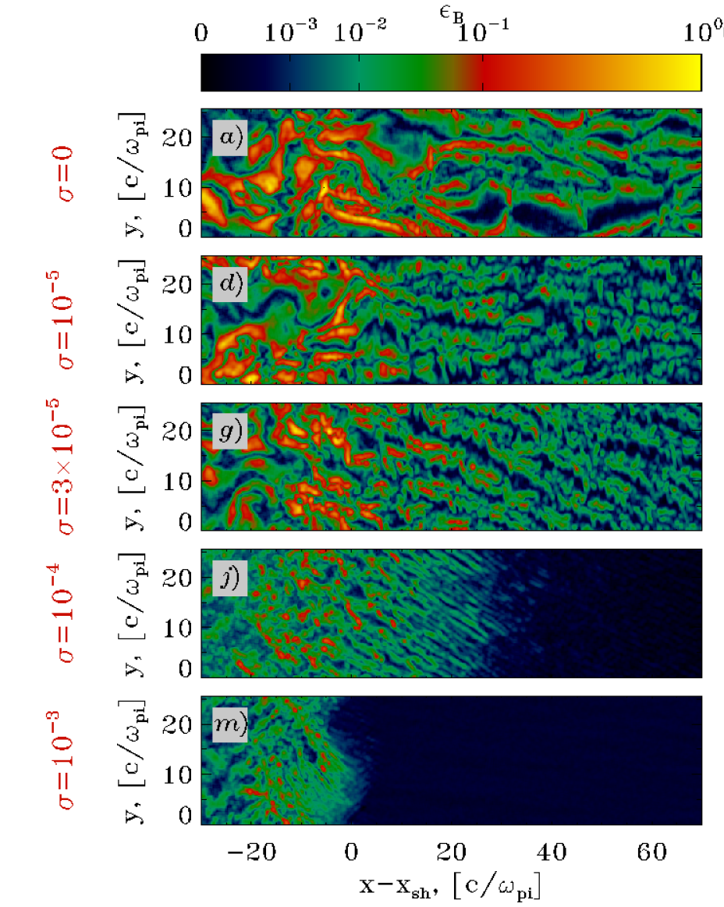
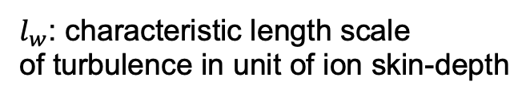
Magnetic energy distribution
$l_{w}$: characteristic length scale
of turbulence in unit of ion skin-depth

Slide 18
Model :cbabs*ztbabs*(cflux*cutoffpl)

