Slide 1

Time-Dependent Measurements of Absolute Spectra for Elements up to Fe by SuperTIGER as a Probe of Solar Modulation, Atmospheric and Geomagnetic Rigidity Effects
A.W. Labradorª, Scott Nutter^{e}, and Wolfgang Zober^{b} for the SuperTIGER/SuperTIGER2 Teams
ª California Institute of Technology, Pasadena, CA 91125 USA
b Washington University, St. Louis, MO 63130 USA
e Northern Kentucky University, Highland Heights, KY USA
* E-mail: labrador@srl.caltech.edu

Slide 2
The SuperTIGER/SuperTIGER2 Team
A.W. Labradorª, S. Nutter^{e}, Q. Abarr^{b}, Y. Akaike^{c}, W.R. Binns^{b}, R.G. Bose^{b}, T.J. Brandt^{c}, N. Cannady^{c}, P. Ghosh^{c,d}, T. Hams^{c,d}, M.H. Israel^{b}, L. Lisalda^{b}, R.A. Mewaldtª, J.W. Mitchell^{c}, R.P. Murphy^{b}, N. Osborn^{b}, B.F. Rauch^{b}, K. Sakai^{c,d}, M. Sasaki^{c,d}, E.C. Stoneª, C.J. Waddington^{f}, N.E. Walsh^{b}, J.E. Ward^{b}, A. West^{b}, M.E. Wiedenbeck^{g}, and W. Zober^{b}
a California Institute of Technology, Pasadena, CA 91125 USA
b Washington University, St. Louis, MO 63130 USA
c NASA/Goddard Space Flight Center, Greenbelt, MD 20771 USA
d Center for Research and Exploration in Space Science and Technology (CRESST), Greenbelt, MD 20771, USA
e Northern Kentucky University, Highland Heights, KY USA
f The University of Minnesota, Minneapolis, MN 55455, USA
g Jet Propulsion Laboratory, California Institute of Technology, Pasadena, CA 91109 USA

Slide 3
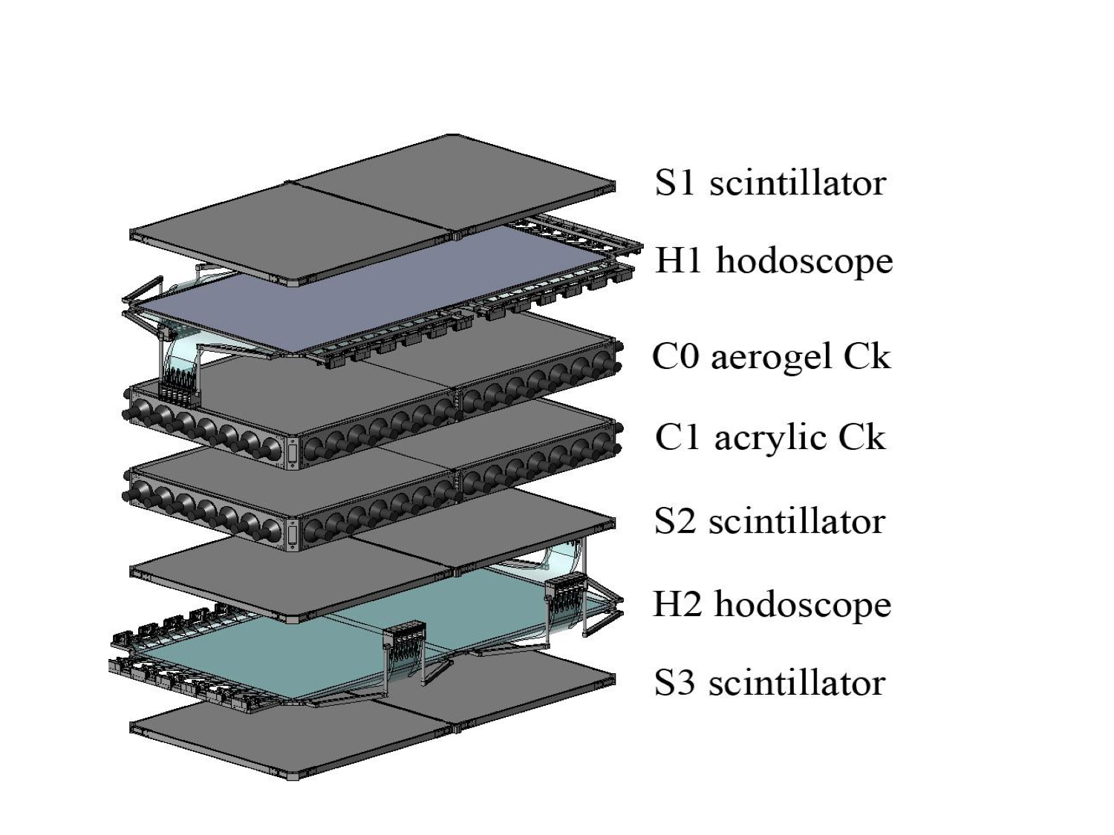
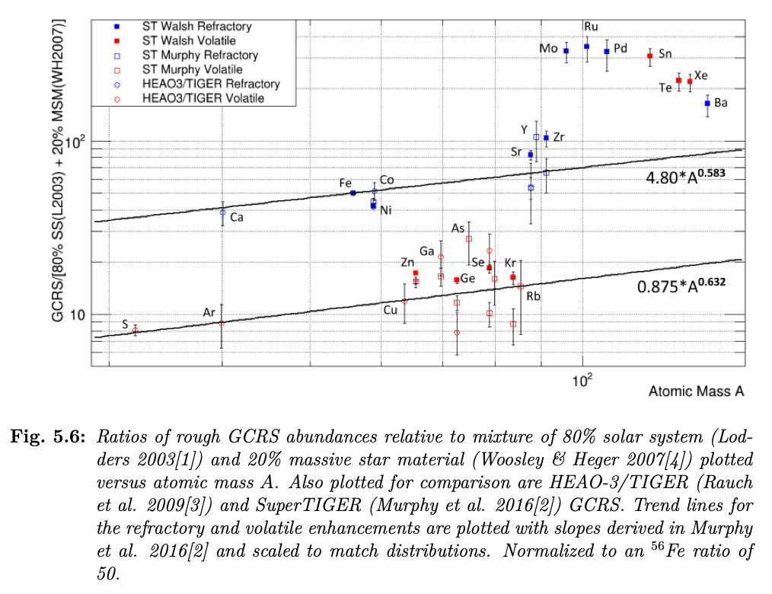
SuperTIGER (Trans-Iron Galactic Element Recorder)
See also the papers by N. Osborn et al. (PO-1 ID 471, and CRD ID 470)

Slide 4
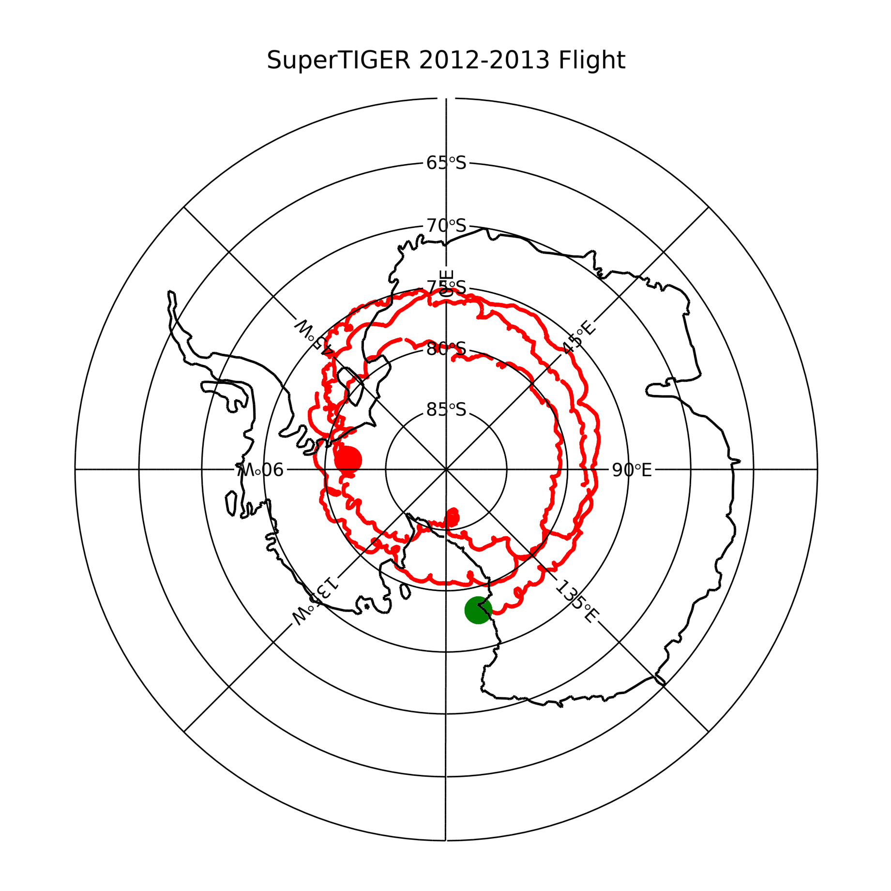
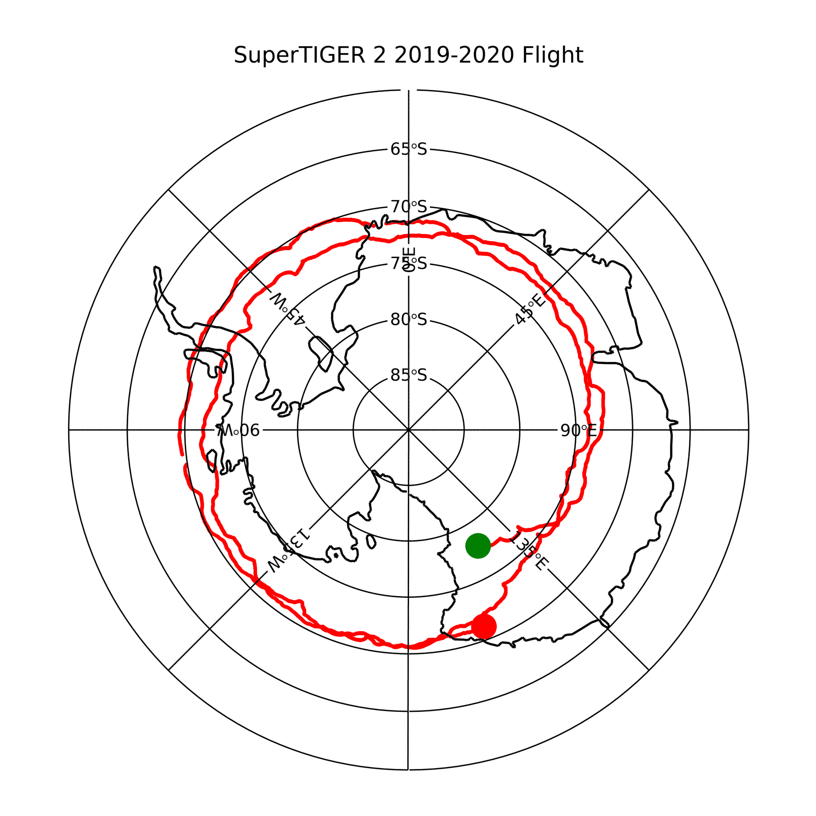
55 days
74.8°S to 86.6°S Latitude
32 days
69.5°S to 77.8°S Latitude

Slide 5
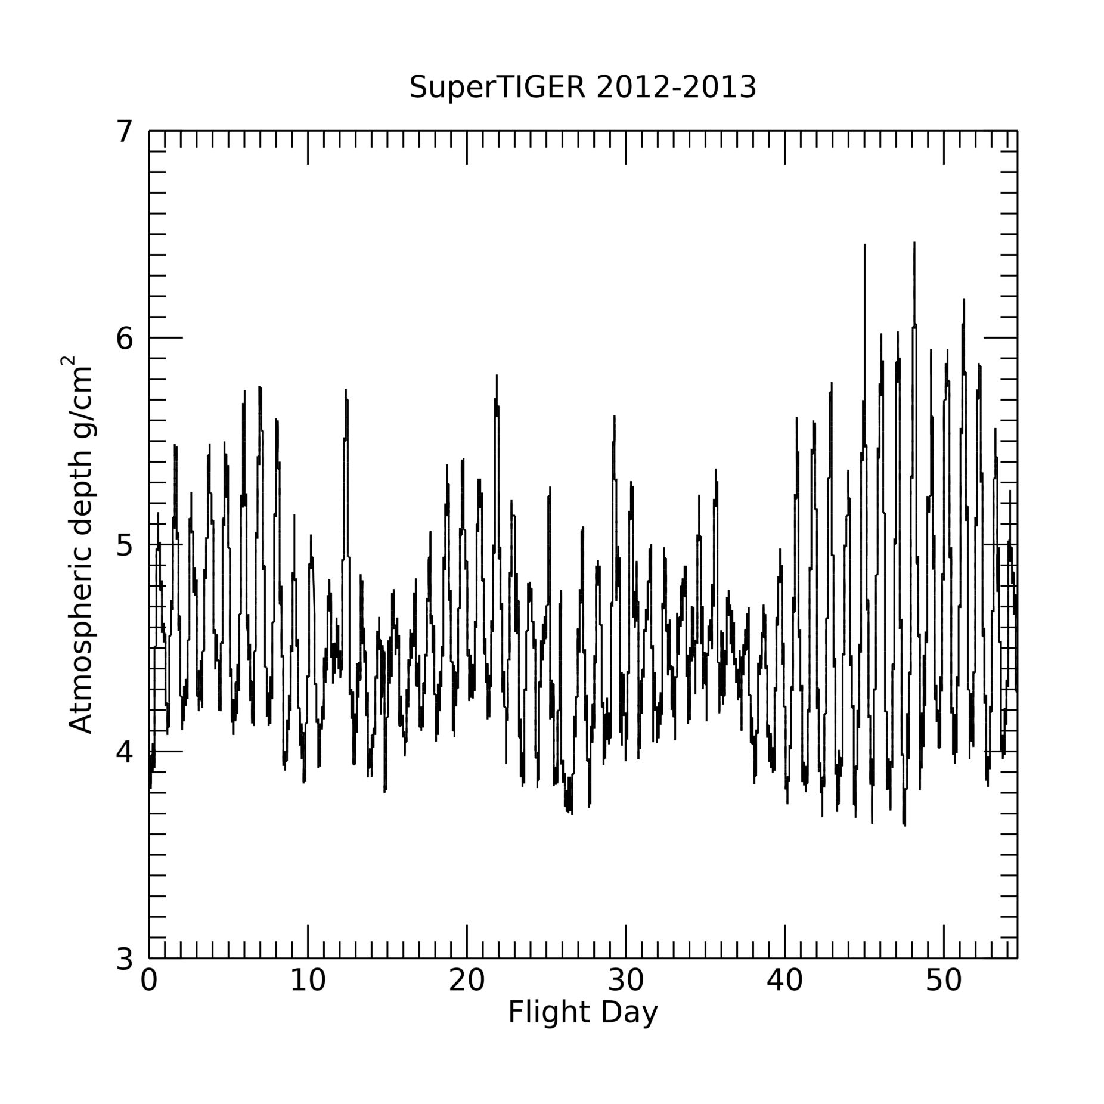
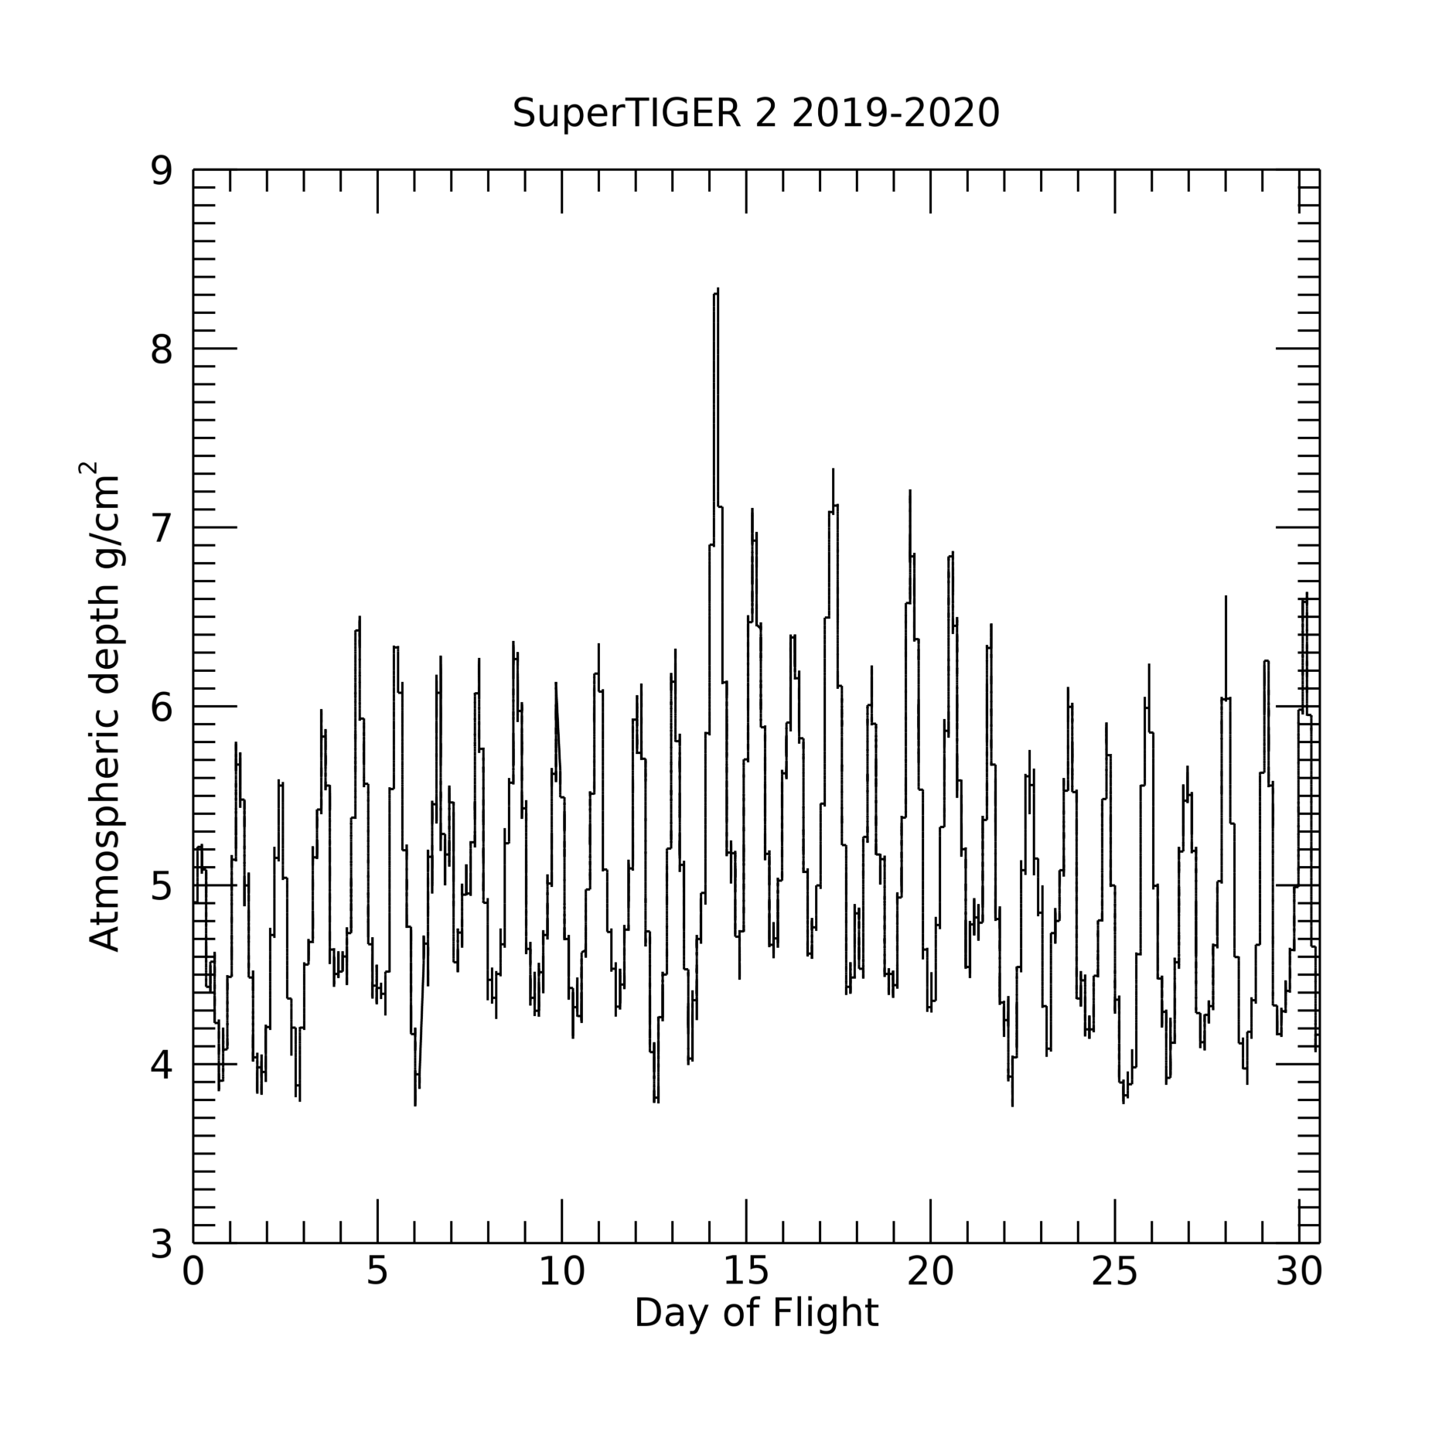
55 days
3.6-6.7 g/cm² atmospheric overburden
4.4 g/cm² average
32 days
3.8—8.3 g/cm² atmospheric overburden
5.0 g/cm² average

Slide 6
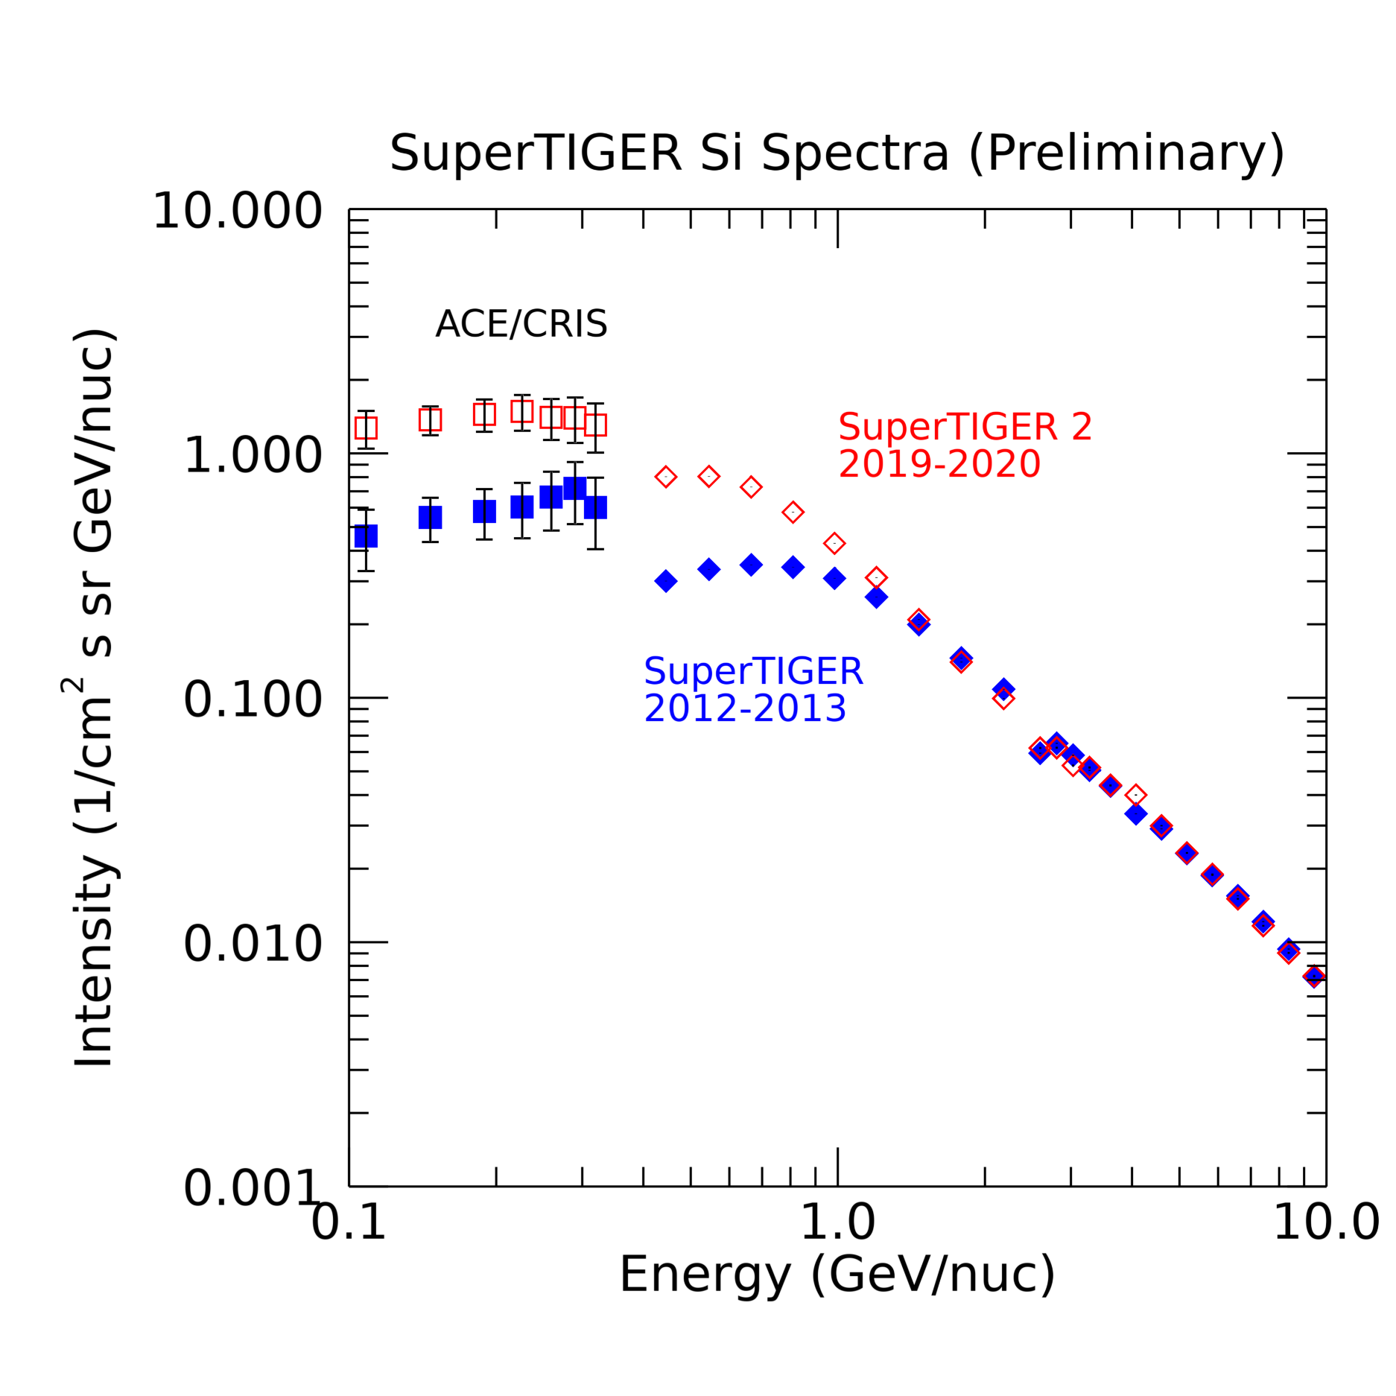
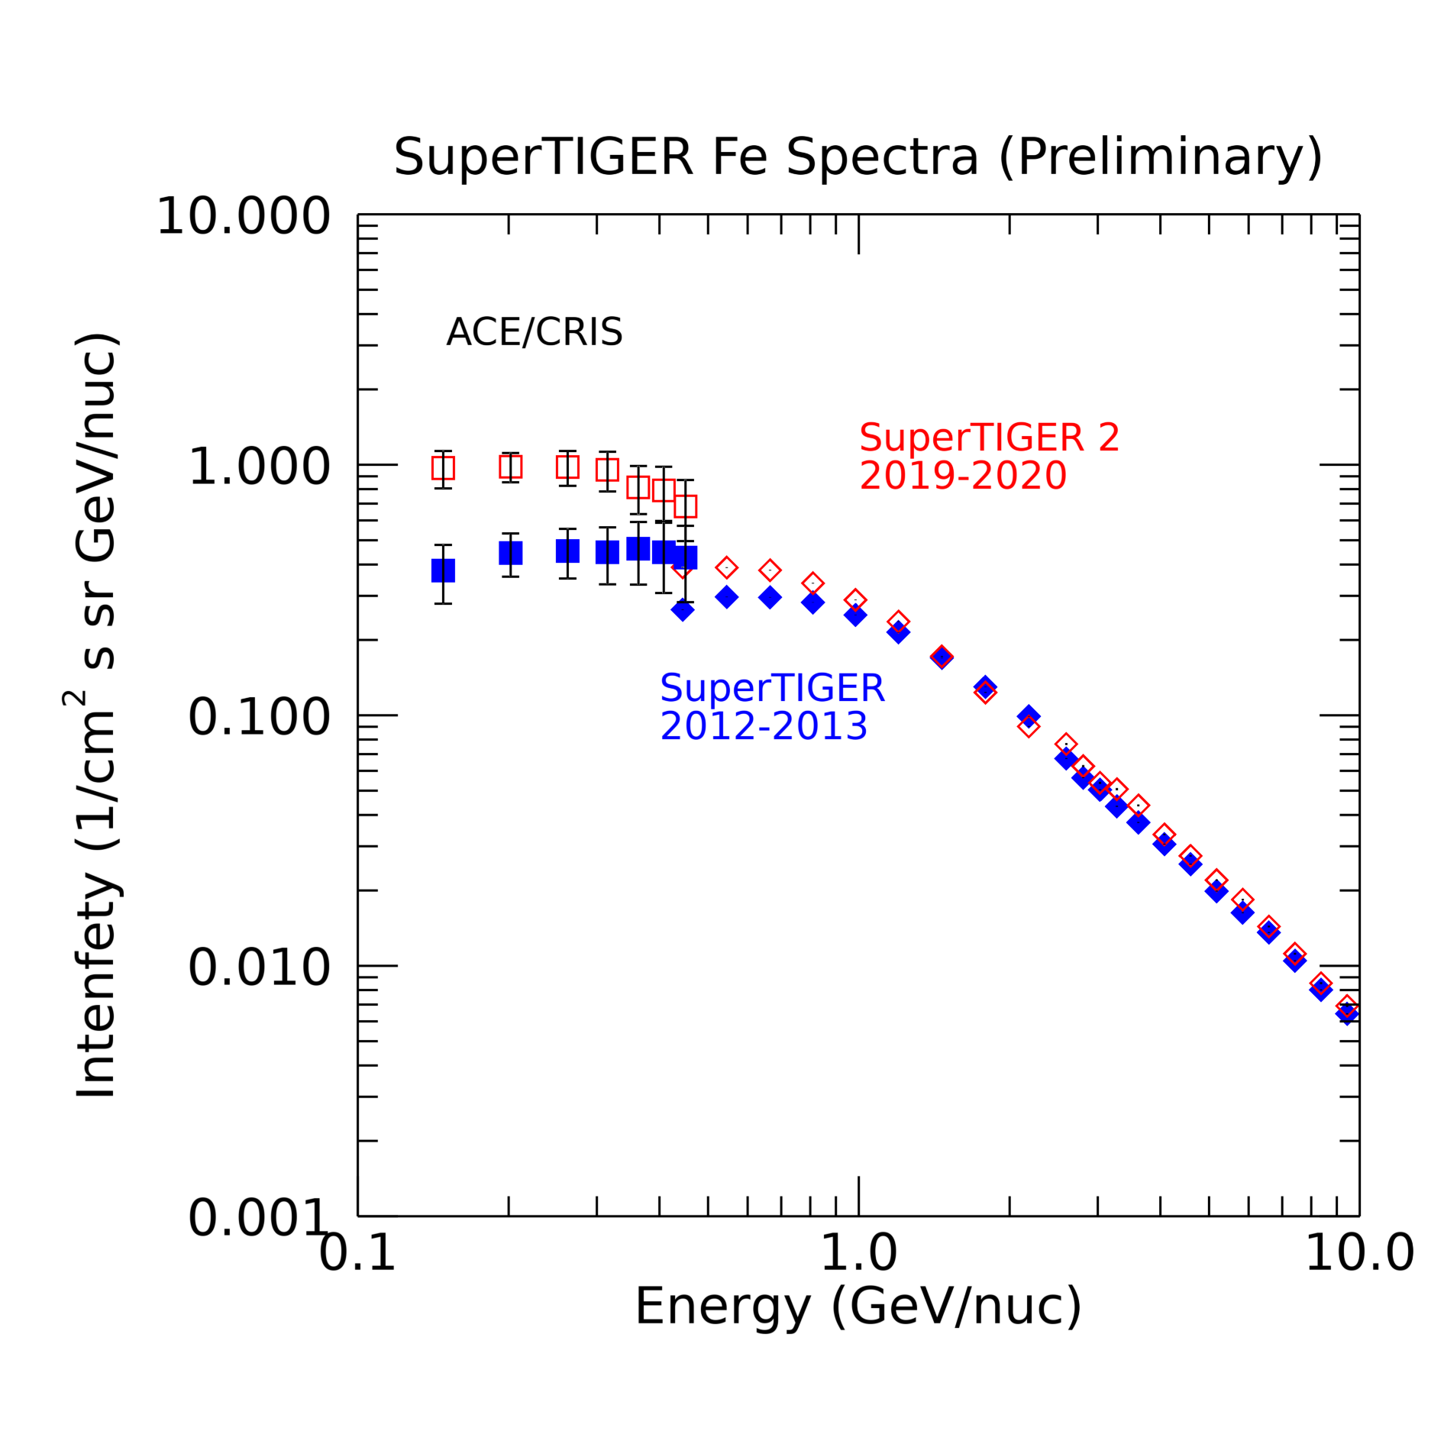

Slide 7
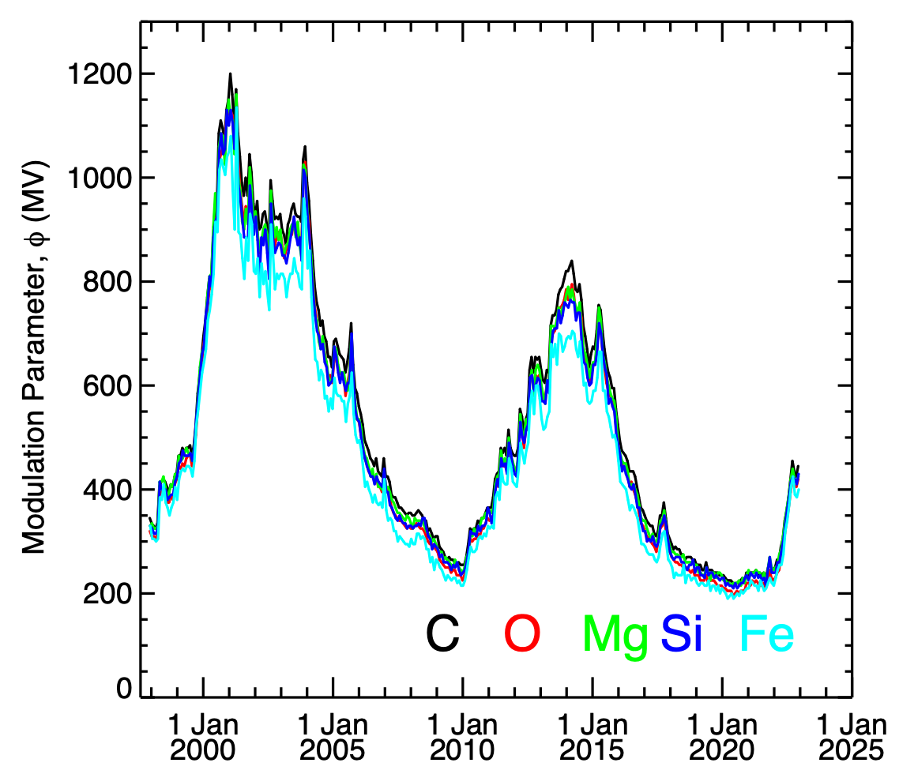

Slide 8
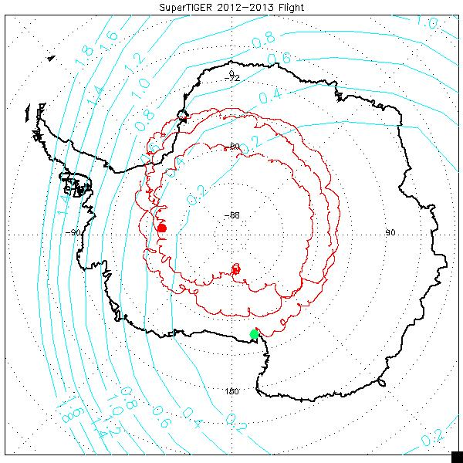
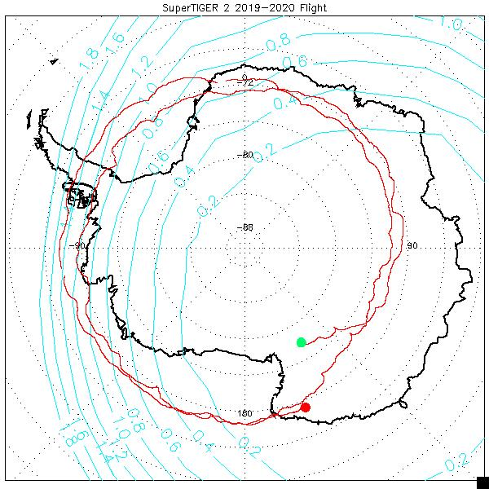
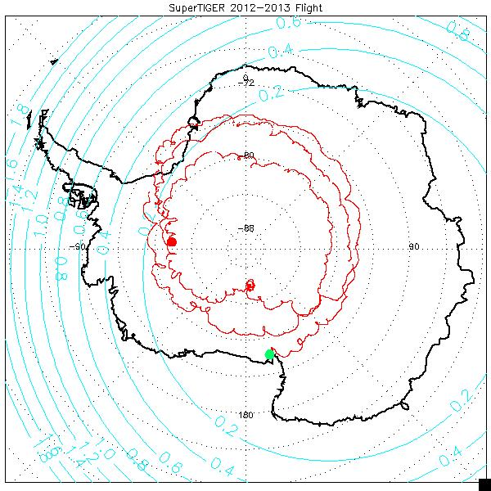
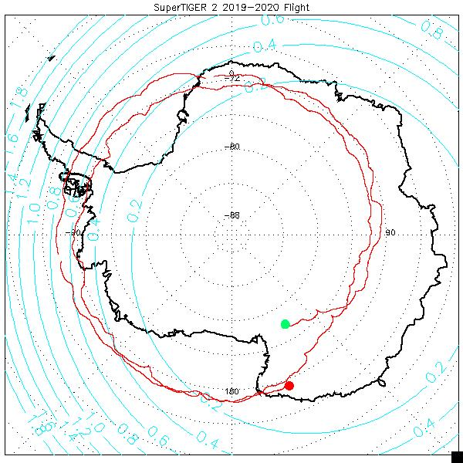
Is SuperTIGER sensitive to Geomagnetic Rigidity Cutoff?
ST1
ST2
Beyond instrumental or analytical effects, can the discrepancy between SuperTIGER and ACE/CRIS be attributed to atmospheric attenuation or geomagnetic effects, or both?
  At L1, ACE is not only well outside of Earth’s atmosphere and magnetic field but beyond the Moon’s orbit.

Slide 9
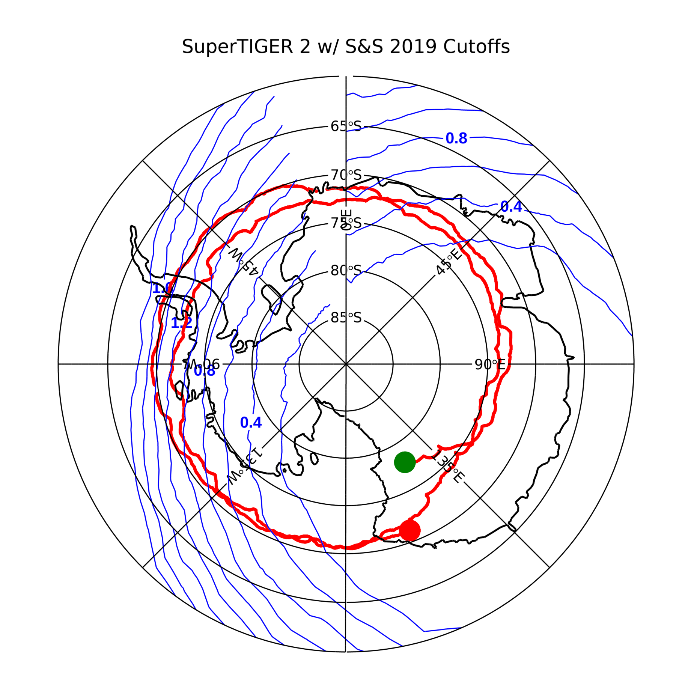
Near Acrylic threshold energies
Fe Z=26, A=56
  $$R_{threshold}=1.83GV$$
Si Z=14, A=28
  $$R_{threshold}=1.70GV$$
  The ground track is the ST2 flight.
  The contour lines show Geomagnetic Rigidity Vertical Cutoffs by Smart & Shea, ICRC 2019.

Slide 10
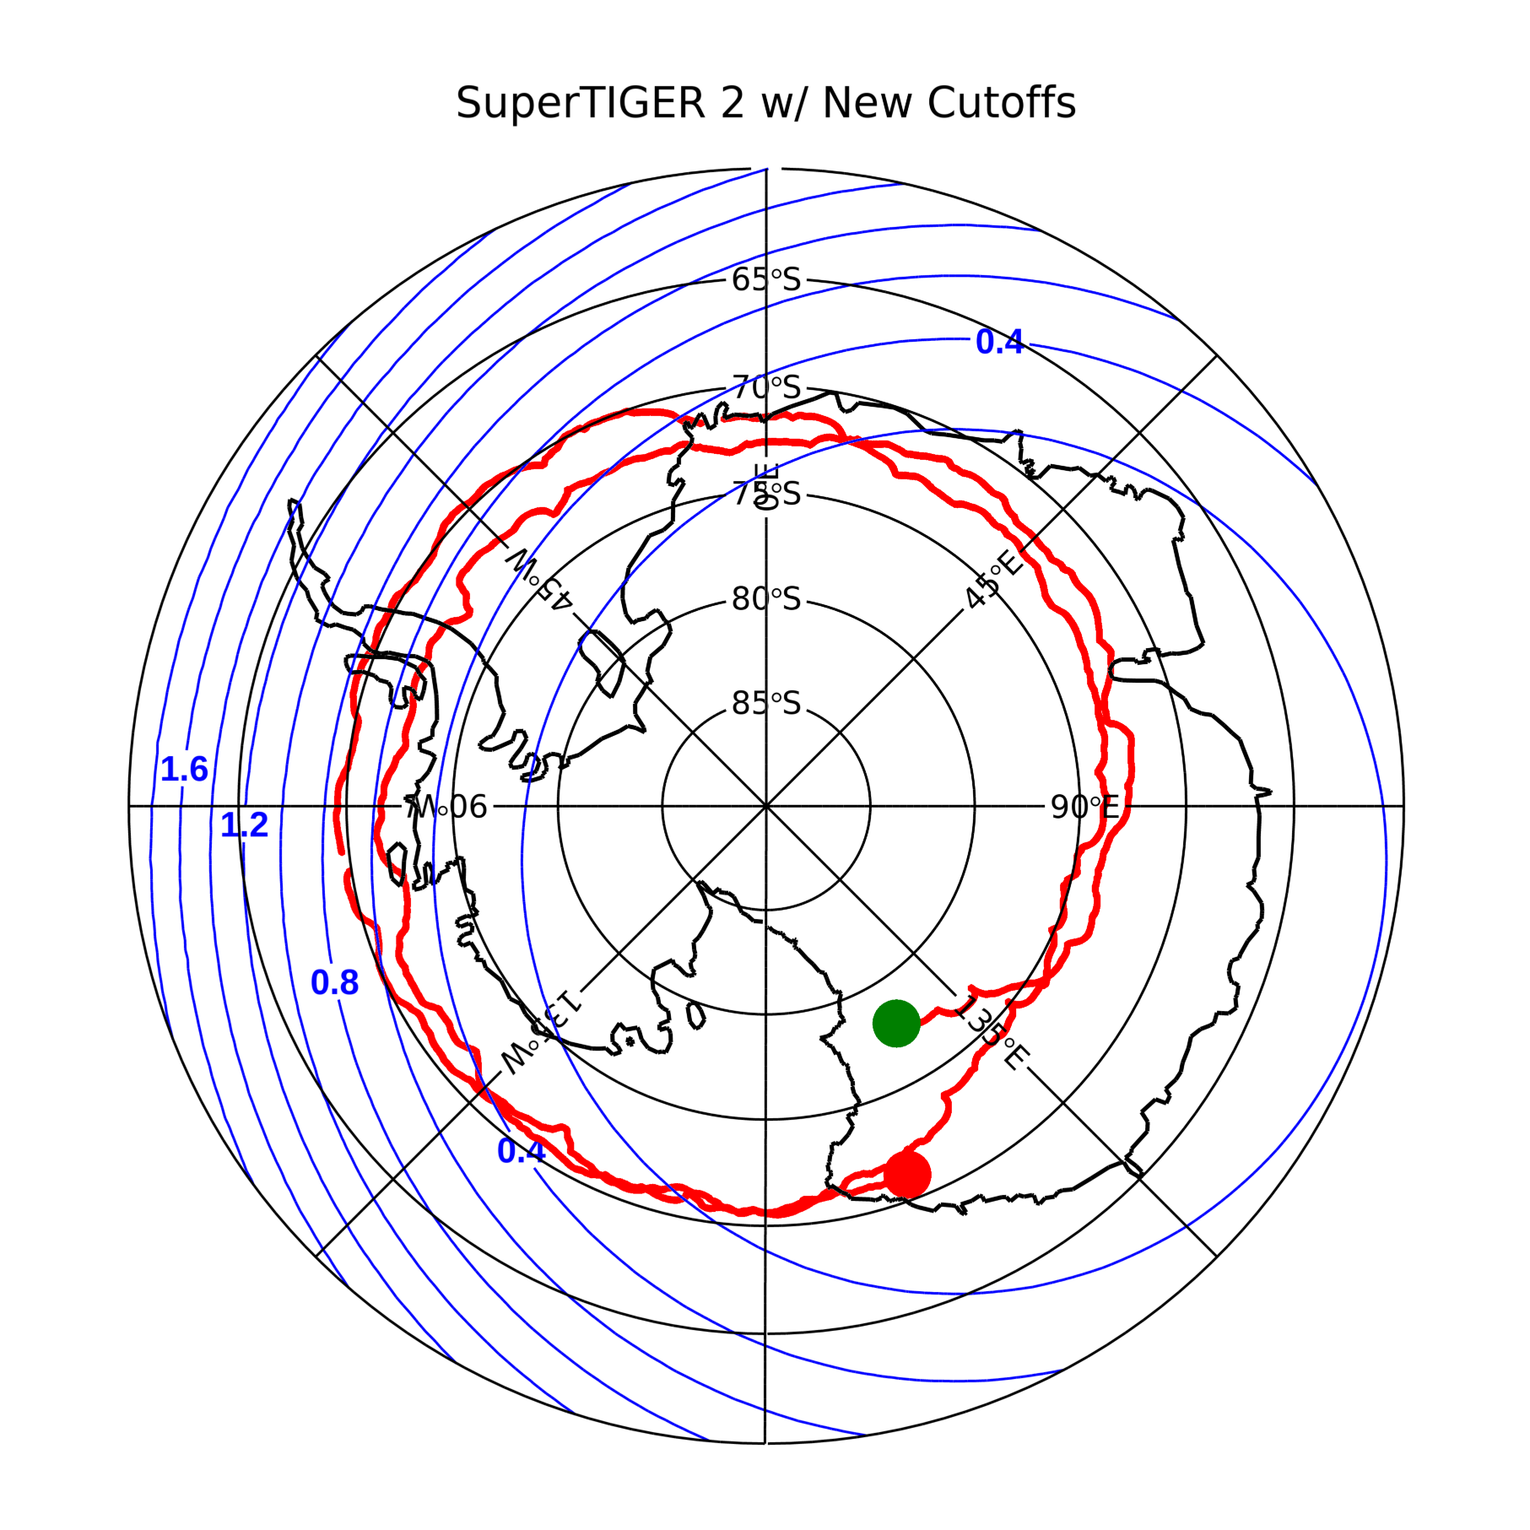
Near Acrylic threshold energies
Fe Z=26, A=56
  $$R_{threshold}=1.83GV$$
Si Z=14, A=28
  $$R_{threshold}=1.70GV$$
  The ground track is the ST2 flight.
  The contour lines show Geomagnetic Rigidity Vertical Cutoffs by W. Zober, this work.

Slide 12
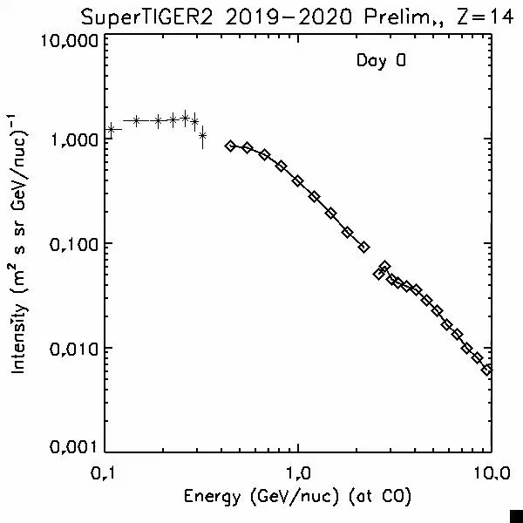
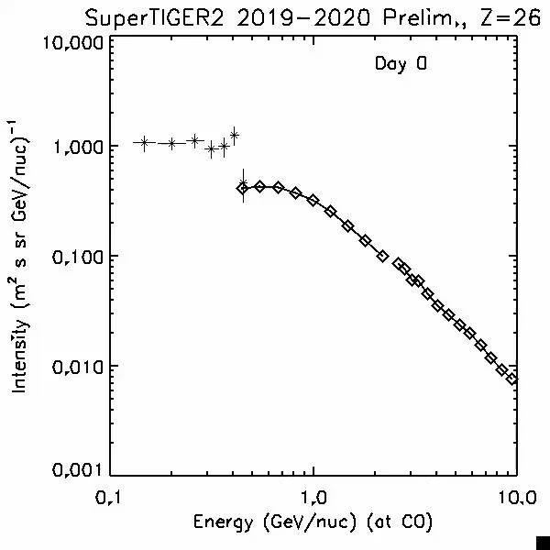
The Smart & Shea 2019 model suggests that a cutoff may be visible around Day 10 during SuperTIGER2’s flight.

Slide 13
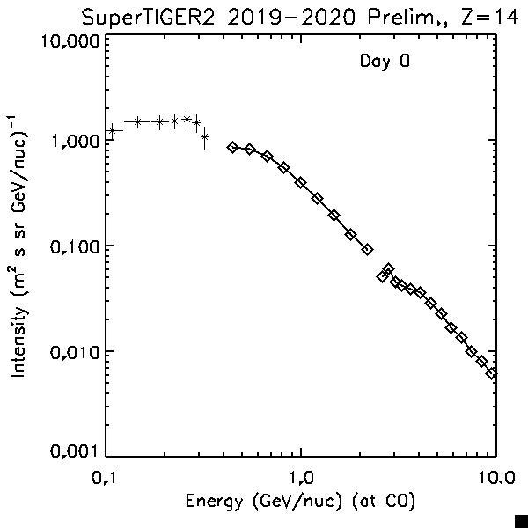

The Smart & Shea 2019 model suggests that a cutoff may be visible around Day 10 during SuperTIGER2’s flight.

Slide 14

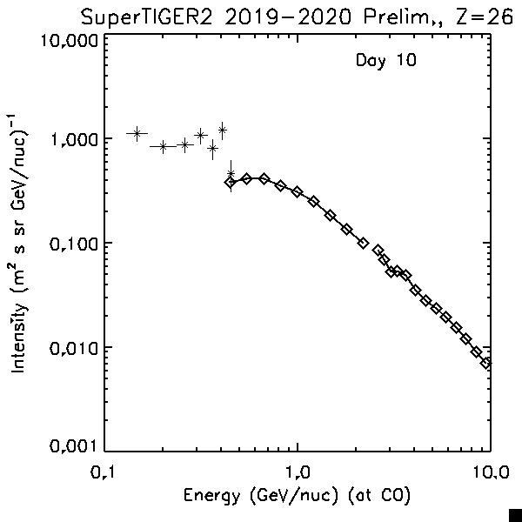
The Smart & Shea 2019 model suggests that a cutoff may be visible around Day 10 during SuperTIGER2’s flight.

Slide 15
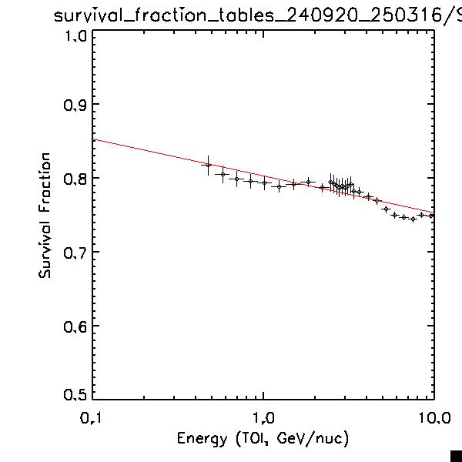
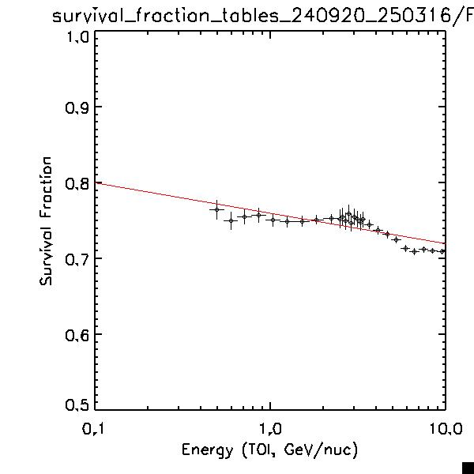
Geant4 Simulations May be used for corrections to Top of the Atmosphere (TOA)
For the spectra shown in this presentation, we use Geant4 to simulate the atmospheric overburden as a slab of material to correct measurements to TOA for Z<30.
  See N. Osborn for details on the calculations.
For the TOA corrections, we fit a power-law to the survival fraction at measured energies, but we know the curve must turn down at energies below those show.
  However, the calculations, as they stand, don’t account for the <~800 MeV/nuc downturns.
Si
Fe

Slide 16
Conclusions
The difference in ~400 MeV/nuc to ~1 GeV/nuc spectra between the SuperTIGER and SuperTIGER 2 flights is generally consistent with changes to solar modulation between the two flights.
The rollover below ~800 MeV/nuc is discontinuous with ACE/CRIS data, at ~400 MeV/nuc, suggestive of either attenuation losses or geomagnetic cutoff.
Whether the gradual deviation of the spectra from the “expected curve” at 400 to 800 MeV/nuc is attributable to geomagnetic effects or inapplicability of Geant4 corrections (e.g. low energy cross sections) — or both — is TBD.
  Angle-distribution effects — due to longer pathlength through the instrument — are accounted for by our Geant4 simulations and are not expected to be significant for Z≥12.

Slide 17
Spares

Slide 18
