Slide 1


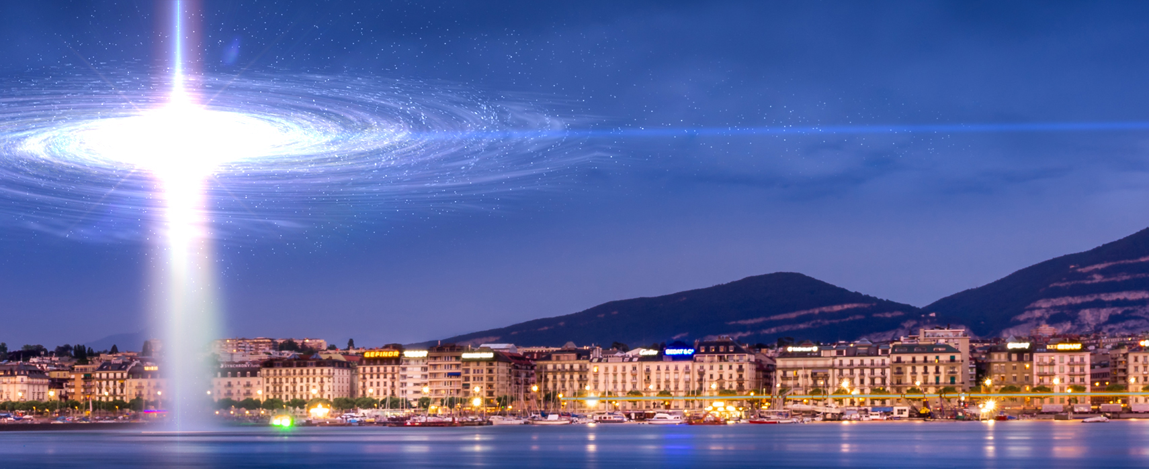


The flux of electron antineutrinos from SN1987A data
Veronica Oliviero*, Riccardo Bozza,
Vigilante di Risi, Giuseppe Matteucci,
Giulia Ricciardi, Francesco Vissani
ICRC 2025 - The Astroparticle Physics Conference, Geneve, Switzerland
*
PhD student at department of physics ‘’Ettore Pancini’’, University of Naples Federico II
veronica.oliviero2@unina.it

Slide 2
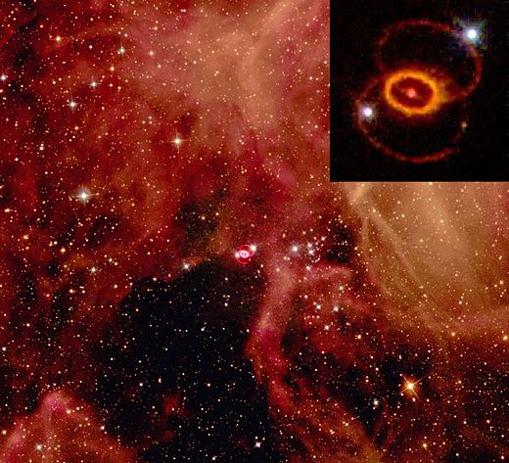
The tale of a dying star: SN1987A
On February 23, 1987, a sudden flash of light illuminated the southern sky—humanity had just witnessed the birth of a new supernova.
SN 1987A, the first supernova visible to the unaided eye since Kepler’s in 1604.
Galaxy: Large Magellanic Cloud (LMC)
Distance: ~51,4 Kpc
Progenitor Star: Sanduleak -69° 202

Slide 3
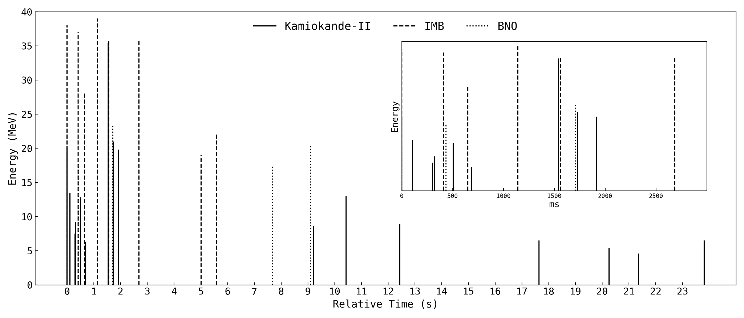
SN1987A (electron anti-) neutrino detection
First Detection of Neutrino Emission:
29 neutrino events were recorded by 3 detectors:
Kamiokande II (Japan)
IMB (USA)
Baksan (Soviet Union)
Importance of Studying Neutrinos:
Neutrinos provide a direct glimpse into the core collapse of a supernova, occurring before the visible explosion.
They help confirm theoretical models of stellar evolution and supernova mechanisms.
Their detection supports the understanding of weak nuclear interactions and neutrino physics
We adopt the IBD hypothesis (the favored one) with a newly refined computation of the cross-section.
Different reactions can produce neutrinos
G. Ricciardi, N. Vignaroli and F. Vissani, An accurate evaluation of electron (anti-)neutrino scattering on nucleons, JHEP 08 (2022) 212 [2206.05567].

Slide 4

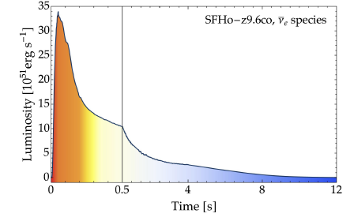
A Model for the Time Evolution
The simplest approximation of the instantaneous neutrino spectrum emitted by supernova is the thermal distribution (i.e. black body model) also called (Kelvin-Helmholtz) cooling.
Sketch from the simulation by Garching Group
BUT simulations show that the initial emission is much more intense:
After a fast growth phase(red), a very intense emission of a fraction of a second (in orange) there is a less intense, slowly decreasing and much longer-lasting emission (from yellow to blue).
The initial phase is missing! We need a more elaborate model.
Vissani, F.; Gallo Rosso, A. On the Time Distribution of Supernova Antineutrino Flux. Symmetry 2021, 13, 1851.

Slide 5
Two phased model
Proposal: In our model we include a surface (black-body) emission, but also a volume emission, resulting from reactions occurring in the initial moments following the onset of gravitational collapse.
We describe the electronic antineutrino emission with a parametric model
Motivated on physical basis
Easily adaptable to future observations
The spectrum is given by the superposition of two contributions:
Accretion phase (initial)
Non thermal emission;
brief duration ∼O(100ms);
due to the interaction between thermal e⁺e⁻ and free nucleons:
Cooling phase (final)
Thermal emission;
longer duration ∼O(10s);
due to the surface of the black body
Notes:
with alpha and tau chosen according to the emission phase.
A qualifying and useful aspect of getting a parameterization for the time distribution
as in Equation (23) is to describe it through quantities that are easily inferred from the data:
1. the position of the maximum of the curve t0;
2. the two timescales that drive the decrease in luminosity, a and c, for accretion and
cooling emission, respectively.

Slide 6
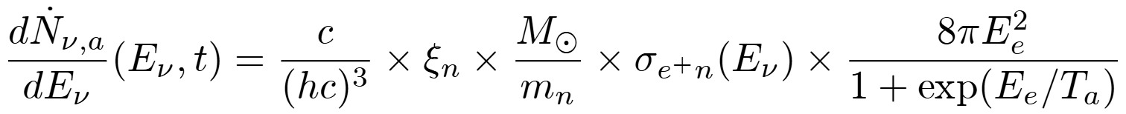
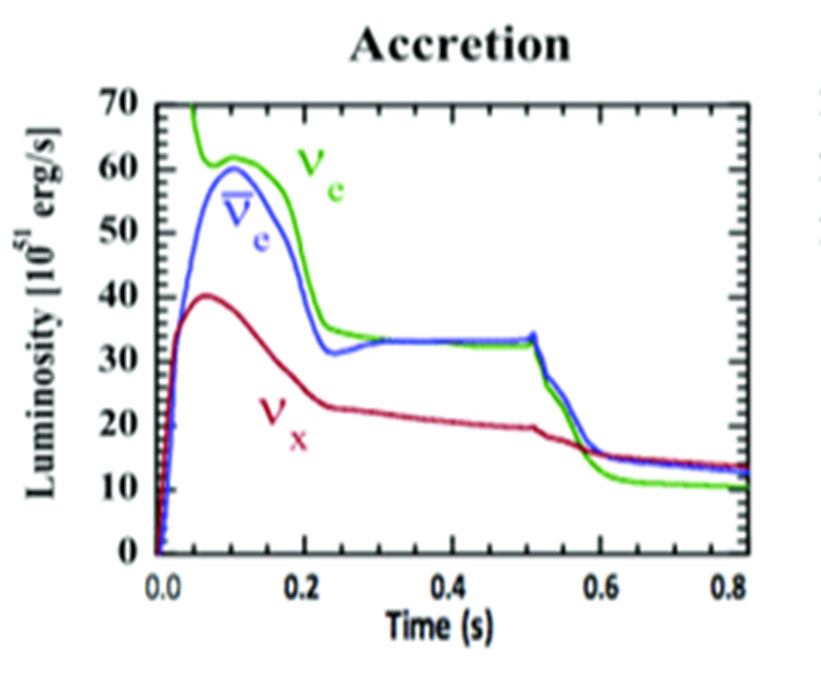
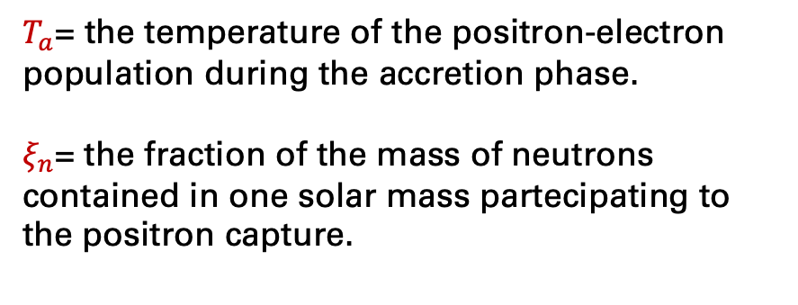
The time-structure
the accretion spectrum (positron capture)
$T_{a}$= the temperature of the positron-electron population during the accretion phase.
$ξ_{n}$= the fraction of the mass of neutrons contained in one solar mass partecipating to the positron capture.
Vissani and A. Gallo Rosso, On the time distribution of supernova antineutrino flux, Symmetry 13 (2021) .

Slide 7
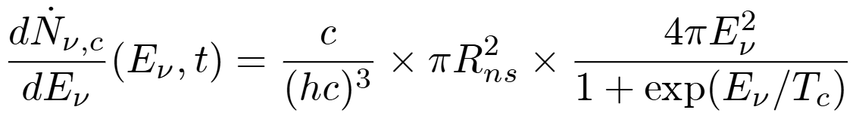
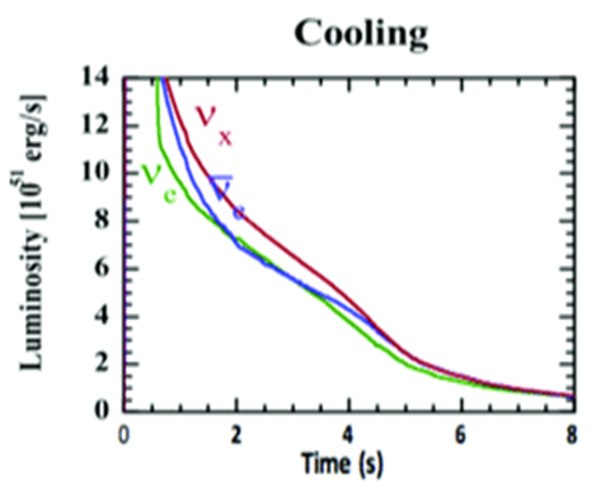
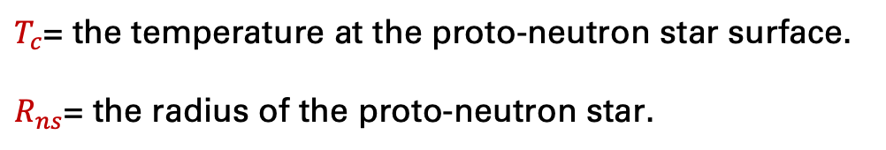
The time-structure
the cooling spectrum (neutrino-antineutrino production)
$T_{c}$= the temperature at the proto-neutron star surface.
$R_{ns}$= the radius of the proto-neutron star.
Vissani and A. Gallo Rosso, On the time distribution of supernova antineutrino flux, Symmetry 13 (2021) .

Slide 8
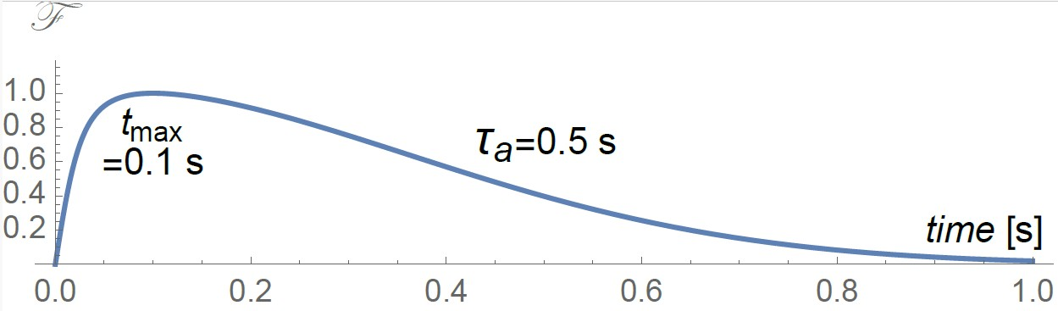
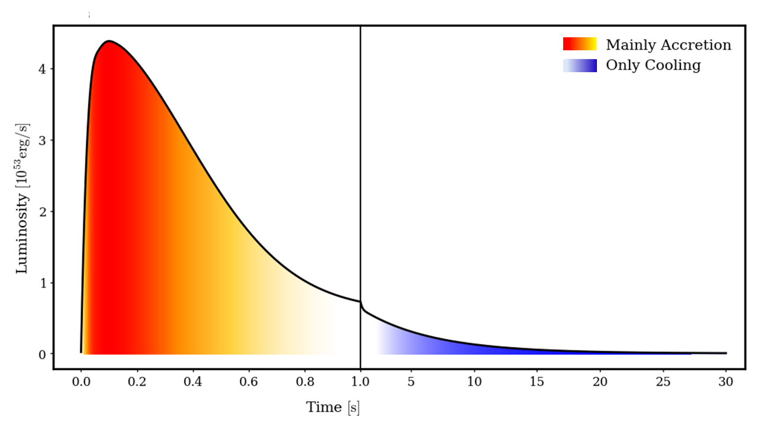
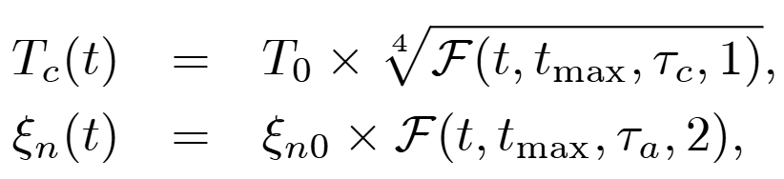
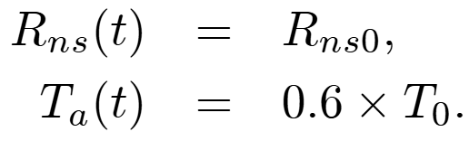
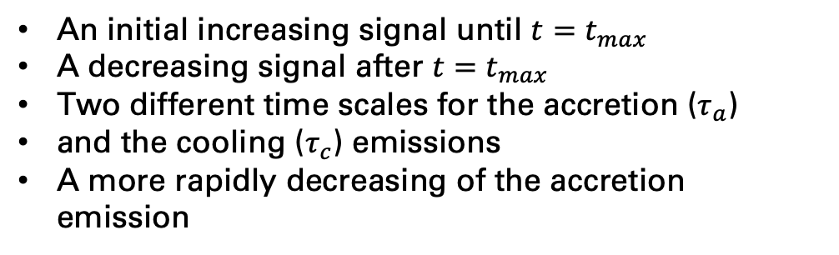
The time-structure
We describe the variation in time of the spectrum by means of the function $ℱ(t, t_{max},τ,α)$ where: $α=1$ for cooling, $α=2$for accretion.
Vissani and A. Gallo Rosso, On the time distribution of supernova antineutrino flux, Symmetry 13 (2021)
An initial increasing signal until $t=t_{max}$
A decreasing signal after $t=t_{max}$
Two different time scales for the accretion ($τ_{a}$)
and the cooling ($τ_{c}$) emissions
A more rapidly decreasing of the accretion emission

Slide 9
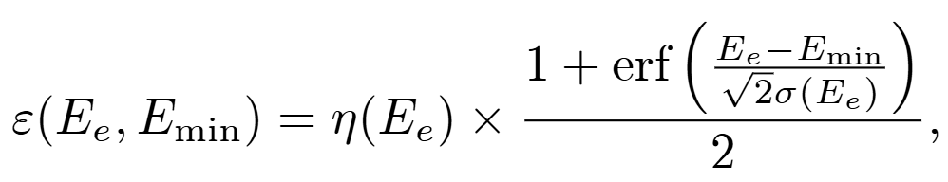
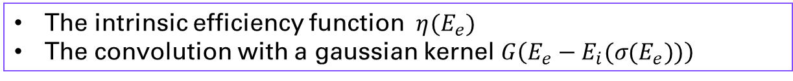
Modeling the signal and detectors response
An ideal detector would measure the following signal, triply differential in time, energy and cosine of the scattering angle
We account for non-ideal behaviour by means of :
The intrinsic efficiency function $η(E_{e})$
The convolution with a gaussian kernel $G\left(E_{e}−E_{i}(σ(E_{e}))\right)$
$σ\left(E_{e}\right):$ 𝑜𝑏𝑡𝑎𝑖𝑛𝑒𝑑 𝑓𝑖𝑡𝑡𝑖𝑛𝑔 𝑜𝑛 𝑡ℎ𝑒 𝑒𝑛𝑒𝑟𝑔𝑖𝑒𝑠 𝑢𝑛𝑐𝑒𝑟𝑡𝑎𝑖𝑛𝑖𝑡𝑖𝑒𝑠 𝑚𝑒𝑠𝑎𝑢𝑟𝑒𝑑 𝑏𝑦 𝑡ℎ𝑒 𝑐𝑜𝑙𝑙𝑎𝑏𝑜𝑟𝑎𝑡𝑖𝑜𝑛𝑠
Notes:
where σ(Ee) is obtained by fitting on the uncertainties of the energies of the events measured by the experimental collaborations the formula:

Slide 10
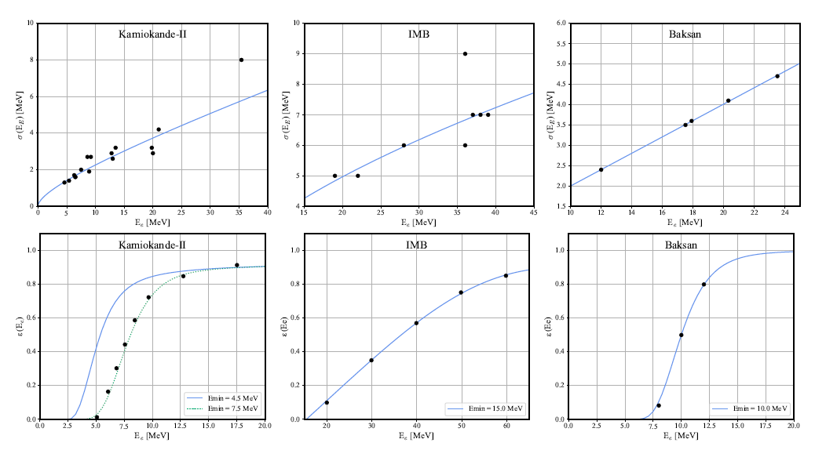
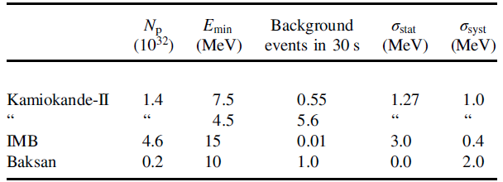
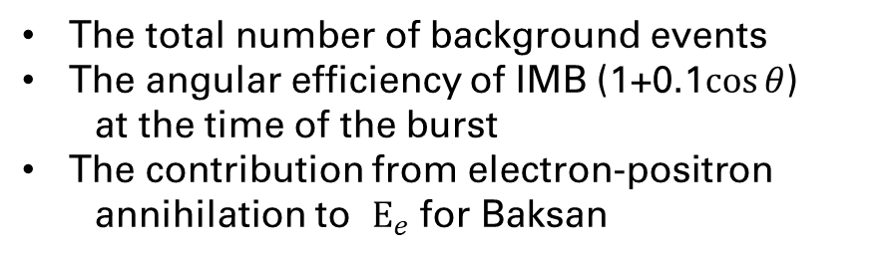
Modeling the signal and detectors response
The total number of background events
The angular efficiency of IMB (1+0.1$\cos{θ}$)
at the time of the burst
The contribution from electron-positron
annihilation to $E_{e}$ for Baksan

Slide 11
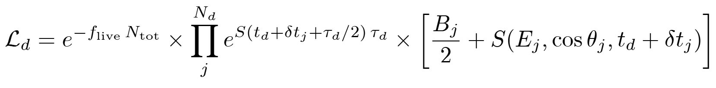
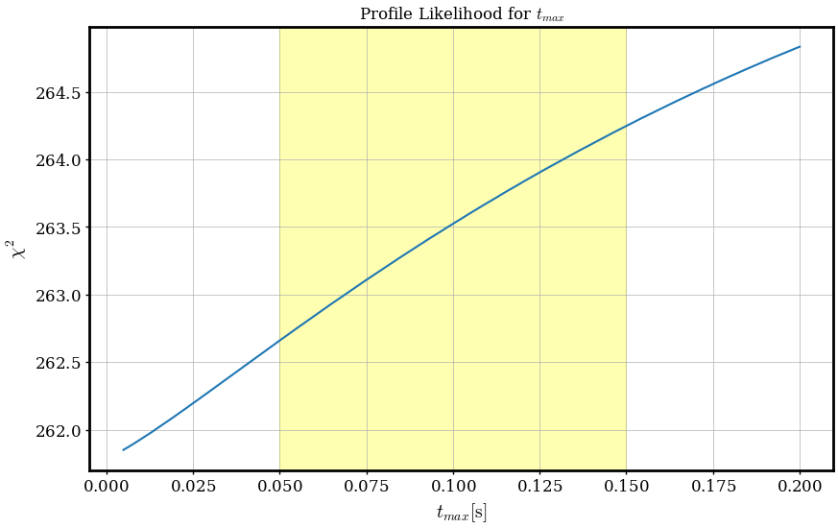
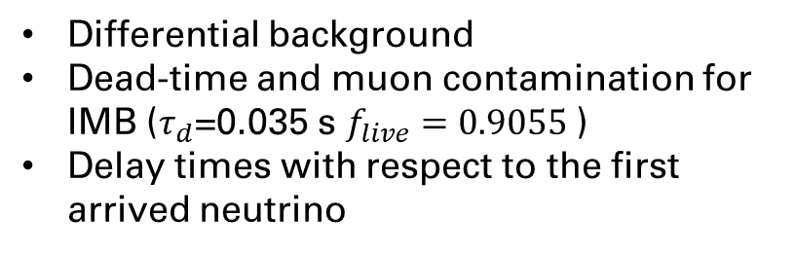
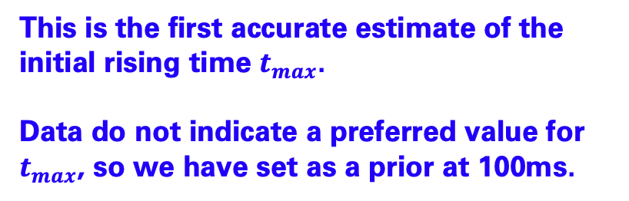
The likelihood Analysis
Differential background
Dead-time and muon contamination for IMB ($τ_{d}$=0.035 s $f_{live}=0.9055$)
Delay times with respect to the first arrived neutrino
This is the first accurate estimate of the initial rising time $t_{max}$.
Data do not indicate a preferred value for $t_{max}$, so we have set as a prior at 100ms.

Slide 12
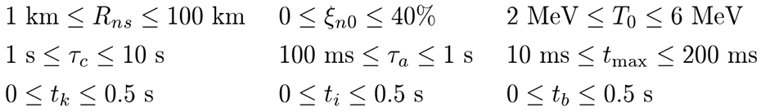
The likelihood Analysis

Slide 13
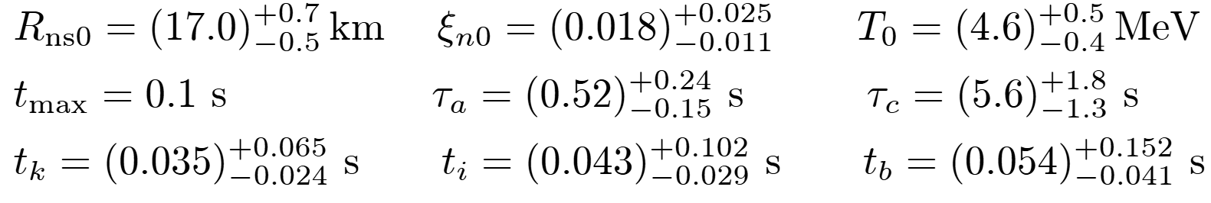
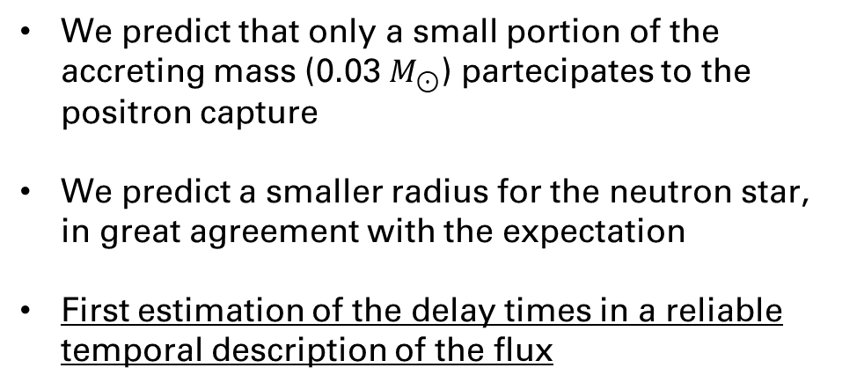
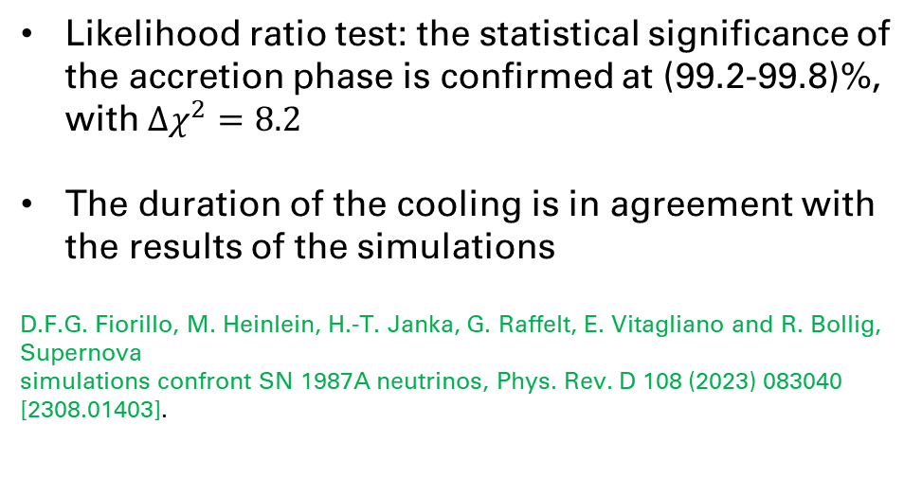
The likelihood Analysis
We predict that only a small portion of the accreting mass (0.03 $M_{⊙}$) partecipates to the positron capture
We predict a smaller radius for the neutron star, in great agreement with the expectation
First estimation of the delay times in a reliable temporal description of the flux
Likelihood ratio test: the statistical significance of the accretion phase is confirmed at (99.2-99.8)%, with $Δχ^{2}=8.2$
The duration of the cooling is in agreement with the results of the simulations
D.F.G. Fiorillo, M. Heinlein, H.-T. Janka, G. Raffelt, E. Vitagliano and R. Bollig, Supernova
simulations confront SN 1987A neutrinos, Phys. Rev. D 108 (2023) 083040 [2308.01403].

Slide 14
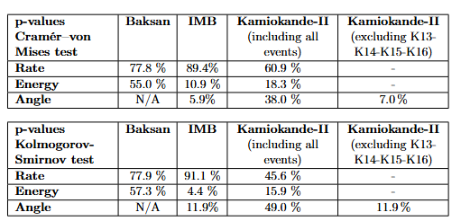
The likelihood Analysis
How good is the model to describe the data?
Excellent agreement with the theoretical energy and temporal distributions
Some tension with the empirical angular distribution

Slide 15
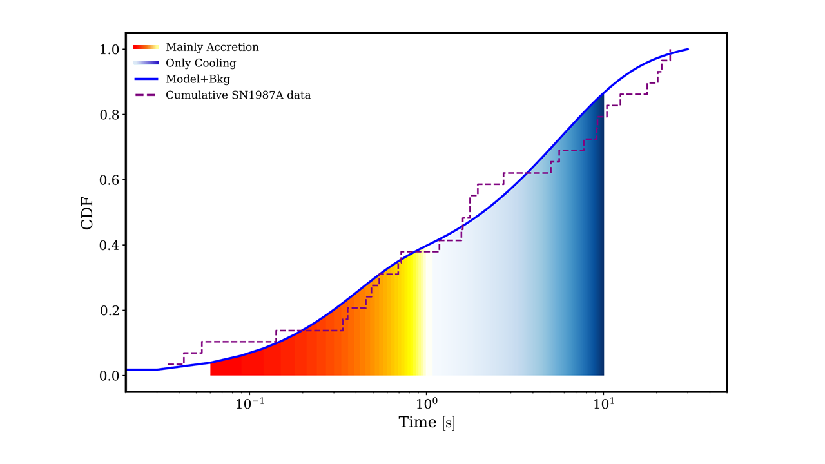
The likelihood Analysis
Combining the three data sets:
P-values 50.7% (Kolmogorov-Smirnov) 77.7% (Cramer-Von Mises) for the energy distribution
P-values 5.5% (Kolmogorov-Smirnov) 2.0% (Cramer-Von Mises) for the angular distribution
P-values 82.8% (Kolmogorov-Smirnov) 88.4% (Cramer-Von Mises) for the temporal distribution (see figure)
Combined goodness of fit

Slide 16
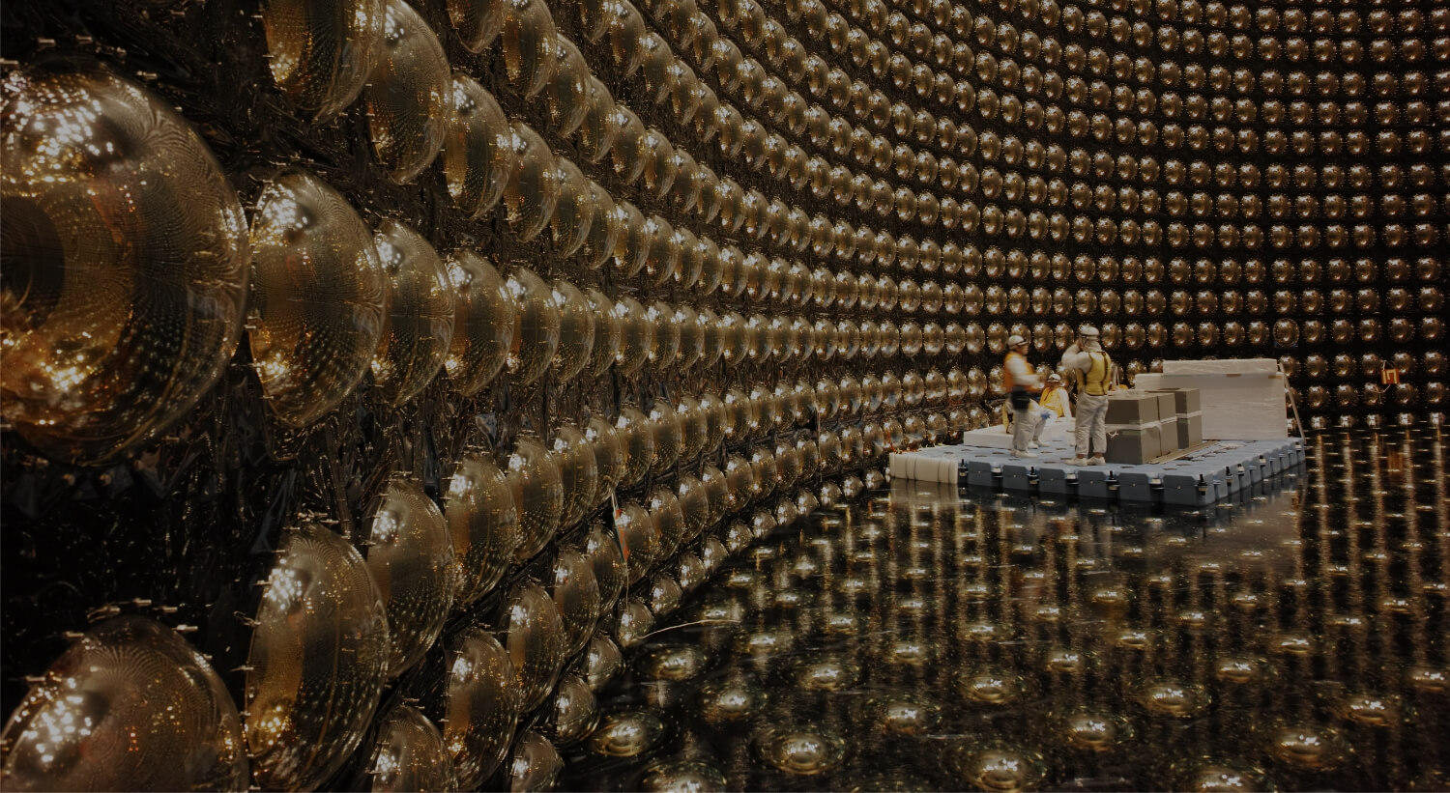
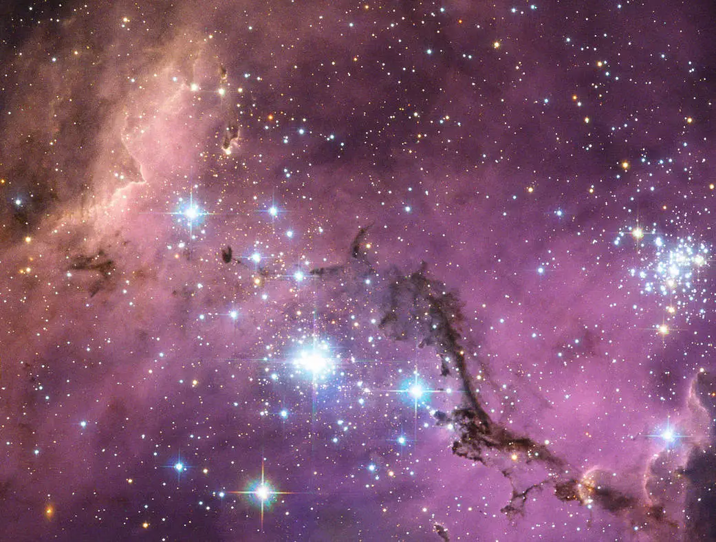
Novelties | The most refined IBD cross section at date; A new model for the emission, featuring an initial increasing ramp; First estimation of the delay times in a reliable temporal description of the emission; State-of-art modelling of the neutrino detectors.
Analysis | Comprehensive analysis of the entire data set on SN1987A neutrino emission (energy, time, angle and background); Best-fit values of the parameters of the model.
Statistics results | Confidence level on the existence of the accretion phase; Goodness of fit test.
Grazie per l’attenzione

Slide 17


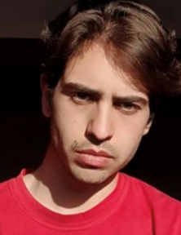

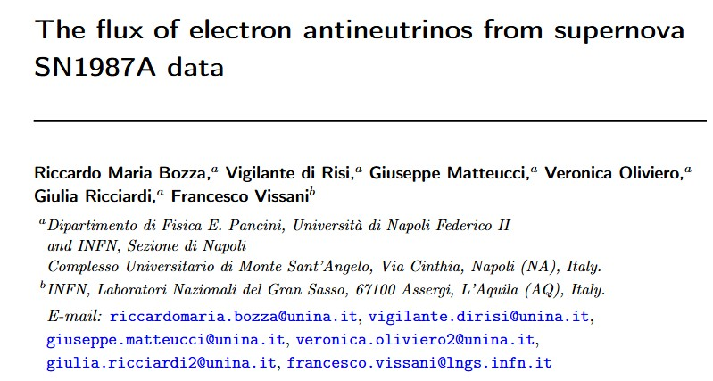


SN 1987A TASK FORCE
Veronica Oliviero
Riccardo Bozza
Vigilante di Risi
Giuseppe Matteucci
Giulia Ricciardi
Francesco Vissani
JCAP 05 (2025) 027 - arXiv:2501.09445v1 [hep-ph]

Slide 18
Back-up slides

Slide 19
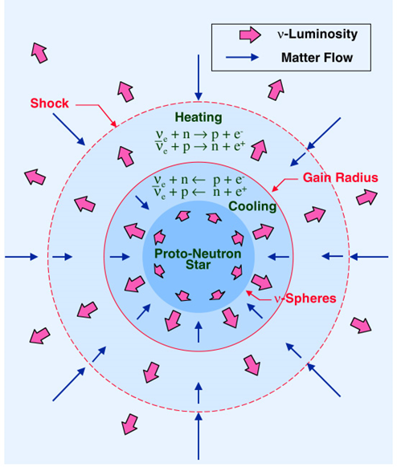
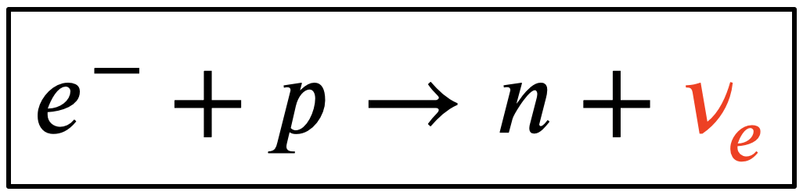
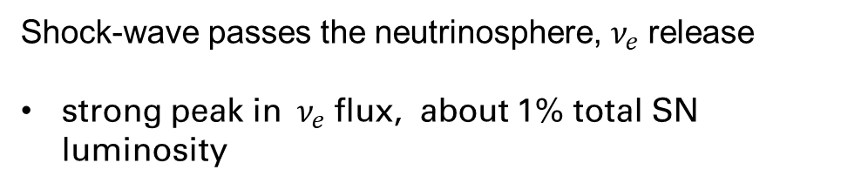

CCSN physics
General consensus towards 4 phases:
Infall ( ~ 100 ms):
iron core growth
gravitational collapse
iron core compressed and heated ​
Photodissociation of heavy nuclei
​
Electron Capture
$$γ+{}_{}^{56}{Fe} →13α+4n \& a→2n+2p$$
Neutrinos get trapped
When density O(${10}^{12}$) $\frac{g}{cm^{3}}$ neutrino trapping
2) Neutronization Burst (~ 10 ms)
Shock-wave passes the neutrinosphere, $ν_{e}$release
strong peak in$ν_{e}$flux, about 1% total SN luminosity

Slide 20
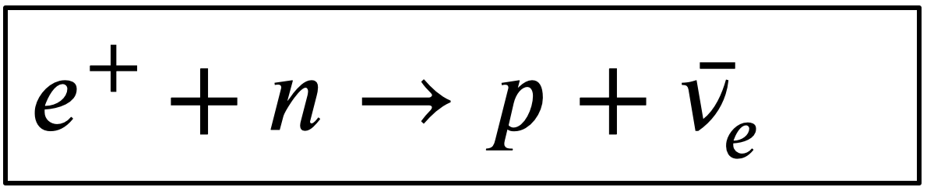
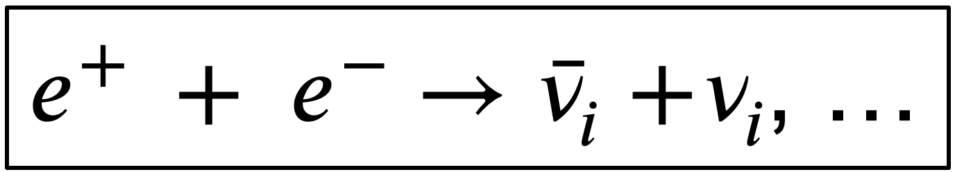


CCSN physics – Bulk of neutrino production
3) Accretion ($τ_{a}=0.5 s$):
below the shock matter falls on the surface of the proto-neutron star (PNS), accreting it
Nuclear Fe dissosaction goes on
shock stalls outside the neutrinospheres
CC and thermal processes in PNS
neutrino-mediated energy transfer in the gain region
shock revives
SN explosion
4) Cooling ($τ_{c}=10 s$)
PNS cools and emits all-flavour thermal neutrinos

Slide 21
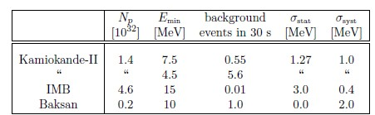
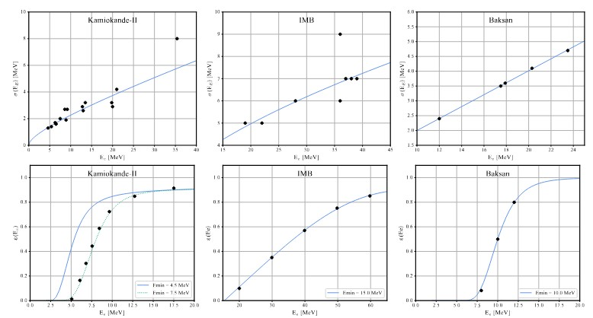
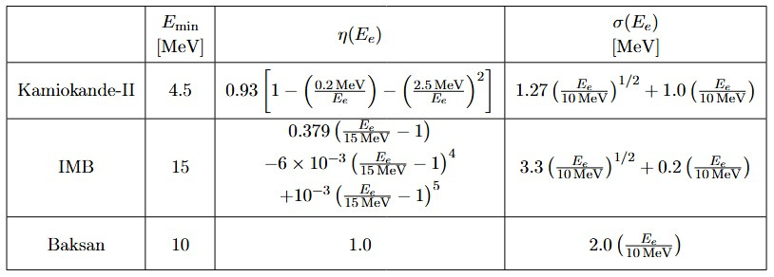
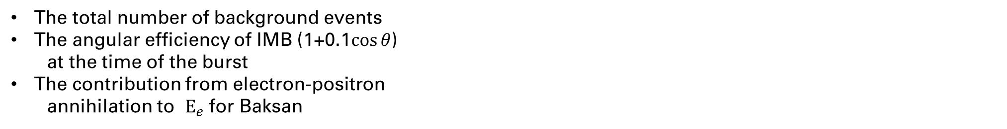
Modeling the signal and detectors response
We account for
The total number of background events
The angular efficiency of IMB (1+0.1$\cos{θ}$)
at the time of the burst
The contribution from electron-positron
annihilation to $E_{e}$ for Baksan

Slide 22
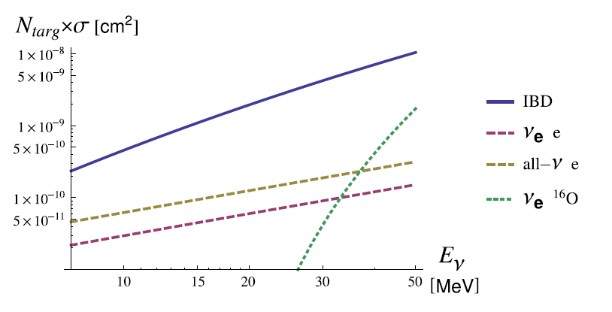
Assumption on the interactions
We exploit a new refined computation of the Inverse Beta Decay (IBD) cross section, electron antineutrinos on protons, yielding positron+neutron
G. Ricciardi, N. Vignaroli and F. Vissani, An accurate evaluation of electron anti-neutrino scattering on nucleons, JHEP 08 (2022) 212 [2206.05567].
Priors on other reactions:
15.11 MeV photon from C12 de-excitation: expected events 0.05-0.12
5-6 MeV photon from N15 or O15 de-excitation: expected events 0.03-0.07
Elastic Scattering in Kamiokande-II: 30% for the event K1
Figure: Cross section of the processes relevant for the SN1987A neutrino burst inside a water Cherenkov detector (1 Kton of water)
F. Vissani, Comparative analysis of SN1987A antineutrino fluence, J. Phys. G 42 (2015) 013001 [1409.4710].
A new cross-section

Slide 23
The role of oscillations
Oscillation in the dense supernova environment is still an open topic M.C. Volpe, Neutrinos from dense environments: Flavor mechanisms, theoretical approaches,
observations, and new directions, Rev. Mod. Phys. 96 (2024) 025004 [2301.11814].
Limited statistics and astrophysical uncertainties hinder the ability to draw firm conclusions
M. Kachelriess, A. Strumia, R. Tomas and J.W.F. Valle, SN1987A and the status of
oscillation solutions to the solar neutrino problem, Phys. Rev. D 65 (2002) 073016
[hep-ph/0108100].
Limited effect for normal ordering, relevant effects for the inverse ordering during the accretion but the question remains open
In view of the current uncertainties, we do not model oscillations:
Limited effect for normal ordering, which is favored and we assume it.
Our fit can be interpreted as a flux effectively including oscillations
P. Dedin Neto, M.V. dos Santos, P.C. de Holanda and E. Kemp, SN1987A neutrino burst:
Limits on flavor conversion, Eur. Phys. J. C 83 (2023) 459 [2301.11407].

Slide 24
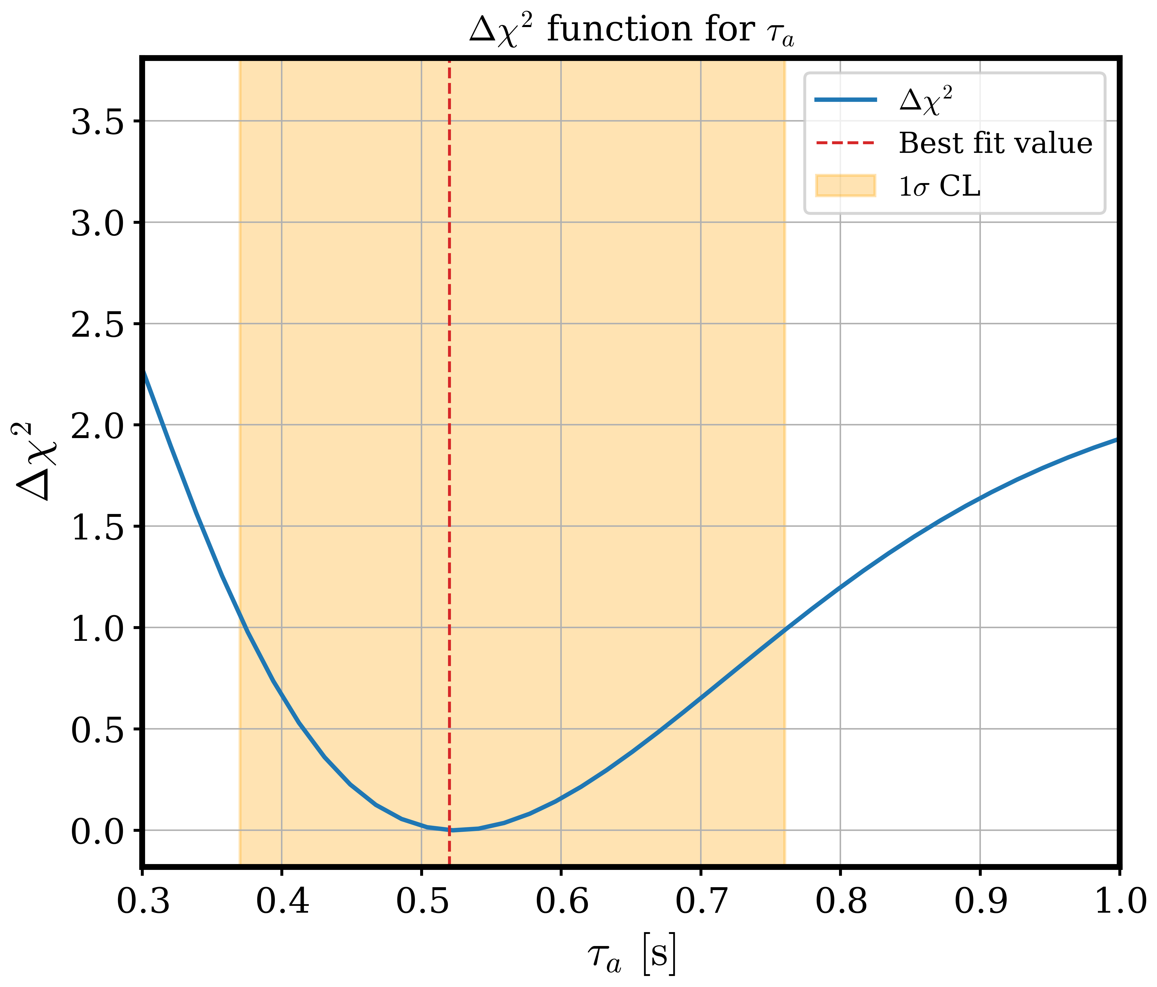
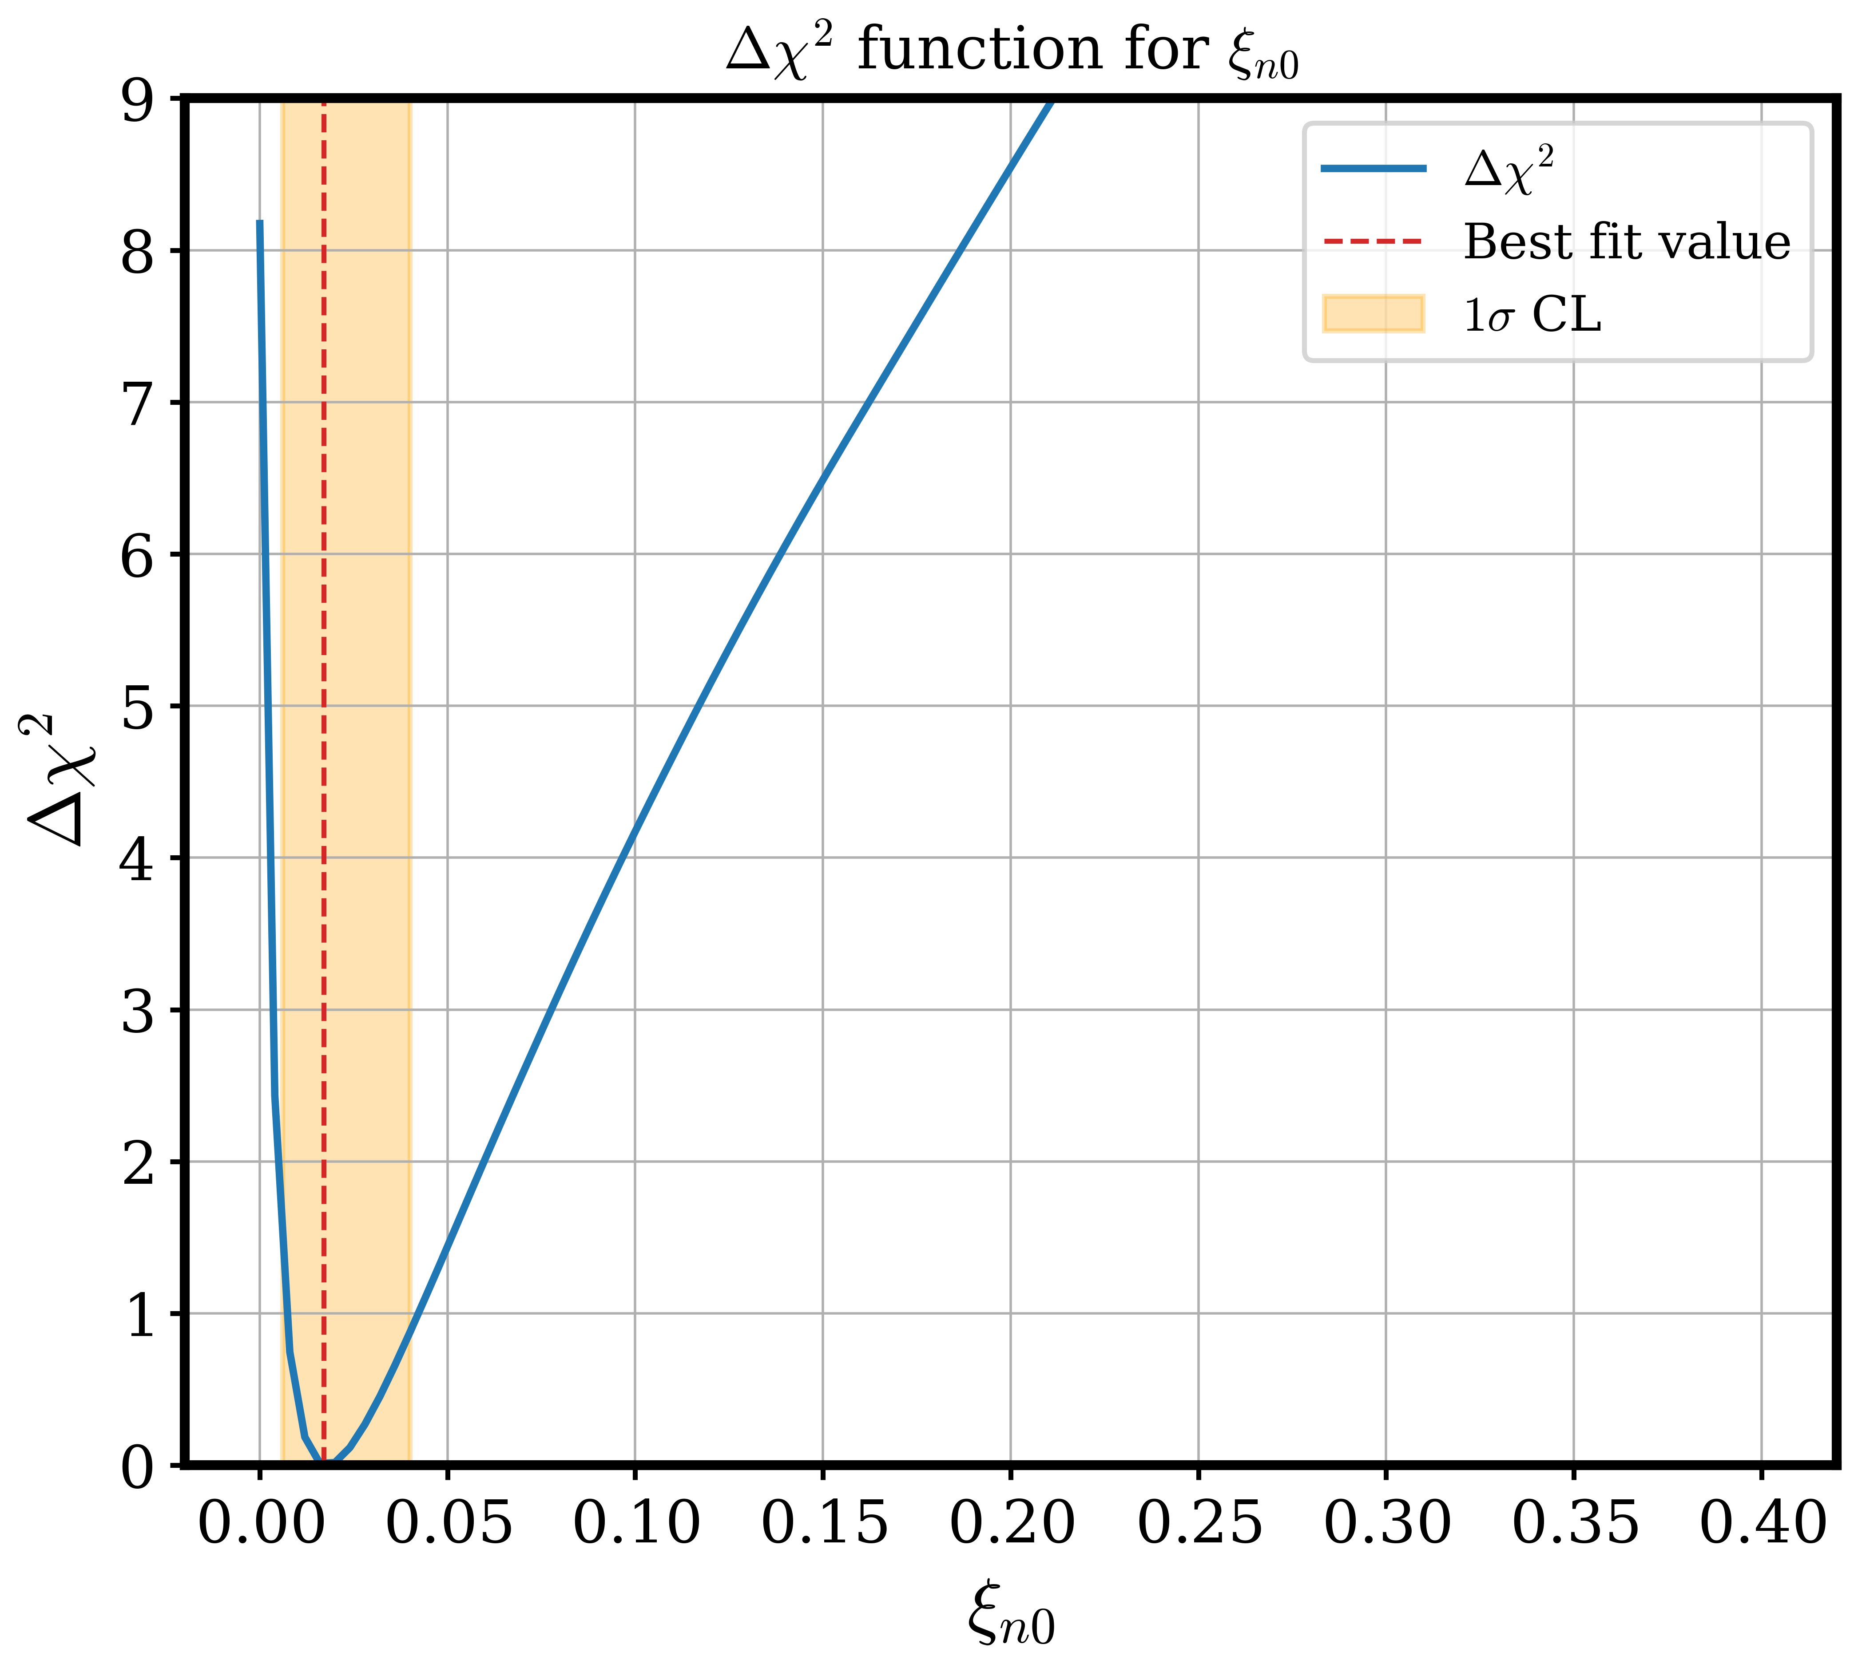
Likelihood analysis results

Slide 25
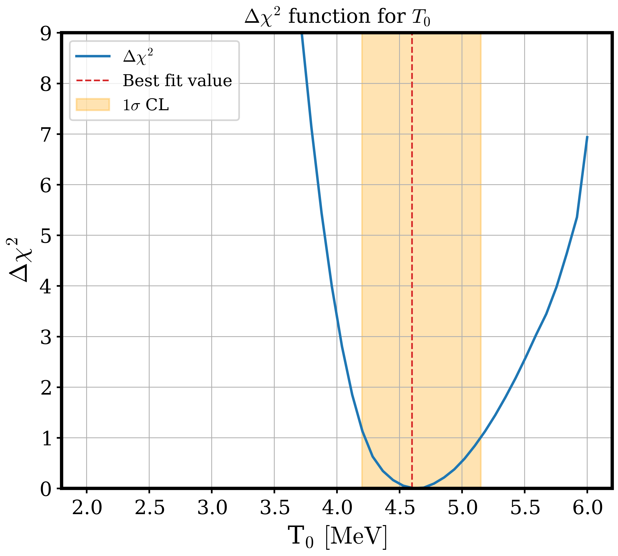
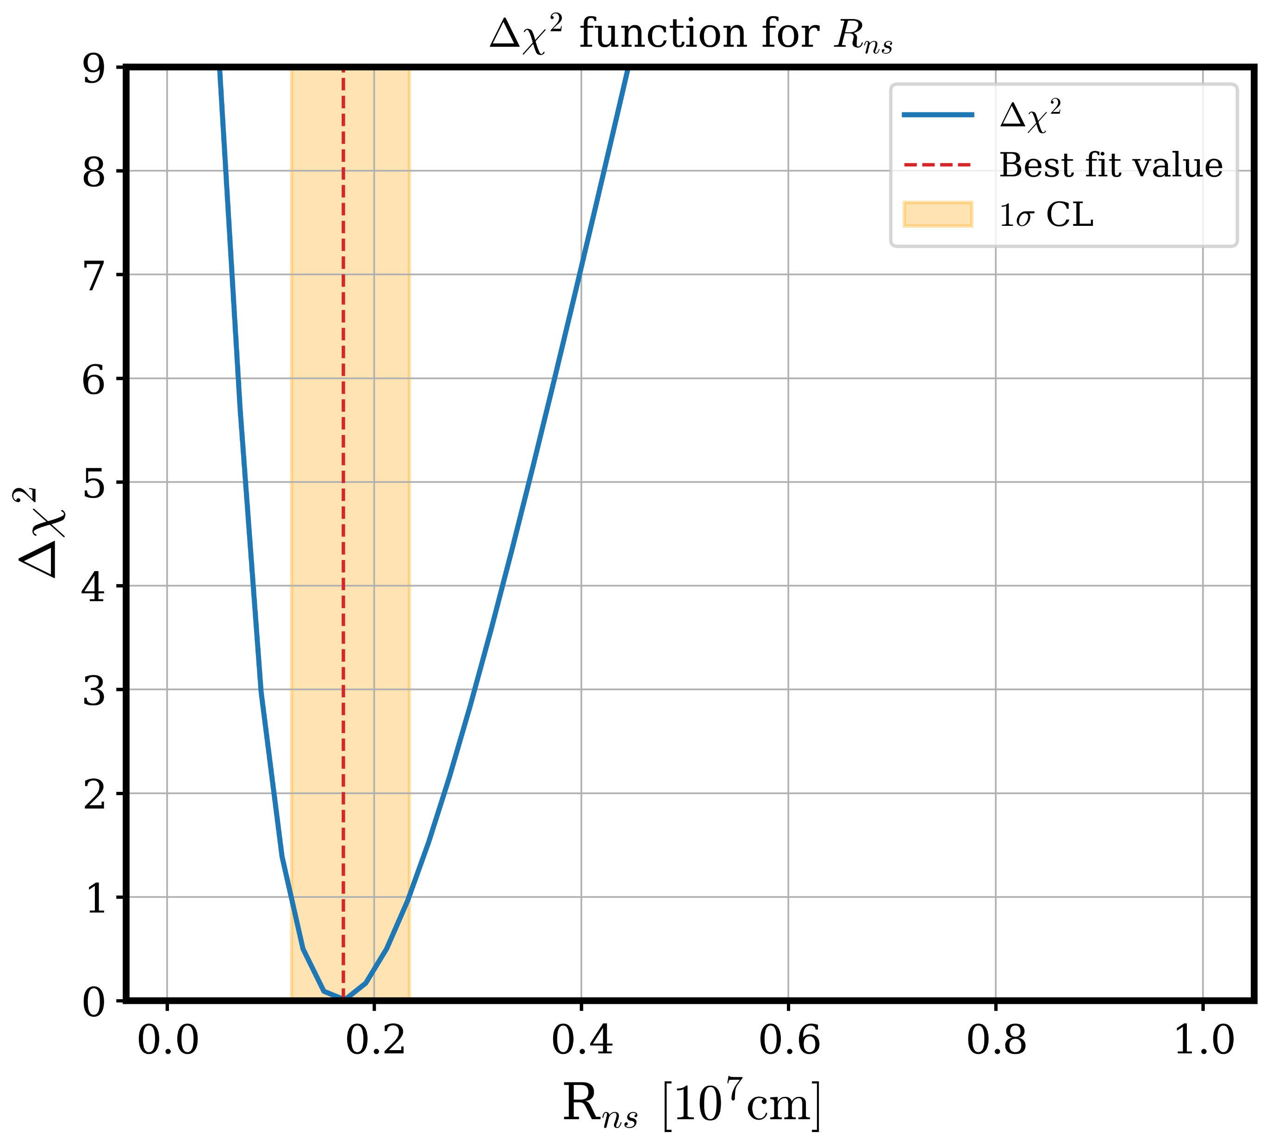
Likelihood analysis results

Slide 26
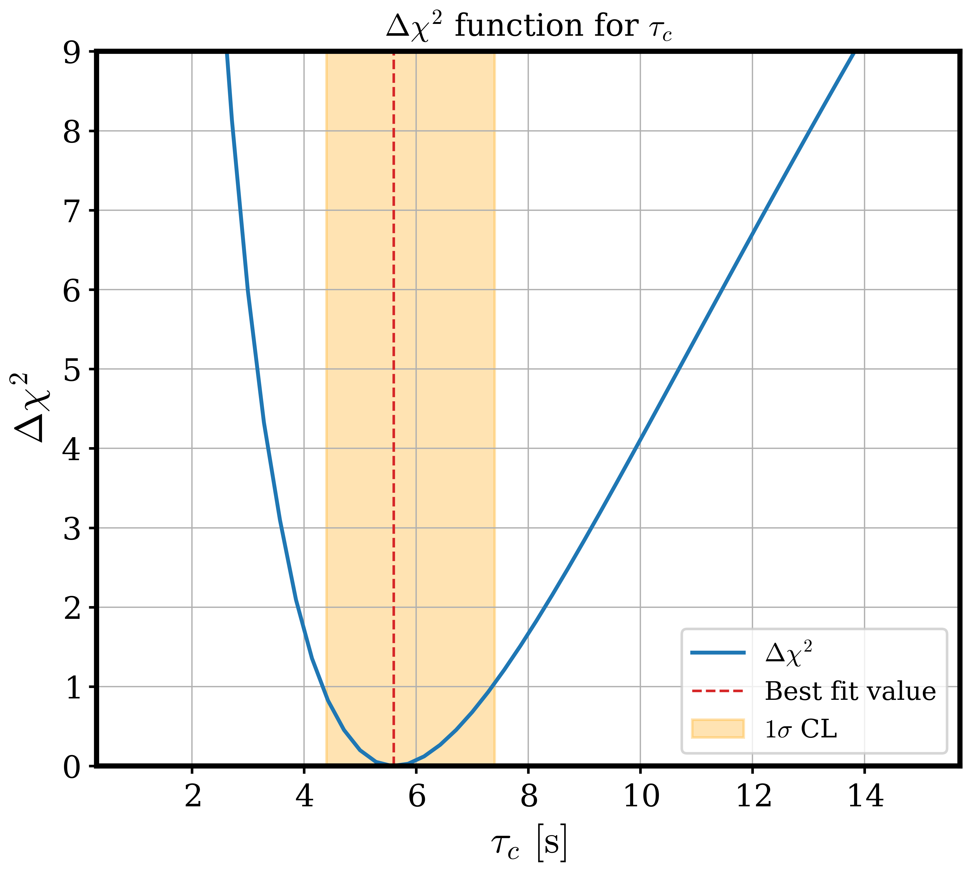
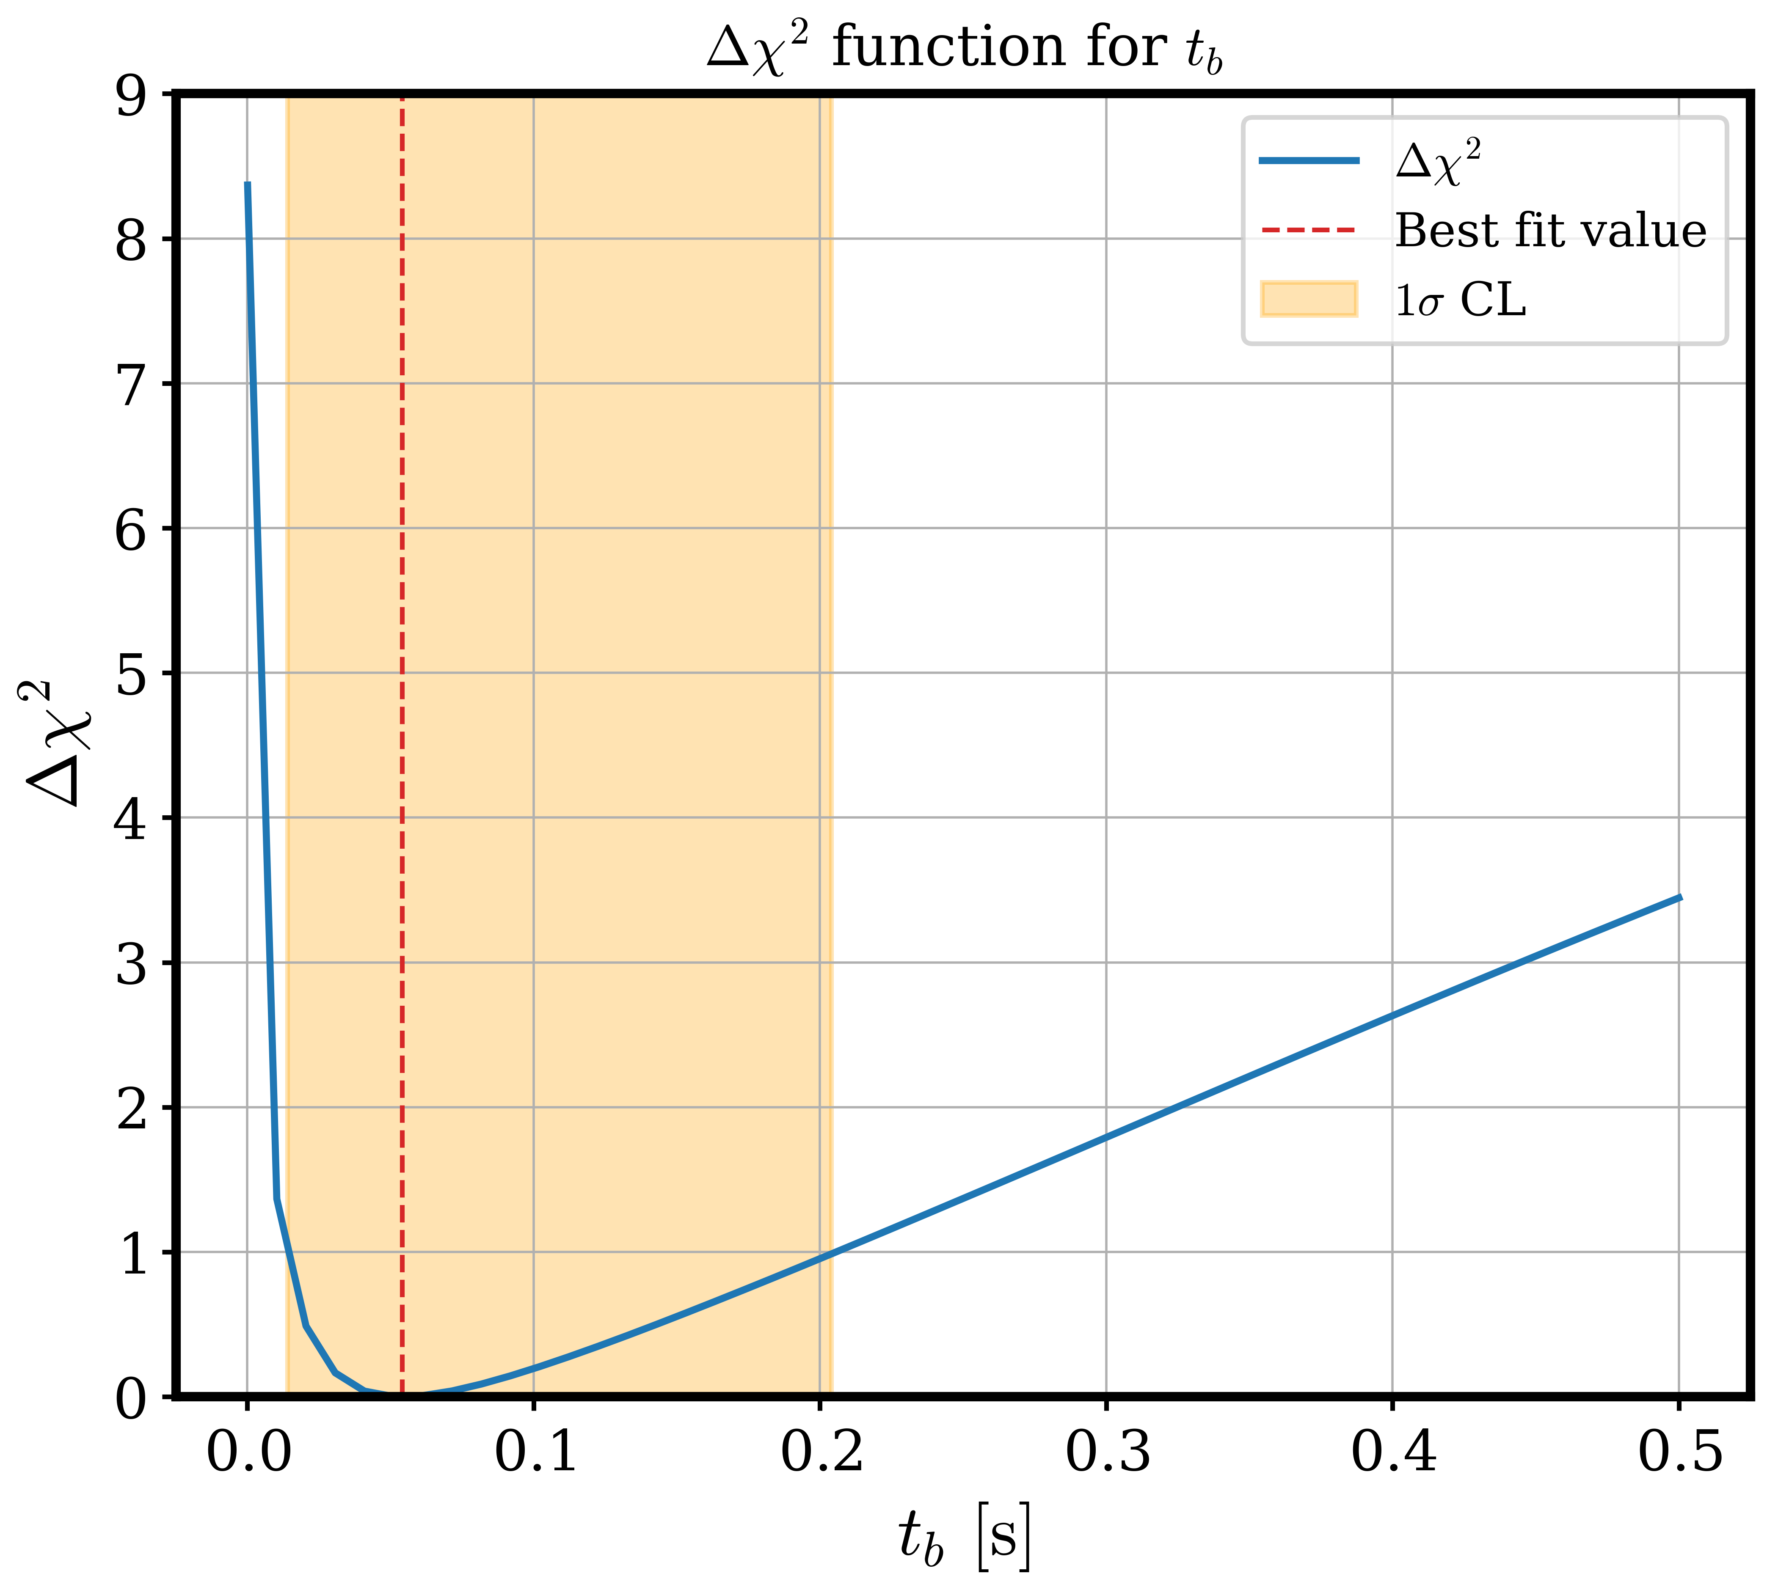
Likelihood analysis results

Slide 27


Likelihood analysis results

Slide 28
Motivations
SN1987A only case of a measured neutrino signal from stellar core collapse.
many large-scale detectors running or in preparation to provide a high-statistics data from next nearby supernova.
progress in theory and simulations with respect to original analysis of SN1987A - need to revisit data and enhance precision.
addressing the time structure of the neutrino emission (accretion and cooling)
operating in the context of a parameterized model

