Slide 1

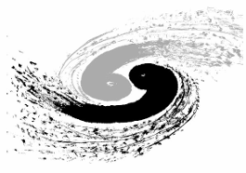
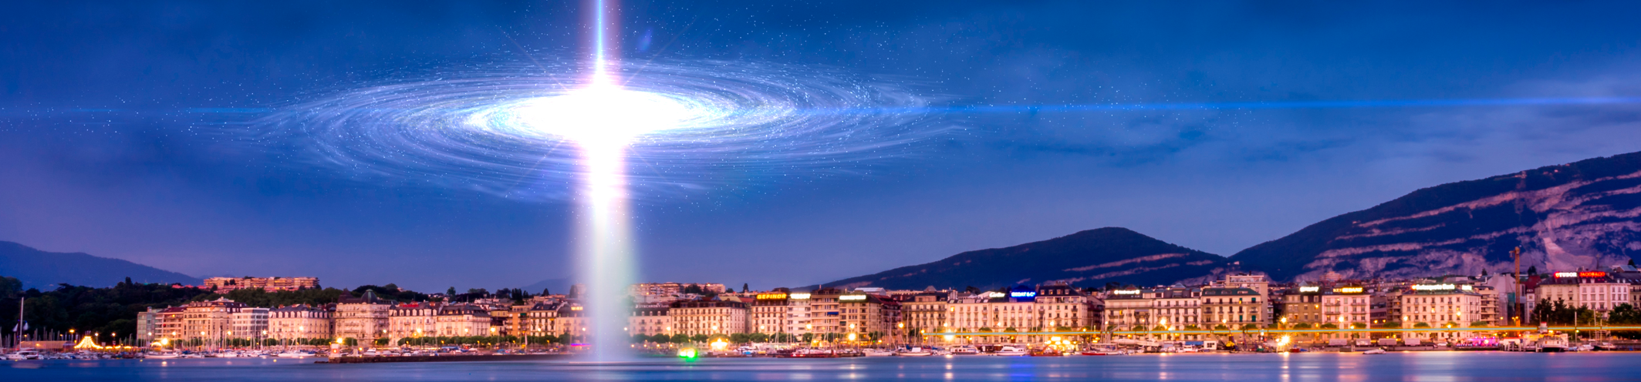
Atmospheric Neutrino Flux Calculation in Low Energies
Jie Cheng, North China Electric Power University
Yu-Feng Li, Institute of High Energy Physics, Chinese Academy of Sciences
2025.07.22

Slide 2
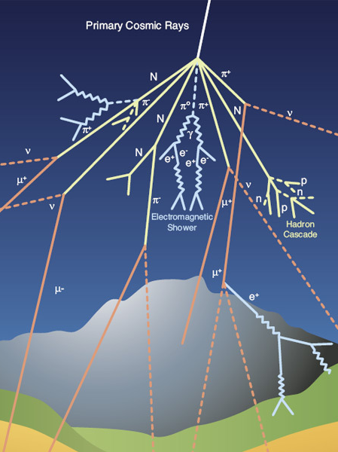
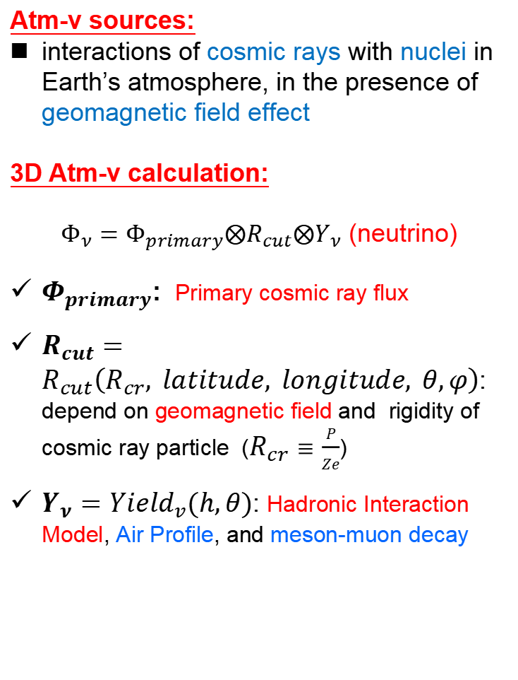
Atmospheric Neutrino
Atm-v sources:
interactions of cosmic rays with nuclei in Earth’s atmosphere, in the presence of geomagnetic field effect
3D Atm-v calculation:
$Φ_{ν}=Φ_{primary}⨂R_{cut}⨂Y_{ν}$ (neutrino)
$Φ_{primary}$: Primary cosmic ray flux
$R_{cut}=R_{cut}\left(R_{cr}, latitude, longitude, θ,φ\right)$: depend on geomagnetic field and rigidity of cosmic ray particle ($R_{cr}≡\frac{P}{Ze}$)
$Y_{ν}={Yield}_{v}(h,θ)$: Hadronic Interaction Model, Air Profile, and meson-muon decay
©cern

Slide 3
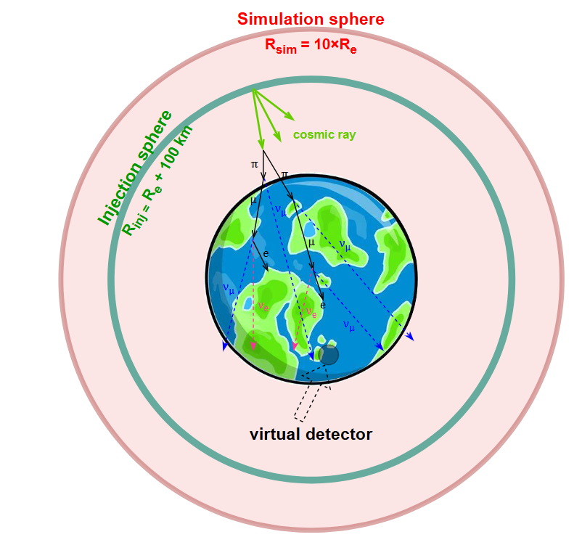


A Full 3D Calculation
Based on the calculation scheme by Honda-san
HKKMS11：Phys. Rev. D 83, 123001 (2011)
HKKMS15：Phys. Rev. D 92, 023004 (2015)
1. Injection sphere ($R_{inj}=R_{e}+100km$)
Randomly sample primary cosmic ray
2. Simulation sphere
Propagation of cosmic rays
Rigidity cutoff test
3. Virtual detector
Collect neutrinos passing through the virtual detector
Around true detector
One major update on $E_{ν}$<100 MeV:
include propagation of muons inside earth

Slide 4
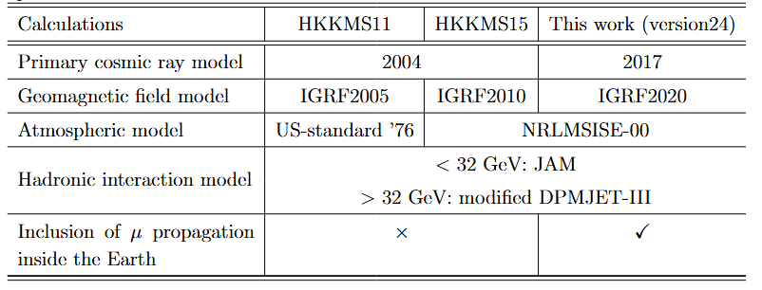
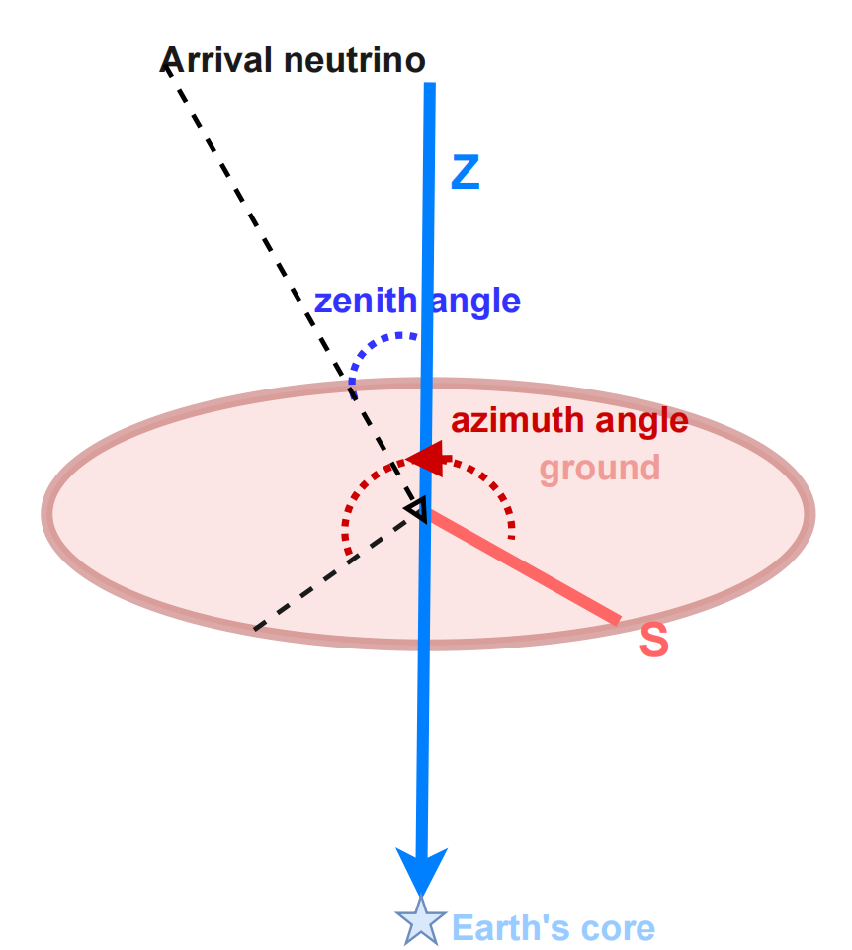
Overview of Previous HKKMS Flux and Current Calculation
HKKMS Flux Calculations: Phys. Rev. D 83, 123001 (2011)，Phys. Rev. D 92, 023004 (2015)
definitions of arrival zenith angle and azimuth angle of neutrino
zenith angle: angle between two directions: one pointing downward vertically and the other representing neutrino arrives
azimuth angle: counter-clockwise from the south

Slide 5
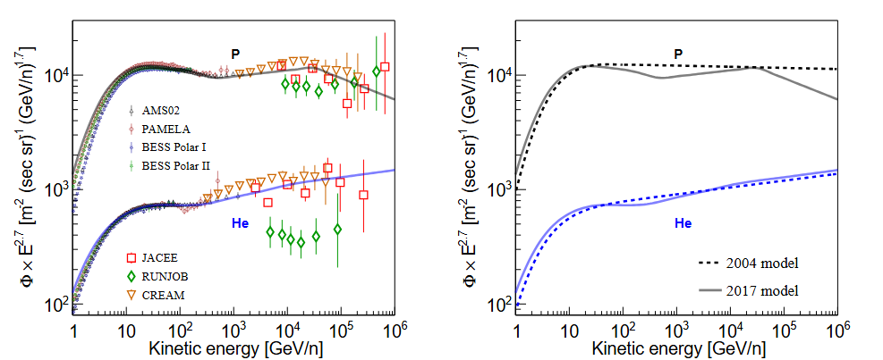
Primary Cosmic Ray Model
Preliminary
Preliminary
➔ Left plot: present cosmic ray model
Based on recent AMS02 and other measurements, looking forward to more future measurements
New fitting method is used
Right plot: present model vs. previous model
Previous model used in HKKMS15

Slide 6
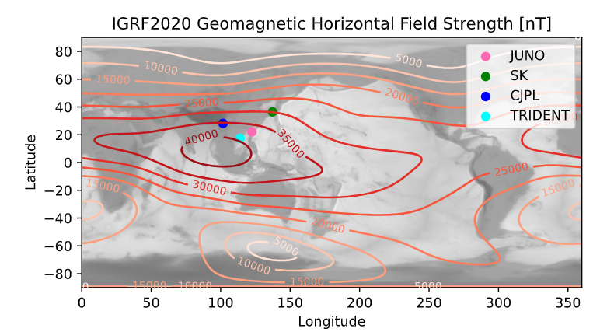
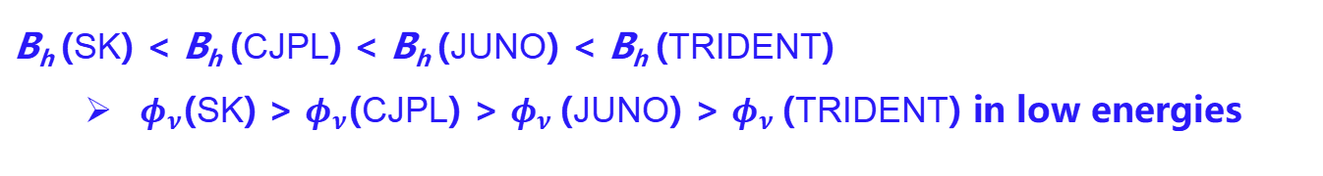
Geomagnetic Effects
Geomagnetic field model: International Geomagnetic Reference Field
IGRF2020 (latest version) is used in current calculation
IGRF2020 Geomagnetic Horizontal Field Strength (B_{h})
B_{h} (SK) < B_{h} (CJPL) < B_{h} (JUNO) < B_{h} (TRIDENT)
$φ_{ν}$(SK) > $φ_{ν}$(CJPL) > $φ_{ν}$ (JUNO) > $φ_{ν}$ (TRIDENT) in low energies

Slide 7
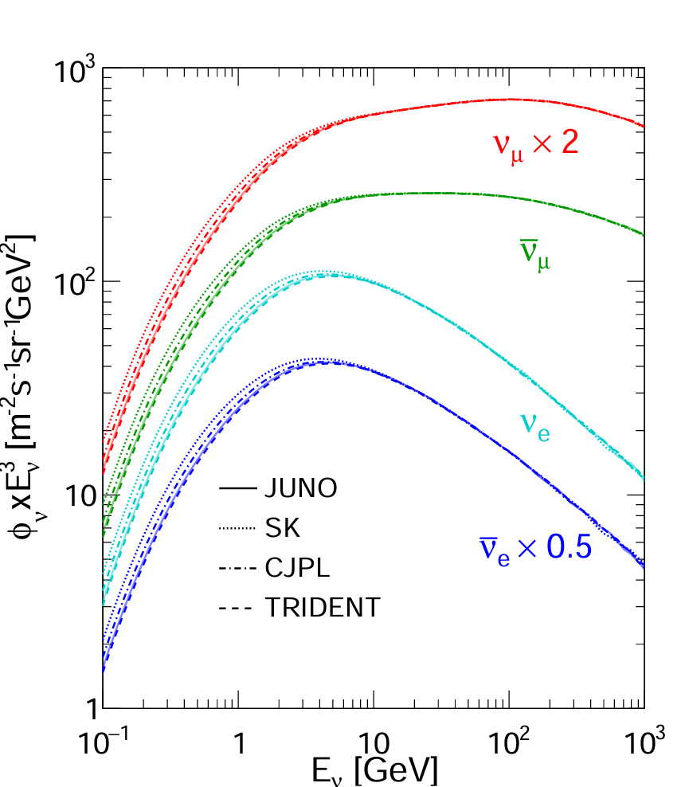
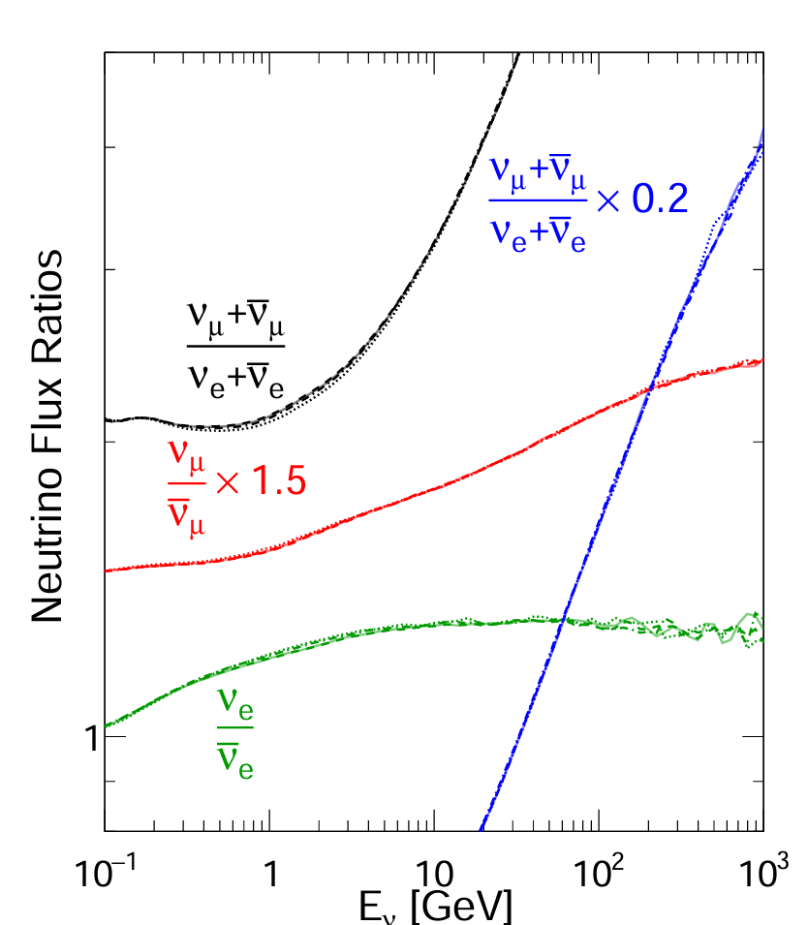



Current Atmospheric Neutrino Flux (>100 MeV)
Preliminary
Preliminary
2
1.5
All direction averaged flux
The differences in <10 GeV for 4 site: related to different local geomagnetic field strength
Assuming all mesons and muons decay:
$$\frac{ν_{μ}+{\overline{ν}}_{μ}}{ν_{e}+{\overline{ν}}_{e}}\sim 2$$
$$\frac{ν_{μ}}{{\overline{ν}}_{μ}}\sim 1$$
$$\frac{ν_{e}}{{\overline{ν}}_{e}}\sim 1$$

Slide 8
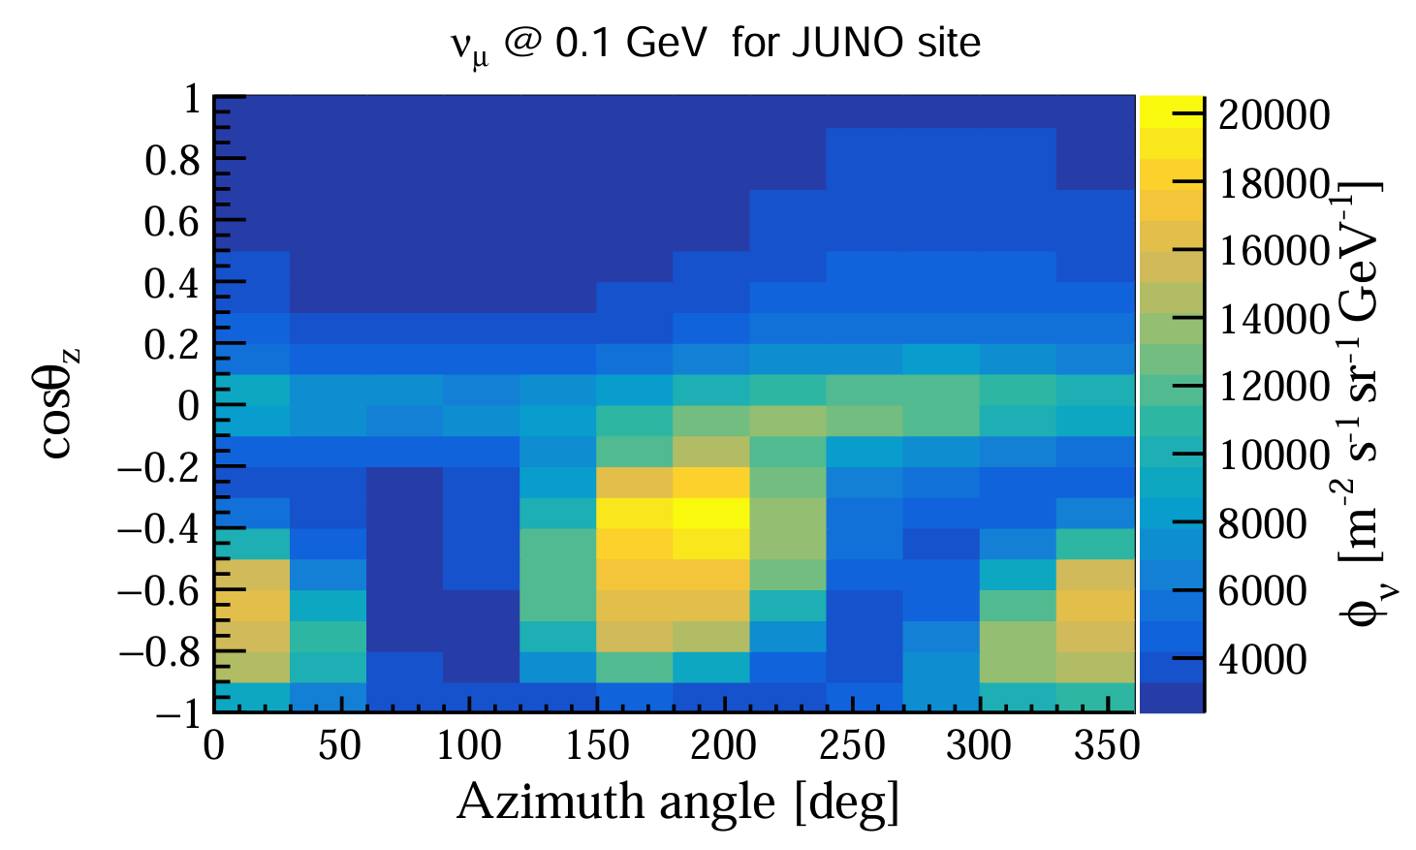
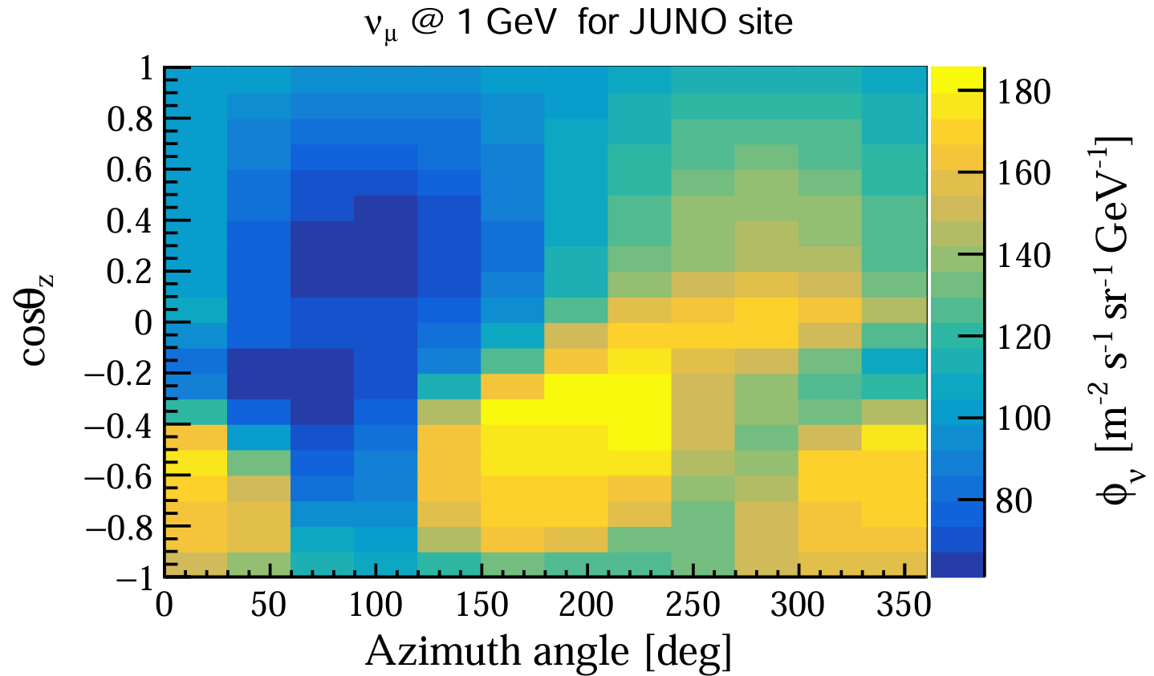
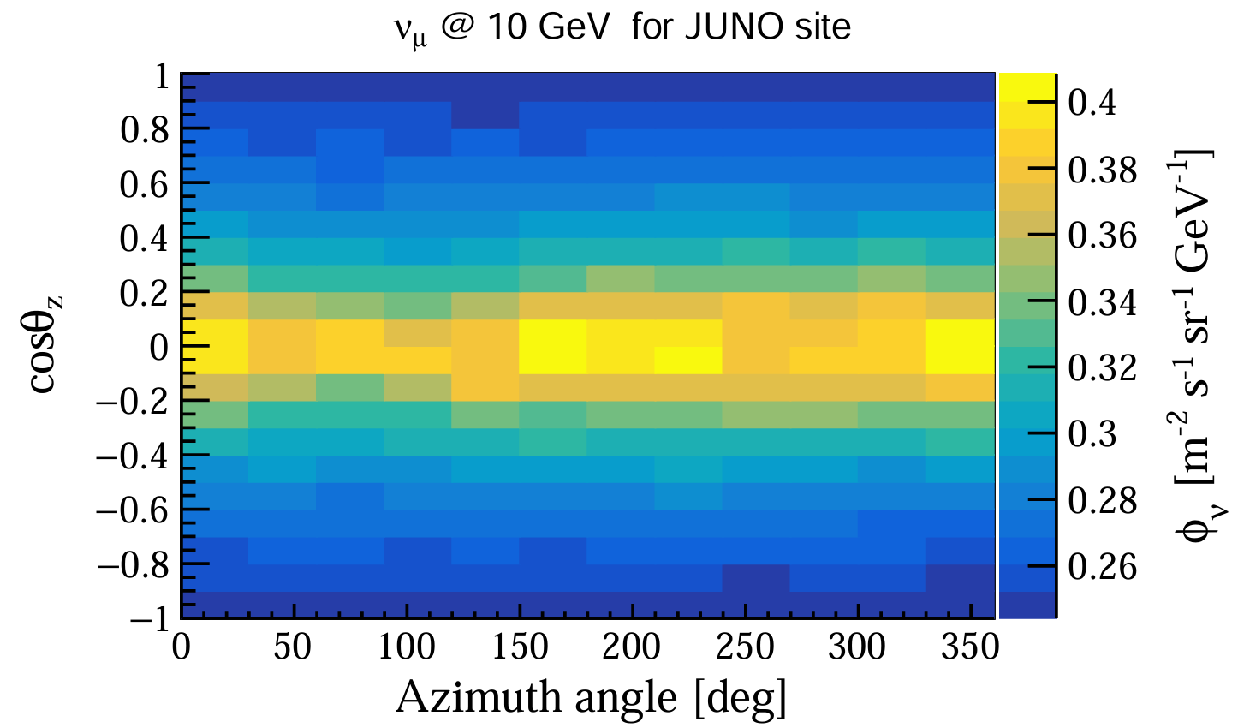
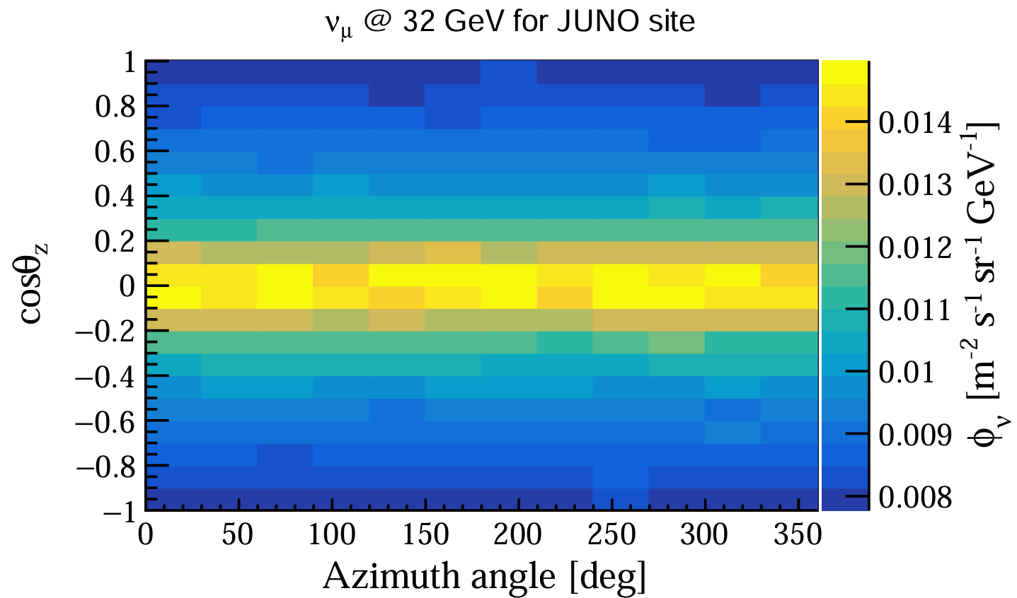
Atmospheric Neutrino Flux at Different Directions
Preliminary
Preliminary
Preliminary
Preliminary
In neutrino energy range (<10 GeV), 3D structures are obvious

Slide 9
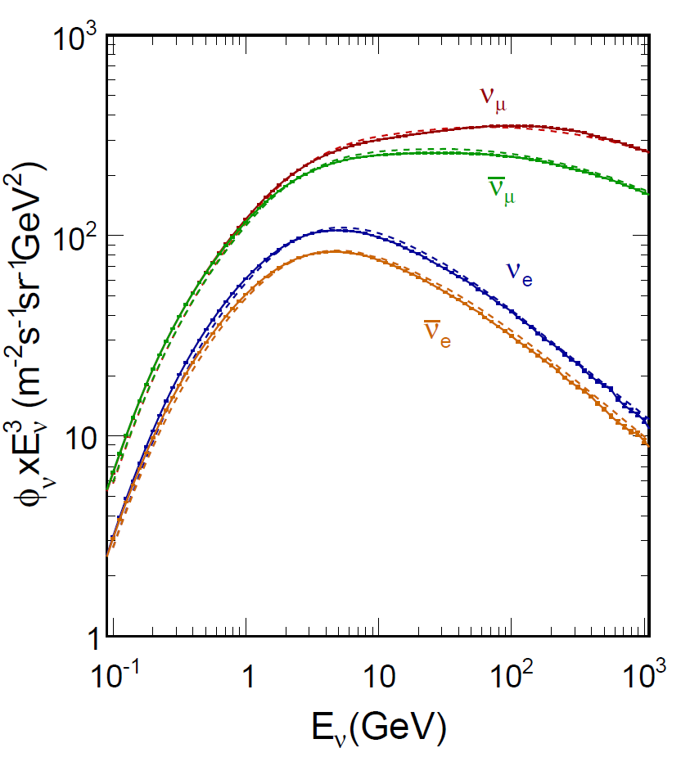
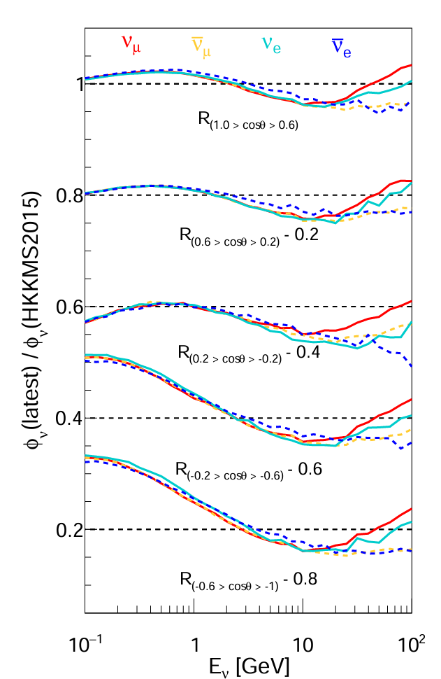
Comparison between Current Calculation and HKKMS15
Preliminary
Preliminary
JUNO
All direction averaged flux
15%
Dash line: flux provided in the following (http://www.icrr.utokyo.ac.jp/~mhonda/nflx2014/index.html)
Solid line: Current calculation

Slide 10
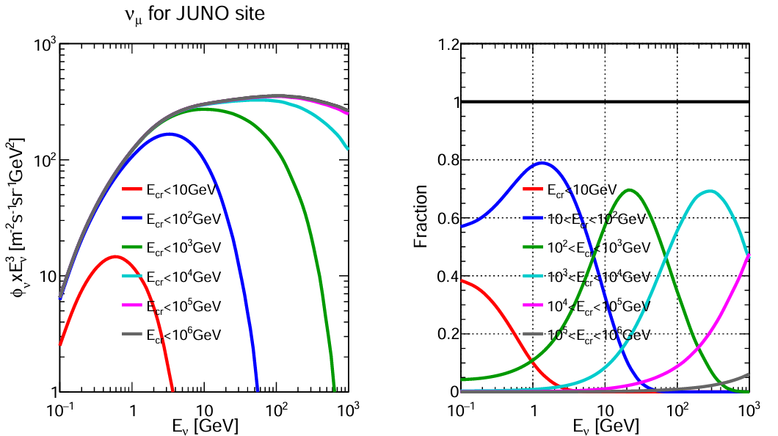
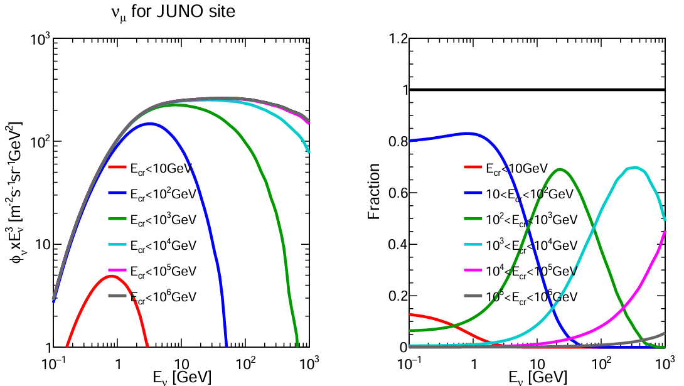
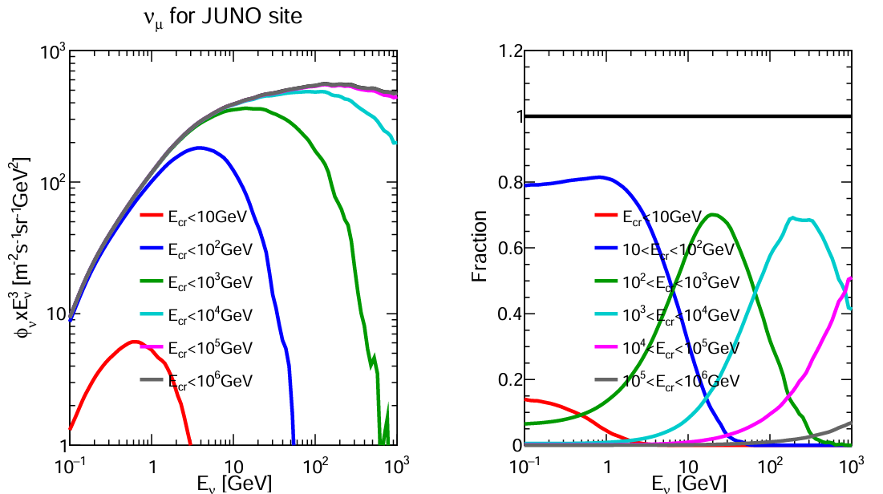
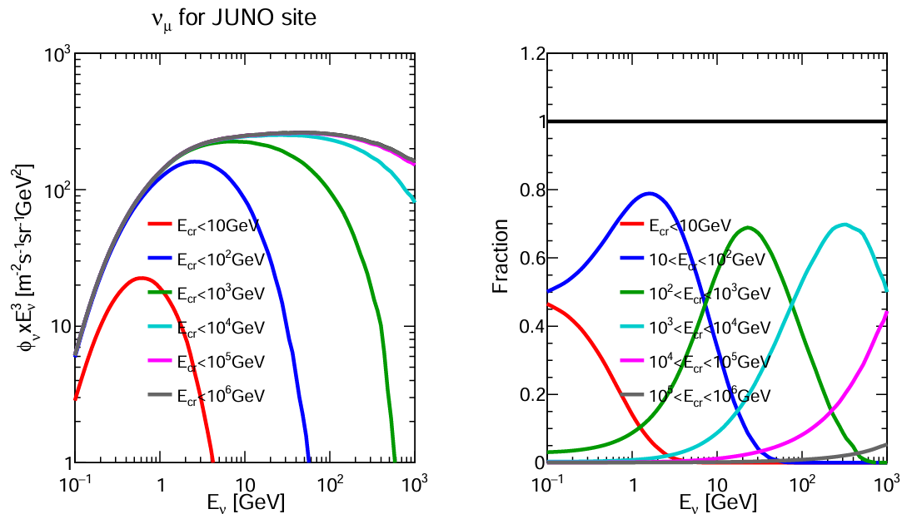

Link between Primary CR and Atm. $ν$ Flux
All direction averaged flux
downward
Preliminary
Preliminary
horizontal
upward
Preliminary
Preliminary
For $E_{ν}$<10 GeV, contributions from primary CR with energy<1 TeV: dominant
For $E_{ν}$<100 GeV, primary CR with energy<10 TeV: dominant

Slide 11
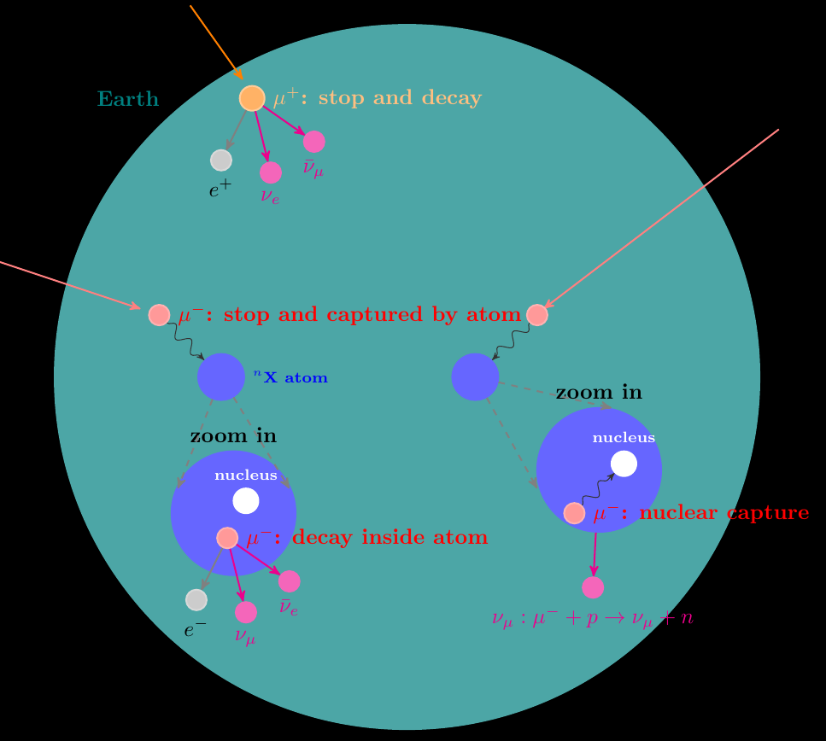
The possible physical processes of muons inside the Earth

Slide 12
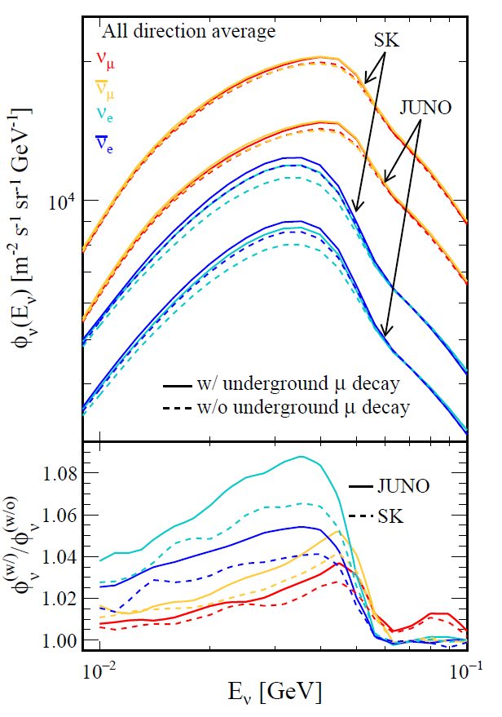
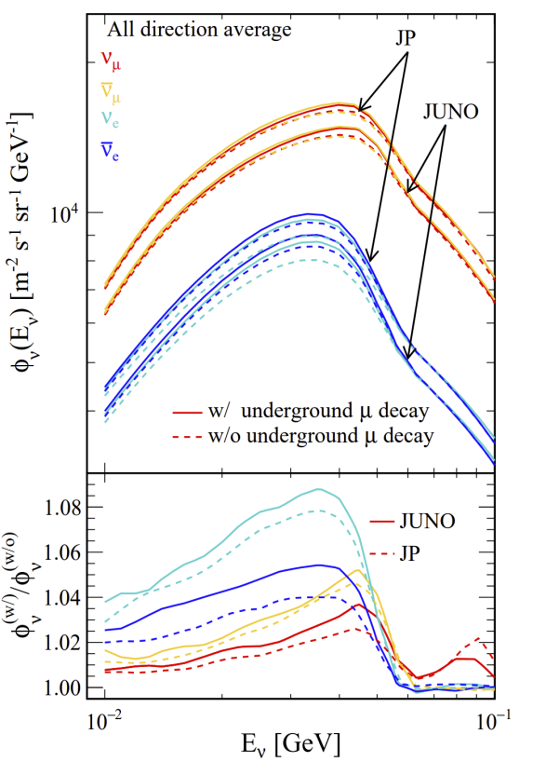
Flux Calculation below 100 MeV
Preliminary
Preliminary
Because of lower geomagnetic intensity in SK, more low energies cosmic rays can pass the cutoff rigidity
The magnetic field effect can be verified by comparing the different sites
12

Slide 13
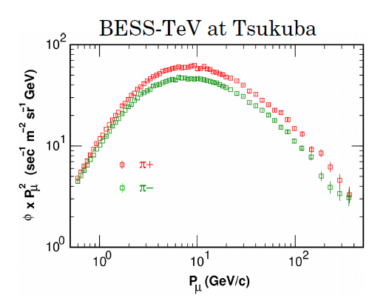
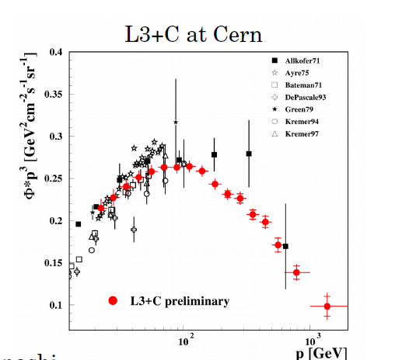
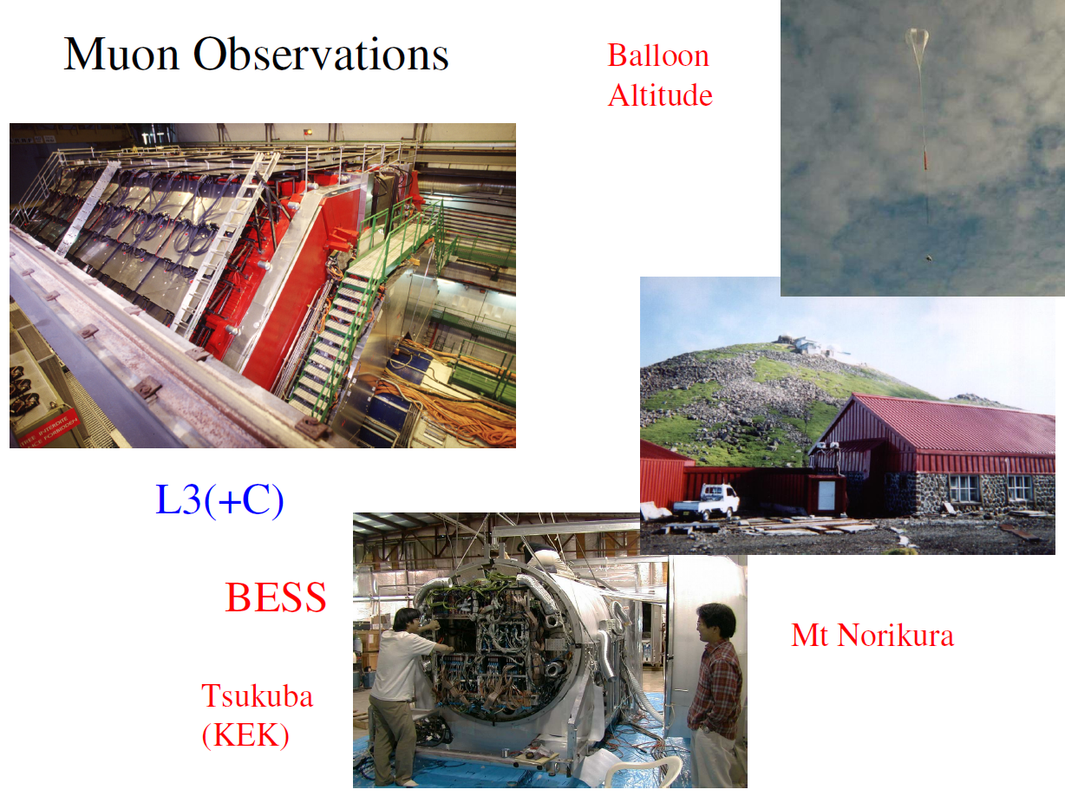
Hadronic Interaction Model
Models of hadron production: based on accelerator data
< 32 GeV: JAM model
> 32 GeV: modified DPMJET-III
Muon observations used to calibrate the hadronic models and constraint the associated uncertainty
Fine-tuning continues throughout the calculation process
Honda @ PANE 2018

Slide 14
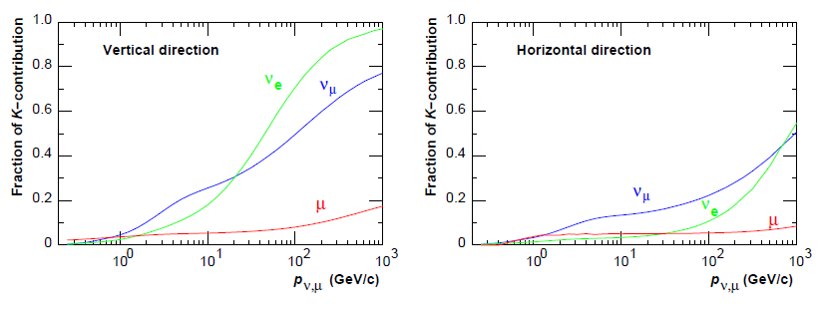
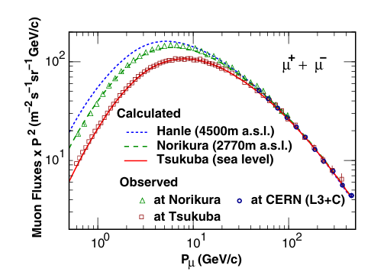
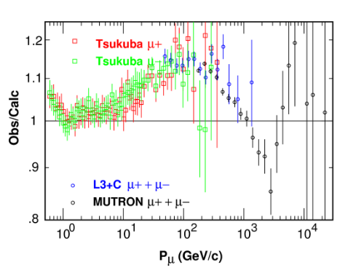
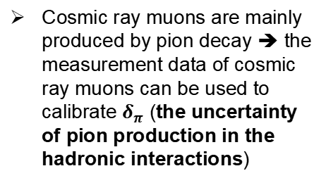
Observation / Calculation Ratio
Honda et al., PRD100,123022(2019)
PRD 75 (2007) 043005
Cosmic ray muons are mainly produced by pion decay ➔ the measurement data of cosmic ray muons can be used to calibrate $δ_{π}$ (the uncertainty of pion production in the hadronic interactions)
New primary model + previous Int. model
Honda @ PANE 2018

Slide 15
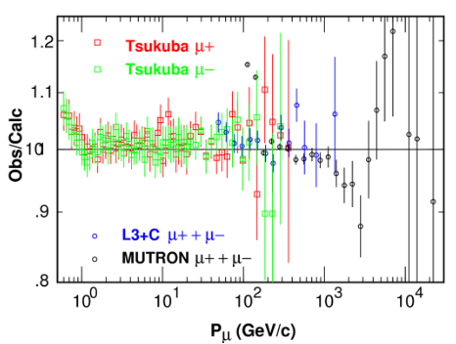
Observation / Calculation Ratio
Honda et al., PRD100,123022(2019)
PRD 75 (2007) 043005
Cosmic ray muons are mainly produced by pion decay ➔ the measurement data of cosmic ray muons can be used to calibrate $δ_{π}$ (the uncertainty of pion production in the hadronic interactions)
New primary model + new Int. model
Honda @ PANE 2018

Slide 16
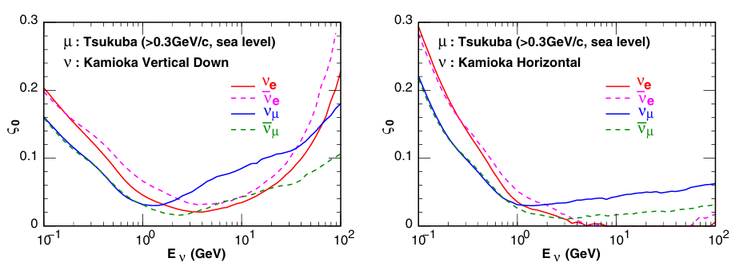
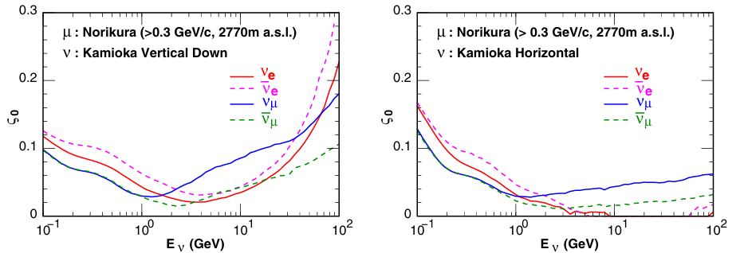
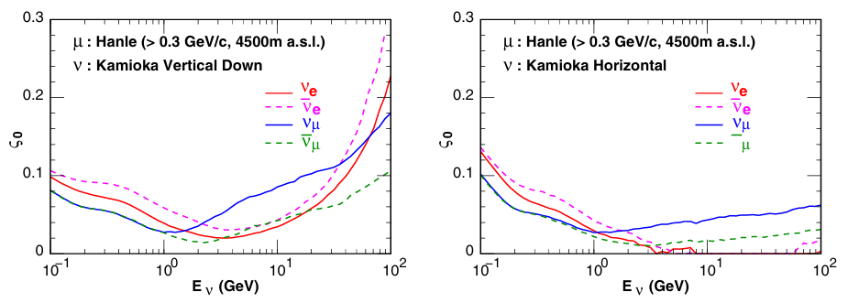
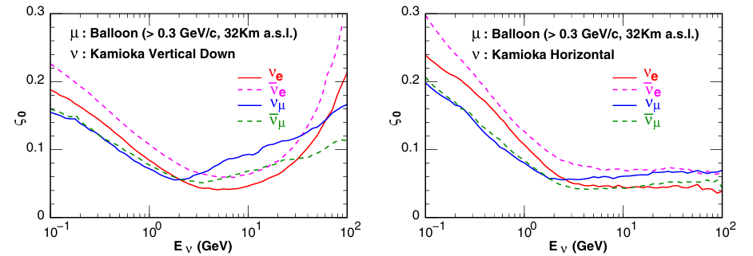
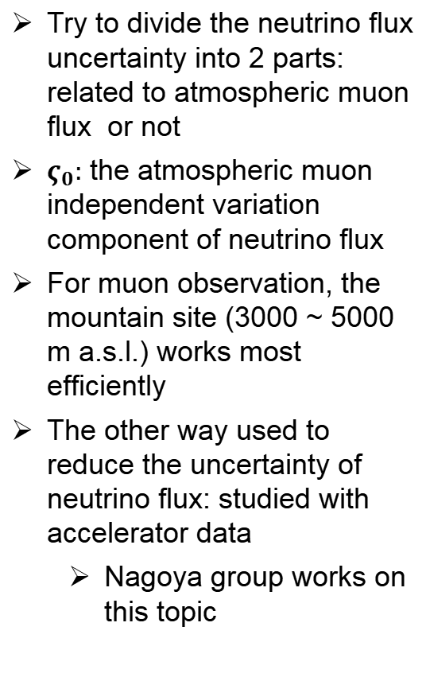
Survey of Calibration Power at Muon Observation Site
Honda et al., PRD100,123022(2019)
PRD 75 (2007) 043005
Try to divide the neutrino flux uncertainty into 2 parts: related to atmospheric muon flux or not
$ς_{0}:$ the atmospheric muon independent variation component of neutrino flux
For muon observation, the mountain site (3000 ~ 5000 m a.s.l.) works most efficiently
The other way used to reduce the uncertainty of neutrino flux: studied with accelerator data
Nagoya group works on this topic
Altitude increases

Slide 17
Summary
We provide a new atmospheric neutrino flux model, based on the previous HKKMS calculation
Latest (preliminary) atmospheric neutrino flux, including neutrino energy < 100 MeV, are presented
Deeply understand the geomagnetic effects on neutrino flux and the link between the primary cosmic ray and atmospheric neutrino flux
Compared to HKKMS15, major changes are because the updated primary cosmic ray models (CR flux model closer to measurements)
To improve the precision of atmospheric neutrino flux calculation, the most challenge part is how to constraint the uncertainty from the hadronic interaction model
Atmospheric muon flux measurement still works at low energy range, more measurements at high mountain are required
Using acceleration data and build a good cooperation with accelerator study
Thanks

Slide 18
Backup

Slide 19
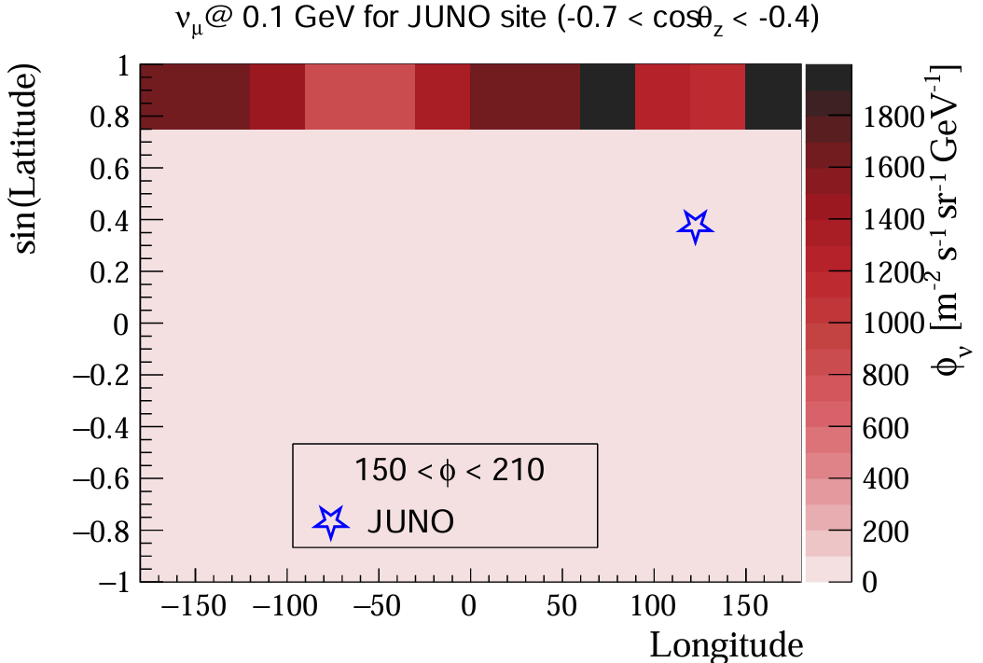
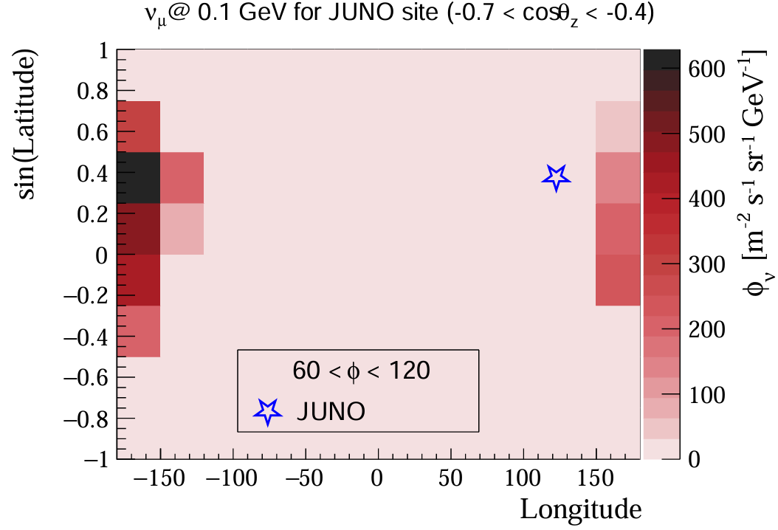
Neutrino Produced Position Zone
Preliminary
Preliminary
Preliminary

Slide 20
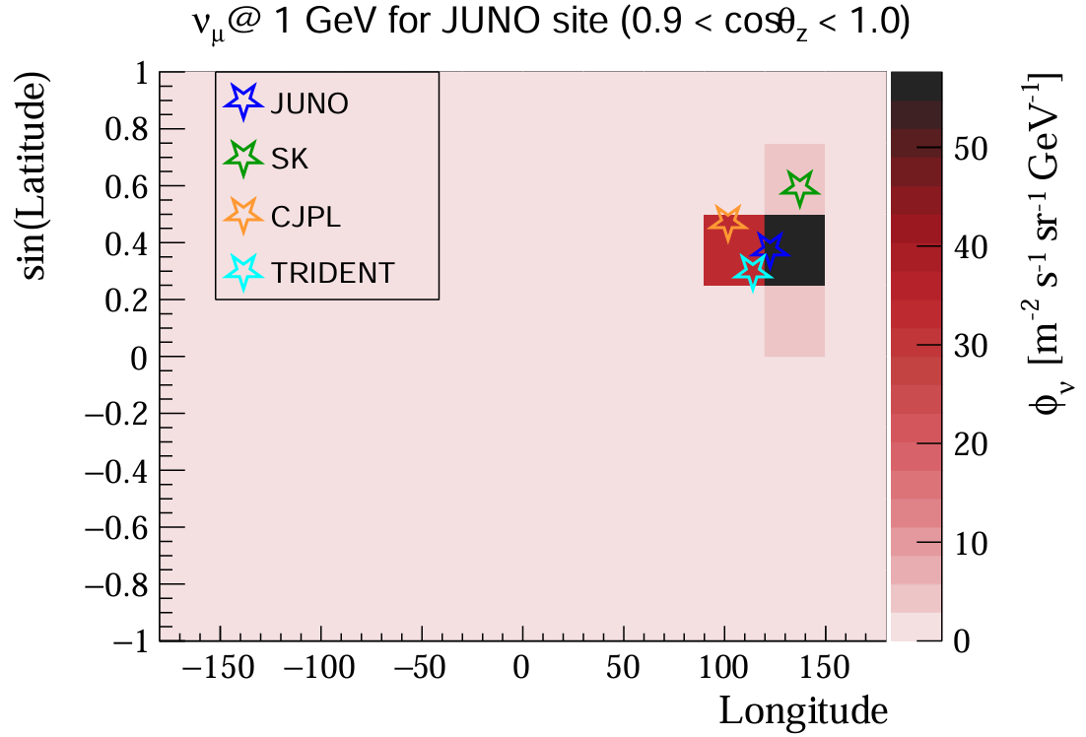
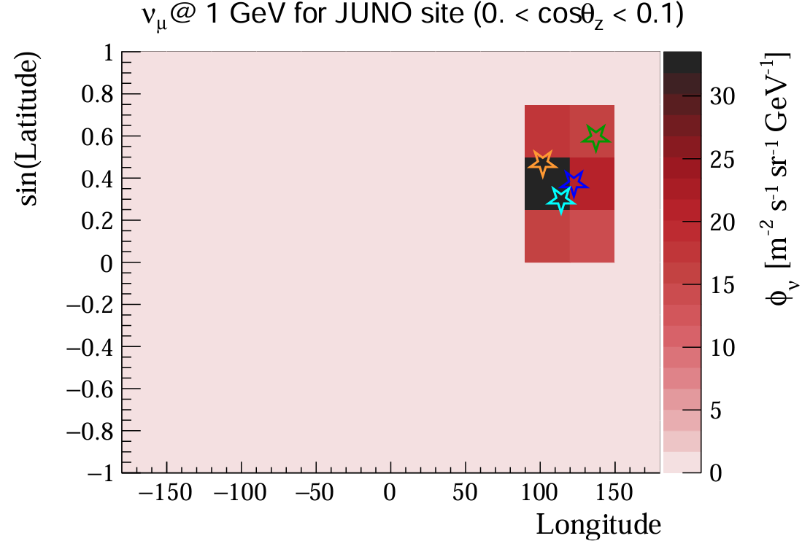
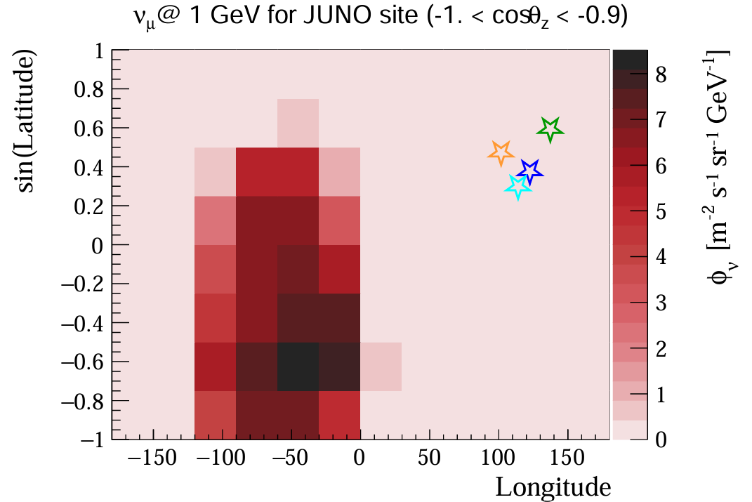
Neutrino Produced Position Zone
downward
Preliminary
Preliminary
horizontal
upward
Preliminary
Preliminary

Slide 21
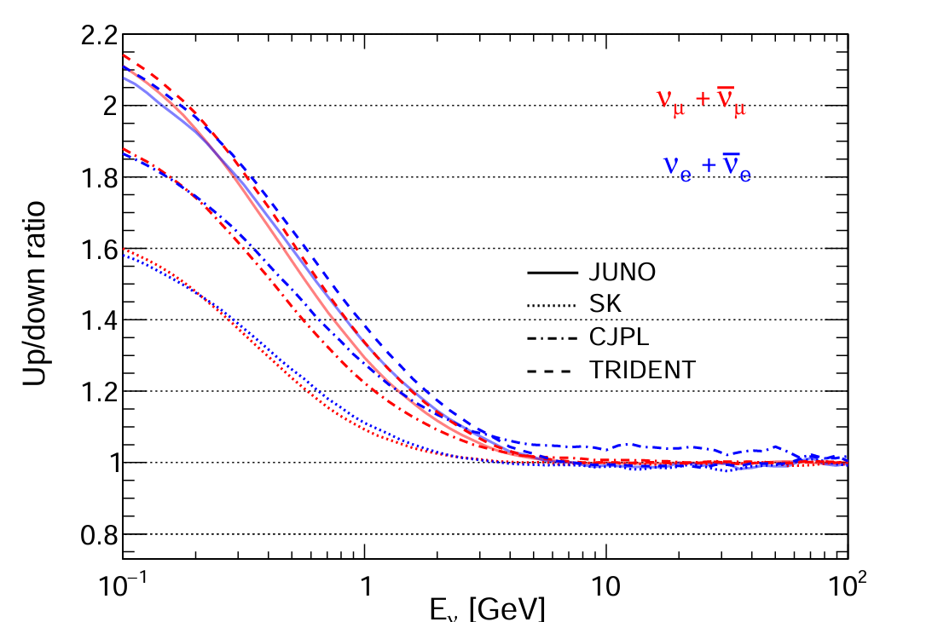
Asymmetry in Up-to-Down Ratio
Preliminary
Average all azimuth angles
Downward direction flux: dependent on local geomagnetic field
Upward direction flux: quite similar for these 4 sites, neutrinos from a wide range

Slide 22
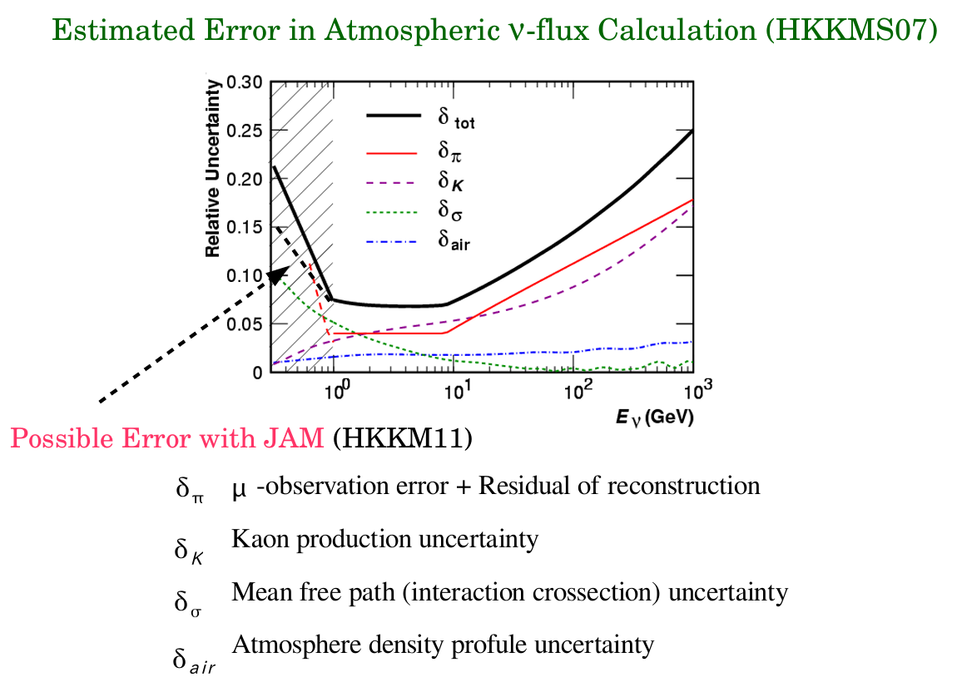
Honda @ PANE 2018

