Slide 1



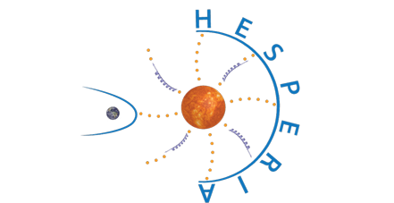
Earth as a giant spectrometer: neutron monitor network and latitude survey
Bernd Heber on behalf of the HESPERIA, SPEARHEAD consortium and many others
Christian-Albrechts-Universität Kiel

Slide 2
Why are neutron monitors still an important ingredient in cosmic ray research, Space Weather, Dosimetry, Atmospheric physics and environmental science?
  How does a neutron monitor look like and how does it work?
  Where do the neutrons come from?
  What is the influence of the earth magnetic field?
How can this be used to define Spaceship Earth as a particle telescope to measure about 1 GV to above 15 GV particles?
What can one do with such a detector?
  Investigation of Ground Level Enhancements,
  Computation of the dose rates at flight altitudes
  Environmental science

Slide 3
Long term observations
From Bindi et al. (this conference)

Slide 4
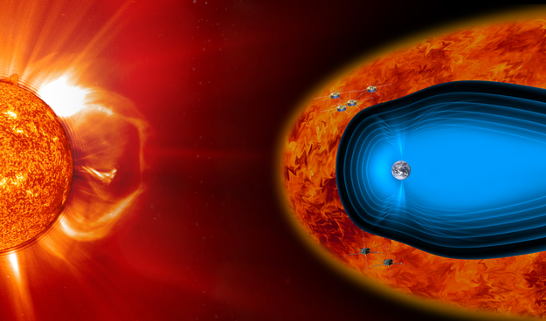
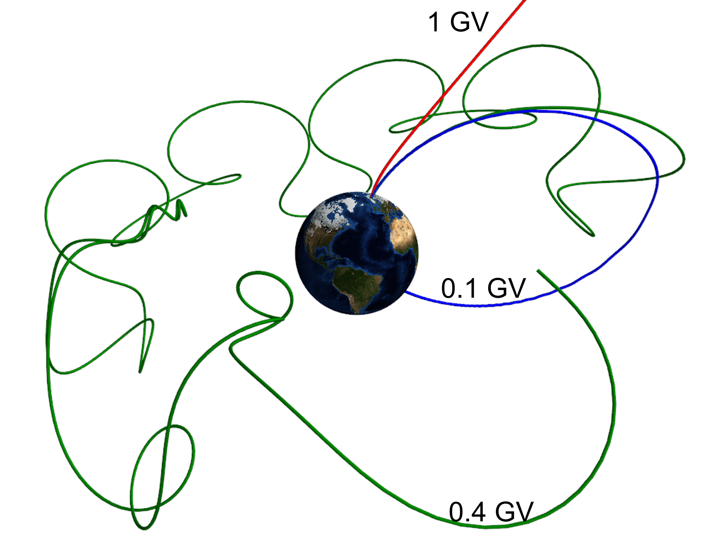
Motivation
The worldwide neutron monitor (NM) network together with the Earth’s magnetic field is a huge spectrometer for cosmic rays in the energy range >500 MeV to ̴15 GeV

Slide 5
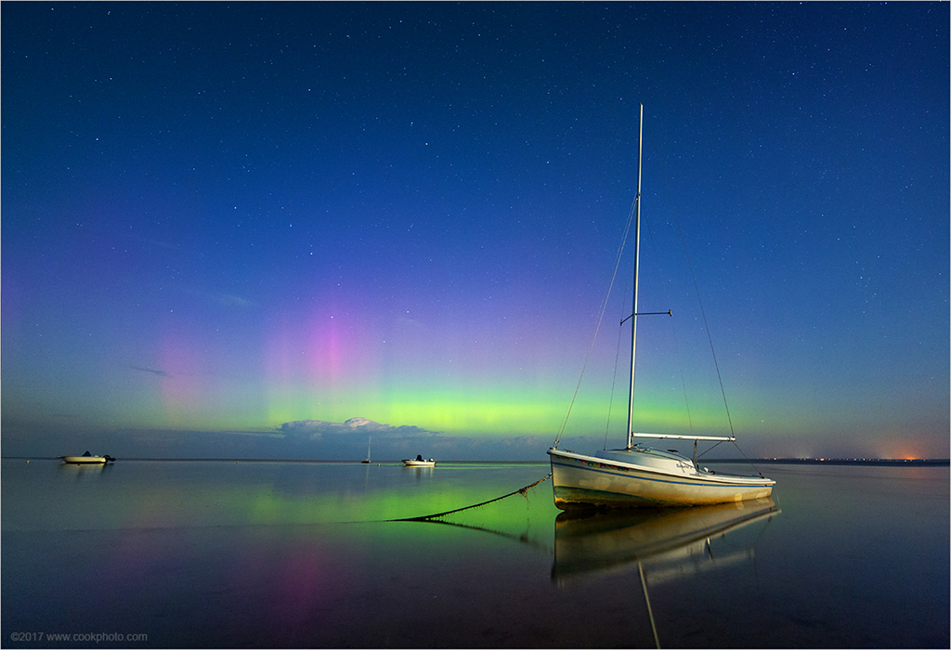
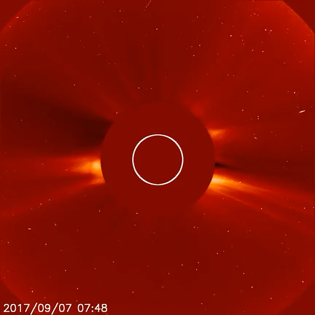
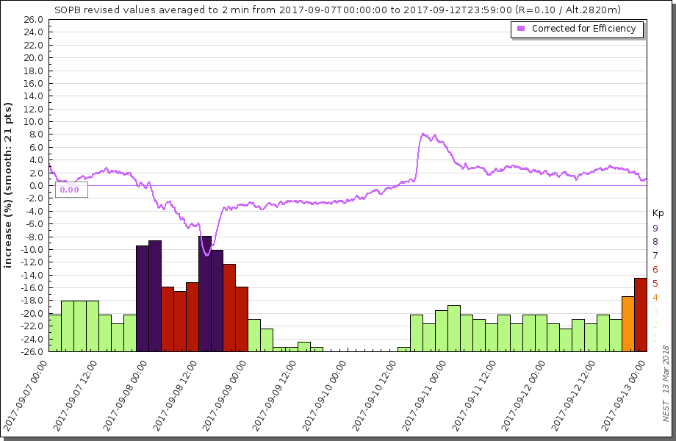
Space Weather Research
  Solar energetic particle (SEP) event,
  September 10. 2017)
Forbush Decrease
data retrieved from http://nest.nmdb.eu
Image Credit & Copyright: Chris Cook
LASCO from https://www.esa.int/esatv/Videos/2017/09/Solar_events

Slide 6
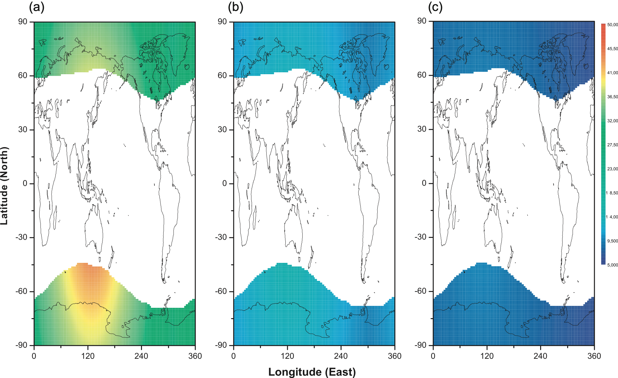
Radiation at flight altitudes
Effective dose rate (lSv h1) at flight altitudes during GLE 70 (13 December 2006):
initial phase of the event,
main phase of the event,
late phase of the event.
32 µSV/h
42 µSV/h

Slide 7
Why are neutron monitors still an important ingredient in cosmic ray research, Space Weather, Dosimetry, Atmospheric physics and environmental science?
  How does a neutron monitor look like and how does it work?
  Where do the neutrons come from?
  What is the influence of the earth magnetic field?
How can this be used to define Spaceship Earth as a particle telescope to measure about 1 GV to above 15 GV particles?
What can one do with such a detector?
  Investigation of Ground Level Enhancements,
  Computation of the dose rates at flight altitudes
  Environmental science

Slide 8
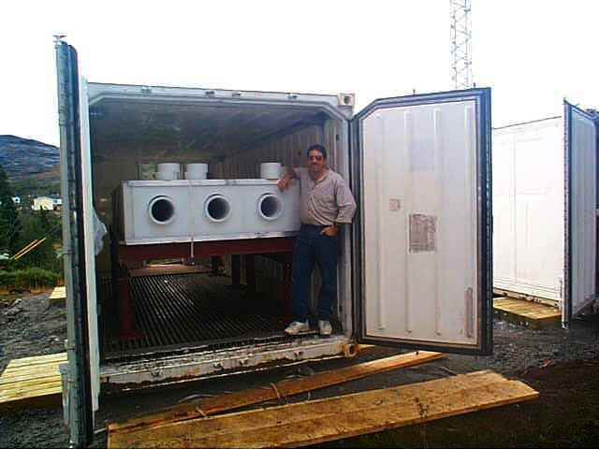
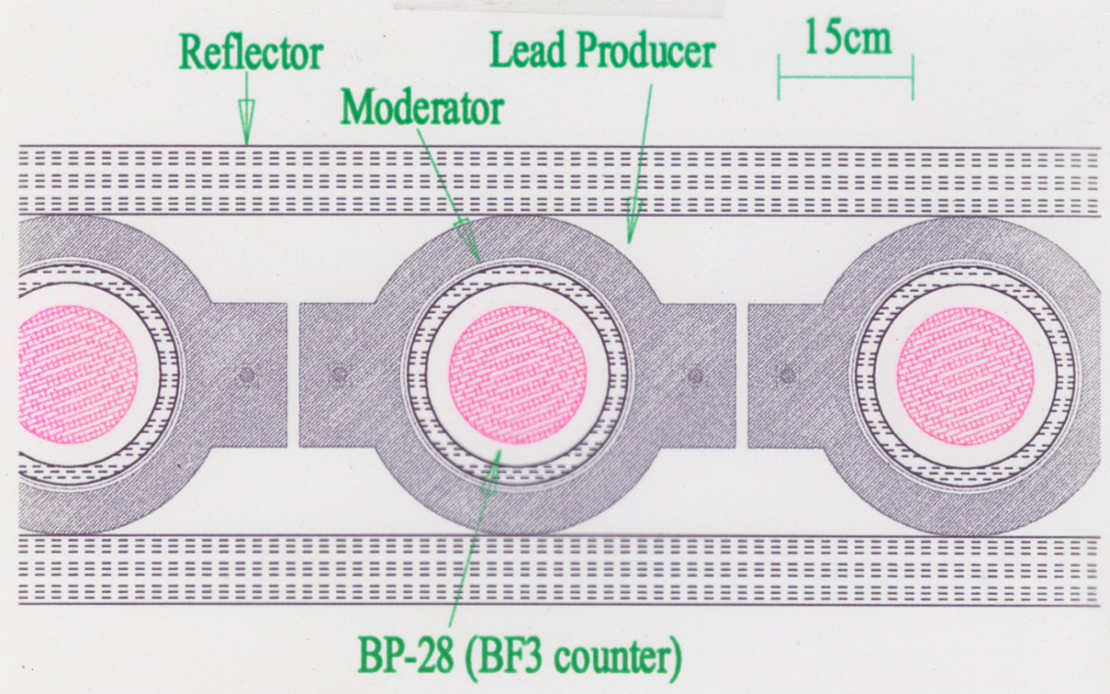
From Mishev & Usoskin (2015)
Instrument
Neutron Monitor in Nain, Labrador
Construction completed November 2000
Size ≈ 2.4 m × 2.4 m × 1.2 m
Weight ≈ 10–12 tons
Neutron sensitive proportional tubes (¹⁰BF₃ or ³He gas)
Moderator material (Low Density Polyethelene)
Lead target (neutron producer)
Reflector

Slide 9
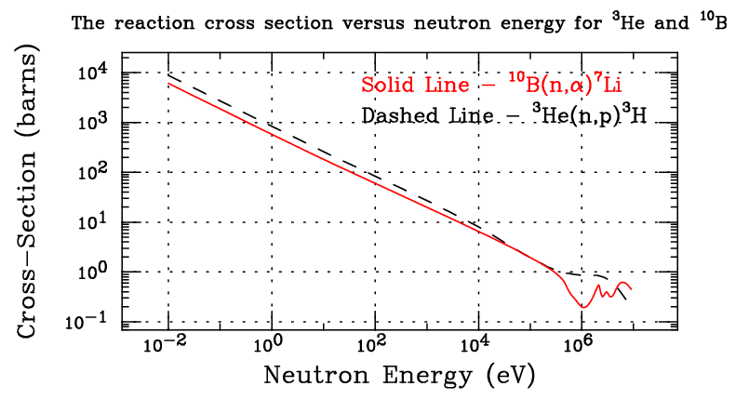
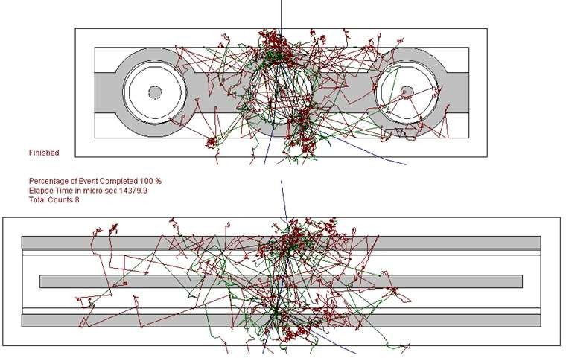
From Mishev & Usoskin (2015)
Incident Neutron
Reaction cross-sections for ¹⁰B(n,α)⁷Li and ³He(n,p)³H :
Inversely proportional to the neutron energy
Thermal endpoint (0.025eV): σ = 3840 barns and σ = 5330 barns

Slide 10
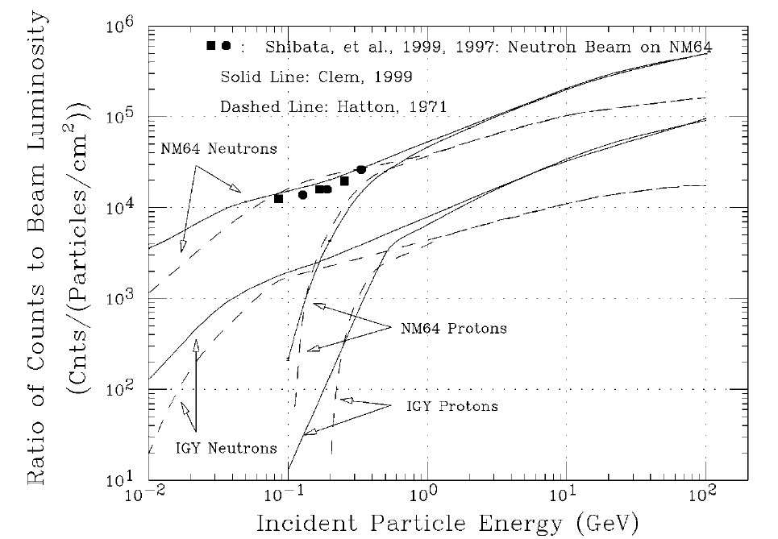
From Mishev & Usoskin (2015)
Incident Neutron
Computation of the instrument efficiency (eg. Clem and Dorman, 2000) utilizing GEANT 4 or FLUKA

Slide 11
Why are neutron monitors still an important ingredient in cosmic ray research, Space Weather, Dosimetry, Atmospheric physics and environmental science?
  How does a neutron monitor look like and how does it work?
  Where do the neutrons come from?
  What is the influence of the earth magnetic field?
How can this be used to define Spaceship Earth as a particle telescope to measure about 1 GV to above 15 GV particles?
What can one do with such a detector?
  Investigation of Ground Level Enhancements,
  Computation of the dose rates at flight altitudes
  Environmental science

Slide 12
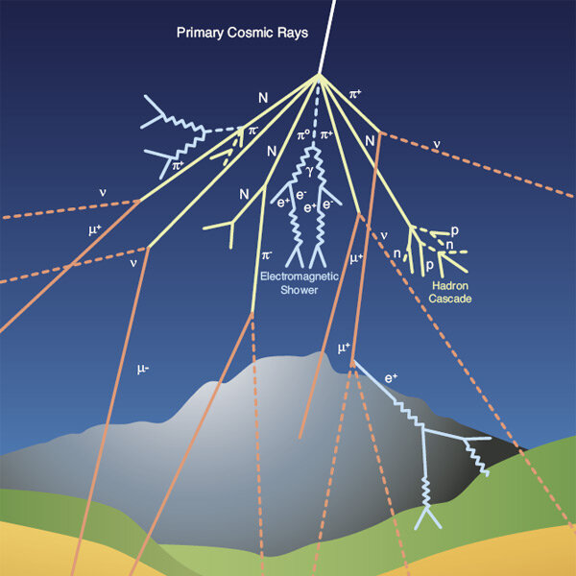
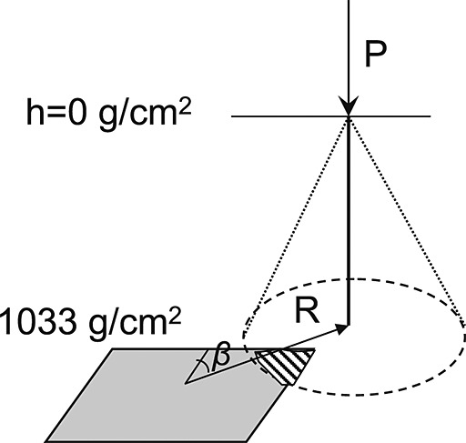
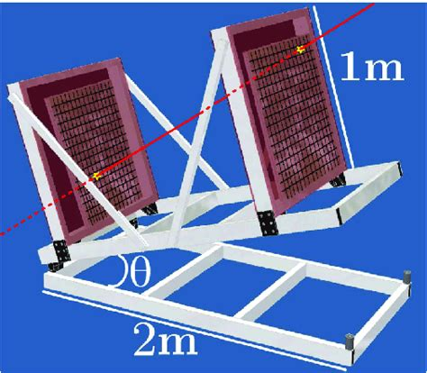
Setup for PLANETOCOSMICS or FLUKA modeling of cosmic ray interaction with the atmosphere
Muon-
Hadron component
Mishev et al. (2013)

Slide 13
Simple Estimation of the atmospheric shielding
Location | Altitude (m) | Atmos. depth (g/cm²) | Min. kinetic energy (GeV) | Proton Rigidity (GV) | Helium Rigidity (GV) | Cutoff rigidity (GV)
Sea level | 0 | ~1030 | ~1.1 | 1.8 | 3.6 | 0 – ~17
Jungfraujoch | 2650 | ~750–800 | ~0.75 | 1.4 | 2.8 | 4.5
South Pole Station | 2835 | ~700–740 | ~0.75 | 1.4 | 2.8 | 0.1
Dome C | 3233 | ~680 | ~0.7 | 1.3 | 2.7 | 0

Slide 14
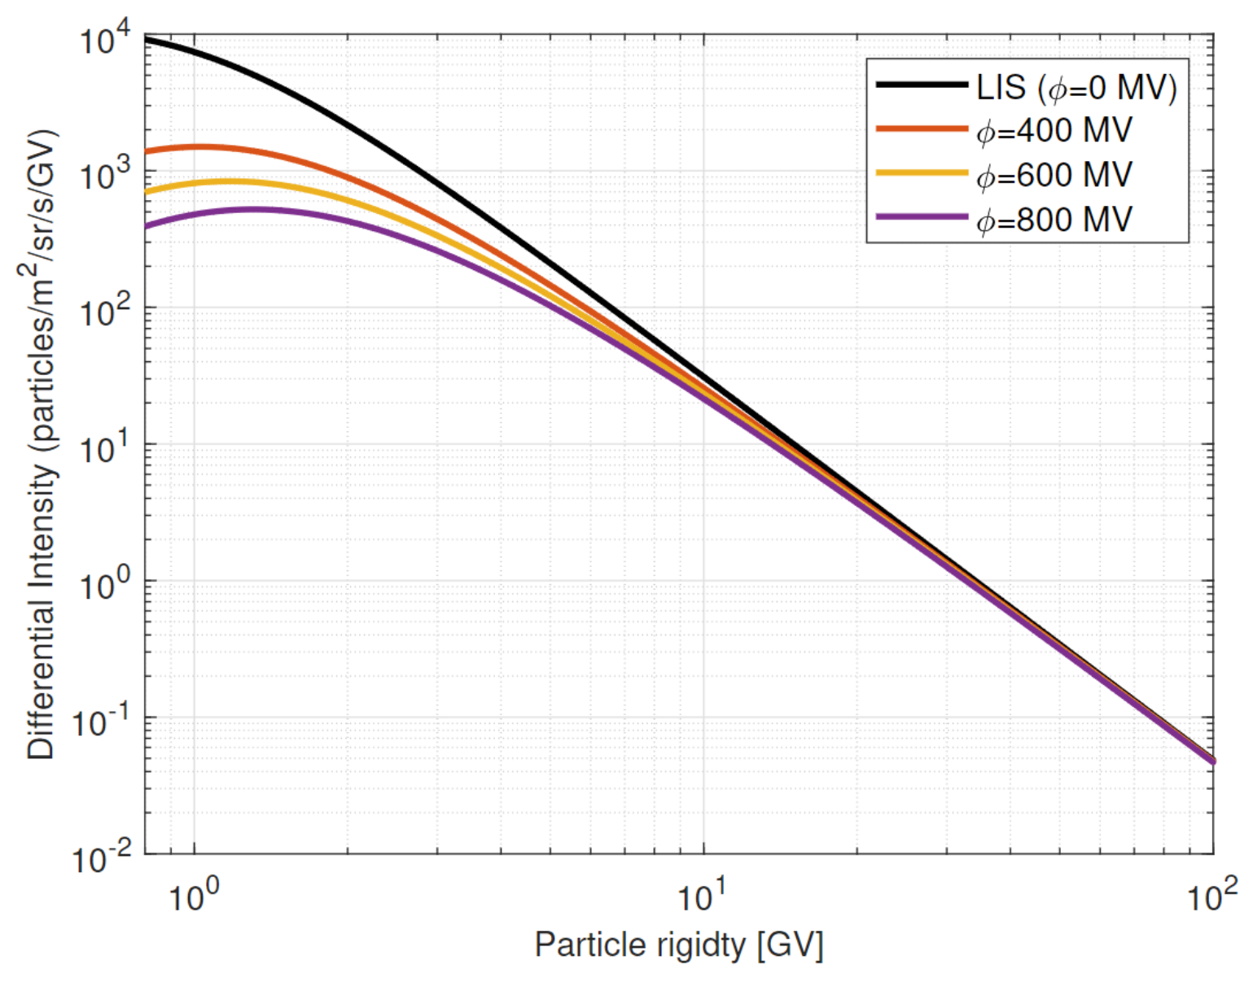
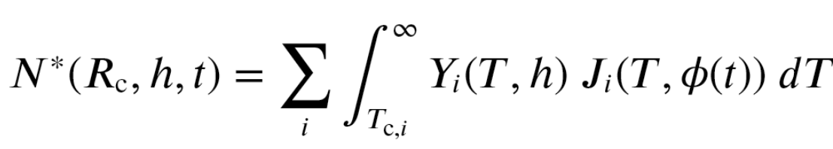
The yield function
yield functions Y_{i}(T,h)
Spectra Ji(E,Φ)
The critical regions
Inversion gives Φ(t). See Pauli et al. This conference

Slide 15
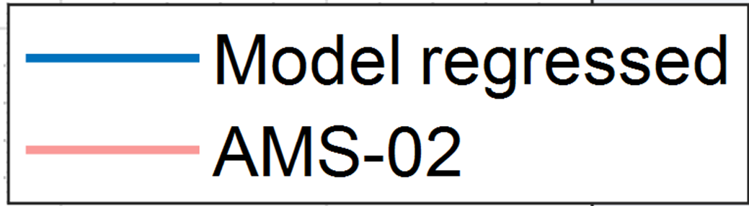
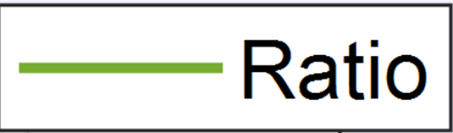
Validation with AMS-02 protons
From Pauli et al., this conference
😀

Slide 16
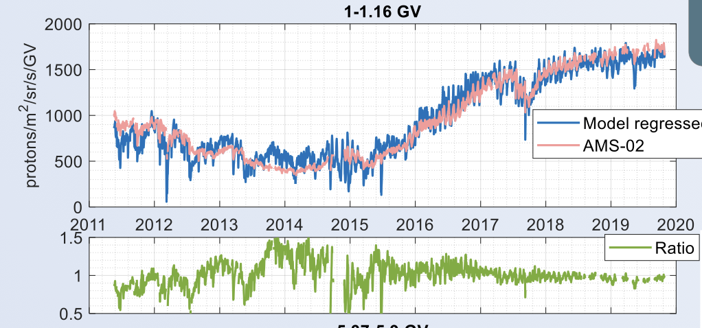
Validation with AMS-02 protons @ low rigidities
😑
The comparison with AMS 02 at low rigidities show large discrepancies as expected.
From Pauli et al., this conference

Slide 17
Why are neutron monitors still an important ingredient in cosmic ray research, Space Weather, Dosimetry, Atmospheric physics and environmental science?
  How does a neutron monitor look like and how does it work?
  Where do the neutrons come from?
  What is the influence of the earth magnetic field?
How can this be used to define Spaceship Earth as a particle telescope to measure about 1 GV to above 15 GV particles?
What can one do with such a detector?
  Investigation of Ground Level Enhancements,
  Computation of the dose rates at flight altitudes
  Environmental science

Slide 18
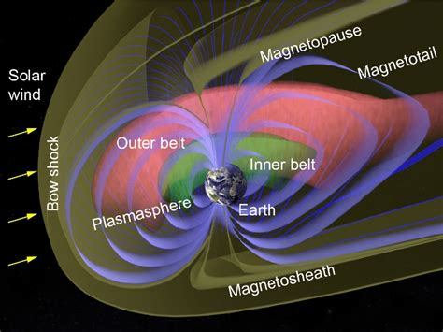
Cosmic ray transport in the geomagnetic field
The transport of cosmic ray particles in the geomagnetic field is calculated by backward trajectory-tracing technique by integration in a magnetic field model (inner and outer part).
International Geomagnetic Reference Field is approximate the Earth's magnetic field up to the near-Earth
Tsyganenko 1989 … 2005 magnetic field models provides the state of the outer magnetosphere for different levels of solar activity

Slide 19
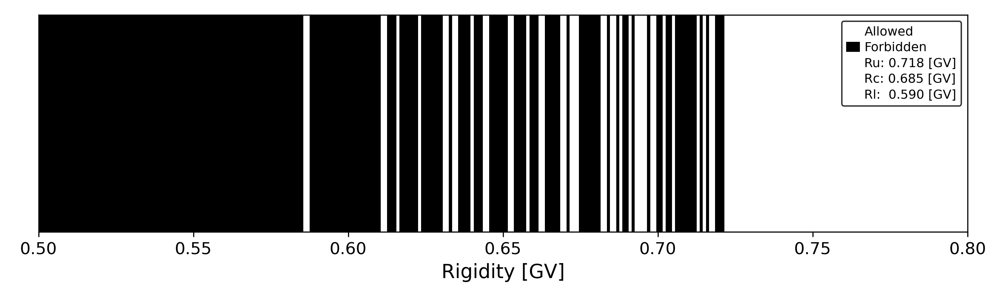
Cosmic ray transport in the geomagnetic field
The transport of cosmic ray particles in the geomagnetic field is calculated by backward trajectory-tracing technique by integration in a magnetic field model (inner and outer part).
Cutoff rigidity (R_{c}): “Lowest” rigidity reaching the top of the atmosphere in vertical direction at a given location.

Slide 20
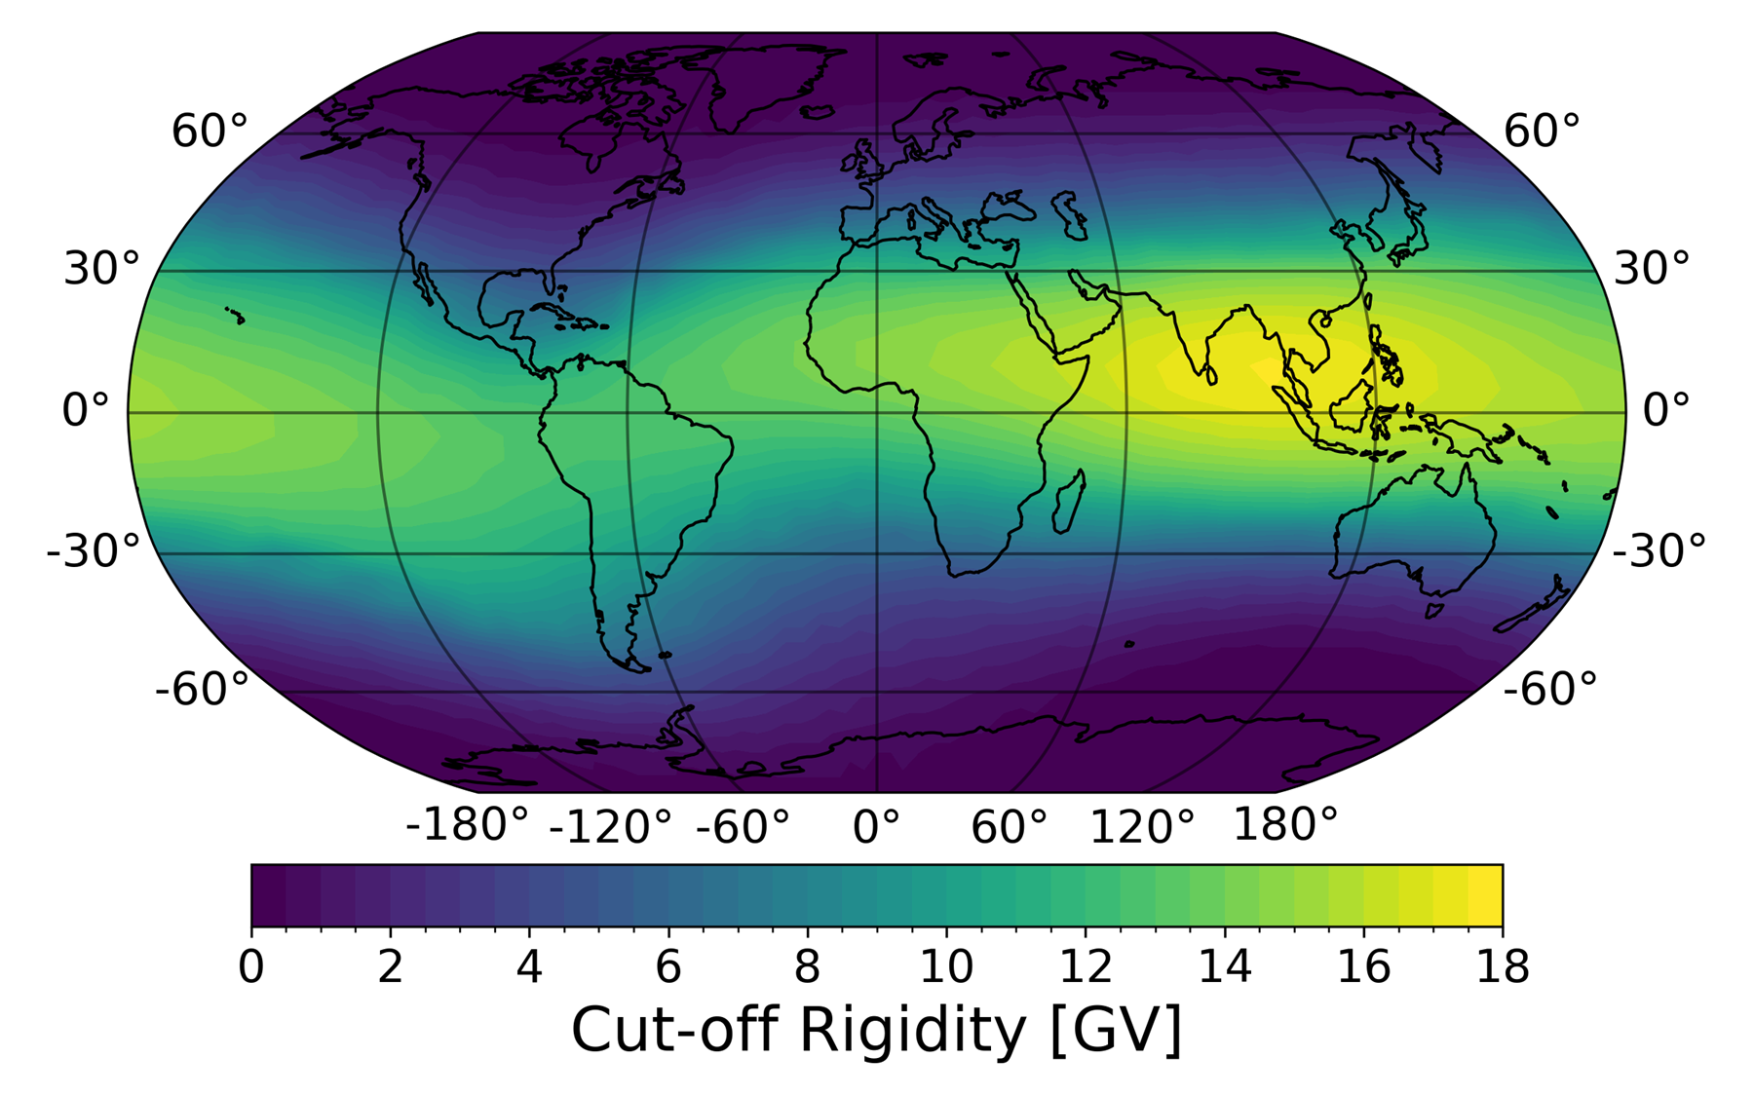
Vertical cutoff rigidity computation performed with OTSOPy (https://github.com/NLarsen15/OTSOpy/tree/main)
Example taken from https://github.com/NLarsen15/OTSOpy/tree/main/src/images

Slide 21
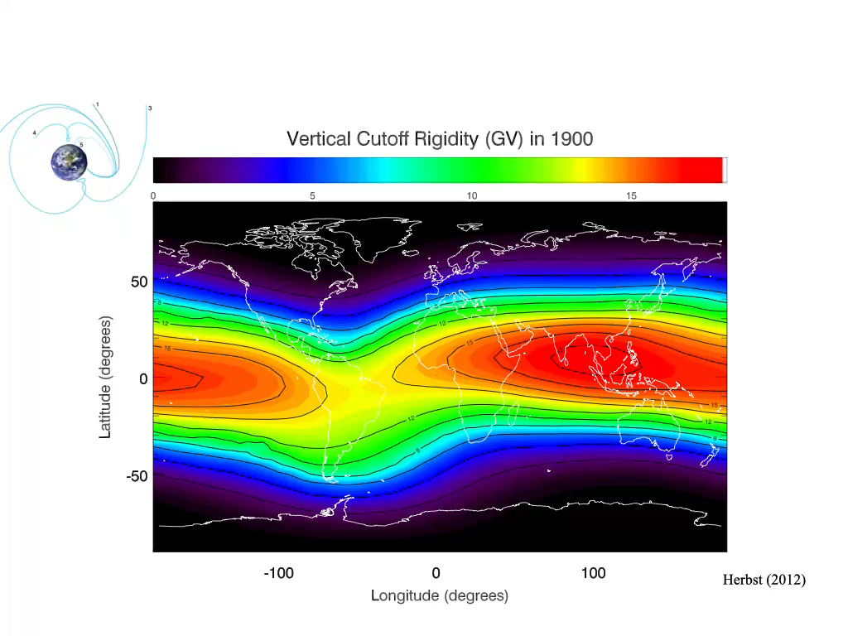
Influence of the variable IGRF on the vertical cutoff.
Computations by Herbst (2012) utilizing Planetocosmics (Desorgher L. et al., 2006).

Slide 22
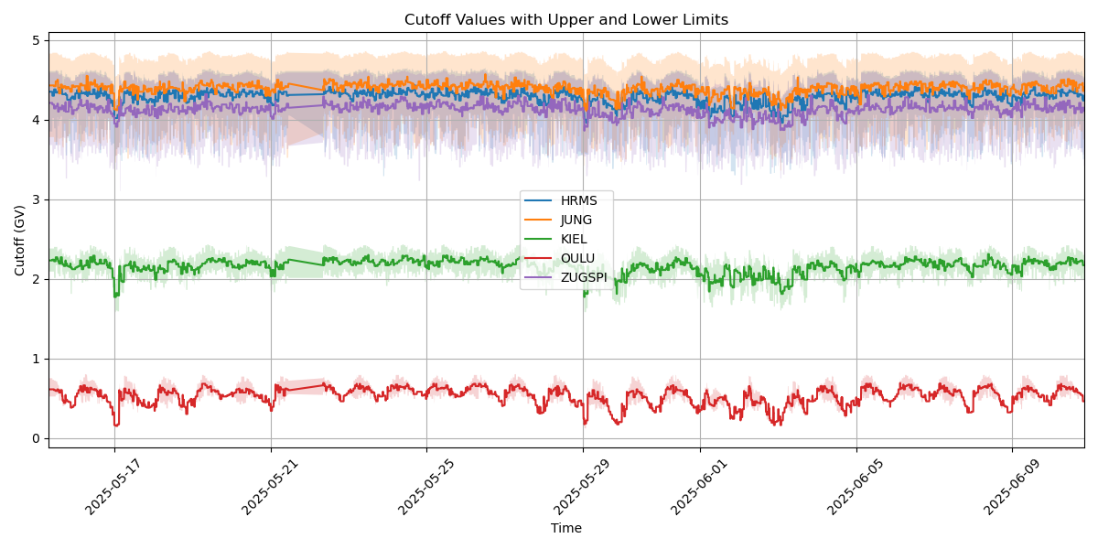
Vertical Cutoff computations utilizing TSY 89 with variable Kp (OTSOpy)

Slide 23
Why are neutron monitors still an important ingredient in cosmic ray research, Space Weather, Dosimetry, Atmospheric physics and environmental science?
  How does a neutron monitor look like and how does it work?
  Where do the neutrons come from?
  What is the influence of the earth magnetic field?
How can this be used to define Spaceship Earth as a particle telescope to measure about 1 GV to above 15 GV particles?
What can one do with such a detector?
  Investigation of Ground Level Enhancements,
  Computation of the dose rates at flight altitudes
  Environmental science

Slide 24
Validation?
Validation of the yield function:
yield functions Y_{i}(T,h)
Spectra Ji(E,Φ)
The count rate depends on the lower limit. Thus we expect that the count rate decreases with increasing cutoff rigidity (energy)
The critical regions
Inversion gives Φ(t).

Slide 25
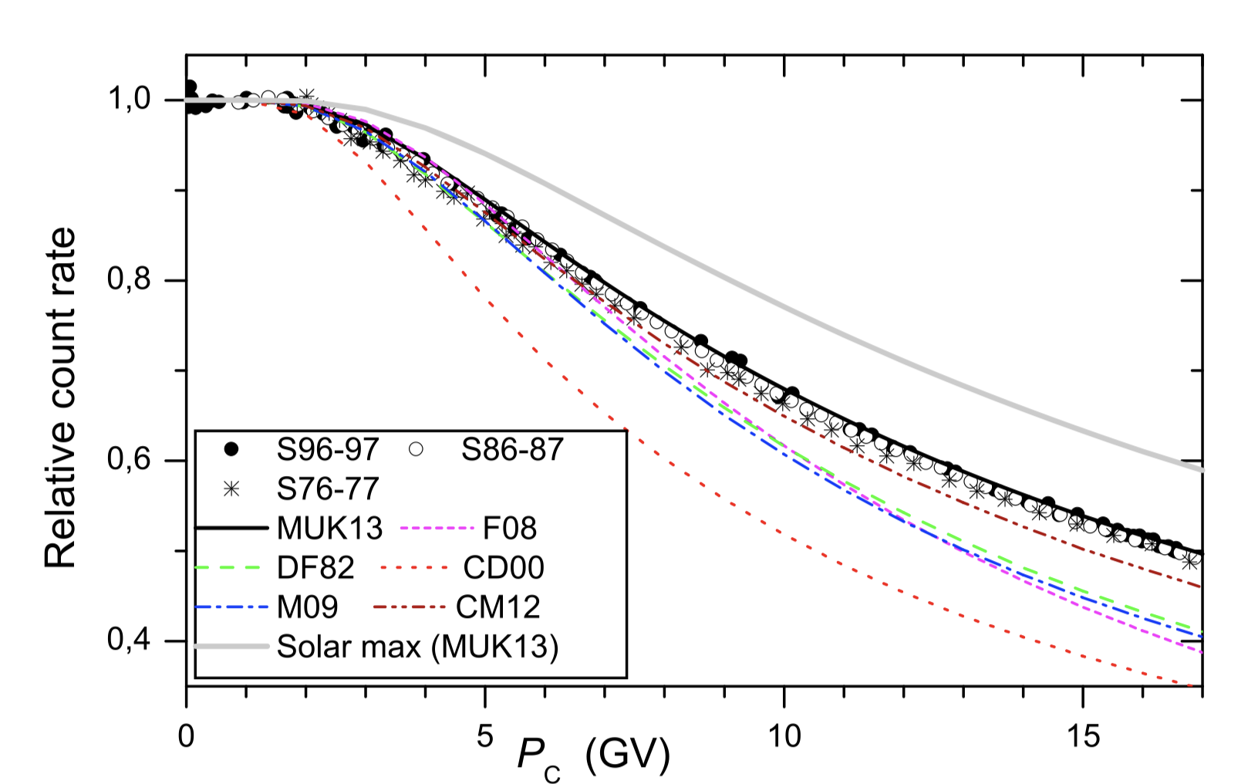
Count rate depencence of the Neutron Monitor on the vertical cutoff rigidities @solar minimum
Computed latitude dependence for different Yield Functions.
The one computed by Mishev et al. (2013) reveals the best agreement with latitude surveys (Nuntiyakul et al., JGR 2018),
(Mishev et al., JGR 2013)

Slide 26
Why are neutron monitors still an important ingredient in cosmic ray research, Space Weather, Dosimetry, Atmospheric physics and environmental science?
  How does a neutron monitor look like and how does it work?
  Where do the neutrons come from?
  What is the influence of the earth magnetic field?
How can this be used to define Spaceship Earth as a particle telescope to measure about 1 GV to above 15 GV particles?
What can one do with such a detector?
  Investigation of Ground Level Enhancements,
  Computation of the dose rates at flight altitudes
  Environmental science

Slide 27
Solar Energetic Particles
Energetic Particles from the Sun are sporadic events
76 have been detected on the ground (GLEs)
How can we derive the radiation environment from the Neutron Monitor Network?
  Solar energetic particle (SEP) event,
  September 10. 2017)
Forbush Decrease

Slide 28
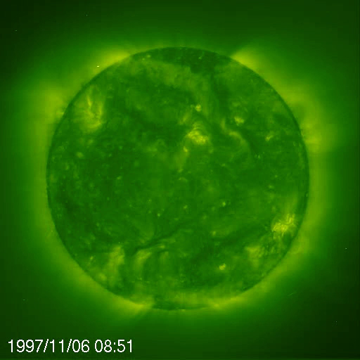
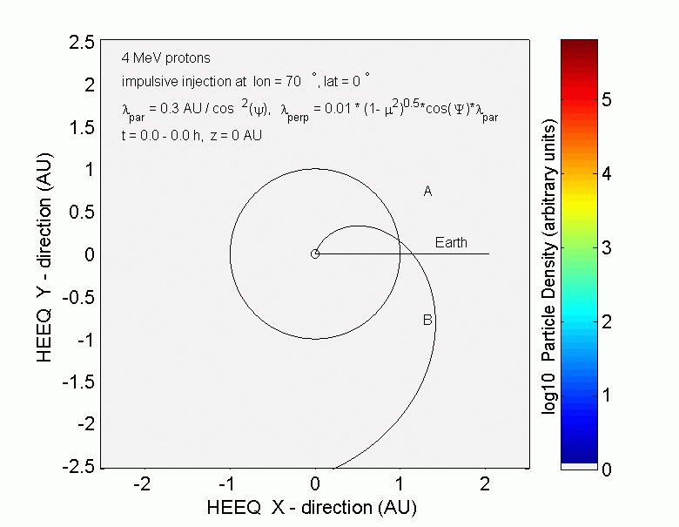
Solar Energetic Particle Events

Slide 29
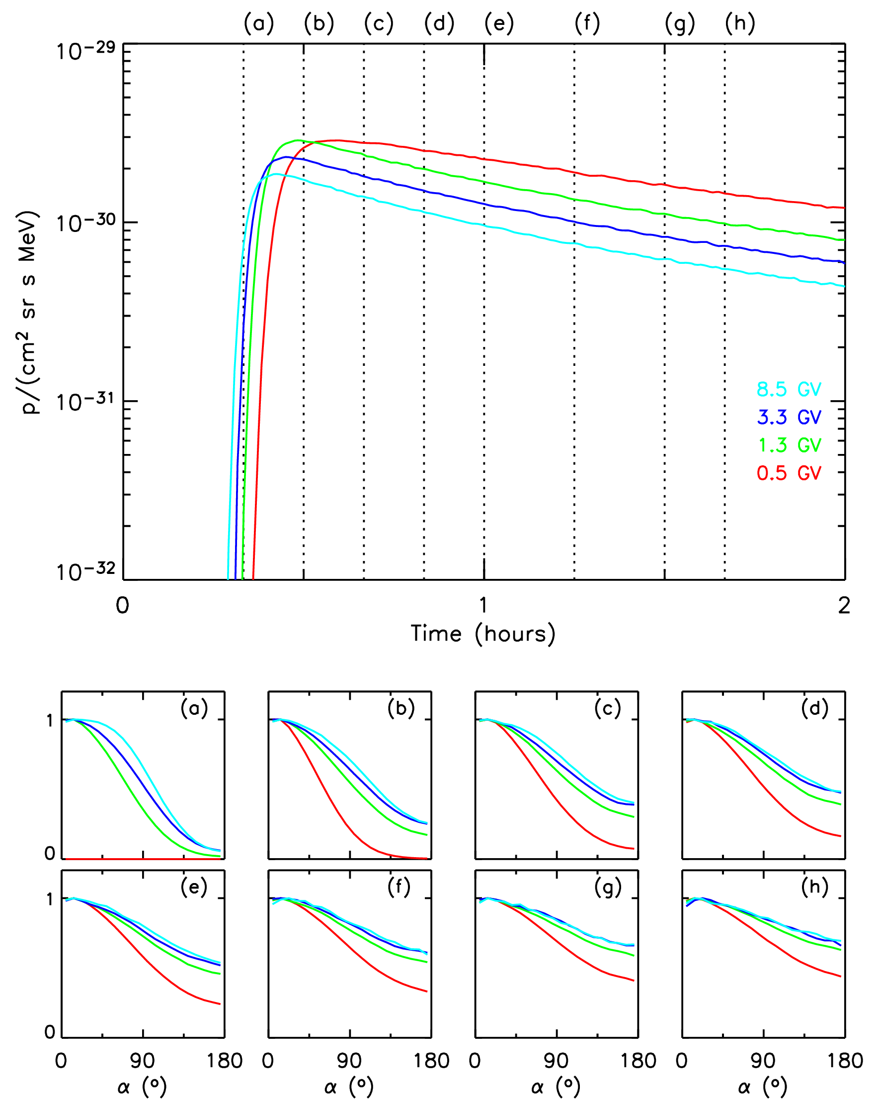
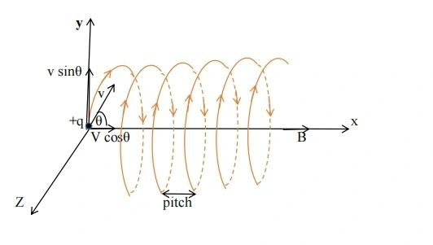
Need of direction
Interplanetary Magnetic Field (IMF) can be described by an Archimedean spiral with superposed fluctuations.
Quantitative description with focused transport equation (Roeloff 1969)
Omnidirectional time profile shown in the upper panel
Pitch angle distribution in the lower panel.

Slide 30
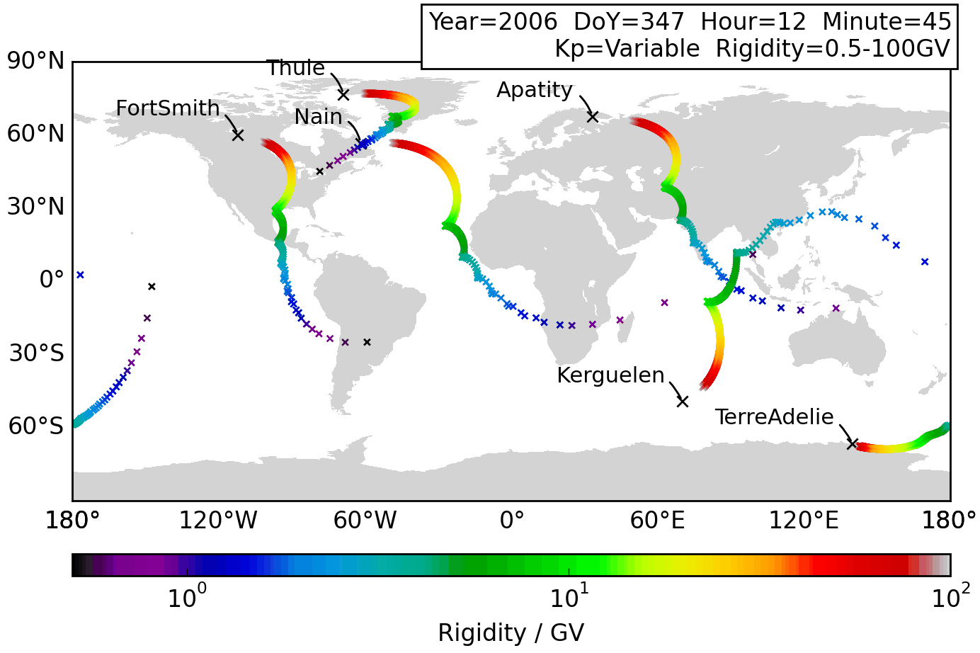
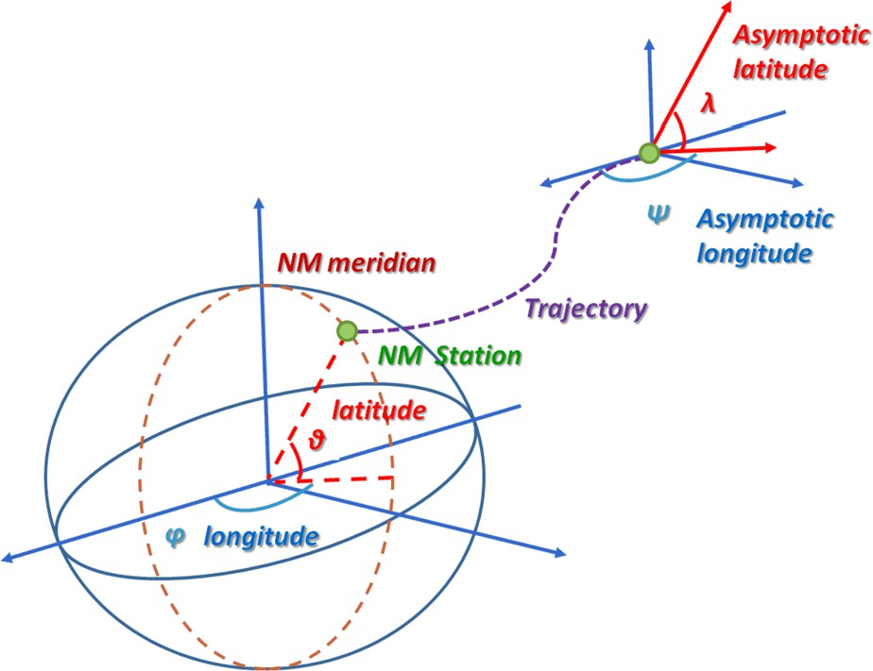
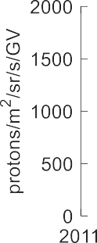
Asymptotic direction: Direction of particle incidence prior to entry in the geomagnetosphere. It depends on NM location, particle R, time and solar activity.
Galsdorf, 2019

Slide 31
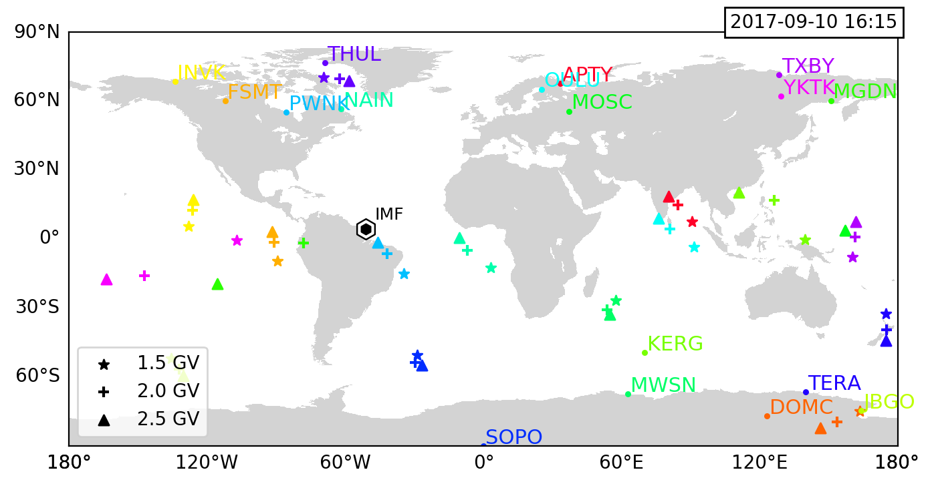
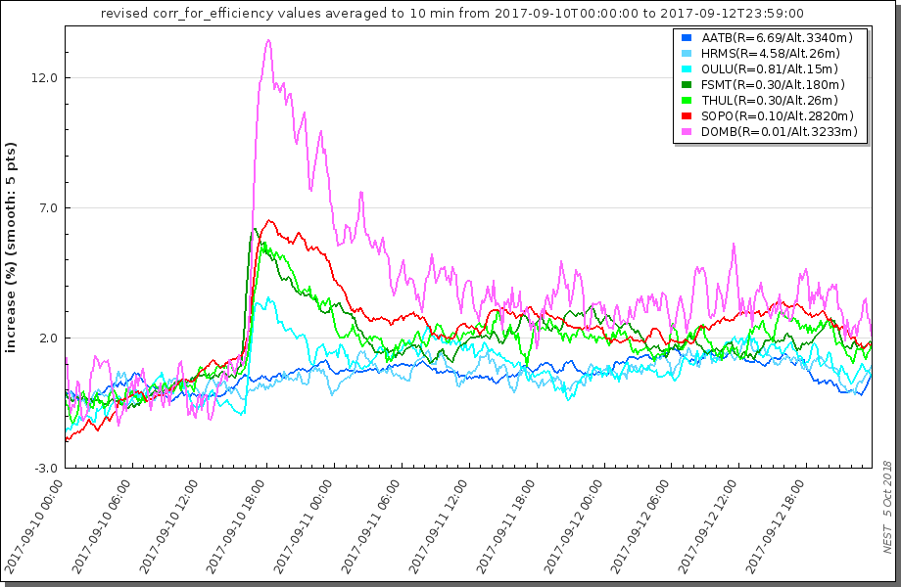
Asymptotic direction wrt. IMF ➔ pitch angle
Onset analysis: Ordering by pitch angle, but backstreaming particles.

Slide 32
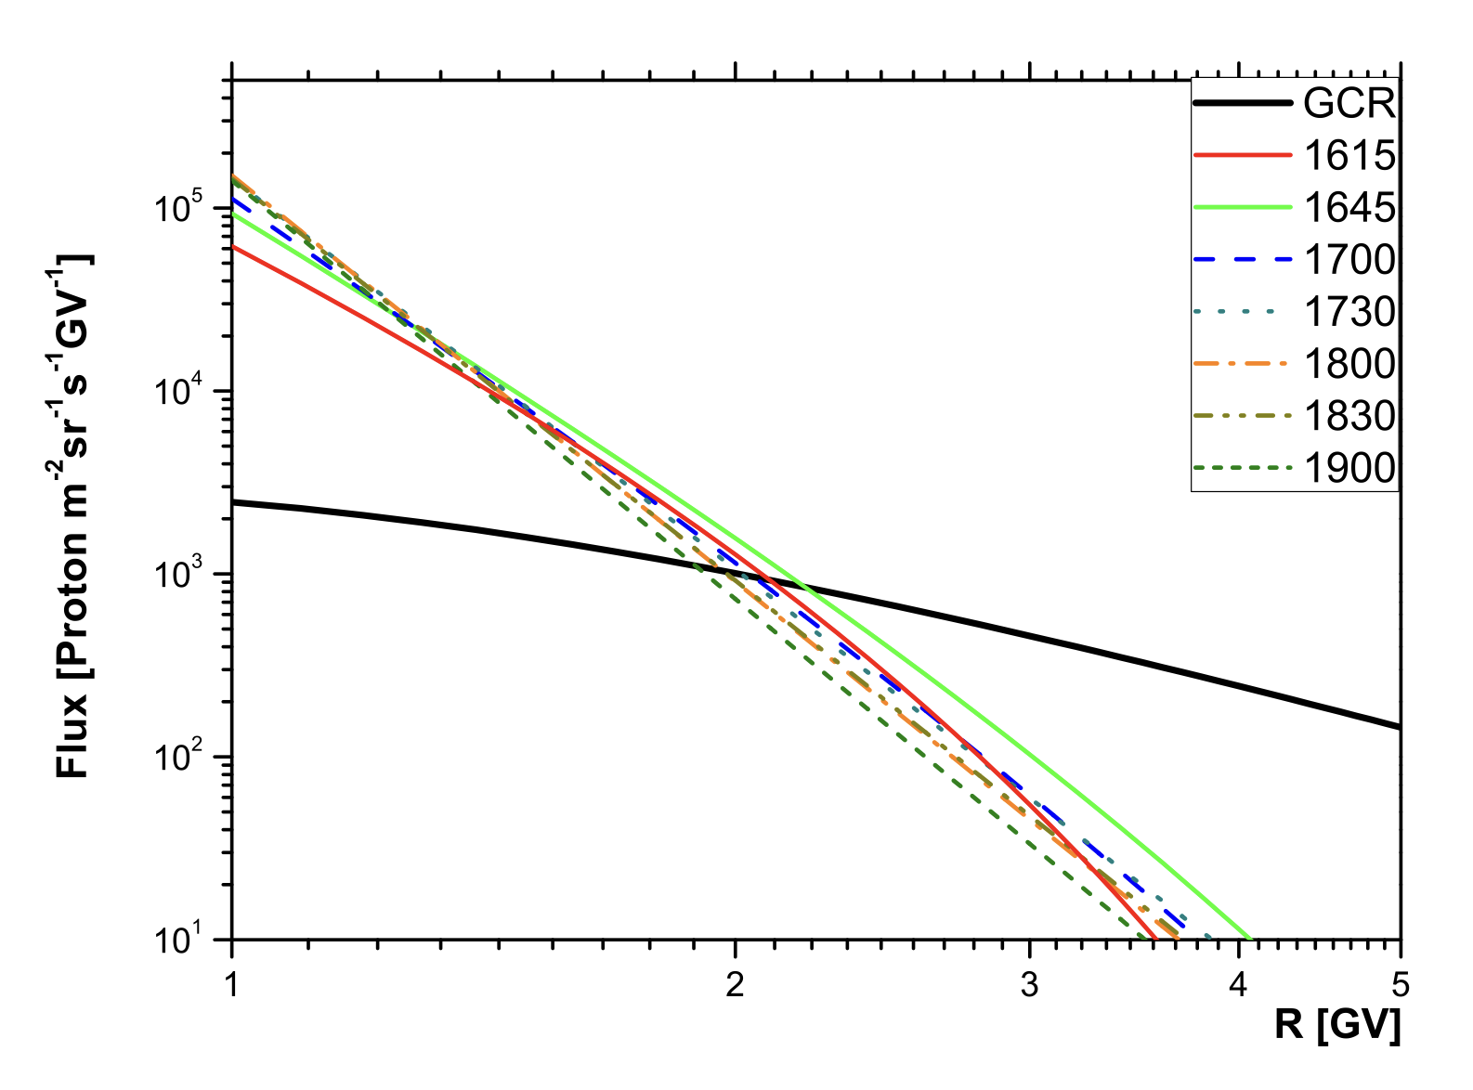
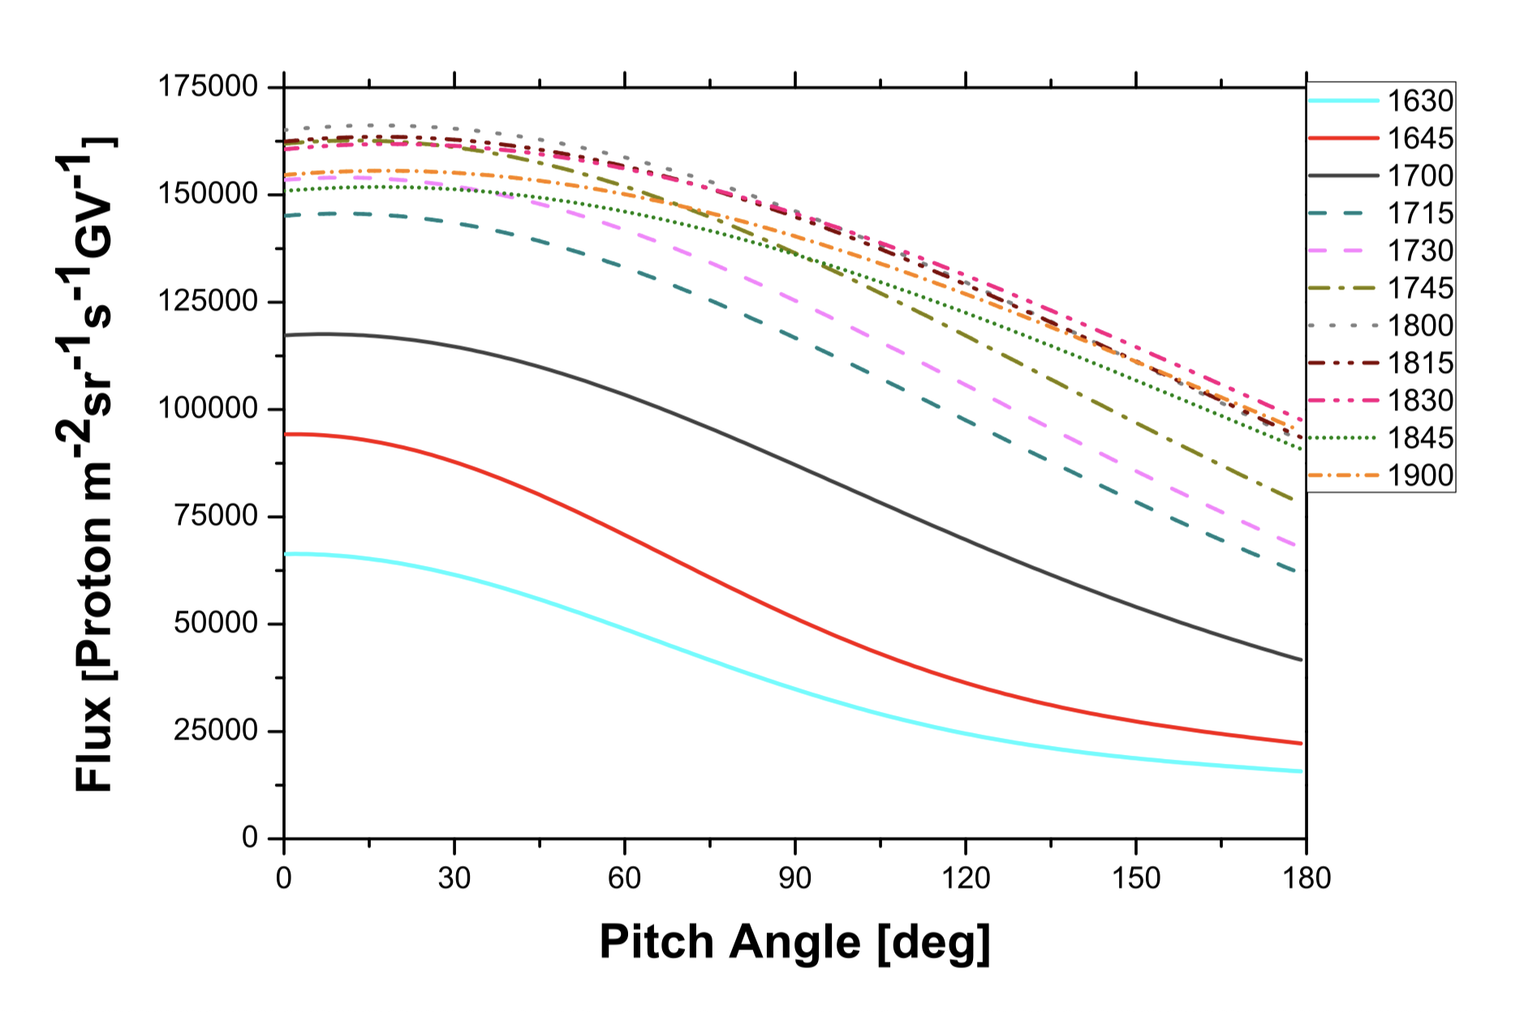
Imposes an Inversionproblem
Mishev et al. 2018 used
a double Gaussian for the pitch angle distribution
power law for the energy spectra
to generate synthetic count rate profiles.
Minimization of the difference leads to the most probable description

Slide 33
Why are neutron monitors still an important ingredient in cosmic ray research, Space Weather, Dosimetry, Atmospheric physics and environmental science?
  How does a neutron monitor look like and how does it work?
  Where do the neutrons come from?
  What is the influence of the earth magnetic field?
How can this be used to define Spaceship Earth as a particle telescope to measure about 1 GV to above 15 GV particles?
What can one do with such a detector?
  Investigation of Ground Level Enhancements,
  Computation of the dose rates at flight altitudes
  Environmental science

Slide 34
Radiation at flight altitudes
Results of the previous Inversion lead to a full description of the radiation environment outside the Magnetosphere.
Effective dose rate (lSv h1) at flight altitudes during GLE 70 (13 December 2006):
initial phase of the event,
main phase of the event,
late phase of the event.
32 µSV/h
42 µSV/h

Slide 35
Why are neutron monitors still an important ingredient in cosmic ray research, Space Weather, Dosimetry, Atmospheric physics and environmental science?
  How does a neutron monitor look like and how does it work?
  Where do the neutrons come from?
  What is the influence of the earth magnetic field?
How can this be used to define Spaceship Earth as a particle telescope to measure about 1 GV to above 15 GV particles?
What can one do with such a detector?
  Investigation of Ground Level Enhancements,
  Computation of the dose rates at flight altitudes
  Environmental science

Slide 36
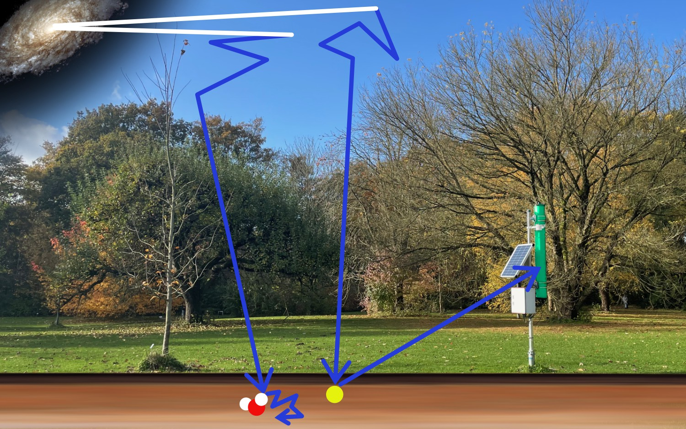
Climate Change poses pressure on agriculture:
When to water and when not?
Here comes in the cosmic ray neutron sensing method.
Dry soil suprathermal neutrons are scattered back
Wet soil suprathermal neutrons thermalized
Neutron flux
Air pressure
humidity
Biomass
Water content in the soil

Slide 37
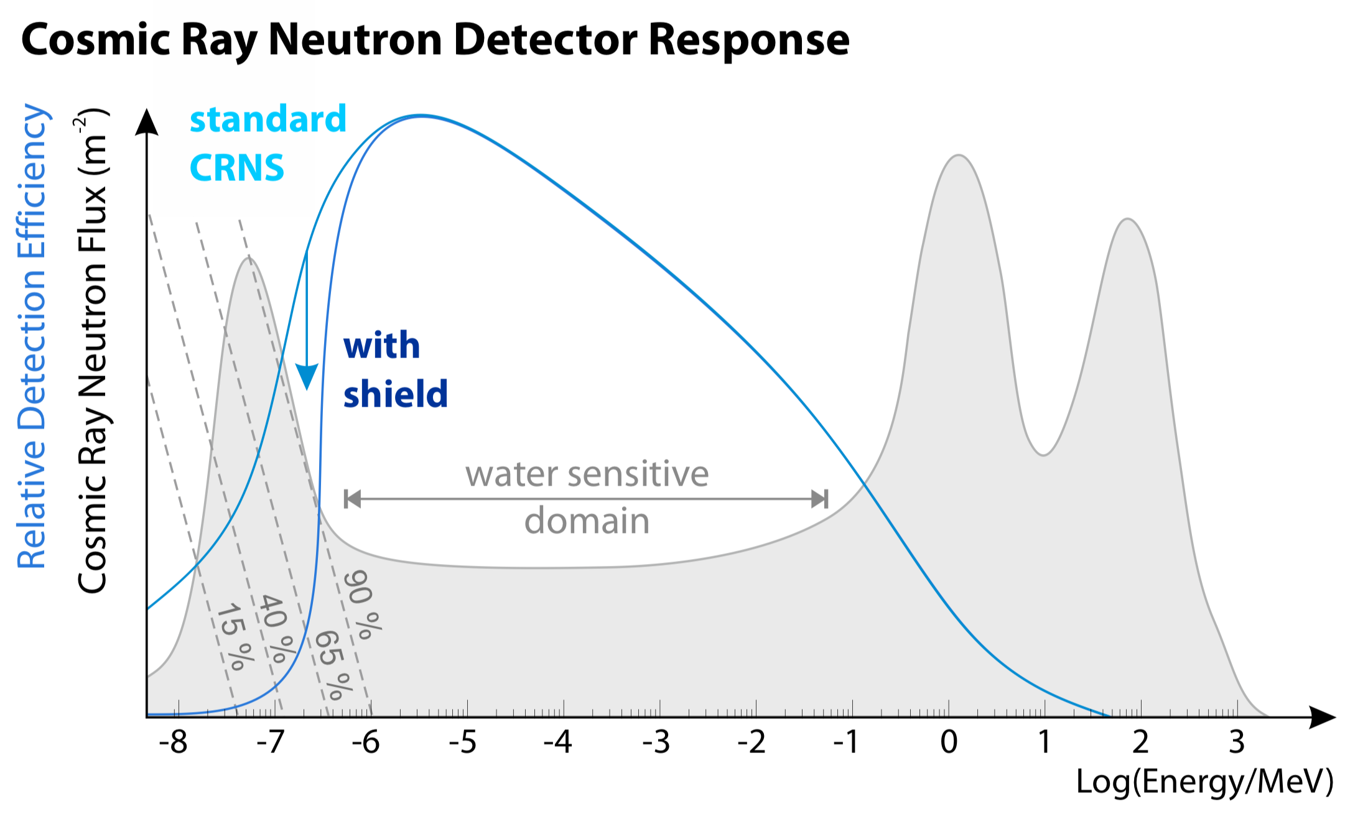
Neutron spectrum at sea level has different components:
Thermal neutrons @ E=0.025 eV
Elastic scattering moderated neutrons (eV to 100 keV)
Neutrons from nuclear interactions in the atmosphere (>few hundreds keV)
Shielding with Gadolinium absorbs the thermal component.
Only energetic components remain.

Slide 38
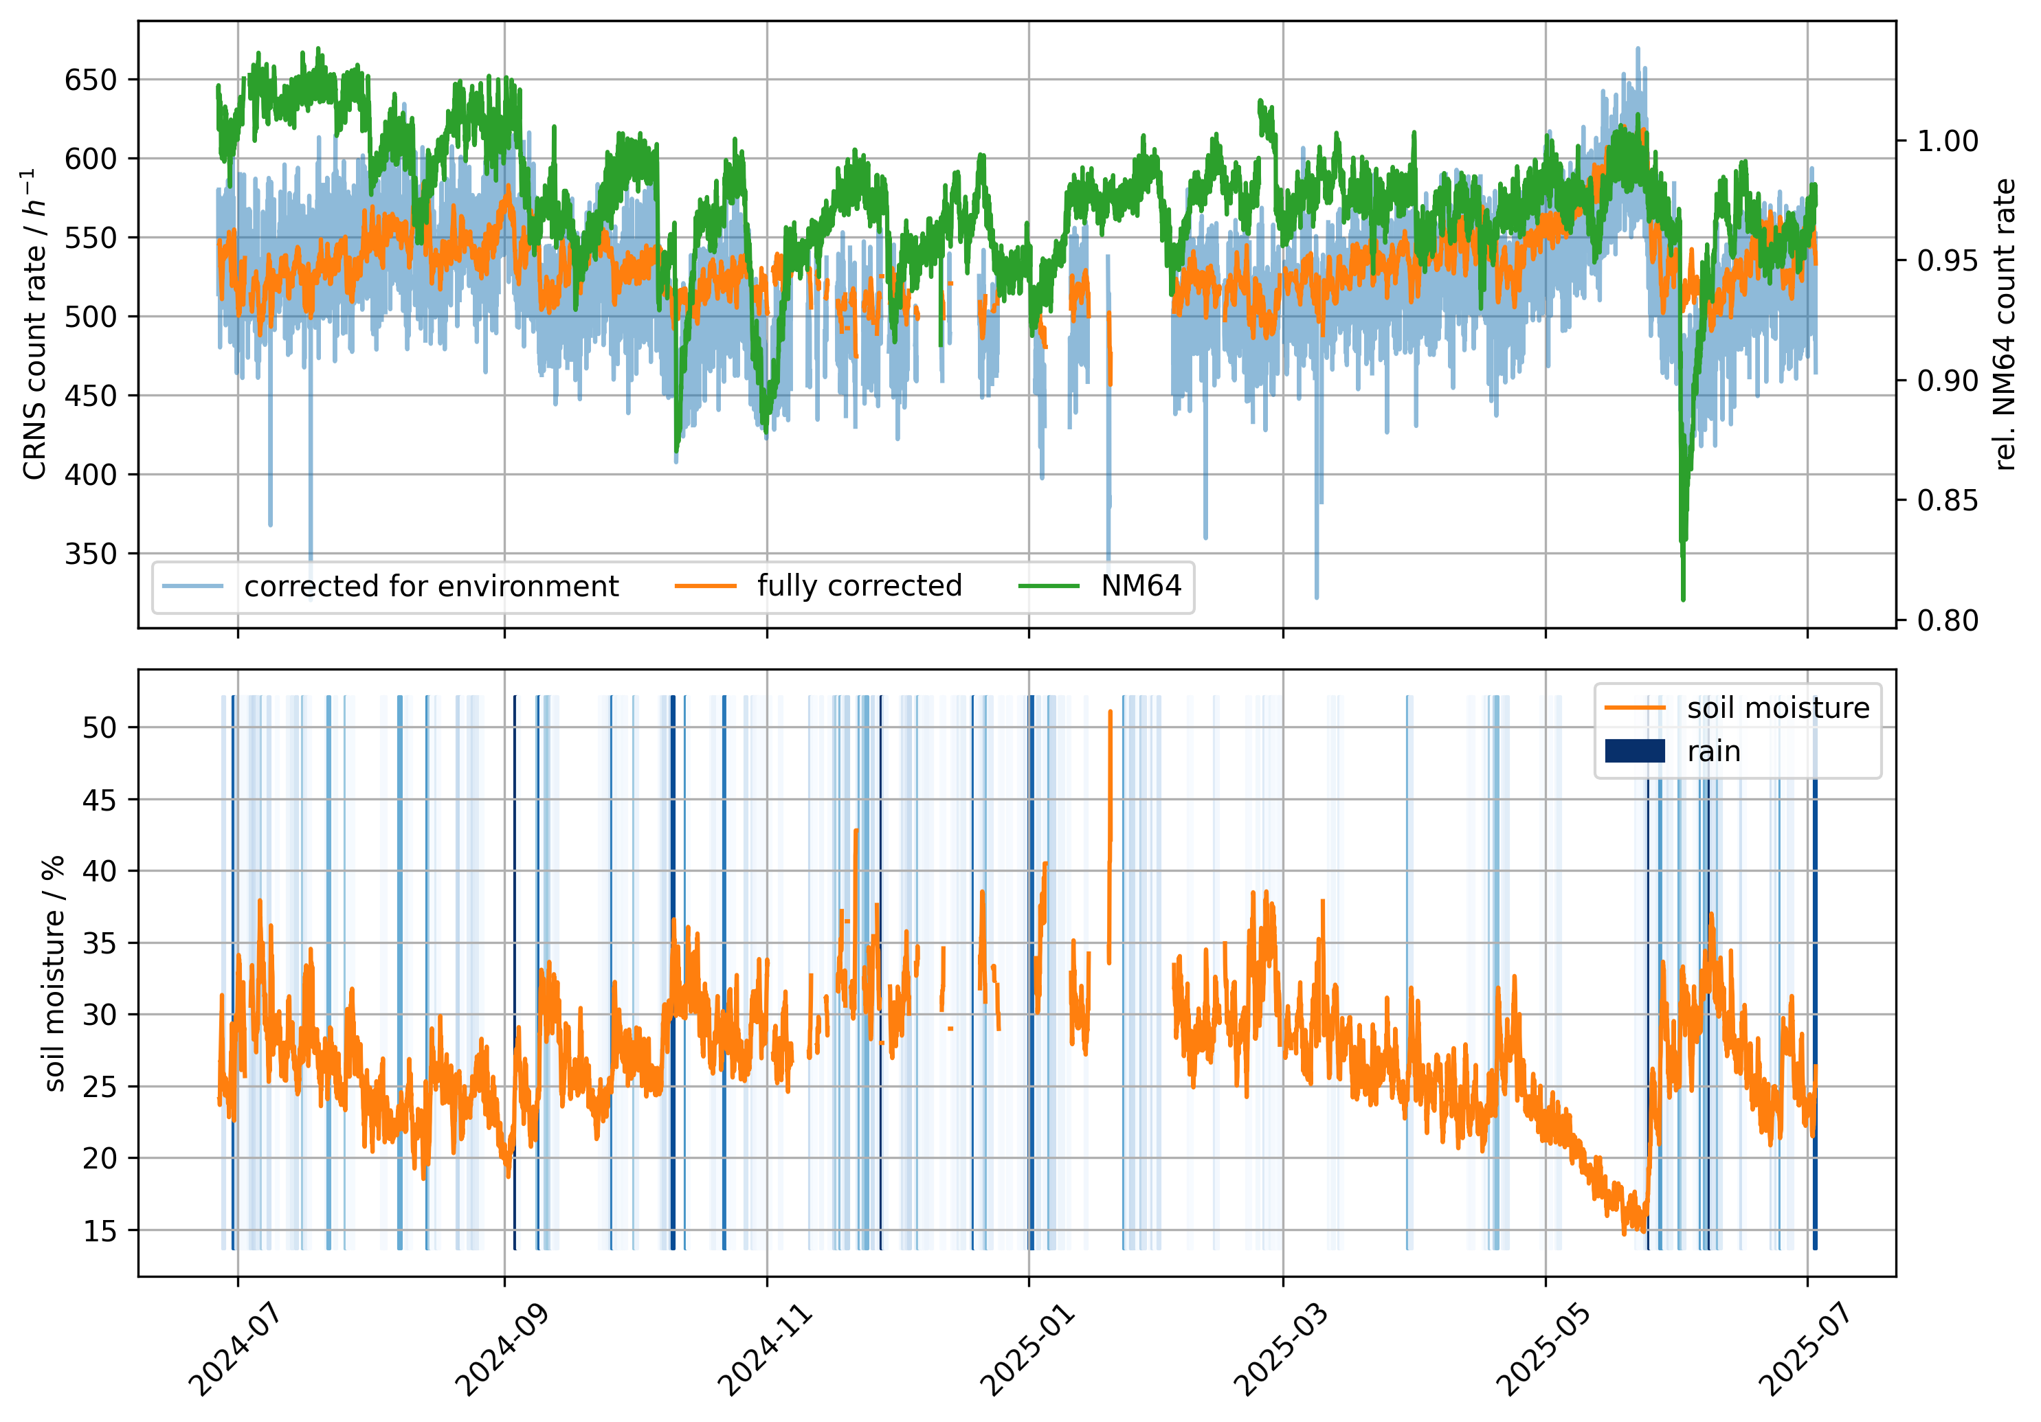
Neutron flux
Air pressure
humidity
Biomass
Water content in the soil?
Giese 2025
Green curve Kiel NM64)
Orange curve corrected CRNS detector counts
Soil moisture

Slide 39
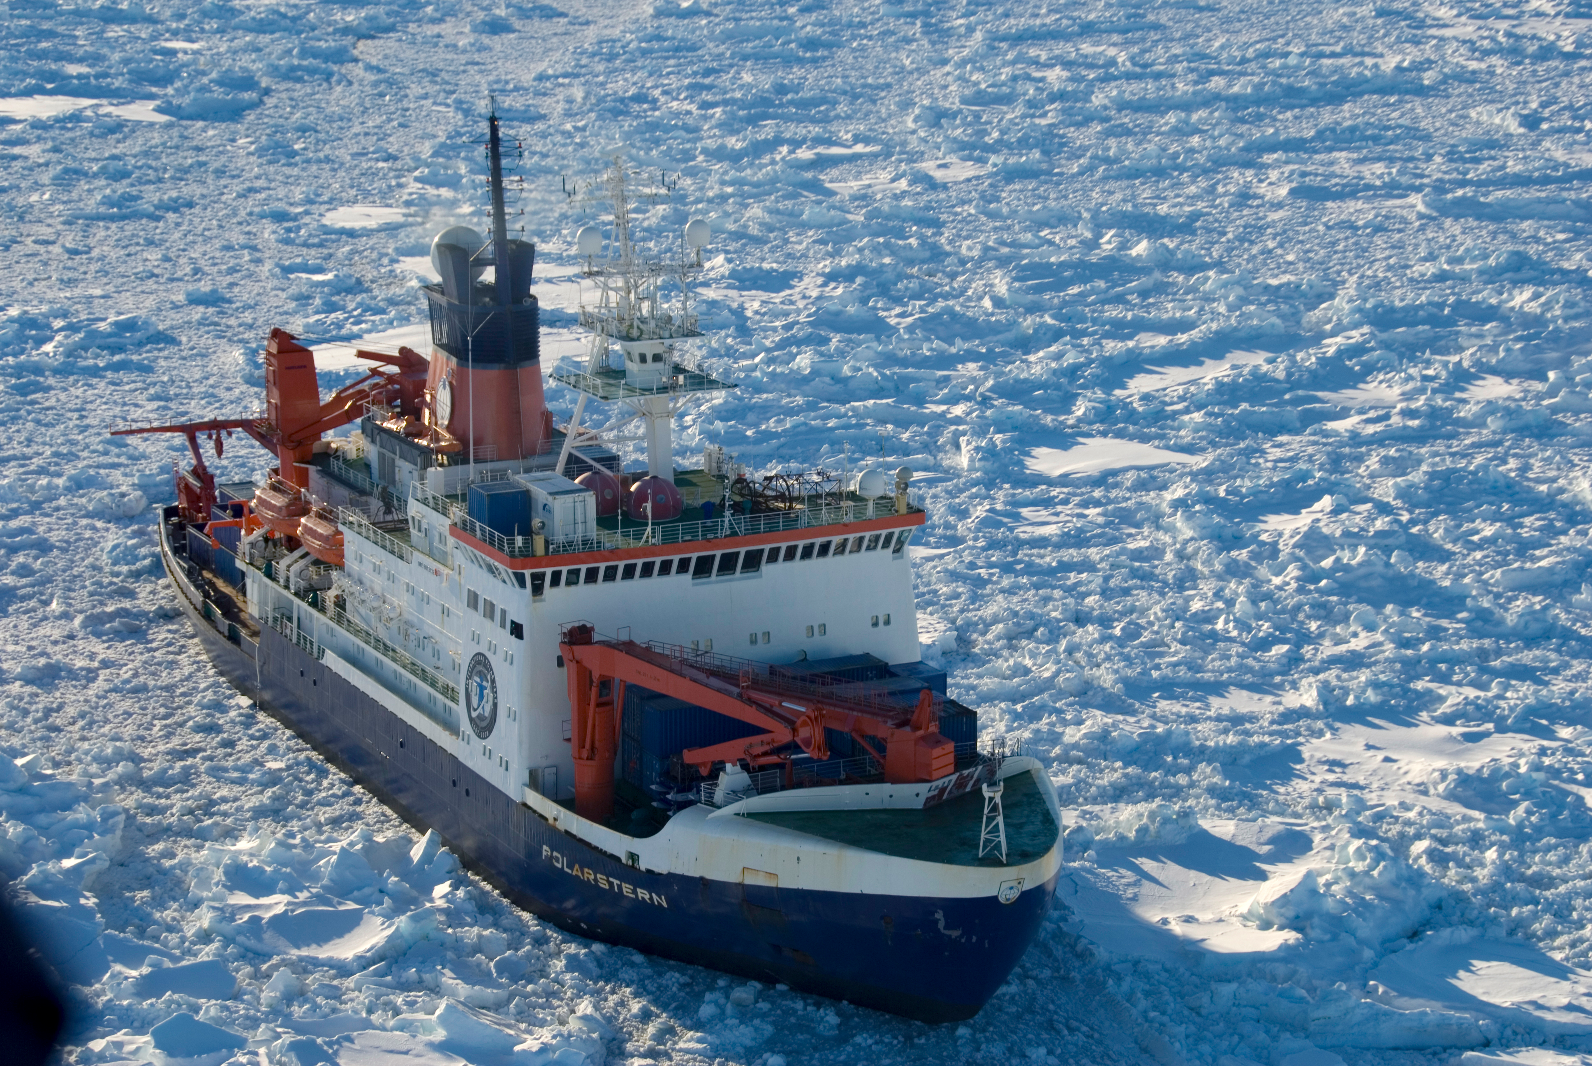
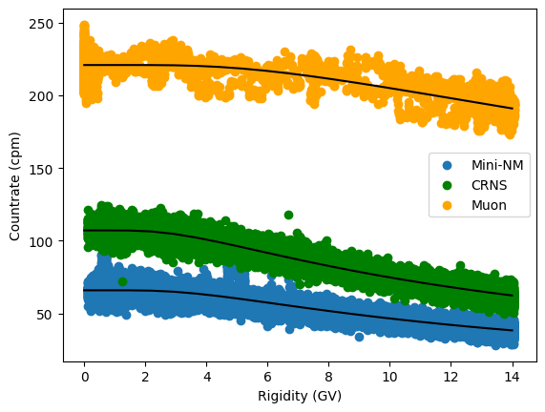
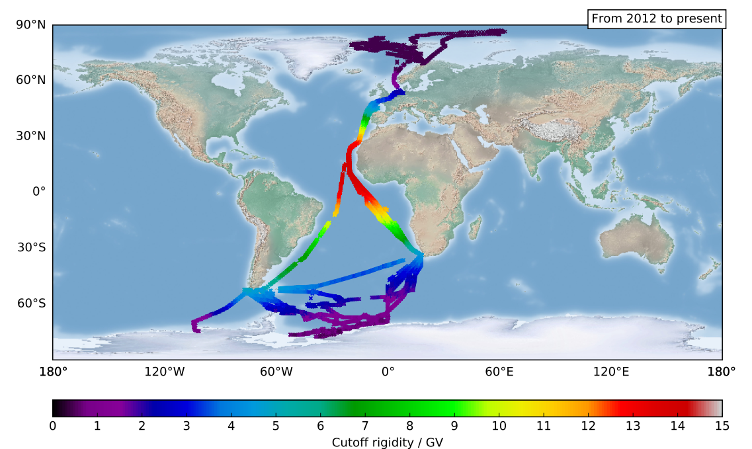
2024: First Latitude scan with several neutron experiments and a muon telescope aboard the Polarstern.
CNRS counter behaves like the Mini neutron monitor.
More to come
Counts/min
Rigidity / GV
Hertie, 2025

Slide 40
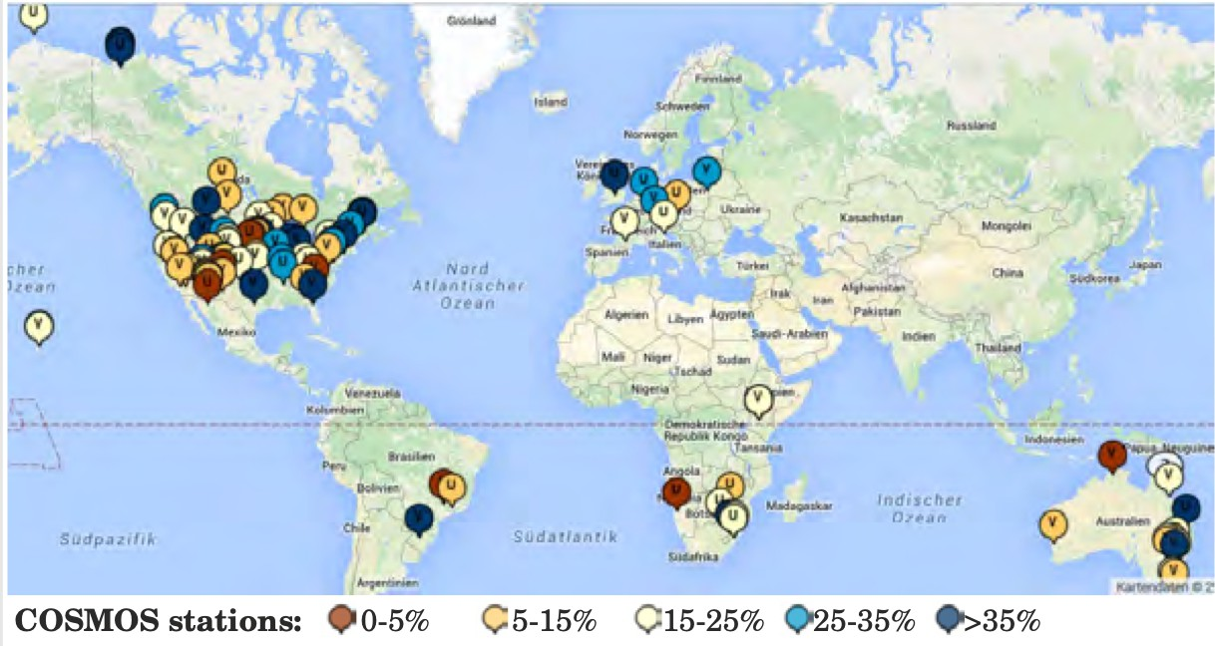
Schrön(2016)

Slide 41
Neutron monitors are still crucial to study or to determine:
  The characteristics of Ground Level Enhancements:
    energy spectra
    More important pitch angle distributions
  Computation of the dose rates at flight altitudes
    From the spectra and the asymptotic directions, the dose rate at flight altitudes can be computed
  Environmental science:
    Neutron monitors are needed to define the reference to the CRNS systems

Slide 42
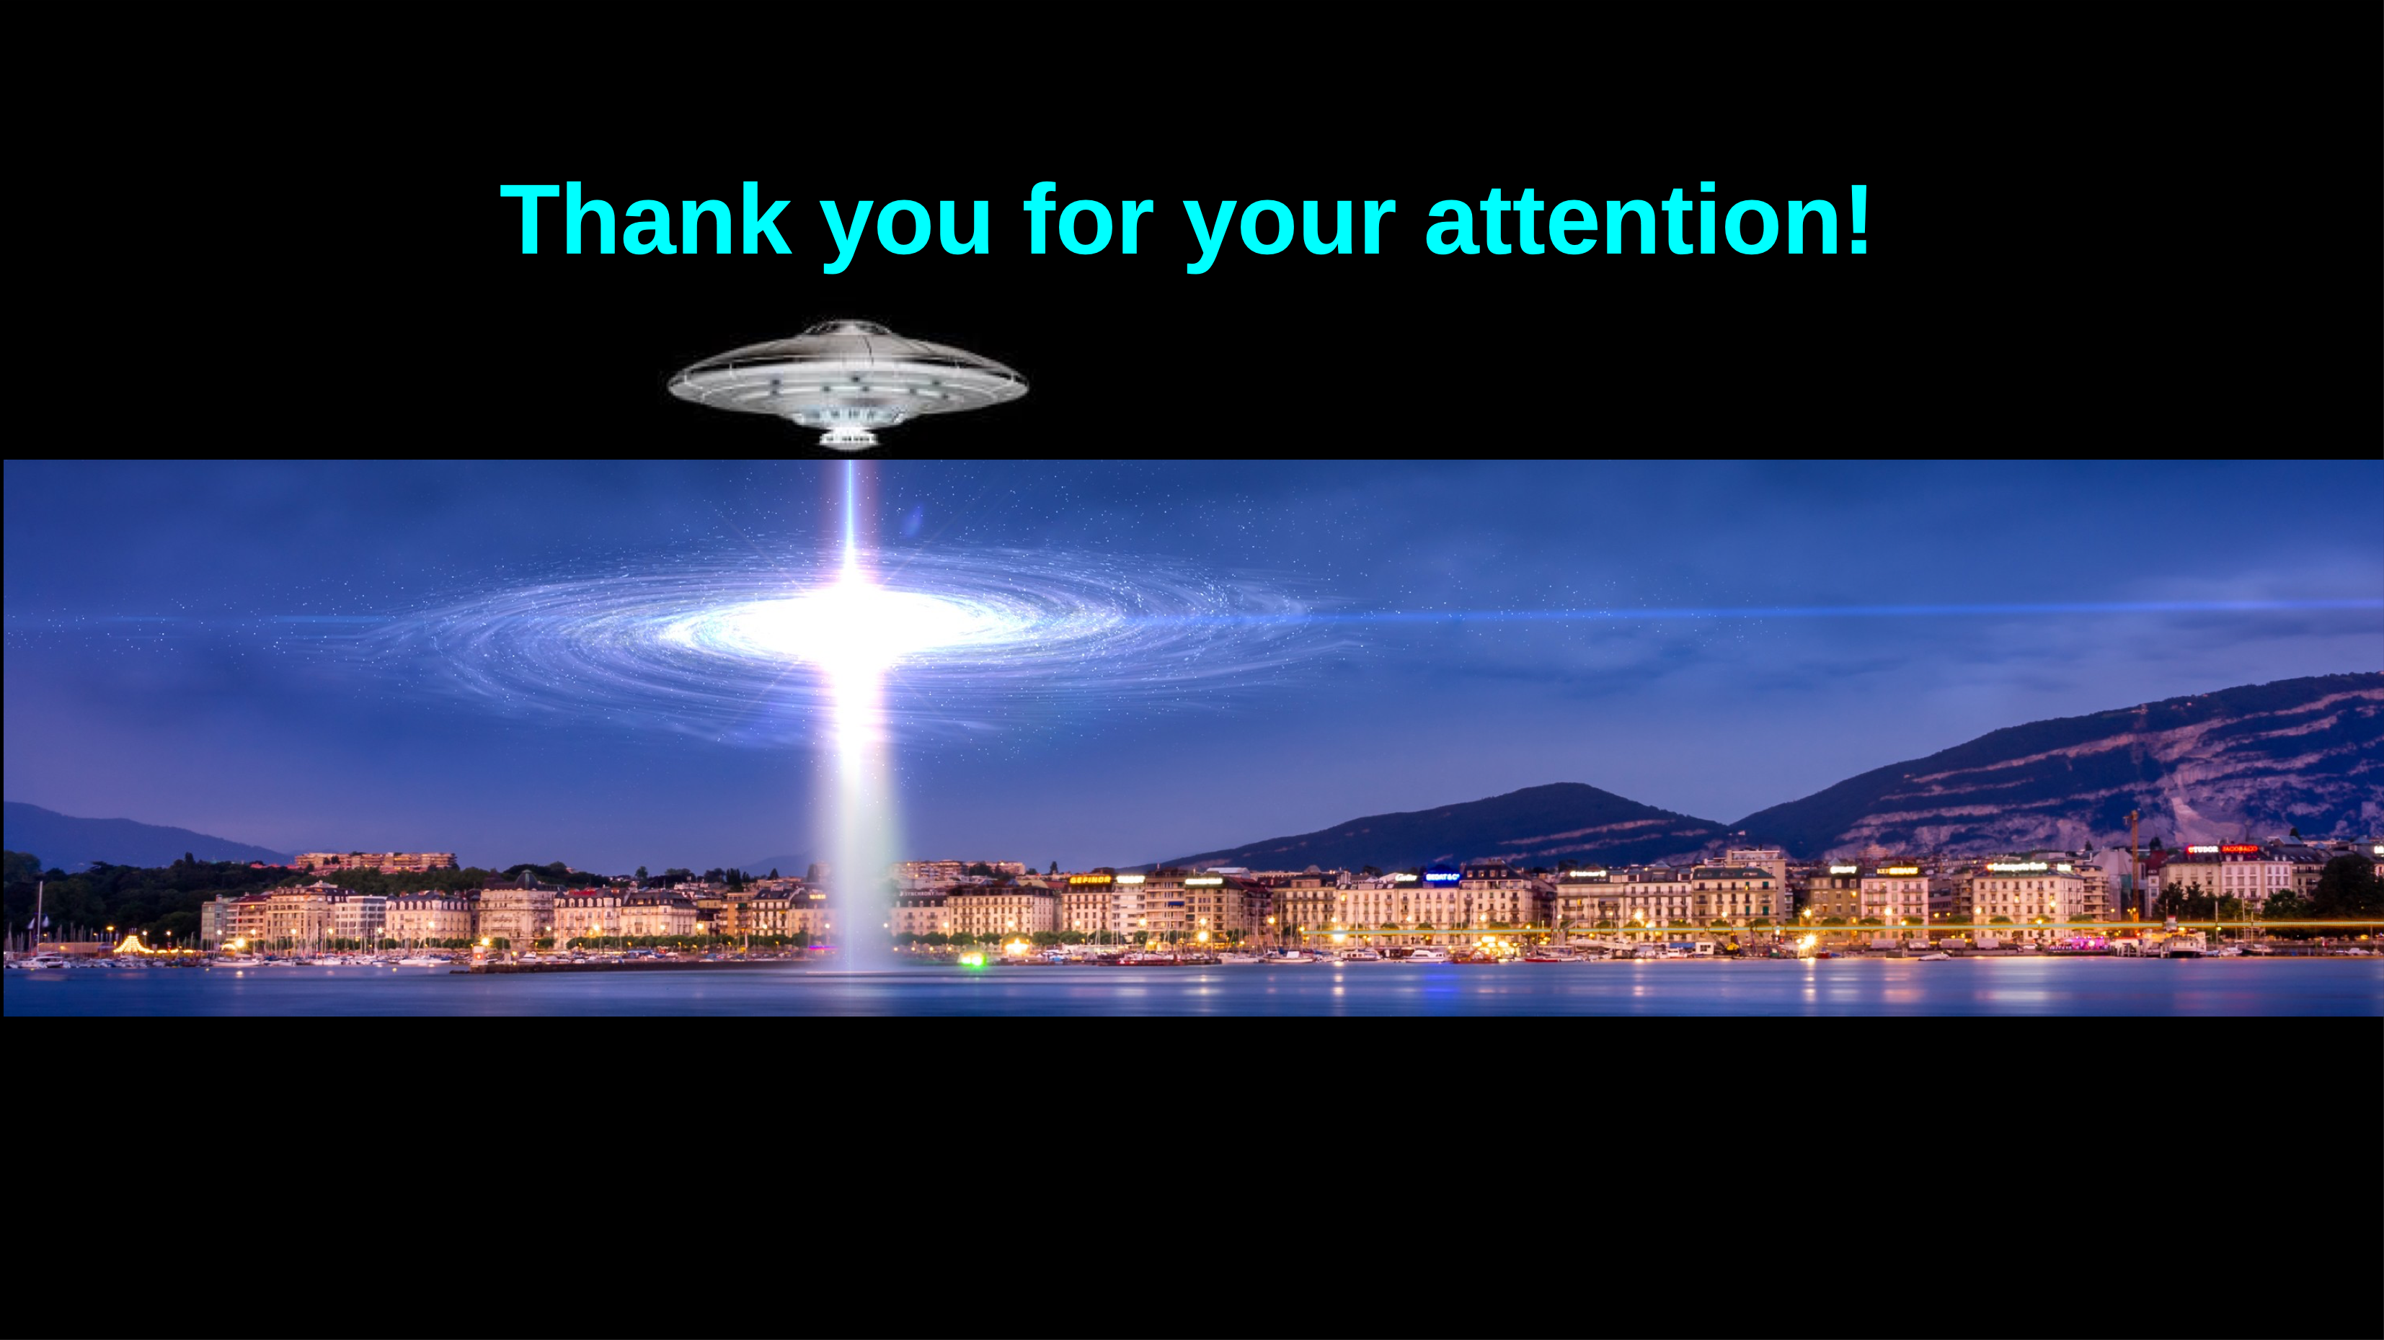
Consolandi, this conference

Slide 43
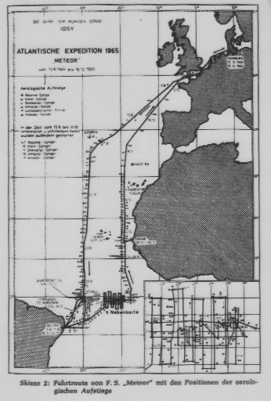
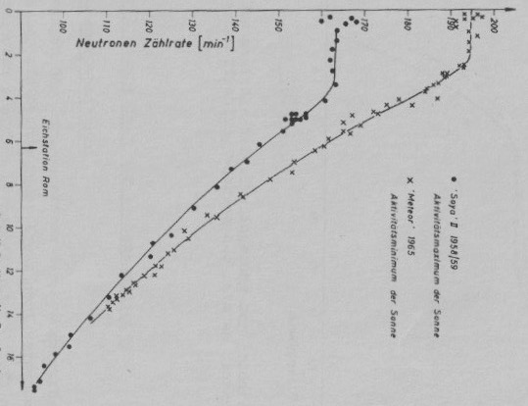
Latitude surveys

Slide 44
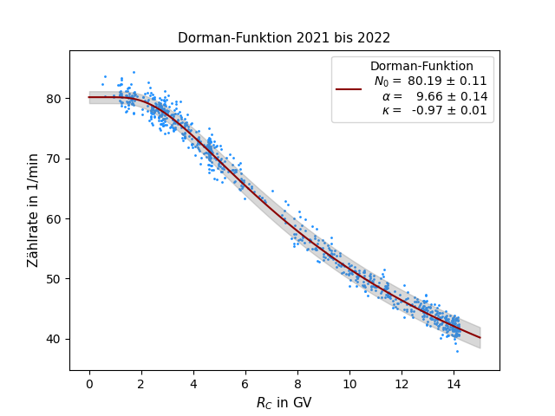
Latitude surveys
Polarstern is a research vessel run by the Alfred-Wegner-Institute that explores the Arctic and Antarctic region.A Mini Neutron Monitor was installed on the Polarstern in 2012 allowing to:
  investigate the latitude dependence of the GCR flux and
  determine the instrument sensitivity

Slide 45
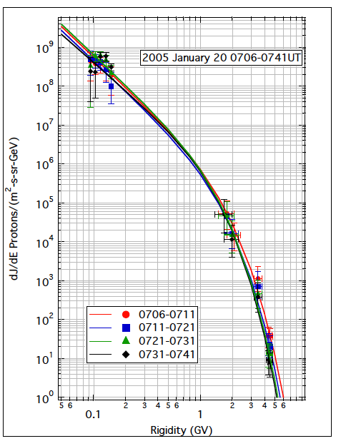
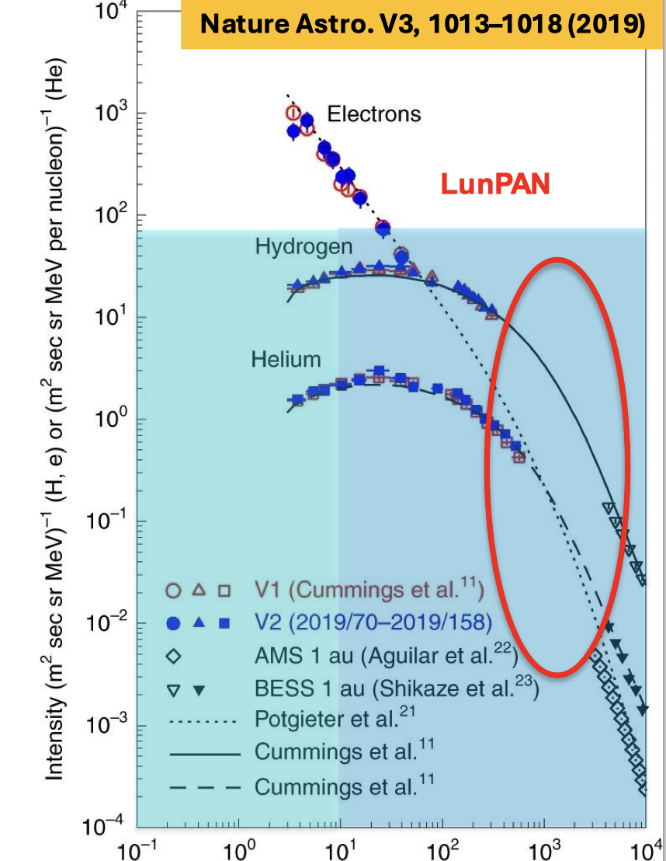
What to do next?
Hullmann, this conference
GCR modulation above 4 GeV very well understood ☺
Electrons are different.
Solar energetic particles: >2 GeV from Neutron monitors.
Energy range [200, 2000 MeV] is the goal
Spacecraft observations
Critical Gap
Currently partially covered by PAMELA and AMS observations
ground based observations

