Slide 1
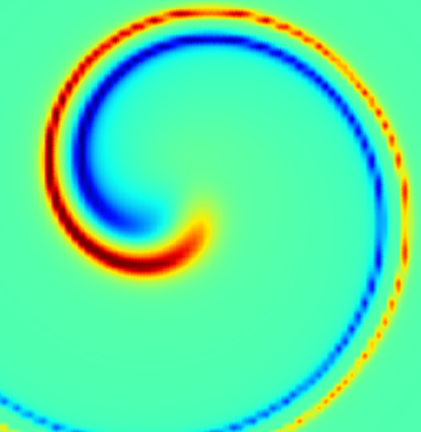


On Acceleration of >100 EeV CRs
in Novel Scenario of Magnetar Transients
Tohoku Univ, NCHU,
Tomoki Wada
Collaborator: Jiro Shimoda
Wada & Shimoda (2024) ApJ,972,58W
Shimoda & Wada (2025) ApJ,986,213S
250718 ICRC

Slide 2
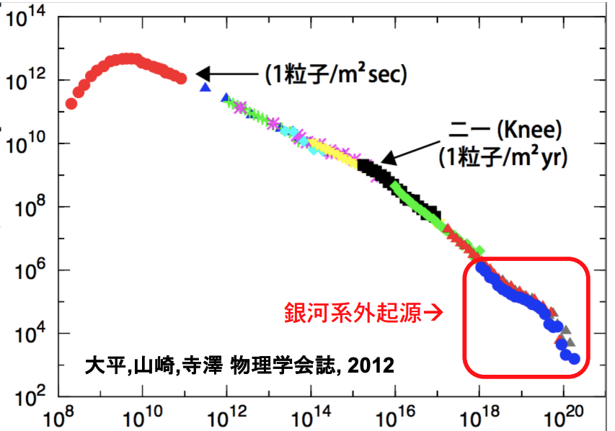
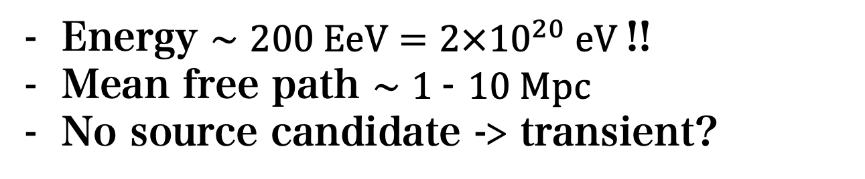
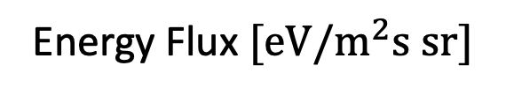
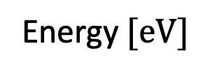
Neutron star in local void
Detection of Amaterasu particle
Energy Flux $[eV/m^{2}s sr]$
Amaterasu
Extragalactic
Ohira, Yamazaki, Terasawa 2012(JPS)
TA collaboration (2023)
2021 May 27th
Energy $[eV]$
Energy $∼200 EeV=2×10^{20} eV$!!
Mean free path $∼1$- $10 Mpc$
No source candidate -> transient?
Where & How is it accelerated?

Slide 3

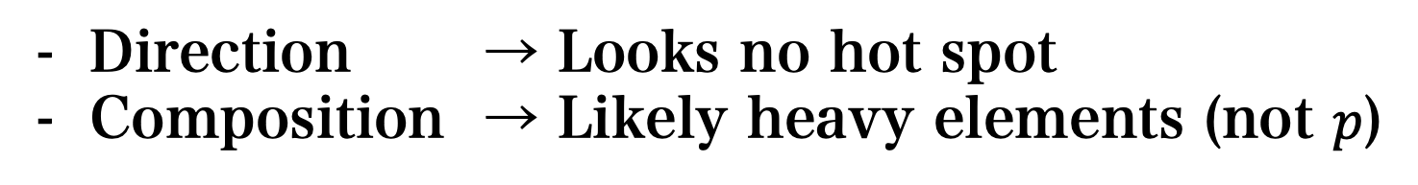
Observations of ~$10^{20}$ eV Cosmic Rays
Direction → Looks no hot spot
Composition → Likely heavy elements (not $p$)

Slide 4
KM3Net: Too bright neutrino?
100 PeV neutrino
Special TRANSIENT origin?

Slide 5
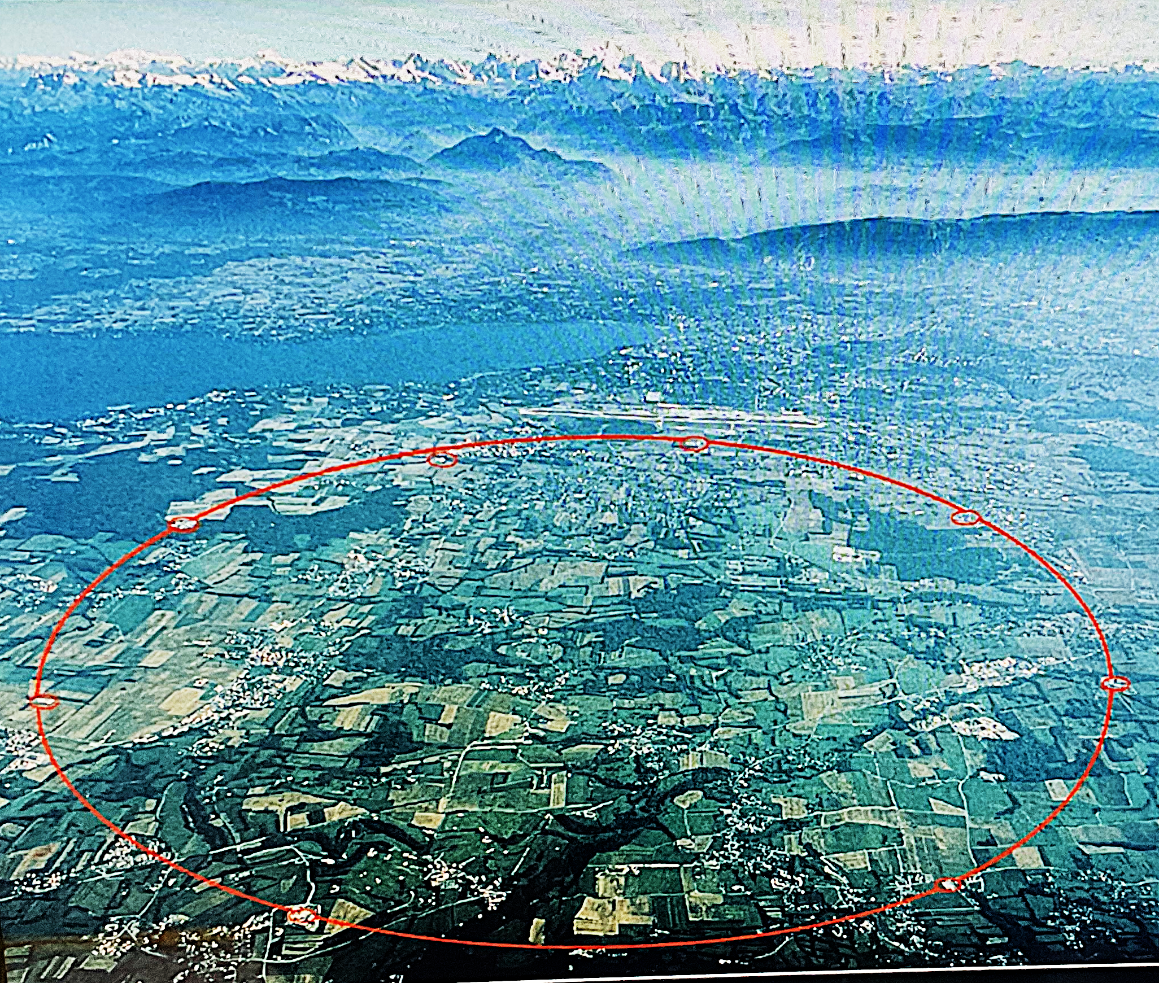

Credit: Maximilien Brice/CERN
Hillas condition & Magnetars
→Confine the CRs
We are here!
LHC
(Hillas 1984, Kotera+2011)

Slide 6

Credit: Maximilien Brice/CERN
Hillas condition & Magnetars
Amaterasu from local void
→Confine the CRs
LHC
(Hillas 1984, Kotera+2011)

Slide 7

Credit: Maximilien Brice/CERN
Hillas condition & Magnetars
→Confine the CRs
LHC
Neutron star -> CR Accelerator
How to accelerate *nuclei* in Magnetar?
(Hillas 1984, Kotera+2011)

Slide 8
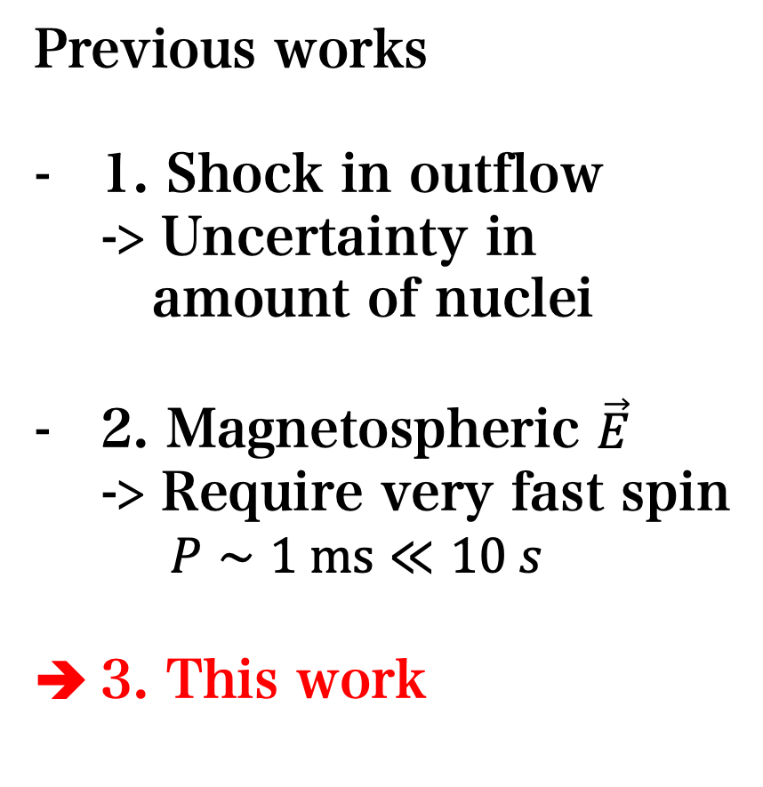

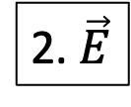

Magnetars as a cosmic accelerator
How to accelerate *nuclei* in magnetars?
1.Shock
Previous works
1. Shock in outflow
-> Uncertainty in
amount of nuclei
2. Magnetospheric $\vec{E}$
-> Require very fast spin
$P∼1 ms≪10 s$
3. This work
$$Ze$$
$$Ze$$
2. $\vec{E}$
magnetar
(Arons 04, Kotera 11, Asano+06)

Slide 9
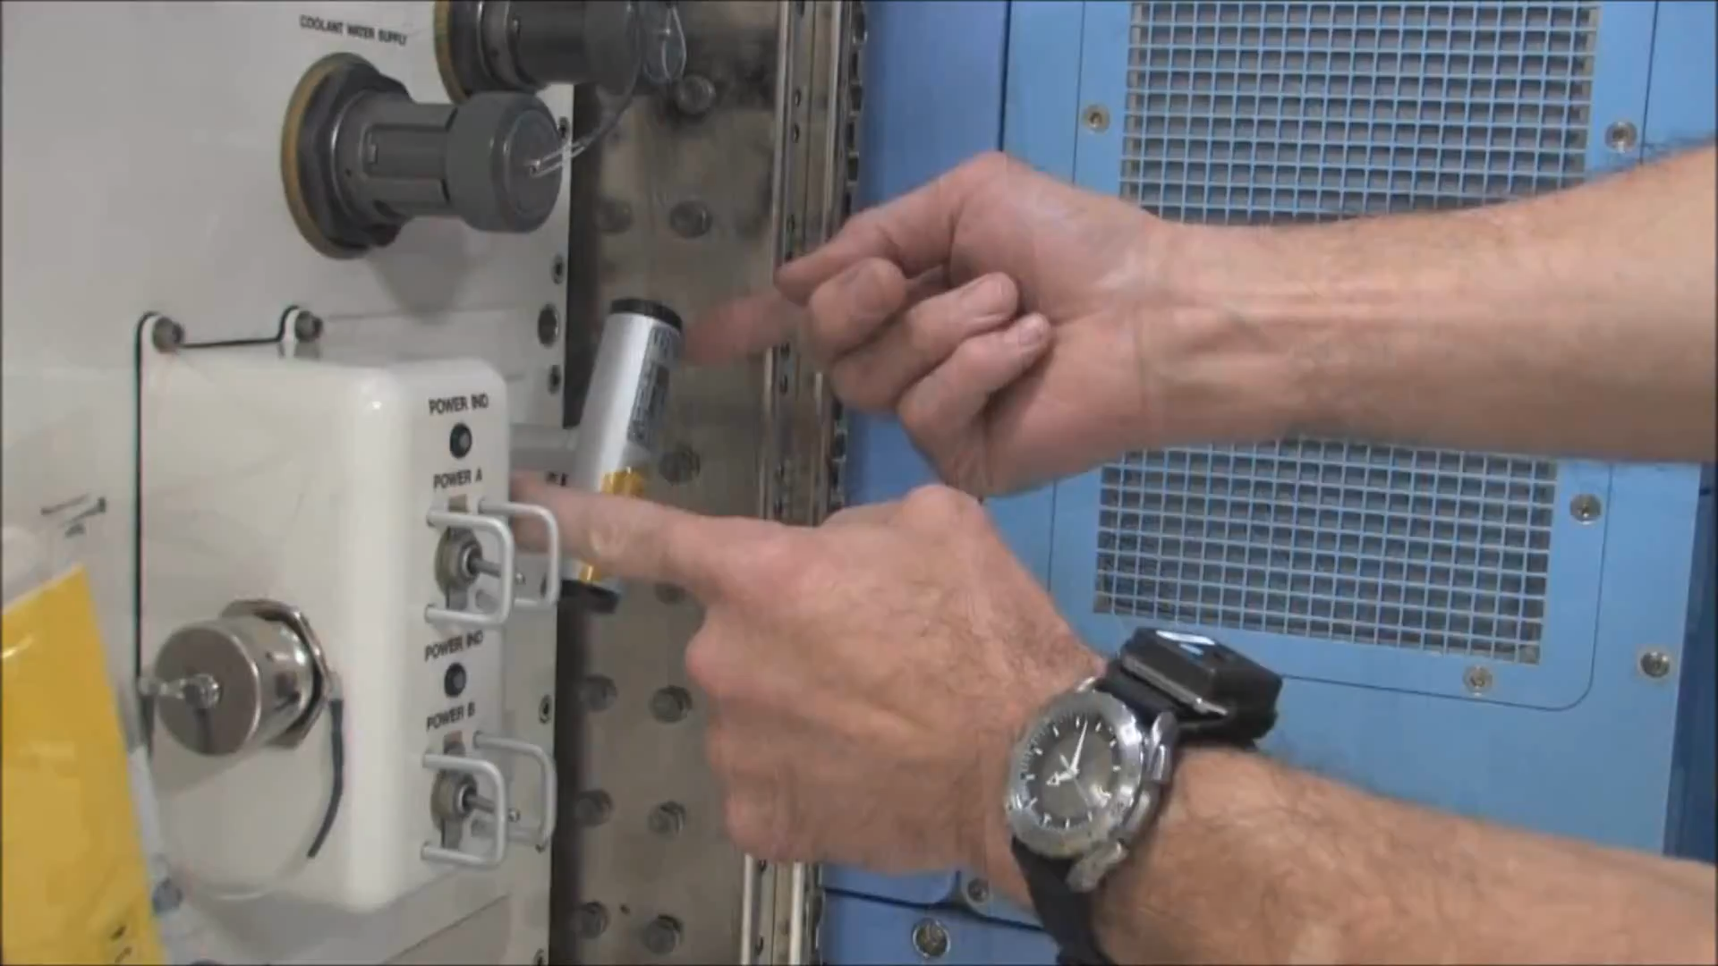
Astronaut
Wada & Shimoda 2024
Our Idea: Dzhanibekov effect
Rotation of triaxial spinning top can be unstable
https://www.youtube.com/watch?v=1x5UiwEEvpQ
Credit:NASA

Slide 10
Wada & Shimoda 2024
Triaxial Spinning Top
Euler’s Equations
The flip
-> One of solutions
The flip!!

Slide 11
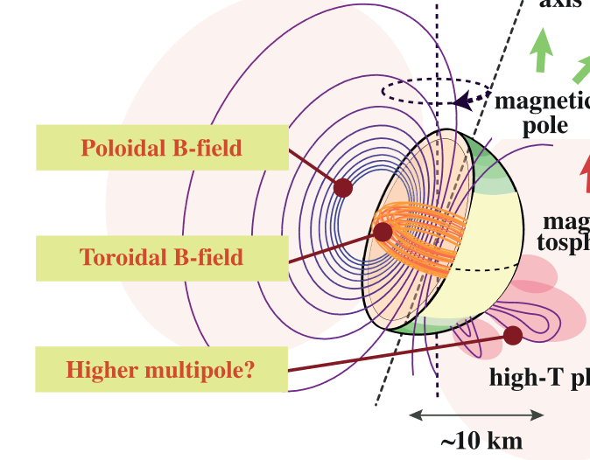
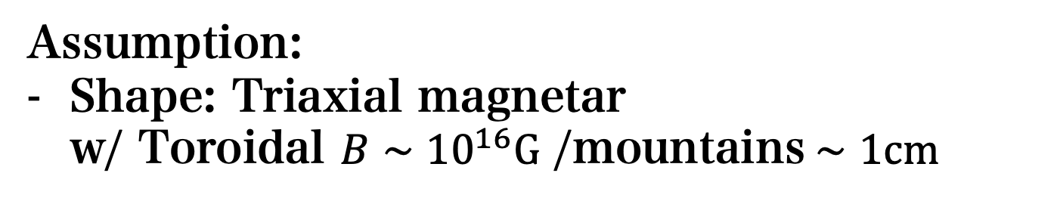
Wada & Shimoda 2024
Triaxial magnetar
Poloidal B
Toroidal B
(inner)
Assumption:
Shape: Triaxial magnetar
w/ Toroidal $B∼{10}^{16}G$ /mountains$∼1cm$
Enoto+19

Slide 12
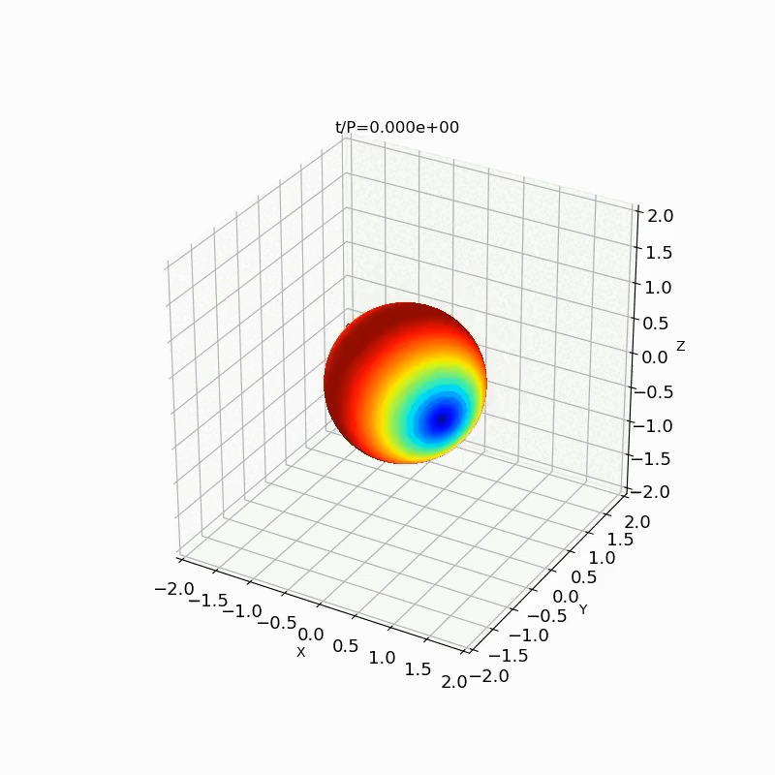
Wada & Shimoda 2024
Dzhanibekov effect of a Magnetar
図5：オイラー角の解析解
EoM > Magnetar can flip in ~100 years
https://www2.yukawa.kyoto-u.ac.jp/~tomoki.wada/share/anim2.mp4

Slide 13
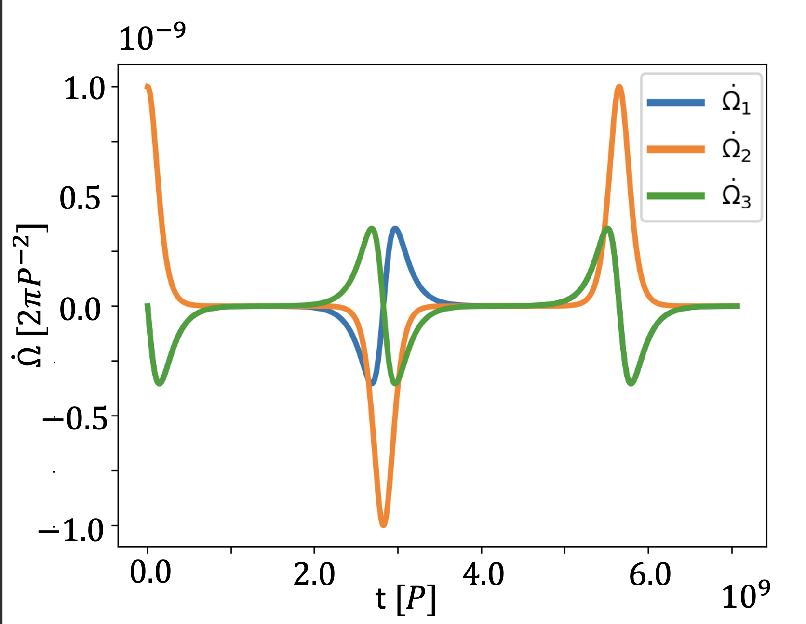
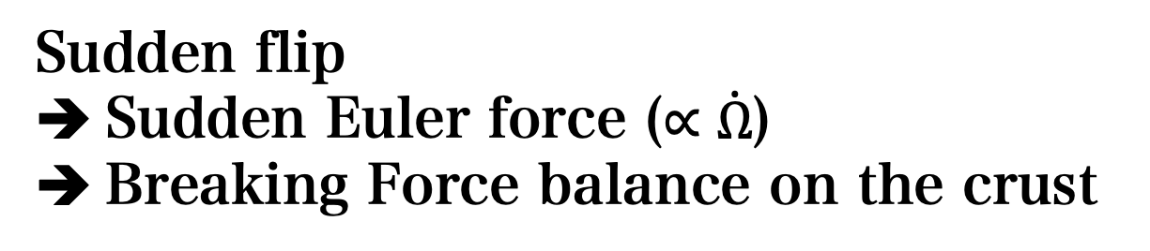
Wada & Shimoda 2024
Dzhanibekov effect as a trigger
Sudden flip
Sudden Euler force ($∝\dot{Ω}$)
Breaking Force balance on the crust

Slide 14













Shimoda & Wada 2025
X-ray emission
$$E[erg]$$
H=7 m
H=63 cm
H=110 m
Fractured!
$${10}^{44}$$
$$Fe+e^{−}$$
$${10}^{40}$$
Crust
Core
$${10}^{36}$$
$$∼1 km$$
$${10}^{32}$$
$${10}^{28}$$
$$∼10 km$$
$${10}^{−12}$$
$${10}^{−8}$$
$${10}^{−4}$$
$$ρ^{−1}[g^{−1}cm^{3}]$$
Fracture from the surface to inner
More available total internal energy
Hot plasma creation
X-ray emission

Slide 15
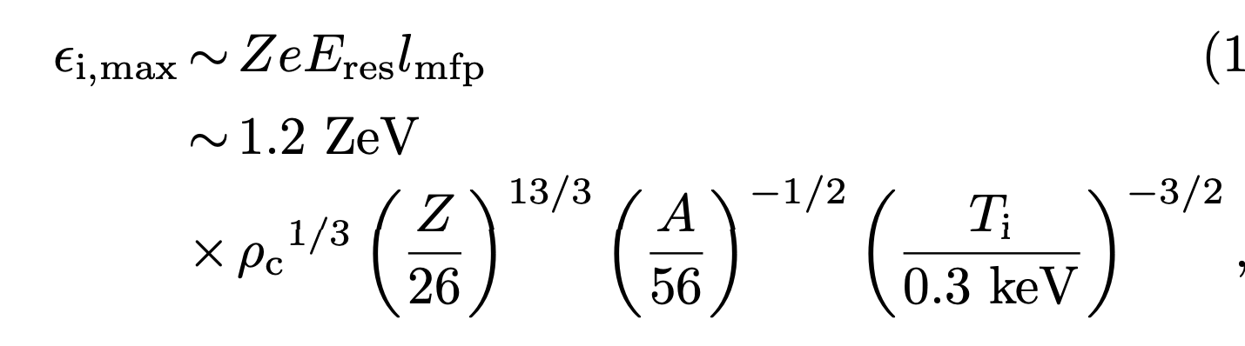
Shimoda & Wada 2025
Cosmic Ray Acceleration
@surface, very strong electric field is induced.
-> Ion acceleration!
Instant ZeV-ion-acceleration in Upset Magnetar Origin Bursts
→ IZUMO Bursts

Slide 16
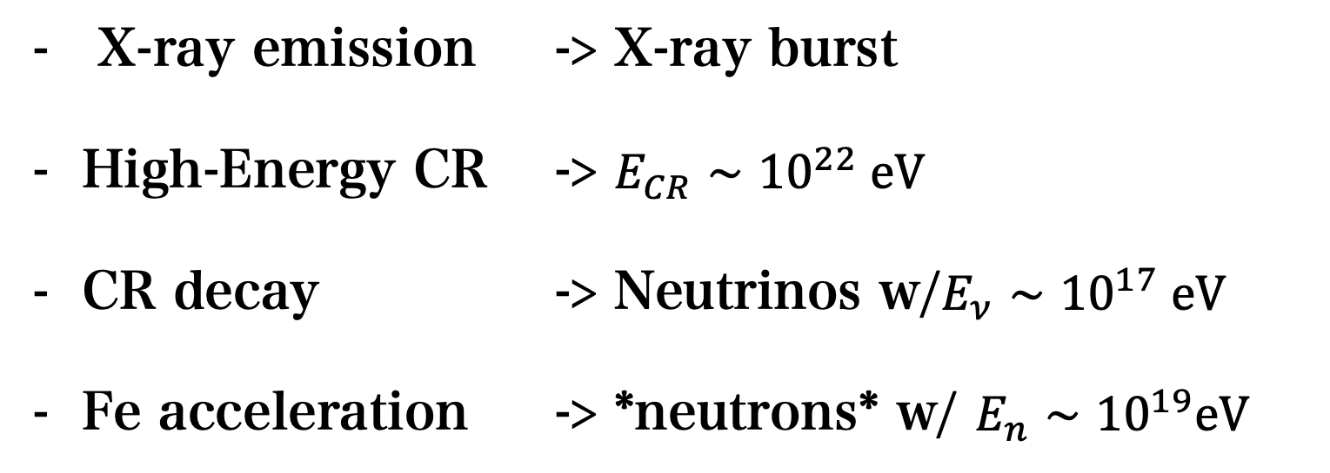
>100 EeV nuclei
20 EeV neutron
Shimoda & Wada 2025
Prospects
100 PeV neutrino
100 keV photon
Fractured!
Time & position coincidences of
UHECR *neutron* event & NS transient
from nearby galaxies
X-ray emission -> X-ray burst
High-Energy CR -> $E_{CR}∼10^{22} eV$
CR decay -> Neutrinos w/$E_{ν}∼10^{17} eV$
Fe acceleration -> *neutrons* w/ $E_{n}∼10^{19}eV$

Slide 17
Summary
Magnetar can flip in a timescale of ~100 year
> Dzhanibekov effect!
Sudden Euler force can induce magnetar transient
(IZUMO burst)
1. X-ray emission
2. Ultra high energy cosmic ray
Especially *neutron* and *neutrino*
Time & Position coincidences of UHECR *neutron*
event & NS transient from nearby galaxies.

Slide 18

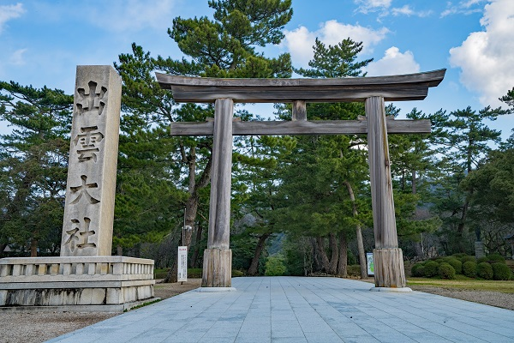
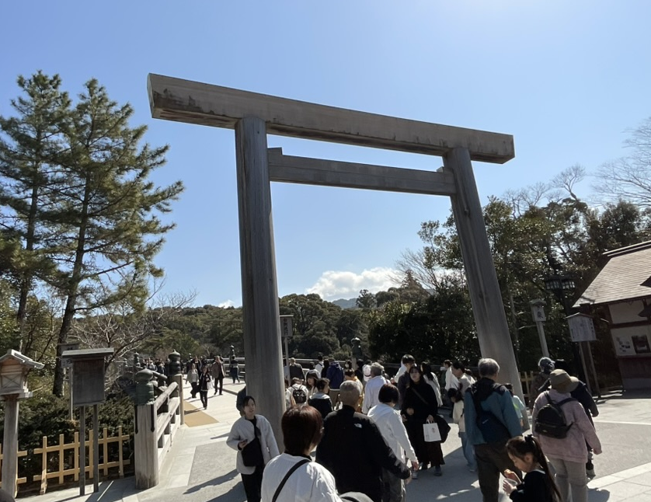
Summary
Magnetar can flip in a timescale of ~100 year
> Dzhanibekov effect!
Sudden Euler force can induce magnetar transient
(IZUMO burst)
1. X-ray emission
2. Ultra high energy cosmic ray
Especially *neutron* and *neutrino*
Time & Position coincidences of UHECR *neutron*
event & NS transient from nearby galaxies.
IZUMO-Taisha shrine
Shrine for Amaterasu

Slide 20
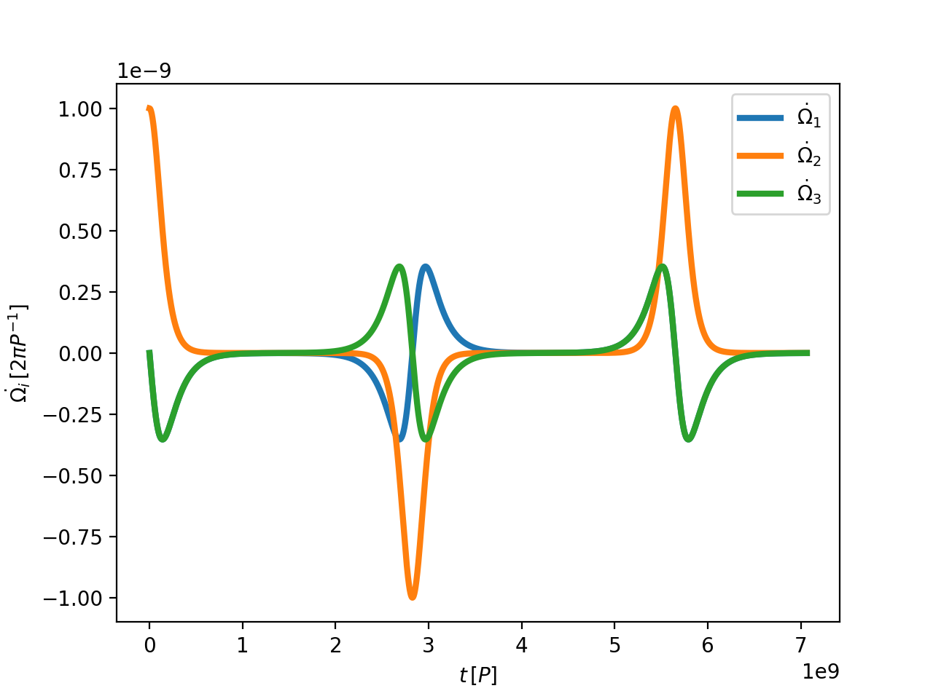






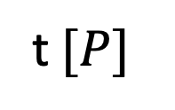






$${10}^{−9}$$
$$1.0$$
$$0.5$$
$$\dot{Ω} [2πP^{−2}]$$
$$0.0$$
$$−0.5$$
$$−1.0$$
$$0.0$$
$$2.0$$
$$4.0$$
$$6.0$$
t$[P]$
$${10}^{9}$$

Slide 21
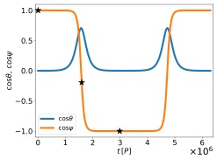
Wada & Shimoda 2024
Wada & Shimoda 2024
Dzhanibekov effect of a Magnetar
Euler equation of magnetar
for a given initial condition
Known as the Dzhanibekov effect as a solution of the Euler equation.
New Scenario for *Trigger* Mechanism of NS-transients
図5：オイラー角の解析解
Magnetar can flip in 100 years

Slide 22
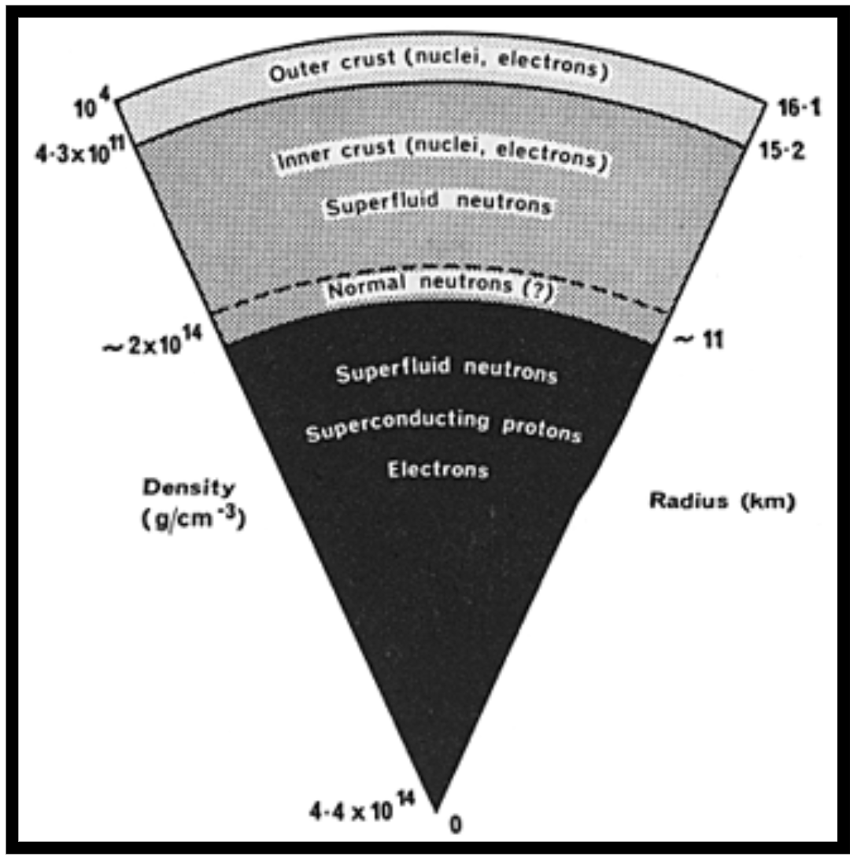
What happens in the NS under the Dzhanibekov effect?
The crust will be significantly affected within Δτ_{f} ~ 10⁻³ τ_{f} ~ 3 months δ₋₉⁻¹
Euler vs. Stiffness
Cracks reaches at H ~ 63 cm
Euler force can deform the NS surface at
ρ < 1.0e6 g/cc (r < 60 cm)
(Outer crust)

Slide 23

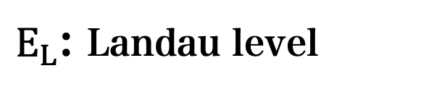





Shimoda & Wada 2025
X-ray emission
$E_{L}$: Landau level
Fracture!
$$N+e^{−}$$
$e^{−}$
Crust
Core
$$γ$$
$$γ$$
$$∼1 km$$
$γγ→e^{−}e^{+}$
$e^{−}$
$$∼10 km$$
$e^{−}$ motion
Electron deexcitation
Photon emission
Pair creation -> e+e- plasma formation
23

Slide 24


Эффект Джанибекова
Try with your smartphone
Throwing smartphone just around x_2 axis is difficult. Rotation around x_1, x_3 arise.

Slide 25
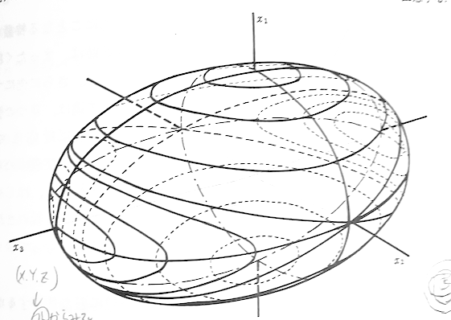
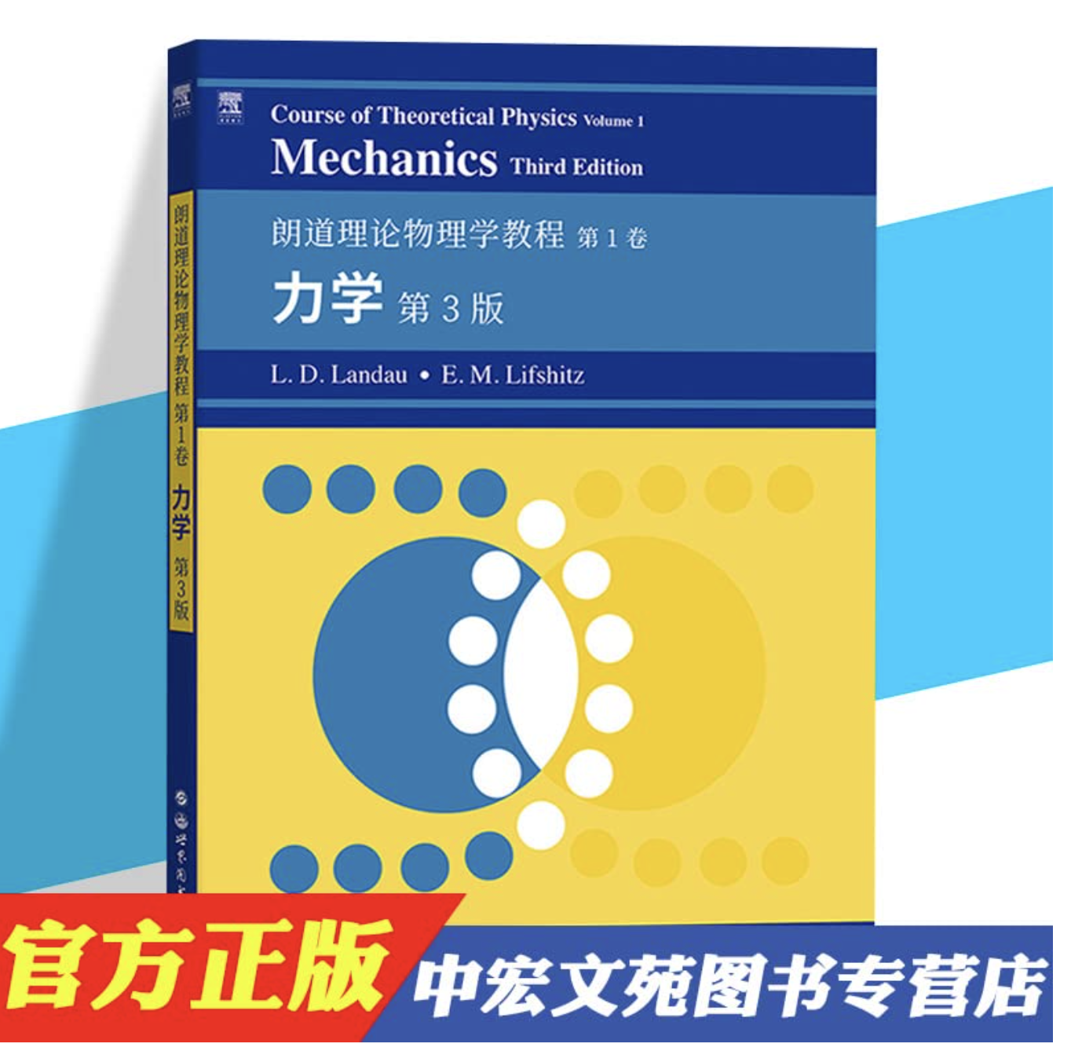
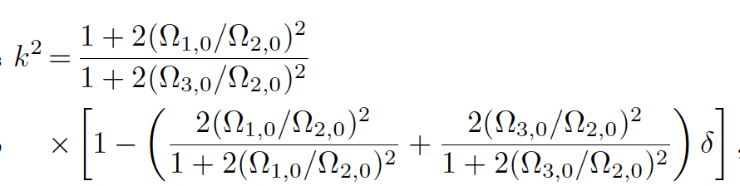
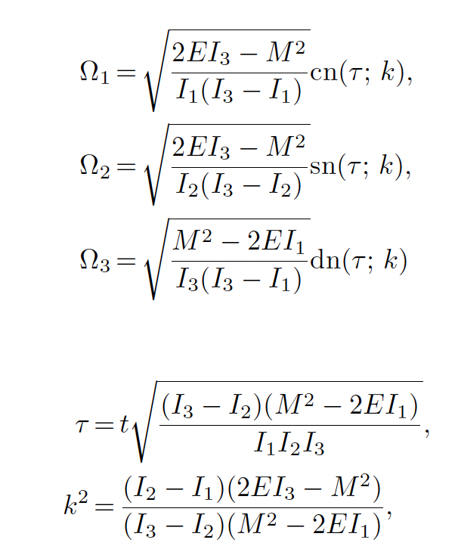
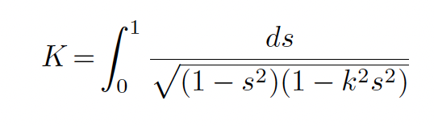
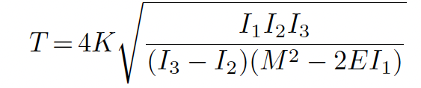

Analytic solution

Slide 26
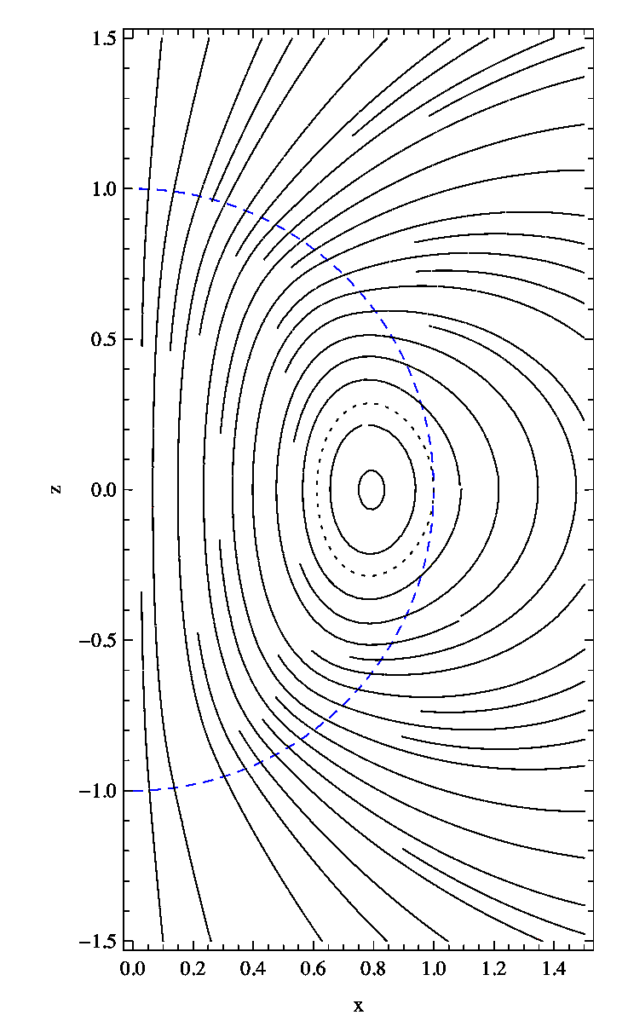
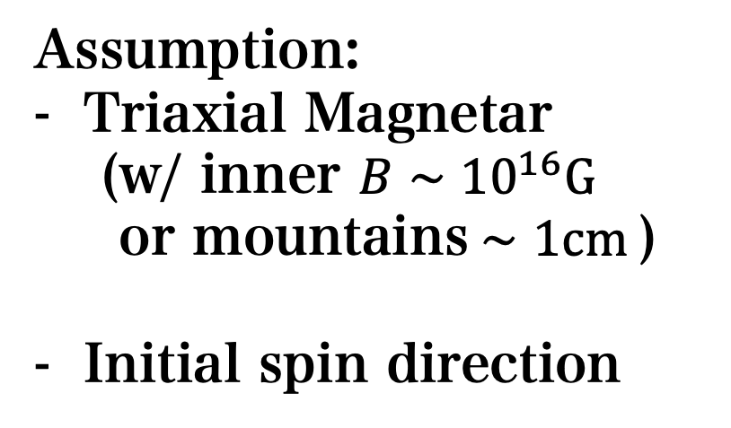
Wada & Shimoda 2024
Wada & Shimoda 2024
Triaxial magnetar
Assumption:
Triaxial Magnetar
(w/ inner $B∼{10}^{16}G$
or mountains$∼1cm$)
Initial spin direction
図5：オイラー角の解析解

