Slide 1
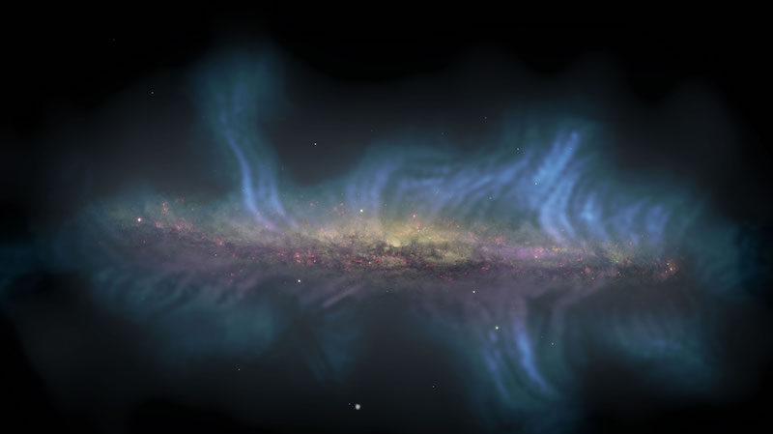

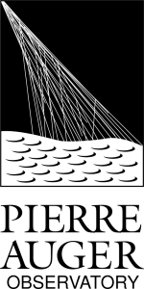










1) Anisotropy and Ultra-High-Energy Cosmic Ray Flux Composition
Implications of temporal features of
UHECR fluxes on large scale anisotropies
Janning Meinert, Leonel Morejón, Veronika Vašíčková, Lukas Merten, Sophie Aerdker, Julia Tjus, Karl-Heinz Kampert
CRI Session
21st of July 2025
kampert@uni-wuppertal.de

Slide 2
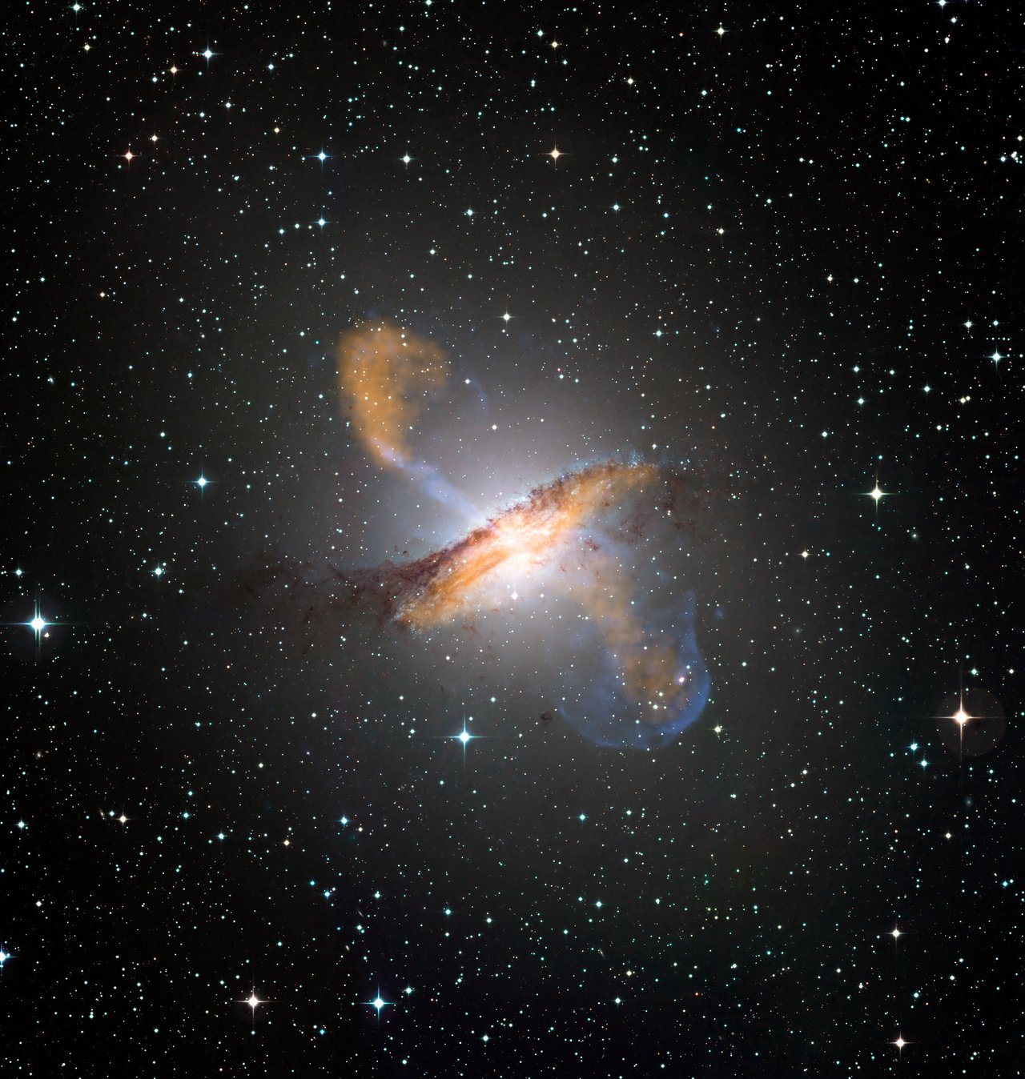
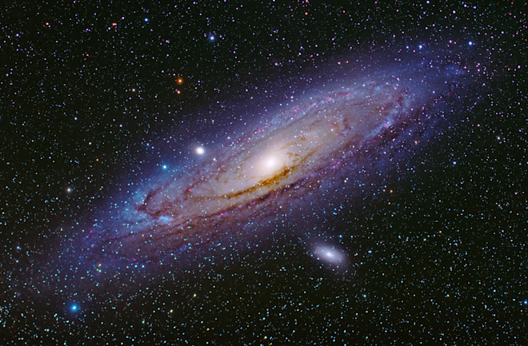
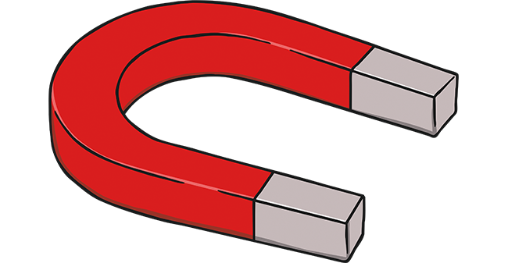
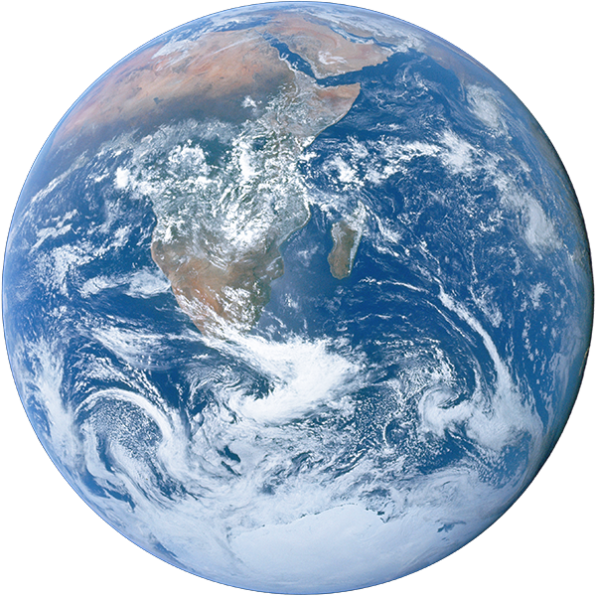


Introduction and motivation
UHECR source
Deflection ∝ Z/E
Observation
1
Notes:
Typical starting slide, AGN on the left-hand side as a potential source, deflection in our own galaxy

Slide 3



Introduction and motivation
UHECR source
Deflection ∝ Z/E
Observation
Confinement is rigidity dependent
1
Notes:
Main message: We want to understand the origin of UHECRs; therefore, we need a detailed description of propagation (rigidity dependent, e.g.) of CR in our galaxy.

Slide 4
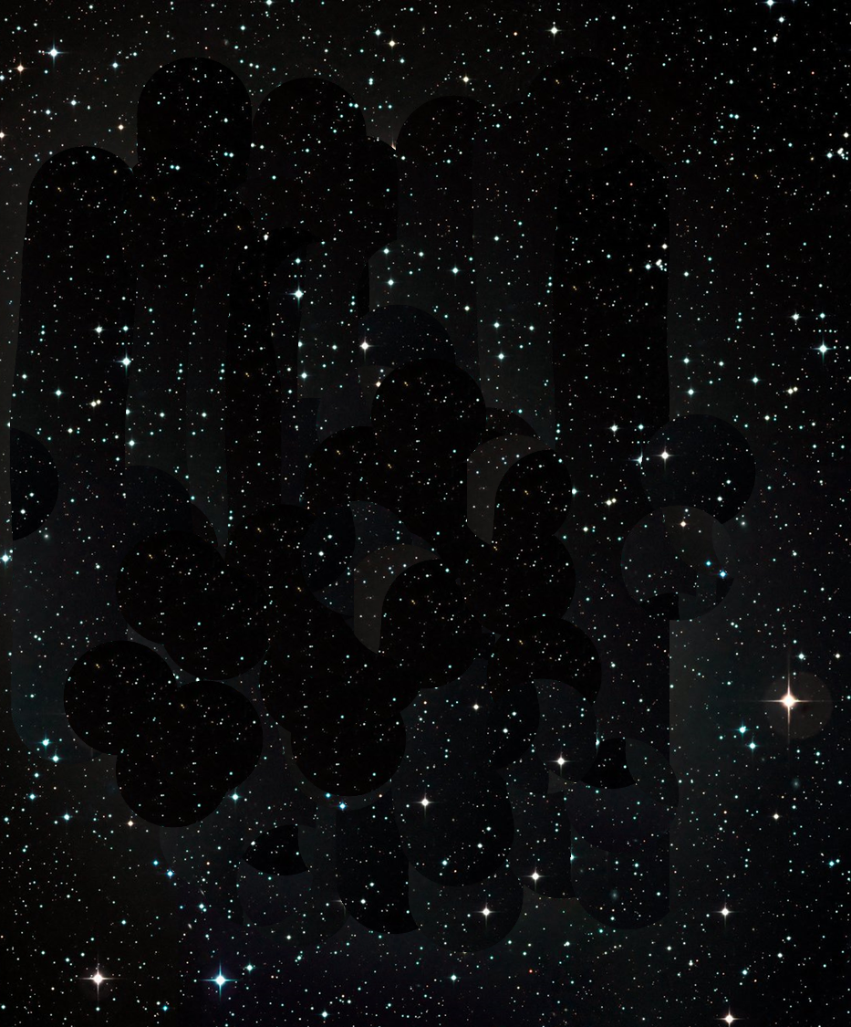
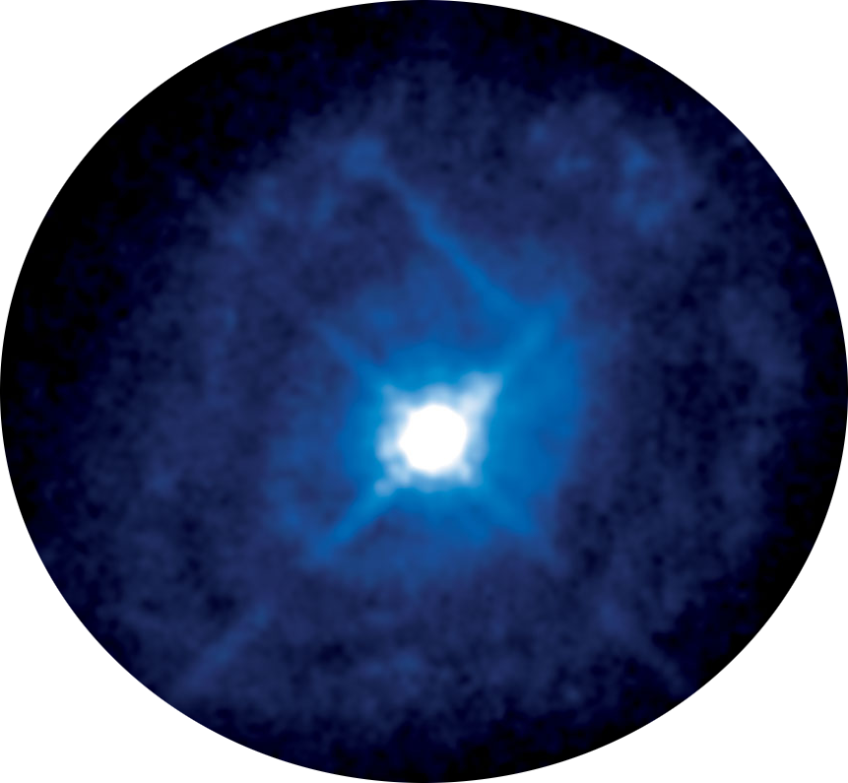
Which burst frequency to achieve a constant flux?
∝ Z/E
1
Notes:
In our study, we looked at bursting sources and observed how long UHECRs propagated in our galaxy.
A typical question thus might be, how many bursting sources do we need (in an idealized scenario) to have a constant UHECR flux? (Answer: one every 300 kyrs in our simulation setup)
Animation: The AGNs are appearig when clicking, as well as the CRs

Slide 5
What are the effects on anisotropy?
∝ Z/E
1
Notes:
We also want to study anisotropy effects in this framework

Slide 6
What are the effects on the transition region?
∝ Z/E
1
Notes:
And also the effects on the transition region

Slide 7
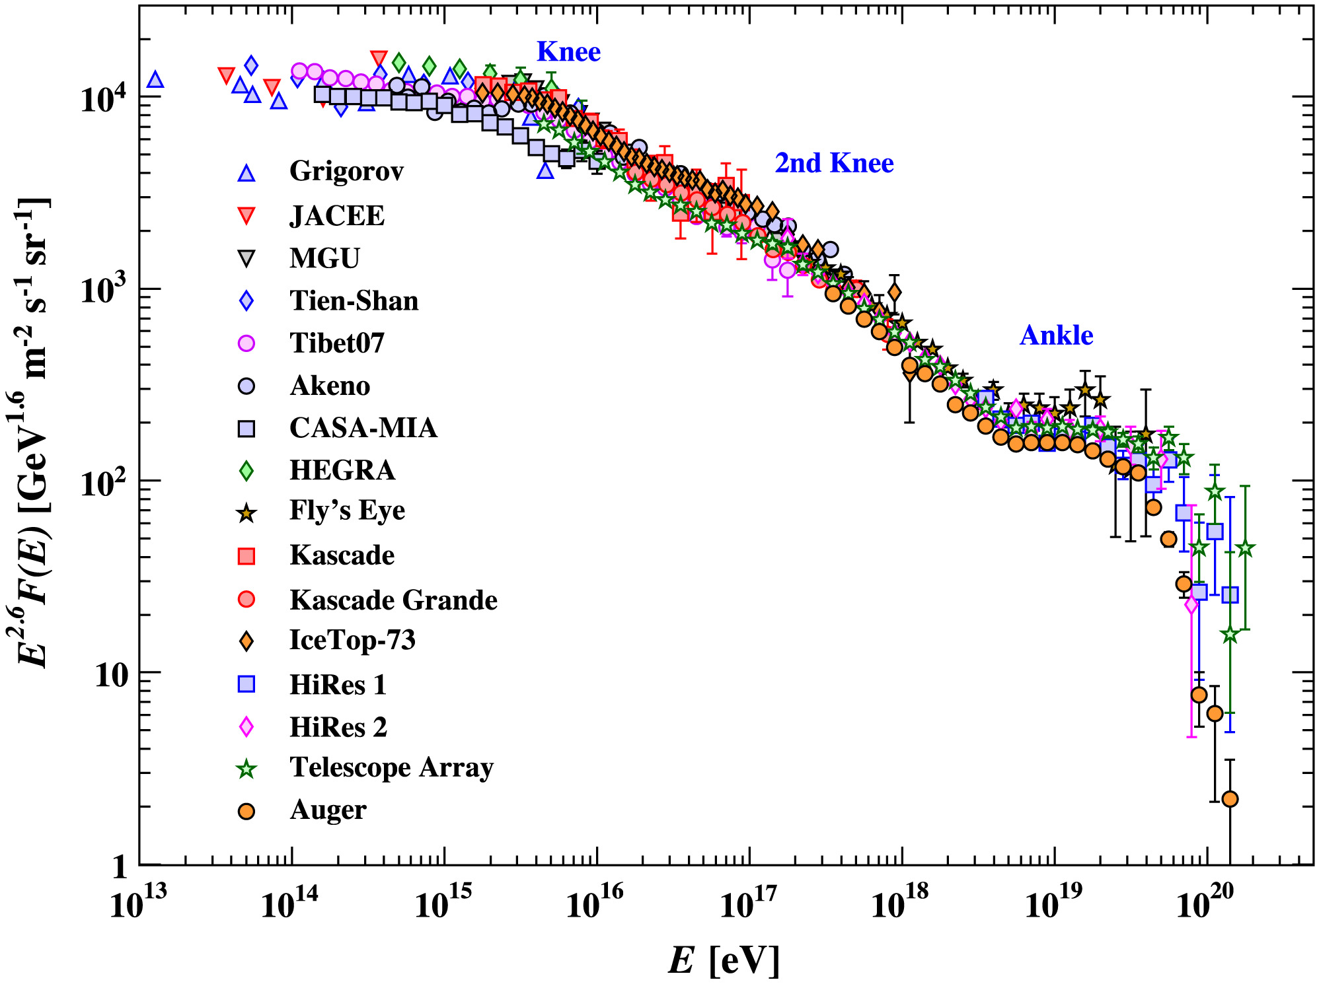
Transition Region
1st Knee
2nd Knee
Ankle
galactic
origin
?
extra-galactic
origin
2
Patrignani et al., 2016
Notes:
Small recap: where and what is the transition region

Slide 8
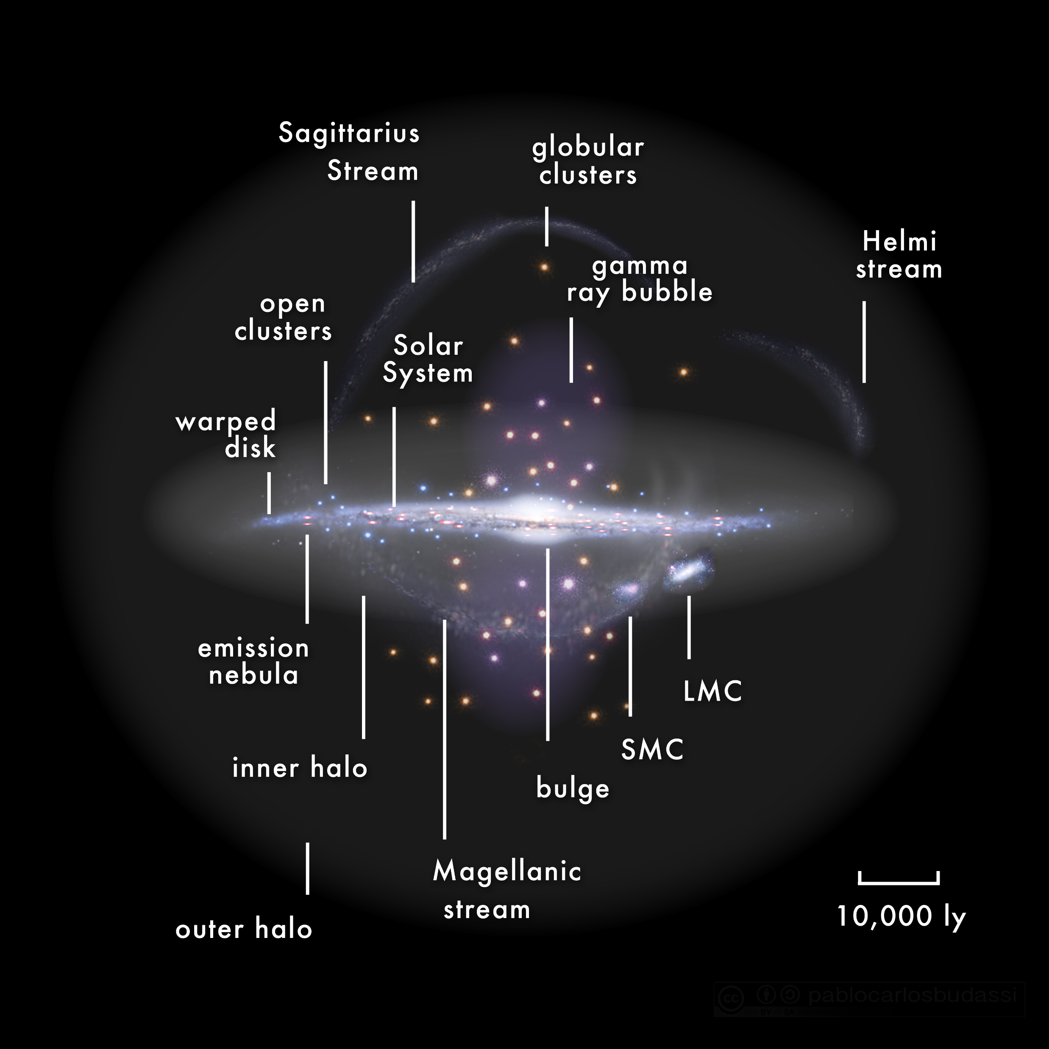
Simulation Setup
solar system
or ~ 3 kpc
3
Notes:
Introduction of our simulation setup

Slide 9
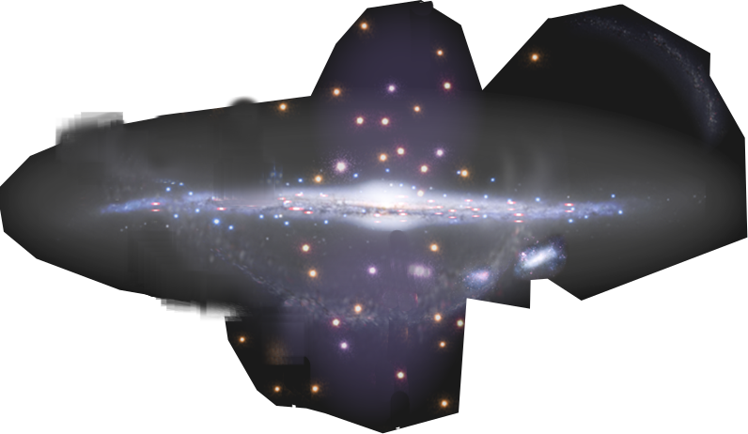
Simulation Setup
solar system
or ~ 3 kpc
3
Notes:
We care about the position of Earth in our simulation setup

Slide 10
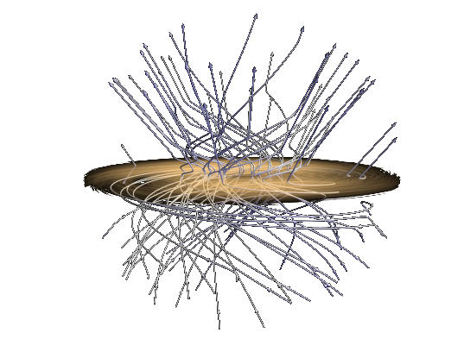
Simulation Setup
B-field: PlanckJF12b
solar system
or ~ 3 kpc
3
Notes:
We used PlanckJF12b for propagating our UHECRs, this is a picture of JF12 B-field lines

Slide 11
Simulation Setup
B-field: PlanckJF12b
GMF with CRPropa
solar system
20 kpc radius
injection
sphere
1 kpc radius
capture
sphere
or ~ 3 kpc
3
Notes:
We have one injection sphere
Animation: B-field is appearig when clicking

Slide 12









Simulation Setup
Propagation length within Galaxy
GMF with CRPropa
solar system
20 kpc radius
injection
sphere
1 kpc radius
capture
sphere
or ~ 3 kpc
3
Notes:
And propagated all particles, with the ability to differentiate rigidity

Slide 13
Simulation Setup
GMF with CRPropa
solar system
20 kpc radius
injection
sphere
1 kpc radius
capture
sphere
or ~ 3 kpc
3

Slide 14
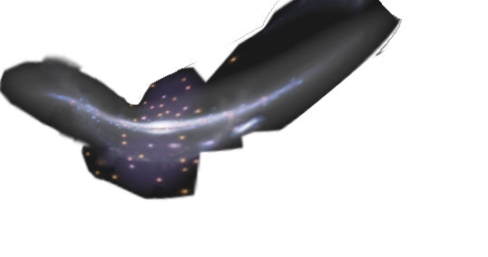
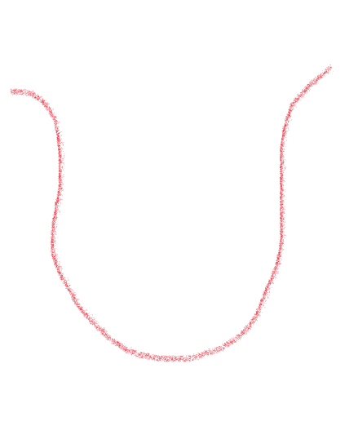
Simulation Setup
GMF with CRPropa
solar system
20 kpc radius
injection
sphere
1 kpc radius
capture
sphere
Equatorial
or ~ 3 kpc
3
Notes:
We need to change coordinate system to discuss the final part of our setup to equatorial coordinates

Slide 15

Simulation Setup
RA bins
GMF with CRPropa
solar system
20 kpc radius
injection
sphere
1 kpc radius
capture
sphere
Equatorial
or ~ 3 kpc
3
Notes:
As we now identify RA bins to use for our injection of pulses.
We simulated one bunch of protons and now are stitching it time-dependent together.

Slide 16
Simulation Setup
RA bins
We are injecting bursts at different times & RA
GMF with CRPropa
solar system
20 kpc radius
injection
sphere
1 kpc radius
capture
sphere
Equatorial
or ~ 3 kpc
3
Notes:
For example like so: first one delta like peak in the orange RA bin, then the purple, then pink
Animation: The bins are appearig when clicking

Slide 17
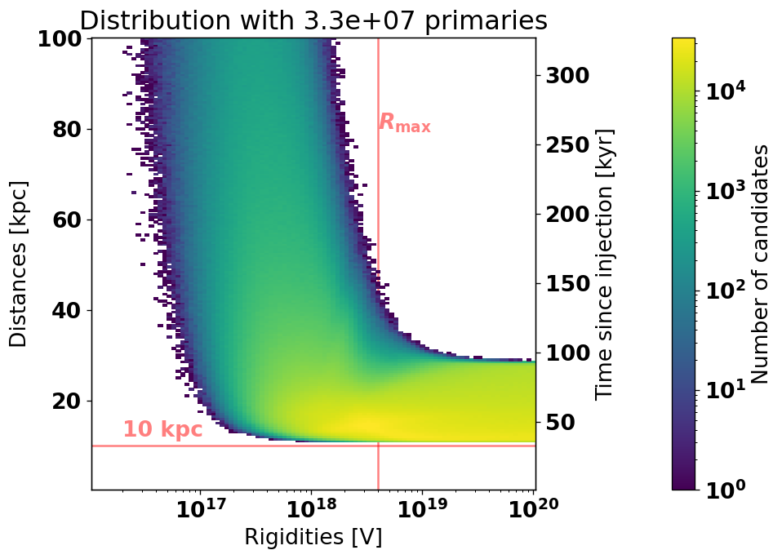
Rigidity 𝑅 versus total path length 𝐿
27 Billion injected protons
33 Million detected
The geometrical efficiency
is 0.2 %
Detected efficiency
of 0.12 %
4

Slide 18
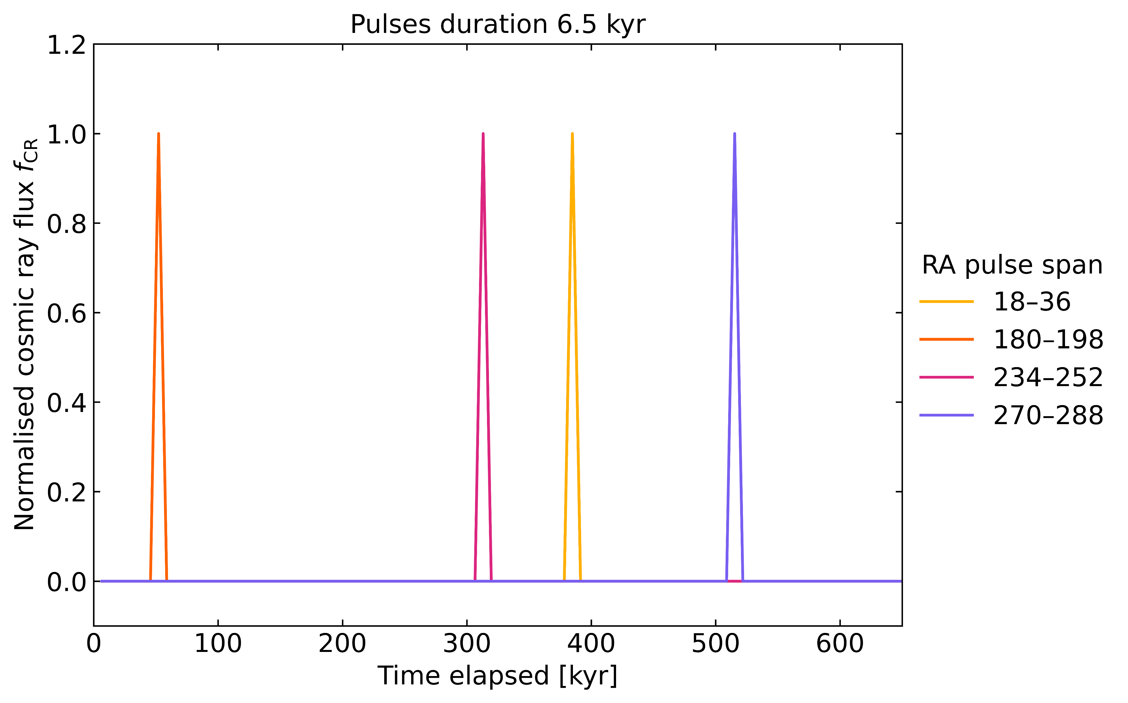



Example bursts scenario
q(t) injection profile
5
Notes:
This is how those injections look on a time coordinate. Different bursting events at different RAs.
Overall we are obtaining an injection profile q(t).

Slide 19
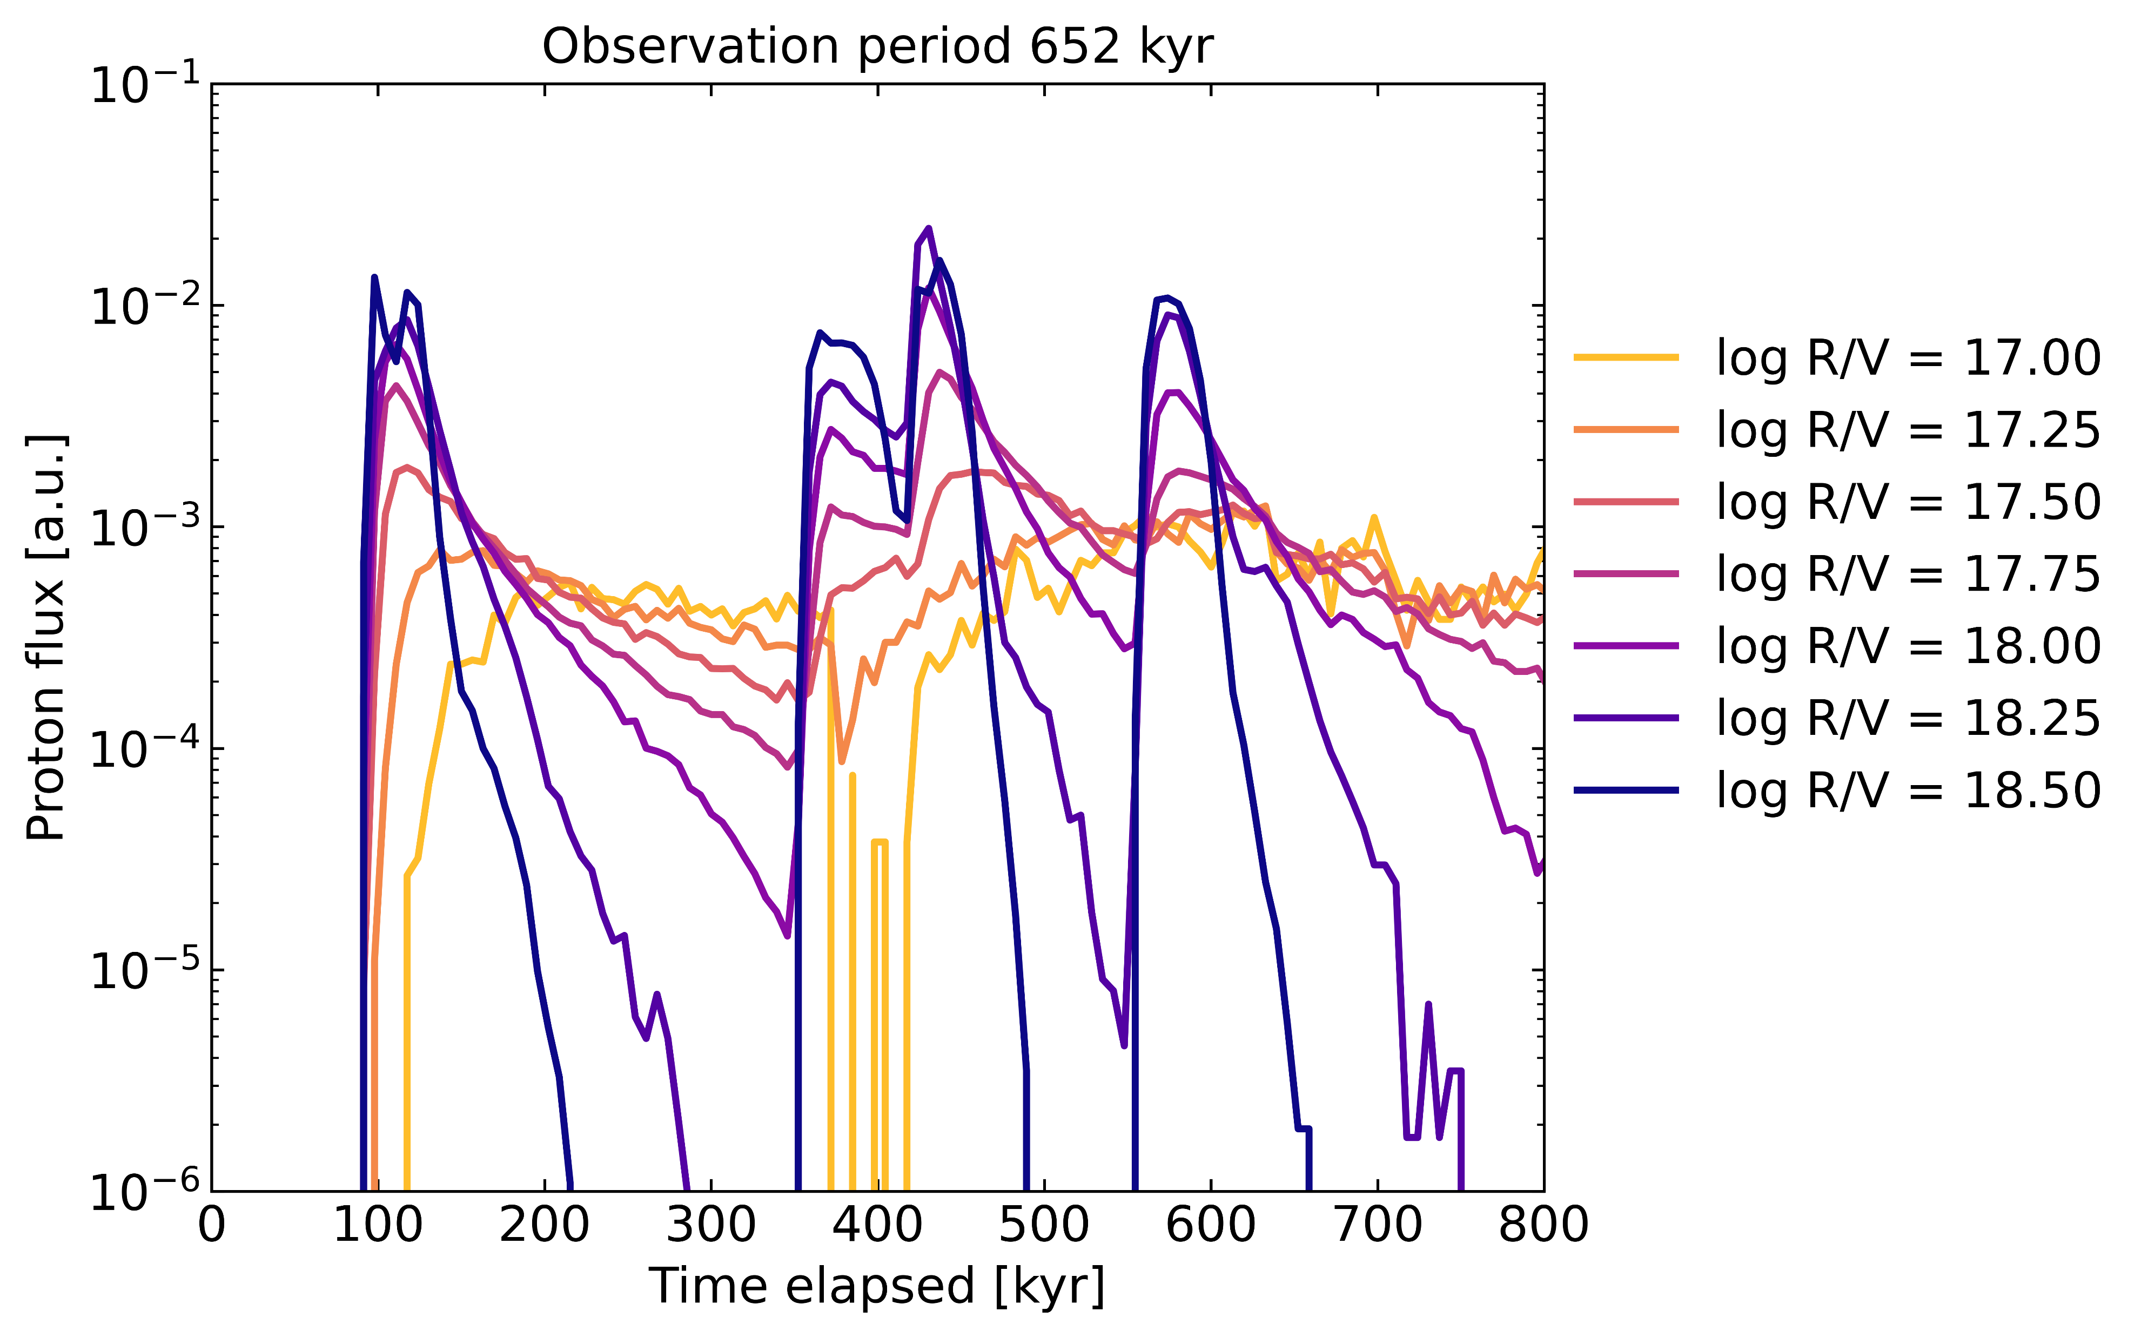



Example bursts scenario
total flux: f(t) = q(t)∗ h(t)
h(t) propagation kernel
6
Notes:
Now we can convolve that injection profile with the propagation kernel h(t) (propability of an UHECR travelling to Earth) to obtain the total flux f(t) on Earth.

Slide 20
Example bursts scenario
Observation frame [40 kyr]
6
Notes:
And now we can study observation on Earth if we integrate over a time frame (e.g. 40 kyrs)

Slide 21
Example bursts scenario
Observation frame [40 kyr]
6
Notes:
We can look at the first injection

Slide 22
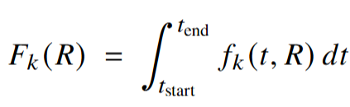
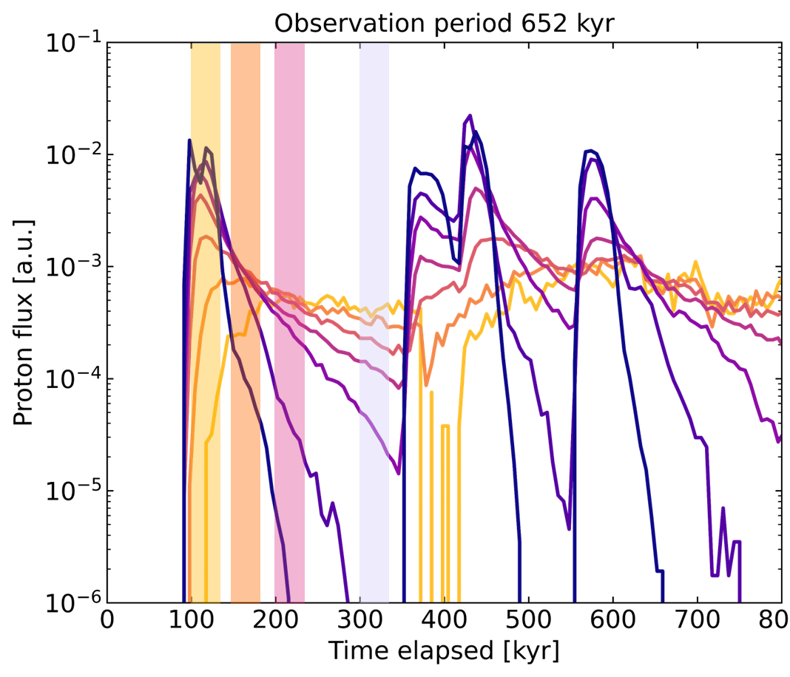
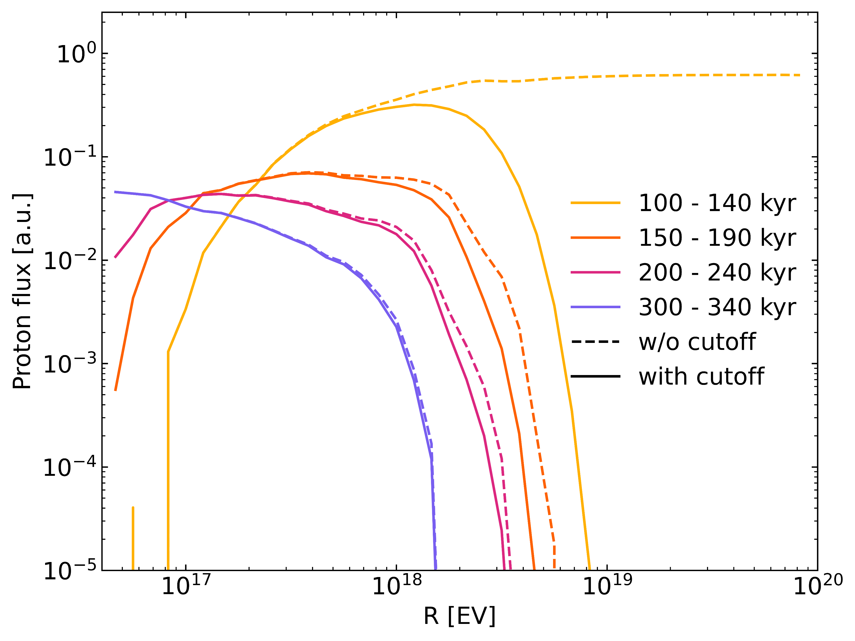
UHECR flux on Earth: first peak
Observation time frame [40 kyr]
7
Notes:
And see a strong burst in yellow which is slowly „melting“ to lower rigidities on the right hand side over time
Animation: The equation is appearing when clicking

Slide 23
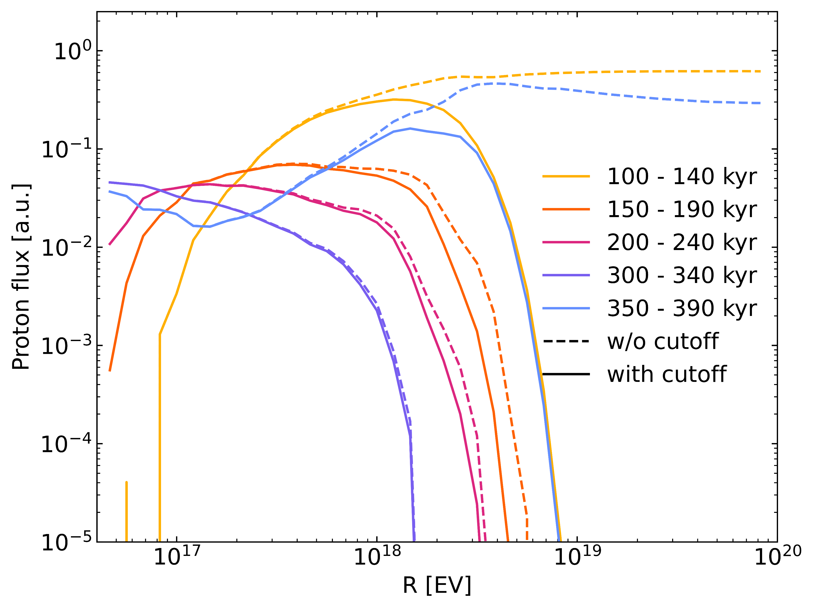
UHECR flux on Earth: first peak
Ankle like feature
Observation time frame [40 kyr]
7
Notes:
With another injection burst, we easily get ankle-like features (sky blue) in our observation spectrum (right).

Slide 24
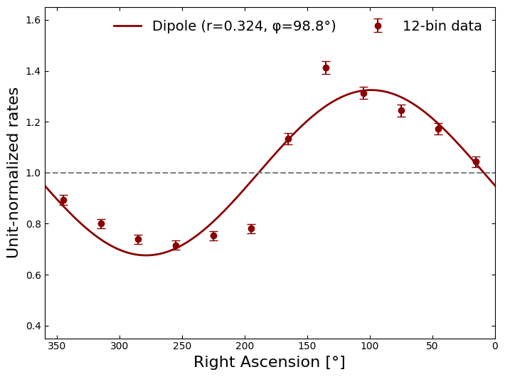
Anisotropy
RA 180-198
234-252
18-36
270-288
Observation time frame [40 kyr]
8
Notes:
And we can also investigate the anisotropy caused by the injected UHECRs

Slide 25
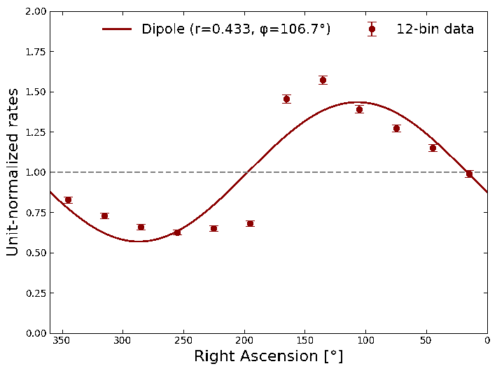
Anisotropy
RA 180-198
234-252
18-36
270-288
Observation time frame [40 kyr]
8
Notes:
This is a convoluted animation: The blue bar on the left side is our observation frame which moves as the gif is playing on the right
The gif plays once, everything starts when the slide show without clicking before!

Slide 26
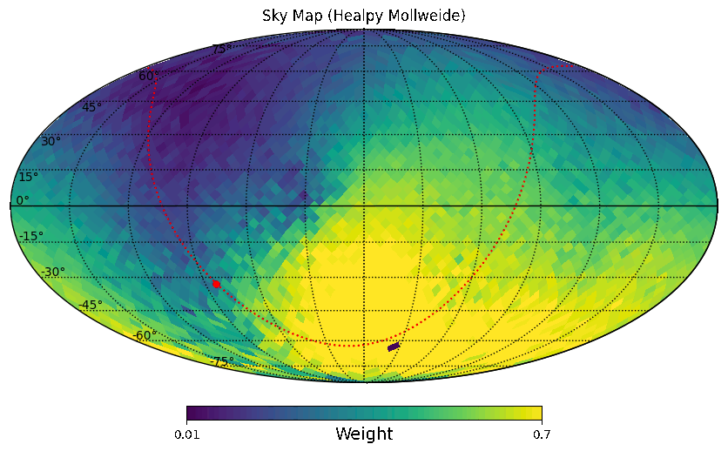
Anisotropy: skymaps
RA 180-198
234-252
18-36
270-288
Observation time frame [40 kyr]
9
Notes:
The same procedure for the skymaps

Slide 27
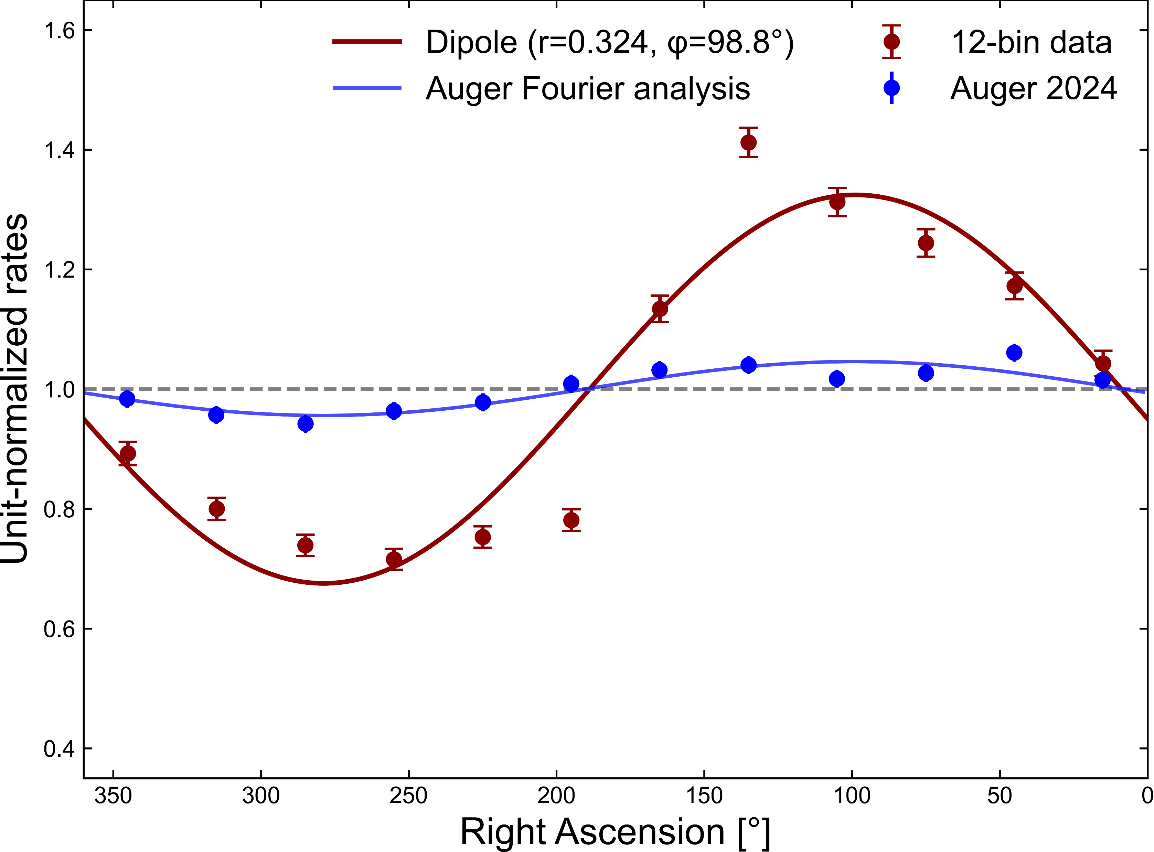
Anisotropy: Comparison with Auger
RA 180-198
234-252
18-36
270-288
Simulation
Pierre Auger Observatory:
A. Abdul Halim et al (2024) ApJ 976 48
Observation time frame [40 kyr]
10
Notes:
So currently we are only close to an Auger-like dipole around the injection of a new burst.
But the future is bright: In principle, we can fit all available observables (anisotropy, flux on Earth, and also composition) to an individual time profile of UHECRs in the past. This is very ambitious but also very exciting.

Slide 28

Summary
∝ Z/E
Time delays matter
11
Notes:
So the main message really is: Time delays of UHECRs are crucial for understanding our available observables (anisotropy, flux on Earth)
We want to leverage this into learning more about the origin of UHECRs
Animation: The text and watch are appearing when clicking

Slide 29






Summary
Anisotropy
∝ Z/E
CR spectrum
Time delays matter
11
Notes:
So the main message really is: Time delays of UHECRs are crucial for understanding our available observables (anisotropy, flux on Earth)
We want to leverage this into learning more about the origin of UHECRs
Animation: The text and watch are appearing when clicking

Slide 30

Thank you!
CRI Session
21st of July 2025
kampert@uni-wuppertal.de
Notes:
This is Geneva by the way

