Slide 1


Measurement of All-Particle Energy Spectrum and Mean Logarithmic Mass of Cosmic Rays up to hundreds of PeV
Heng-Ying Zhang (Yunnan University)
Co-authors: Hui-Hai He, Cun-Feng Feng, Ling-Ling Ma
(On behalf of the LHAASO Collaboration)
2025.07.23

Slide 2

1
Introduction
Outline
2
LHAASO
3
Analysis and Result
4
Preliminary Conclusion

Slide 3
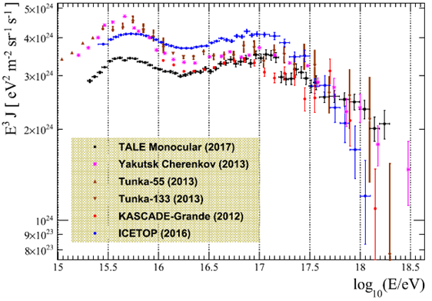
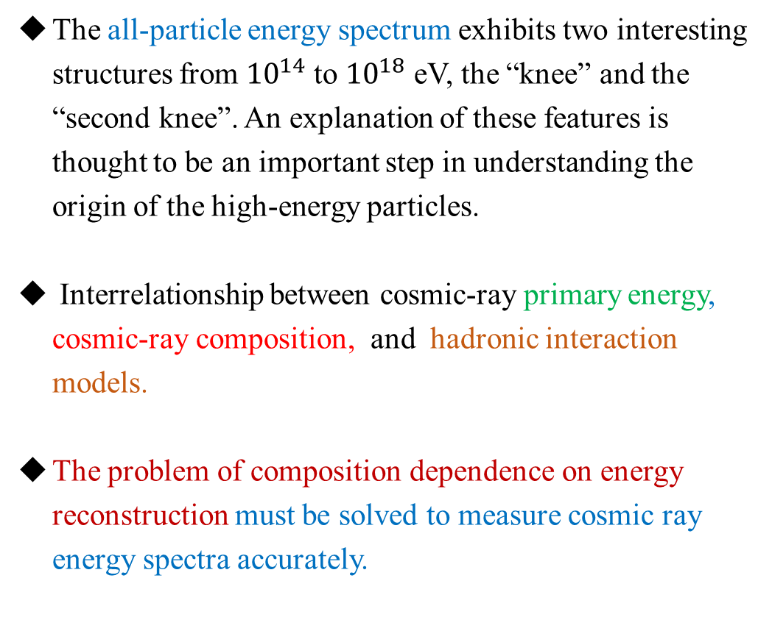
Introduction
The all-particle energy spectrum exhibits two interesting structures from ${10}^{14}$to ${10}^{18}$ eV, the “knee” and the “second knee”. An explanation of these features is thought to be an important step in understanding the origin of the high-energy particles.
Interrelationship between cosmic-ray primary energy, cosmic-ray composition, and hadronic interaction models.
The problem of composition dependence on energy reconstruction must be solved to measure cosmic ray energy spectra accurately.
The Astrophysical Journal 865:74 (18pp), 2018.

Slide 4
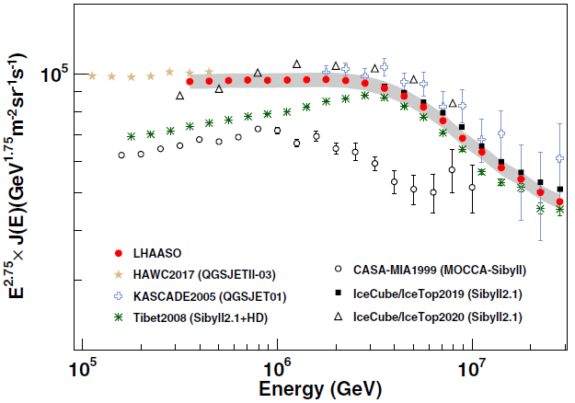
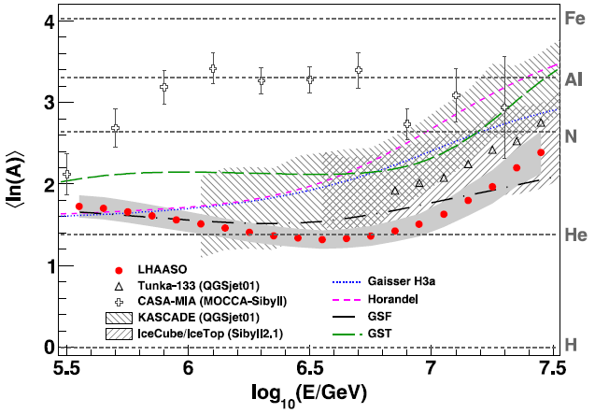
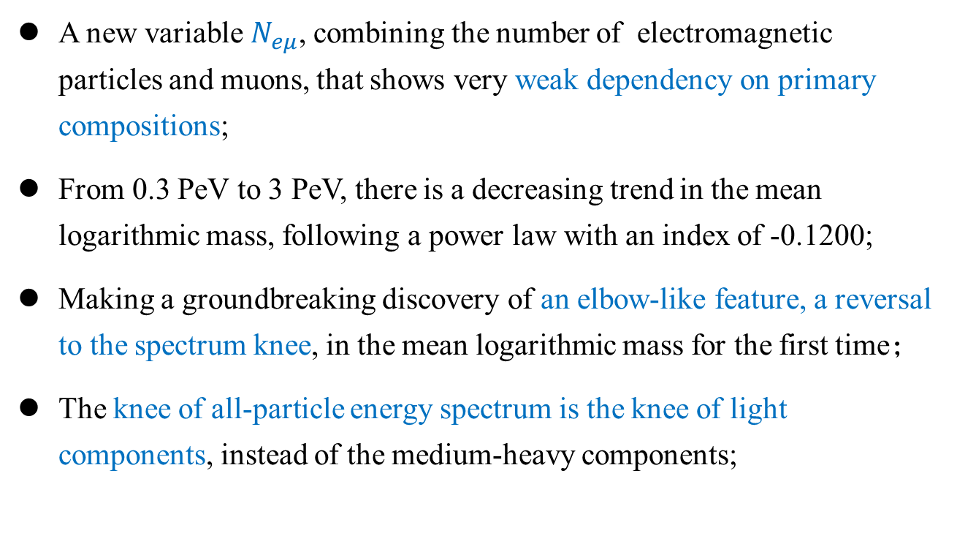
Introduction
A new variable $N_{eμ}$, combining the number of electromagnetic particles and muons, that shows very weak dependency on primary compositions;
From 0.3 PeV to 3 PeV, there is a decreasing trend in the mean logarithmic mass, following a power law with an index of -0.1200;
Making a groundbreaking discovery of an elbow-like feature, a reversal to the spectrum knee, in the mean logarithmic mass for the first time；
The knee of all-particle energy spectrum is the knee of light components, instead of the medium-heavy components;
Second knee?
PRL 132, 131002 (2024)

Slide 5
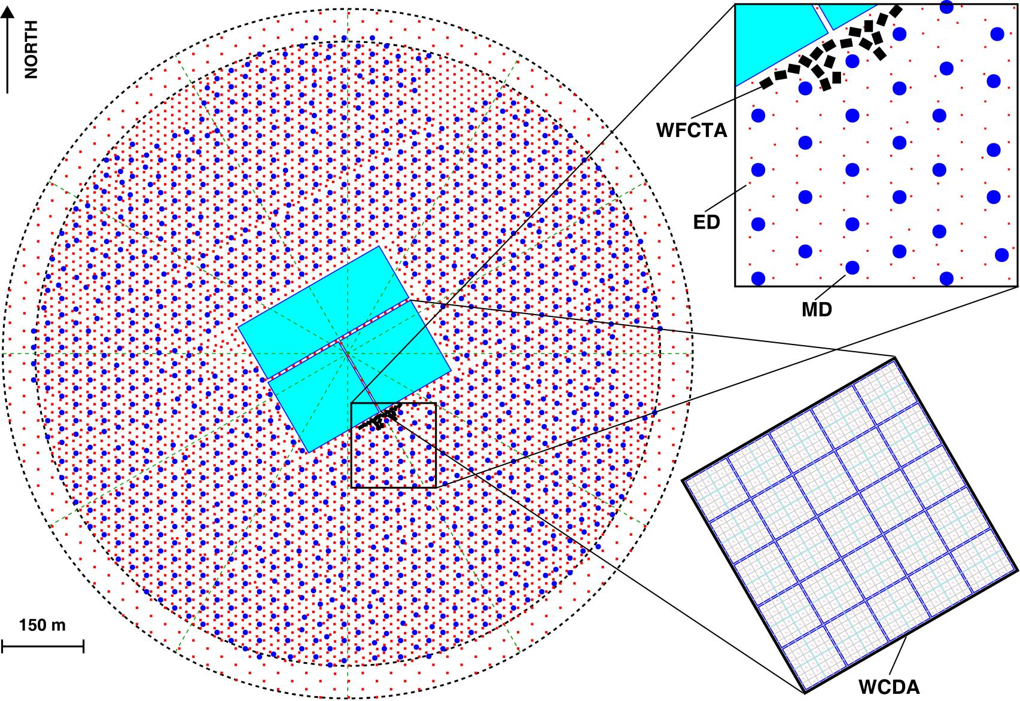
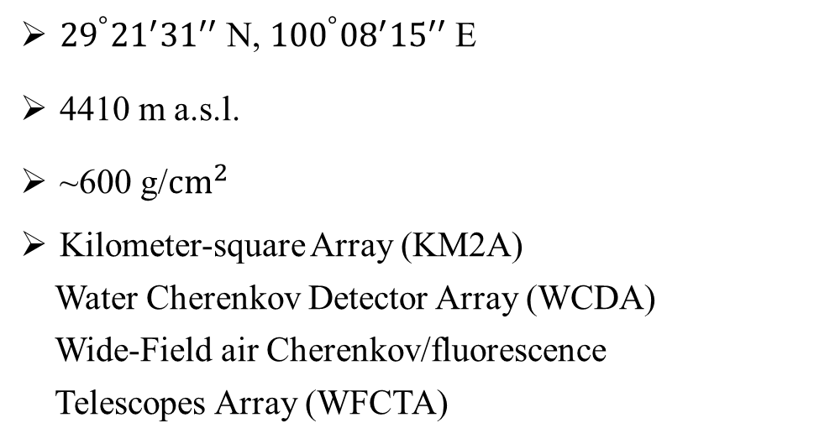
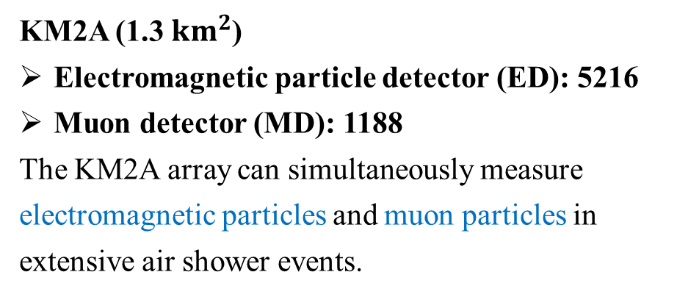
LHAASO
${29}^{°}{21}^{′}{31}^{′′}$ N, ${100}^{°}{08}^{′}{15}^{′′}$E
4410 m a.s.l.
~600 g/${cm}^{2}$
Kilometer-square Array (KM2A)
Water Cherenkov Detector Array (WCDA)
Wide-Field air Cherenkov/fluorescence
Telescopes Array (WFCTA)
KM2A (1.3 ${km}^{2}$)
Electromagnetic particle detector (ED): 5216
Muon detector (MD): 1188
The KM2A array can simultaneously measure electromagnetic particles and muon particles in extensive air shower events.

Slide 6
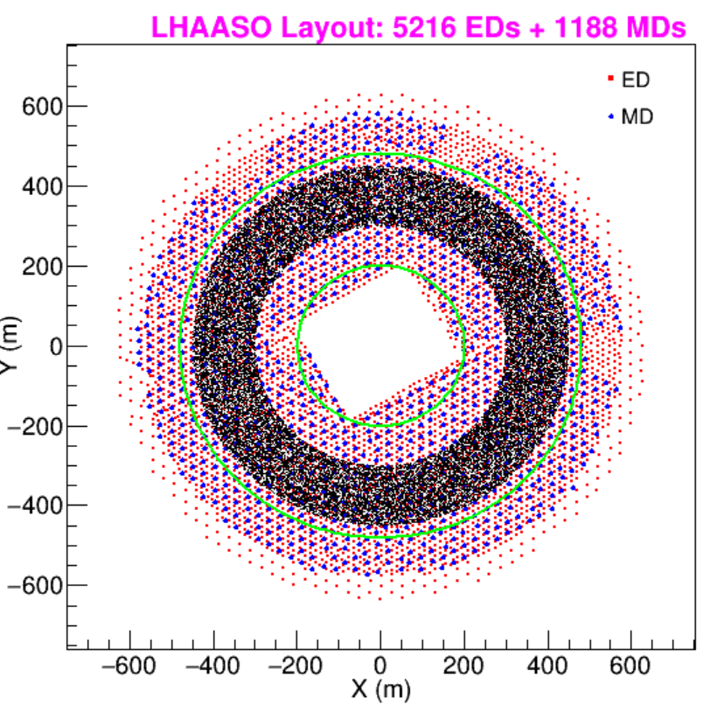
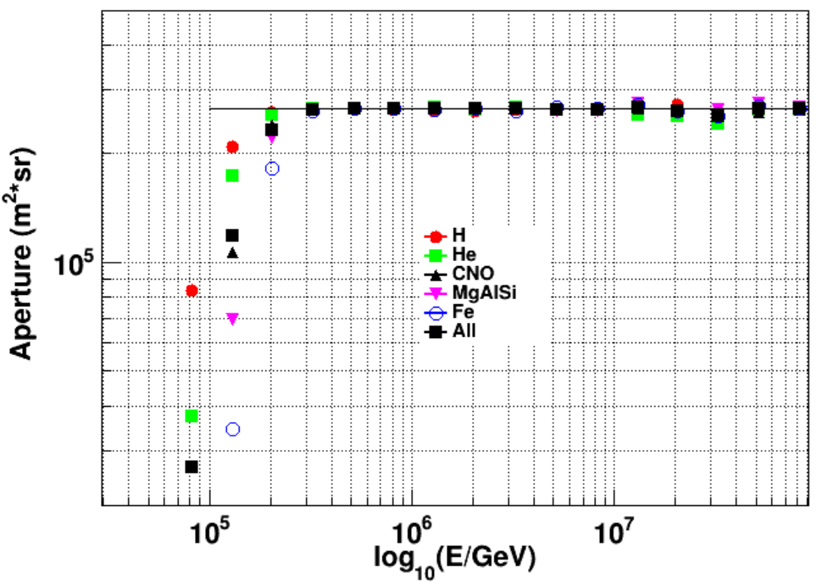
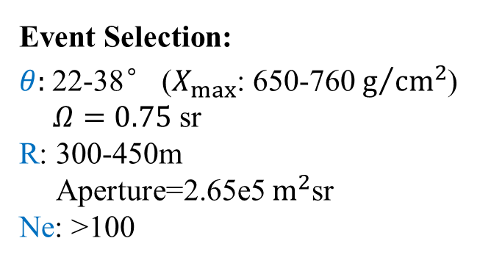
Analysis and Result
KM2A full array simulation data
QGSJETII-04_fluka and EPOS-LHC_fluka
Proton He CNO MgAlSi Fe
Theta:0-40°
Slope: -2
Sample Radius：200-480m
Event Selection:
$θ:$22-38° ($X_{max}$: 650-760 $g/{{cm}^{2}}$)
$Ω=0.75$ sr
R: 300-450m
Aperture=2.65e5 $m^{2}$sr
Ne: >100

Slide 7
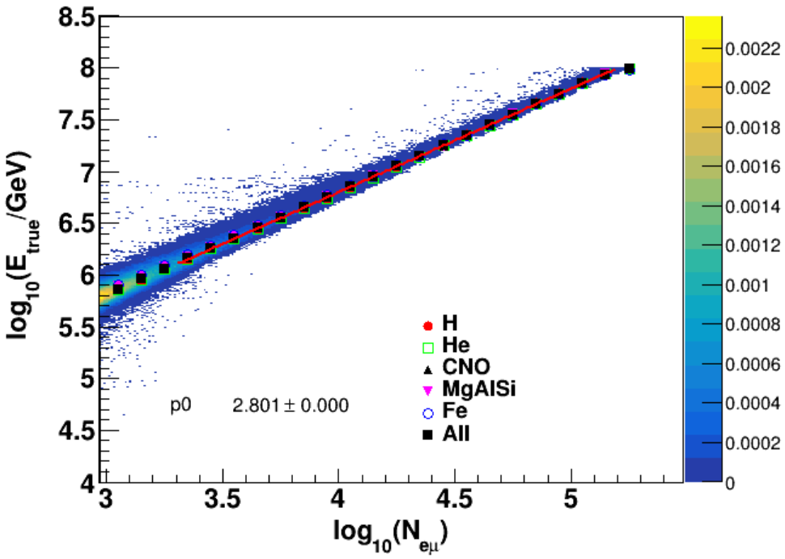
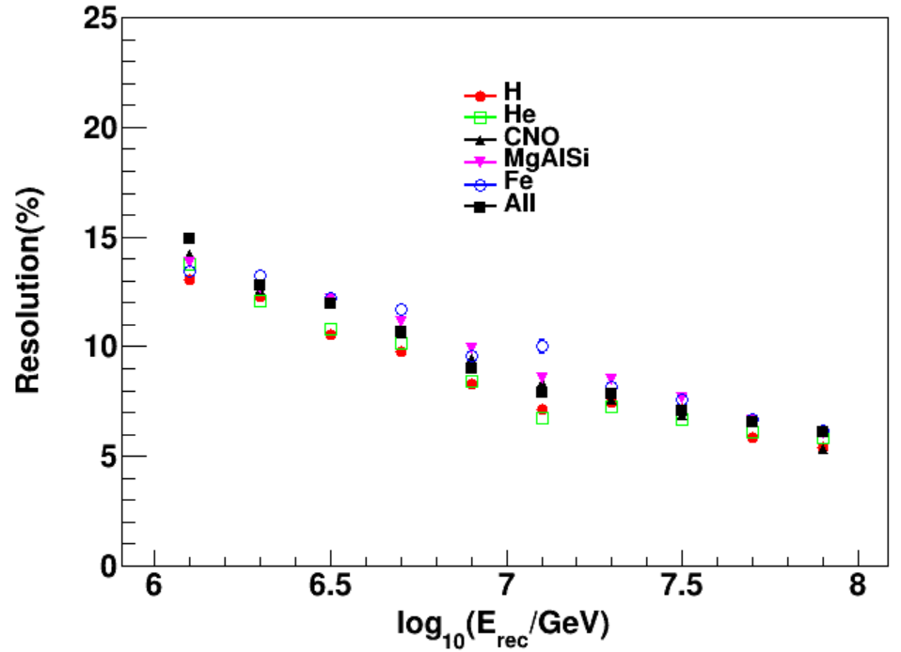
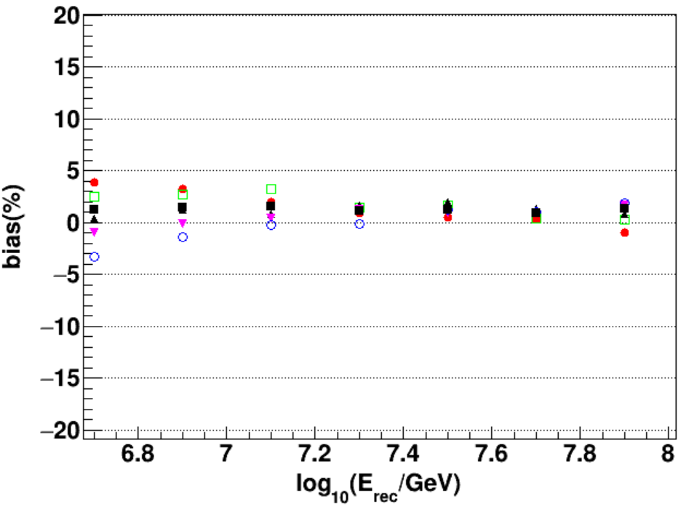



Analysis and Result
Energy reconstruction
As Heitler’s EM model and Matthews’ hadronic showers model introduced that the primary energy is finally divided between pions and electromagnetic particles in sub-showers.
$$E_{0}=E_{e}+E_{h}$$
$${E=0.85GeV(N}_{e}+25∗N_{μ})$$
J. Matthews Astroparticle Physics 22 (2005) 387–397
one combined variable to reconstruct the cosmic ray energy weakly dependent on the components
$${N_{eμ}=N}_{e}+2.8∗N_{μ}$$
H.Y. Zhang, H.H. He and C.F. Feng PRD 106, 123028 (2022)

Slide 8
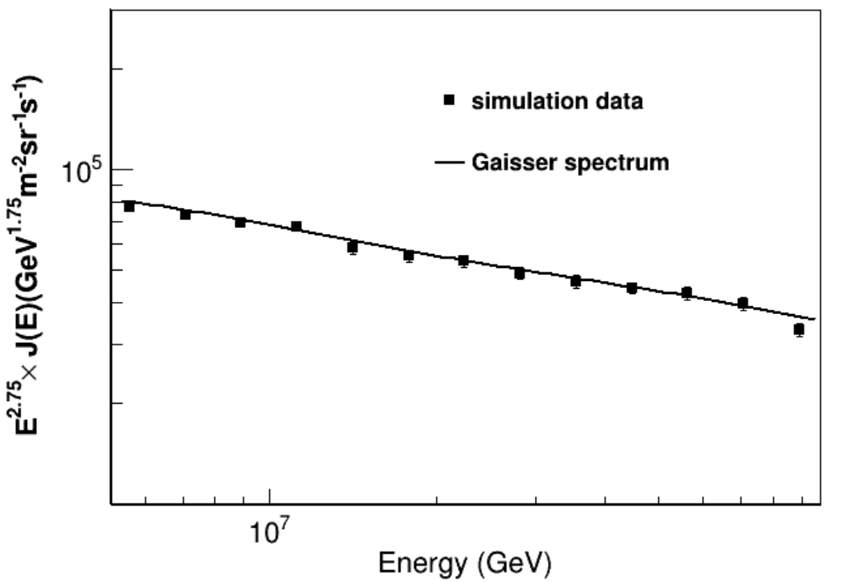
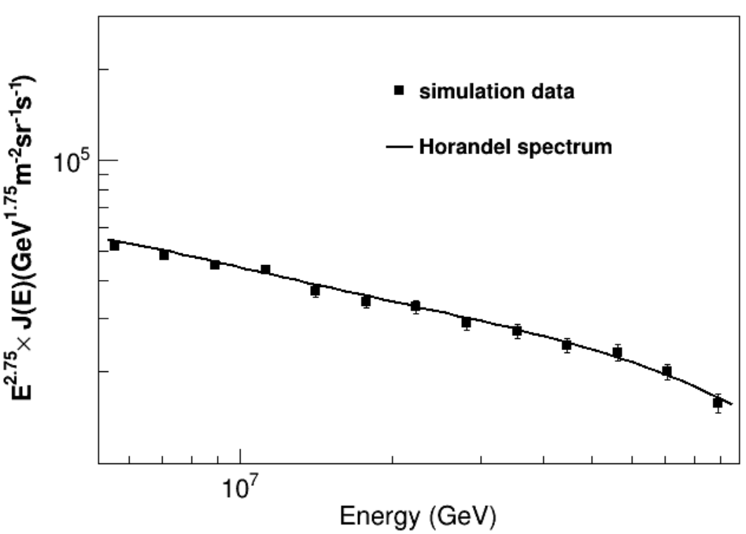

Analysis and Result
Check all-particle energy spectrum measurement method with assumption model
$$flux=\frac{∆N}{∆E∗Aperture∗T}$$
Line：primary spectrum : Gaisser model and Horandel model
Point: Results of measuring the all-particle energy spectrum based on simulation data

Slide 9
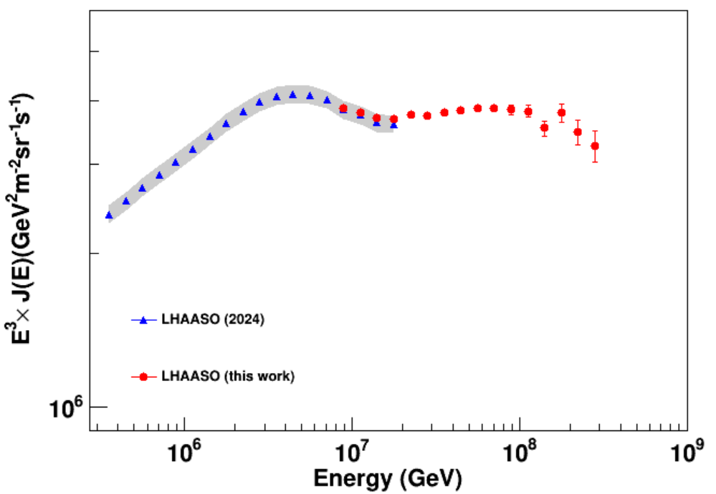

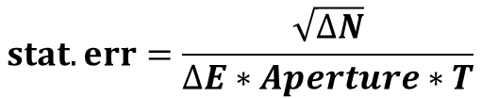
Analysis and Result
All-Particle Energy Spectrum of cosmic ray
$$flux=\frac{∆N}{∆E∗Aperture∗T}$$
$$stat.err=\frac{\sqrt{∆N}}{∆E∗Aperture∗T}$$
preliminary
Red dot：2021.09-2024.06 data measured all-particle energy spectrum of cosmic ray

Slide 10
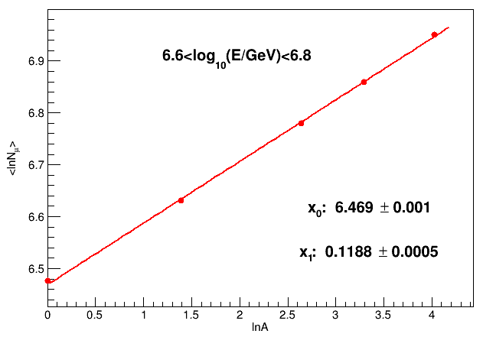
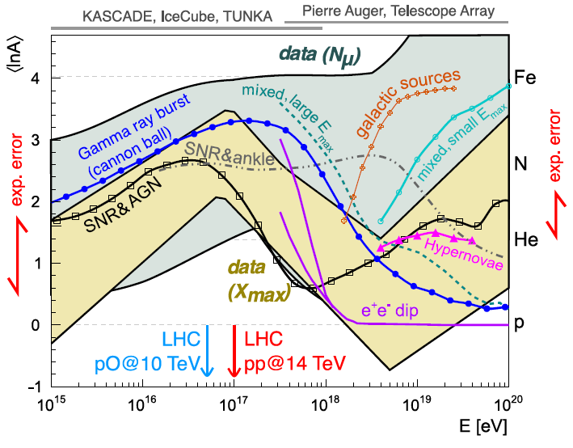



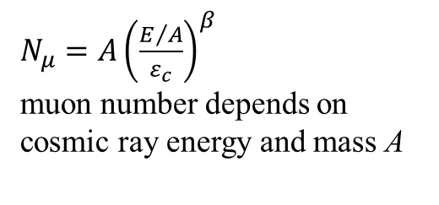
Analysis and Result
Measurement of muon content
Muons are the direct messengers of the hadronic processes occurring in the shower. The number of muon is a sensitive parameter to study the composition of cosmic rays and test hadronic interaction model.
$N_{μ}=A{\left(\frac{E/A}{ε_{c}}\right)}^{β}$
muon number depends on cosmic ray energy and mass A
$$\left\langle \ln{N_{μ}}\right\rangle{=x_{0}+x_{1}\left\langle \ln{A}\right\rangle }$$
$$x_{0}={\left\langle \ln{N_{μ}}\right\rangle }_{H}$$
EPJ Web Conf. 210 (2019) 02004
$$x_{1}=1−β$$

Slide 11
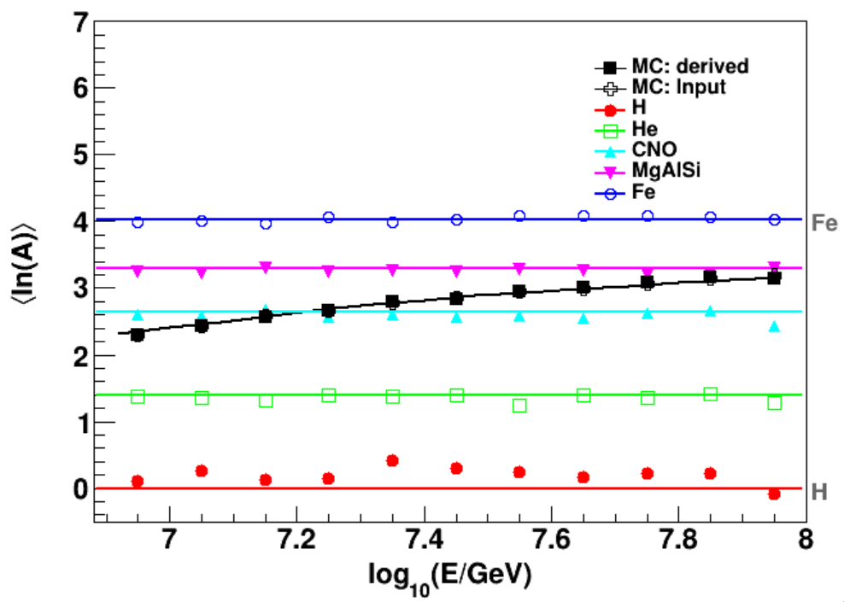
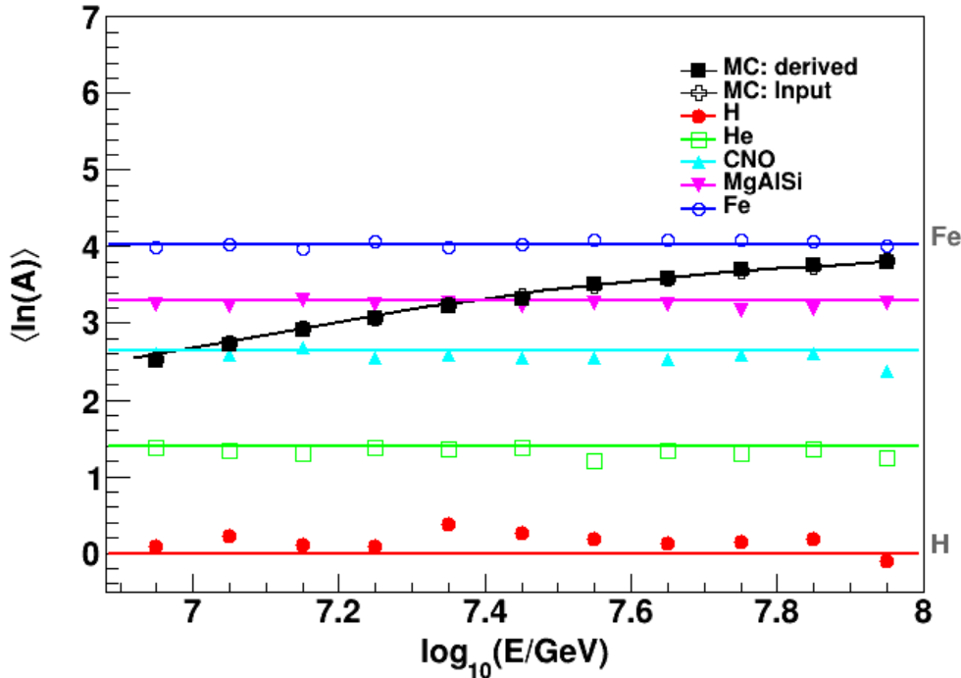
Analysis and Result
Check the derived mean mass method with assumption model
Gaisser model
Horandel model
preliminary
preliminary
Line：primary lnA spectrum : Gaisser model and Horandel model
Point: Results of measuring the $\left\langle \ln{A}\right\rangle$ based on simulation data

Slide 12
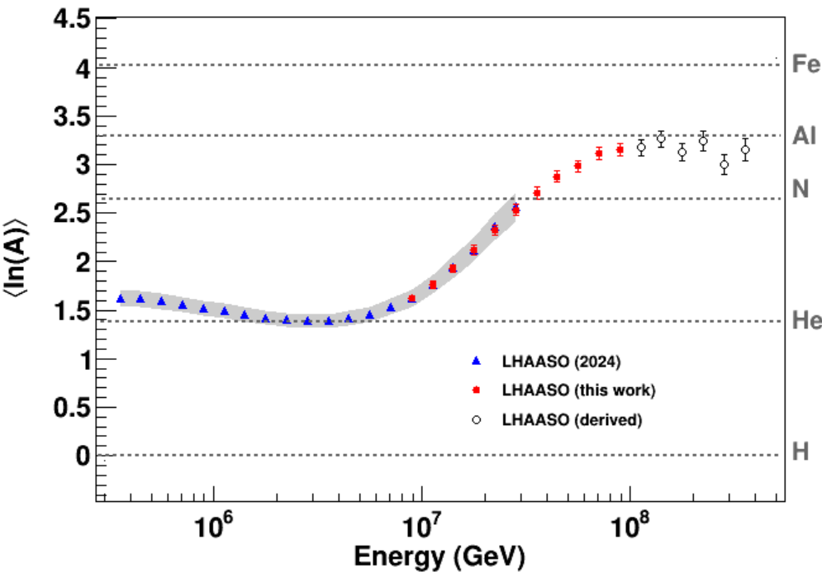
Analysis and Result
Mean logarithmic mass ⟨𝐥𝐧⁡𝑨 ⟩ of cosmic rays
Red dot：2021.09-2024.06 data measured mean logarithmic mass ⟨𝐥𝐧⁡𝑨 ⟩ of cosmic rays
preliminary
Above “knee” region, the cosmic ray component becomes heavier and then flattens at 100 PeV and shows a decreasing trend with increasing energy, suggesting that the cut-off of the all-particle energy spectrum is heavy components.

Slide 13
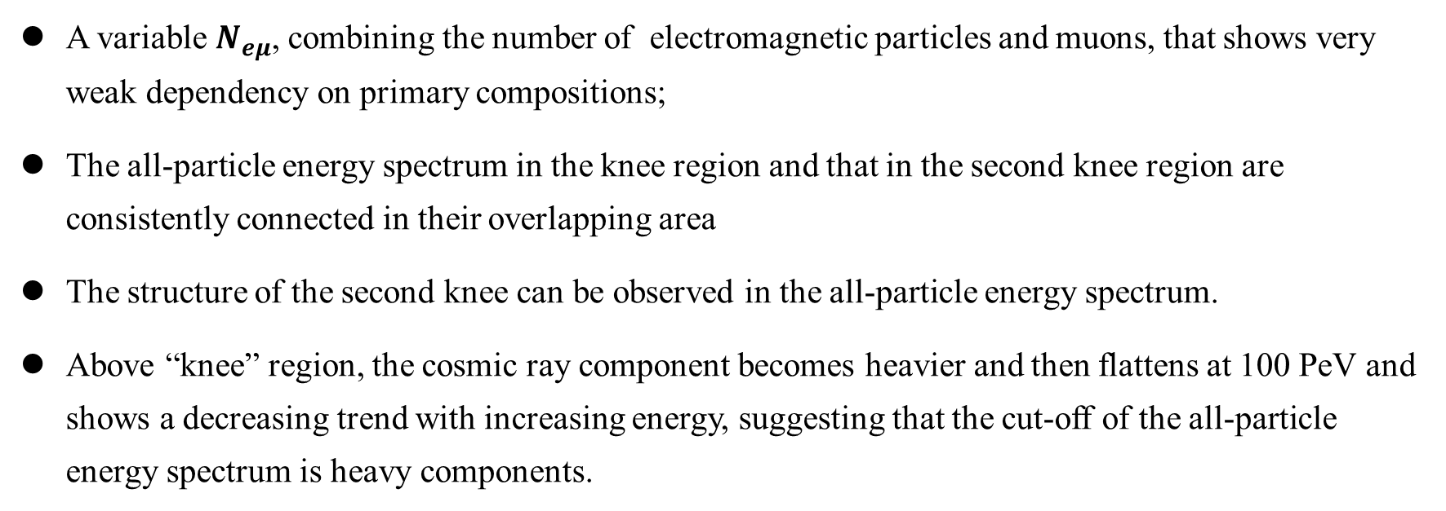
Preliminary Conclusion
A variable $N_{eμ}$, combining the number of electromagnetic particles and muons, that shows very weak dependency on primary compositions;
The all-particle energy spectrum in the knee region and that in the second knee region are consistently connected in their overlapping area
The structure of the second knee can be observed in the all-particle energy spectrum.
Above “knee” region, the cosmic ray component becomes heavier and then flattens at 100 PeV and shows a decreasing trend with increasing energy, suggesting that the cut-off of the all-particle energy spectrum is heavy components.
Thanks for your attention!

