Slide 1
Unveiling the Nature of the Cosmic Ray All-particle Spectrum Knee by LHAASO
Huihai He¹, Hengying Zhang², Qinyi Cheng¹, Lingling Ma¹, Cunfeng Feng³
Institute of High Energy Physics, Beijing, China
Yunan University, Kunming, China
Shandong University, Qingdao, China

Slide 2
Outline
Introduction
A calorimetric energy estimator
The all particle energy spectrum and <lnA> in 0.3-30 PeV
TLM: the total logarithmic mass and a cocktail method
The nature of the cosmic ray spectrum knee
Discovery of an ankle-like structure
Summary
PRD 106, 123028 (2022)
PRL 132, 131002 (2024)
arXiv:2411.13793

Slide 3
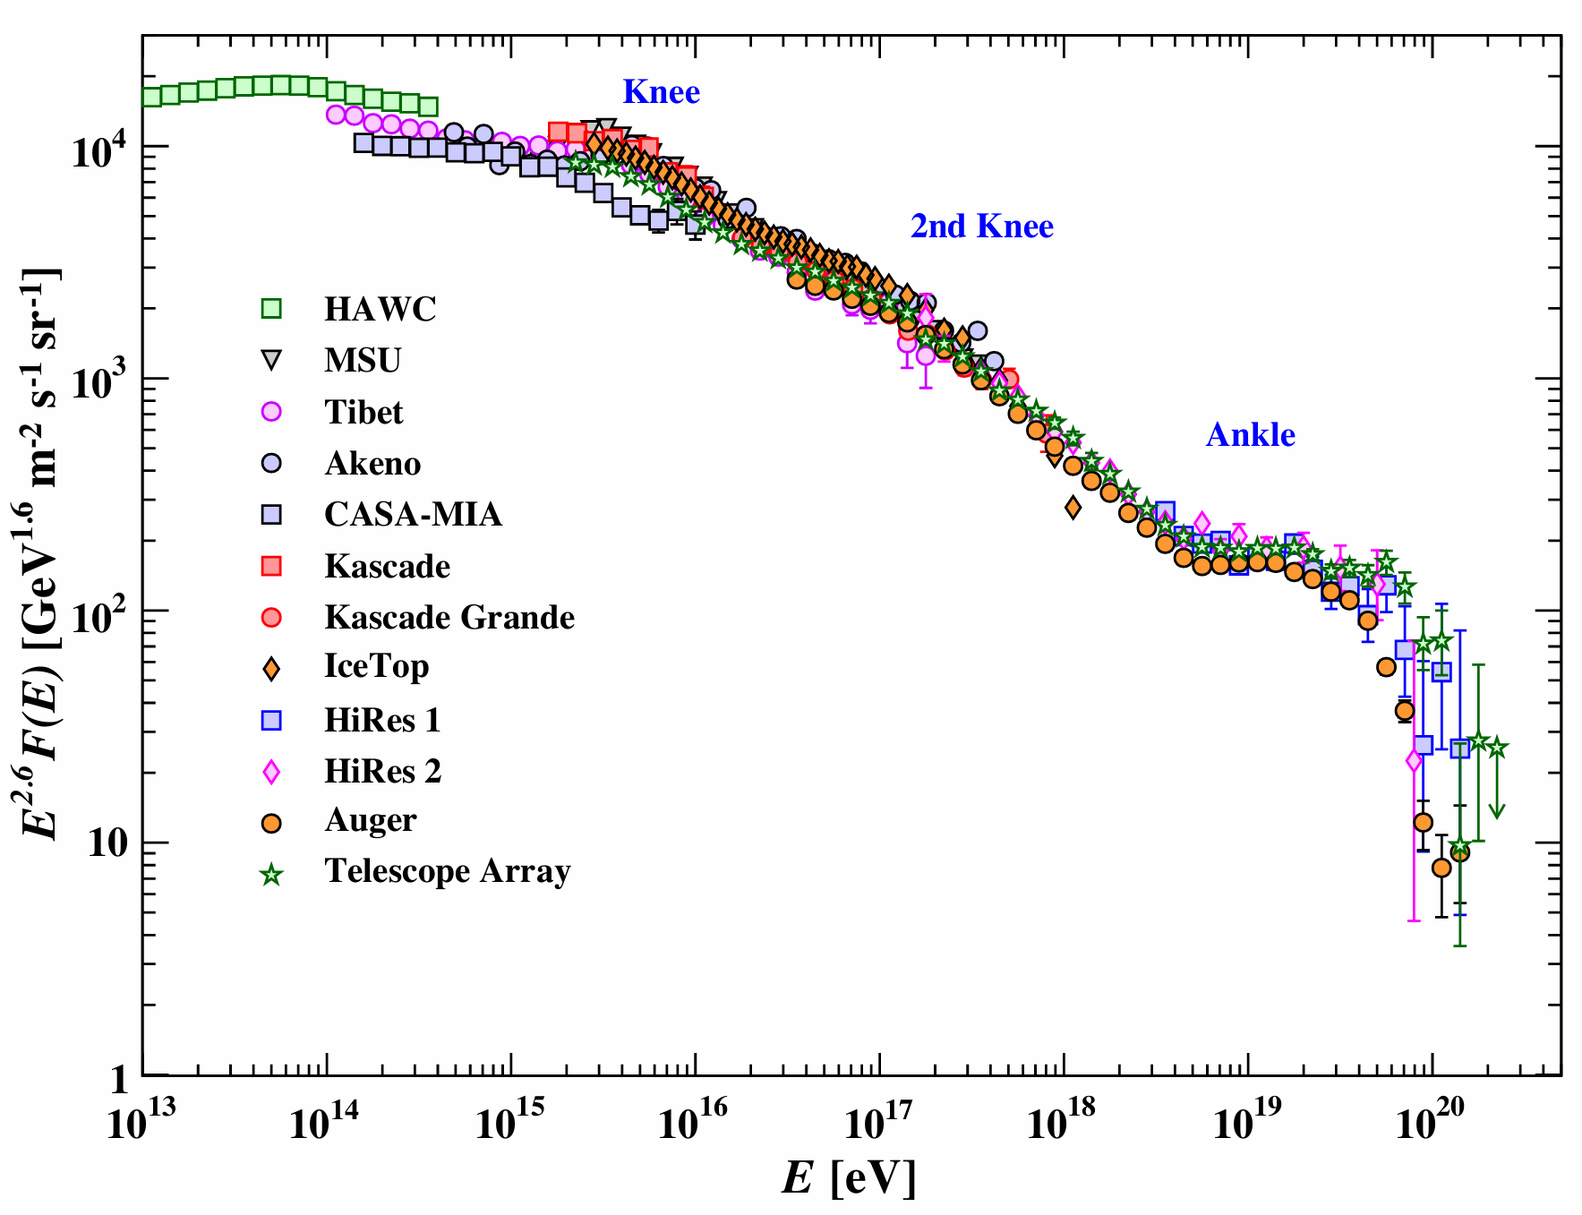
The knee: a 65-year-old puzzle
The most striking feature in the cosmic ray energy spectrum, whose origin remains enigmatic
A key to the origin, acceleration and propagation of GCRs
A result of subsequent cutoffs for individual elements, starting with the proton component
Z-dependent: E_{c}=ZE_{p}, associated with acceleration or propagation processes
A-dependent: E_{c}=AE_{p}, associated with new physics
Constant: E_{c}=E_{p}
Credit: Beringer et al.

Slide 4
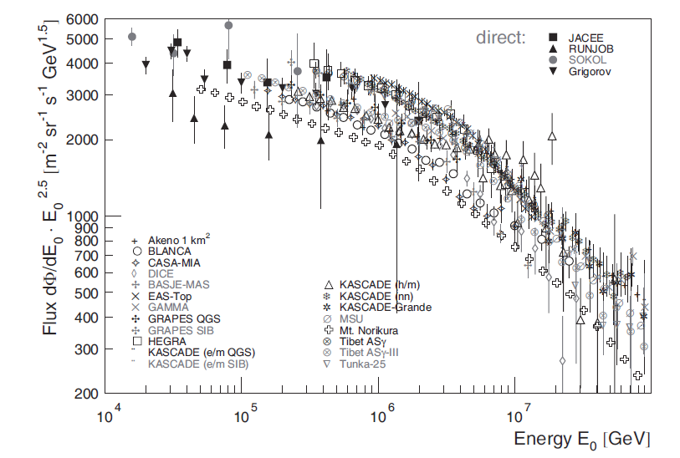
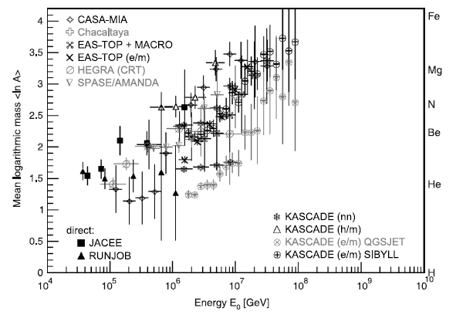
A mess in current measurements
Precision measurements of the spectrum and mass are mandatory

Slide 5
Challenges in indirect measurement
Spectra of single species: seriously dependent on MC
Interaction models
Composition models
Consistency between MC and data
All particle spectrum
Composition-dependency in primary energy reconstruction
Model-dependency in both composition discrimination and energy reconstruction
Measurement of shower front, and far from shower maximum
<lnA>: energy-dependent, interaction model dependent

Slide 6
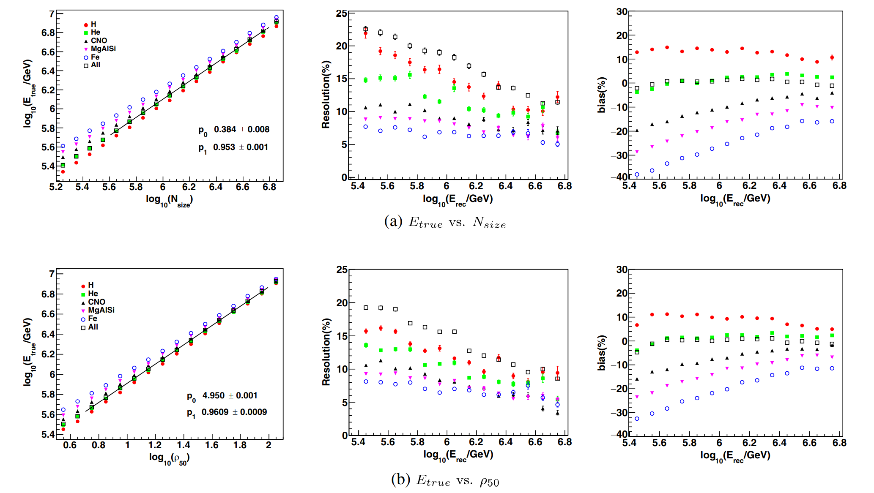

Problems in traditional energy estimators
Shower size (or density) is a function of primary energy and mass
$$N_{e}∝E^{α}A^{1−α}, α≠1$$
Strong dependence on composition!

Slide 7
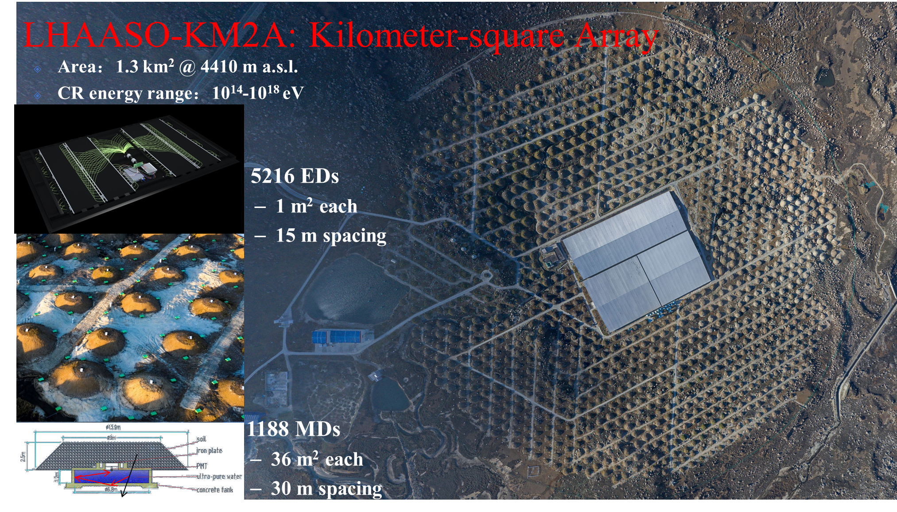
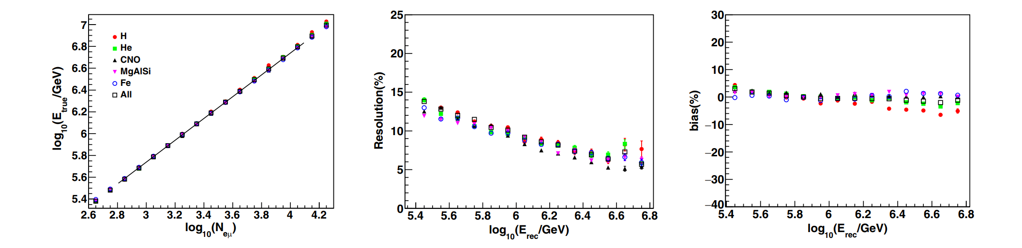
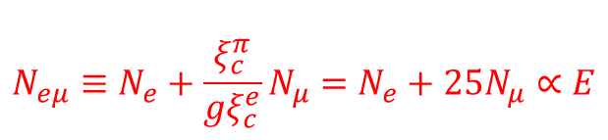
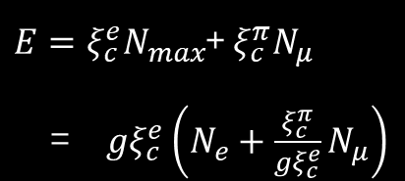
A calorimetric energy estimator
Heitler-Matthews model
$E=ξ_{c}^{e}N_{max}$+ $ξ_{c}^{π}N_{μ}$
= ${gξ}_{c}^{e}\left(N_{e}+\frac{ξ_{c}^{π}}{{gξ}_{c}^{e}}N_{μ}\right)$
$$N_{eμ}≡N_{e}+\frac{ξ_{c}^{π}}{{gξ}_{c}^{e}}N_{μ}=N_{e}+25N_{μ}∝E$$
Works only at shower maximum!
bias<5%
Very weak dependence on interaction models!

Slide 8
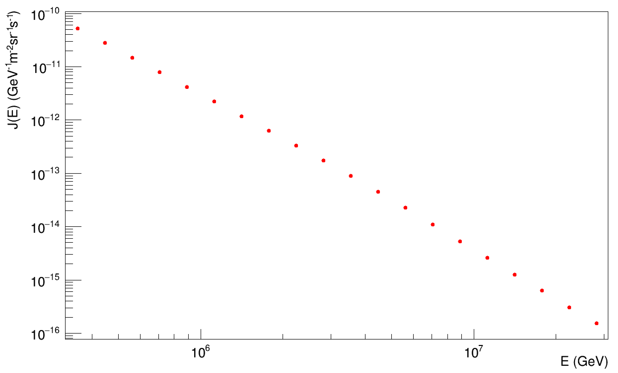
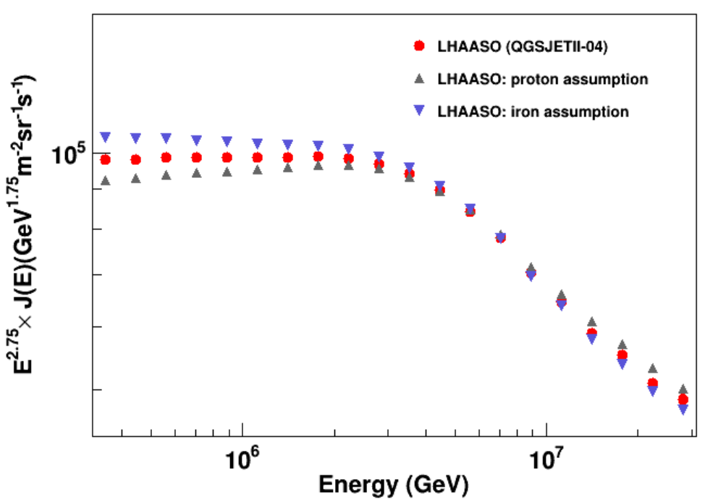
Precision measurement of the knee by LHAASO
10 times better than previous measurements!
Maximum 12% @ 0.3 PeV
Flux: 6 orders
±1.4% (stat) ±4.2% (sys)
Energy: 1 order before/after the knee（0.3-30 PeV）
Notes:
1-order better than previous measurements!

Slide 9
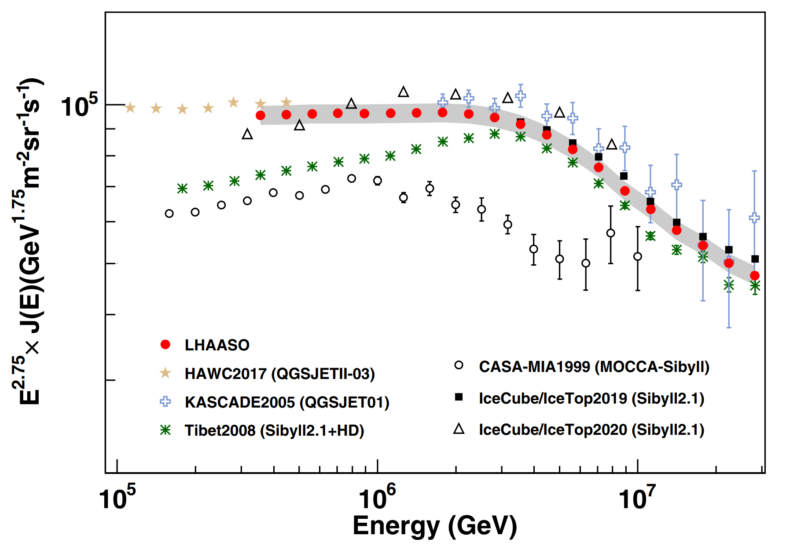
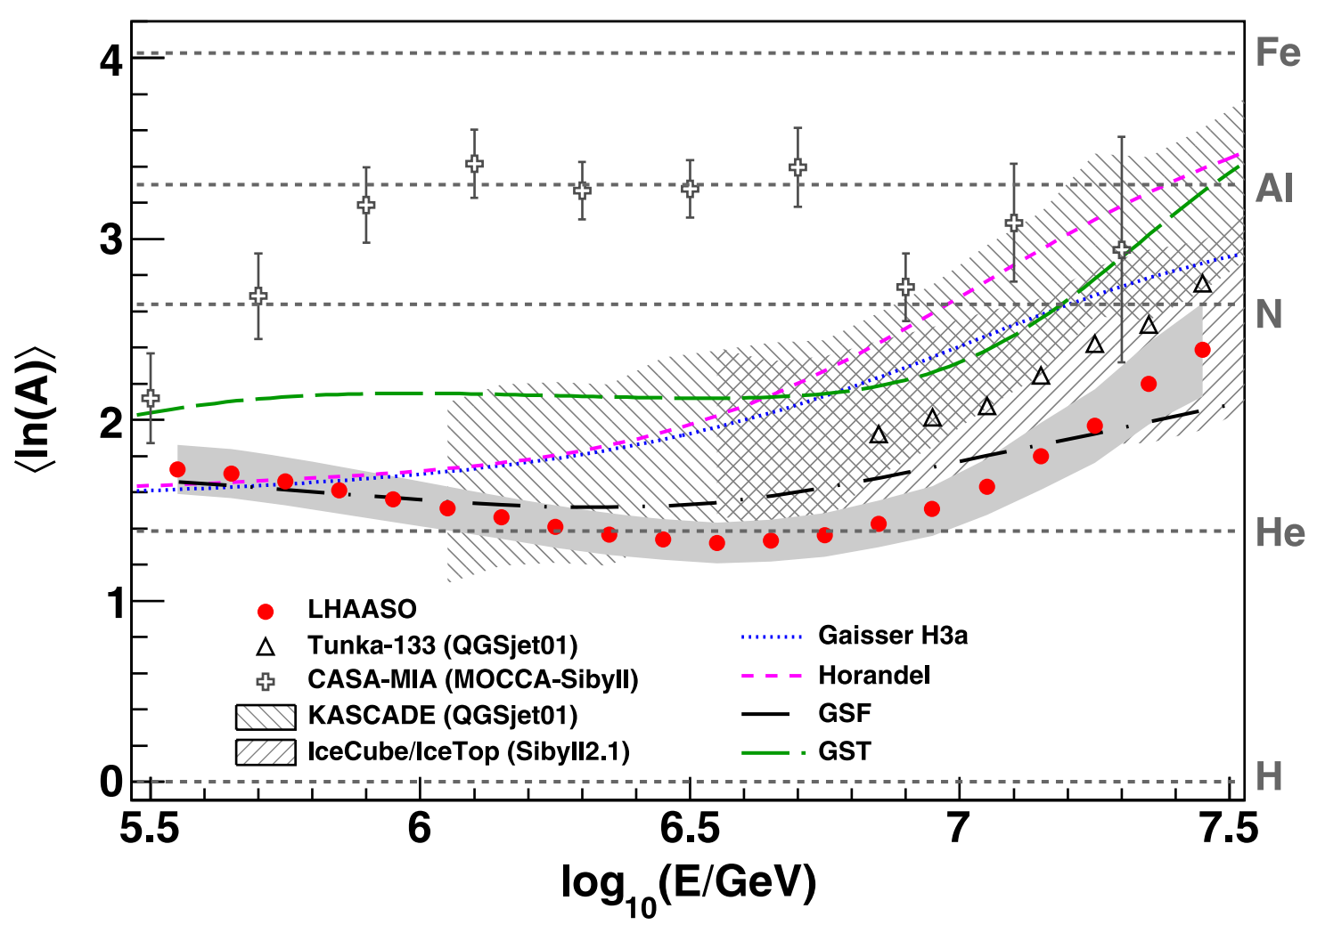
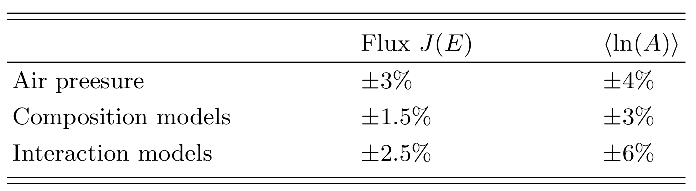
All-particle energy spectrum & <lnA> by LHAASO

Slide 10
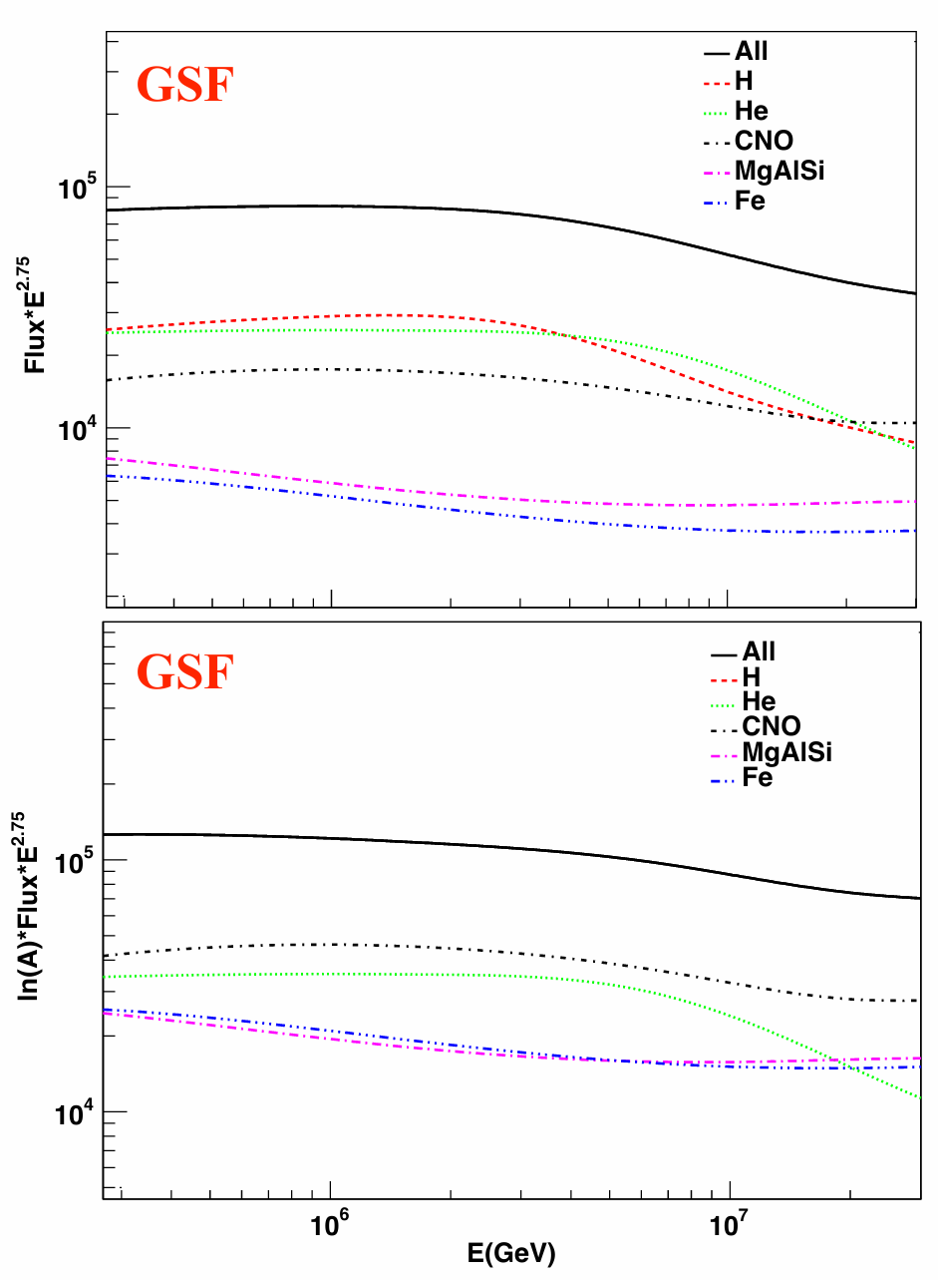
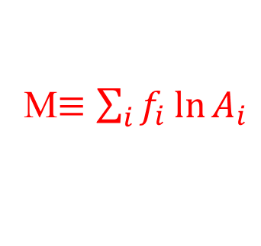
TLM: total logarithmic mass
M$≡\sum_{i}{f_{i}\ln{A_{i}}}$
 | P | He | CNO | MgAlSi | Fe
lnA | 0 | 1.39 | 2.64 | 3.30 | 4.03
More sensitive to structures of heavy nuclei
P (lnA=0) doesn’t contribute to TLM, thus TLM serves as a touchstone for testing if proton spectrum breaks at the knee
No → a similar “knee” structure in TLM

Slide 11
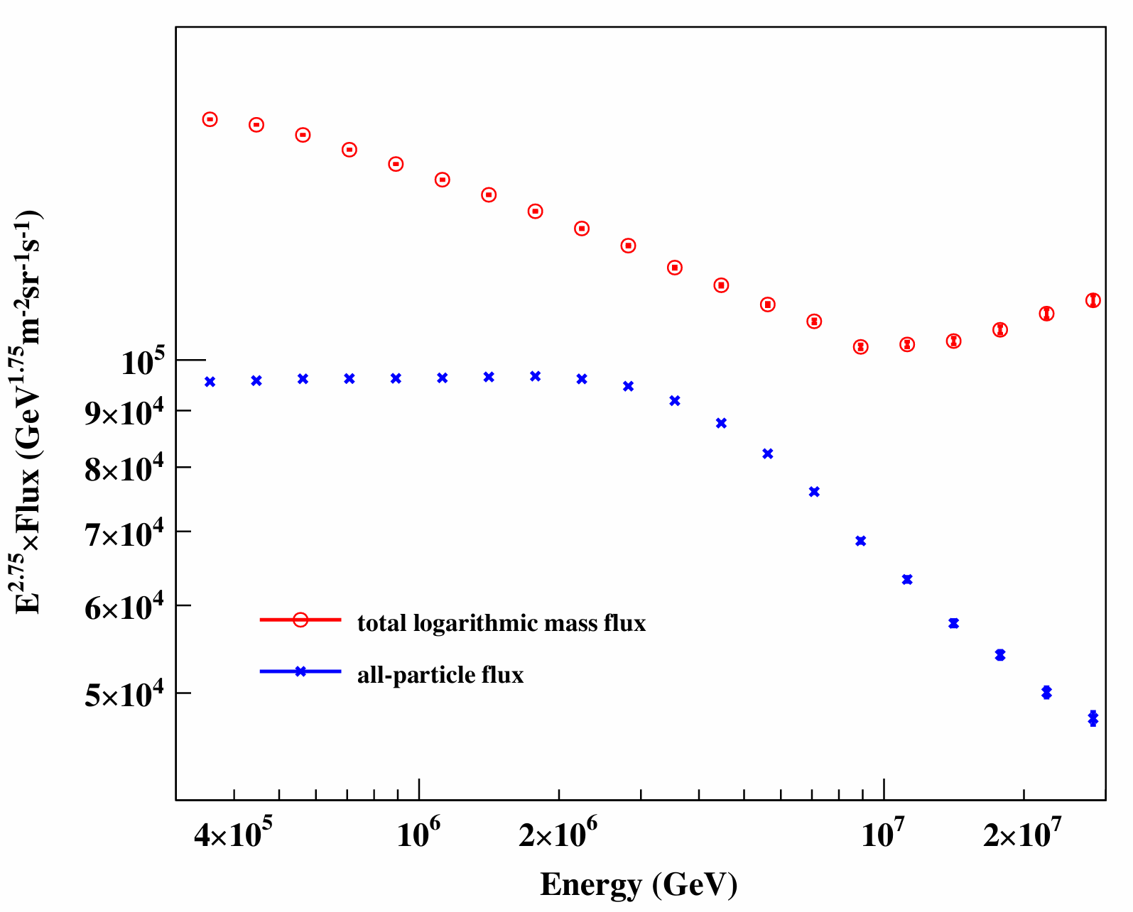
TLM by LHAASO-KM2A

Slide 12
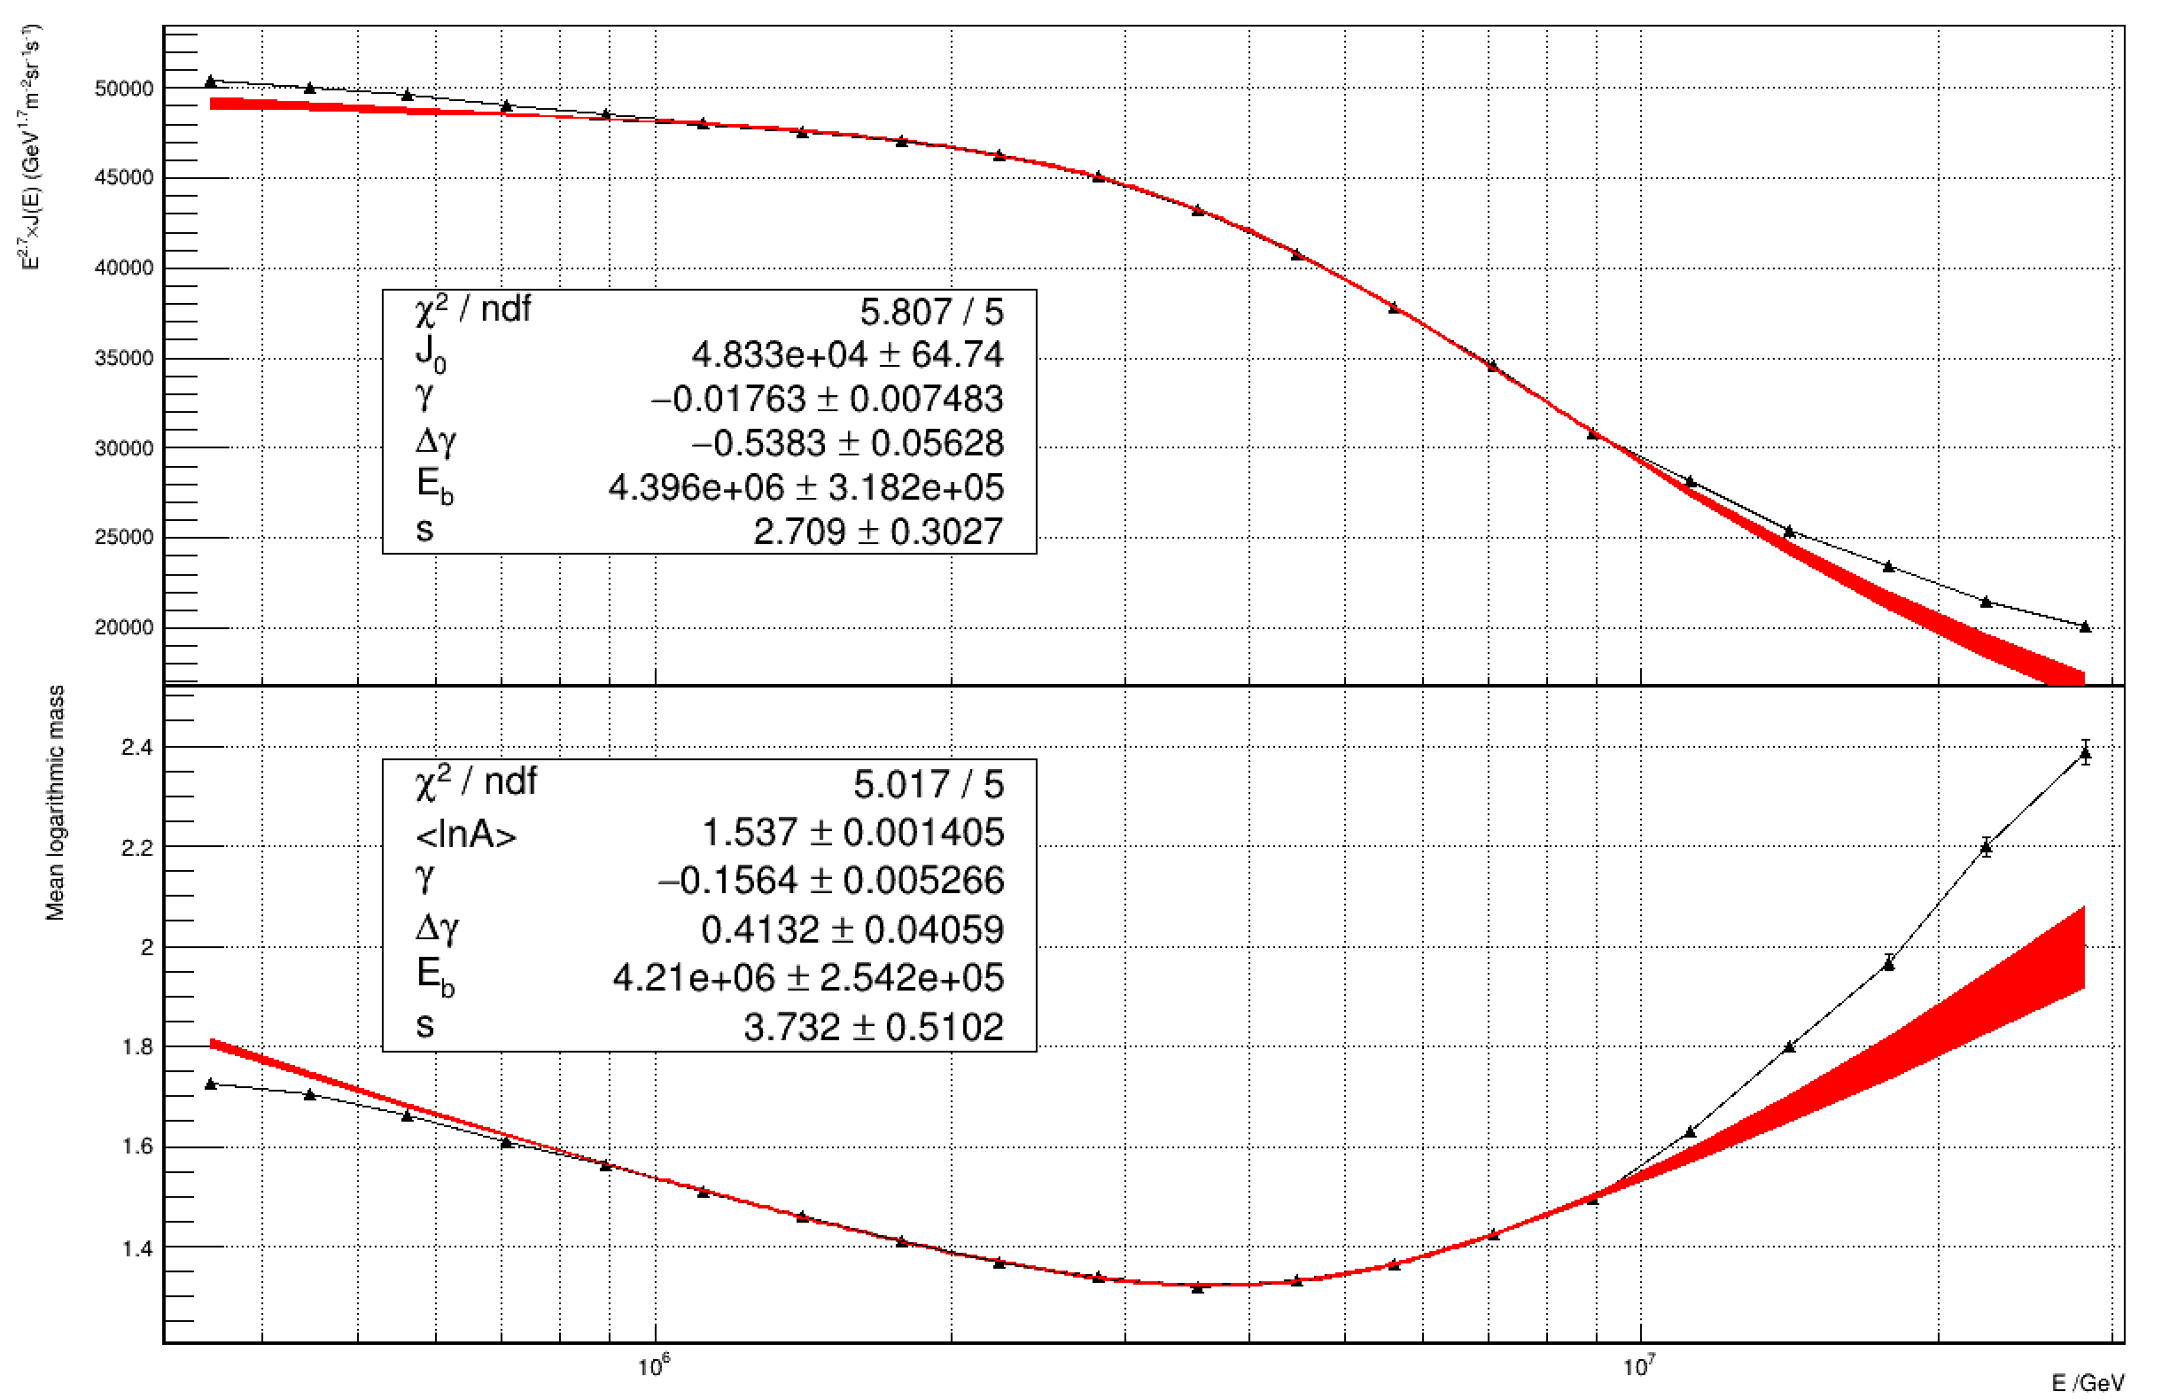
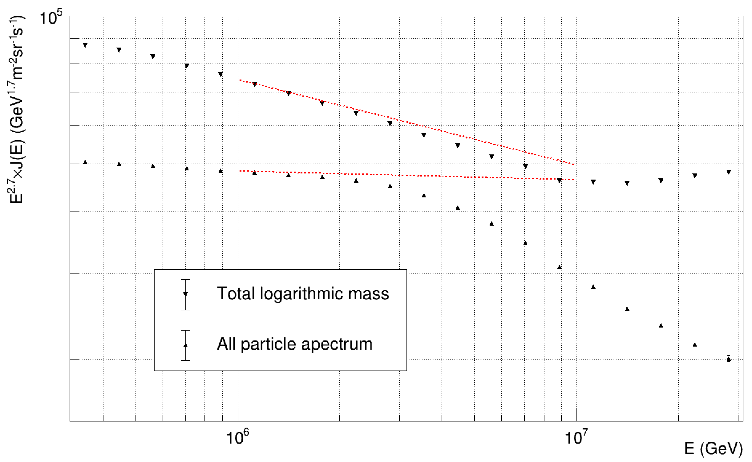


Does proton spectrum break at the knee?
Parameters fitted around the knee (1-10 PeV)
Significance of rejecting H₀: 12 σ
$$m_{∆F}=\frac{∆M}{∆F}=q_{p}×m_{p}+\left(1−q_{p}\right)×m_{≥He}=\left(1−q_{p}\right)×m_{≥He}$$
H₀: no, q_{p}=0
H₁: yes, q_{p}>0
$$∆M=M^{′}−M$$
→Proton spectrum breaks at the knee!
$$∆F=F^{′}−F$$

Slide 13


Only proton spectrum breaks at the knee?
H₀: yes, q_{p}=1
H₁: no, q_{p}<1
Significance of rejecting H₀: 6.3σ
proton proportion @1-10 PeV:
72.6%±4.5%$≤$q_{p}$≤$90.6%±1.5%
$$m_{∆F}=\frac{∆M}{∆F}=\left(1−q_{p}\right)×m_{≥He}$$
→Proton dominates the knee but it’s not the only one whose spectrum breaks!
$$∆M=M^{′}−M$$
$$∆F=F^{′}−F$$

Slide 14

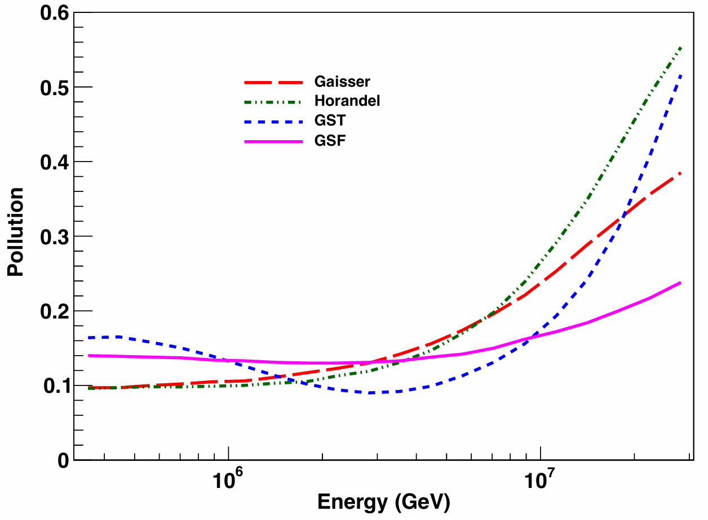

A cocktail method
A light cocktail
$$L=ALL−\frac{TLM}{\ln{56}}≈{ F}_{P}+0.655F_{He}$$
 | all | TLM | Light
P | 1 | 0 | 1
He | 1 | 1.39 | 0.655
CNO | 1 | 2.64 | 0.345
MgAlSi | 1 | 3.30 | 0.181
Fe | 1 | 4.03 | 0
GSF “Purity” >85% (<10 PeV)

Slide 15
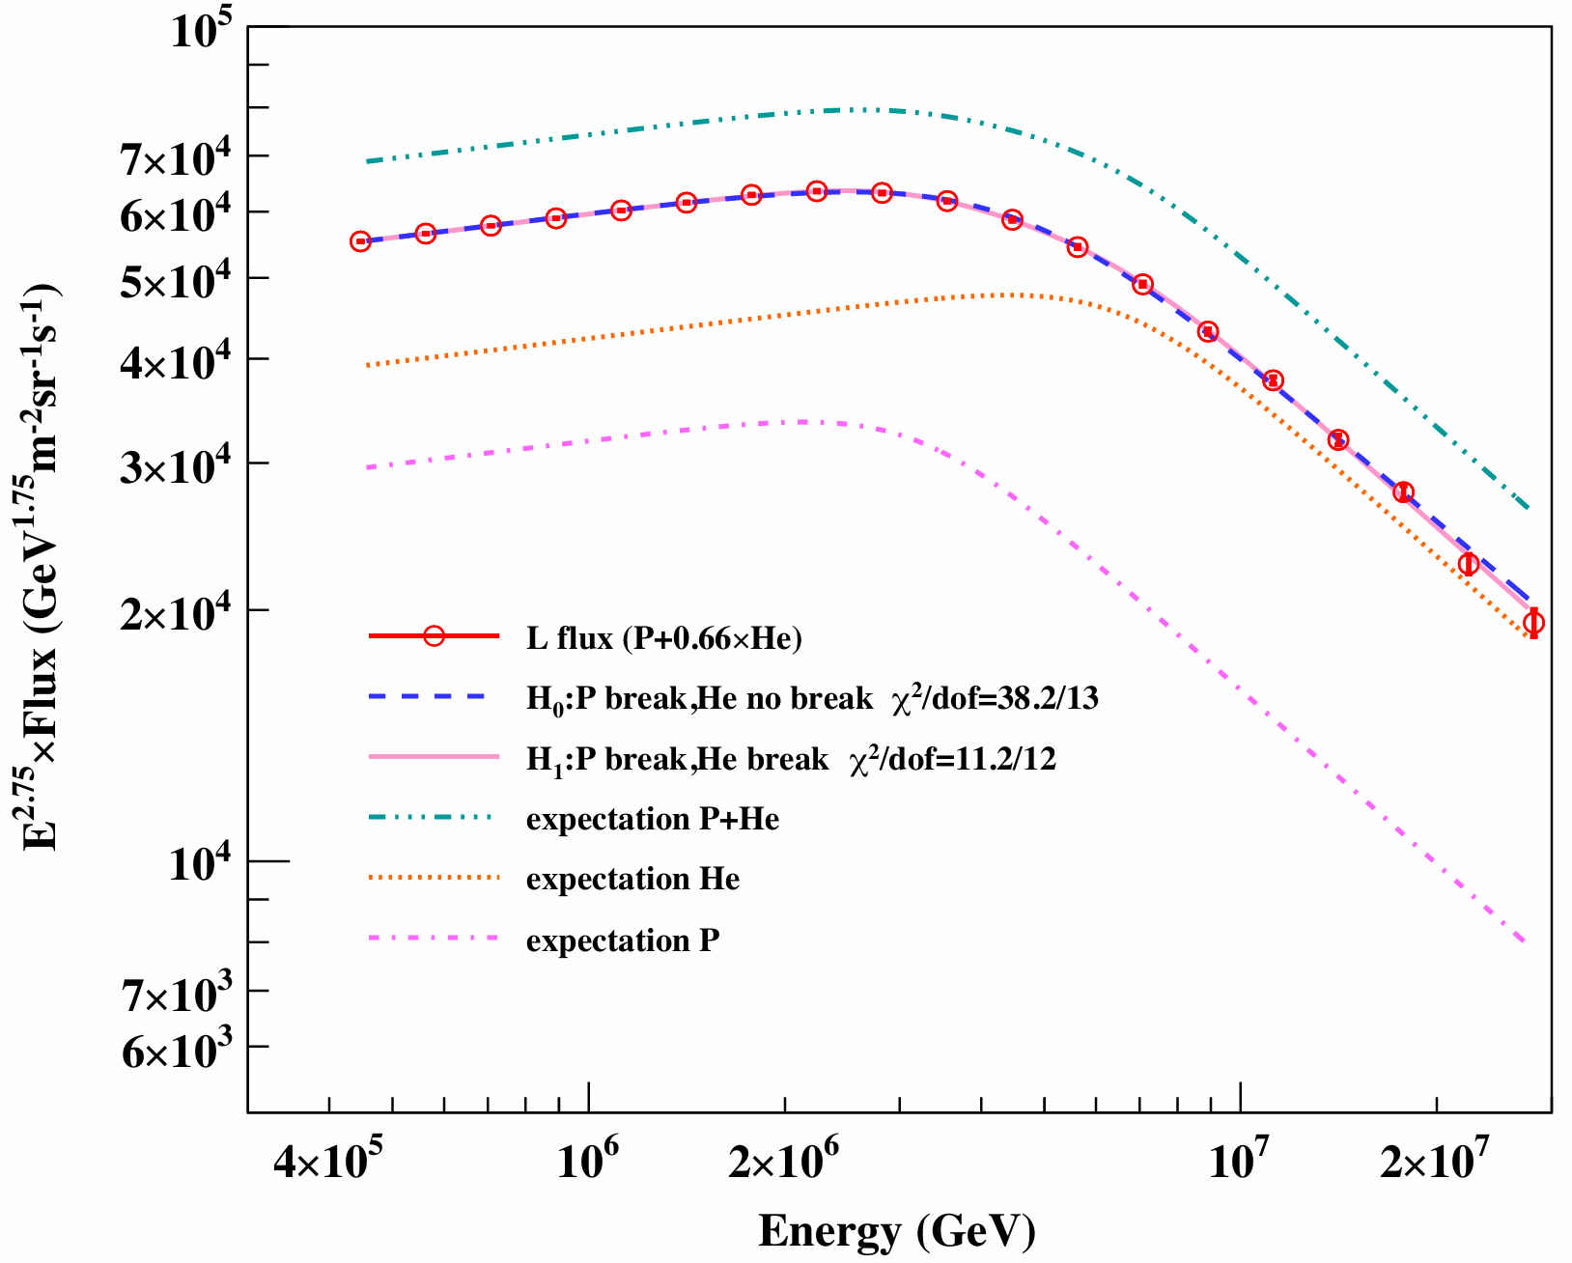

Z/A dependent?
$$H_{0}: J\left(E\right)=J_{0}{\left(\frac{E}{1 PeV}\right)}^{γ}\left\{f_{P}{\left[1+{\left(\frac{E}{E_{P}}\right)}^{s}\right]}^{∆γ/s}+\left(1−f_{P}\right)\left(1−\frac{\ln{4}}{\ln{56}}\right)\right\}$$
$$H_{1}: J\left(E\right)=J_{0}{\left(\frac{E}{1 PeV}\right)}^{γ}\left\{f_{P}{\left[1+{\left(\frac{E}{E_{P}}\right)}^{s}\right]}^{∆γ/s}+\left(1−f_{P}\right)\left(1−\frac{\ln{4}}{\ln{56}}\right){\left[1+{\left(\frac{E}{{nE}_{P}}\right)}^{s}\right]}^{∆γ/s}\right\}$$
Hypothesis test: 5.2 σ
n=2.06±0.09, rules out A-dep with 22 σ, agrees with Z-dep

Slide 16
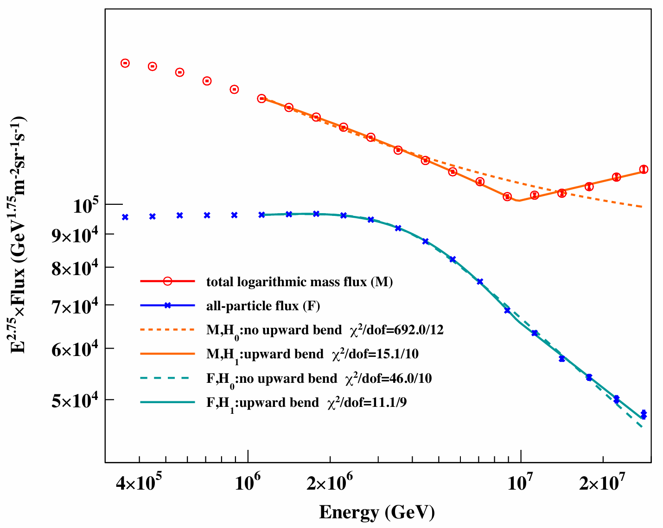
Discovery of an ankle-like structure due to Fe
Break energy: 9.7±0.2 PeV
 | significance | index before break | index after break
TLM | 25.9σ | 2.950±0.005 | 2.65±0.01
All-particle | 5.9σ | 3.25±0.05 | 3.08±0.01

Slide 17
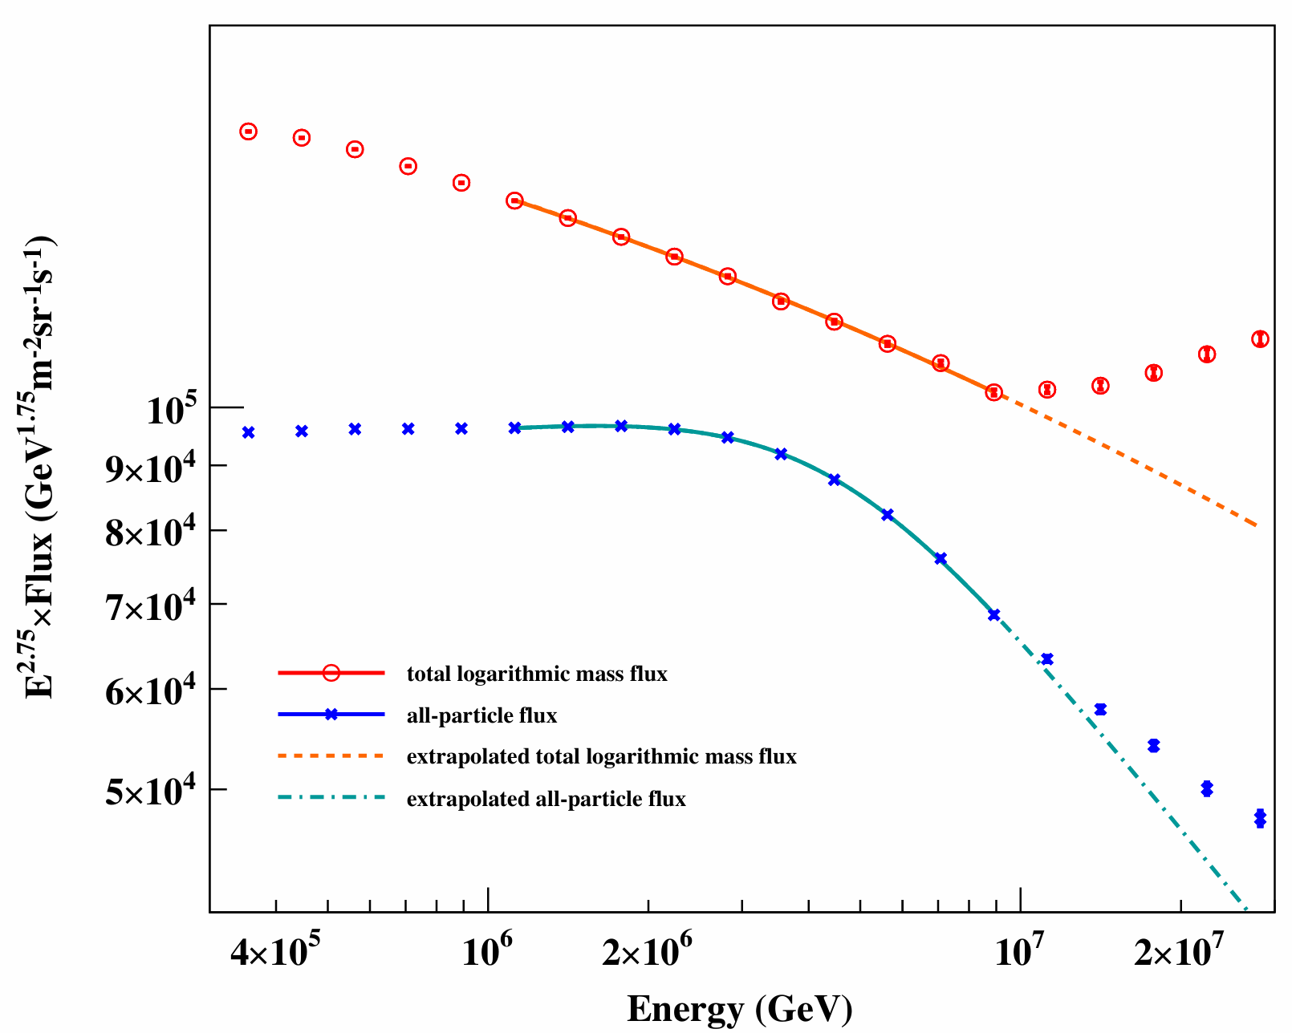
Discovery of an ankle-like structure due to Fe
Break energy: 9.7±0.2 PeV
 | significance | index before break | index after break
TLM | 25.9σ | 2.950±0.005 | 2.65±0.01
All-particle | 5.9σ | 3.25±0.05 | 3.08±0.01

Slide 18
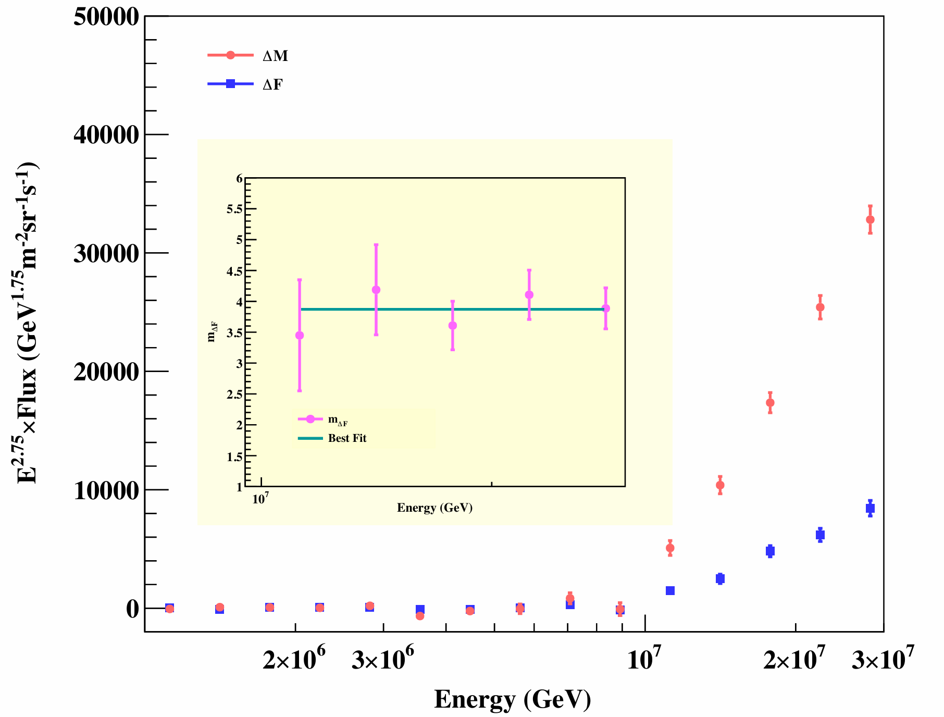
Discovery of an ankle-like structure due to Fe
Break energy: 9.7±0.2 PeV
 | significance | index before break | index after break
TLM | 25.9σ | 2.950±0.005 | 2.65±0.01
All-particle | 5.9σ | 3.25±0.05 | 3.08±0.01
m_{ΔF}=3.9±0.2→Fe

Slide 19
Summary
A calorimetric energy estimator is developed for the LHAASO-KM2A experiment
The all-particle energy spectrum and <lnA> is measured with unprecedent precision
The total logarithmic mass is introduced and a cocktail method is developed
The CR knee is attributed to P and He with rigidity-dependent cutoff energy
An ankle-like structure due to Fe at 9.2 PeV is discovered

Slide 21
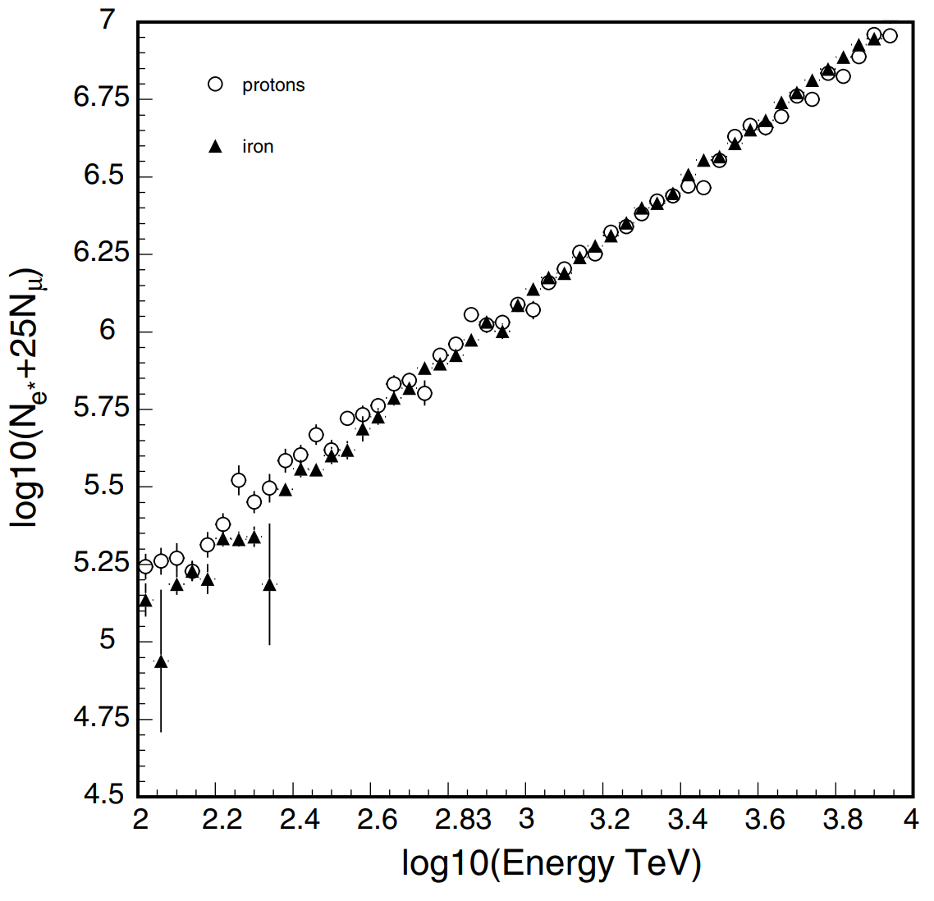
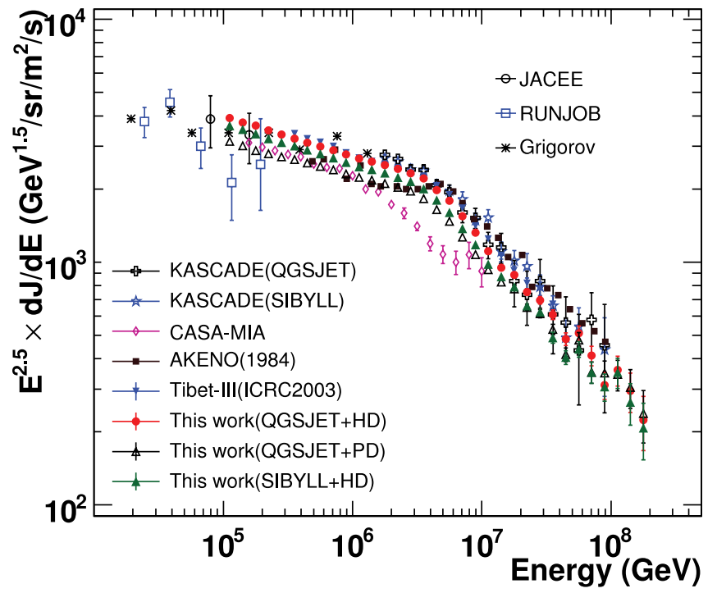
CASA-MIA: 860 g/cm²
proton diviates gradually from iron below 1 PeV.

Slide 22
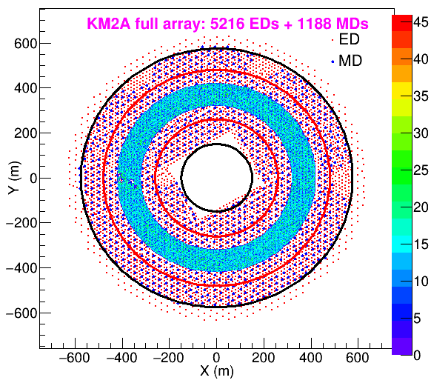
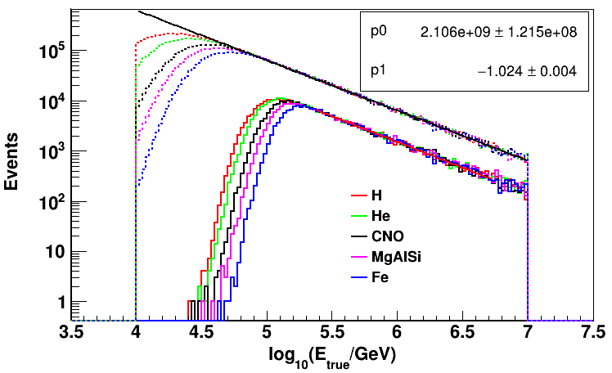
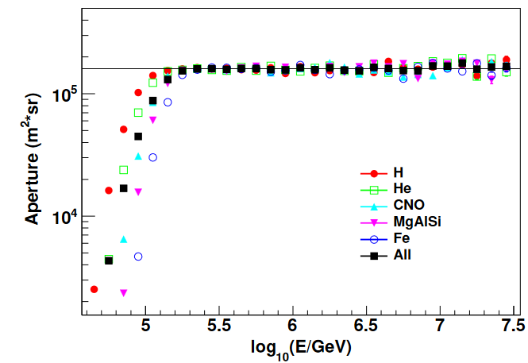
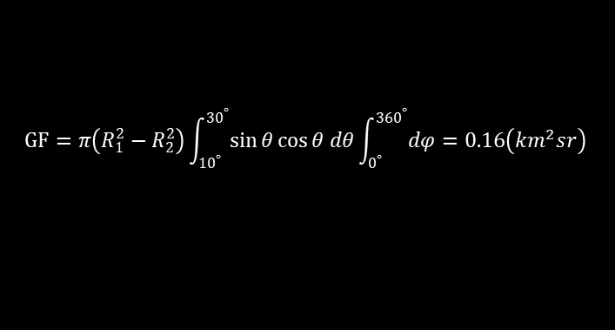
Event selection
Event selection criteria:
θ: 10°- 30° → (610-690 g/cm²) ~ Xmax (0.3-30 PeV)
R_{core}: 320 - 420 m → shower well contained, full efficiency @>0.3PeV
Ne & Nμ in (40-200m) to avoid punch-through
GF is MC-independent
$$GF=π\left(R_{1}^{2}−R_{2}^{2}\right)\int_{{10}^{°}}^{{30}^{°}}{\sin{θ\cos{θ dθ}}}\int_{0^{°}}^{{360}^{°}}{dφ}=0.16\left(km^{2}sr\right)$$

Slide 23
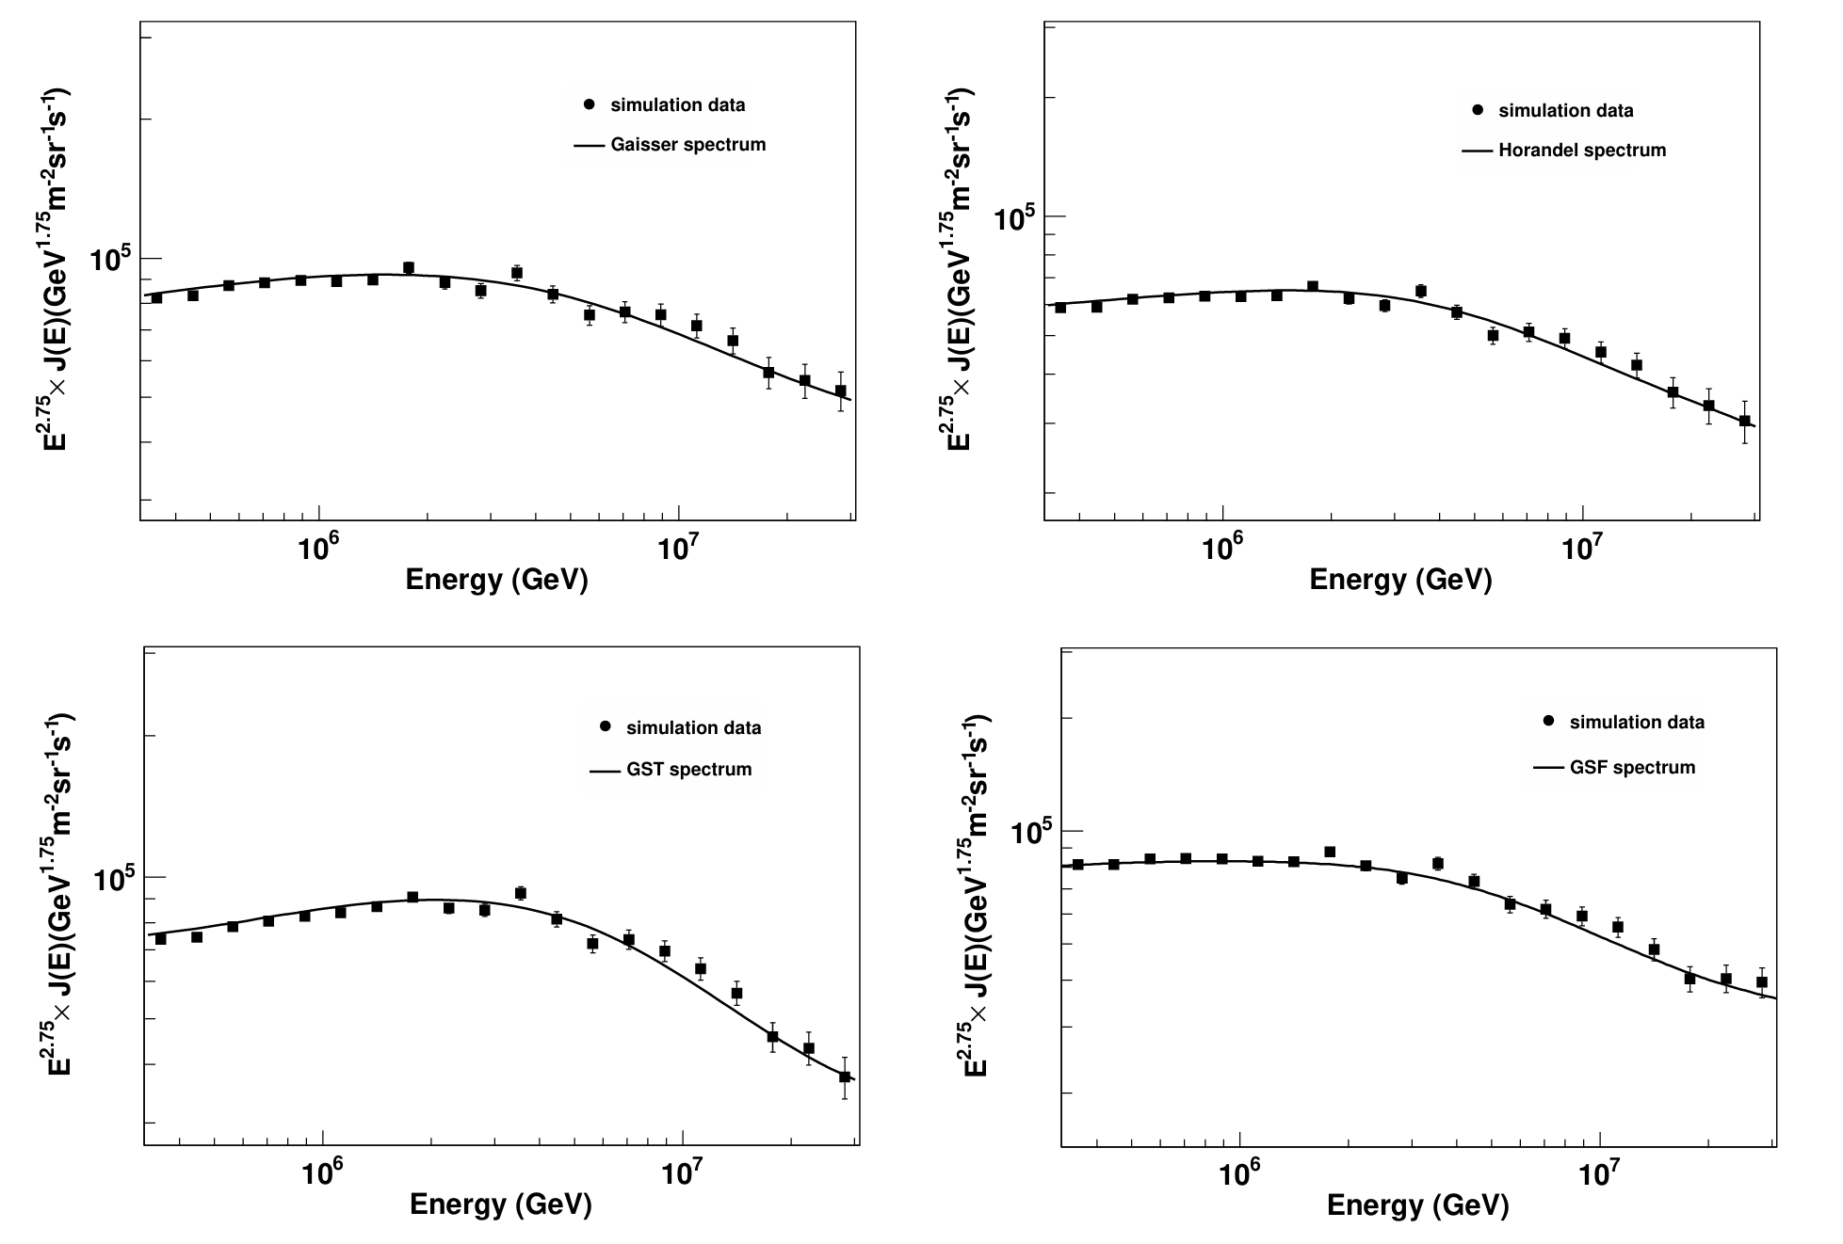
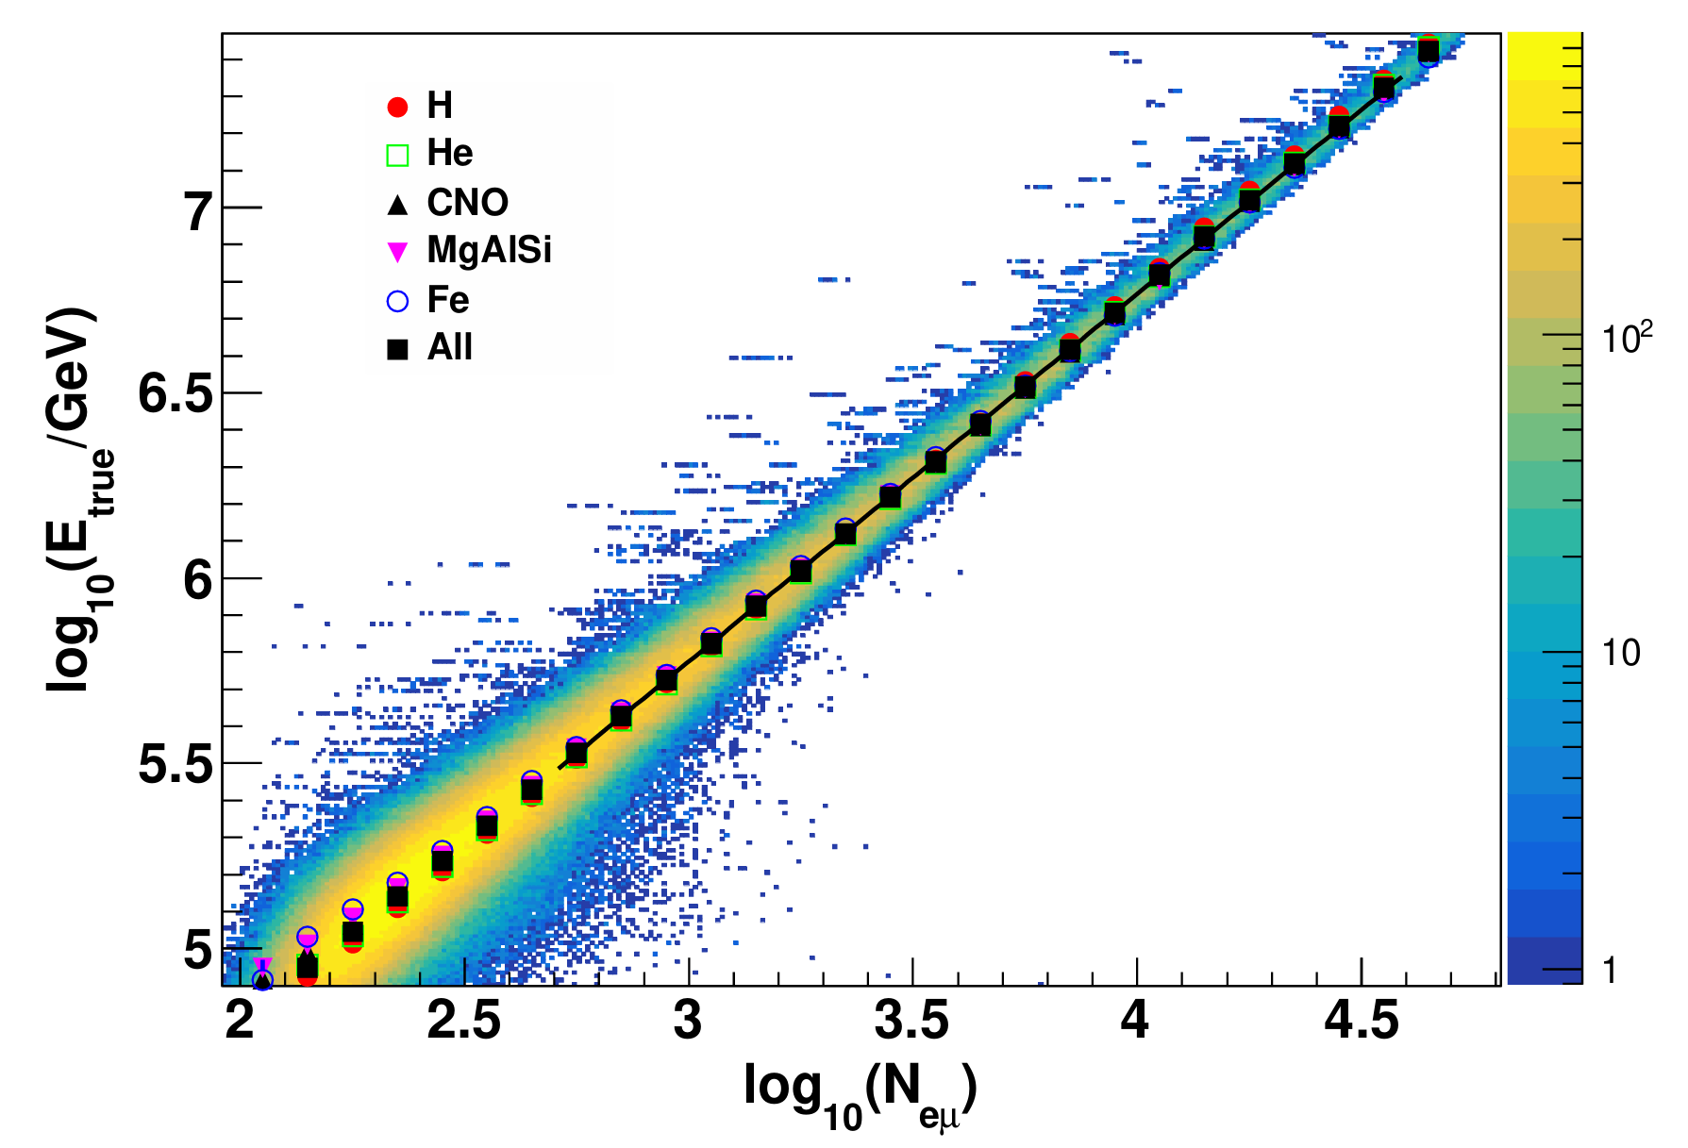
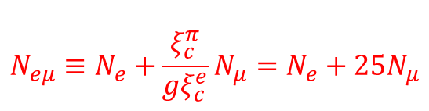

Energy reconstruction
$$N_{eμ}≡N_{e}+\frac{ξ_{c}^{π}}{{gξ}_{c}^{e}}N_{μ}=N_{e}+25N_{μ}$$
$$N_{eμ}=N_{e}+2.8N_{μ}$$
Notes:
MD和ED的总面积比为8.937

Slide 24
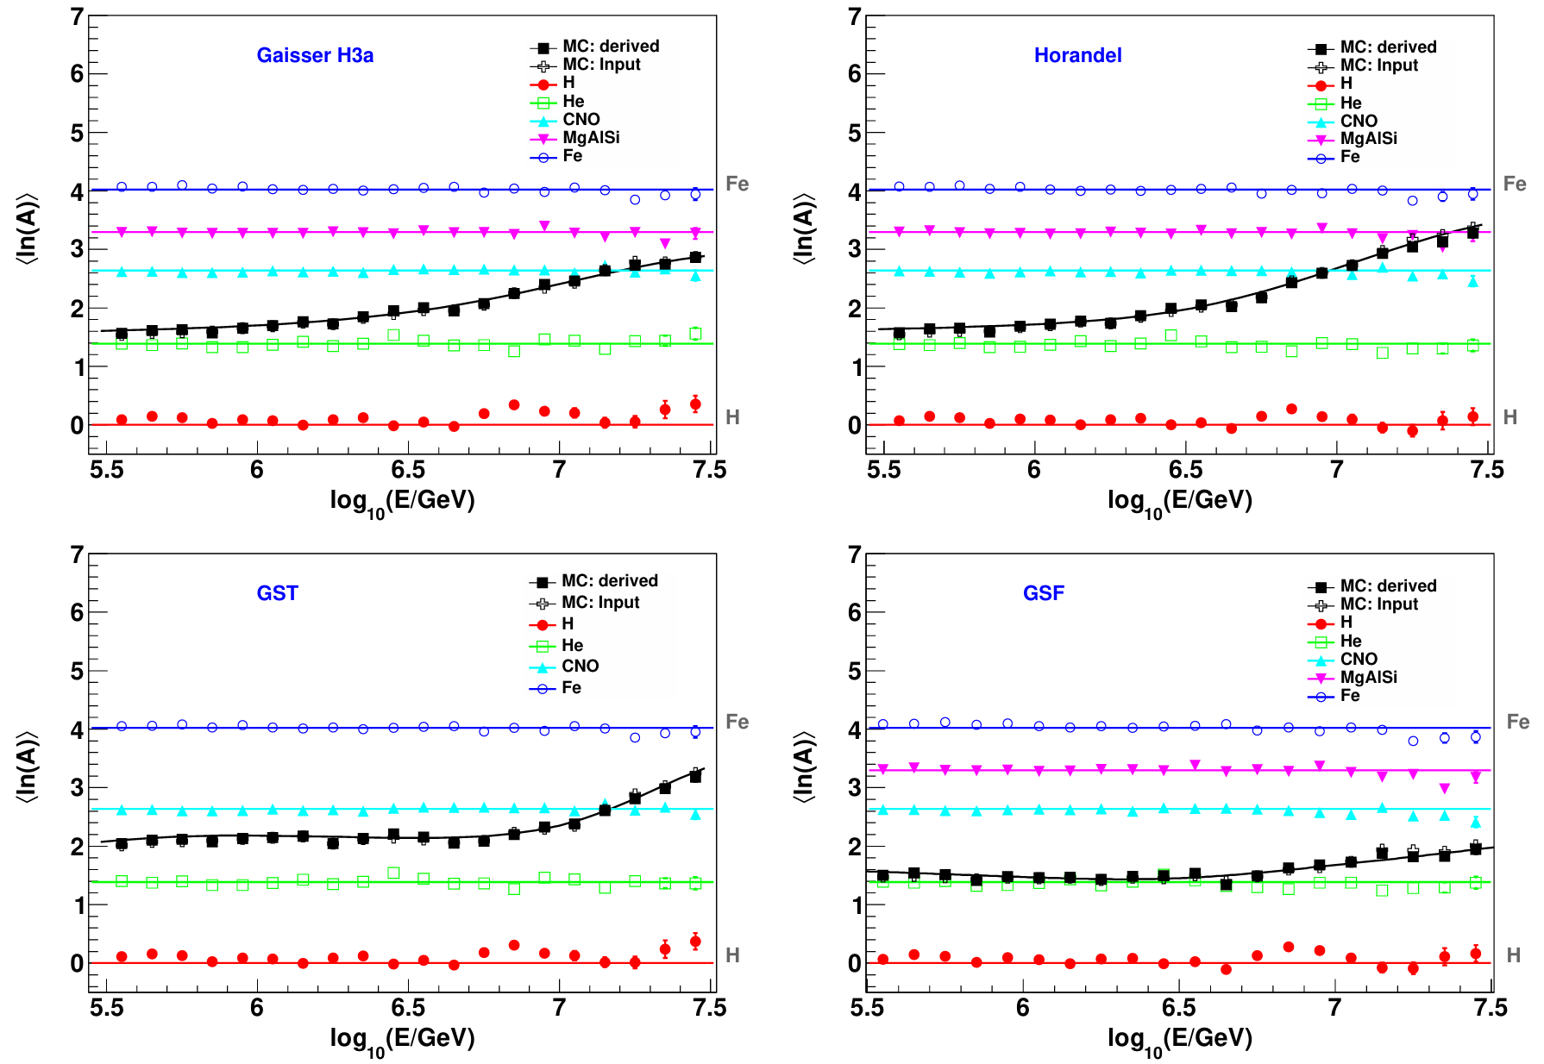
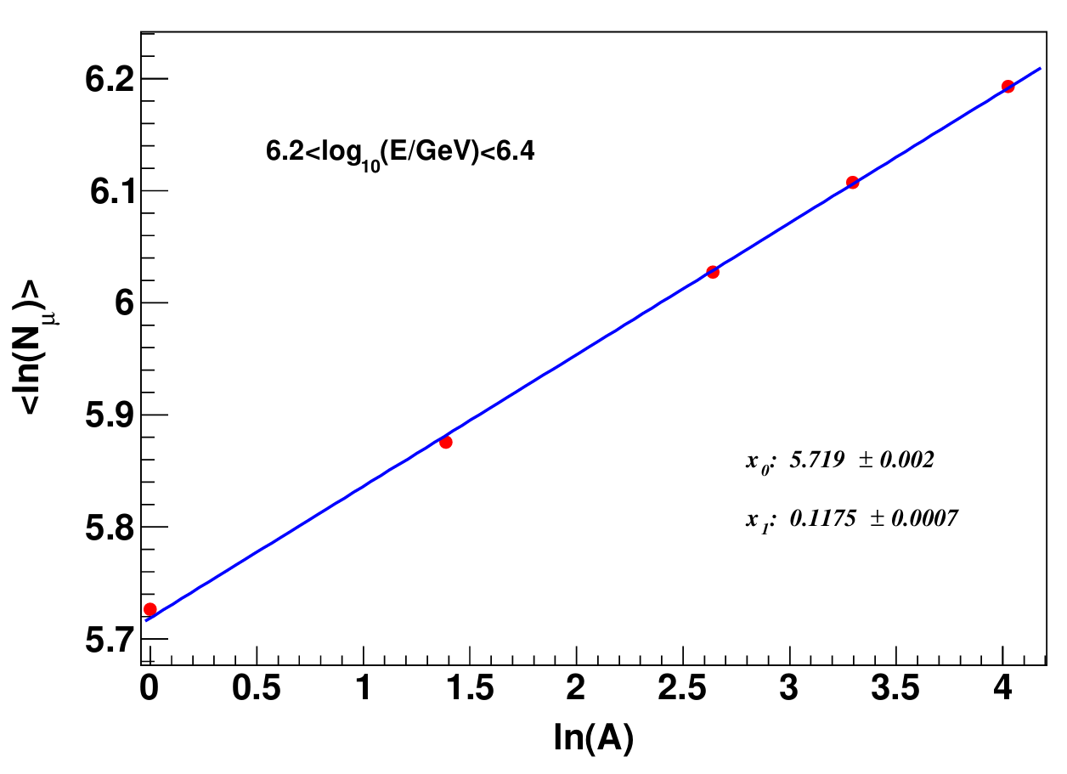

<lnA> reconstruction
$$\ln{N_{μ}}=x_{0}+x_{1}∙\ln{A}$$
Notes:
2338955608

Slide 25
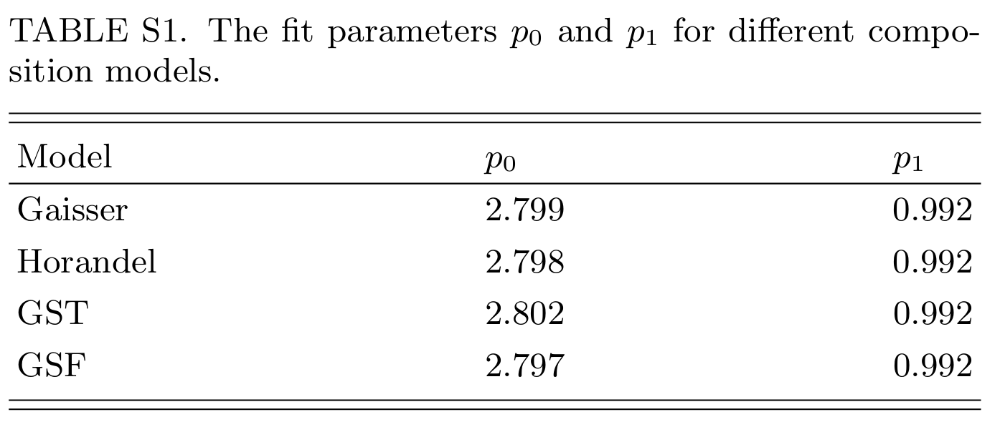
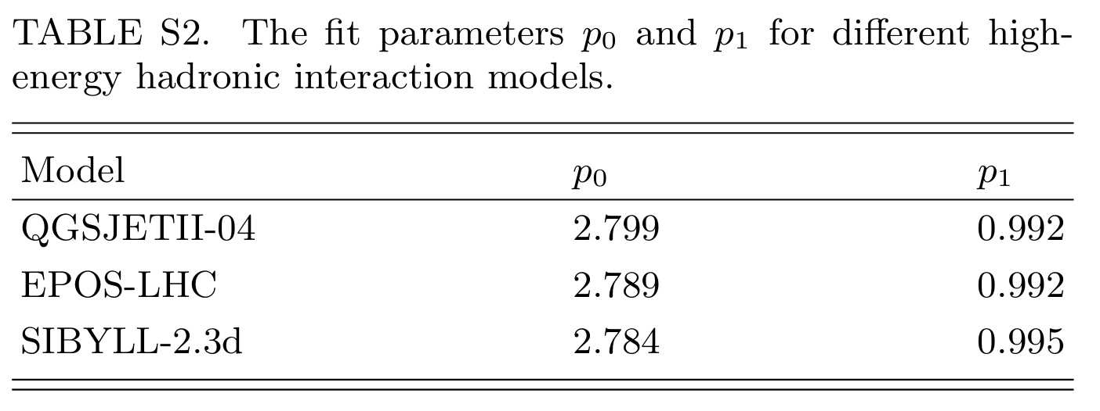
Energy reconstruction: model-dependence

Slide 26
Features of the proton knee
E_{p} = 3.2±0.2 PeV
Spectral index before the cutoff: -2.6559±0.0009
Change of spectral index: -0.79±0.03
Sharpness：5.1±0.5
f_{p}=0.43±0.06
Light: 2.35±0.06×10⁻¹² /GeV/m²/sr/s
(all: 3×10⁻¹² /GeV/m²/sr/s)

Slide 27
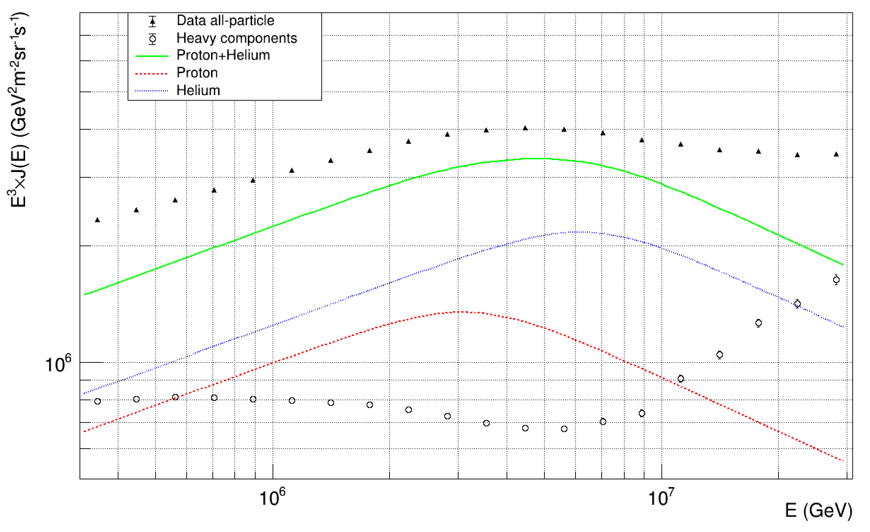
 | P | He | CNO | MgAlSi | Fe
All | 1 | 1 | 1 | 1 | 1
TLM/log(56) | 0 | 0.345 | 0.655 | 0.819 | 1
P+0.655He | 1 | 0.655 | 0.345 | 0.181 | 0
All-(P+He) |  |  | 0.569 | 0.773 | 1

