Slide 1


From Ground to Space: An Overview of the JEM-EUSO Program for the Study of UHECRs and Astrophysical Neutrinos
Zbigniew Plebaniak INFN Rome, Tor Vergata for the JEM-EUSO Collaboration
The 39th ICRC Conference, July 22nd 2025, Geneva, Switzerland

Slide 2
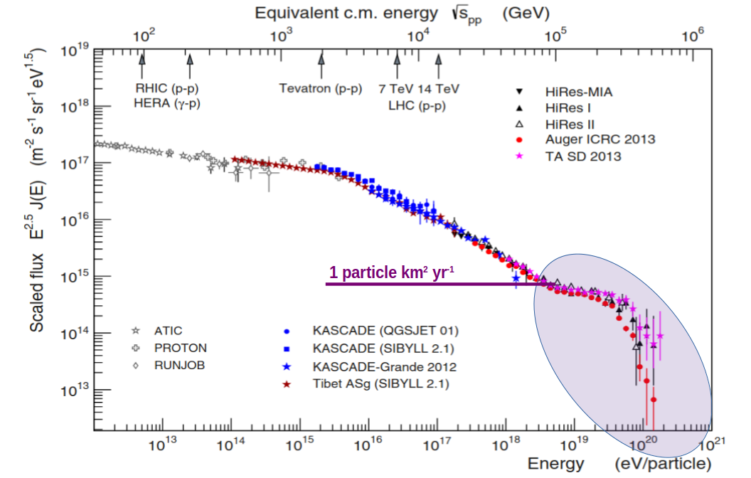
Ultra-High-Energy Messengers: too rare for ground-only astronomy
Ultra-high-energy cosmic rays (≥ 5x10¹⁸ eV): < 1 event km⁻² year⁻¹ - statistics require million-km² yr exposure
Ground observatories (TA, Auger) capture only a few × 10³ km² sr yr per year - too small and hemisphere-biased
From orbit, we can deliver ≥ 3 × 10⁴ km² sr yr annually and monitor the Earth limb for PeV - EeV τ-neutrinos
Adapted from T. Pierog et al., EPJ Web Conf. 89 (2015) 01003
An orbital eye can turn century-scale statistics into year-scale data, enabling spectrum, anisotropy, and source correlation at the highest energies.

Slide 3
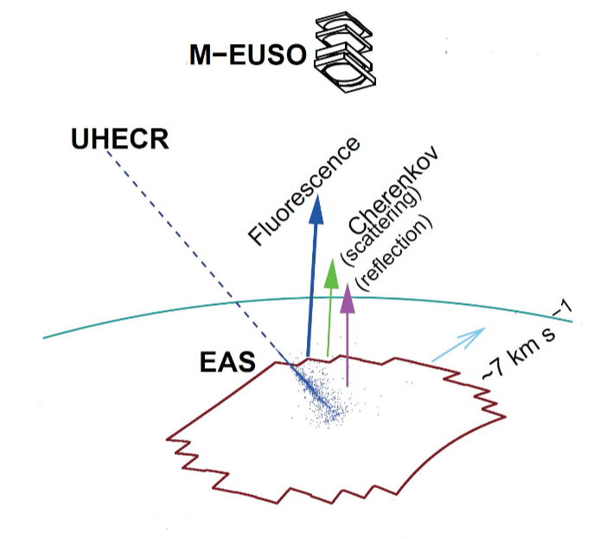
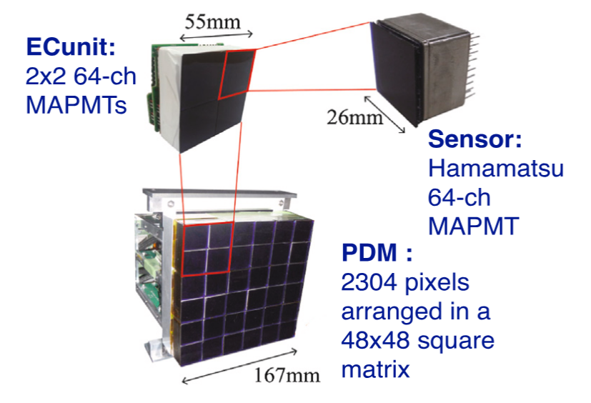
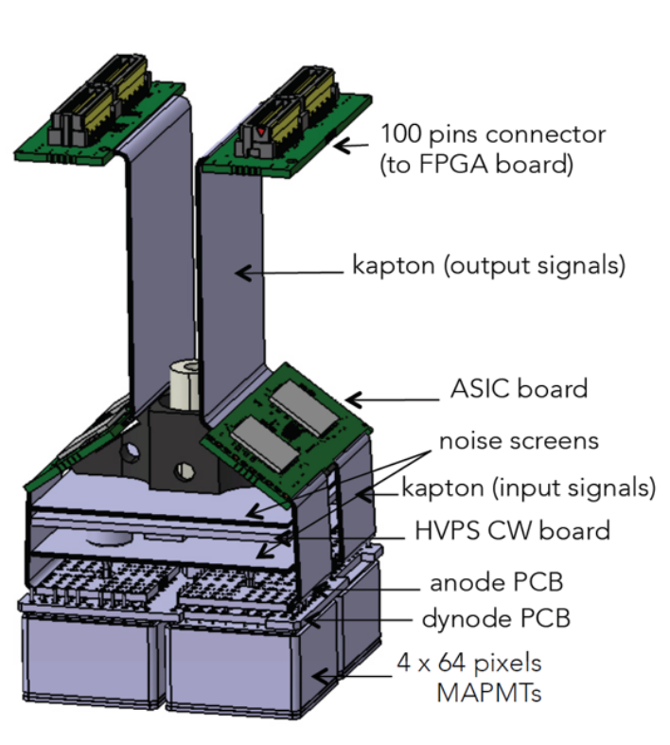
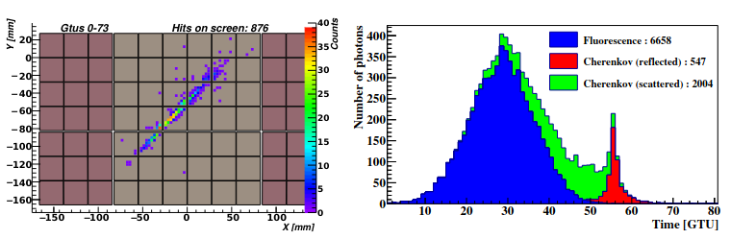
JEM-EUSO: observational principle with fluorescence camera
UV measurements in photon counting mode:
µs -scale integration window
energy and direction reconstruction
reconstruction of the X_{max} → sensitivity to primary-particle composition

Slide 4
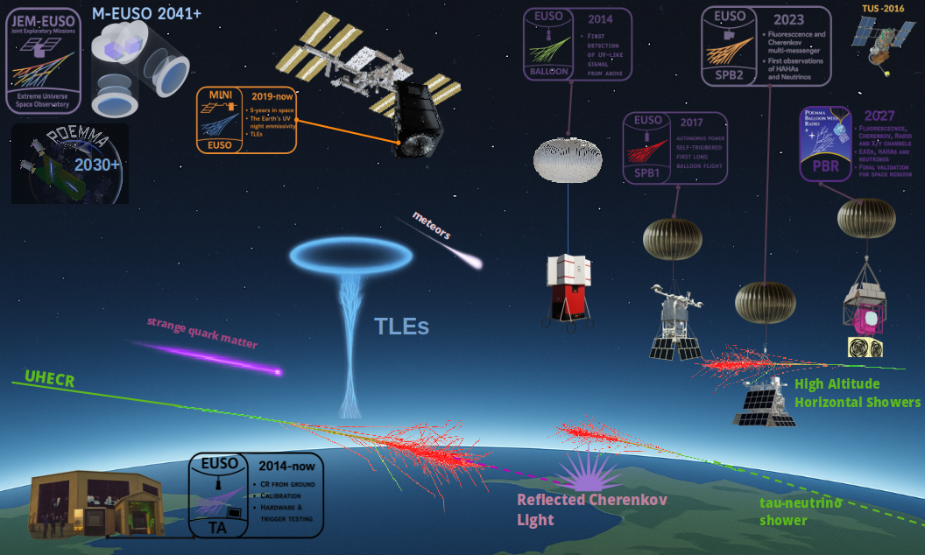





The JEM-EUSO Program in 2025
12 countries
160 scientists
supported by the major space agencies

Slide 5
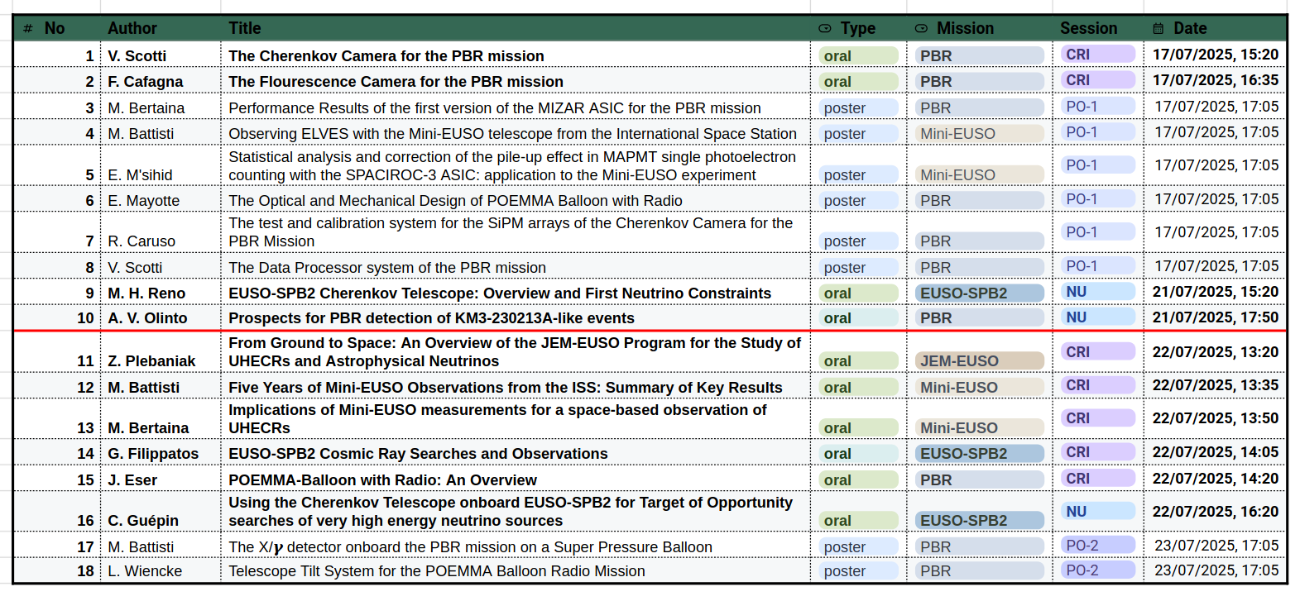
The JEM-EUSO contributions at ICRC2025

Slide 6

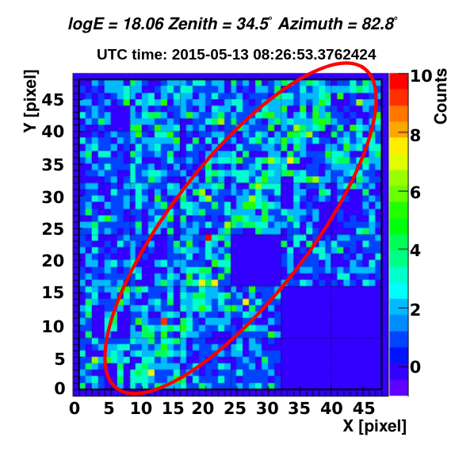
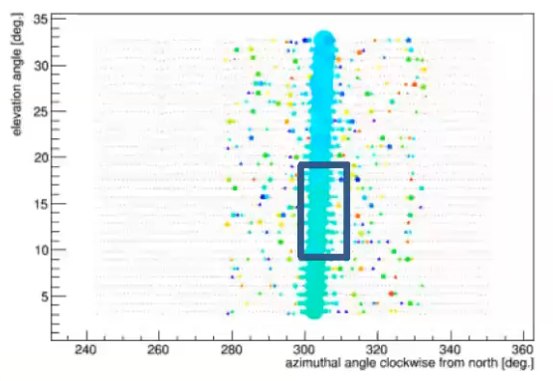
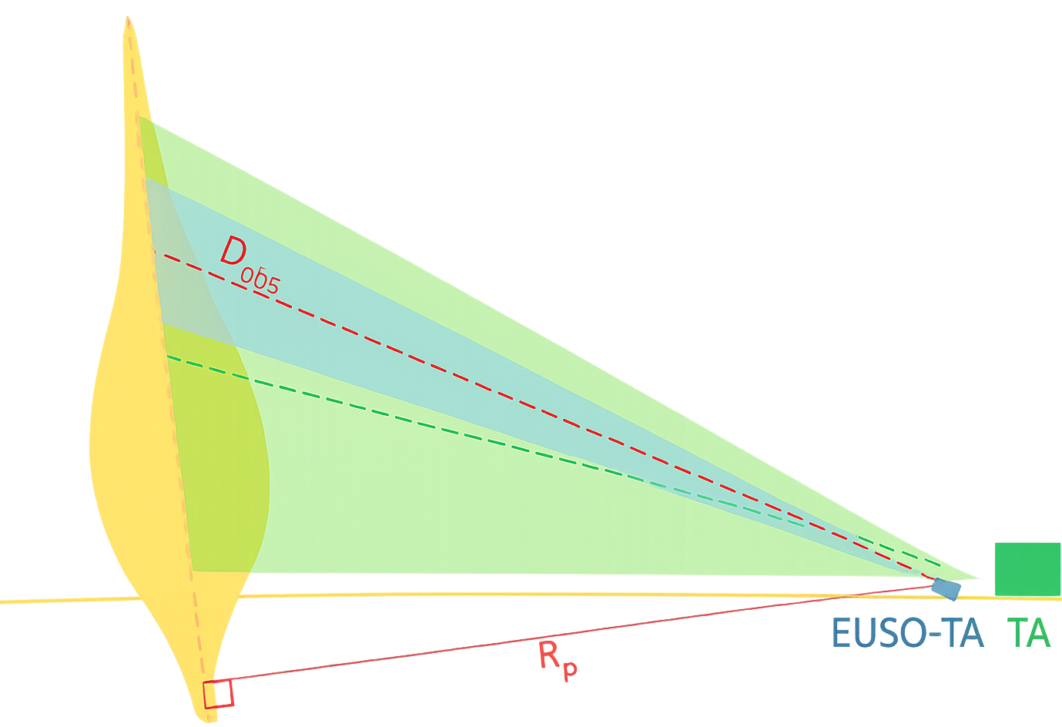
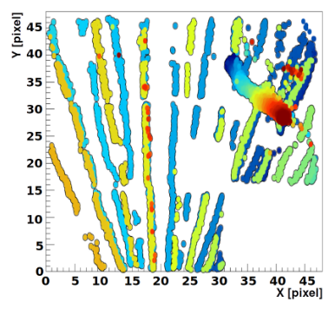
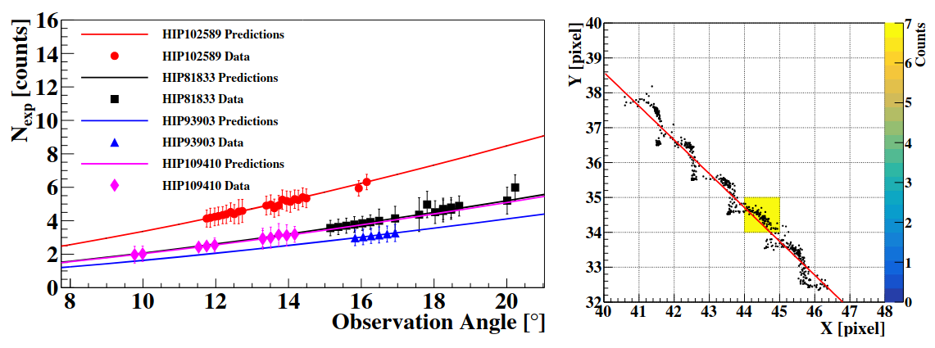
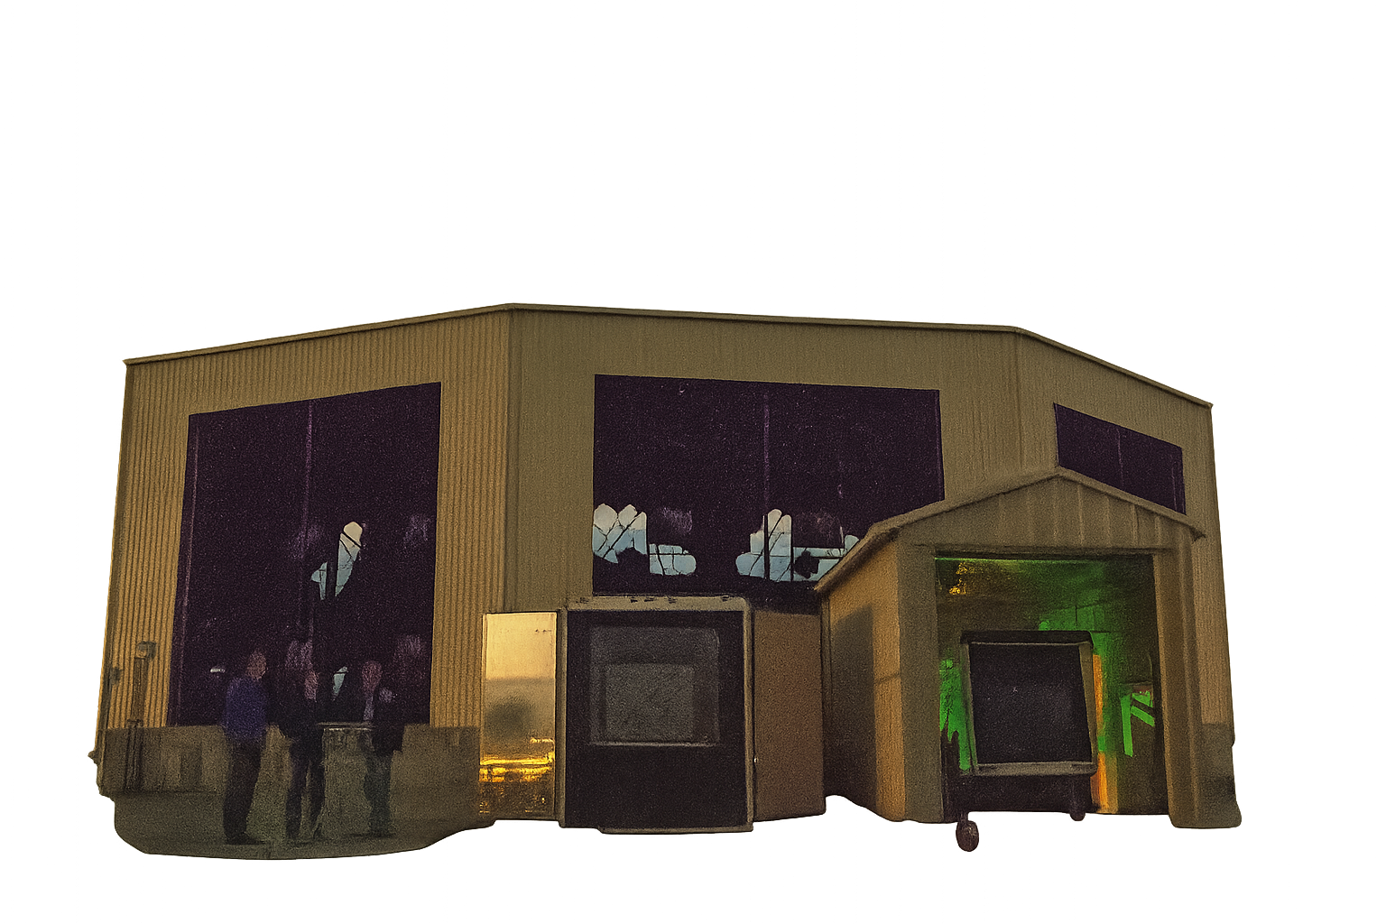
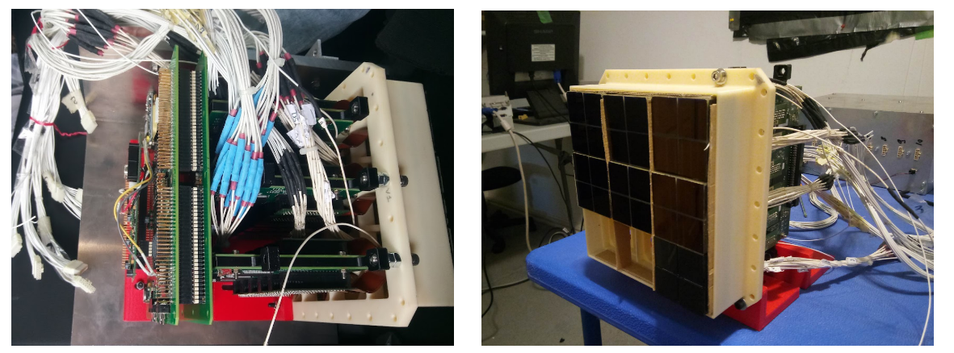
EUSO-TA – Ground Demonstrator & Calibration Testbed (Utah, USA)
Thanks to collaboration with the Telescope Array, we can perform ground-based observations of UHECRs and test individual components of the JEM-EUSO detector. The first instrument was installed in 2014, and observations were conducted from 2015 to 2022 detecting 9 UHECRs. The measurement system is currently undergoing an upgrade.
Parameters:
Dual Fresnel lens: 2 × 1 m²
FoV: 10.5°, 2.1 × 2.1 km² at 3 km
Camera: 36 MAPMTs, 2 304 pixels
Sampling: 2.5 µs
Observations in parallel with TA

Slide 7
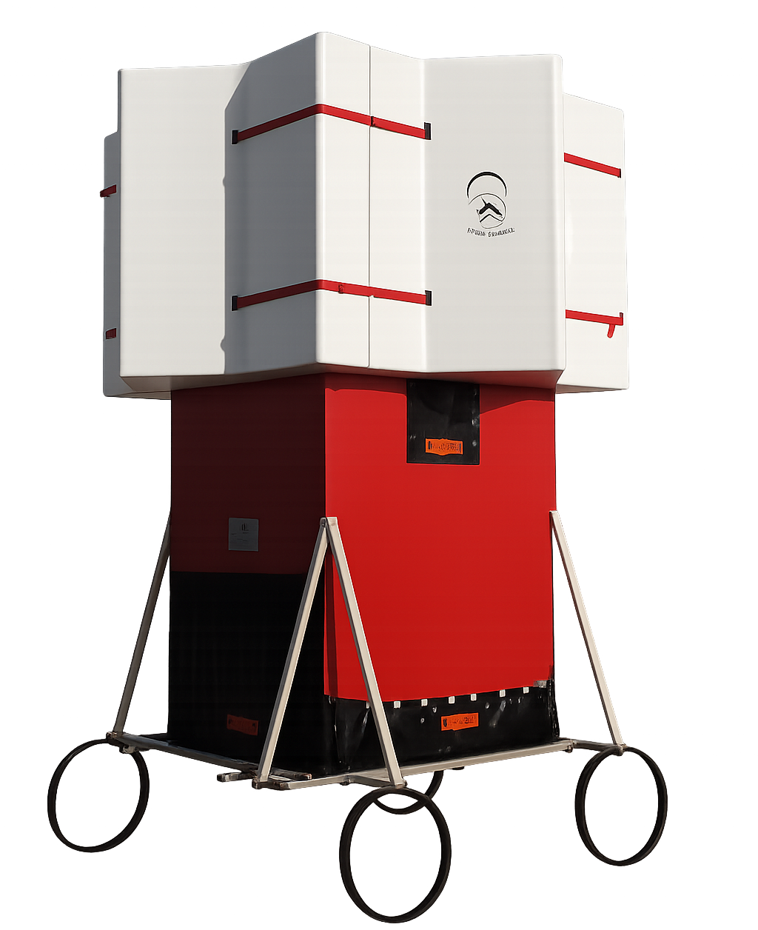
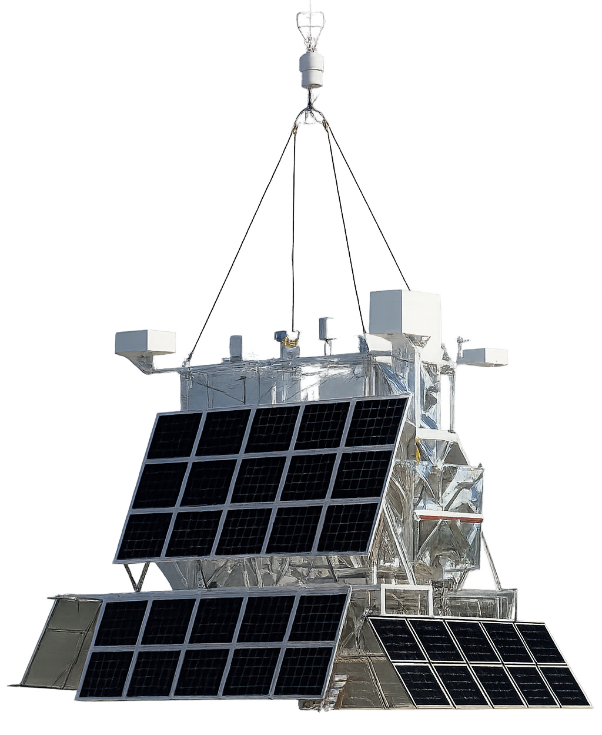


Stratospheric Balloon Program
EUSO-Balloon 2014
https://www.youtube.com/watch?v=64C9DxmE0sY
Led by CNES, 5h flight over Timmins, Canada, August 2014
1 PDM pointing downward
First EAS-like laser tracks detected
Validated optics & trigger at 38 km
The detector recovered after flight

Slide 8
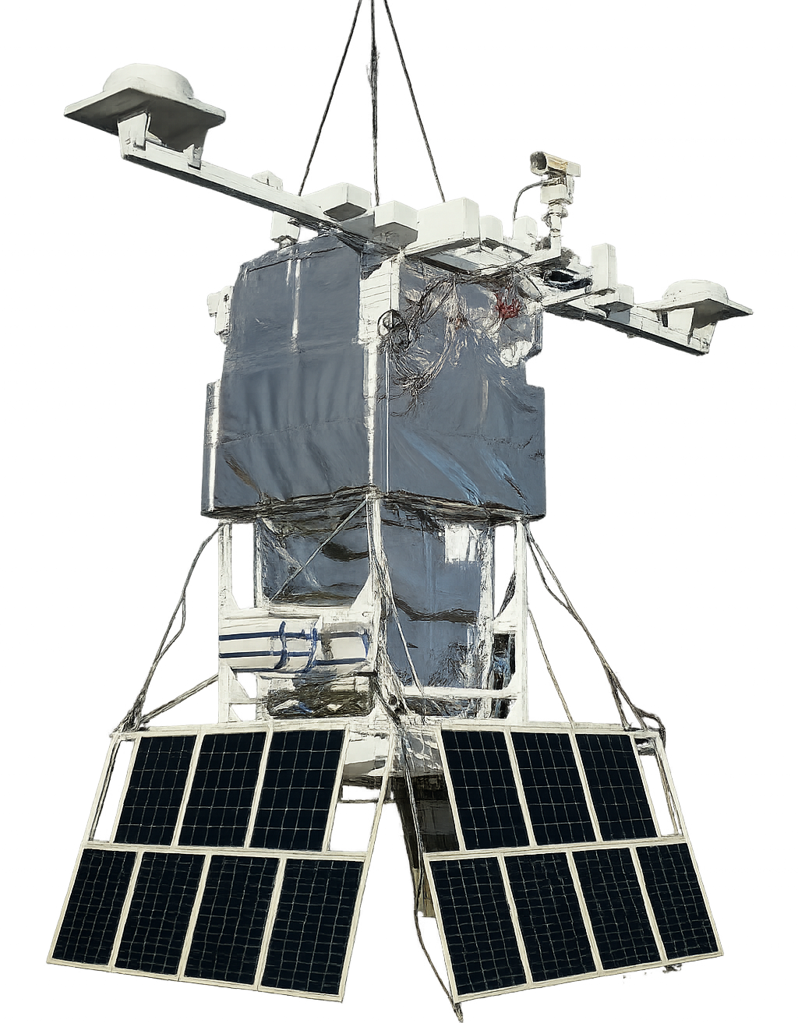
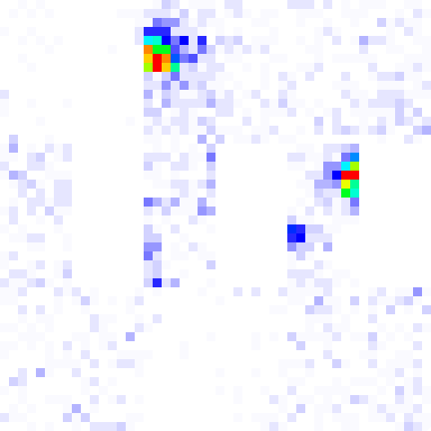
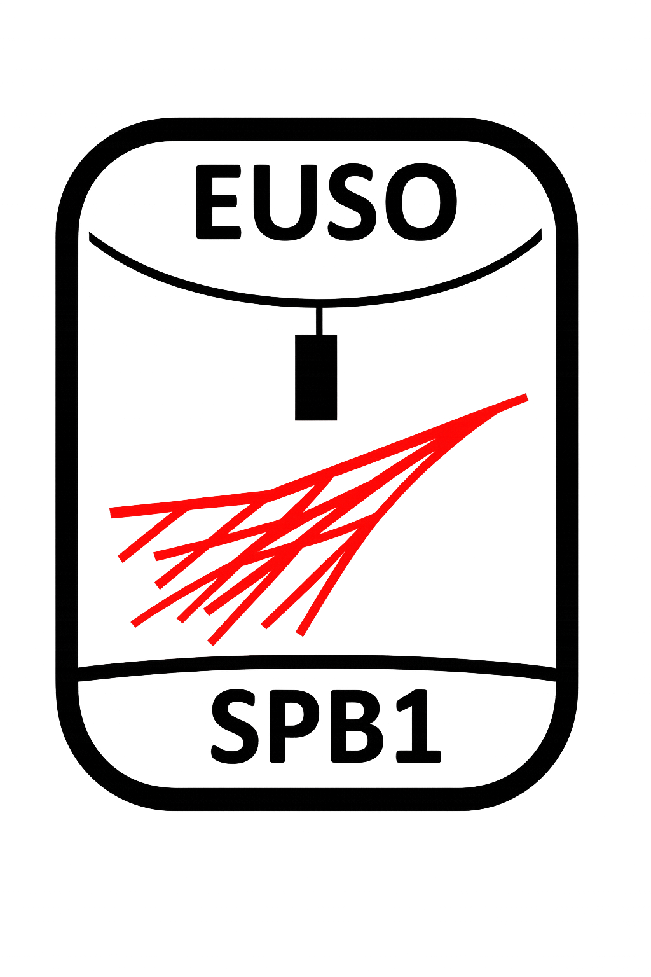
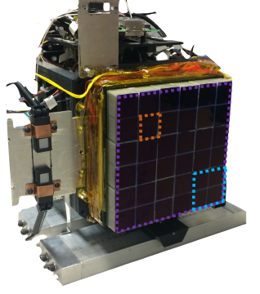
Stratospheric Balloon Program
EUSO-Balloon 2014
EUSO-SPB1 2017
https://www.youtube.com/watch?v=64C9DxmE0sY
https://www.youtube.com/watch?v=BfvMS76whEU
NASA SPB, New Zealand, Wanaka, April 2017
25h UV data (mission aborted early)
1 PDM, looking downward
No UHECR candidates but clouds and direct CR clearly visible
Proved long-duration power & comms
Led by CNES, 5h flight over Timmins, Canada, August 2014
1 PDM pointing downward
First EAS-like laser tracks detected
Validated optics & trigger at 38 km
The detector recovered after flight

Slide 9
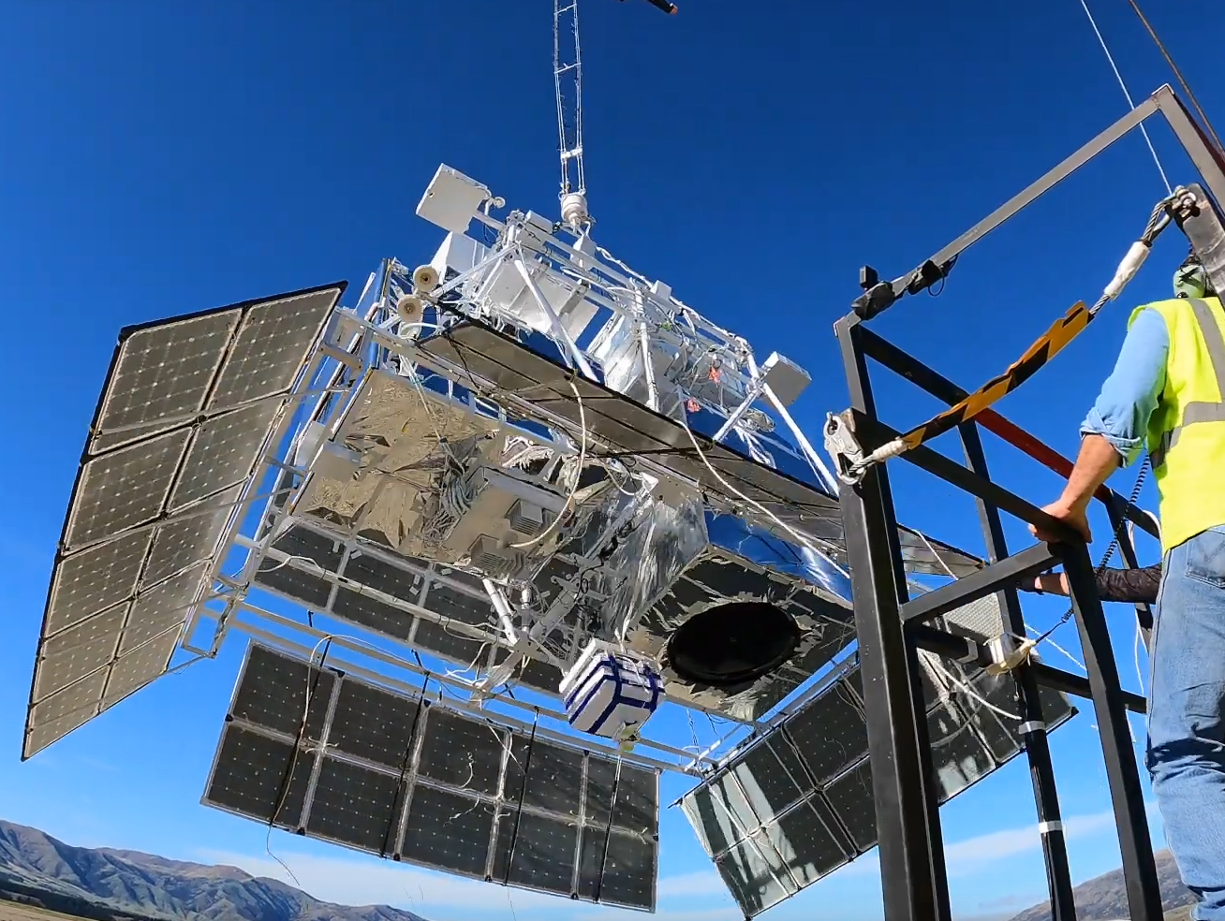

Stratospheric Balloon Program
EUSO-Balloon 2014
EUSO-SPB1 2017
EUSO-SPB2 2023
https://www.youtube.com/watch?v=64C9DxmE0sY
https://www.youtube.com/watch?v=BfvMS76whEU
https://www.youtube.com/watch?v=cbghe-vWizc
NASA SPB, New Zealand, Wanaka, April 2017
25h UV data (mission aborted early)
1 PDM, looking downward
No UHECR candidates but clouds and direct CR clearly visible
Proved long-duration power & comms
NASA SPB, Wanaka, May 2023 (terminated after two days)
Dual telescope: 6912-pix Fluorescence (3PDMs) & 512-pix Cherenkov
120k fluorescence + 32k Cherenkov triggers
First upward-shower ν_{𝝉} search, a few PeV candidates
The bi-focal Schmidt optics for cherenkov signals
Led by CNES, 5h flight over Timmins, Canada, August 2014
1 PDM pointing downward
First EAS-like laser tracks detected
Validated optics & trigger at 38 km
The detector recovered after flight

Slide 10
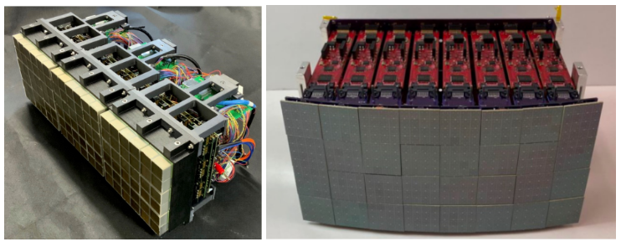
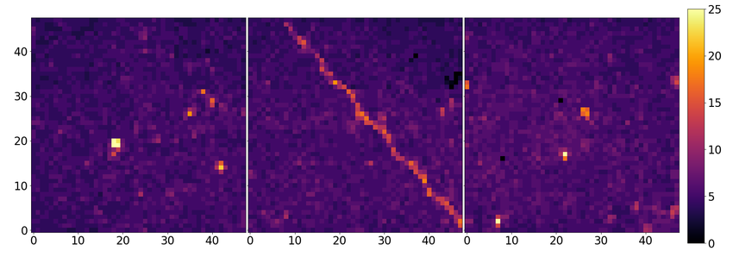
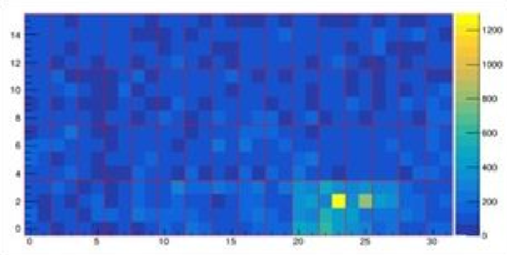
Stratospheric Balloon Program
EUSO-Balloon 2014
EUSO-SPB1 2017
EUSO-SPB2 2023
https://www.youtube.com/watch?v=64C9DxmE0sY
https://www.youtube.com/watch?v=BfvMS76whEU
https://www.youtube.com/watch?v=cbghe-vWizc
See G. Filippatos #309
NASA SPB, New Zealand, Wanaka, April 2017
25h UV data (mission aborted early)
1 PDM, looking downward
No UHECR candidates but clouds and direct CR clearly visible
Proved long-duration power & comms
NASA SPB, Wanaka, May 2023 (terminated after two days)
Dual telescope: 6912-pix Fluorescence (3PDMs) & 512-pix Cherenkov
120k fluorescence + 32k Cherenkov triggers
First upward-shower ν_{𝝉} search, a few PeV candidates
The bi-focal Schmidt optics for cherenkov signals
Led by CNES, 5h flight over Timmins, Canada, August 2014
1 PDM pointing downward
First EAS-like laser tracks detected
Validated optics & trigger at 38 km
The detector recovered after flight

Slide 11
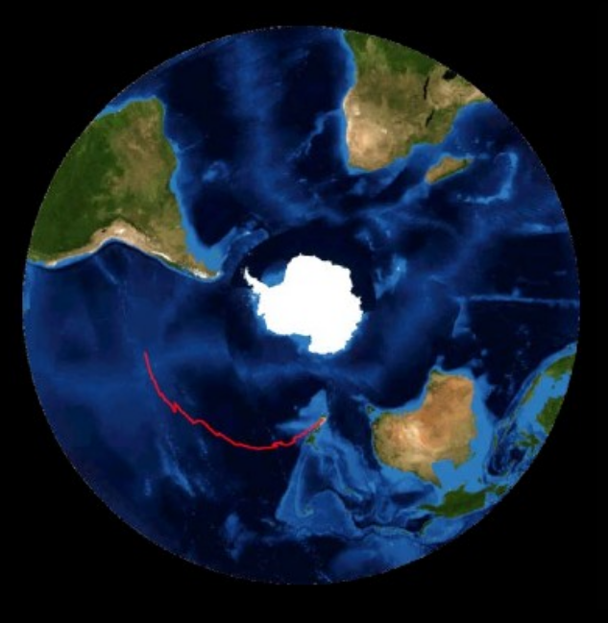
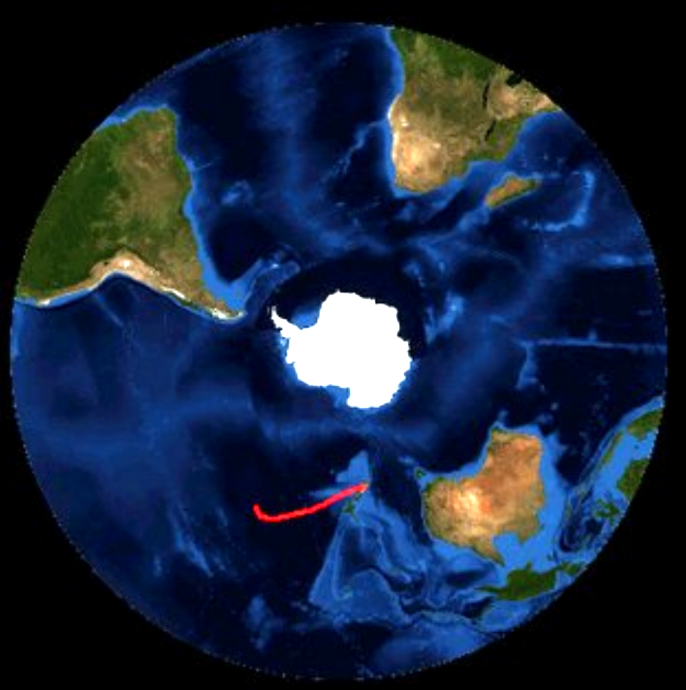
Stratospheric Balloon Program
EUSO-Balloon 2014
EUSO-SPB1 2017
EUSO-SPB2 2023
12d 14h
1d 13h
https://www.youtube.com/watch?v=64C9DxmE0sY
https://www.youtube.com/watch?v=BfvMS76whEU
https://www.youtube.com/watch?v=cbghe-vWizc
See G. Filippatos #309
NASA SPB, New Zealand, Wanaka, April 2017
25h UV data (mission aborted early)
1 PDM, looking downward
No UHECR candidates but clouds and direct CR clearly visible
Proved long-duration power & comms
NASA SPB, Wanaka, May 2023 (terminated after two days)
Dual telescope: 6912-pix Fluorescence (3PDMs) & 512-pix Cherenkov
120k fluorescence + 32k Cherenkov triggers
First upward-shower ν_{𝝉} search, a few PeV candidates
The bi-focal Schmidt optics for cherenkov signals
Led by CNES, 5h flight over Timmins, Canada, August 2014
1 PDM pointing downward
First EAS-like laser tracks detected
Validated optics & trigger at 38 km
The detector recovered after flight

Slide 12
Stratospheric Balloon Program
EUSO-Balloon 2014
EUSO-SPB1 2017
EUSO-SPB2 2023
12d 14h
1d 13h
https://www.youtube.com/watch?v=64C9DxmE0sY
https://www.youtube.com/watch?v=BfvMS76whEU
https://www.youtube.com/watch?v=cbghe-vWizc
See G. Filippatos #309
NASA SPB, New Zealand, Wanaka, April 2017
25h UV data (mission aborted early)
1 PDM, looking downward
No UHECR candidates but clouds and direct CR clearly visible
Proved long-duration power & comms
NASA SPB, Wanaka, May 2023 (terminated after two days)
Dual telescope: 6912-pix Fluorescence (3PDMs) & 512-pix Cherenkov
120k fluorescence + 32k Cherenkov triggers
First upward-shower ν_{𝝉} search, a few PeV candidates
The bi-focal Schmidt optics for cherenkov signals
Led by CNES, 5h flight over Timmins, Canada, August 2014
1 PDM pointing downward
First EAS-like laser tracks detected
Validated optics & trigger at 38 km
The detector recovered after flight
??

Slide 13
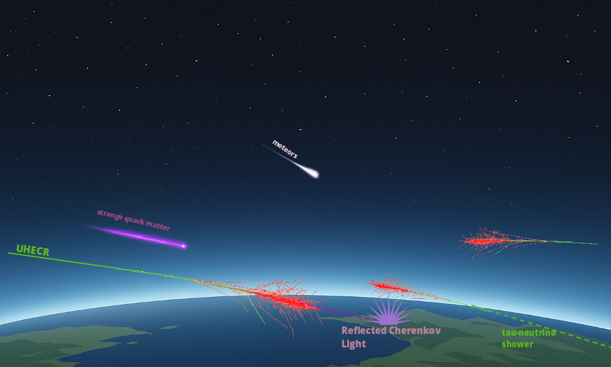
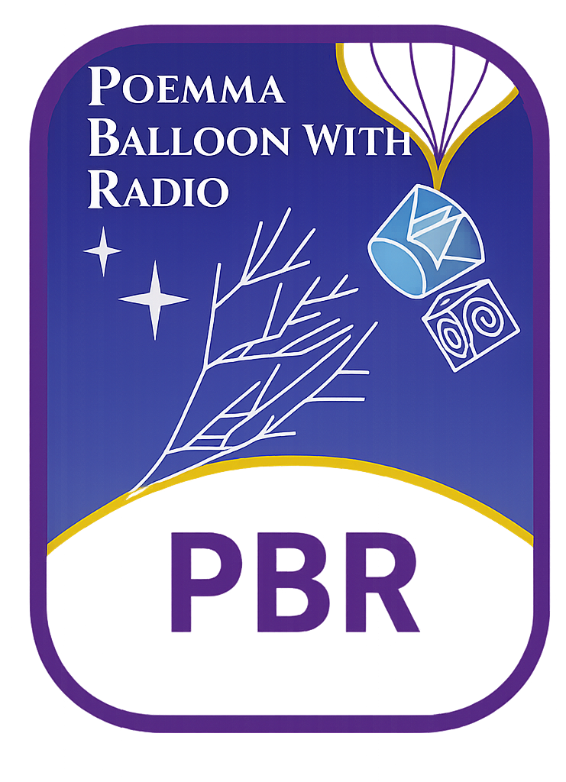
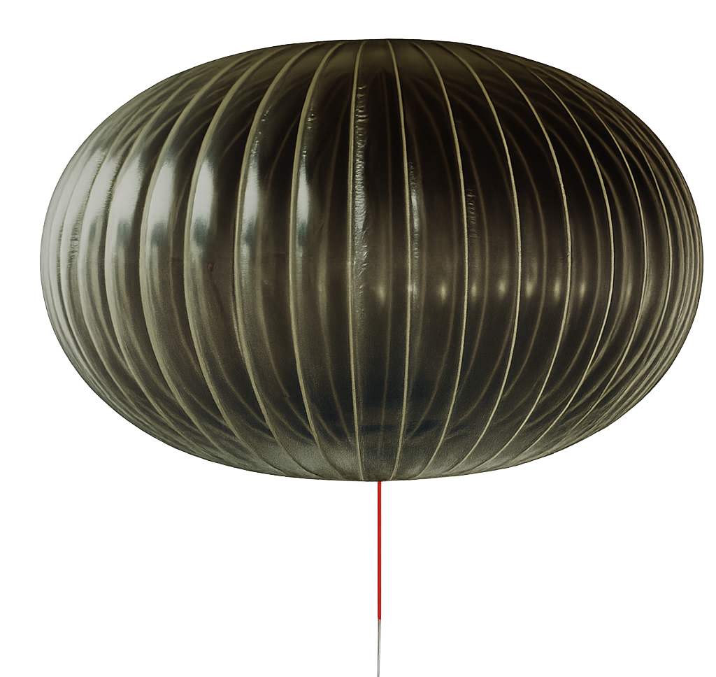
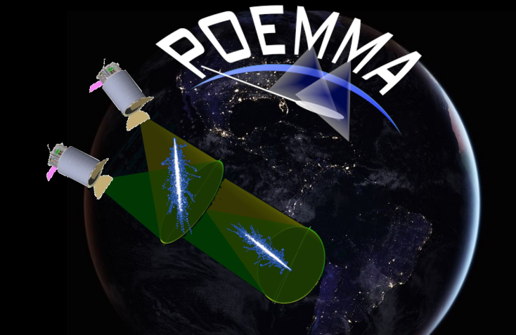
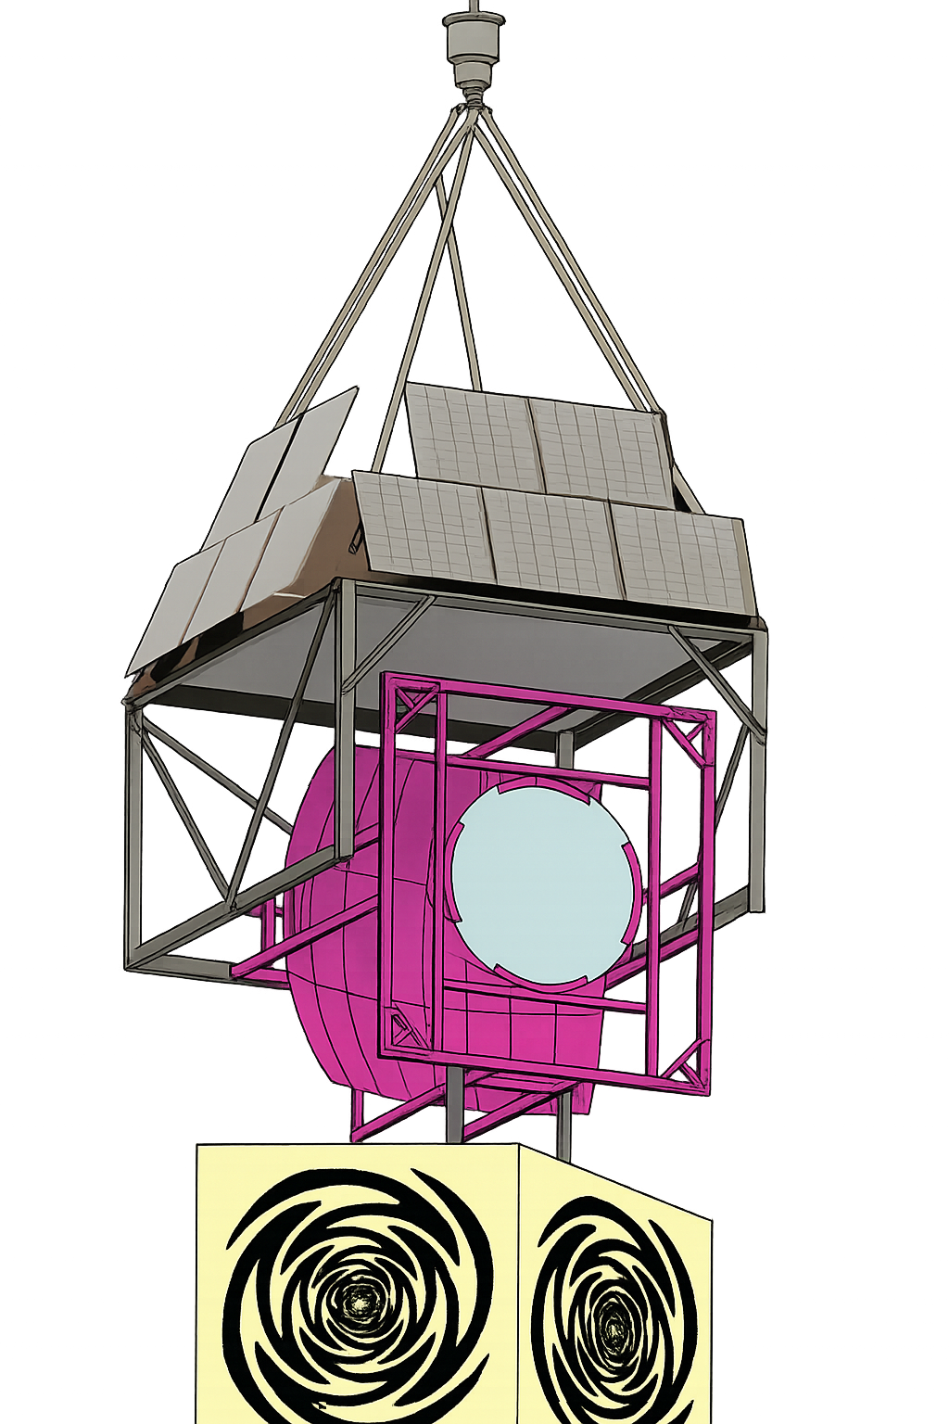
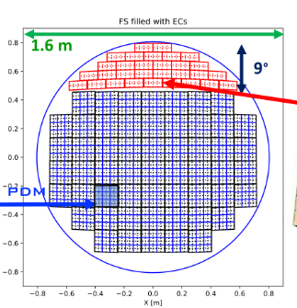
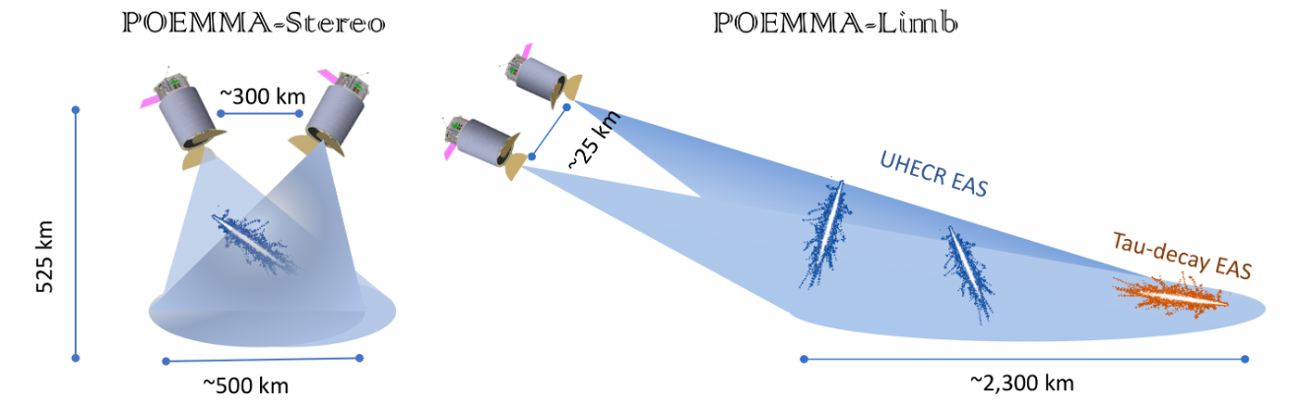
From balloons to satellite missions: POEMMA Balloon with Radio
Probe Of Extreme Multi-Messenger Astrophysics
SiPM
See J. Eser, #934
Long-duration (~50 days) NASA SPB flight in 2027
Fluorescence, fast Cherenkov, plus compact radio array (200–800 MHz)
Raise TRL of large-format focal surface & high-speed readout
Provide atmospheric, cloud, and background data for orbit modelling
Measurements of UHECR, neutrinos (ToO), HAHAs and background, calibration in flight
ToO observations - rapid-response observation mode triggered by transient astrophysical events like neutrinos, gamma-ray bursts, or gravitational waves See C. Guépin-Detrigne, #1210

Slide 14

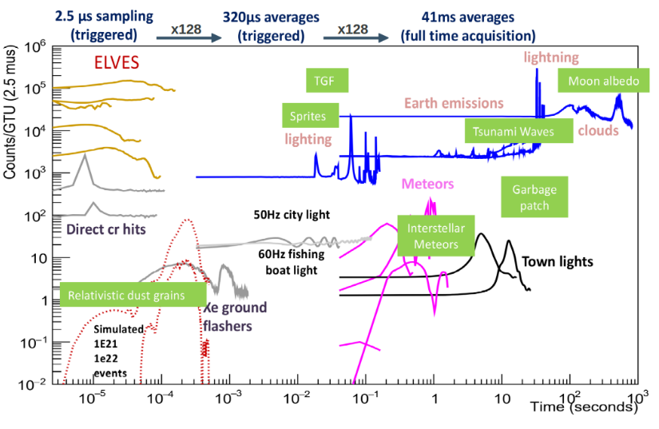
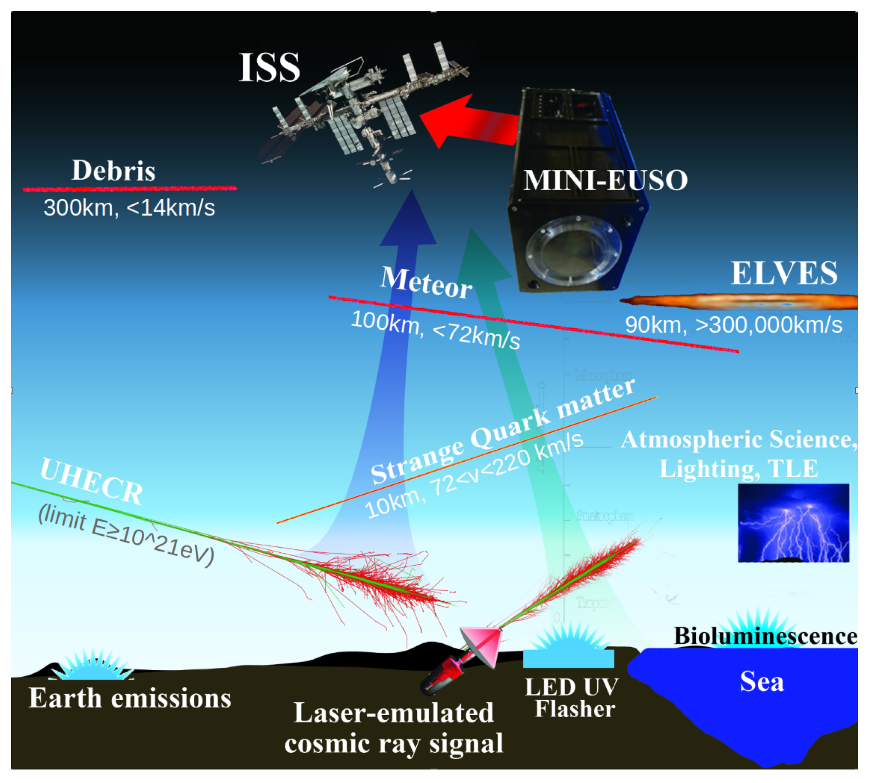
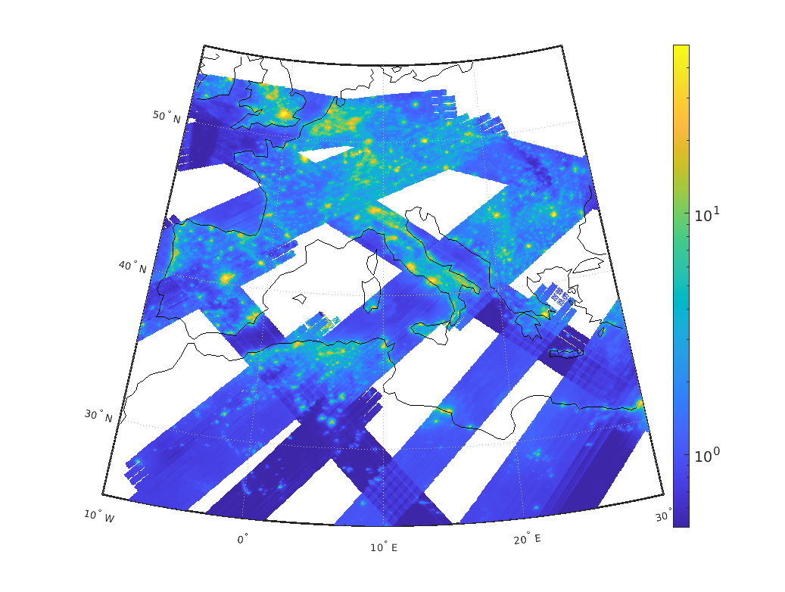
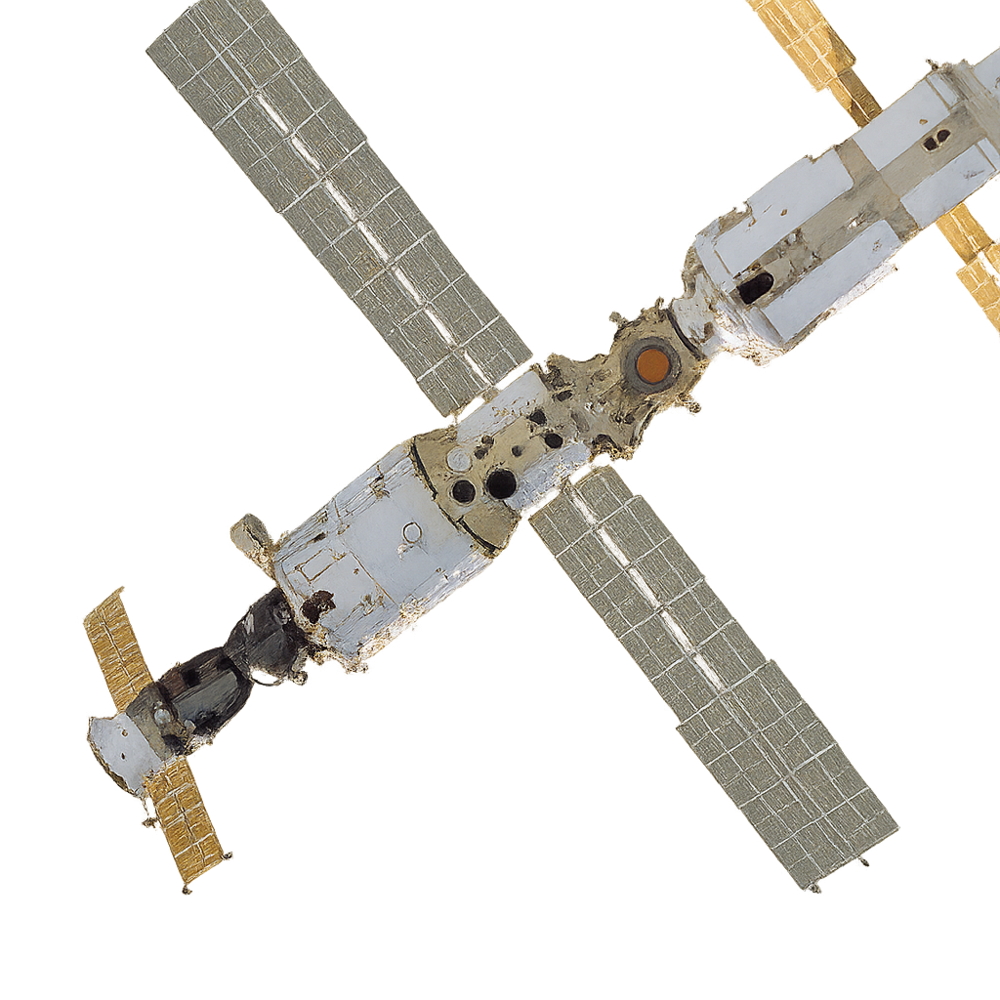
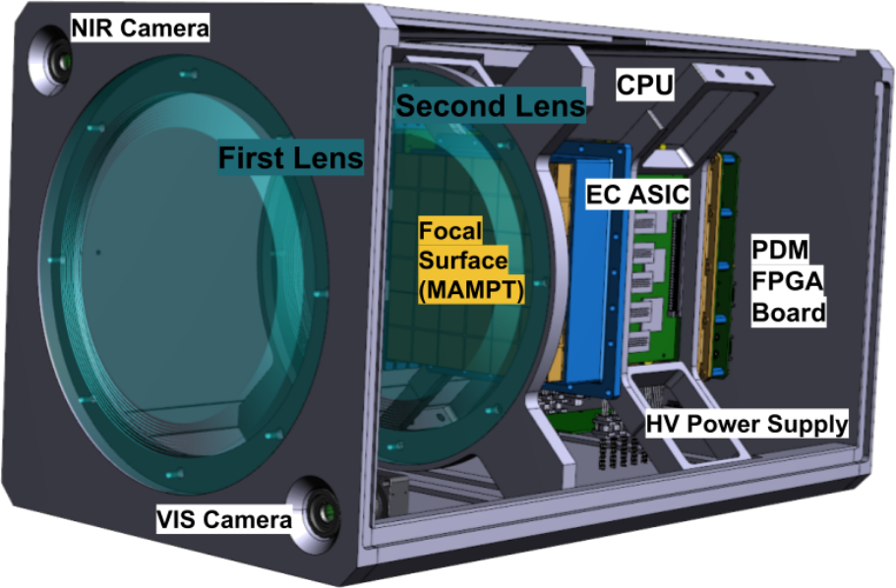
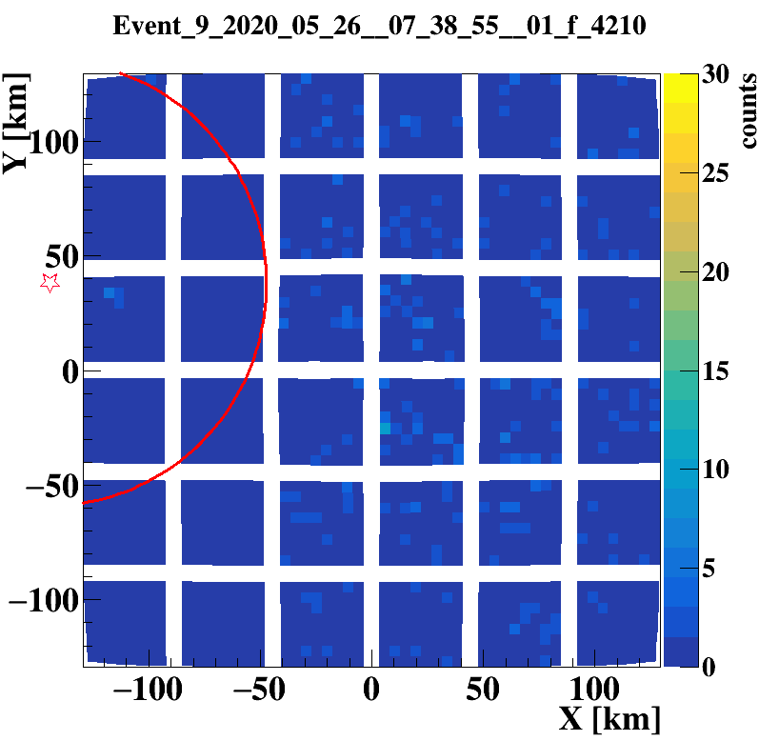
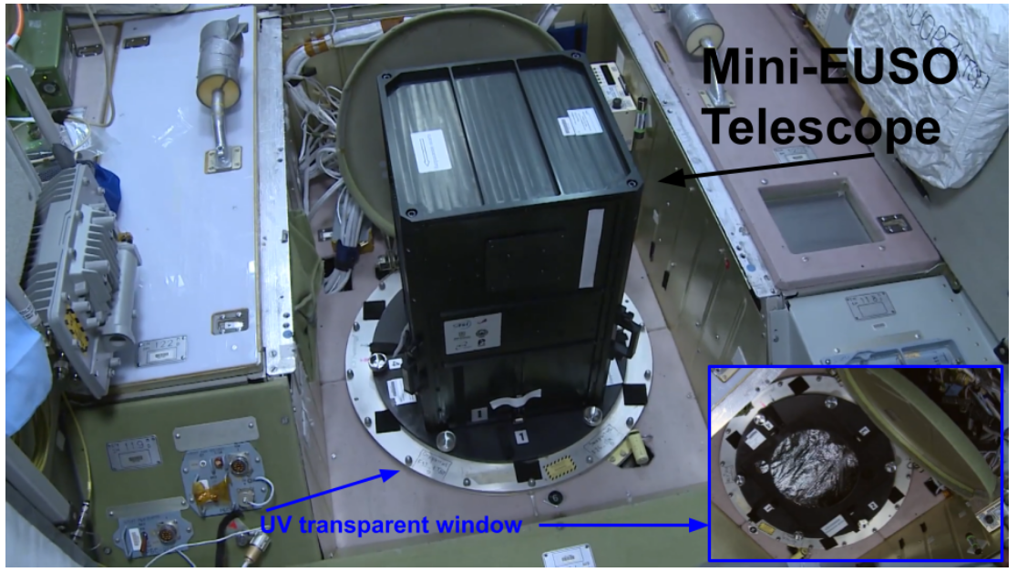
Mini-EUSO: First JEM-EUSO detector in Space (since 2019)
150 sessions, over 5 years of Mini-EUSO in space:
see talk by M. Battisti #372
Implications for a space-based observations:
see talk by M. Bertaina #777
Key observations:
TLEs
Meteors
UV night emissivity/maps
Calibration from ground
TRL ⋝ 6

Slide 15


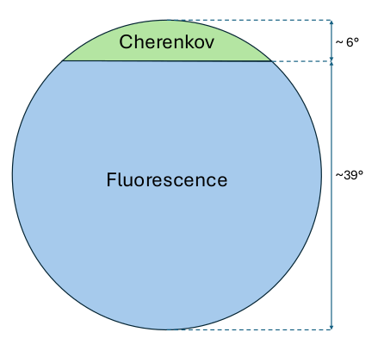
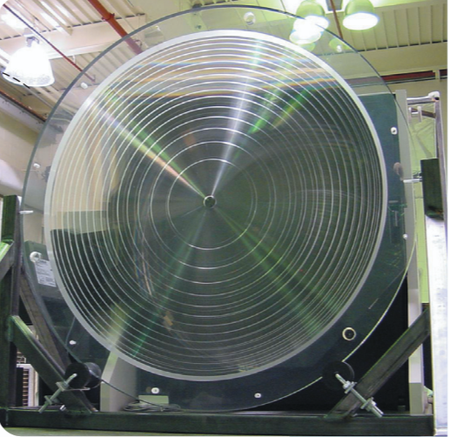
M-EUSO - Satellite Multi-Messenger 2.3 m UV Telescope in LEO Proposed to ESA M8 call
Satellite free-flyer instrument
Double Fresnel lens Ø 2.3 m (≈ 4 m²) • FoV 40°×40° • 0.12° / px
Dual Focal Surface:
Fluorescence: 49 PDM → 112 896 MAPMT pixels • Gates 2.5 µs / 320 µs / 40 ms
Cherenkov: 6 000 SiPM pixels • 10 ns sampling
Mass 770 kg • Power 1 kW • Telemetry 2 MB s⁻¹
TRL: ≥ 6 (through Mini-EUSO, EUSO-SPB2 and PBR)

Slide 16
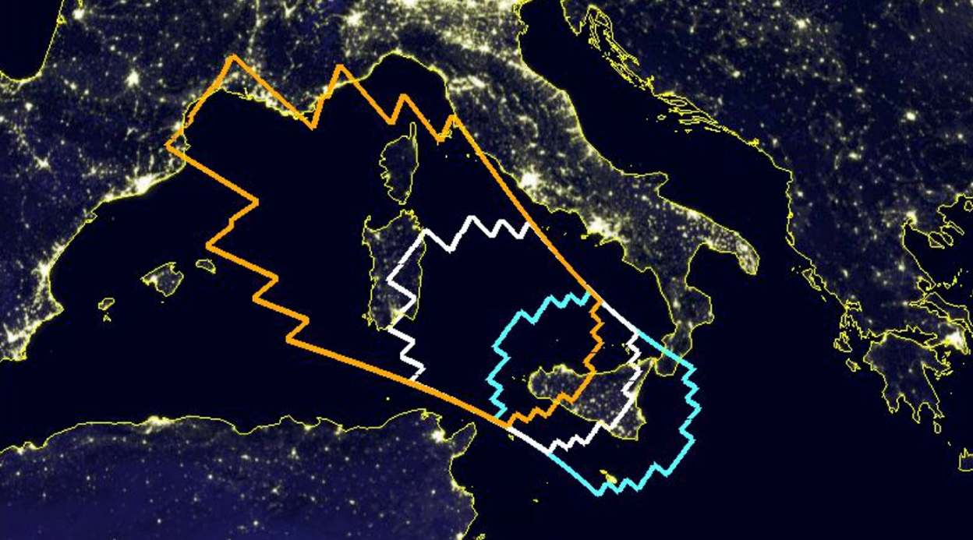
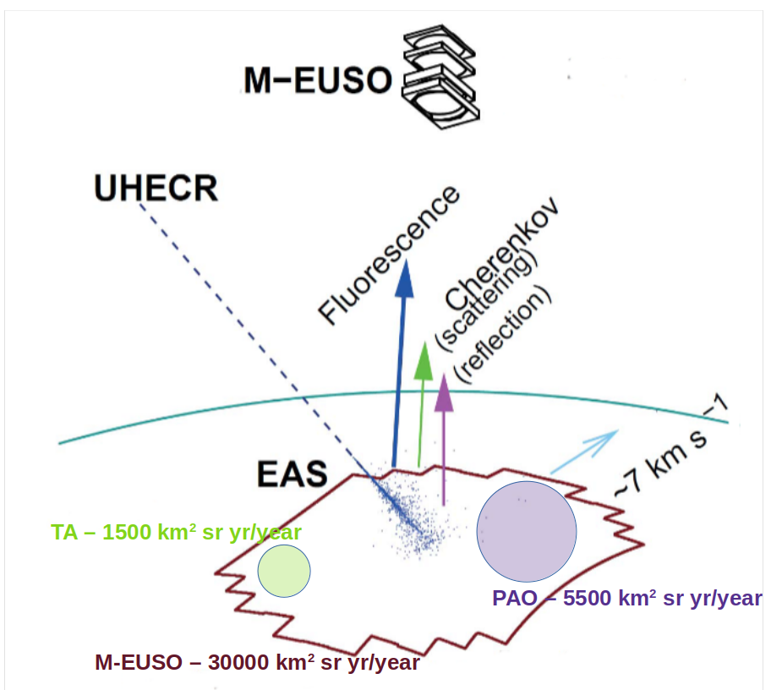
M-EUSO - Satellite Multi-Messenger 2.3 m UV Telescope in LEO Proposed to ESA M8 call
Satellite free-flyer instrument
Double Fresnel lens Ø 2.3 m (≈ 4 m²) • FoV 40°×40° • 0.12° / px
Dual Focal Surface:
Fluorescence: 49 PDM → 112 896 MAPMT pixels • Gates 2.5 µs / 320 µs / 40 ms
Cherenkov: 6 000 SiPM pixels • 10 ns sampling
Mass 770 kg • Power 1 kW • Telemetry 2 MB s⁻¹
TRL: ≥ 6 (through Mini-EUSO, EUSO-SPB2 and PBR)
Objectives:
UHECR > 30 EeV: First single-instrument, uniform full-sky map; ≈ 250 events yr⁻¹, ≤ 5° precision
Nadir: ≥ 30 kkm² sr yr yr⁻¹ • Tilt: ≈ 100 kkm² sr yr yr⁻¹ (>3 × 10²⁰ eV)
τ-neutrinos > 40 PeV: Earth-skimming Cherenkov, opens EeV-ν window
Hadronic physics > LHC: Cross-sections & X_{max} at √s ≈ 100 TeV; LIV & SHDM tests
Multi-messenger: Fast tilt ToO for GW, GRB, blazar alerts; complements IceCube, CTA, Athena
Atmosphere & exotica: High-res TLE, ELVES, meteors; searches for SQM, UV transients

Slide 17
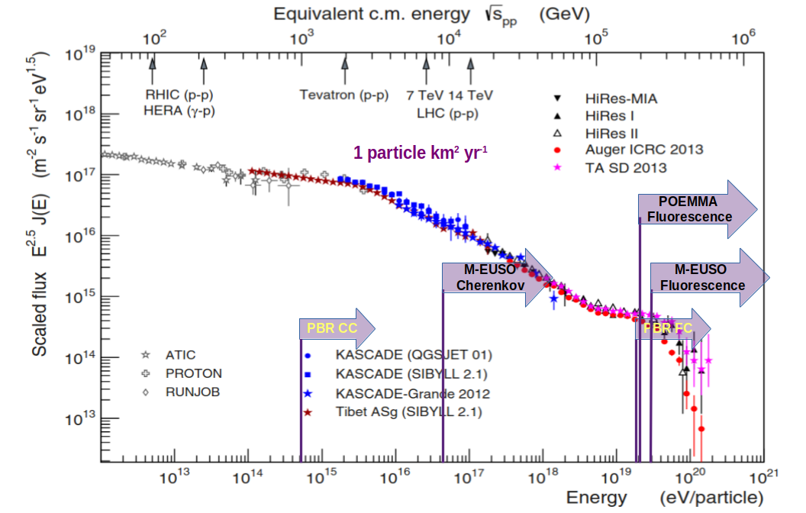
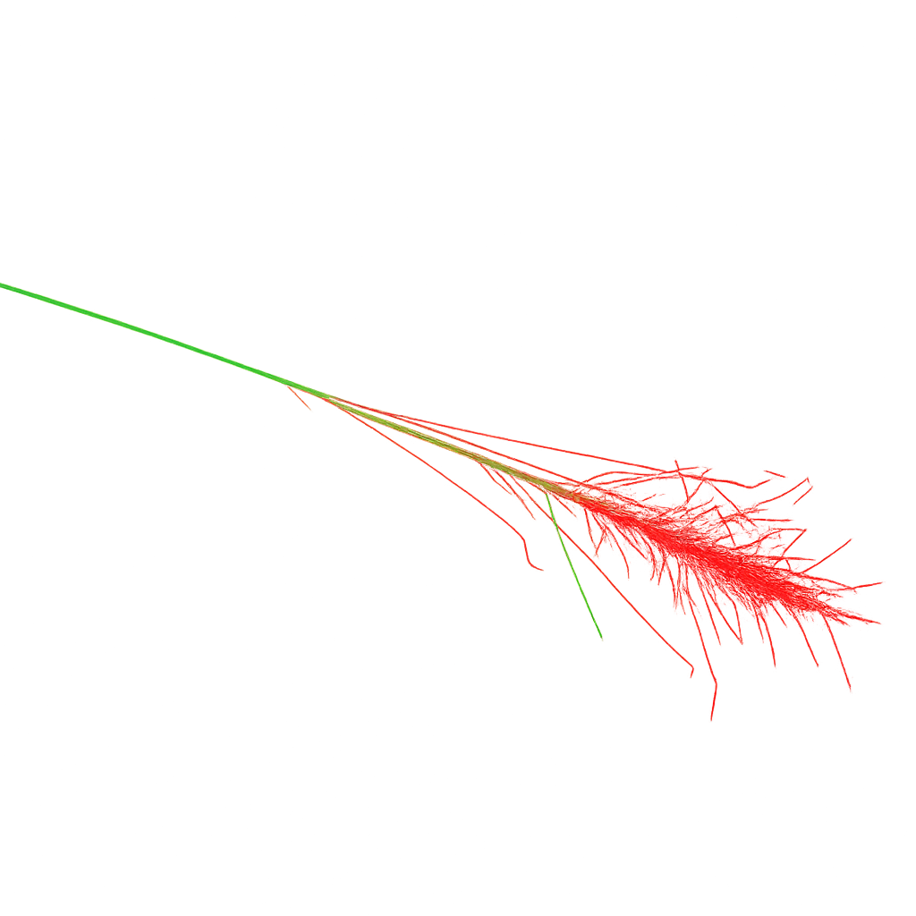
Energy thresholds for planned experiments
Adapted from T. Pierog et al., EPJ Web Conf. 89 (2015) 01003

Slide 18
Summary
The JEM-EUSO program can provide answers to the most fundamental questions in cosmic ray physics and constitutes an essential element of the UHECR community roadmap
Although the preparation of satellite experiments is expensive it solves the issue of infrastructure accessibility and maintenance of large-scale ground-based observatories
The JEM-EUSO experiments conducted so far have confirmed the readiness of the technology for a large-scale space mission; the Technology Readiness Level (TRL) of the key components has been validated at level 6
Satellite measurements using the POEMMA or M-EUSO missions have been preliminarily designed. The defined angular and energy resolutions would enable effective studies of the sources and mass composition of UHECRs
Conducting hybrid measurements from space and ground of the same events would improve measurement accuracy and open new possibilities for understanding the nature of UHECRs
The JEM-EUSO technology is ready to be used in space
Thank you for your attention

