Slide 1

The glass ceiling and all that
Patrizia Caraveo

Slide 2
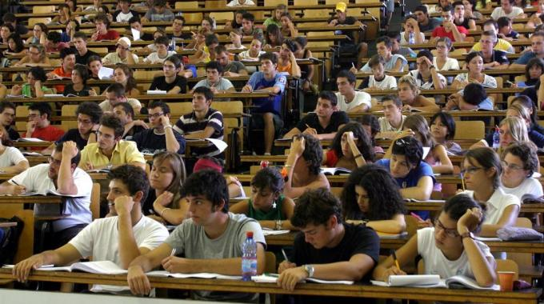
In Universities
Girls outnumber boys

Slide 3


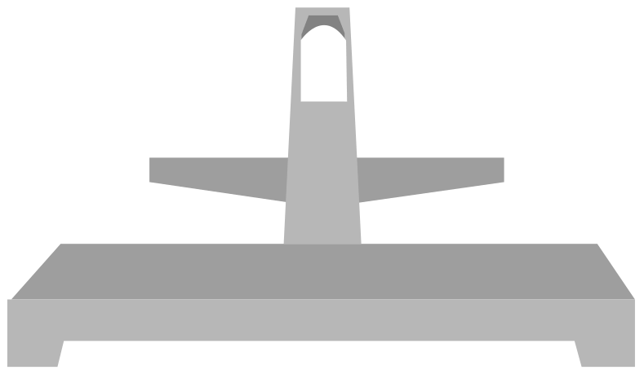
How equal are you?

Slide 4

148 countries→1 answer

Slide 5
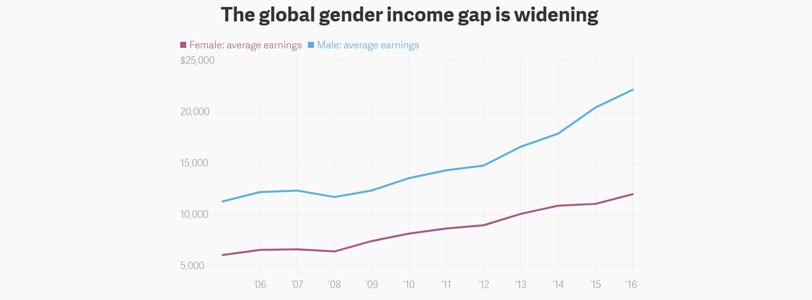
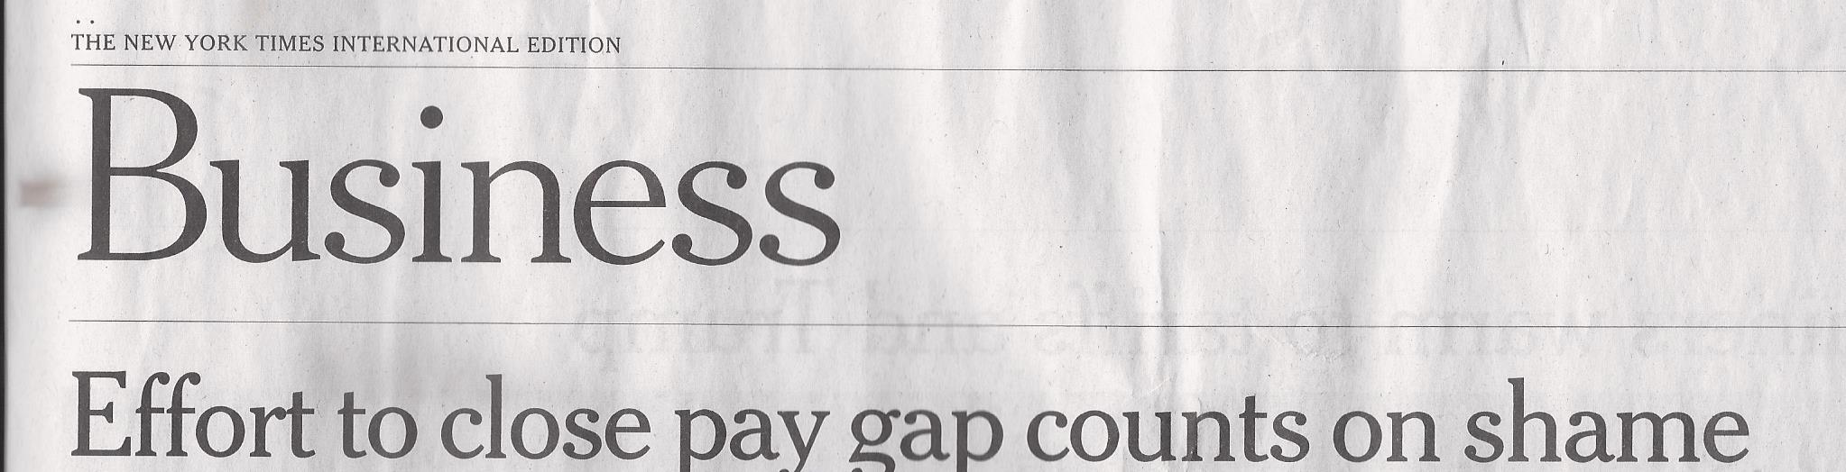
April 6, 2018

Slide 6
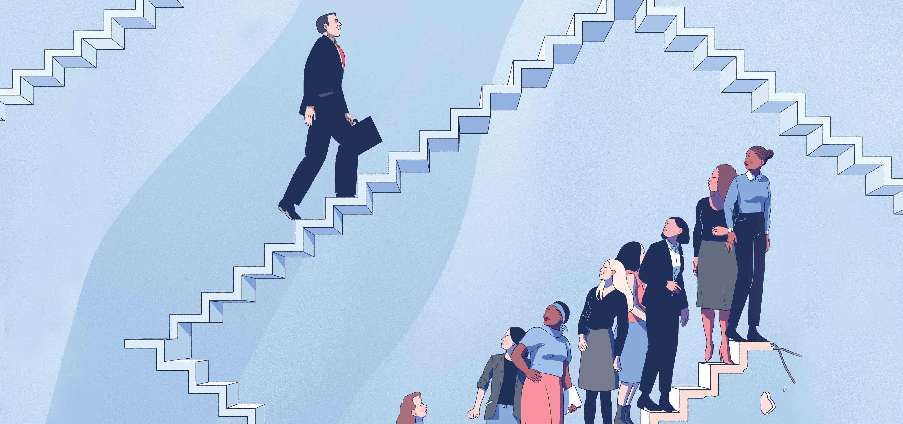
Career perspectives are different
The glass ceiling

Slide 7
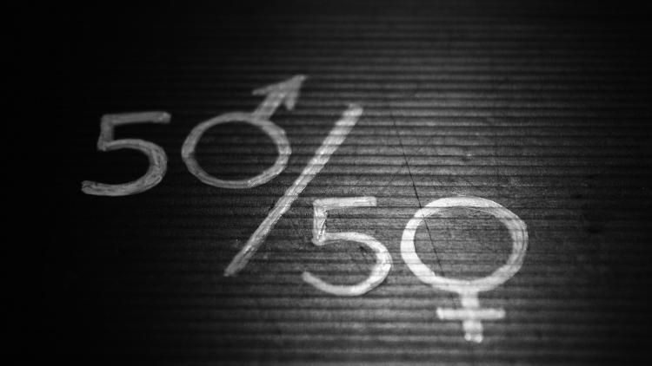
Fair proportion

Slide 8
Why?
Family committements
Different style of work
Intrinsec biases
Old-boys network

Slide 9
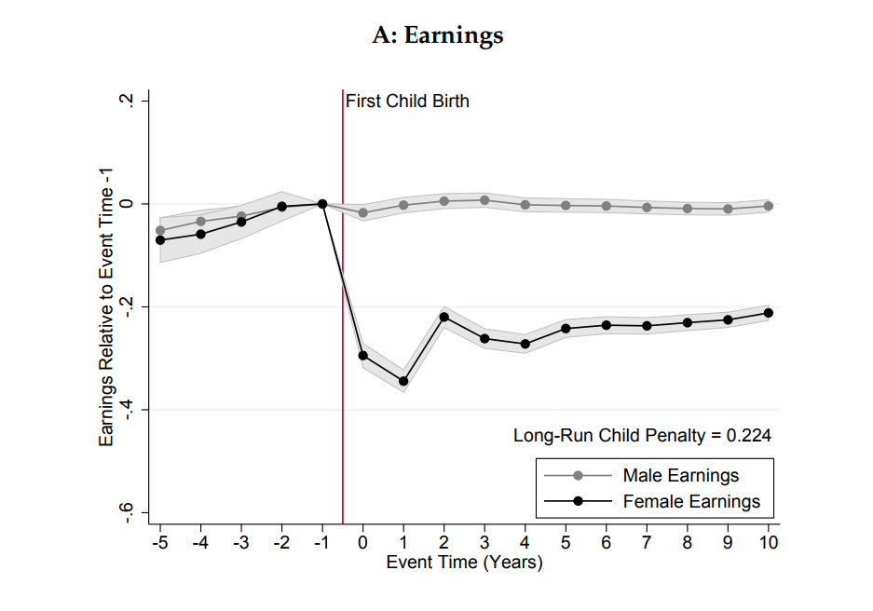

Slide 10
Why?
Family committements
Different style of work
Intrinsec biases
Old-boys network

Slide 11

Sheryl Sandberg
Men are more confident
Women are more competent

Slide 12
Why?
Family committements
Different style of work
Intrinsec biases
Old-boys network

Slide 13
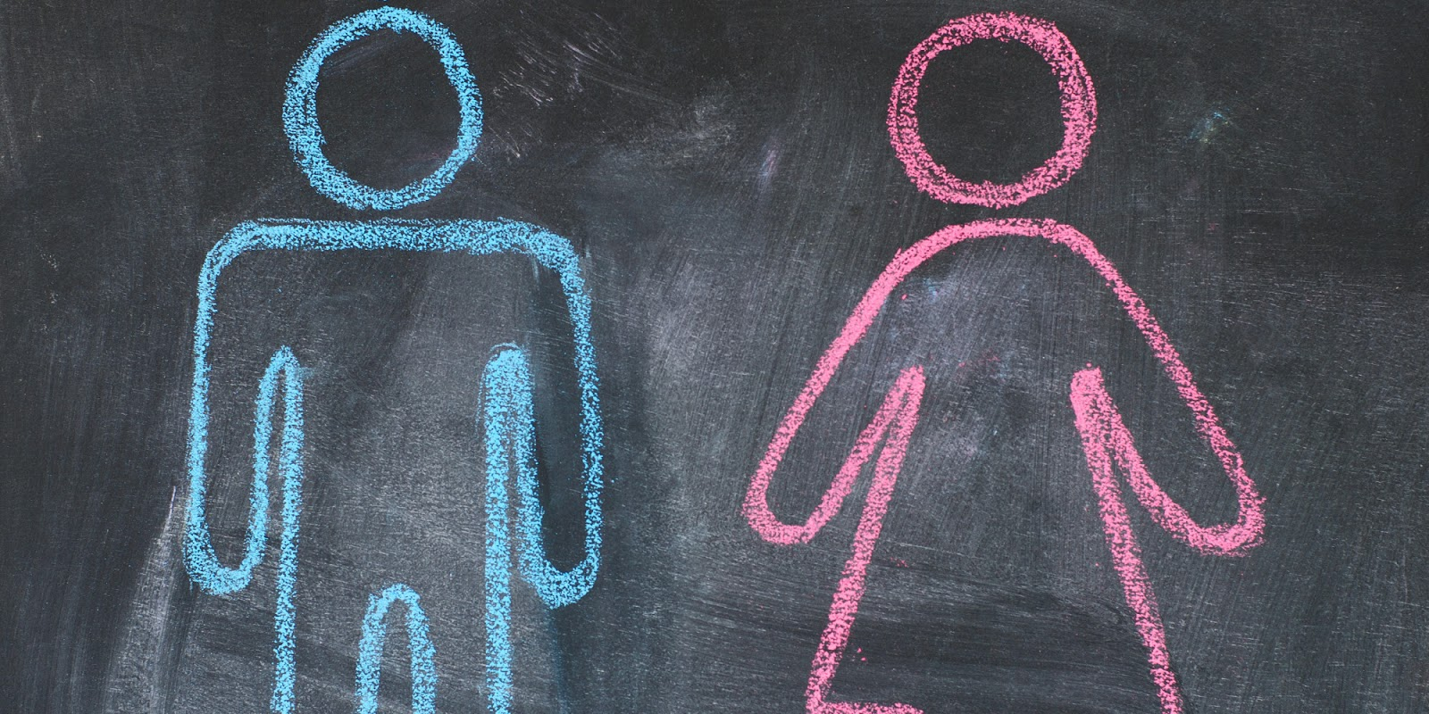
BIASES
Let’s see how students judge their professors

Slide 14
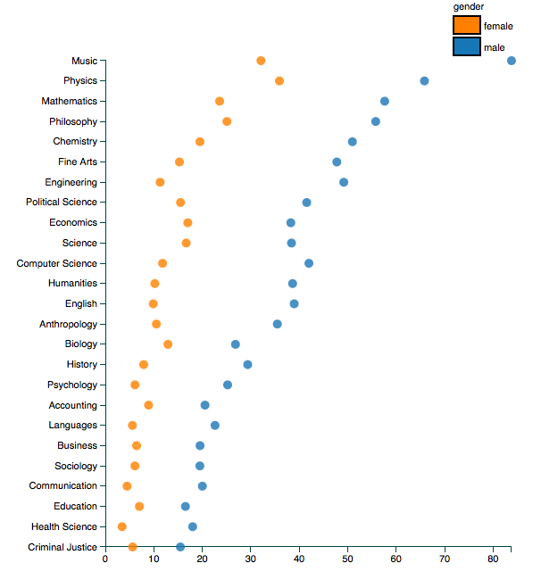
Rate myprofessor 14 M students
genius

Slide 15
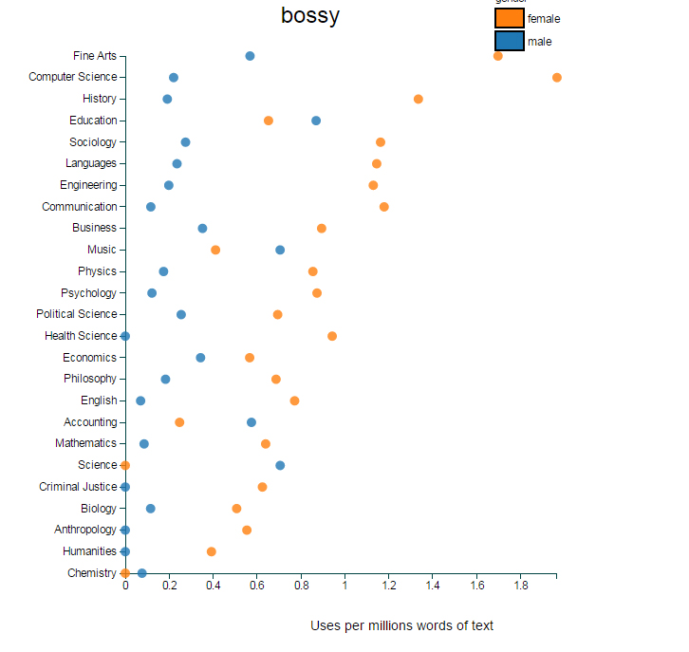
Women are bossy
but not very bright

Slide 16
Why?
Family committements
Different style of work
Intrinsec biases
Old-boys network

Slide 17
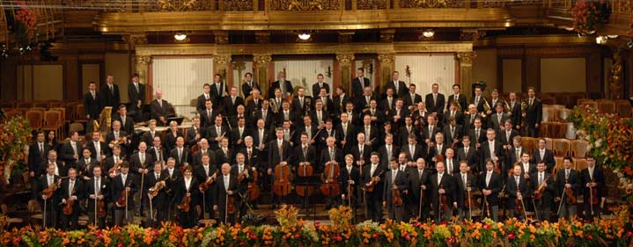
Wiener Philharmoniker Orchestra

Slide 18
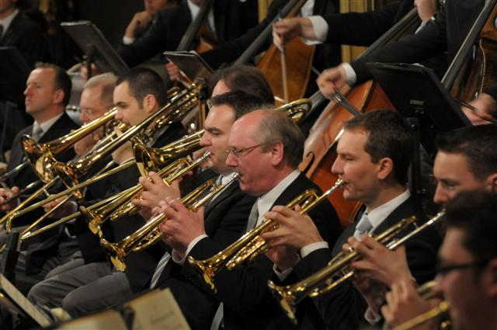
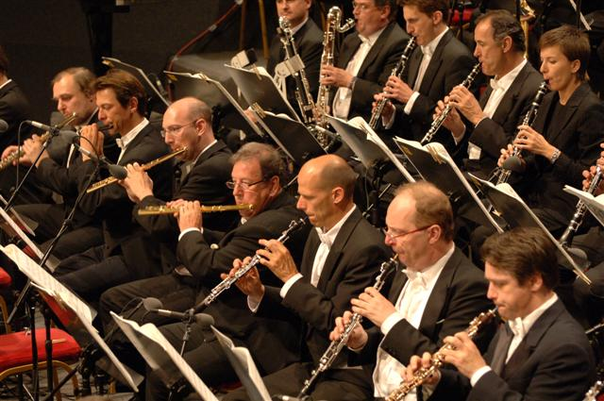
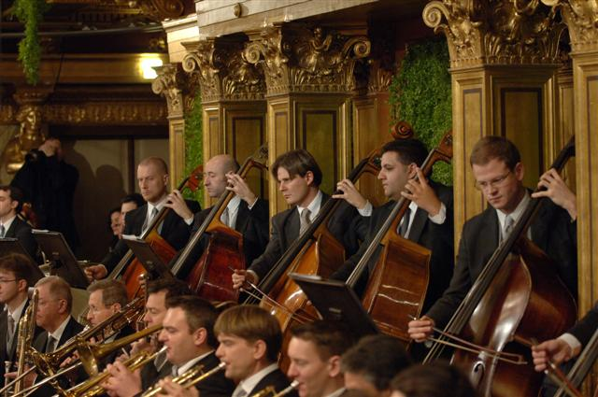

Slide 19
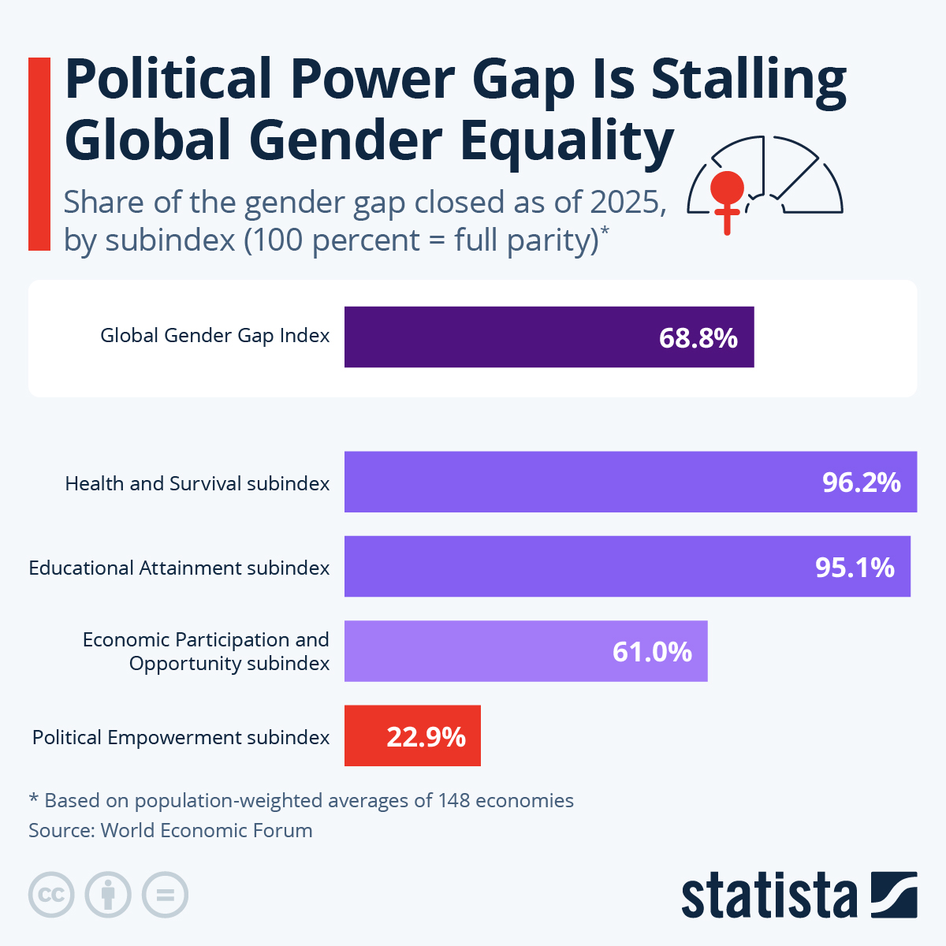

Slide 20
Global gender gap 2025
The global gender gap score in 2025 for 148 economies stands at 68.8%
Looking at the constant set of 145 economies included also in 2024, the global gender gap closed by +0.3 percentage points in 2025, from 68.4% in 2024 to 68.8% in 2025. When considering 100 economies covered continuously since the 2006 edition, the gap has narrowed by 0.4 percentage points, from 68.6% in 2024 to 69.0% in 2025.
It will take 123 years to reach full parity globally.

Slide 21
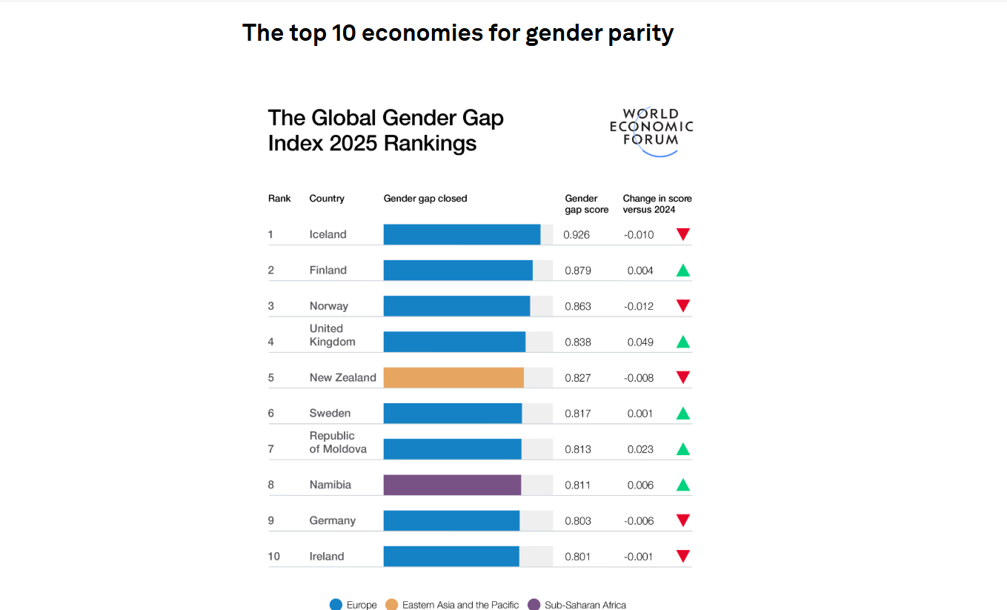

Slide 22
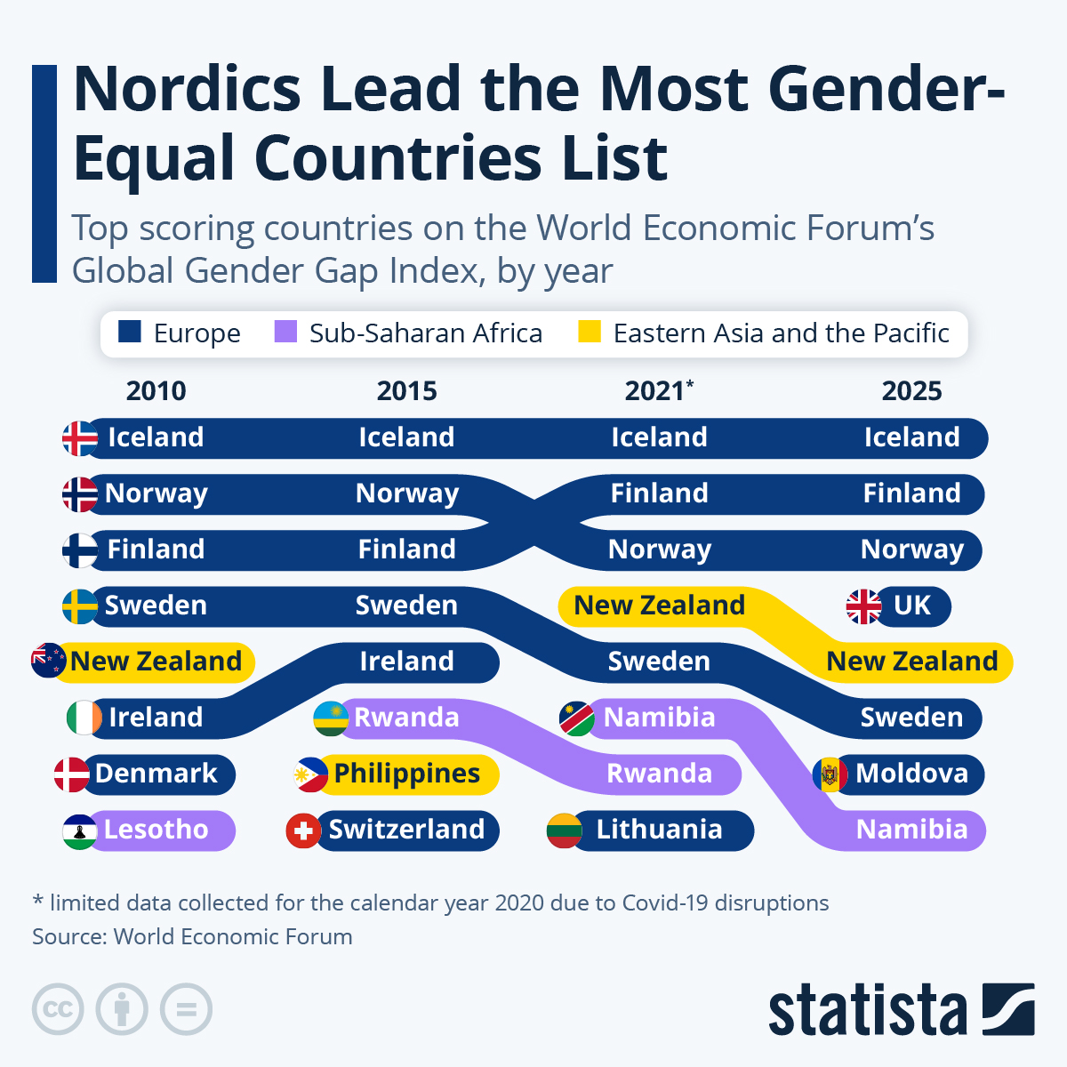

Slide 23
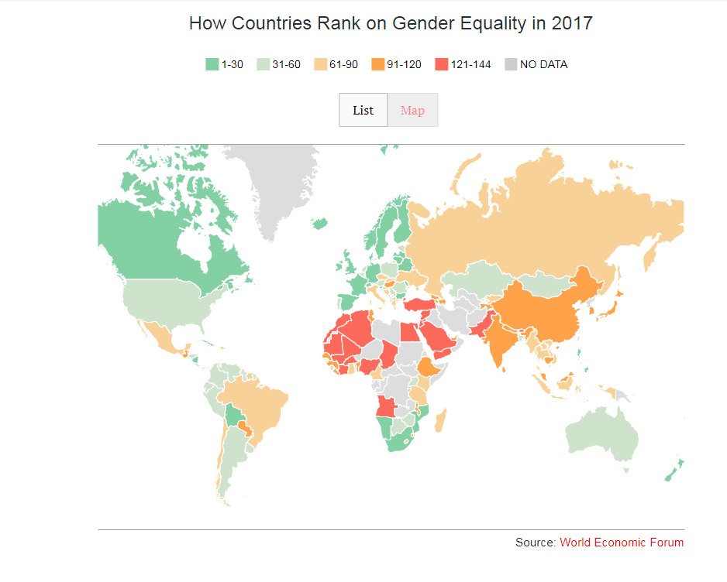

Slide 24
The Glass ceiling index
The Economist’s glass-ceiling index which measures where women have the best chance of equal treatment at work, shows that following decades of improvement, the progress for women in the workplace has stalled in recent years.
The index ranks 29 members of the OECD, a group of mostly wealthy countries, based on ten indicators, from labor-force participation and salaries to paid parental leave and political representation.

Slide 25
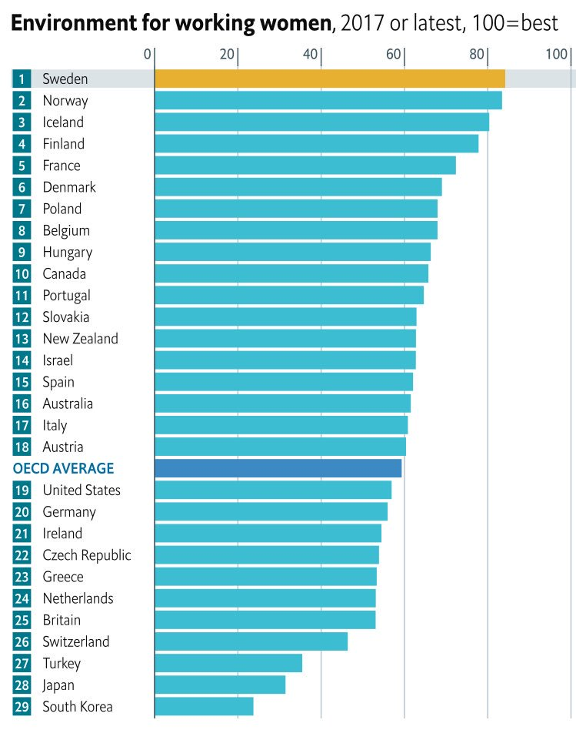
The glass ceiling index

Slide 26
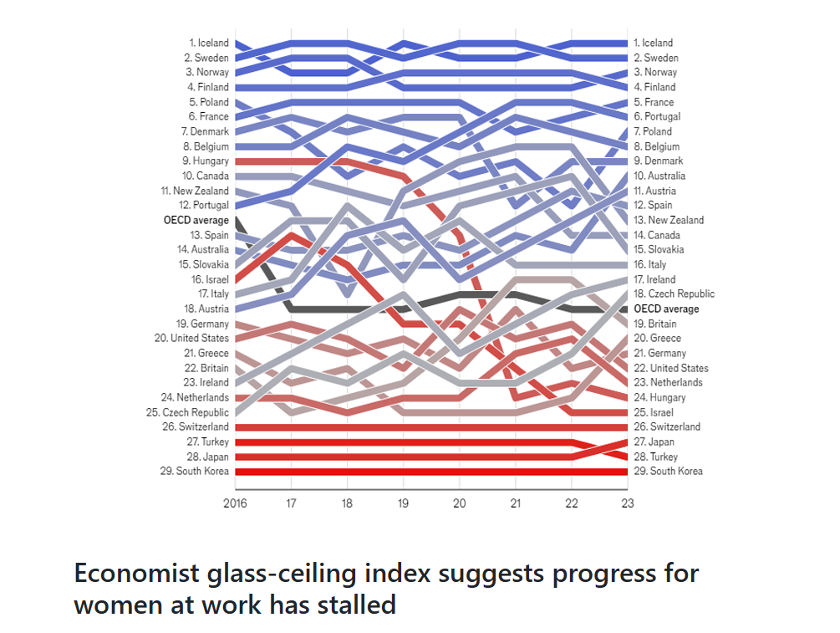

Slide 27
Beware of rankings
The results depend on the parameters used

Slide 28
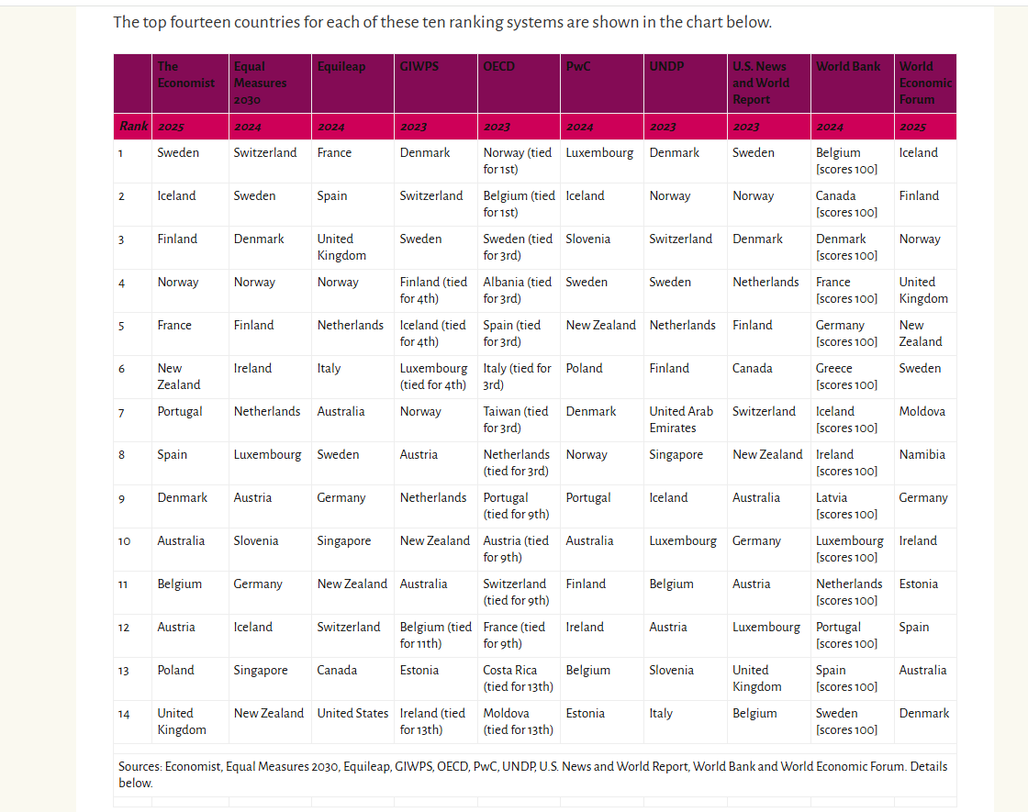

Slide 29
Still far from a fair proportion

Slide 30
Possible actions ?
Anonimous CVs-proposals
→Orchestrating Impartiality: The Impact of "Blind" Auditions on Female Musicians
Women within the selection committees
Avoid the nefarious «old boys network»
Pay attention

Slide 31
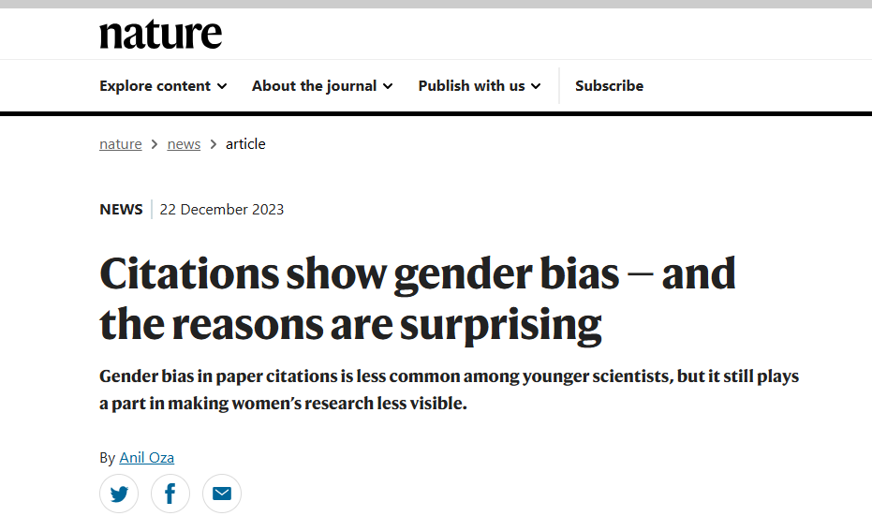
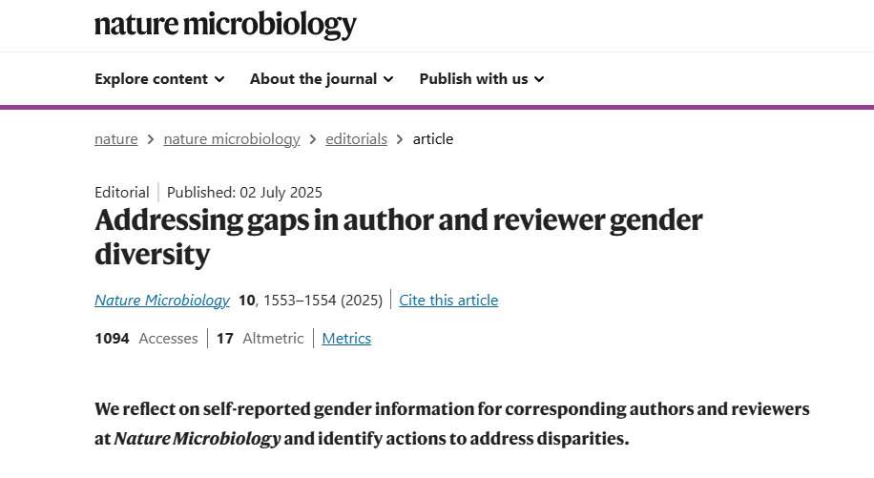

Slide 32
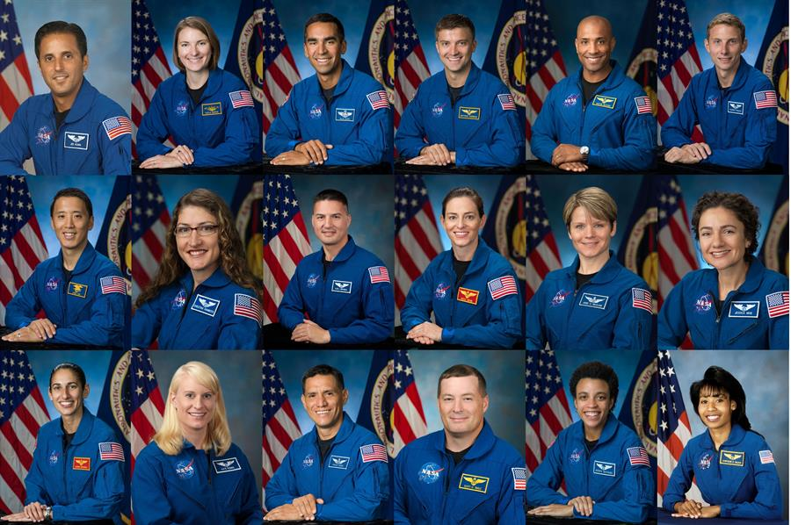
Dicembre 2020: Artemis Team

