Slide 1
Task 9.5: Improvement of mechanical and superconducting properties of RF resonator by laser radiation.
Arturs Medvids
Laboratory of Semiconductor Physics, Institute of Technical Physics, Faculty of Materials Science and Applied Chemistry, Riga Technical University, P. Valdena 3/7, Riga, LV-1048, Latvia
1.03.2023.

Slide 2
Task 9.5: Improvement of mechanical and superconducting properties of RF resonator by laser radiation.
Partners:
1.Riga Technical University(RTU),Dr.A.Medvids;
2.United Kingdom Research and Innovation (UKRI),Dr.R.Valizadeh;
3.Institute of Electrical Enginering (IEE),Dr.E.Seiler;
4.Helmholz-Zentrum Berlin (HZB),Dr.O.Kugeler;
5.Instituto Nazionale di Fisica Nucleare(INFN), Dr.C.Pira.

Slide 3
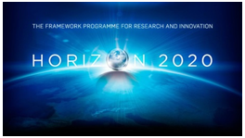

Accelerator Research and Innovation for European Science and Society (ARIES), coordinated by CERN
PROGRAMME: Horizon 2020 (Integrating Activity)
DURATION: May 2017- April 2021 (4 years)
TOTAL BUDGET: €24.8M
CONSORTIUM: 41 participants from 18 countries
WEBSITE: aries.cern.web.ch
PROJECT COORDINATOR: Maurizio Vretenar (CERN)

Slide 4
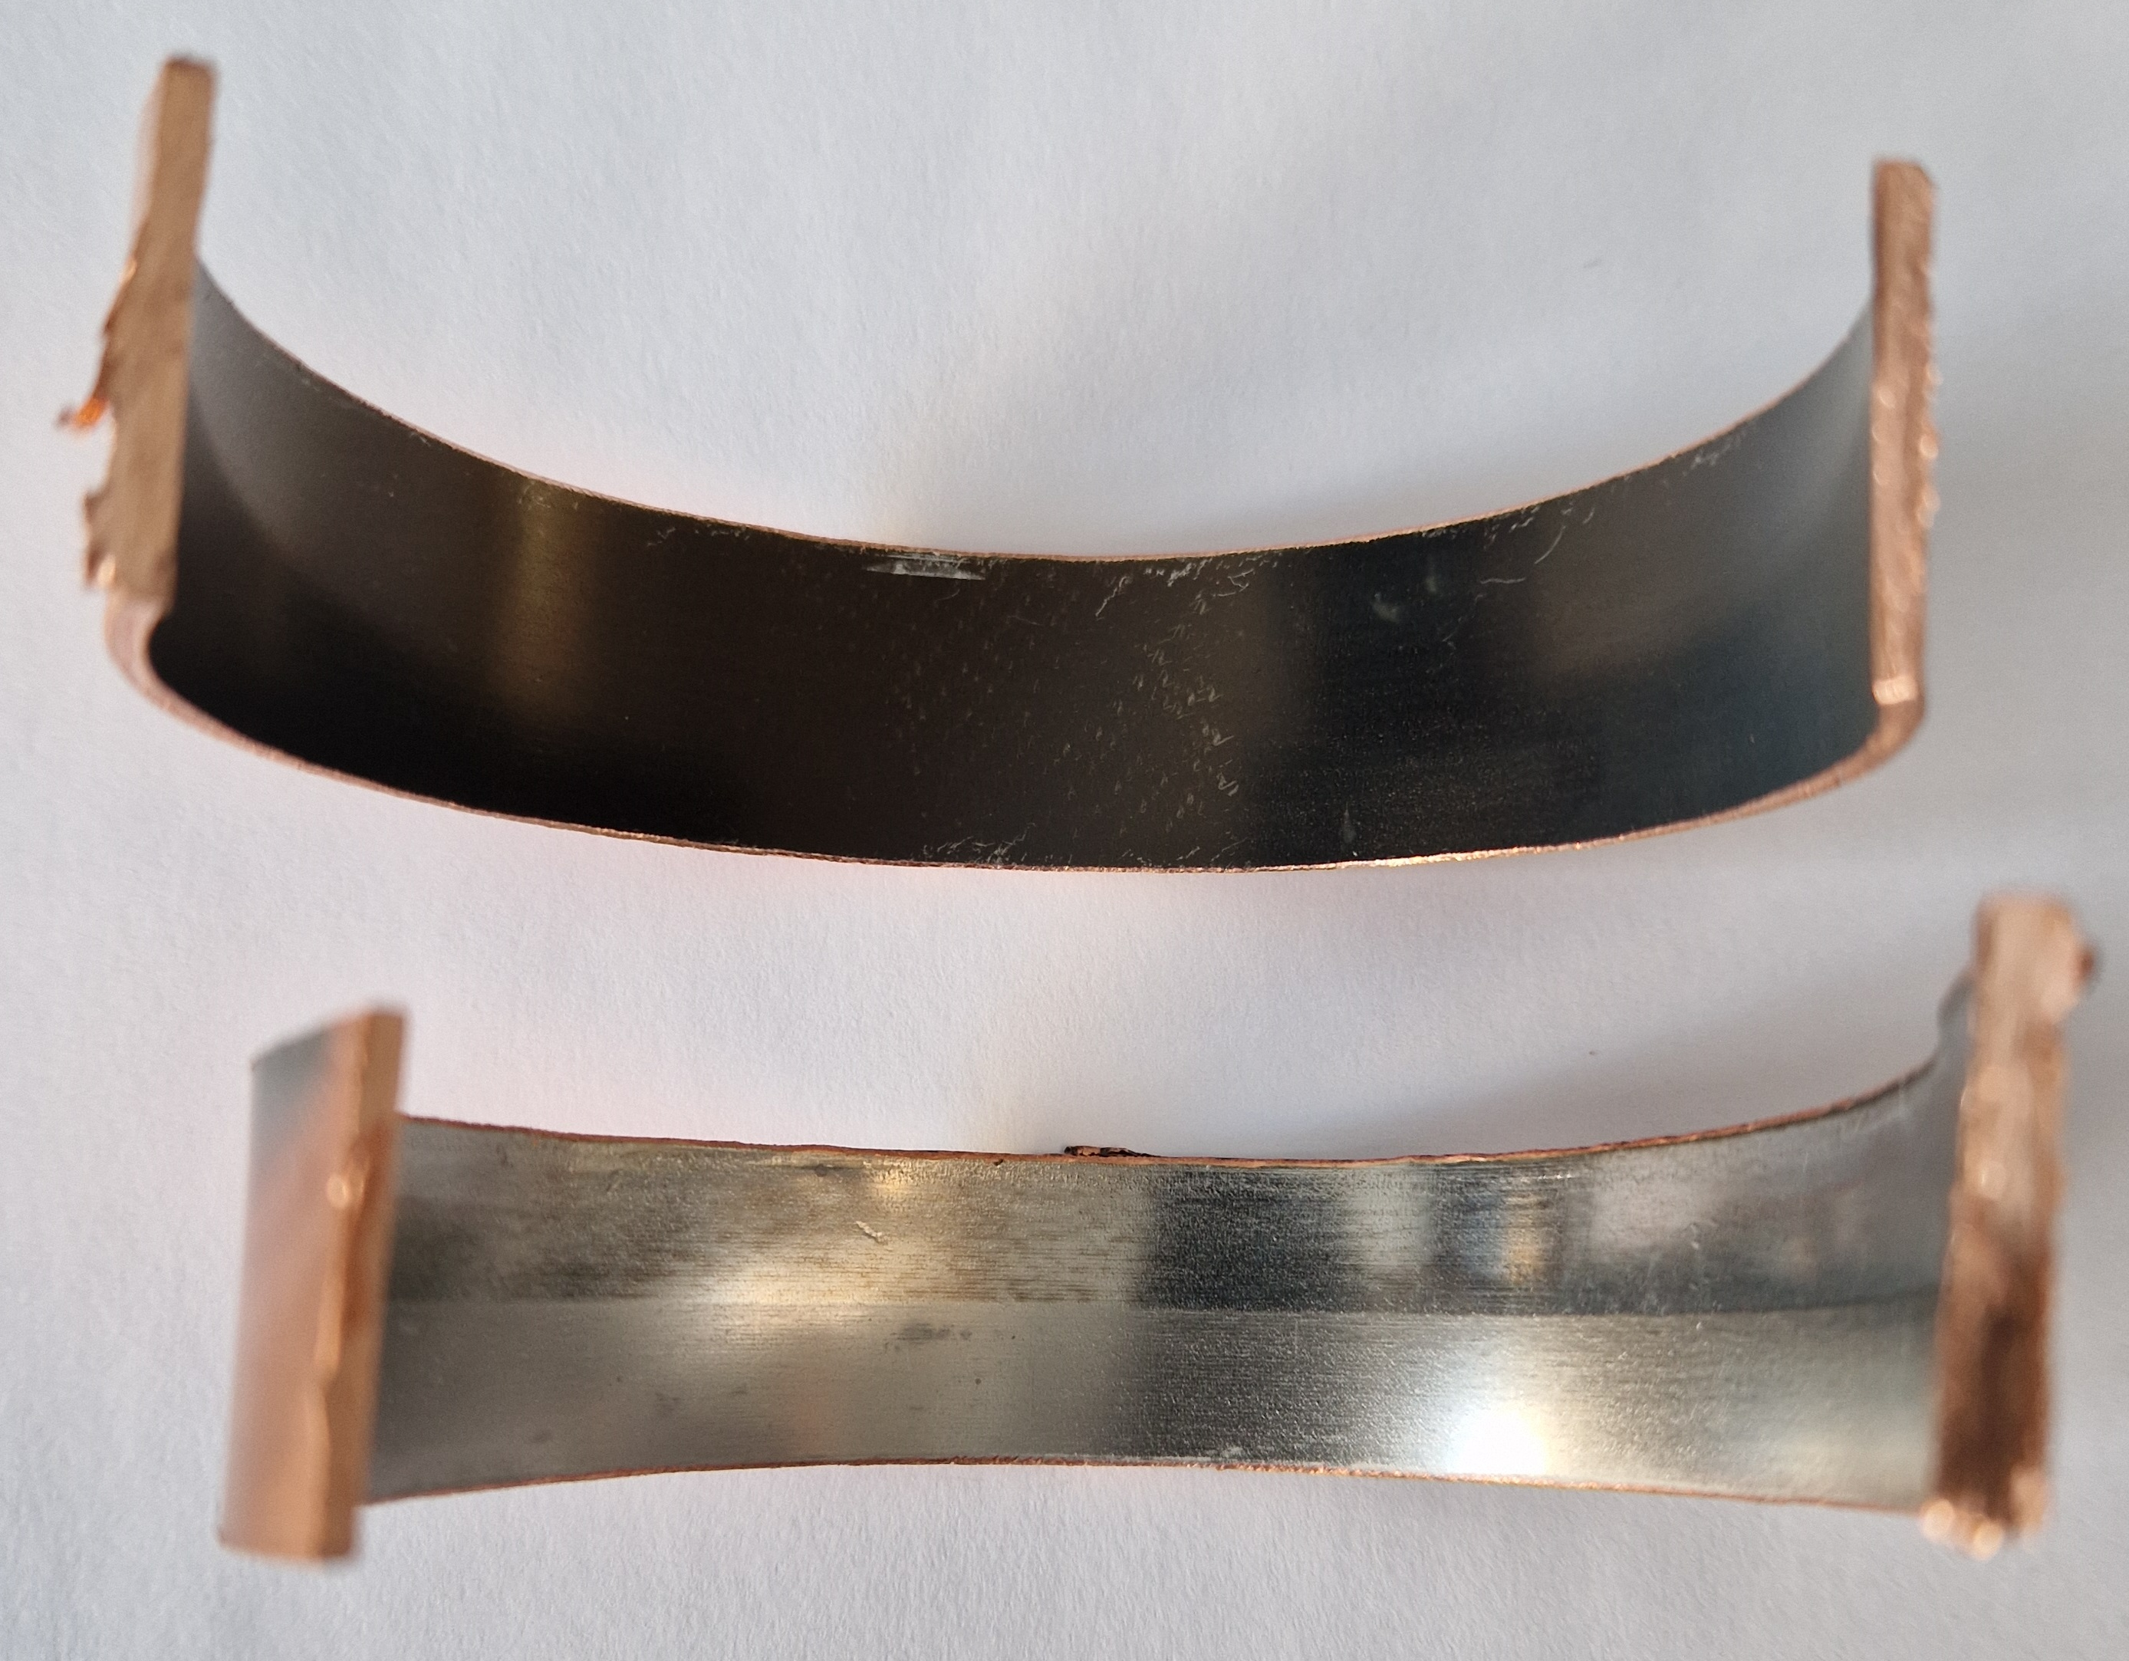
Irradiated sample

Slide 5
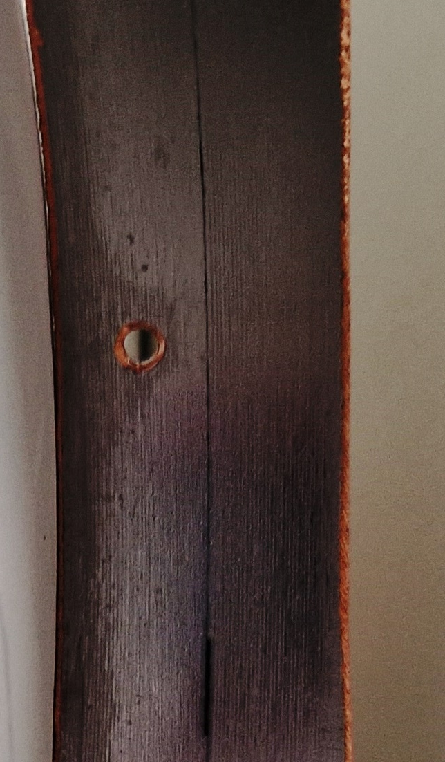

Slide 6
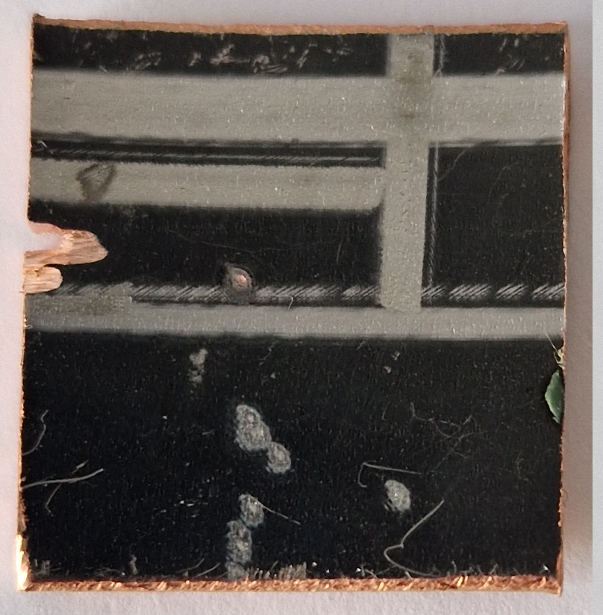
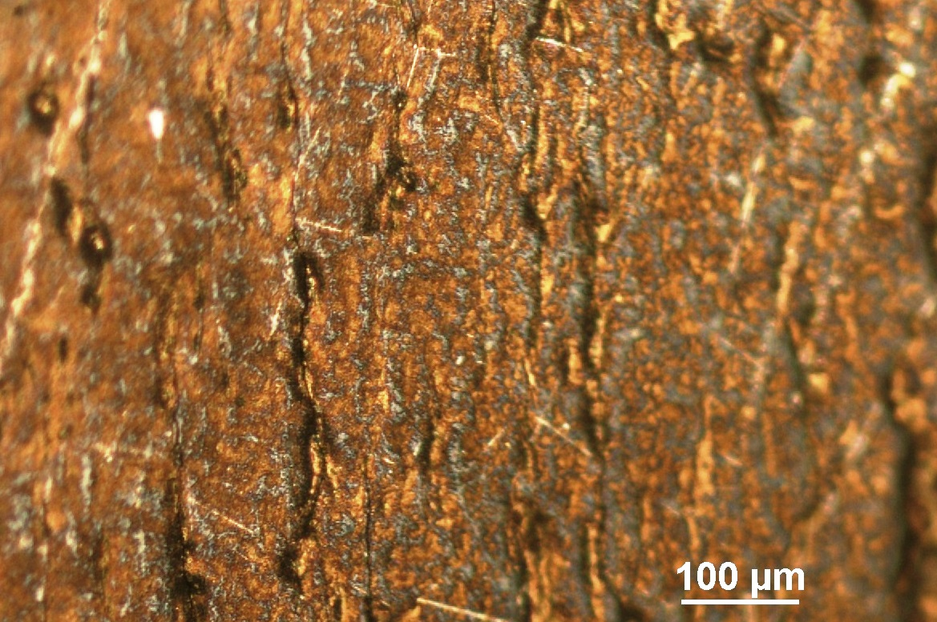
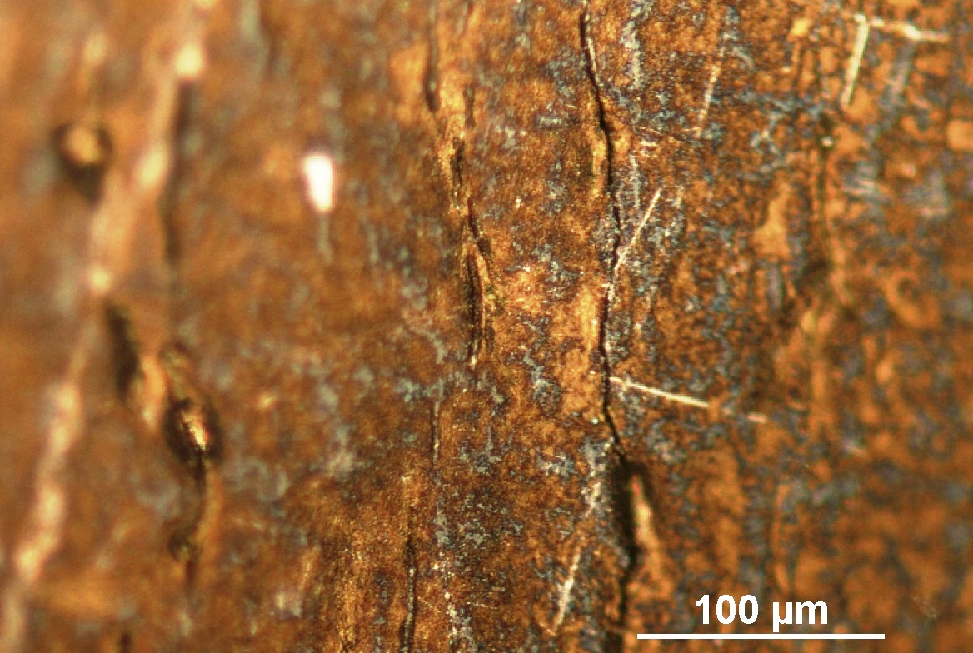
Cracks
2cm x 2cm
Cracks

Slide 7
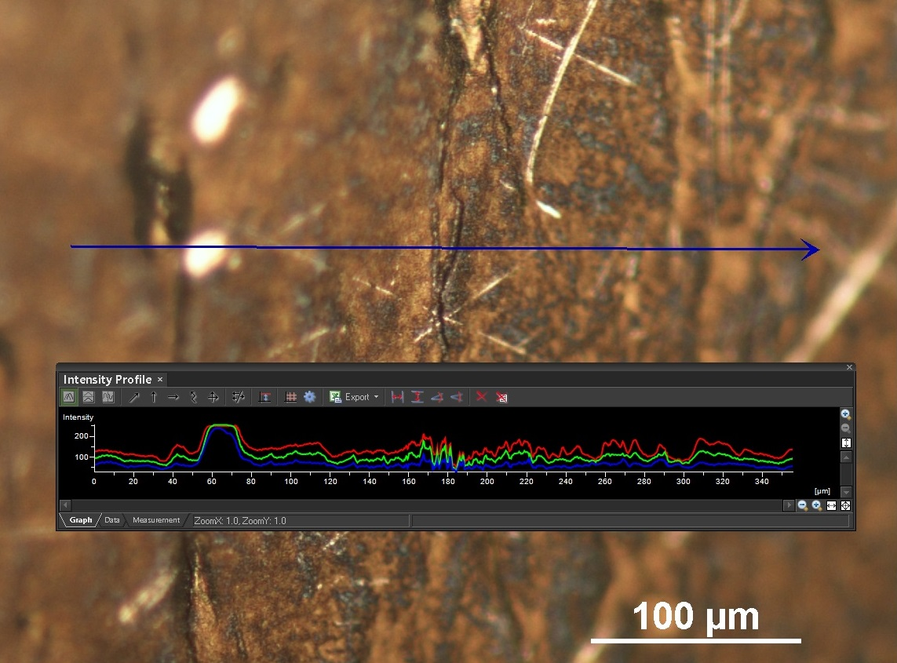
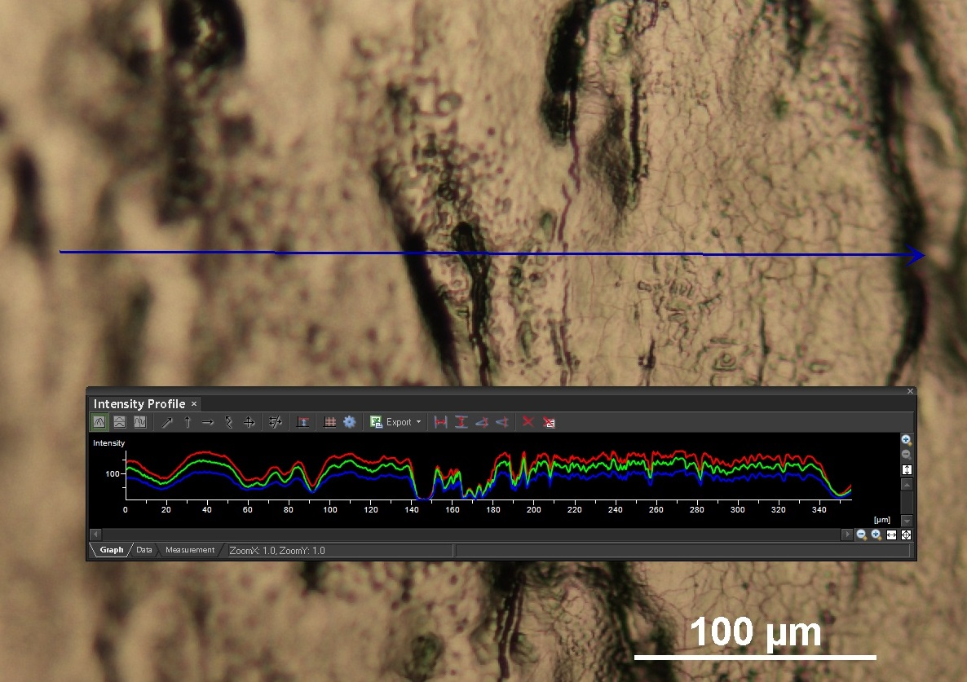

Slide 8
Thank you very much for your attention!

