Slide 1
Update on RP optics & MQSXW options
S. Fartoukh
Recap
“Q4off configuration” as baseline for RP optics
MQSXW option on the nIP side of D1
Aperture
Next step(s)

Slide 2
Recap (.. a very short summary of all the attempts made so far)
A multitude of configurations are possible (on paper), with 2 main categories
Polarity inversion till quad. Q_{n}, nominal polarity recovered as of Q _{n+1}
Tried out for n=3 (i.e. IT polarity inversion .and. Q3 & Q4 with same polarity)
Works for the injection and collision optics, but not for the phases
See PowerPoint Presentation (cern.ch) for more details
b) Polarity inversion till quad. Q_{n}, Q_{n+1} switched off, nominal polarity as of Q _{n+2}
Tried out for n=3, n=4 & n=5
Works for the injection and collision optics .and. the phases
The cases n=3 (Q4off) and n=4 (Q5off) shows a good aperture at injection but tricky collision optics
The case n=6 (Q6 off) shows a very flexible collision optics but tight Q5 aperture at injection:
0.5-1 sigma missing w.r.t. to target (after compromise and optimization) , unless Q5 b.s. rotation by 90º ..
After getting the information that the Q5 polarity inversion was extremely difficult (HW-wise)
I put all my efforts on the Q4off configuration, i.e. polarity inversion of the IT only,
and I am slowly converging towards a complete solution

Slide 3
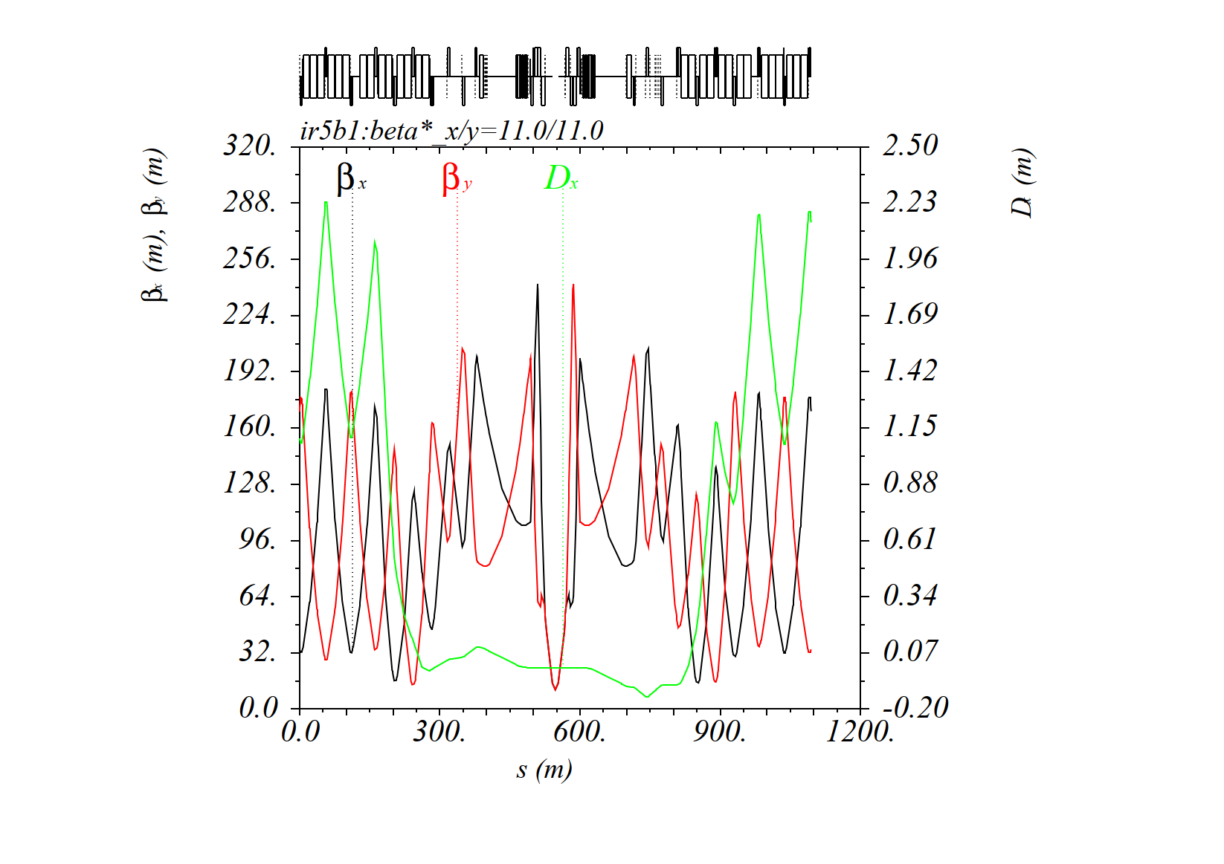
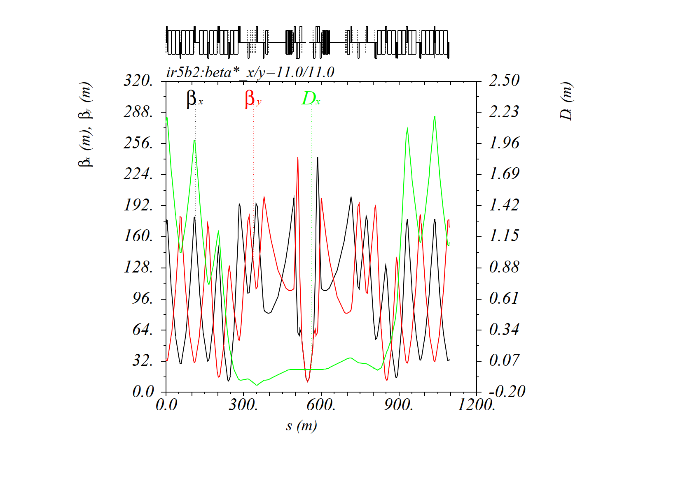
The Q4off configuration
Nominal injection optics: FDF for the IT on the outgoing beam side
Q4 is ON
Beam1
Beam2

Slide 4
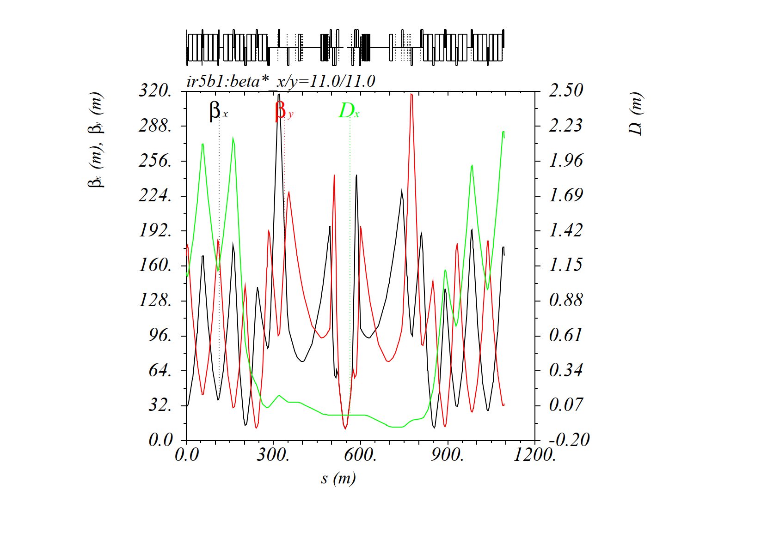
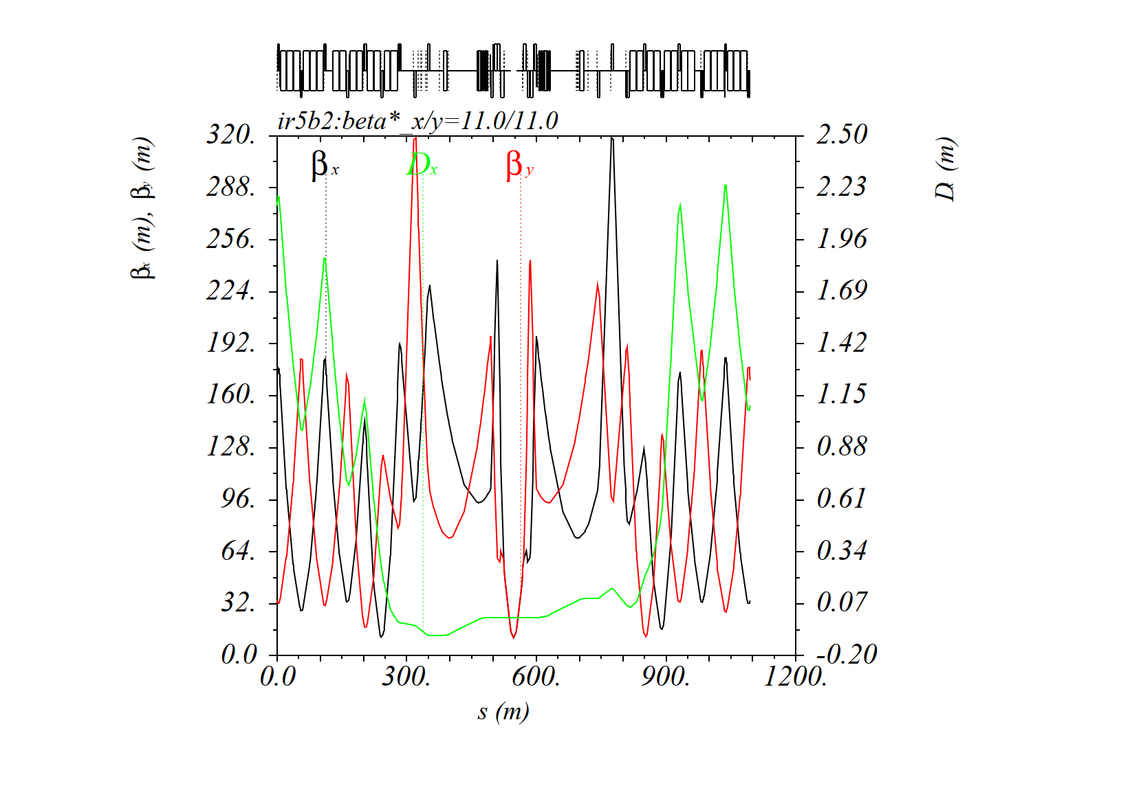
The Q4off configuration
RP injection optics (11 m): DFD for the IT on the outgoing beam side
Q4 is OFF
Beam1
Beam2
Sensibly larger beta-function at Q5 & Q6 but in the right plane of the b.s.!
→ Aperture is expected to be reduced but OK (see later)

Slide 5
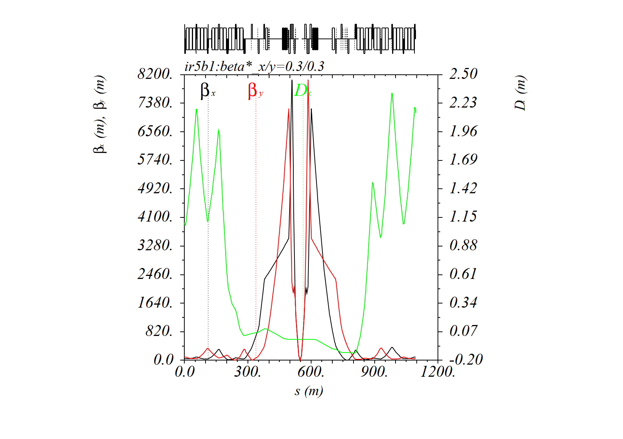
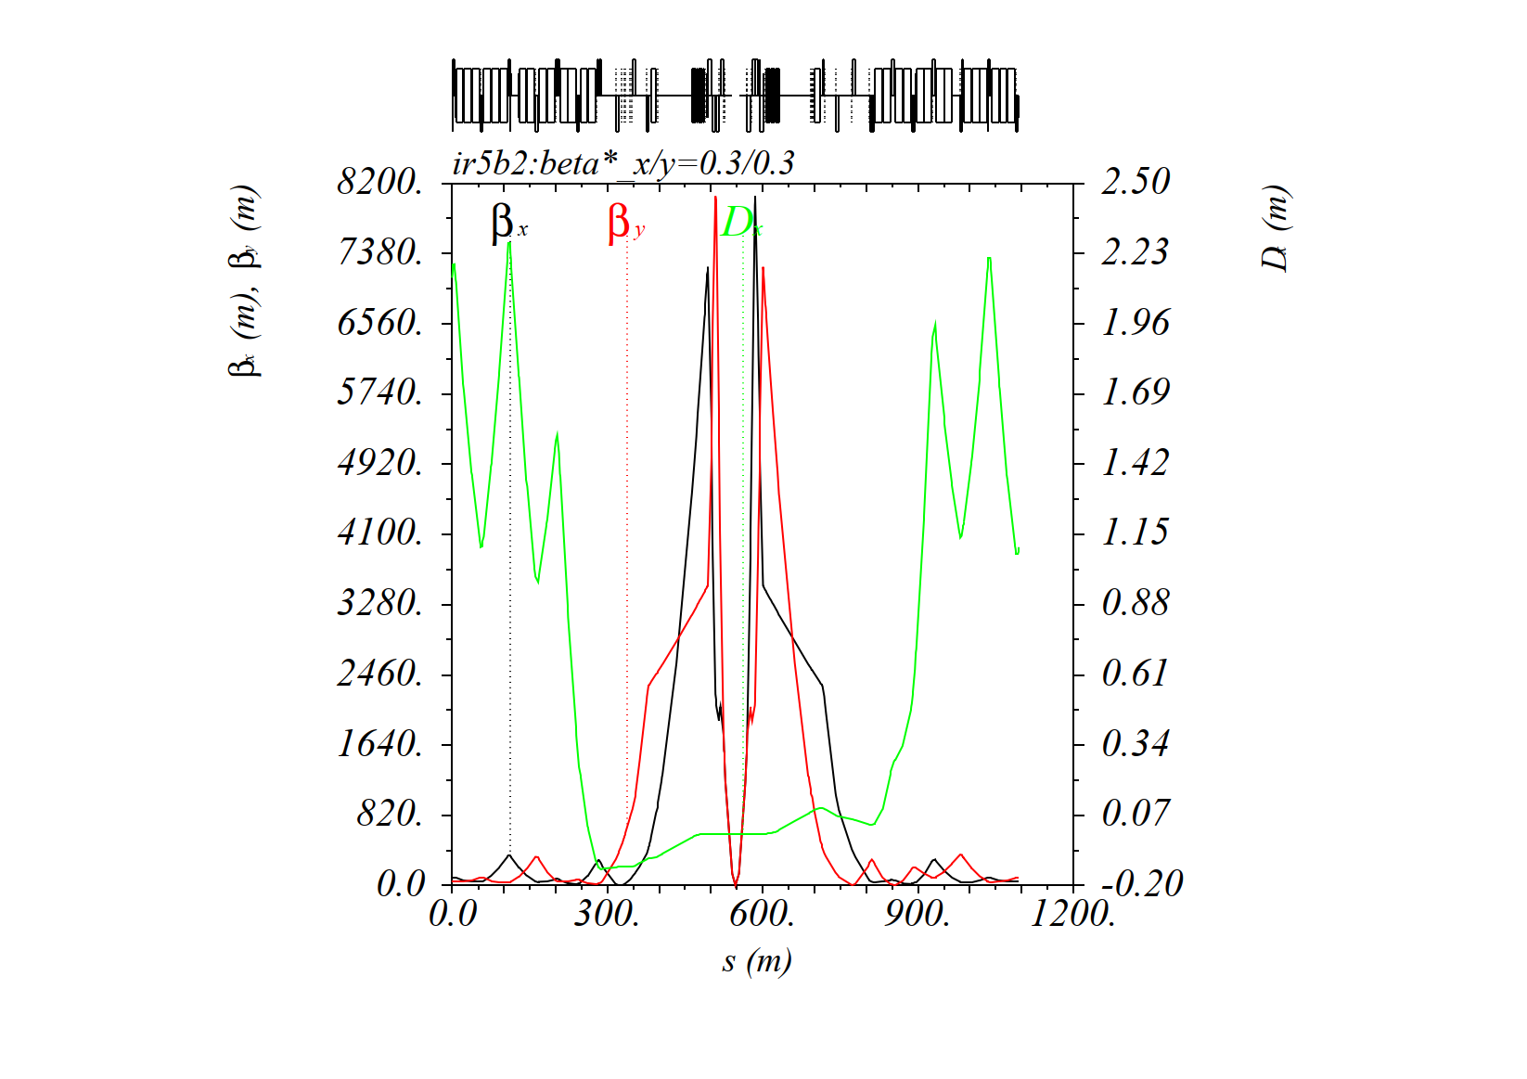
The Q4off configuration
Nominal 30 cm optics: 60 cm pre-squeeze with a tele-index of 2
Beam1
Beam2
IT gradient [T/m] @ 6.8 TeV [201.57 T/m HWC’d in 2023 vs. 210.00 T/m in 2022]
Q1 | 197.70
Q2 | 198.82
Q3 | 199.10

Slide 6
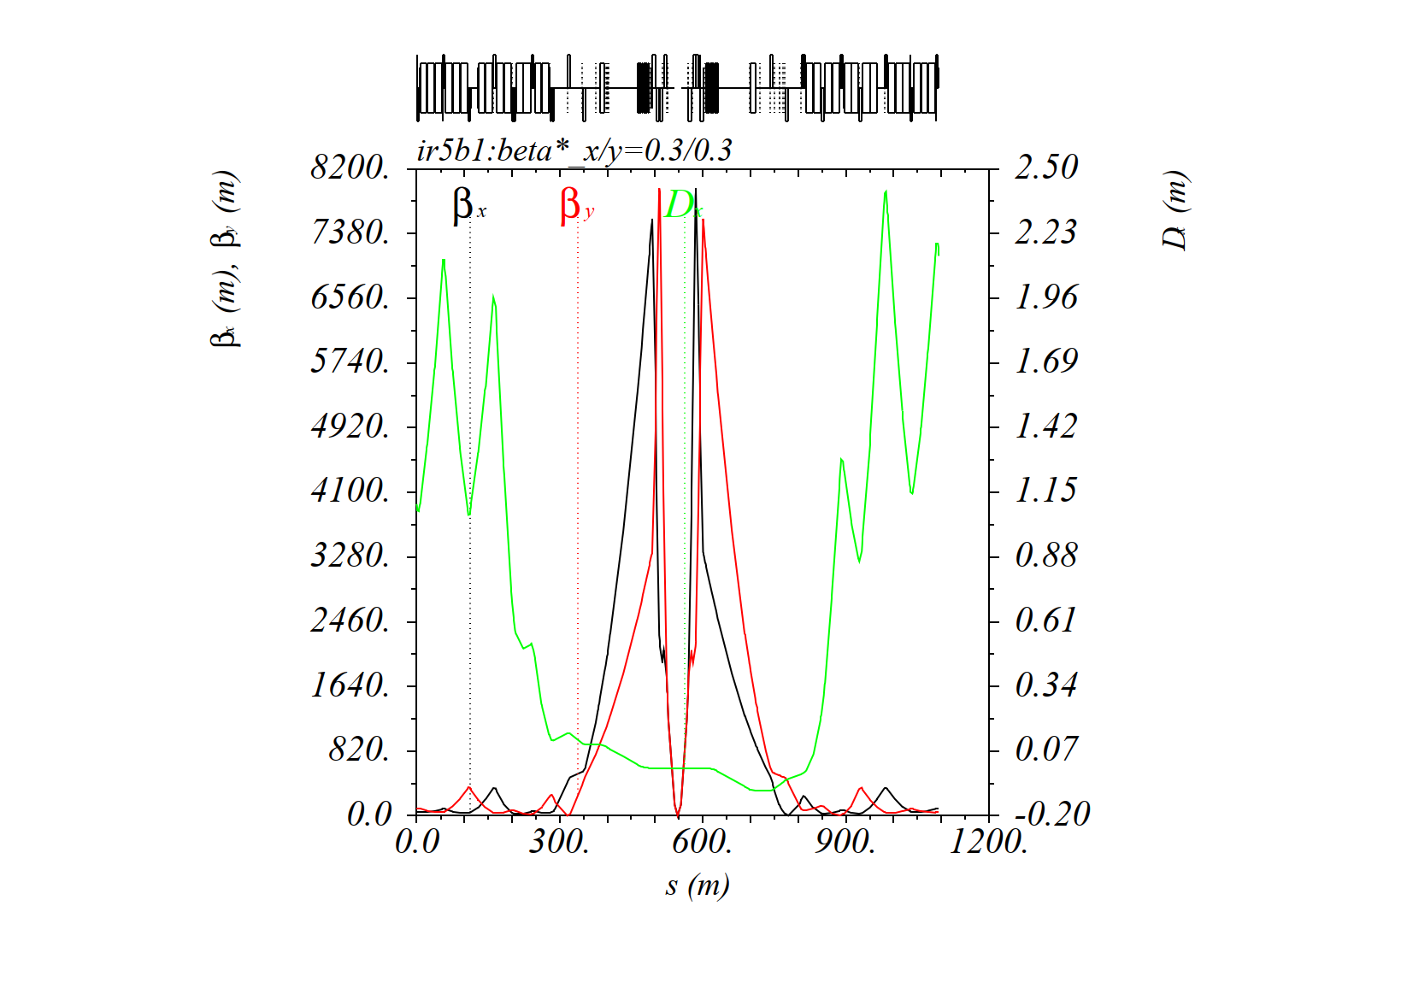

The Q4off configuration
RP 30 cm optics: RP 60 cm optics combined with nominal telescope
Beam1
Beam2
IT gradient [T/m] @ 6.8 TeV [201.57 T/m HWC’d in 2023 vs. 210.00 T/m in 2022]
Q1 | 194.66 ↓
Q2 | 199.49 ↑
Q3 | 194.66 ↓
Still very good gradient in Q5/Q6
(faster squeeze expected)

Slide 7
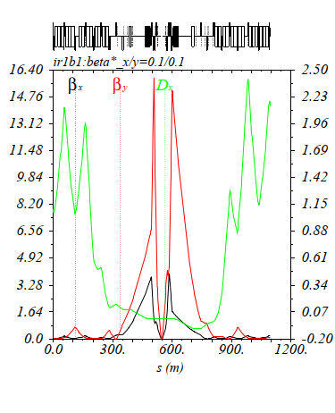
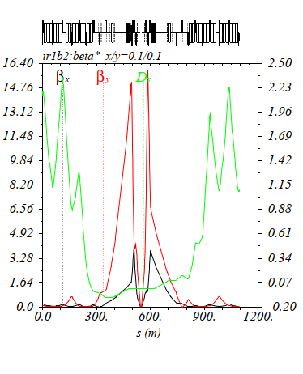
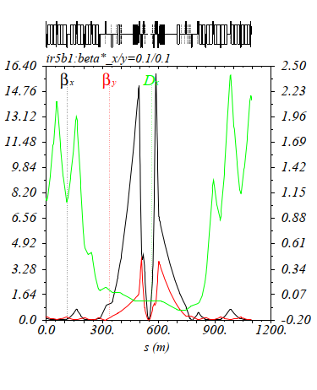
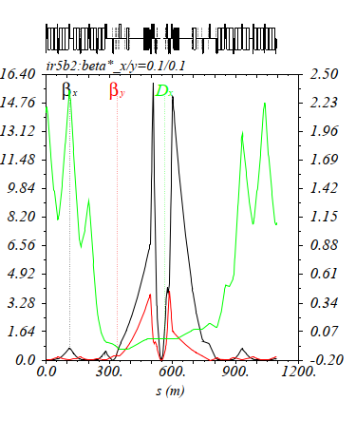
The Q4off configuration
RP flat optics 15-60 cm: RP 60 cm optics combined with 1441 telescope
→ To maximize the peak lumi reach with H/V crossing in ATLAS/CMS
IR1: β*(H/V)=60/15cm
IR5: β*(H/V)=15/60cm
Beam1
Beam2
Beam1
Beam2

Slide 8
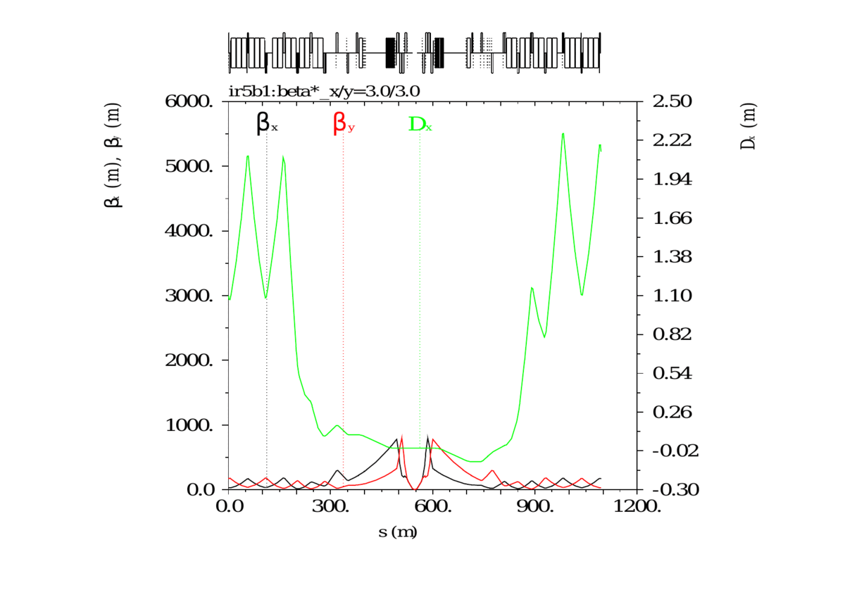
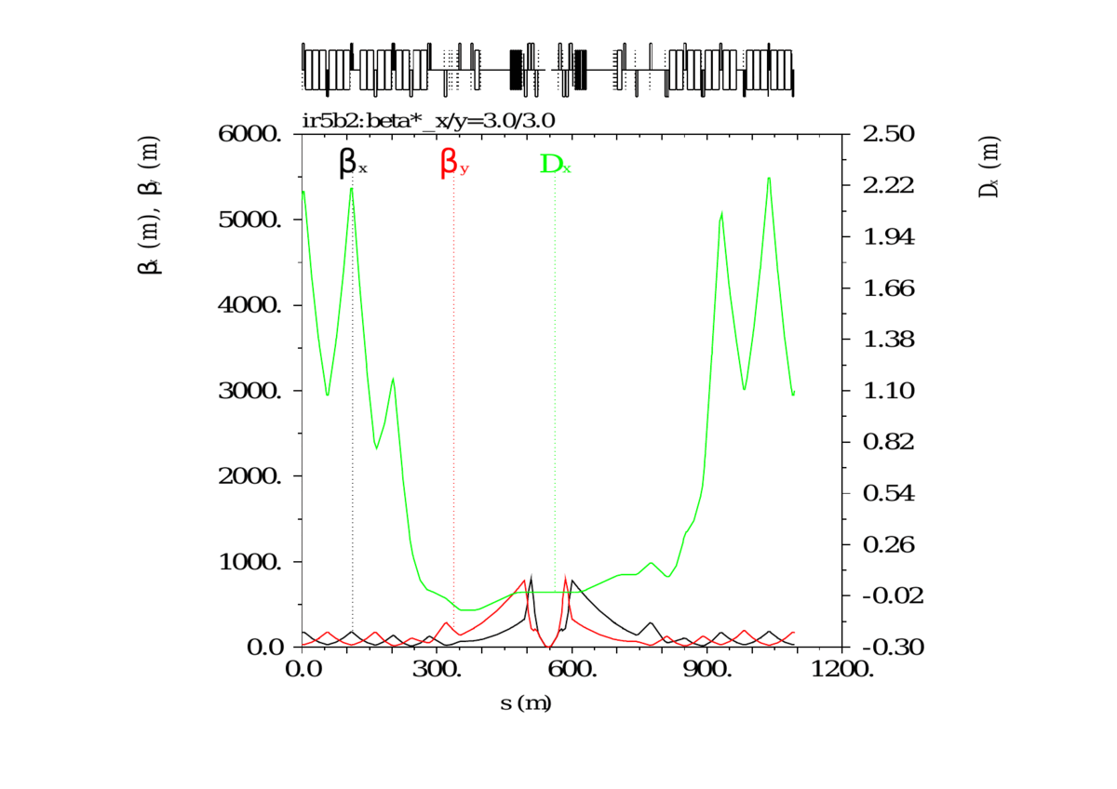
The Q4off configuration
Optics transitions (pre-squeeze only, because the nominal telescope can be recycled below a certain β*)
The nominal ATS phases (mandatory for the deployment of the nominal telescope) can be reached as of β∗= 3 m (improved w.r.t. the nom. optics where the β*=2 m needs to be reached before the telesc.)
The optics transition from 11 m (injection) down to 3 m remains to be done, but the most difficult
3 m - 60 cm segment is basically done, even extended down to 40 cm (to cover the ion optics case)
Beam1
Beam2

Slide 9
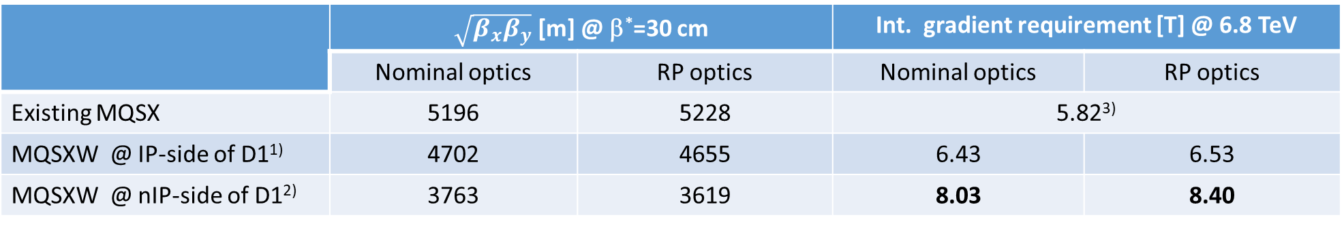
MQSXW option: strength requirement
Integrating the MQSXW on the IP side of D1 seems tricky → See Paolo @ the previous meeting
.. Unless moving the first MBXWA module on the nIP side of D1 for radiation related reasons (Paolo’s idea), and therefore liberating enough room for the MQSXW on the IP side of D1.
This configuration would increase the D1/2 strength by 5.22%, which is OK for the magnets (for 6.8 TeV: 1.255 T→1.320 T in D1 – 2.71 T → 2.85 T in D2), OK for the RD1 circuit, but TBC for the RD2 PC (4.6 KA needed v.s. 4.4 KA for the present nominal current of the D2s in IR1/5 @ 7 TeV)
In the next slides, we will focus on the nIP-side-of-D1 option for aperture, but both options are presented below for the MQSXW strength requirements
 | $\sqrt{β_{x}β_{y}}$ [m] @ β*=30 cm |  | Int. gradient requirement [T] @ 6.8 TeV
 | Nominal optics | RP optics | Nominal optics | RP optics
Existing MQSX | 5196 | 5228 | 5.82³⁾
MQSXW @ IP-side of D1¹⁾ | 4702 | 4655 | 6.43 | 6.53
MQSXW @ nIP-side of D1²⁾ | 3763 | 3619 | 8.03 | 8.40
¹⁾: In this scenario the MQSXW centre corresponds to the magnetic center of the existing MBXWA module (which is shifted on the niP side of D1
²⁾: In this scenario the MQSXW centre is located 2.7 m upstream the magnetic center of the existing MBXWF module (3.4 m long)
³⁾: for the present worst case (k.mqsx.=1.15e-3 for MQSX.3L1), and assuming that the source of errors are evenly distributed along the triplet.
Running out of strength by 20% (e.g. 7.0 T vs. 8.4 T for RP optics) would however have marginal impact on performance (4% virtual lumi loss)

Slide 10
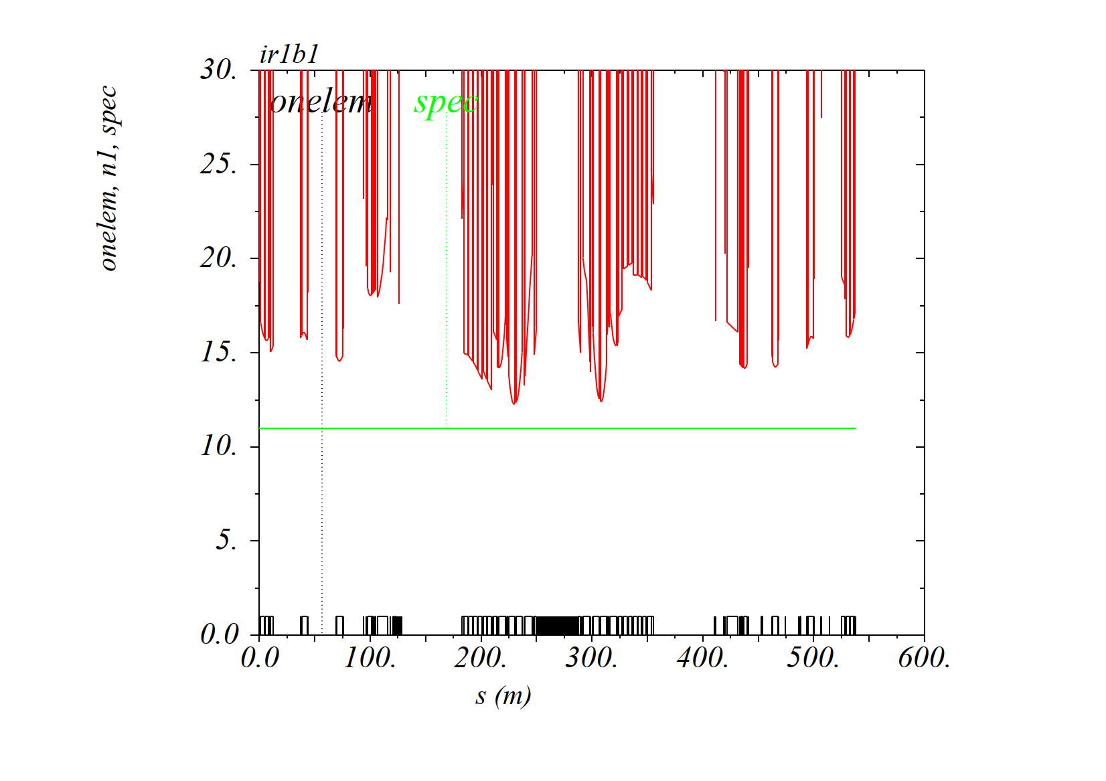
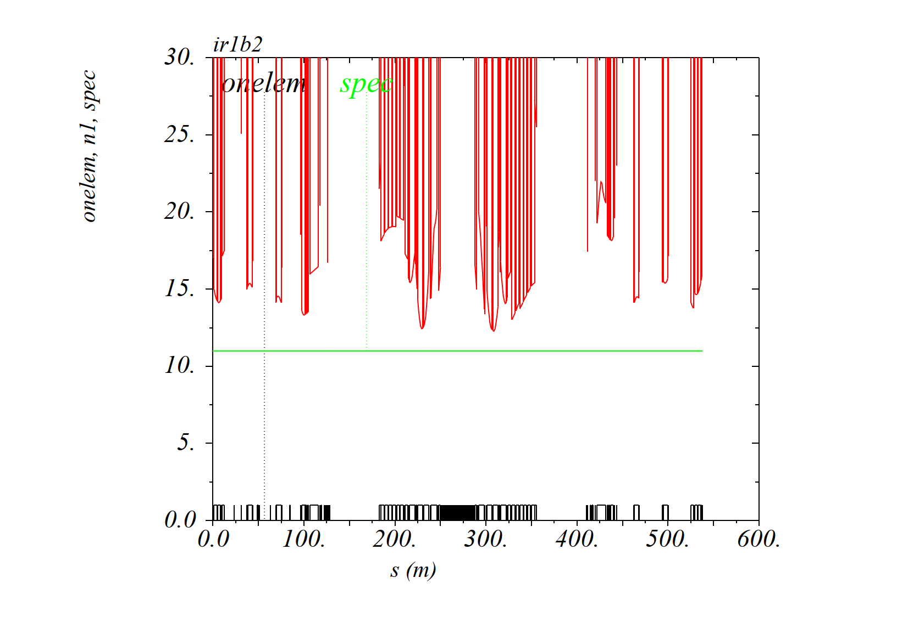
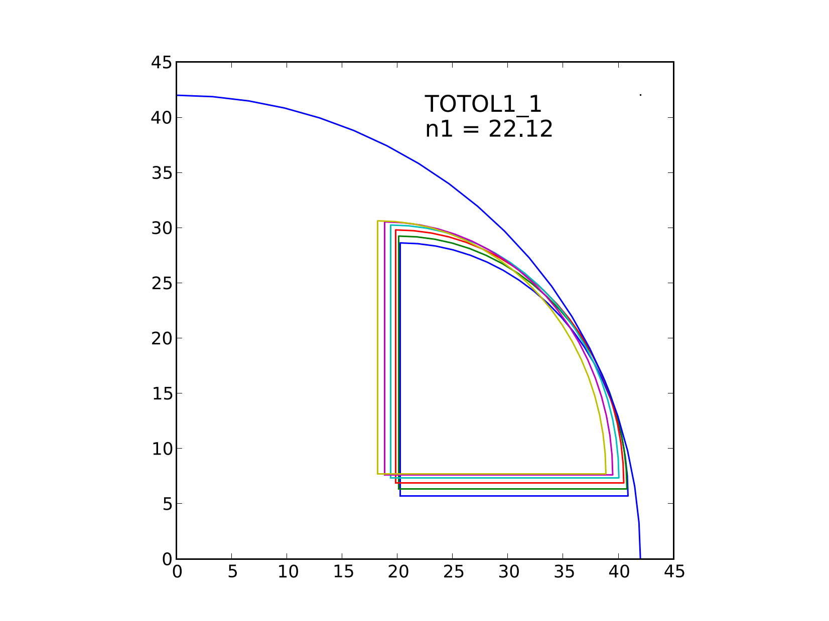
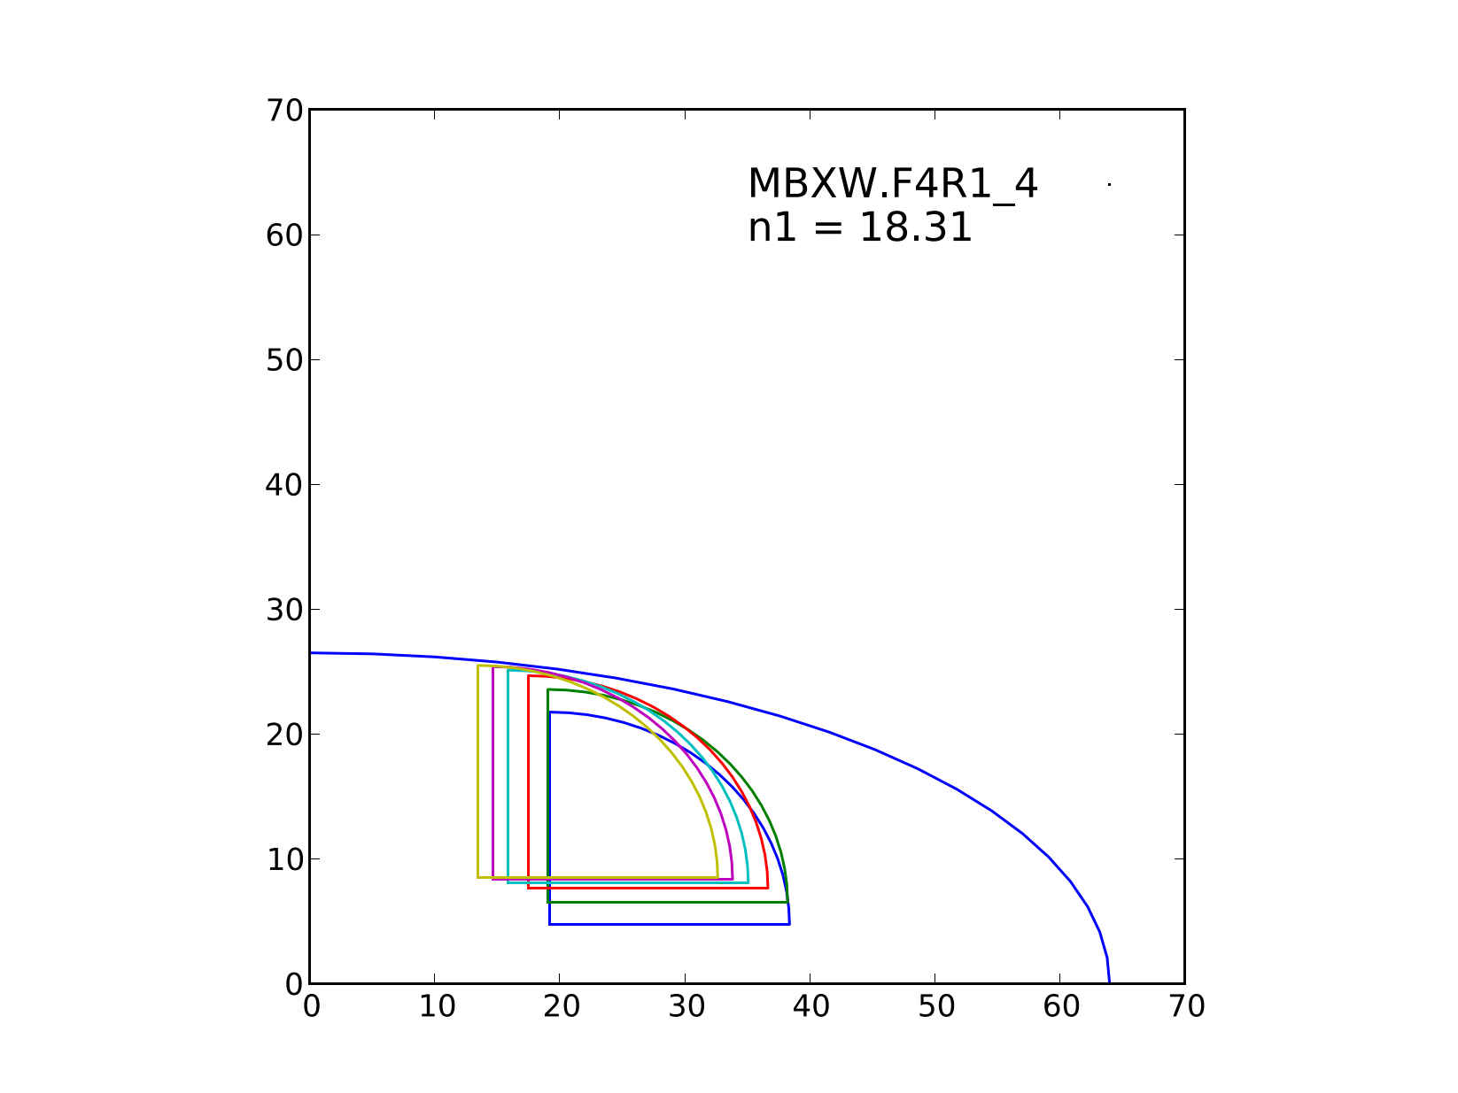
Aperture inc. MQSXW on nIP-side of D1 (42 mm rad. aperture with ALL tol.)
Nominal IR1 injection optics (β*=11 m, V crossing, θ_{X}/2=170 μrad)
Beam1
Beam2
MQSXW aperture essentially
limited by the H plane
D1 aperture essentially
limited by the V plane

Slide 11
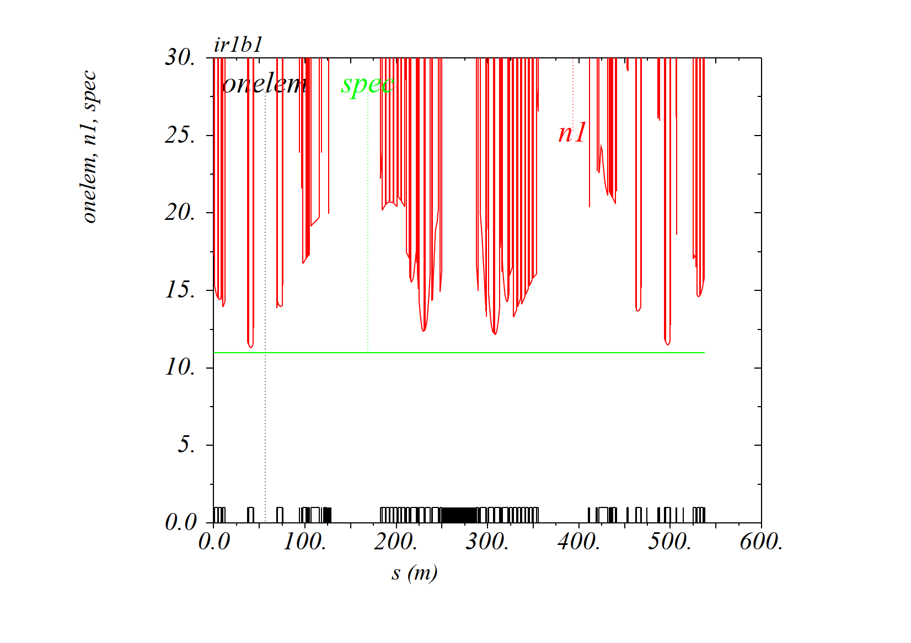
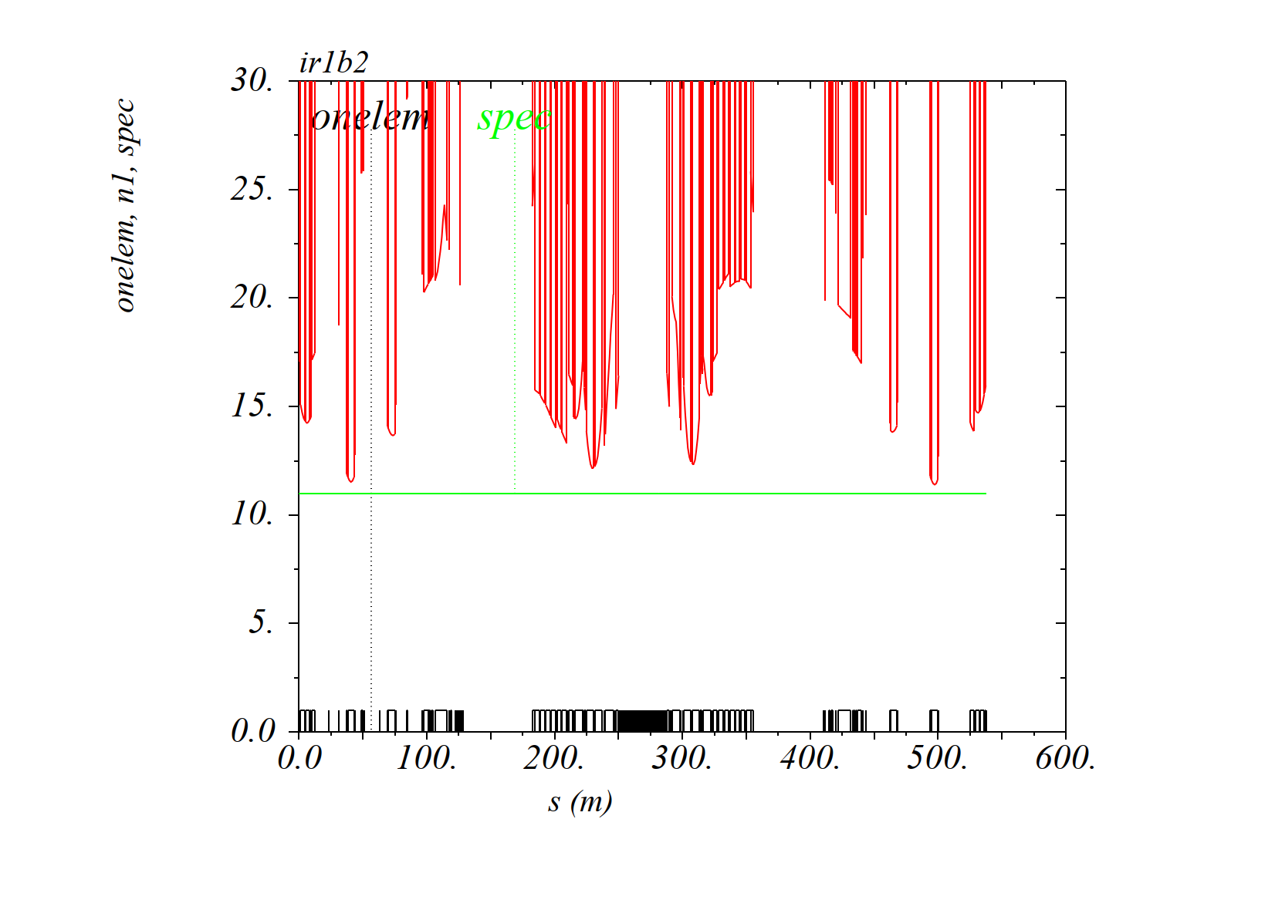
Aperture inc. MQSXW on nIP-side of D1 (42 mm rad. aperture with ALL tol.)
RP IR1 injection optics (β*=11 m, V crossing, θ_{X}/2=170 μrad)
Beam1
Beam2
MQSXW OK!
MS aperture
reduced but OK!

Slide 12
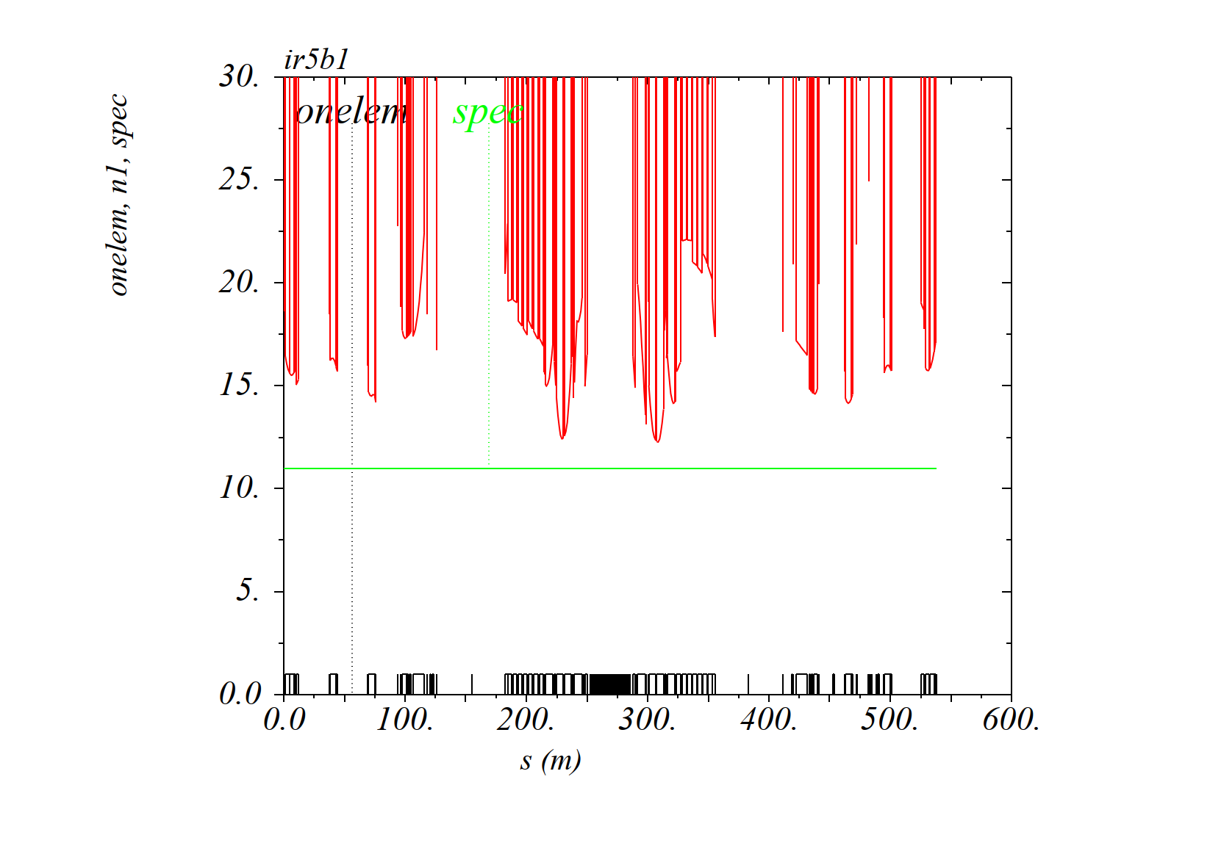
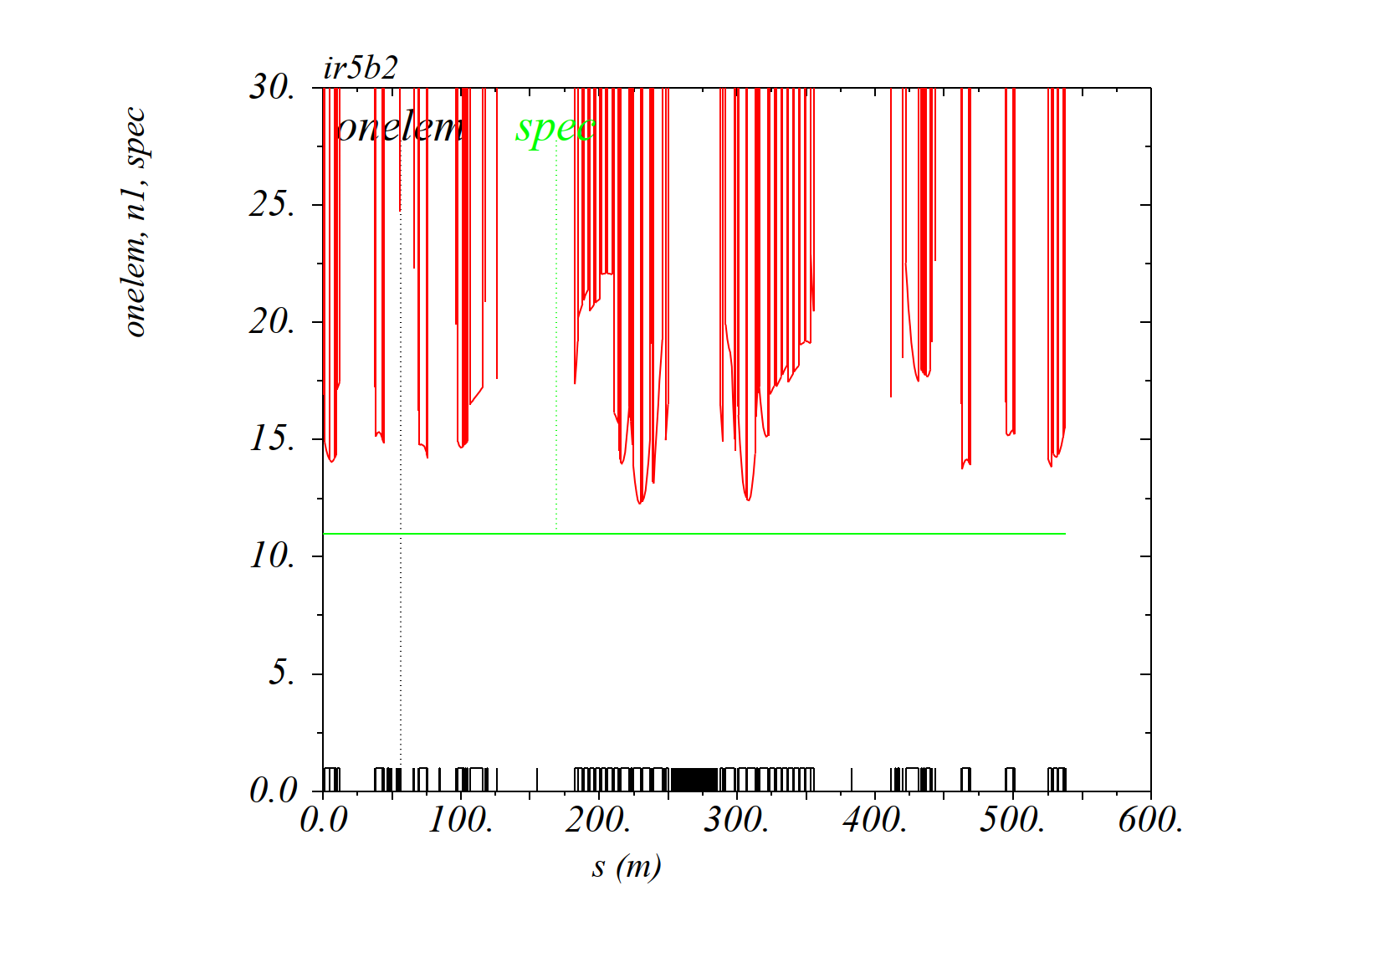
Aperture inc. MQSXW on nIP-side of D1 (42 mm rad. aperture with ALL tol.)
Nominal IR5 injection optics (β*=11 m, H crossing, θ_{X}/2=170 μrad)
Beam1
Beam2

Slide 13
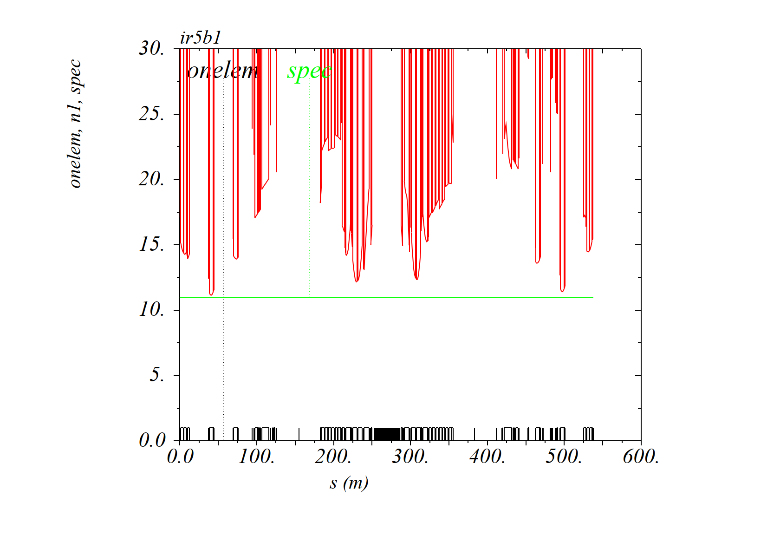
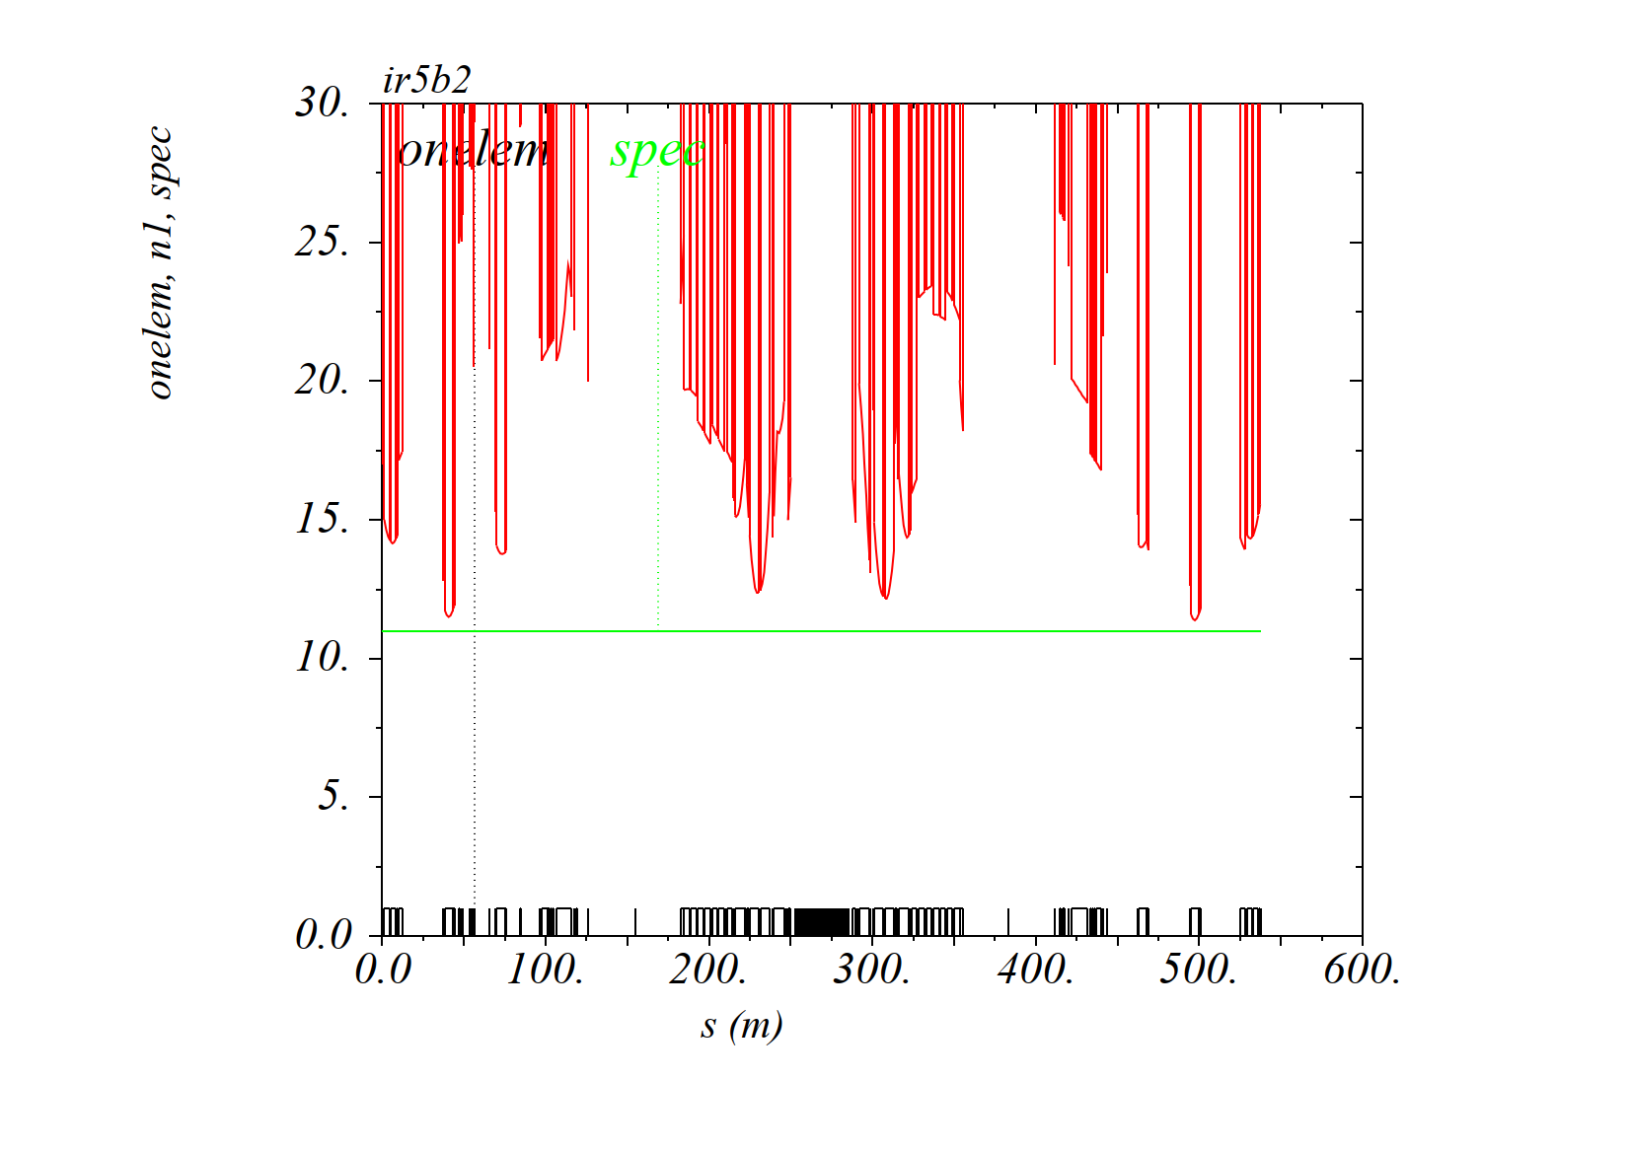
Aperture inc. MQSXW on nIP-side of D1 (42 mm rad. aperture with ALL tol.)
RP IR5 injection optics (β*=11 m, H crossing, θ_{X}/2=170 μrad)
Beam1
Beam2

Slide 14
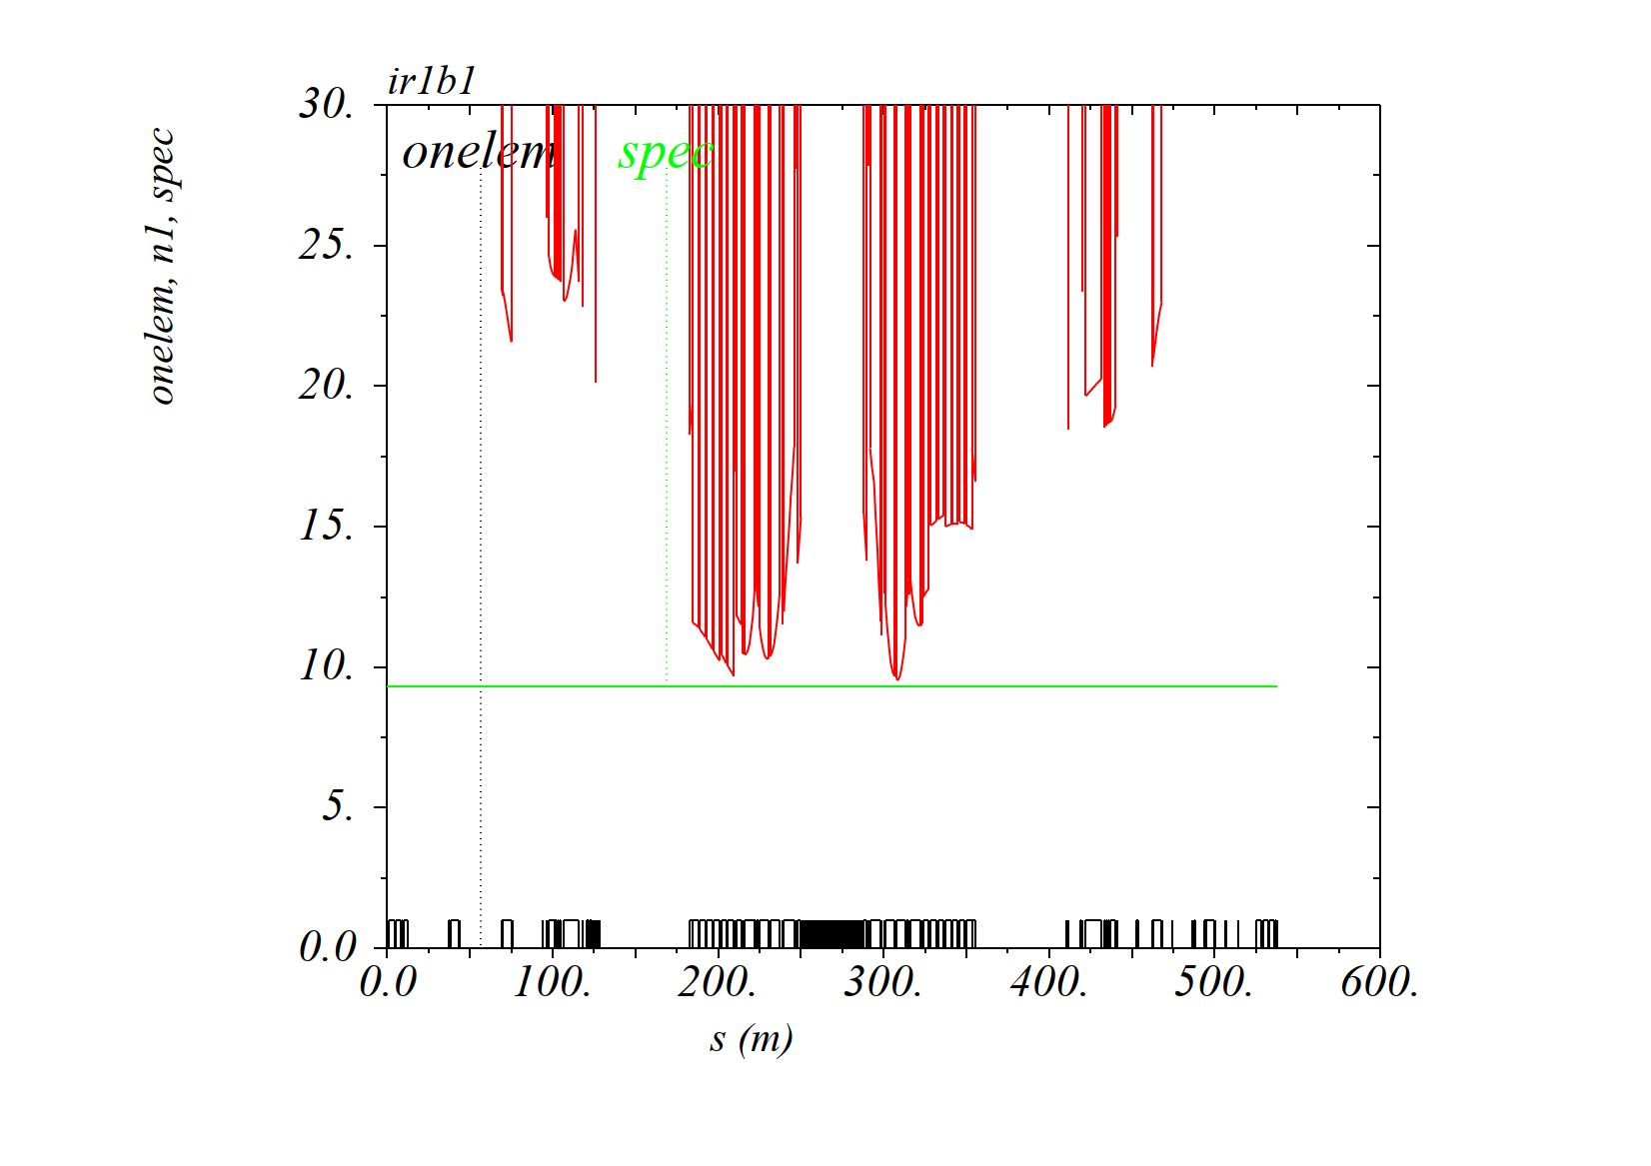
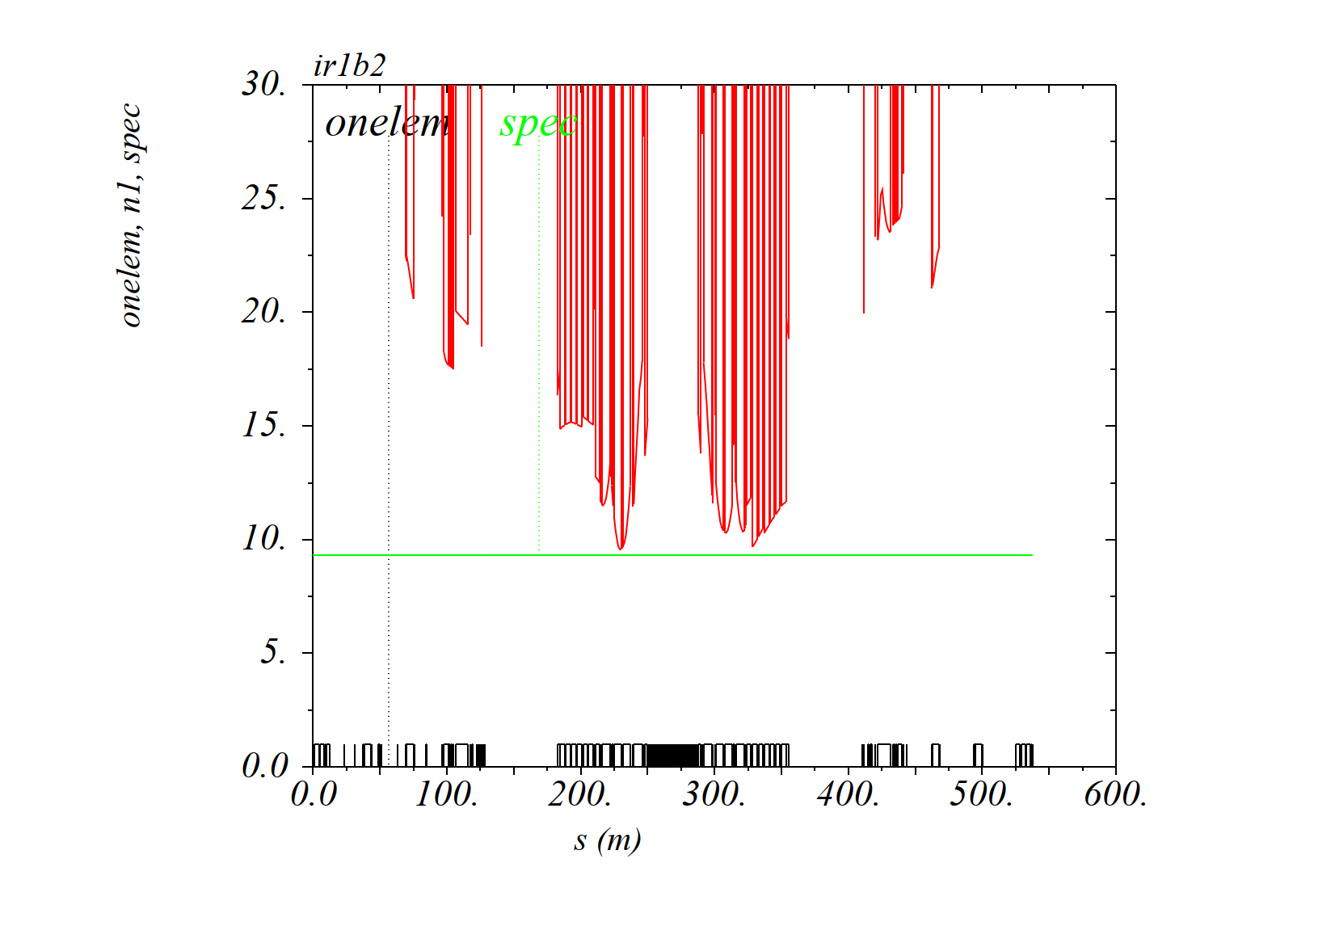
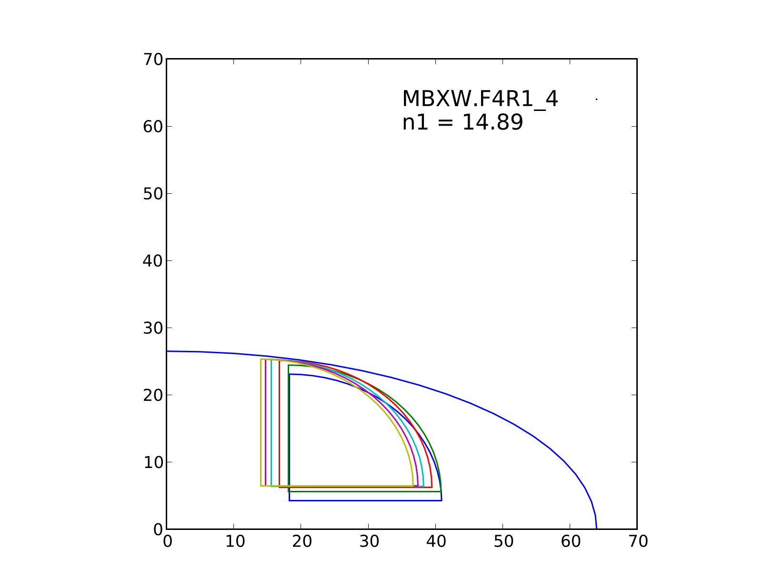
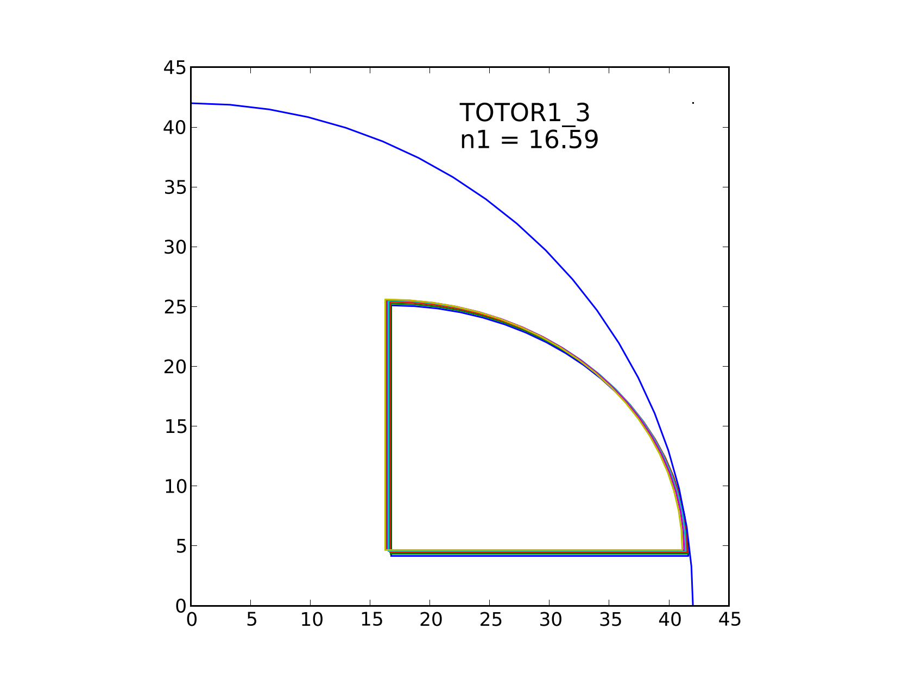
Aperture inc. MQSXW on nIP-side of D1 (42 mm rad. aperture with ALL tol.)
Nominal IR1 collision optics (β*=30 cm, V crossing, θ_{X}/2=160 μrad)
Beam1
Beam2
MQSXW aperture still
limited by the H plane
D1 aperture still
limited by the V plane

Slide 15
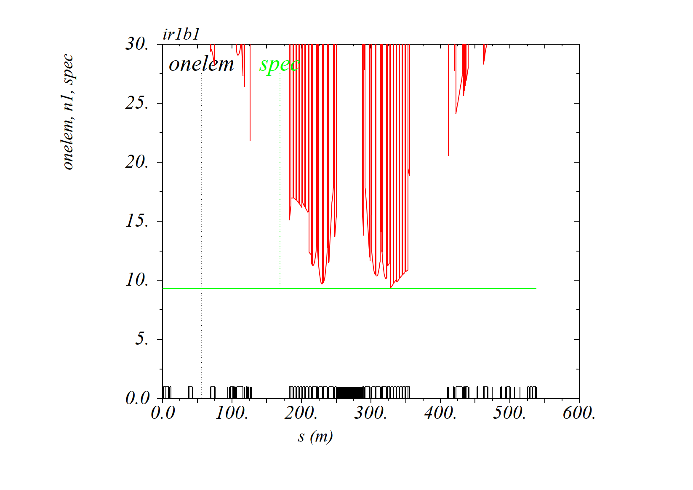
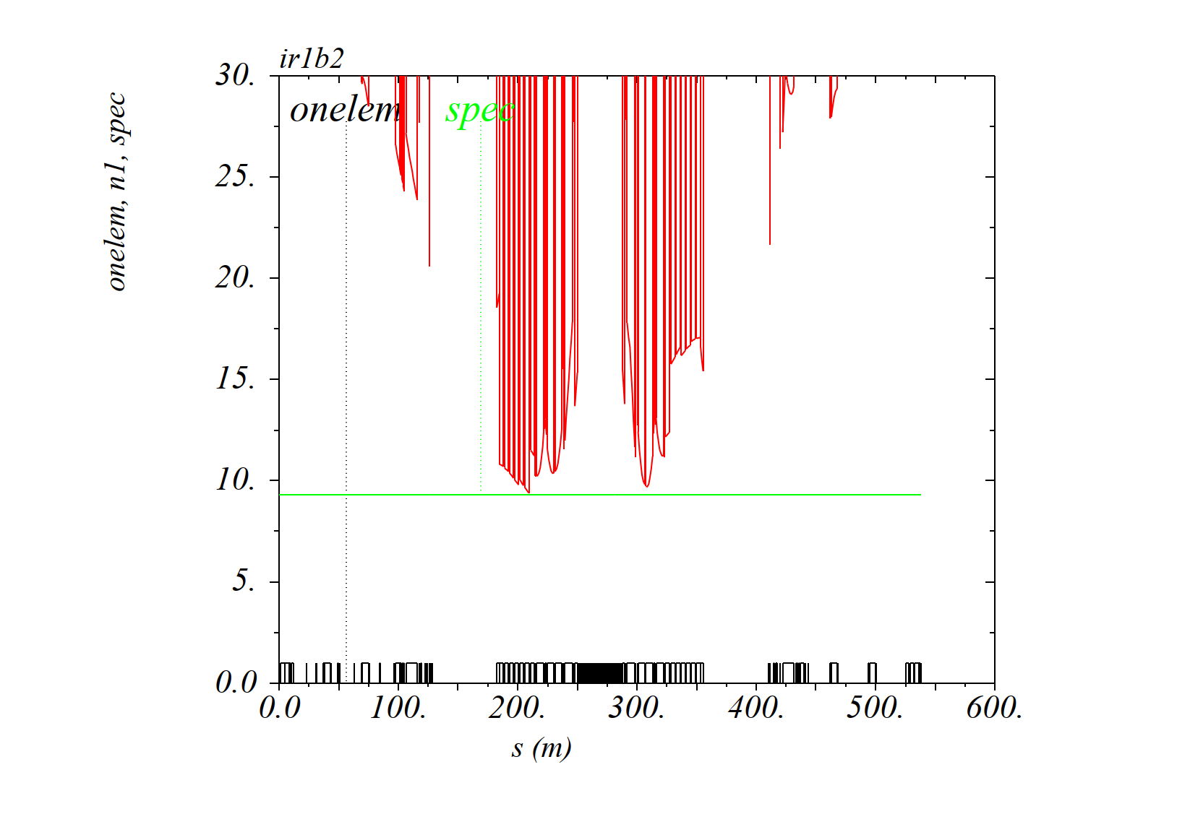
Aperture inc. MQSXW on nIP-side of D1 (42 mm rad. aperture with ALL tol.)
RP IR1 collision optics (β*=30 cm, V crossing, θ_{X}/2=160 μrad)
Beam1
Beam2

Slide 16
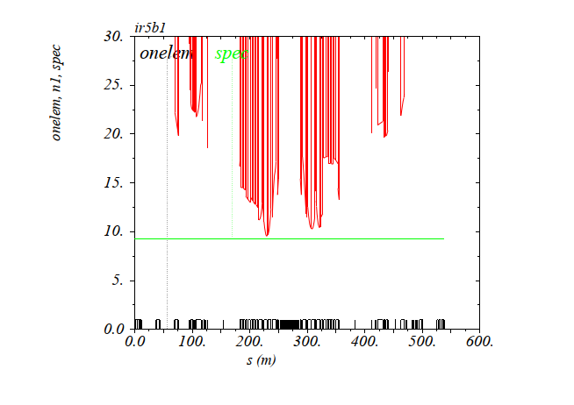
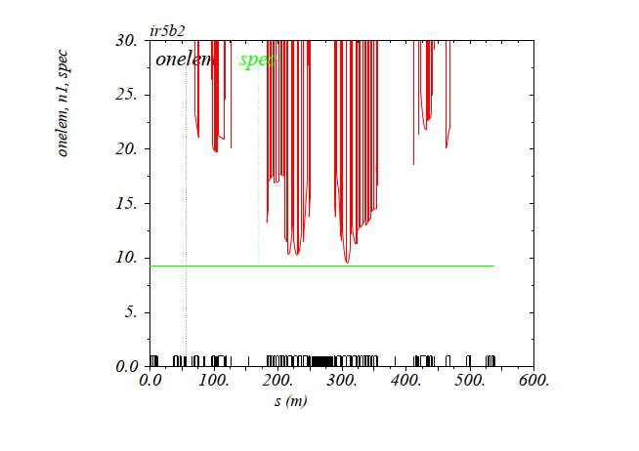
Aperture inc. MQSXW on nIP-side of D1 (42 mm rad. aperture with ALL tol.)
Nominal IR5 collision optics (β*=30 cm, H crossing, θ_{X}/2=160 μrad)
Beam1
Beam2

Slide 17
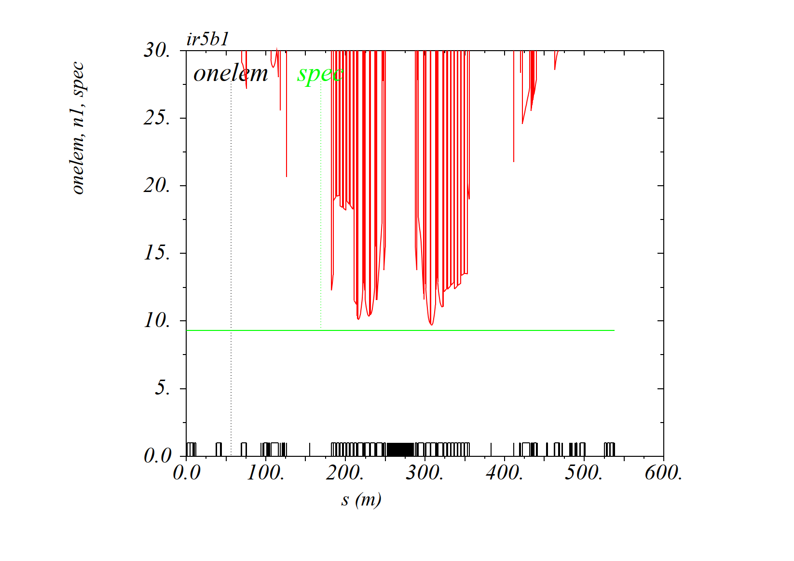
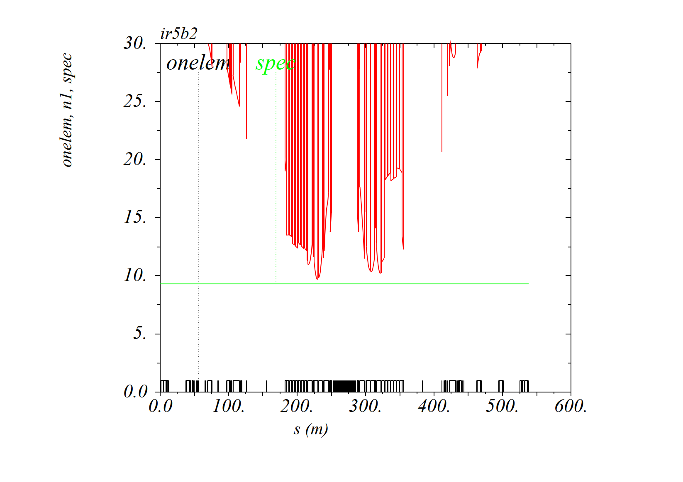
Aperture inc. MQSXW on nIP-side of D1 (42 mm rad. aperture with ALL tol.)
RP IR5 collision optics (β*=30 cm, H crossing, θ_{X}/2=160 μrad)
Beam1
Beam2

Slide 18
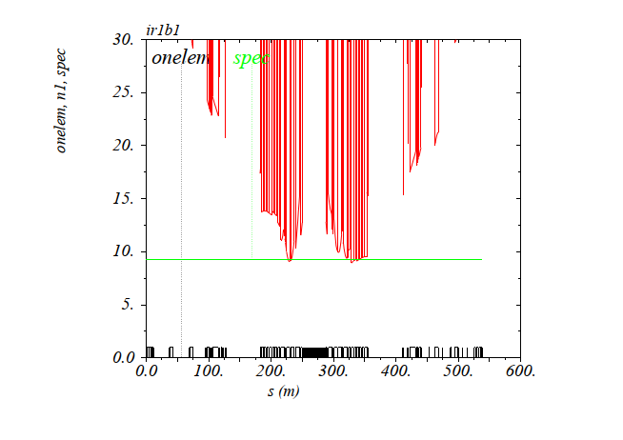
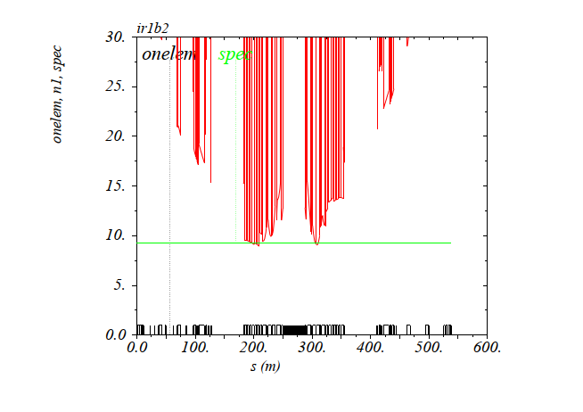
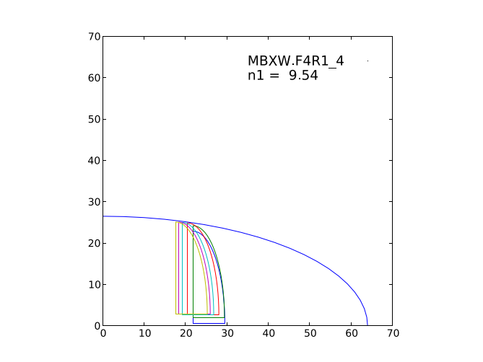
Aperture inc. MQSXW on nIP-side of D1 (42 mm rad. aperture with ALL tol.)
RP IR1 flat collision optics (β*=60/15 cm, H crossing, θ_{X}/2=160 μrad)
Beam1
Beam2
D1 (& Q2) aperture limited in the V plane (probably 15 cm should be fine-tuned a bit), but MQSXW OK!

Slide 19
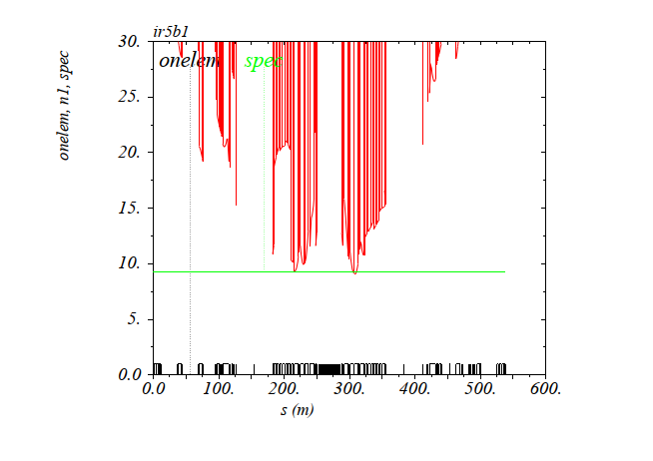
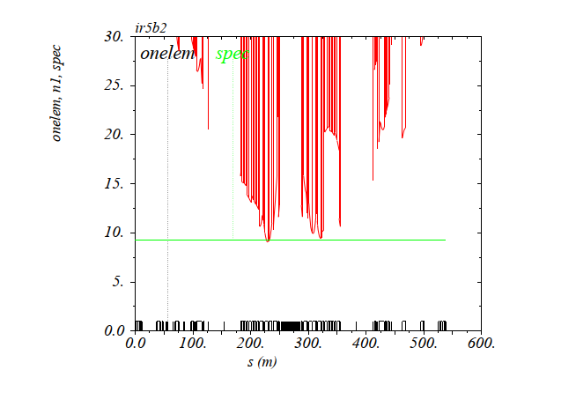
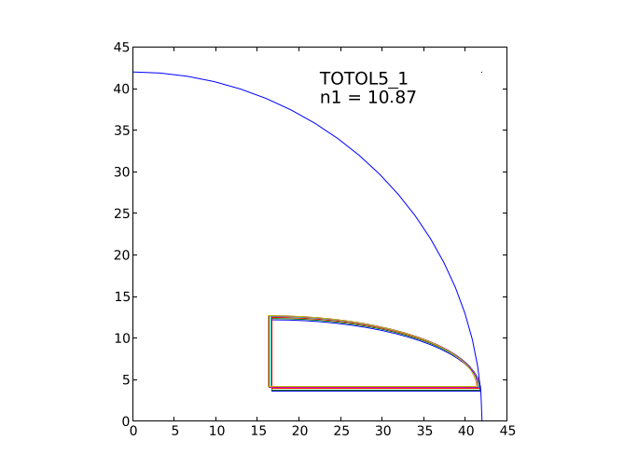
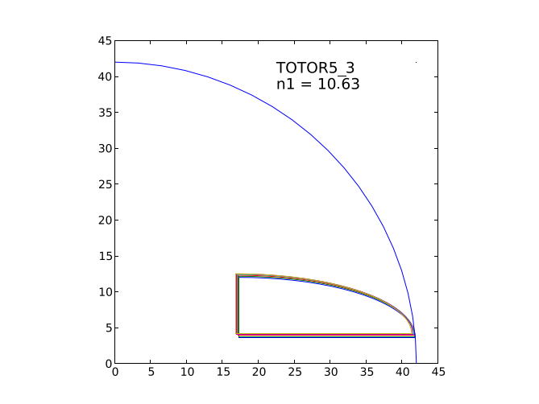
Aperture inc. MQSXW on nIP-side of D1 (42 mm rad. aperture with ALL tol.)
RP IR5 flat collision optics (β*=15/60 cm, V crossing, θ_{X}/2=160 μrad)
Beam1
Beam2
The MQSXW is still in the shadow of the IT. In absolute the MQSXW aperture of 10.5-11.0 σ is still expected to increase when fine-tuning β*=15 cm in the || plane, and reducing the 3 mm assumed tolerance budget (42 vs. 45 mm).

Slide 20
Summary and outlook
The “Q4off configuration”, which leads to “minimal HW changes” (polarity inversion of the IT only) is near to be certified. Last steps are
  Completion of the optics transition from injection (11 m+) to 40 cm in pre-squeezed mode (60 cm is sufficient for protons, 50 cm is needed for ions)
  Demonstration of VdM RP optics (β*=19 m)
  Decision of injection β*(if the aperture of VdM optics is OK for Q6 at injection, then one may try to inject with VdM optics and already rotated X-angle in IR1/5)
The MQSXW aperture is OK even if installed on the non-IP side of D1 (provided the overall beam-pipe and alignment tolerances does not exceed 3 mm radially, and the 90 mm aperture restriction does not extend by more than 2 m upstream the magnetic entry of D1). In this configuration the integrated MQSXW gradient should ideally reach 8.4 T, but 7.0 T would be OK (compromising on a few % of virtual lumi)
The configuration where the MBXWA module is displaced to the nIP-side of D1 (and the MQSXW is installed on the IP-side of D1) remains to be studied for the MBXWA aperture (but looks OK for the D1/D2 field and only 6.5 T needed in the MQSXW).

