Slide 1
KM3NeT – INFRADEV2
Kick-off meeting
HORIZON-INFRA-DEV-02
Ioannis Andredakis - Project Officer
REA C.4

Slide 2

Content
Role distribution
Reporting guidelines
Amendments
Communication, Dissemination, Exploitation
Open Science
Audits

Slide 3
Role Distribution
DG Research and Innovation
-> Definition of Policies
-> Drafting the Work Programme
Research Executive Agency (REA)
‘Reforming European Research & Innovation and Research Infrastructures’, Unit C4
-> Implementation of calls for proposals
-> Grant Management
Coordinator
-> Monitor that the action is implemented properly
-> Act as the intermediary for all communications with REA
-> Distribution of payments

Slide 4
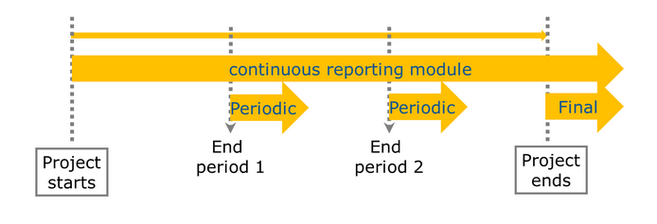
Reporting guidelines

Slide 5
Overview: Monitoring and Reporting
End of reporting period
Revisions and explanations
End of reporting and payment
Within 60 days
DELIVERABLES submitted
Periodic REPORT
submitted (technical and financial)
Submission of revised version of reports (technical and financial)
ALL documents received, correct and accepted
Comments from
Project Officer and Financial Officer – clarifications and modifications may be requested
More than one iteration may be necessary
Initiation payment
Review meeting
Review report submitted

Slide 6
Periodic Report: overview
WHEN
60 days after reporting period end
WHAT
Periodic Report:
HOW
via Portal
1. Technical report
- Prepared by the Coordinator
* What was done and achieved?
* Which problems were encountered?
* How can progress so far be assessed?
* Were there any deviations or corrective actions?
2. Financial report
- Individual financial statement
- Explanation of the use of resources and information on subcontracting
- The certificates on the financial statements (CFS)

Slide 7
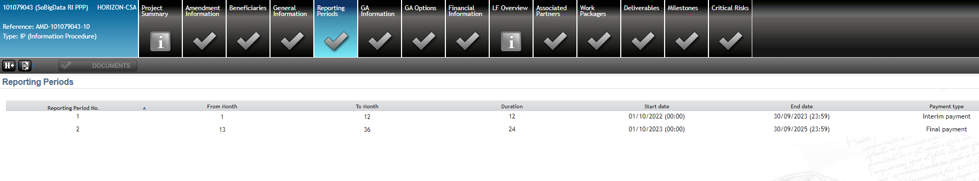
Periodic Reporting
Periodic reporting module is automatically activated after each reporting period, except if amendment is on-going or a previous periodic report is still open
Beneficiaries complete on-line the financial statements including explanations on the use of resources
Coordinator uploads the Part B of the periodic technical report (narrative part)
At the time the coordinator submits the periodic report, the IT tool will capture the information from the continuous reporting module in order to generate automatically the Part A of the Periodic report

Slide 8
Reviews: periodic reporting
Reviews planned at the end of each reporting period (ca. 1 month after submission of reports). Article 21 of the GA
Review (optional): Present the work carried out, main achievements and use of resources.
Participation of the coordinator, participation of WP leaders.
REA is assisted by external expert(s)

Slide 9
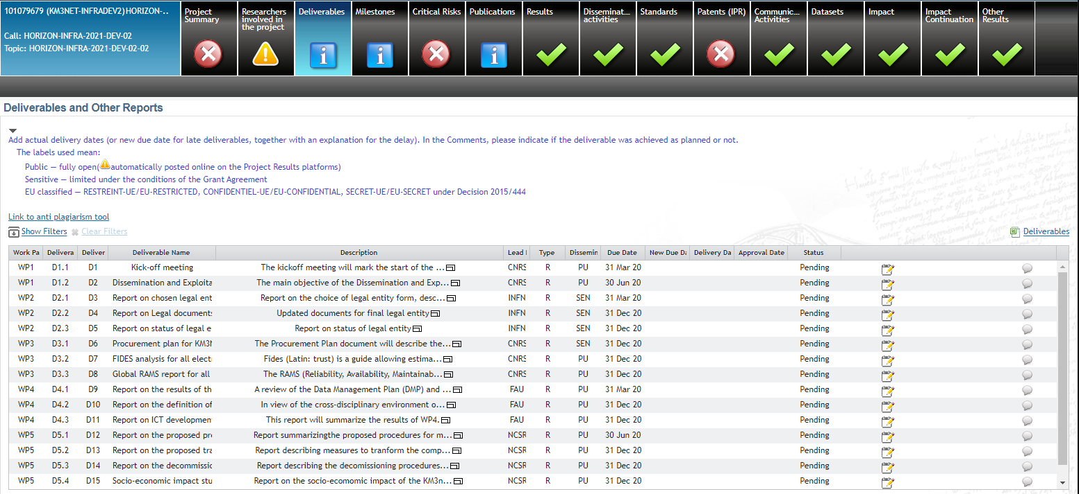

Continuous Reporting
!!!!! All HE deliverables flagged as 'PUBLIC' will be published in Cordis
Be particularly attentive to quality of all public deliverables!

Slide 10
Periodic reporting – eligibility of costs (art.6 GA)
ELIGIBLE COSTS
Actually incurred by the beneficiary
Incurred during the action
Connected to the action
Identifiable and verifiable - accounting
Compliant with national law
Reasonable financially sound
Tips:
Be transparent
Treat all costs according to your usual accounting practice
Check for exceptions beforehand!
Ask: PO, FO
INELIGIBLE COSTS
Identifiable taxes and duties
Deductible VAT
Interest owed / Bank charges
Possible future losses charges
Exchange
losses
Excessive / reckless expenditure
From other EU project
Tips:
Non-deductible VAT is an eligible cost
Ask: PO, FO
Costs incurred during suspension are ineligible

Slide 11
Project Reviews: M18 & M36
EXAMPLE
When?
  Period Reviews @ M12 & M36 aligned with the reporting periods
  Usually reviews take place around 5-6 weeks after the end of the period
What?
  Presentation of the project progress, the main achievements and the use of the resources
  Who?
  Coordinator, WP Leaders, other beneficiaries
  PO + external expert/s

Slide 12
Payments
EXAMPLE
Pre-financing
80% of maximum grant amount – 5% guarantee fund
All Payments (interim and final):
Linked to the submission of complete and correct report, deliverables and financial statements
Paid within 90 days from receiving the full technical and financial report
Interim payments:
Limit to 90% of the maximum grant amount
Final payment
Final balance and release of guarantee fund

Slide 13
Financial reporting: submission on-line
Single submission & single rejection
Technical report and all financial statements to be submitted by the coordinator as a "single package"
  "If a beneficiary does not include its related financial statement in a periodic report, the costs will be considered 'zero' for this reporting period but the beneficiary can declare its costs with the next financial report (for the next reporting period)."
Full package rejected if one document requires changes or corrections
Important note: « One iteration only » principle to correct the package if required, the payment will be processed on the basis of the info available after the first resubmission, there will not be further opportunities to correct mistakes or provide additional information (i.e. corresponding costs will be rejected)

Slide 14
Financial reporting: explanation on the use of resources
Personnel : actual or unit costs
  Number of PM broken down per WP
  Amounts and description if in kind contribution from third parties
Subcontracting : actual costs paid for subcontracts (usually in Annex 1)
+Third parties –non-financial resources made available free of charge by third parties.) and Art.9.2 of the GA Breakdown of total + explanation + if foreseen in Annex 1
  Details to be provided if not foreseen
    explicit approval from the PO is required during the payment process
    (no need to process amendment before approving)
Other direct costs : actual incurred for
  Travel & subsistence, Equipment, Costs of other goods and services, Costs of large research infrastructures
  Explanation needed ONLY if amount > 15% of personnel
    - Cost, description, WP, if foreseen in Annex 1, explanation if not
  Amounts and description if in kind contribution from third parties

Slide 15
CFS – Certificates of the Financial Statements
EXAMPLE
Only at the final reporting if a beneficiary/linked third party requests a total of €430. 000 or more as reimbursement of actual costs and unit costs calculated according to its usual cost accounting practices
CFS must be issued by an external auditor, using the template in Annex 5.
scanned copy (PDF) together with the financial statement, original remains at the beneficiary (might be audited!)
Special threshold for beneficiaries with a systems and process audit (see Article 24): financial statement: requested EU contribution to costs ≥ EUR 725 000

Slide 16
Financial management: some advice
Personnel Costs: KEEP TIME RECORDS of the hours worked on the action (if not working full time on an EU project)
Meetings: collect participants’ signatures (especially if you reimburse or claim travel costs)
Any subcontracting?
  If you need a subcontract which is not planned in the Description of Action, ask approval to the REA project officer beforehand as this may require an AMD
Note to the coordinator if one partner overspends, it is up to the coordinator with the Consortium to decide internally how the EU contribution will be distributed (i.e. full amount if the overspending is due to anticipated work, or only the budget share agreed for the reporting period).

Slide 17
Subcontracting vs. contracting
Subcontracting – Art. 6.2B of the GA
Subcontracting can be used to implement certain action tasks described in Annex I.
Subcontracting may cover only a limited part of the action.
If applicable , the tasks to be implemented and the estimated cost for each subcontract must be set out in Annex 1 and the total estimated costs of subcontracting per beneficiary must be set out in Annex 2.
Contracting – Art. 9.3 of the GA
Contracting can be used for purchasing goods, works and services which are necessary to implement the action tasks but not directly linked to them.
If applicable, they should be set out in Annex 1 and the total estimated costs for contracting declared in Annex 2.

Slide 18
The unhappy path…
Article 28 – Reduction of the grant
  improper implementation/breach of obligations
  may occur at payment of balance or after with pre-information letter
Article 30 — Suspension of Payments
  Suspicion of substantial errors, irregularities, fraud or serious breach of obligations
  Contradictory procedure before suspending a payment
Article 31 — Suspension of Implementation of the action
  Costs not eligible during the time of suspension
Article 32 —Termination
  GA – effective date triggers final periodic reporting
  Beneficiary – effective date triggers "termination report" + calculation of balance for beneficiary

Slide 19
Amendments

Slide 20
Amendments
Budget transfer is allowed between beneficiaries and among existing budget categories without filing an amendment
Amendment needed if:
Change of the coordinator’s bank account for payments
Addition/removal of linked third party
Change of action’s title, acronym, duration, reporting periods
Change of Annex 1 (description of action)
Change of Annex 2 estimated budget
Change of coordinator or its legal status
Change of dissemination status of a deliverables (PU→SEN or SEN→PU)
Action to be implemented as described in Annex I
If the change is significant, an amendment to the GA is needed
Grant agreement duration is as a rule not extended except Force Majeure
TIP
Always contact the REA PO (Coordinator – PO) to discuss the typology and impact of change

Slide 21
Communication, Dissemination, Exploitation

Slide 22
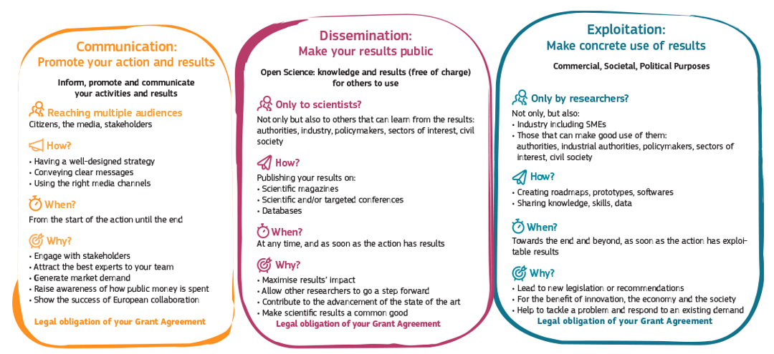
Communication, dissemination and exploitation

Slide 23



Acknowledge EU Funding
Make sure to display the European flag (emblem), do not use the European Commission logo!
Find guidance and download the EU emblem: https://europa.eu/!m83Myq

Slide 24
Disclaimer
Disclaimer GA art . 17.3 must be added in any publication/output:
” Funded by the European Union. Views and opinions expressed are however those of the author(s) only and do not necessarily reflect those of the European Union or [name of the granting authority]. Neither the European Union nor the granting authority can be held responsible for them.”

Slide 25
How can REA support you?
Has your project won an important scientific award? Have you made a ground-breaking discovery and are featured in the press?
Don’t forget to inform your project officer!
REA’s Communication team can help promote by:
• Highlighting & multiplying your news and results through our own and the Commission’s social media channels (please tag us!)
• Proposing your project’s success story for inclusion in the European Commission’s free-of-charge communication channels.

Slide 26
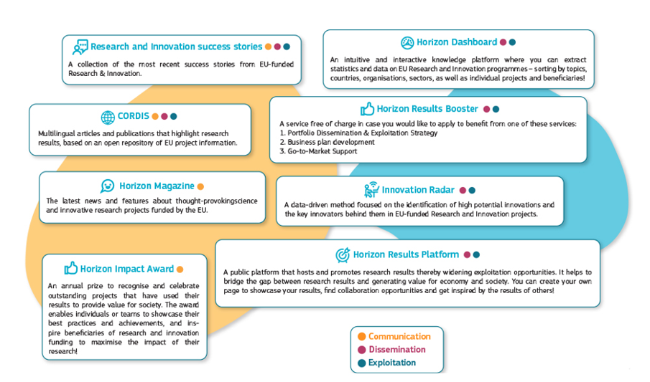
Free-of-charge European Commission dissemination tools

Slide 27
Open Science
Model Grant Agreement requirements
1. Open access to scientific publications
2. Research Data Management

Slide 28
Key points on open science in Horizon Europe
Beneficiaries must manage the digital research data generated in the action responsibly, in line with the FAIR (“Findable”, “Accessible”, “Interoperable”, “Reusable”) principle
Establish + regularly update a data management plan (‘DMP’) for generated (and/or collected) data
Ensure open access ‘as open as possible as closed as necessary'
Useful resources
Horizon Europe Annotated Model Grant Agreement (Annex 5, section 2 -pg 154)
Horizon Europe Data Management Plan Template (under reference documents of the Funding and Tenders portal).

Slide 29

1. Open access to publications (1/2)
Beneficiaries must ensure open access to peer-reviewed scientific publications relating to their results. In particular, they must ensure:
  at the latest upon publication, deposition of the Author Accepted Manuscript or Version of Record in a trusted repository + immediate open access via the repository under a Creative Commons Attribution license (CC BY) or equivalent (Creative Commons Attribution Non Commercial/Non Derivatives licenses or equivalent are allowed for long-text formats)
  information via the repository about any research output/tools/instruments needed to validate the conclusions of the scientific publication
Metadata must be open under a Creative Commons Public Domain Dedication (CC 0) or equivalent, in line with the FAIR principles and provide information about the licensing terms and persistent identifiers, amongst others.

Slide 30
Open access to publications (2/2)
Beneficiaries (or authors) must retain sufficient intellectual property rights to comply with the open access requirements
Publication in venue of their choice but publication fees are reimbursable only if publishing venue is full open access (publication fees in hybrid venues are not reimbursed)
Beneficiaries have the possibility to publish at no costs in Open Research Europe, the European Commission open access publishing platform

Slide 31
2. Research data management (1/2)
Beneficiaries must manage the digital research data generated in the action responsibly, in line with the FAIR (“Findable”, “Accessible”, “Interoperable”, Reusable”) principles and:
  establish + regularly update a data management plan (‘DMP’) for generated (and/or collected) data
  as soon as possible and within the deadlines set out in the DMP, deposit the data in a trusted repository (federated in the EOSC if required in the call conditions) + ensure open access under CC BY, CC 0 or equivalent, following the principle ‘as open as possible as closed as necessary’
  provide information via the repository about any research output/tools/instruments needed to re-use or validate the data
Metadata must be open under CC 0 or equivalent (to the extent legitimate interests or constraints are safeguarded), in line with the FAIR principles and provide information about the licensing terms and persistent identifiers, amongst others.

Slide 32
Research data management (2/2)
There are exceptions to open access to research data.
Data may be kept closed if:
providing open access is against the beneficiary’s legitimate interests, including regarding commercial exploitation;
it is contrary to any other constraints, such as data protection rules, privacy, confidentiality, trade secrets, Union competitive interests, security rules, intellectual property rights or would be against other obligations under the Grant Agreement.

Slide 33
Trusted repositories under Horizon Europe
Trusted repositories are either certified repositories (e.g. CoreTrustSeal, nestor Seal DIN31644, ISO16363) and/or disciplinary/domain repositories that are commonly used/endorsed by the research communities (e.g. ELIXIR deposition databases).
General-purpose repositories and institutional repositories are, in general, also acceptable.
Trusted repositories share essential properties:
  Mechanisms to ensure integrity and authenticity of contents.
  Offer clear information about their policies/services.
  Provide broad, and ideally open access to content (consistent with legal and ethical constraints).
  Assign PIDs, ask for detailed metadata in a standardized (e.g. Dublin Core) and machine-readable way.
  Ensure mid- and long-term preservation of contents, expert curation, quality assurance.
  Meet national and/or international security criteria

Slide 34
Guidance/resources on open science in Horizon Europe
Horizon Europe Annotated Model Grant Agreement (p.154 ff.)
Horizon Europe Data Management Plan Template (under reference documents of the Funding and Tenders portal).

Slide 35
Open Research Europe
Why Open Research Europe?
Support our open access policy and beneficiary capacity to adhere to it and also enables publishing post-grant
Leading by example in operationalising open science principles within scientific publishing and enabling the European Research Area
Contribute to transparency and cost-effectiveness and explore sustainable open access publishing business models
What is Open Research Europe?
A peer-reviewed publishing platform. Not a repository. Post-publication peer-review model. First you publish, then review takes place. Publication and review reports open access under CC BY licenses. Optional service for our beneficiaries at no cost to them.

Slide 36
Ethics

Slide 37
Ethics in Horizon Europe
Integral part of research from beginning to end
  Participation in Horizon Europe requires compliance with the highest standards of research ethics and integrity, and with EU, national and international law.
  Horizon Europe regulation 2021/695 (Articles 18 and 19) & Grant Agreement (Art 14, Annex 5): guiding principles and general obligations (including ineligible activities and specific rules e.g. in case of hESC/hE).
Before starting an action task raising ethical issues, the beneficiaries must have obtained all approvals or other mandatory documents needed for implementing the task, notably from any (national or local) ethics committee or other bodies.
The documents must be kept on file and submitted by the coordinator to the granting authority upon request.
  Please pay uttermost attention and contact the PO, whenever you modify activities with potential ethical issues, such as collect or process "personal data" (e.g. name, e-mail address,...), involve volunteers (informed consent procedure required), exchange data between EU – non-EU countries.

Slide 38
Ethics Appraisal in the Project Life Cycle
Call deadline
GAP invitation
Grant signature
Project end
Ranking
Submission Evaluation (merit) GA preparation Project execution
Self-assessment
Screening
Ethics Checks/Reviews
Assessment
All proposals
Main / reserve list
proposals
Selected projects
Notes:
Ethics guide A-Z (v4.0, 19 Jul 2021)
https://myintracomm-collab.ec.europa.eu/projects/H2020drafting/_layouts/15/WopiFrame.aspx?sourcedoc=/projects/H2020drafting/Business%20Documents%20Grants/Guidance_Ethics%20Guide%20A-Z.docx&action=default&DefaultItemOpen=1

Slide 39
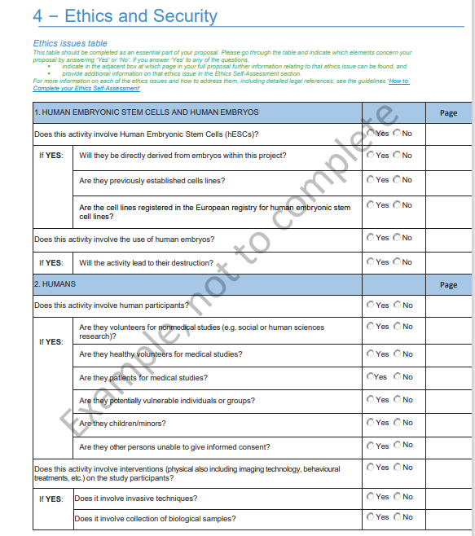

Applicants’ Ethics Self-Assessment
Part A – Section 4

Slide 40
Implementing ethics: Check or Review (ethics issues cleared)
An Ethics Check / Review is requested
    When: it is important to reassess the global situation or specific ethics issues during the implementation of the project, or when the ethics self-assessment does not contain all necessary elements.
    Ethics WP/Deliverables: no specific deliverables, although the PO may have set one or more deliverables during GAP to allow submission of supporting ethics documents and/or information to check/review (clearance).
    Difference between check and review:
    Ethics Check: internal check by the project officer or REA ethics correspondent who may be supported by external ethics experts.
    Ethics Review: more elaborate and in-depth procedure carried out by REA with up to 5 external ethics experts (formerly known as 'Ethics Check' in H2020).
    The choice between Ethics Check and Ethics Review reflects the size of the grant and the seriousness/complexity of the ethics issues.

Slide 41
Implementing ethics: Advisor or Board (ethics issues conditionally cleared)
Appointment of an external, independent ethics Advisor / Board
    When: It is necessary for the project to be advised by one or more independent experts.
    Ethics WP/Deliverables: yes, for appointment and regular ethics reporting by the ethics advisor/board (conditional ethics clearance).
    Advisor/Board members must be totally independent and free from any conflict of interest.
    The Advisor/Board members get paid for their services (via e.g. a service contract).
    The Coordinator must grant ethics Advisors/Board members with access to the relevant documents needed to perform their duties. It is advised to build a collaborative relationship with ethics Advisors/Board members (see section 9.2 of How to complete ethics self assessment).
    Obligation to send independent report(s) to Agency. Each report represent a deliverable and must be submitted at the month set by the PO during GAP, the appointment of the Ethics Advisor/Board members being the first deliverable.

Slide 42
Implementing ethics: specific requirements (conditional clearance)
Specific Ethics Requirements are formulated:
    If serious/complex ethics issues are identified, then ethics requirements may be included in the ethics summary report.
    Ethics WP/Deliverables: yes, specific deliverables are set; they may include ethics supporting documents, additional information or clarifications (conditional ethics clearance).

Slide 43
Policy Feedback

Slide 44
Policy feedback overview 1/2
What is policy feedback?
A mechanism through which your project results feed into current and/or future policy-making
Why is policy feedback necessary?
  to monitor the achievement of policy objectives
  to encourage evidence-based policy making
  to fine-tune policy, where necessary

Slide 45
Policy feedback overview 2/2
What’s in it for you?
  you actively feed into EU policy discussions
  you interact with similar projects
  you promote your own project
Type of policy feedback activities during project life-time
  policy brief as a mandatory deliverable (see next slide)
  ad hoc requests e.g. for monitoring purposes
  partake in cluster events

Slide 46
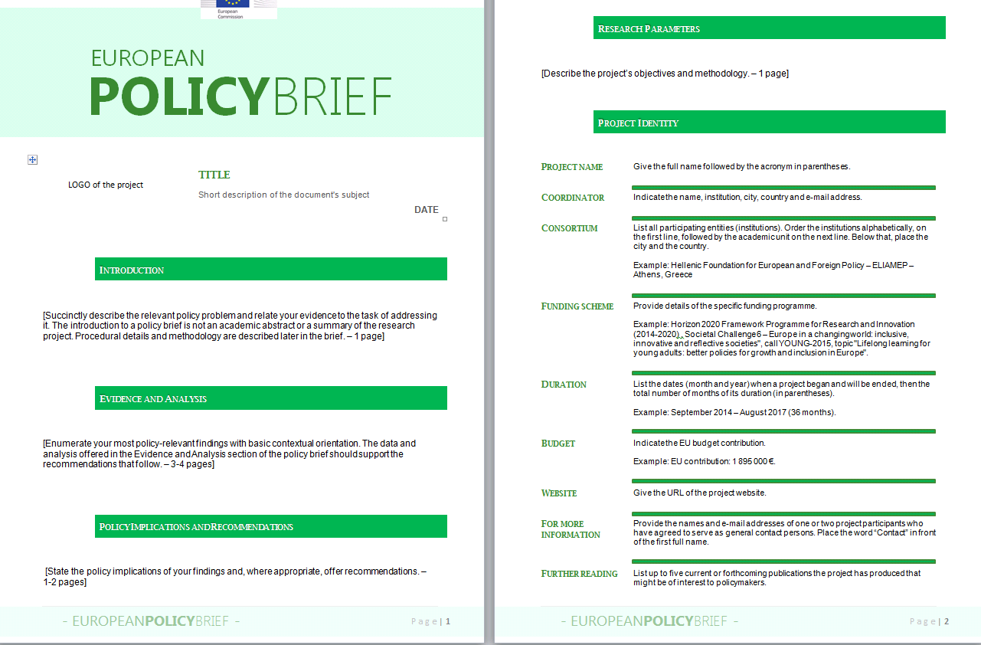
Policy Briefs – to be adapted for each project!!!
Main elements:
mandatory deliverable(s) at each reporting period
supports knowledge transfer to upcoming host city (ESOF) or organising entity (EUCYS)
Supports the EC in monitoring achievements & impact
basis for reflection on potential recommendations/best practice
means for ensuring evidence-based policy making within HE
unless specified in the GA, the policy brief can be based on a template provided by the REA
4 key aspects to be addressed:
  Evidence and Analysis
  Policy implications and recommendations
  Sustainability and legacy
  Project objectives and methodology
Add reference to specific deliverables of the GA

Slide 47
Audits

Slide 48
Audits
Keeping records: Keep a clear account of the project activities during the reporting period (Article 20 Grant Agreement).
Beneficiaries must keep records and other supporting documentation up to 5 years in order to prove the proper implementation and the costs declared as eligible.
Audits can be carried out during the entire lifetime of the project, by the European Commission, not later than 2 years after the payment of the balance.
Two types of audits: financial and/or technical audits

Slide 49
Links and useful information

Slide 50
HE Online Manual
https://webgate.ec.europa.eu/funding-tenders-opportunities/display/OM/Online+Manual
Grant management
Keeping records
Amendments
Reports & payment requests
Deliverables & milestones
Dissemination & exploitation
Communicating your project
Acknowledgement of EU funding
Checks, audits, reviews & investigations

Slide 51
Useful links
  HE Annotated Model Grant Agreement
  Guidance on social media for EU funded R&I projects
  Horizon Europe – Funding Programme for Research and Innovation
  Factsheet ‘Open Science in Horizon Europe’
  Communication on ‘A new ERA for Research and Innovation’
  Pact for Research and Innovation in Europe

Slide 52







Keep in touch
ec.europa.eu/info/research-and-innovation_en
europeancommission
rea.ec.europa.eu
@EuropeanCommission
@REA_research
EUTube
European Research Executive Agency (REA)
EU Spotify

Slide 53

Thank you
© European Union 2020
Unless otherwise noted the reuse of this presentation is authorised under the CC BY 4.0 license. For any use or reproduction of elements that are not owned by the EU, permission may need to be sought directly from the respective right holders.
Notes:
Update/add/delete parts of the copy right notice where appropriate.
More information: https://myintracomm.ec.europa.eu/corp/intellectual-property/Documents/2019_Reuse-guidelines%28CC-BY%29.pdf

